Slide 1
Welcome
Class B Bridge Inspection Course
Twin Atria, Edmonton, AB
April 30 – May 4, 2018
Notes:
Welcome
Personal Introduction

Slide 2
Course Instructors
Trainers
Garry Roberts
Randy Bredo
Guest Lecturers
AT staff – Des Williamson, Matt Spratlin, Dave Besuyen.
Abdul Waheed
Refer to Course Schedule

Slide 3
General Information
Emergency Protocol
Washrooms
Room Access
Opens at 7:30 am
Locked at 5:00 pm
Open at lunch
Computers
Smoking
At designated locations only - minimum 30 ft from building entrances

Slide 4
General Information (cont’d)
Registration and Payment
Note Taking & Course Materials
Course Evaluation must be completed

Slide 5
PARKING

Slide 6
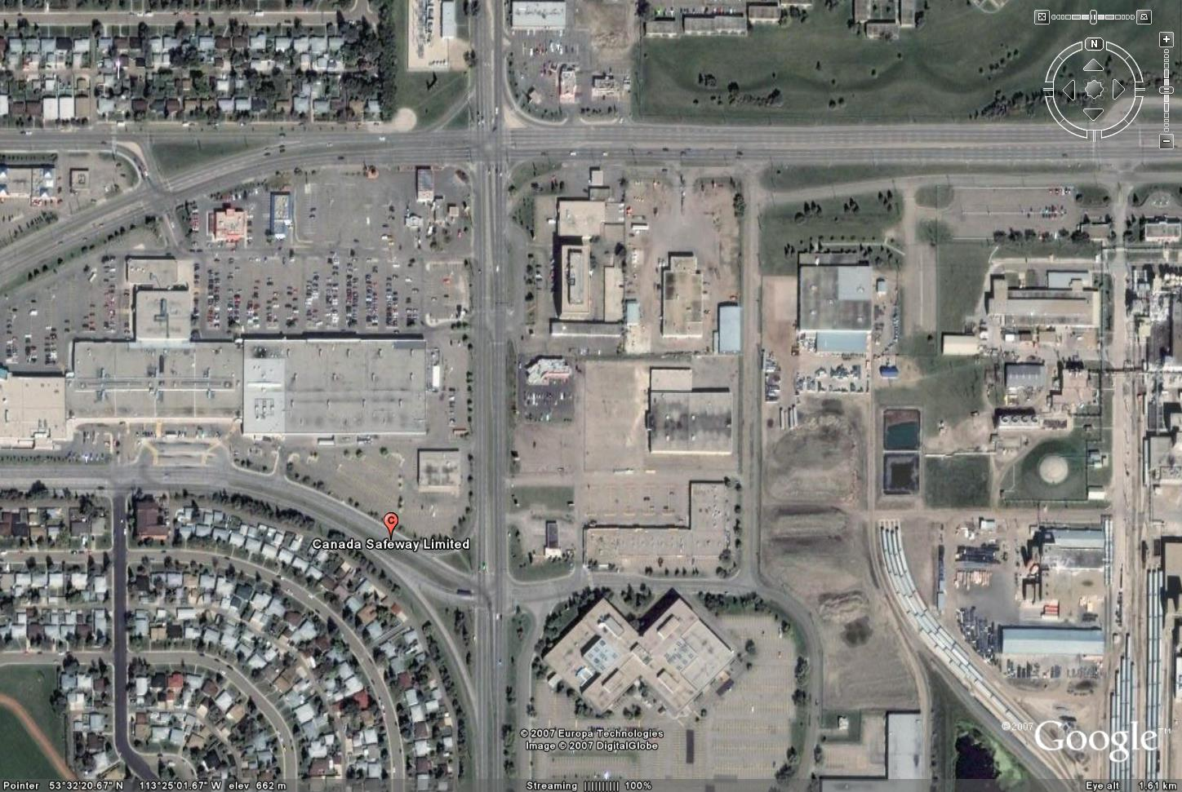
EATERIES
A & W
KFC/Taco Bell
Tim Hortons
Oodle Noodle
Mucho Burrito
Quiznos
MacDonalds
Highrun Pub
Chinese Buffet
Eat in Room

Slide 7
Self Introduction
Name
Organization
Present or Proposed Involvement with Bridges
Fill out Name Tag/Placeholder

Slide 8
BIM Inspector Training
**Alberta Transportation Requires All BIM course participants to self register for TIMS/BIS application for certification tracking purposes**
https://extranet.inftra.gov.ab.ca/inftra_login.html
https://extranet.inftra.gov.ab.ca/Self_Registration_Guide_to_Access_TIMS.pdf

Slide 9
Course Schedule
Monday – Friday
Start Time 8:00 am
Finish Times 4:30 - 4:45 pm
Field Trip on Wednesday
Hard Hat, Traffic Vest, Hip Waders, Boots
Clip board, flashlight, hammer, tape measure
Transportation provided. Bring lunch.
Preparation Requirements
Questions allowed at anytime

Slide 10
Quizzes
Four Closed Book Exams:
Tuesday morning;
Thursday morning;
Friday morning; and
Friday afternoon
Pass mark is 70%
Marks posted daily – any objections to posted marks contact the instructor

Slide 11
Courtesies
Turn cell phone OFF/vibrate
– no text messaging.
No talking during exams – leave room and talk in hall once exam is completed.

Slide 12
Course Objectives
Introduction to AT’s BIM system
Learn bridge inspection terminology
Learn inspection protocol and principles
Introduction to bridge/culvert maintenance

