Slide 1
HYDROTECHNICAL CONSIDERATIONS
Notes:
Inspect bridge re: its interaction with the stream

Slide 2
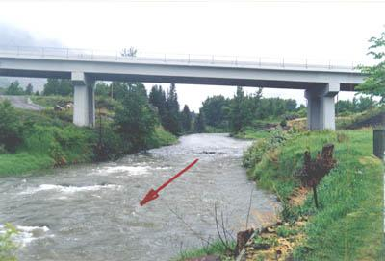
Notes:
How a typical site looks in the field.

Slide 3
Overview
Hydrotechnical Design
River Issues
  Lateral Stability
  Vertical Stability
  Blockage - ice, drift
River Protection Works
Notes:
Hydrotechnical Design – how much water to design for
ATEC guidelines
River Issues
Lateral – stream alignment
Vertical – scour, degradation
Blockage – drift, ice …
RPW – rock riprap, guidebanks, spurs

Slide 4
Hydrotechnical Design
Hydrotechnical Design

Slide 5
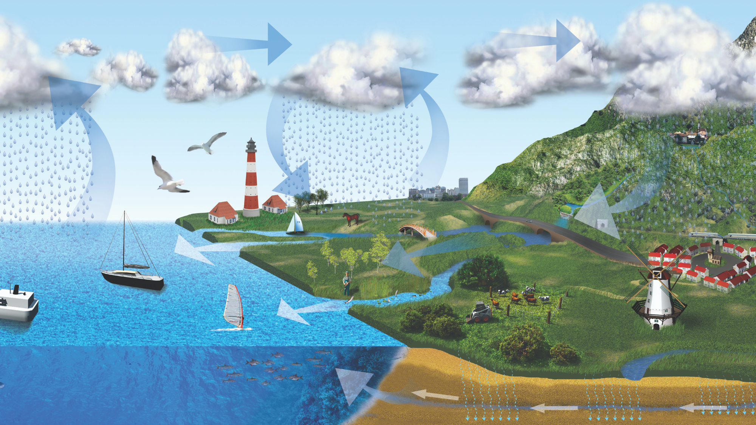
The Hydrologic Cycle
Notes:
*on exam* Hydrologic Cycle : Evaporation from groundwater, lakes, rivers, streams, oceans up to atmosphere and results in precipitation in form of snow (snow melt from mountains) rain, hail to continue cycle
Precipitation - rain, snow, sleet
Interception – intercepted; precipitation prevented from reaching the ground
Infiltration - Water absorbed by the ground; groundwater flow
Runoff - Water that flows on the ground surface; overland or in streams
Evaporation - water returned to the atmosphere as vapour (also transpiration)

Slide 6
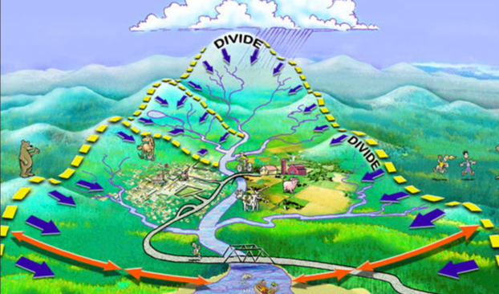
Drainage Basin Parameters
Area
Shape
Slope
Storage
Density
Vegetation
Soil Type
Initial Moisture
Notes:
Hydrological Response
Area - it is unlikely that one rainfall will entirely cover a basin at peak intensity.
Shape - Elongated vs round basins, will impact how fast water will runoff
Slope - Steeper basins respond more quickly with higher peaks and shorter durations. “Flash floods”
Storage - percentage of basin area covered by lakes, sloughs, etc. Storage reduces the flow peak and increase the duration.
Density – Number of channels/area. Higher values indicate well drained basins with higher flow concentration.
Vegetation - Higher amounts of vegetation will increase infiltration and flow routing.
Soil Type - sands and gravels having high infiltration rates and clays having much lower capacities.
Initial Moisture - degree of saturation of soil prior to storm will impact response.

Slide 7
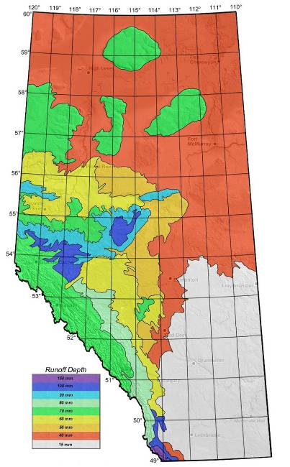
Hydrotechnical Design
Channel Capacity
  channel size result of long-term runoff
  channel size affects routing of runoff
  typical channel
  activate overbank storage
Historic Highwater Data
  HWM – AT, AE, WSC, site, air photo, news
  Location, description
Runoff Potential
  Limit on supply of runoff
  Unit discharge
Notes:
Modelling – too complex, not enough data
Statistics – ignores physics, limited data, extrapolation, no context
HDG – channel capacity, historic HW, runoff potential

Slide 8
Hydraulic Definitions
V = Q
Water Surface
A
Y
A
Q
Thalweg
Notes:
Q – Discharge = the rate of flow of water. It is the volume of water passing through a cross section of a channel in a given period of time. A A - Area = Cross sectional area of flow in the channel. A function of the geometry of the channel.
V - Velocity = the mean velocity for the cross section, as determined by V=Q/A.
Thalweg - lowest point on streambed: German – thal = valley, weg=way or course
Water Surface - Elevation of surface of flowing water
Y - depth of flow

Slide 9
Flow Area - Stream Crossing
Bridge
Culvert
Notes:
Bridges and culverts may provide less flow area than the typical channel – constriction.
Impact of constriction varies with magnitude and shape.
New design – try to right size structures to be similar to natural channel

Slide 10
Flowlines - Natural
Bank
Flow
Notes:
This diagram shows a typical distribution of flow across a straight portion of channel.
There is an equal amount of flow between each line.
The shorter spacing between lines near the middle of the channel indicates deeper depths and higher velocities.

Slide 11
Flowlines - Culvert Constriction
Q=V*A
Q=V*A
Q= V*A
Notes:
Plan view of impact of constriction :
Contraction of flow u/s – relatively efficient.
High velocity through culvert.
Expansion of flow d/s, less efficient, eddies.This diagram illustrates the impact of a constriction on the flow.

Slide 12
Flow Profile - After Constriction
Energy Grade Line
Water Surface
Notes:
Elevation view of impact of flow constriction :
Rapid loss of energy at both the contraction and expansion
At the expansion, the energy loss is not always apparent on the water surface because of the conversion of kinetic energy in the pipe (higher velocity) to potential energy downstream.
At the contraction, the energy loss will be apparent on the water surface due to the lower kinetic energy upstream.
Hydraulic modelling will determine the magnitude of backwater caused by proposed structures and the velocities in the vicinity of the structure that may require protection works.

Slide 13
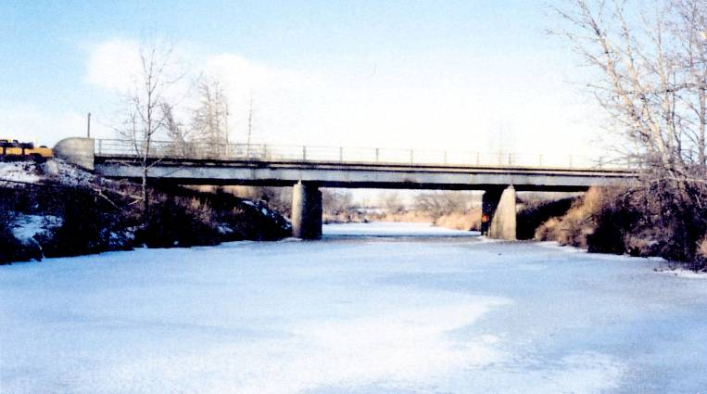
File 00278 - Battle River
Notes:
When the bridge is being inspected under non-flood conditions, it can be difficult to imagine the entire hydraulic opening filled with water.

Slide 14
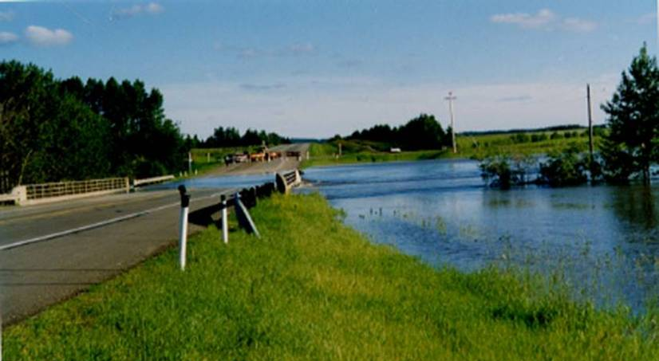
File 00278 - Battle River
Notes:
July 1990 flood on Battle River, Hwy 2A, just S of Ponoka.

Slide 15
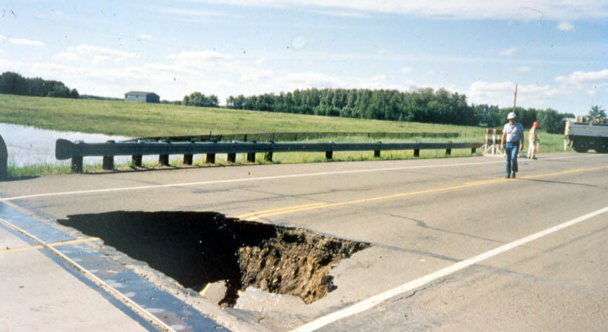
File 00278 - Battle River
Notes:
Example of damage that floods can cause, sometimes not evident until water has receded.
Void behind abutment caused by loss of material under or around abutment.
Story – RCMP vehicle almost ended up in hole.

Slide 16
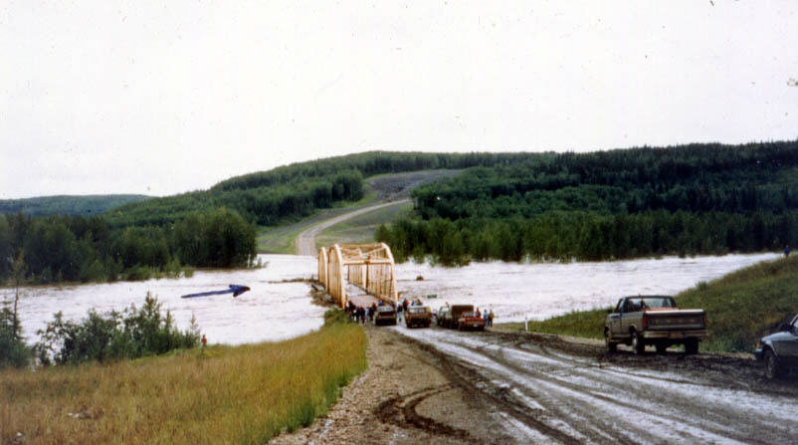
File 75194 - Simonette River
Notes:
1987 Flood - Simonette River - SH734 - E of Grande Prairie
The storm that accompanied the tornado that struck Edmonton passed over the Simonette basin dropping ~120mm of rain on the first day. The next day, it reversed its course dropping another ~120mm of rain on this basin. This is considered a very extreme event.
This photo shows water flowing over the road to the south. In some cases on low volume roads, the approach road is deliberately designed to be lower than the bridge to act as a flow relief channel
Note the accumulation of drift at the u/s face of the bridge

Slide 17
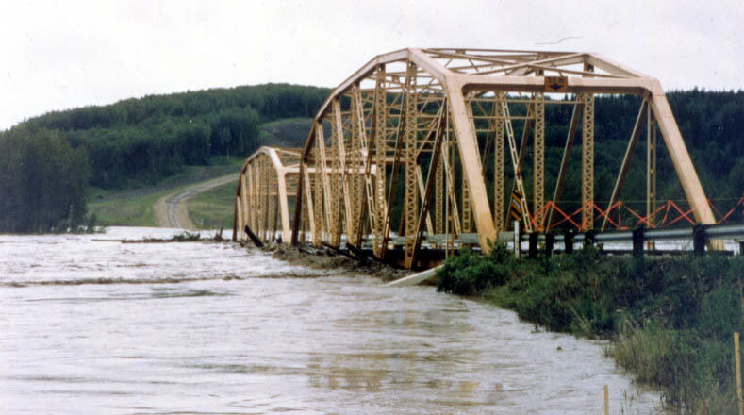
File 75194 - Simonette River
Notes:
1987 Flood - Simonette River - SH734 - E of Grande Prairie
A closer look at the drift accumulation at the bridge as all freeboard has been lost

Slide 18
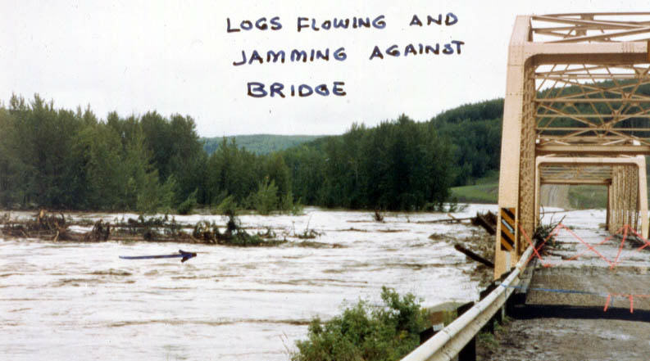
File 75194 - Simonette River
Notes:
1987 Flood - Simonette River - SH734 - E of Grande Prairie
Note that the bridge is still aligned with the roadway

Slide 19
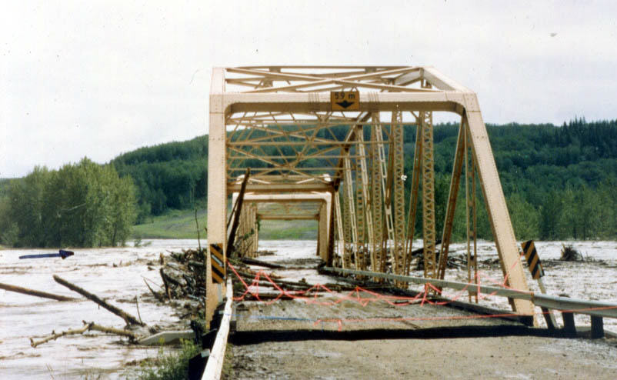
File 75194 –
Simonette River
Notes:
1987 Flood - Simonette River - SH734 - E of Grande Prairie
Bridge is no longer aligned with the road as trusses have been removed from the substructure

Slide 20
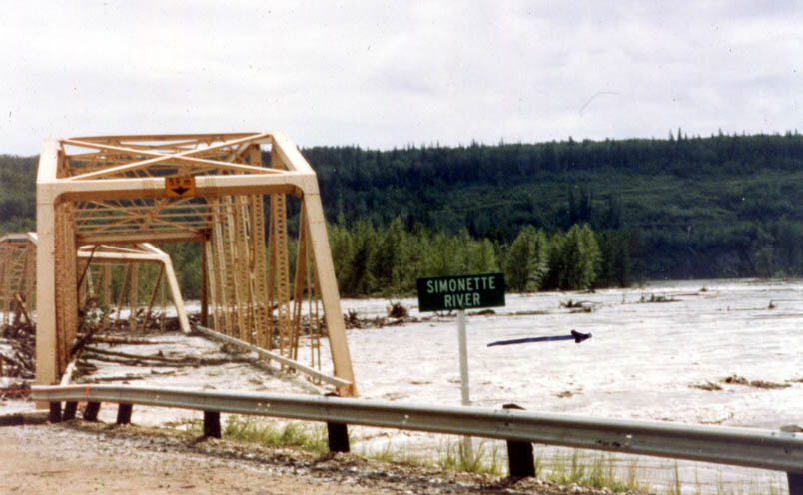
File 75194 - Simonette River
Notes:
1987 Flood - Simonette River - SH734 - E of Grande Prairie
Trusses getting carried off d/s

Slide 21
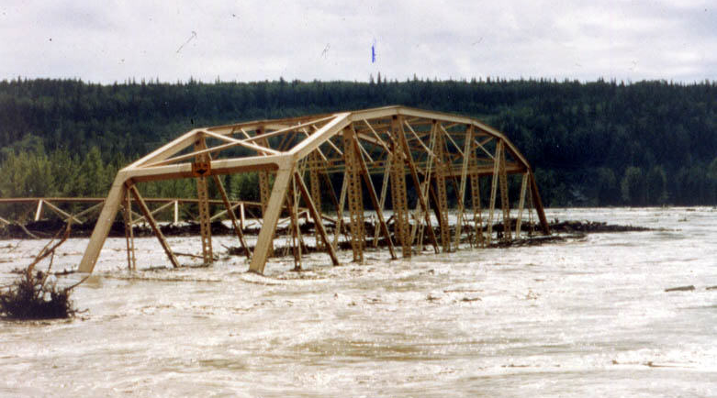
File 75194 - Simonette River
Notes:
1987 Flood - Simonette River - SH734 - E of Grande Prairie

Slide 22
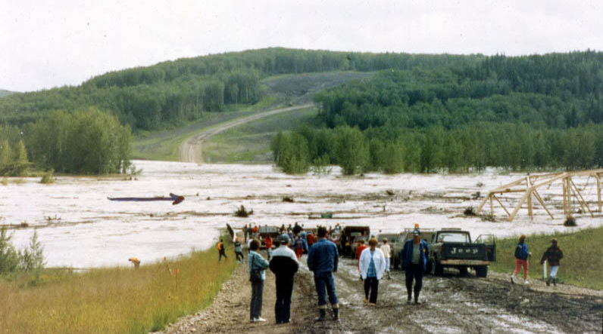
File 75194 - Simonette River
Notes:
1987 Flood - Simonette River - SH734 - E of Grande Prairie

Slide 23
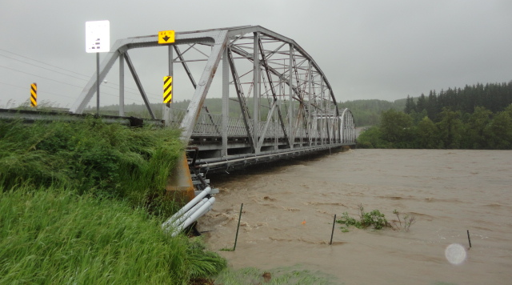
File 111 – Bow River Cochrane
Notes:
2013 Flood – Row River in Cochrane, Water levels within 0.5m of bottom chord – no room to pass flood debris.

Slide 24
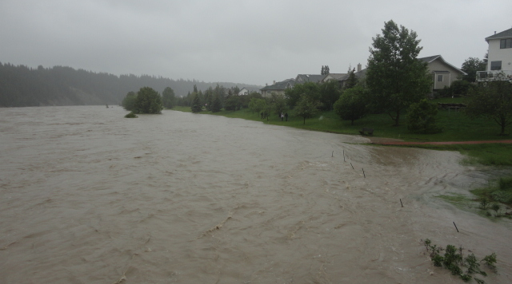
File 111 – Bow River Cochrane
Notes:
2013 Flood – Row River in Cochrane, Water levels to back yards of north bank houses.

Slide 25
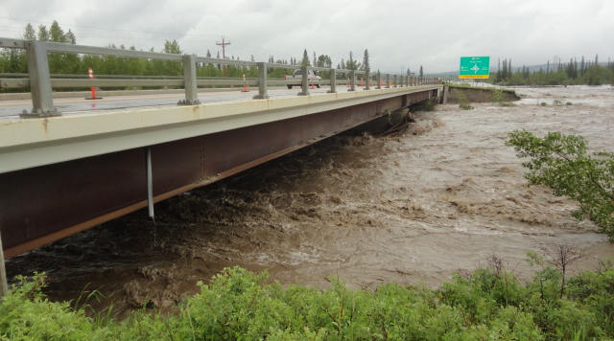
File 13545 – Elbow River
Notes:
2013 Flood – Elbow River south of Cochrane, Water level to girder tops (picture is after water receded. 1/2 of South approach washed out – overflow to south and overtopped Hwy. 22 and Hwy. 8.

Slide 26
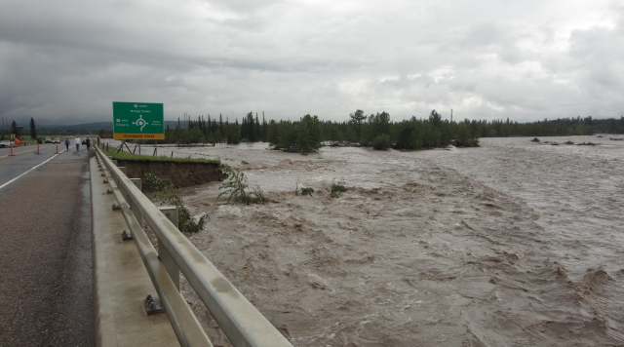
File 13545 – Elbow River
Notes:
2013 Flood – Elbow River south of Cochrane. ½ South approach washed out – overflow to south for 3 km and overtopped Hwy. 22 and Hwy. 8.

Slide 27
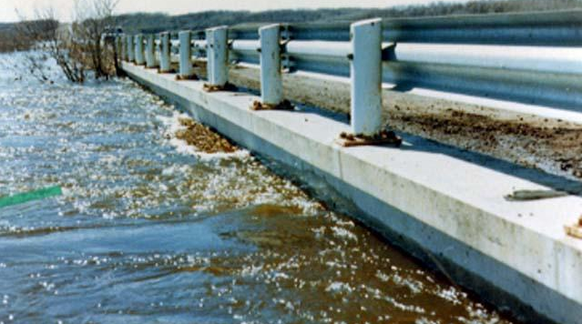
File 07107 - Iron Creek
Notes:
1974 Spring Flood - Iron Creek near Hardisty
This bridge is operating slightly beyond it’s design capacity.

Slide 28
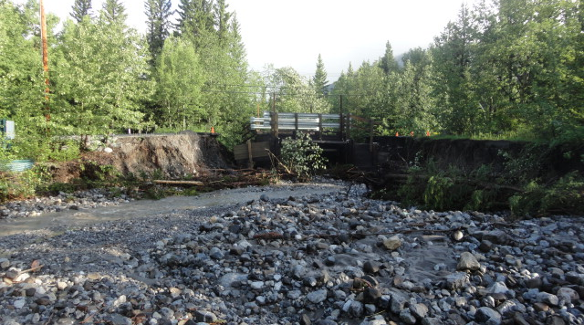
File 76887 – Smith Creek
Notes:
Lac Des Arc 2013 post flood after water levels receded. Gravel wash; high volume of debris/sediment. Bridge causing restriction compared to channel width
.

Slide 29
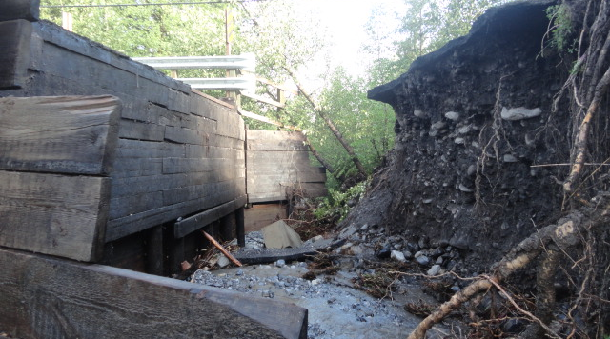
File 76887 – Smith Creek
Notes:
Lac Des Arc 2013 Spring Flood washed out both approach roads due to severe restriction and undersidersized bridge opening
.

Slide 30
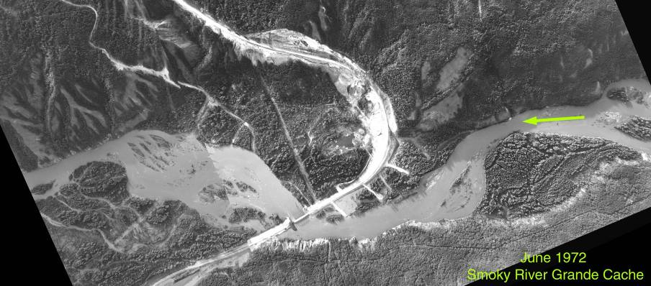
BF76474 – Smoky River at Grande Cache
Notes:
Close to peak of June 1972 flood.
Bridge opening less than channel width, alignment also an issue.
Spurs to try to direct flow
left approach span was washed out.

Slide 31
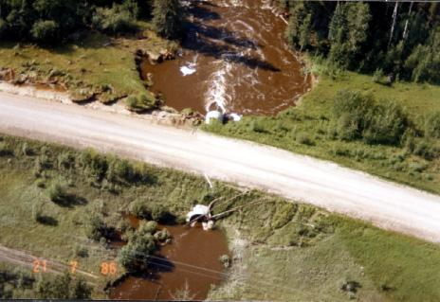
File 80827 - Nelson Creek
Notes:
Nelson Ck near Lodgepole - Local Road – After July 1986 flood.
Note hanging invert (located above streambed), d/s erosion, embankment erosion
Example of culvert constriction, flow expansion and contraction

Slide 32
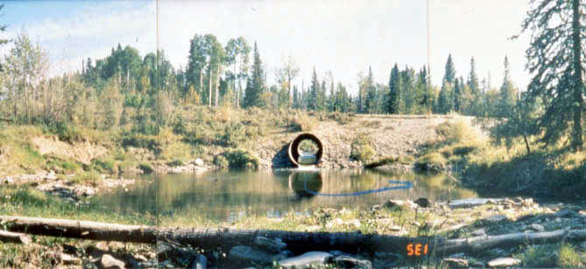
File 80827 - Nelson Creek
Notes:
View form d/s at lower flow – note scour pool.

Slide 33
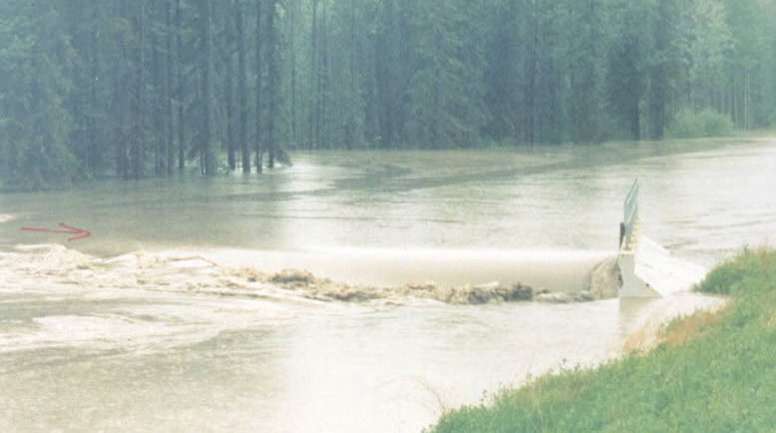
File 79475 - Bald Mountain Creek
Notes:
Hwy 40

Slide 34
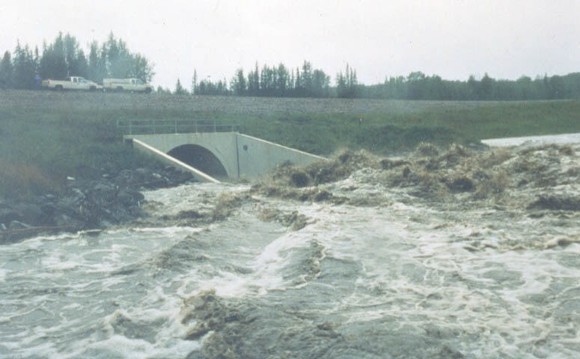
File 79475 - Bald Mountain Creek
Notes:
1990 Flood - Bald Mountain Creek - Hwy 40 - S of Grande Prairie
Close-up of flow expansion at outlet - hydraulic jump formed as flow was converted from supercritical in pipe to subcritical in the channel
Fortunately a lot of the hydraulic jump was located at the concrete end
Eye witnesses reported large noise and vibrations from the jump
Notice that the water surface is well below the crown and roadway surface. This drop across the roadway is what drives the water through the pipe, but it also means the roadway is acting as a dam.

Slide 35
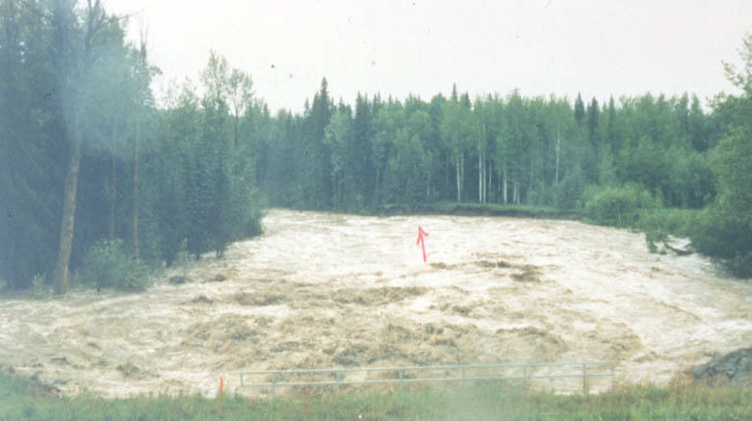
File 79475 - Bald Mountain Creek
Notes:
1990 Flood - Bald Mountain Creek - Hwy 40 - S of Grande Prairie
Looking d/s at flow expansion – erosion of opposite bank some distance away.

Slide 36
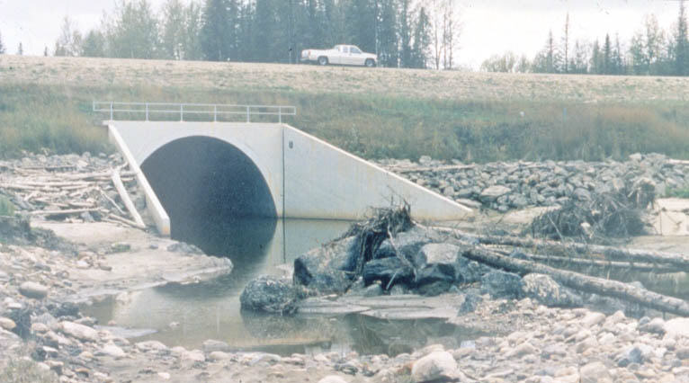
File 79475 - Bald Mountain Creek
Notes:
1990 Flood - Bald Mountain Creek - Hwy 40 - S of Grande Prairie
Same area after the flood

Slide 37
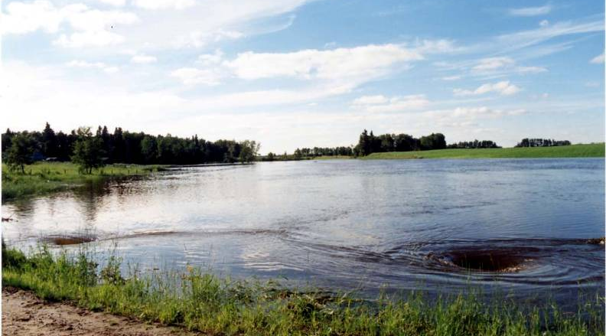
File 01324 - Pigeon Creek
Notes:
July 1990 flood – local road.
Water ponded u/s, vortexes located above culvert inlets.

Slide 38
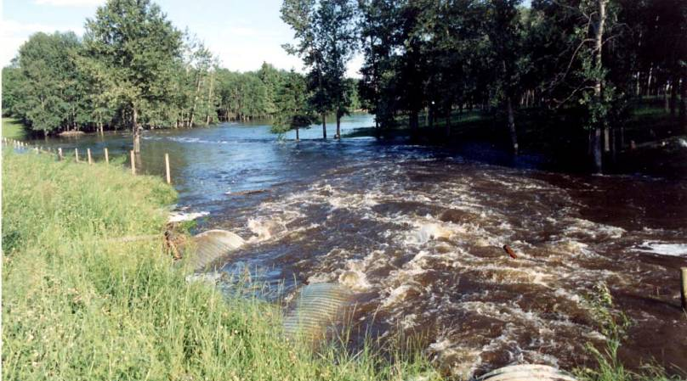
File 01324 - Pigeon Creek
Notes:
Same site, looking d/s.
Note water level lower, flow much more rough at expansion.

Slide 39
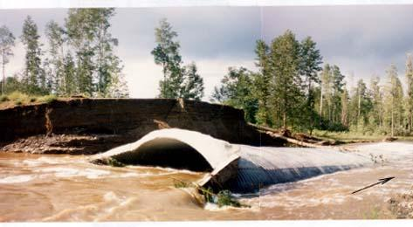
File 78230 - Brewster Creek
Notes:
July 1986 flood – local road.
Loss of culvert backfill material due to lack of a clay seal.
Pipe was not damaged until truck drove through “road closed” barrier and landed on top of unsupported pipe.

Slide 40
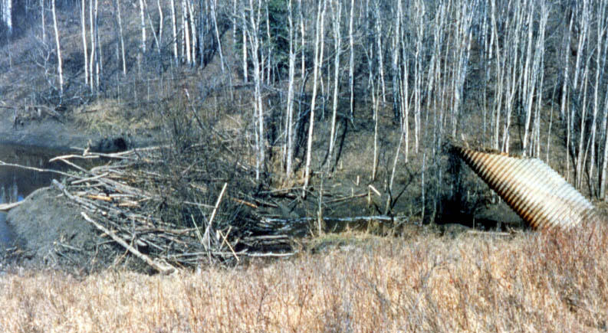
File 81653 – Unnamed Watercourse
Notes:
Watercourse culvert on local road near Spirit River
Severe uplift failure as a result of running under head.

Slide 41
River Issues
River Issues
Lateral Stream Stability

Slide 42
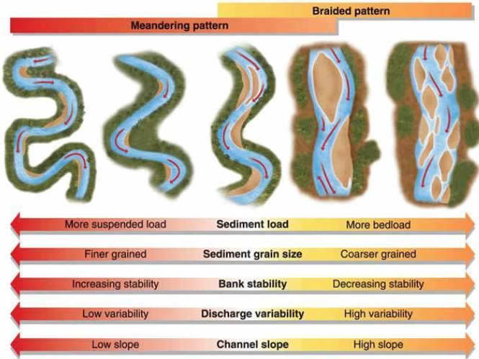
Stability of Stream Types
Prairies
Mountains

Slide 43
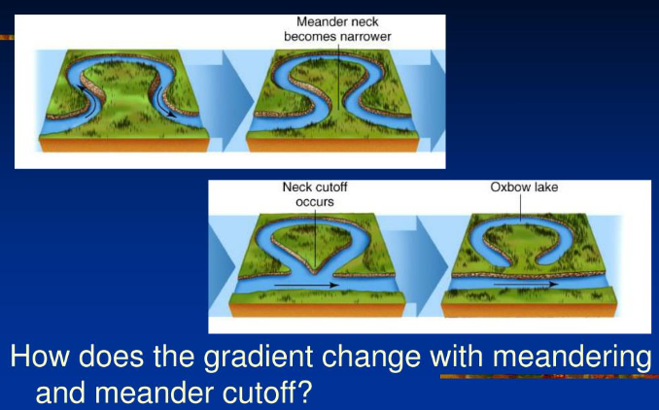
Meander Cutoff

Slide 44
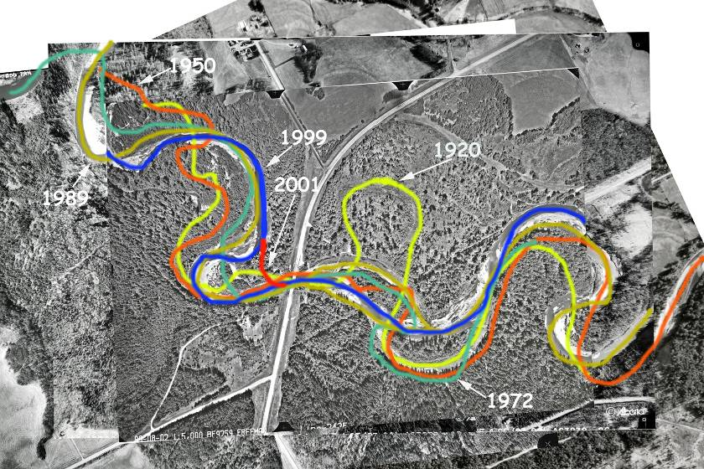
BF9259 – Freeman River
Notes:
Alignment changes can be tracked using historic airphotos
Note cutoffs between 1920 and 1950, and in 2001.

Slide 45
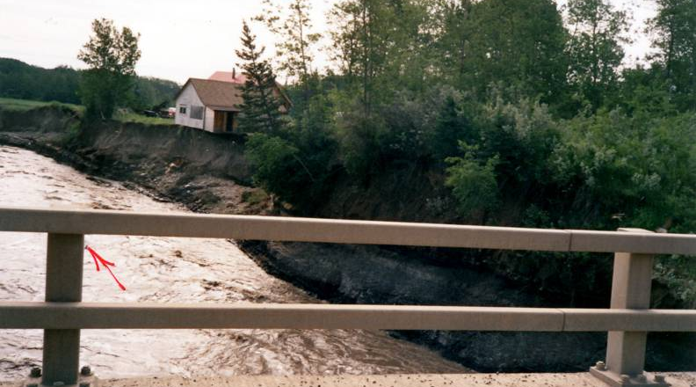
BF8036 – Redwillow River
Notes:
June 1990 flood, Hwy 722.
Note d/s bank erosion, loss of property.

Slide 46
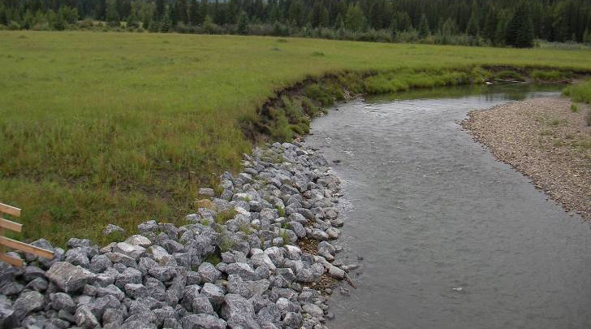
BF13078 – Little Red Deer River
Notes:
Local Road near Water Valley.
U/s bend continues to migrate to south – loss of land, likely impact on RPW in future.

Slide 47
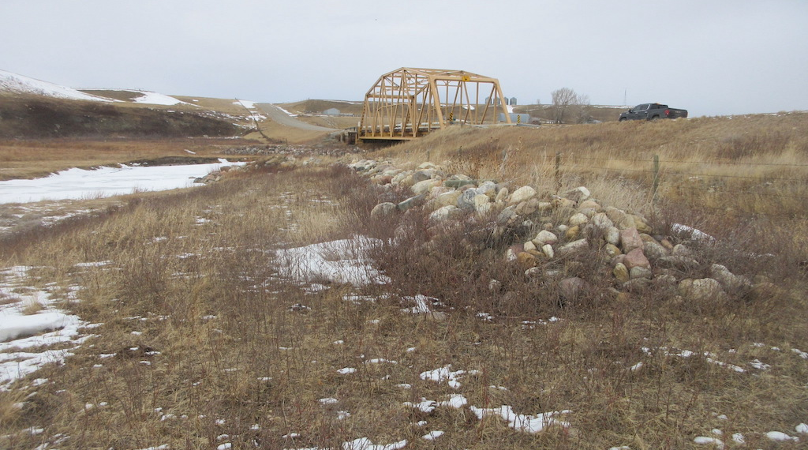
BF 9311 WCTS – North Milk River
Notes:
Local Road Del Bonita. WCTS (BGR) rock berm placed to mitigate U/S channel migrating to south and protect road.

Slide 48
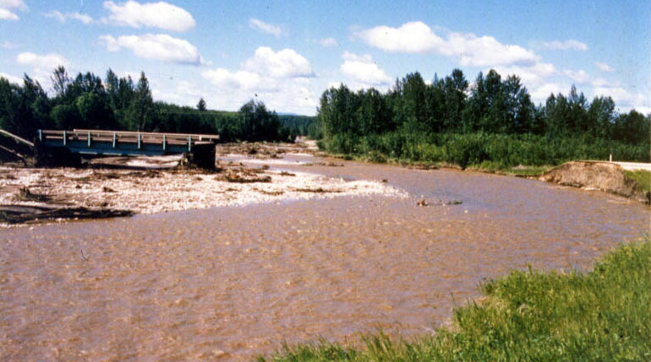
File 75904 - Island Creek
Notes:
1988 Flood - Island Ck - Hwy 33 - S of Slave Lake
Channel removed about 50m of highway fill to the north and about 10m of fill to the south of the 18m bridge
Braided streams can switch channel alignments very quickly.

Slide 49
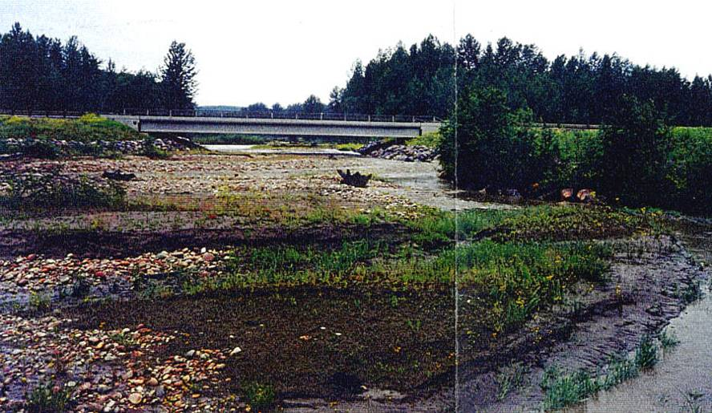
File 75904 - Island Creek
Notes:
Island Ck - Hwy 33 - S of Slave Lake
Looking d/s at new bridge - note the growth around the spurs in the foreground

Slide 50
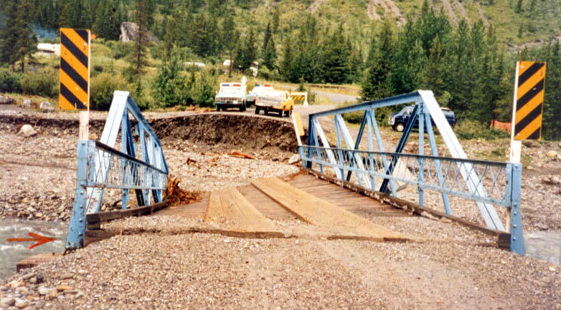
File 73204 - Whitehorse Creek
Notes:
1989 Flood - Whitehorse Ck near Cadomin - Local Road
Flood washed out ~ 30m of road fill to the north of the 18m bridge
There was a gravel berm located on the left (north) bank u/s of the bridge in front of the campground prior to the flood but it was demolished by the flood

Slide 51
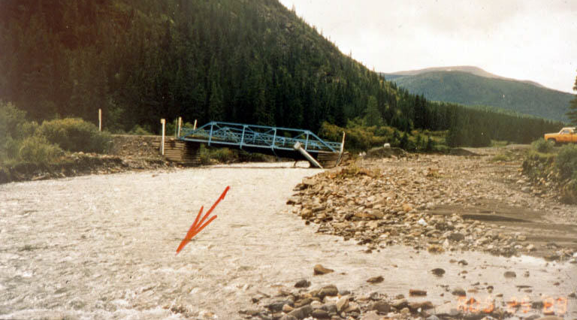
File 73204 - Whitehorse Creek
Notes:
1989 Flood - Whitehorse Ck near Cadomin - Local Road
Looking u/s at eroded channel
Right (south) abutment was protected by a natural rock outcrop

Slide 52
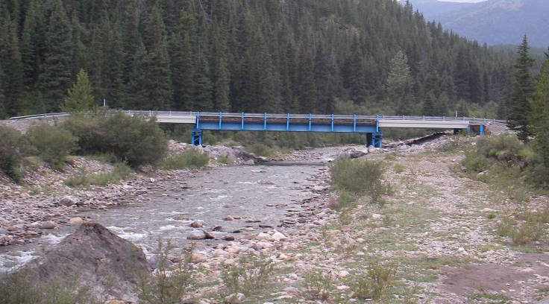
File 73204 - Whitehorse Creek
Notes:
2007 photo looking U/S at 1989 bridge replacement.

Slide 53
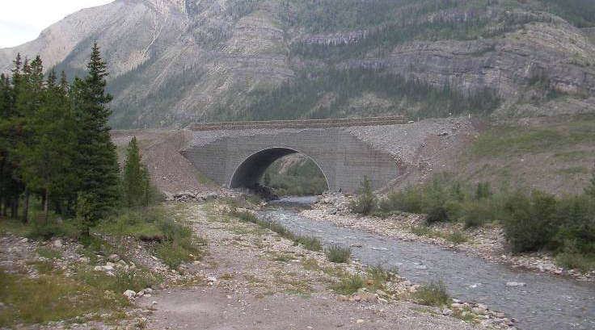
File 73204 - Whitehorse Creek
Notes:
2007 photo looking d/s at ~ 2005 culvert
~ 24m open bottom arch built by mining company
susceptible to failure should channel migrate as per July 1989 flood.

Slide 54
River Issues
Blockage - Drift, ice …
Blockages, Drift, Ice…

Slide 55
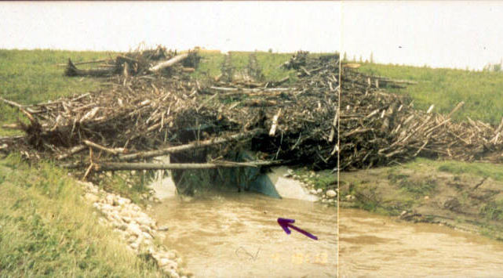
File 78889 - Whitecourt Creek
Notes:
1989 Flood - Whitecourt Ck - SE of Whitecourt
Drift accumulation at u/s end of culvert partially blocking the entrance
Blockage results in higher u/s water levels and increased differential pressures on the culvert
Note that the highest piece of drift does not necessarily coincide with high water level as it may have been shoved up the embankment by the flowing water or may have been pulled out by a maintenance crew

Slide 56
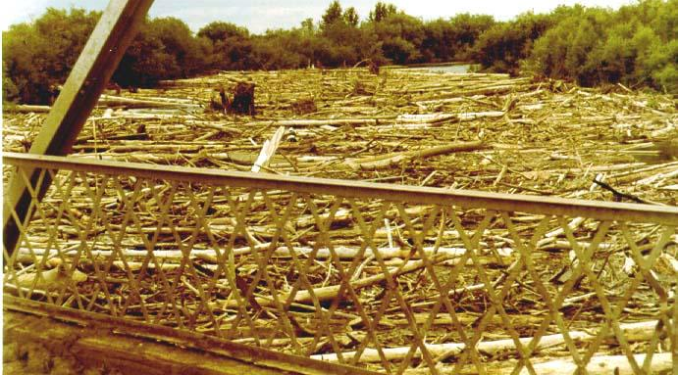
File 71979 - Heart River
Notes:
Heart River near High Prairie
Deadfall, beaver activity and landslides move debris downslope onto the river edges where it can be mobilized.

Slide 57
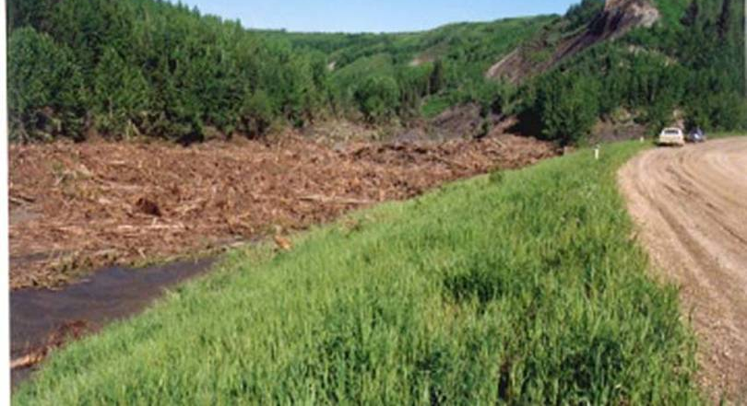
File 72964 – Howard Ck
Notes:
June 1990 flood – SH727 near Spirit River.

Slide 58
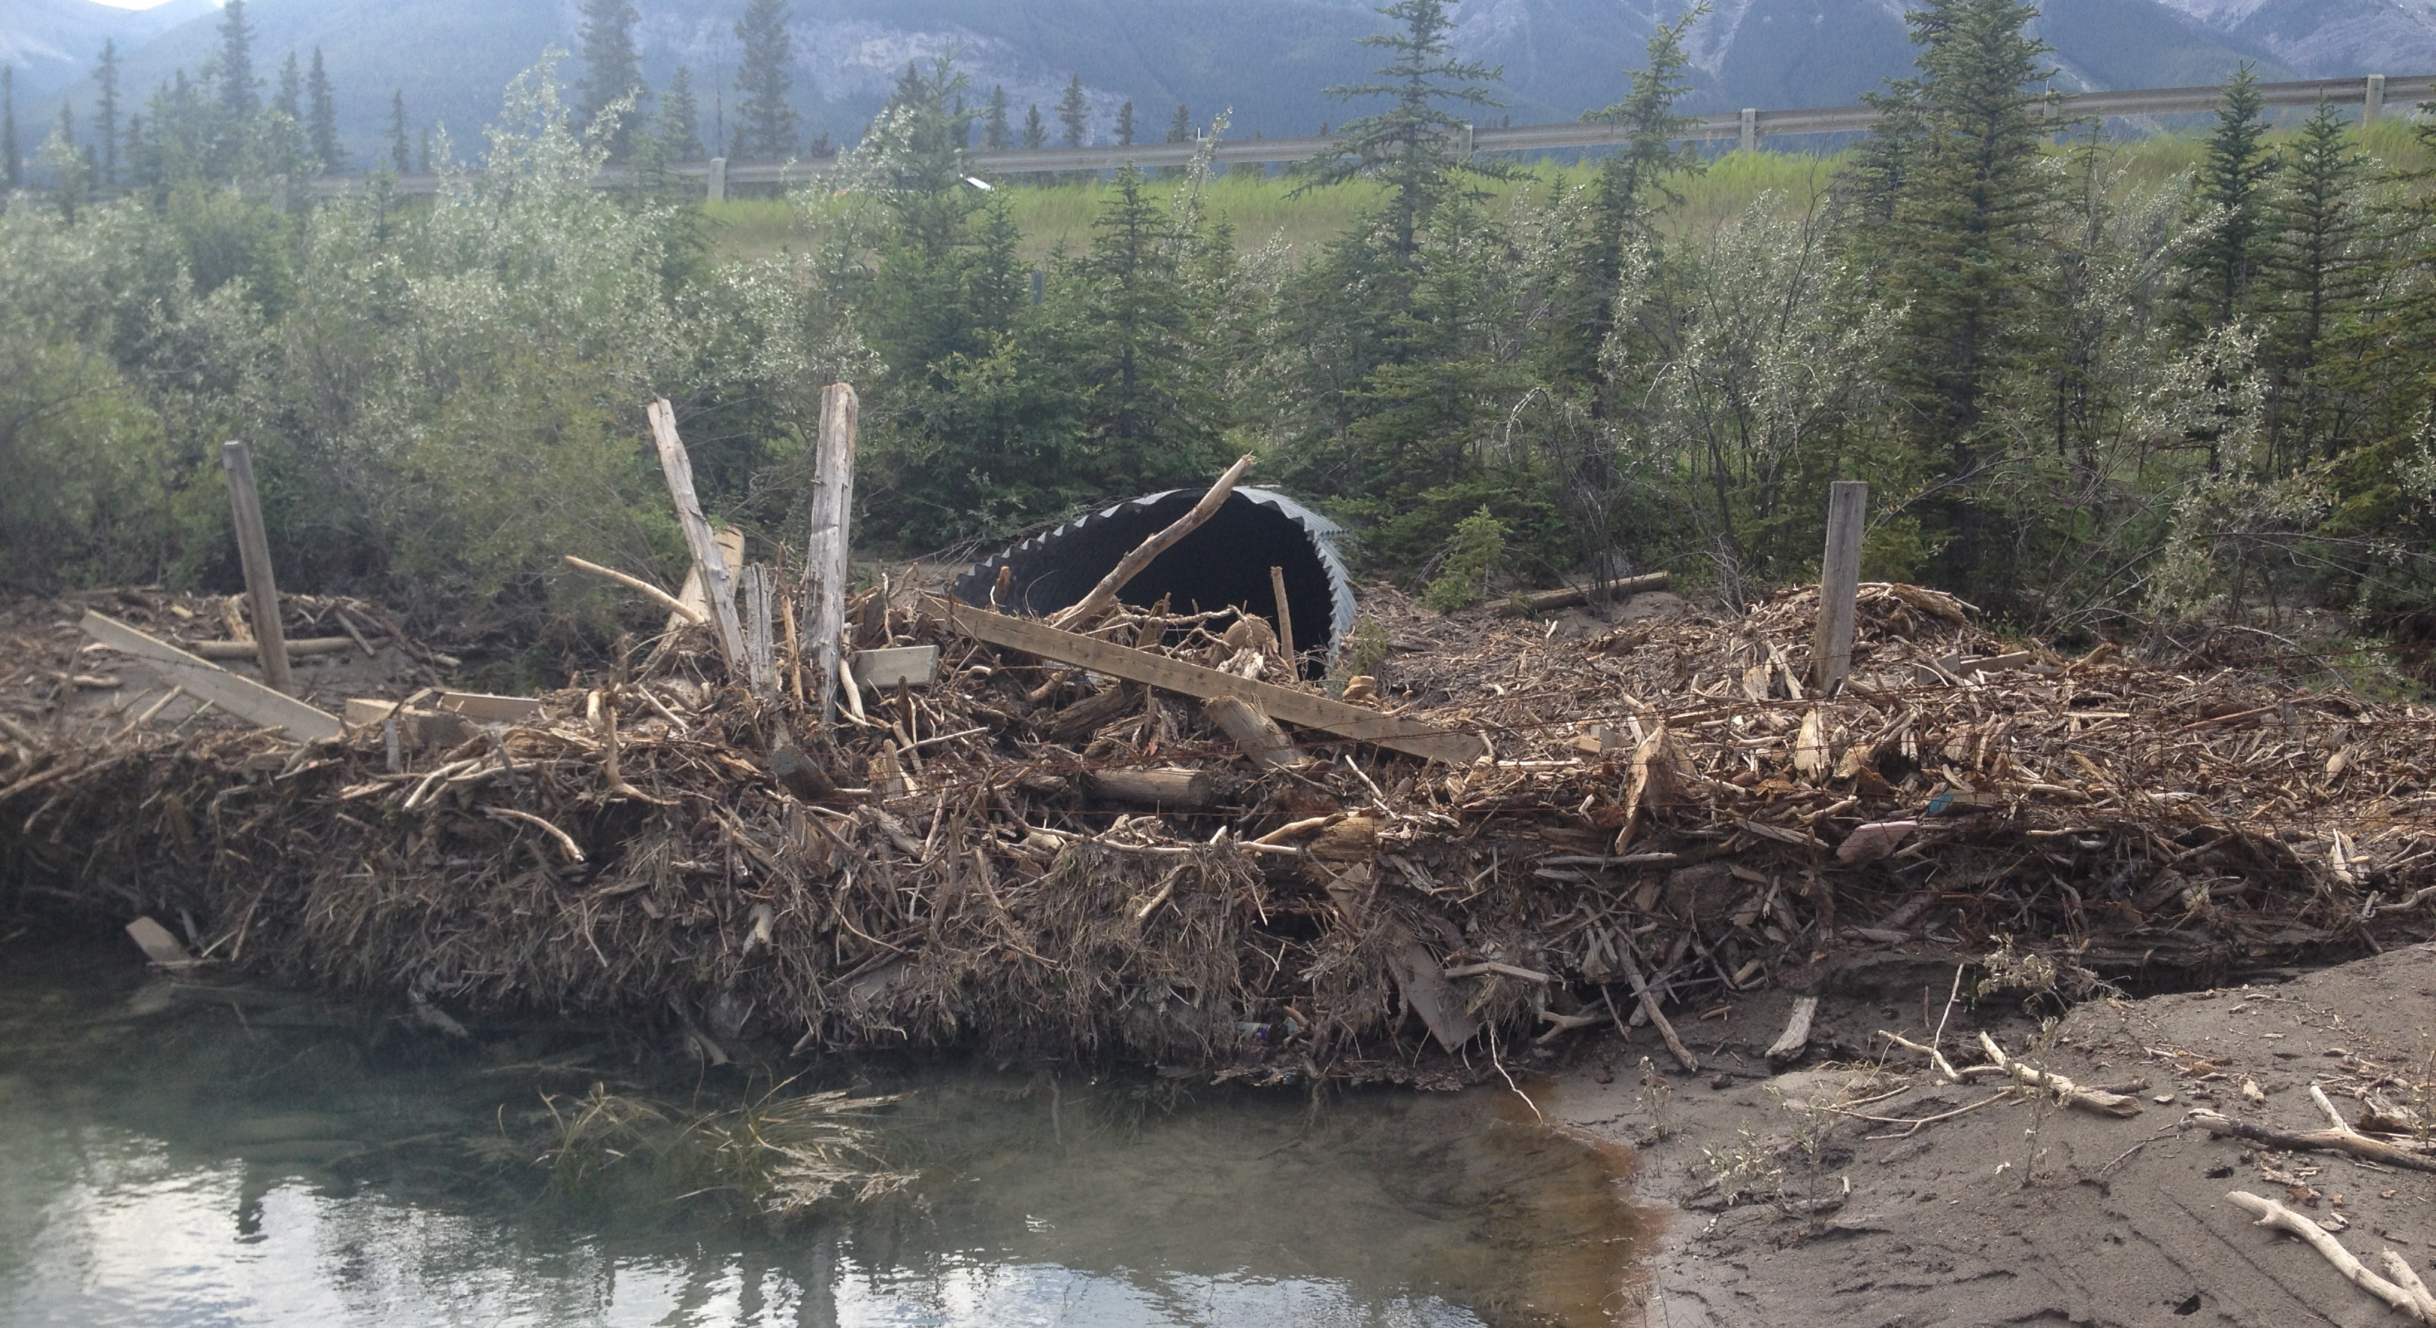
File 74364 – Tributary to Bow River
Notes:
July 2013 flood – Hwy. 1 near Canmore. 80% blockage at inlet of 2490 mm pipe

Slide 59
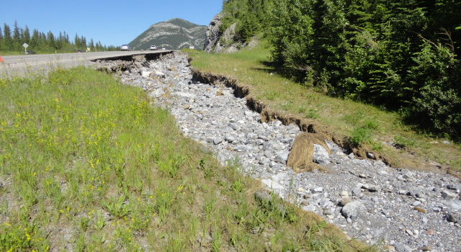
File 74364 – Tributary to Bow River
Notes:
July 2013 flood – Hwy. 1 near Canmore. 80% blockage at inlet of 2490 mm pipe diverted flow along TCH and undermined shoulder

Slide 60
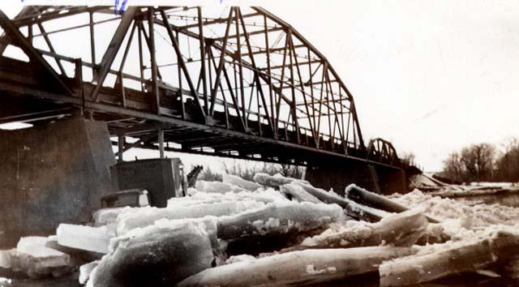
BF 6754 Bow River at Cluny
Notes:
Ice jams – right conditions of ice strength and increase in flow – more common in northerly flowing rivers.
Can result in drastic increase in stage due to roughness on surface e.g. Athabasca River at Fort McMurray – HI 6 – 8m higher than HW.

Slide 61

Ice scarring on trees
Notes:
These ice scars can be seen facing upstream on trees right at the top of bank.
This information is extremely valuable to bridge designers.

Slide 62


Ice impact damage and abrasion on piers
Notes:
Ice scars can also be found on the bridge structure itself in the form of:
abrasion to timber pier piles, mass concrete piers or nose irons,
scraped paint on pipe piles,
bending of lower elements of truss structures.

Slide 63


BF 7363
Notes:
Ice impact to mid height of lead pier pile resulted in broken/split pile,

Slide 64

Other debris?
Notes:
1986 Flood - Baptiste River
Existing bridge washed away and got stuck under the replacement structure ~300m d/s, which was close to being opened

Slide 65
River Issues
Blockage - Drift, ice …
Vertical Stream Stability

Slide 66
Typical Stream Profile
Erosion Reach
Transport Reach
Deposition Reach
Steeper Slope
Erosion = Deposition
Flatter Slope
Degradation
Aggradation
Deltas, Fans
Elevation (m)
Bedrock
Sediment
Distance From Headwater (km)
Notes:
Erosion Reach - Initially, the stream will be quite steep. It will be actively eroding in this reach as the stream picks up sediment to complement its sediment transport capacity. Most of the sediment transport will be in the form of bed load - larger particles tumbling along the stream bed. These reaches may be actively degrading and unstable braided patterns are common.
Transport Reach - This reach is characterized by a balance between erosion and deposition. The channel may still be actively eroding laterally, but will not be degrading. Typical channel patterns in this reach is the meandering river. Channel slopes will be flatter. Sediment transport will include both bed load and suspended sediment - finer particles remaining suspended in the water for a long period of time.
Deposition Reach - As the slope gets even flatter, the stream will lose its sediment transport capacity and there will be a net deposition of material. These reaches may be actively aggrading, and lateral channel stability decreases. These reaches may be characterized by alluvial fans and deltas.
Downcutting - An alternative to the deposition reach near the mouth of the river is a downcutting reach, where the channel may be actively degrading in order to cut down to match the elevation of the receiving stream.

Slide 67

File 76617 - Cougar Creek
Notes:
Cougar Creek near Canmore after cleaning which occurred annually but eventually lessened..

Slide 68

File 76617 - Cougar Creek
Notes:
Cougar Creek Triple cell concrete boxes completely plugged and flow diverting around boxes.

Slide 69

File 76617 - Cougar Creek
Notes:
BF 76617 Cougar Creek near Canmore. 2013 flood moved rock and granular from normally dry U/S channel causing complete blockage of triple cell (2438 – 7314 clear opening) concrete boxes that had not been recently cleared of granular and diverted flow to east. Top of inspectors head is at grade with TCH. .

Slide 70

File 74352W&E damage from 76617 Cougar Ck Overflow
Notes:
Overflow from blocked triple cell concrete boxes at Cougar Creek ran east in ditch and median of TCH causing significant damage to BF 74352 WB (on left) and EB (on right) – both with washed out approaches, undermined abutments and approach slabs, and 50% of TCH washed out. .

Slide 71

File 74352W&E damage from BF 76617 - Cougar Creek overflow
Notes:
Near 1 km section of Hwy 1 closed from Cougar Creek overflow. For 3 days TCH was parking lot of semi trucks that could not turn around. .

Slide 72

BF74852 – Bear River
Notes:
Channel degradation resulting from channel modifications by AENV.
Note steep channel banks, blue paint on pier piles.

Slide 73

BF74852 – Bear River
Notes:
Same site looking u/s from bridge.

Slide 74

BF73235 – Cucumber Ck
Notes:
Local road near Hairy Hill
After June 2007 local storm, severe damage to d/s end of culvert and d/s channel.
Survey measurements suggest degradation rather than just expansion scour hole.

Slide 75

BF73235 – Cucumber Ck
Notes:
Bank several 100m d/s shows sign of recent downcutting, and HWM that are too high for current channel.

Slide 76

BF73235 – Cucumber Ck
Notes:
Looking u/s at d/s end of pipe.
Pipe was constructed in previous year with some burial and protection works.

Slide 77
General Scour
Notes:
General scour is sometimes also referred to as constriction scour. The higher velocities through a channel constriction will cause a general lowering of the stream bed across its width. The depth of scour will depend on the degree of constriction of the flow, the geotechnical conditions, and the runoff hydrograph properties.
General scour will quite often infill during the recession limb of the runoff hydrograph, and can be difficult to measure. The stability of substructure components must be examined under assumed general scour conditions.
Another type of scour that would occur even if the bridge was not in place is called Natural Scour. Many streambeds become mobile during flood events, with increased sediment transport, bedform migration, and channel shifting.

Slide 78

BF74710 – Berland River
Notes:
Hwy 40 :
Constricted opening resulting in lowering of bed through opening.
Note exposed pier piles. Rock and piles have been added.

Slide 79
Local Scour Profile
Notes:
Local scour is a lowering of the streambed in response to an obstruction to the flow. Complex 3D flow patterns result from an obstruction to the flow, with high local stresses which can remove bed material from around the obstruction. At bridge sites, this is mostly of concern at piers and abutments.
The depth of local scour holes is largely dependent on the effective width of the obstruction relative to the flow. Another major factor is the approach angle of the flow (skew) which can change over time in dynamic river environments. Other factors that affect the depth of scour include : bed material gradation and size, velocity and depth of flow, shape of pier, duration of hydrograph, foundation configuration, and interaction with other scour processes.
As with general scour, the depth of local scour can be difficult to measure after a flood due to infilling. However, local scour can often occur at less extreme events than general scour. Geotechnical conditions have more impact on the time required for the expected local scour to form, than on the actual depth of scour. In Alberta, significant local scour has been observed at many sites where the foundations were placed on bedrock, but the rock weathered over time.

Slide 80

Drift accumulation
Increased velocities and scour around piers.
Notes:
Obstruction to flow can increase velocities around the pier causing localized scour on the stream bed and deflect flow against banks. Drift should be manually cleared if it accumulates.

Slide 81

Smoky River CanFor Bridge
Failure of a pier on spread footing due to general scour
Notes:
This pier failed because of general scour dropping the sand bed below the elevation of the spread footing.

Slide 82
River Issues
Blockage - Drift, ice …
River Protection Works

Slide 83
Location of River Protection Works
Embankment
Spurs
Spurs
Guidebank
Grade Control
Structure
Dyke
Notes:
In addition to lining a headslope or bank with protection materials, some other structures can be employed to improve protection at a site. These include :
Spurs - structures projecting into the flow, placed close to perpendicular to the flow. Intended to stabilize or protect banks by deflecting flows away from the bank. They are usually built in groups or designed to act in combination with a guidebank or other protected structure.
Guidebank - built parallel to the flow. Stabilize banks and align flow through structures, decreasing the effect of the expansion and contraction of flow.
Embankment Spurs - stub fills placed perpendicular to the roadway fill to prevent floodplain flow from flowing parallel to the roadway fill.
Dyke - an embankment that generally parallels the channel to minimize the impact of flood levels on surrounding properties.
Grade Control Structure - a weir placed across the channel downstream of a crossing structure to maintain the bed elevation (arresting degradation and general scour) and generate higher tailwater levels.

Slide 84
Typical Rock Riprap Section
1
2
Notes:
Rock riprap is one of the major materials used in river protection systems. Some of its advantages are : relatively easy handling during construction, flexibility to handle minor settlements, and easy maintenance. Four classes of rock are in use of by Alberta Transportation, with gradations specified. Rock durability and angularity are important aspects of the effectiveness of a protection system
The typical rock protection will include a launching apron at the toe of the slope, which will have enough rock to fill into a scour hole while maintaining protection of the fill. Most riprap will be underlain by non-woven geotextile filter fabric to prevent loss of fine material from the fill.
The class of rock to use depends on the flow characteristics (velocity, shear stress). The extent of rock will depend on the site geometry and channel stability.
In some cases, rock can be very expensive due to large transportation costs. In these cases, alternative materials may become more attractive. These include : concrete, gabions (wire baskets filled with cobbles), interlocking concrete blocks, and concrete filled mattresses, and even sandbags. In some cases, encouraging vegetation growth may be a suitable form of protection.

Slide 85

File 81795B - Red Deer River (1992)
Notes:
Hwy 10 encroachment - Red Deer River - E of Drumheller
Airphoto view of entire reach shortly after construction

Slide 86

File 81795B - Red Deer River
Notes:
Hwy 10 encroachment - Red Deer River - E of Drumheller

Slide 87

File 81795B - Red Deer River (1999)
Notes:
Hwy 10 encroachment - Red Deer River - E of Drumheller
More recent airphoto view of entire reach, note deposition of material between spurs

Slide 88

File 81778B - Wapiti River
Notes:
Wapiti River - Hwy 40 - S of Grande Prairie
More recent airphoto showing material deposition and vegetation around spurs

Slide 89

File 81793B - Swan River
Notes:
Swan River - Hwy 2 - near Kinuso
Airphoto view of site (NE to the top of photo, flow from right to left)
Third group of spurs is located on the left bank just u/s of the bridge (in front of driveway to farm)
The rating curve for the WSC gauge at this location is very unstable due to channel changes, including degradation due to downstream man-made channel realignments
This portion of the river is somewhat like a delta as the Swan River meets Lesser Slave Lake in the ancient lakebed deposits.

Slide 90

File 81793B - Swan River
Notes:
Swan River - Hwy 2 - near Kinuso
This group is located where the river bends back towards the highway d/s

Slide 91

File 81793B - Swan River
Notes:
Swan River - Hwy 2 - near Kinuso
3 groups of timber spurs have been used at this site to prevent bank erosion and protect the highway and bridge
The bridge is located between two meander loops
This group is located at a bend just u/s of the bridge, with the highway just behind the trees

Slide 92

Questions?

