Slide 1
MAJOR SUPERSTRUCTURE INSPECTION & RATING

Slide 2
Wearing Surface
Bonded or fastened to the deck
In direct contact with the traffic
Not part of the “structural” deck
Purpose
  Protects the bridge deck
    traffic wear
    salt and water infiltration
  Provides a smooth wearing surface
  Provides skid resistance

Slide 3
Wearing Surface
  Concrete overlay
    silica fume
    high density
    latex modified
    other (Pyrament)
    fiber reinforced
  Others
    Steel grating
  May have more than one type
    i.e. polymer membrane on concrete overlay
Types
  Asphalt
    Current standard is 2 - 40 mm lifts and 10 mm waterproofing membrane
  Timber
    untreated
    Treated
  Polymer membranes

Slide 4
Wearing Surface
Drive over deck at design or posted speed
Observe traffic crossing bridge
  Look for deflections or movement
  Listen for unusual noises
Look for defects common to the material
Look for debonding, loosening or loss of wearing surface
  Sound for debonding using hammer if suspected
Look for protruding nails in timber wearing surfaces
Look for loss of aggregate from polymer wearing surfaces or seal coats
Look for polishing of concrete overlays especially high density

Slide 5
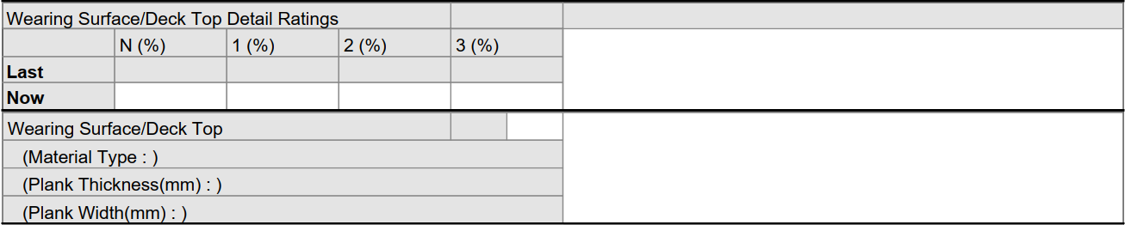
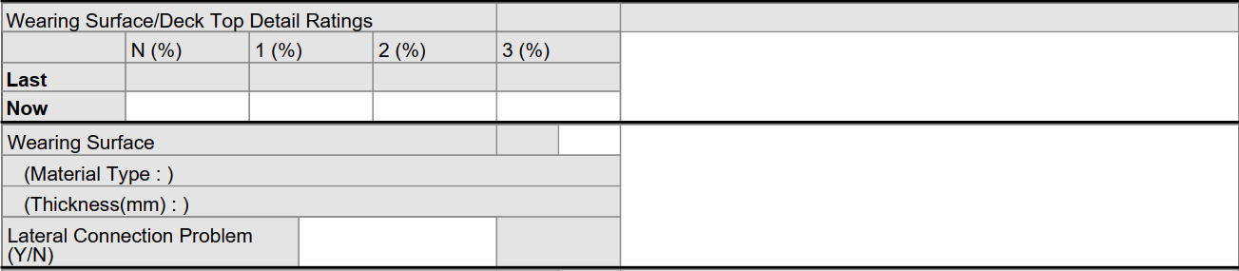
Wearing Surface
TT, TH and PT forms
PCS and PSR only
PCS, PSR, SG, SS, DT and CON forms

Slide 6
Wearing Surface
Record or verify type
Record or verify
  Thickness (design curb heights can be found in table 7.2)
  Size (TH & PT only)
Record or verify the presence of Lateral Connection Problem (Y/N)
  PSR and PCS only
  Rate under girders
If no wearing surface, rating is for Deck Top
  TH, PT and TT only

Slide 7
Wearing Surface
Record in Explanation of Condition location, severity and extent of
  Wear
  Scaling / raveling
  Cracks
  Debonding
  Wearing surface loss

Slide 8
Wearing Surface
Rate according to existing condition and functionality
If wearing surface does not have sufficient skid resistance
  rate 4 or less
If wearing surface does not cover the entire deck (curb to curb) and the condition creates a possible wheel trap
  rate 4 or less
  rate 2 if traffic hazard
Exposed nails or other fasteners
  rate 4 or less
Speed reduced due to potholes, missing planks, ruts or other deterioration
  rate 4 or less

Slide 9
Wearing Surface
Asphalt wearing surface
  longitudinal or transverse cracks - rate 7 or less
  cracks with edges raveling – rate 4 or less
  rutting rate 4 or less
  potholes or debonding (difficult to determine on Level 1) – rate 4 or less
Concrete to Grade or Concrete Overlay wearing surface
  narrow cracks - rate 5
  Wide cracks - rate 4 or less
  Severe scaling exposed aggregate, spalling or debonding – rate 3 or less

Slide 10
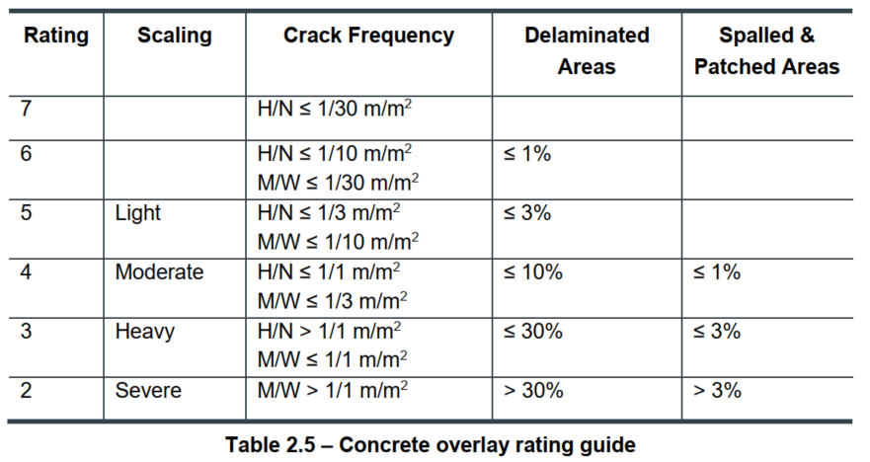
Wearing Surface
Crack definitions
  Hairlines <0.1 mm
  Narrow >0.1 mm and <0.3 mm
  Medium >0.3 mm and <1.0 mm
  Wide >1.0 mm
Note: Table is from Level 2 Manual

Slide 11
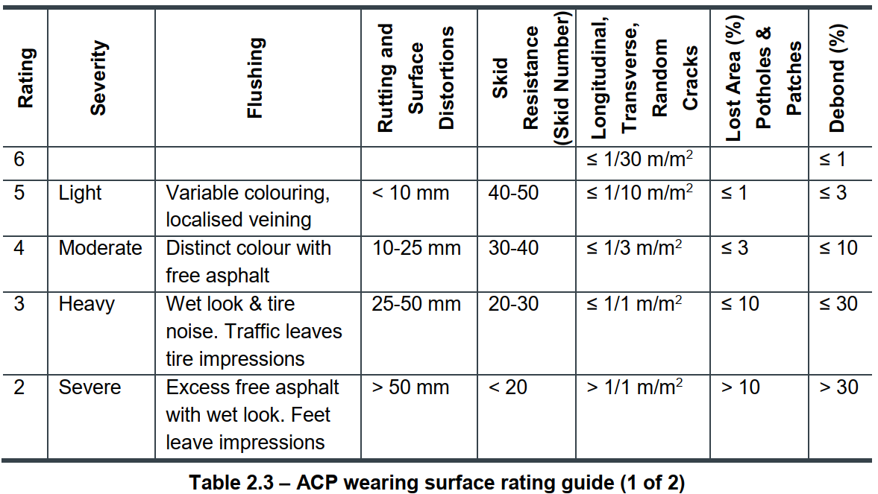
Wearing Surface
Note: Table is from Level 2 Manual

Slide 12
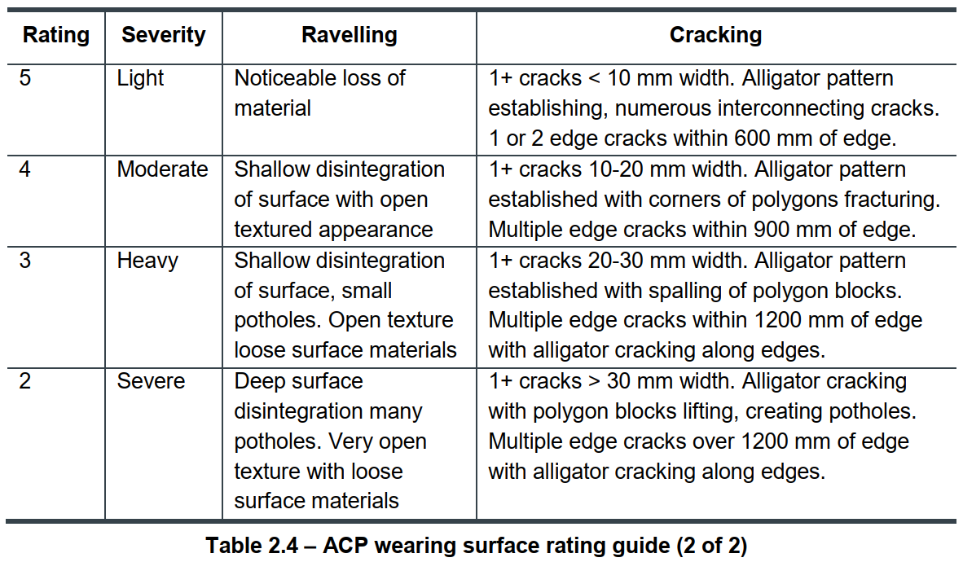
Wearing Surface
Note: Table is from Level 2 Manual

Slide 13
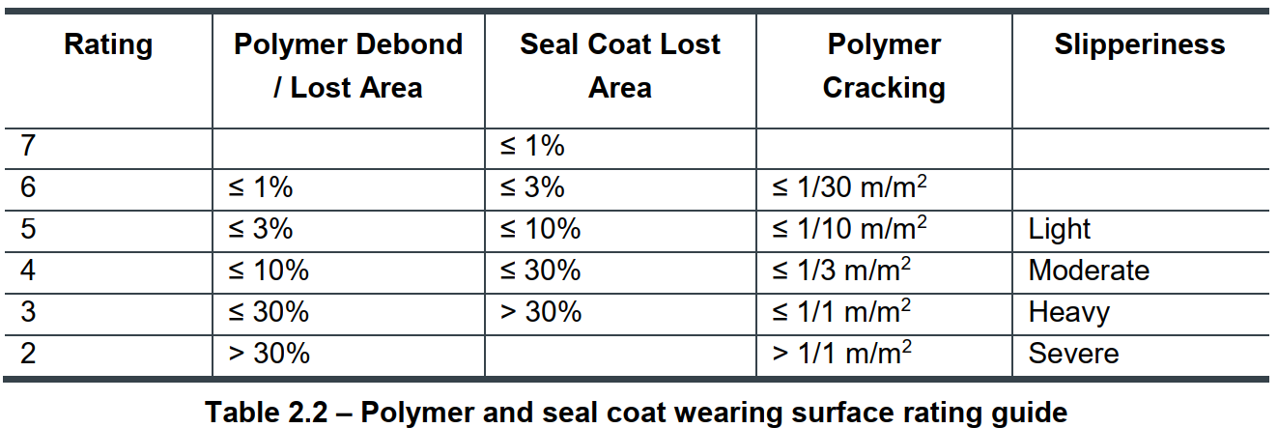
Wearing Surface
Note: Table is from Level 2 Manual

Slide 14
Deck Drainage
Not included on TT, PT or TH forms
Poor drainage
  Common cause of deck deterioration
  May cause a hazard due to hydroplaning or icing
  Caused by inadequate design, construction or maintenance practices
  May affect other bridge elements
    superstructure
    substructure
    headslopes and sideslopes

Slide 15
Deck Drainage
Drainage system includes
  gutters, inlet boxes, scuppers, downpipes and catch basins
  drainage problems at deck joints
    sealed
    with plumbing
    non-watertight

Slide 16
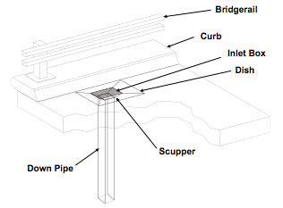
Deck Drainage
Deck Drain

Slide 17
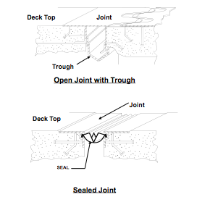
Deck Drainage

Slide 18
Deck Drainage
Check drainage systems for:
  plugging of inlet boxes, scuppers, downpipes and joint plumbing
  corrosion of metal components
  gouges, cracks, breaks or tears
    joint seals
  integrity of attachments and connections
    loose or missing bolts
    cracked or broken welds
    loose or open connections
  length of downpipes

Slide 19
Deck Drainage
Check for:
  signs of ponding on the deck
  damage to the deck, curbs, girders and substructure
    staining (water and rebar corrosion)
    scaling
    freeze-thaw
    delaminations
    spalling
  erosion below downpipe

Slide 20
Deck Drainage
Record or verify if drains or joint plumbing is clogged

Slide 21
Deck Drainage
For timber decks or steel grating rate X
  not on TT, TH & PT forms
Water ponded on the deck rate 4 or less
Ponding water is a hazard rate 2
Drains leak or downpipes too short rate 4 or less
Ponding, leakage or discharge causes significant deterioration of deck, curbs, girders or substructure rate 3 or less
Erosion on sideslopes or headslopes from discharge rate 4 or less
Deck joint leakage causing damage - reduce rating

Slide 22
Deck Top/ Underside
Purpose
  Carries traffic loads
  Transfers loads to main structural members
  Can be in direct contact with traffic in the absence of a wearing surface
Types
  Cast in place concrete
  Precast concrete
  Timber
  Steel grate
Separate ratings for top and underside
  Except for PCS, rate underside with top and girders
May not be inspectable from the top
  Wearing surface
  Snow, ice or gravel

Slide 23
Deck Top/ Underside
Drive over deck at design or posted speed
Observe deck under traffic
  Listen for unusual noises
  Look for deflections or movement
Look over deck top and underside for problems with material
On concrete decks, sound suspect areas with a hammer to detect delaminations
  Birdbath locations
  Stained areas
  Badly cracked areas or adjacent to large cracks

Slide 24
Deck Top/ Underside
Deck Top rated separately except for PT, TH and TT where Wearing Surface / Deck Top combined
Applies to PT, TH and TT only
Applies to DT and SS only
Remainder applies to SG, PSR, CON, DT and SS

Slide 25
Deck Top/ Underside
Record or verify subdeck type and size for TH, PT& TT
Record or verify deck underside
  % defects for TH, PT & TT
  % stains for all others
Record if snow slots filled for DT & SS
Record location, severity and extent of
  Staining
  Scaling
  Cracks
  Delaminations
  Spalling

Slide 26
Deck Top / Underside
Rate according to existing condition and functionality
Speed reduced due to deterioration
  rate 4 or less
Surface does not have sufficient skid resistance
  rate 4 or less
Steel grating
  connections are loose or broken rate 4 or less
  improper bearing or support on girders rate 4 or less
Timber
  minor splitting in non-adjacent planks - rate 5 or more
  any rot - rate 4 or less
  broken planks - rate 4 or less
  connections loose or broken - rate 4 or less

Slide 27
Deck Underside
Box or voided girder units (e.g. PM, VM, RD, RM) deck underside is not directly visible but is considered as deck underside and rated accordingly
- rating would govern girder rating if no top side defects
Concrete deck underside with Minot crack and stains – rate 5
Spalling, severe scaling (exposed aggregate/>25 mm deep – rate 4 or less

Slide 28
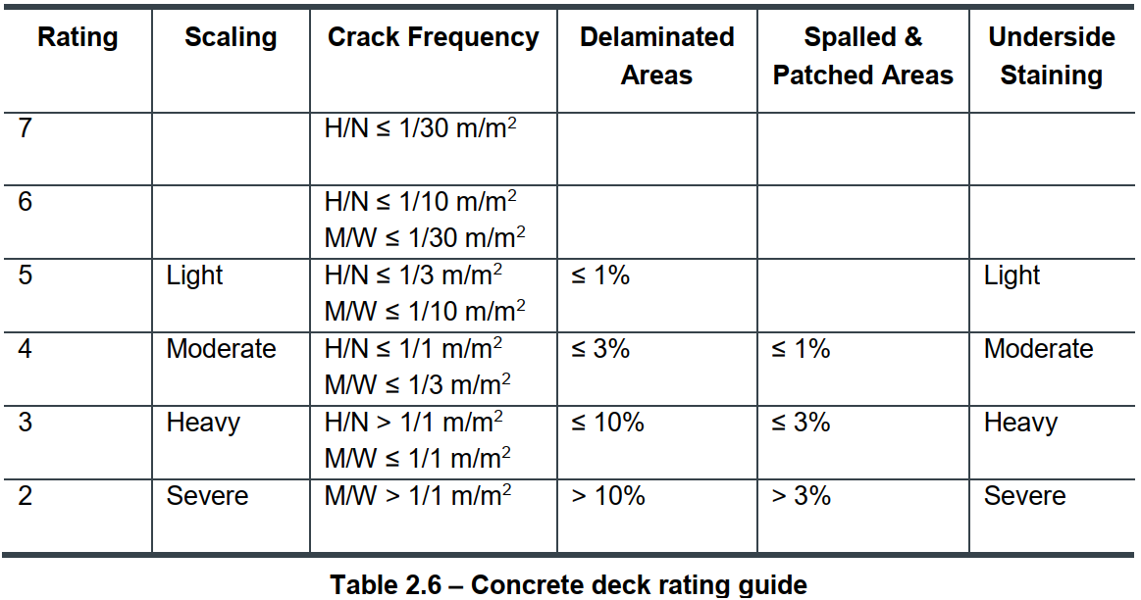
Deck Underside
Crack definitions
  Hairline <0.1 mm
  Narrow >0.1 mm and <0.3 mm
  Medium >0.3 mm and <1.0 mm
  Wide >1.0 mm
Note: Table is from Level 2 Manual

Slide 29
Deck Underside
Concrete Staining Deck Rating Guide
Notes:
Appears this slide can now be removed? Staining criteria is now covered (in less detail) on table 2.6 in the previous slide

Slide 30
Concrete Girders
Purpose
  Receive the loads from the deck
  Transmit the loads to the substructure (through the bearings)
Three types
  Cast-in-place standard reinforced
  Standard reinforced precast
  Prestressed or post-tensioned precast

Slide 31
Concrete Girders
Inspection is primarily visual, looking for
  Staining
  Scaling
  Cracks
  Delamination's
  Spalling
Observe girders under traffic and look for unusual deflections or movement
  Independent movement on laterally connected girders
Evidence of grout key or lateral connection failure
  Cracking or loss of grout in grout key
  Cracking in pavement
  Corrosion, or missing, loose or broken bolts at channel connectors
  staining on underside of keys

Slide 32
Concrete Girders
Grout key failure

Slide 33
Concrete Girders
On post-tensioned girders check end anchorage zones
Check for corrosion of prestressing or post-tensioning cables
  rust stains or cracking along sides of girders
  leakage onto ends of girders with staining from ends of cables
Cracking in end anchorage zone of prestressed girders
High load damage which breaks the concrete around the pre- or post-stressed cables
  Look for damaged or broken cables

Slide 34
Concrete Girders
Record or verify the presence of cracking
  PCS, PSR & CON
  Not hairline/narrow flexural on PCS or CON
Record or verify the amount of spalling in %
  PCS and PSR
  Corrosion induced spalling on bottoms and sides over stirrups only
  % of total leg or girder length
Girder Detail Ratings on PCS forms only

Slide 35
Concrete Girders
Record in Explanation of Condition location, severity and extent of
  Staining
  Scaling
  Cracks
  Delamination's
  Spalling
  Grout Key failure

Slide 36
Plain Reinforced Concrete Girder Rating
Applies to all plain reinforced concrete girders
  Not prestressed or post-tensioned
If curb girder only affected, can increase ratings by one
  Applicable only if girder does not carry direct wheel load
  Has lower load carrying function
  Does not apply to shear cracks

Slide 37
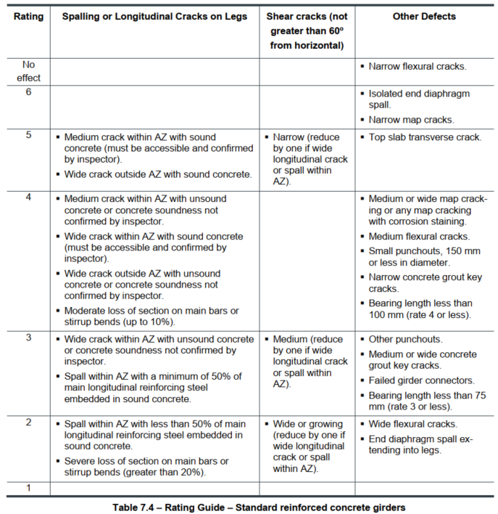
Plain Reinforced Concrete Girder Rating
Guide

Slide 38
Plain Reinforced Concrete Girder Rating
Rating | Description
5 | Medium crack & sound concrete – in anchor zone (AZ) Wide crack with sound concrete or spall with 50% bar embedment - outside anchor zone
4 | Medium crack in unsound concrete - anchor zone Wide crack in sound concrete – anchor zone Wide crack unsound concrete or soundness not confirmed, spall <50% outside AZ
4 | Moderate section loss on main bars or stirrup bends up to 10%
3 | Wide cracks in unsound concrete or spall ≥50% main bar embedment in AZ
2 | Spall with <50% of main bar embedded in sound concrete – anchor zone
2 | Severe loss of section on main bars or stirrup bends greater than 20%

Slide 39
Plain Reinforced Concrete Girder Rating
Shear Cracks
*Must be 60 degrees or less from horizontal
RATING DESCRIPTION
5 Narrow*
3 Medium*
2 Wide or growing*
*Reduce by one if wide longitudinal crack or spall in anchorage zone

Slide 40
Plain Reinforced Concrete Girder Rating
Other Defects
Rating | Description
No effect Hairline or narrow flexural cracks
6 | Isolated end diagram spall Narrow map cracks
5 | Top slab transverse crack
4 | Medium or wide map cracking or any map cracking with staining
4 | Medium flexural or narrow grout key cracks
4 | Small punchouts (≤150 mm diameter)

Slide 41
Plain Reinforced Concrete Girder Rating
Rating | Description
4 | Bearing length less than 100 mm
3 | Medium or wide grout key cracks
3 | Other punchouts
3 | Failed girder connectors
3 | Bearing length less than 75 mm
2 | Wide flexural cracks
2 | End diaphragm spall extending into legs

Slide 42
Plain Reinforced Concrete Girder Rating
Typical Defects
Notes:
Not the best diagram

Slide 43
Prestressed Concrete Girder Rating
Applies to all prestressed and post-tensioned concrete girders
Reduce as needed to reflect condition & function
If curb girder only affected, can increase ratings by one
  Applicable only if girder does not carry direct wheel load
  Has lower load carrying function
  Does not apply to shear cracks
  Does not apply to any “Major concrete structure types” listed in Table 7.1

Slide 44
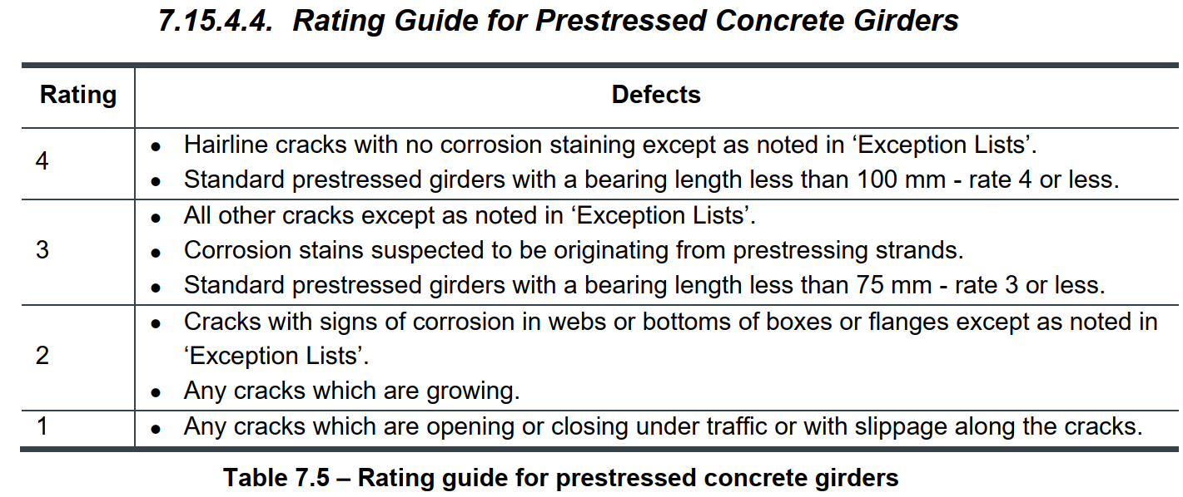
Prestressed Concrete Girder Rating
* Some cracks are acceptable and don’t affect rating.

Slide 45
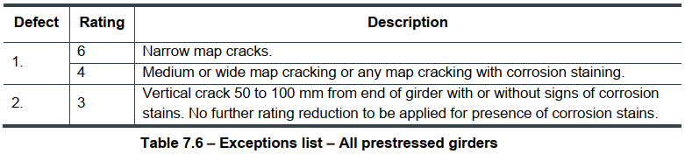
Prestressed Concrete Girder Rating
For the following typical cracks and defects in Table 7.7 through Table 7.12, unless noted otherwise:
  Crack width assumed as narrow
  Reduce rating by 1 point with presence of corrosion staining

Slide 46
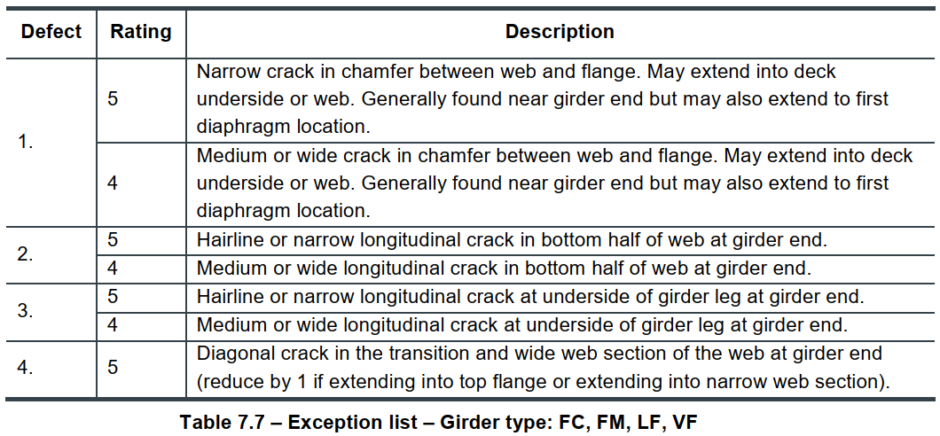
Prestressed Concrete Girder Rating
Type FC, FM, LF, VF

Slide 47
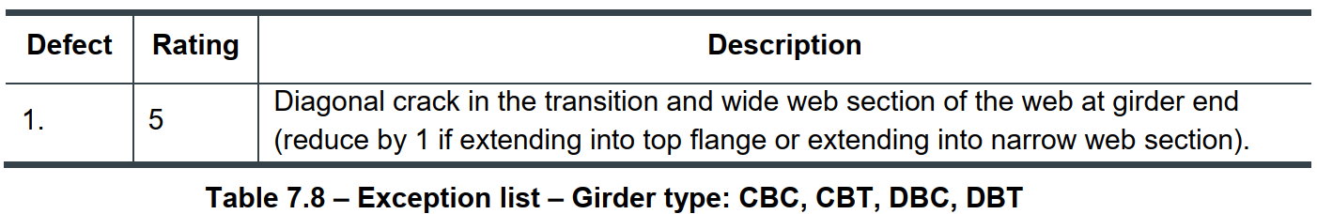
Prestressed Concrete Girder Rating
Type CBC, CBT, DBC, DBT
Crack in girder end block
through transition zone

Slide 48
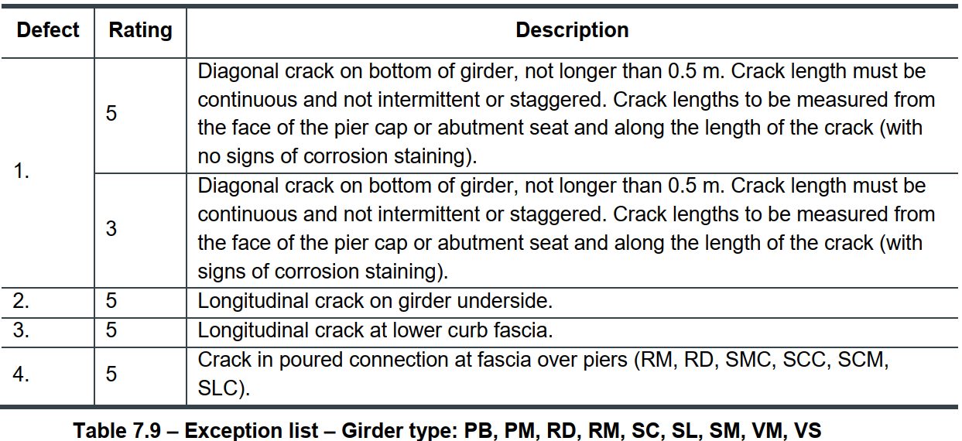
Prestressed Concrete Girder Rating
Type PB, PM, RD, RM, SC, SL, SM, VM, VS

Slide 49
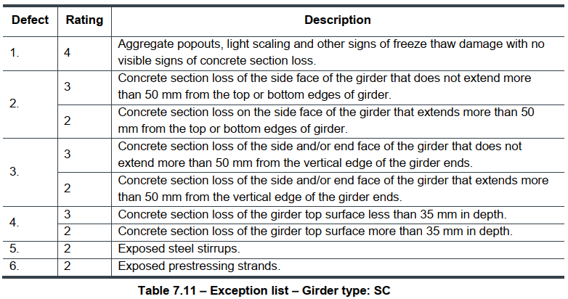
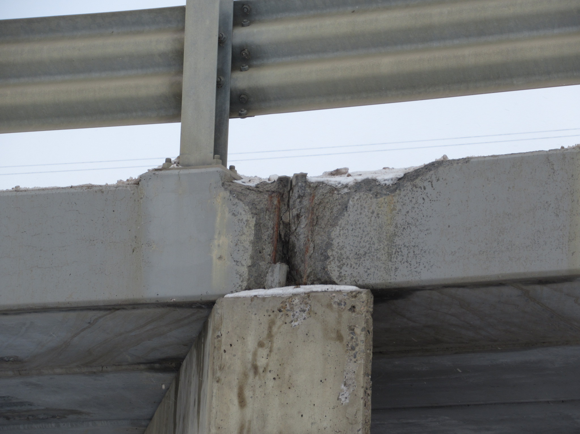
Prestressed Concrete Girder Rating
Type SC – Premature Freeze/Thaw Deterioration

Slide 50
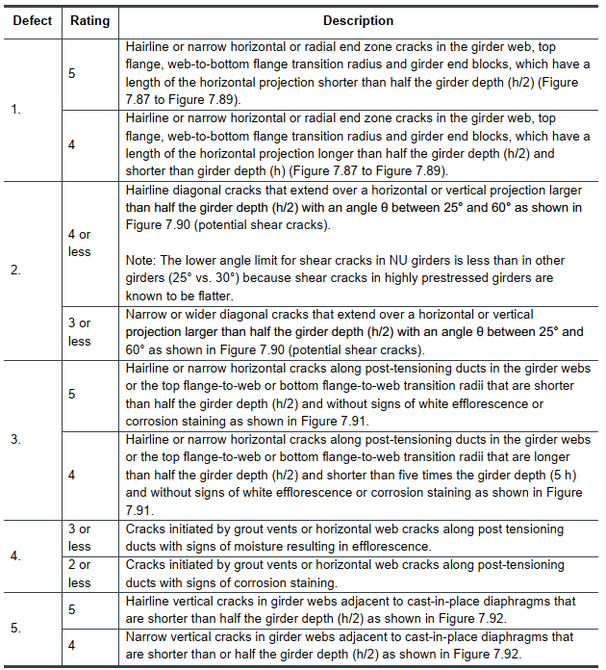
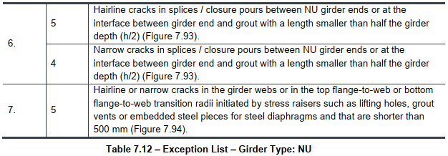
Prestressed Concrete Girder Rating
Type NU – Table 7.12

Slide 51
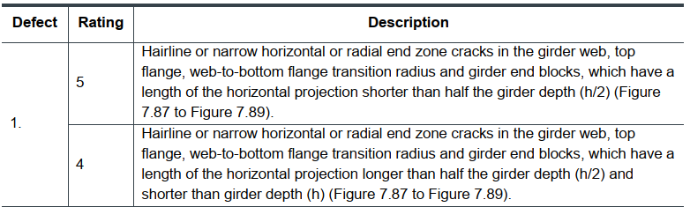
Prestressed Concrete Girder Rating
Type NU – Horizontal or Radial End Zone Cracks

Slide 52
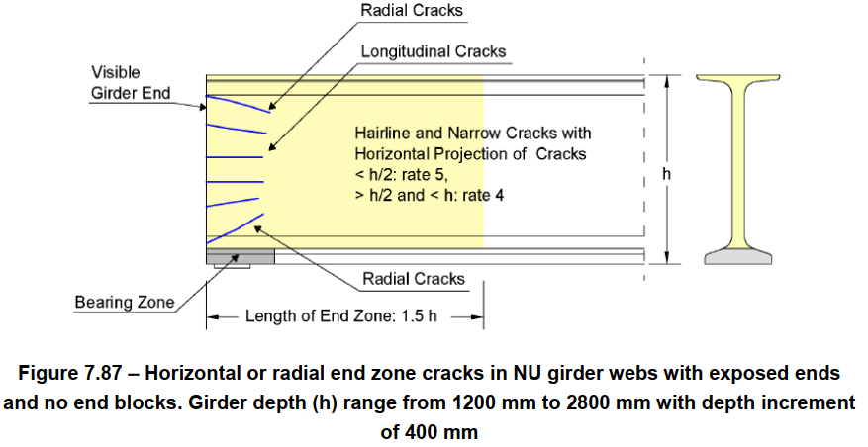
Prestressed Concrete Girder Rating
Type NU – Horizontal or Radial End Zone Cracks

Slide 53
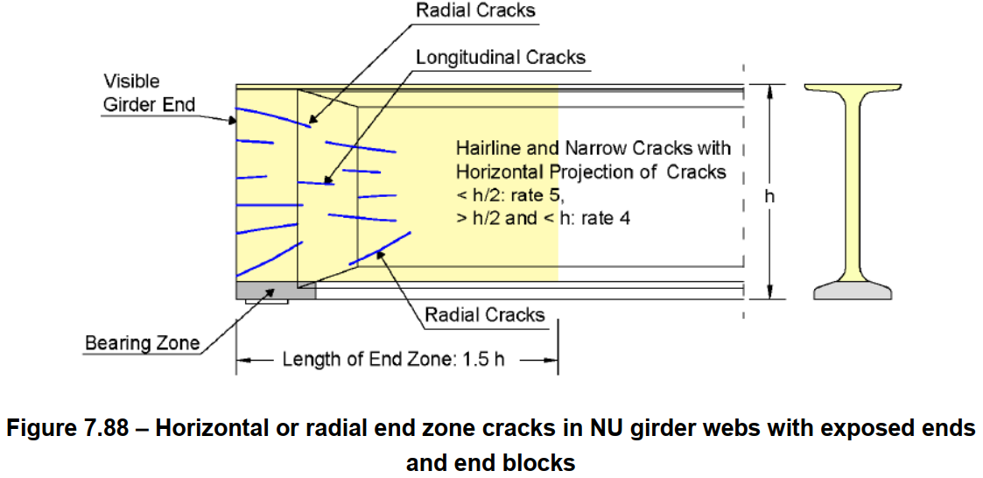
Prestressed Concrete Girder Rating
Type NU – Horizontal or Radial End Zone Cracks

Slide 54
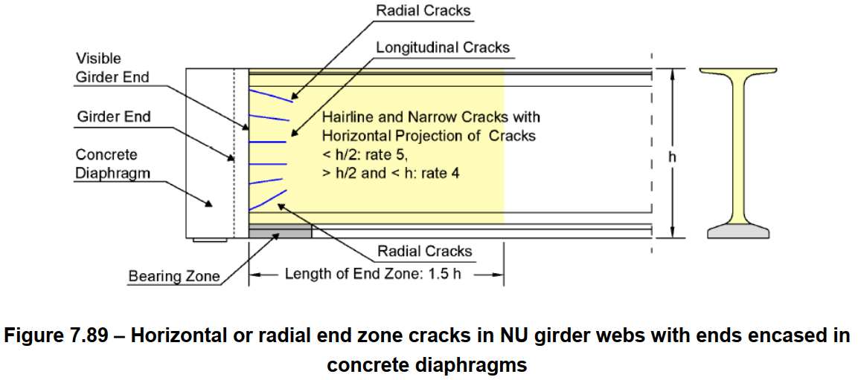
Prestressed Concrete Girder Rating
Type NU – Horizontal or Radial End Zone Cracks

Slide 55
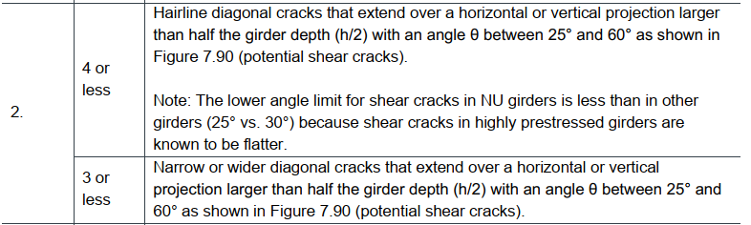
Prestressed Concrete Girder Rating
Type NU – Potential Shear Cracks

Slide 56
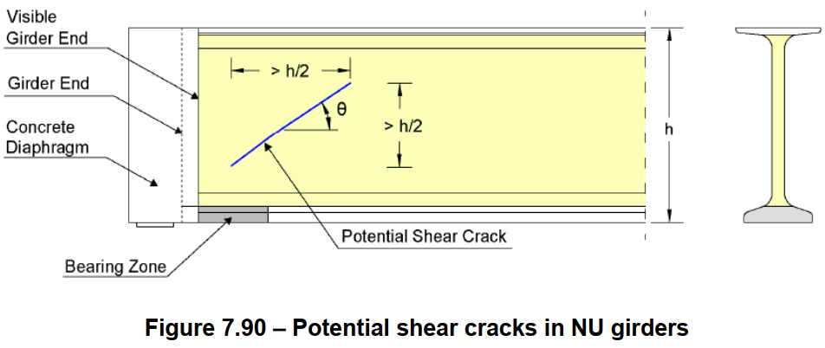
Prestressed Concrete Girder Rating
Type NU – Potential Shear Cracks

Slide 57
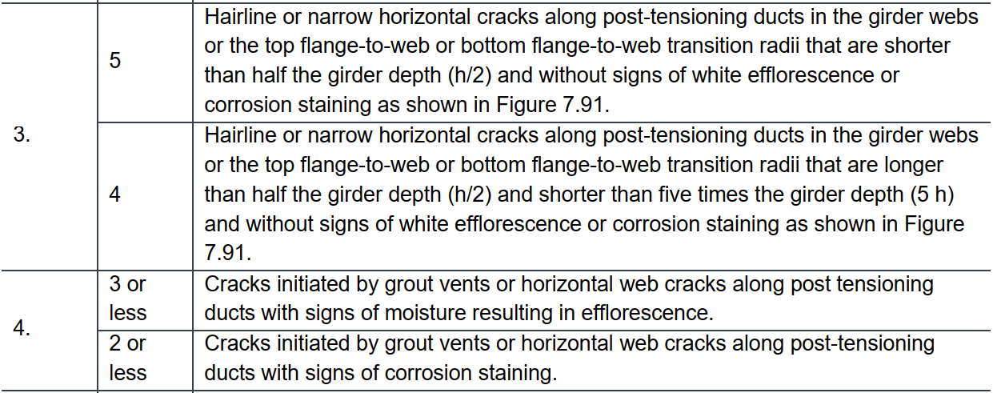
Prestressed Concrete Girder Rating
Type NU – Horizontal Web Cracks

Slide 58
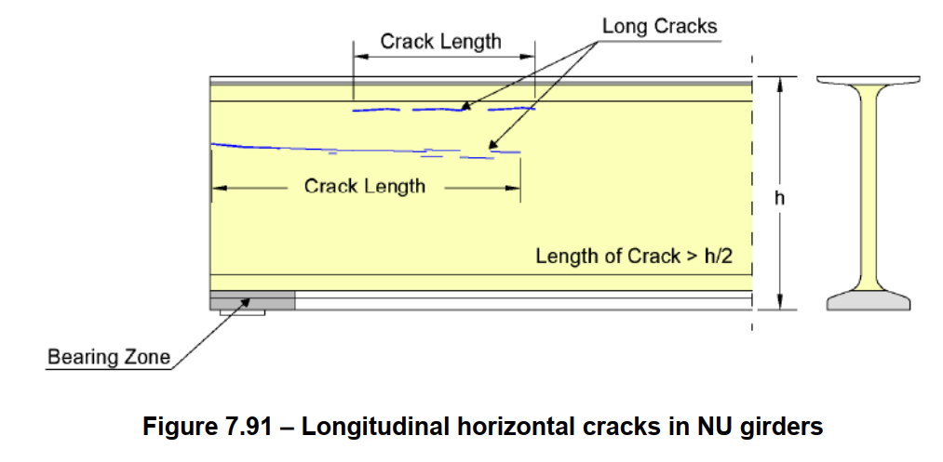
Prestressed Concrete Girder Rating
Type NU – Horizontal Web Cracks

Slide 59
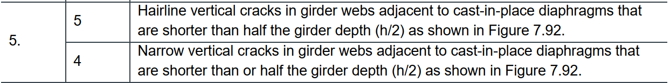
Prestressed Concrete Girder Rating
Type NU – Vertical Web Cracks

Slide 60
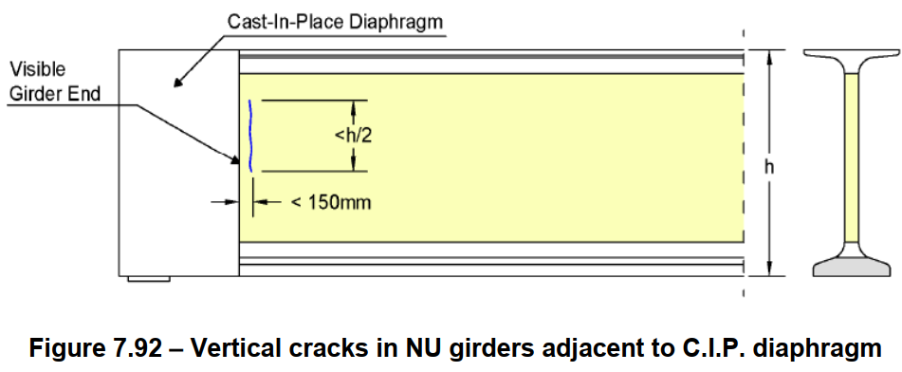
Prestressed Concrete Girder Rating
Type NU – Vertical Web Cracks

Slide 61
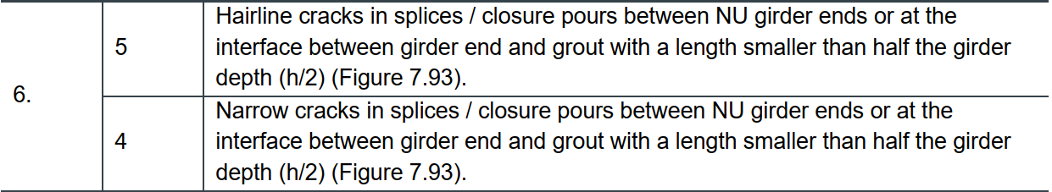
Prestressed Concrete Girder Rating
Type NU – Cracks in Girder Splices and Closure Pours

Slide 62
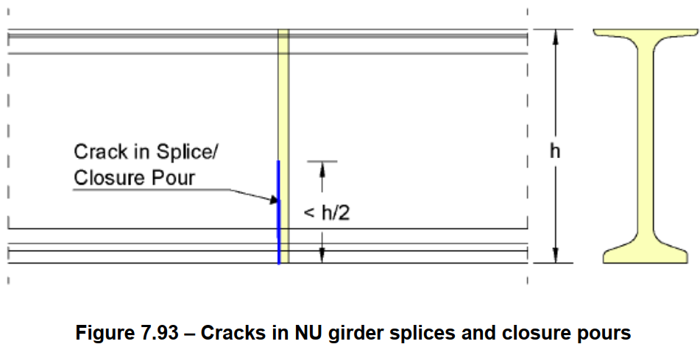
Prestressed Concrete Girder Rating
Type NU – Cracks in Girder Splices and Closure Pours

Slide 63
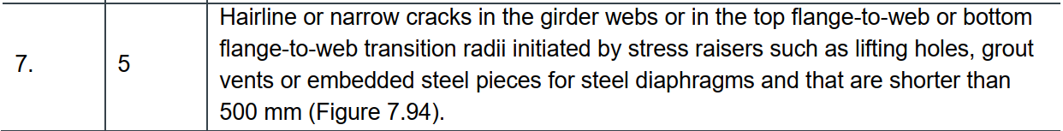
Prestressed Concrete Girder Rating
Type NU – Cracks at Stress Raisers

Slide 64
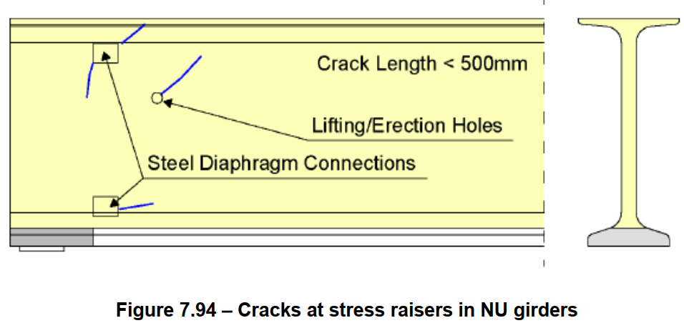
Prestressed Concrete Girder Rating
Type NU – Cracks at Stress Raisers

Slide 65
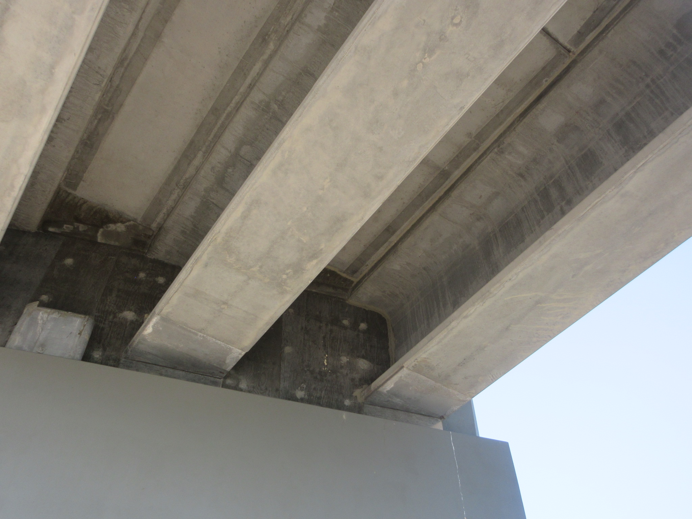
NU Girder – End Cast into Diaphragm

Slide 66
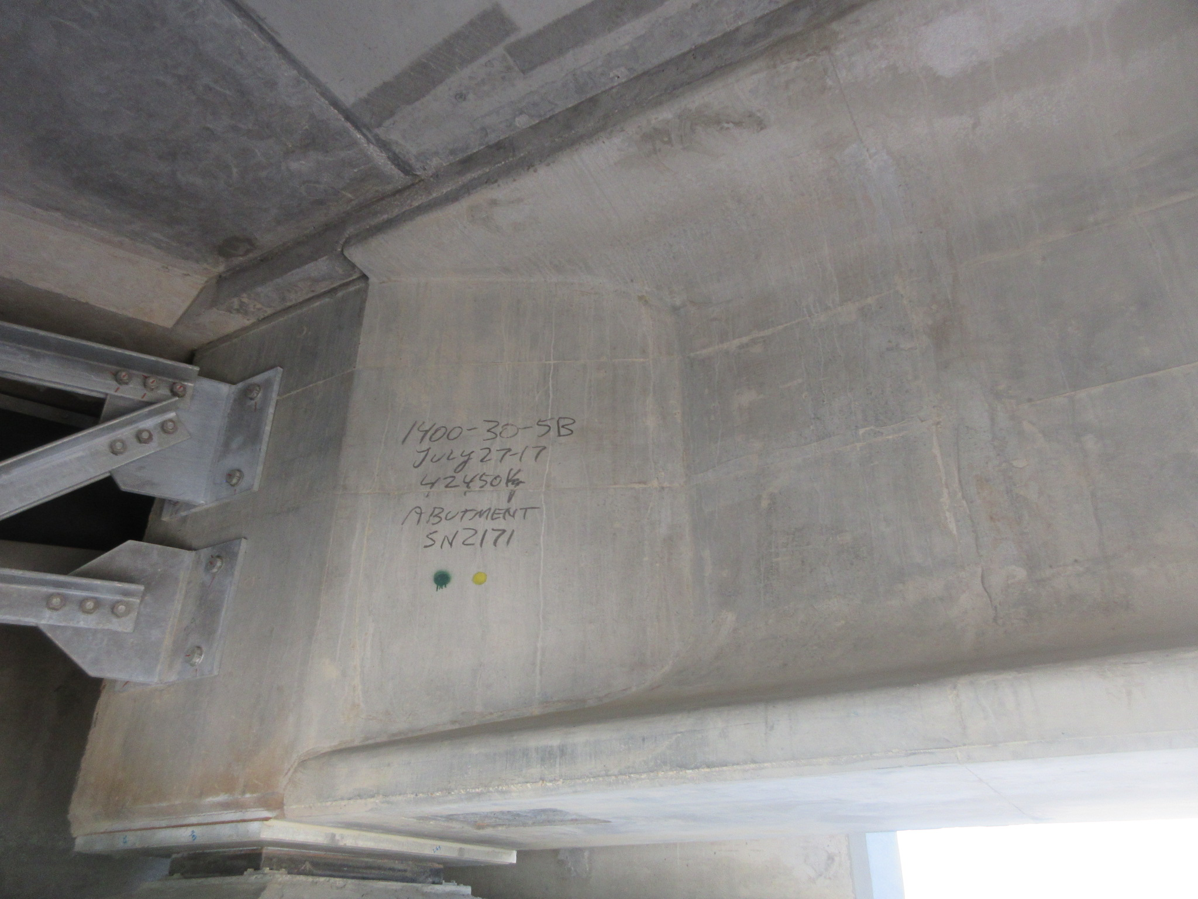
NU Girder – with End Block

Slide 67
NU Girder – with No End Block

Slide 68
Cast in Place Concrete Superstructures
Section 7.15.5
Cast-in-place (CIP) concrete superstructures found in a variety of configurations including flat slabs, slab and beam, box sections, frames, and arches.
All configurations can be conventionally reinforced or post-tensioned.
The sheer variety of configurations makes it very difficult to provide guidance on every possible scenario; however the following general guidelines should be used to guide the inspector’s ratings

Slide 69
Cast in Place Concrete Superstructures
CIP Concrete Flat Slabs – Section 7.15.5.1
Flat slab acts as both the bridge deck and primary longitudinal load carrying element and should be rated in all three of the deck top, deck underside and girder sections
Deck top and underside are rated according to Section 7.5 and 7.21 of BIM manual
Shear cracks in the deck are rated according to Section 7.15.3.3.
Flexural cracks are rated according to Section 7.15.3.4.3.
Flexural cracks that are localized and do not extend across more than 25% of the width of the deck, the ratings presented in Section 7.15.3.3 and/or 7.15.3.4.3 may be increased by one rating point

Slide 70
Cast in Place Concrete Superstructures
CIP Concrete Beams – 7.15.5.2
Cast-in-place concrete beams, including concrete frames, concrete tees, and concrete boxes are rated in the girder section of the form.
Conventionally reinforced beams should be rated according to Section 7.15.3 except No rating increases permitted for cast-in-place beams and the anchorage zone only applies to the free ends of the beams. Longitudinal cast-in-place beams are often continuous over interior supports and transverse cracks in the deck or girder tops over or near the supports should be rated as flexural cracks.
Prestressed beams should be rated according to Section 7.15.4 of the BIM manual.

Slide 71
Cast in Place Concrete Superstructures
CIP Concrete Arches – 7.15.5.3
The deck top and underside on concrete arch bridges should be rated according to Section 7.5 and Section 7.21 of the BIM manual.
Any transverse floor beams, if present, should be included in the ‘Piers / Bents – Bearing Seats / Caps’ rating and rated according to Section 8.5.
Any longitudinal beams, if present, should be rated in the girder section according to Section 7.15.5.2.
Any bents and the arch itself should be rated under the ‘Piers / Bents – Pier Shaft / Piles’ section according to Section 8.8 of the BIM manual.

Slide 72
Steel Girders
Stiffeners
  Vertical at bearings & along span
  Vertical stiffeners not connected to top and/or bottom flanges can cause fatigue cracks in web at top of stiffener
  Intersection of vertical and horizontal stiffeners susceptible to fatigue cracks or sudden fracture
  Horizontal in high bending stress areas
Cover plates
  Extra plates welded to flanges to increase capacity in high bending areas
Purpose
  Receive loads from the deck
  Transmit loads to the substructure
Two types
  Rolled beam
  Welded plate girders
Usually I-shaped
  Web
  Flanges
Each part of girder rated separately

Slide 73
Steel Girders
Cracks
  Tension areas
  End of cover plates
  Stiffeners welded to bottom flange
  Re-entrant corners
  Changes in section
  Stiffener welds that cross the weld from flange to web
  Gouges, nicks, holes, collision damage
Buckling
  High stress areas such as at bearings

Slide 74
Steel Girders
Alignment
  Twists, bows, bends, sags
Corrosion
  Top of bottom flange
  Around connections
  Under joints
Connections
  Loose or missing bolt or rivets
  Poorly fitted connections
  Misaligned bolt holes
  Deformed bolt holes
  Corrosion between plates
    warping of plates
Collision damage
  Grade separations

Slide 75
Steel Girders
Notches or stress raisers in tension areas
  rate 4
If corrosion is causing a loss of section
  rate 4 or less
If any signs of distortion or misalignment
  rate 4 or less
If fatigue cracks or signs of distortion
  rate 4 or less
Elements with visible cracks
  rate 3 or less
Fatigue cracks in a tension flange or element
  rate 2 or less

Slide 76
Diaphragms / Cross Frame
Purpose
  Distribute loads between girders
  Resist torsion forces
  Support the compression flange of the girder
Generally made out of the same material as the girder
  If not, usually steel
Rate according to condition and ability to function as designed
If diaphragms contribute to defects in the girder - rate 4 or less

Slide 77
Steel Truss Members
Purpose of truss as a unit is to:
  Receive loads from deck
  Transmit loads to substructure (through bearings)
Three types of trusses
  Through
  Pony
  Deck
Member types are rated separately
Includes stringers and floor beams
Truss members in tension or compression
  Inspector must identify each
  Different concerns

Slide 78
Steel Truss Members
Check alignment of trusses
  top chord alignment especially important because it is in compression
Check for wide or high load damage
  If any present, indicate “YES” and explain in Explanation of Condition
  Especially look at portal bracing and sway bracing
  Wide or high load damage will affect the rating of the member(s) damaged
    compression members rating are especially lowered by bends
    tension members by cracks or nicks
  Check connections and members adjacent to damaged member

Slide 79
Steel Truss Members
Check each truss member in an orderly fashion
On tension members or collision damaged members look for cracks at connections
  crack will most often be at first bolt hole on the member side
  light members with significant stress or stress reversal
On compression members look for kinks or bows
Look for welds or torch cuts
  crack prone
Look for fatigue prone details
  sharp radius corners
  notches
  light members - especially with stress reversal
Check which member(s) govern load capacity
  Allowable Load on first page of form

Slide 80
Steel Truss Members
Check each connection in an orderly fashion
  Loose or missing bolt or rivets
  poorly fitted connections
  misaligned bolt holes
  deformed bolt holes
  corrosion between plates
    warping of plates
Check for Corrosion
  Between Built up members
  Splash zone
  bottom chord, especially channel section

Slide 81
Steel Truss Members
Distortion or misalignment on a tension member, no other defects - rate 5
Minor misalignment or damage to cross-bracing or portal - rate 5
Corrosion causing a loss of section - rate 4 or less
Missing rivets or bolts – rate 4 or less
Cracked member - rate 3 or less
  Cracks on bottom flange of floorbeam or stringer extending into web - rate 2 or less

Slide 82

Questions?

