Slide 1
MAJOR MAINTENANCE & REHABILITATION OF CONCRETE BRIDGES

Slide 2
Concrete Bridge Decks
Large Percentage of All Bridge Decks (over 90%)
Two Main Mechanisms of Deterioration
freeze thaw damage
corrosion of rebar – delamination of concrete
Prevention of Freeze Thaw Damage
proper concrete mix design and air entrainment

Slide 3
Concrete Bridge Decks
Prevention of Corrosion Damage
prevent moisture/chloride entering concrete
ensure concrete around rebar remains passive
use non-corrosive rebar
Deck Durability – New Construction
membrane and ACP
epoxy coated rebar
stainless steel/stainless steel clad rebar
corrosion inhibitors

Slide 4
Deck Rehabilitation - Timing
Optimum timing gives best life cycle cost
Too early
existing deck protection still working
no significant damage to deck
future life of deck/bridge not shortened if rehabilitation delayed
Too late
significant corrosion damage to deck
rehabilitation costs have significantly increased
high chlorides or other factors have significantly shortened life of deck/bridge
Great deal of experience and judgement to determine optimum timing

Slide 5
Methods/Options for Rehabilitation
Concrete Overlays
provides durable long lasting wearing surface
less permeable – reduces moisture in deck
reduces rate of corrosion
Waterproofing Membrane and ACP
waterproofs deck surface
stops additional moisture getting in deck
significantly reduces corrosion
membrane/ACP not as long lasting of a wearing surface as concrete

Slide 6
Methods/Options for Rehabilitation
Thin Polymer Overlays
membrane without protection of ACP
does not add significant dead load
existing concrete deck in good condition
need very good bond with concrete
subject to damage from snow plows, vehicle wear, UV rays

Slide 7
Methods/Options for Rehabilitation
Cathodic Protection
electric potential over deck surface prevents additional corrosion
use when existing corrosion activity very high
need power source at site
generally needs to be used with concrete overlay
monitoring and maintenance required to ensure system is working

Slide 8
Concrete Overlays

Slide 9
Types of Concrete Overlay
High Density Concrete
started using in mid-1970’s
low water/cement ratio – low slump
site batched with mobile mixer
placed with special finishing machine
very good durability
less permeable than normal concretes
still relatively high permeability

Slide 10
Types of Concrete Overlays
Latex Modified Concrete
also started using in mid-1970’s
latex used to replace some of the water in mix
also site batched
low permeability/high slump
can be used for thin overlays < 40 mm
difficult to finish and cracks easily
section of overlay can become loose if bonding problems present

Slide 11
Types of Concrete Overlays
Pyrament Cement Concrete
cement with high fly ash content – 35%
on market in early 1990’s
pre-bag mix – water added at site
fast setting, high strength, low permeability
hard to finish – shrinkage cracks
AAR problems – reduced bond

Slide 12
Types of Concrete Overlays
Modified Silica Fume Concrete
small amount of fly ash in mix
fog curing immediately behind finishing machine
seven day wet curing
increase strength – reduces cracks
can be used with and without steel fibres

Slide 13
Types of Concrete Overlays
High Performance Concrete (HPC) 45 Mpa – commonly used on AT decks
Silica fume in mix (6-8%)
Fly ash in mix (11-15%)
early use – pre-bag mix – water at site
presently mostly transit mix
low permeability – good durability
little more difficult to finish
more sensitive to shrinkage cracks when used without fibers
1st trial deck in Alberta 2022 using 15% lime (GUL replacing GU) BF 1973 – Longview
Part of “green” initiative – lime more environmentally friendly to produce

Slide 14
Types of Concrete Overlays
HPC with Steel Fibres
steel fibres added to mix
increases tensile strength
reduces/controls shrinkage cracks
holds overlay together if debonded
commonly used in AT overlays

Slide 15
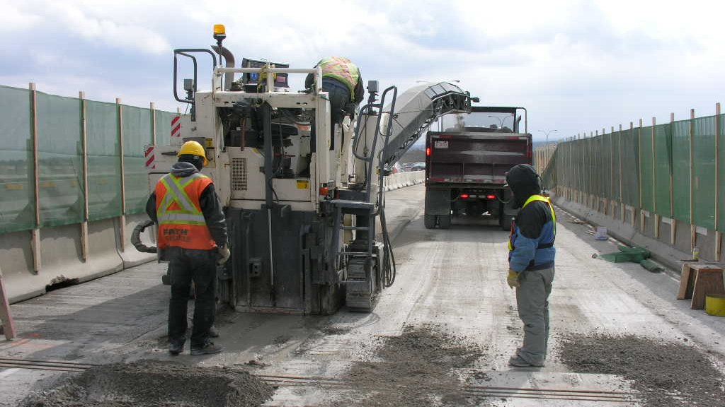

Slide 16
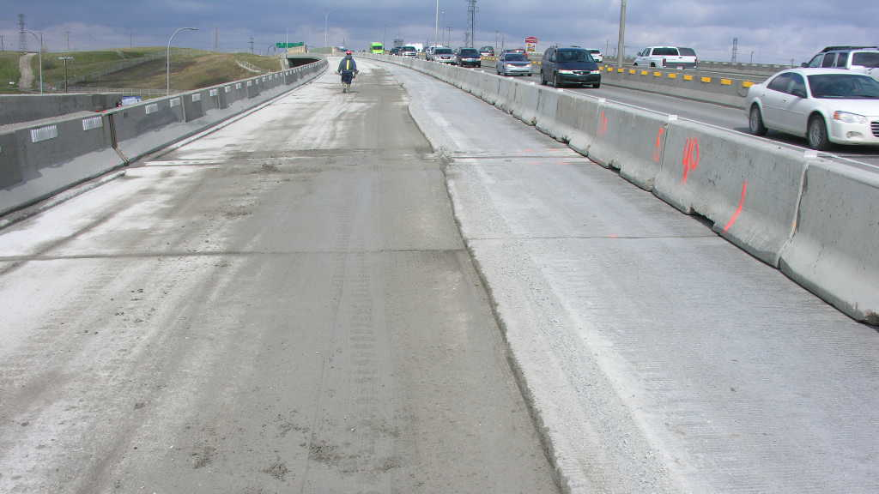

Slide 17
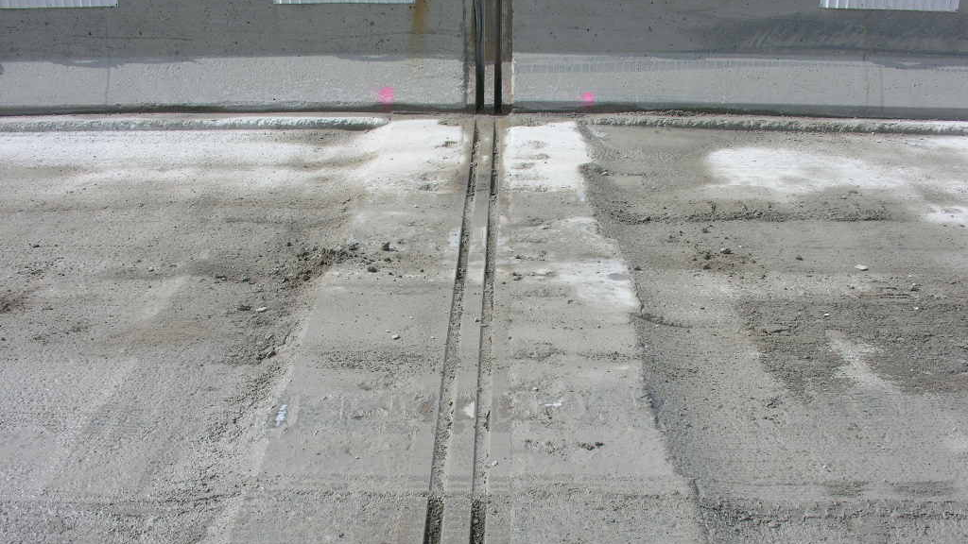

Slide 18
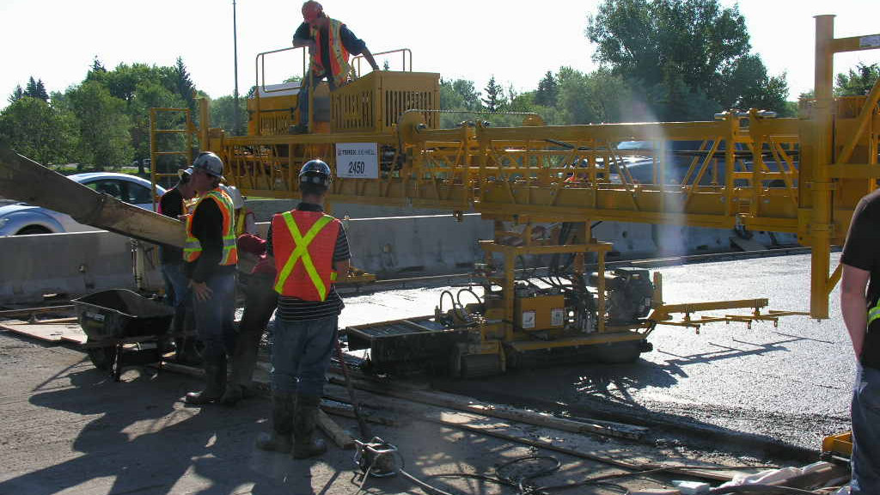

Slide 19
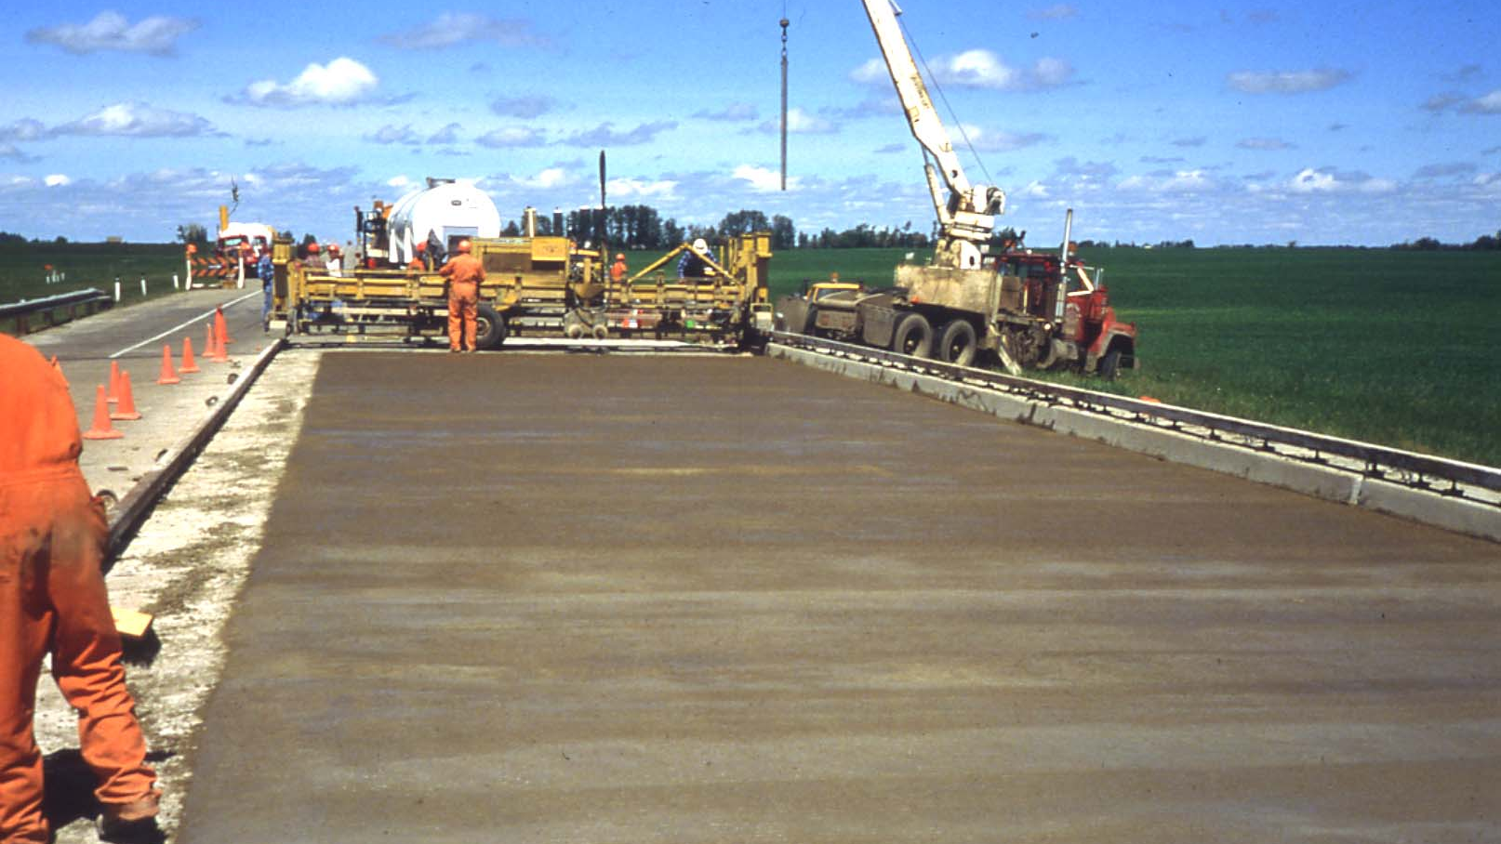

Slide 20
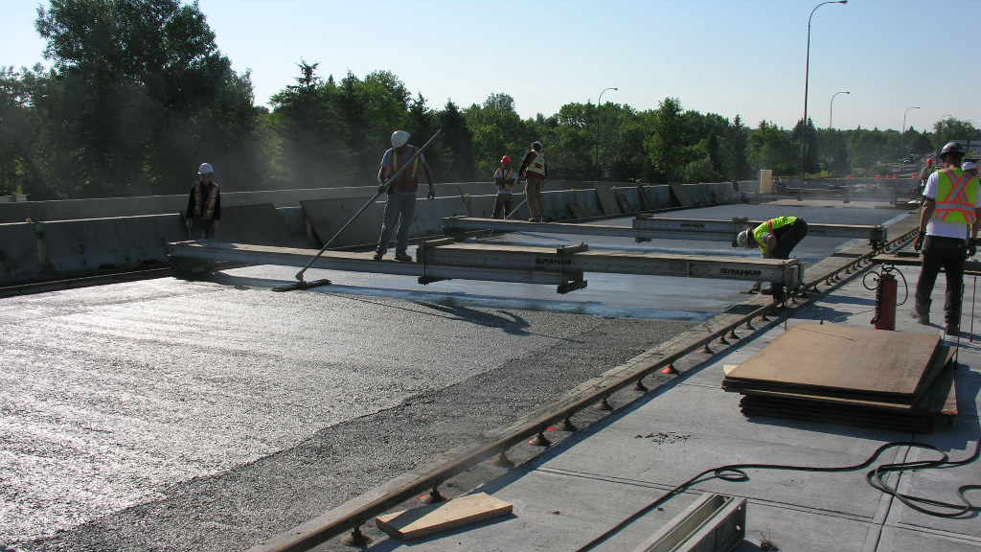

Slide 21
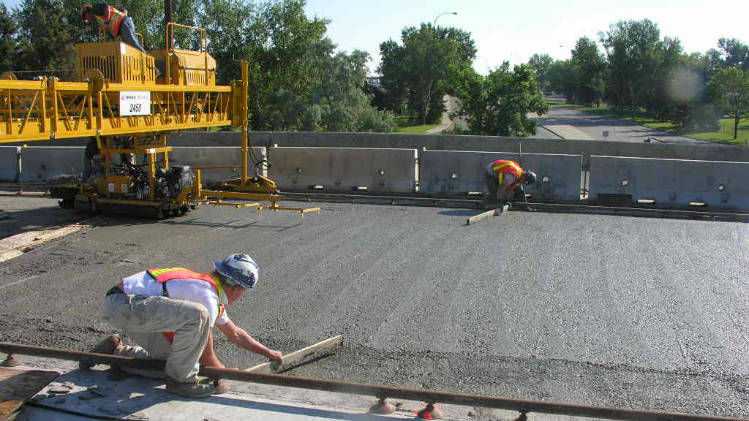

Slide 22
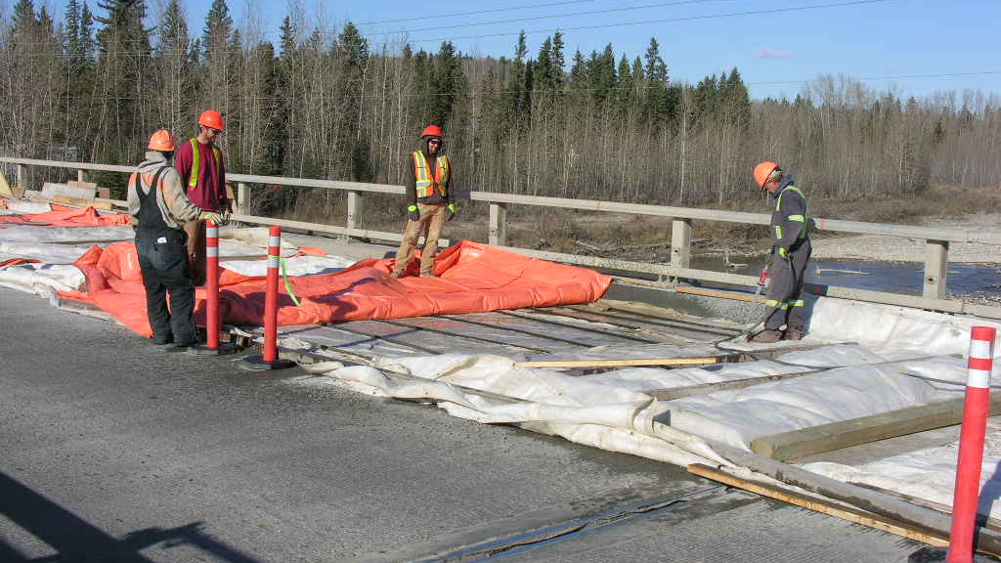

Slide 23
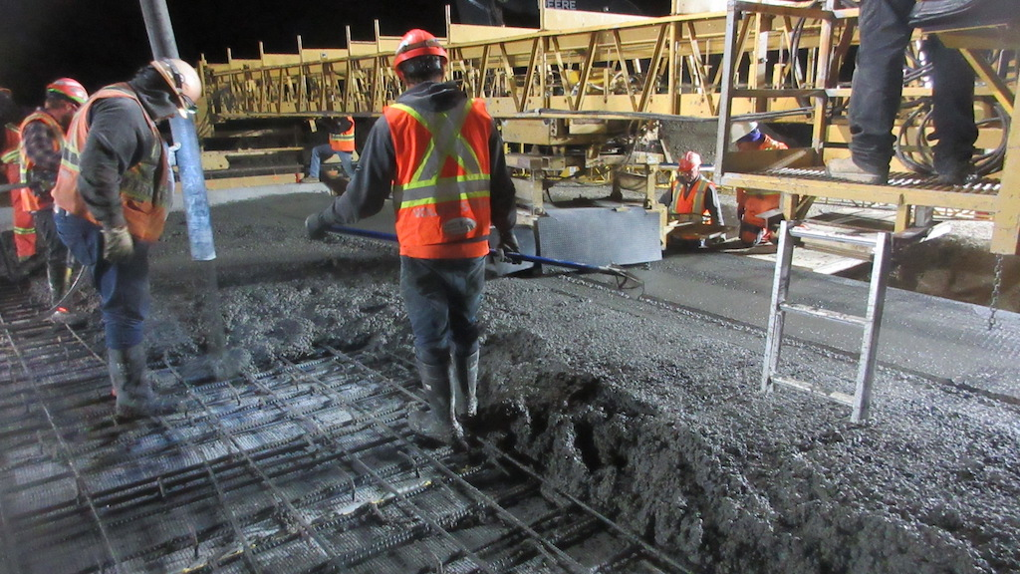

Slide 24
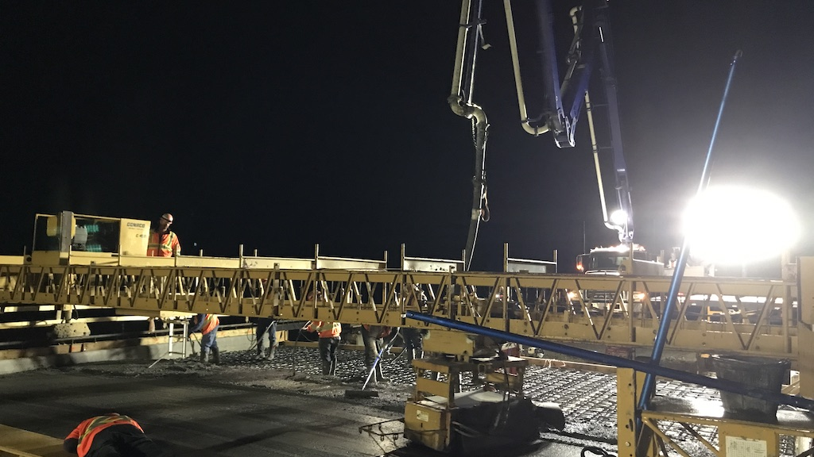

Slide 25
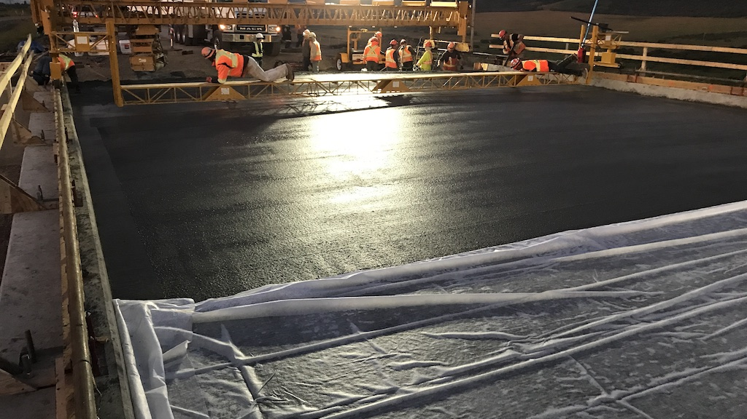

Slide 26
ACP and Polymer Overlays

Slide 27
Types of Membrane/ACP
Hot Applied Rubberized Membrane & Protection Board with 2-40 mm Layers ACP (80 mm + 10 mm membrane = 90 mm)
used on new construction
dead load limits use for rehabilitation
Sheet Membrane with 50 mm ACP
repair any damage to deck
requires fairly smooth surface
bond with concrete and joints between sheets main concerns
top of sheet rough surface to protect from and provide bond with ACP

Slide 28
Types of Membrane/ACP
Polymer Membrane with 50 mm ACP
requires relatively smooth surface
good bond with concrete decks
bond with ACP problem unless some aggregate in top layer
aggregate can affect permeability of membrane

Slide 29
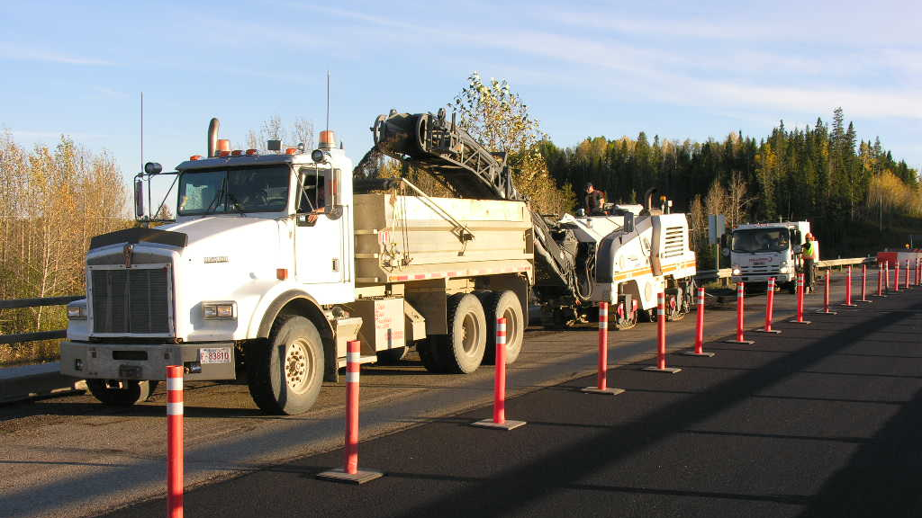

Slide 30
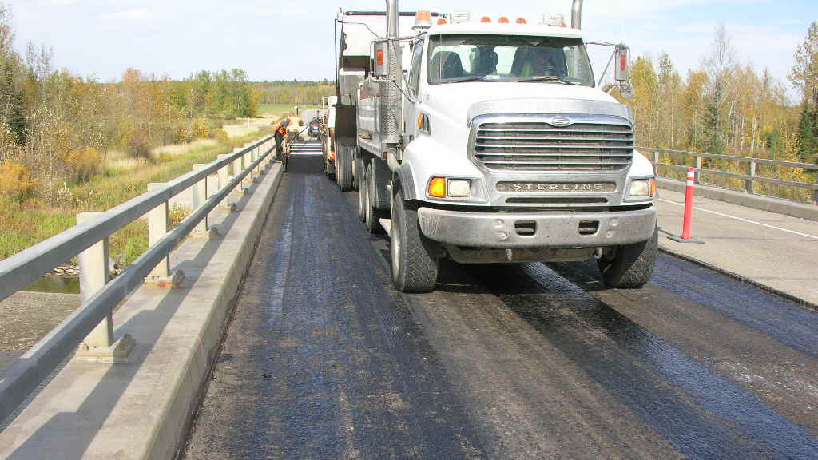

Slide 31
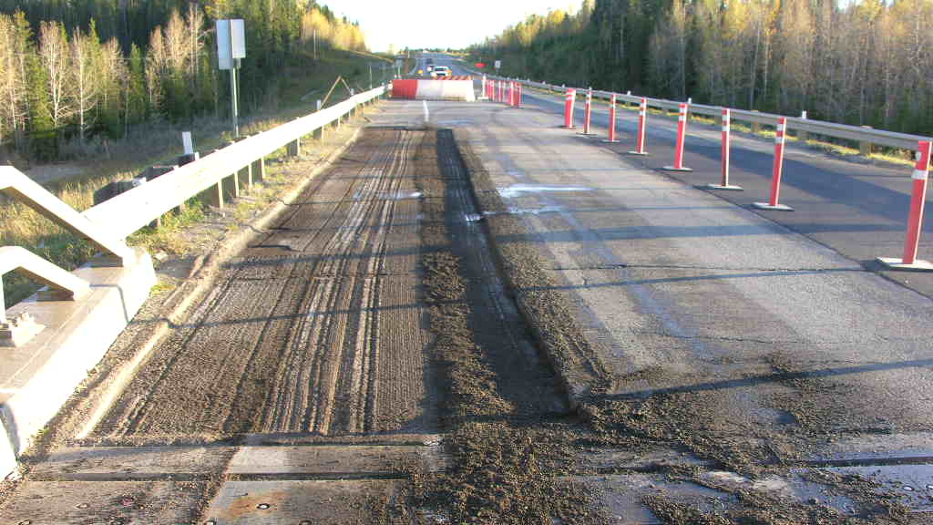

Slide 32
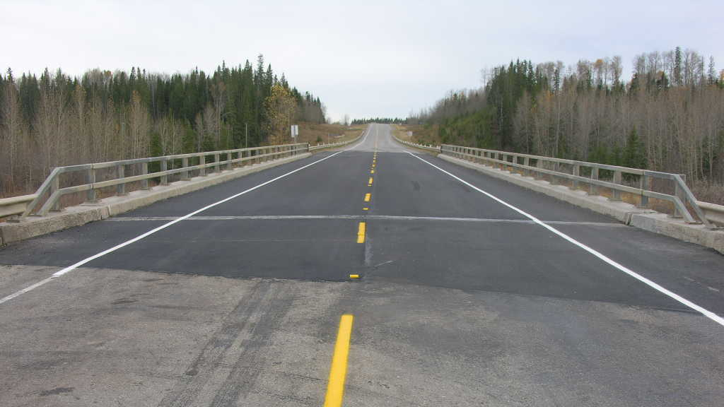

Slide 33
Thin Polymer Overlays
Flexible Epoxy Overlays
two components - must be mixed properly
can be multi-layer system
very low permeability
requires very good preparation of concrete surface
rough texture but clean
very sensitive to weather conditions
concrete internally dry
even flexible epoxy is a relatively brittle material

Slide 34
Thin Polymer Overlays
MMA Overlays
more flexible, thicker material
single layer
somewhat more expensive than epoxy
also requires very good concrete surface preparation
works better on more flexible decks
Urethane Overlays
use in parking garages
not durable enough for highway traffic

Slide 35
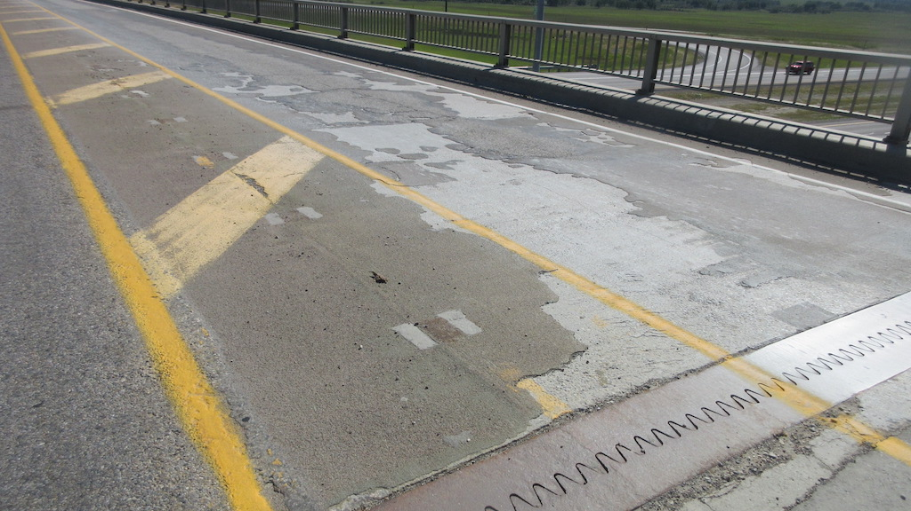

Slide 36
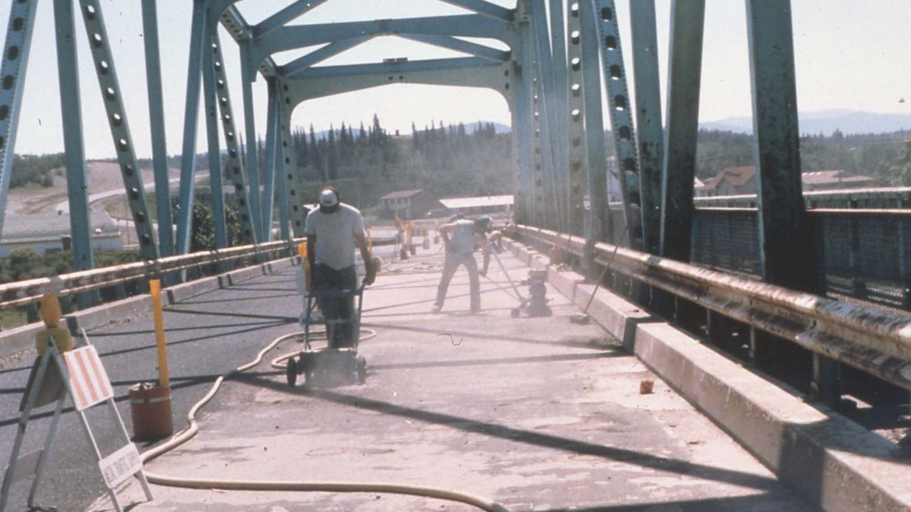

Slide 37
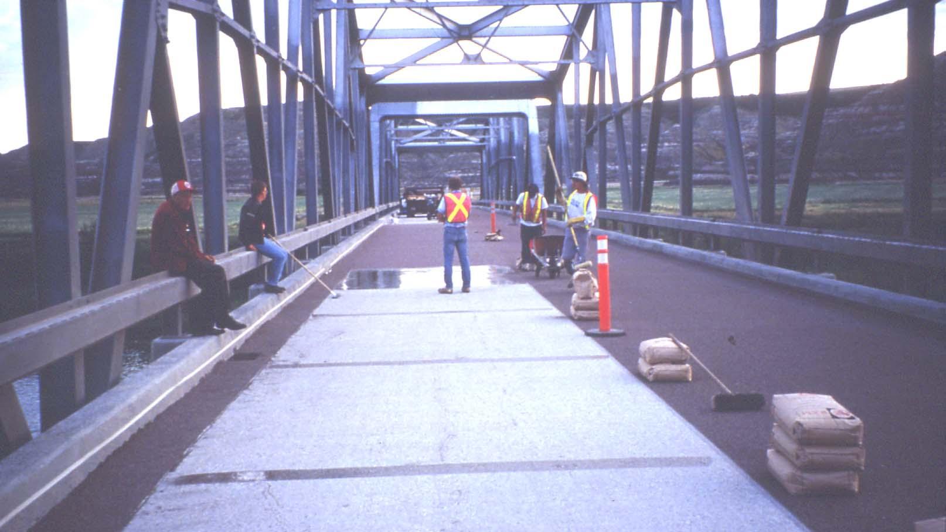

Slide 38
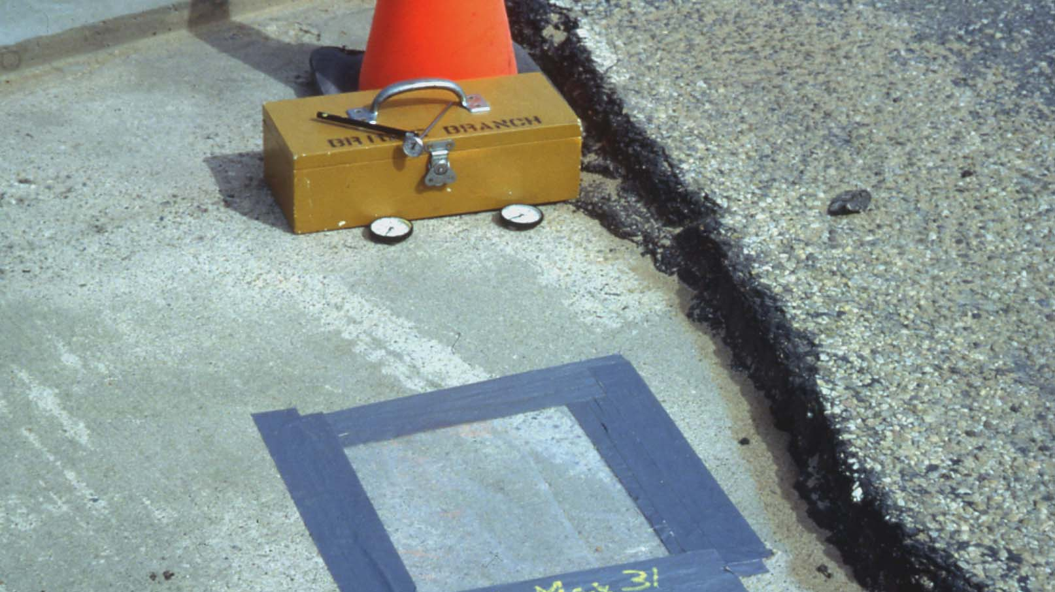

Slide 39
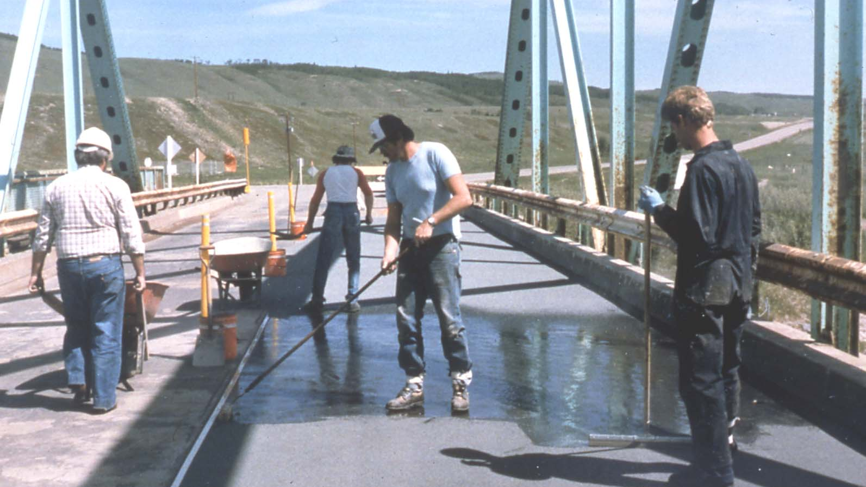

Slide 40
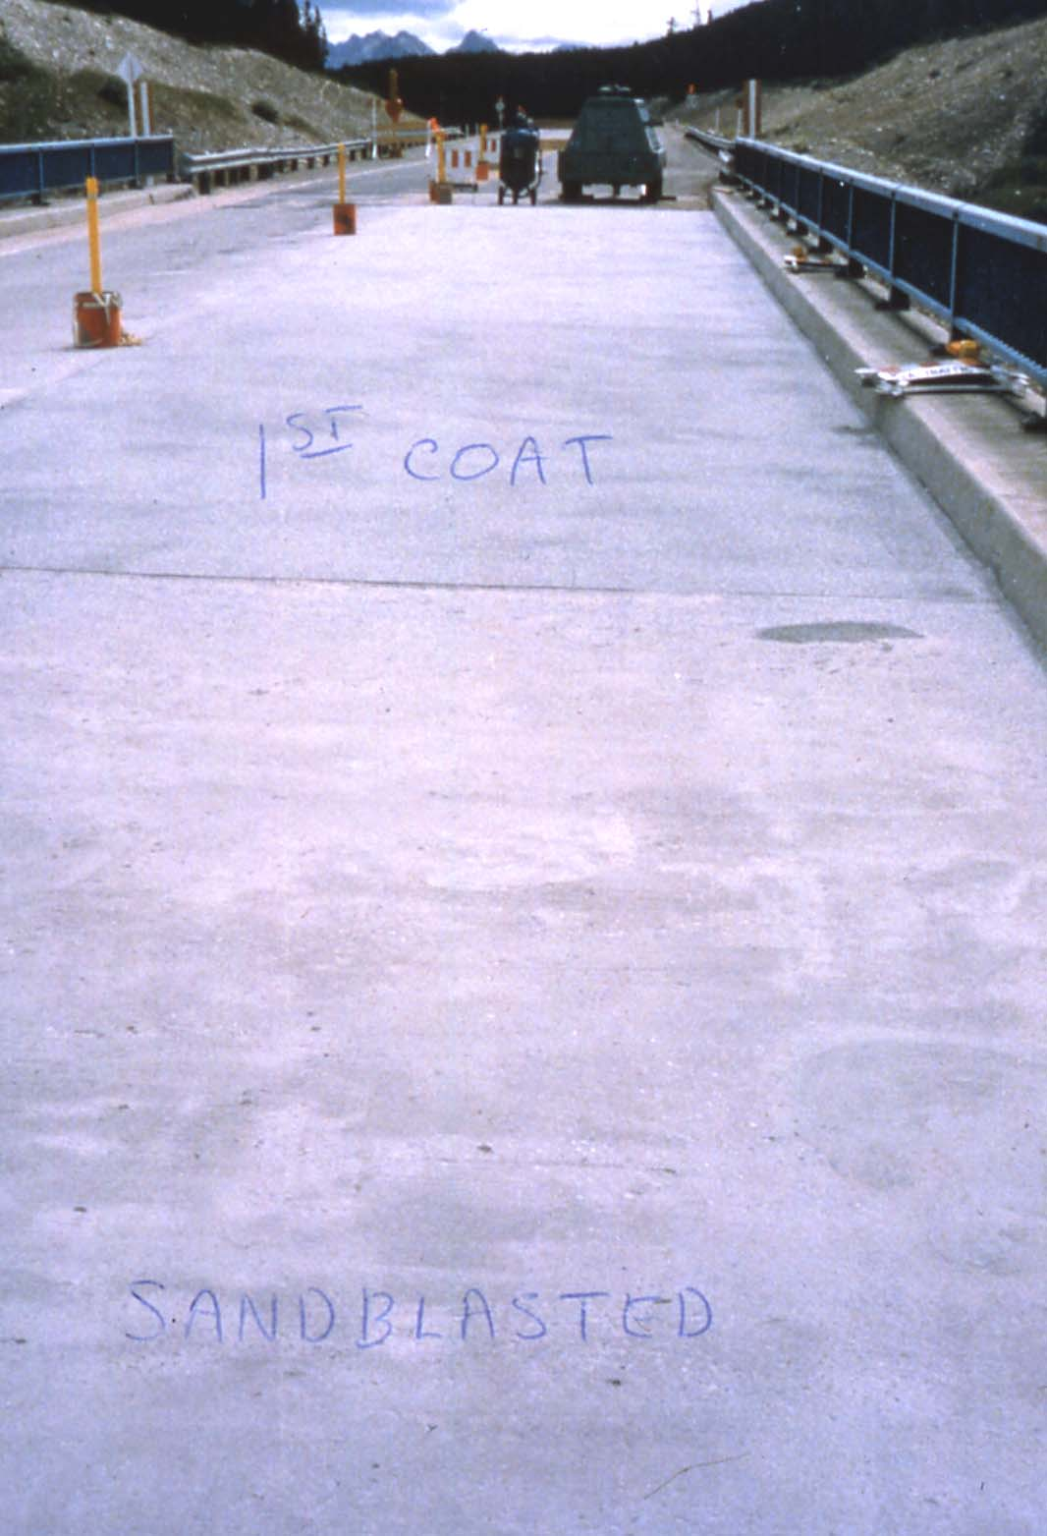

Slide 41
Cathodic Protection Systems
Conductive Wire Mesh in Overlay (Titanium)
requires concrete overlay
must eliminate all shorts between mesh and deck
requires monitoring
Under Deck Conductive Coating
do not require concrete overlay
still must eliminate all shorts
requires monitoring
long-term performance not proven
coating system appears to dry out and become non-conductive with time

Slide 42
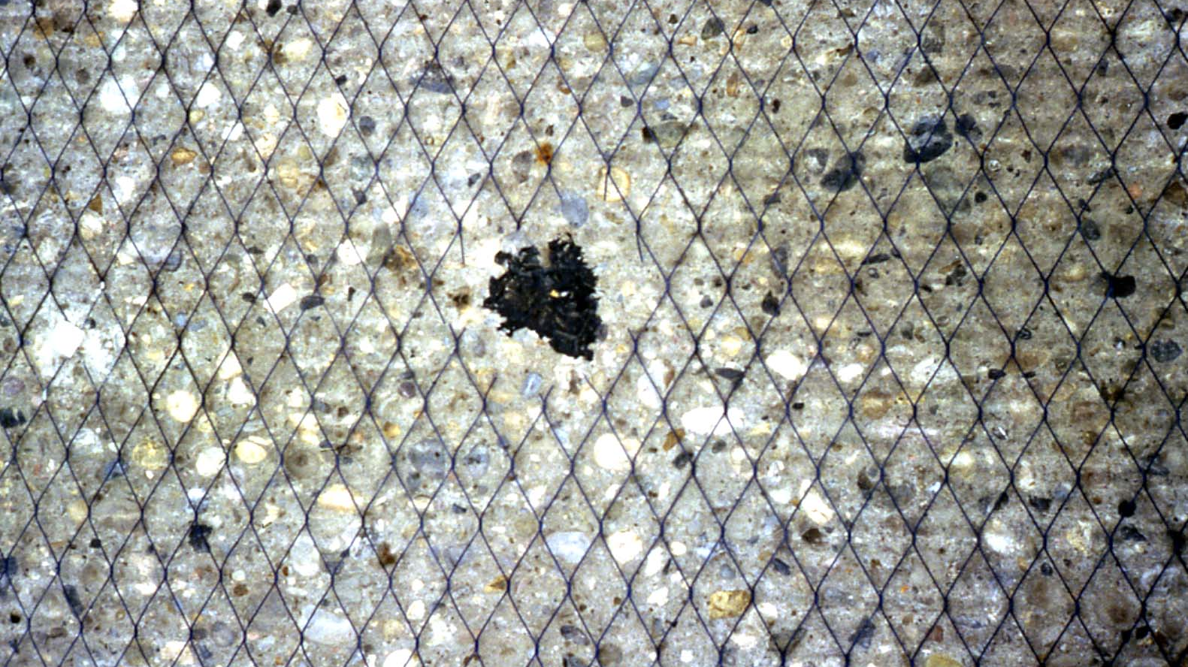

Slide 43
Girder Connections and Strengthening

Slide 44
Lateral Connection Between Girders
AT has a number of concrete girder types that are placed side by side and connected together by grout-keys or connector bolts
These grout keys have not stood up well over time
During rehabilitation of these type bridges the lateral connections are usually upgraded and supplemented (underslung beams, lateral post-tensioning)

Slide 45
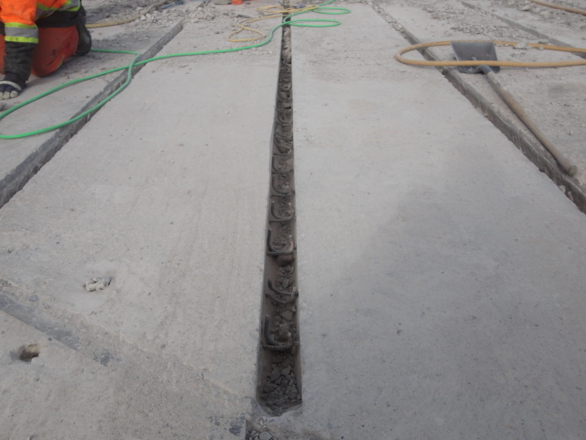
Typical Shear Key – PM Girders

Slide 46
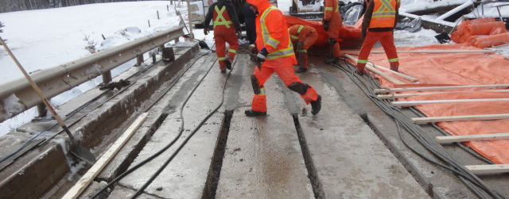
Grouting Girder Shear Keys

Slide 47
Lateral Connection Between Girders
Short Span Girders with Bolted Connector Pockets (HC,VS,SM,SL)
reinforced concrete overlay (nominally 150 mm)
hair pin bars and grouting
Longer Span Girders (FC, VF, FM)
lateral stressing
underslung beams
combination of both

Slide 48
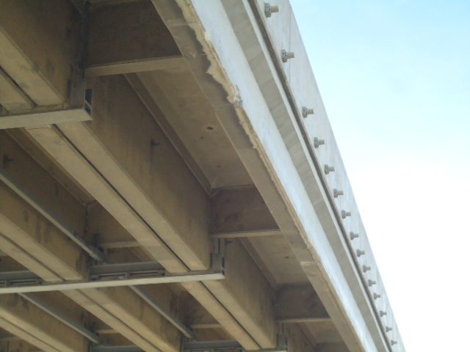
Lateral Stressing and Underslung Beam – FC Girders

Slide 49
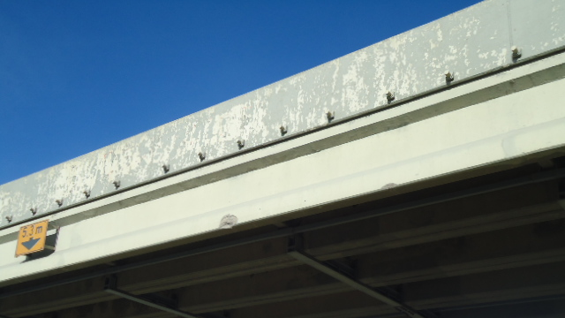

Slide 50
Girder Shear Strengthening

Slide 51
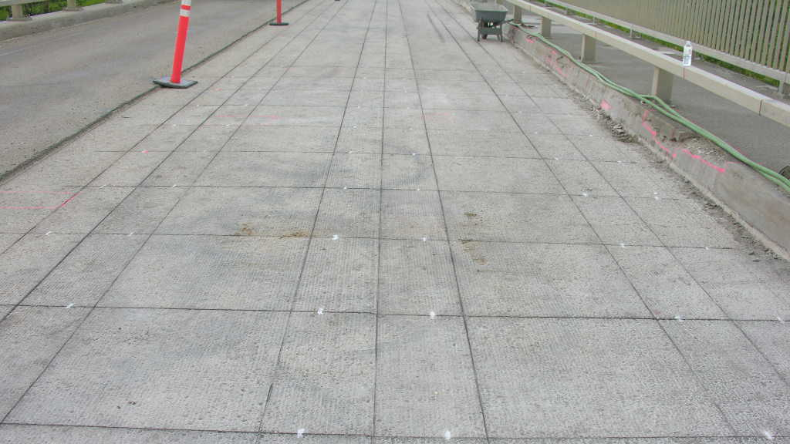

Slide 52
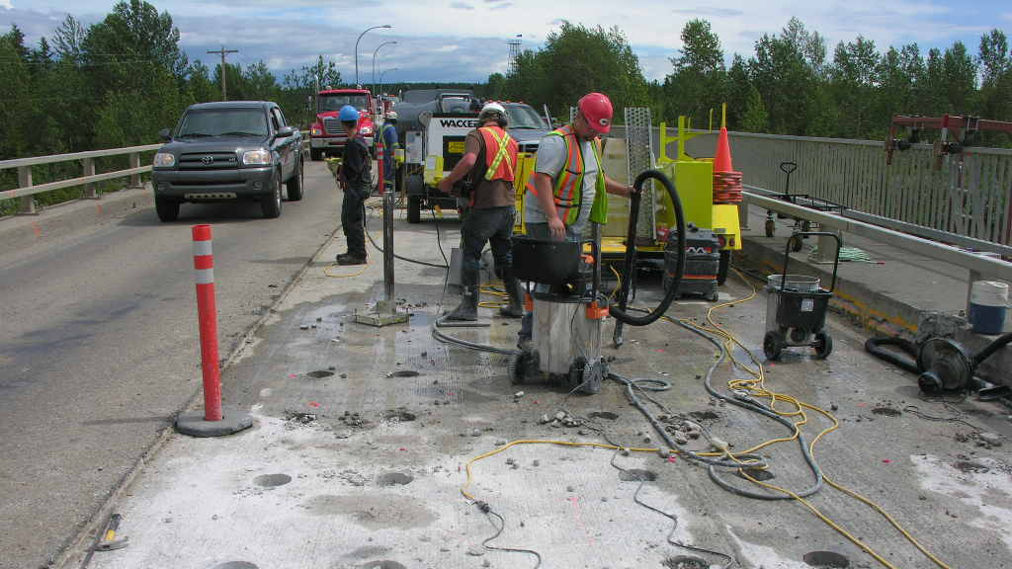

Slide 53
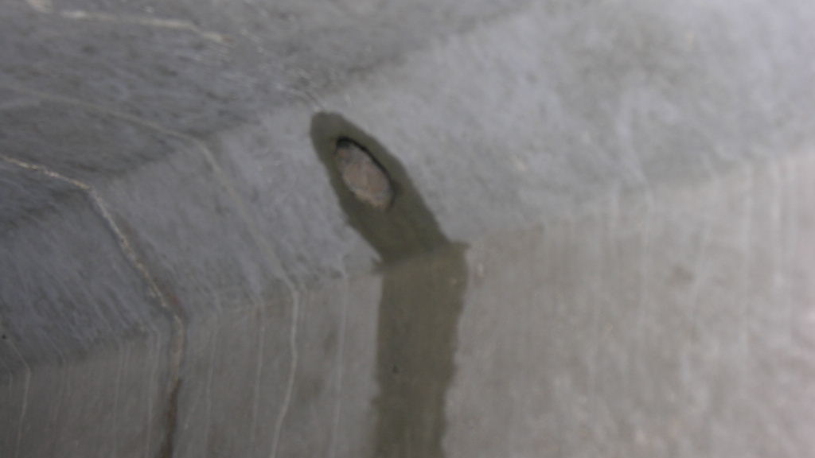

Slide 54
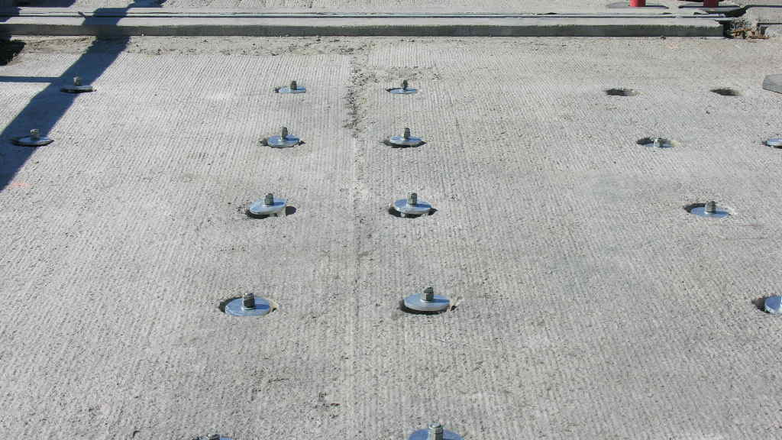

Slide 55
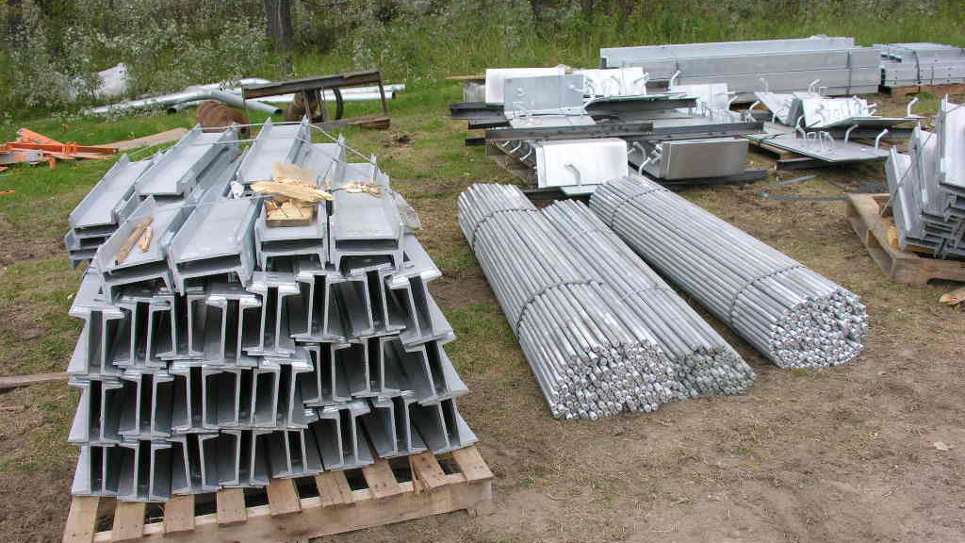

Slide 56
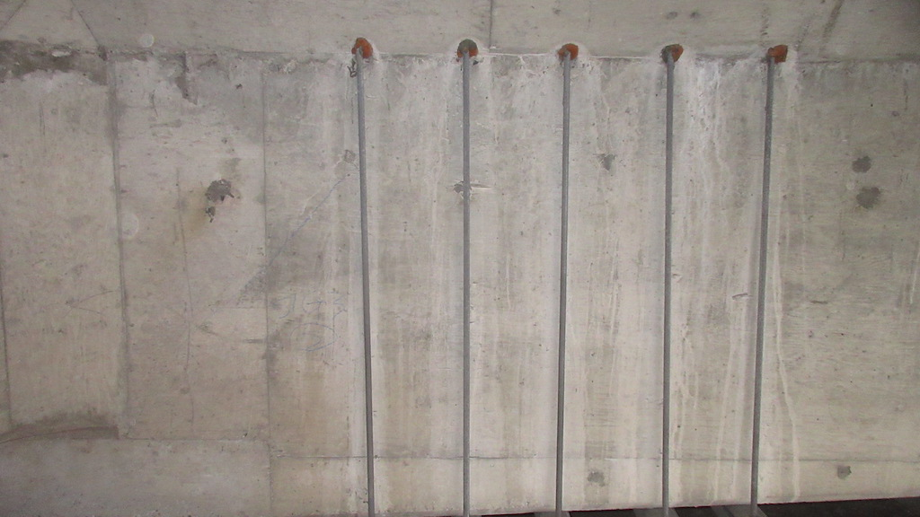

Slide 57
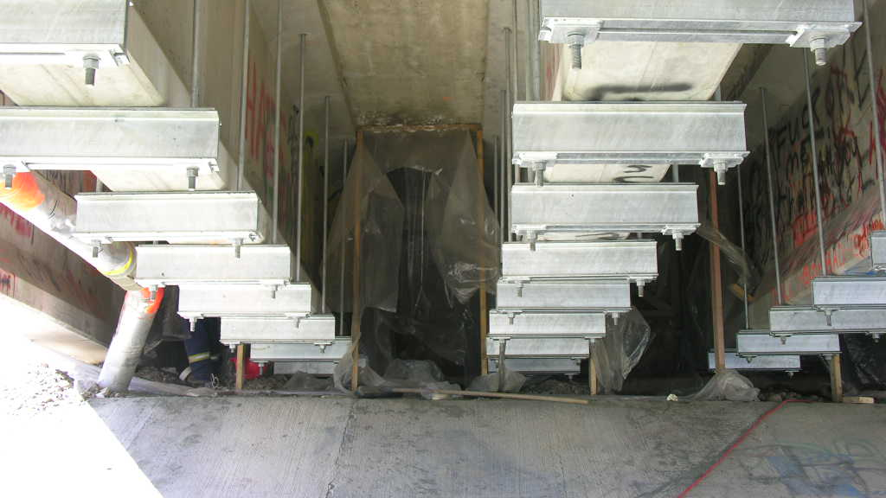

Slide 58
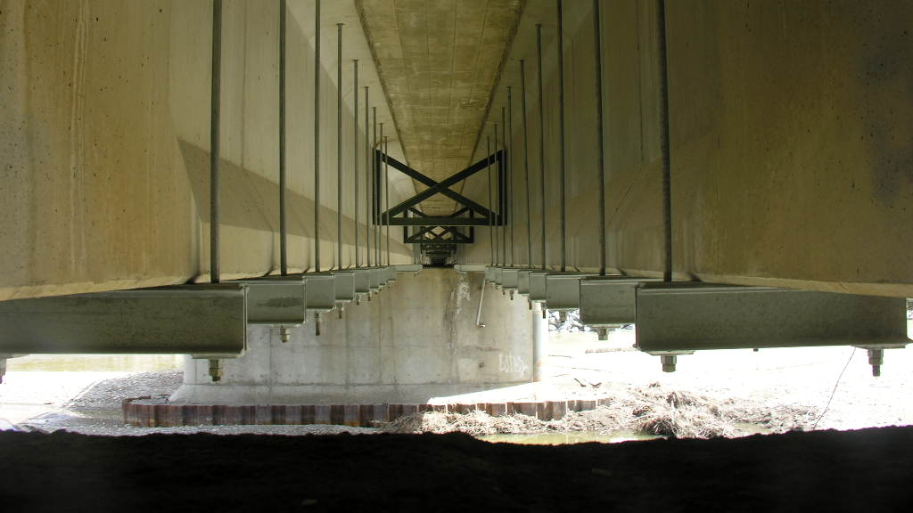

Slide 59
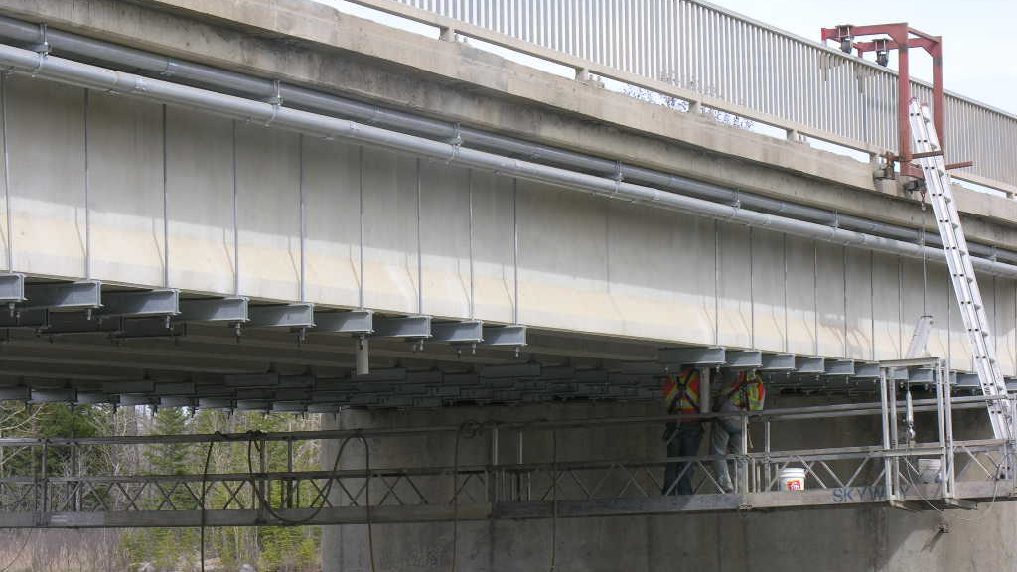

Slide 60
Deck Joints

Slide 61
Bridge Deck Joints
Pre – 1975 Bridges
lots of simple spans
lots of non-waterproof joints
Existing Practice
continuous spans, eliminate deck joints where possible
joints waterproof or with drainage systems

Slide 62
Types of Deck Joints
Strip Seal Joints
waterproof
a rubber/neoprene seal attached to metal extrusion
moderate thermal movements (up to approx. 75 mm)
make sure installation fills all voids behind extrusions
work well but seals must be replaced from time to time

Slide 63
Types of Deck Joints
Finger Plate Joints
non-waterproof
sliding finger plates with plumbing/drainage system
works for large thermal movements (> 75 mm)
careful to fill all voids behind plates when installing
mis-alignment of fingers due to dead load creep and abutment rotation
plumbing/drainage systems need to be cleaned out from time to time

Slide 64
Types of Deck Joints
Small Movement Joints
small movements due to live load deflection, etc.
compression seals
types of caulking materials

Slide 65
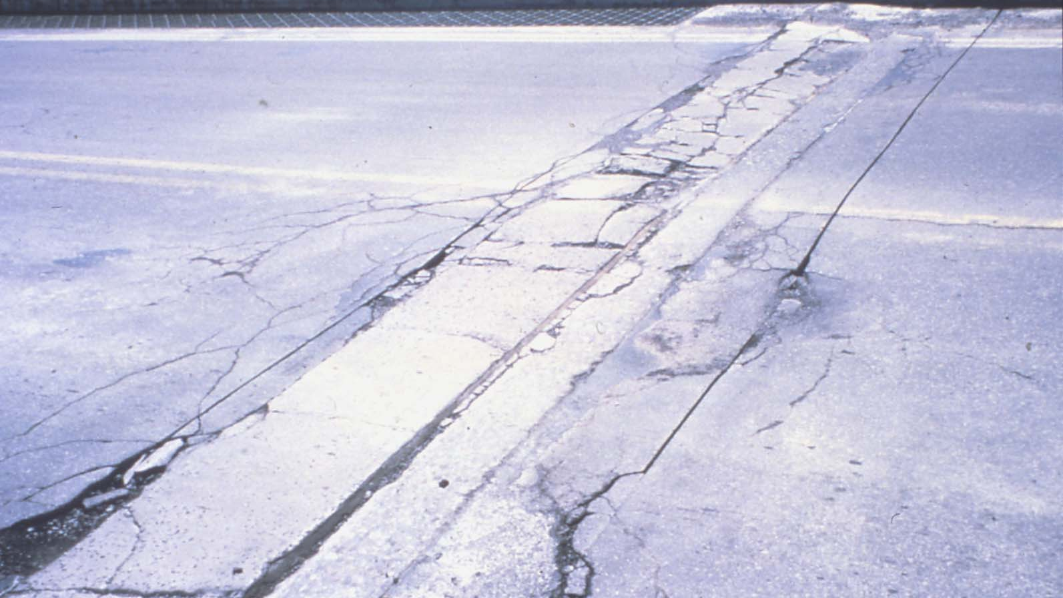

Slide 66
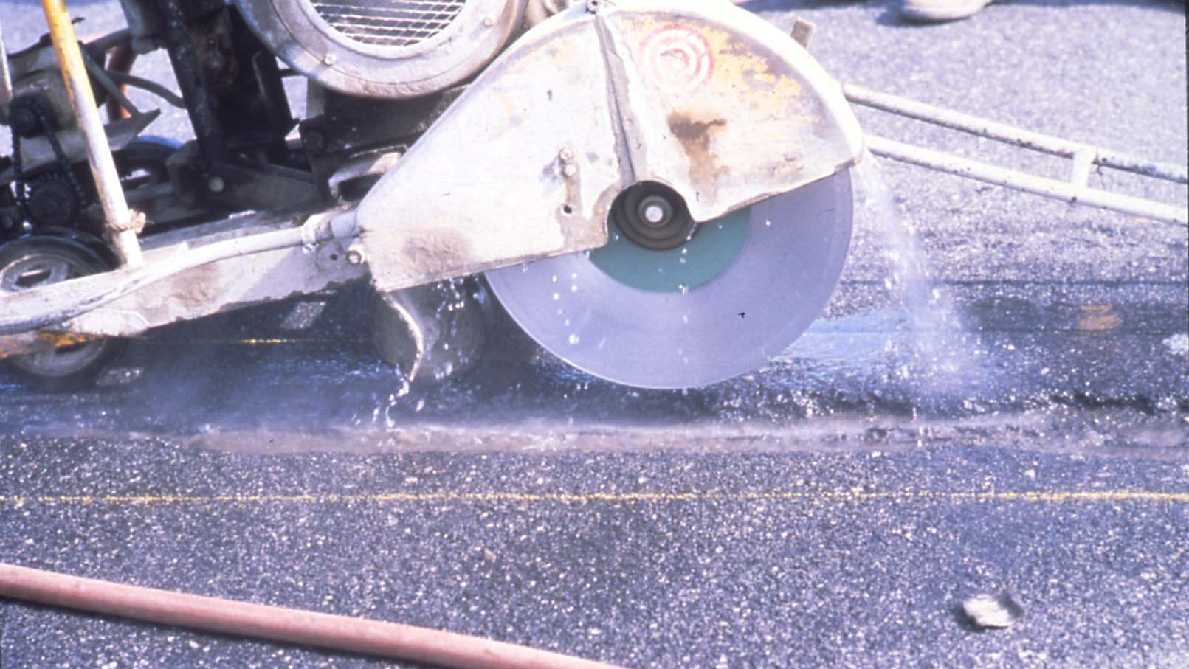

Slide 67
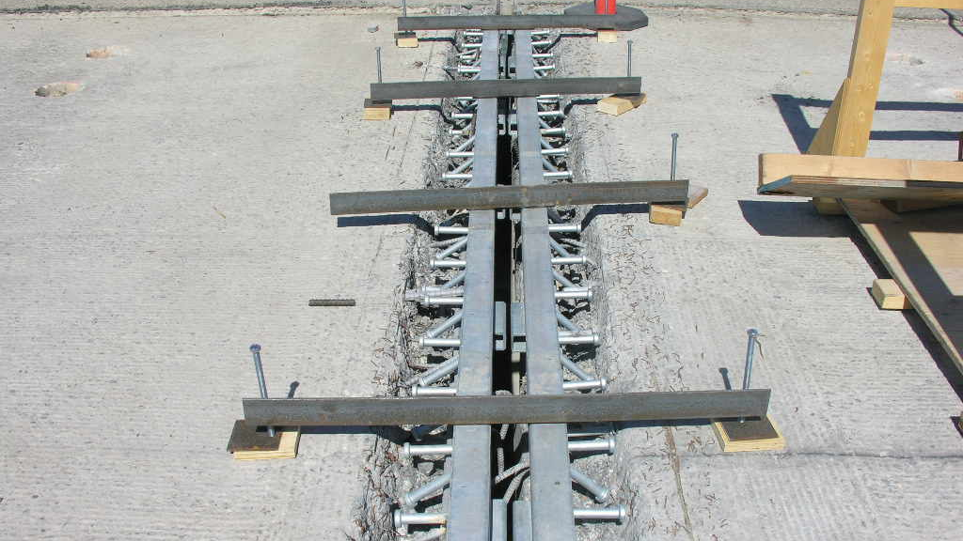

Slide 68
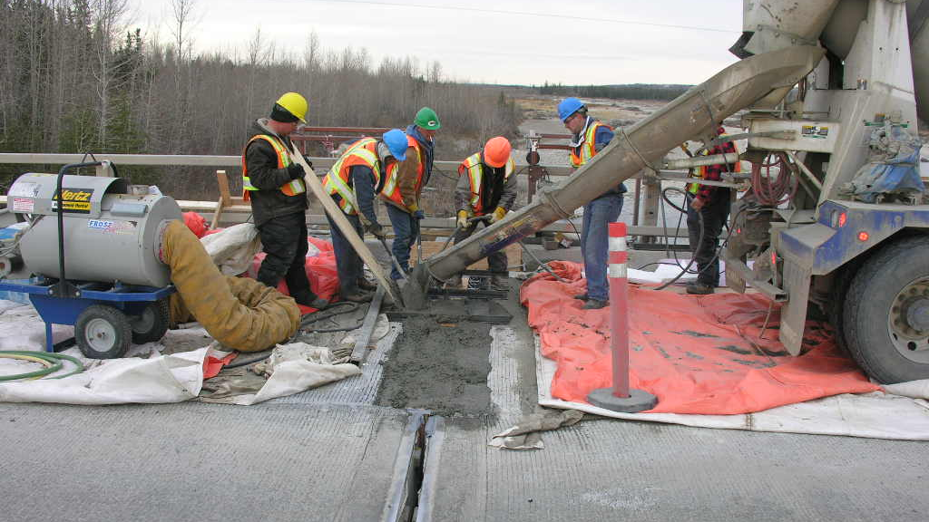

Slide 69
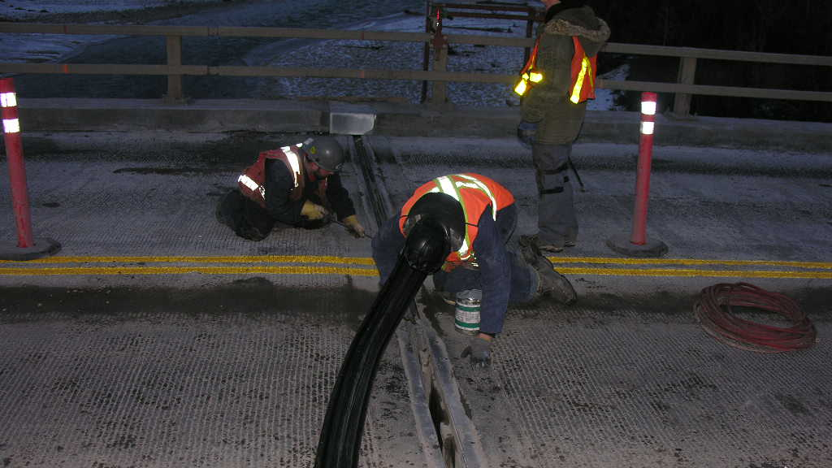

Slide 70
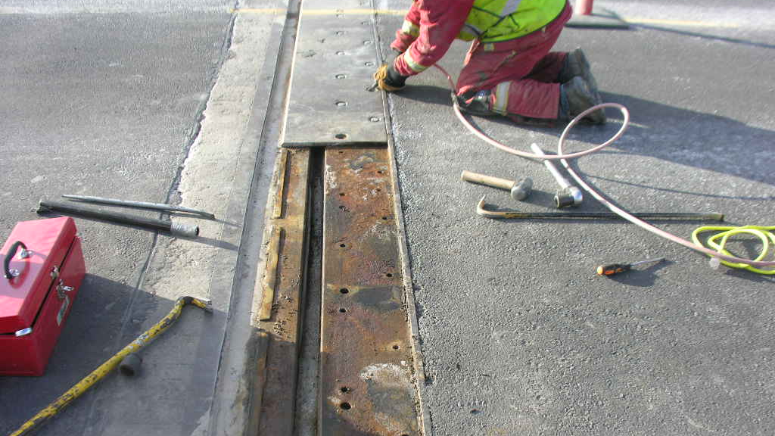

Slide 71
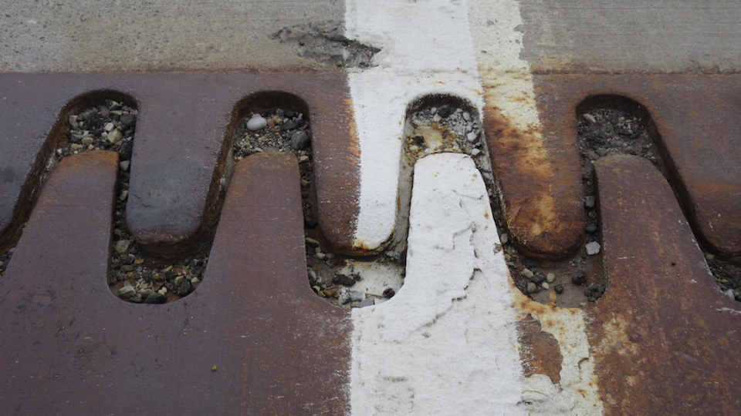

Slide 72
Full and Partial Depth Deck Repairs

Slide 73
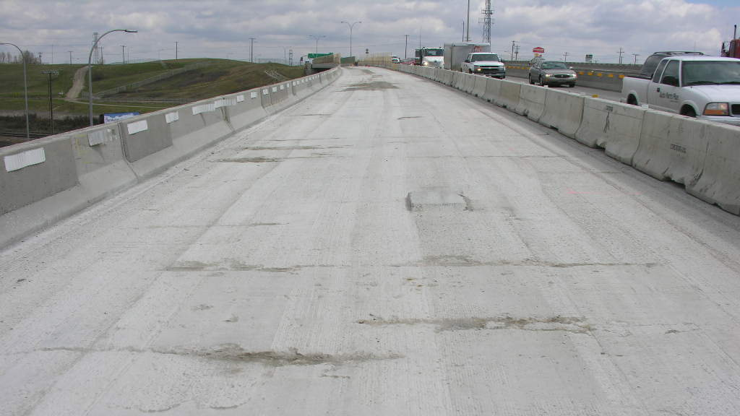

Slide 74
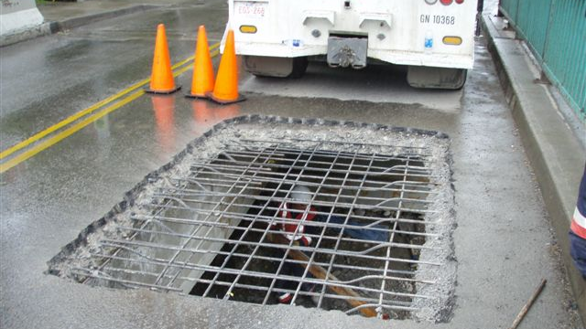

Slide 75
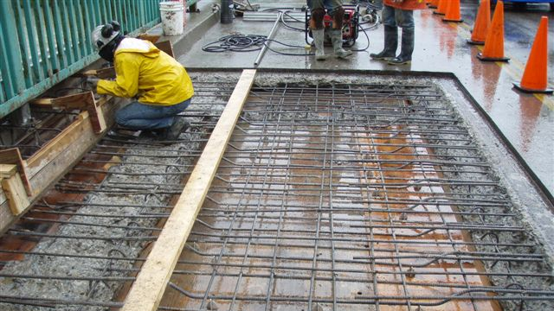

Slide 76
High Load Repairs – Concrete Girders

Slide 77
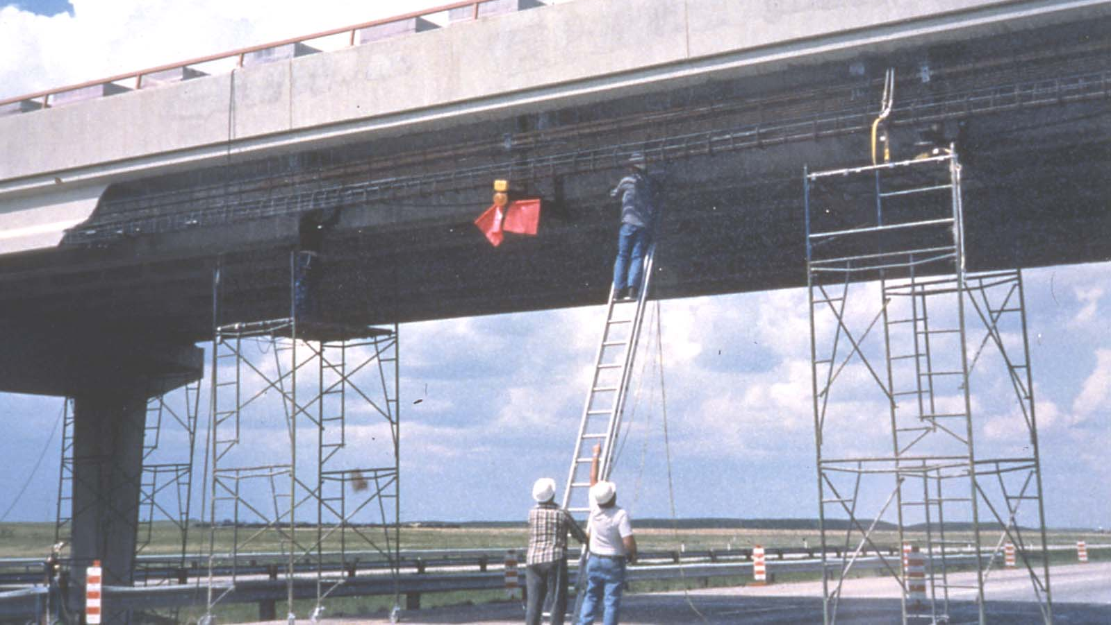

Slide 78
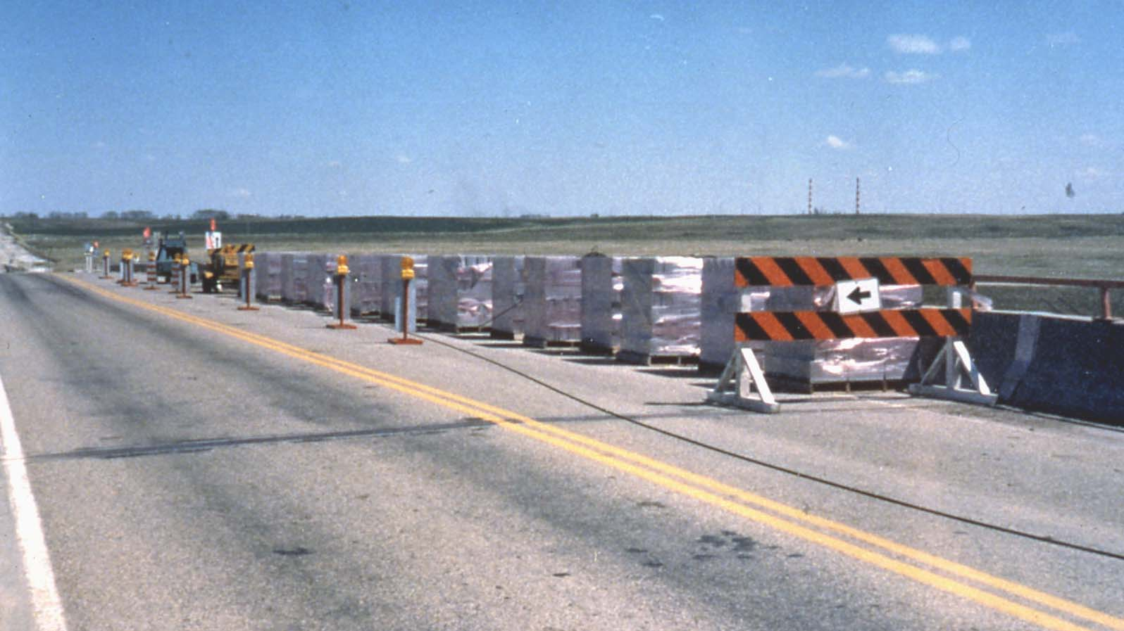

Slide 79
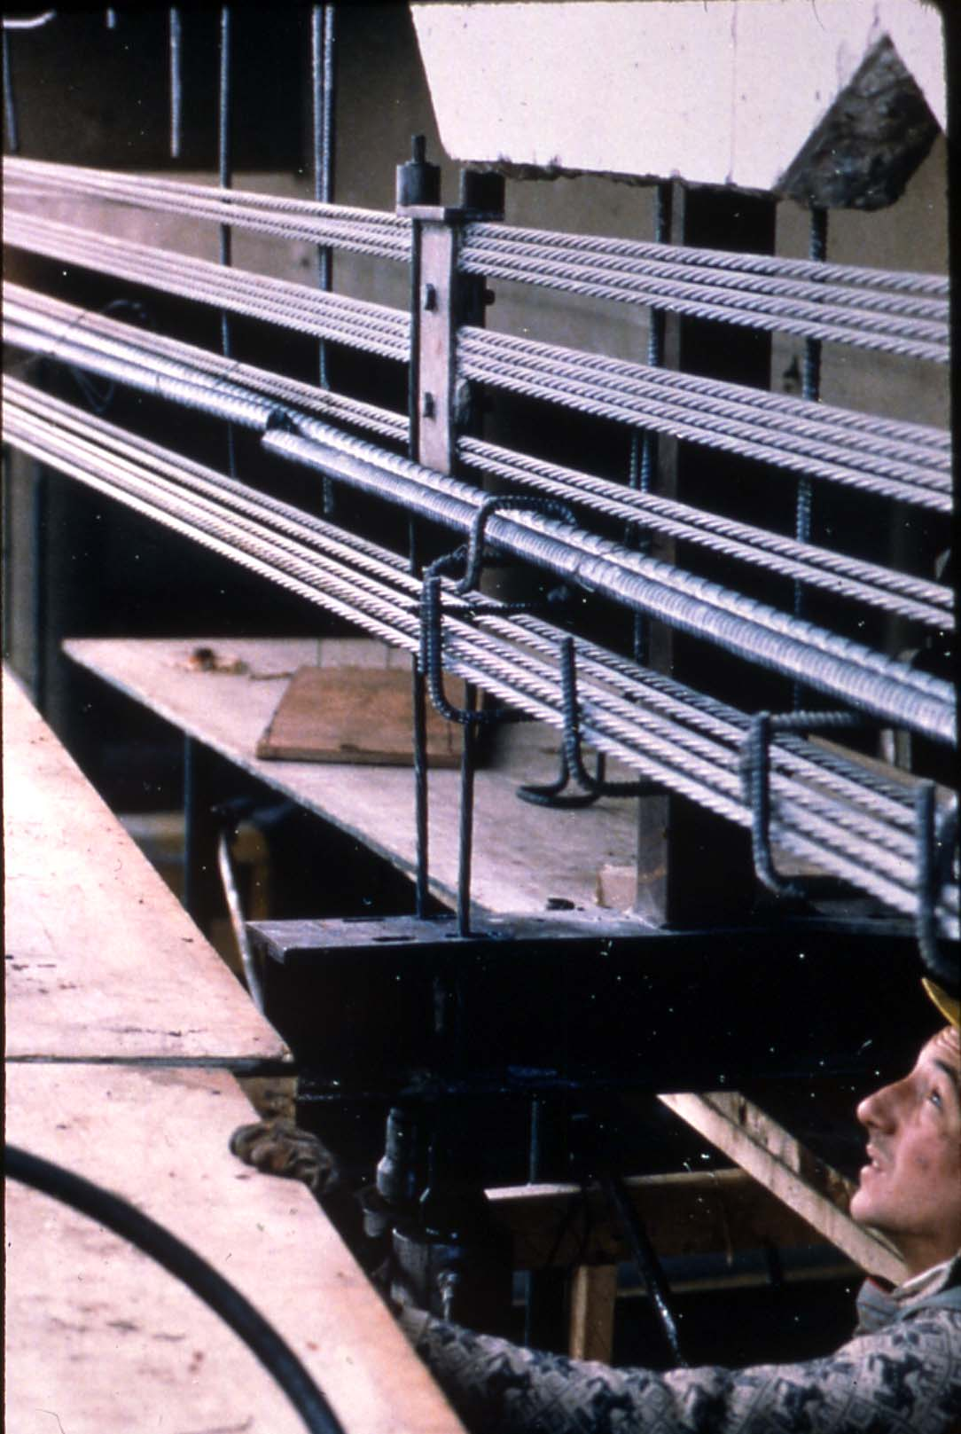

Slide 80
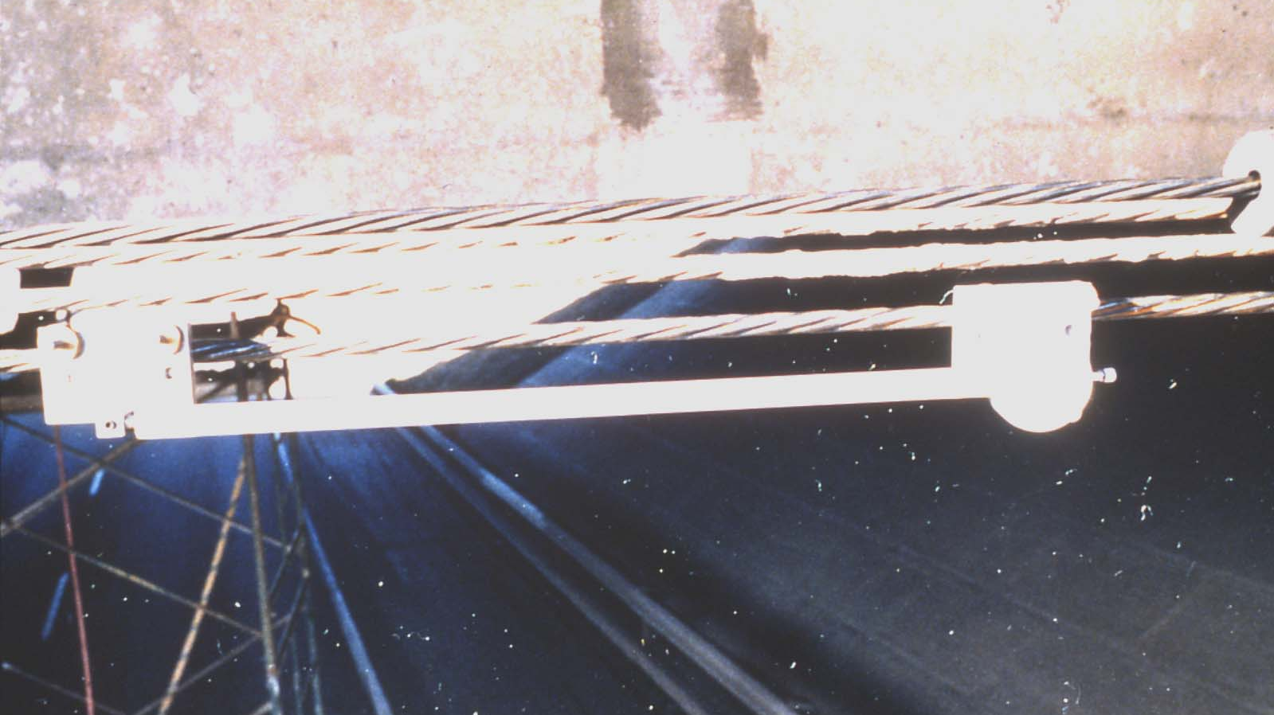

Slide 81
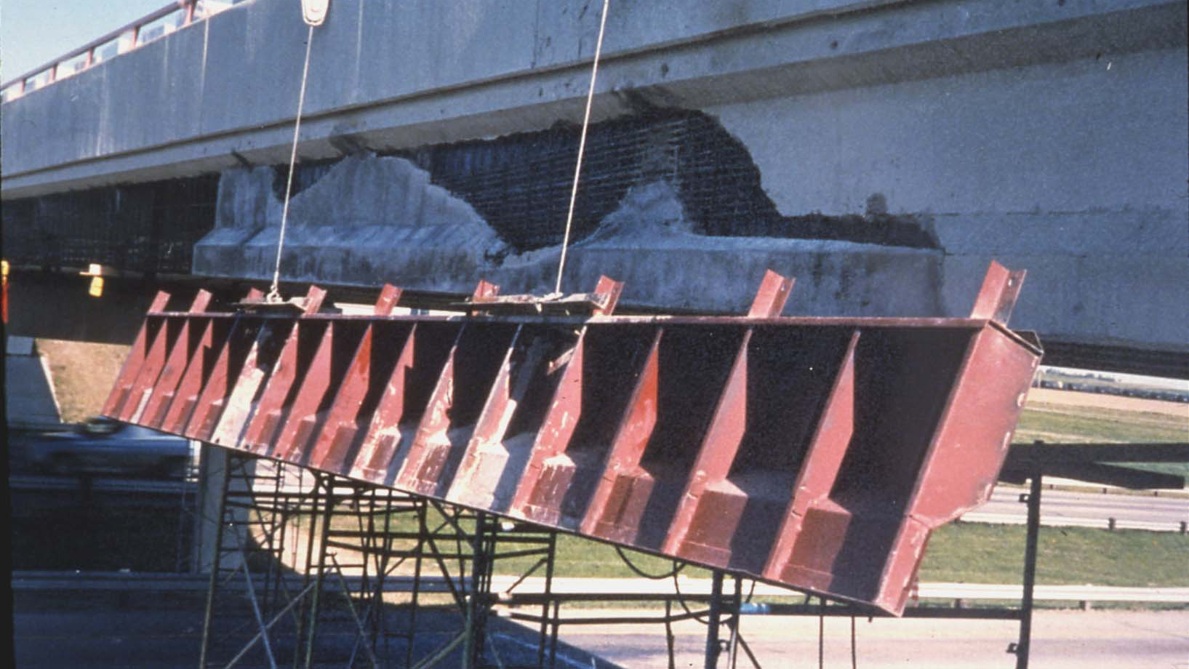

Slide 83
Shotcrete Concrete Repairs

Slide 90
Curb Concrete Repairs/Replacement

Slide 95
Concrete Crack Repairs

Slide 99
Concrete Sealing – Preventative Maintenance

Slide 104
Specifications for Bridge Construction
Section 4 - Cast in Place Concrete
Section 15 - Polymer Overlays
Section 16 - Bridge Deck Waterproofing
Section 20 – Deck Overlays and Concrete Rehabilitation
Link to Specifications for Bridge Construction:
https://open.alberta.ca/publications/standard-specifications-for-bridge-construction-edition-17

Slide 105
Questions?

