Slide 1
APPROACH ROAD INSPECTION AND RATING

Slide 2
Introduction
Approach road is the road leading up to the bridge or culvert
Basic rule is alignment OVER is rated in Approach Road section and Alignment UNDER is rated in Grade Separation or Channel section
For purpose of this presentation – not road under bridge or through culvert – covered in GS
For culverts it includes the road fill over the culvert
Considerations for rating
Geometric alignment at the bridge site
Condition of approach fill
Inventory and condition of guardrails on approaches
Drainage on approaches to bridge

Slide 3
Road Use
Drivers unfamiliar with the area
Vehicles/Tires in poor condition
All of these factors have to be accommodated by the approach road alignment.
Roads are used by:
People with reduced abilities
People who just got licensed or new to driving
Inattentive drivers
Dangerous / erratic drivers

Slide 4
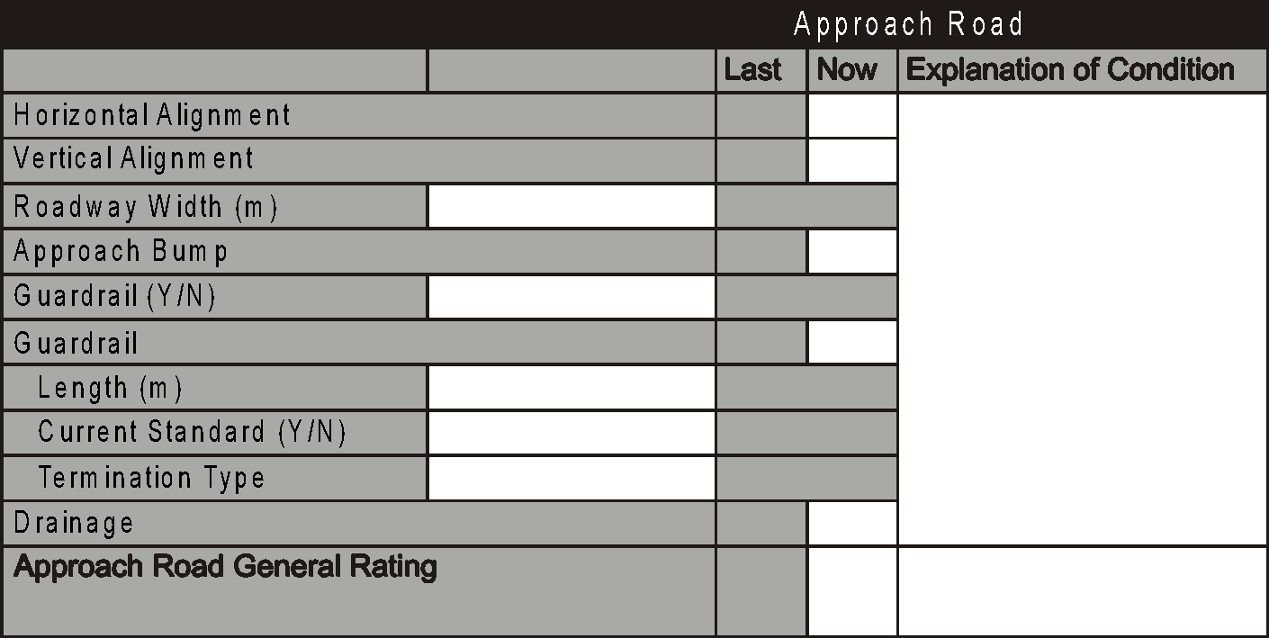
Approach Road Section - Bridges

Slide 5
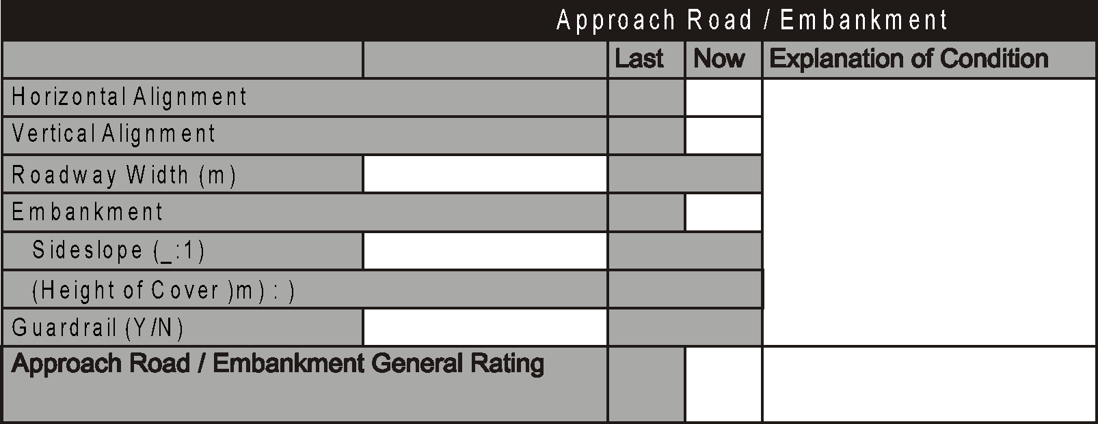
Approach Road Section - Culverts
Upstream End
End Treatment (Concrete,
Direction
Steel, Others, None)
Headwall
Wingwalls
Collar/Concrete Slope Protection
(Shape : )

Slide 6
Alignment
Separate ratings are provided for horizontal and vertical alignments
Defects in alignment must be categorized in either the horizontal or vertical components
Inspector should consider road alignments are used during adverse weather or road conditions – e.g. fog, heavy rain, snow, un-gravelled surfaces, icy roads

Slide 7
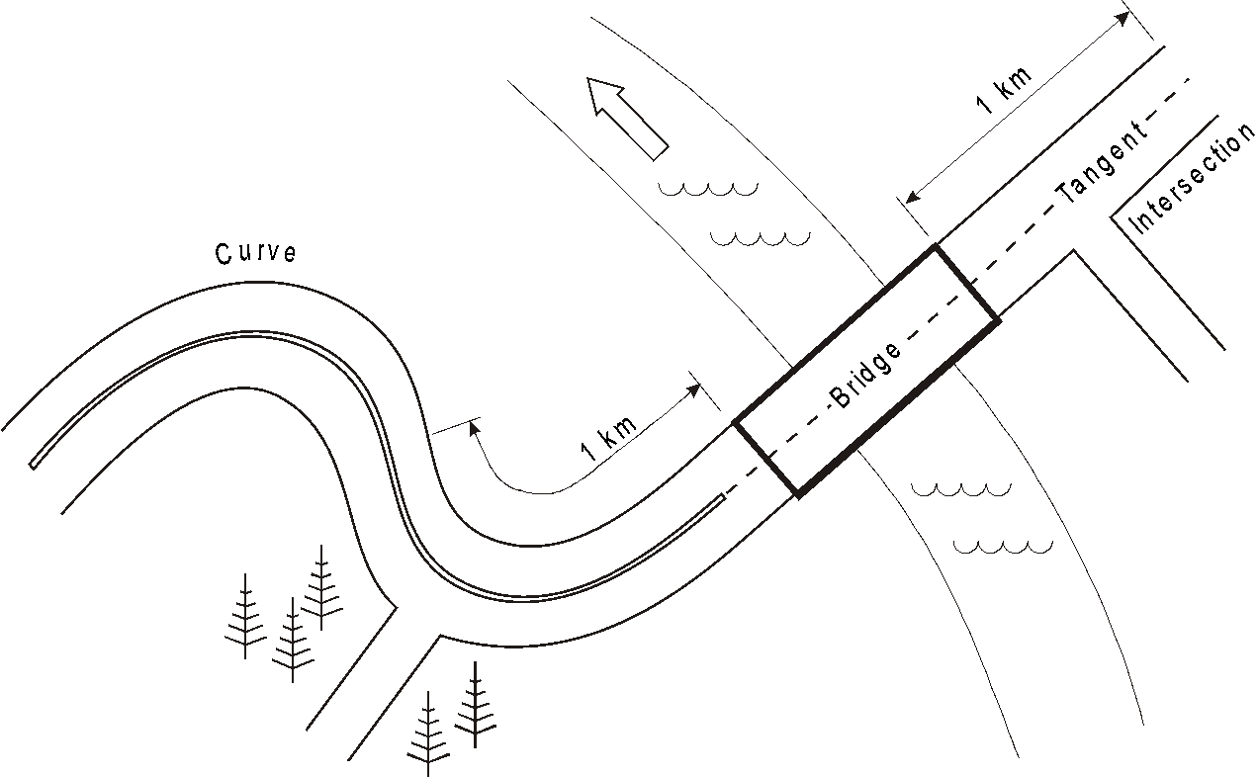
Length of Approach

Slide 8
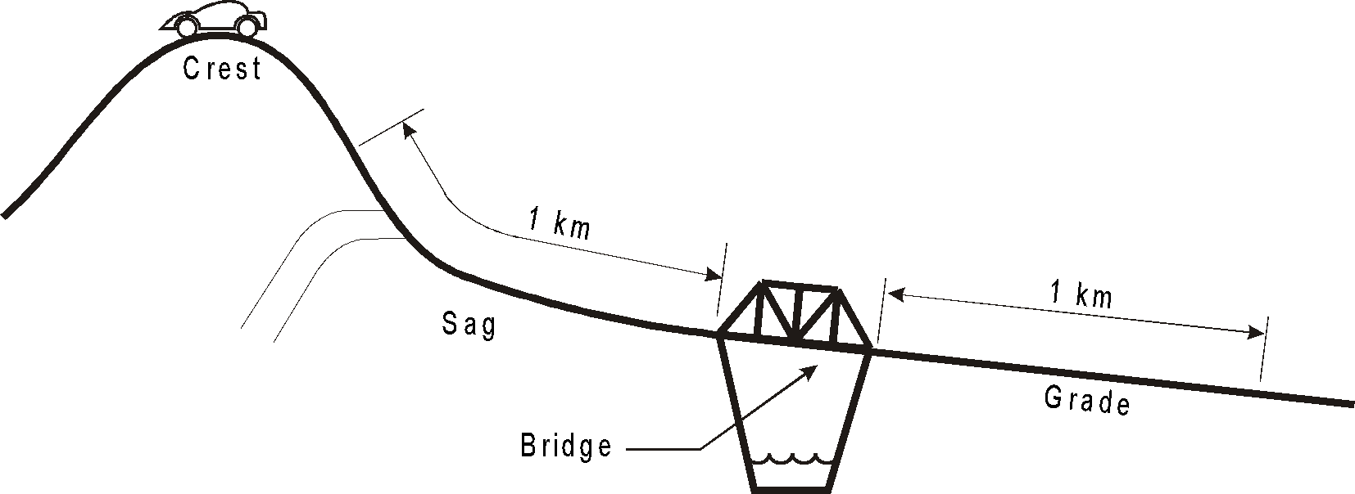
Length of Approach

Slide 9
Alignment
Design speed is the posted legal speed for road plus 10 kph
Evaluate by driving legal speed limit - if safe to do so and conditions permit.
Observe sight distances
Note if bridge is super-elevated
Note presence of speed limit or other signs
Sharp curve
Steep hill
Intersection ahead
Could indicate sight distance problem

Slide 10
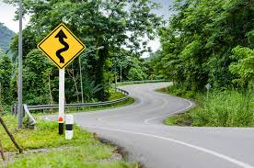
Horizontal Alignment
Horizontal defects result in a reduction in speed to drive the road safely. They include:
Reduced visibility – trees, buildings, embankments
Sharp corners
Intersecting or access roads
Bridge is at beginning of or in curve
Bridge is offset from straight alignment
Limited sight distance for passing safely

Slide 11
Horizontal Alignment Ratings
Note presence and record location of intersections or access roads including residential or commercial (field accesses do not affect rating).
Rate 7 or less depending on visibility, traffic volume and traffic type.
Rating may be 8 or 9 if on tangent and no intersections within 1km
If horizontal defect is cause of reduced speed, then rate:
6 or more if driven safely at legal speed limit
5 can be driven safely and posted not more than 20 km/hr below legal speed limit
4 or less if posted more than 20 km/hr below the legal speed limit
4 or less if sharp or blind curves
5 if Land Access bridge and appropriate warning signs are in place
Rate 2 if combined effect of horizontal and vertical alignment is hazardous (e.g. very steep hill combined with sharp hair-pin curve)

Slide 12
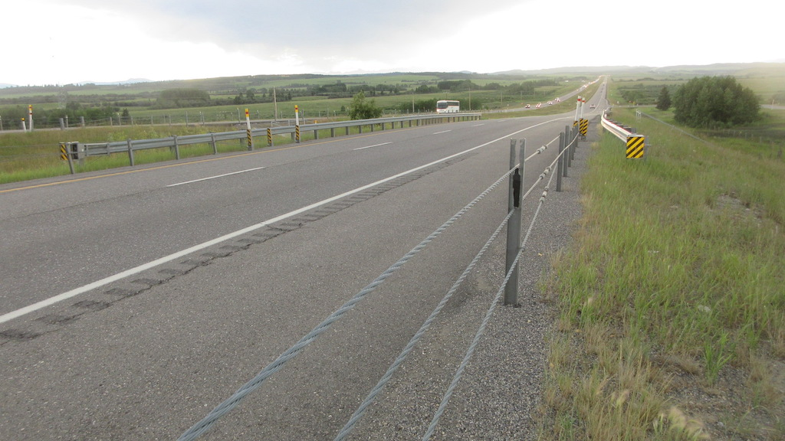

Slide 13
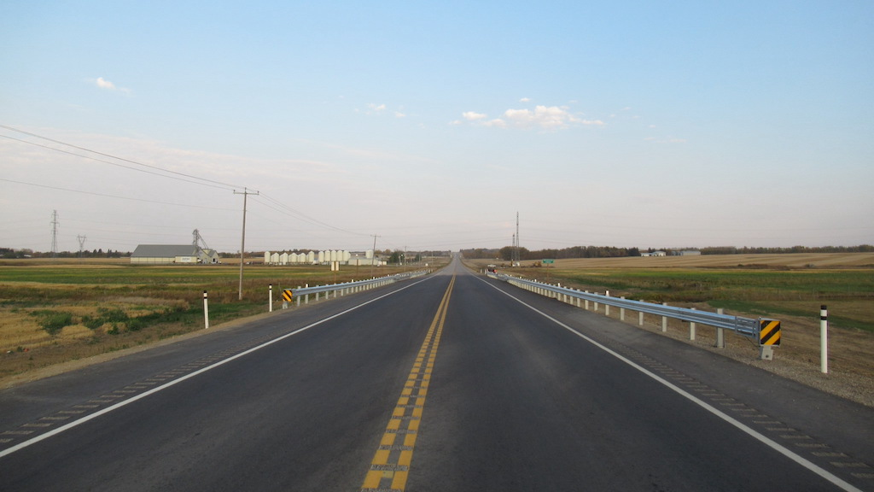

Slide 14
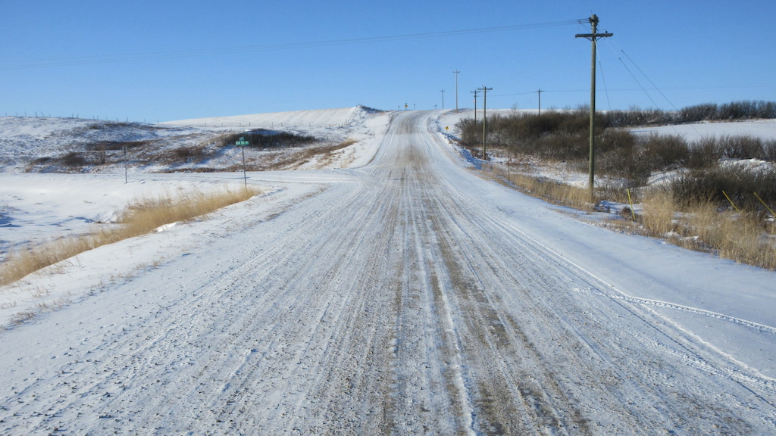

Slide 15
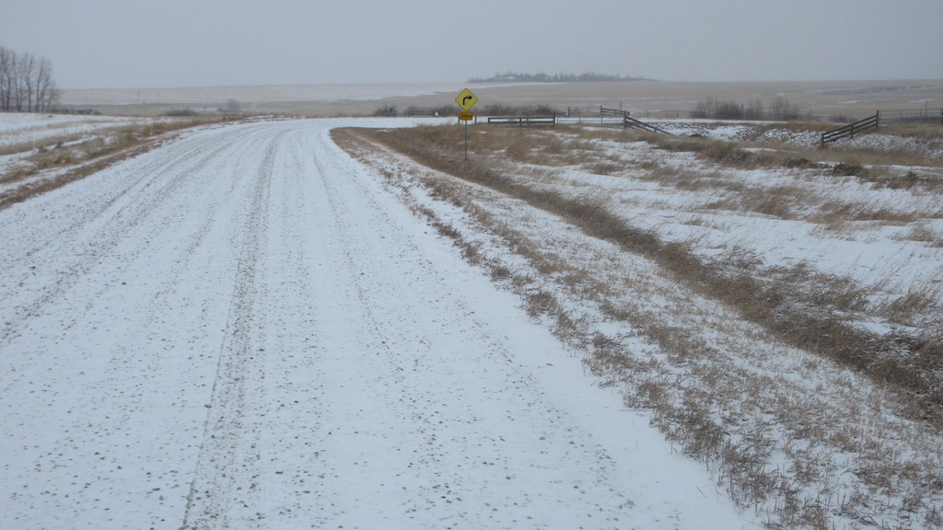

Slide 16
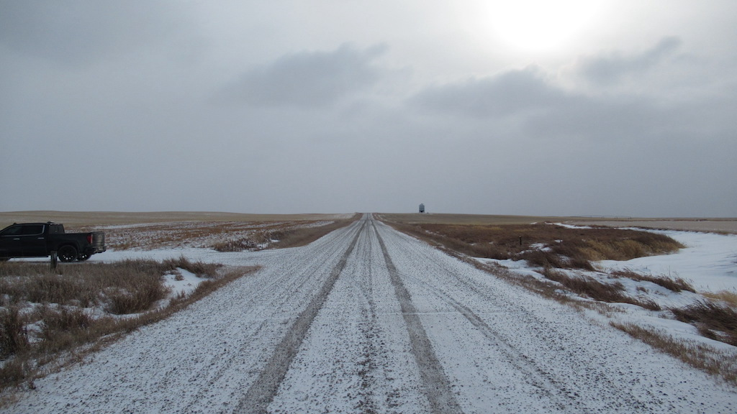

Slide 17
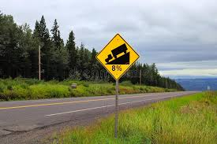
Vertical Alignment
Vertical alignment defects result in a reduction in speed to drive the road safely. They include:
Reduced visibility – crests
Steep grades (take into consideration road surface e.g. loose gravel)
Adequate sight distance for stopping or passing
Intersecting roads

Slide 18
Vertical Alignment Rating
Vertical alignment with a straight grade of 1% or less - rate 9
If road can be driven safely at legal speed limit rate 6 or more
If road can be safely driven and posted not more than 20 km/hr below legal rate 5
Rate 4 or less if:
posted more than 20 km/hr below posted speed
sight distance is less than required
Steep grades, blind crest curves
Rate 2 if combined effect of horizontal and vertical alignment is hazardous (e.g. very steep hill combined with sharp hair-pin curve)
Rate 5 if Land Access bridge

Slide 19
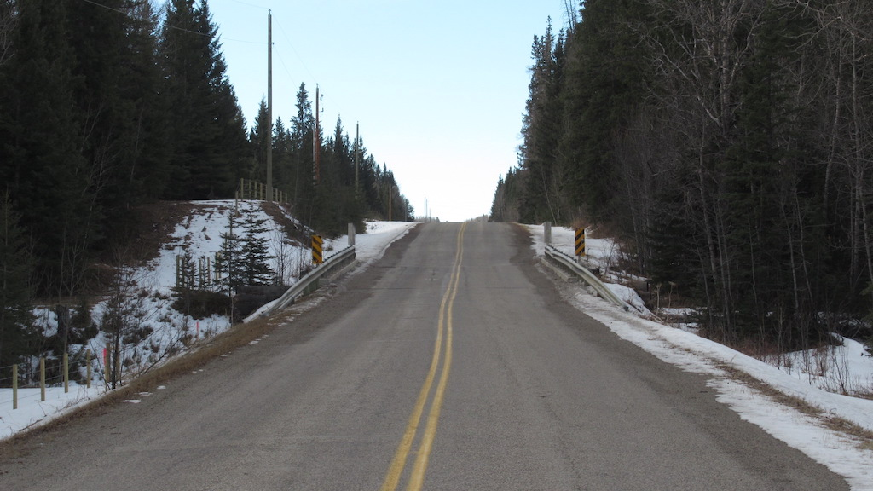

Slide 20
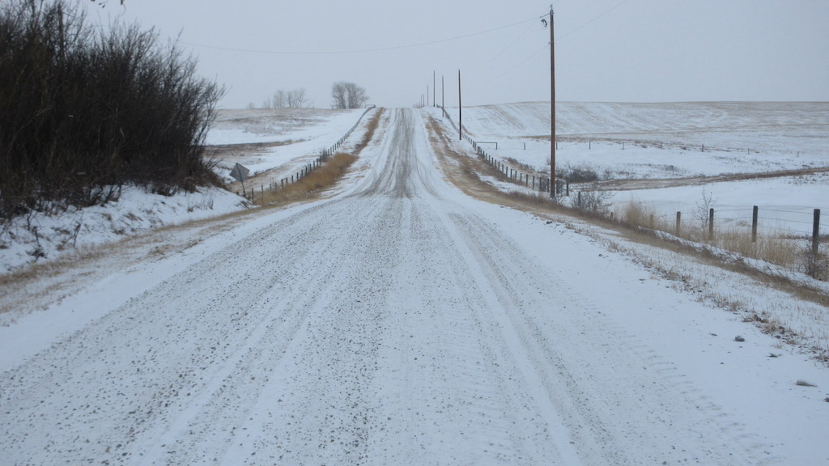

Slide 21
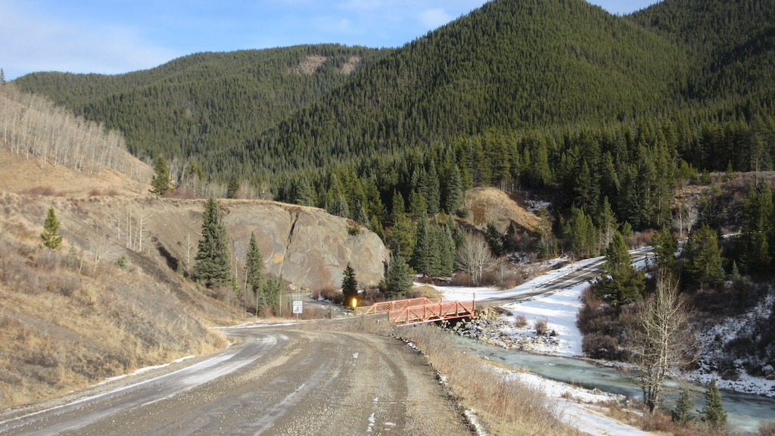

Slide 22
Alignment – Vertical And Horizontal
For land access structures:
Road services land only, not residential access, minimal traffic
Appropriate warning signs in place
Previous rating guidelines do not apply – rate 5
Alignment of railway, pedestrian and animal overpasses, and utility structures crossing over top are rated X
If both Horizontal and Vertical alignments rated X, General Rating is rated 5.
Pedestrian bridges over streams/watercourse or roadways
Grade Separation - Wildlife crossing over top of roadway
Grade Separation - Railway crossing over roadway

Slide 23
Culvert Grade Separation – Wildlife Over Horizontal & Vertical Approach Road Alignment Rated X so Gen. Rating = 5

Slide 24
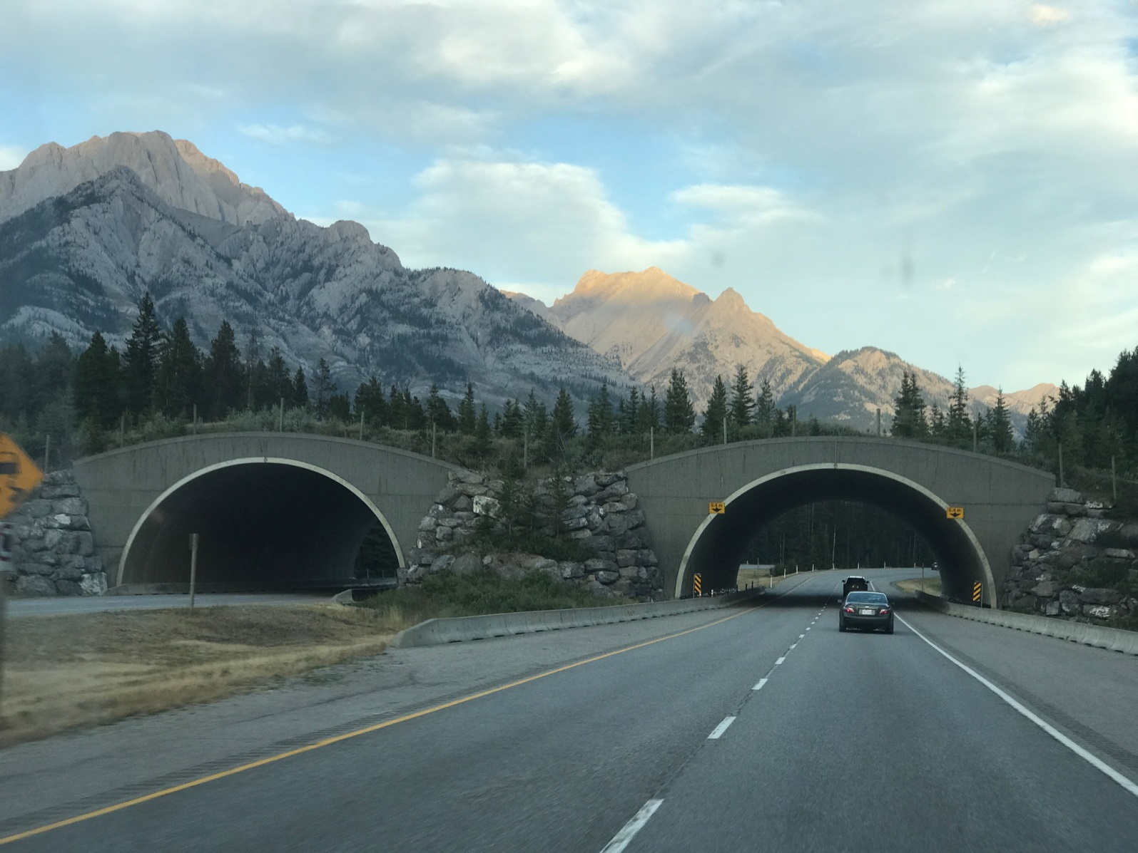
Culvert Grade Separation - Wildlife Overpass Vertical & Horizontal Road Alignment OVER Rated X, Gen. Rating = 5

Slide 25
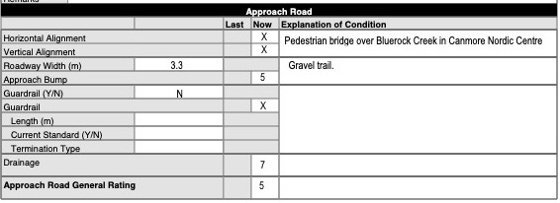
Pedestrian Bridge – Stream Under Horizontal & Vertical Approach Road Alignment Rated X – Gen. Rating =5

Slide 26
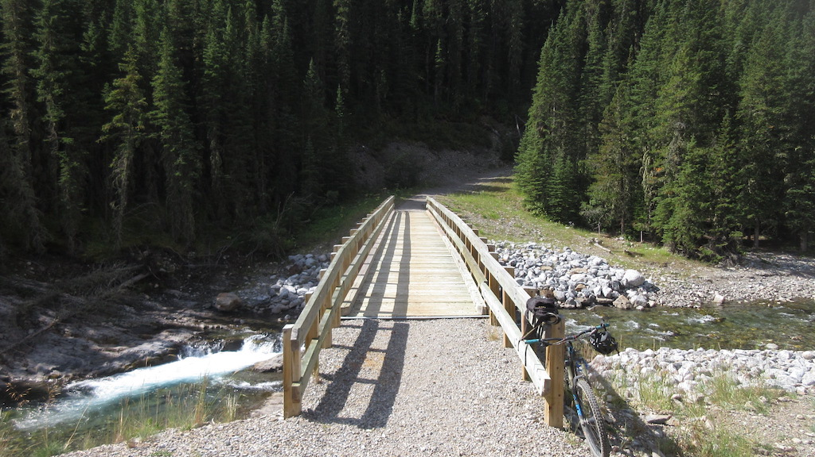

Slide 27
Roadway Width
This is the width of the traveled lanes and shoulders
Do not include median width if present on approach road
If curbs on the approach road, measure between faces
Measure at a representative cross-section
Record minimum width to the nearest 0.1m if different between ends
Provide explanation if different on each side of structure

Slide 28
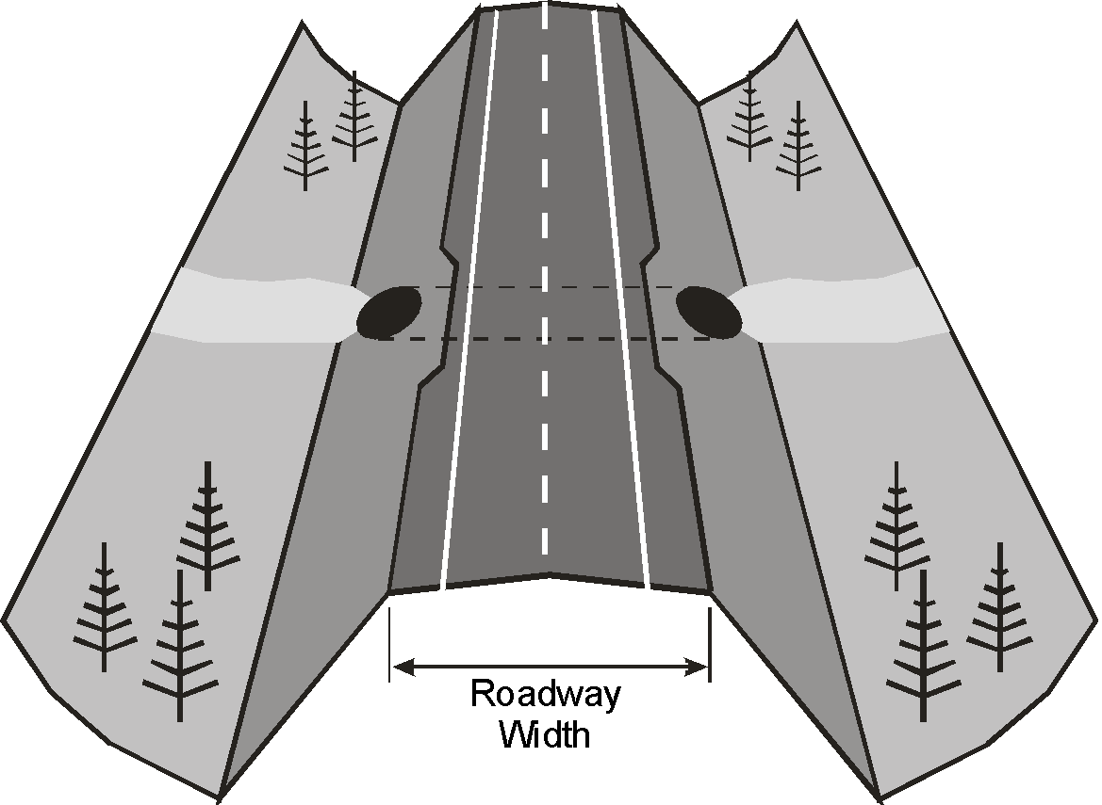
Roadway Width

Slide 29
Approach Bump
Bridges only
Refers to the smoothness of the transition onto the structure
Severe bump
Can be hazard to traffic (2 or less)
Can lead to increased impact loading on structure (4 or maybe 3 or less)

Slide 30
Approach Bump
May be a symptom of
Settlement of the approach fill
Instability of the fill (slumping)
Undermining of fill by water
Settlement of or damage to approach slab
Drive over at legal speed if safe – or at safest speed that conditions allow
Observe traffic crossing structure
If no defects and smooth transition rate 9
If bump is noticeable but tolerable - rate 5
If speed must be reduced - rate 4 or less
If causing significant impact loading on bridge deck – rate 3 or less
If hazardous to traffic - rate 2 or less

Slide 31
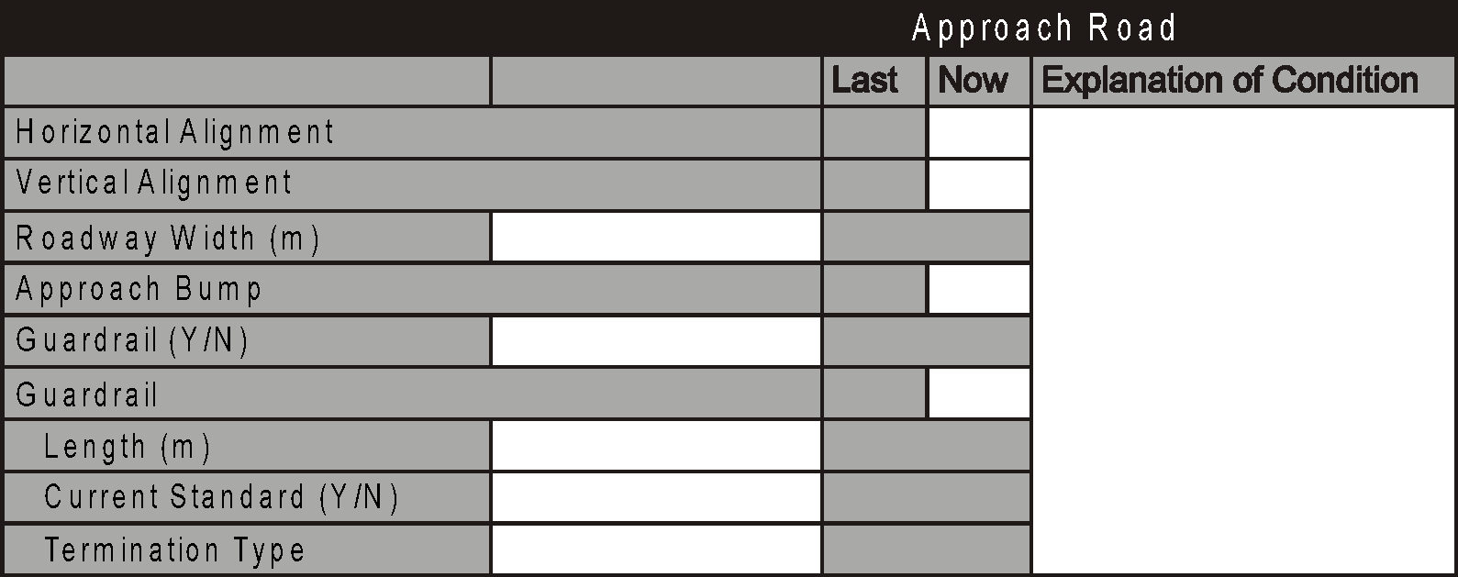
Guardrail
Refers to guardrail or other traffic barrier along edges of the approach road
Purpose:
Prevent traffic from leaving the roadway at the structure
Prevent traffic from impacting structure

Slide 32
Guardrail - Culverts
Rating is not required
Record the presence of guardrail by Yes or No
Provide comment if guardrail is on one shoulder only
Guardrail that is too short or is otherwise ineffective – provide comment and maintenance recommendation
Provide comment and maintenance recommendation if missing and is required for safety
Note defects (e.g. - broken posts, damaged rails) and provide comment and maintenance recommendation
No indicates no guardrail

Slide 33
Guardrails - Bridges
Record the presence of guardrail by Yes or No
Record the minimum length to the nearest meter
Comment/Explain if different lengths exist
Maximum is 99 m
Record the type of termination
Common type is Turned Down End, Wing End, Attenuator, Fleat
Built based on current Standard Drawings
Since 2001 most common S1643, 1649, 1651, 1652, 1653, and S1705 (newest)
Record if the guardrail meets current standards (Yes/No)
Explain if “No”
Common acceptable explanation is “Not thriebeam” or “Not attenuator”
HTCB is currently preferred standard and may transition with W-beam
https://www.alberta.ca/assets/documents/trans-bridge-barrier-drawings.pdf

Slide 34
Guardrails - Bridges
Inspect up to 20 m from bridge
Inspect all components of guardrail
Posts
Rail or Cable if HTCB
Connections
Splices
Termination (if within 20 m). Comment is more than one type
Rate according to condition only - not standard
e.g. do not down-rate if not built to current standard. Rate condition and functionality
E.g. W-beam 550mm road top to center – down-rate if too low or high to function

Slide 35
Guardrails - Bridges
Inspect up to 20 m from bridge
Inspect all components of guardrail
Posts
Rail
Connections
Splices
Termination (if within 20 m)
Rate according to condition only - not standard
Minor damage but still functional – rate 5
Missing bolts or improper laps - 4 or less
Damaged - requires replacement – rate 3 or less
Damaged – potential hazard – rate 2 or less
Rate “X” if no guardrail exists
If required, comment and recommendation

Slide 36
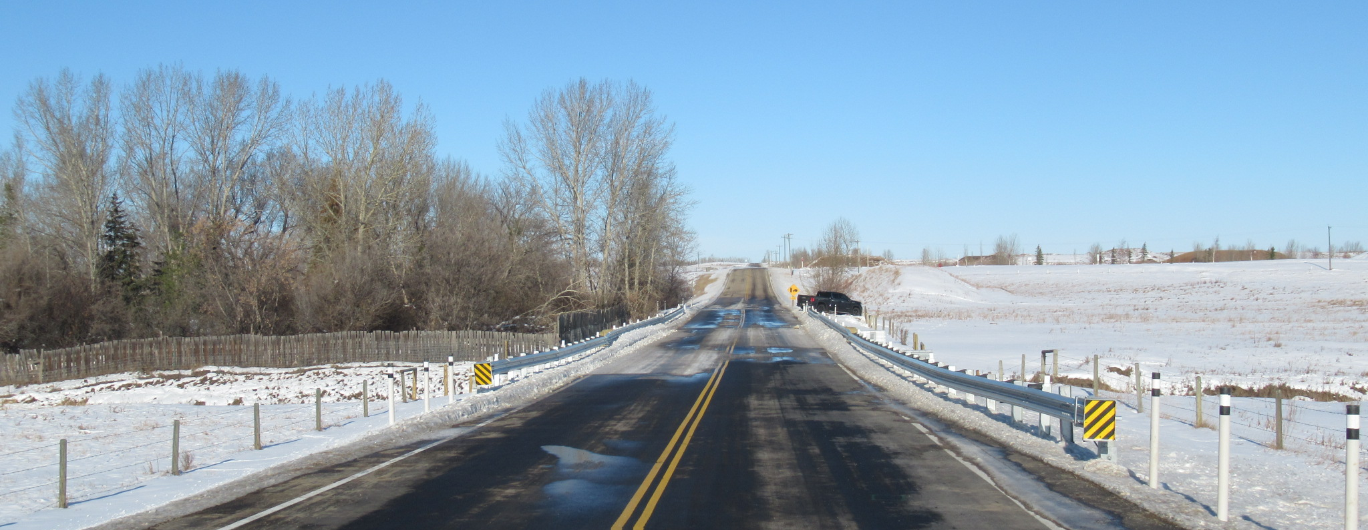
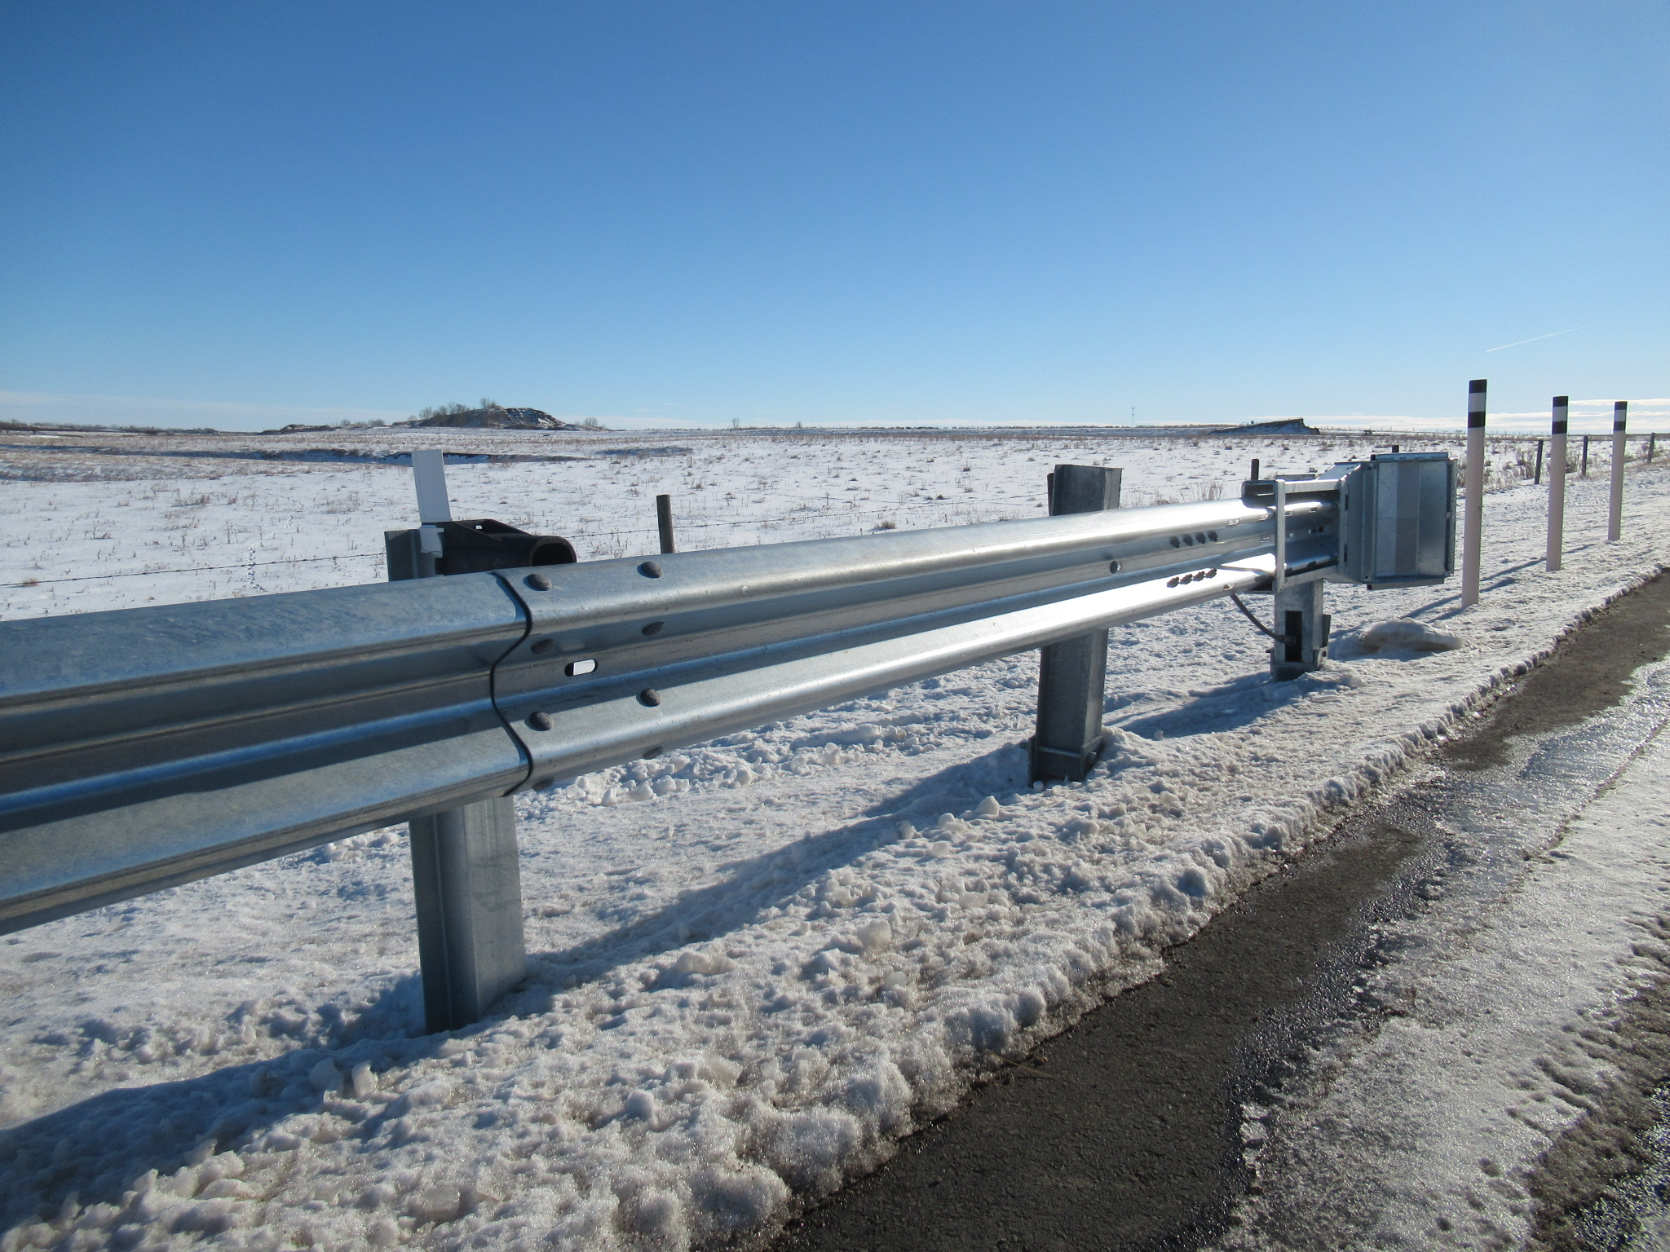
Guardrails – RDG-B1.5
New W-Beam guardrail installed with Fleat 350 Energy Absorbing Terminals
By design, the 3rd post from the Fleat 350 Terminal is left unbolted from the rail. Does not affect the guardrail rating.

Slide 37
http://www.transportation.alberta.ca/Content/docType233/Production/RDG-B1-5.pdf

Slide 39
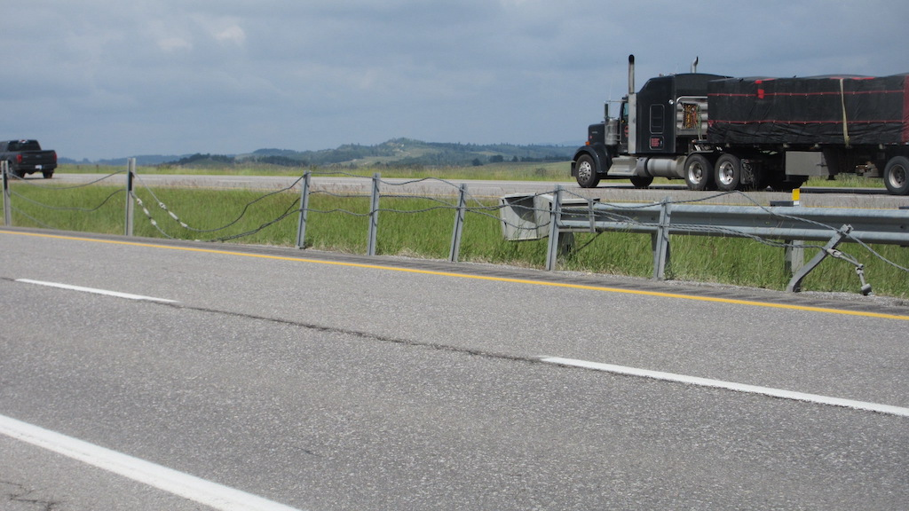

Slide 40
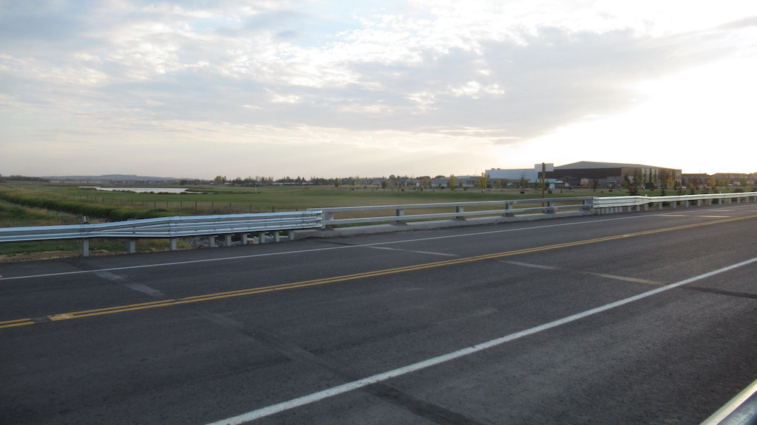

Slide 41
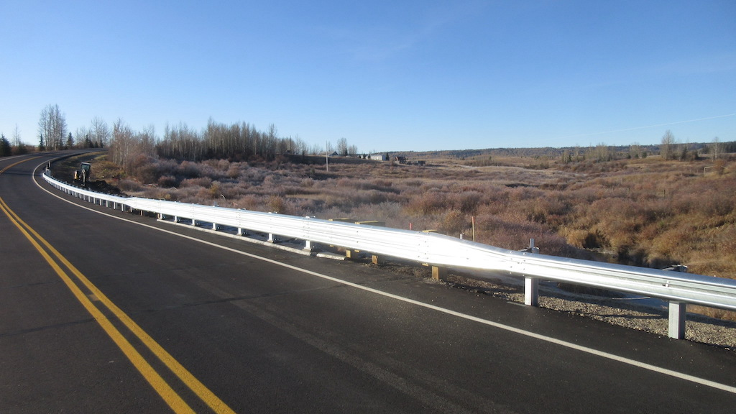

Slide 42
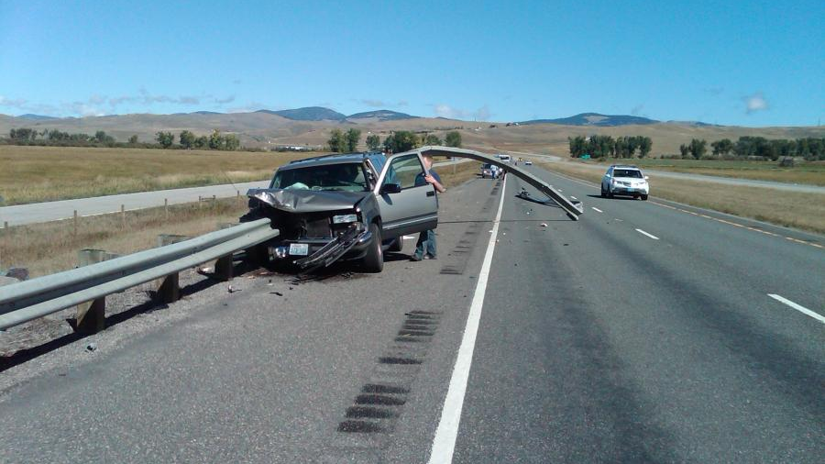

Slide 43
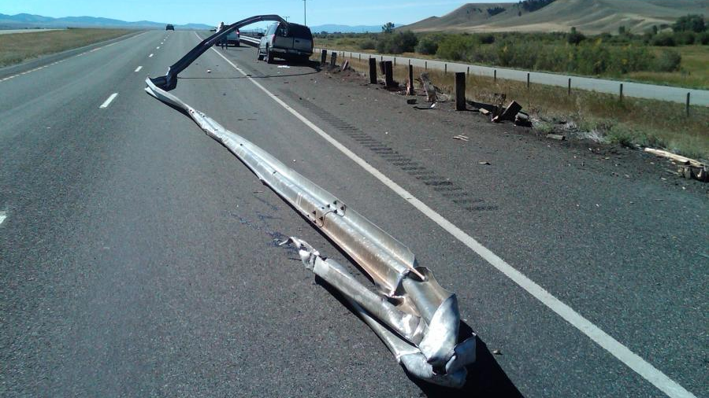

Slide 44
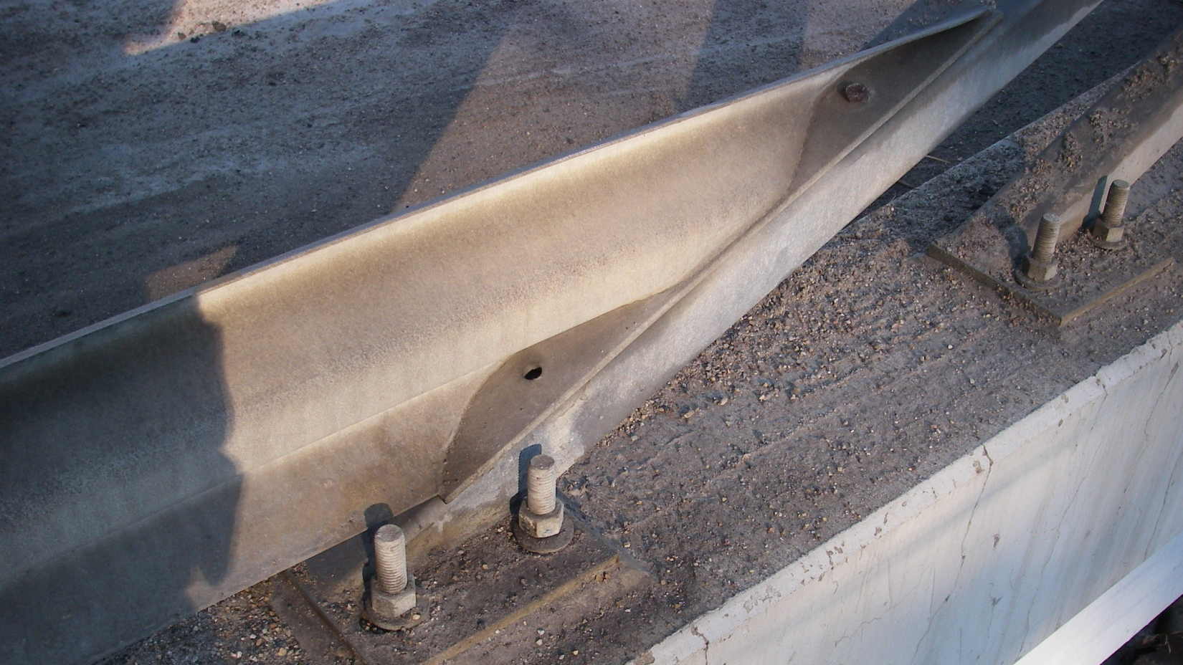

Slide 45
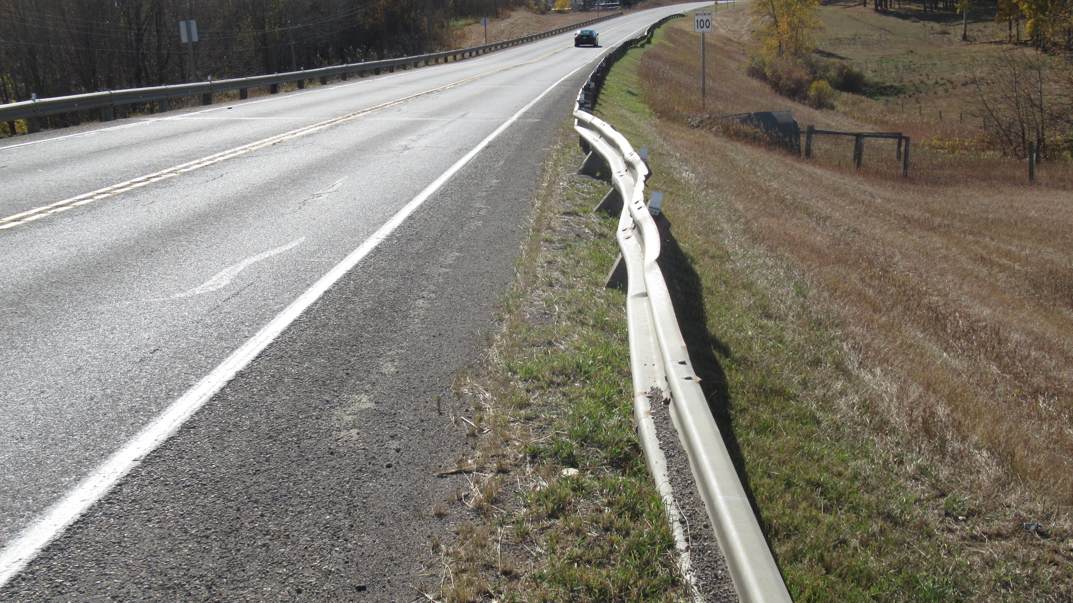

Slide 46
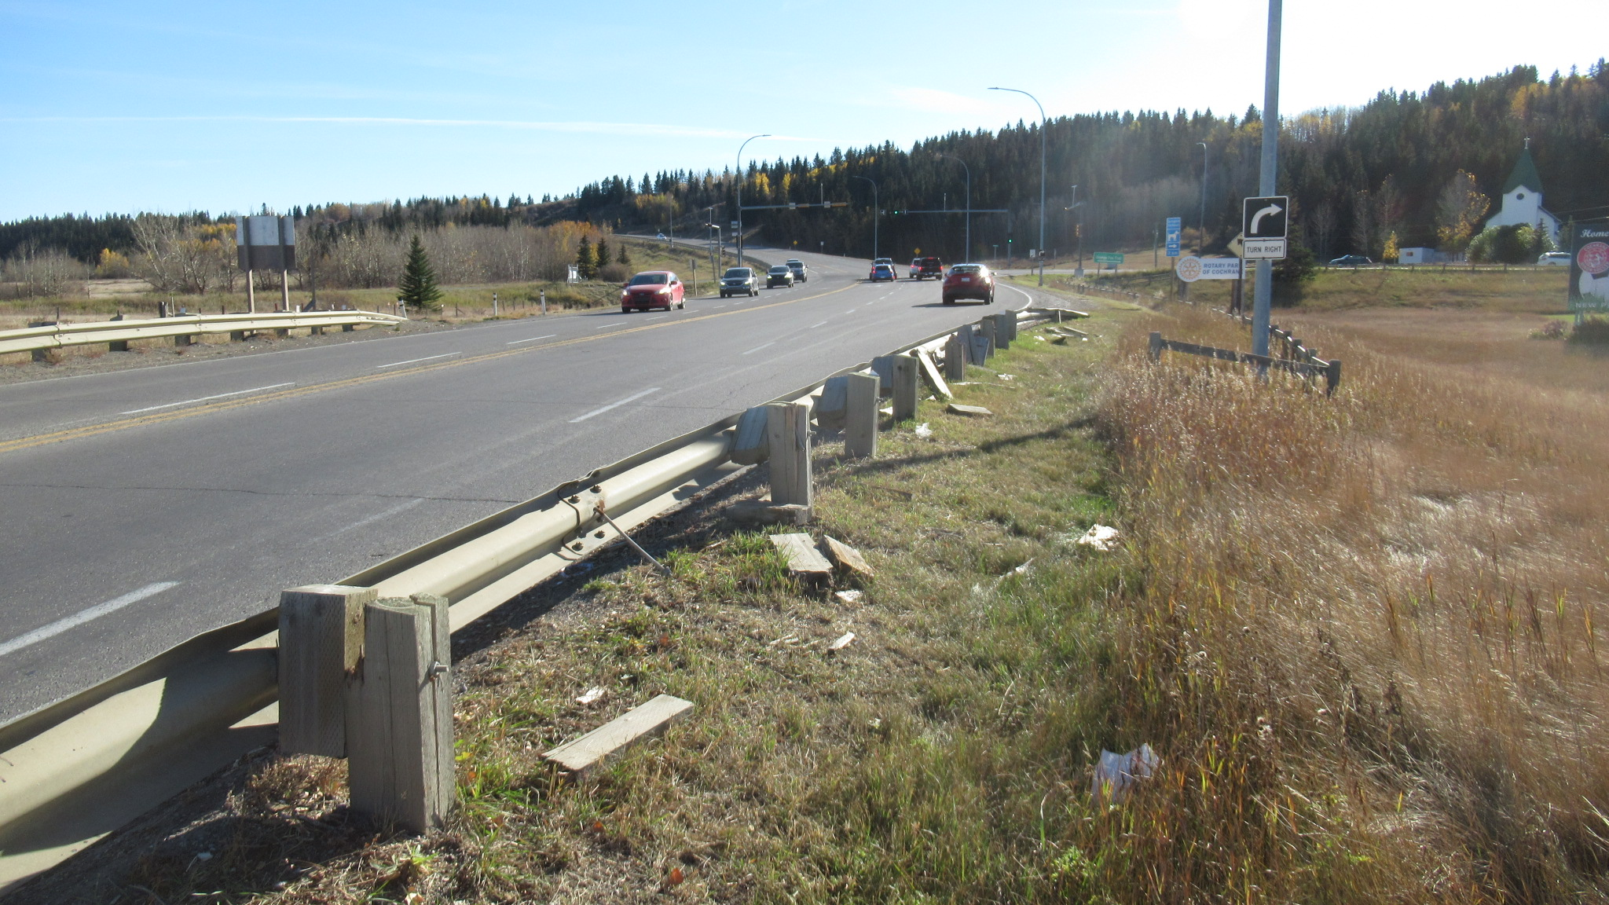

Slide 47
Drainage
Applies to bridges only
Refers to the ability of the approaches to handle drainage
Must not allow water to drain onto structure
Must not allow damage to fills or headslopes
Must not pond on approaches
Includes drain troughs on approaches
Water may originate from
Precipitation onto approaches
Runoff from roadway
Runoff from structure

Slide 48
Drainage
Look for:
Ponding of water on approaches or ends of structure
Erosion of fills, road embankment, headslope or ditches
Voids under approach slabs or abutments
Undermining of drain troughs
Damage or deterioration of drain troughs

Slide 49
Drainage
Good drainage away from bridge – rate 5 or more
Drainage onto bridge gutters - rate 4 or less
Drainage onto bridge driving lanes-rate 3 or less
Drainage eroding headslope or sideslope – rate
4 or less
Erosion from approach road ditch drainage – rate 4 or less
Drainage causing a hazard - rate 2 or less (e.g. ponding or icing into travel lanes)

Slide 50
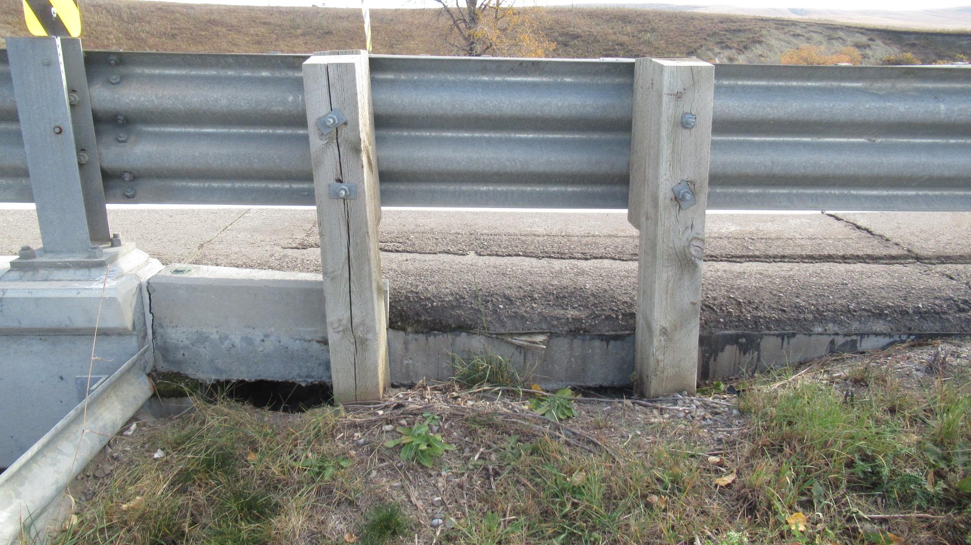

Slide 51
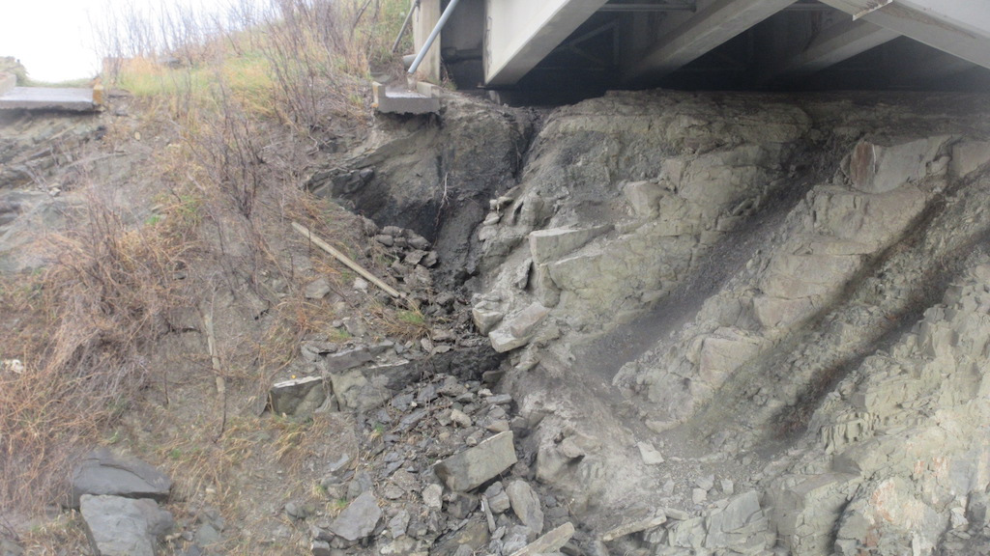

Slide 52
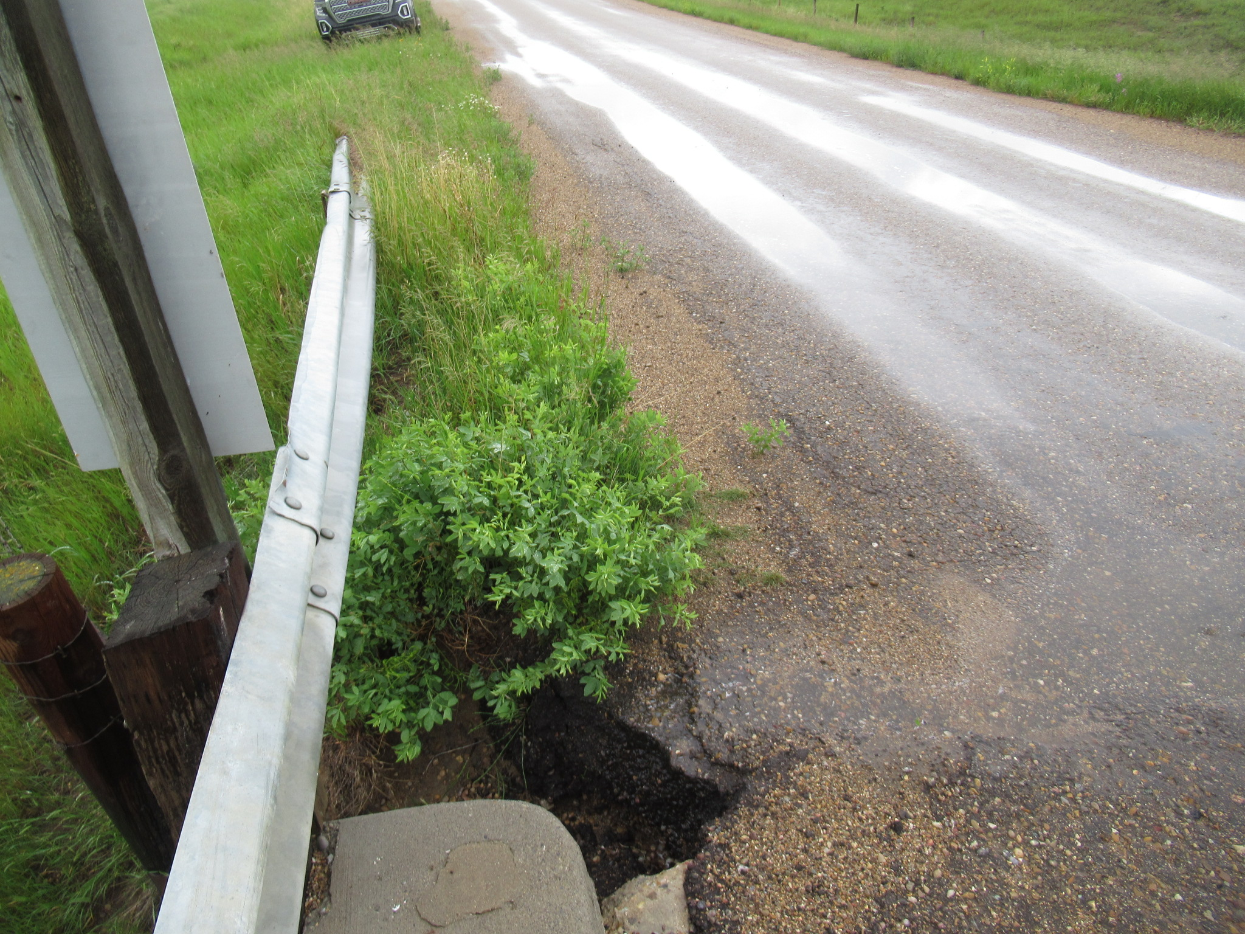

Slide 53
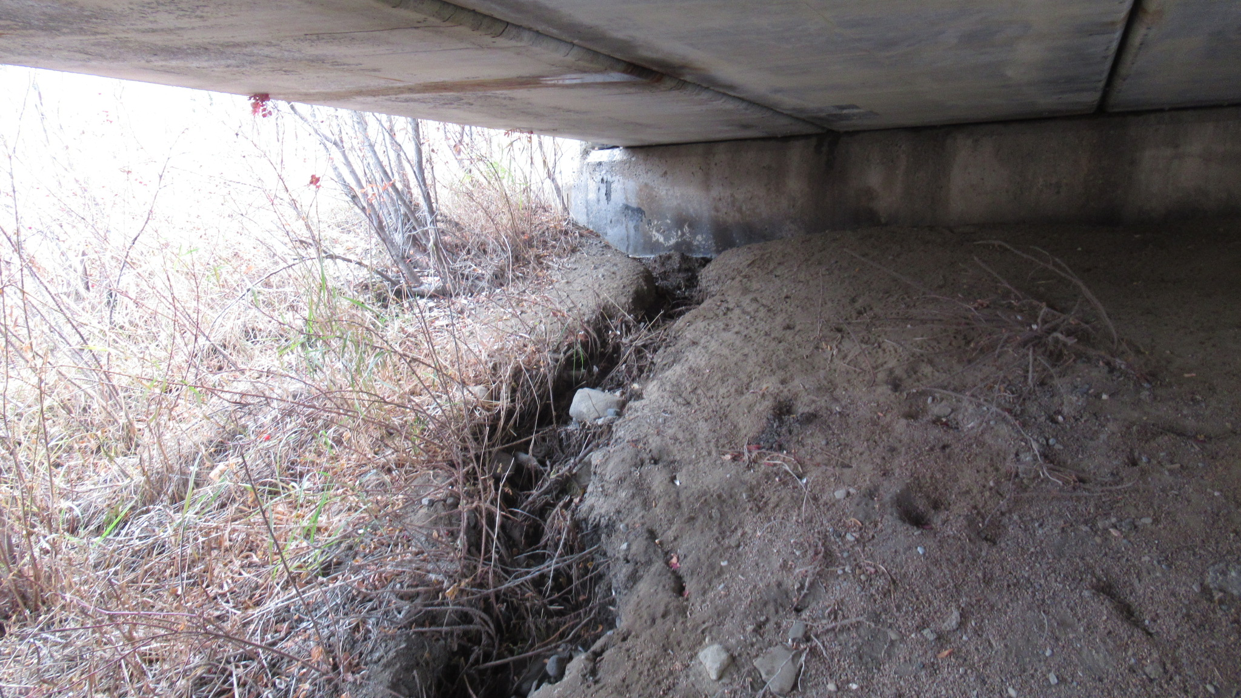

Slide 54
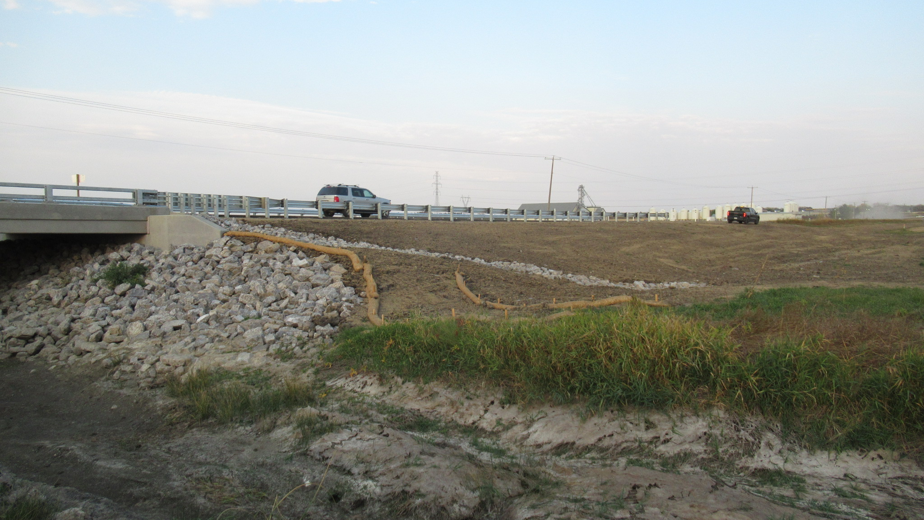

Slide 55
Embankment
Applies to culverts only
Rates the stability of the road embankment at the culvert and the effects on:
traffic
structural and functional integrity of the culvert
Evaluates:
roadway surface
Side slopes
transitions at ends of culvert

Slide 56
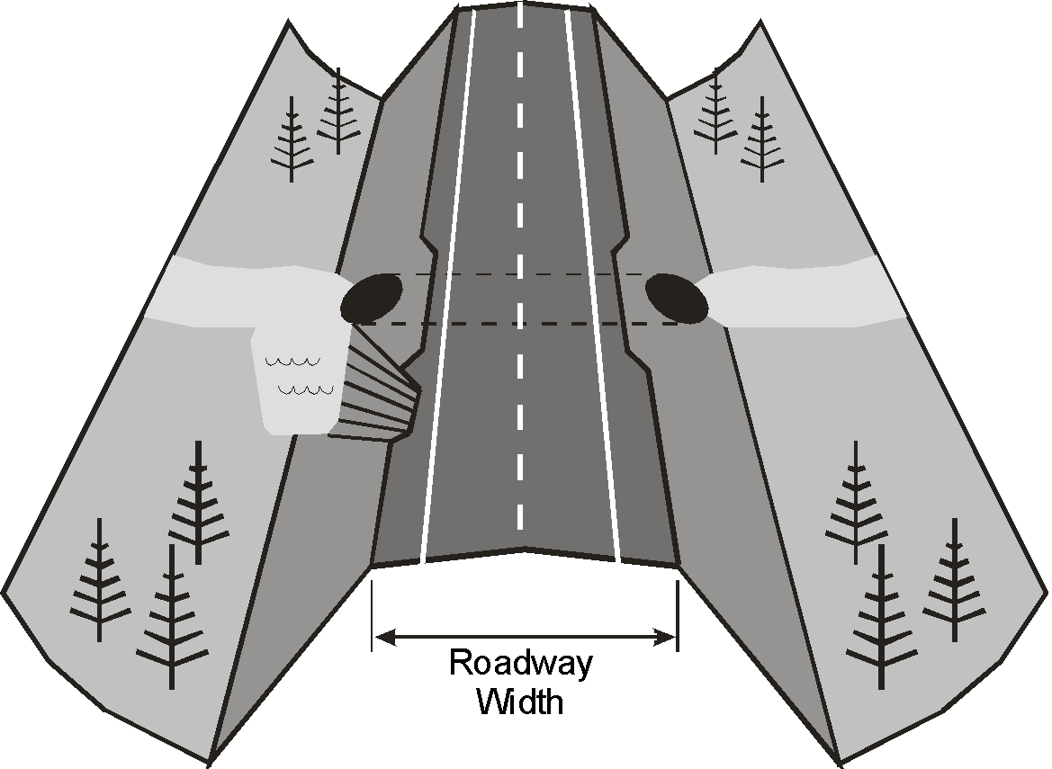
Embankment – Culvert Approach Road

Slide 57
Embankment
Refers to Culvert Approach Roads
Look for:
cracks or other evidence of instability
signs of erosion such as gullying on sideslopes
scour at toes of sideslopes or end transitions
Embankments with no instability or scour/erosion - rate 7 or better
Embankments with erosion problems - rate 4 or less
Unstable embankments causing damage to the culvert - rate 3 or less
Unstable embankments affecting roadway - rate 3 or less

Slide 58
Sideslopes
Not rated
Estimate or measure the slope of the sideslope (h:v)
Record steeper of upstream or downstream sideslope
If berms or different slopes on the same side, record steepest slope
Do not record average slope
Explain if sideslopes are irregular
varying slopes
benches or berms
different slopes on each sideslope

Slide 59
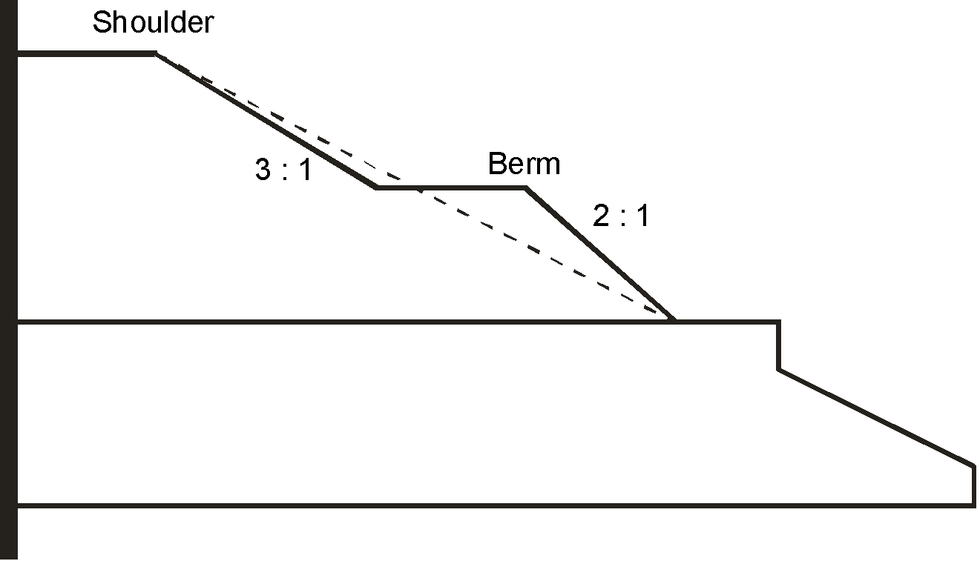
Sideslopes

Slide 60
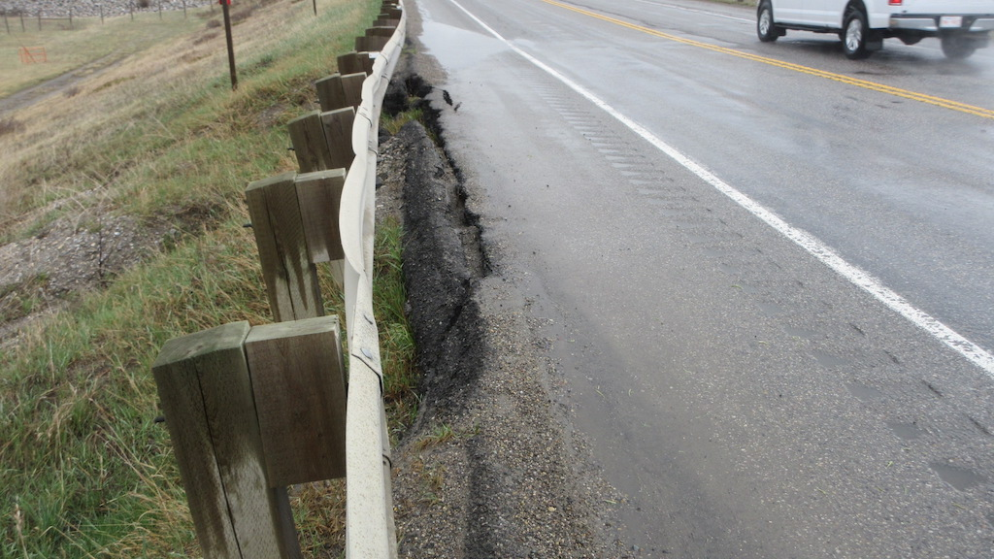

Slide 61
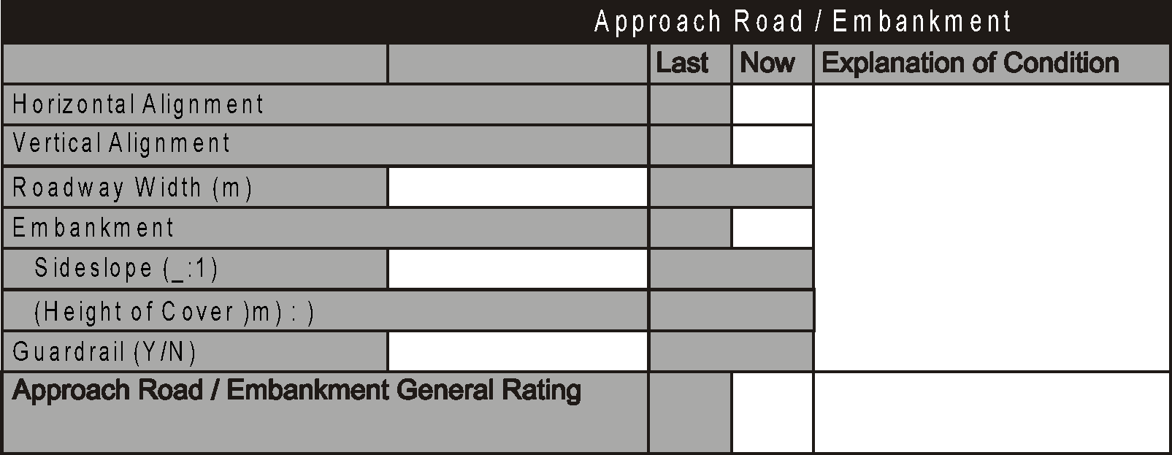
Height of Cover
Inventory item (grey box on form). Record if blank, revise if incorrect.
The vertical distance between top of roadway at centerline and top of the culvert at the upstream end
Need to be accurate, especially for low covers
Live load effects are greater
Record to the nearest 0.1m

Slide 62
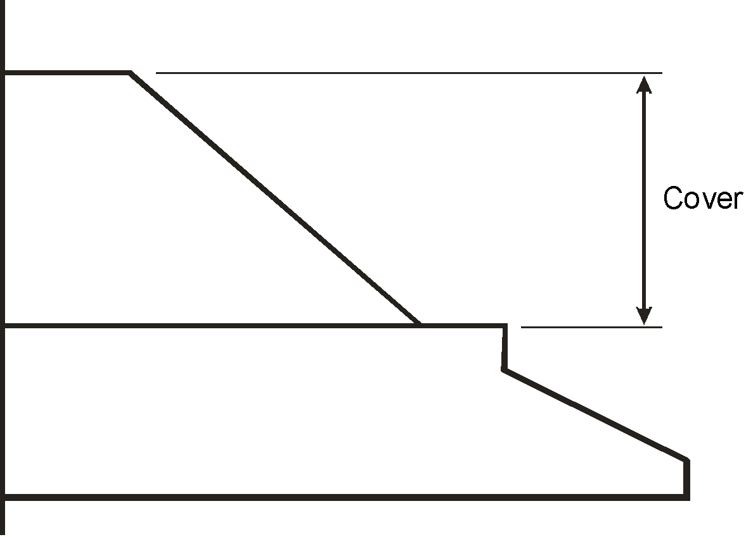
Height of Cover
Top of Road
Top of Roof at U/S
Flow

Slide 63
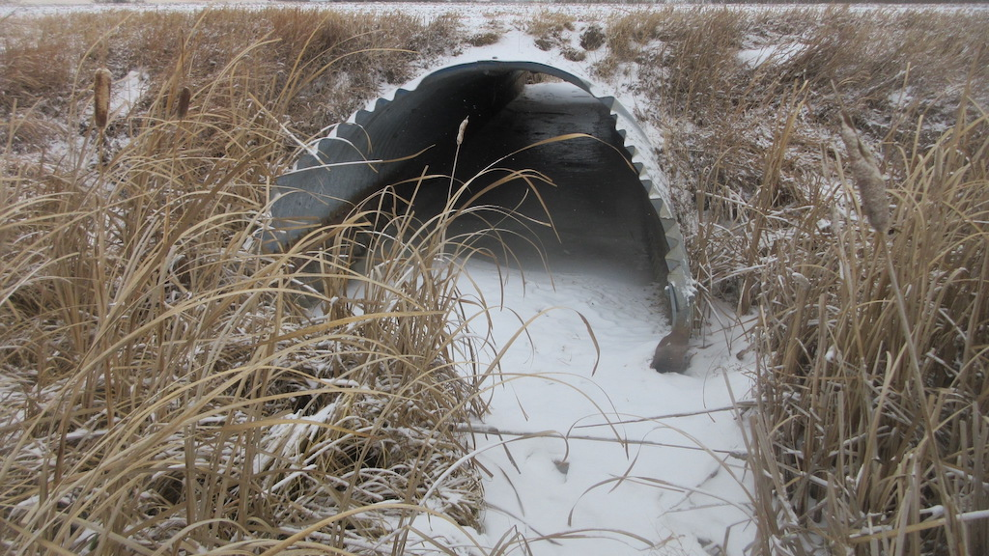

Slide 64
General Rating
Refer to 1.10. 1 and 6.8 (Bridges)
Refer to 1.10.6 and 13.4.6 (Culverts)
Governing Elements
Horizontal alignment
Vertical alignment
Safety Concerns (severe approach bump)
Potential hazards (Drainage causing ponding/icing
Embankment rating of 3 or less (Culverts)
Guardrail that is damaged resulting in a hazard (i.e. missing sections)
No approach rails but hazardous governs the General Rating (rate 2)
Horizontal and Vertical alignment rated X – General rating is 5

Slide 65
Questions?

