Slide 1
PREPARATION FOR INSPECTION AND INSPECTION SAFETY

Slide 2
Inspection Safety
Occupational Health & Safety Act
high rigging
scaffold & swing stages
crane safety and rigging
confined spaces
working over water
working alone

Slide 3
Inspection Safety (Continued)
General Safety Issues
use proper equipment
park in a safe location
avoid unnecessary risk
assume all electrical is live
do not wear chest waders in fast moving water
use caution on ice
do not enter confined spaces
un-even ground
slippery culverts
fast flowing water
3-point contact on bridgerails
inspect facing traffic – be alert
Working alone. Use the check-in procedure – test it!!

Slide 4
Inspection Safety (Continued)
Traffic Safety
If possible, schedule during low-traffic flow
Inform road authority
Park vehicles in a safe location completely off the driving surface
If not possible due to snow, steep side slopes etc. than vehicle must be parked a minimum of 1.0 m from the outside edge of the shoulder.
If no safe parking is available, may have to find nearest driveway or field access and walk back to site.
Avoid parking in vicinity of blind corners or hills
Inspection vehicles must be equipped with a Cl. 1 or 2 amber LED light bar that remains for the duration of the inspection
A magnetic sign (24 x 15”) or similar must be on the back of the inspector's vehicle stating “”Bridge/Culvert Inspection in Process” at all times during the Level 1 Inspection.

Slide 5
Inspection Safety (Continued)
Wear high visibility vests (must be CSA Cl. 2 standard)
Be efficient and follow a routine – don’t cross back and forth in traffic un-necessarily
Be alert – be safe. Always be aware of surroundings, particularly when working near an active roadway
During Level 1.5 and Level 2 inspections over railways or navigated water obtain permission from Railway/Transport Canada. Ensure all their requirements are met if inspector or equipment is within their ROW

Slide 6
Personal Safety
Personal Equipment
hard hat (as required)
proper footwear (non-slip soles)
hip waders
chest waders*
eye protection
warm clothing
extra clothing
rain gear
1st aid kit
bug spray
bear spray
snake bite kit
safety harness – Level 2
life jackets – Level 2
cell phone, gps
satellite communication device when working remotely

Slide 7
Basic Tools for Inspection
BIM Manual
Reference Manual
Clip board and extra pencils
Camera
Long tape & steel weight
Short (5-8m) wide blade tape
Chipping hammer
Prism pole or similar sturdy device for probing
Pocket knife
Binoculars
Crack width gauge
Angle finder
Flashlight and headlamp c/w extra batteries
Marking crayons
Inspection mirror
Compass

Slide 8
Basic Tools for Inspection
Surveyor hand level
Regular hand level
Wire brush/scraper
Plumb bob
String line
Measuring pole or laser measuring device
Personal equipment
Shovel
Decontamination supplies (discussed further with Whirling Disease)

Slide 9
Inspection Equipment
Level 2
portable ladders
base 1/4 of length from wall
do not work on top two rungs
base firm and non-slip
extension ladders proper overlap
scaffold
anchor properly
design = 4X load
inspect daily
safety harness – Level 2
adjust to fit
attach to fixed anchor
check prior to use
must be certified for use

Slide 10
Preparation for Inspection
Bridge Inventory Information
use to confirm bridge characteristics
Inspection requirements
check bridge file number
update inventory during inspection
Hazard Assessment
Complete a Field Level Risk Assessment prior to start of inspections.
A FLRA can represent multiple sites if hazards are similar
BIM Inspection Forms
order from BIS
carry blank forms
review previous inspections
Bridge File Maps or AT Maps
shows bridge locations
GPS co-ordinates
plan route
set-up designated check-in person or system – test it!

Slide 11
Whirling Disease
Whirling disease is caused by a microscopic parasite of salmonid fish.
This disease is not harmful to humans or other mammals but can have significant effects on some fish populations. It can be transmitted from infected locations to other water bodies:
through equipment used for swimming, paddling, boating, water pumping, and fishing
The movement of fish, mud, and water can potentially spread whirling disease.
Basic Preventative Practices as outlined by Alberta Environment and Parks (AEP)
Clean
Drain
Dry

Slide 12
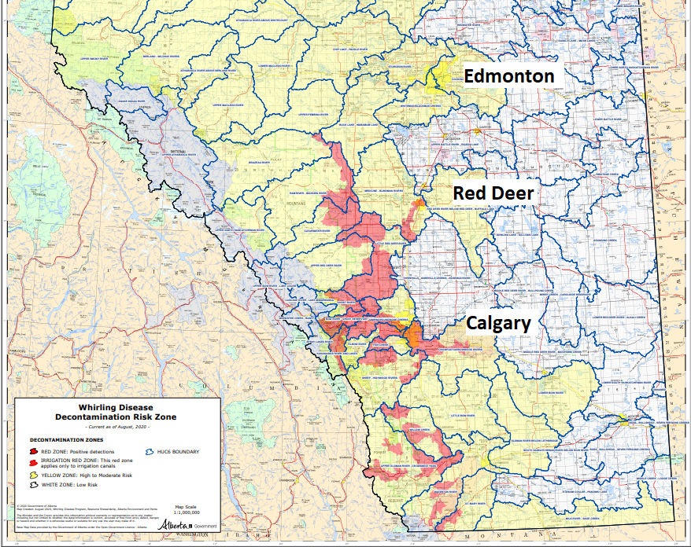
Whirling Disease – 2020 Heat Map

Slide 13
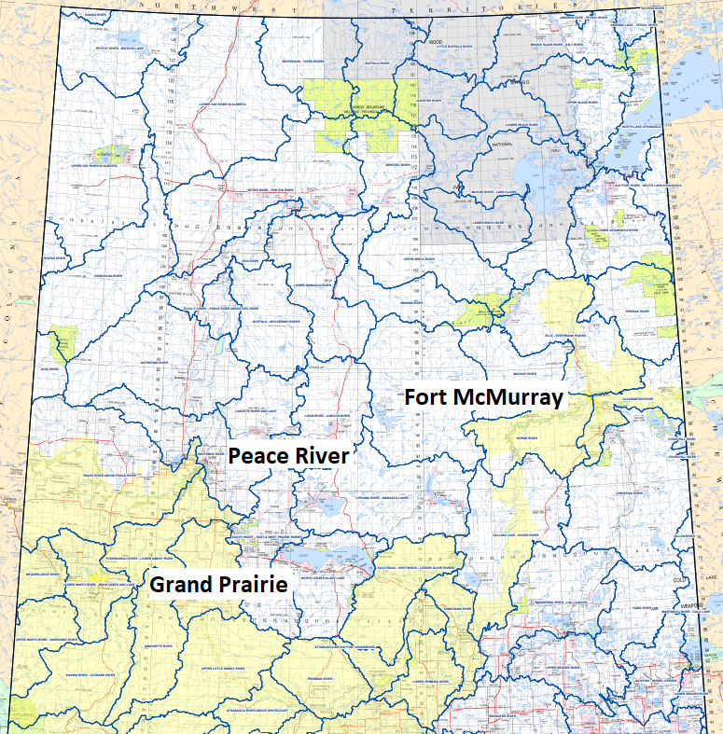
Whirling Disease – 2020 Heat Map

Slide 14
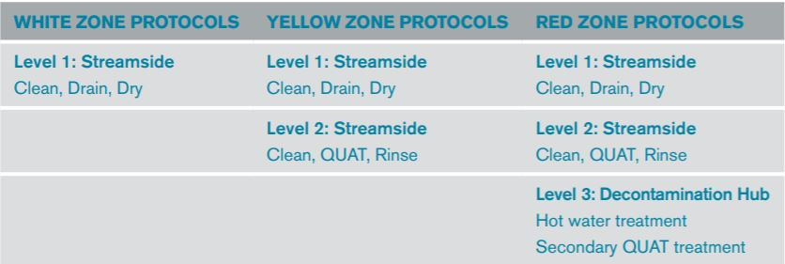
Whirling Disease
AEP has four useful documents on their website that inspectors are required to familiarize themselves with and adhere to:
Decontamination Protocol - Watercraft & Equipment
Decontamination Risk Map
Decontamination Quick Reference Guide
Decontamination Equipment List
https://www.alberta.ca/whirling-disease.aspx
Decontamination Protocols as they apply to Bridge Inspection:
Different levels of decontamination required depending on what zone you are working in.

Slide 15
Whirling Disease
Zone (HUC6 boundary) is identified on BIM form in “Department Comments” area.
Make appropriate preparations prior to inspections.
Development of internal protocols is a requirement.

Slide 16
Questions?

