Slide 1
GRADE SEPARATION INSPECTION & RATING

Slide 2
Grade Separation Form
For purpose of this presentation does not apply to road alignment above – road alignment and other elements rated in Approach Road section
Basic rule is alignment OVER is rated in Approach Road section and Alignment UNDER is rated in Grade Separation or Channel section
.
Applies to bridges with traffic going under and culverts going through
Applies to Animal, Pedestrian or Railway Underpass structures
Replaces channel section
Has items specific to under/overpass rather than channels
Generated automatically
Can be requested for blank forms (select GS instead of Channel)

Slide 3
Grade Separation Form
Refer to Chapter 10 in BIM Manual for Bridge Grade Separations
Refer to Chapter 13 – Section 13.8 for Culvert Grade Separations

Slide 4
Grade Separation Form
Generated from BIS for following usage types:
  GS - vehicle grade separation
  PS - pedestrian grade separation
  SP - wildlife or cattlepass
  RO - railway overpass
  RU - railway underpass
  All types above can be either bridge or culvert Grade Separation

Slide 5
Grade Separation - Road Alignment Under
The Grade Separation section is different for bridges and culverts
Refers to H & V road alignment passing under Bridge Grade Separations or through Culvert Grade Separations
Includes road surface condition for bridge GS
Road surface given separate rating for culvert GS
Does not refer to road above (rated in Approach Road section)

Slide 6
Road Alignment - Rating
Inspection and rating considerations include:
  Evaluating Horizontal Vertical alignment for 1 km each direction, then summarized in a single Road Alignment rating
  vertical and horizontal alignment that may contribute to damage to the bridge
  look for indications of reduced vertical clearance
  Bridge GS includes condition of road that may lead to damage of the bridge
  Railway, pedestrian / stock / animal passes and utilities alignments are rated “X”
  If alignment can be safely driven at legal or posted speed limit rate 5 or more.

Slide 7
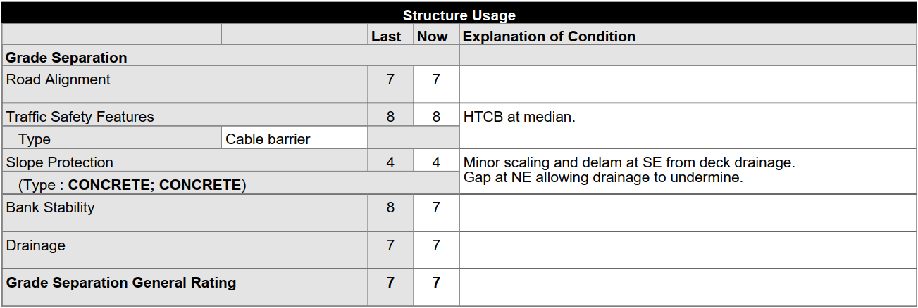
Grade Separation - Bridge
The grade separation section of the BIM inspection form replaces the channel section for structures that are not over streams.
Grade Separation Section for a bridge:

Slide 8
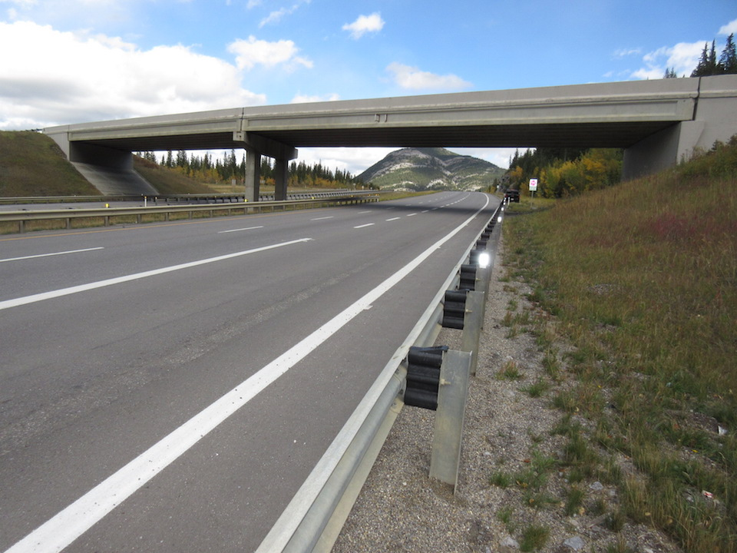
Bridge Grade Separation – Road Under Grade Separation Road Alignment (rating road under)

Slide 9
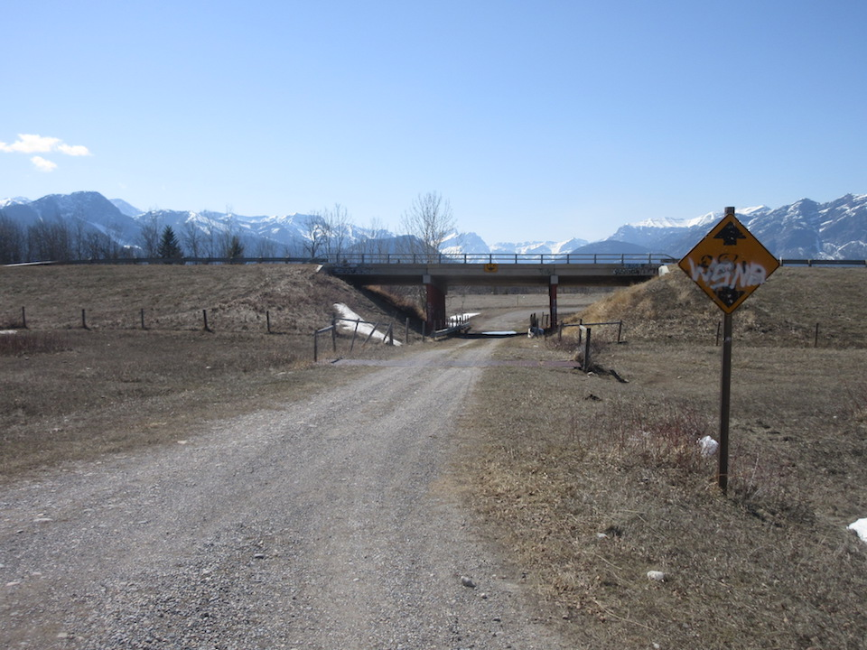
Bridge Grade Separation – Road Under Grade Separation Road Alignment (rating road under)

Slide 10
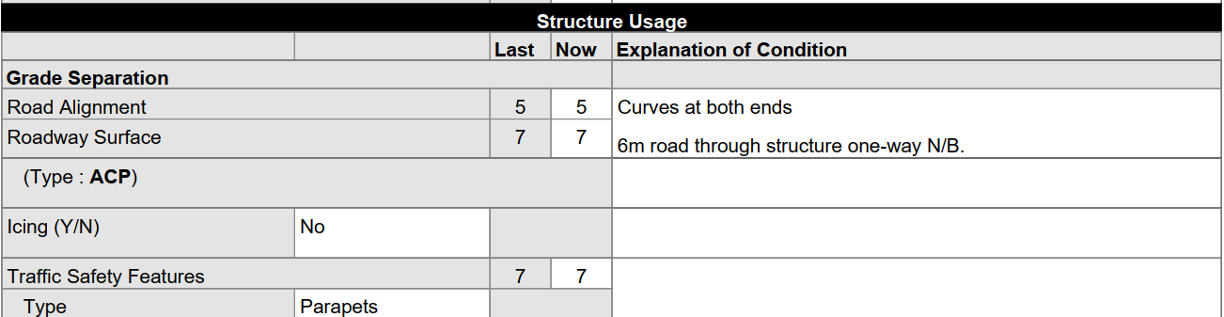
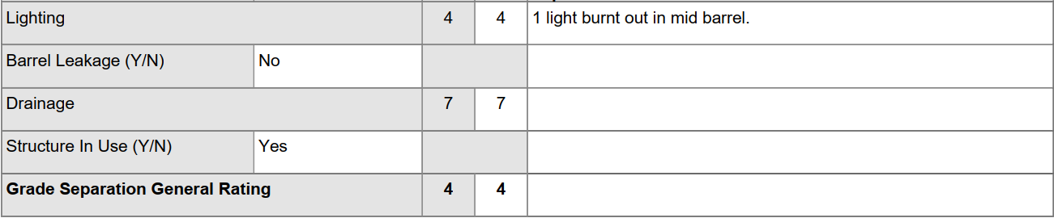
Grade Separation - Culvert
Grade Separation Section for a culvert carrying vehicles:

Slide 11
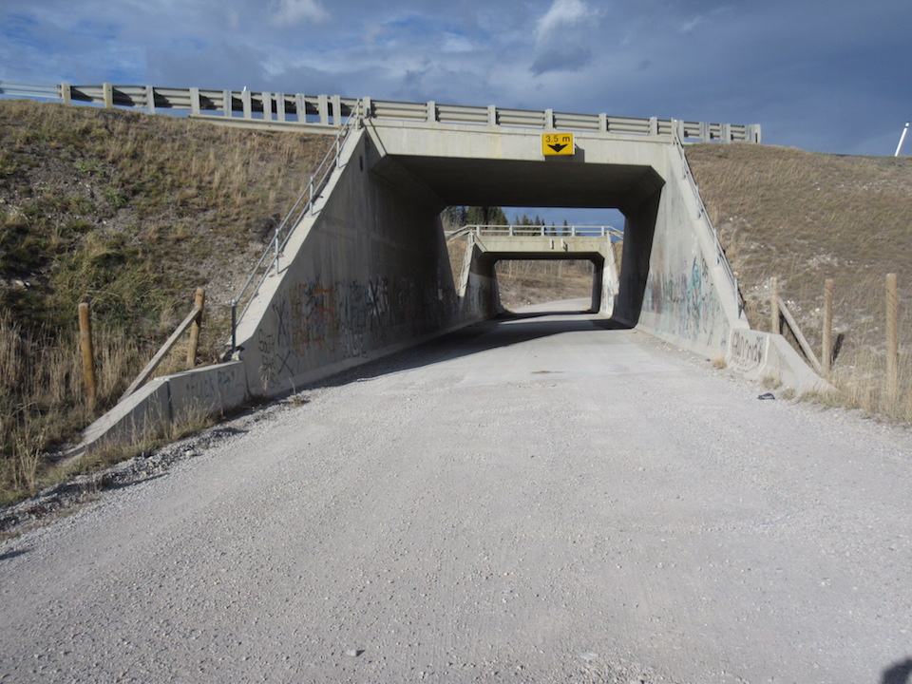
Culvert Grade Separation Grade Separation Road Alignment (rating road under)

Slide 12
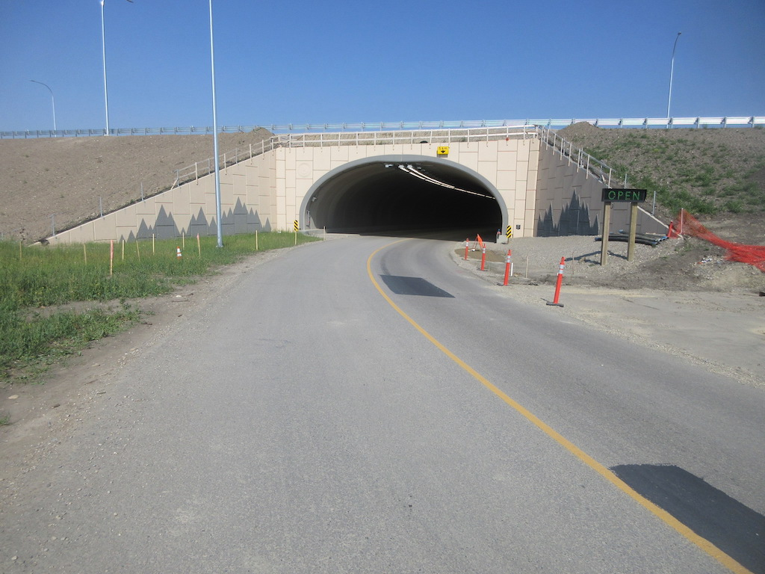
Culvert Grade Separation Grade Separation Road alignment (rating road under)

Slide 13
Bridge or Culvert Grade Separation Pedestrian, Animal, Railroad Underpass
Refers to Pedestrian, Animal, or Railway underpasses under the Bridge or Culvert Grade Separation
In these instances, Road Alignment is rated “X”.

Slide 14
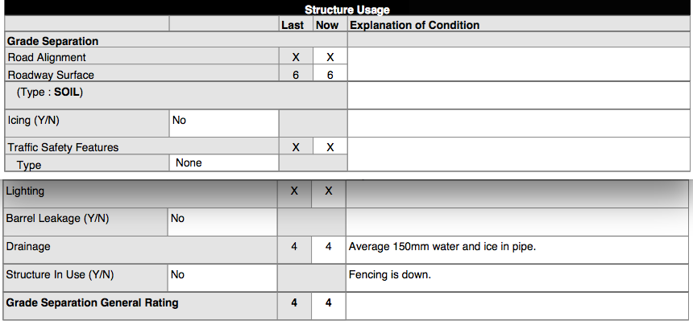
Culvert Grade Separation Form Wildlife, Cattle, Pedestrian - Road Alignment UNDER Rated X
Culvert Section–Chapter 13 Section 13.8

Slide 15
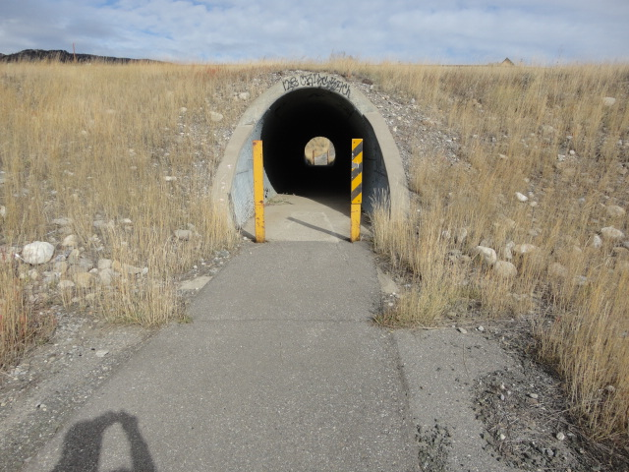
Culvert Grade Separation – Pedestrian Grade Separation Road Alignment UNDER Rated X

Slide 16
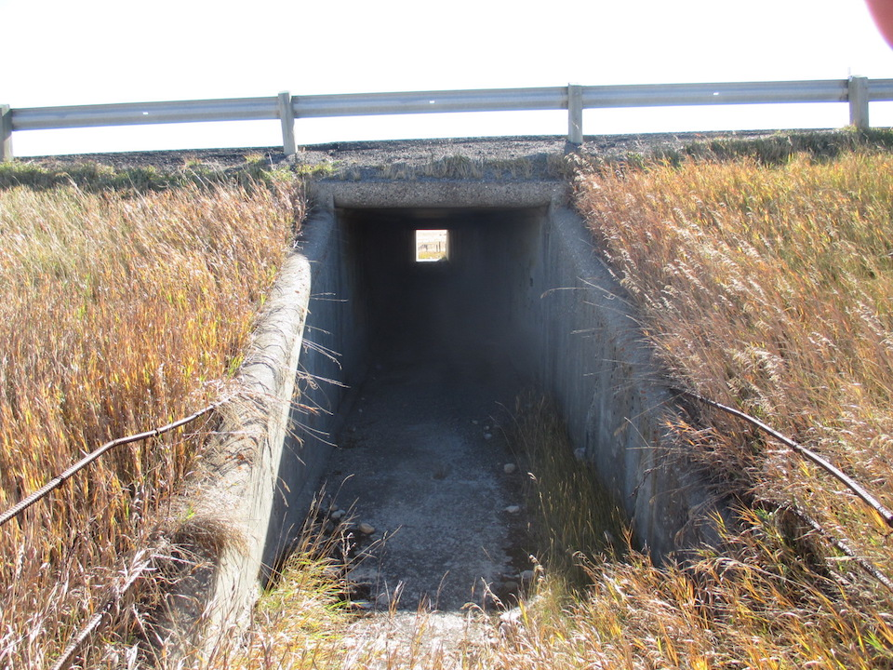
Grade Separation BP – Animal Underpass Grade Separation Road Alignment UNDER Rated X

Slide 17
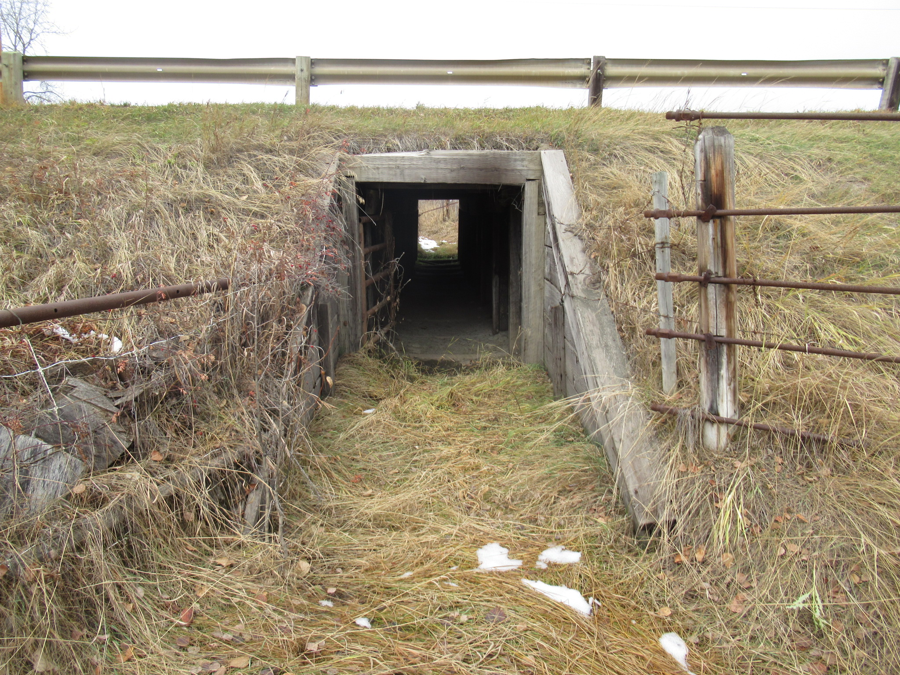
Grade Separation TT – Animal Underpass Grade Separation Road Alignment UNDER Rated X

Slide 18
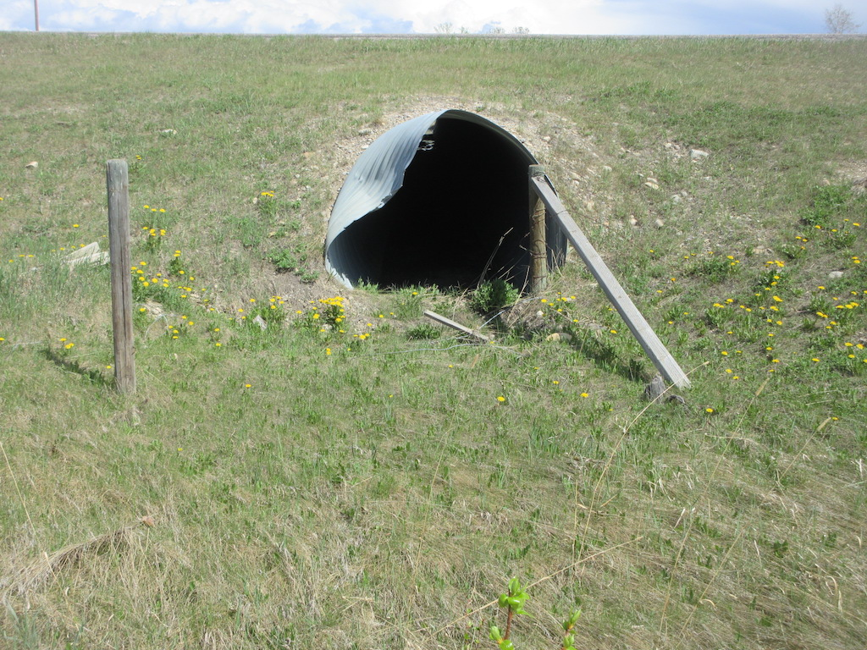
Grade Separation TT – Animal Underpass Grade Separation Road Alignment UNDER Rated X

Slide 19
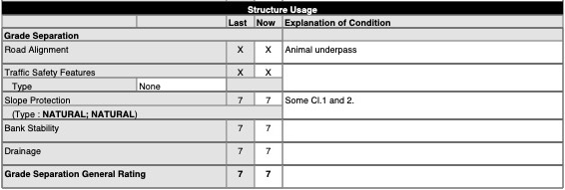
Bridge Grade Separation Form Wildlife, Cattle, Pedestrian - Road Alignment UNDER Rated X
Bridge Section–Chapter 10

Slide 20
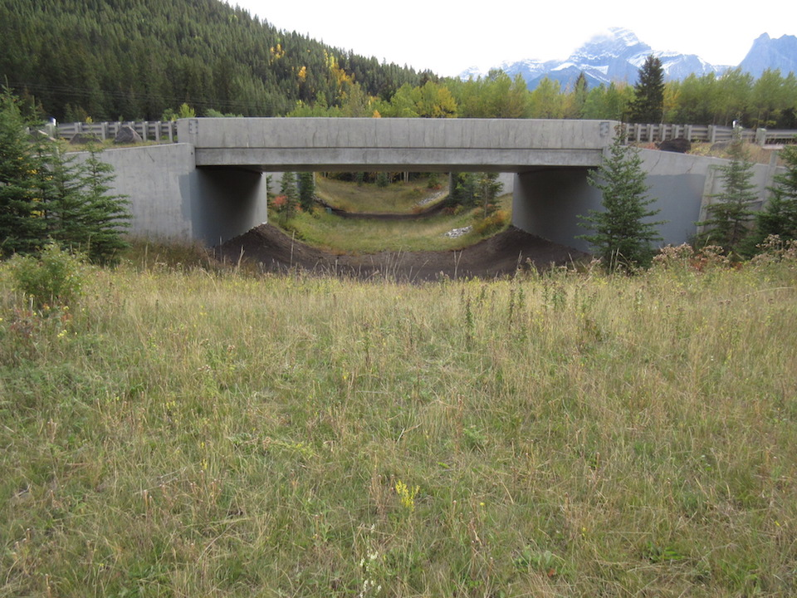
Bridge Grade Separation – Wildlife Underpass Grade Separation Road Alignment UNDER Rated X

Slide 21
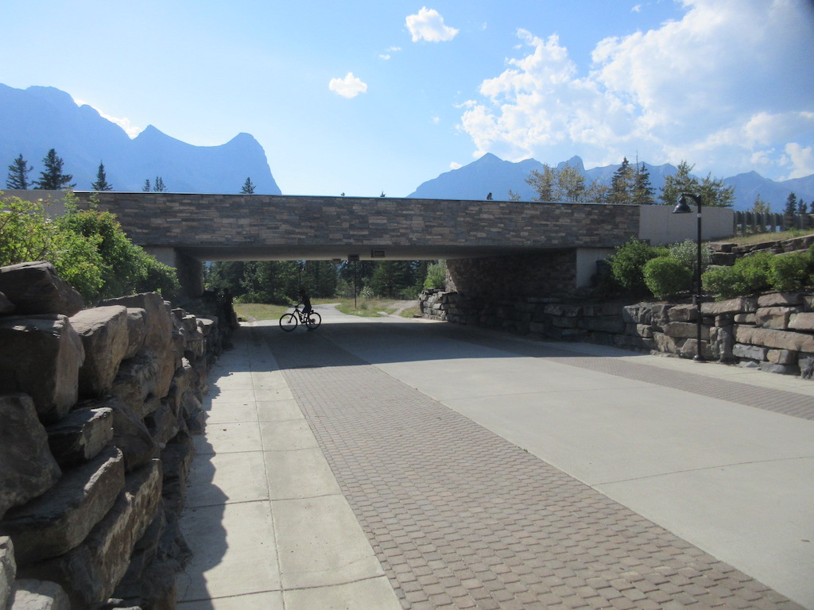
Bridge Grade Separation – Pedestrian Underpass Grade Separation Road Alignment UNDER Rated X

Slide 22
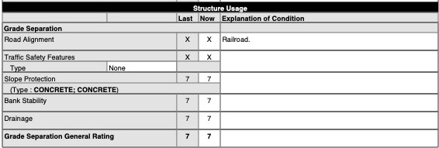
Bridge Grade Separation - RXR UNDER Rail Alignment UNDER Rated X

Slide 23
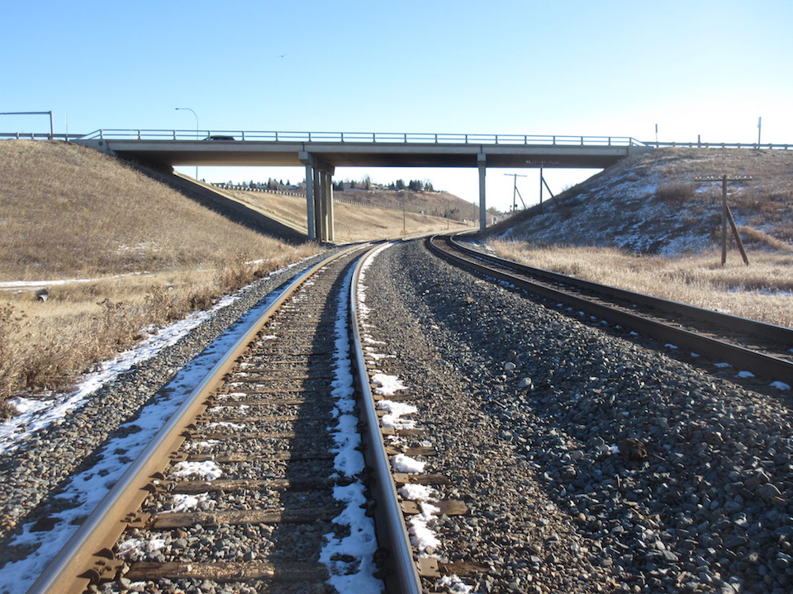
Grade Separation – Railroad Overpass Rail Alignment Rated X

Slide 24
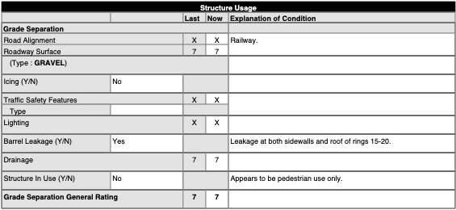
Culvert Grade Separation – RxR Underpass Rail Alignment UNDER Rated X

Slide 25
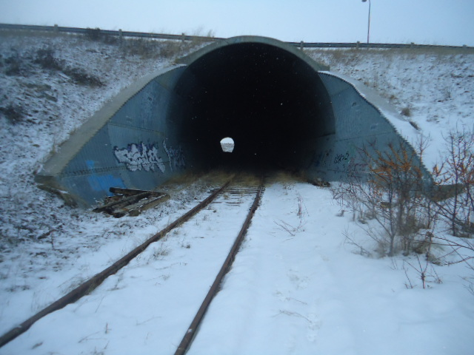
Grade Separation – Culvert RXR Underpass Rail Alignment Rated X

Slide 26
Bridge or Culvert Grade Separation Pedestrian, Animal, Railroad Overpass
Refers to Pedestrian, Animal, Utility or RxR overpasses over top of roadway
Road alignment under is rated in Grade Separation section
Road alignment over is rated in Approach Road section
In these instances, both Horizontal and Vertical Road Alignment is rated “X
Results in General Rating of 5
Refer to Sections 1.10.1 and 1.10.6

Slide 27
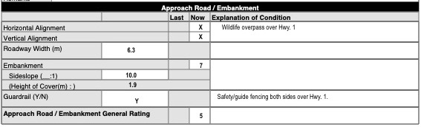
Bridge or Culvert Grade Separation Form
Wildlife Overpass – Horizontal & Vertical Alignment Rated X
Bridge Section Chapter 10.3 Culvert Section Chapter 13 Section 13.8

Slide 28
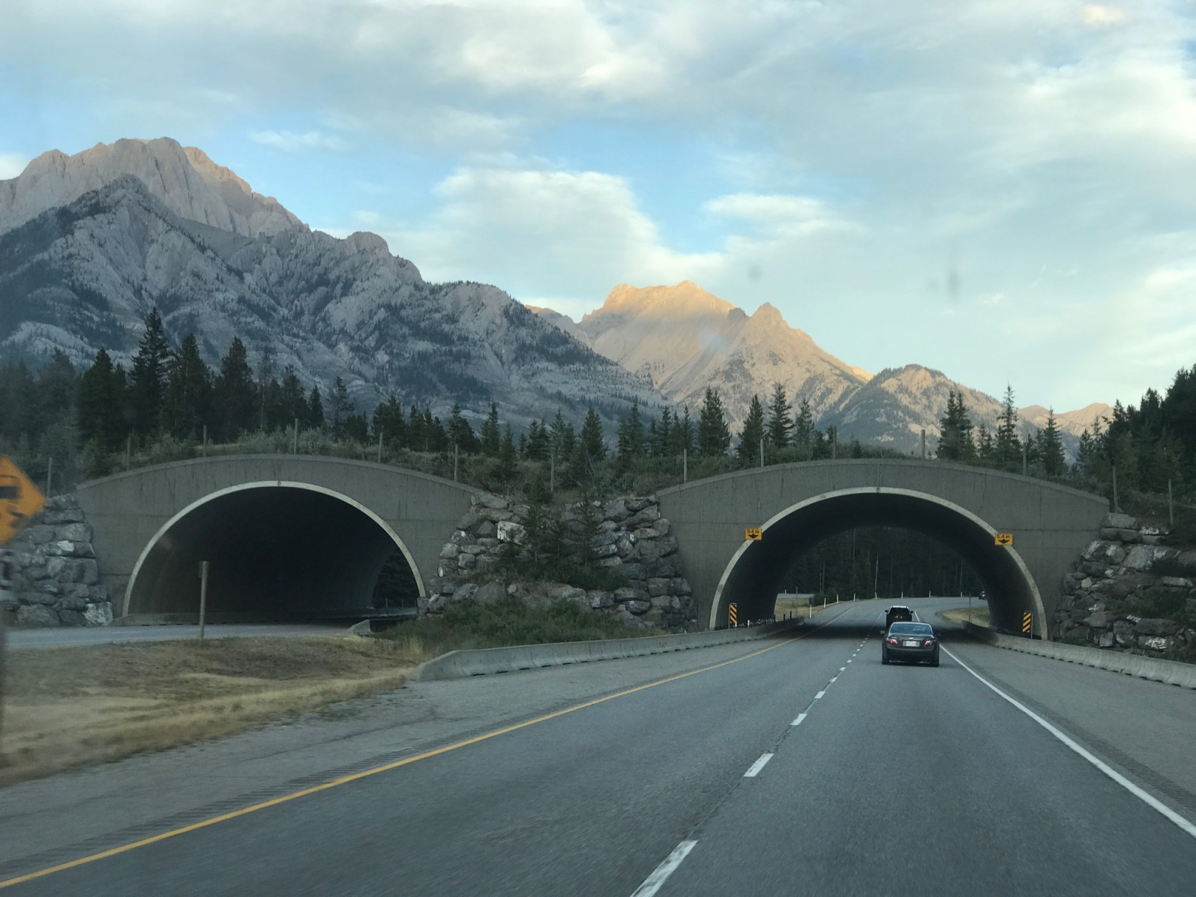
Culvert Grade Separation - Wildlife Overpass Vertical & Horizontal Road Alignment (Over) are Rated X so Gen. Rating = 5

Slide 29
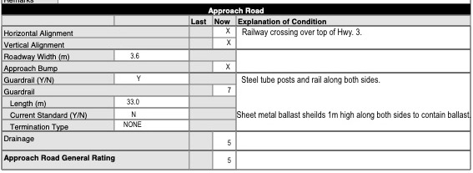
Bridge Grade Separation Form – RxR Overpass Rail Alignment OVER Rated X
Bridge Section Chapter 10.3 Culvert Section Chapter 13 Section 13.8

Slide 30
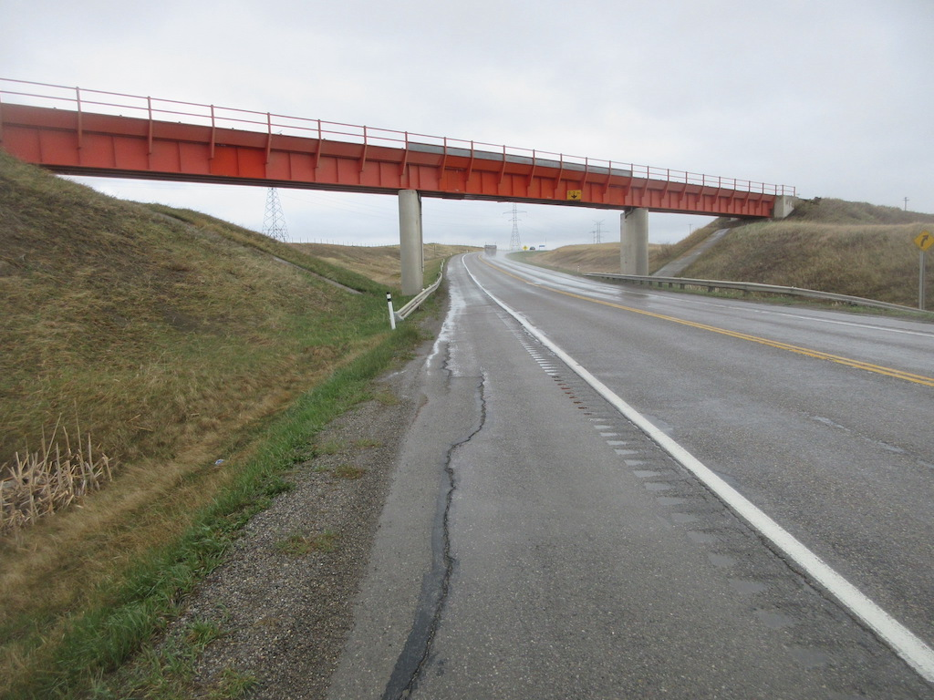
Bridge Grade Separation – RXR Overpass (Cl. A) Horizontal and Vertical Alignment of Railway (OVER) Rated X so Gen. Rating = 5

Slide 31
Roadway Surface
Look for defects that might affect high-load vehicles
Defects that create hazards to traffic or pedestrians
Record the presence of icing on the roadway or barrel Y/N – comment if Yes. May affect Drainage rating.
If defects a problem for stock/traffic, rate 4 or less
If hazardous, rate 2 or less (holes, projections, icing on traffic or pedestrian surfaces)
Refers to Culvert Grade Separations and Animal/Pedestrian Underpasses
Purpose is to provide a surface for traffic usage
  Smooth surface
  No holes, depressions or projections
  Not slippery
Record type of surface
  Asphalt
  Concrete
  Gravel
  Soil

Slide 32
Traffic Safety Features
Refers to curbs, medians, guardrails, attenuators, high tension cable barriers, advance warning signs, vertical clearance signs, crash protection/attenuators
Inspect 20 m each direction of guardrails, barriers, HTCB
Not applicable for stock underpasses
Indicate type and rate condition and functionality
If not present record type as “None” and rate “X”

Slide 33
Traffic Safety Features
Inspection and rating considerations for safety features are as follows:
do not rate standard of safety feature, rate functionality and condition as per original design
rating includes all components of the safety feature, including connections
if elements are missing but there is evidence that they were previously there, then rate “4” or less
use “explanation of condition” to further describe features or to indicate concerns, maintenance required, etc.

Slide 34
Slope Protection
Refers to protection system on headslopes of bridges to prevent erosion
Look for:
  evidence of settlement
  cracked, broken or bulging concrete protection
  Deck drainage away from system
  voids under concrete slabs
Note graffiti
Rate 4 or less for:
  Significant settlement or moving downwards
  Significant heaving or cracking of concrete slope protection
  Voids under concrete slope protection
  Any maintenance required

Slide 35
Bank Stability
Refers to stability of bridge headslopes
Look for:
  damage or displacement
  settlement at abutment and piers
  bulging at toe of slope
  loss of material at toe of slope
  wet or slumping areas
Rate 4 or less if:
Settled and exposing underside of abutment seat
Instability that affects the Substructure or Superstructure
Instability requiring monitoring

Slide 36
Drainage
Refers to the ability to dispose of water at:
Toe of headslopes and transitions on bridges
Roadway surface from Culvert Grade Separations
Ends and barrel of Pedestrian or Animal underpasses
  Typ. water sources are deck and approach road drainage, ditch drainage, and weep holes.
  Some underpasses are also designed for water flow
    See “Special Comments for Next Inspection”

Slide 37
Drainage – Bridge or Culvert GS
On Bridge or Culvert Grade Separations handling vehicle traffic look for:
Ponding at toe of headslopes and transitions or inside culverts
Blockage of existing drainage systems
Damage to embankments
Record “Yes” if barrel leakage – comment
Ratings:
  If functioning and no damage to slope protection, embankments and no bank instability rate 5 or more
  If damage or slope instability rate 4 or less
  Drainage causing ponding, icing on travel lanes & potential hazard rate 2 or less
Abutment scour/erosion and pier scour rated X on Bridge Grade Separations

Slide 38
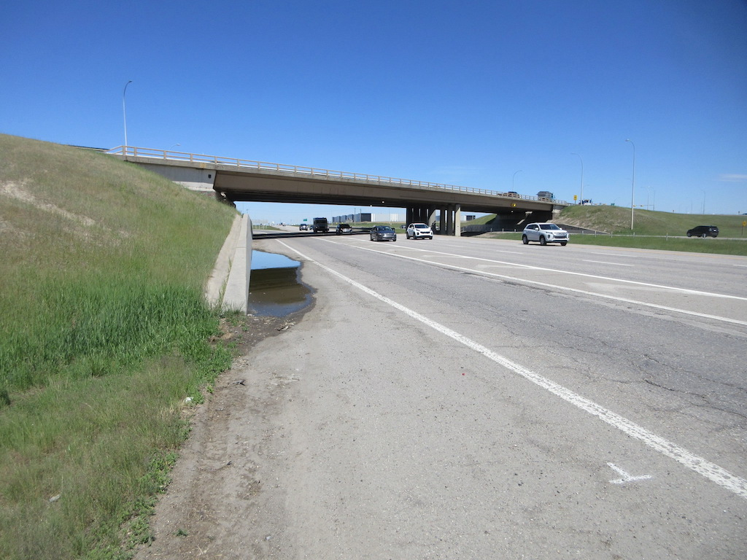
Bridge Grade Separation – Poor Drainage

Slide 39
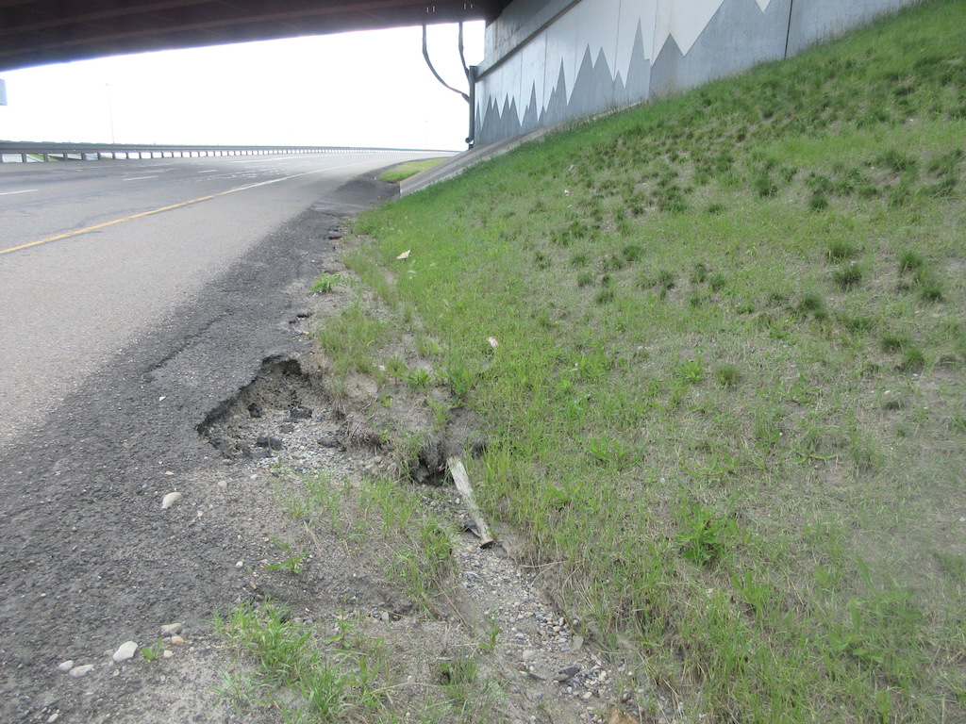
Bridge Grade Separation – Poor Drainage

Slide 40
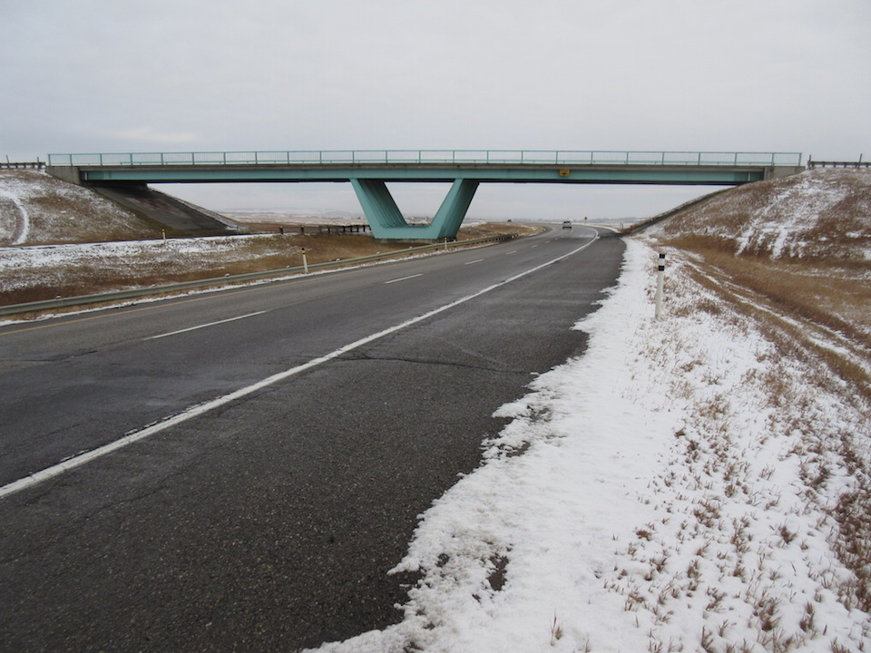
Bridge Grade Separation – Poor Drainage

Slide 41
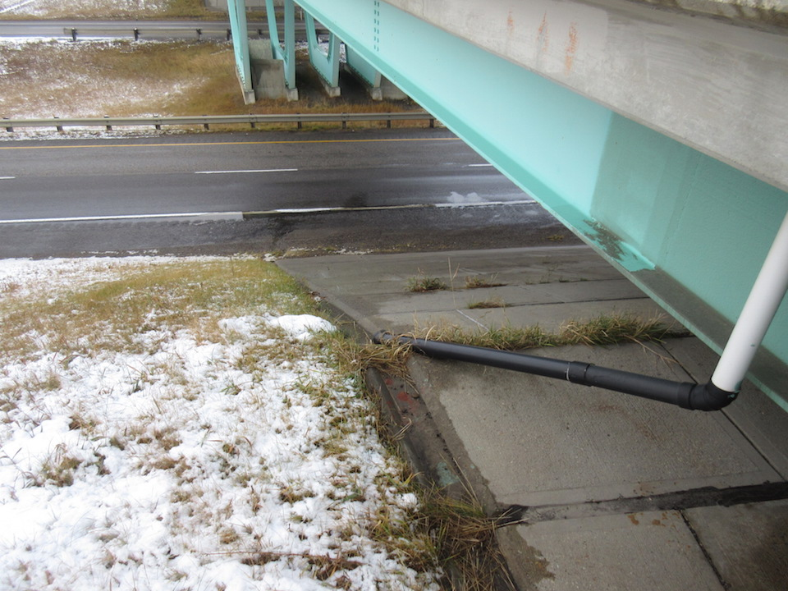
Bridge Grade Separation – Poor Drainage

Slide 42
Drainage – Ped/Animal Underpass
Ratings:
Functioning, no damage to sideslope or embankment rate 5 or more
If poor drainage causes icing or ponding around animal underpasses rate 4 or less
If drainage causes ponding or icing and potential hazard on pedestrian underpass 2 or less
On Pedestrian/Animal Underpasses look for:
Ponding in culvert barrel or at ends
Any condition contributing to icing
Damage to sideslopes or embankments
Record “Yes” if barrel leakage and provide comment. Rating is not required but if “Yes” leakage may effect rating of Roadway surface and Drainage

Slide 43
Animal Underpass – Other Drainage Considerations
Normally the following are not applicable (rate “X”)
  scour and scour protection at ends
  fish passage in barrel
  waterway adequacy in barrel
If designed to also handle water flow
  Note in “Special Comments for Next Inspection” (This culvert also handles drainage. 05/06/2016)
  Inspect and provide ratings for:
    scour and scour protection at ends
    fish passage
    waterway adequacy

Slide 44
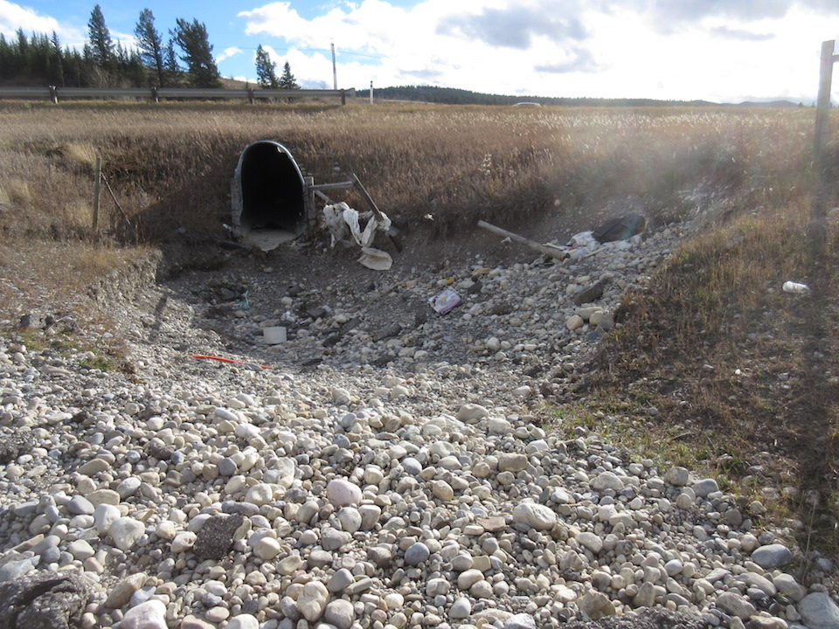
Animal Underpass – Handles Drainage

Slide 45
Lighting
Refers to lighting in culvert grade separations and pedestrian underpasses
Not applicable for stock underpasses - rate X
If lighting does not exist but in opinion of inspector is required rate X and provide comment and recommendation
Minor damage that does not affect operation or functionality rate 5
Defects affecting operation and functionality rate 4 or less

Slide 46
Structure In Use
Refers to whether the Stock underpass is used for it’s intended purpose
Indicate “In Use” by Yes or No
If there is evidence the structure is no longer in service, then circle “N” and make a note in the “explanation of condition” regarding the circumstances (e.g. guide fence is down)
Provide comment/explanation if “No” (e.g. guide fencing is down)

Slide 47
General Rating – Grade Separations – Road Under
Governing Elements – (refer to 1.10.5 and 10.7 (Bridges), 1.10.10 and 13.8.7 (Culverts)).
  Road Alignment rating
  Roadway Surface rating (Culvert GS only)
  Traffic Safety Features rating (except improperly lapped guardrail)
  Bank Stability rating of 4 or less
  Drainage rating

Slide 48
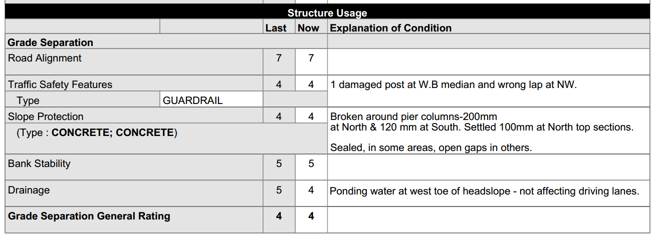
Sample Completed Form
Grade Separation – Road Under

Slide 49
General Rating – Animal or Pedestrian Underpasses
Governing Elements – (refer to 1.10.10 and 13.8.7)
  Road Surface rating
  Drainage rating

Slide 50
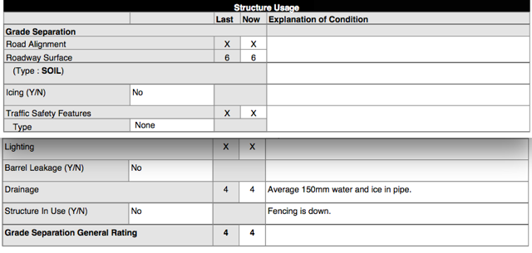
Sample Completed Form
Animal Under Pass

Slide 51
Alberta Infrastructure and Transportation Extranet
https://extranet.inftra.gov.ab.ca/inftra_login.html

Slide 52

Questions?

