Slide 1
BRIDGE MATERIALS
Notes:
~75 slides for 60 min (including questions) = 45 seconds per slide
So in order to identify bridge element defects and make sound maintenance recommendation, we need to understand the materials that are used
Concrete, steel, and timber are most common and have quite different mechanical properties
Thus, how they perform in service, their mechanisms of deterioration, and maintenance needs are also quite different
This lecture is intended to provide a brief background for the primary bridge materials

Slide 2
CONCRETE
Notes:
We’re going to start with concrete, because it’s the coolest
It’s the most widely used commercial building material in the world
it can be made with very basic ingredients, or very complex ingredients
the ingredients and proportioning can be altered to have a multitude of different properties
it’s economical
and it can be cast into almost any shape!

Slide 3
What is Concrete?
A mixture of various components which chemically react to form a strong construction material
Unit Weight – normal 2400 kg/m³ or semi 1900 kg/m³
Component Ratios:
Cement (10 to 15%)
Aggregate (75 to 80%)
Water and Air (remainder)
Admixtures
Notes:
So what is concrete?
Concrete is a mixture of various components (the basis of which are cement, fine and coarse aggregate, water, and various admixtures)
When mixed, these components react chemically to form a composite material
Its unit weight is mostly influenced by the coarse aggregate and is typically ~2400 unless lower density aggregates are used (some girders, for example)

Slide 4
Cement Manufacturing
Limestone Train
Clay Quarry
Hammermill Crusher
Additive Silos
Preheater Tower
Preblend Dome
Clinker
Finishing Mill
Roller Mill
Gypsum
Rotary Kiln
Cement Silos
4
Notes:
This is a general overview of cement manufacturing:
Limestone (mostly) and clay (minimal) are crushed and blended
Additives are added as required using additive silos
Roller mill is used to grind the material (centimeters in diameter)
The material is then preheated and then heated in a rotary kiln to ~1,500C to produce “clinker”
Gypsum is needed to prevent immediate setting and is added before the clinker and gypsum are run through a finishing mill (100 microns or 0.1 mm in diameter)

Slide 5
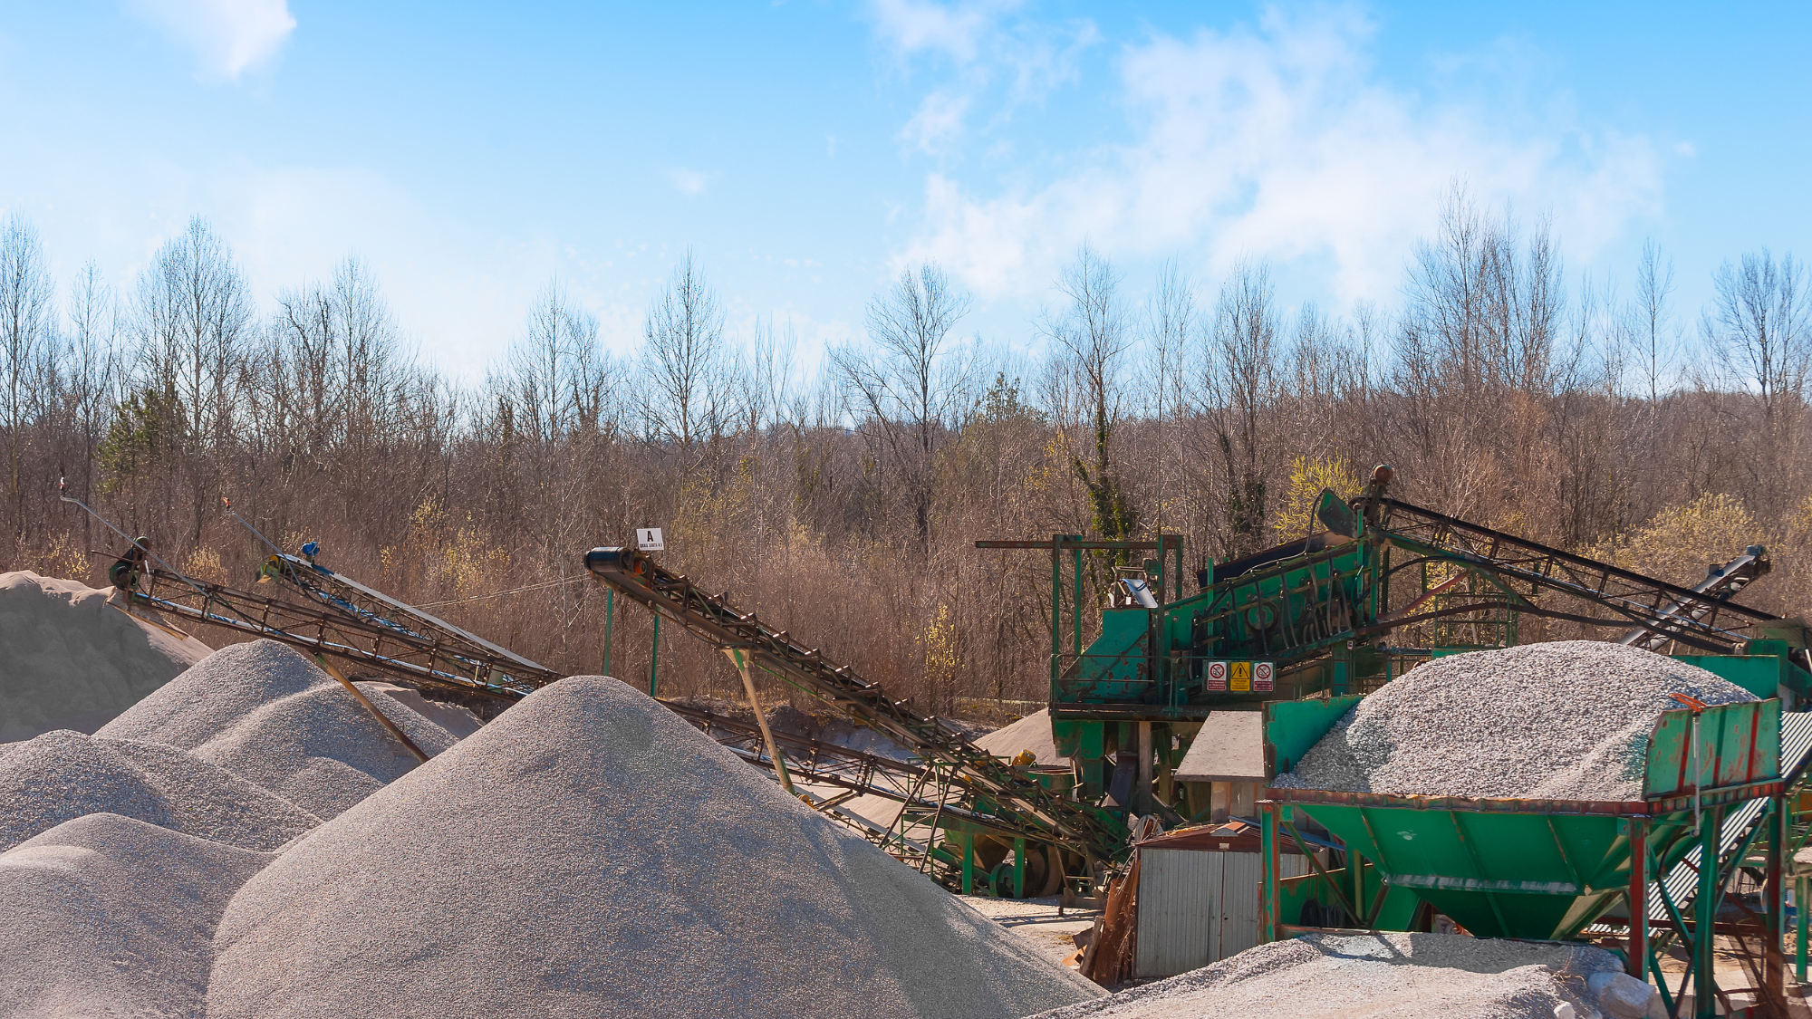
Aggregate
Aggregate qualities for strong and durable concrete:
Abrasion resistance
Freeze/thaw resistance
Chemical stability
Cleanliness and even gradation
5
Notes:
When it comes to aggregates, the following qualities are required to produce durable concrete
(slide)
Whats also important is how the aggregates react with concrete.
Map cracking can be due to a phenomenon called ASR (Alkali-silica reactivity), which is the reaction between the alkaline cement paste and amorphous silica which will cause expansion and the concrete to crack and spall if not mitigated for in the concrete mix design.

Slide 6
Water
Notes:
Water needs to be potable and free from contaminants.

Slide 7
Entrained Air
Entrained air 5% to 8%
Improves freeze thaw resistance
Improves workability
Reduces segregation and bleeding
Improves sulfate resistance
Notes:
“Entrained” air is very important; and should not be confused with “entrapped” air.
Entrained = microscopic, spherical air bubbles, with uniform distribution
NOT Entrapped = large, irregular air bubbles, with non-uniform distribution
Plastic air content is typically specified as 5% to 8% for most concretes and has many benefits:
It improves freeze-thaw resistance,
(slide)

Slide 8
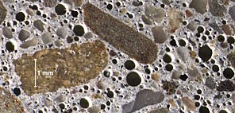
Air-Entrained Concrete
Notes:
This is an example of an air entrained concrete
Note the spherical shape and multiple small air voids, which wouldn’t be seen if air was simply entrapped.
Now when it comes down to freeze-thaw resistance, the spacing factor of the voids is arguably more important than the total air content
If the spacing factor is adequate, you only need a minimum total hardened air content of 3% to reach adequate freeze-thaw resistance

Slide 9
Admixtures
Ingredients used to modify certain properties of concrete to have a desired function
Two types of admixtures:
Mineral admixtures
Chemical admixtures
Notes:
There are two main types of admixtures to be covered in the next slides:

Slide 10
Mineral Admixtures
Fly Ash
Reduces heat of hydration & increases workability
Increases set time & reduces early strength
Silica Fume
Increase overall strength & abrasion resistance
Increases water demand during hydration
Reduces permeability & workability
Limestone
First used in trial project in 2022. GU replaced with GUL (up to 15% as per CSA)
Part of a “green initiative”, more environmentally friendly to produce.
Notes:
The 2 most popular types of mineral admixtures are fly ash and silica fume:
FA results in longer set times, thus reducing heat of hydration and improving workability (this can be very important if pouring mass concrete where temperature control is a key concern)
FA also improves durability by mitigating ASR and sulfate attack
SF increases overall strength, abrasion resistance, and impermeability
But increases the water demand during hydration and results in a sticky, tough to finish mix
Limestone is also being used for certain roadway flatwork, but additional study is still required before implementation in bridges. (slide)

Slide 11
Chemical Admixtures
Water Reducers – reduces water demand
Super Plasticizers – increases slump, workability, strength
Accelerators – decreases set time
Retarders – increases set time
Notes:
Chemical admixtures include:
Water reducers (they do just that)
Super plasticizers (increase slump, workability, and strength)
Now be careful to understand that the SP doesn’t increase strength directly, rather it allows you to control slump and workability with a chemical instead of water
Accelerators (decrease set time – mainly used in prebagged batching materials only when permitted – decrease long-term strength)
Retarders or Hydration Stabilizing Admixtures (increase set time)

Slide 12
Physical Properties
Compressive strength (f’c) (28 day) (e.g. HPC = 45 Mpa)
Tensile strength (6 to 7% f’c)
Shear strength (12-13% f’c)
Flexural strength (14% f’c)
Notes:
Typical physical properties of concrete include:
(slide)

Slide 13
Physical Properties (Cont’d)
How to increase Compressive Strength
Increased cement content
Increased aggregate strength
Decreased entrained air
Increased curing time
Use of admixtures (SF)
Notes:
Now there are certain ways to increase compressive strength:
(slide)
Historically, we have very little issue with meeting our minimum strengths
Rather our main challenges include meeting permeability requirements while maintaining adequate finishability/workability on site

Slide 14
Concrete Stress-Strain Diagram
stress
strain
Notes:
The following slide shows a typical stress-strain diagram for concrete:
We don’t have time to go into detail, however there are 3 main parts of this graph:
1st : the linear elastic region – where stress and strain are proportional (its slope is the modulus of elasticity
2nd : the Transition Region – where concrete begins to exhibit plastic deformation
3rd : the Plastic Region - the concrete deforms plastically until reaching maximum compressive stress, fc’, (at this point the concrete is no longer able to withstand additional stress)

Slide 15
Physical Properties (Cont’d)
Creep
Fire resistance
Durability
Isotropy
Permeability
Affected by
mix ingredients (silica fume, water-reducing admixtures, etc.)
excess water (i.e. high water/cement ratio)
micro-cracking
porous aggregates
improper mixing, finishing (adding water to finish)
maintenance (concrete sealing)
Notes:
Other physical properties include:
(slide)
FYI: Isotropic only when uncracked (modulus is the same in all directions). Becomes orthotropic when cracked (different modulus in different directions).

Slide 16
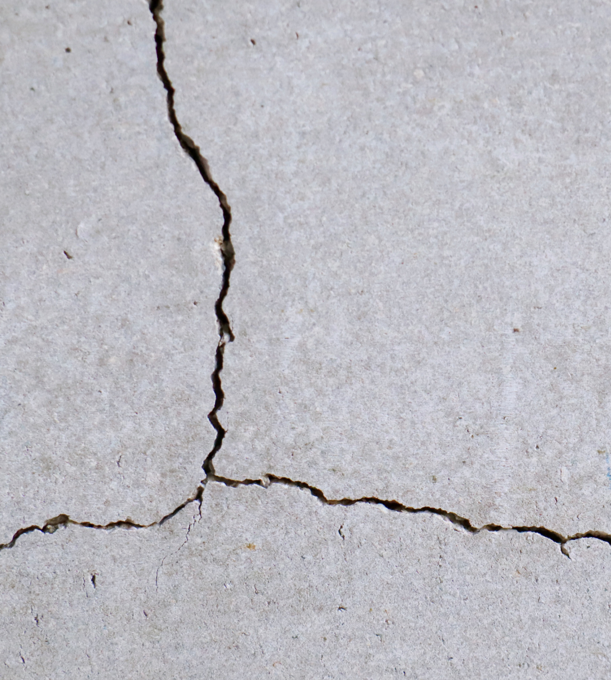
Concrete Damage & Deterioration
1. CRACKS
A crack is a linear fracture in concrete
Plastic shrinkage cracks
Premature drying cracks
Thermal induced cracks
Differential settlement
Corrosion driven delaminations
Alkali-aggregate reactivity (ASR)
Load induced (flexure, shear, tension, pre-stressing forces)
Etc.
Notes:
In the following slides we’re going to discuss the most common types of concrete deterioration
There are MANY types of concrete cracks and as an inspector, identifying their width, orientation, location, frequency, etc. is critical in helping to assess the root cause, which is ultimately required to provide appropriate maintenance recommendations.

Slide 17
Structural Cracks (load induced)
Unloaded Beam
Flexural Cracks
Flexural Cracks
Shear Cracks
Notes:
Notwithstanding some exceptions, structural or load induced cracks have specific orientations and characteristics.
The following picture shows some examples of flexure and shear cracks on concrete beams.
Note that…

Slide 18
Concrete Damage & Deterioration
Non-Structural Cracks
Crazing cracks (surface shrinkage)
Temperature cracks (thermal restraint)
Shrinkage cracks
Crack Size
Hairline less than 0.1 mm
Narrow ≥ 0.1 mm < 0.3 mm
Medium ≥ 0.3 mm < 1.0 mm
Wide ≥ 1.0 mm
Notes:
Some non-structural cracks include:
(slide)

Slide 19
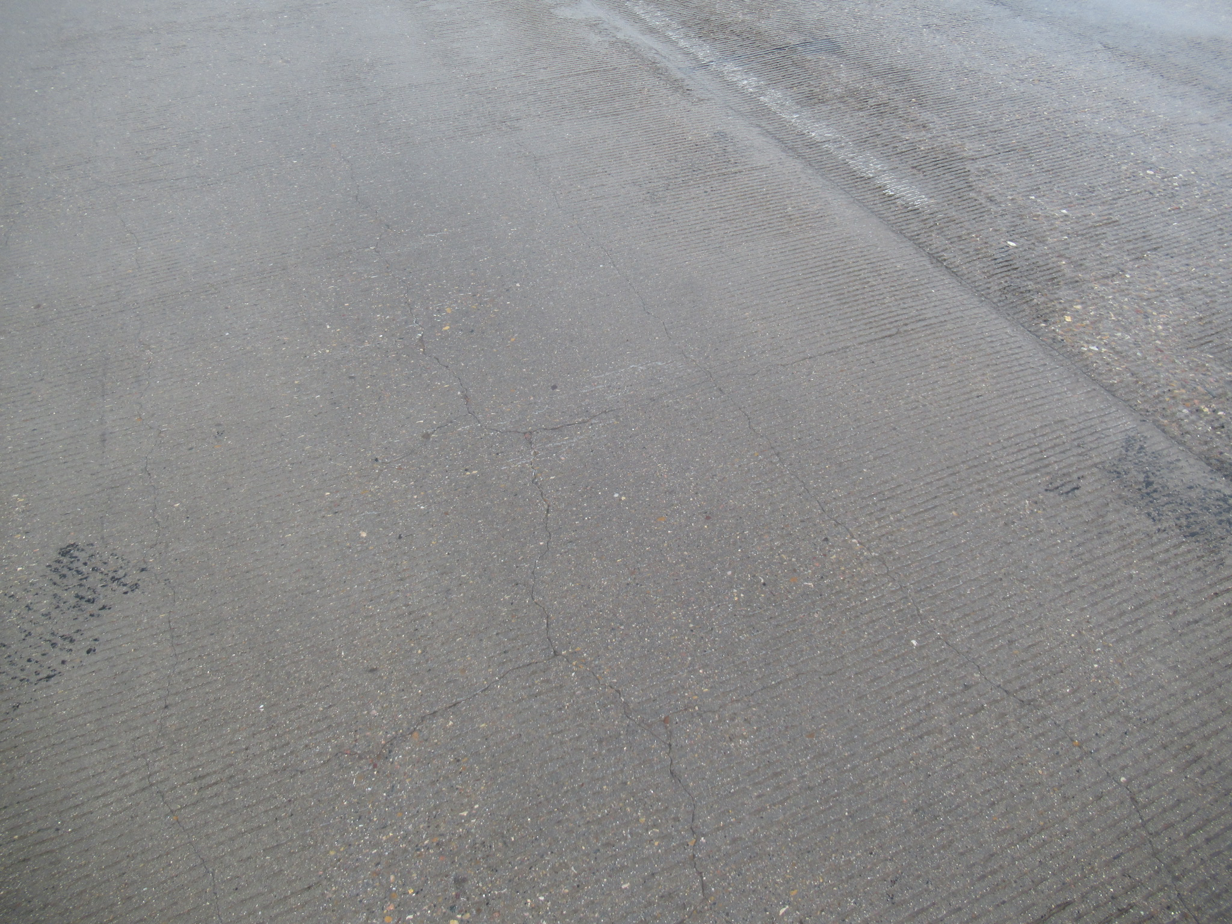
Map Cracking in Concrete Deck
Notes:
This is an example of map cracking in a concrete deck or overlay
Now in order to develop sound maintenance recommendations, we want to try and understand the root cause of the cracking.
In this case:
The map pattern is too spread out to be ASR or crazing…
It doesn’t appear to be load induced based on crack pattern…
It doesn’t appear to be locally caused by corroding rebar…
It could have been caused by drying shrinkage cracking restrained by underlying deck if overlay/deck was relatively new
or it could also be due to thermal contraction if the tensile forces simply exceeded cracking strength (doesn’t appear to have fibers and reinforcement may have been placed too low?)
Determining the root cause of a crack can sometimes be difficult, and thus capturing crack widths, locations, frequency, patterns, etc. is very important!

Slide 20
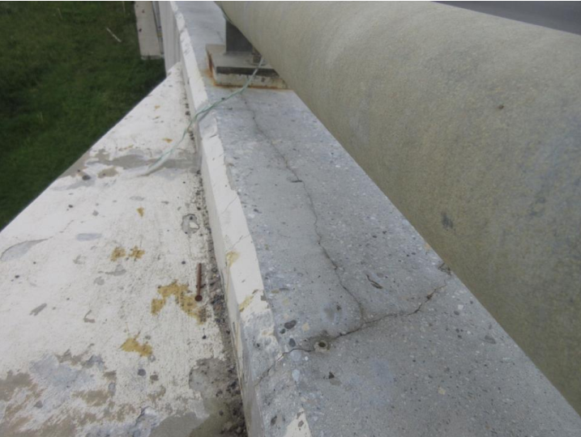
Shrinkage Cracks in Concrete Curb

Slide 21
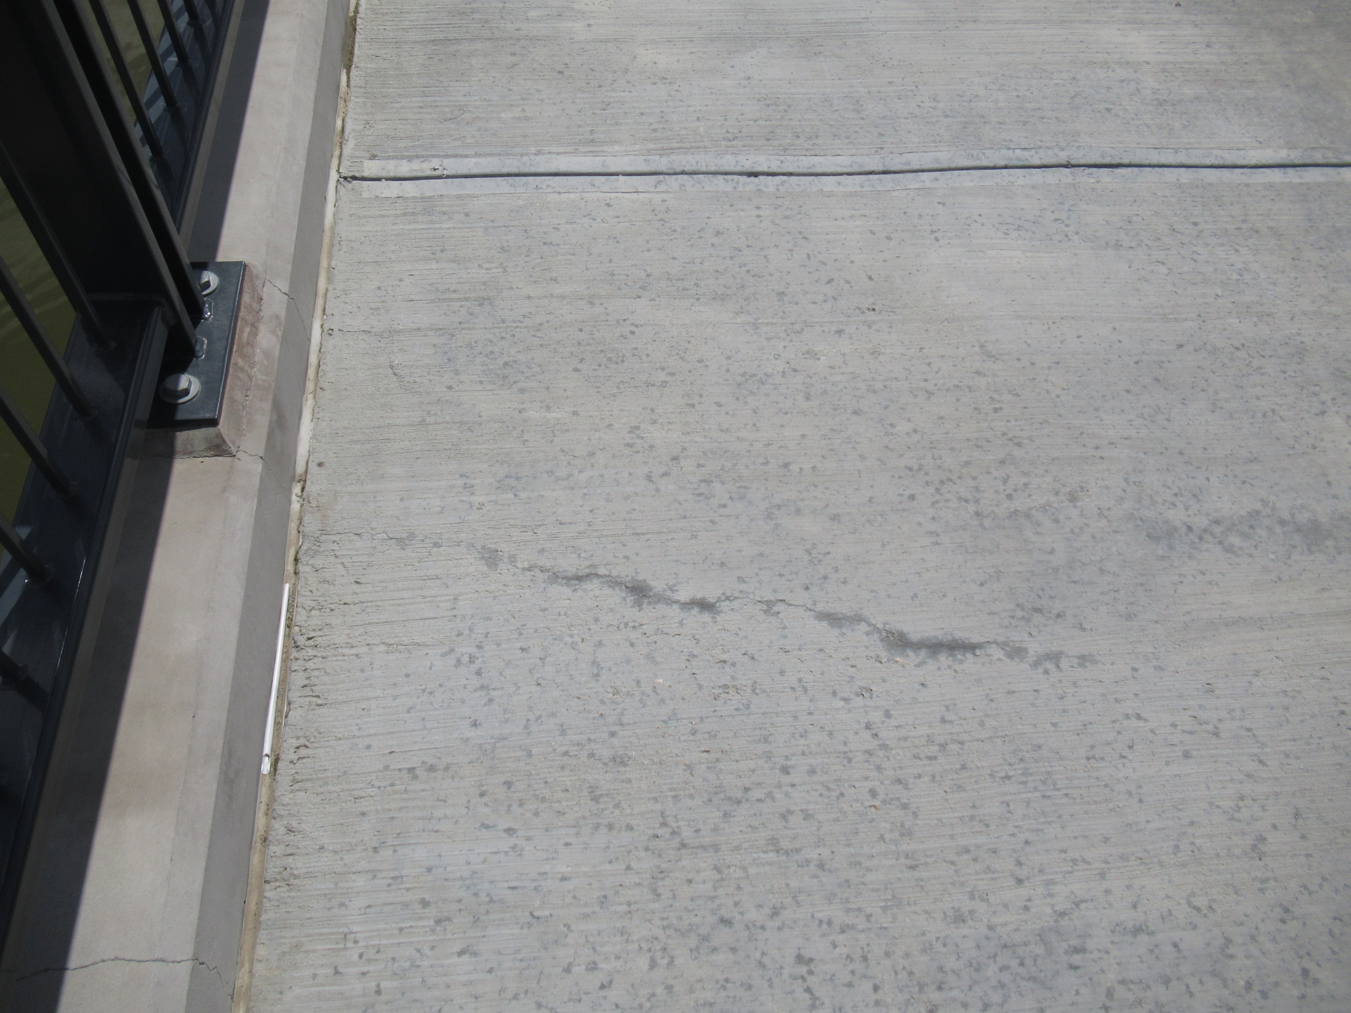
Hairline Transverse Crack in Sidewalk

Slide 22
Concrete Damage & Deterioration
2. SCALING
Scaling is a gradual loss of mortar and aggregate
Categories of Scaling
Light scaling loss of surface mortar 6 mm deep
Medium Scaling loss of surface mortar 6 to 13 mm deep
Heavy scaling coarse aggregate exposed
Severe scaling loss of coarse aggregate
Notes:
Scaling is a type of freeze/thaw damage resulting from the hydraulic pressure of repeated freezing cycles
Scaling in new concrete is typically due to 3 reasons:
Working water into the surface (bleed water or during finishing)
Premature exposure to chlorides (before adequate curing, strength, etc.)
Insufficient curing, which results in a weak surface
Scaling will also occurs naturally over time as the concrete surface is subjected to multiple freeze-thaw cycles.

Slide 23
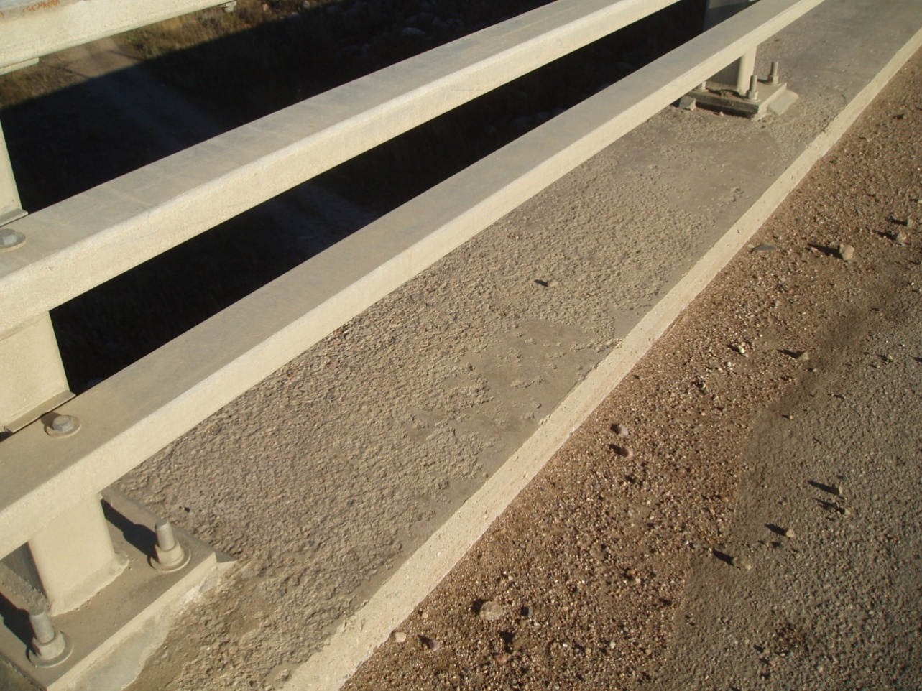
Light Scaling
Notes:
Loss of surface mortar up to 6 mm deep (no exposed aggregate)

Slide 24
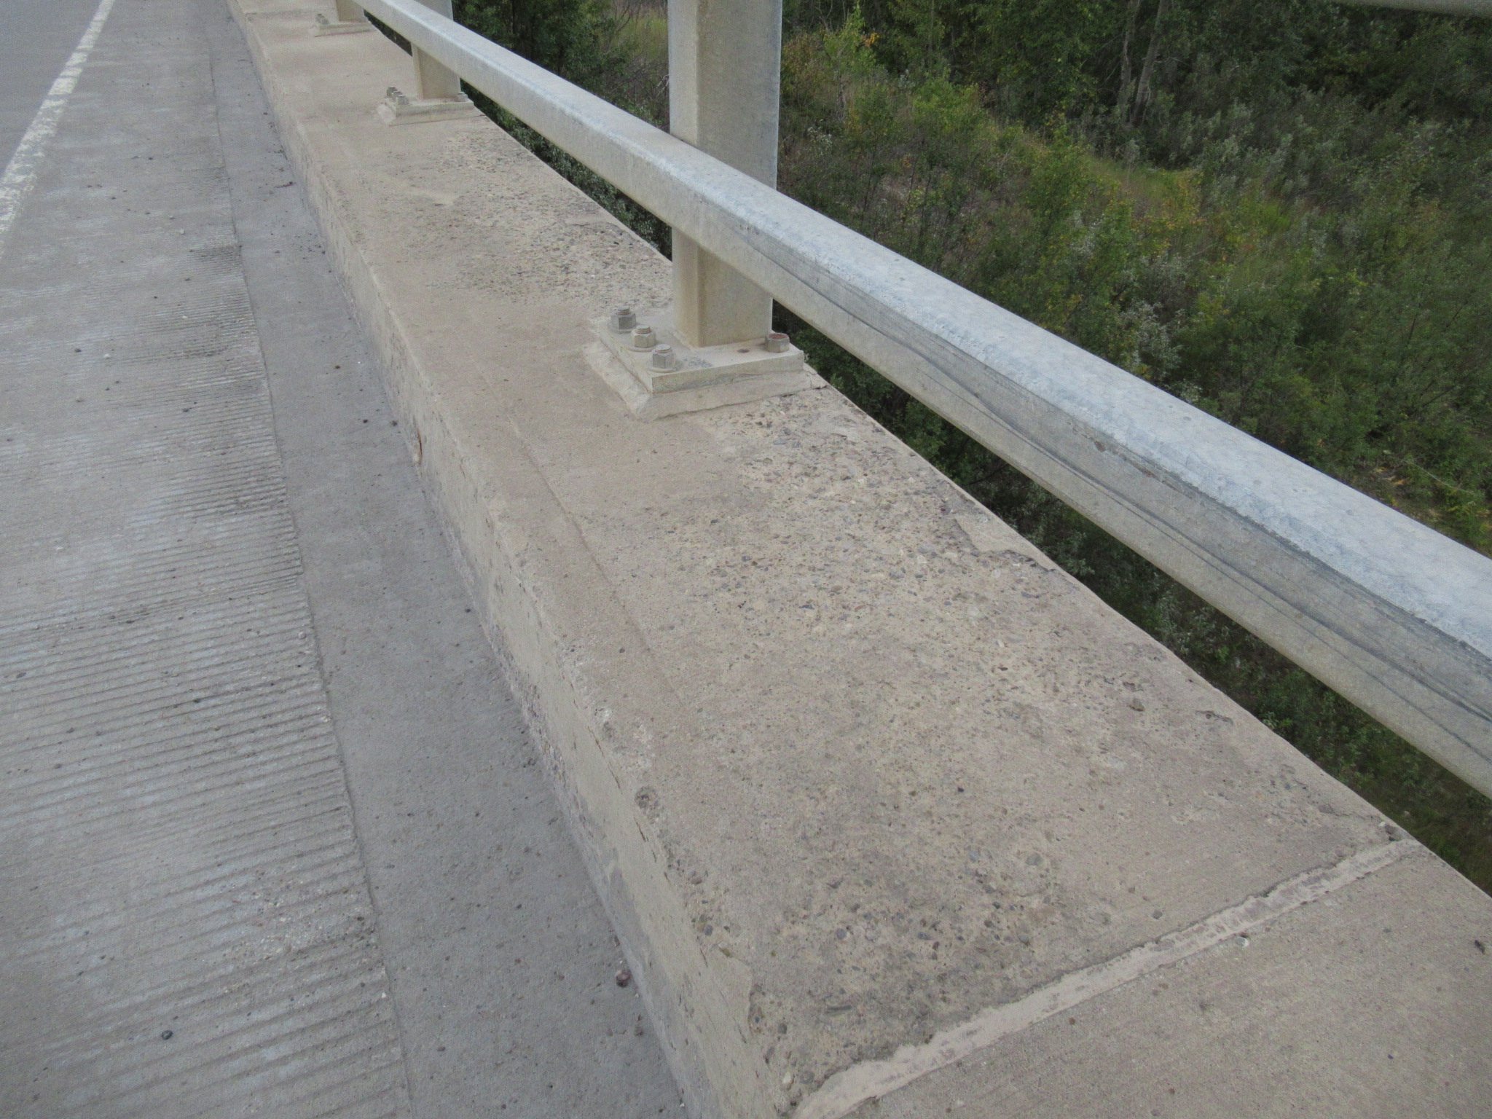
Medium Scaling
Notes:
Loss of surface mortar up to 6 mm to 13 mm deep (may begin to see some exposed rock)

Slide 25
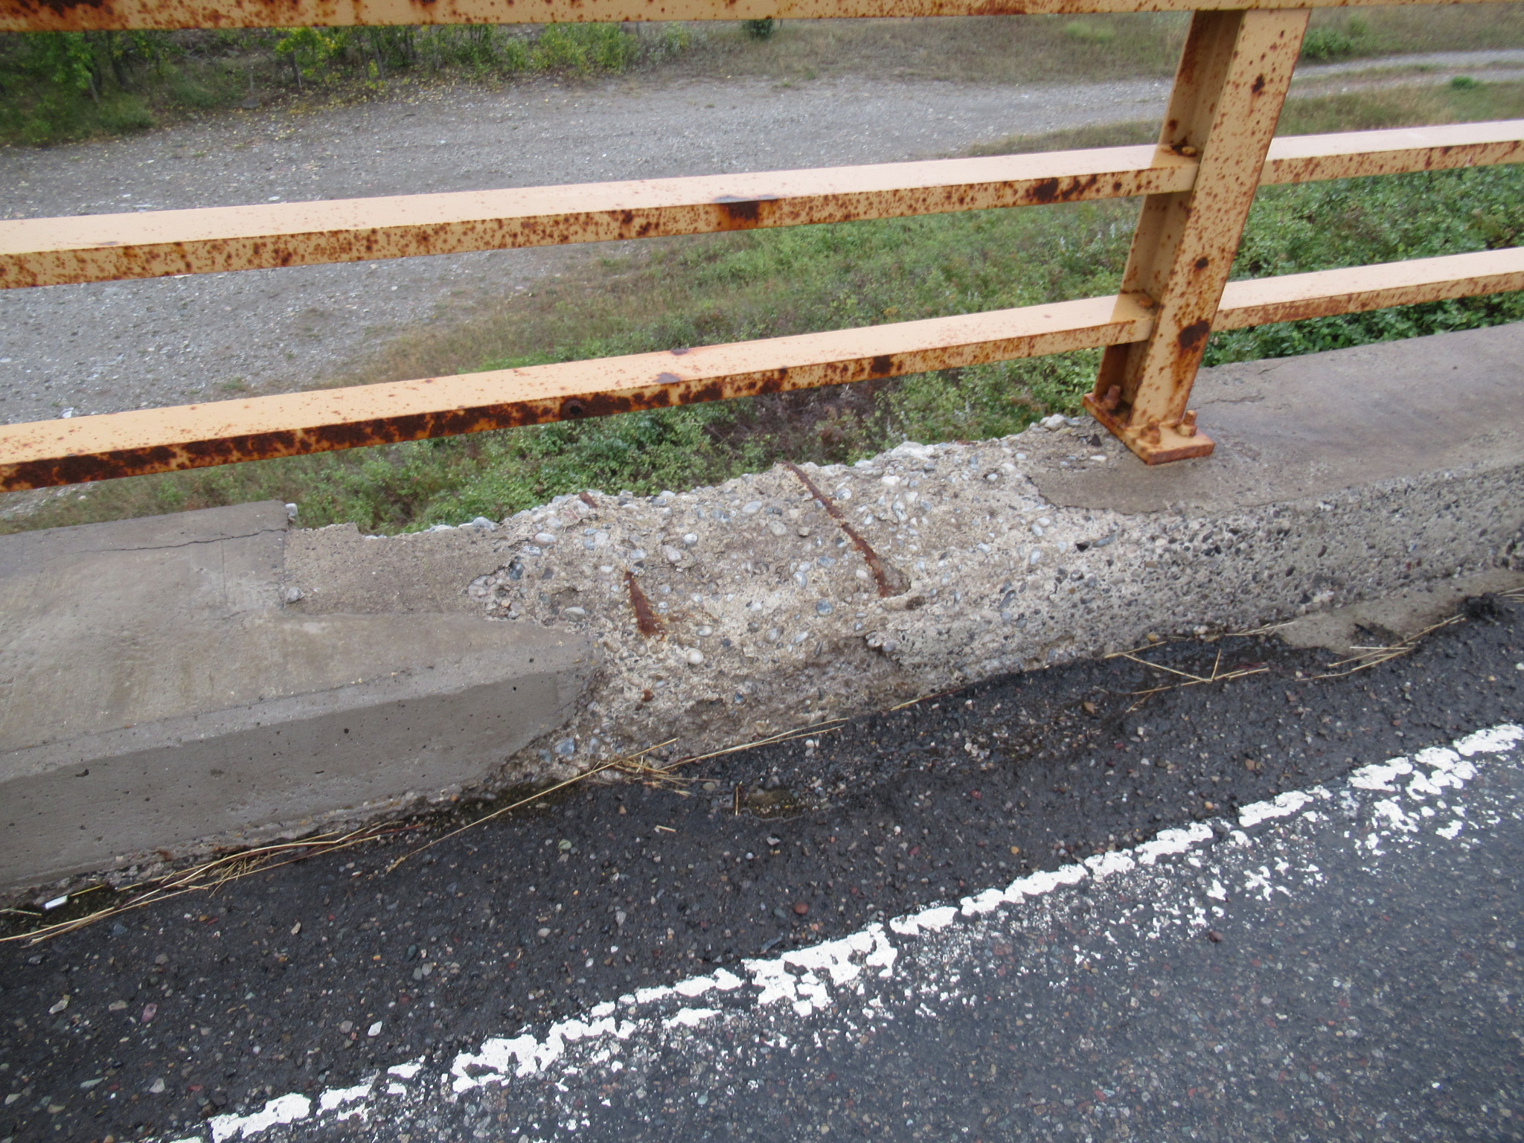
Heavy & Severe Scaling
Notes:
Heavy = coarse aggregate is exposed
Severe = loss of coarse aggregate

Slide 26
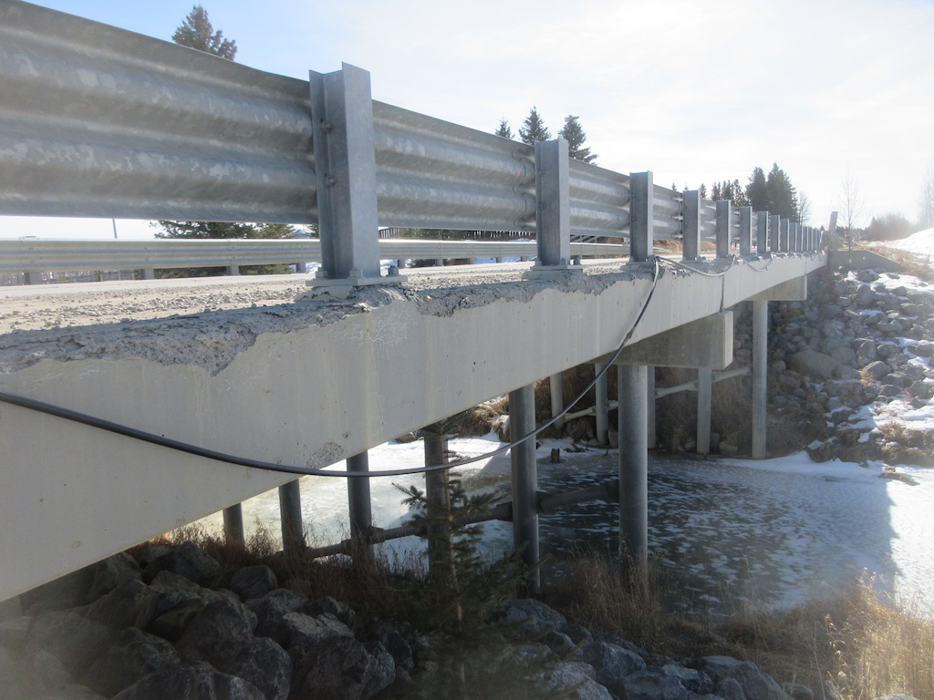
Freeze/Thaw Deterioration of Deck
Notes:
The following is an example of freeze-thaw damage.
As an inspector, freeze-thaw damage can be identified by lack or corrosion staining, or by investigating the air matrix of the fractured concrete up-close.

Slide 27
Concrete Damage & Deterioration
3. POP-OUTS
Due to porous aggregate
4. ABRASION
Due to wheel wear
Notes:
(slide)
Pop-outs =rock absorbs and retains water and expands as it freezes

Slide 28
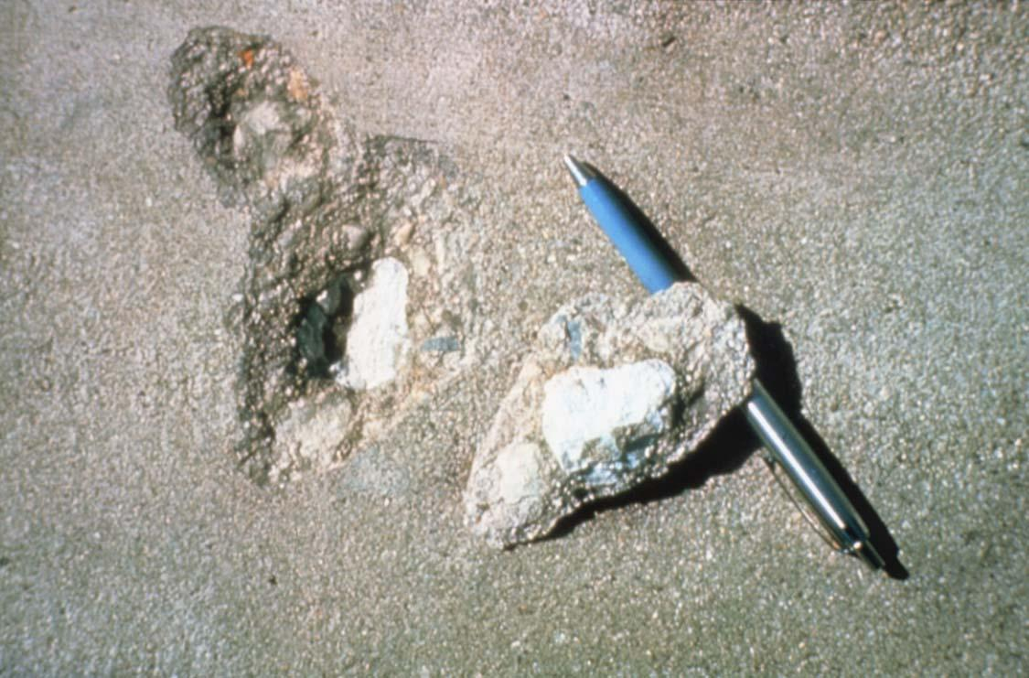
Expansive Aggregate Pop-out

Slide 29
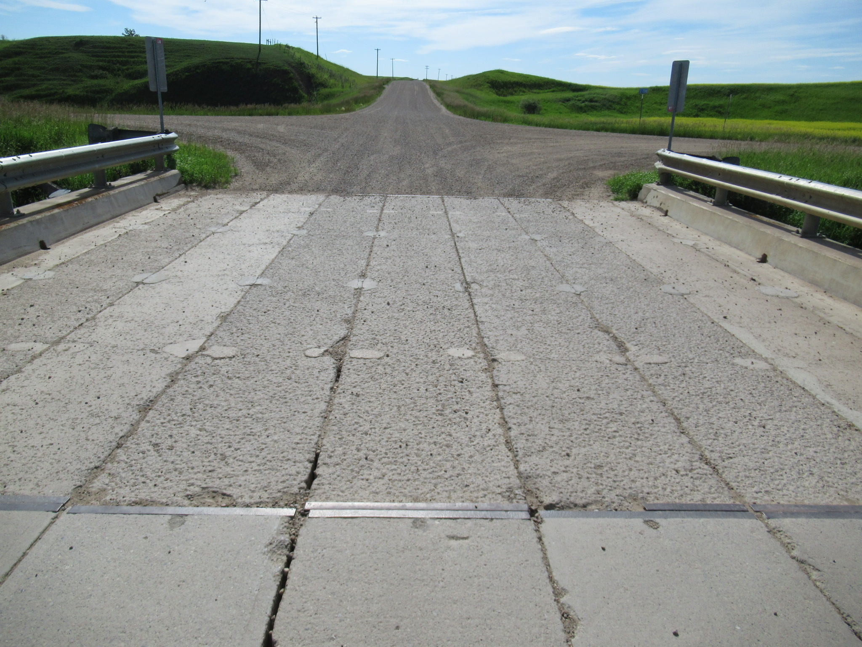
Abrasion Damaged Girders
Notes:
Typical on surfaces that are adjoined with gravel roads

Slide 30
Concrete Damage & Deterioration
5. & 6. DELAMINATION & SPALLING
Delamination is the separation of the paste layer within concrete (i.e. an internal crack). Delamination leads to spalling. Typically caused by the volumetric expansion of corroding rebar.
7. STAINING
Includes rust, efflorescence, or water stains leaching through cracks
8. ALKALAI AGGREGATE REACTION
9. CARBONATION
10. EFFLORESCENCE
Notes:
(slide)
AAR = like Alkali-Silica-Reaction we discussed previously
Carbonation = carbon dioxide in air reacts with calcium hydroxide in concrete to produce calcium carbonate (photo of deposits shown later). This increases concrete compressive strength, but de-passivates the steel.
Efflorescence = migration of salt to the surface of porous material, leaving a white/chalky residue – hard to remove.

Slide 31
Delamination & Spalling Mechanism (corrosion driven)
Top of concrete
Wearing surface
Reinforcement
Corrosion by-products
Notes:
The following shows a visual representation of a corrosion driving delamination and spalling mechanism
Requires de-passivation of the steel (chloride ingress, carbonation, etc.)
The volumetric expansion resulting from corrosion by-products is up to 6 times!

Slide 32
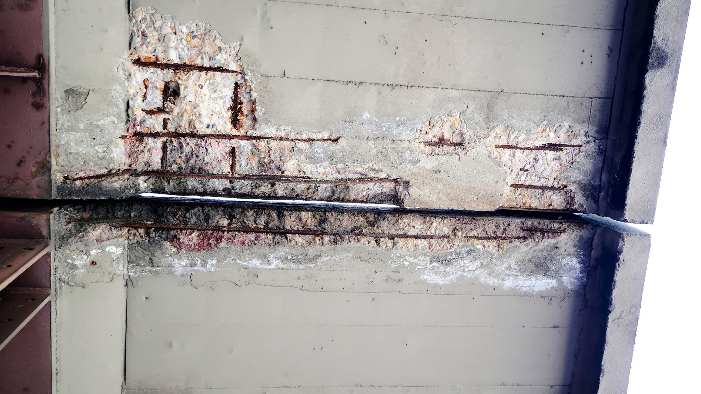
Delamination & Corroded Rebar
Notes:
This is the underside of a deck overhang with a notable concrete spall
note the efflorescent staining, which is proof that chlorides and salts are migrating through the full depth of concrete at this location

Slide 33
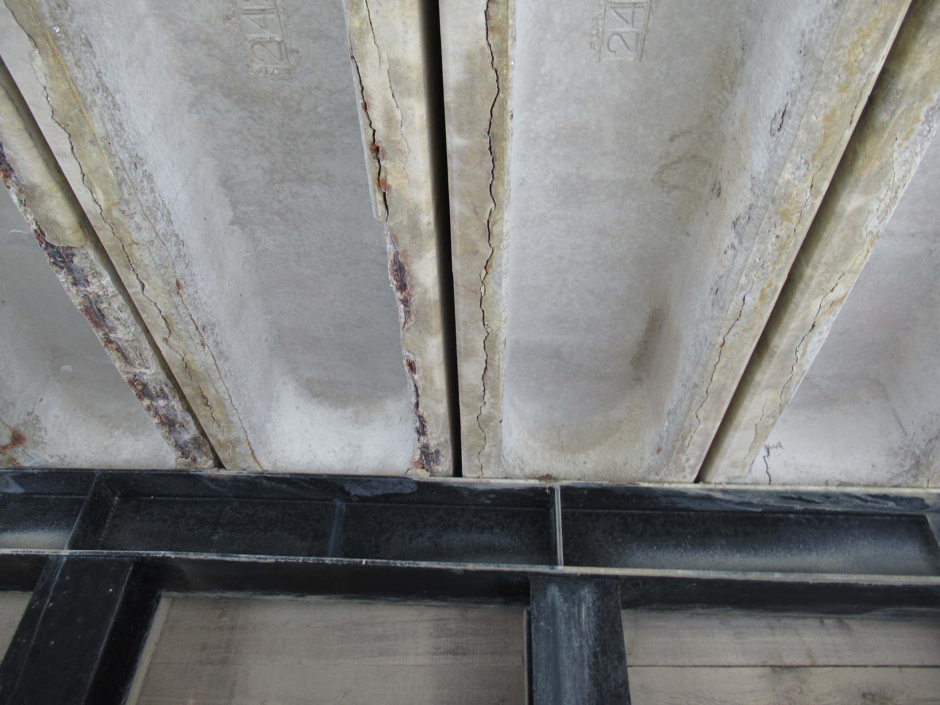
Longitudinal Cracks & Corroded Rebar
Notes:
Here we have some longitudinal cracks and corroded rebar.
One might say this is the case of what came first, the chicken or the egg?
Cracks may be due to a phenomenon called “splitting”, which then could have promoted corrosion staining; or
Leaking shear keys could have resulted in corrosion of the longitudinal steel over time
This is why its so important that we conduct regular inspections by certified individuals such as yourselves, which would help identify the cause of the cracks!

Slide 34
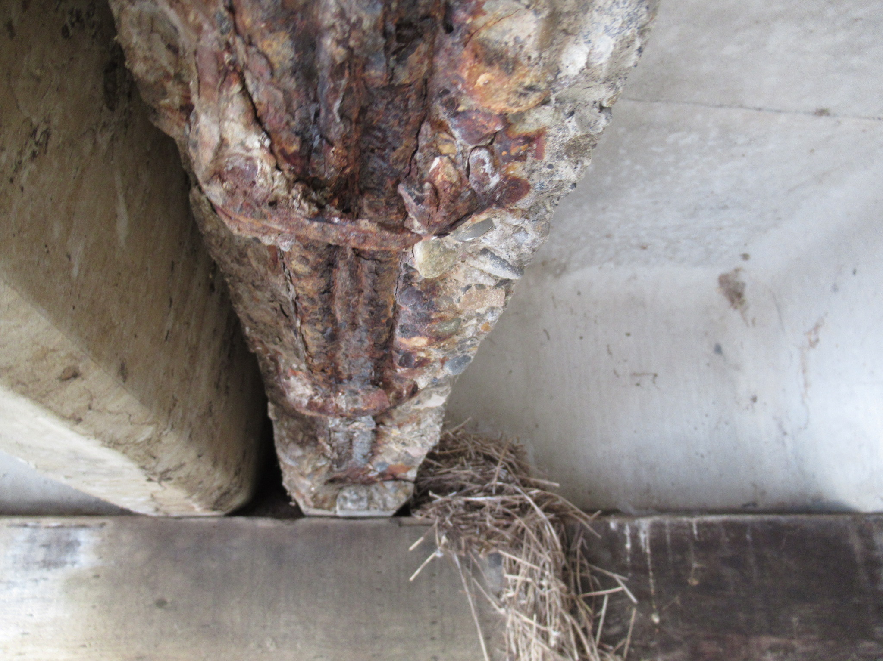
Spalled Concrete – Corroded Rebar and Broken Stirrup
Notes:
This shows an example corroded flexural bar with a broken shear stirrup.
Inspectors should pay special attention for flexural or shear cracks when this happens because the development length of this rebar has been compromised!

Slide 35
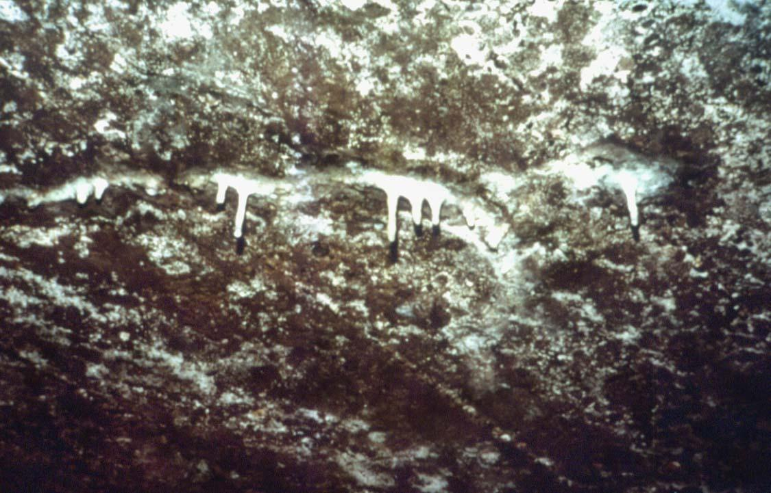
Calcium Carbonate Deposits
Notes:
This picture shows calcium carbonate deposits on the underside surface of carbonated concrete.
So how do we differentiate b/w efflorescence?
Efflorescence is more like a staining and will not build up and “drip” as shown
Efflorescence is also porous; and should darken in color when wet
You also want to ask yourself if the concrete is very old, or has been subjected to heightened amounts of carbon dioxide (river crossing probably not)

Slide 36
Concrete - Steel Combination
Reinforced Concrete
Concrete has high compressive strength and low tensile strength
Typically cracks under tensile load
Traditional reinforcing steel (rebar) carries tensile load
Prestressed Concrete
Use of both rebar and high-strength steel strands
Concrete is pre-compressed as a result of pre-tensioning the steel strands
Carries load without cracking
Notes:
Although concrete is great in compression, it is pretty terrible in tension, and thus required reinforcing in most structural applications
Typical reinforcements include traditional rebar and pre-stressing cables, however other materials such as fibre reinforced polymers (FRP) are being adopted.

Slide 37
STEEL
Notes:
With concrete wrapped up, we’ll be moving onto steel.

Slide 38
What is Steel?
Steel is an alloy of iron, carbon and other trace metals
Typical carbon and trace metal ratios:
Carbon 0.15 to 0.30%
Manganese 0.50 to 2.00%
Phosphorus 0.02 to 0.20%
Sulphur 0.02 to 0.06%
Silicon 0.15 to 0.80%
Notes:
So what is steel?
Steel is an iron alloy with carbon and other trace metals.
Typical trace metals and their compositions are shown above.
Note that in the bridge world we have specific limitations on some of these materials:
Silicon, for example, can adversely affect the hot-dip galvanizing process and thus there are limitations in the bridge specs
Boron isn’t shown, but can increases risk of embrittlement at welded locations if in excess

Slide 39
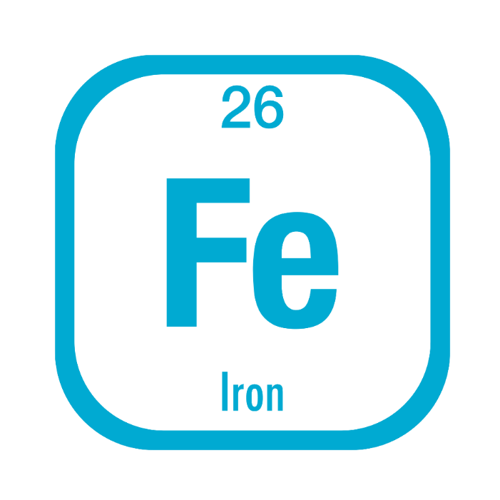
Iron
Iron in the pure form is a soft, shiny metal like aluminum.
However, it is never found in this state.
Iron oxidizes extremely easily.
In nature it is always found as an oxide.
Notes:
The main element in steel is Iron
Iron oxidizes very easily and is never found in its original form, which would be quite soft and shiny (like aluminum)
This is why structural steel requires other trace metals to improve its physical properties (hardening, corrosion resistance, etc.)

Slide 40
Steel Making Process
Iron ore, coke and limestone are major raw materials.
Raw material is charged into Blast furnace which has a temperature of 1600°C.
Iron melts and settles at the bottom.
Solidified iron is called “Pig Iron”
Molten metal from blast furnace and silicon is taken into Basic Oxygen furnace (and potential recycled steel)
Chemical analysis of the molten material is done
Steel billets are heated to 1200°C for rolling and finished products.
Notes:
Steel is made from 3 major raw materials: Iron ore, coke (which is made from coal), and limestone
These materials are charged into a Blast furnace at 1600C, which generates molten iron and pig iron
The molten iron, recycled steel, and silicon are mixed in an oxygen furnace to create molten steel, which is then refined and finished by rolling into shape

Slide 41
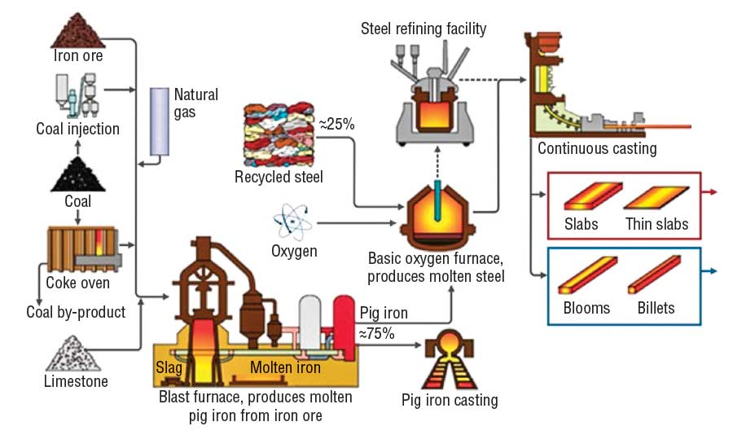
Steel Making Process
Notes:
The following diagram illustrates the steel making process we just discussed
Here you can see the iron ore, coke (made from coal) and limestone being added to the blast furnace
Both molten iron and pig iron is produced
The molten iron is sent to an oxygen furnace with scrap metal and silicon
Then its refined and cast into shape

Slide 42
Effects of Various Elements
Effects of Carbon in steel:
Increases strength, hardness, and improves hardenability
Reduces ductility (brittleness increases), toughness, machinability and weldability once heat treated
Effects of Phosphorus in steel:
Increases strength and hardenability
Reduces ductility and weldability
Notes:
Because we can’t make steel with iron alone, its important to understand the effects of various elements that are added.
The following slides discuss some of these elements and some advantages and disadvantages:
Carbon is used primarily to increase strength, hardness, and hardenability, but reduces ductility, toughness, and its ability to be worked once heat treated (forged in fire)
Like carbon, Phosphorus also increases strength and hardenability and reduces ductility and weldability

Slide 43
Effects of Various Elements
Effects of Manganese in steel:
Helps remove oxygen and sulfur during casting and as an alloy decreases brittleness and imparts strength
Reduces weldability
Effects of Sulfur in steel:
May cause porosity and hot cracking in welding
Can cause brittleness
Notes:
Manganese helps remove oxygen and sulfur during casting and as an alloy decreases brittleness and imparts strength – in turn it reduces weldability
Sulfur is an undesirable impurity and can lead to brittleness and other adverse affects

Slide 44
Effects of Various Elements
Silicon in steel:
Used as a primary deoxidizer and can slightly increase strength and hardness (less so than manganese)
Can be detrimental to surface quality of welds
Certain amounts of silicon can adversely affect hot-dip galvanizing
Copper, Chrome, Nickel:
Weathering steel
Notes:
Silicon is used as a primary deoxidizer during the smelting process and can also slightly increase strength and hardness, but can be detrimental to surface quality of welds and affects HDG
Copper, Chrome, and Nickel are used to create weathering steel

Slide 45
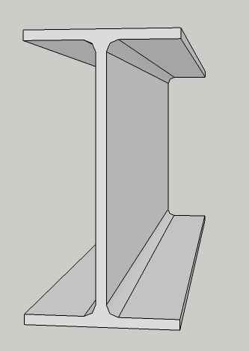
Common Steel Shapes
Wires
Cables
Steel Plates
Steel Bars
Rolled Beams
Built-up Shapes
Notes:
Some common steel shapes include… (slide)

Slide 46
Rolled Sections
Angle
Channel
Rolled I Beam
Notes:
Common rolled sections include angles, channels, and rolled I-beams

Slide 47
Built-up Sections
Notes:
(slide)
Box members are also very popular for truss members

Slide 48
Important Physical Properties
Strength
Compression
Tension
Fatigue
Ductility
Notch toughness
Weldability
Corrosion Resistant
Fire Resistant
Notes:
Some important physical properties of steel include:
Strength
Ductility
Notch Toughness (the ability of the steel to absorb energy when a stress concentrator is present, which is very important for girders to resist crack development!)
Weldability
Corrosion and fire resistance

Slide 49
Tension & Compression
Stress Strain Diagram
tension
(+)
shorten (-)
lengthen (+)
compression
(-)
Notes:
The following is an example of the typical stress-strain diagram for structural steel.
More information can be found online since we don’t have the time to cover the specifics.
The main difference with concrete is that steel can strain harden after reaching its yield strength until it reaches its ultimate strength (whereas concrete reaches its yield strength and then fails)

Slide 50
Steel Damage and Deterioration
Corrosion
Environmental corrosion
Stray current corrosion
Stress corrosion
Cracking
Fatigue
Impact
Excessive loading
Steel may also crack when flaws are present, especially if near the surface.
Note: Any crack in a steel member is serious
Notes:
Common modes of steel damage include corrosion and cracking, both of which can be caused by multiple different ways
Please note that any crack in a steel member is a serious problem!
Steel is prone to crack propagation, and thus once a crack develops, special safeguards and evaluation need to be employed

Slide 51
Steel Damage and Deterioration
Deformation
Excessive loading
Heat damage
Impact
Notes:
Other damage includes:
Deformation (caused by impact, welding, mishandling)
Overloading
Heat damage (vehicle collisions, improper welding or heat straightening techniques)
Impact (HLD)

Slide 52
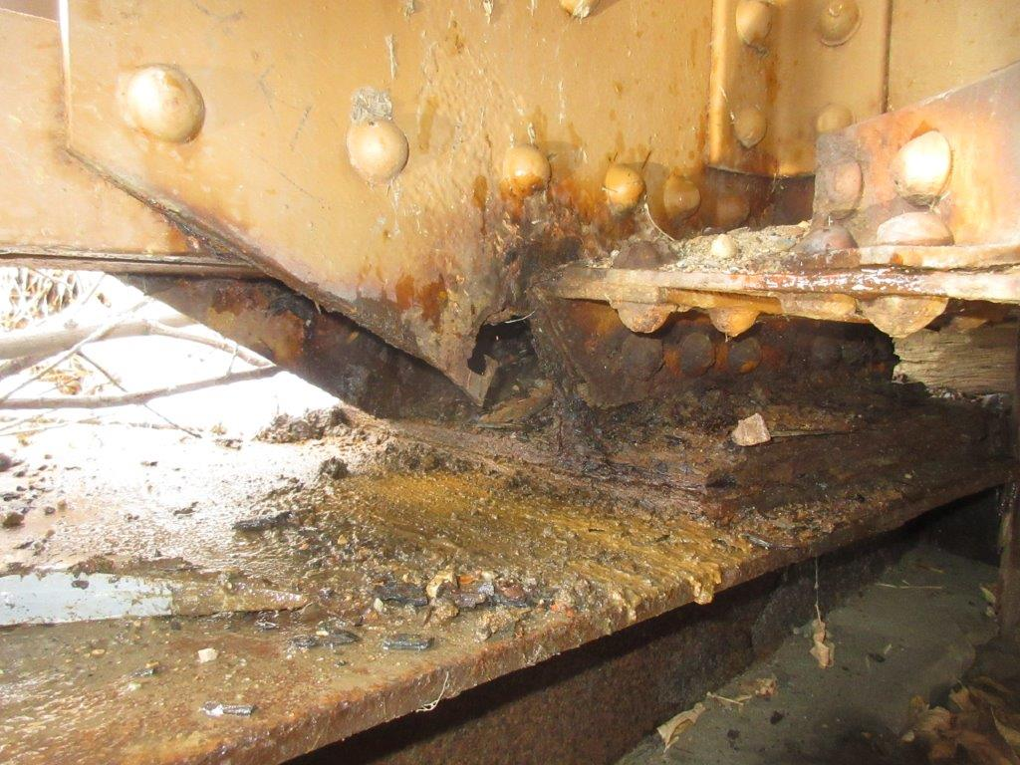
Corrosion Perforations in Tie Plate – BF 9315
Notes:
This slide shows an example of steel corrosion, which can cause considerable section loss and fastener damage if not addressed appropratly.

Slide 53
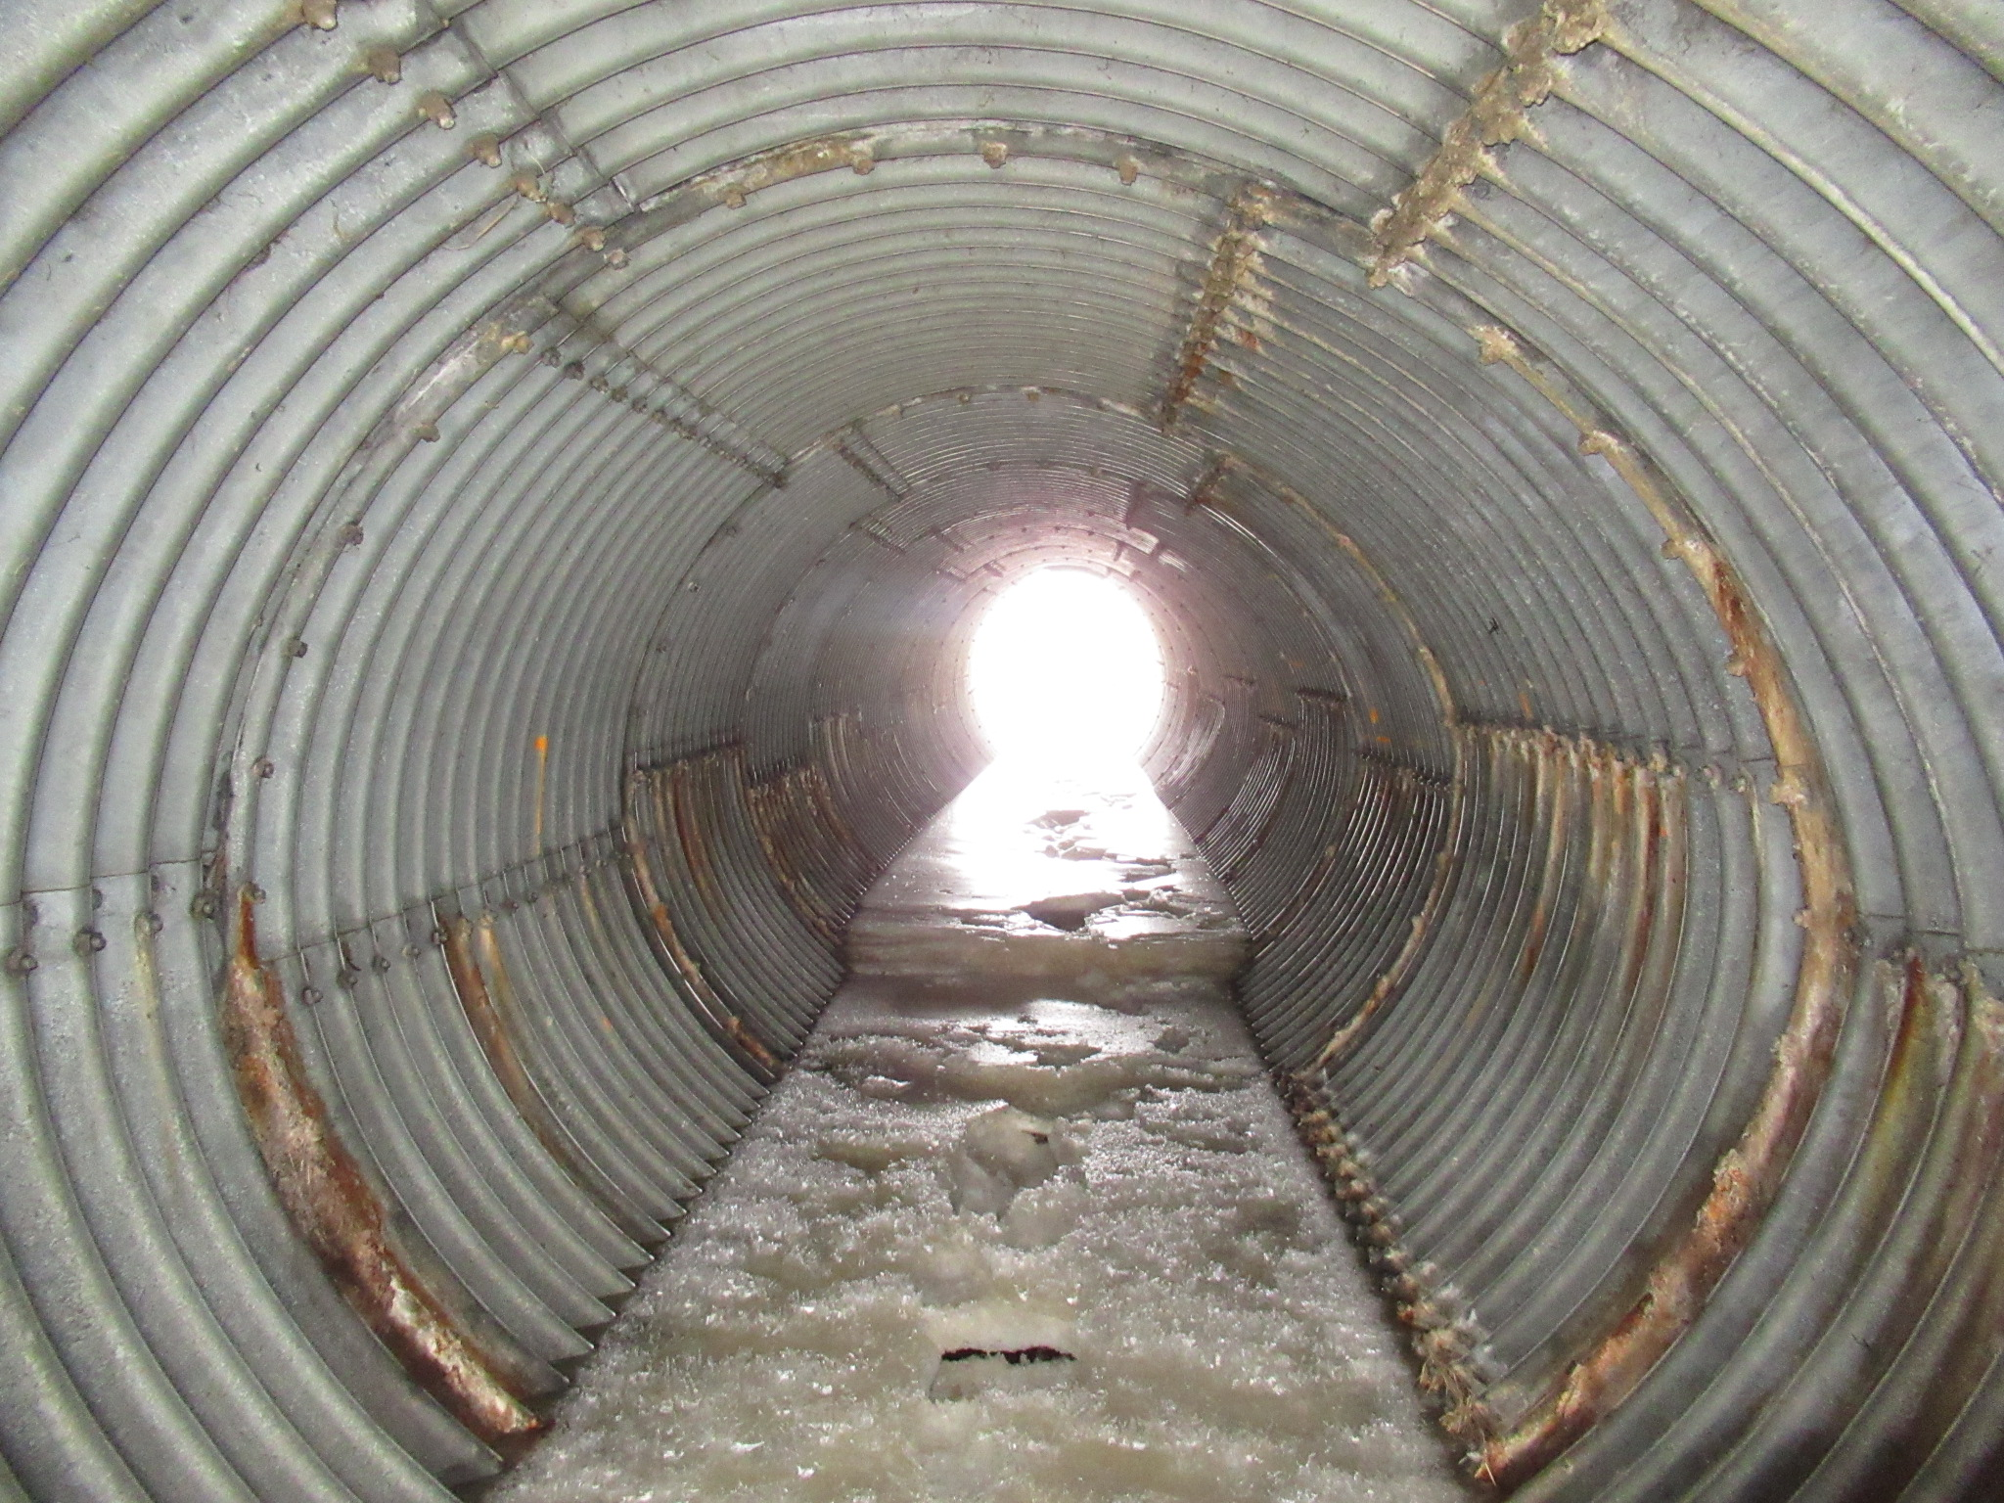
Soil Side Corrosion in Culvert Barrel
Notes:
Here we see culvert corrosion along the side-walls that are in contact with soil and fill

Slide 54
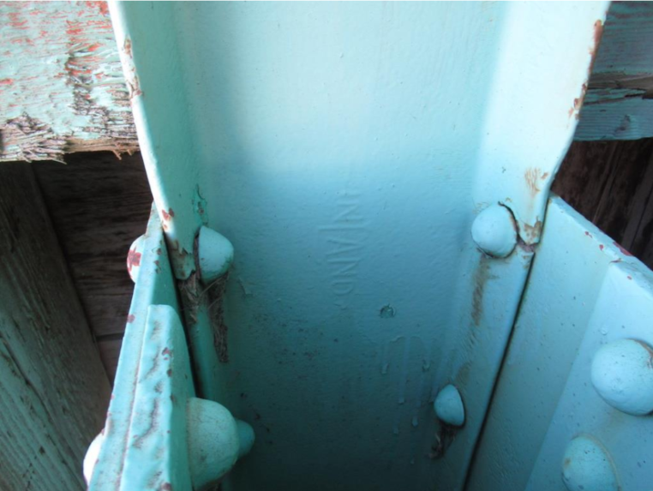
Crack Intersecting Bolt Hole
Notes:
In this photo you can see a crack that is intercepted by a bolt hole. Its hard to tell if it was load induced and the crack was arrested by the hole or initiated at the hole (say if it wasn’t deburred)

Slide 55
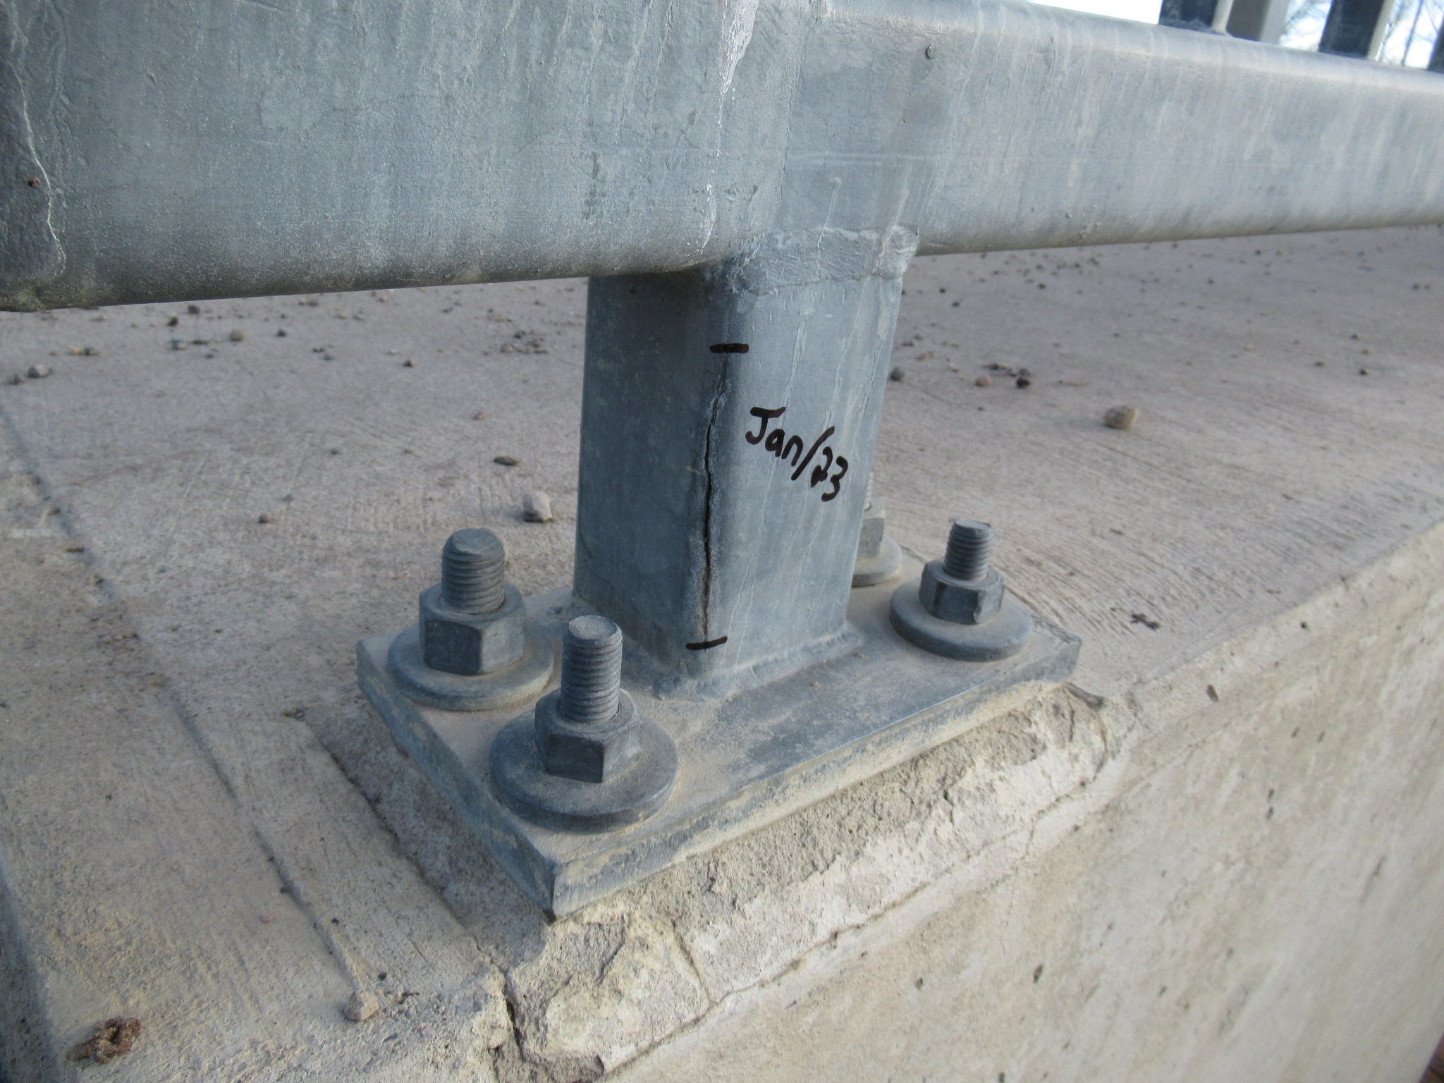
Crack in post base initiated by expanding frozen water
Notes:
Here we have a crack in a bridgerail post base – likely caused by freezing water due to inadequate, plugged, or missing drain hole

Slide 56
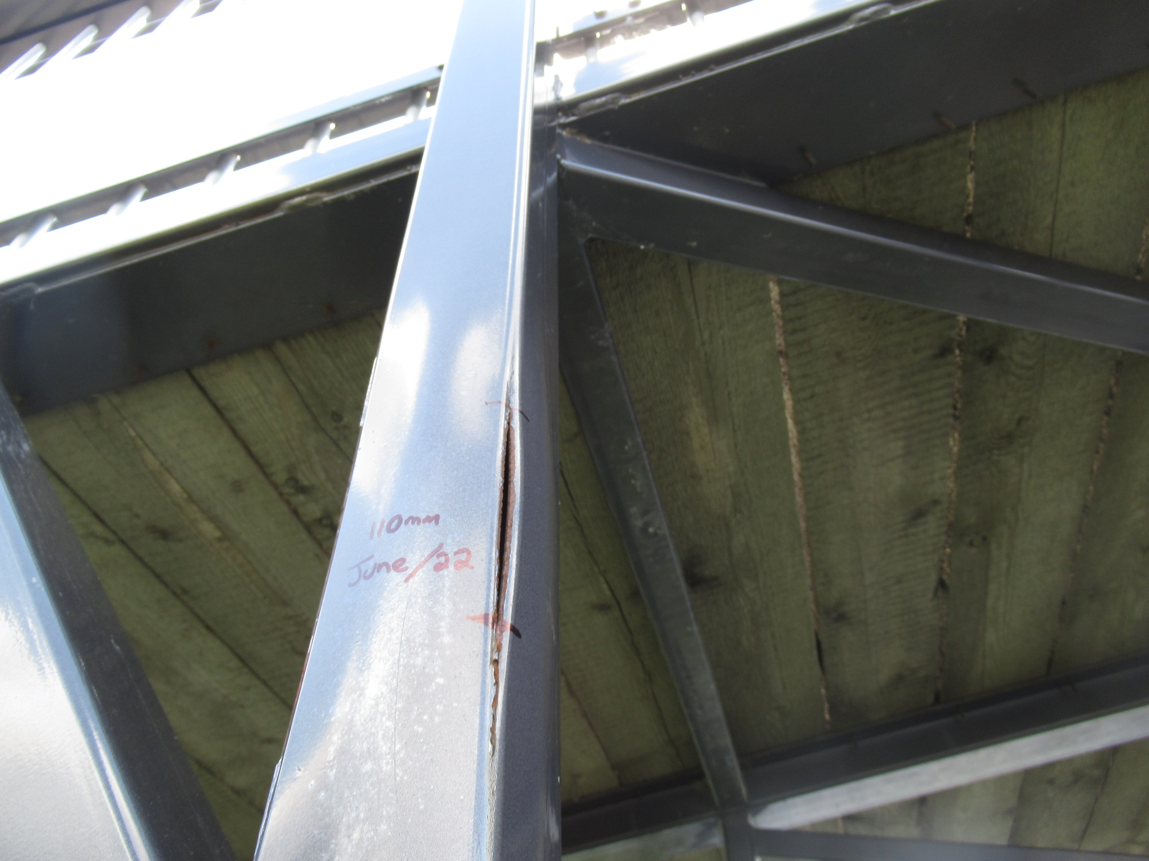
Crack in post initiated by expanding frozen water
Notes:
Here is another example of freezing water damage

Slide 57
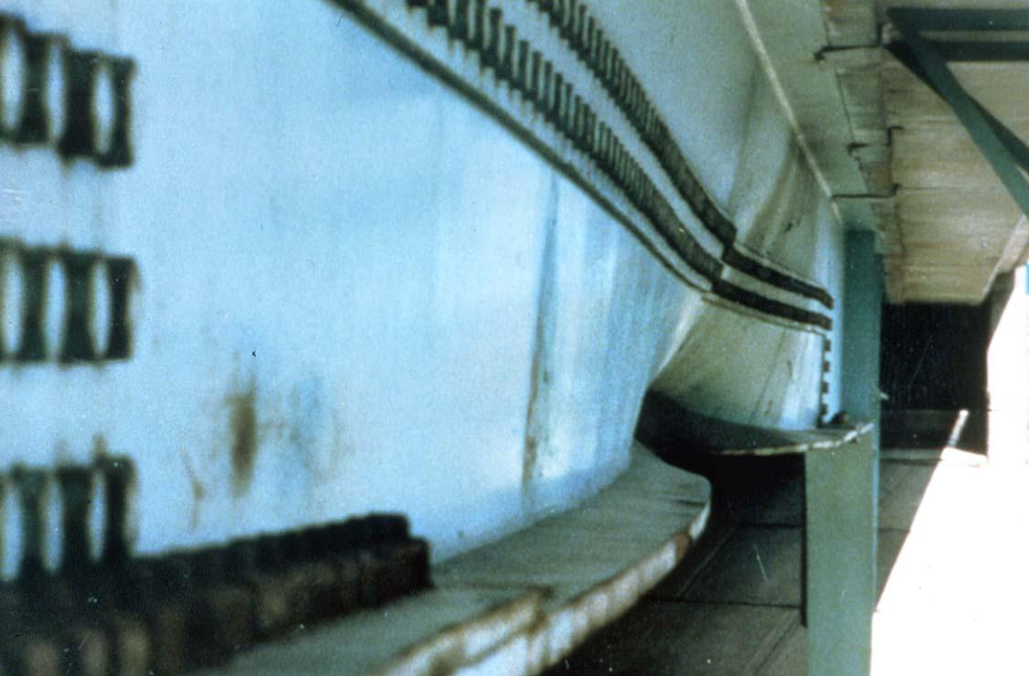
Collision damaged steel girder.
Notes:
This is an example of HLD induced distortion

Slide 58
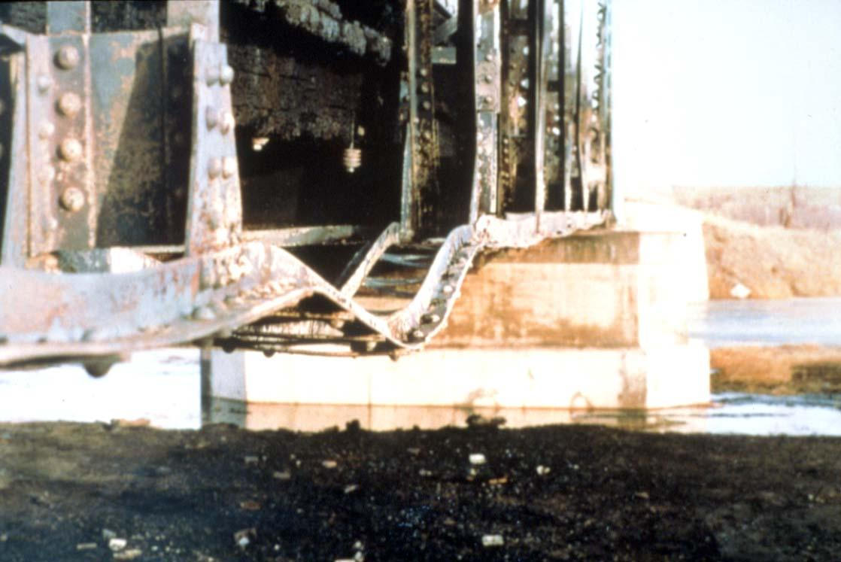
Fire Damaged Truss
Notes:
This is a somewhat archaic photo of fire damage – note that the yield strength of steel is greatly reduced when heated (about half at 600C and typical orange flames are about 1200C)

Slide 59
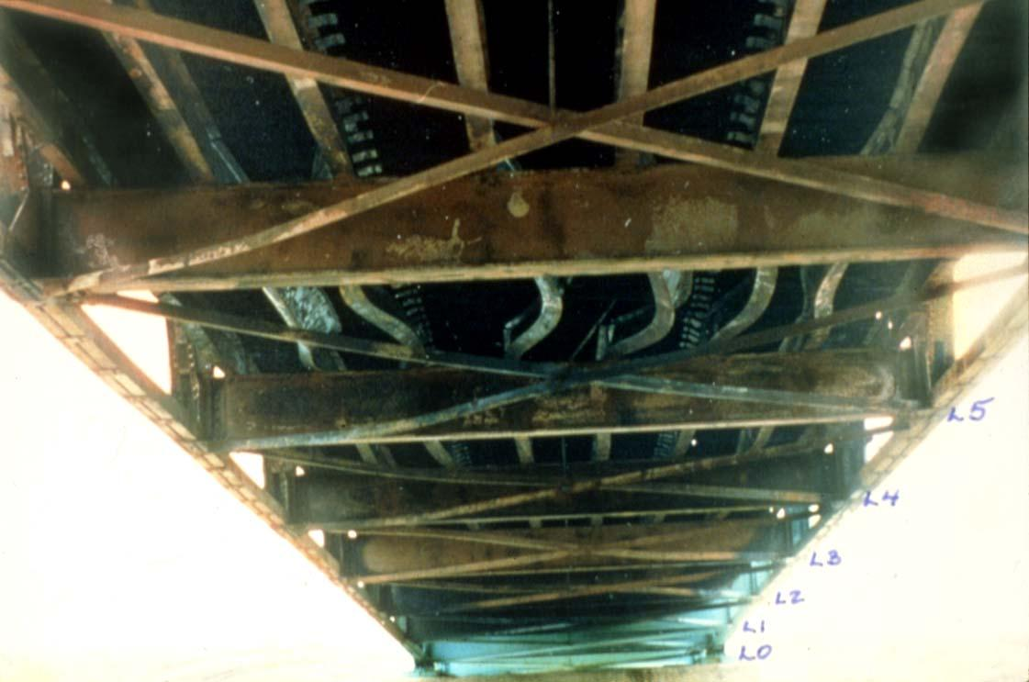
Fire Damaged Truss.
Notes:
Another example of fire damage.

Slide 60
UNCONTROLLED WELDING IS NOT ALLOWED ON BRIDGE STRUCTURES
Notes:
Now when it comes to welding, uncontrolled practice can be very damaging and is not permitted
For example:
If the material isn’t prepared properly (whether that’s removing stress risers or conducting preheating), welding can cause cracking and hydrogen embrittlement
Uncontrolled temperatures and cooling rates can cause undesirable hardening and embrittlement
Considerations also need to be made for differential cooling induced distortion
Etc.

Slide 61
TIMBER
Notes:
Although timber is becoming less and less common for new construction, many of our existing structures have wood components and is still relevant

Slide 62
Wood
What is wood?
A naturally occurring non- homogeneous material.
Composition of timber:
Carbohydrate fibres
Water
Classification of timber:
Hardwood
Softwood
Notes:
Wood is a naturally occurring non-homogeneous material (which is just a fancy way of saying that its physical properties change depending on the orientation of the member)
It is made-up of carbohydrate fibers and water
And is classified, in general terms, as either hardwood or softwood.

Slide 63
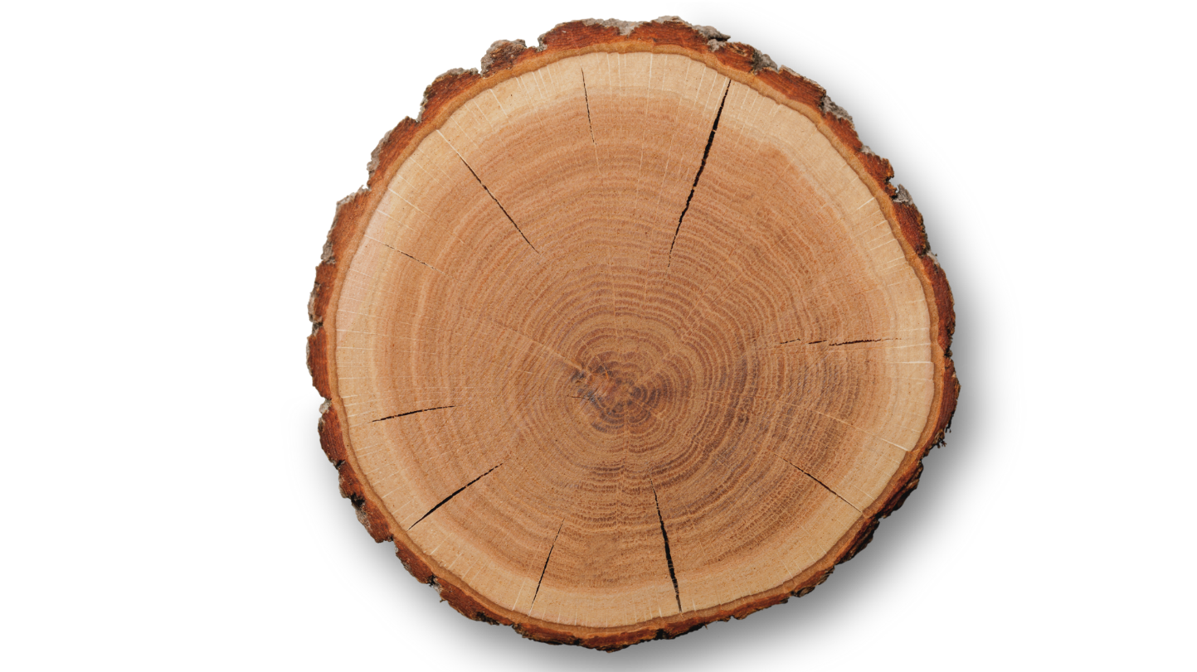
Cross Section of Tree
Check
Outer Bark
Inner Bark
Cambium
Sapwood
Rays
Heartwood
Pith
Check
Notes:
The following slide shows a cross-section of a timber log and its various elements
Outer and inner bark is located around the outside perimeter
The interior wood consists of sap wood and heartwood
And rays radiate from the central pith
Also noted are “checks”, which will be discussed in the next slides

Slide 64
Growth Features
Growth features
Knots
Splits, Checks
Moisture content
Moisture affects dimensional stability
19% moisture content is considered seasoned wood
Notes:
There are growth features such as knots, checks and splits that occur naturally within wood
As wood dries, it will shrink, causing some distortion and cracking.
In most cases the amount of warping and cracking is acceptable, but this should be considered before construction.
Wood is considered dry (or “seasoned”) when its moisture content is 19% or less

Slide 65
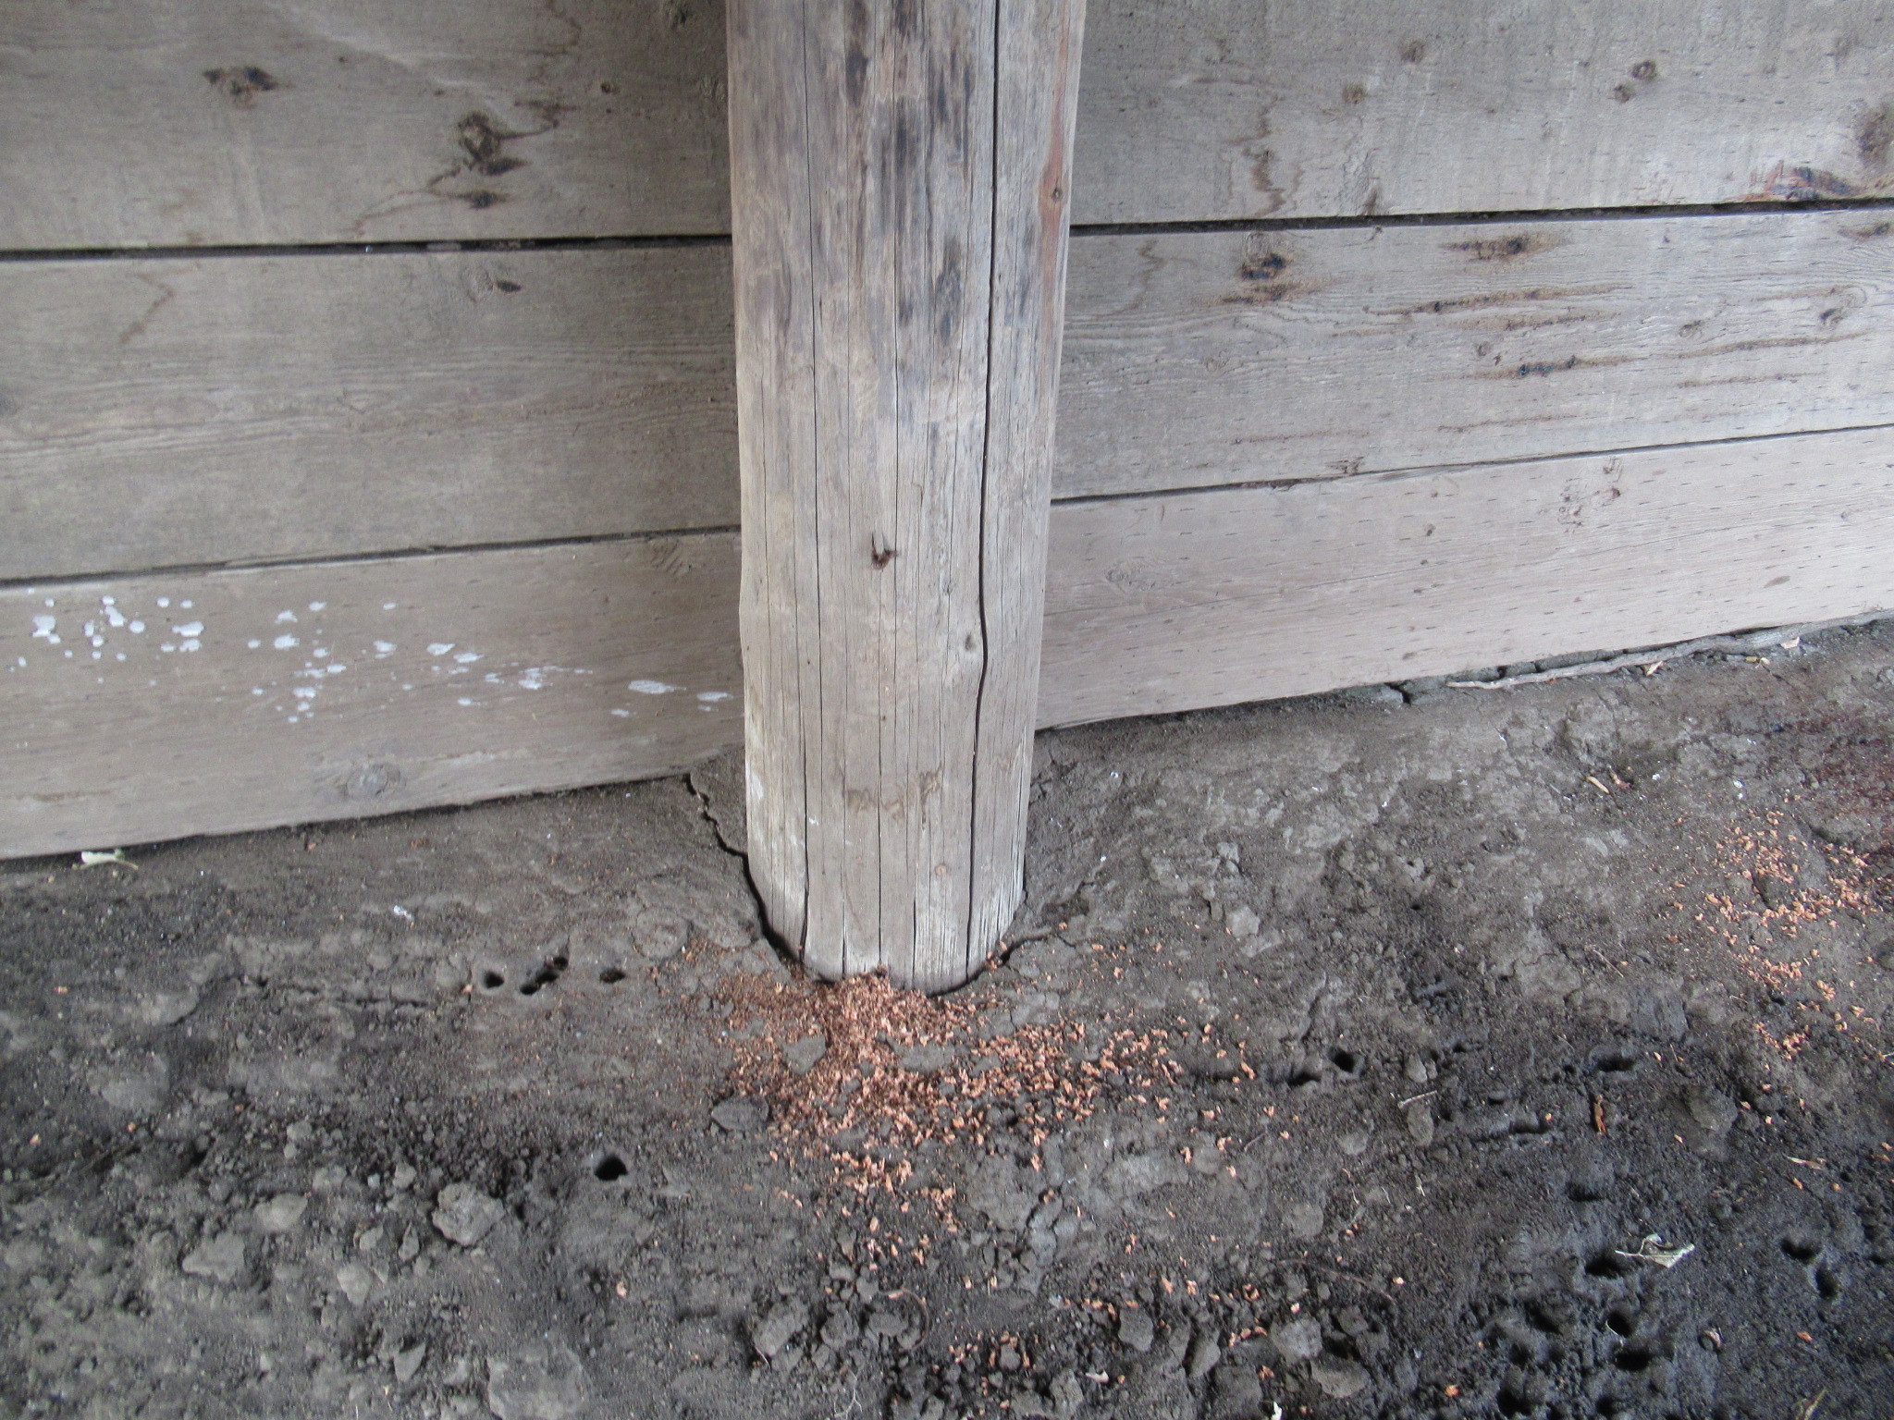
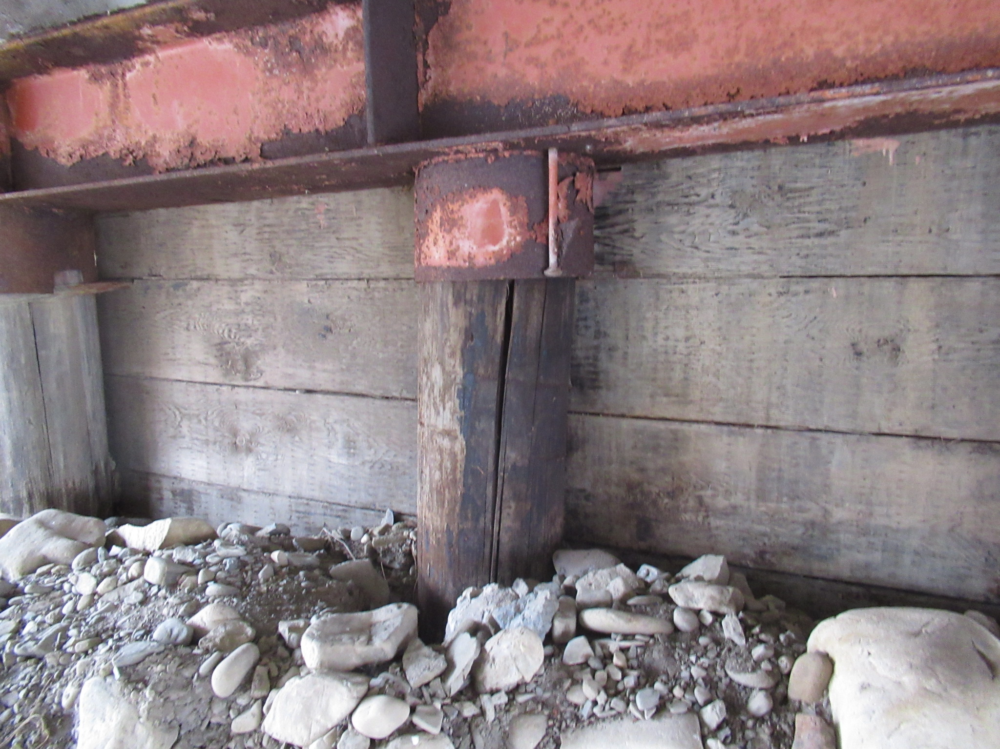
Checks
Occur naturally
Not generally considered a defect in timber
Can be differentiated from cracks by the presence of creosote or other preservatives visible on the inside surface of the check
Cracks that have formed after application of the wood preservative will have not have preservative present at the inside surface.
Notes:
“Checks” are naturally occurring cracks, don’t typically extend full depth, and are typically not considered a defect
Because checks are naturally occurring, its important that inspectors differentiate them from load induced stress cracks.
Because most bridge wood is treated with a preservative that affects color, there should be visual evidence of the preservative within the opening of the check
If non-treated wood is visible within the opening, you are likely dealing with a stress-induced crack

Slide 66
Physical Properties
Compression
perpendicular to grain
parallel to grain
Tension
Bending
Fatigue
Shrinkage
60% radially
2% longitudinally
Notes:
Physical properties of timber include:
Compression
Tension
Bending
Fatigue
And shrinkage (which occurs primarily around the cross-section vs. along its length)
Note that because wood is orthotropic, the capacity of these properties will be different when measured parallel or perpendicular to the grain – thus orientation is very important!

Slide 67
Timber Damage & Deterioration
Decay and fungal growth
Abrasion
Warping
Splits
Wide checks or checks within wet / dry zone of pile (> 25 mm)
Cracking
Flexural
Horizontal Shear
Fire Damage
Collision Damage
Notes:
Common types of timber damage & deterioration include:
Decay and fungal growth (otherwise known as rot)
Abrasion
Warping
Splits
Wide checks
Cracking
and Fire & Collision Damage

Slide 68
Timber Damage & Deterioration
Decay is caused by fungi
Fungi need the following to grow:
Oxygen
Temperature
Moisture
Food (lignin – forms the chief constituent of wood)
Fungal growth will not occur while wood remains submerged under water or buried deep in ground (oxygen depleted environments).
Insects – Pine beetles can be a serious problem in Alberta
Notes:
There's a misconception around rot, which is commonly thought to occur if wood remains wet
Rather, rot requires specific moisture, temperature, and oxygen conditions to promote fungal growth in the wood tissue. Once alive, the fungi then feeds on the wood fibers, causing rot.
Therefore, rot actually won’t occur while wood remains submerged under water or buried deep in the ground because these are oxygen depleted environments.
Insects, such as pine beetles, can also cause serious damage in Alberta.

Slide 69
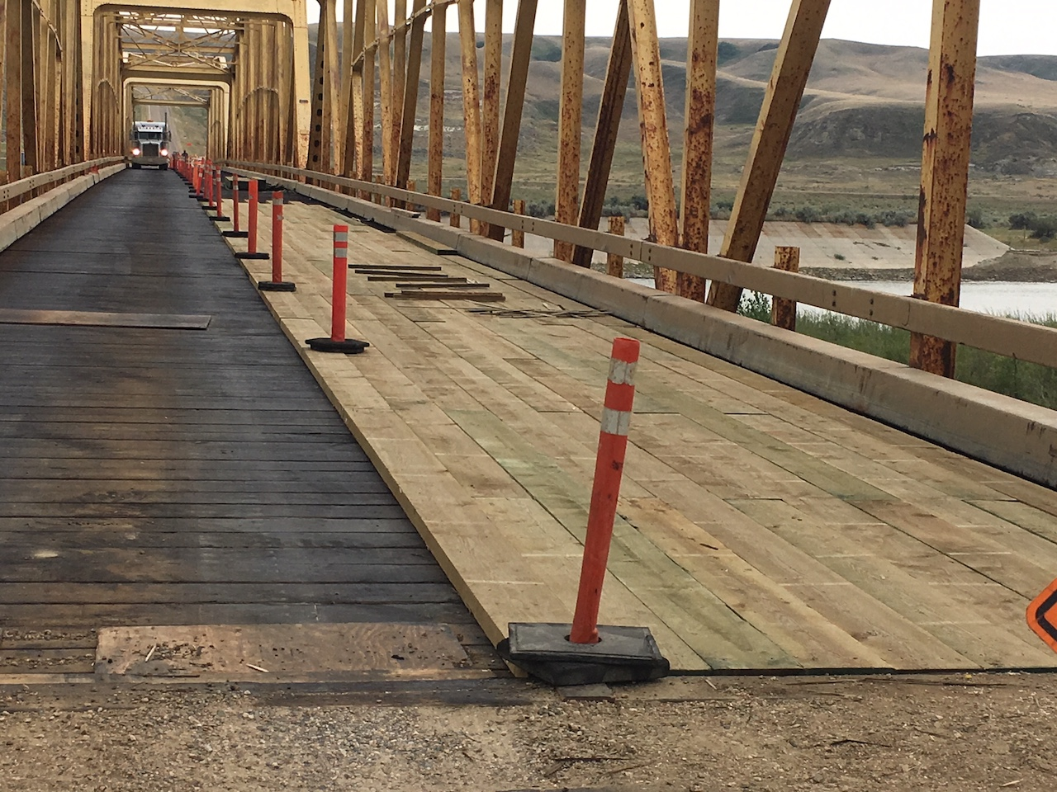
Protective Systems
Water repellents
Preservatives
Creosote
Chromated Copper Arsenate (CCA) – green color
Alkaline Copper Quaternary (ACQ) – brown color
Ammoniacal Copper Zinc Arsenate (ACZA)
Paint
Notes:
Now for timber elements to provide meaningful service lives in our elements, preservatives are often required.
The most common preservative in AB is creosote (byproduct of oil and gas production)
Chromate Copper Arsenate is the 2nd most popular and can be distinguished by its greenish color.
Paint is also an option, but doesn’t last nearly as long as impregnated preservatives

Slide 70
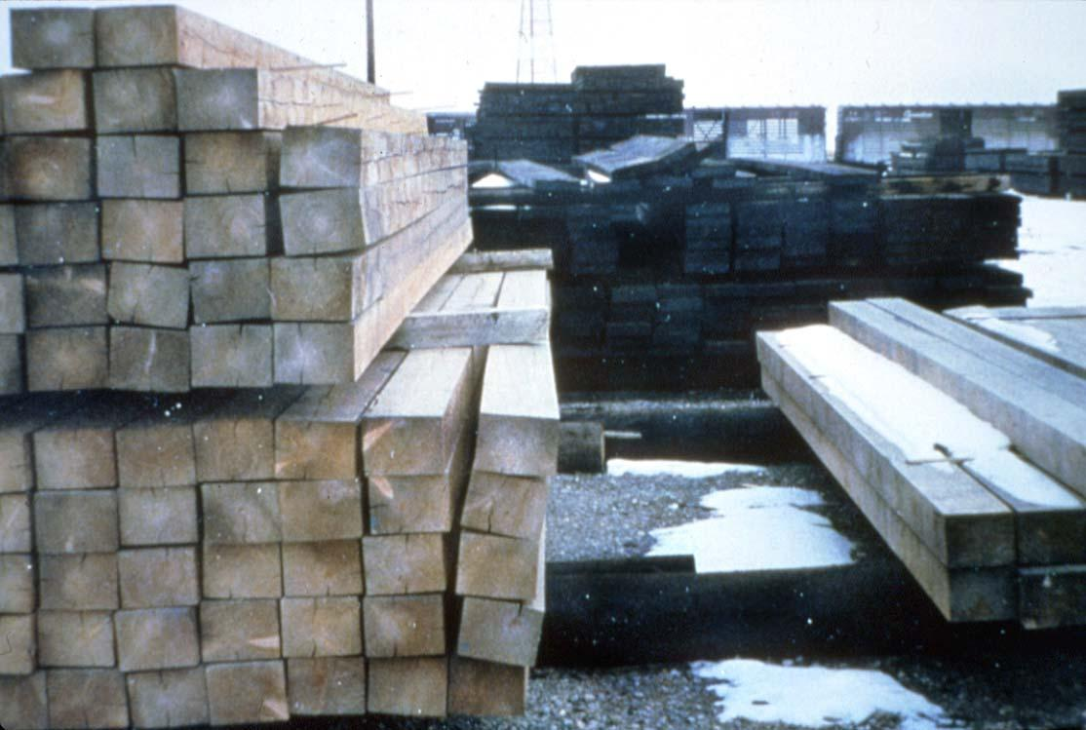
Warping due to Drying Shrinkage
Notes:
Here is an example photo of warping due to drying shrinkage (as the wood shrinks radially, checks begin to form, which can be seen here)

Slide 71
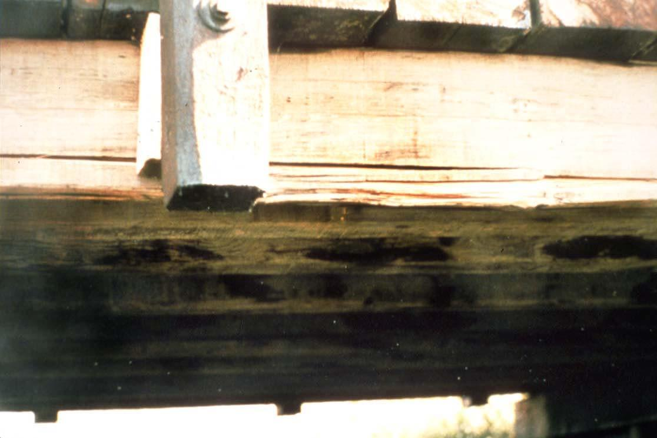
Horizontal Shear Crack.
Notes:
This is an example of a horizontal shear crack

Slide 72
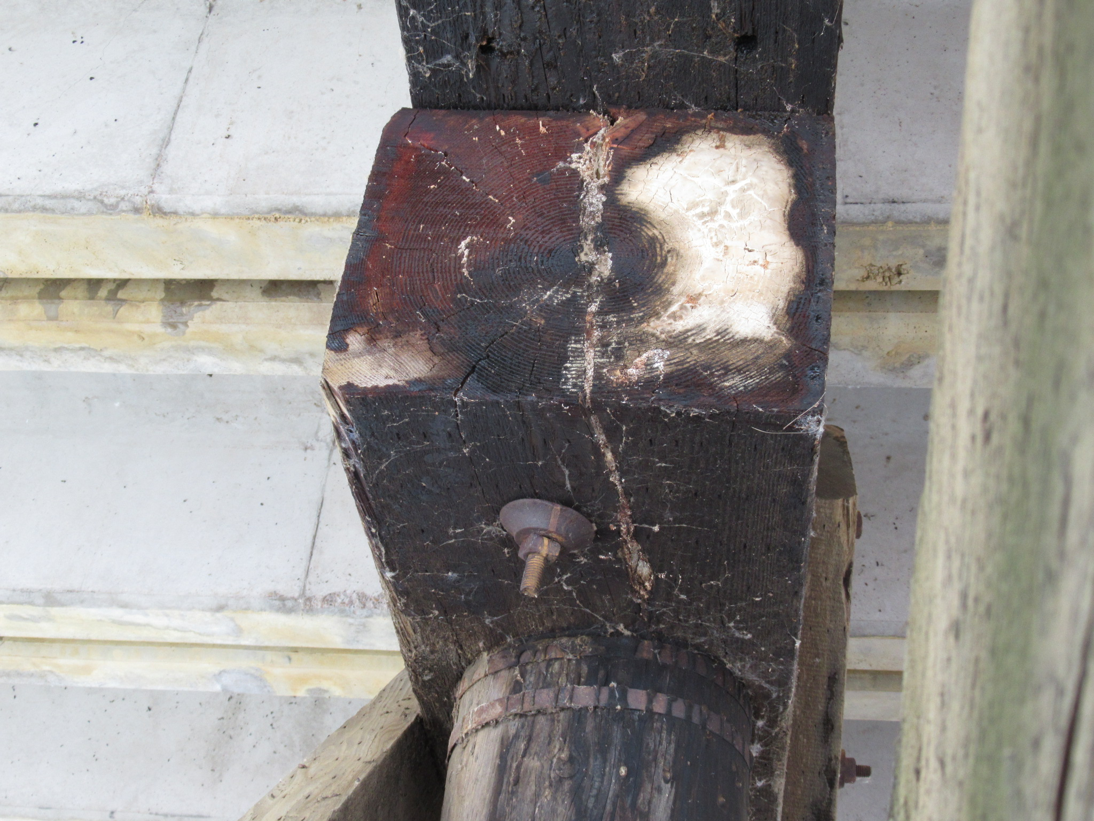
Fungal Growth and Beginning Rot
Notes:
And this is an example of fungal growth and the early stages of rot

Slide 73
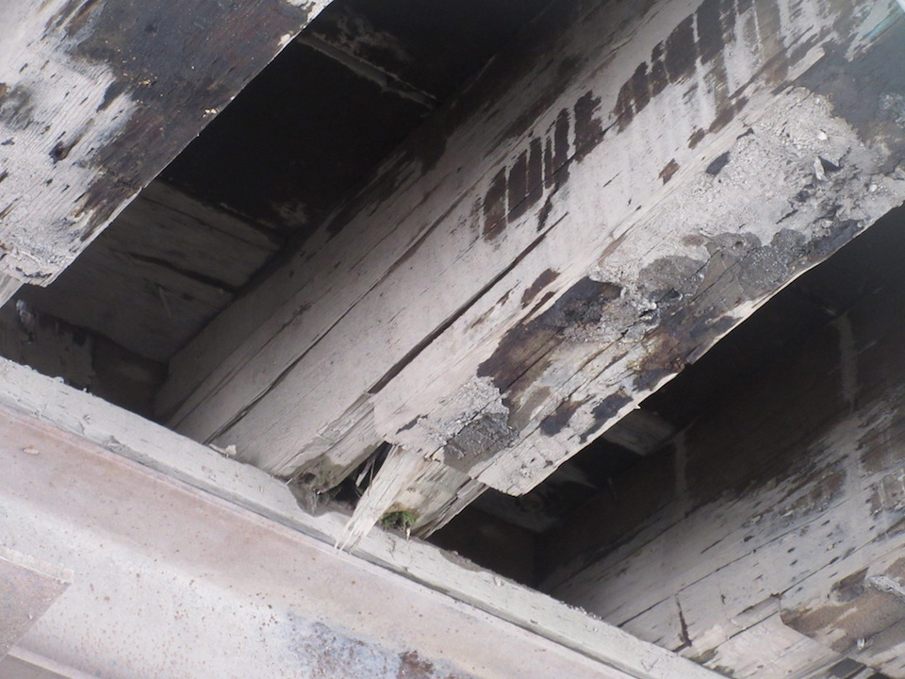
Rot in Stringer End
Notes:
Here we have another example of rot at the end of a stringer

Slide 74
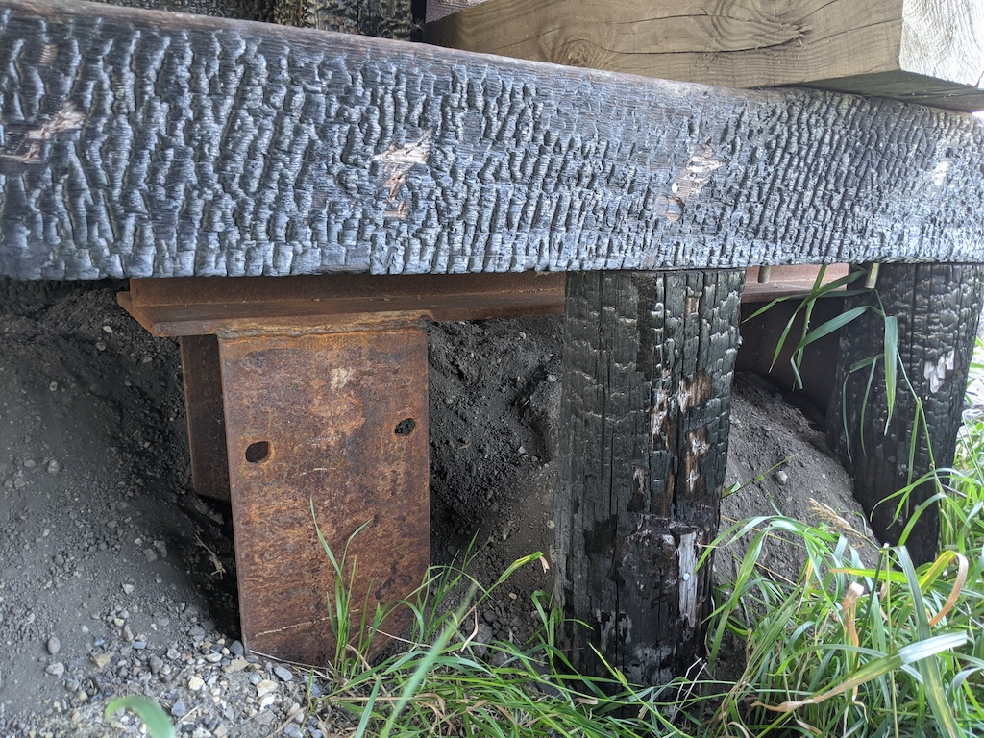
Fire Damaged Timber
Notes:
And finally we see some fire damage along a pier cap

Slide 75
Questions?

