Slide 1
Bridge Engineering Section
Functional Planning
Bridge Management
Bridge Inspection
& Maintenance
New
New Bridge or Existing?
Existing
Bridge Assessment
Replace
Repair or Replace?
Repair
New Design
Rehabilitation
Design
Conceptual
Design
Detailed Design
Tender Preparation
and Advertisement
Construction
Notes:
Key Messages:

Slide 2
Bridge Engineering Section
Functional Planning
Bridge Management
Bridge Inspection
& Maintenance
New
New Bridge or Existing?
Existing
Bridge Assessment
Replace
Repair or Replace?
Repair
New Design
Rehabilitation
Design
Conceptual
Design
Detailed Design
Tender Preparation
and Advertisement
Construction
Notes:
Key Messages:

Slide 3
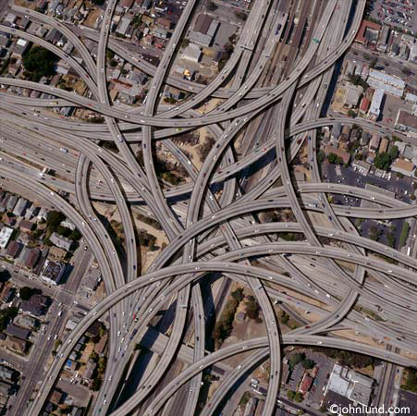
Conceptual Design
Why?
What?
How?
Notes:
Why: Some sites very complex
All sites are unique
Without coordination can end up with bridge to nowhere (Alaska ran out of $)
What: scope/process
aka bridge planning (don’t confuse with FPS) aka preliminary engineering
How: AT guidelines, tools, data

Slide 4
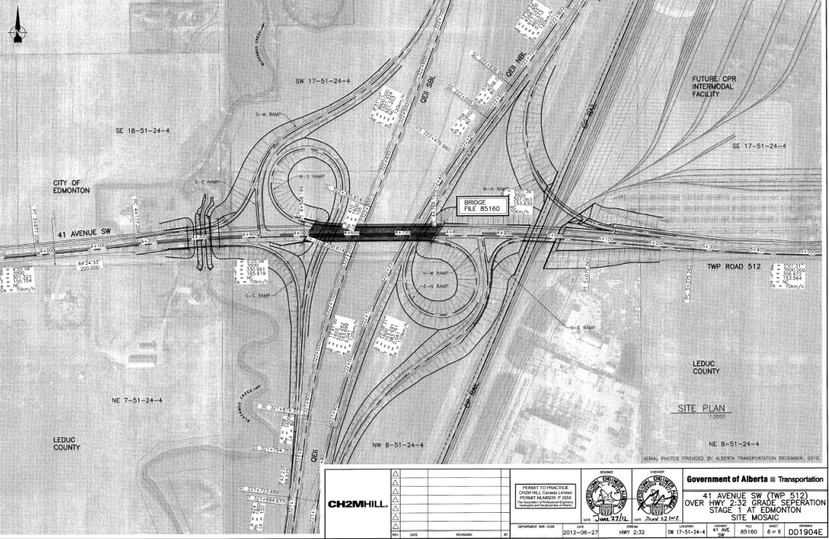
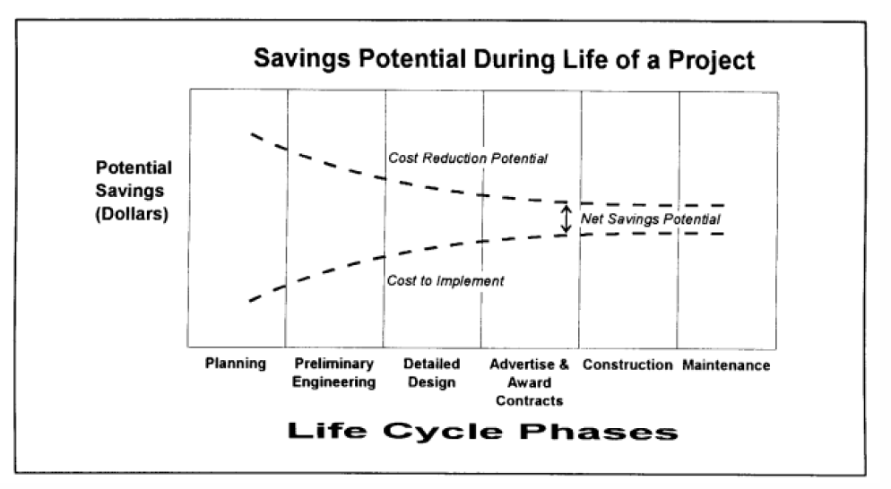
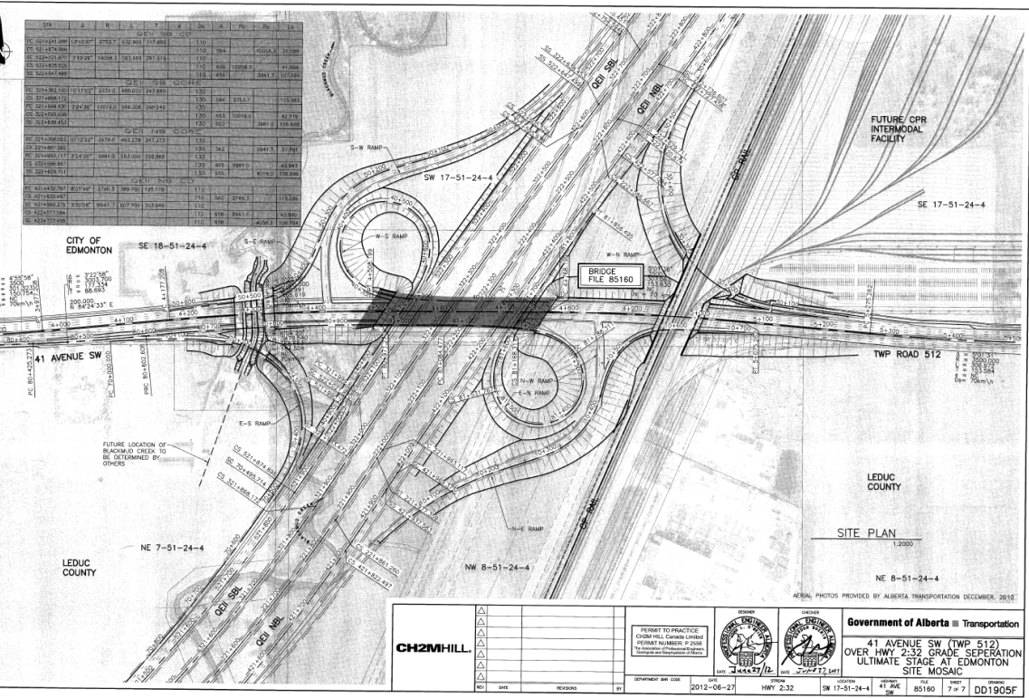
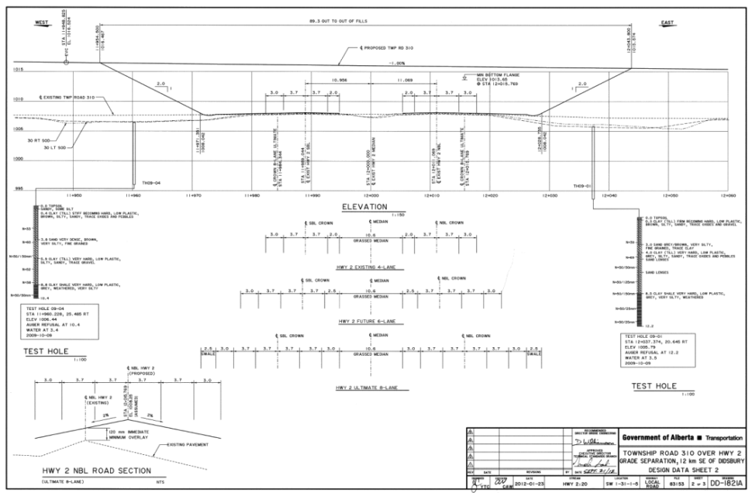
Conceptual Design
Why?
Notes:
-easiest time to make changes and find savings (vs detailed design or construction)
-life of 100 years; design considers short and long term (vs road design ~30yrs)
-high cost vs roads (limited budgets, rehab popular)
-examples – road crossfall change
- realigned Hwy 2, RoW limits/grading/minimize throw away required for ultimate

Slide 5
Conceptual Design
Why?
+/-
$
Notes:
-identify potential constraints upfront
-consult with appropriate specialized areas
-typically coordinates and brings together other areas (geotech, structural, enviro (fish, birds, trees, contaminants), utilities, historical, roadway)
-optimize all constraints, known and foreseeable to the lifespan of the structure
-pros and cons, costs (now and lifecycle)

Slide 6
Conceptual Design
What?
Develop an optimal solution for a roadway to cross a watercourse, another roadway, or railway
Notes:
-bridge opening that will work for the lifespan of bridge
-link between FPS and detailed design
-pass on info to detailed design to fill in opening
-still some room for flexibilty (assumed span lengths/depths), small changes to gradelines

Slide 7
Conceptual Design
What?
Notes:
-gradeline, Horozontal, vertical
-Roadway design knowledge (k values, grades, road classifications)
-Bridge design knowledge (freeboard, bridge gradients, deck drainage)
-River knowledge (how mobile laterally, design highwater/velocity, detailed design of RPWs)
-Other (geotechnical – benches, shallower headslopes, environmental -fish, construction – berms, pier placement)
-define an opening for structure to fit
-images from BPG tool and GIS (global mapper)

Slide 8
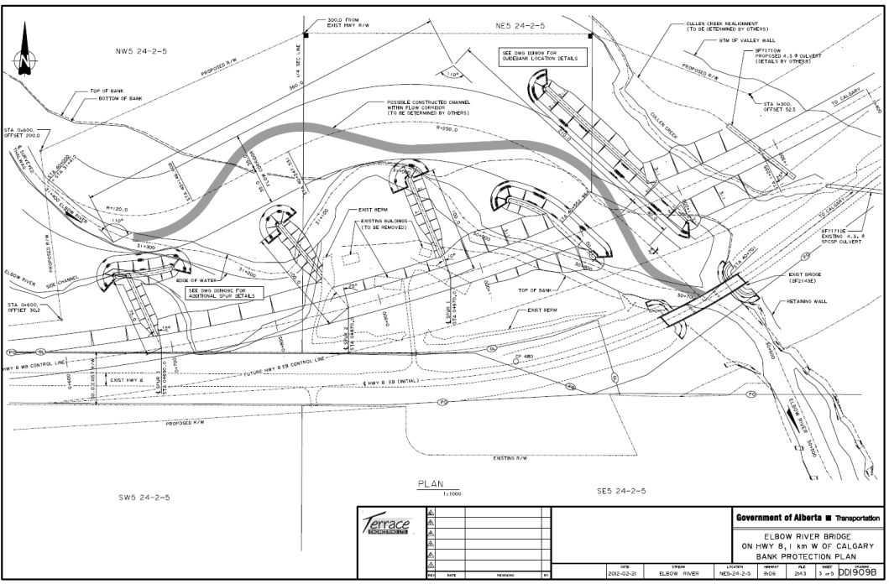
Conceptual Design
What?
Notes:
-involvement in FPS
-bridge location studies
-bridge assessments (new vs rehab, hydrotechnical input)
-bridge rehab (river engineering)
-detailed design of RPWs
-drainage and stormwater management

Slide 9
Conceptual Design
Resources
Notes:
Main document
New and consolidates old documents like hydrotechnical design guidelines
Describes process, commentary, methodology, tools

Slide 10
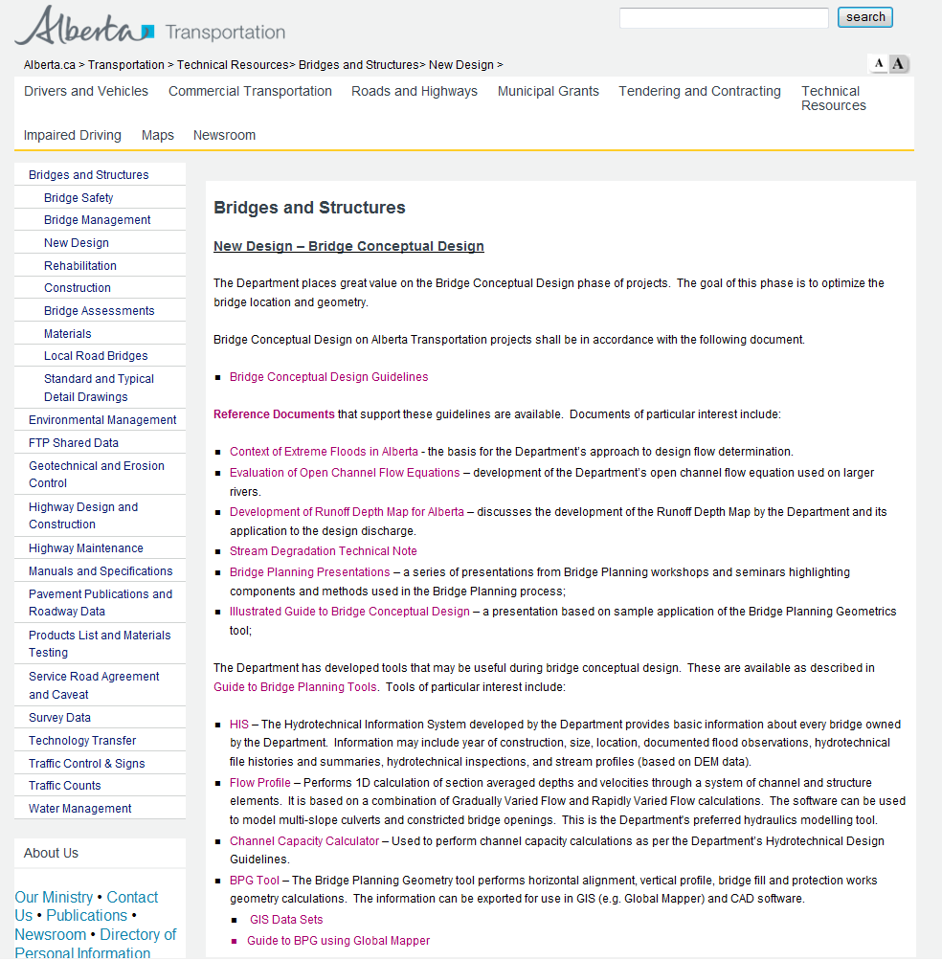
Conceptual Design
Resources
Notes:
Other reference documents online
-why we don’t do detailed modelling, rationale for our hydrotechnical guidelines
HIS database
Other tools – channel capacity, BPG
Presentations from previous workshops

Slide 11
Conceptual Design
QUESTIONS?
Ernie.Waschuk@gov.ab.ca
780-415-1014
Caroline.Watt@gov.ab.ca
780-415-1013
Notes:
Key Messages:
-what, why, how
-Coordinate a plan that works with site constraints
-develop an optimal solution – savings in initial phases,
-Develop a bridge opening for the structural design to fit into
-References, tools

