Slide 1

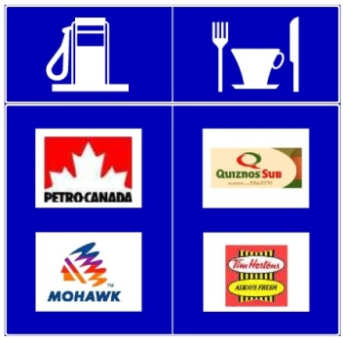

Basic Knowledge
Seminars
Traffic Engineering
Highway Operations

Slide 2
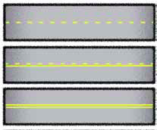
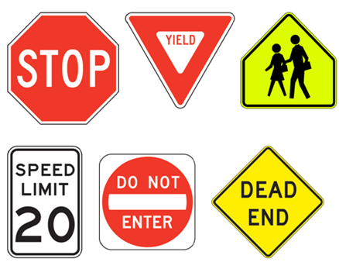
Traffic Engineering
Develop and Refine Standards and specifications regarding Signs, Traffic Signals, Lighting, and Pavement Markings. Answer any questions related to this area
Maintain the Traffic Signal System Application (TSSA) and the Railway Crossing Inventory Application (RCIA)
Do final technical review for Speed Amendment Process

Slide 3
Why Standards…..why are we so picky… we’re all professionals here
Well, sometimes we need a reminder

Slide 4
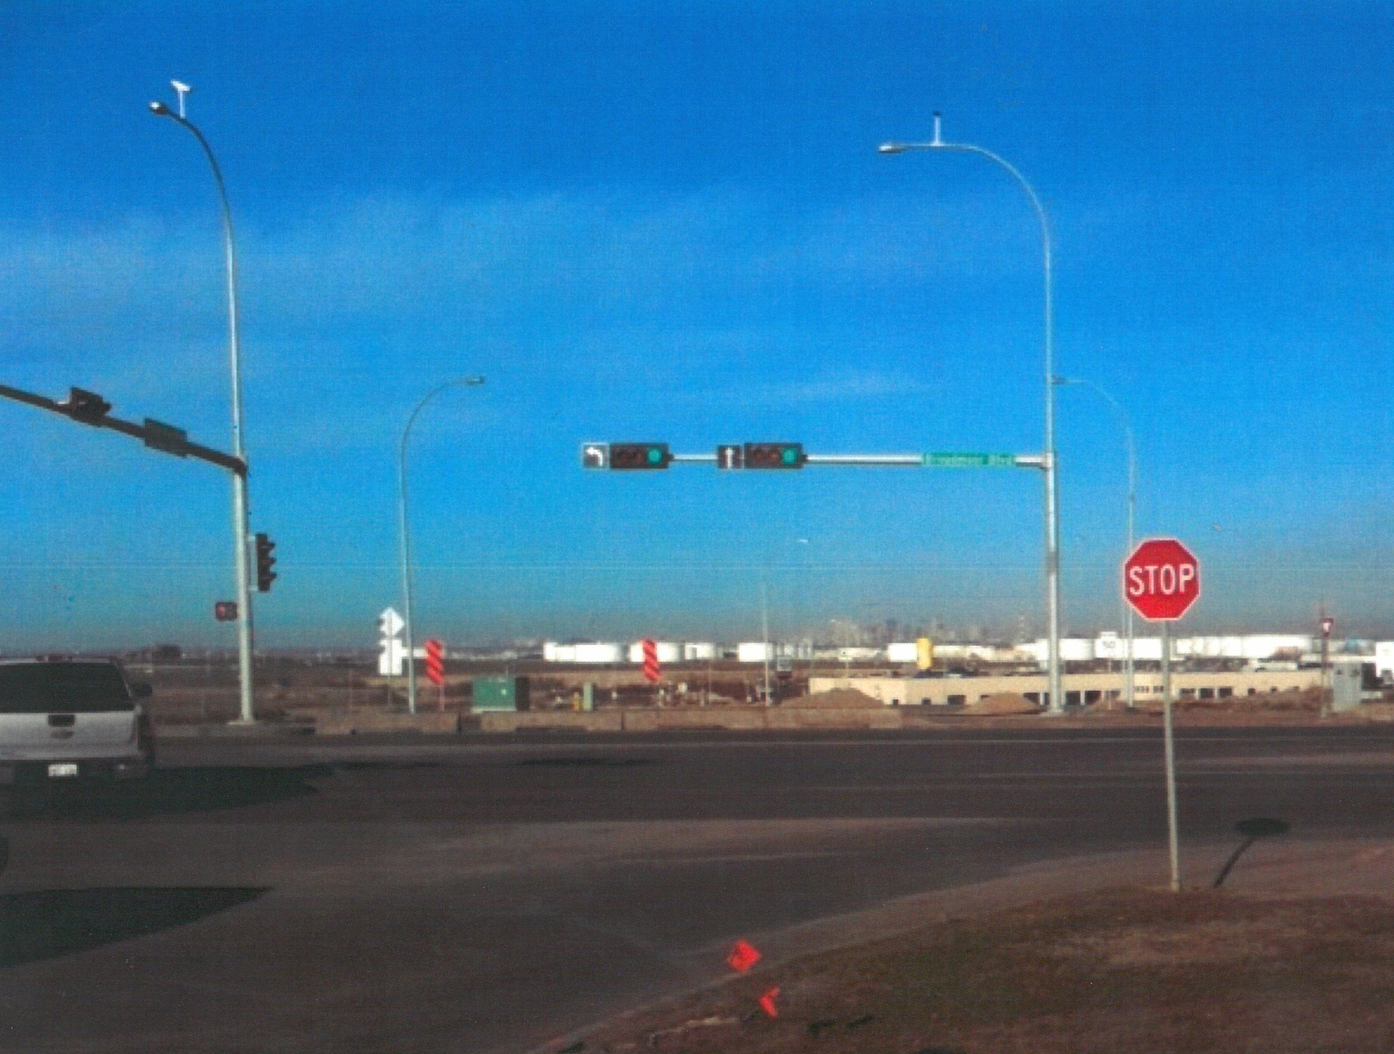
Anyone see the potential for a collision here?

Slide 5
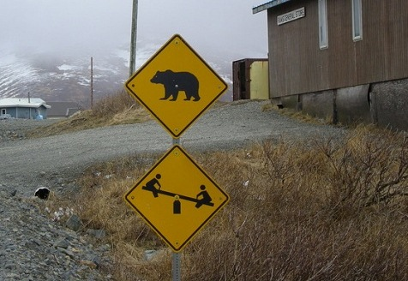
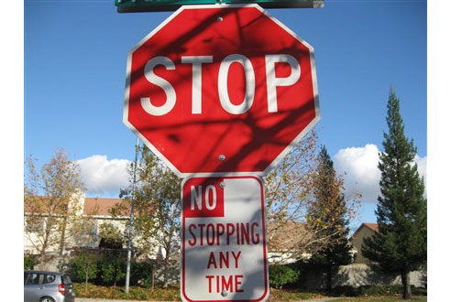
Bad Planning
ONLY ONE MESSAGE PER POST
Engineered Confusion

Slide 6
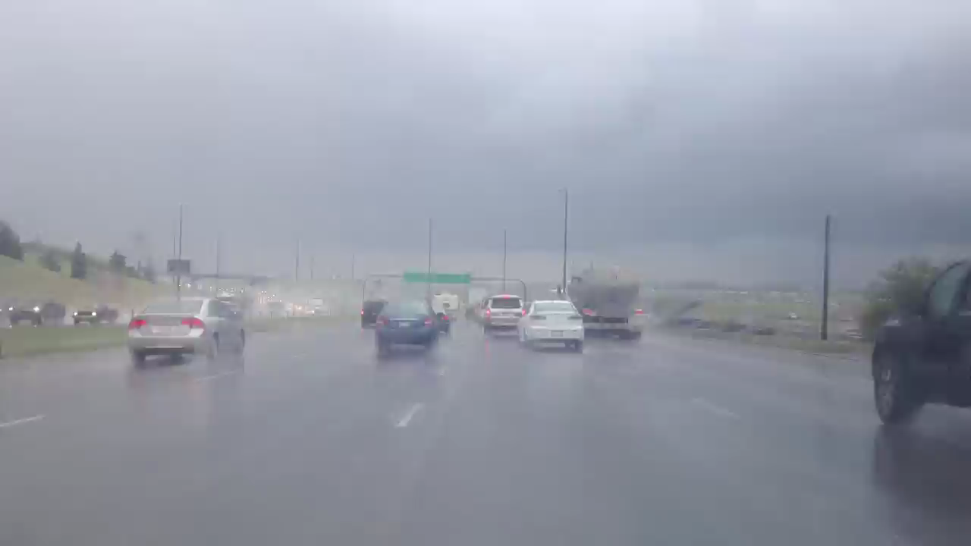
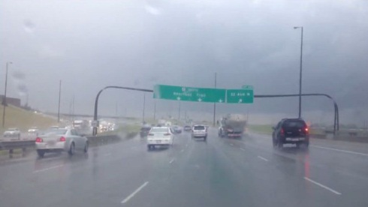

Slide 7
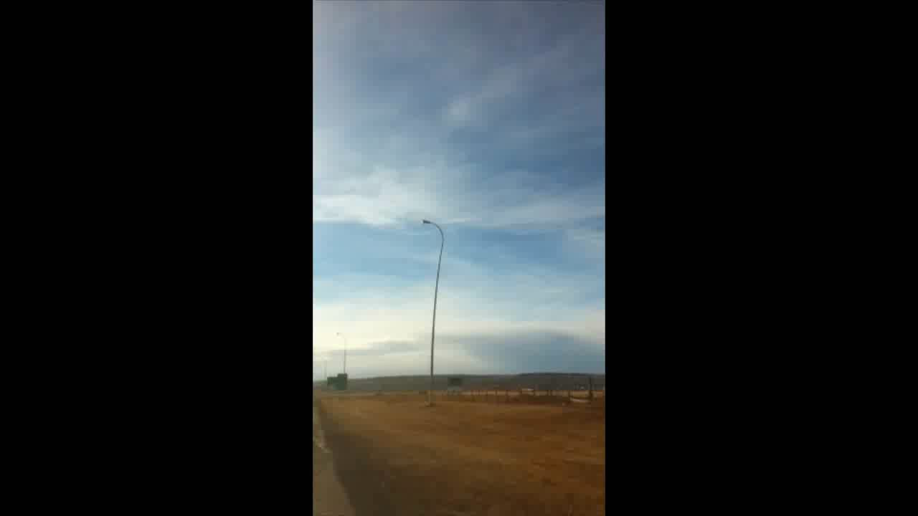

Slide 8
TSSA ?
RCIA ?

Slide 9

W T F

Slide 10
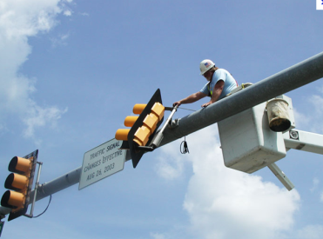

Traffic Signal System Application (TSSA)
Allows tracking of our signal inventory and maintenance
Allows Alberta Transportation to streamline maintenance
Fully updated inventory this year
Notes:
TSSA was meant to work with Traffic signal inspectors, regional budgetting and maintenance contractors
We prefer that all Traffic signal work be circulated through the operations section
---------(because, signals are meant to resolve operational issues, signals can be very complicated and poorly set up signals can have a detrimental effect on operations)------
This will allow operations staff to access traffic signal information in their region in a few minutes from any computer with internet access
------------(not optimized for smart phones).-----------
.

Slide 11
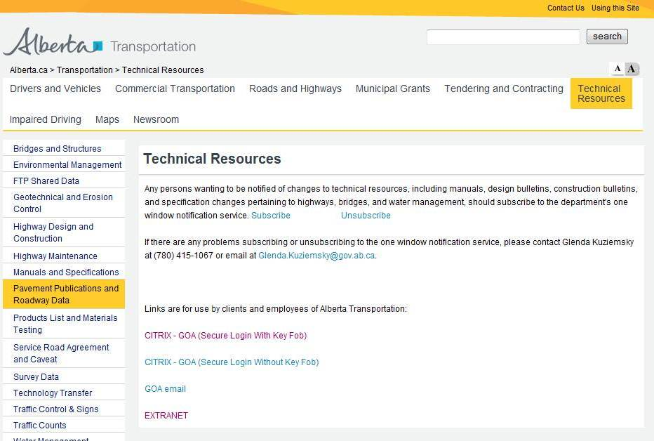

Slide 12
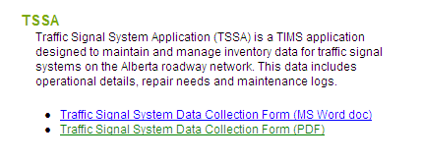
Traffic Signal System Application
And extranet page:
Notes:
Data Collection sheet has signal location and stakeholders, timing, and equipment

Slide 13
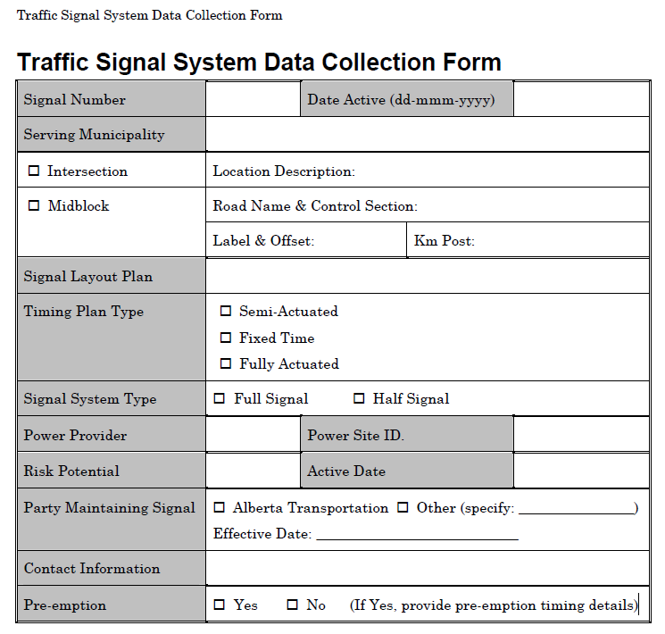

Slide 14
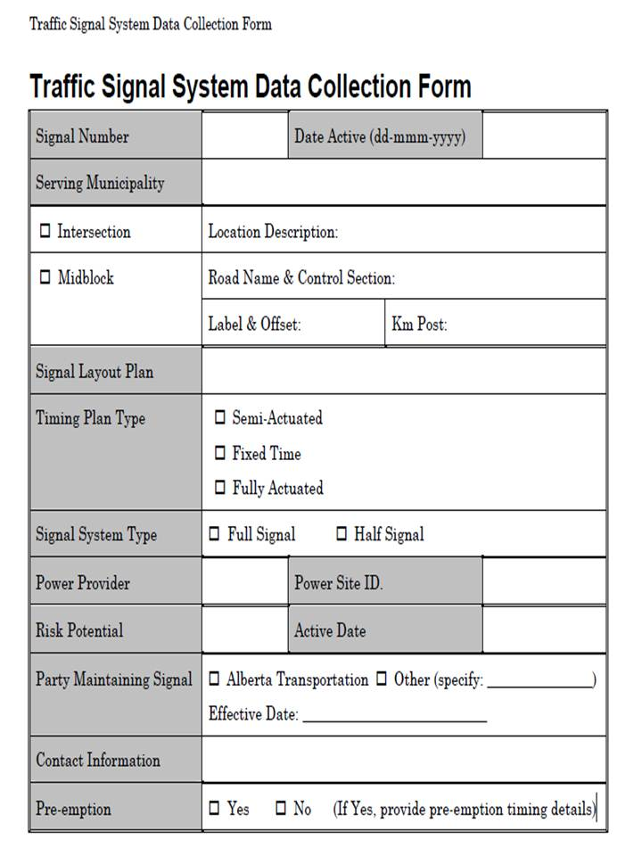
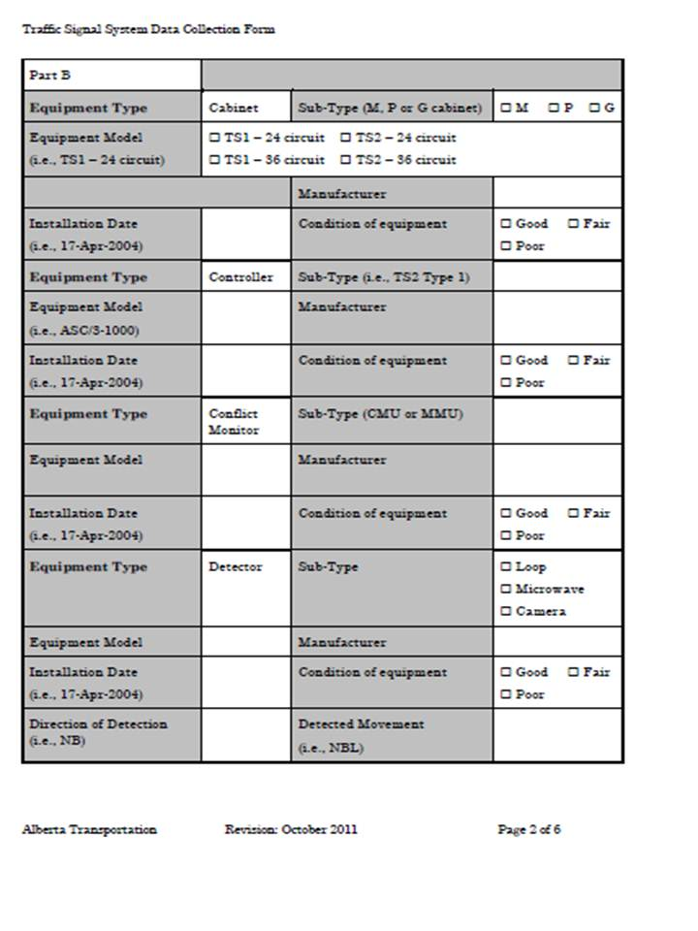

Slide 15
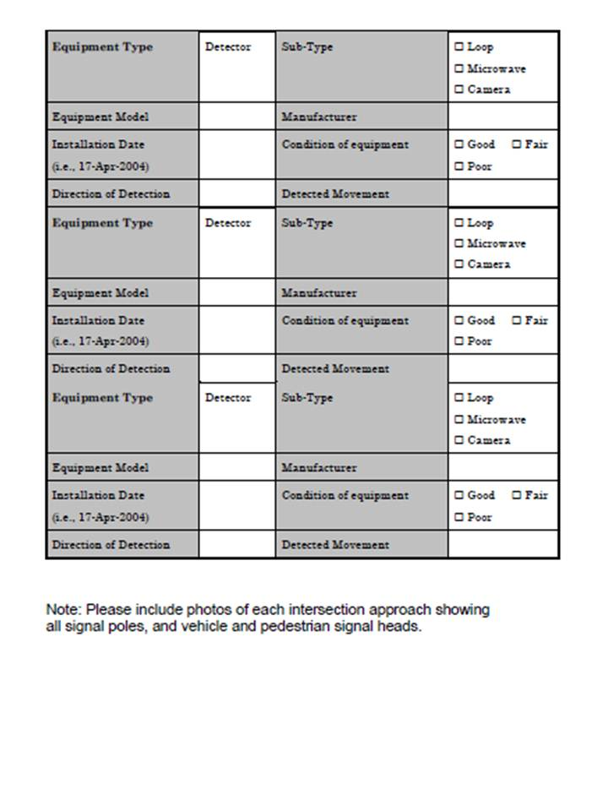
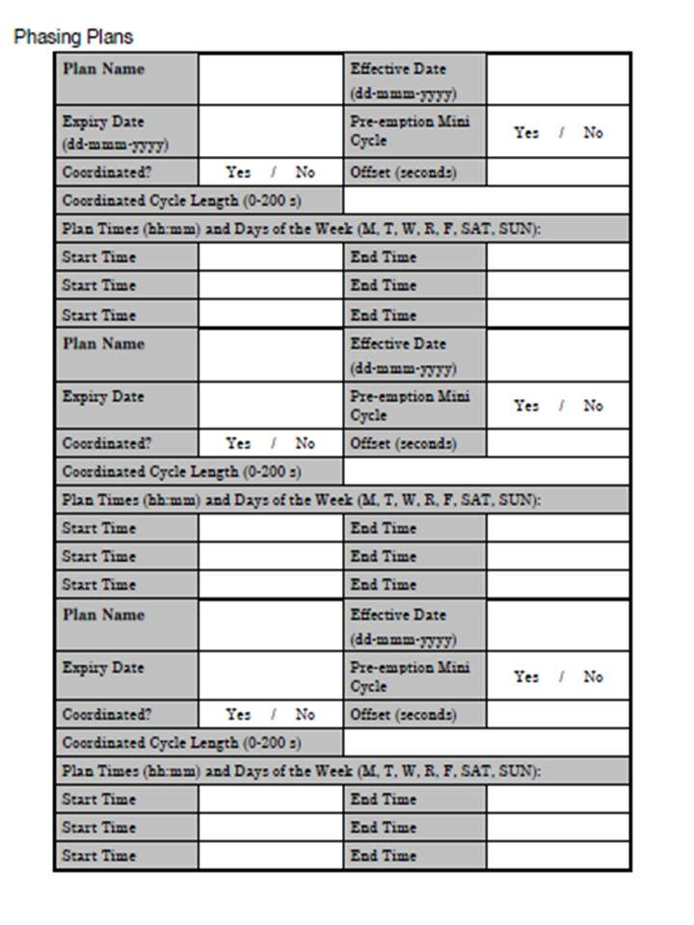

Slide 16
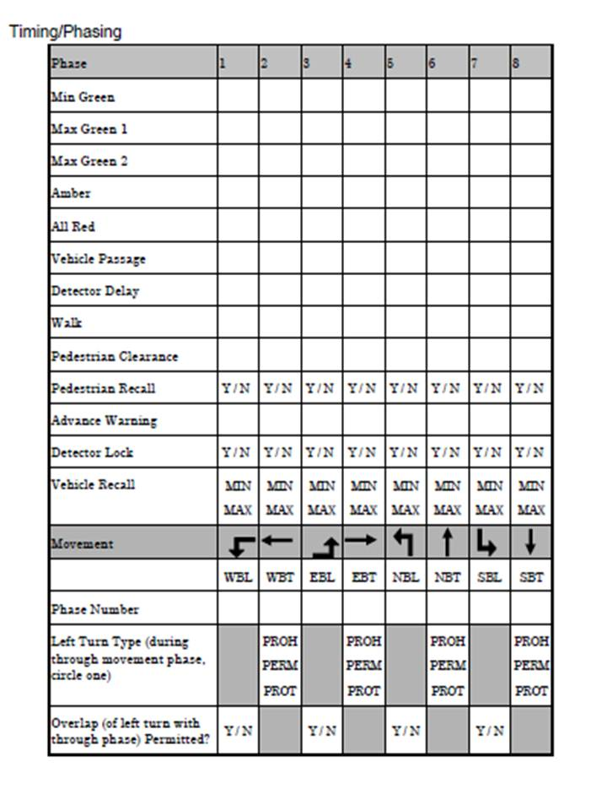
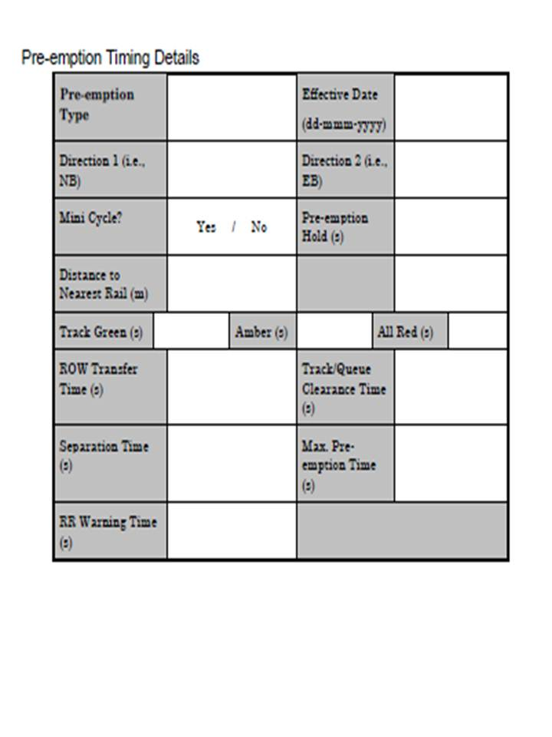

Slide 17
Railway Crossing Inventory Application (RCIA)
Allows tracking of inventory, maintenance and cost sharing. Check with us first.
This is in preparation for the eventual release of the Canadian Railway-Roadway Grade Crossings Standards (CRRGCS)
If you do work that involves any changes to a crossing, please let us know and please send all official documentation into Technical Standards Branch- Highway Operations Section.

Slide 18
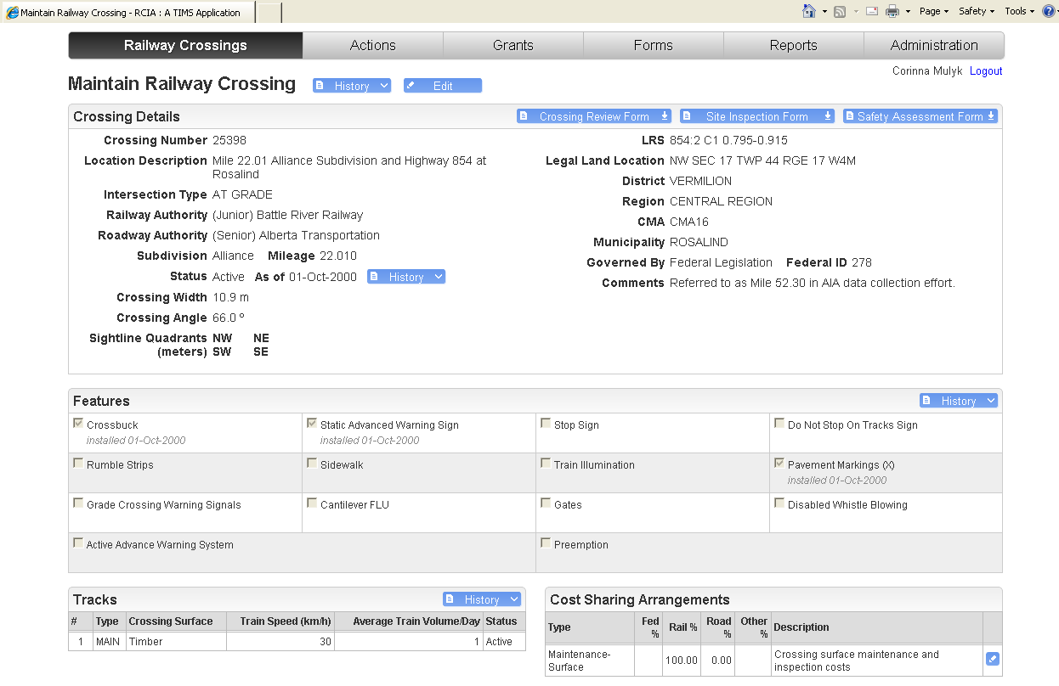

Slide 19
LEDs
Light Emitting Diode
(Highway Lighting)

Slide 20
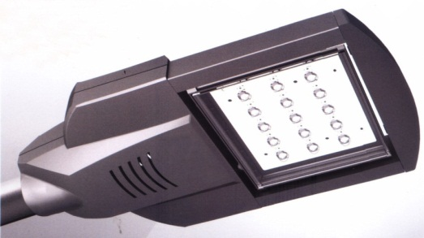
LED Lighting
Why the heck aren’t we using these already?!!?
LED Highway Lighting is still a developing technology and the industry has hundreds of different competitors. The technology is varied and much more complex than the old standard High Pressure Sodium (HPS) lighting (mature technology)
We use 13-15m poles while cities use 7-11m poles commonly (The more powerful LEDs have only been around for 3 years)
Notes:
Through the P3 process a number of new lighting systems were introduced. Some concerns developed regarding design quality and applicability of products for lighting.

Slide 24
Where Are We At?
Pilot done on Delineation Lighting-not overly successful.
Our group and our innovations section will be working with a new spec for evaluations of LED Streetlight product submissions.
Short trials will be followed with limited applications to low risk sites.

Slide 25
So, if you don’t like standards? You can just stick with lucky

Slide 26


Slide 27
Questions?

Slide 28
If you have questions or concerns about
any of these matters,
Contact Blair Knott
blair.knott@gov.ab.ca
Or call
780-415-1140

