Slide 1
Hydrotechnical Design and Fish Passage Considerations
AT-DFO Committee
July 2022

Slide 2
Overview
Hydrotechnical Design Basics
Culvert Sizing
Fish Passage

Slide 3
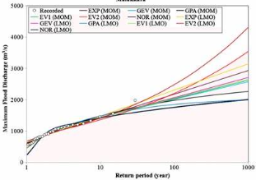
Hydrotechnical Design
Component | Governs | % System
Channel Capacity | Most channels | > 80%
Historic Highwater | Large streams | ~ 10%
Runoff Potential | Small basins | < 5%
*since ~2001
Notes:
HDG:
Established in 2001
3 components
Examples provided for > 1500 bridge sites in HIS
Historic HWM seldom >> Qcc, usually confirms
Runoff Potential – seldom governs, important when it does

Slide 4
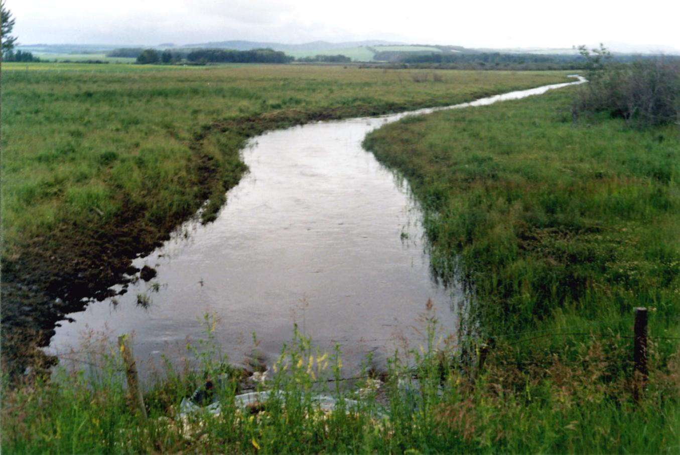
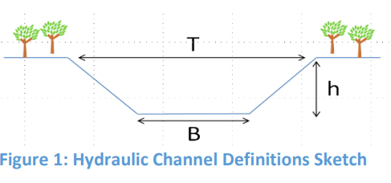
Channel Capacity
Notes:
Physics:
Most channels have trapezoidal shape up to bankfull
Beyond this level, much of water goes into storage
Does runoff make the channel or does channel control the runoff? - Yes

Slide 5
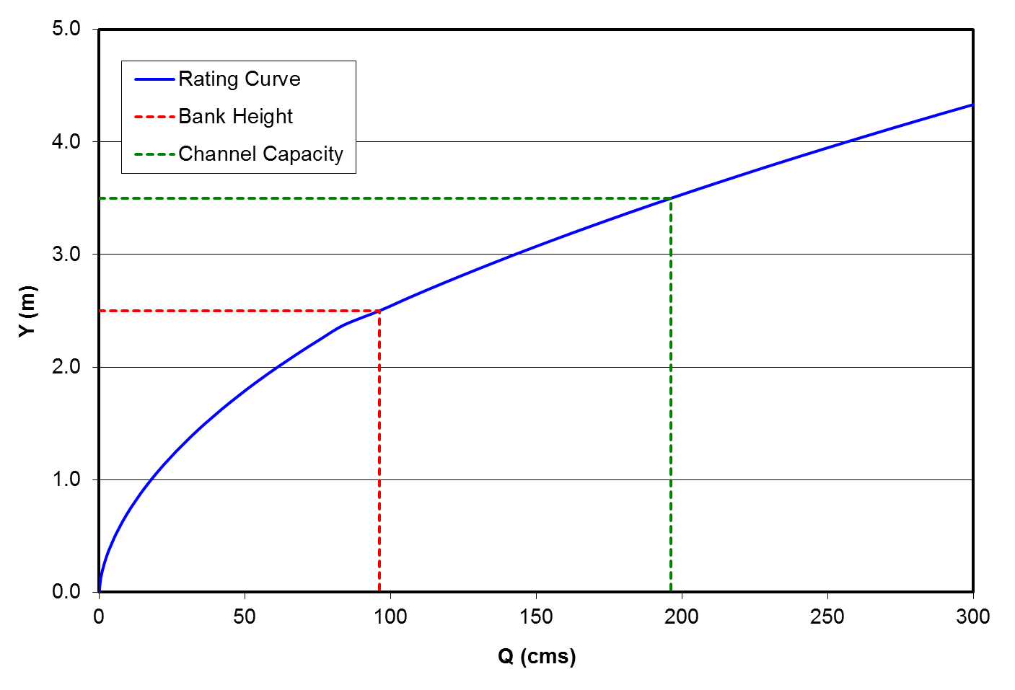
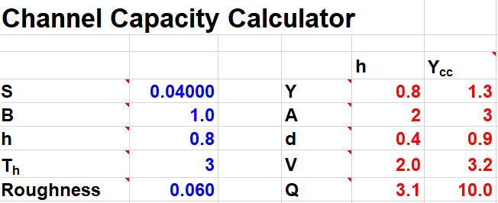
Channel Capacity
Notes:
Typical Rating Curve:
Qcc >> Qh
Increase in A and V due to increase in Y

Slide 6
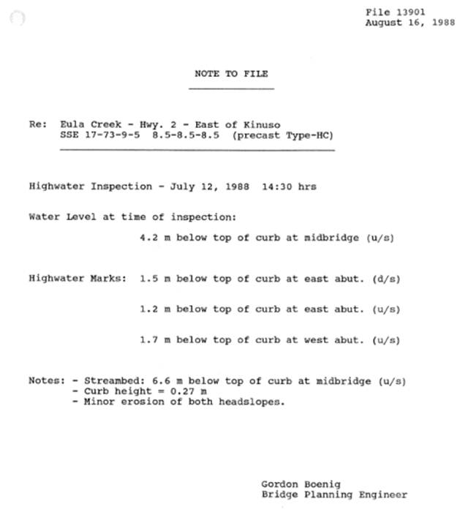
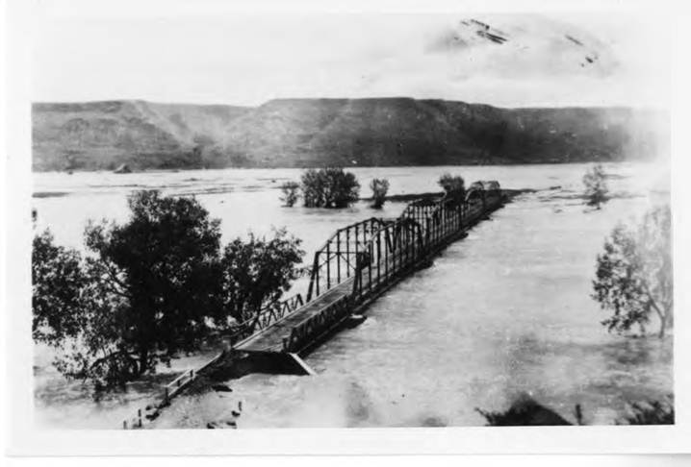
Historic Highwater
*HIS database on GOA website
Notes:
AT Records:
Access in HIS
Flood records and file histories
> 4000 event-site combinations – flood records
Photos, measurements
Look u/s and d/s for more coverage

Slide 7
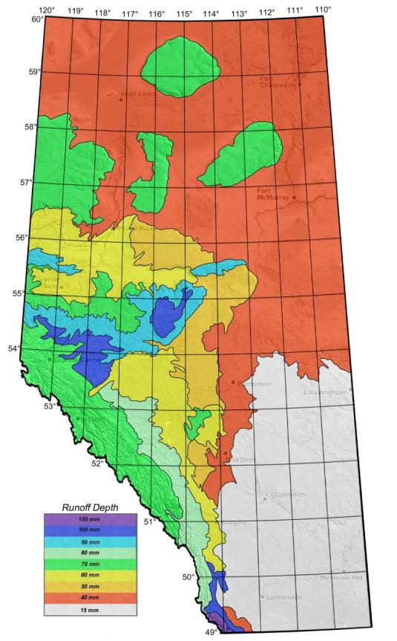
Basin Runoff Potential
~3000 events analyzed across Province
Qbrp = unit runoff rate X drainage area
Notes:
Basin Runoff Potential
Upper bound check – ability of basin to supply water if routing was not a constraint
Analysis of >3000 runoff events at WSC gauges
Geographic assignment based on envelope curves for distinct hydrologic districts
Map created for design use

Slide 8
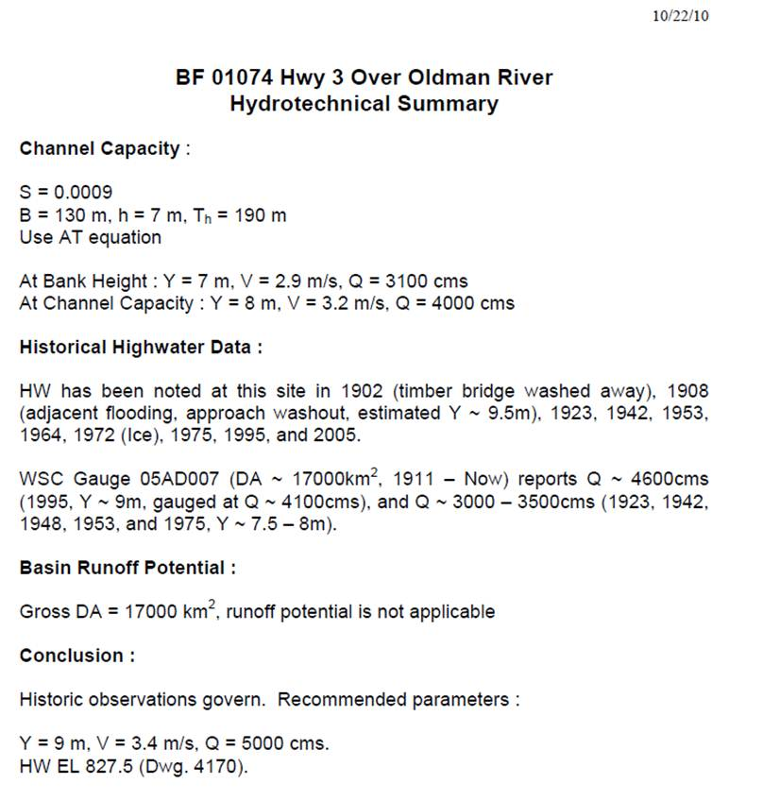
Hydrotechnical Summary
~1500 in HIS
Notes:
Putting it all together:
Hydrotechnical summaries published for >1500 bridges (most of the big ones)
Combine 3 components to one set of parameters

Slide 9
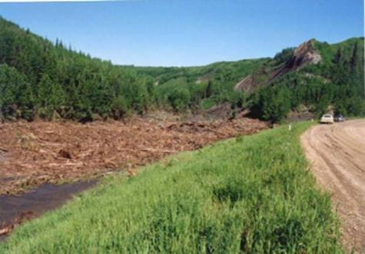
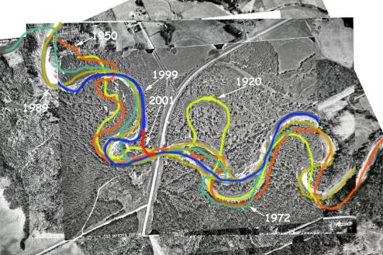
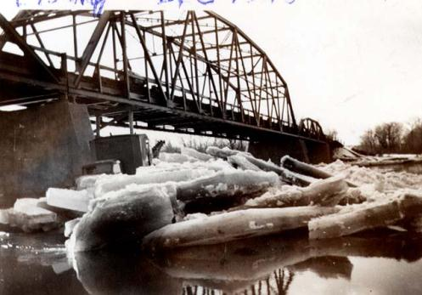
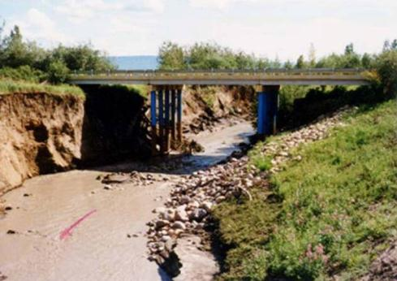
Other Considerations
Notes:
Don’t be too precise:
Drift
Ice
Alignment changes
Channel changes

Slide 10
Channel Hydraulics

Slide 11
Natural Channel Flow
Q = VA
Y
Water surface
S
1
Streambed
V = 14 Y^{0.67} S^{0.4}
Notes:
Water surface is parallel to the streambed; velocity related to

Slide 12
Flow = Velocity *Area
If area ; velocity
Undersized
Oversized
Right Sized
Notes:
Relationship between V and A; issues with too small and too big
Goal to have structure similar to natural channel
Need to do hydraulic calculations to evaluate sizing options

Slide 13
ROAD
EMBANKMENT
CULVERT
Velocity lines: tighter = faster
Notes:
Exaggerated view of constricted opening in plan view:
Contraction of flow u/s – relatively efficient.
High velocity through culvert.
Expansion of flow d/s, less efficient, eddies.

Slide 14
Historically…
Gradually varied flow
Rapidly varied flow
Normal
Water surface
S
Culvert
1
Streambed
Undersized and perched culvert

Slide 15
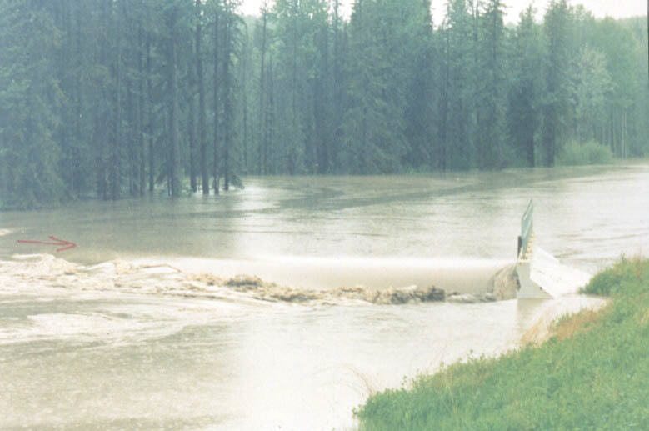
Notes:
Inlet – relatively smooth transition

Slide 16
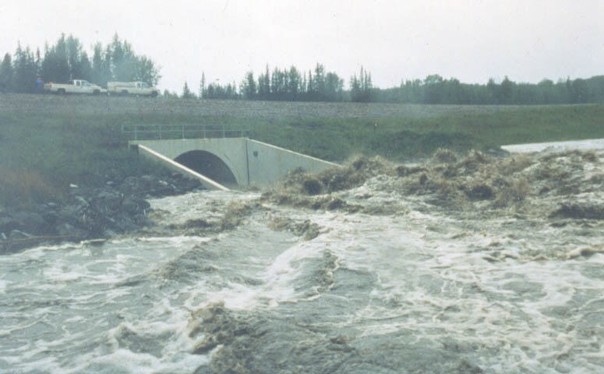
Notes:
Outlet – rough transition

Slide 17
Current Practice
Freeboard
D/S Channel
Transition
*Design Flow conditions
Notes:
D/s Channel – often normal flow : Sf = So (balance gravity with resistance)
D/S Transition – Adverse flow profile due to burial
Outlet – RVF due to expansion of flow (headloss over short distance, different shape of flow, ~ V2)
Barrel – usually GVF due to BW from burial, may approach normal flow, may have jump, may be full or partial full flow
Inlet – RVF due to contraction of flow (change in shape, less headloss than expansion)
U/S Transition – steep slope due to burial but rough due to rock, too short to form predictable profile
U/S Channel – usually GVF (due to accumulated headloss), approaching normal flow some distance u/s (length varies inversely with slope)

Slide 18
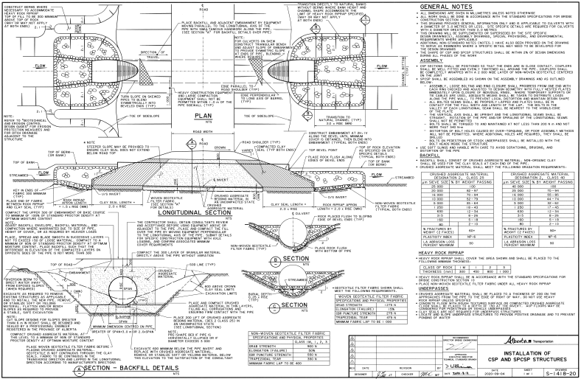
Overview Hydraulic Sizing:
Complex hydraulics – need modelling
Comparable to natural channel
Other parameters - road design, geotechnical, drift, ice, future needs, wildlife, fish passage*)
Consider options, assess pros/cons/risks
*Bridge Conceptual Design Guidelines

Slide 19
Fish Passage

Slide 20
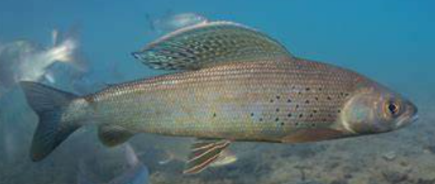
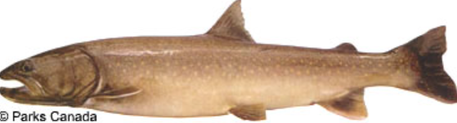
Fish Passage - A Brief History
3Q10
  Wait 3 days, ok to not pass 1/10 years
  First used in 1979, Alaska study w/ Artic Grayling
  1:10 year first noted in 1992 at GOA
  Stats and flow data needed
    30+ years to get 10 year flow
Every species, every stream?
Fish impacts?
Notes:
Fish Habitat Protection Guidelines (1992, AESRD)
Why ten years, impact on fish species?
Artic grayling vs bull trout

Slide 21
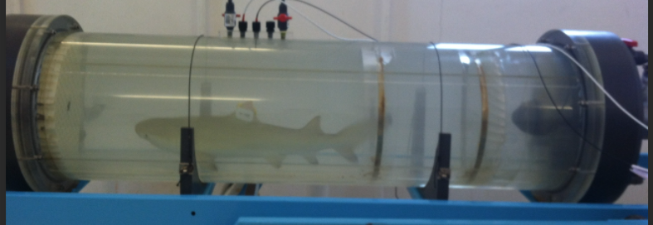
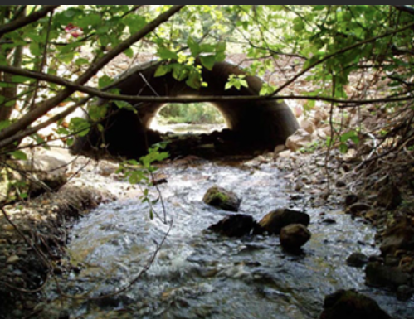
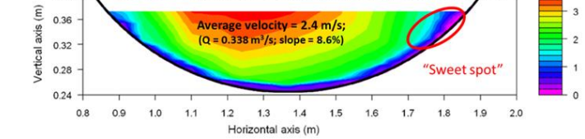
A Brief History
Fish Swimming Database & Performance Curves (Katapodis, DFO 2016)
  “Most data from .. swim tunnels”
  Average velocity
  Fish motivation?
Notes:
2000 sources – English language; US, Canada, others
Tunnel vs culvert velocity
Swimming because being forced to vs needing food/spawning
Running on treadmill vs on a soccer field vs being chased by a bear

Slide 22
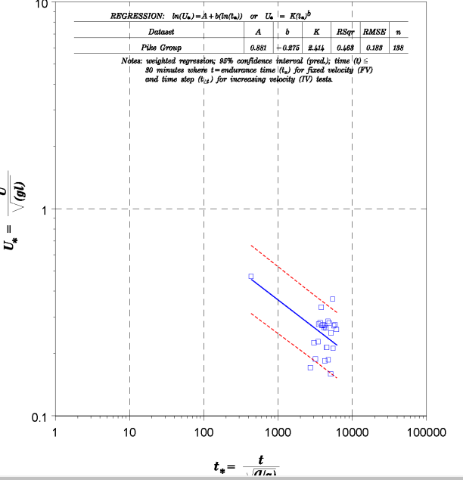
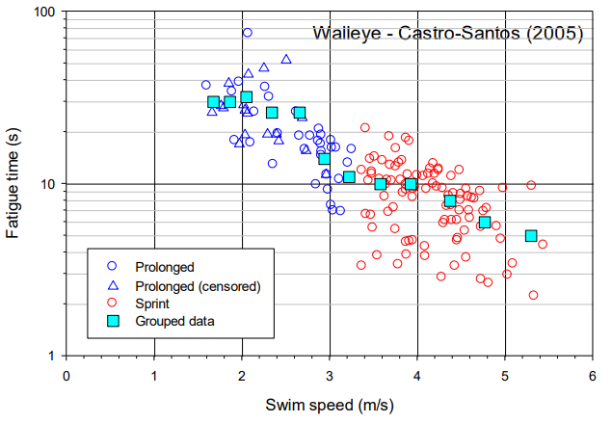
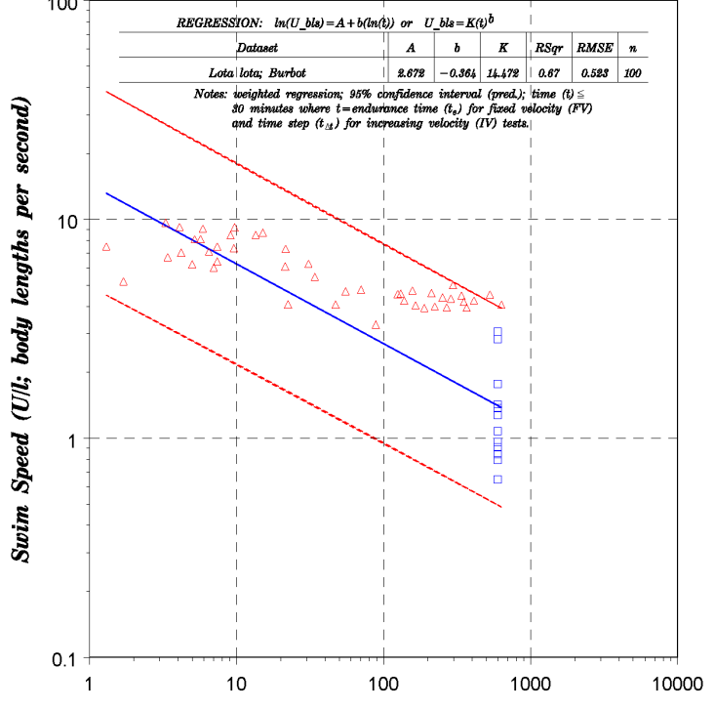
A Brief History
  collapsing data, trend lines
  “average values rather than measurements from individual fish”
  131 species grouped into 6 categories
Notes:
Impact of grouping data
What if data was wrong?
75% interval lines more spread out
Single data point to create a line

Slide 23
Alberta’s Approach
Is there a better way?
Physical channel parameters vs extrapolated math?
Apply to all fish and all streams?
Notes:
Physical approach, could work across all sites and species?
41 gauges of about 1100 in province

Slide 24
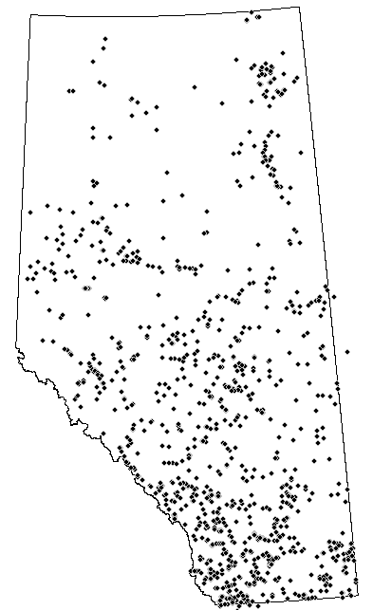
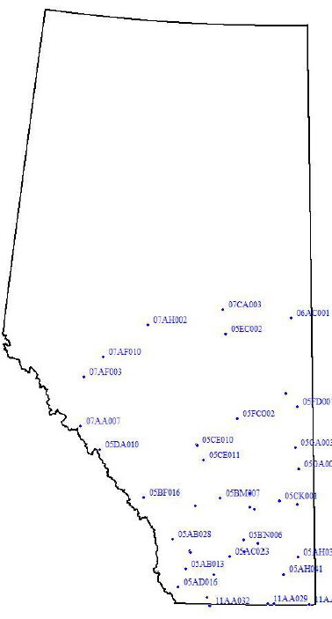
Alberta’s Approach
In 2007
  Study with DFO
  WSC Gauges with 30+ years, DA’s <100sqkm
  3Q10 flow calculated for each gauge
  Flow, depth, velocity calculated at 3Q10 flow

Slide 25
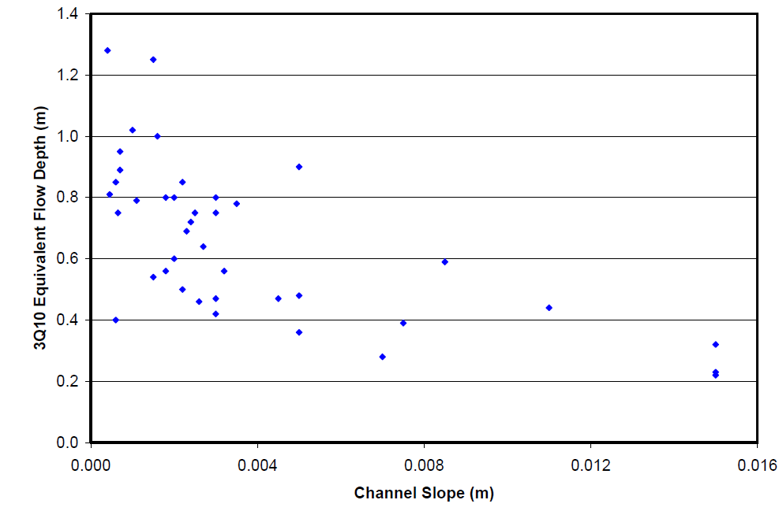
Alberta’s Approach
Y vs S relationship
Alberta 2008 Method
  Assess range of Y
  Vculvert < Vchannel

Slide 26
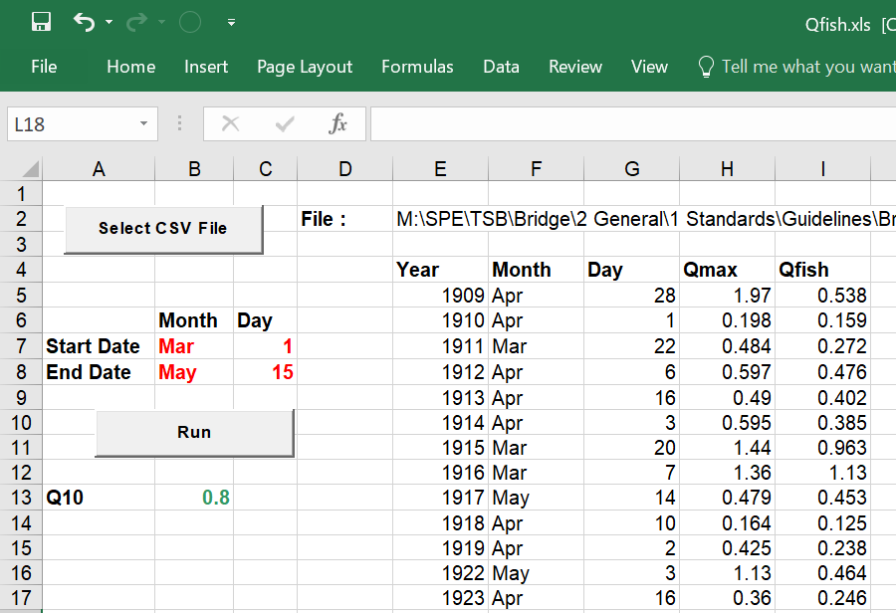
Alberta’s Approach
2012 Study Update
  Specific period of the year
  DFO: Mar 1 - May 15, Sept 1 – Oct 30
Calculated Y,V,Q values for 3Q10
Notes:
2012
We know fish are more likely to move at certain times of the year such as spring spawning

Slide 27
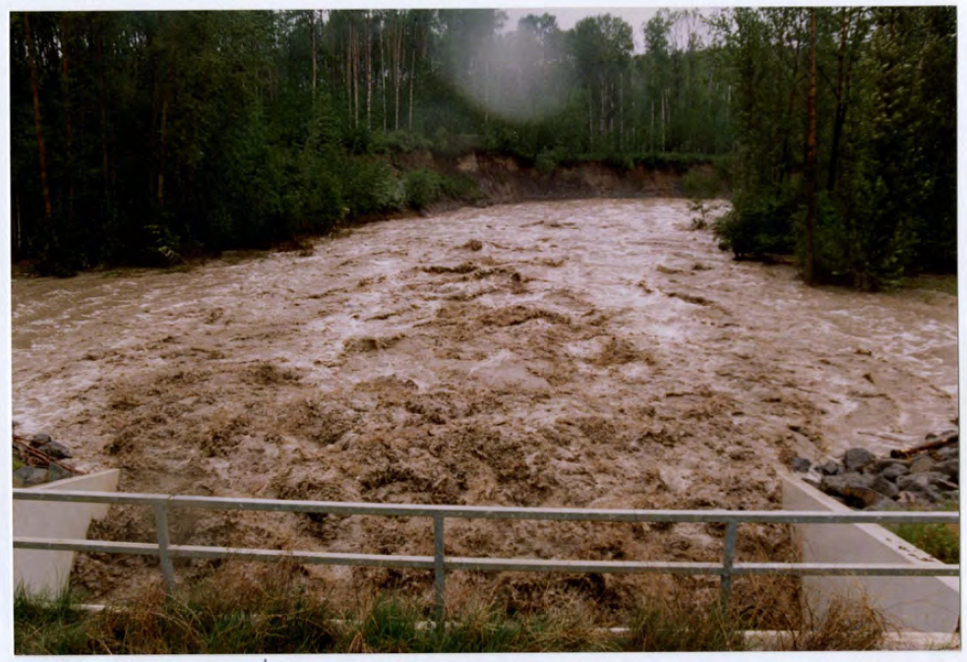
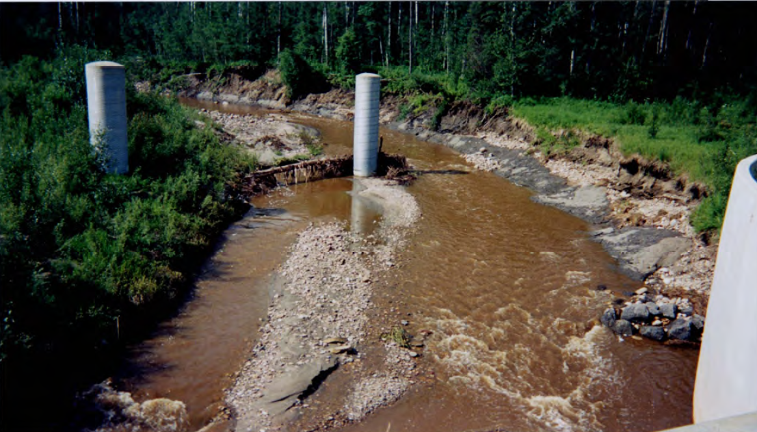
Alberta’s Approach
Compared Qmax vs 3Q10
3Q10 (98.7%) - under flood conditions (red)
Q > normal, Q < flood? (yellow)
Average flow (green)
Notes:
Evaluate at Q > normal, Q < flood
Choose Q_{fpd} – only exceeded 5% of days
Calculate hydraulically (no statistics)
1990 flood

Slide 28
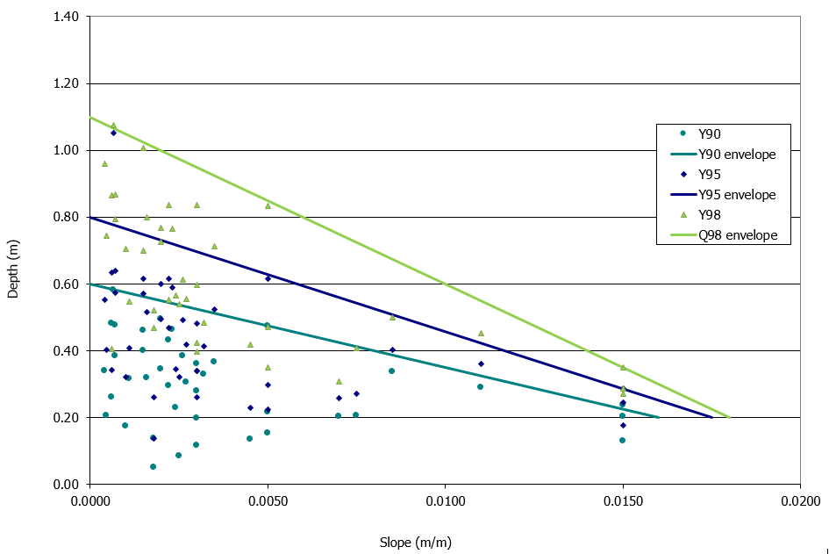
Alberta’s Approach
Evaluated Y @ Q98, Q95, Q90
Envelope curves
Yfpdd = 0.8 – 34.3*S
Notes:
DFO conversation. They suggested Q95

Slide 29
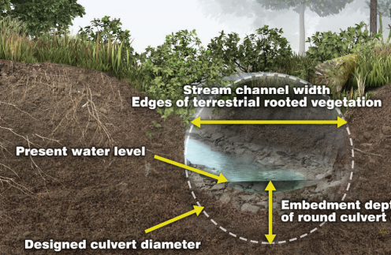
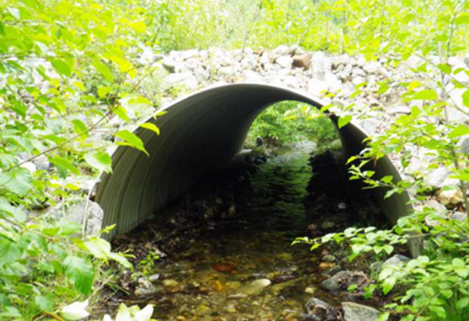
Alberta’s Approach
Vculv < Vchannel @ Qfpdd
Culvert Embedment (D/4)
Stream simulation approach
Notes:
Sediment transfer

Slide 30
Alberta’s Approach
Backwater from burial
Prevent hanging outlet
Sediment processes
Backwater – Y up, V down

Slide 31
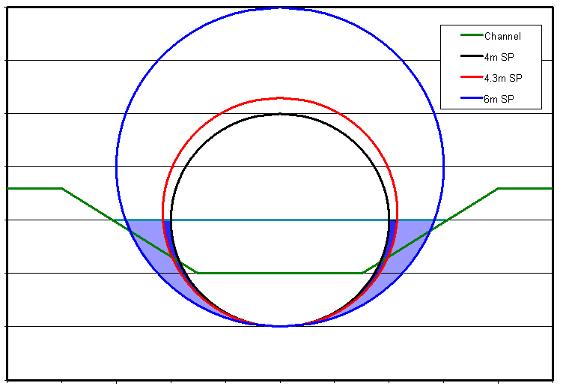
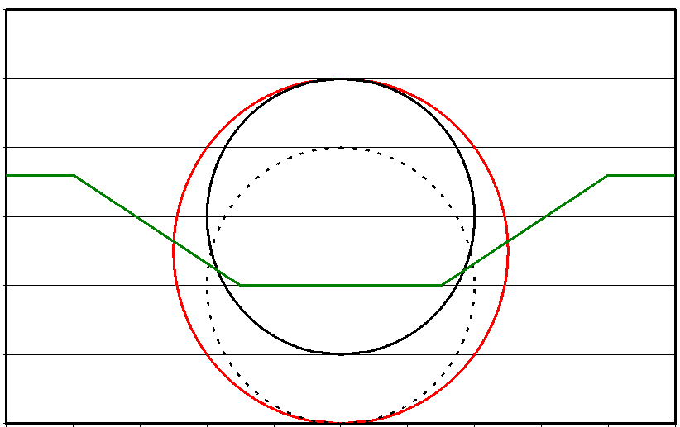
Velocity Reduction Options – NOT Effective
Increase Pipe Diameter - mostly air space
Increase Burial – ineffective >1m, ponding, u/s barrier, excavation?

Slide 32
Velocity Reduction Options - Effective
Increase Roughness – substrate holders
Multiple Pipes – wide, shallow channels; consider drift blockage
Shape (Box, Ellipse) – cost, hydraulics?
If none work - bridge

Slide 33
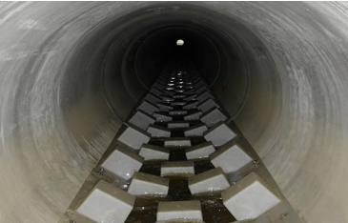
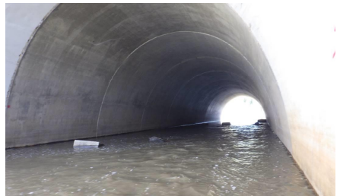
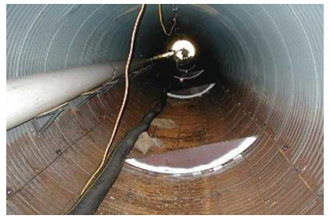
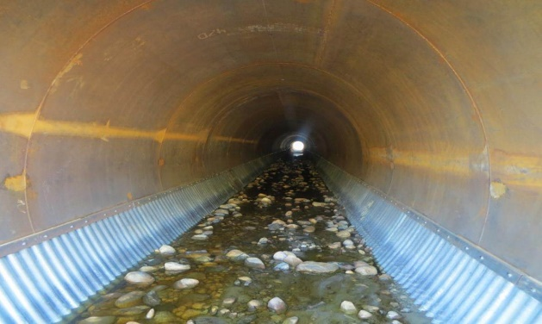
Substrate Holders
vs baffles
sediment accumulation
easily damaged
Beneath Streambed
Holds substrate for stream simulation
Increased Roughness

Slide 34
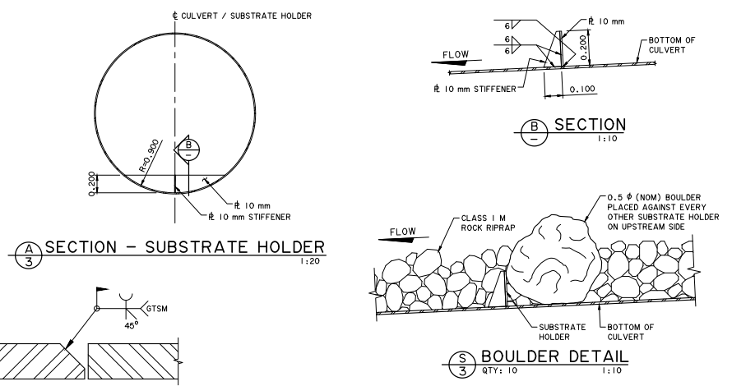
Substrate Holders
Design Guidelines for Bridge Sized Culverts
the following parameters are recommended:
• Substrate holder should be made of steel and conform to the shape of the pipe up to the desired height.
• Height of substrate holder should be 0.3m (0.2m if pipe diameter < 3m)
• Spacing of holders should be in the range of height divided by slope of pipe (minimum spacing = 7m)
• Substrate should be Class 1M or Class 1 rock, with an average thickness matching the height of the holder.
• Substrate and holders are only required where the mean velocity exceeds the mean channel velocity (typically the upstream portion of the pipe).

Slide 35
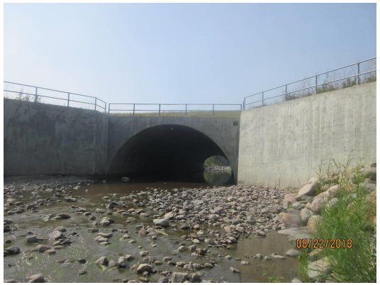
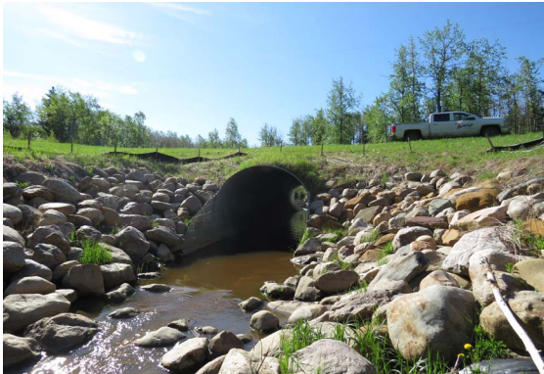
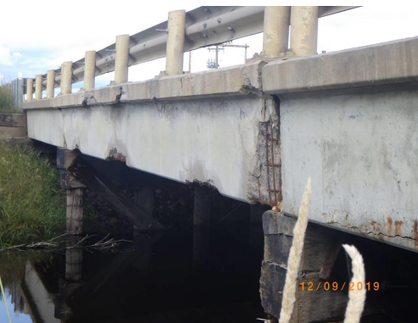
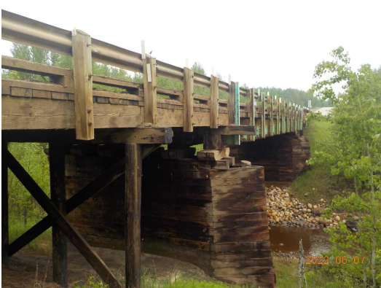

Slide 36
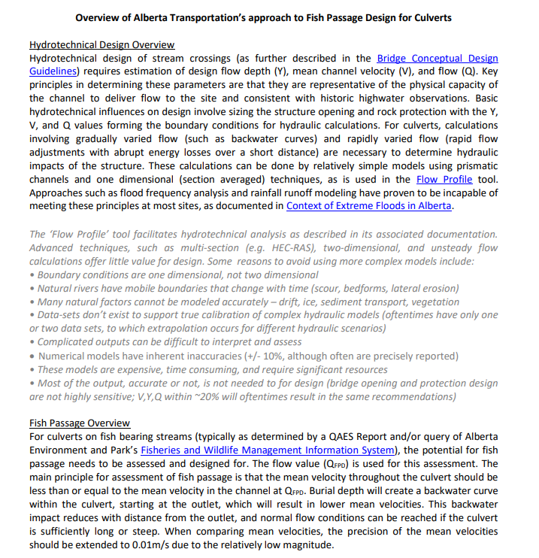
QUESTIONS?
Microsoft Word - Fish Passage Design Summary.docx (alberta.ca)

