Slide 1
Welcome
Class B Bridge Inspection Course
Twin Atria, Edmonton, AB
August 29 – September 2, 2016
Notes:
Welcome
Personal Introduction

Slide 2
Course Instructors
Trainers
  Randy Bredo
  Garry Roberts
Guest Lecturers
  AT staff - Caroline Watt, Matt Spratlin, Dave Besuyen, Bryan Wai.
  Ted Belke, Reg Quinton, Abdul Waheed
Refer to Course Schedule

Slide 3
General Information
Emergency Protocol
  Washrooms
Room Access
  Opens at 7:30 am
  Locked at 5:00 pm
  Open at lunch
  Computers
Smoking
  At designated locations only - minimum 30 ft from building entrances

Slide 4
General Information (cont’d)
Registration and Payment
Note Taking & Course Materials
Course Evaluation must be completed

Slide 5
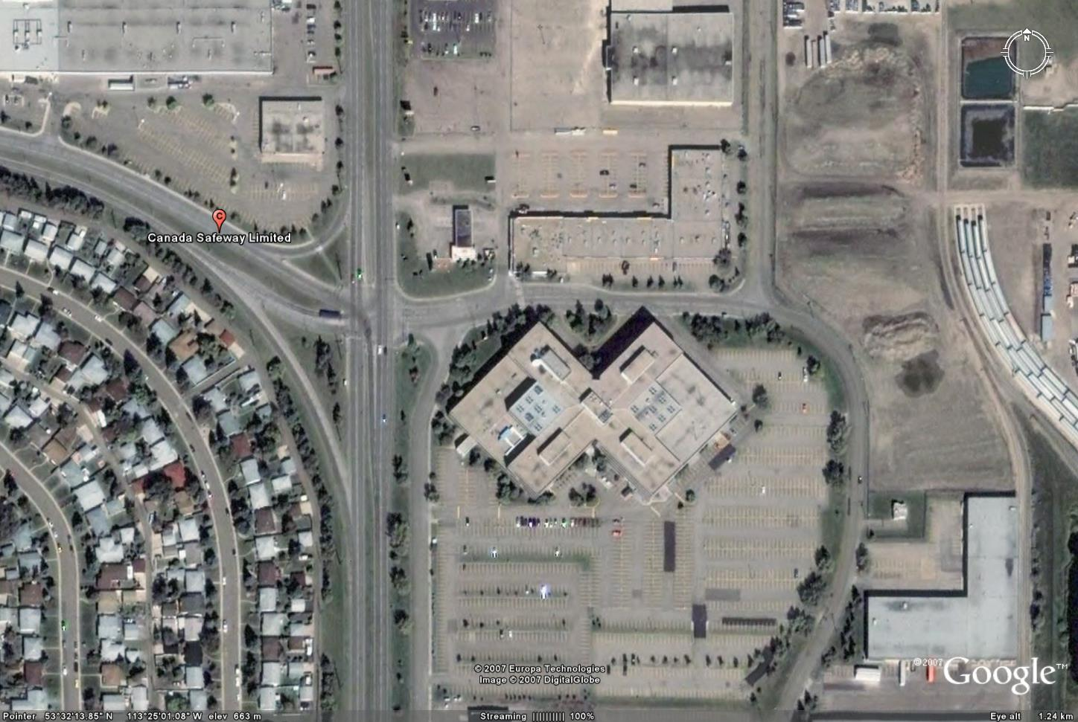
PARKING

Slide 6
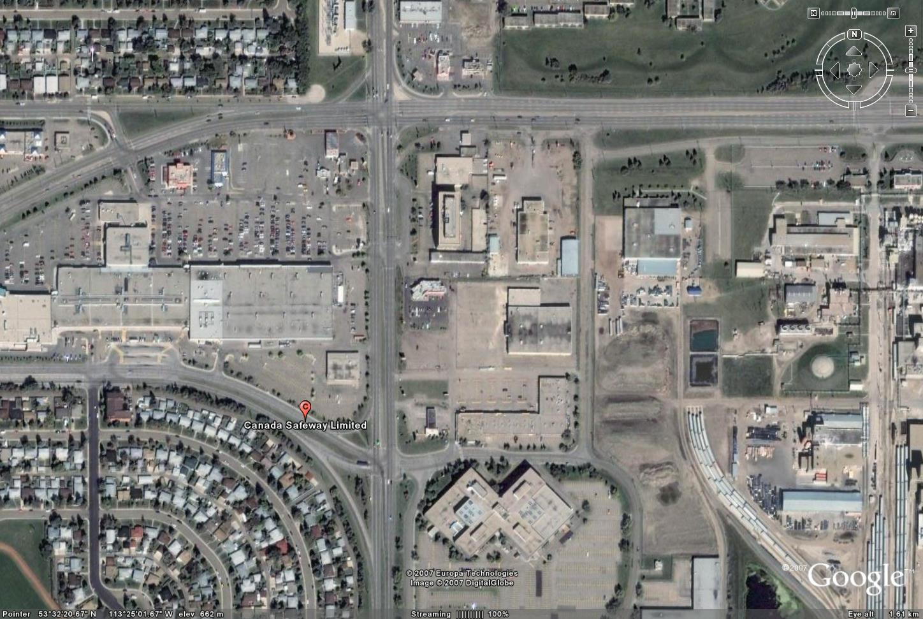
EATERIES
A & W
KFC/Taco Bell
Tim Hortons
Oodle Noodle
Mucho Burrito
Quiznos
MacDonalds
Highrun Pub
Chinese Buffet
Eat in Room

Slide 7
Self Introduction
Name
Organization
Present or Proposed Involvement with Bridges
Fill out Name Tag/Placeholder

Slide 8
BIM Inspector Training
**Alberta Transportation Requires All BIM course participants
to self register for TIMS/BIS application for certification tracking purposes**
https://extranet.inftra.gov.ab.ca/inftra_login.html
https://extranet.inftra.gov.ab.ca/Self_Registration_Guide_to_Access_TIMS.pdf

Slide 9
Course Schedule
Monday – Friday
  Start Time 8:00 am
  Finish Time 4:15 - 4:45 pm
Field Trip on Wednesday
  Hard Hat, Traffic Vest, Hip Waders, Boots
  Clip board, flashlight, hammer, tape measure
  Transportation provided. Bring lunch.
Preparation Requirements
Questions allowed at anytime

Slide 10
Quizzes
Four Closed Book Exams:
    Tuesday morning;
    Thursday morning;
    Friday morning; and
    Friday afternoon
Pass mark is 70%
Marks posted daily – any objections to posted marks contact the instructor

Slide 11
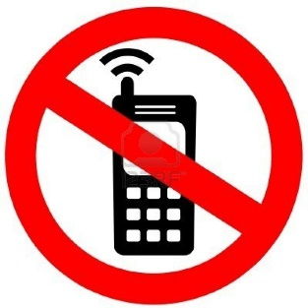
Courtesies
Turn cell phone OFF/vibrate
– no text messaging.
No talking during exams – leave room and talk in hall once exam is completed.

Slide 12
Course Objectives
Introduction to AT’s BIM system
Learn bridge inspection terminology
Learn inspection protocol and principles
Introduction to bridge maintenance

