Slide 1
Rating Grade Separations

Slide 2
Grade Separation
The grade separation section applies to structures which have the following “Structure Usage” as classified in the BIS inventory:
  GS - vehicular grade separation
  PS - pedestrian grade separation
  RO - railway overpass
  RU - railway underpass
  SP - stockpass or cattlepass

Slide 3
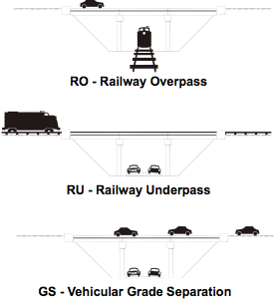

Slide 4
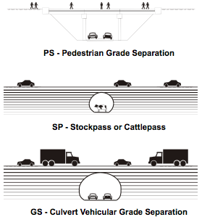

Slide 5
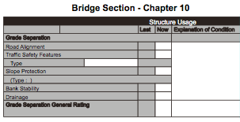
Grade Separation
The grade separation section of the BIM inspection form
replaces the channel section for structures that are not
over streams. The grade separation section is different
for bridges and culverts as shown:

Slide 6
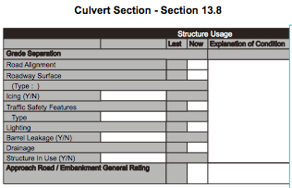
Grade Separation

Slide 7
Road Alignment
This element refers to road vert.& horiz. alignment below or through the bridge or culvert and condition of the road surface surface. The limits of evaluation are 1 km in each direction
Inspection and rating considerations include:
  vertical and horizontal alignment that may contribute to damage to the bridge
  look for indications for reduced vertical clearance
  railway alignments should be rated “X”
  alignments that can be safely driven and do not contribute to collision with the structure should be rated “5” or higher
  bridge structures include condition of road, cracks, heaves etc. that may lead to damage of the bridge.

Slide 8
Traffic Safety Features
For the purposes of the BIM system this item refers to safety features such as:
curbs or barriers
medians
guardrails
energy attenuators
vertical clearance signs
advance warning signs
The type of safety features are to be noted on the BIM form.

Slide 9
Traffic Safety Features
Inspection and rating considerations for safety features are as follows:
do not rate standard of safety feature… rate functionality and condition as per original design
rating should include all components of the safety feature, including connections
if elements are missing but there is evidence that they were previously there, then rate “4” or less
use “explanation of condition” to further describe features or to indicate concerns, maintenance required, etc.

Slide 10
Slope Protection
This item refers to the slope protection system used on the headslopes of bridges to prevent erosion damage and provide an aesthetic finish (graffiti).
Some considerations for inspection and rating include:
look at abutment front for evidence of settlement
for concrete treatments, look for cracking, surface deterioration, crushing, settlement or heaving
look for signs of undermining at the toe or by loss of soil material below the protection system
significant movement or settlement should be rated “4” or less
if maintenance required it should be rated “4” or less and a description provided
Good condition but somewhat unattractive rate 7

Slide 11
Bank Stability
This refers to the stability of the headslopes and transitions. It is influenced by factors such as:
type of backfill material
construction techniques
degree of compaction
drainage system
underlying soil stratigraphy
Consequences of instability may range from minor settlement to major structural distress .

Slide 12
Bank Stability
Considerations for inspection and rating of bank stability include:
look for evidence of damage to bridge components
look for evidence of settlement and shifting of substructure elements
check for evidence of soil bulging at toe of slopes
record locations of wet and slumping areas
instability affecting bridge elements rate “4” or less
instability that requires monitoring rate “4” or “3“

Slide 13
Drainage - Bridge G/S
This item refers to the handling of water that reaches the toe of the headslopes and its transitions. Sources of water include:
deck drainage
approach road drainage
highway ditch drainage
weep holes in abutments and concrete slabs
Considerations for inspection and rating include:
Drainage functional not causing damage rate 5 or more
if drainage causes safety concerns or damage, rate “4” or less
ponding or icing causing hazard on travel lanes below rate 2 or less

Slide 14
Drainage / Barrel Leakage
This item refers to disposal of water that reaches culvert roadway surface.
Considerations for inspection
  look for ponding in culvert
  gutters clogged or not functioning
  damage caused by roadway drainage
Record “Y” if there is barrel leakage and explain
Drainage functioning, rate 5 or more
Ponding causing a hazard, rate 2 or less

Slide 15
Roadway Surface
This item is limited to culvert structures and refers to the condition and functionality of the roadway through the structure. The purpose of the roadway surface is to provide a suitable surface for vehicular or other traffic. Considerations for inspection and rating include:
record the type (pavement, concrete, gravel, etc.) of roadway surface on the inspection form
evaluate the condition of the surface and its ability to function as designed
roadway surfaces requiring maintenance to provide the required level of service should be rated “4” or less
roadway surfaces that are hazardous due to icing should be rated “2” or less and icing should be indicated on the inspection form
if there is leakage of water through the barrel onto the roadway, indicate “Y” and explain

Slide 16
Lighting
This item refers to the lighting system used in the culvert to enhance visibility and to provide for safe passage through the culvert. Some considerations for inspection and rating include:
if the lighting is not operational, rate “4” or less
check guardrail and safety features for damage as this may indicate visibility problems in the culvert
check all connections and features to determine condition and functionality
no lighting (cattlepass) rated “X”
inadequate lighting or no lighting and hazardous situation for the user should be rated “2” or less with “explanation of condition”.

Slide 17
Structure In Use
This item refers mostly to cattlepasses and stockpasses but may also apply to other uses. If there is evidence that the structure is no longer in service, then circle “N” and make a note in the “explanation of condition” regarding the circumstances.

Slide 18
General Rating
The general rating of the grade separation section of the BIM inspection should reflect the significant structural and safety concerns relative to the items being inspected and rated. Governed by:
Bridge G/S
  road alignment
  traffic safety features
  bank stability
  drainage
Culvert G/S
  road alignment
  roadway surface
  traffic safety features
  drainage

