Slide 1
Level II Inspection

Slide 2
Introduction
Level I
  primarily visual with standard tools
  no special access
  in accordance with BIM manual
Level II
  specialized knowledge / training and equipment
  detailed information on a particular component or components
  supervised by certified bridge inspector

Slide 3
Level II Inspection Types
Copper Sulfate Electrode (CSE Testing)
Chloride Testing
Concrete Deck Inspection
Ultrasonic Truss Inspection
Culvert Barrel Measurements
Vertical Clearance Measurements

Slide 4
Types of Level II Inspection
Concrete Girder Inspection
Paint Inspection
Timber Coring
Scour Monitor
Special Structure Monitor
Underwater Inspection
Steel Culvert Corrosion Testing
Pin and Hanger Connection Testing
Steel Girder Cover Plate Inspection

Slide 5
General Principles
BIM condition rating system
Quantifies rating categories
Provides technical data / measurements
As required / ordered by Level I Inspector
Regular / predetermined schedule

Slide 6
When Required?
Special access required
  swing stages or manlifts
  dewatering culverts
  underwater (scour or foundations)
Overall assessment for rehabilitation or major maintenance
  deck or paint inspections
  condition evaluation
  CSE, timber coring, ultrasonic

Slide 7
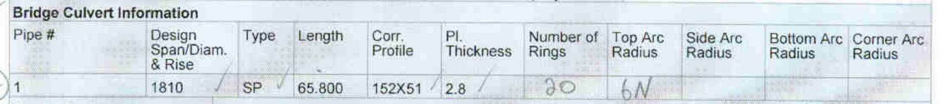
Level II Inspection Forms
Bridges
Culverts

Slide 8
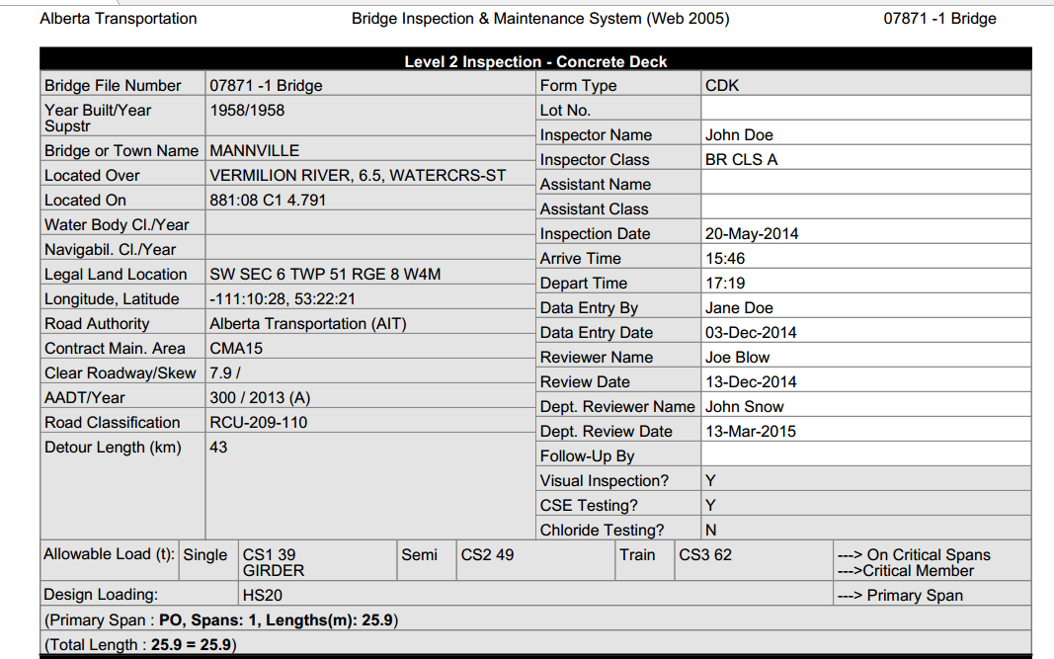
Level II Inspection Forms – Common Inventory Information

Slide 9
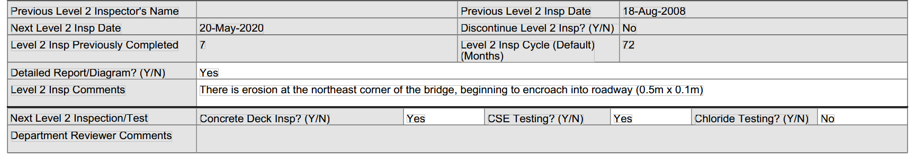
Level II Inspection Forms – Inspection Scheduling Information

Slide 10
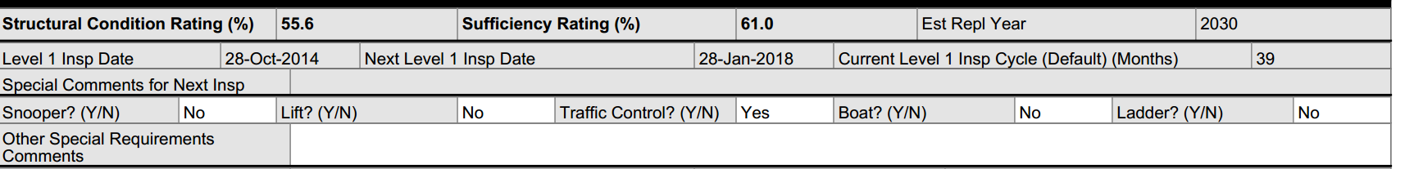
Level II Inspection Forms – Inspection Scheduling Information

Slide 11
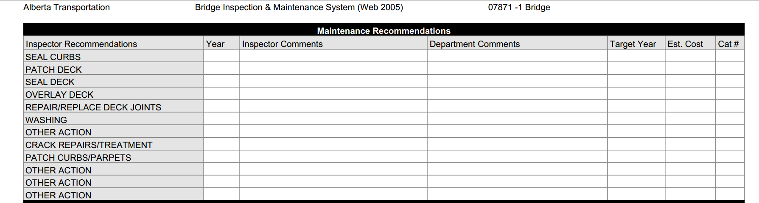
Level II Inspection Forms – Maintenance Recommendations

Slide 12
Concrete Deck Inspection
Primarily visual with standard tools
Measurement of damage / condition
Components inspected are
  wearing surfaces
  concrete overlay
  concrete deck
  concrete edge elements
  deck joints

Slide 13
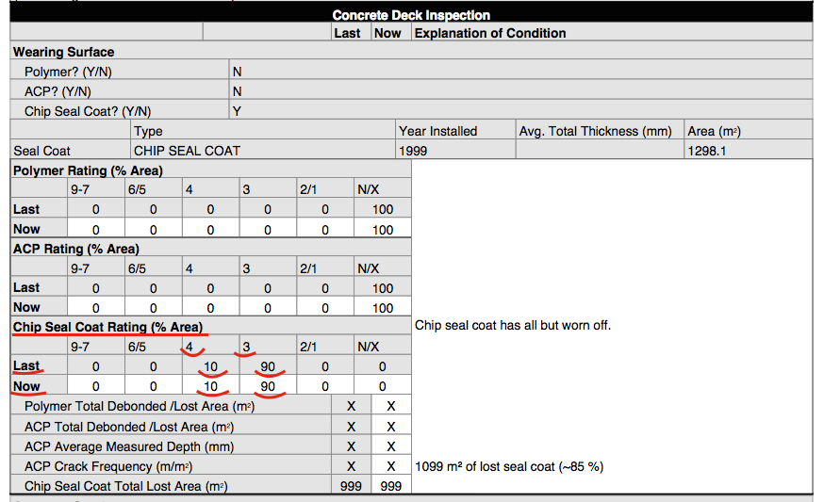
Concrete Deck Inspection – Wear Surface Inventory and Condition

Slide 14
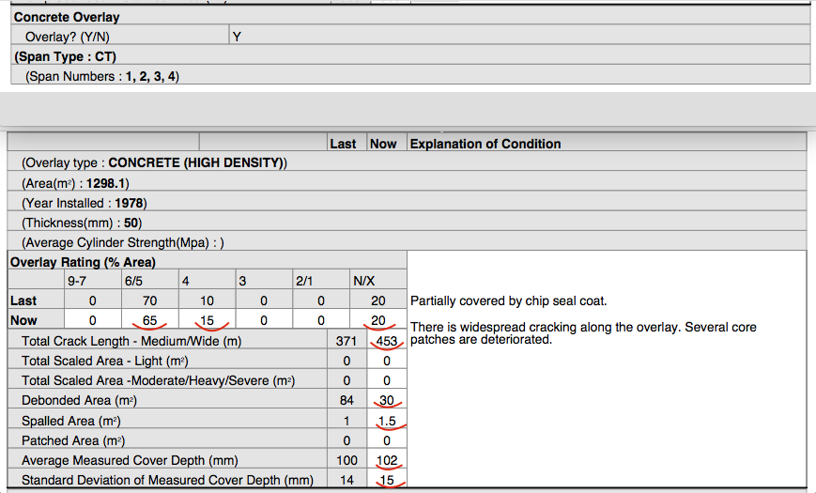
Concrete Deck Inspection – Concrete Overlay Inventory and Condition

Slide 15
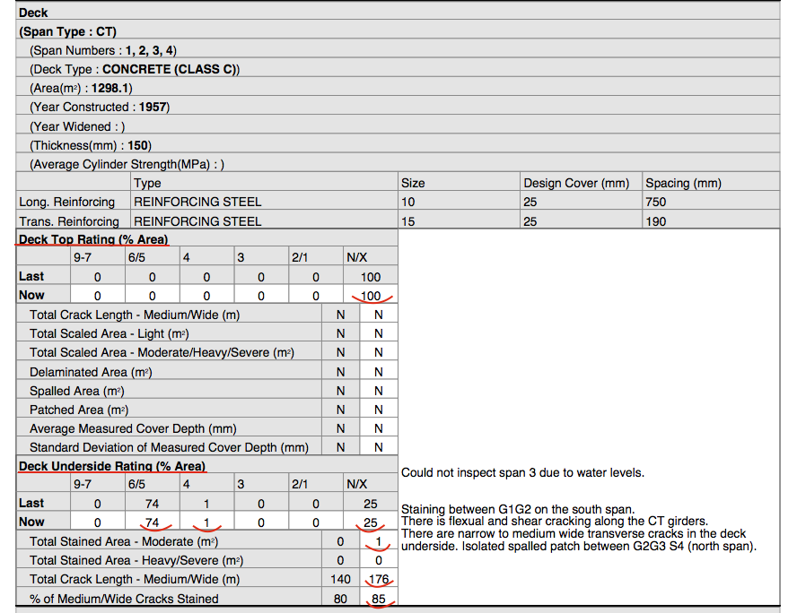
Concrete Deck Inspection – Concrete Deck and Underside Inventory and Condition

Slide 16
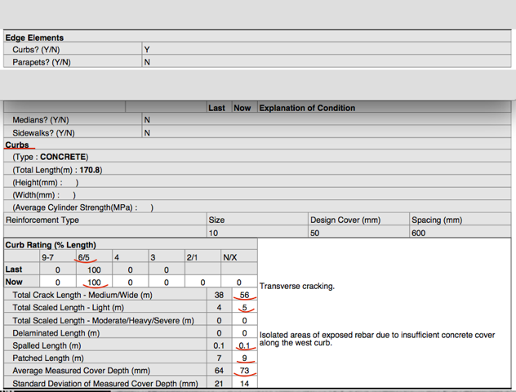
Concrete Deck Inspection – Edge Elements Inventory and Condition

Slide 17
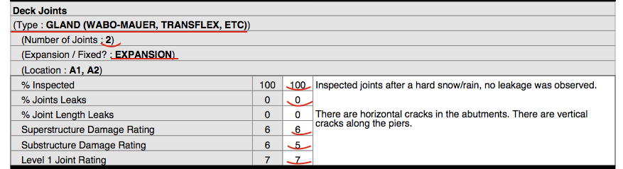
Concrete Deck Inspection – Deck Joint Inventory and Condition

