Slide 1
INTRODUCTION TO THE BRIDGE INSPECTION AND MAINTENANCE SYSTEM (BIM)

Slide 2
BIM System
Definition
A comprehensive management system with the ability to process inspection and component information to support:
  Inspection management
  Maintenance programming
  Strategic planning
    Rehabilitation programs
    Replacement programs
    Budget development
Page 1

Slide 3
BIM System
Functions
Ensures appropriate levels of safety and service.
Maximizes life and utility of bridge structures.
Assists service life prediction of bridge elements or structure types.
Identifies need for continued monitoring.
Provides a electronic system for managing inspection information and collecting and verifying inventory data.
Provides data for setting priorities.
Page 2

Slide 4
BIM System
Functions (cont’d)
Assists the allocation of resources.
Provides information to develop maintenance costs (.i.e. materials, quantities).
Facilitates information exchange with others.
Provides a framework for training and evaluation of inspectors.
Provides information for evaluating design, construction and maintenance standards.
Page 3

Slide 5
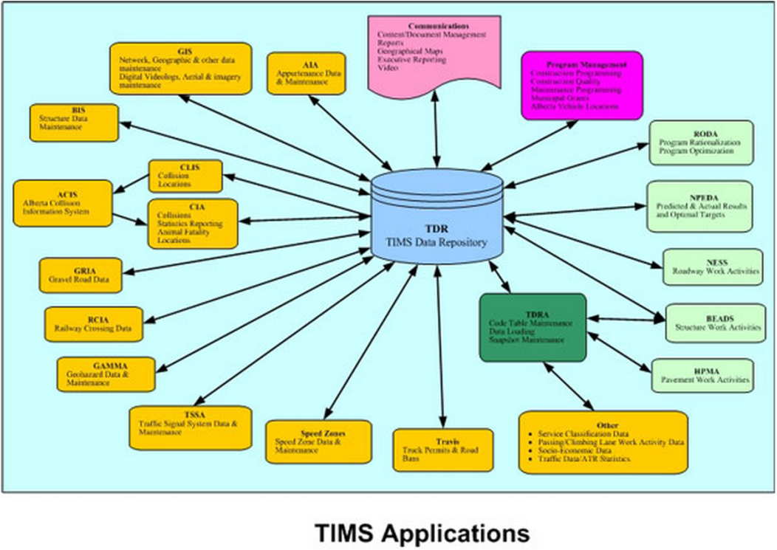
BIM System Management
Alberta Transportation uses a single Web Based knowledge system designed manage infrastructure assets known as the Transportation Infrastructure Management System (TIMS).
Page 4

Slide 6
BIM System Management
TIMS
BIS Application (BIM)
Inventory
Inspection
Maintenance
TIMS - BIS Application
Standard Bridge: BF 02397
Culvert: BF 77444
Page 5
Notes:
The BIS component of the TIMS system consists of a central database repository containing information for all bridges in the province. Access to the system is web based and provides the ability to view and modify data by the users, depending on the security level assigned.

Slide 7
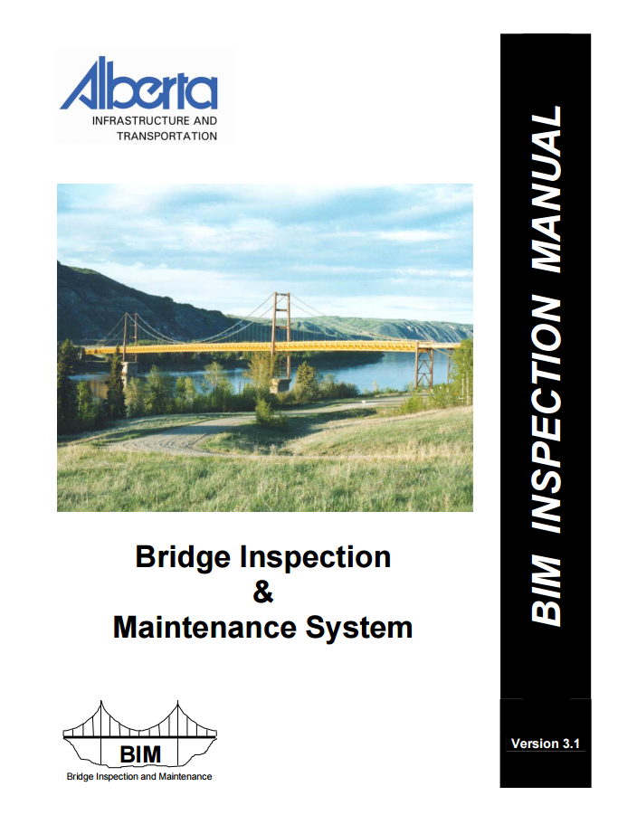
Bridge Information System (BIS)
TIMS
BIS Application (BIM)
Inventory
Inspection
Maintenance
Page 6

Slide 8
Bridge Structure Categories
Standard Bridges
  A bridge constructed using “standard” components and “standard” drawings. (except standard girder bridges with composite overlays, such as SMC, SCC, SLC)
Culverts
  A bridge sized culvert is one with an equivalent diameter of 1500 mm or larger (or multiple smaller diameter culverts with equivalent hydraulic capacity – e.g. - 2-1200mm)
Major Bridges
  All bridges which are not standard
  Also includes SLC bridges
Sign Structures
  Overhead sign structures
Page 7

Slide 9
BIM - Bridge Structure Statistics
Page 8

Slide 10
Bridge Structures Statistics
Number of Bridge Structures Built per Year by Road Type
Page 9

Slide 11
BIM System – Critical Considerations
The accuracy of the information contained within the BIM system directly impacts the effectiveness of the system.
  Consistency of inspection standards
  Inspection accuracy
  Inventory accuracy
  Maintenance accuracy
  The bridge inspector must adhere to the highest standard at all times.
Page 10

