Slide 1
BRIDGE MATERIALS

Slide 2
CONCRETE
1

Slide 3
What is Concrete?
A mixture of various components which chemically react to form a strong construction material
Unit Weight – normal 2400 kg/m³ or semi 1900 kg/m³
Component Ratios:
  Cement (10 to 15%)
  Aggregate (75 to 80%)
  Water and Air (remainder)
  Admixtures
2

Slide 4
Cement Manufacturing
Limestone Train
Clay Quarry
Hammermill Crusher
Additive Silos
Preheater Tower
Preblend Dome
Clinker
Finishing Mill
Roller Mill
Gypsum
Rotary Kiln
Cement Silos
3

Slide 5
Aggregate
Aggregate qualities for strong and durable concrete:
  Abrasion resistance
  Weather resistance
  Chemical stability
  Cleanliness and even gradation
4

Slide 6
Water
5

Slide 7
Entrained Air
Entrained air 5% to 8%
Improves freeze thaw resistance
Improves workability
Reduces segregation and bleeding
Improves sulfate resistance
6

Slide 8
Air-Entrained Concrete
7

Slide 9
Admixtures
Ingredients used to modify certain properties of concrete to have a desired function
Two types of admixtures:
  Mineral admixtures
  Chemical admixtures
8

Slide 10
Mineral Admixtures
Fly Ash
Reduces heat of hydration & increases workability
Increases set time & reduces strength
Silica Fume
Increase strength & abrasion resistance
Increases water demand
Reduces permeability & workability
9

Slide 11
Chemical Admixtures
Water Reducers – reduces water demand
Super Plasticisers – increases slump, workability, strength
Accelerators – decreases set time
Retarders – increases set time
10

Slide 12
Physical Properties
Compressive strength (f’c) (28 day)
Tensile strength (10% f’c)
Shear strength (12-13% f’c)
Flexural strength (14% f’c)
11

Slide 13
Physical Properties (Cont’d)
How to increase Compressive Strength
Increased cement content
Increased aggregate strength
Decreased w/c ratio
Decreased entrapped air
Increased curing time
Use of admixtures
12

Slide 14
Concrete Stress-Strain Diagram
stress
strain
13

Slide 15
Physical Properties (Cont’d)
Creep
Fire resistance
Durability
Isotropy
Permeability
  Affected by
    evaporation of bleed water
    excess water
    micro-cracking
    porous aggregates
    improper mixing, finishing
14

Slide 16
Concrete Damage & Deterioration
CRACKS
Crack is a linear fracture in concrete
  Working Cracks
  Structural Cracks
    Flexure cracks
    Shear cracks
15

Slide 17
Structural Cracks
Unloaded Beam
Flexural Cracks
Flexural Cracks
Shear Cracks
16

Slide 18
Concrete Damage & Deterioration
  Non-Structural Cracks
    Crazing cracks
    Temperature cracks
    Shrinkage cracks
  Crack Size
    Hairline less than 0.1 mm
    Narrow ≥ 0.1 mm < 0.3 mm
    Medium ≥ 0.3 mm < 1.0 mm
    Wide ≥ 1.0 mm
17

Slide 19
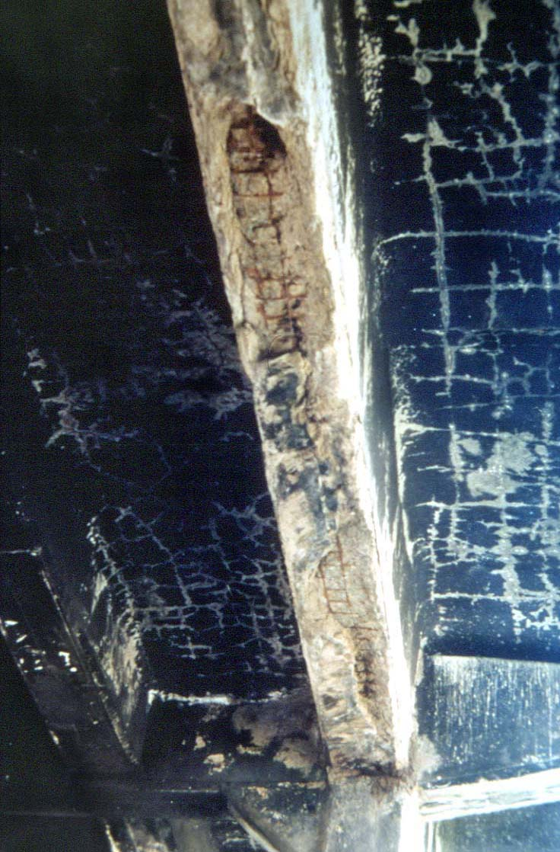
Shrinkage Cracks on Deck Underside.
18

Slide 20
Concrete Damage & Deterioration
2. SCALING
Scaling is a gradual loss of mortar and aggregate
Categories of Scaling
  Light scaling loss of surface mortar 6 mm deep
  Medium Scaling loss of surface mortar 6 to 13 mm deep
  Heavy scaling coarse aggregate exposed
  Severe scaling loss of coarse aggregate
19

Slide 21
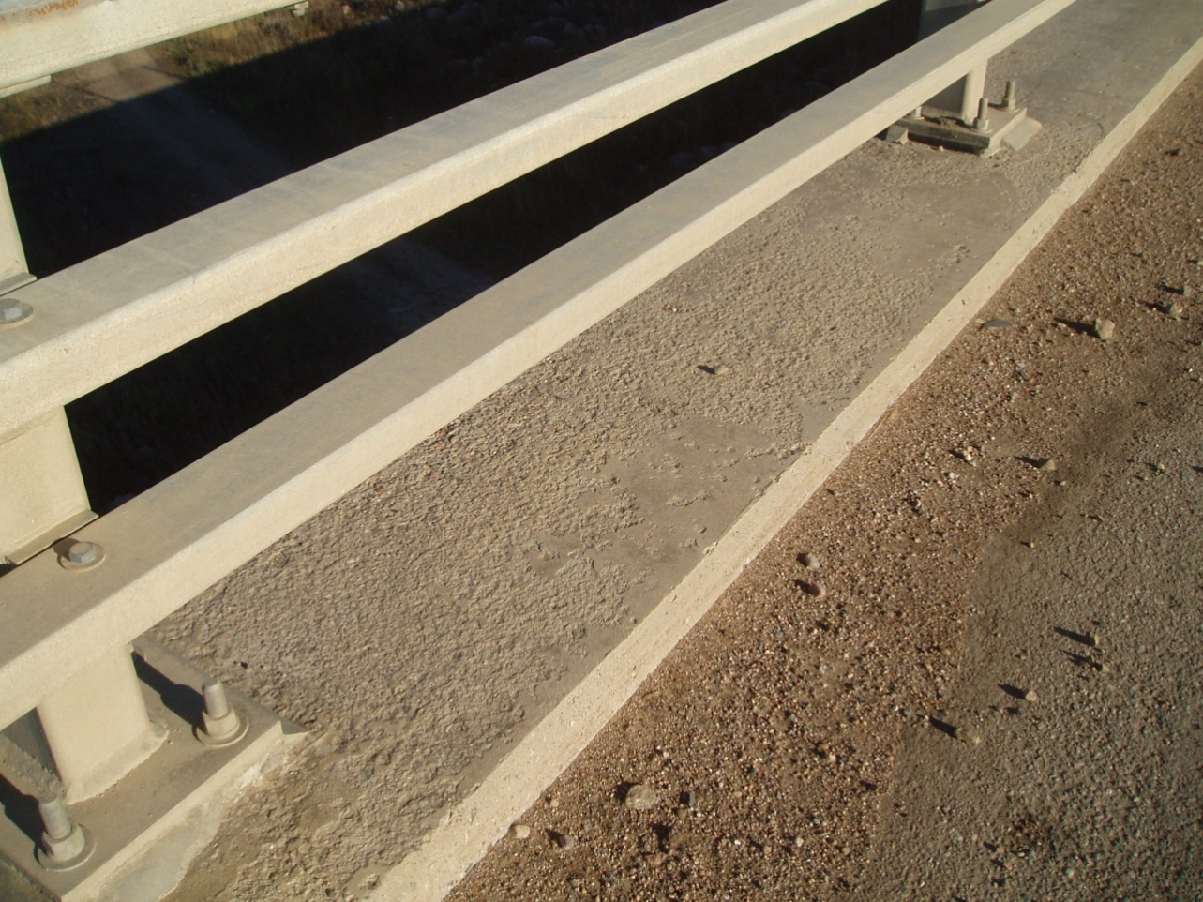
Light Scaling
20

Slide 22
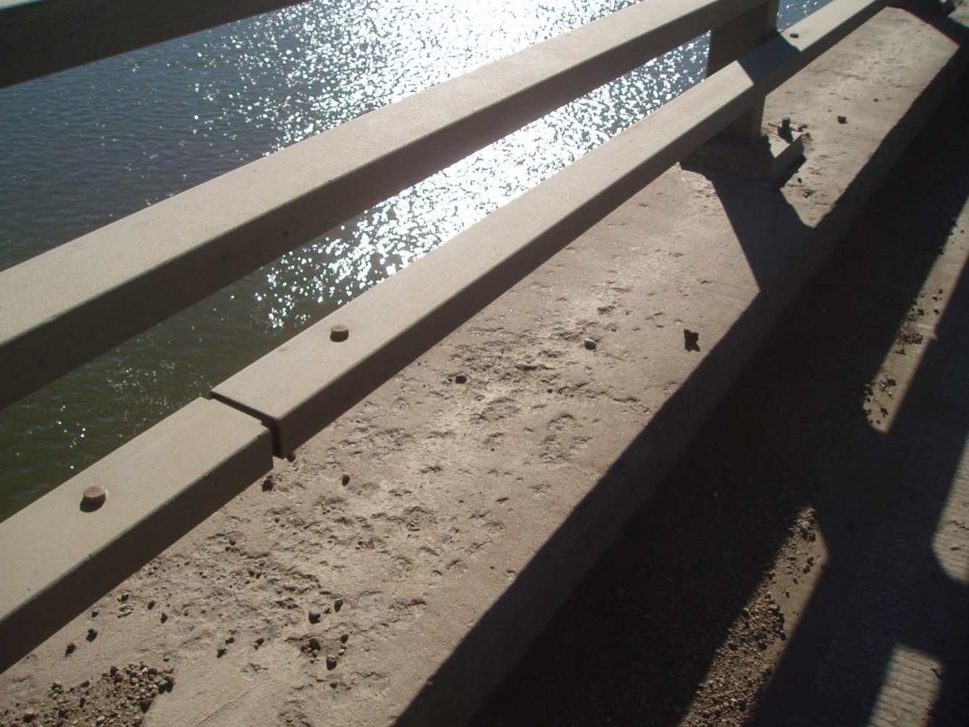
Medium Scaling
21

Slide 23
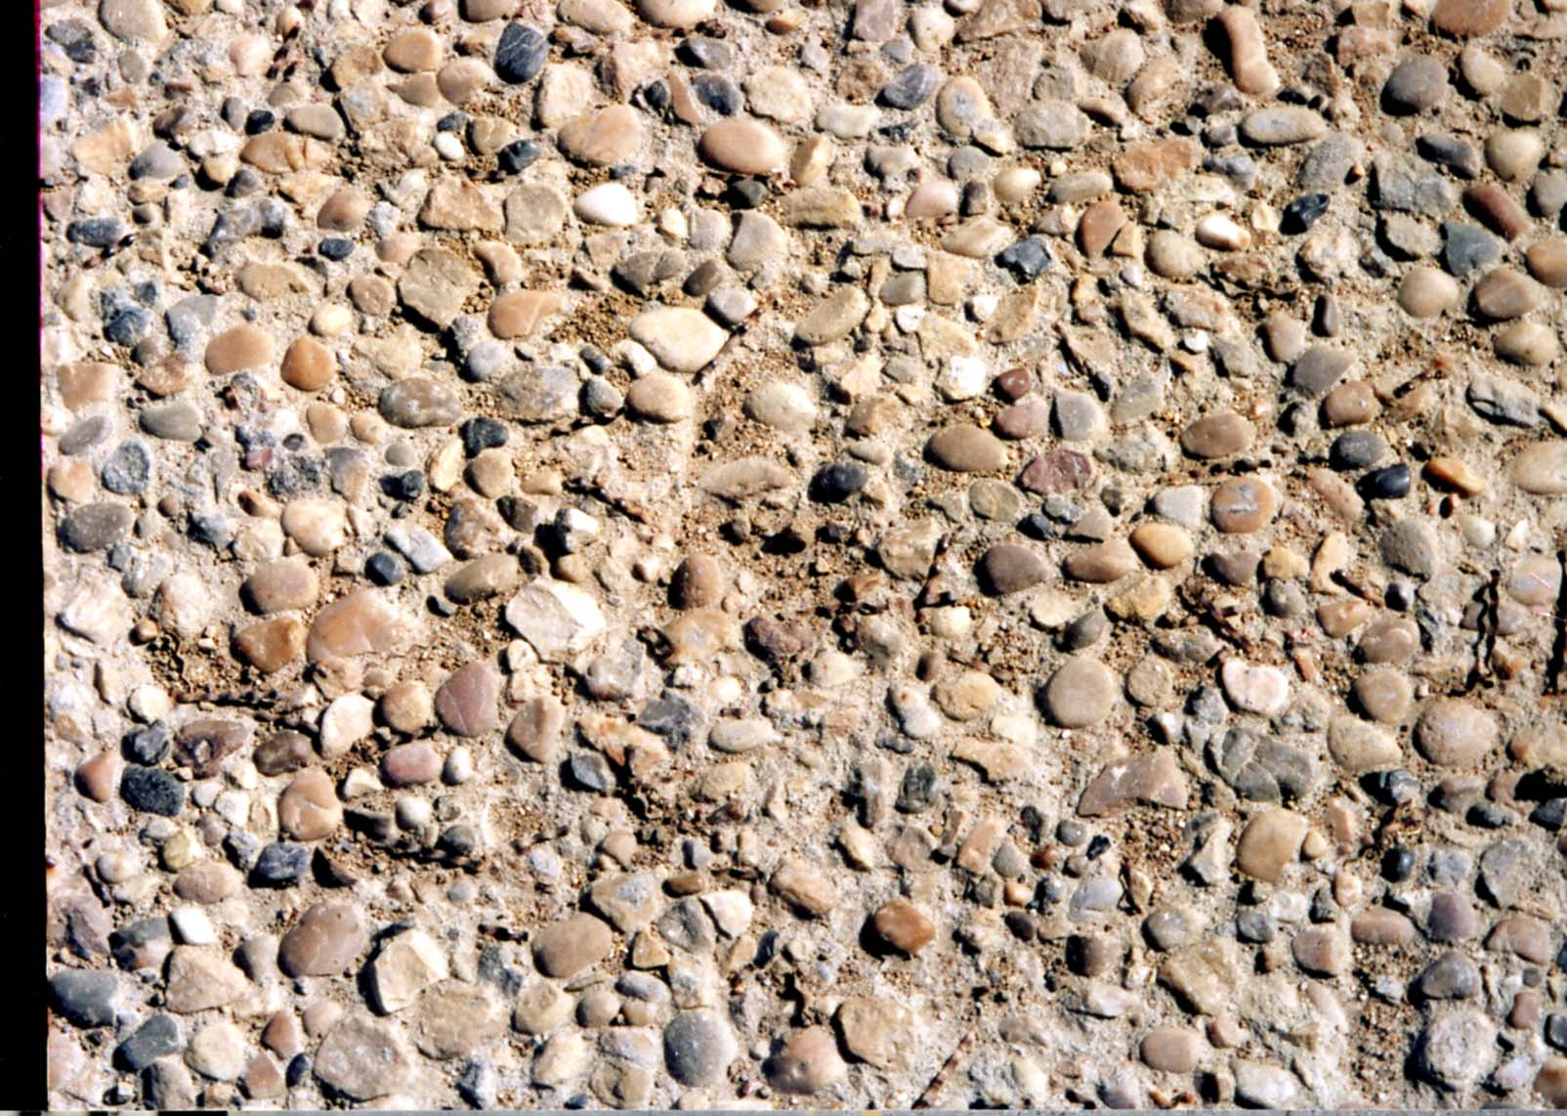
Heavy Scaling
22

Slide 24
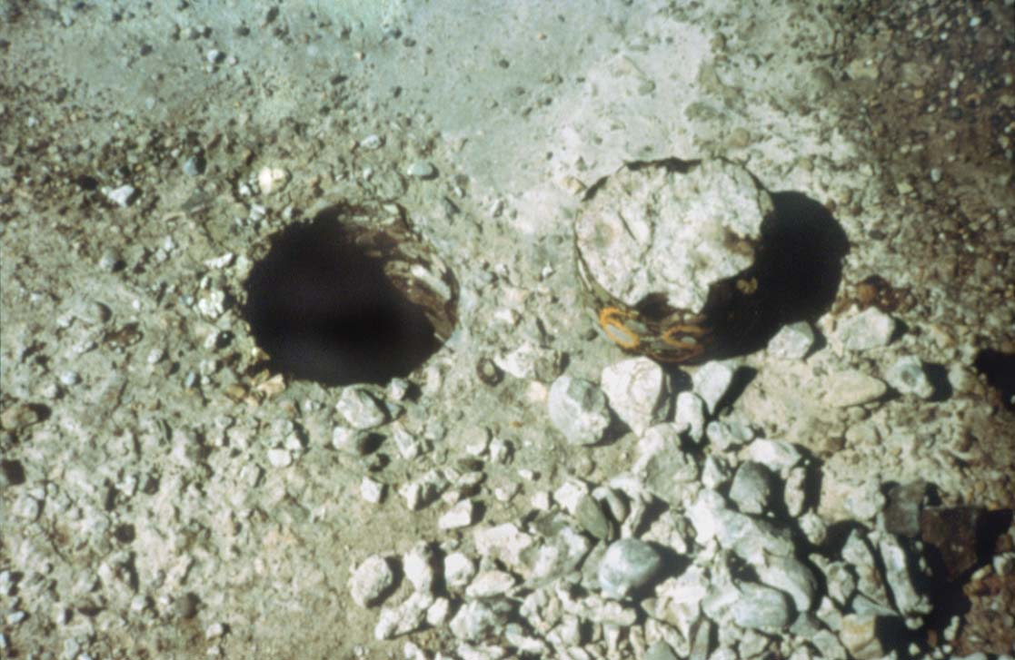
Freeze/Thaw Deterioration of Deck
23

Slide 25
Concrete Damage & Deterioration
3. POP-OUTS
Due to porous aggregate
4. ABRASION
Due to wheel wear
5. SPALLING
Expansion of corroding rebar and overstressing
24

Slide 26
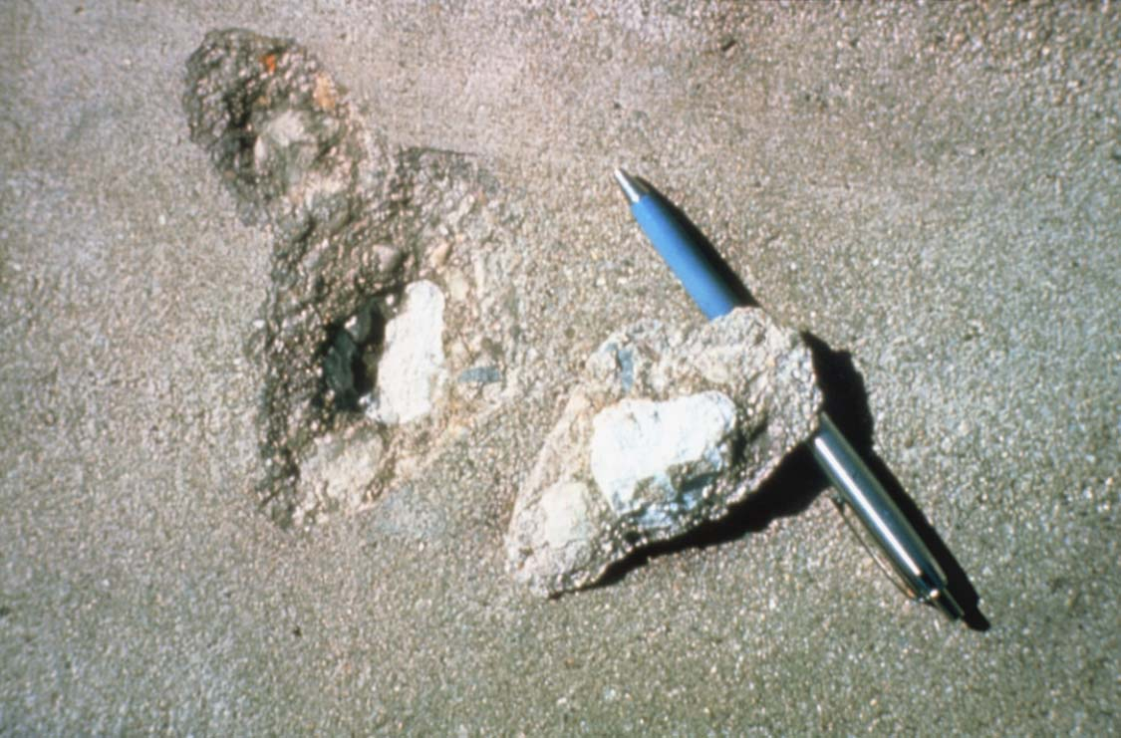
Expansive Aggregate Pop-out
25

Slide 27
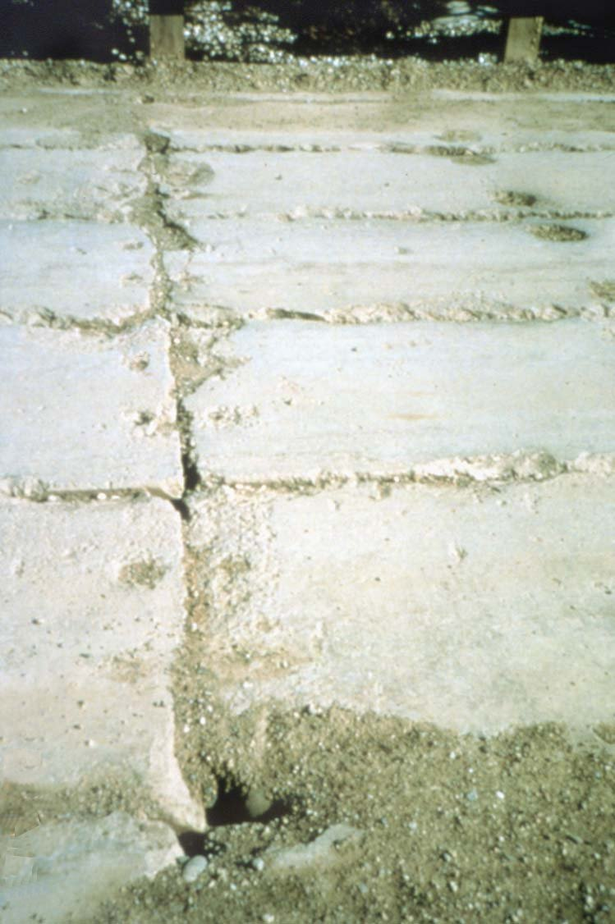
Abrasion Damaged Girders
26

Slide 28
Concrete Damage & Deterioration
6. DELAMINATION
Bond failure between old and new concrete and expansion of corroding rebar
7. STAINING
Rust stains leaching through cracks
8. ALKALAI AGGREGATE REACTION
9. CARBONATION (EFFLORESCENCE)
27

Slide 29
Delamination Mechanism
Top of concrete
Wearing surface
Reinforcement
Corrosion by-products
28

Slide 30
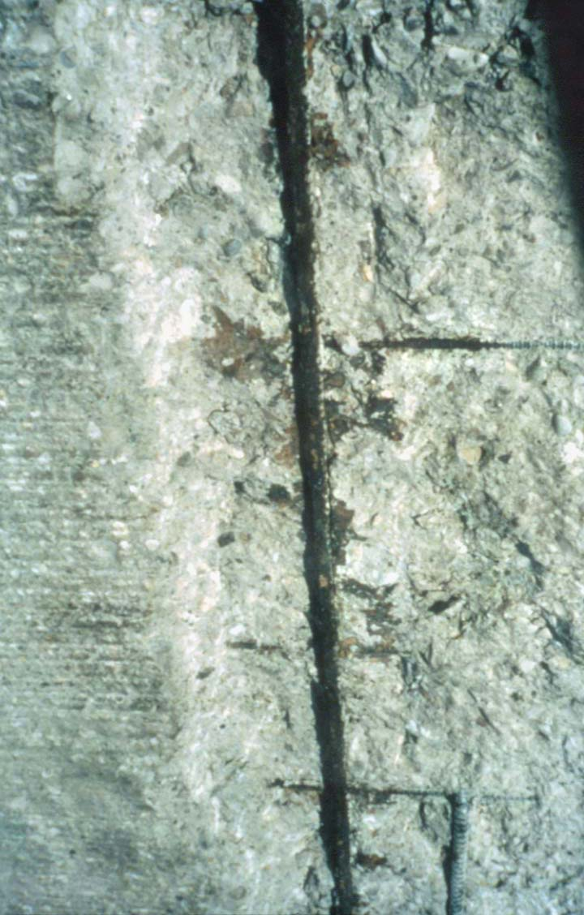
Delamination & Corroded Rebar
29

Slide 31
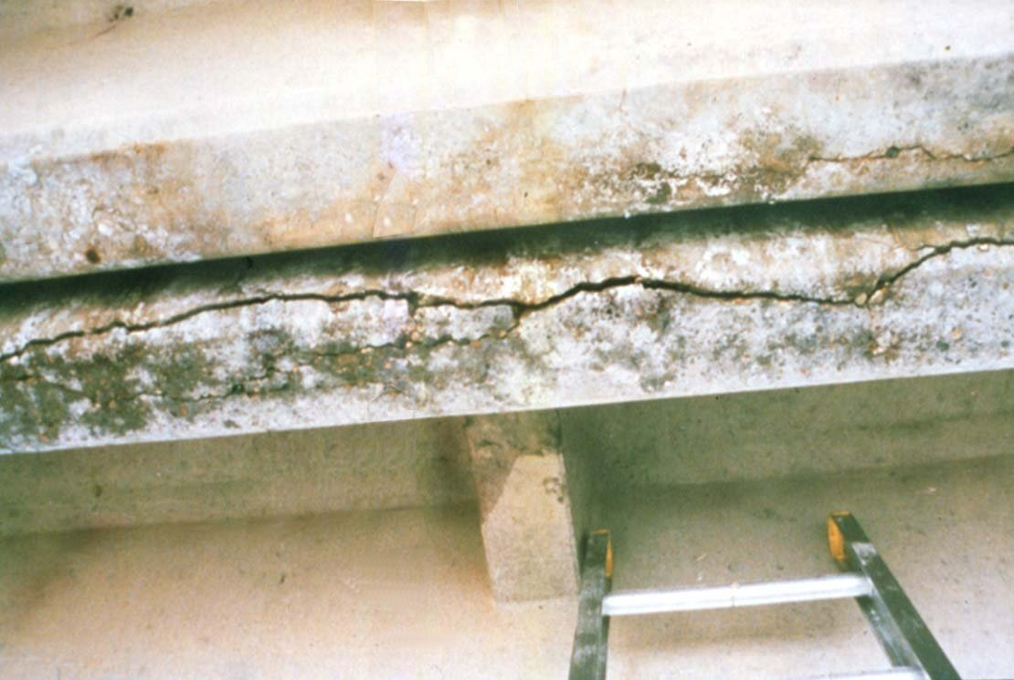
Longitudinal Crack & Corroding Rebar
30

Slide 32
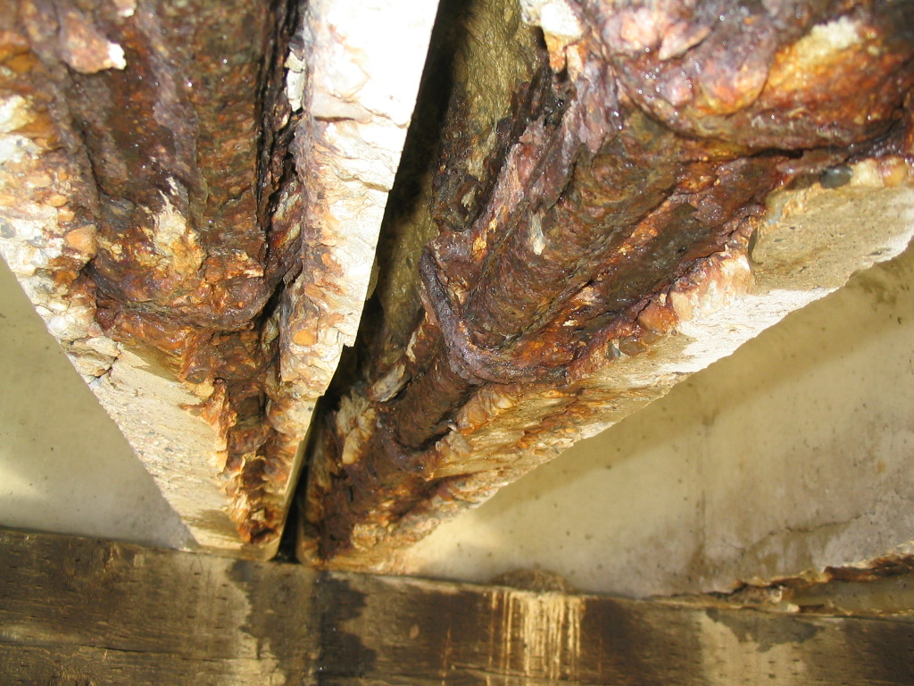
Corrosion Spall
350
31

Slide 33
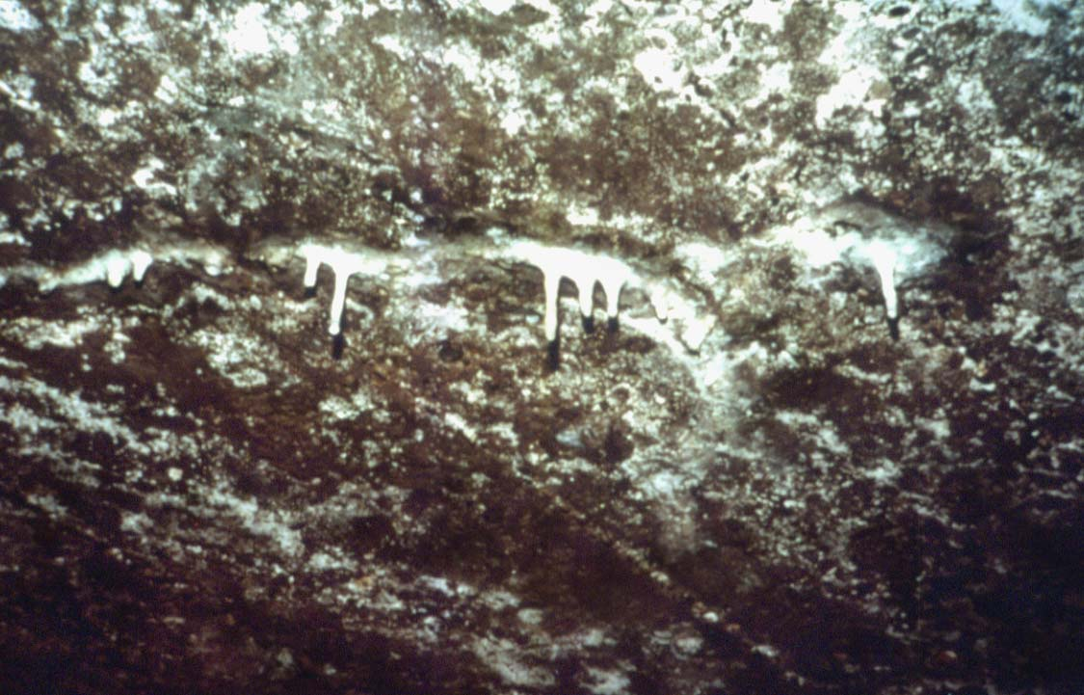
Calcium Carbonate Deposits
32

Slide 34
Concrete - Steel Combination
Reinforced Concrete
  Concrete has high compressive strength and low tensile strength
  Always cracks under tensile load
  Mild steel carries tensile load
Prestressed Concrete
  High strength steel strands
  Concrete is pre-compressed
  Carries load without cracking
33

Slide 35
STEEL
34

Slide 36
What is Steel?
Steel is an alloy of iron, carbon and other trace metals
Carbon and trace metal ratios:
  Carbon 0.15 to 0.3%
  Manganese 0.50 to 2.0%
  Phosphorus 0.02 to 0.2%
  Sulphur 0.02 to 0.06%
  Silicon 0.15 to 0.8%
35

Slide 37
Iron
Iron in the pure form is a soft, shiny metal like aluminum.
However, it is never found in this state.
Iron oxidizes extremely easily.
In nature it is always found as an oxide.
36

Slide 38
Steel Making Process
Iron ore, coke and limestone are major raw materials.
Raw material is charged into Blast furnace which has a temperature of 1600°C.
Iron melts and settles at the bottom.
Solidified iron is called “Pig Iron”
37

Slide 39
Steel Making Process
Molten metal from blast furnace and silicon is taken into Basic Oxygen furnace
Chemical analysis of the molten material is done
Steel billets are heated to 1200°C for rolling and finished products.
38

Slide 40
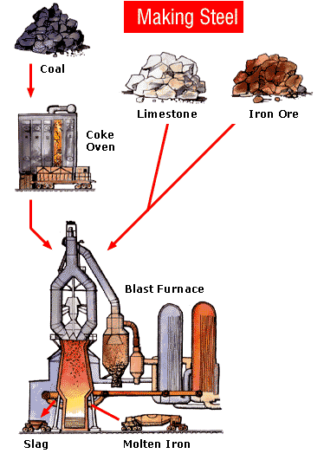
39

Slide 41
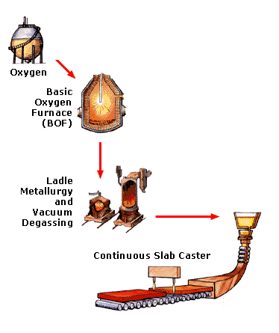
Molten Iron
40

Slide 42
Effects of Various Elements
Effects of Carbon in steel:
  Increases strength and hardness
  Reduces ductility, weldability, machinability and toughness
Effects of Phosphorus in steel:
  Increases strength and hardenability
  Reduces ductility and weldability
41

Slide 43
Effects of Various Elements
Effects of Manganese in steel:
  Increases strength, hardenability and notch toughness
  Reduces weldability
  Reduces ill effects of sulfur
Effects of Sulfur in steel:
  May cause porosity and hot cracking in welding
  Can cause brittleness
42

Slide 44
Effects of Various Elements
Silicon in steel:
  Increases strength, hardenability and notch toughness
  Reduces weldability
  Deoxidizer in steel making
Copper, Chrome, Nickel:
- Weathering steel (Cor-ten)
43

Slide 45
Common Steel Shapes
  Wires
  Cables
  Steel Plates
  Steel Bars
  Rolled Beams
  Built-up Shapes
44

Slide 46
Rolled Sections
Angle
Channel
Rolled I Beam
45

Slide 47
Built-up Sections
46

Slide 48
Important Physical Properties
Strength
  Compression
  Tension
  Fatigue
Ductility
Notch toughness
Weldability
Fire Resistant
Corrosion Resistant
47

Slide 49
Tension & Compression
Stress Strain Diagram
tension
(+)
shorten (-)
lengthen (+)
compression
(-)
48

Slide 50
Steel Damage and Deterioration
Corrosion
  Environmental corrosion
  Stray current corrosion
  Stress corrosion
Cracking
  Fatigue
  Impact
  Excessive loading
Note: Any crack in a steel member is serious
49

Slide 51
Steel Damage and Deterioration
Deformation
  Excessive loading
  Heat damage
  Impact
50

Slide 52
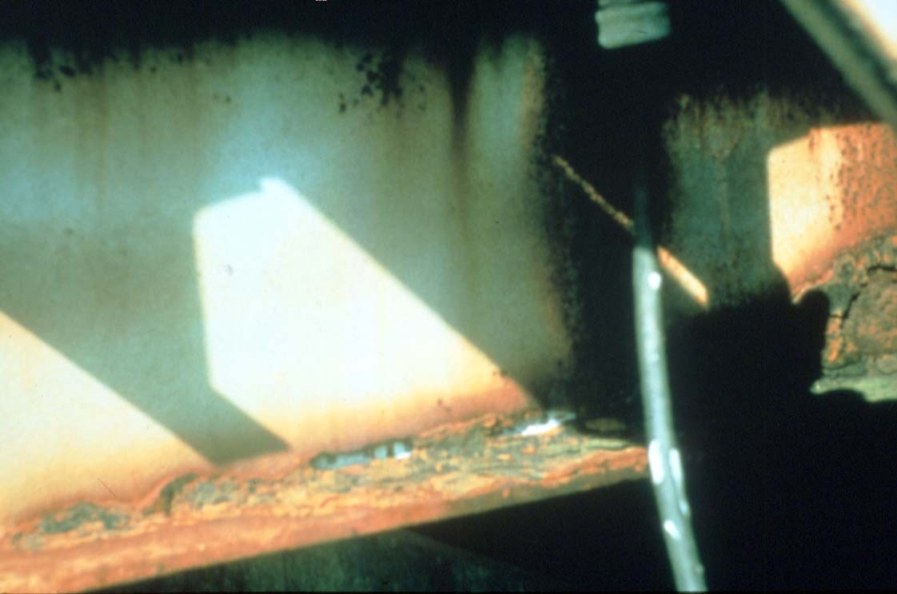
Corrosion Holes in Girder Web
51

Slide 53
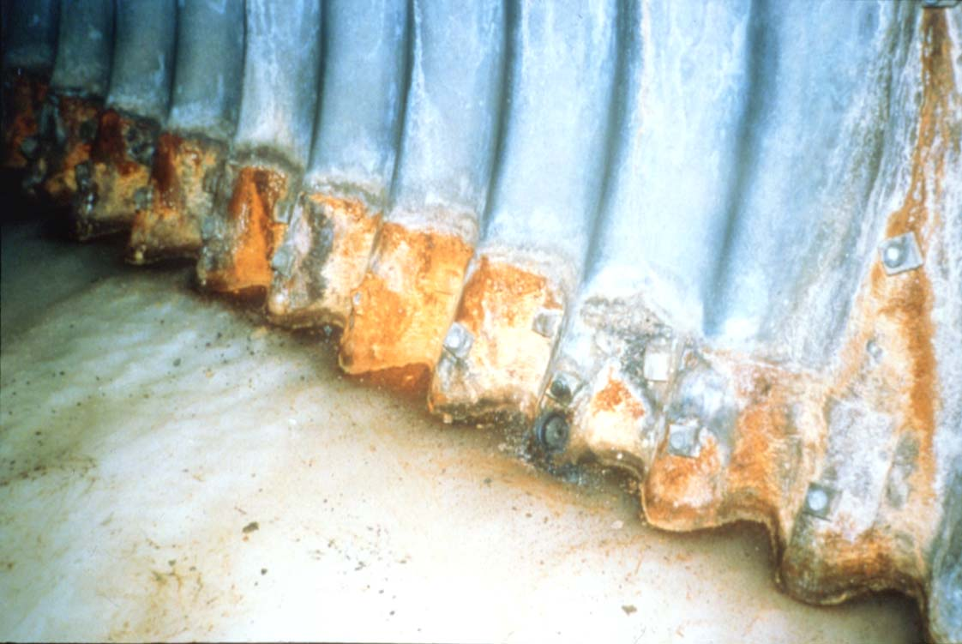
Stains from Soil Side Corrosion
52

Slide 54
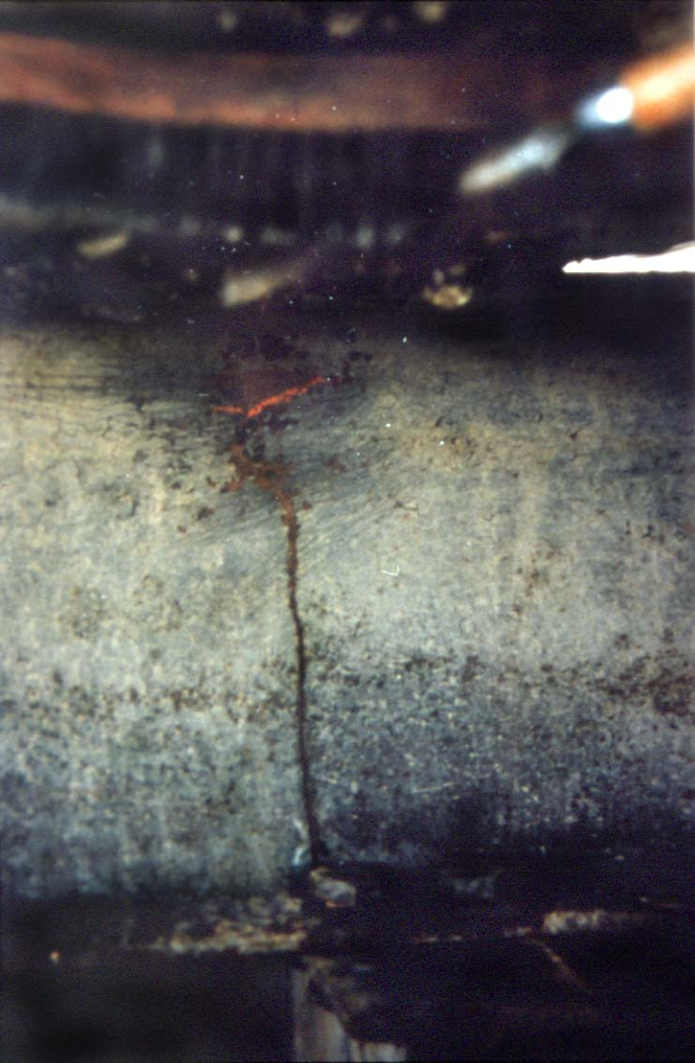
Crack initiated by Bolt Hole
53

Slide 55
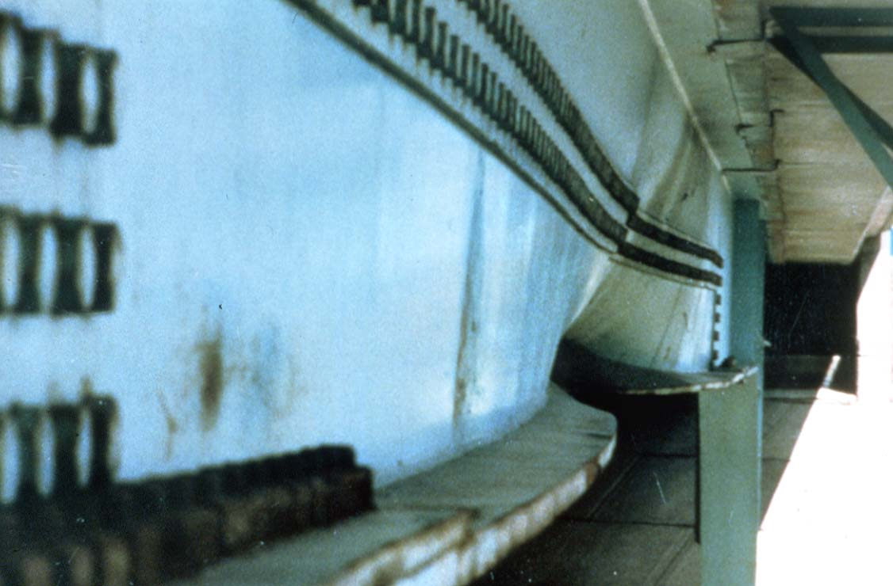
Collision damaged steel girder.
54

Slide 56
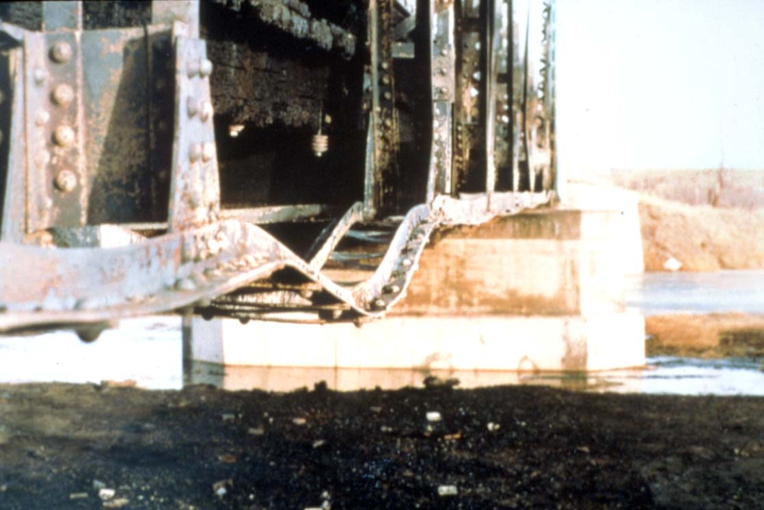
Fire Damaged Truss.
55

Slide 57
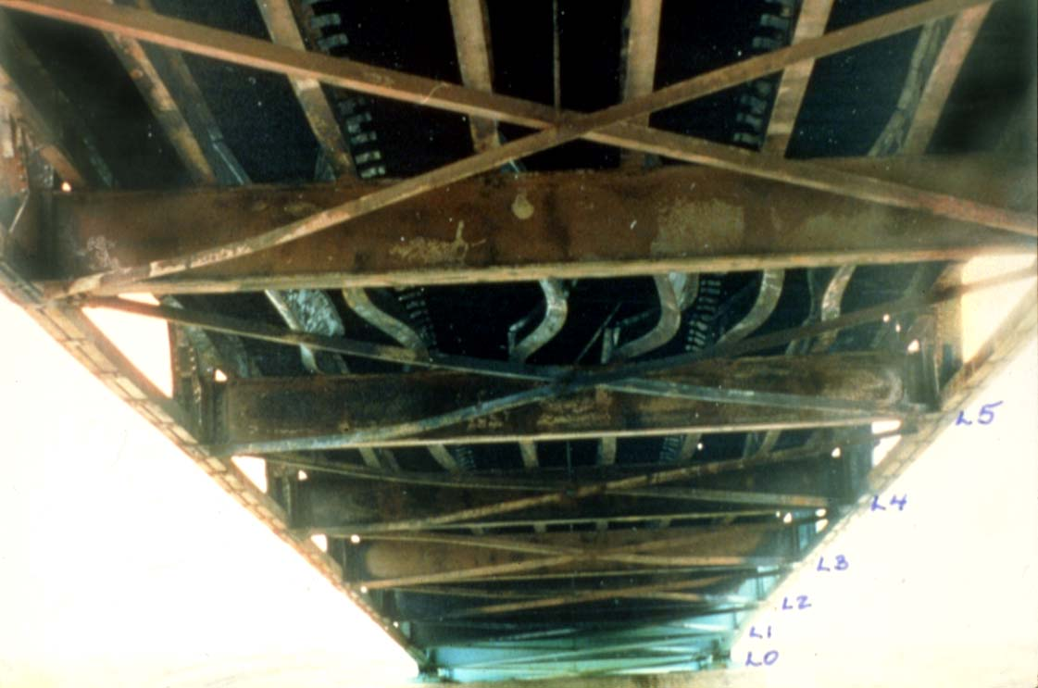
Fire Damaged Truss.
56

Slide 58
UNCONTROLLED
WELDING
IS NOT ALLOWED
ON BRIDGE
STRUCTURES.
57

Slide 59
TIMBER
58

Slide 60
Wood
What is wood?
  A naturally occurring non- homogeneous material.
Composition of timber:
  Carbohydrate fibres
  Water
Classification of timber:
  Hardwood
  Softwood
59

Slide 61
Cross Section of Tree
Outer Bark
Inner Bark
Cambium
Sapwood
Rays
Heartwood
Pith
60

Slide 62
Growth Features
Growth features
  Knots
  Splits, Checks
Moisture content
  Moisture affects dimensional stability
  19% moisture content is considered seasoned wood
61

Slide 63
Checks
62

Slide 64
Physical Properties
Compression
    perpendicular to grain
    parallel to grain
Tension
Bending
Fatigue
Shrinkage
    60% radially
    2% longitudinally
63

Slide 65
Timber Damage & Deterioration
Abrasion
Warping
Checks & Splits
Cracking
  Flexural
  Horizontal Shear
Fire Damage
Collision Damage
Decay
64

Slide 66
Timber Damage & Deterioration
Decay is caused by fungi
To grow fungi need:
  Oxygen
  Temperature
  Food
  Moisture
Insects – Pine beetles can be a serious problem in Alberta
65

Slide 67
Protective Systems
Water repellents
Preservatives
  Creosote
  Cromated Copper Arsenate (CCA)
  Ammoniacal Copper Zinc Arsenate (ACZA)
Paint
66

Slide 68
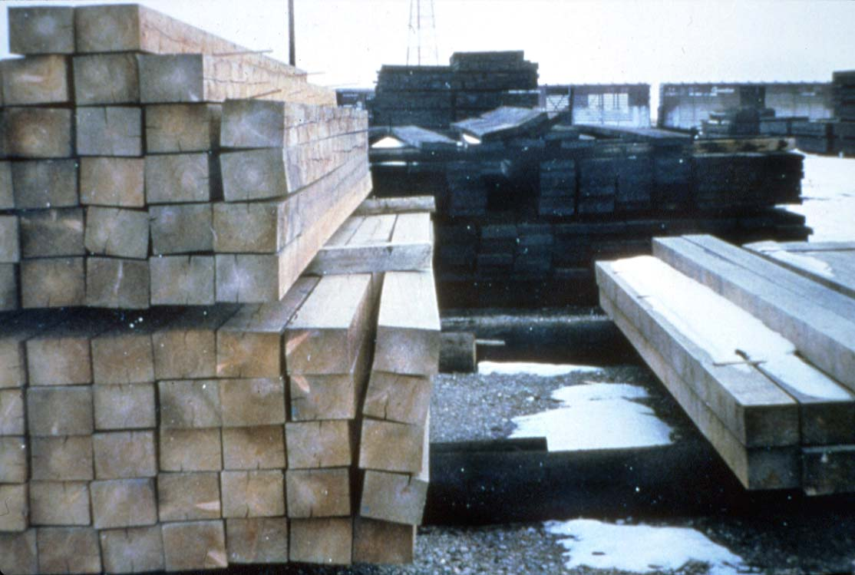
Warping due to Drying Shrinkage
67

Slide 69
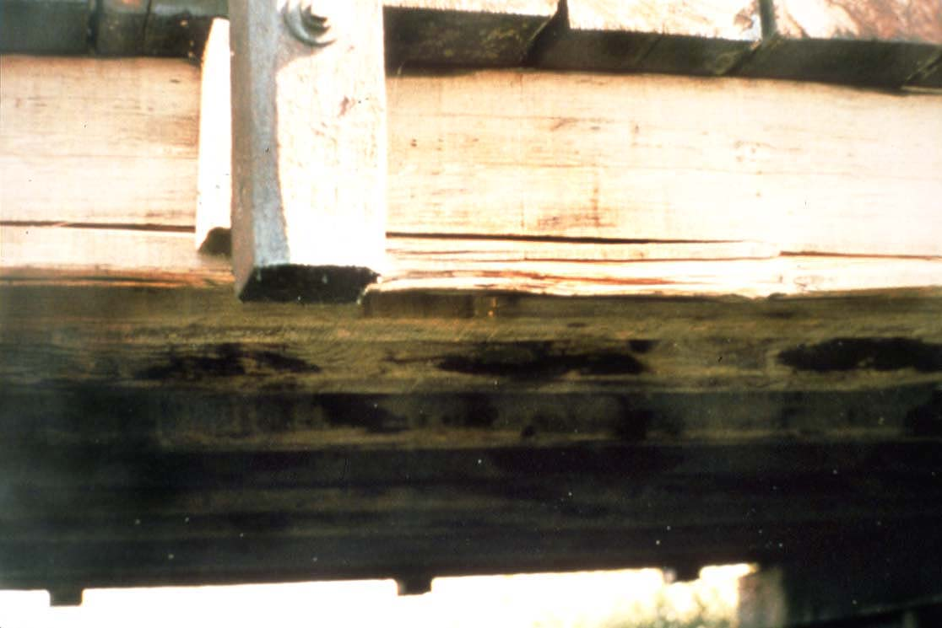
Horizontal Shear Crack.
68

Slide 70
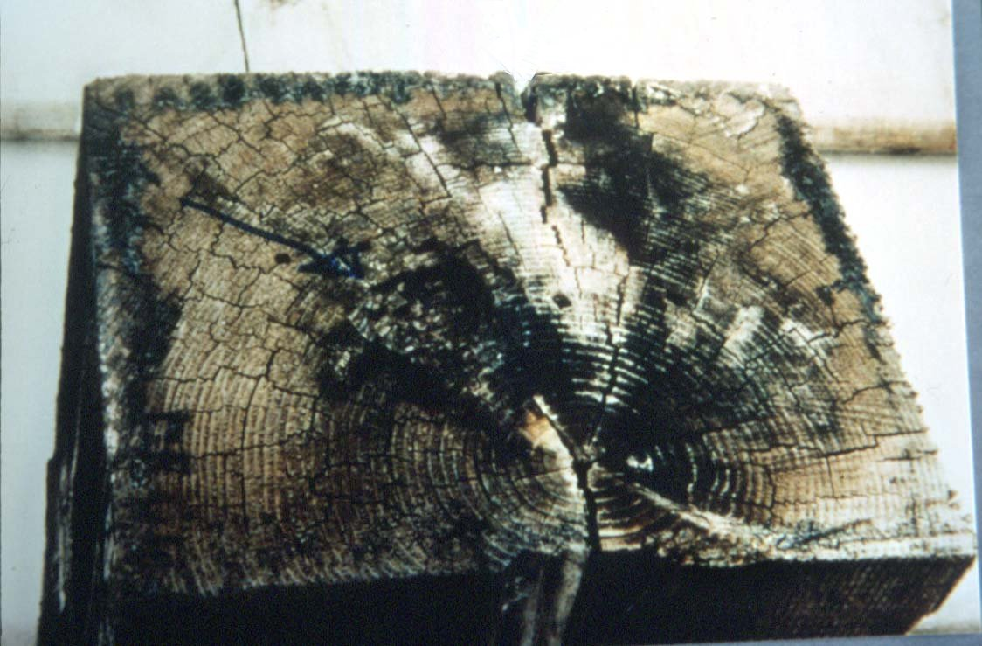
Checking & Start of Rot
69

Slide 71
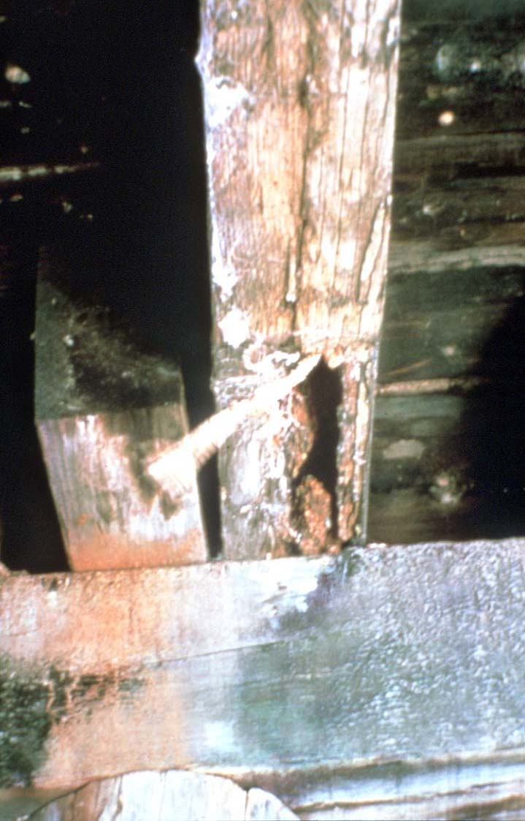
Serious Rot in Stringer
70

Slide 72
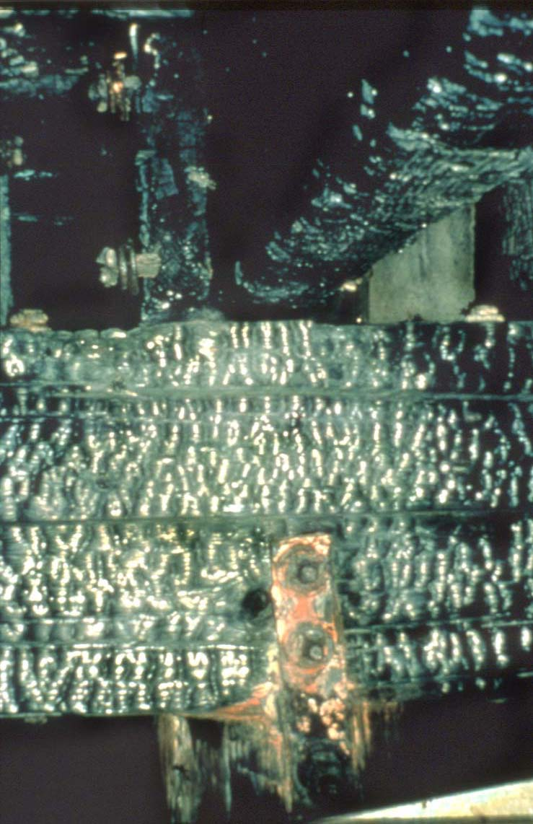
Fire Damaged Timber
71

Slide 73
Questions??
72

