Slide 1
WELCOME
Class B Bridge Inspection Course
Notes:
Welcome
Personal Introduction

Slide 2
Course Instructors
Primary Instructors / Trainers
  Garry Roberts
  Randy Bredo
Guest Lecturers
  AT/Department specialists
  Sub-consultant specialists
Refer to Course Schedule

Slide 3
General Information
Emergency Protocol
  Washrooms
Smoking
  At designated locations only - minimum 30 ft from building entrances
Daily sign out is required at the front desk
Note Taking & Course Materials
Course Evaluations

Slide 4
Room Access
Access key required to gain access through double doors from atrium into conference room area.
Access key required when using the washroom.
Access keys will be left at front of room on coffee table for use by students.
Please return the key after use.

Slide 5
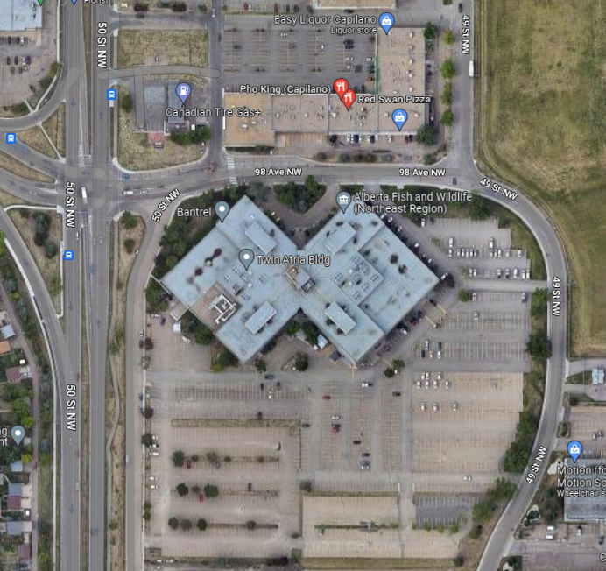
Parking

Slide 6
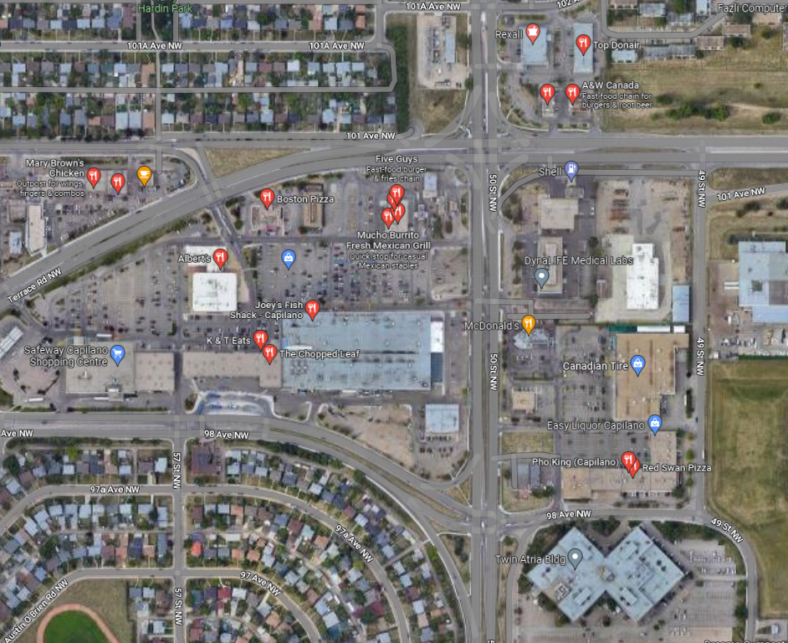
Nearby Lunch Options

Slide 7
Self Introduction
Name
Organization
Present or Proposed Involvement with Bridge and Culvert inspection
Fill out the Name Tag/Placeholder

Slide 8
BIM Inspector Training
**Alberta Transportation Requires All BIM course participants
to self-register for TIMS/BIS application for certification tracking purposes**
https://extranet.inftra.gov.ab.ca/inftra_login.html
https://extranet.inftra.gov.ab.ca/Self_Registration_Guide_to_Access_TIMS.pdf

Slide 9
Course Schedule
Monday – Friday
  Start Time 8:00 am
  Finish Times 4:30 - 4:45 pm
Field Trip on Wednesday
  Hard Hat, Hi-Vis Safety Vest, Hip/Chest Waders, Boots
  Clip board, flashlight, hammer, tape measure
  Transportation provided. Bring lunch.
Preparation Requirements
Questions allowed at anytime

Slide 10



Quizzes
Four Closed Book Exams:
Tuesday morning, Thursday morning;
Friday morning, and, Friday afternoon
Pass mark is 70%
Marks posted daily – any objections to posted marks contact the instructor

Slide 11

Courtesies
Turn cell phone OFF/vibrate
  No text messaging
No talking during exams – leave the room and talk in the hall once the exam is completed.

Slide 12
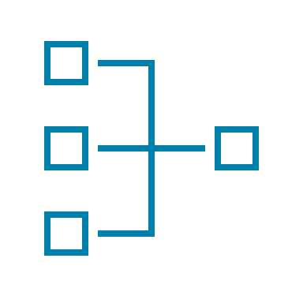


Course Objectives
Introduction to AT’s BIM system
Learn bridge inspection terminology
Learn inspection protocol and principles
Introduction to bridge/culvert maintenance

Slide 13

Questions?

