Slide 1
BIM INSPECTION FORMS

Slide 2
Bridge Types
There are 2 Types of Bridge Inspectors – Class B and Class A
Class B inspectors can only inspect Standard Bridges, Culverts and WCTS
Class A Inspectors can inspect Major & Standard Bridges, Culverts, Signs, & WCTS
Definition of a Standard Bridge - Bridges that are built using standard components and Standard Drawings (exception is standard girder bridges with composite decks – SMC, SCC, SLC – which are considered as major bridges)
Definition of a Major Bridge – Bridges that are not built with Standard Drawings
For a listing of all current and archived drawings refer to:
https://www.alberta.ca/bridges-and-structures-standard-and-typical-detail-drawings.aspx

Slide 3
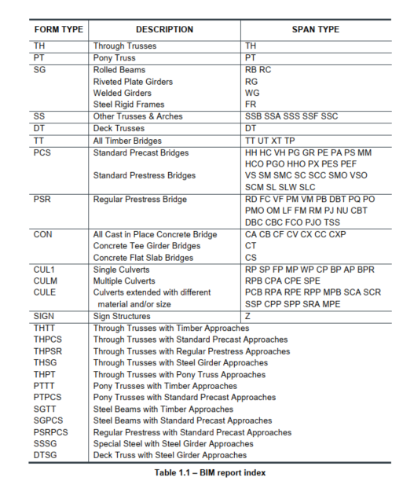
Inspection Form Types
Each form has a unique form identification
10 different inspection report forms for bridges with a single-span type
3 different inspection report forms for culverts
Custom forms generated to suit bridges with multiple form types are unlimited.

Slide 4
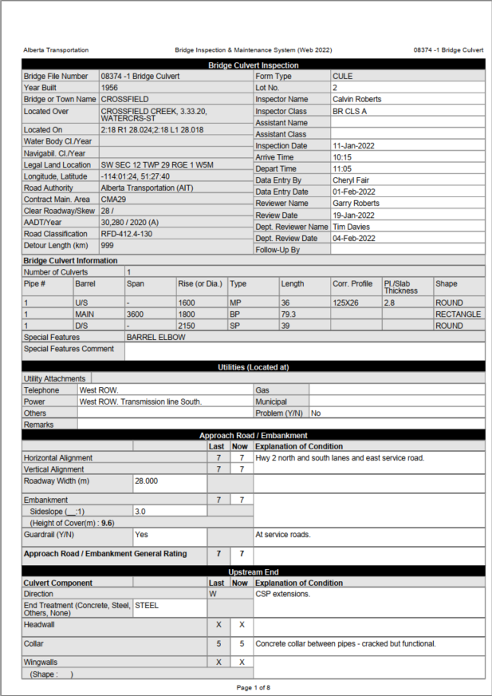
Form Verification
How do you know what the form ID is?
- Look at the form itself.
How do you know what span type it is?
- Look at the form itself.
What if the form ID or span type do not make sense?
  Look at resource material to match up the actual in-field structure with drawings.
  If still in doubt ask a senior inspector or AT representative.

Slide 5
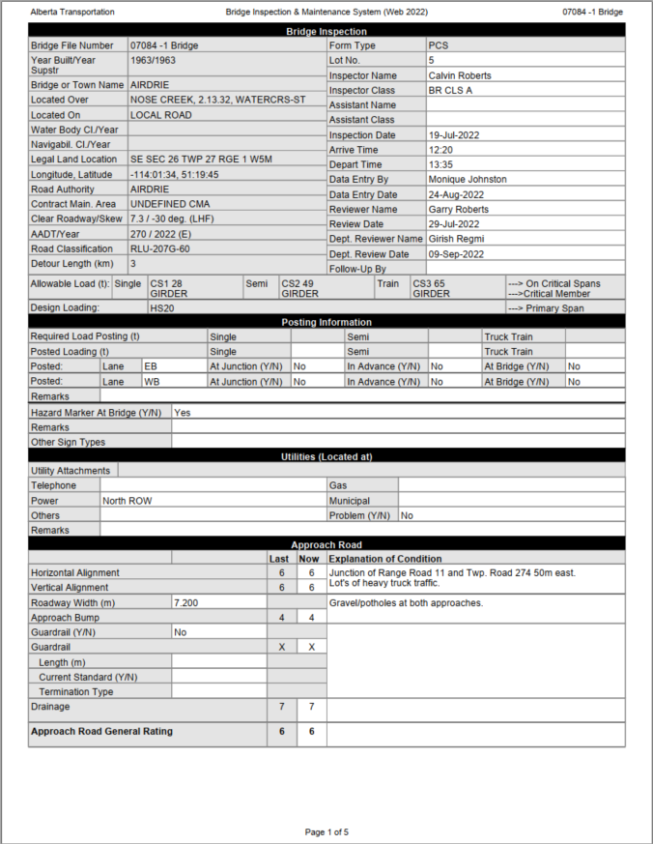

Slide 6
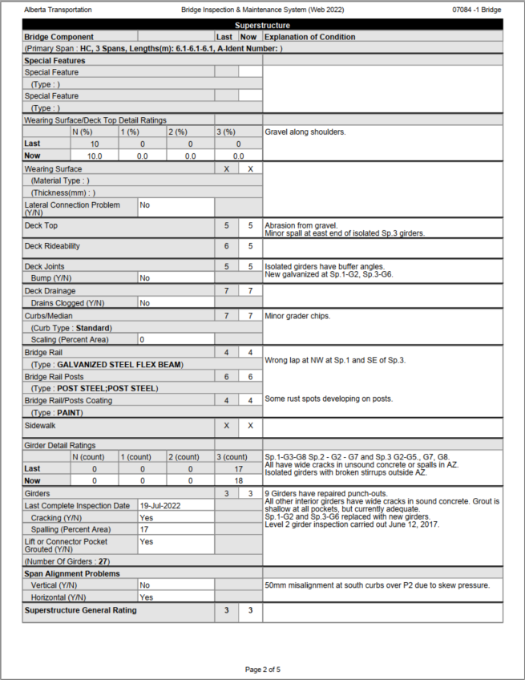

Slide 7
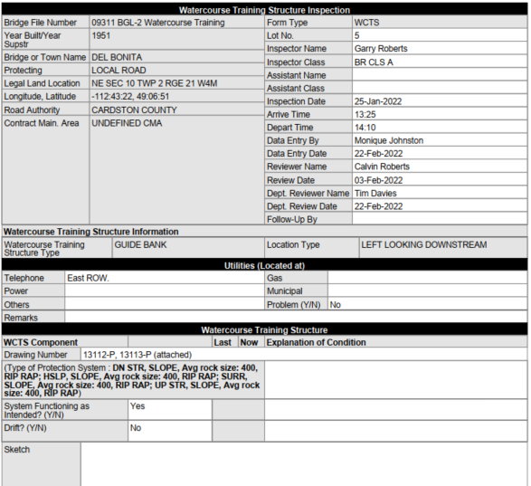
Watercourse Training Structure

Slide 8

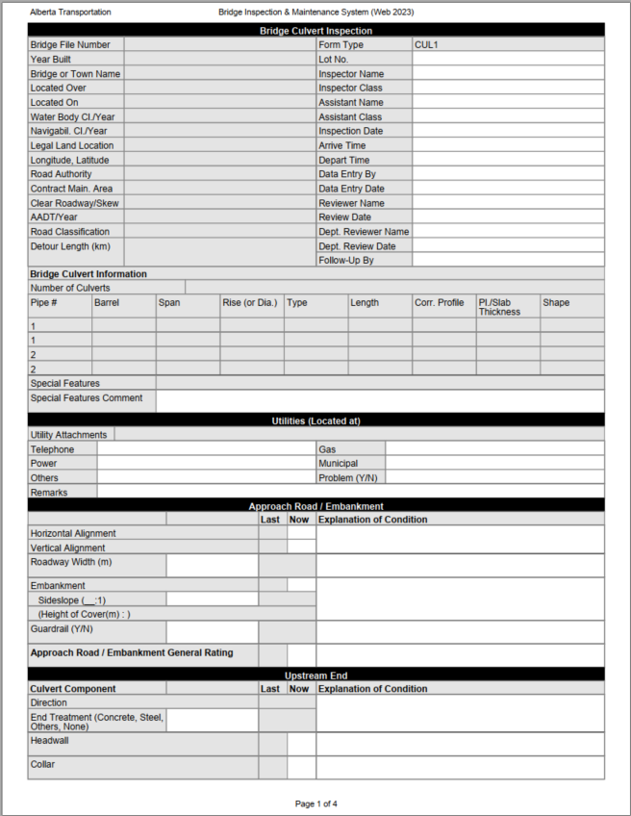
Form Sections
INVENTORY SECTION
UTILITY SECTION
APPROACH ROAD SECTION
UPSTREAM or INLET SECTION

Slide 9
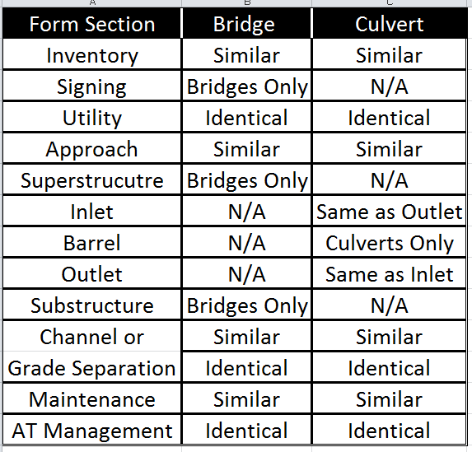
Sections of Standard Bridge & Culvert Forms

Slide 10
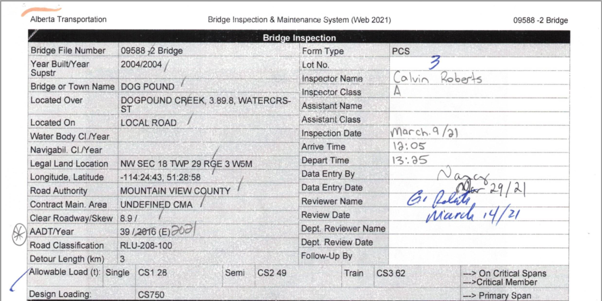
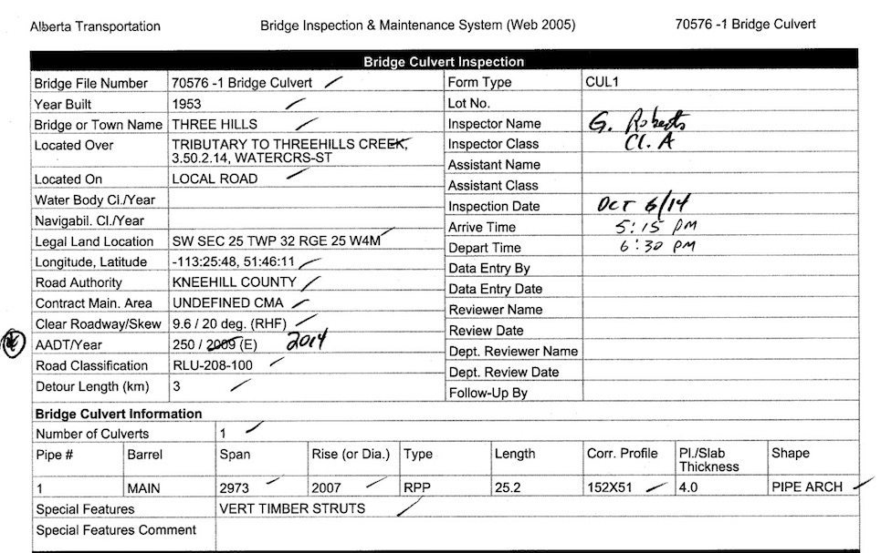
Culverts
Inventory (Similar)
Bridges

Slide 11
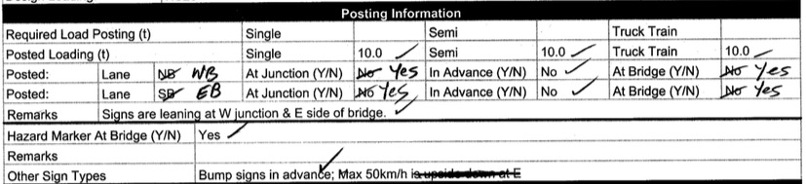
Signage (Displayed on Bridges Only)
Includes Posted Loading, Hazard Markers, Other Sign Types

Slide 12
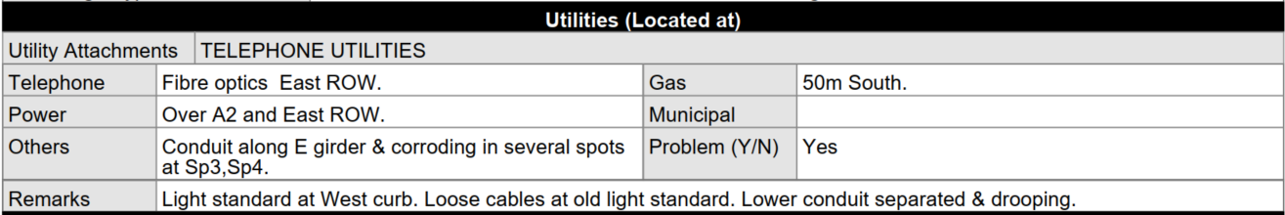
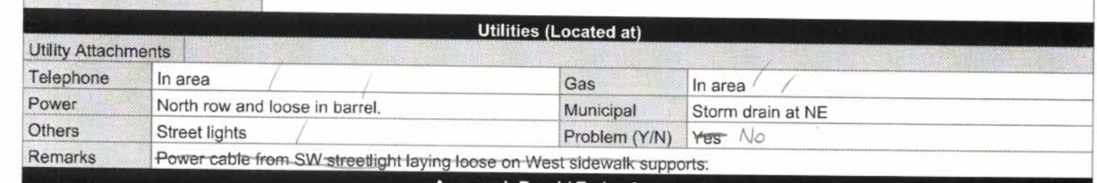
Utility Section (Identical)
Bridges
Culverts

Slide 13
Differences between
Precast Girder and TT Stringer Superstructures
PCS has separate rating boxes for both Deck Top and Wear Surface. Combined on TT form
Adds “Plank Width” to TT Form
Adds “Lateral Connection Problem Y/N” to PCS Form
Deck Joints added to PCS Form
Deck Drainage rated on PCS form only (rated “X” for TT decks)
Curb component PCS vs Wheelguard component TT Form
“Girders” on PCS vs “Timber Stringers” on TT Form
The remainder of the form is the same.

Slide 14
Superstructure
(Bridges Only)
Precast Girders

Slide 15
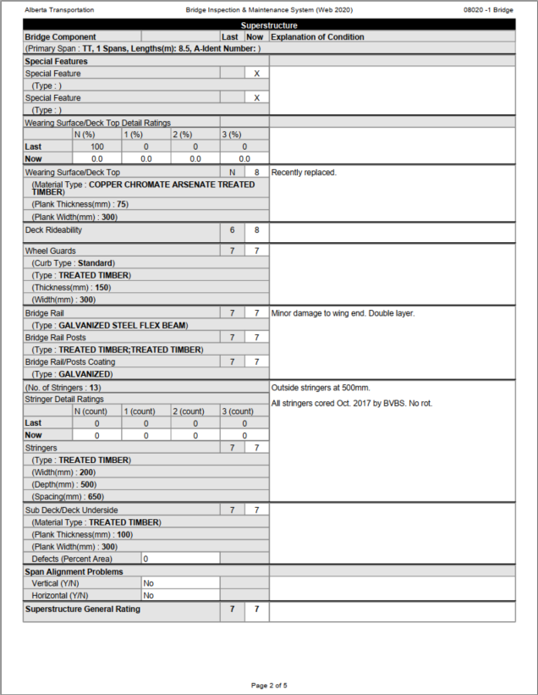
Superstructure
(Bridges Only)
Treated Timber
Stringers

Slide 16
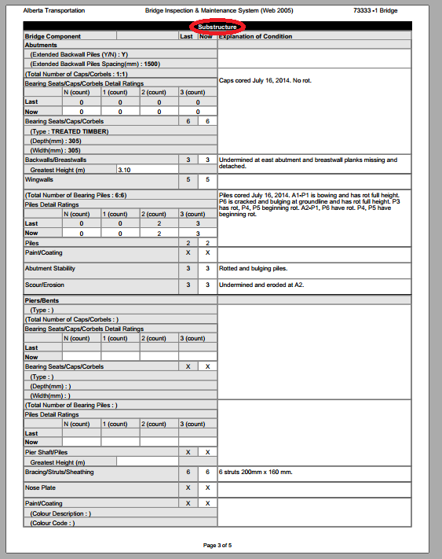
Substructure
(Bridges Only)

Slide 17
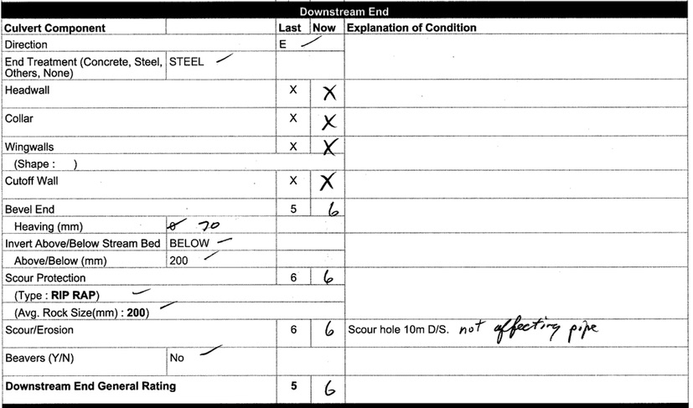
Culvert Inlet (U/S) and Outlet (D/S) (Identical)

Slide 18
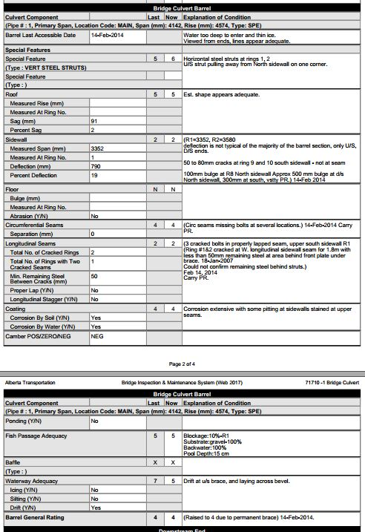
Culvert Barrel

Slide 19
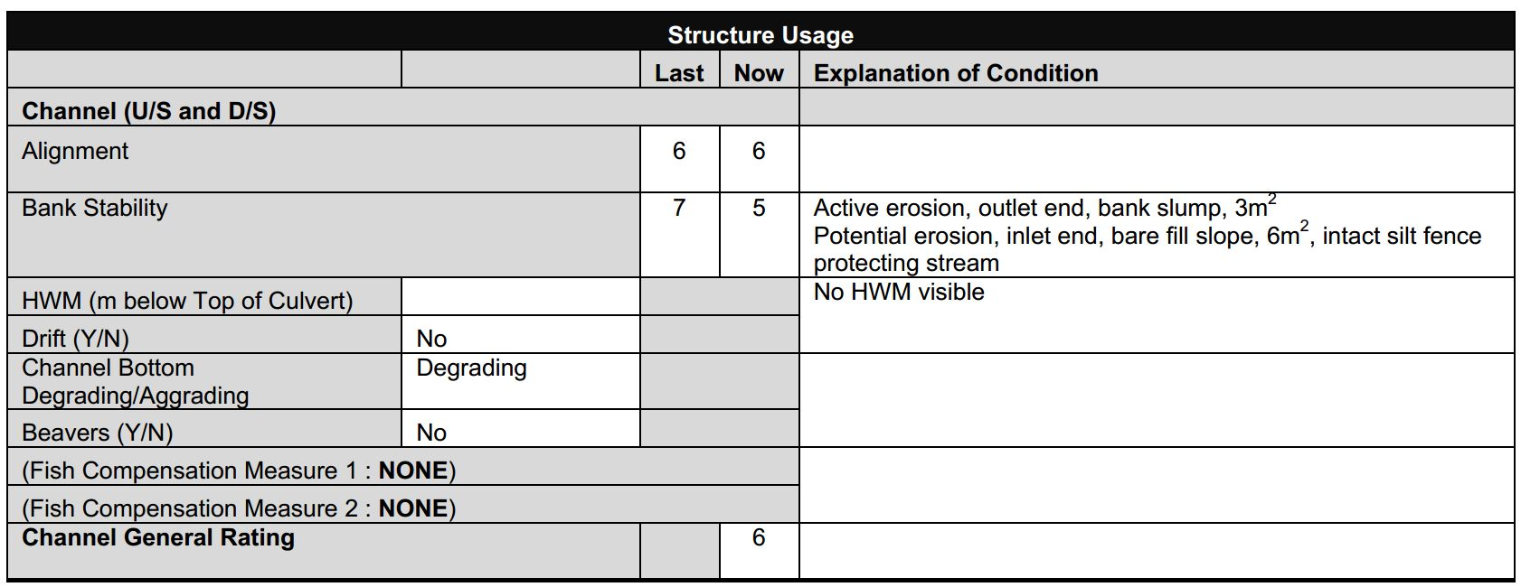
Culvert Channel Section

Slide 20
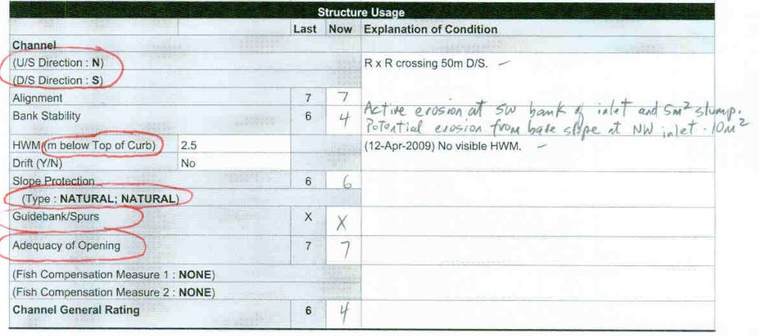
Bridge Channel Section

Slide 21
Bridge and Culvert Channel Section
Record and/or confirm U/S & D/S directions
Note if there is active or potential erosion (no evidence of soil movement, but exposed earth on fill slopes or in ditches leading to stream) in the vicinity of the crossing.
Note source of the erosion (ditch gully, bank slump, fill slope, road surface, other) and indicate if occurring at the inlet, outlet or both.
Note any intact erosion control or established vegetation between the erosion area and the stream
Note the size of the erosion area (m2).
Refer to Chapter 9 (Bridges) and Section 13.7 (Culverts) for additional information.

Slide 22
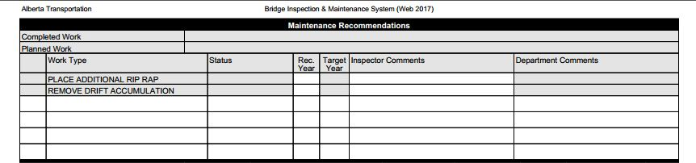
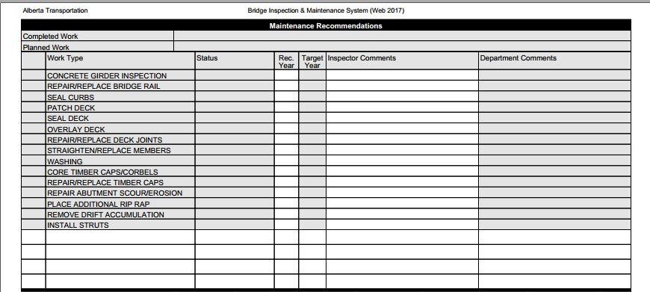
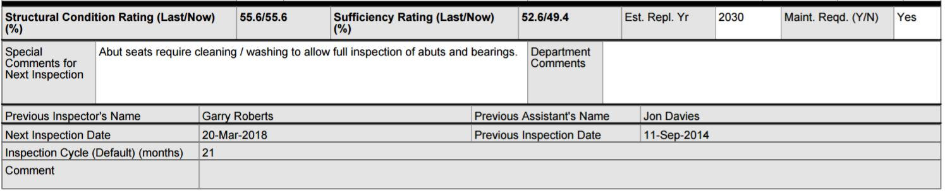
Maintenance (Similar)
Culverts
Bridges
AT Management Section (Identical)

Slide 23
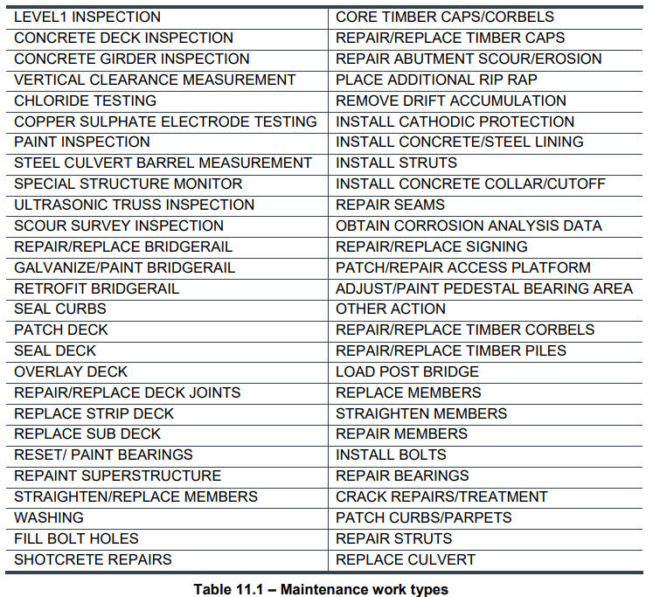
Maintenance Work Types

Slide 24
Culvert Inspection Form Types
Culvert form types:
  CUL1 Form
    single culverts of all types
    single culvert extended with same size and material type
    one barrel section
    therefore - 1 inlet, 1 barrel and 1 outlet
  CULM Form
    multiple pipes or cells
    two cell concrete box extended with steel
    two or more-barrel sections
    therefore - multiple inlets, multiple barrels & multiple outlets
  CULE Form
    single culvert extended with different material or pipe size
    two or more-barrel sections
    therefore – 1 inlet, multiple barrels and 1 outlet
  Custom Forms to suit number & types of barrel sections.

Slide 25
Form Features
Tailored to the span type or types of the particular structure.
Contain full descriptions and full comments, no codes are required.
Shows inventory data needed for a proper inspection.
Provides the design and allowable loads and critical member.
Allows for condition rating of elements and explanation.

Slide 26
Form Features
Allows for general rating of each major category.
Provides a list of typical maintenance items.
Provides for special comments or instructions for the next inspection.
Provides for programming, scheduling, cost estimation, authorization and tracking of maintenance.
Repeats previous inspection data for inspector’s information.

Slide 27
Form Features
Provides sufficiency rating and structural condition ratings based on inspection data.
Clearly indicates if a bridge element is not accessible or not applicable.
A logical sequence to facilitate the inspection process.
Provides for 2 levels of inspection.

Slide 28
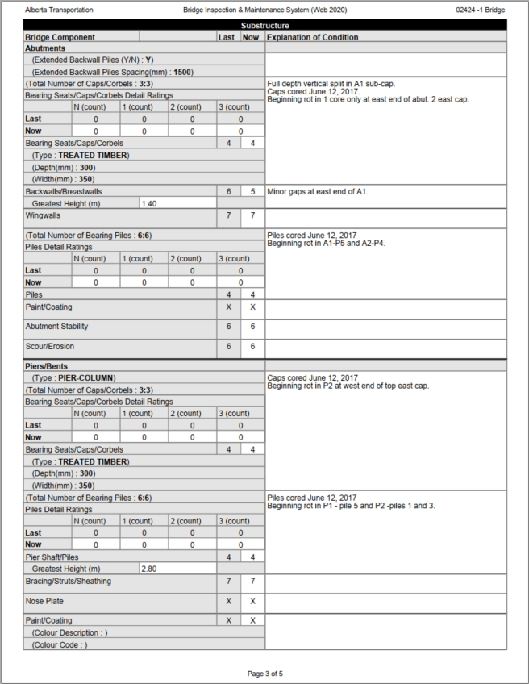
Data Fields
Shaded Fields
  Element and data labels
  Inventory Information (confirm, revise, or add if missing)
  Element descriptions (type, size, etc.)
Unshaded Fields
  Element ratings
  Inspection measurements
  Explanations of condition

Slide 29
BIM System Fills In Shaded Area
Inspector Confirms, Corrects, or Adds

Slide 30
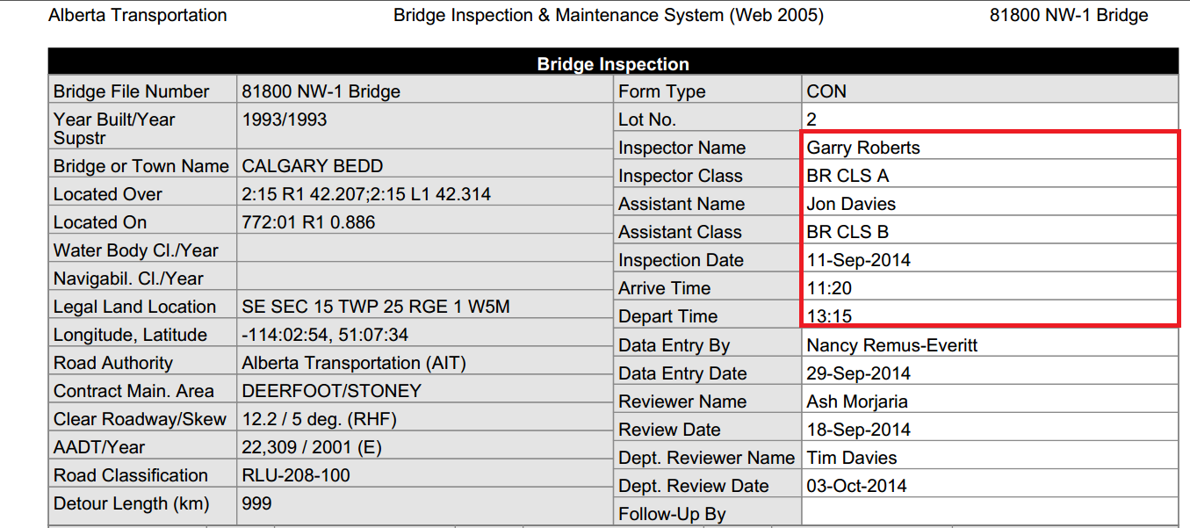
Hi-Lited Section to be Filled in by Inspector

Slide 31
Lot Number
1 = Major maintenance, Assessments, Critical elements rated 3 or less, Level 2 Inspection or reduced cycle.
2 = Minor or routine maintenance
3 = All structures not managed by AT (LRA, Irrigation Districts, Towns)
4 = No action or Monitoring
Lot number is assigned by Reviewer
Certification status of inspector checked by system.

Slide 32
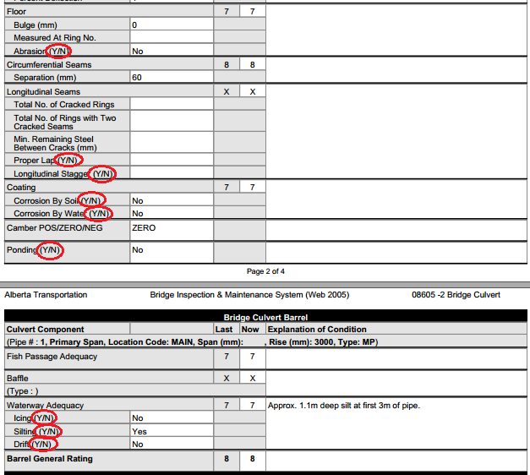
Example of Y/N Field

Slide 33
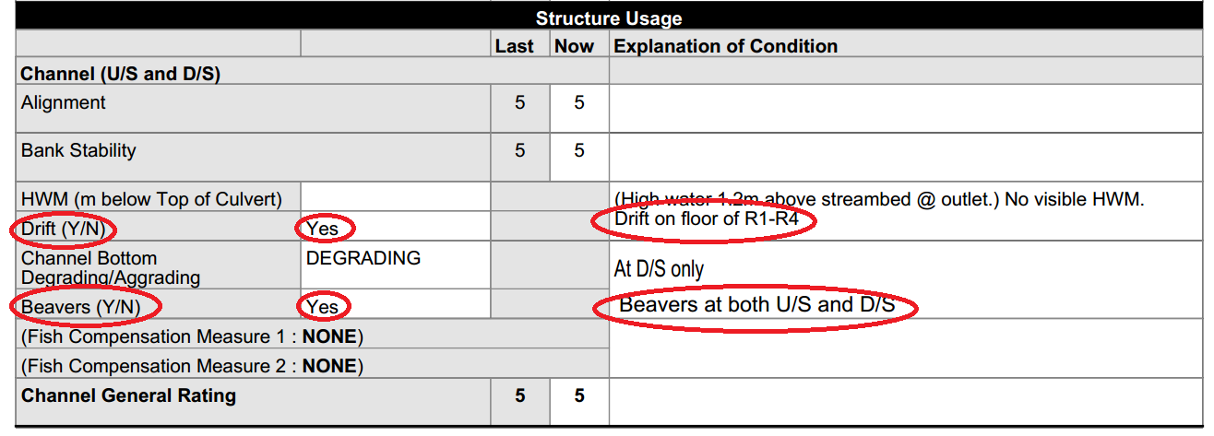
Example of Y/N Supporting Comments Required

Slide 34
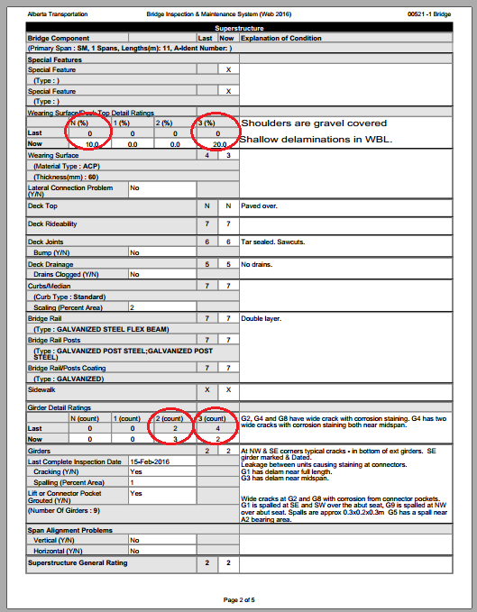
Example of Filling in Data Fields and Detailed Rating Boxes – Superstructure

Slide 35
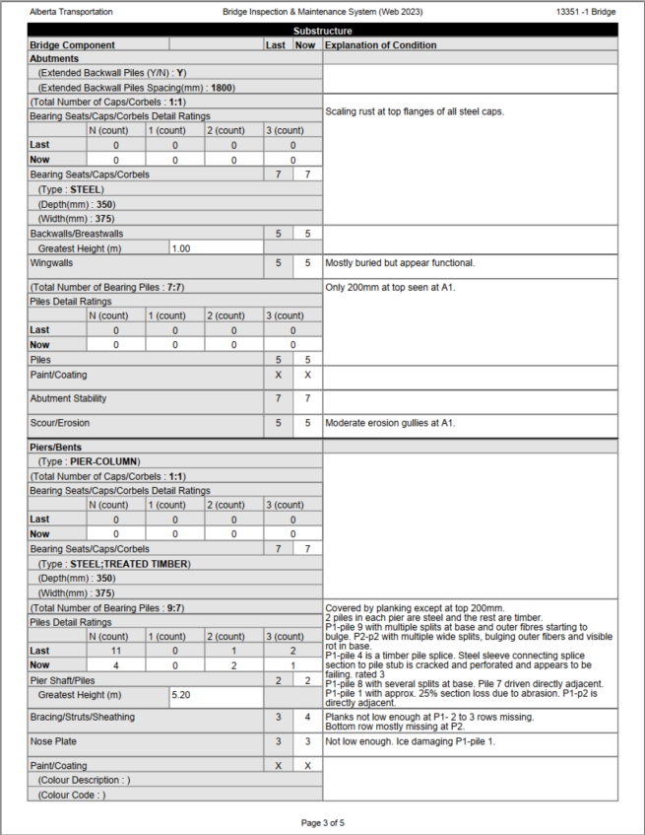
Example of Filling in Data Fields and Detailed Rating Boxes – Substructure

Slide 36
Detail Ratings
Superstructure:
Wearing surface/deck top
TT stringers and PCS girders
Substructure:
Timber caps
Timber piles
Provided when ratings are 3, 2, 1, and N
Record 0 in Detailed Rating boxes if element is rated 4 or more.
Some Detailed Ratings boxes require % of total area (i.e. Wear Surface/Deck Top)
Some Detailed Ratings boxes require “Count” of total numbers (i.e. Caps, Piles)

Slide 37

Questions?

