Slide 1
BRIDGE INVENTORY INFORMATION

Slide 2
Inventory Information
On inspection forms to assist inspector
Information is used to update and keep BIS current
Sources
  Transportation Infrastructure Management System (TIMS)
  Inspectors add new data, verify existing or revise as required
  Future pick lists for addition or revision

Slide 3
How Are Structures Identified?
Bridge File Number (99999) assigned to each bridge site
  5-digit number
  leading zeros, e.g., 00987
  assigned in sequence
  example: 75555
Structure Number (99) assigned to each structure at the site
  example: 1, 2, 3, etc.
  Original structure #1 replaced at same location becomes #2 regardless of structure type
  Multiple structures at same site have same BF# but different structure #

Slide 4
How Are Structures Identified? (cont’d)
Visual Identifiers
Travel Direction
- example W = westbound structure divided highway, EC = Eastbound Collector
  - blank = Two Way Traffic
  Structure Type
  - Z = Sign Structure
  Example: 75555-ZNC-3
Year Built (e.g. 1990/2023)
  First year shown is Substructure or Barrel construction year
  Second year is Superstructure fabrication year, or barrel lined

Slide 5

Where is the Bridge?
Bridge Name or Nearest Town
  bridge official name
  nearest town on road map
Located Over
  Watercourse, Road, Railway, etc.
Located On
  Highway or Local Road
  Includes Control Section (2:03)
Contract Maintenance Area
  Prov. Highways (e.g. CMA 28)
  Local Roads display as “Un-Defined CMA”

Slide 6
Watercourse Designations
Water Body Class & Year
  future
  water class of the watercourse
  year designated by Environment
Navigable Waters Class & Year
  future
  navigable class of stream
  year classified

Slide 7
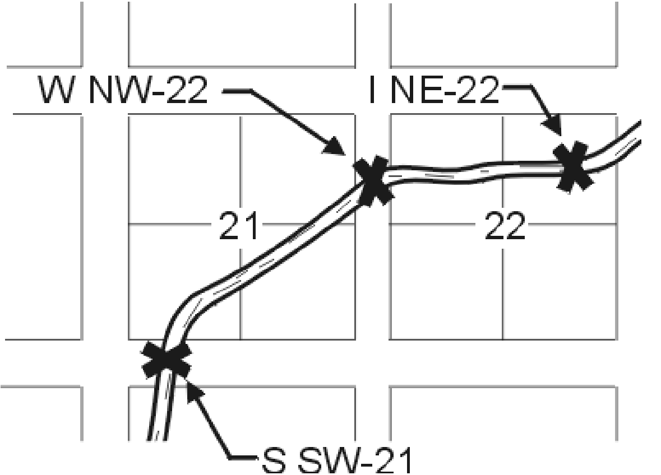
Where is the Bridge?
Legal Land Location
  ie WNW 22 - 028 - 03 – W5M
Prefix is always W, S, or I
Longitude, Latitude
  ie -113:18:04, 51:02:15

Slide 8
Road Authority
Alberta Transportation (AT)
Alberta Environment
Municipal Services Branch (Special Areas)
County or Municipal District (C01 or M36)
Town or Village (T or V)
City (Urban Airdrie)
Municipal Affairs (MA)
Federal Government Departments (FIA)
Private (P)

Slide 9
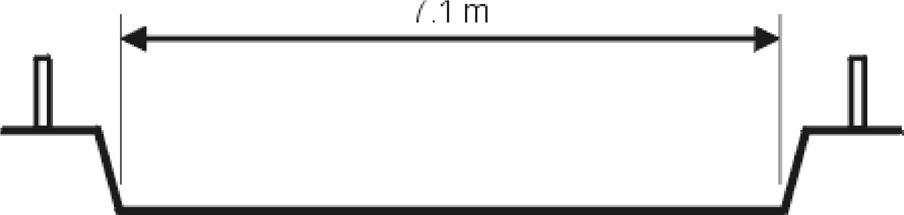
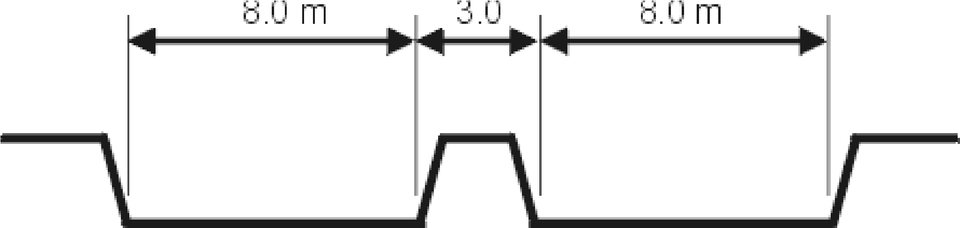
What is Clear Roadway?
Typical Bridge Clear Roadway = 7.1 m
With Median Clear Roadway = 16.0 m
If no curbs or medians present measure inside rails

Slide 10
Average Annual Daily Traffic
Field is three parts (Volume, Year, Type)
Example 150/2022 (E) – most common is Local Roads
  Traffic Volume is 150 vpd (adjusted for time of day & month)
  Year 2022 (year count taken by inspector)
  “E” is estimated by the inspector using Table 4.1
Example 9633/2023(A) – most common is Provincial Highways
  Traffic Volume is 9,633 vpd recorded by dep’t systems and traffic counters
  Year 2023 (year count taken by traffic counters or other dep’t systems
  “A” is actual from inventory and is not changed by inspector

Slide 11
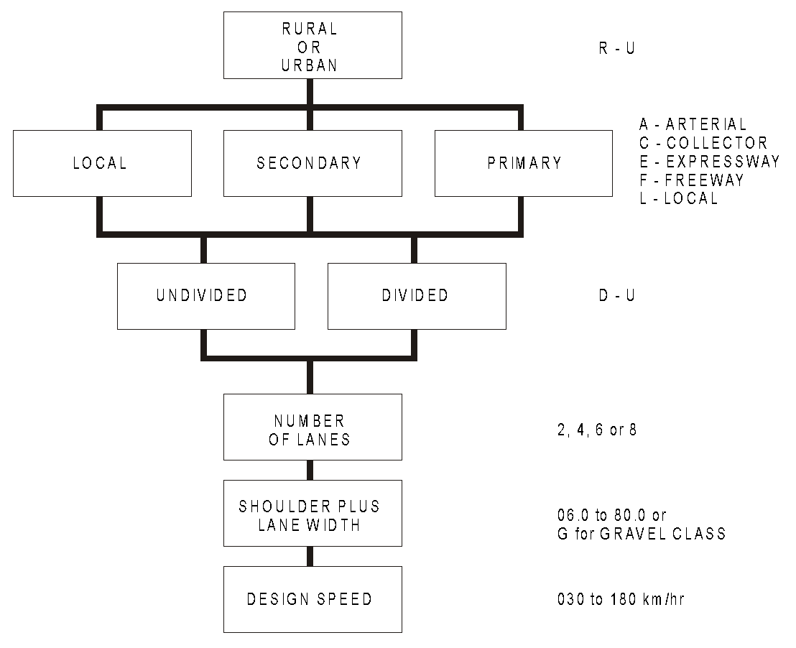
What is the Road Classification?

Slide 12
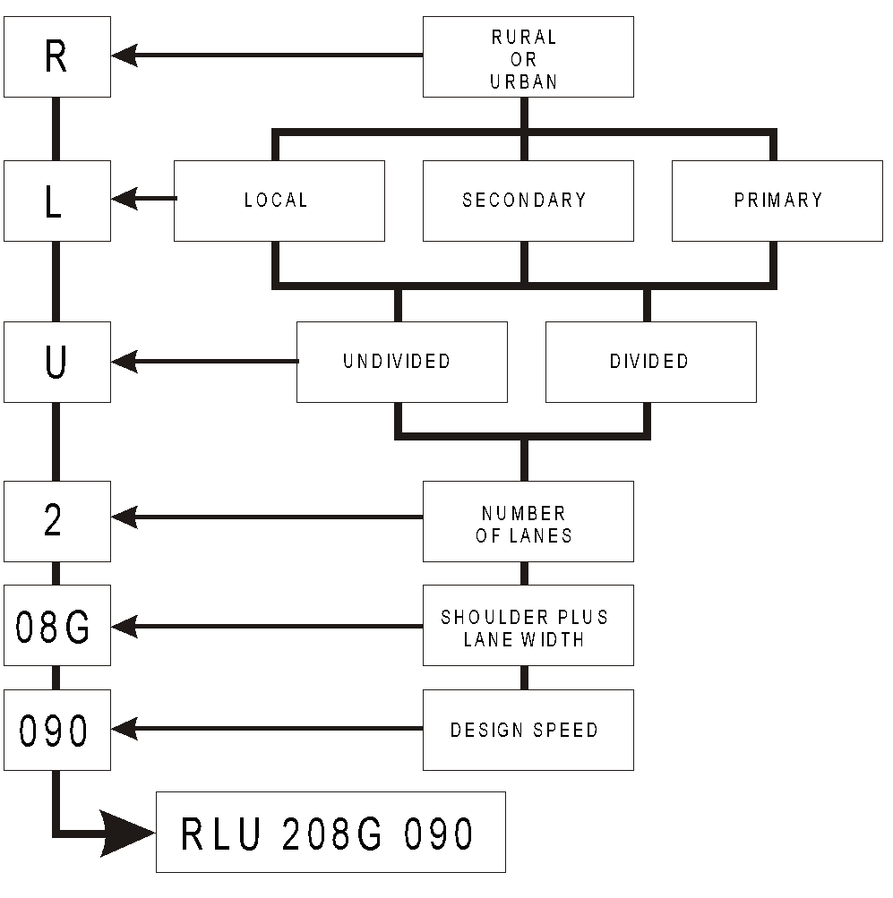
What is the Road Classification?

Slide 13
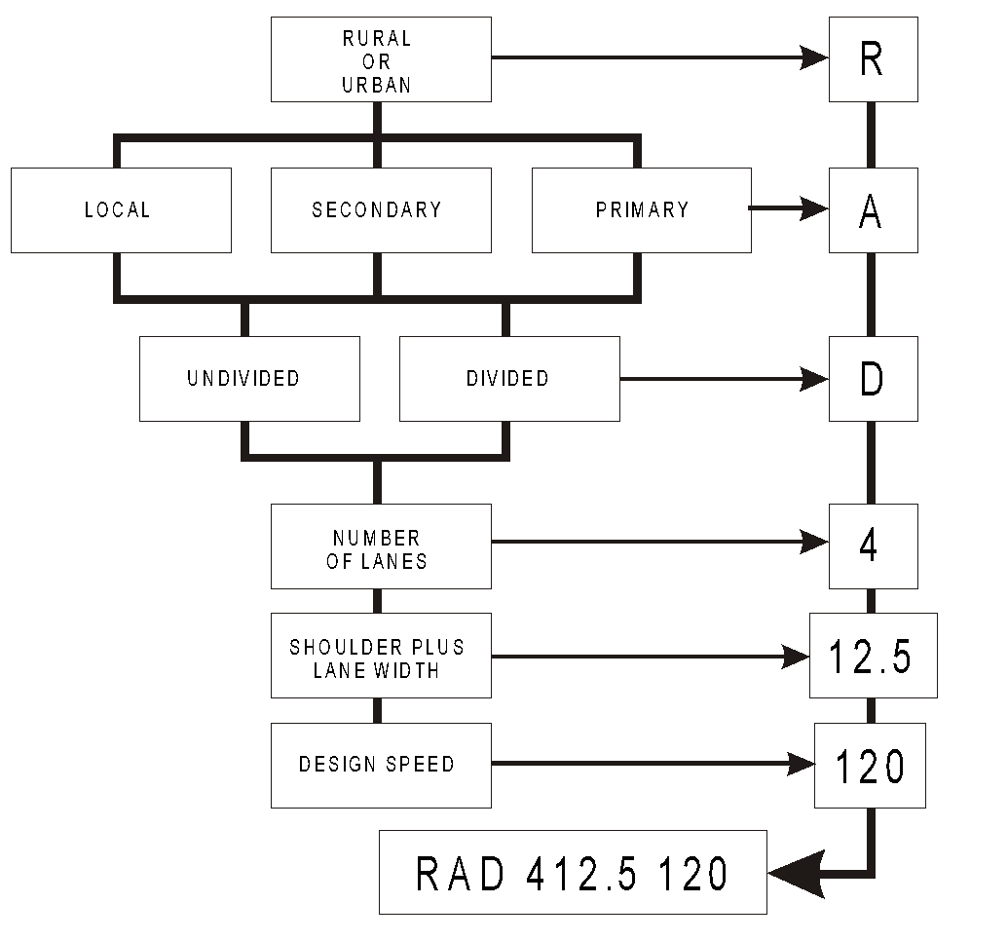
What is the Road Classification?

Slide 14
Standard Road Classifications
Local Roads (G=graveled)
  RLU-206G-60
  RLU-207G-60
  RLU-208G-60
  RLU-207G-90
  RLU-208G-90
  RLU-209G-90
  RLU-210G-90
Local Roads (paved)
  RLU-208-100
  RLU-208-110
  RLU-209-110

Slide 15
Standard Road Classifications cont’d
Provincial Highways (paved)
  RCU-208-110
  RCU-209-110
  RCU-210-110
  RCU-211-110
  RAU-209-110
  RAU-210-110
  RAU-211.8-110
  RAU-212-110
  RAU-213.4-110
  RAU-213-120
  RAU-213.4-120
  RAU-213-130
  UAU-209-070

Slide 16
Standard Road Classifications cont’d
Provincial Highways (divided)
  RAD-412.4-120
  RAD-616.6-130
  RFD-412.4-110
  RFD-412.4-130
  RFD-616.6-130
  RFD-820.8-110
  RFD-1024.5-110
  Important to be accurate – used in calculating Sufficiency Rating.
  Refer to Table 4.2 for further information

Slide 17
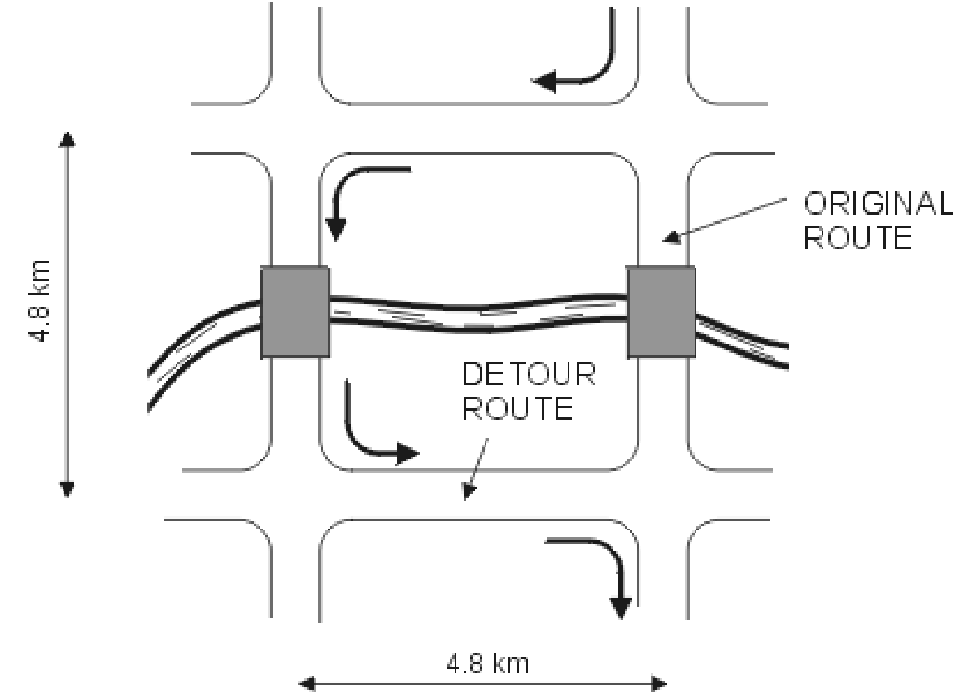
What is the Detour Length?
Detour length is extra distance traveled = 9.6 km

Slide 18
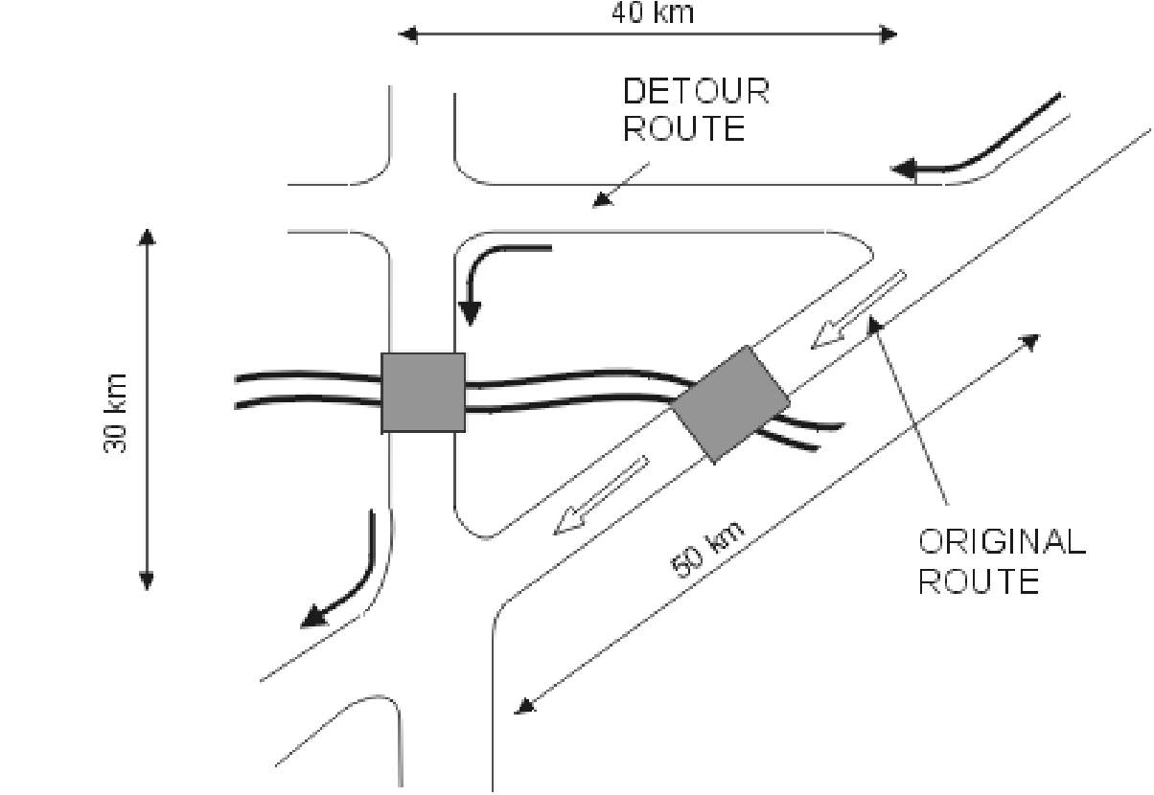
What is the Detour Length?

Slide 19
What is Posted Clearance?
Only on:
  grade separation
  pedestrian overpass
  through truss
  rail over/under pass
Lowest measured clearance between road and bridge less tolerance
Legal w/o permit 4.15M
Calculation
Minimum measured clearance = 4.88 m
Minus Tolerance 0.10 m
  4.78 m
Round down to the nearest decimeter = 4.70 m
(1/10th of a meter)
BIM Required Vert. Clearance Posting = 4.70 m
TIMS Data = 4.80 m

Slide 20
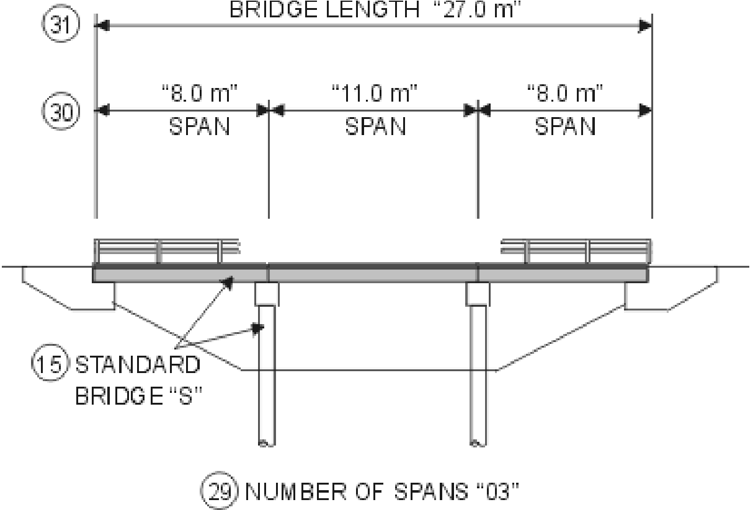
Bridge Details

Slide 21
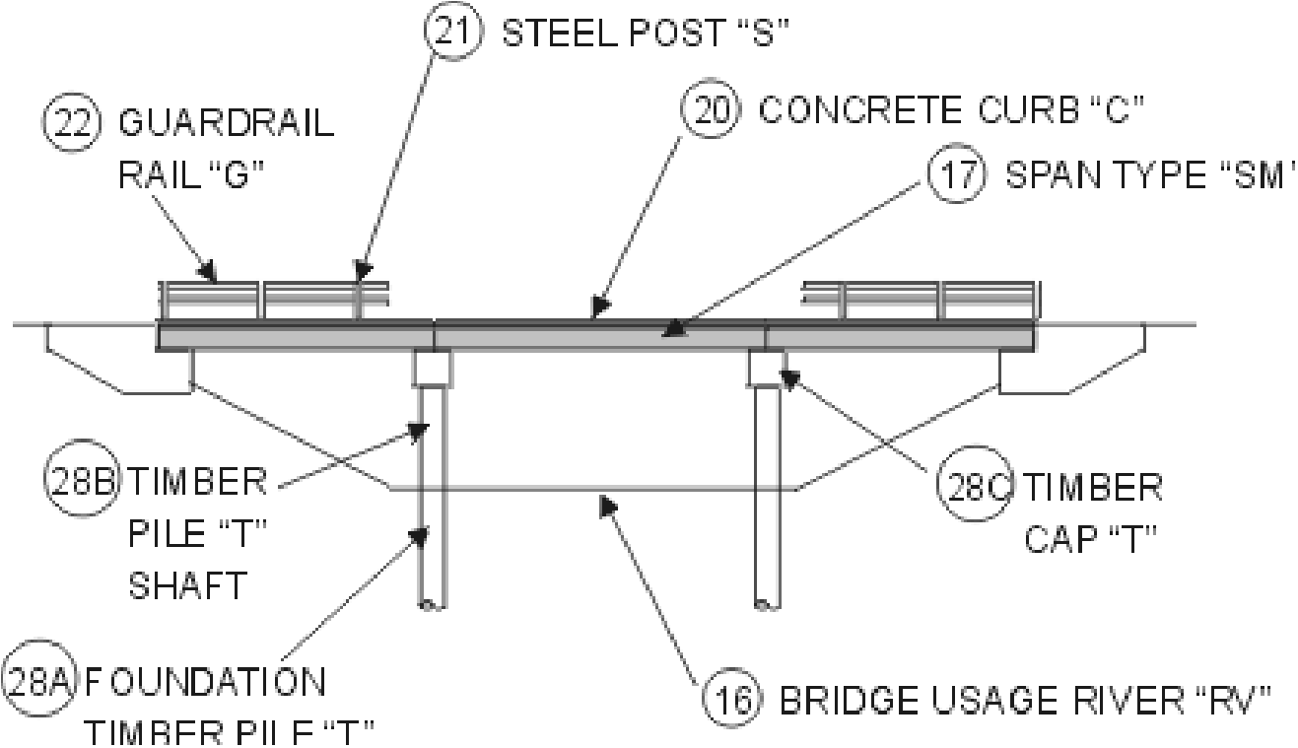
Standard Bridge Components

Slide 22
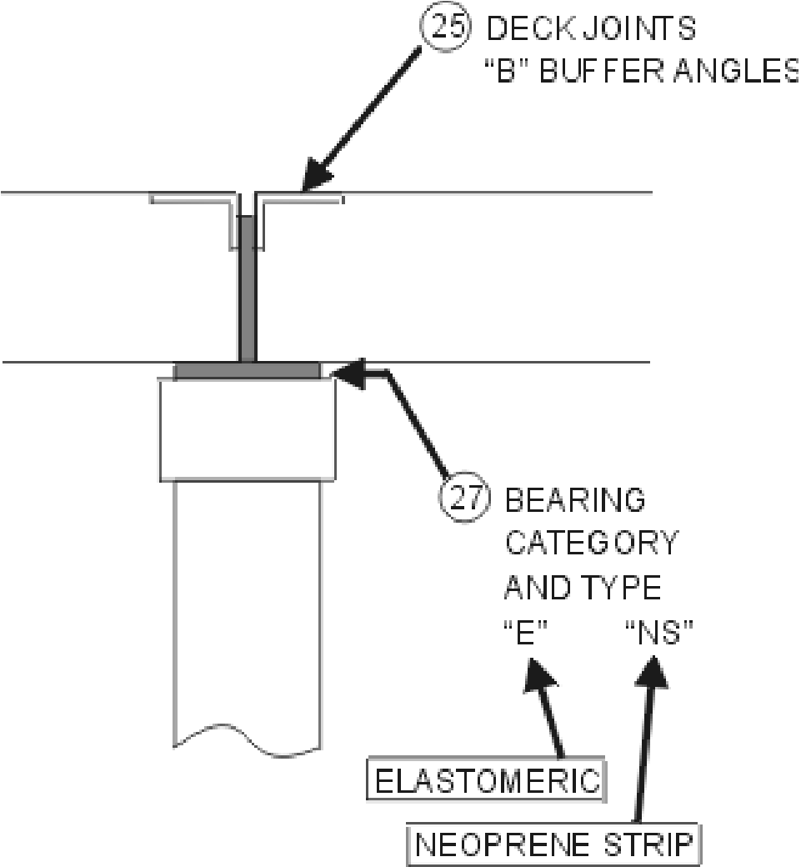
Standard Bridge Components
Timber or Concrete Cap
Timber or Steel Pile

Slide 23

Questions?

