Slide 1
BASIC STRUCTURAL CONSIDERATIONS

Slide 2
Introduction
Bridge members must be able to carry the loads applied to them.
This presentation considers:
  how loads are applied to members
  how bridge members are stressed by loads
  how bridge materials resist stress

Slide 3
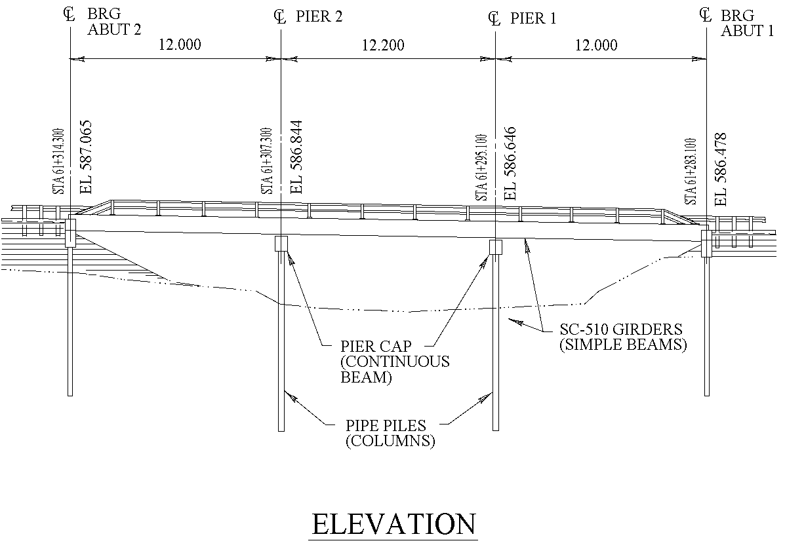
Beams/Girders
Different member types carry load in different ways.
Beams are members which are loaded perpendicular to their length.
They are also referred to as stringers and girders.

Slide 4
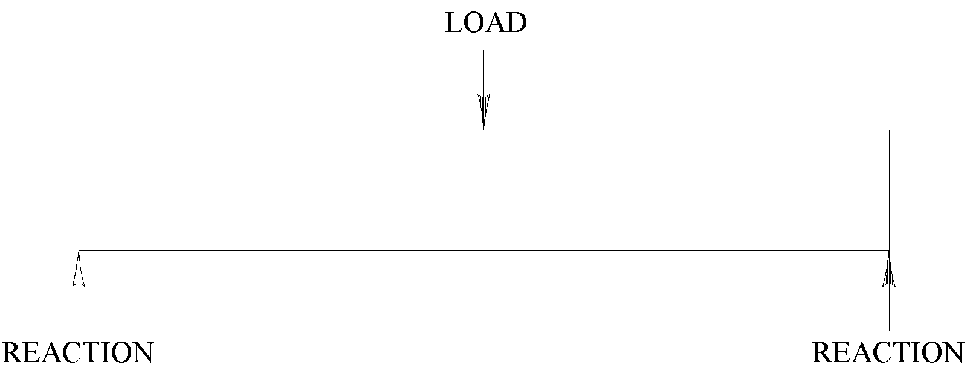
Simple Beams
Shown below is a Free Body Diagram of a simple beam.
In this diagram arrows are used to show the forces (loads and reactions) acting on the beam.
These arrows are drawn at the points the forces are applied and in the directions they act.
Reactions are the forces that support a member.
They are exerted by other members or by the ground.

Slide 5
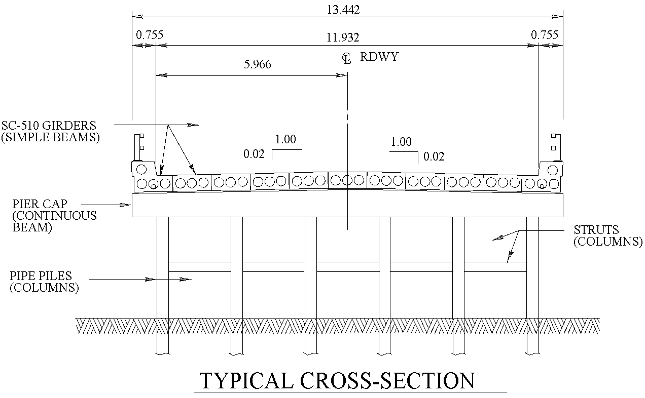
Continuous Beams
A continuous beam is a beam that is supported at intermediate points along its length.

Slide 6
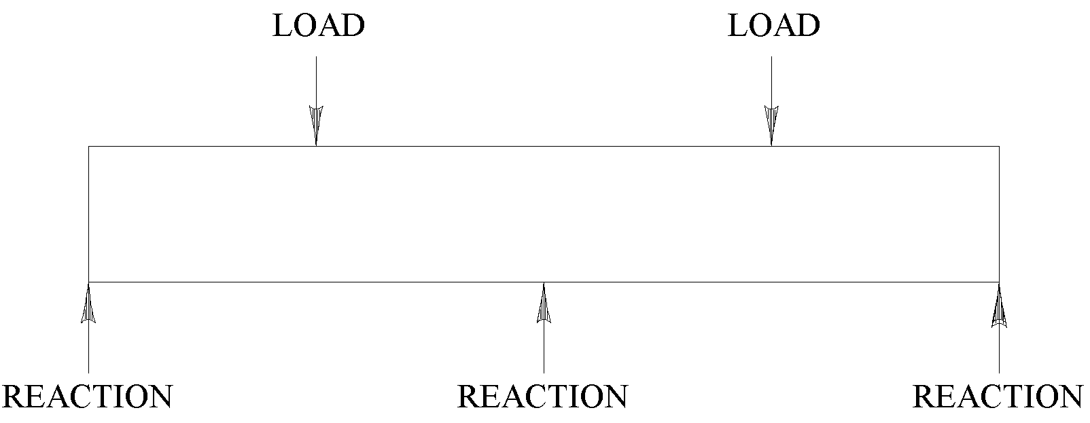
Continuous Beams
Shown below is a Free Body Diagram of a continuous beam.
The addition of intermediate supports allows a beam to carry more load.

Slide 7
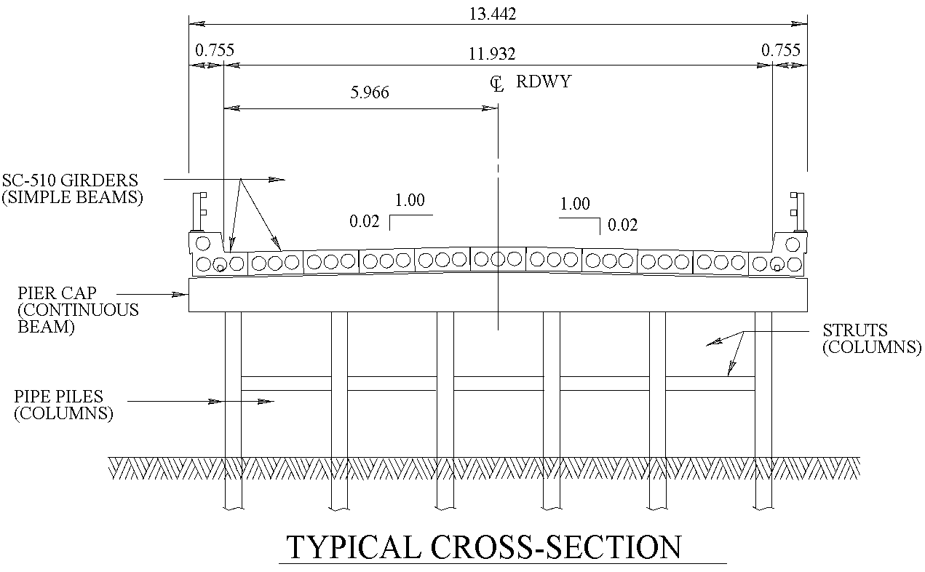
Columns and Hangers
Columns and hangers are members which are loaded parallel to their length.
Columns (piles) are loaded in compression; hangers in tension.

Slide 8
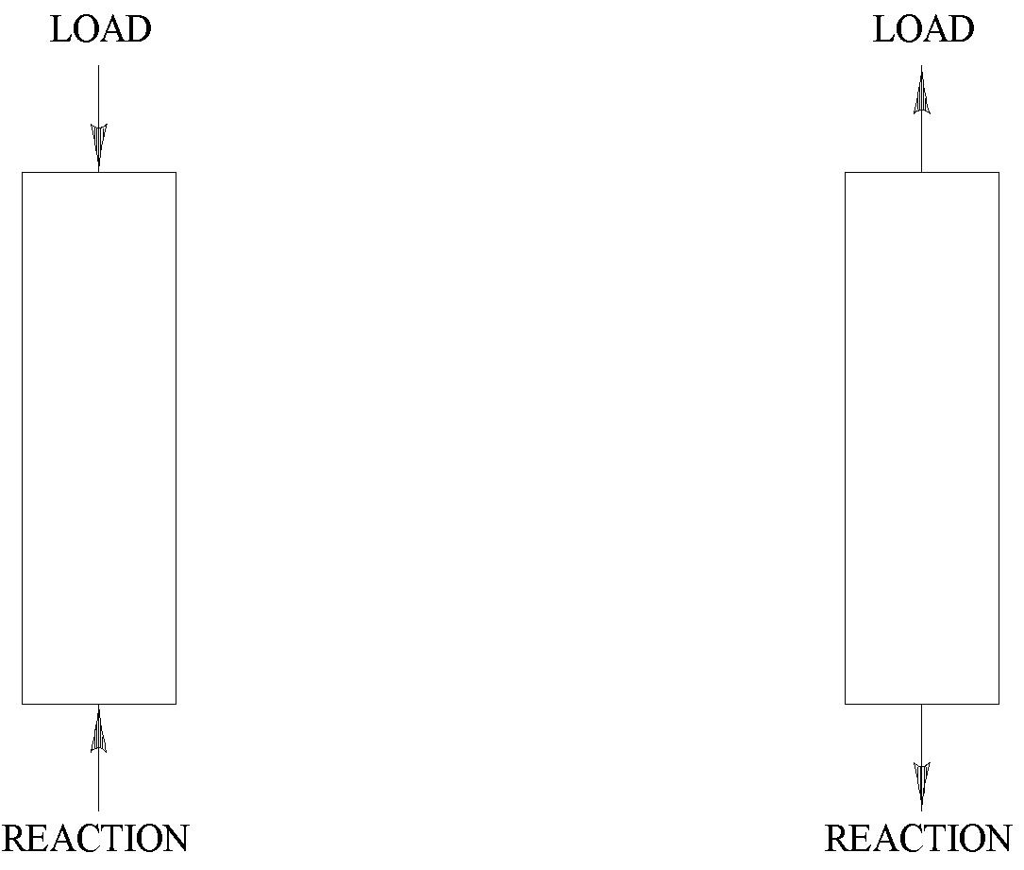
Columns and Hangers
Shown are Free Body Diagrams for a column and a hanger.
Column
Hanger

Slide 9
Stresses
Loads cause stresses in a member.
Stresses are the internal forces that the member experiences at its different locations.
Stress has units of Force/Area e.g., kips per square inch (KSI), Newtons per square millimeter (MPa).
The following types of stress occur in bridge members:
  tension stress
  compression stress
  bending stress
  shear stress

Slide 10
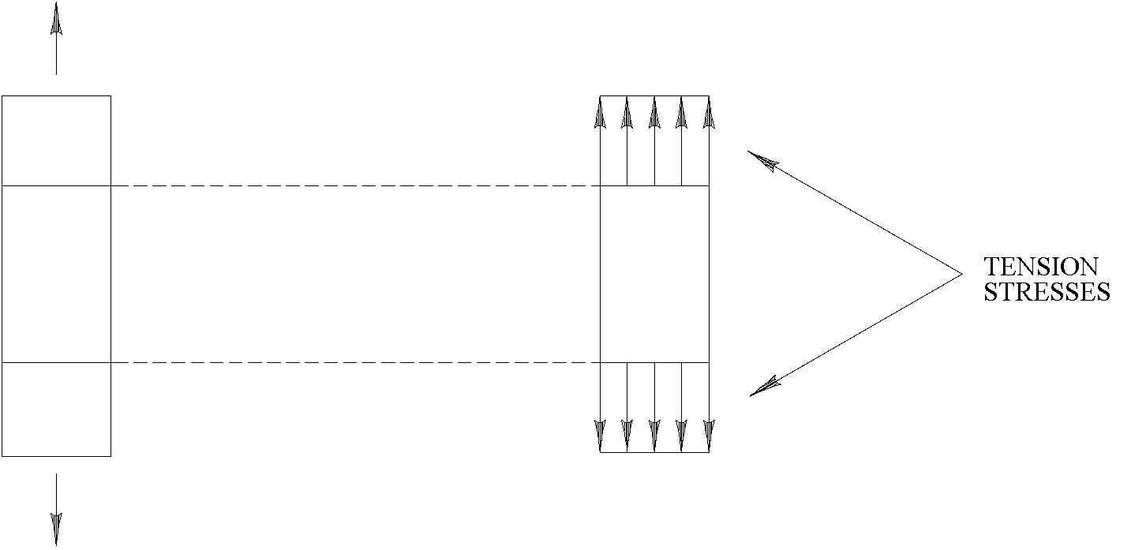
Hangers - Tension Stress
Below is a Free Body Diagram of a hanger as well as a piece cut out from the hanger.
What stresses must be present at the cuts to keep the pieces of the hanger from separating?
The stresses are the same at each location and try to lengthen the hanger.

Slide 11
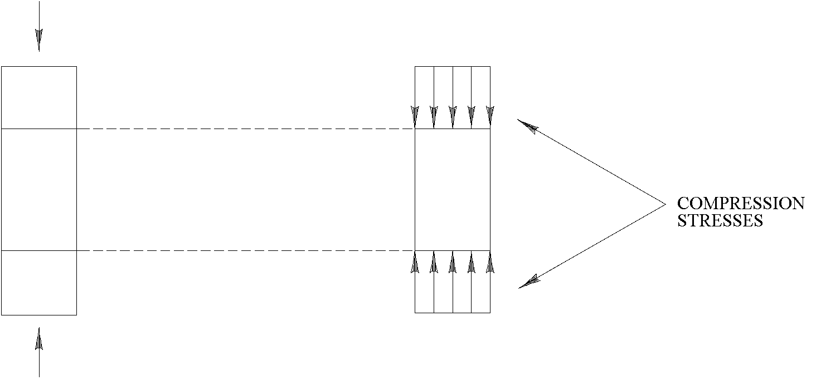
Columns - Compression Stress
Below is a Free Body Diagram of a column as well as a piece cut out from the column.
What stresses must be present at the cuts to keep the pieces of the column apart?
The stresses are the same at each location and try to shorten the column.

Slide 12
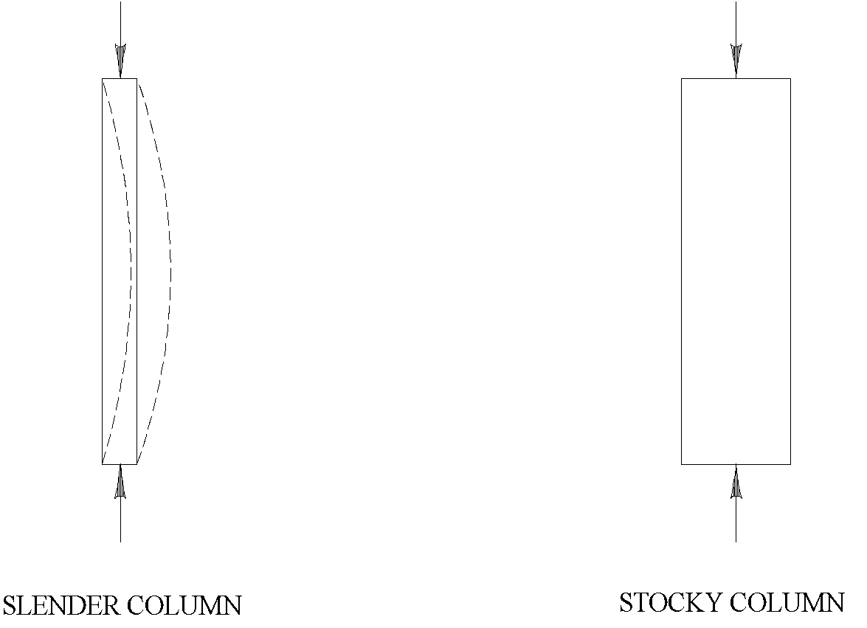
Columns - Buckling
Compression stresses can also cause buckling of a column.
Slender columns buckle easier than stocky ones.
Misaligned columns buckle easier than straight ones.

Slide 13
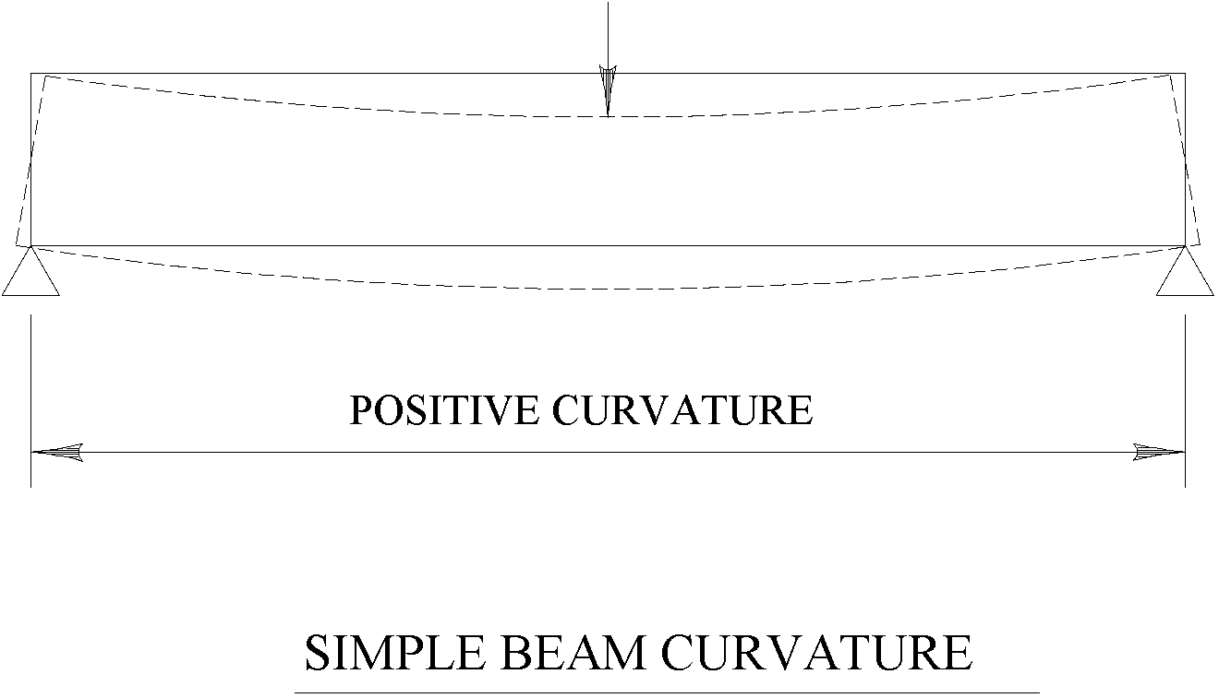
Simple Beams - Curvature
Bending stresses cause curvature of the beam.
The larger the curvature; the larger the bending stresses.
The curvature causes sections of the beam to rotate.
Simple beams go into positive curvature.

Slide 14
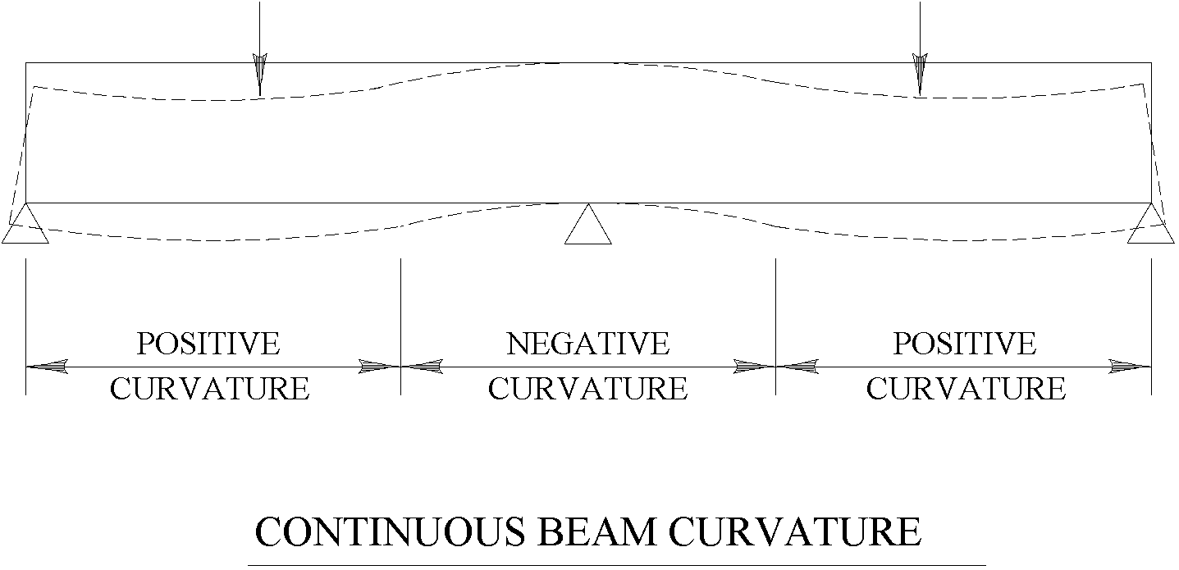
Continuous Beams - Curvature
Continuous beams go into both positive and negative curvature.
Curvature is generally positive away from intermediate supports with maximum positive curvatures occurring beneath the loads.
Curvature is generally negative near intermediate supports with maximum negative curvatures occurring at intermediate supports.

Slide 15
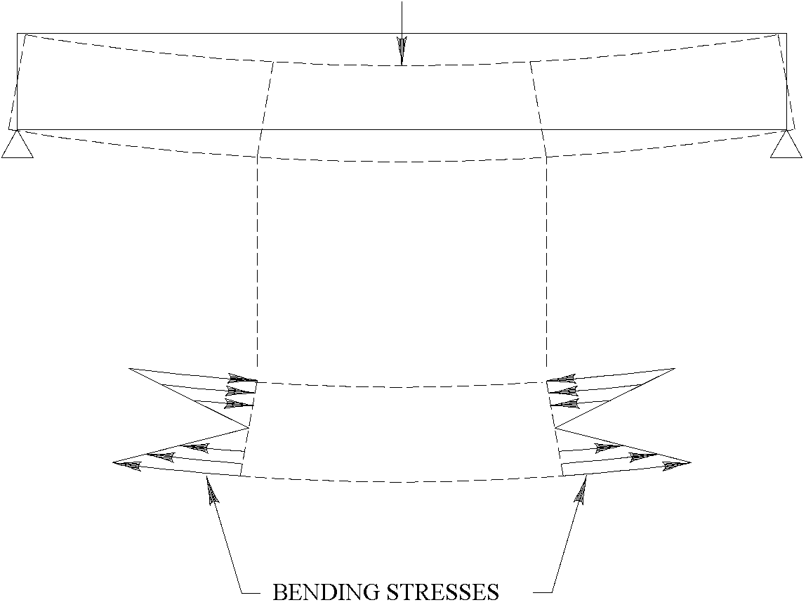
Simple Beams - Bending Stress
Below is a Free Body Diagram showing a section of beam in positive curvature.
The top of the beam is being pushed together (compression) while the bottom of the beam is being pulled apart (tension).
The mid-height of the beam does not change length and is not stressed.

Slide 16
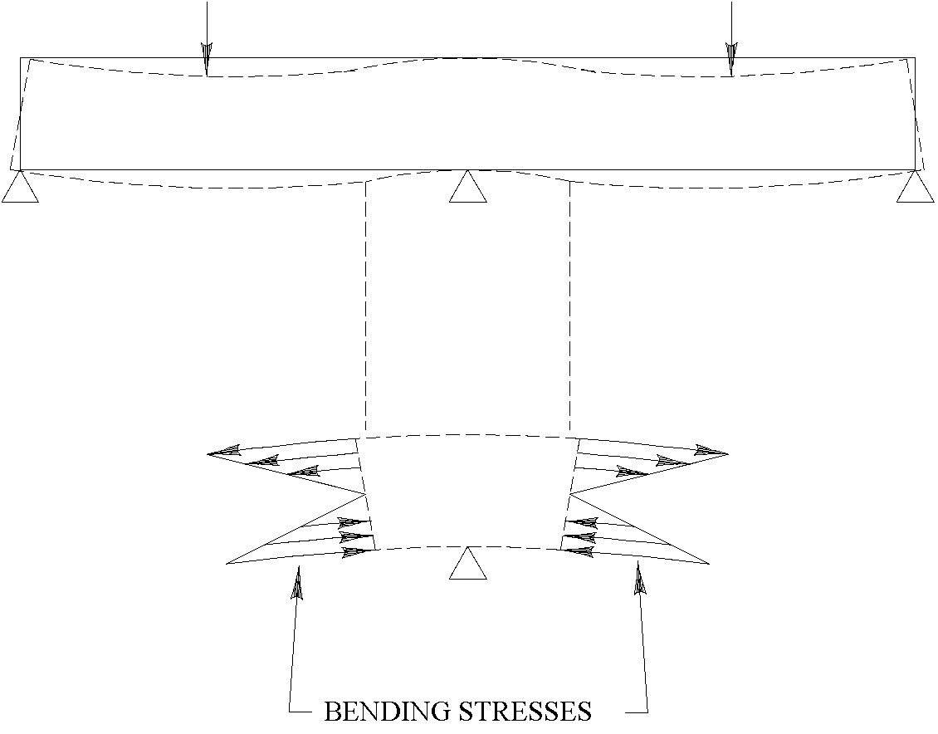
Continuous Beams - Bending Stress
Below is a Free Body Diagram showing a section of beam in negative curvature.
The top of the beam is being pulled apart (tension) while the bottom of the beam is being pushed together (compression).
The mid-height of the beam does not change length and is not stressed.

Slide 17
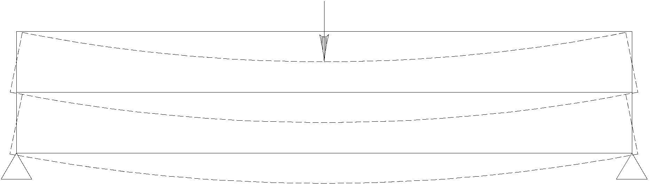
Beams - Horizontal Shear Stress
Horizontal shear stress is caused by beam curvature.
Below are two beams in bending, one on top of the other.
The bottom of the top beam lengthens while the top of the bottom beam shortens causing the beams to slide past each other.
If the two beams become one beam sliding can no longer occur.

Slide 18
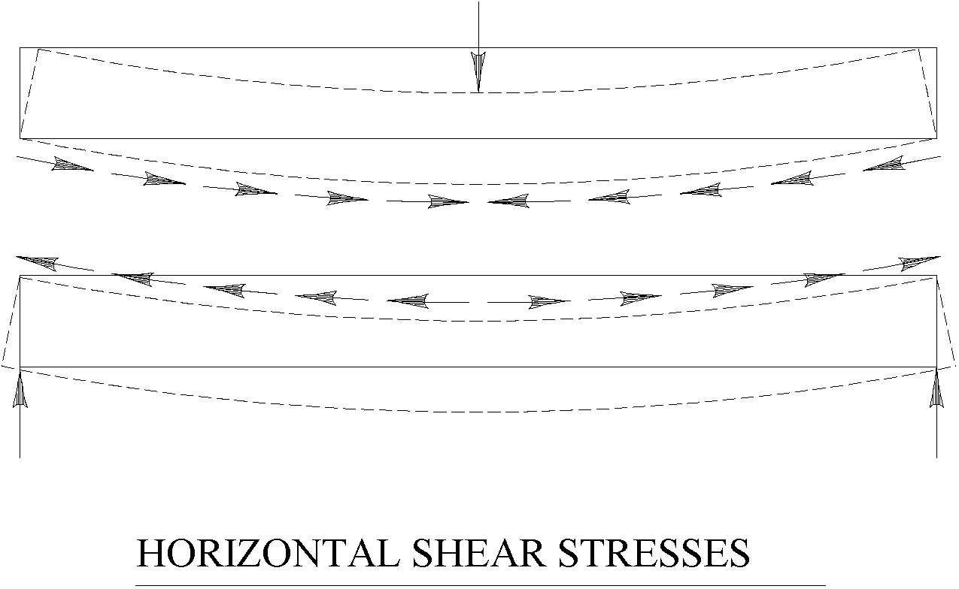
Beams - Horizontal Shear Stress
Below are two Free Body Diagrams showing the horizontal shear stresses required to prevent sliding along a longitudinal cut of a beam in positive curvature.

Slide 19
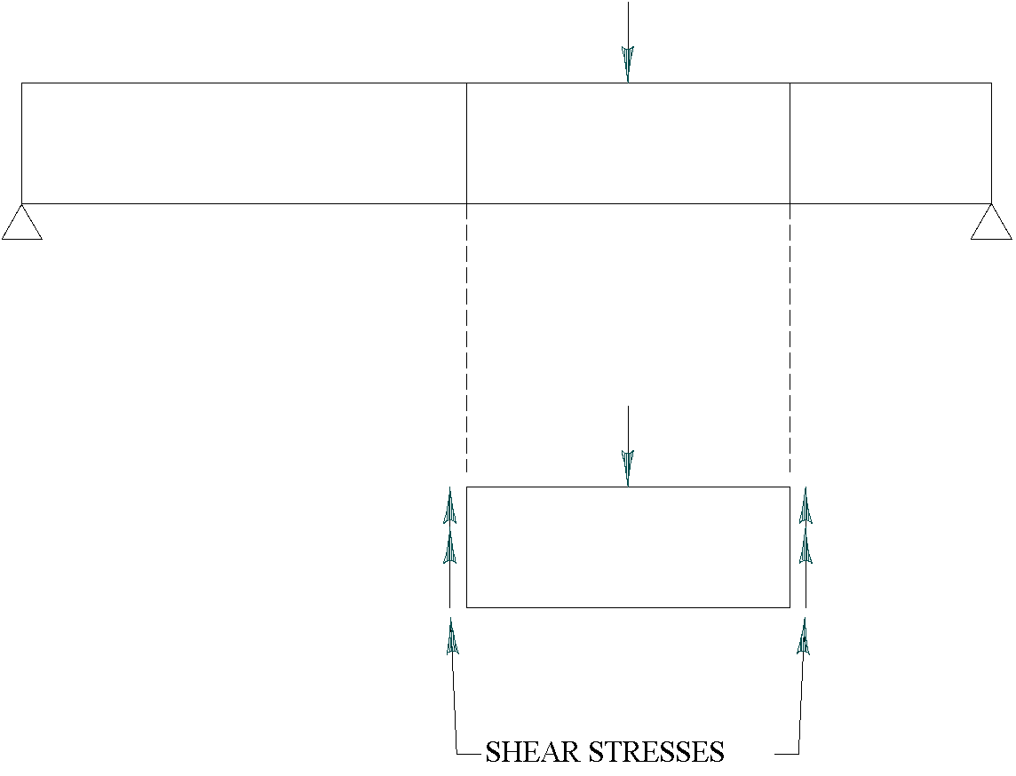
Beams - Vertical Shear Stress
Below is a Free Body Diagram of a piece of beam.
Shear stress must be present at the vertical cuts to keep the pieces of the beam from sliding past each other.

Slide 20
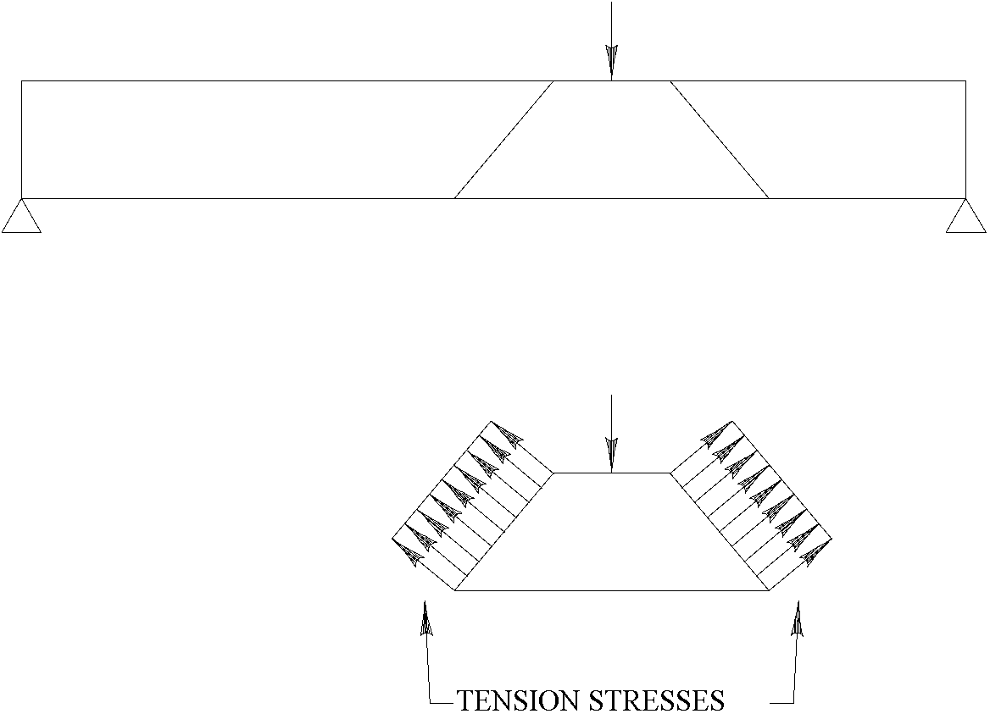
Beams - Vertical Shear Stress
Below is a Free Body Diagram of a different piece of the same beam.
Tension stresses must be present at the inclined cuts to keep the pieces of the beam from separating.

Slide 21
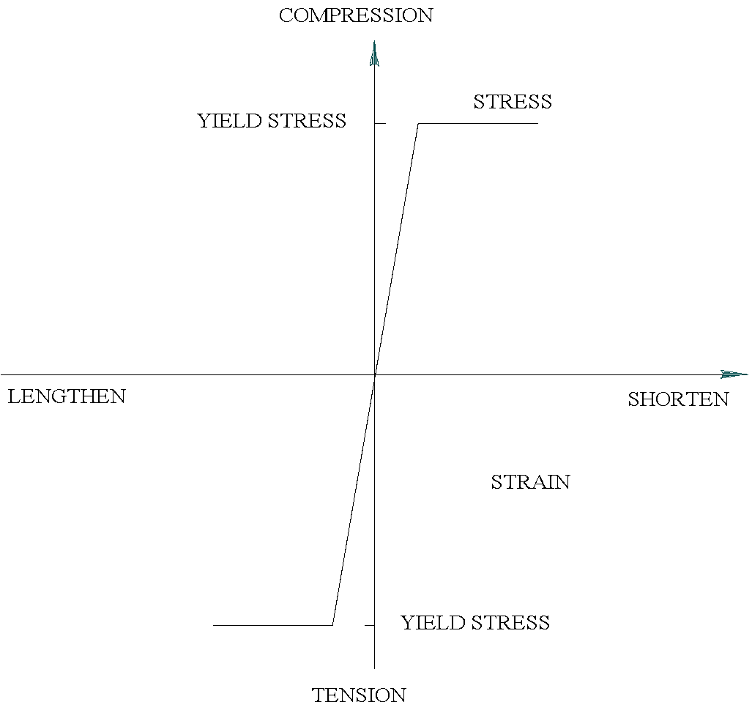
Stress In Steel
Different bridge materials respond to stress in different ways.
Shown to the right is a stress-strain diagram for steel.
Strain is a measure of the stretching or shortening of a member under stress.
Steel is strong in both tension and compression.
Steel that has reached its yield stress lengthens or shortens under constant stress.

Slide 22
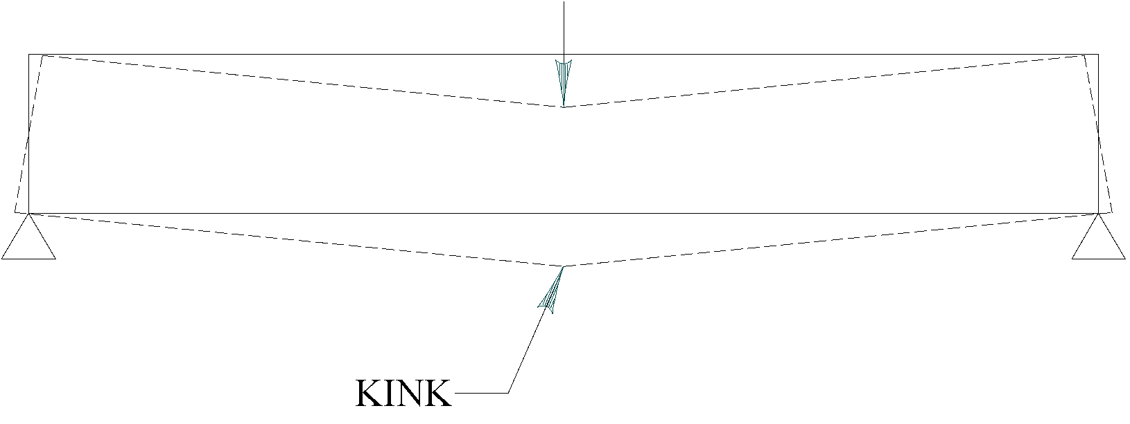
Stress In Steel
An important property to remember when inspecting bridges is that a steel bending member that has reached its yield stress will develop a kink or sag.
A beam that has developed a kink and sagged is shown below.

Slide 23
Stress In Steel
Steel members are normally made up of slender components (flanges and webs).
Therefore, steel compression members (including parts of beams in compression) are susceptible to buckling.
Misalignment of a member in compression lowers the load at which it buckles.

Slide 24
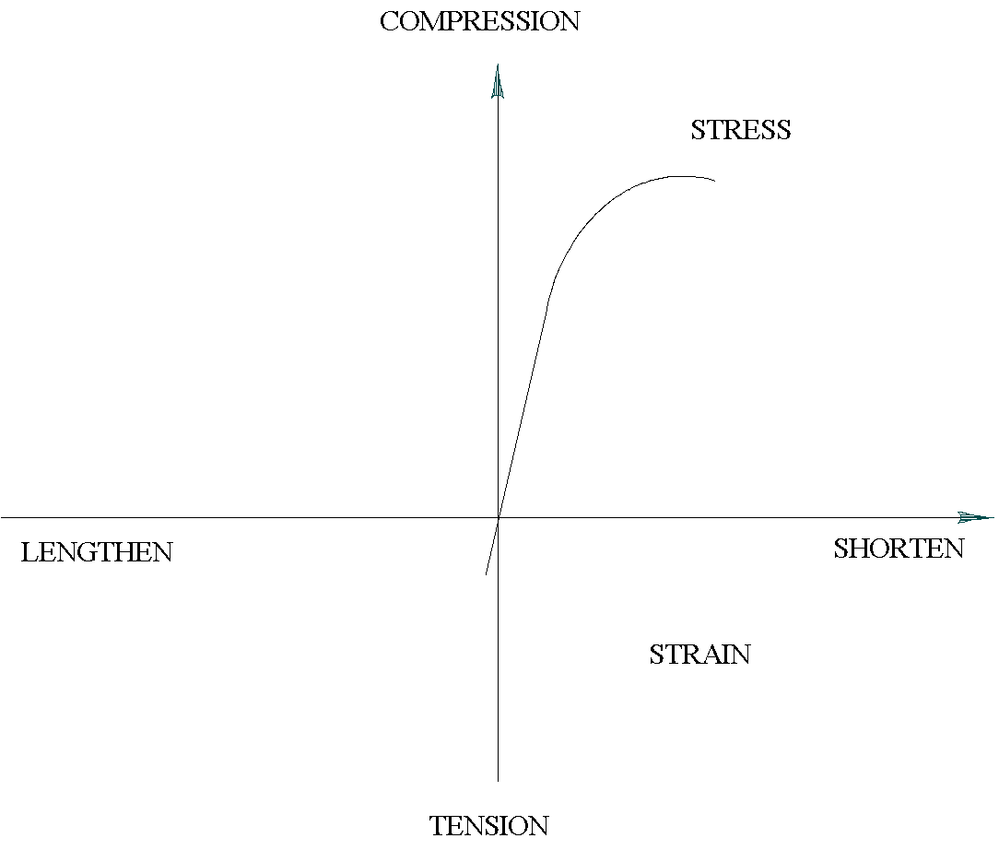
Stress In Concrete
Shown below is a stress-strain diagram for concrete.
Concrete is strong in compression and weak in tension.

Slide 25
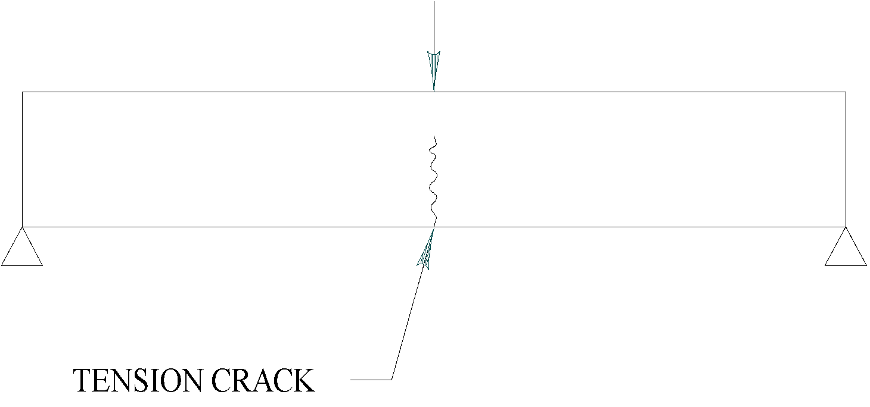
Stress In Concrete
An unreinforced concrete beam will fail in tension under a small load.

Slide 26
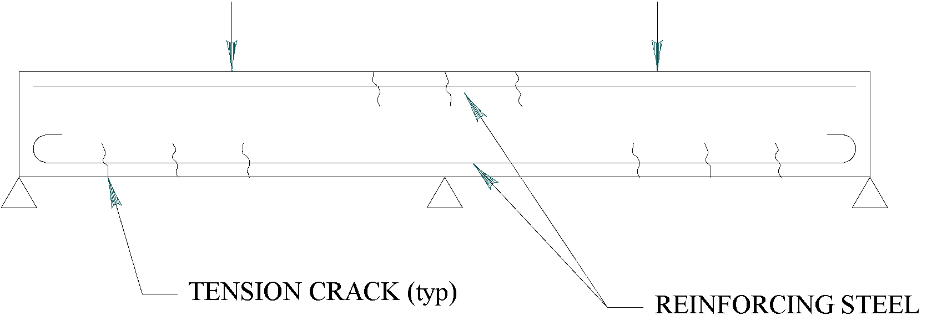
Stress In Concrete
Reinforcing steel placed on the tension side of a beam increases its strength.
Cracking of the concrete may still occur but the reinforcing steel acting in tension prevents failure.
Cracks caused by bending stresses occur in the middle of the span near the bottom of the beam or at intermediate supports near the top of the beam.
These vertical cracks are normal unless they have opened up indicating that the reinforcing steel has yielded.
Notes:
ULS SLS

Slide 27
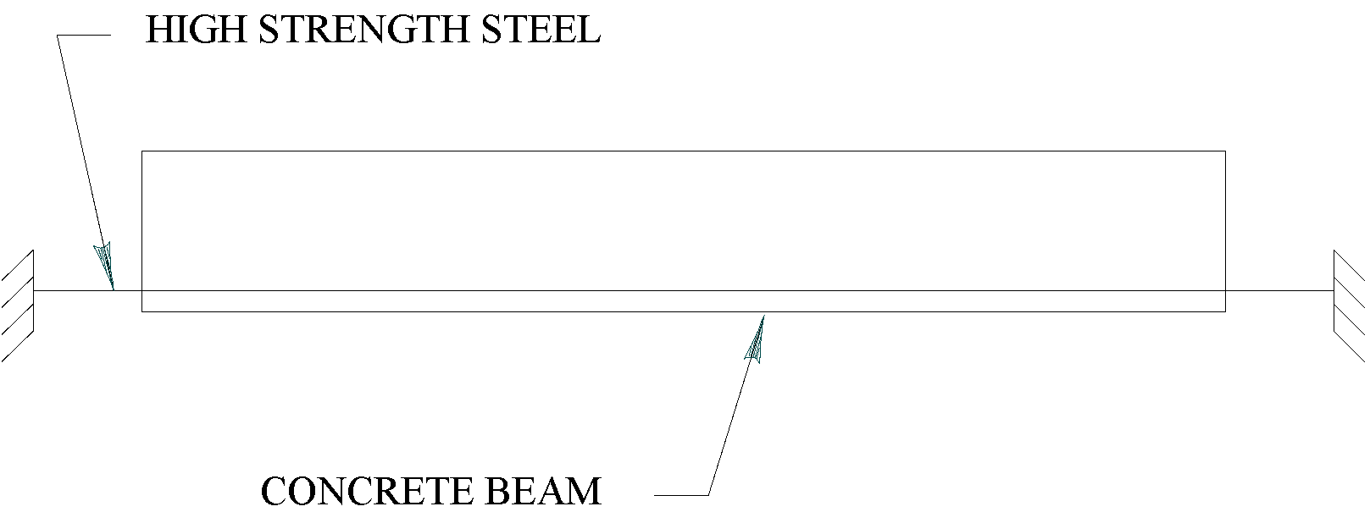
Stress In Concrete
High strength steel strand is sometimes used to control concrete cracking caused by bending stresses.
The high strength strand is stretched, and the concrete beam cast around it.
When the concrete has gained adequate strength the high strength steel is cut.

Slide 28
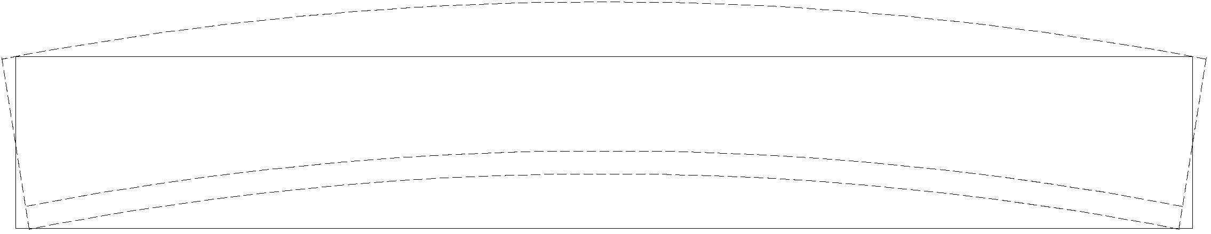
Stress In Concrete
Shown below is a concrete beam after the high strength strand has been cut.
The cutting of the high strength strand results in the strand and also the bottom of the beam shortening and going into compression counteracting the tension caused by the loads and delaying cracking.

Slide 29
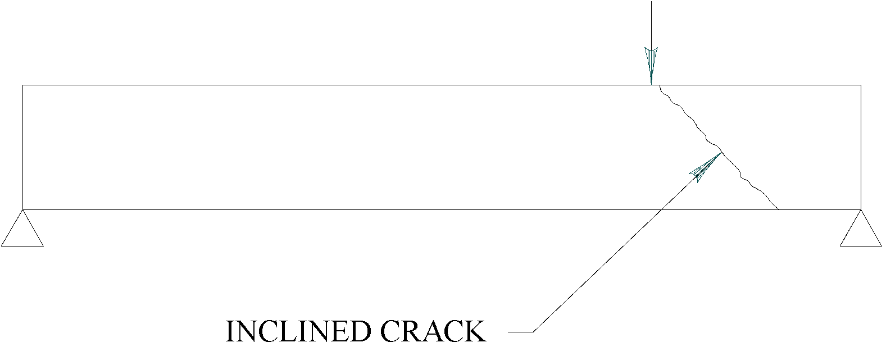
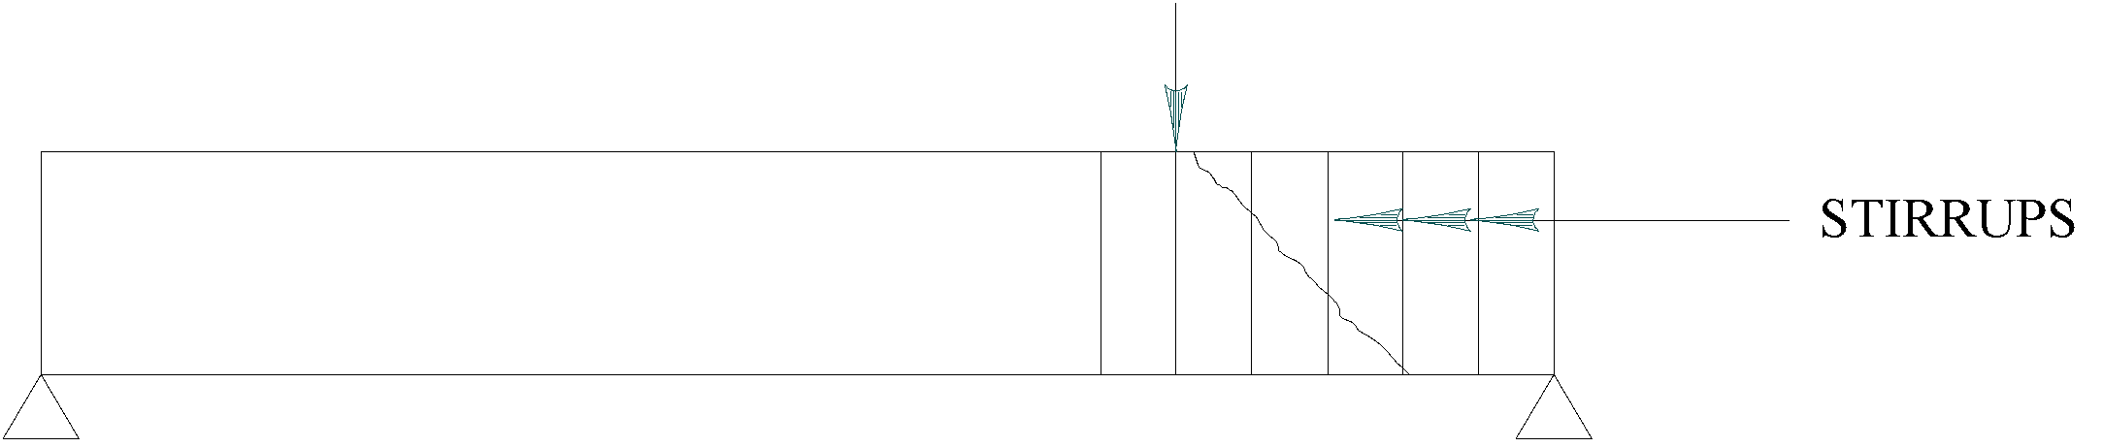
Stress In Concrete
Shear in an unreinforced concrete beam can cause an inclined crack to form resulting in sudden failure.
Stirrups placed across the inclined tension crack increase the shear strength above the concrete cracking strength thus giving warning of failure.
It is important to report inclined cracking in a beam as the opening up of an inclined crack can result in sudden failure of the beam.

Slide 30
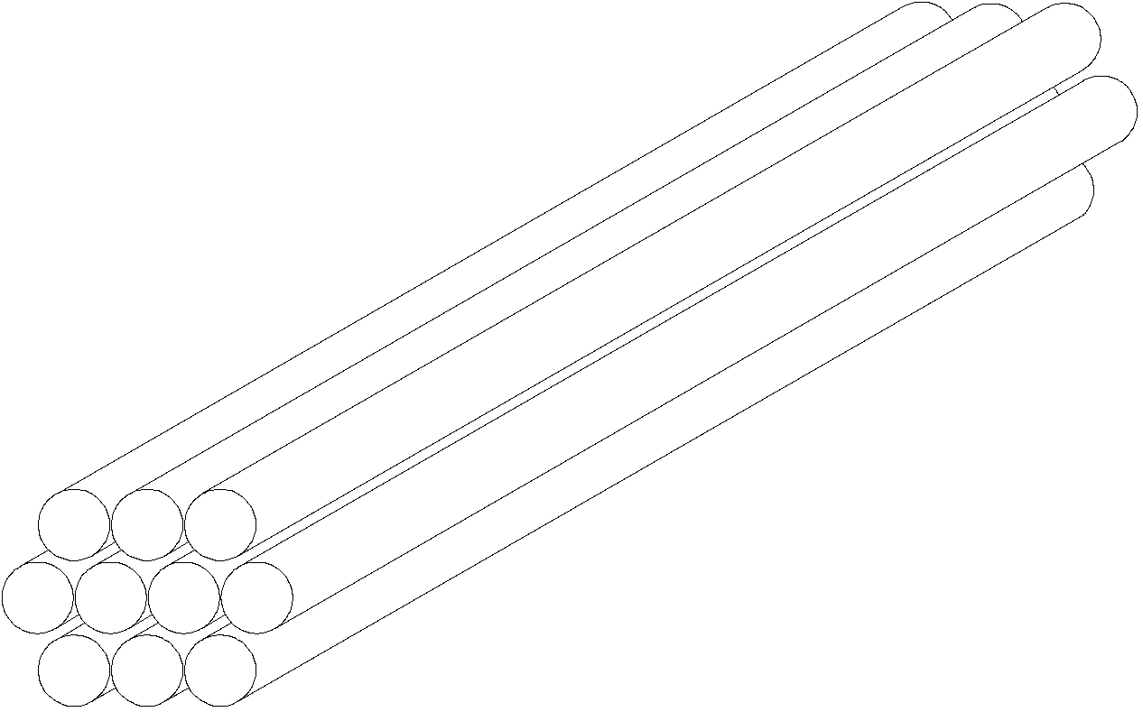
Stress In Timber
Timber is a “natural” material and has different strength properties in different directions.
Its internal structure can be thought of as a bundle of straws running in the direction of the grain.

Slide 31
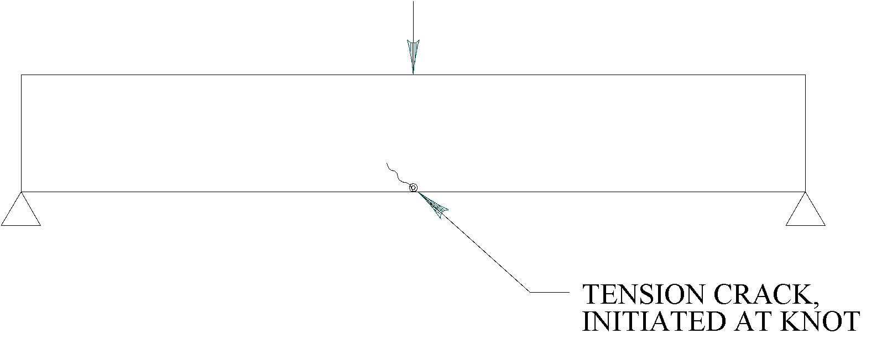
Stress In Timber
Timber is strong in tension and compression in the direction of the grain.
Failure due to bending stresses often occurs at a defect such as a knot.

Slide 32
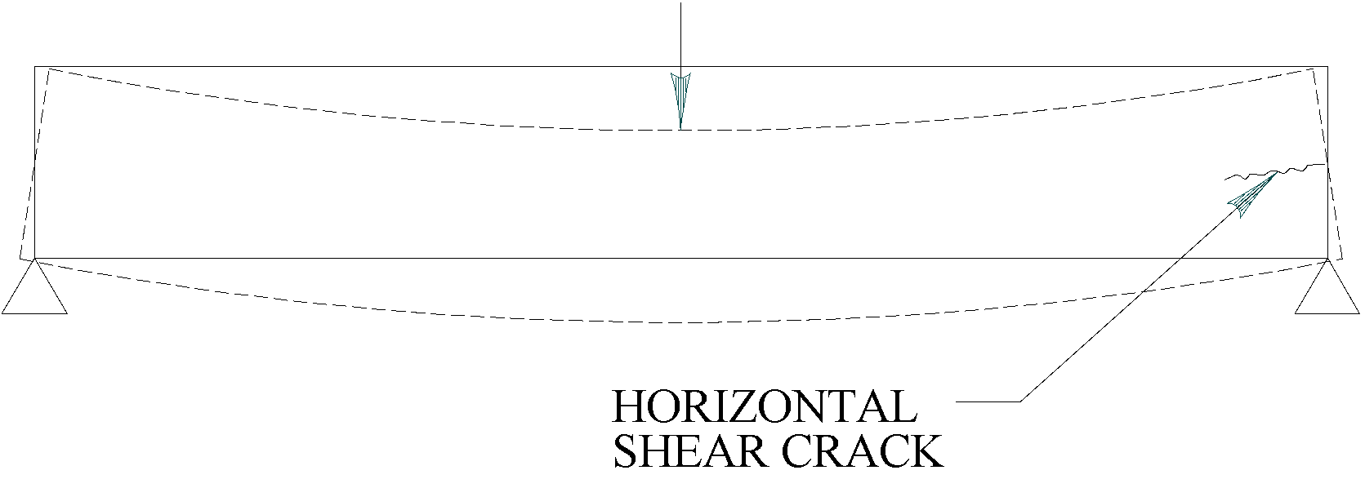
Stress In Timber
Timber is weak in shear along the grain just as straws in a bundle easily slide past each other.
Horizontal cracks caused by horizontal shear stresses can occur at the ends of a timber beam.

Slide 33
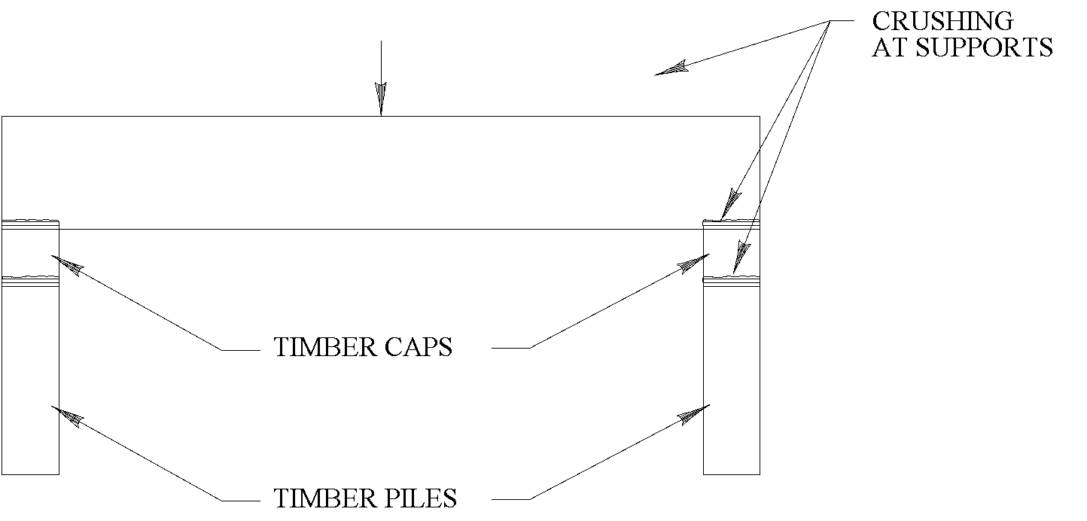
Stress In Timber
Timber is weak in compression across the grain just as straws are weak against crushing.
Crushing can occur where timber caps support beams and also where timber caps are supported by piles.

Slide 34

Questions?

