Slide 1
SUBSTRUCTURE INSPECTION AND RATING

Slide 2
Introduction
Portion of the bridge located below the bearings
  Abutments
  Piers
  Rated separately
Purpose is to:
  Receive the loads from the superstructure
  Transfer forces to the ground
  Contain the approach fills
  Withstand other forces on it
    Ice
    Debris/drift
    Earth pressure

Slide 3
Introduction
Components
  bearing seats, pile caps
  piles
  backwalls
  wingwalls
  bracing and struts
Component materials
  timber
  concrete
  steel
3

Slide 4
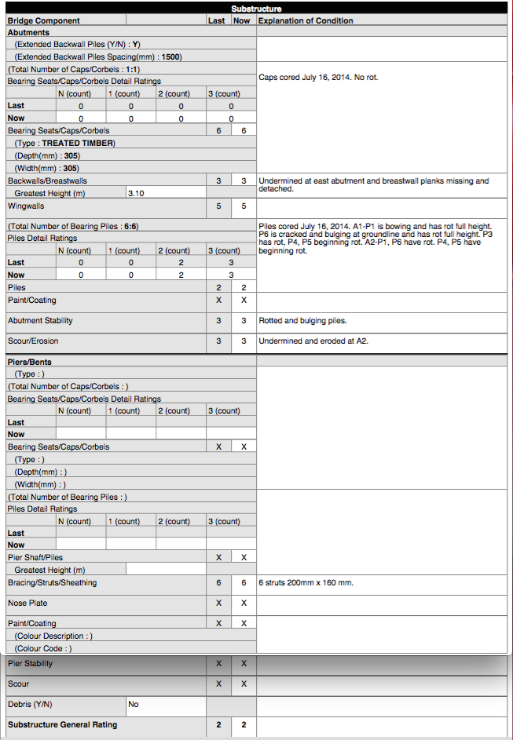

Slide 5
Abutments
Purpose
  Support the ends of the girders or stringers
  Contain the approach fills
Two types in standard bridges - classified according to their height

Slide 6
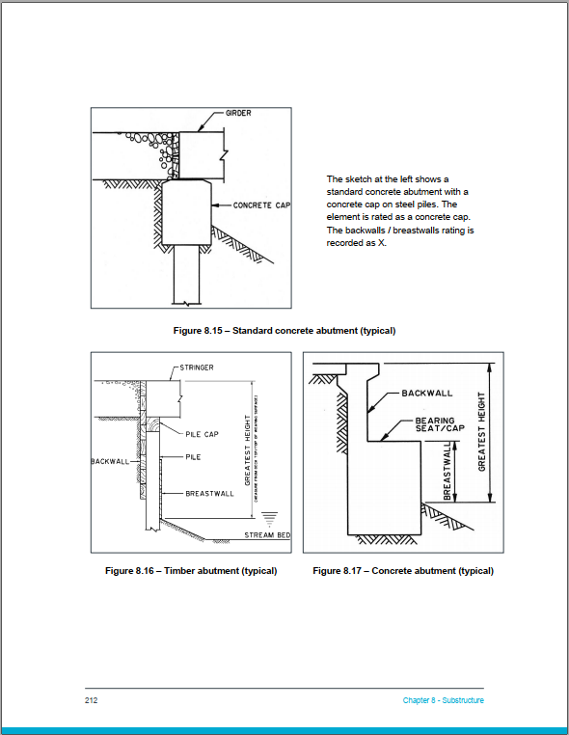
Abutments

Slide 7
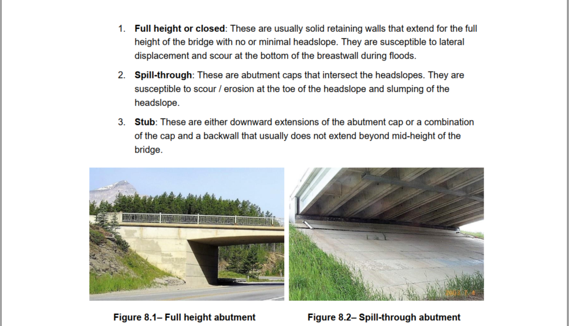
Full Height & Spill Through Abutments

Slide 8
Abutments
Full Height Type
  Solid retaining walls
  Extend the full height of the bridge
  Has wingwalls
  No headslope
  Susceptible to lateral displacement from earth pressure
  Vulnerable to undermining if not protected

Slide 9
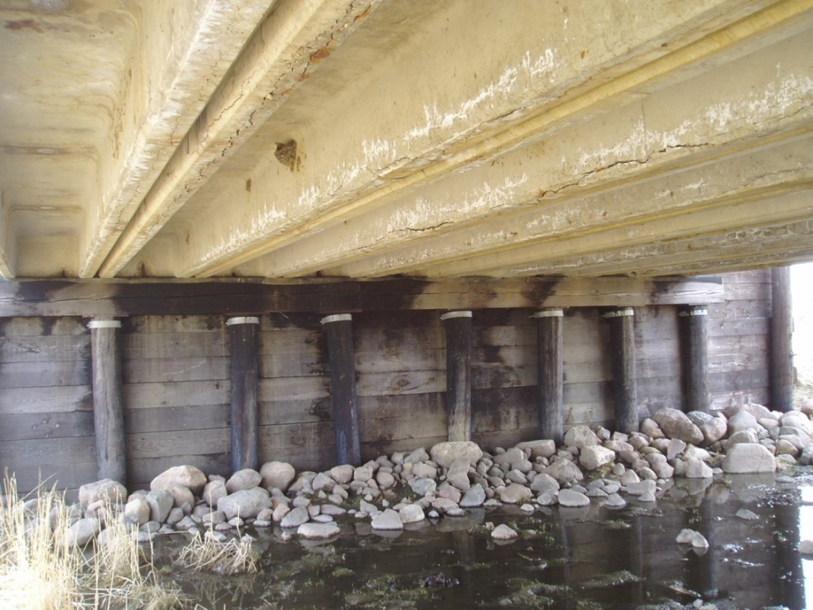
Abutments
Full Height Type

Slide 10
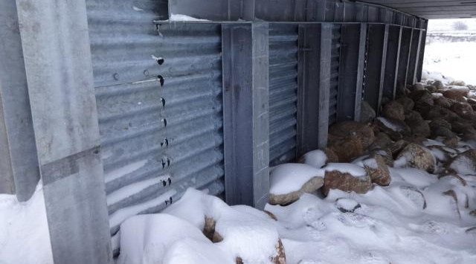
Full Height Abutment

Slide 11
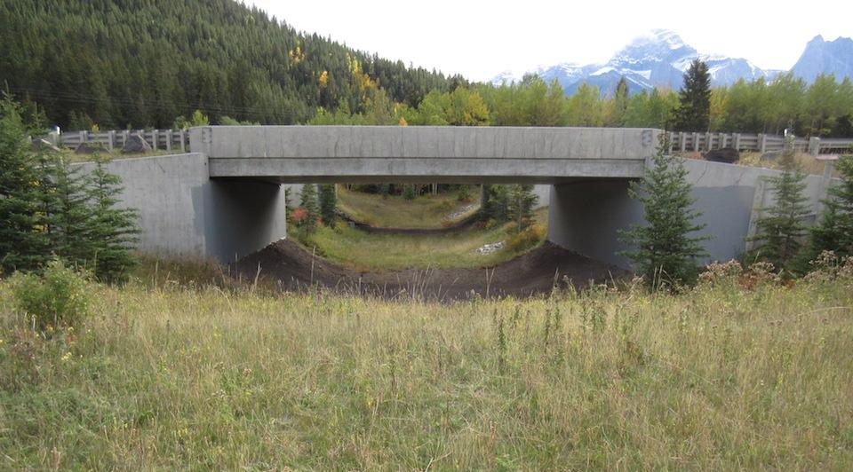
Full Height Abutment

Slide 12
Abutments
Spill Through Type
  Intersect the headslope at the cap height
  No retaining wall (backwalls) below caps
  Short wings
  Vulnerable to undermining if headslope not protected with scour protection
  Susceptible to slumping if headslope too steep or scour at toe

Slide 13
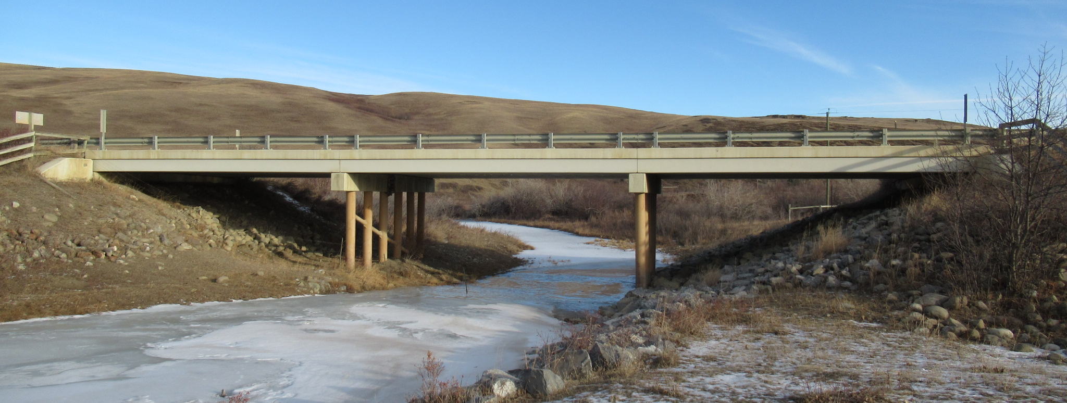
Spill Through Abutment

Slide 14
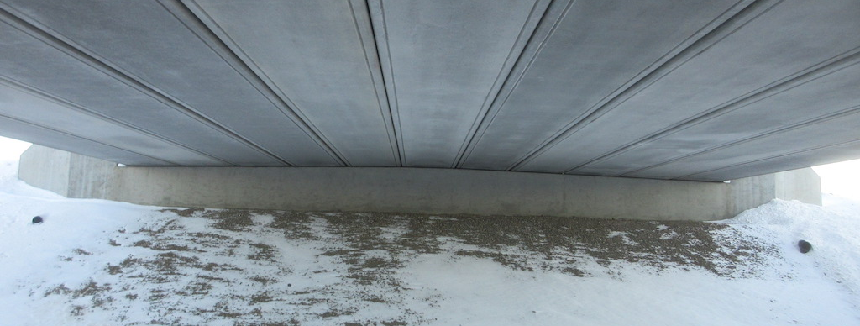
Spill Through Abutment

Slide 15
Abutments
Indicate Extended Backwall Piles “Yes” or “No”
Record Extended Backwall Pile maximum spacing in mm
Provide Backwall/Breastwall rating–refer to 8.6
Measure and record greatest height – lowest point to top of deck
Rate struts on single span bridge in Pier section of form

Slide 16
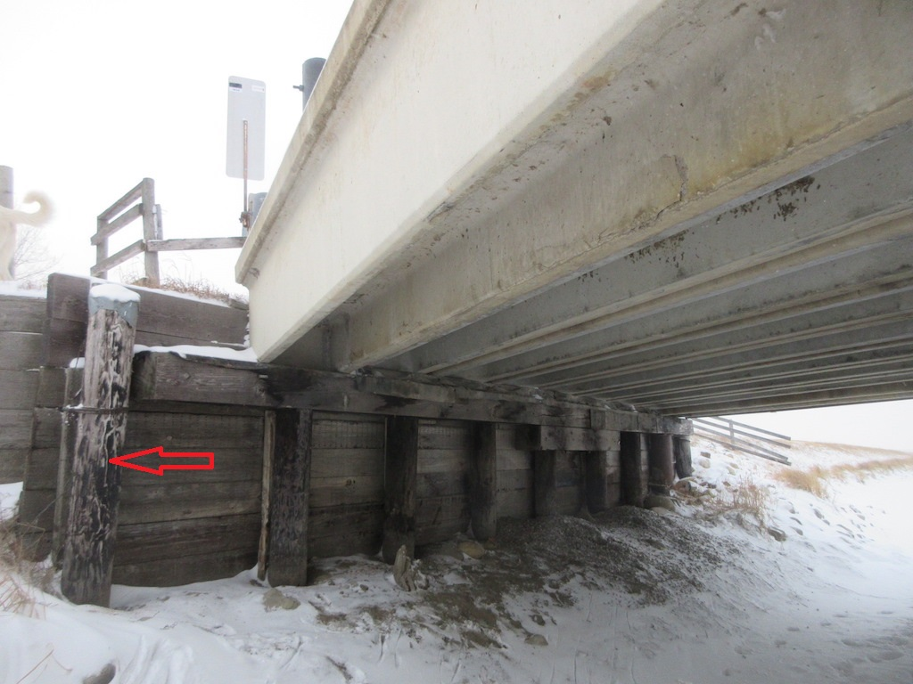
Extended Backwall Pile

Slide 17
Backwalls/Breastwalls
Applies to abutments only
The portion of the abutment sheathing between the wingwalls
Function is to retain the approach fill
On standard bridges, backwalls are:
  horizontal timber planks nailed to the piles
  vertical driven tongue and groove timber planks nailed to whalers attached to piles
  corrugated, galvanized steel plate
  concrete
  Includes extended backwall piles
Measure and record greatest height – lowest point to top of deck

Slide 18
Backwalls/Breastwalls
On Standard bridges Breastwalls refer to planks attached to streamside of abutment piles.
Look for:
  Defects common to timber and steel
  Sheathing not installed low enough
    sheathing to be set 300 mm below ground level or scour protection
  Loss of fill material below the backwall or breastwall
  Loose, missing, or bowing planks

Slide 19
Backwalls/Breastwalls Ratings
Rate according to condition and ability to perform as designed (retaining wall)
Sheathing bowing out from earth pressure rates 5 provided it is functioning (retaining fill).
Not low enough but no loss of backfill material – rate 5
Loss of material under sheathing - rate 4 or less
  Excessive gaps between the planks allowing infiltration rate 4 or less
Decay, broken or missing planks or defects in extended backwall piles - rate 4 or less

Slide 20
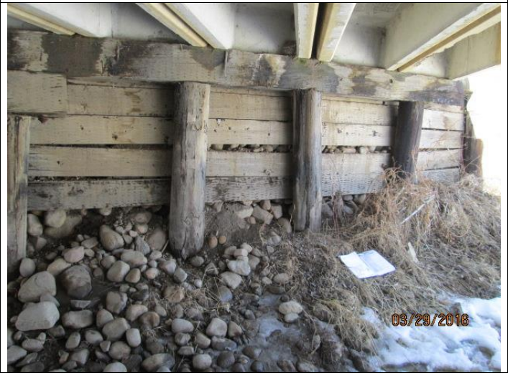
Backwalls/Breastwalls Loss of Fill Rated 4

Slide 21
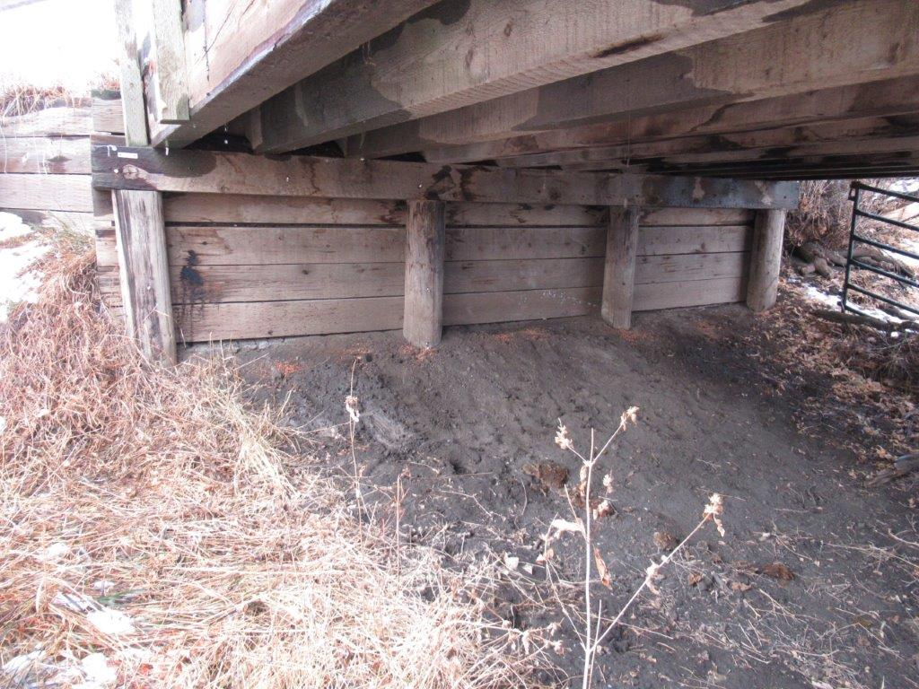
Backwall W/ No Fill Loss - Rated 5

Slide 22
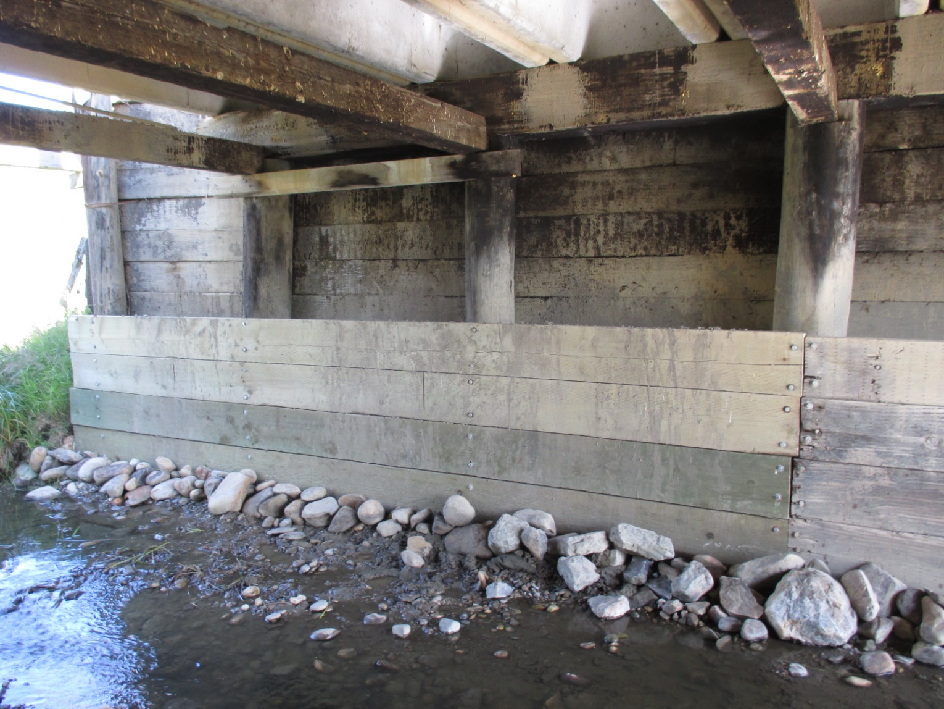
Repair with Breastwall

Slide 23
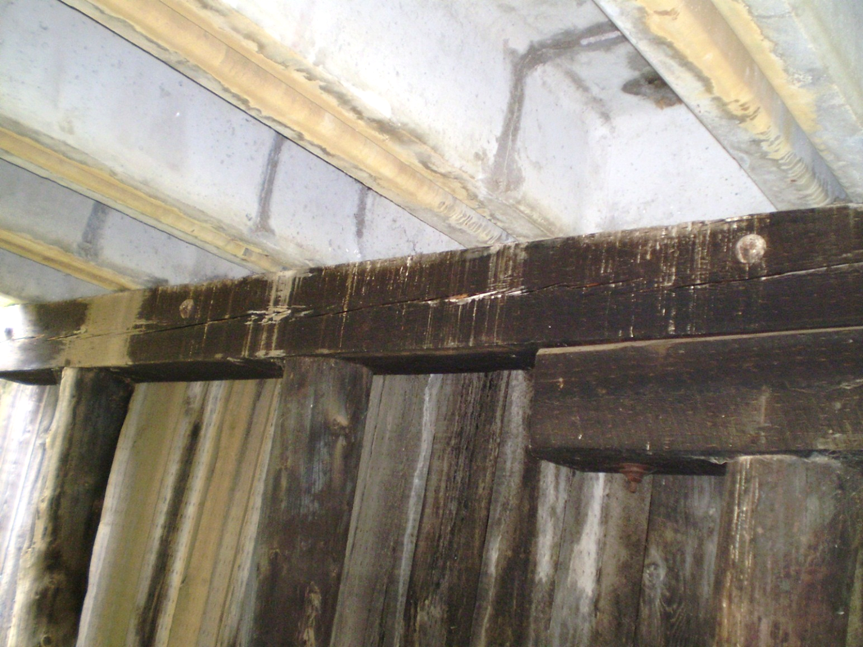
Vertical Driven Backwall Sheathing

Slide 24
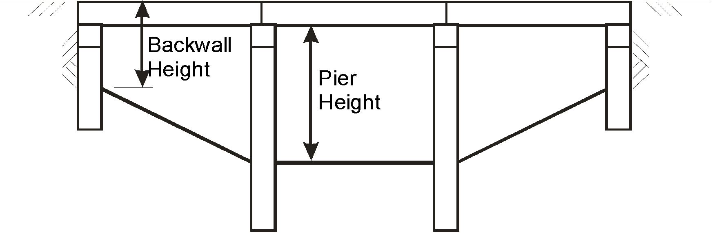
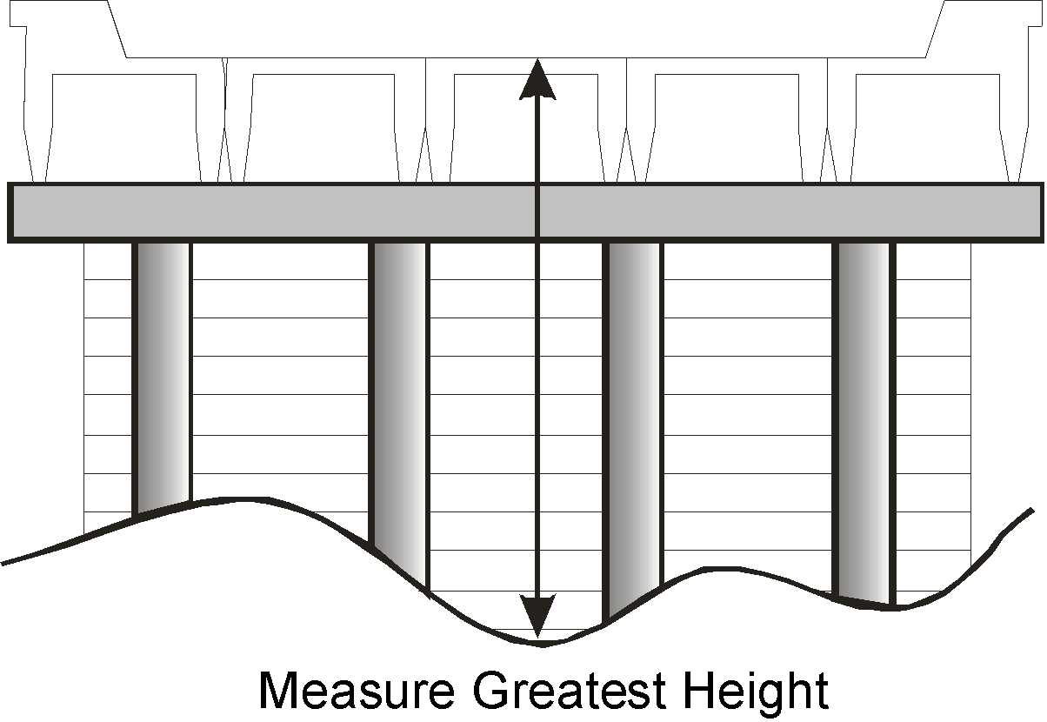
Backwall & Pier Height

Slide 25
Wingwalls
Applies to abutments only
Primary function is to retain fill
Consist of horizontal or vertical driven sheathing attached to piles
Wing piles are included in inspection and rating
Stability and Scour/Erosion are rated separately
Look for:
  Material defects
  Sheathing not installed low enough
    sheathing to be set below the ground level or scour protection installed at the bottom
  Loss of fill material below the wingwall
  Excessive gaps between the planks allowing infiltration
  Sheathing or piles bowing out from earth pressure
  Missing or broken planks or piles
  Missing or damaged tin tops on timber wing piles
    installed to prevent water from entering cut end and rotting interior of pile
  Proper attachment to backwall - loose or missing wing cleat
  Broken or loose anchor tie to pile

Slide 26
Wingwall Ratings
Requires repairs for aesthetics but is still functional - rate 5 or more
Requires repairs to be functional - rate 4 or less
  Loss of fill material – rate 4 or less (also rate under Scour)
  Sheathing or piles bowing out from earth pressure rate 5 or less depending on functionality
  Missing or broken planks rate 5 or less depending on functionality
  Broken or rotted piles rate 4 or less
  Missing or damaged tin tops on wing piles rate 4

Slide 27
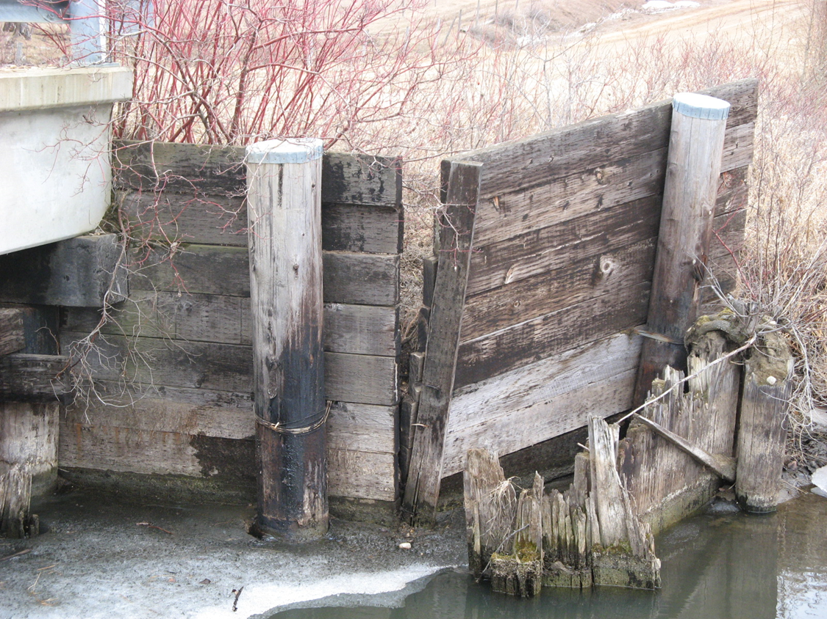
Wingwall – Separation from Backwall

Slide 28
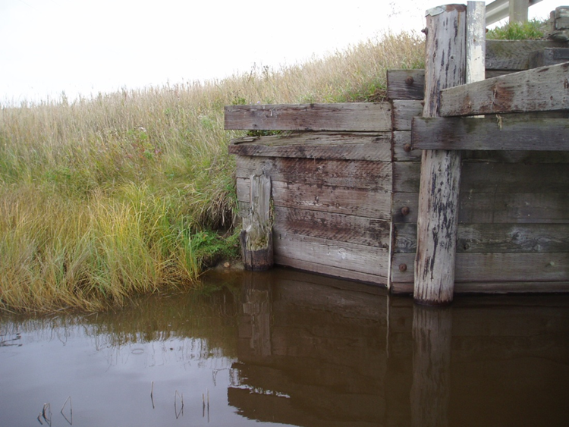
Wingwall – Broken Pile

Slide 29
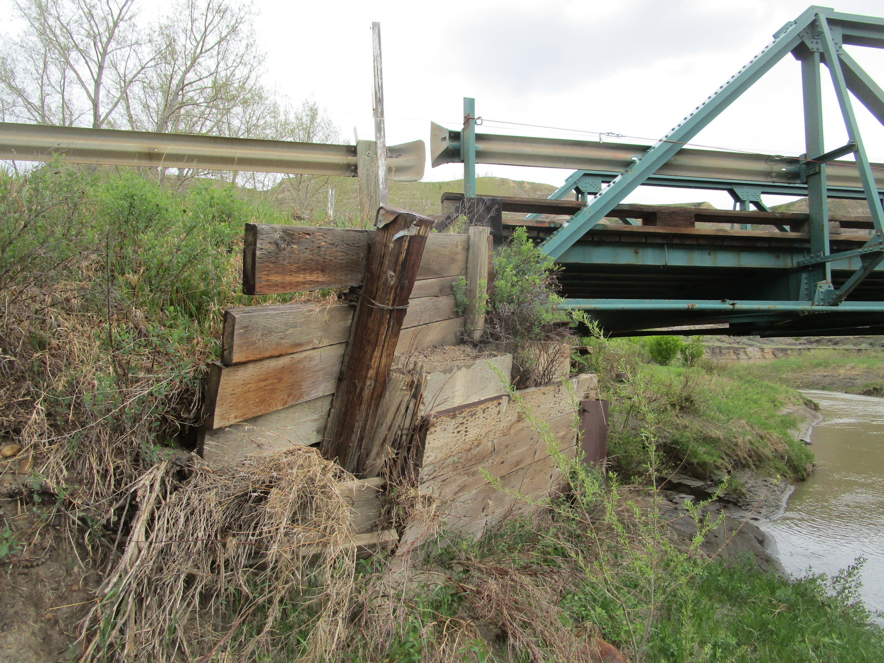
Wingwall – Leaning but still functional

Slide 30
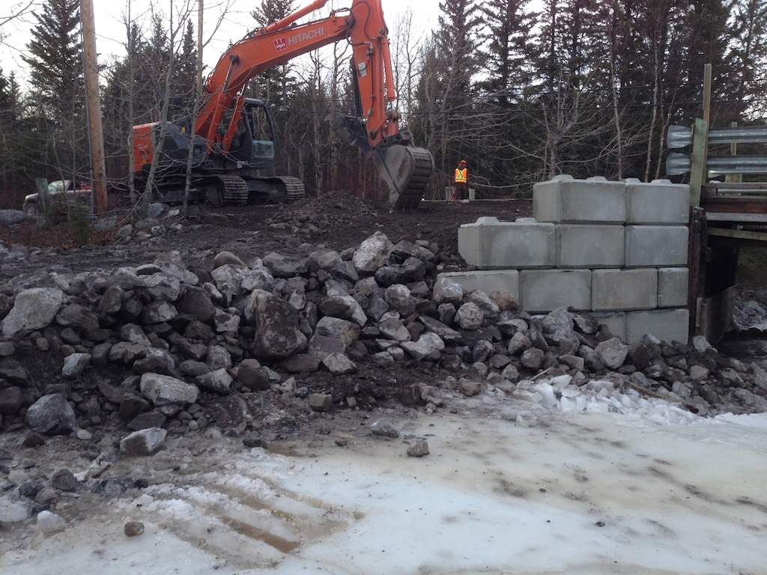
Wingwall – Rebuilt

Slide 31
Piers
Intermediate support between the abutments on multi-span bridges
Record pier type
  On Standard bridges piers are usually “Pile Bents”
  Pile bent is a single row of piles
  Pile Bent is recorded as “Pier Column”
Measure and record greatest height – lowest point to top of pier cap
Material Type:
  Timber
  Steel
  Concrete

Slide 32
Backwall & Pier Height

Slide 33
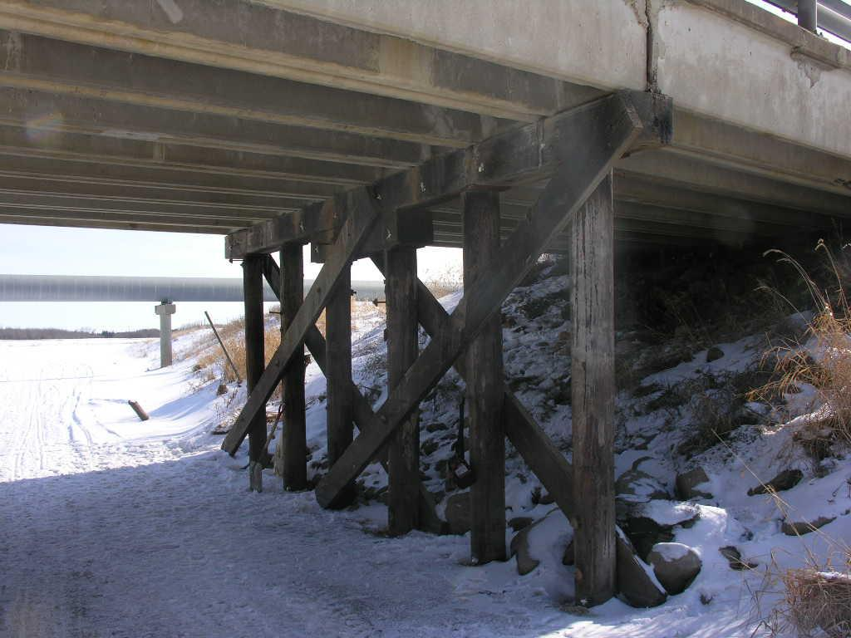
Timber Pier Bent (Column) with Sway Bracing

Slide 34
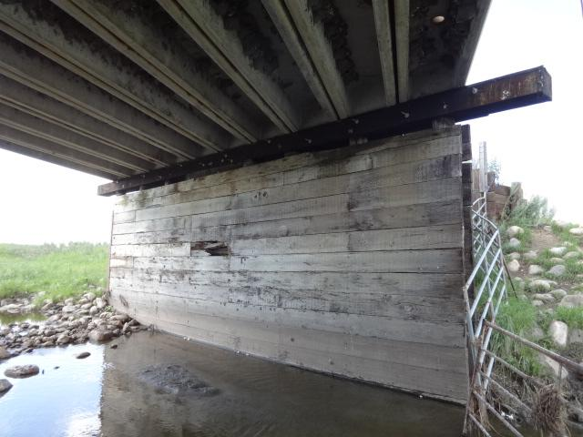
Timber Pier Bent (Column) with Full Sheathing

Slide 35
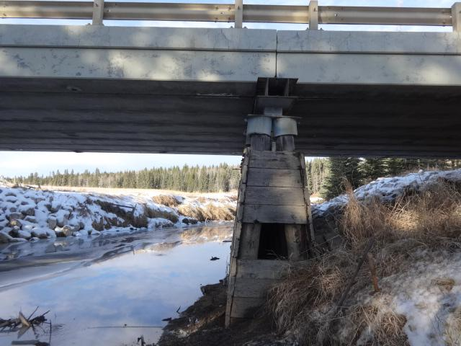
Teepee Pier Bent (Column) with Sheathing, Capitols, Steel Caps

Slide 36
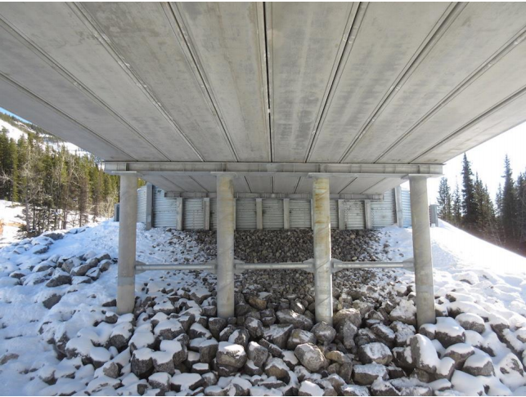
Galvanized Steel Pier Bent (Column) with Bracing

Slide 37
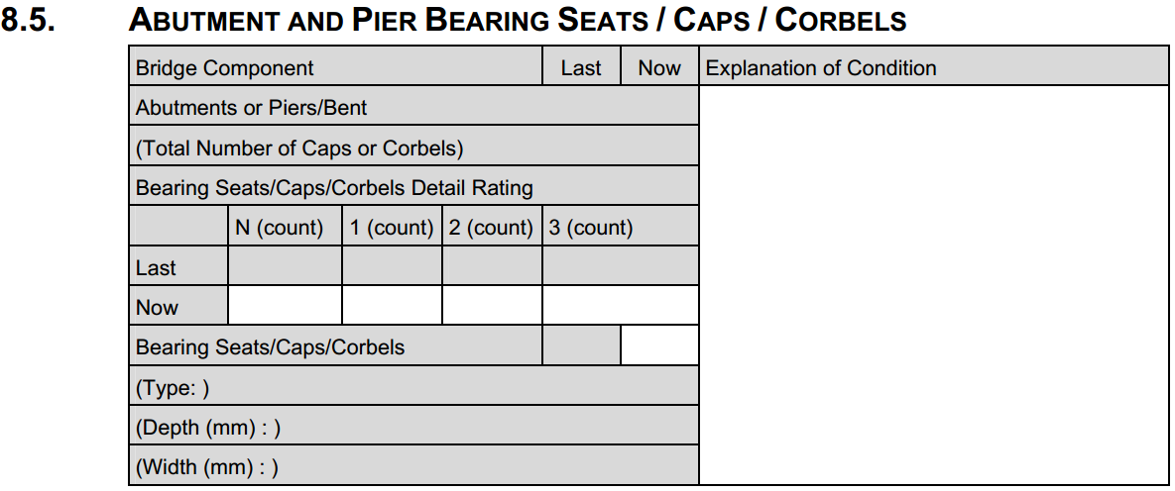
Bearing Seats/Caps/Corbels
Applies to abutments and piers
Corbels used on major bridges only
Purpose
  Receive the loads from the superstructure
  Transfer loads to the piles
High-stress concentrations in bearing areas
  Under girders or timber stringers
  Above piles

Slide 38
Abutment or Pier Caps
Types
  Timber - found on timber pile bents
  Concrete - found on concrete or steel
  Steel - found on steel or timber pile bents
Confirm and/or record:
  Record total number of individual caps at each abut and pier (west:east or south:north) (e.g. 3:3). Steel caps welded together count as 1 cap.
  Caps < 100 mm depth do not count in total (e.g. plywood crown)
  Record Detailed rating boxes for caps
  Record the number of caps not visible in the “N” box
  Record “0’s” if caps are rated 4 or more

Slide 39
Abutment or Pier Caps
Confirm and/or record (cont’d):
Provide cap rating - refer to Section 8.5
Record cap material type
  Timber, steel, concrete
Record width and depth of caps - if different sizes provide comment
  Use nominal dimensions-(250, 305, 356 mm)
  Welded steel caps record total size
Verify the bridge file number on the file tag
  verifies that this is the correct bridge
  if tag is missing, illegible or incorrect, note in maintenance recommendations

Slide 40
Abutment or Pier Caps
Look for:
Concrete caps with wide cracks, delamination, spalls, corrosion of rebar, other deterioration
Material defects
  Especially decay in timber
  Check shape of timber caps (bulging/crushing)
Good contact between girders and caps, and between caps and piles
Fire damage-reduced section and strength
Evidence of defective connections
  Corrosion of dowels or drift pins
  Broken, cracked or poor welds
Capitals
  proper size for pile
Location and installation of steel cap stiffeners
  over pile locations
  on both sides of web
Rotation or displacement
  Usually indicates substructure movement

Slide 41
Timber Caps – Abutments or Piers
Decay in timber
  check moist areas - contact between girders, piles, sheeting planks
  check cut ends, dowel, drift, and bolt holes
  most often occurs in the cap interior while the treated surface remains sound
  look for discoloration at bottom of caps where moisture leaches out decay by-products
  look for crushing or bulging especially in high stress areas at piles or under girders
  sound caps with hammer to detect hollow areas
  recommend Level 2 coring if decay present or suspected based on visual clues

Slide 42
Rating Abutment/Pier Caps
Refer to Section 8.5.3 in Manual
Rate according to condition and functionality
Record number of caps rated N, 1, 2 & 3 in Detail Rating Field. Record “0” if caps rated >3
Any deficiencies reducing ability to transmit loads rate 4 or less
Spalling and rebar exposed - rate 4 or less
Girder bearing less than 100 mm or timber stringer less than 75 mm, rate 4 or less
Girder bearing less than 75 mm rate 3 or less
Timber caps with:
  Vertical or horizontal splits extending through full dimension rate 4 or less
  Early signs of rot rate 4 or less
  Signs of bulging rate 3 or less
  Signs of crushing rate 2 or less

Slide 43
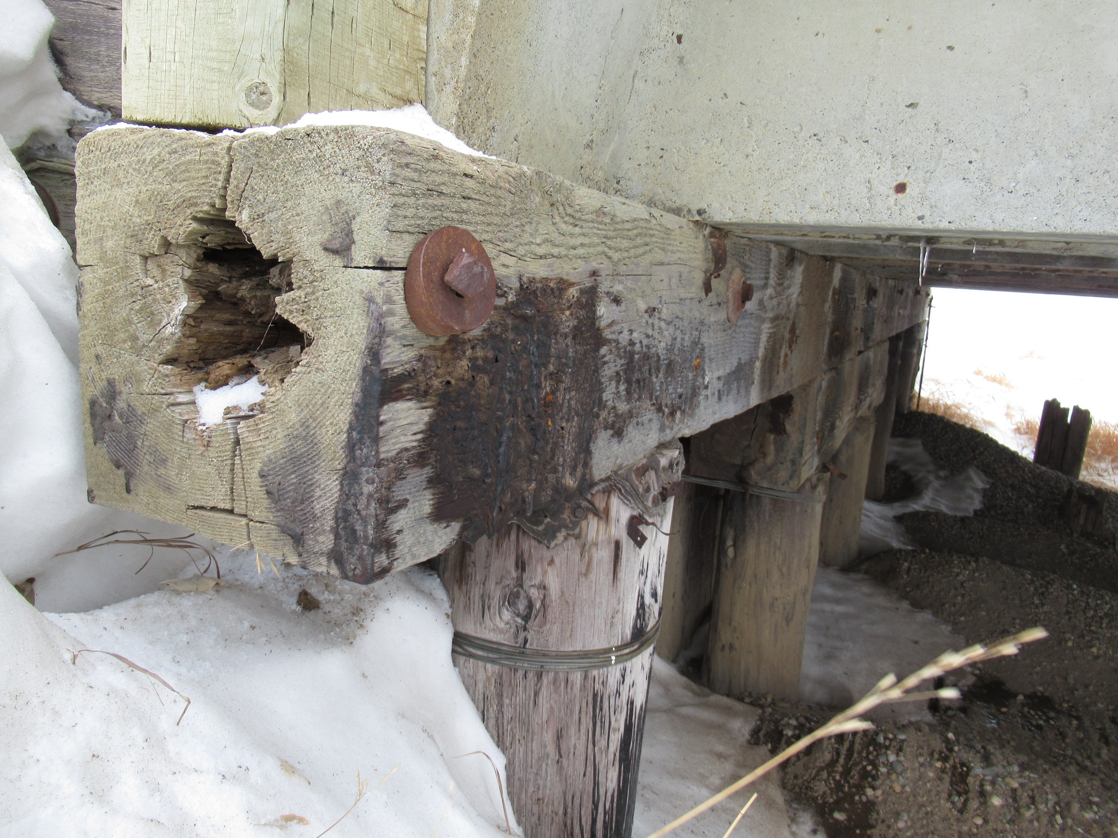
Beginning Rot in Timber Cap – Rated 4

Slide 44
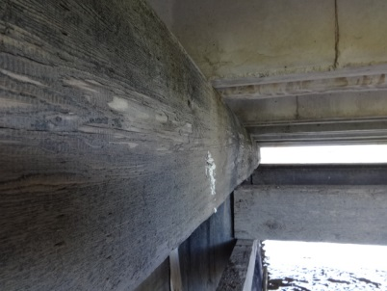
Bulging Timber Cap – Rated 3

Slide 45
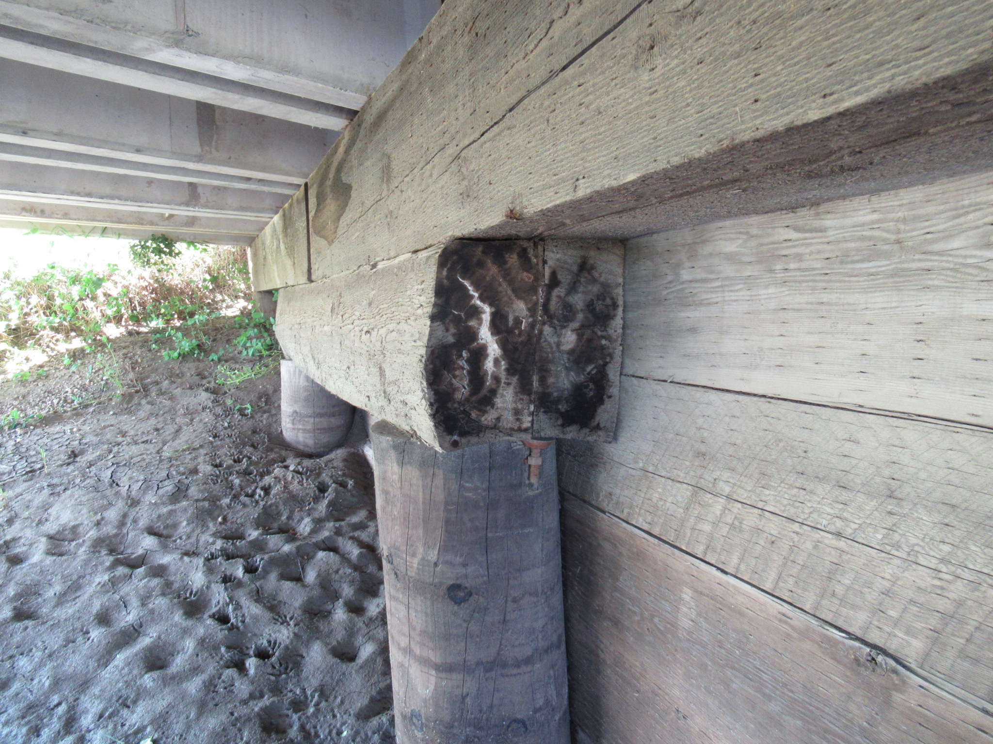
Crushing/Bulging Timber Pier Cap – Rated 2

Slide 46
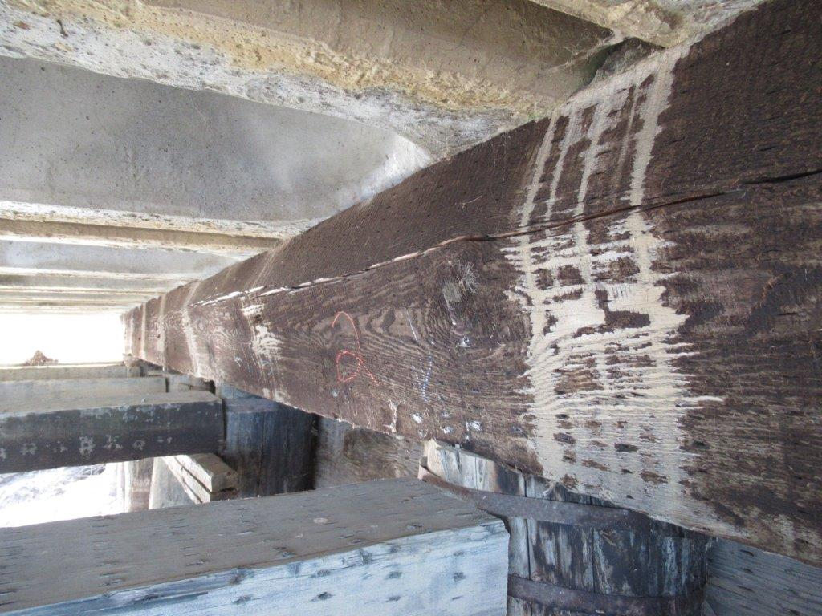
Crushing/Bulging Timber Abutment Cap – Rated 2

Slide 47
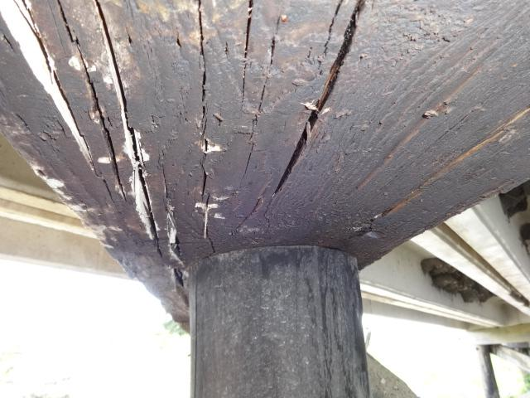
Crushing/Cracked Timber Pier Cap – Rated 2

Slide 48
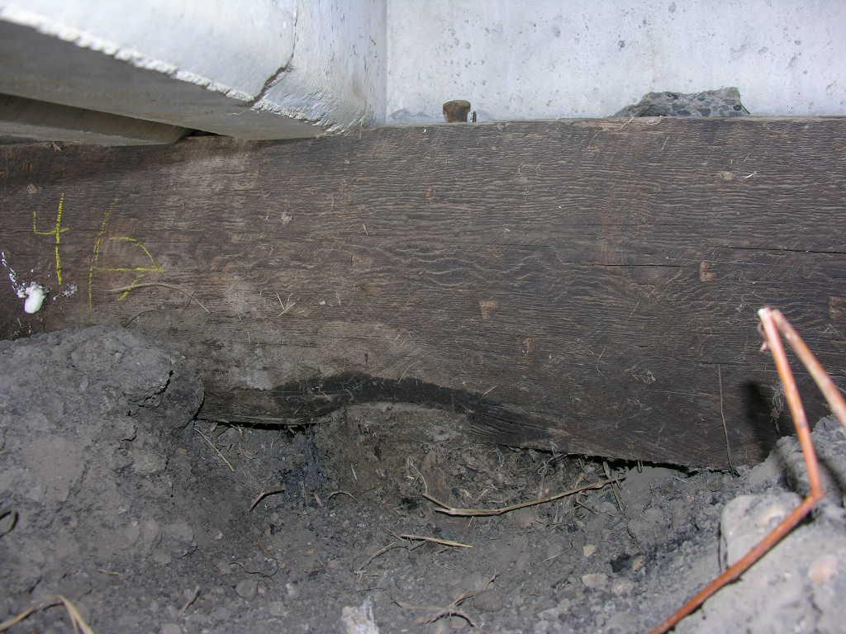
Crushing Timber Abutment Cap – Rated 2

Slide 49
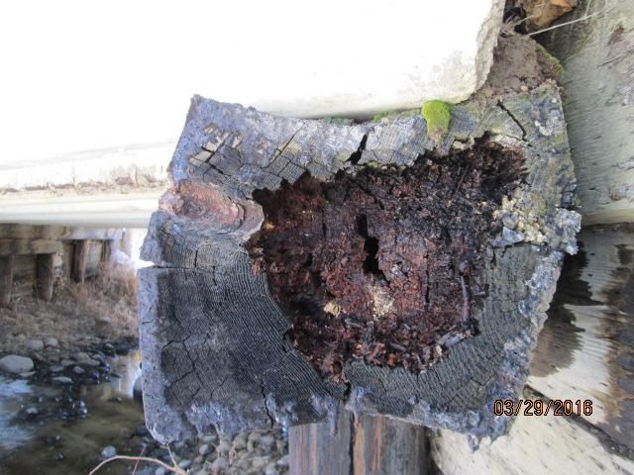
Crushing Timber Cap – Rated 2

Slide 50
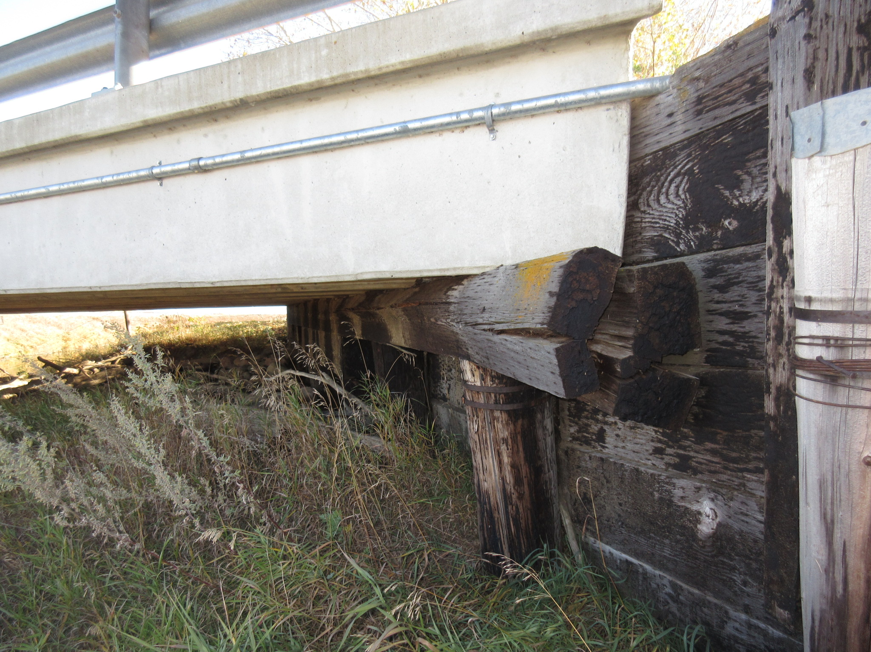
Crushing Timber Cap – Rated 2

Slide 51
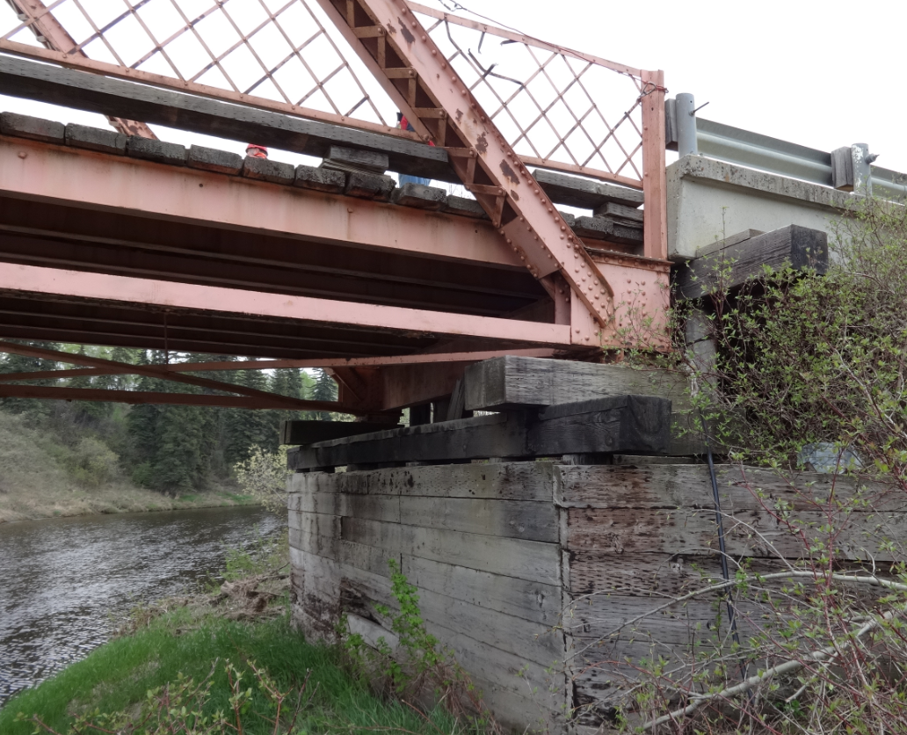
Timber Corbels Major Bridges

Slide 52
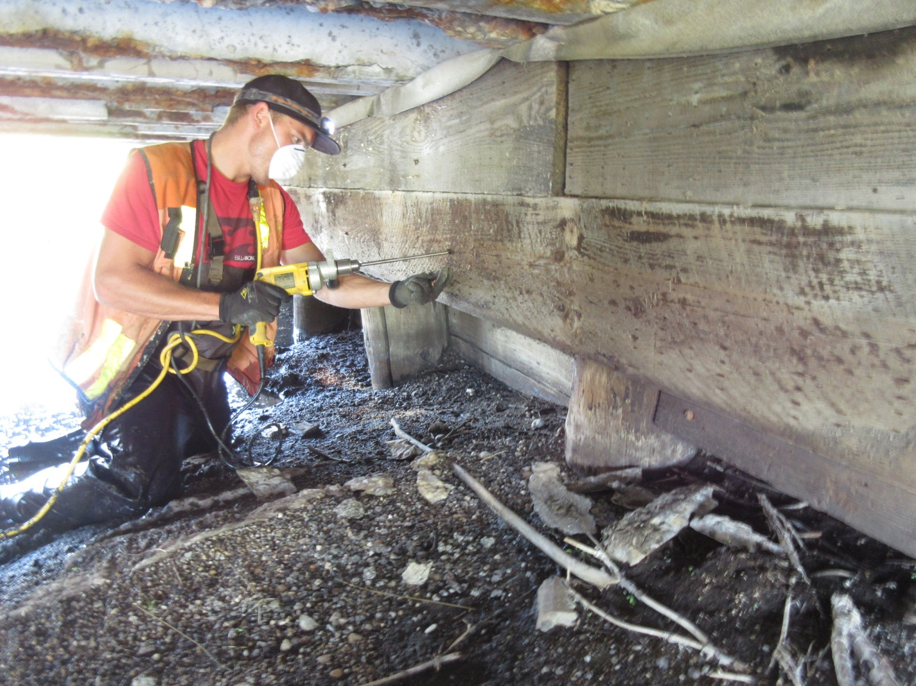
Level 2 Timber Coring

Slide 53
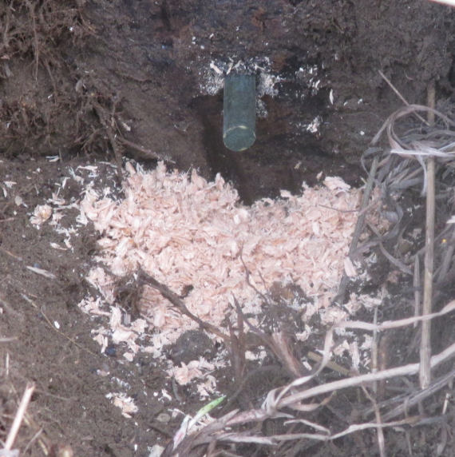
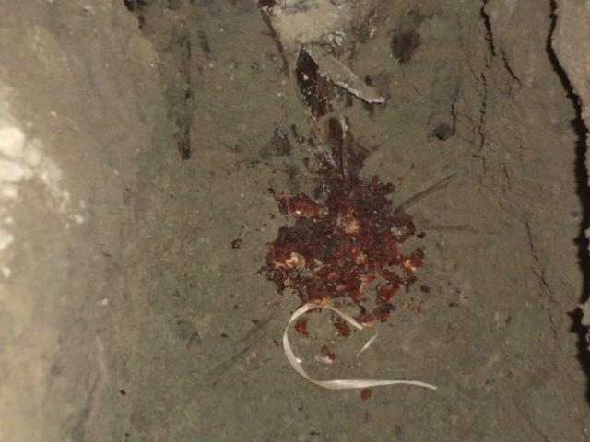
Level 2 Core Samples
Core shavings with rot
Good texture and colour – no rot

Slide 54
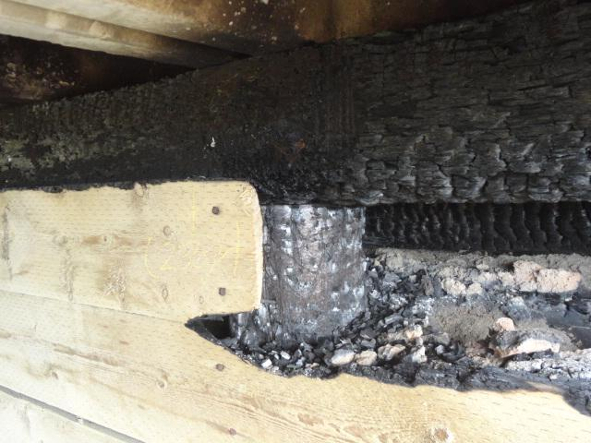
Fire Damaged Timber Cap with Section Loss

Slide 55
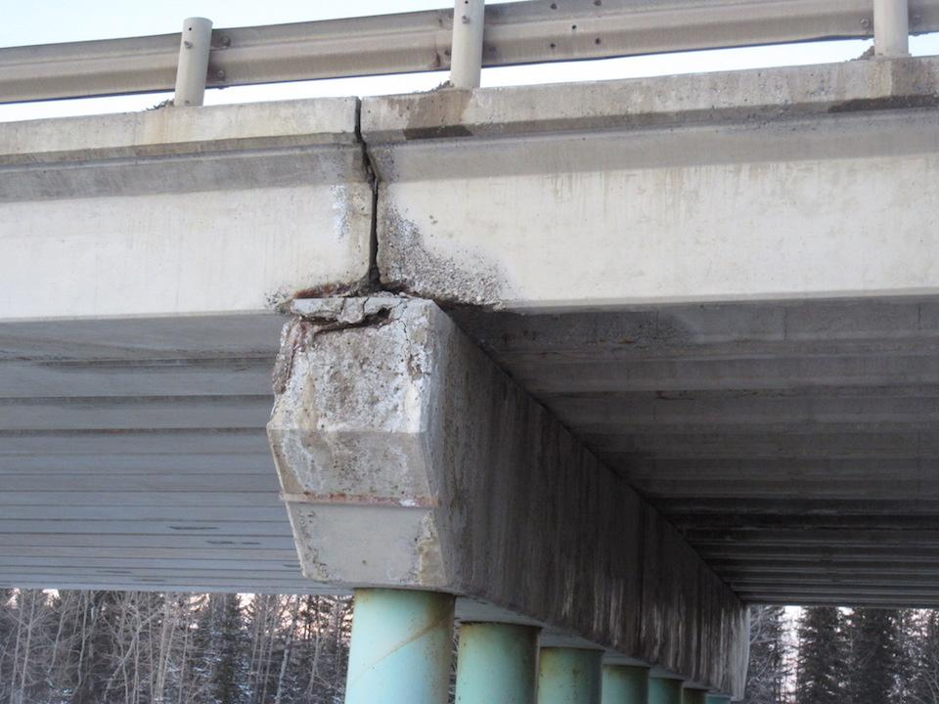
Concrete Pier Cap with Spalling

Slide 56
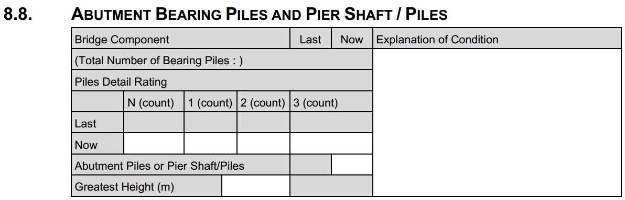
Abutment and Pier Piles
Applies to piles at abutments and piers
Piles receive the loads from the caps and transmit them to the ground
Piles also accommodate lateral loads
  ice and drift
  earth pressure
Record Detail Ratings as “0” if piles rated 4 or more

Slide 57
Abutment and Pier Piles
Pile types
  Timber
  Steel H-pile
  Steel pipe pile filled with concrete
  Concrete
Record the maximum pier height
  Measure from the lowest point to top of pier cap

Slide 58
Abutment and Pier Piles
Look for:
  Material defects
    Cracks, wide splits, rot of timber piles (especially in wet/dry zone
    Cracks, corrosion/loss of section of steel piles
  Collision damage from ice, drift or vehicles (lead pile especially)
  Abrasion from ice or drift
  Bowing due to excessive earth pressure or vertical loads
  Misalignment (out of plumb – not sharing loads) due to lateral forces
    Determine if as built (piles driven out of plumb is common) or related to stability
    Look for sloped cut on pile top or shims between pile and backwall
  Uneven spacing due to poor construction
  Signs of heaving or settlement. Note in vertical misalignment

Slide 59
Abutment and Pier Piles
Confirm and/or record:
Confirm pile type
Total number of bearing piles at each abutment and pier (any pile supporting cap or corbel)
Example 8:7 (numbers may be different)
Provide rating for abutment and pier piles - refer to Section 8.8.3
Record Detailed Rating boxes for piles
  Record total number of abut/pier piles not visible (“N”)
  Record “0” if piles rated 4 or more
59

Slide 60
Abutment & Pier Piles
Horizontal bending cracks rate 3 or less
Crushing from horizontal load of struts rate 3 or less
Bowing under vertical or lateral loads - rate 2 or less
Bulging outer fibers - rate 2
Record number of piles rated N, 1, 2 or 3 in pier/abutment Detail Ratings (0 if rated 4 or more)
Rate condition and functionality
Do not consider
  Stability - rate under abutment or pier stability
  Bracing - rate under bracing
  Struts - rate under struts
Piles not sharing loads from the superstructure - rate 4 or less
Splits, cracks, checks
  >10 and < 20mm - rate 4 or less
  >20 and <30mm – rate 3 or less
  Repaired (banding, clamps - rate 5
Timber abutment piles leaning (>5°) rate 3 or less*
  Confirm entire length in contact & being pushed over by backwall pressure and not due to pile driven out of plumb
60

Slide 61
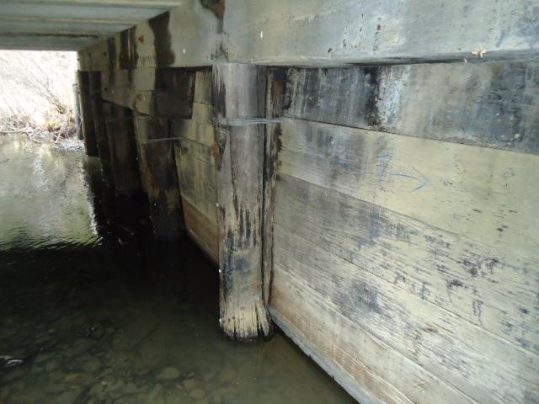
Timber Abutment Pile Bulging – Rated 2

Slide 62
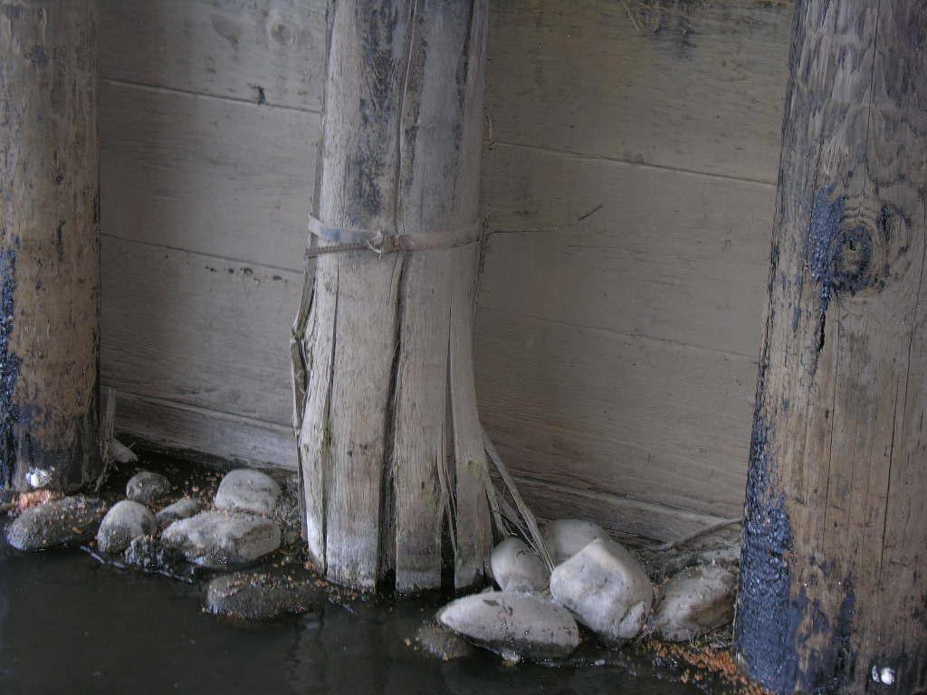
Timber Abutment Pile Bulging – Rated 2

Slide 63
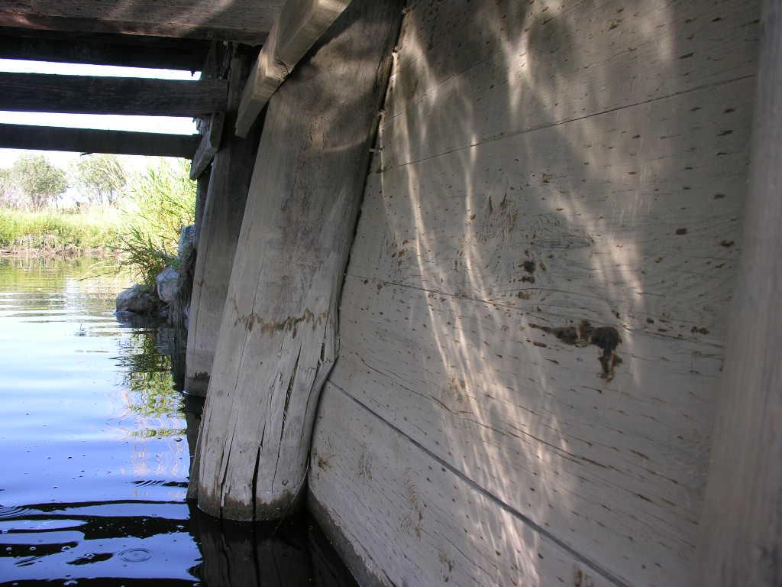
Timber Piles Bulging/ Bowing – Rated 2

Slide 64
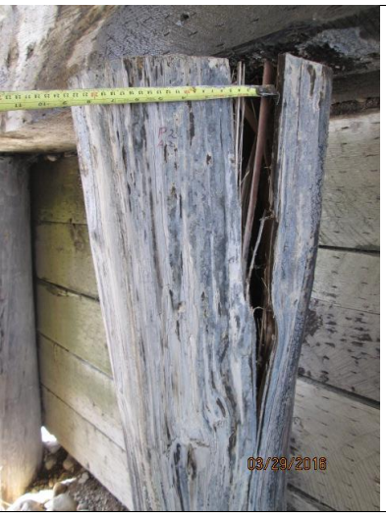
Timber Pile Wide Split <30 mm – Rated 3

Slide 65
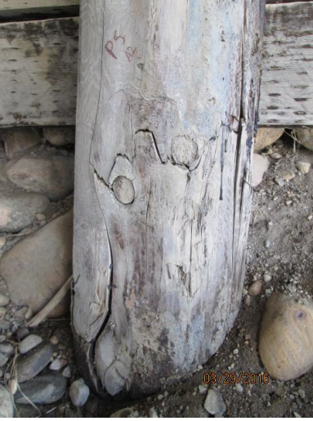
Timber Pile Horizontal Bending Crack – Rated 3

Slide 66
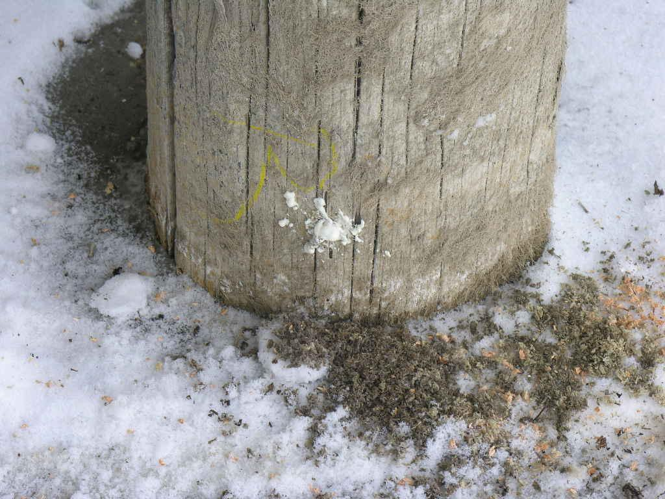
Timber Pile with Rot – Rated 3

Slide 67
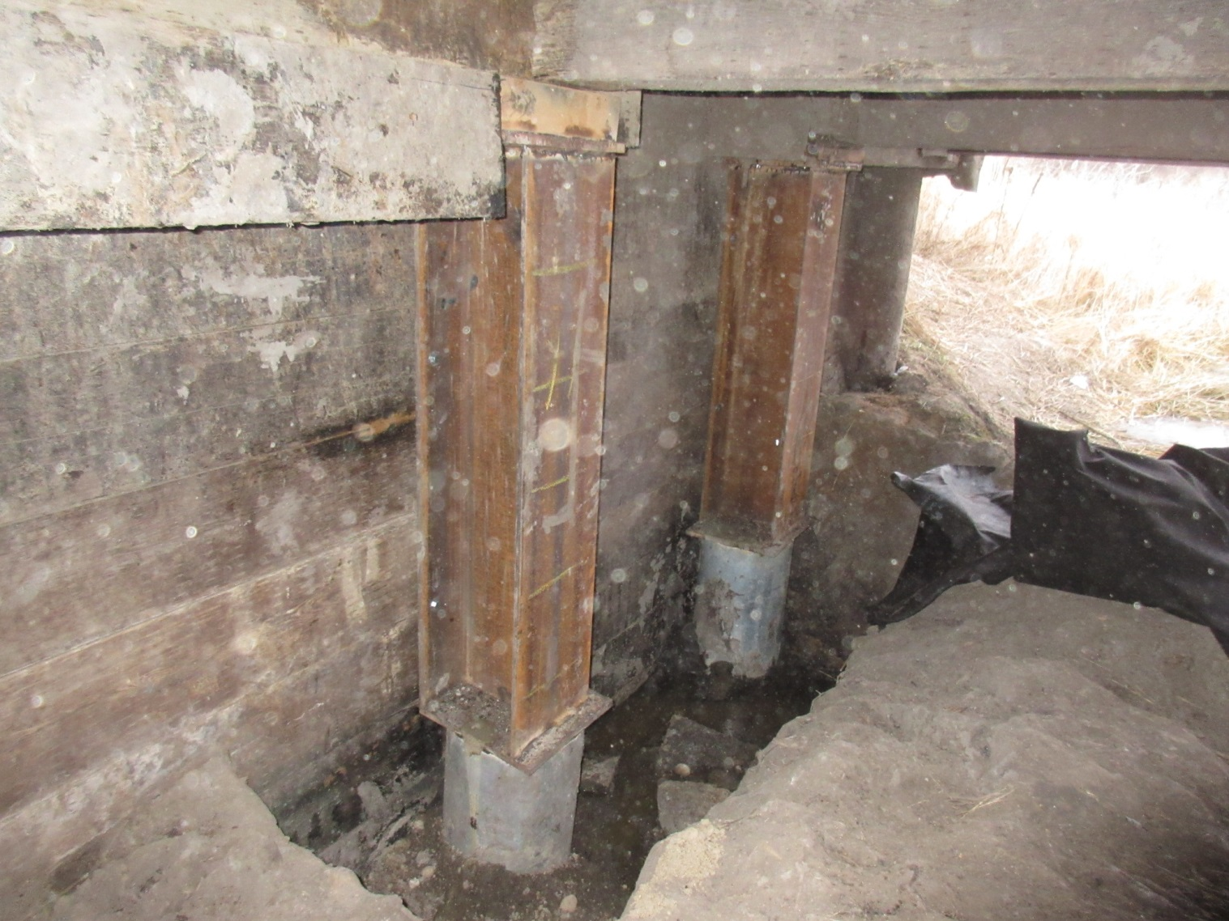
Timber Piles Repaired with Steel Splice

Slide 68
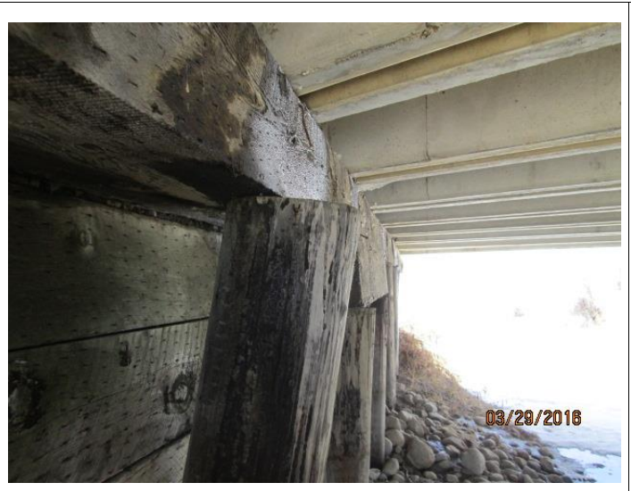
Timber Pile Not Sharing Load – Rated 3

Slide 69
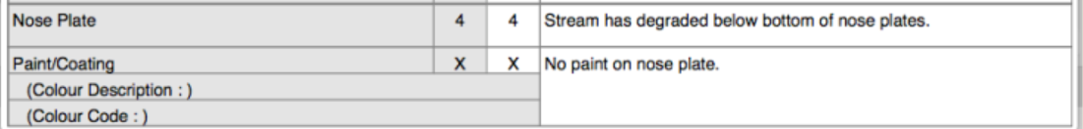
Paint / Coating
Applies to abutments and pier elements
Steel
  Paint
  Galvanizing
Concrete
  Cosmetic coatings
  Pigmented Sealers
  Waterproofing coatings
Does not refer to the creosote on timber components
Refers to nose plate coating only on timber piers
69

Slide 70
Paint / Coating
No coating on treated timber substructures therefore rate X.
  unless there is a nose plate then rate plate coating
Check areas exposed to moisture and or salt
  under leaking joints
  water line
  ground line
Check areas that are difficult to coat
  edges and corners
  bolts and connections
  areas with poor access
70

Slide 71
Paint / Coating
Rate according to condition and ability to protect the underlying element
Top-coat deteriorating but prime coat intact - rate 5
Pitting or loss of section of underlying element - rate 4 or less
Coatings for aesthetics only (pigmented coatings on concrete) - rate 3 or more
If no coating on steel elements and there is corrosion, rate 4 or less.
71

Slide 72
Abutment / Pier Stability
Substructure
Abutment Stability
Pier Stability
Applies to abutments and piers but rated separately
Can cause failure of the structure or problems with superstructure
Small movement can be tolerated
Excessive movements are those which affect load carrying capacity, level of service or cause distress to bridge elements

Slide 73
Abutment / Pier Stability
Types
  Rotational or dipping
    excessive earth pressure
    Scour/erosion
    Superstructure movement
  Vertical
    heaving due to frost
    settlement due to inadequate bearing capacity
  Horizontal
    movement of soil mass or slope failure
73

Slide 74
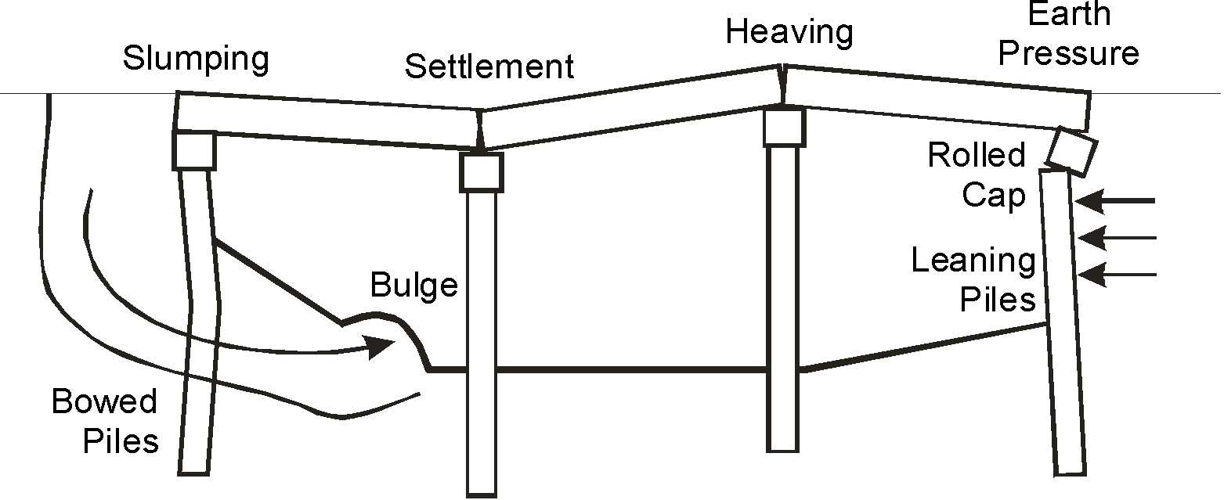
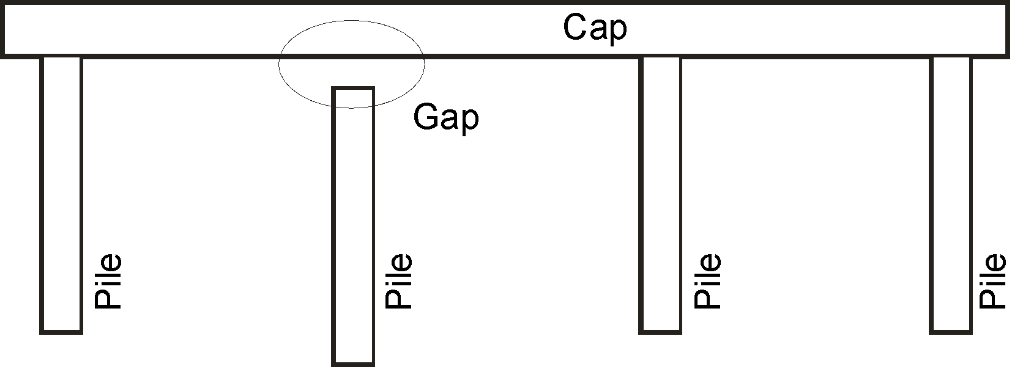
Abutment / Pier Stability

Slide 75
Abutment / Pier Stability
Span alignment problems detected in superstructure inspection may indicate substructure instability
Rotational Movement - look for:
  mis-alignment of caps with backwalls or piles (rotating or rolling)
  damage to connections at bearing areas
  damage to anchoring system
  signs of embankment movement
75

Slide 76
Abutment / Pier Stability
Lateral Movement - look for:
  uneven bearing areas
  horizontal misalignment between spans
  separation between backwall and wingwalls
  signs of embankment movement
  out of plumb piles
  bowed struts
  broken backwall scab/anchor pile connections
76

Slide 77
Abutment/Pier Stability
Vertical Movement - look for:
  unevenness in superstructure
  gaps between piles and caps
  misalignment of structural elements
Significant scour may not affect stability
Movement that requires monitoring - rate 4 or less
Movement causing damage to any bridge element - rate 4 or less
Note elements supporting stability with defects (e.g. struts, bracing). Ratings of these elements should be consistent with stability rating
77

Slide 78

Abutment / Pier Stability Bowed Struts

Slide 79

Stability – Heaved Pier

Slide 80

Stability – Settled Pier

Slide 81
Scour / Erosion
Substructure
Abutments and piers rated separately
Refers to removal of material by flowing water stream or approach drainage
Most bridge failures associated with scour / erosion during floods
Only scour which affects or has the potential to affect the abutments or piers
Scour/Erosion
Scour

Slide 82
Scour / Erosion
Definition – refer to 16.2
Scour – Removal of streambed material due to increased velocities caused by obstruction or constrictions
Erosion – general removal of material on stream banks, drainage ditches etc. by flowing water
Factors
  stream geometry
  type of material in stream banks and bed
  obstructions
    ice, drift, piers, abutments, river training works
  alignment of piers and abutments
  degree or constriction at bridge
  severity of flood

Slide 83
Scour / Erosion
Look for:
  A variation from the natural stream banks or bed
  General stream degradation and associated slumping of banks
  Loss of material
    toe of headslope
    in front of abutment backwalls
    around piers
  Scour if any debris is present (drift caught on pier)
83

Slide 84
Scour / Erosion
Determine the extent of the scour / erosion and probable cause
Approach road drainage that is also causing abutment or pier erosion also rated in Abutment/Pier Scour/Erosion
Scour or erosion causing loss of fill material from below or behind backwall rate 4 or less
If stability of structure threatened rate 3 or less
If vertical bank at the abutment rate 3 or less
If loss of fill is safety concern resulting in a hazard, rate 2 or less (e.g. void under approach road)
84

Slide 85
Bracing / Struts / Sheathing
Applies to:
  Bracing or sheathing on piers
  Horizontal struts which extend between abutment or pier piles
  Rated in pier section (including single span bridges)
Bracing and sheathing
  For load distribution between piles
  Strengthen pier stability
  Bracing are single planks or steel members connecting the piles
  Sheathing is a solid wall of planks on both sides of the pier
    usually combined with a nose plate
Substructure
Bracing/Struts/Sheathing
85

Slide 86
Bracing / Struts / Sheathing
Struts
  Normally timber
  Prevent lateral backwall/earth pressure from pushing the abutment piles out
  If no struts, check that other pile anchor systems in place for backwall type abutment – could be anchor wires or cables, backwall clamps and scabs
86

Slide 87
Bracing / Struts / Sheathing
Look for:
  Material defects
  Adequate connections
    struts include retainer planks (horizontal planks on piles supporting struts)
  Whether struts interfere with passage of drift or ice
  Struts bear on piles and not caps
  Missing or bowing struts
87

Slide 88
Bracing / Struts / Sheathing
Rate according to condition and functionality
If different elements present rate worst with single rating - use “Explanation of Condition” to identify other elements and defects (struts and sway brace)
Missing or broken struts are bowed – rate 3
Loose or missing sheathing rate 4 or less
Cracked, broken, or missing bracing rate 4 or less
88

Slide 89

Bracing / Struts / Sheathing

Slide 90
Nose Plate
Applies to piers only
Located on the upstream side
Protects pier from impact or abrasion from ice or drift
Made from steel and bolted or welded to pier
Found on H-pile and timber piers (for standard bridges)

Slide 91
Nose Plate
Look for:
  Material defects
  Adequate connections to pier shaft/piles
  Impact damage
  Coating
Rate according to condition and functionality
Missing nose plate on timber pier prone to damage from ice or drift rate 3 or less
Pier without a nose plate rate X - but if required to protect from damage provide comments and make maintenance recommendation
91

Slide 92

Nose Plate

Slide 93
Debris
Applies to substructure as a whole – abuts and piers
Material deposited in the bridge opening
  trees and vegetation
  logs
  boulders
  beaver dams
  refuse (tires, washing machines, etc.)
  old piling, retaining walls etc. under bridge

Slide 94
Debris
Problems caused by debris
  reduction in flow carrying capacity of bridge
  localized scour
  impedes fish passage
  upstream siltation
94

Slide 95
Debris
Look at the entire bridge opening for any debris accumulation
If debris is located away from the bridge, record under the “Channel” section
  If has an effect on the bridge or has the potential
Indicate whether any significant debris is present by Yes or No
  If Yes, provide supporting comment
A rating is not required but the presence of debris may affect the Substructure General Rating
Old piling is common debris, respond Yes and provide comment and recommendation if causing damage, impeding flow, or catching other debris
95

Slide 96

Abutments

Slide 97

Piers

Slide 98
General Rating
Governed by; refer to 1.10.3 and 8.15
  Structural load carrying members
  Caps/Seats ratings
  Pile ratings
  Backwall rating of 2 or less
  Abutment and/or pier stability ratings
The structural element ratings for both the abutments and piers must be taken into account when determining Substructure General Rating
98

Slide 99

Questions?

