Slide 1
CULVERTS – BASIC STRUCTURAL CONSIDERATIONS
https://m.youtube.com/watch?v=NTbhyHNA1Vc

Slide 2
Introduction
Currently there are approx. 8515 bridge size culverts in Alberta which accounts for ~63% of all bridge structures in the province.
Two types of culverts:
1) Flexible Structures (corrugated steel) (~96%)
2) Rigid Structures (concrete, steel or timber)

Slide 3
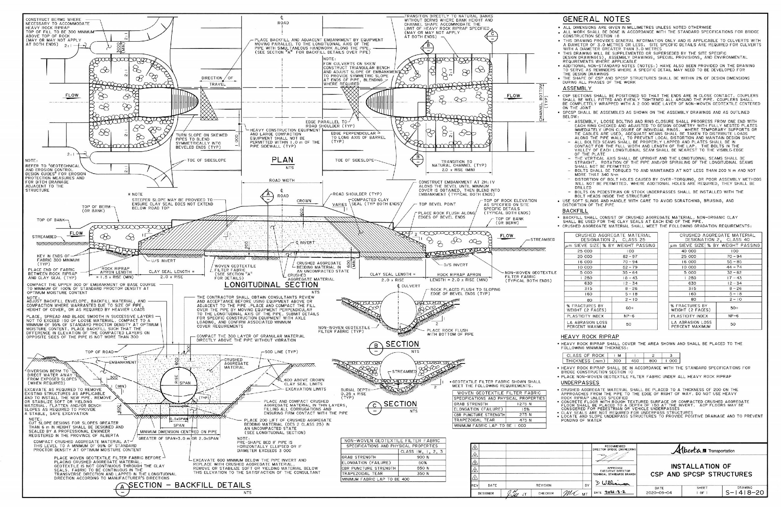
Standard Drawings S-1418-20

Slide 4
Rigid Structures
Concrete (~4%) – either box or pipe
Timber (0.1%) - no longer being built
Smooth wall steel pipe liners (rigid pipe)
No noticeable deflection under loads
Concrete is a durable material
Concrete is relatively expensive

Slide 5
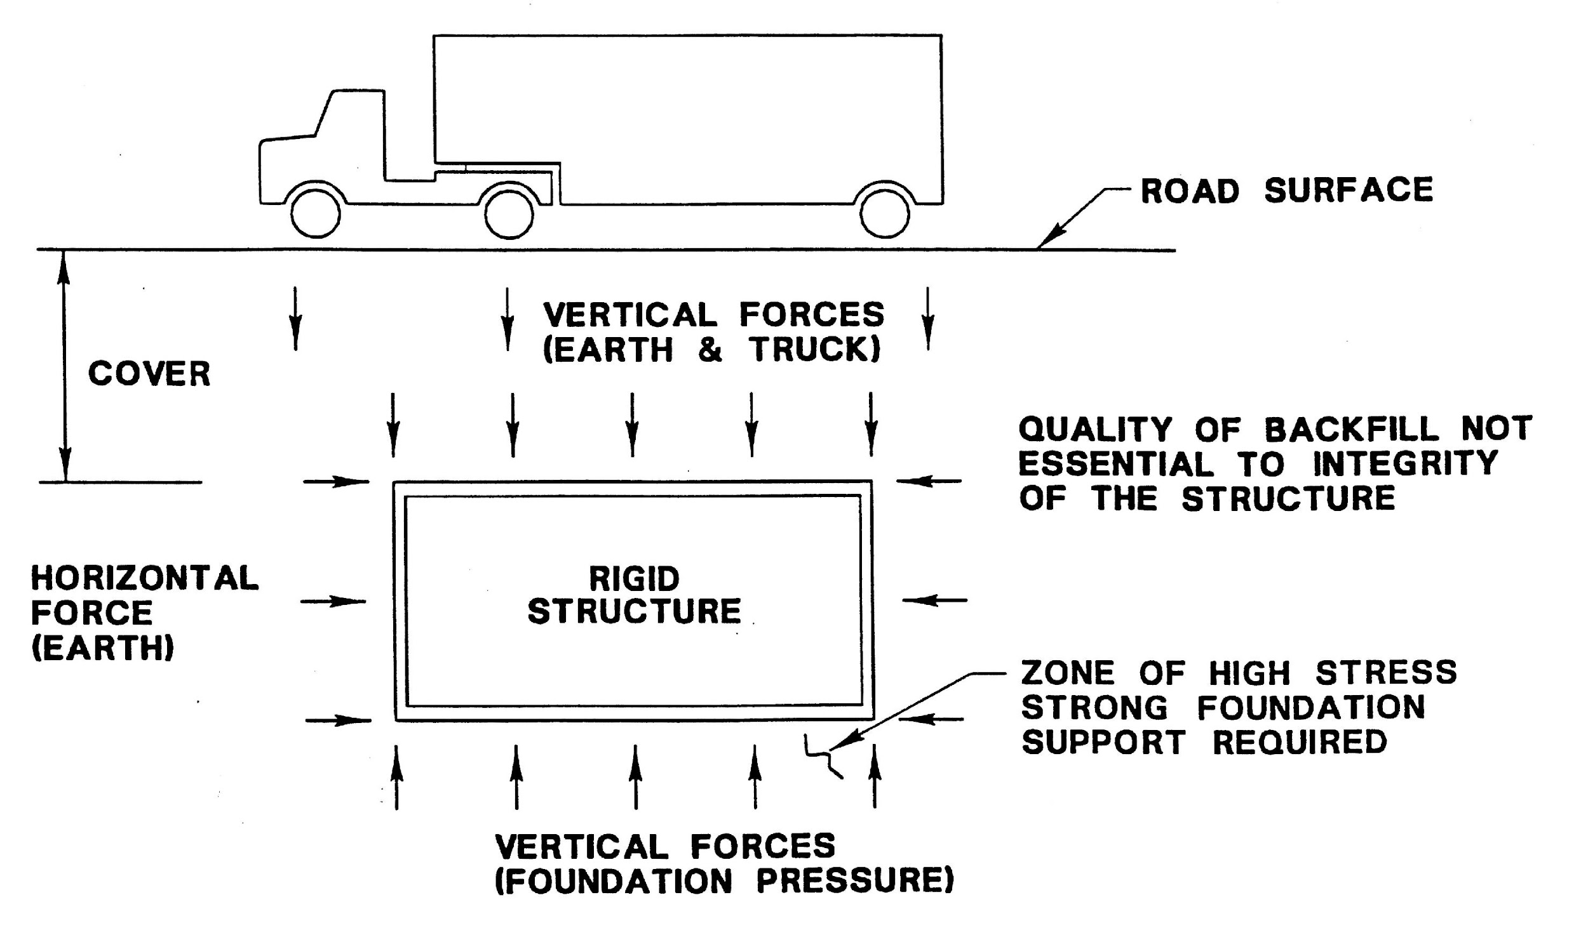
Rigid Structures

Slide 6
Flexible Structures
Metal culverts comprise approximately 96% of culvert inventory
Fabricate to almost any shape
Relatively cheap
Proper Backfill & Installation is CRITICAL
Susceptible to structural problems
Prone to corrosion, abrasion

Slide 7
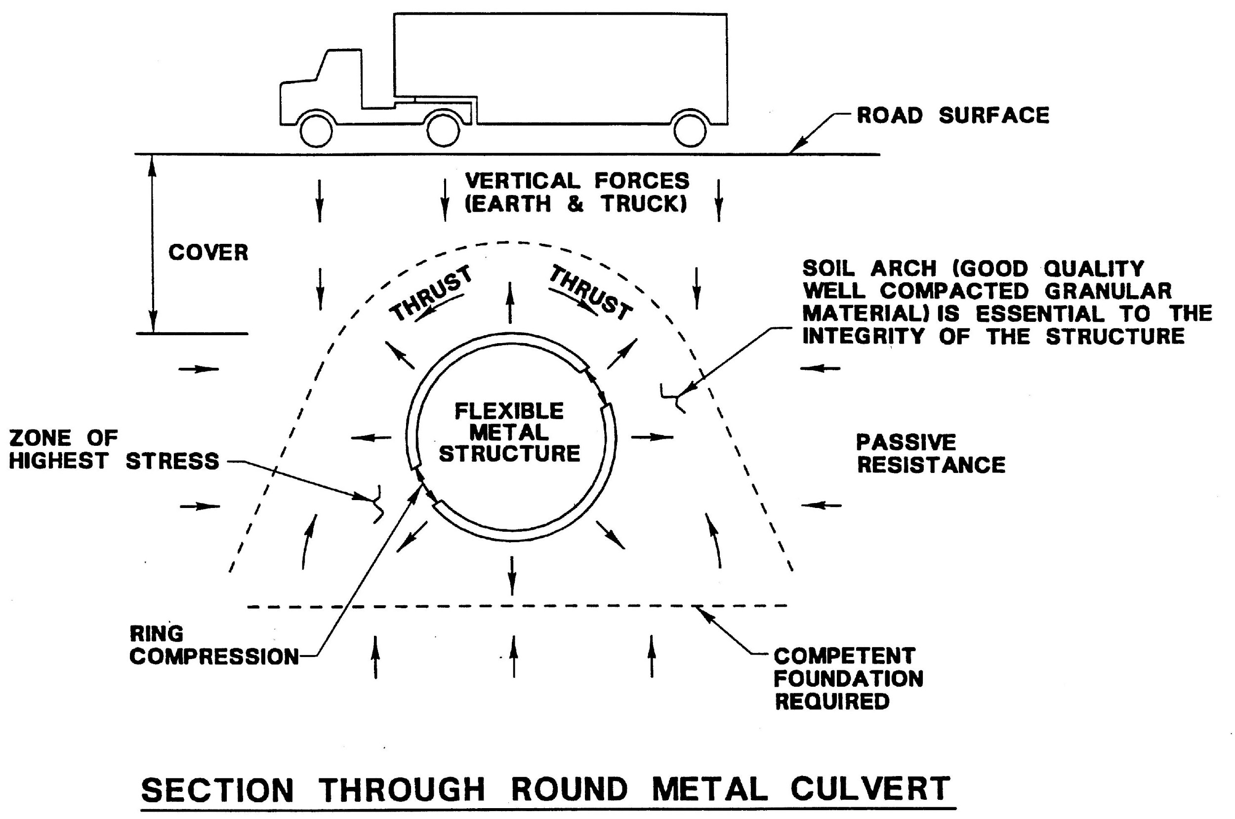
Flexible Structures

Slide 8
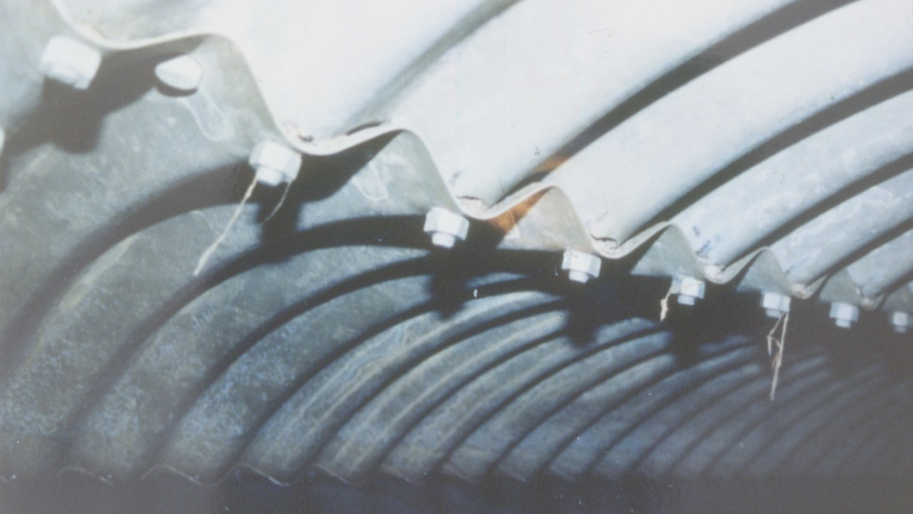

Slide 9
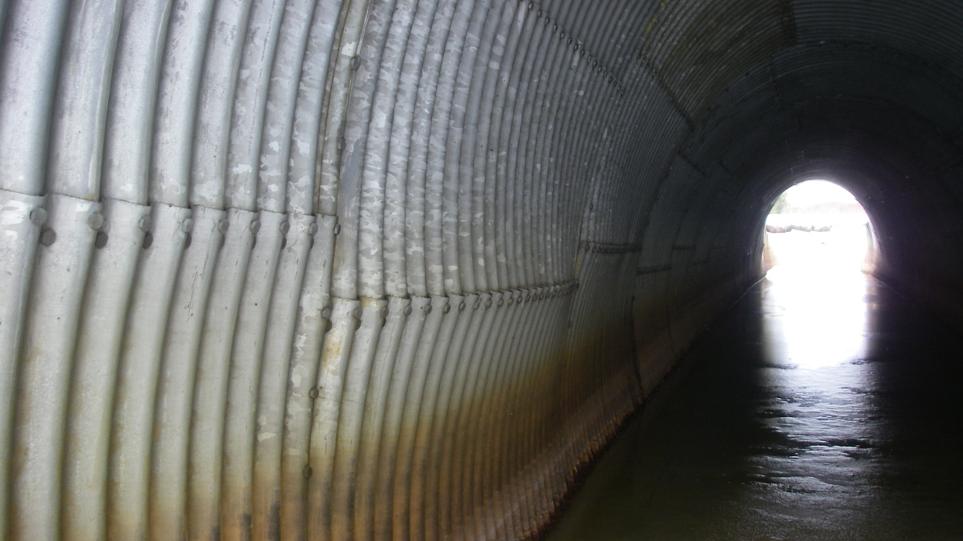

Slide 10
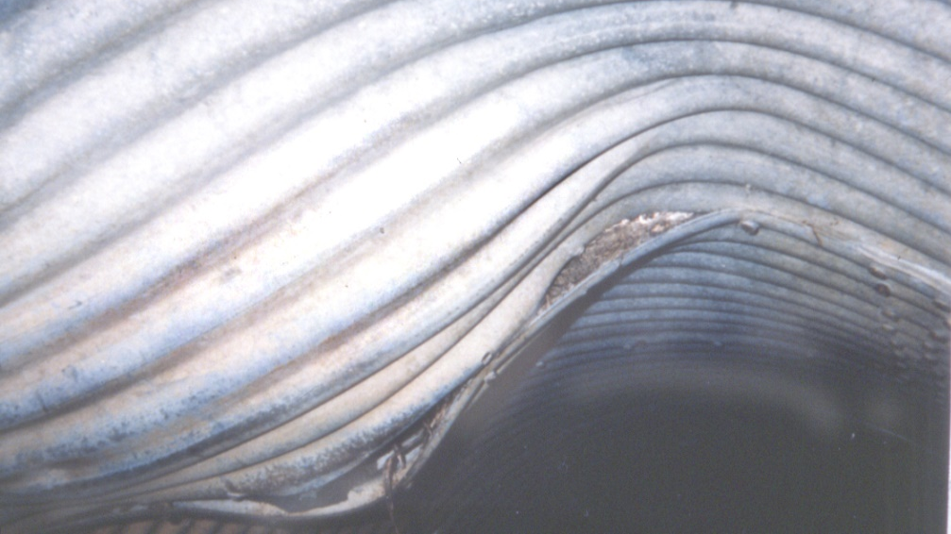

Slide 11
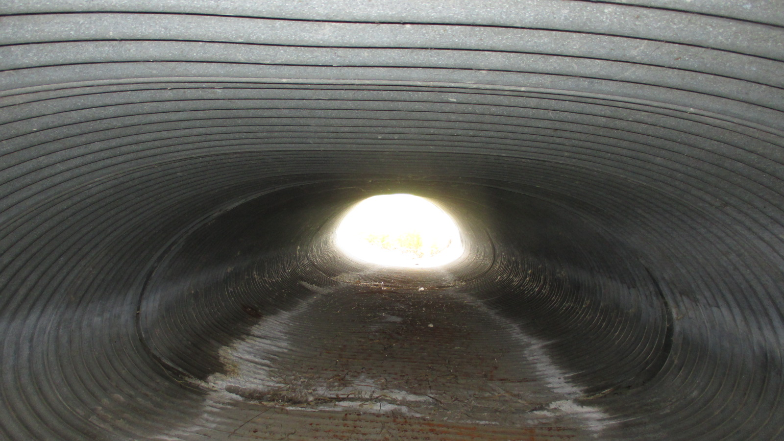

Slide 12
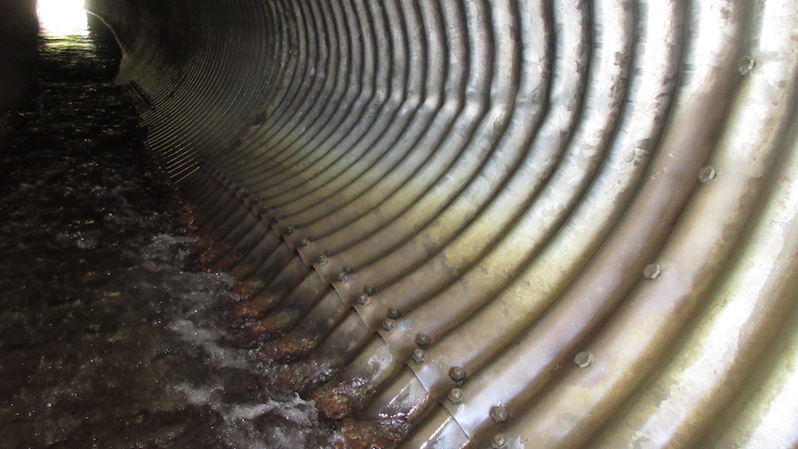

Slide 13
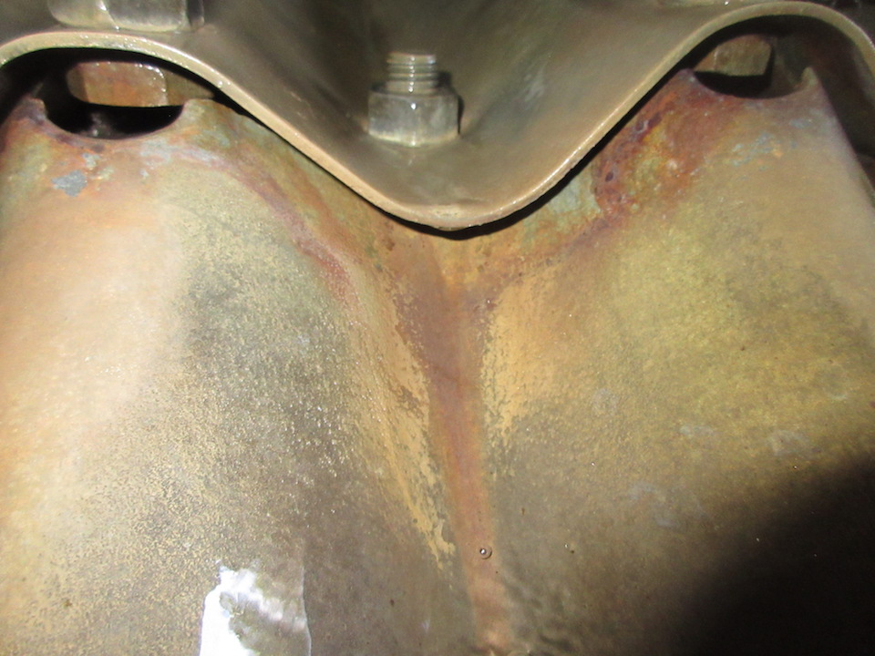

Slide 14
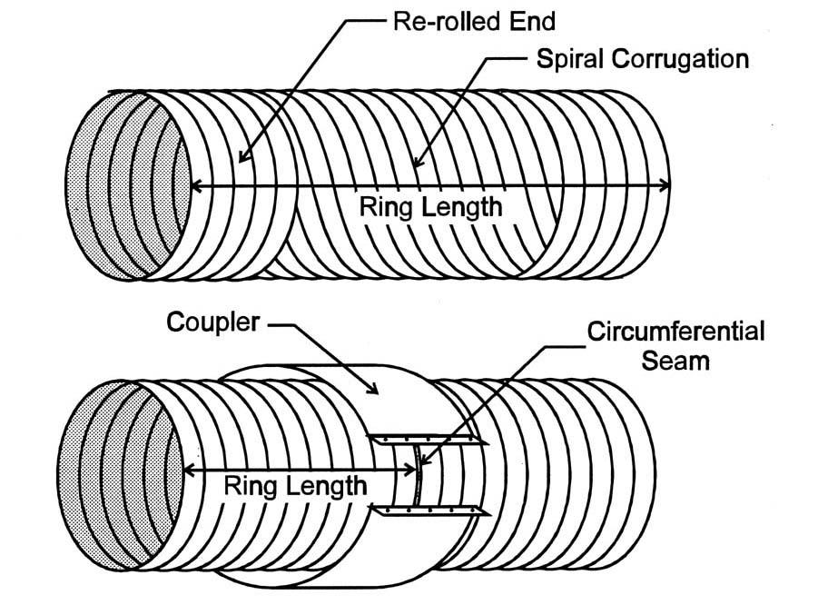
CSP (field jointing)

Slide 15
Flexible Culverts
Two Types:
Corrugated Steel Pipe (CSP)
Structural Plate Corrugated Steel Pipe (SPCSP)

Slide 16
Corrugated Steel Pipe (CSP)
Complete rings fabricated in plant
Rolled helical sections, re-rolled ends
Joined by couplers
Bridge sizes range from 1500 to 3600
Common sizes 1800 to 3000 (in 200mm increments)
Segment produced in lengths to suit transport (2.5 to 15.0 m)

Slide 17
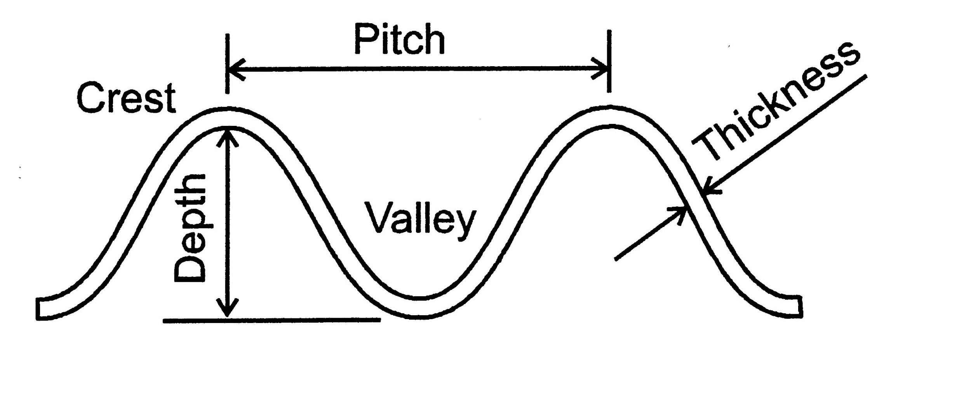
CSP Properties
Common Thickness
  2.8mm, 3.5mm, 4.2mm
Common Profiles
  68mm (Pitch) x 13mm (depth)
  76mm X 25mm, and 125mm X 26mm

Slide 18
Structural Plate Corrugated Steel Pipe (SPCSP)
Flat plate is corrugated & punched
Hot dip galvanized then curved to shape
Five thickness – 3, 4, 5, 6, and 7mm
Profiles - pitch x depth
  152 x 51 mm
  380 x 140 mm
  400 x 150 mm
Individual plates are bolted together

Slide 19
SPCSP (cont.)
Plate lengths
    3,050mm (10 ft)
    3,670mm (12 ft)
Plate width 5N, 6N, and 9N
    N is the circumferential bolt spacing
    N = 3pi (244 mm or 9.6”)
    Ex: Number of bolts in a 3.048m or 10’ diameter ring
    = π x 3048 mm / 244 mm = 39.2 = 39 spaces or 40 bolts per ring

Slide 20
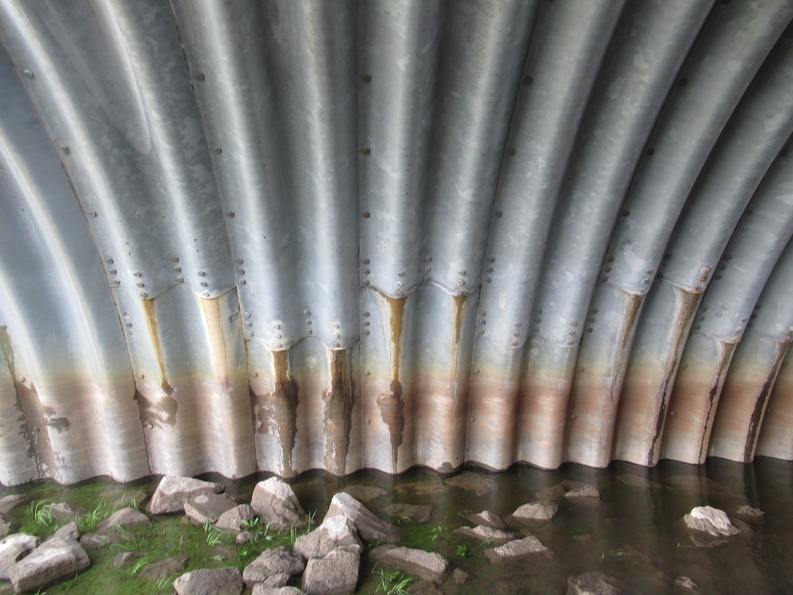
SPCSP - some recent products
Atlantic Industry's ‘Bolt-a-Plate
    width 1067, length 3N to 16N
Twister Pipe’s ‘MP 200’
    pitch 200, depth 55mm
SuperCor, and Bridge Plate
    (pitch 380, depth 140)
New coating systems

Slide 21
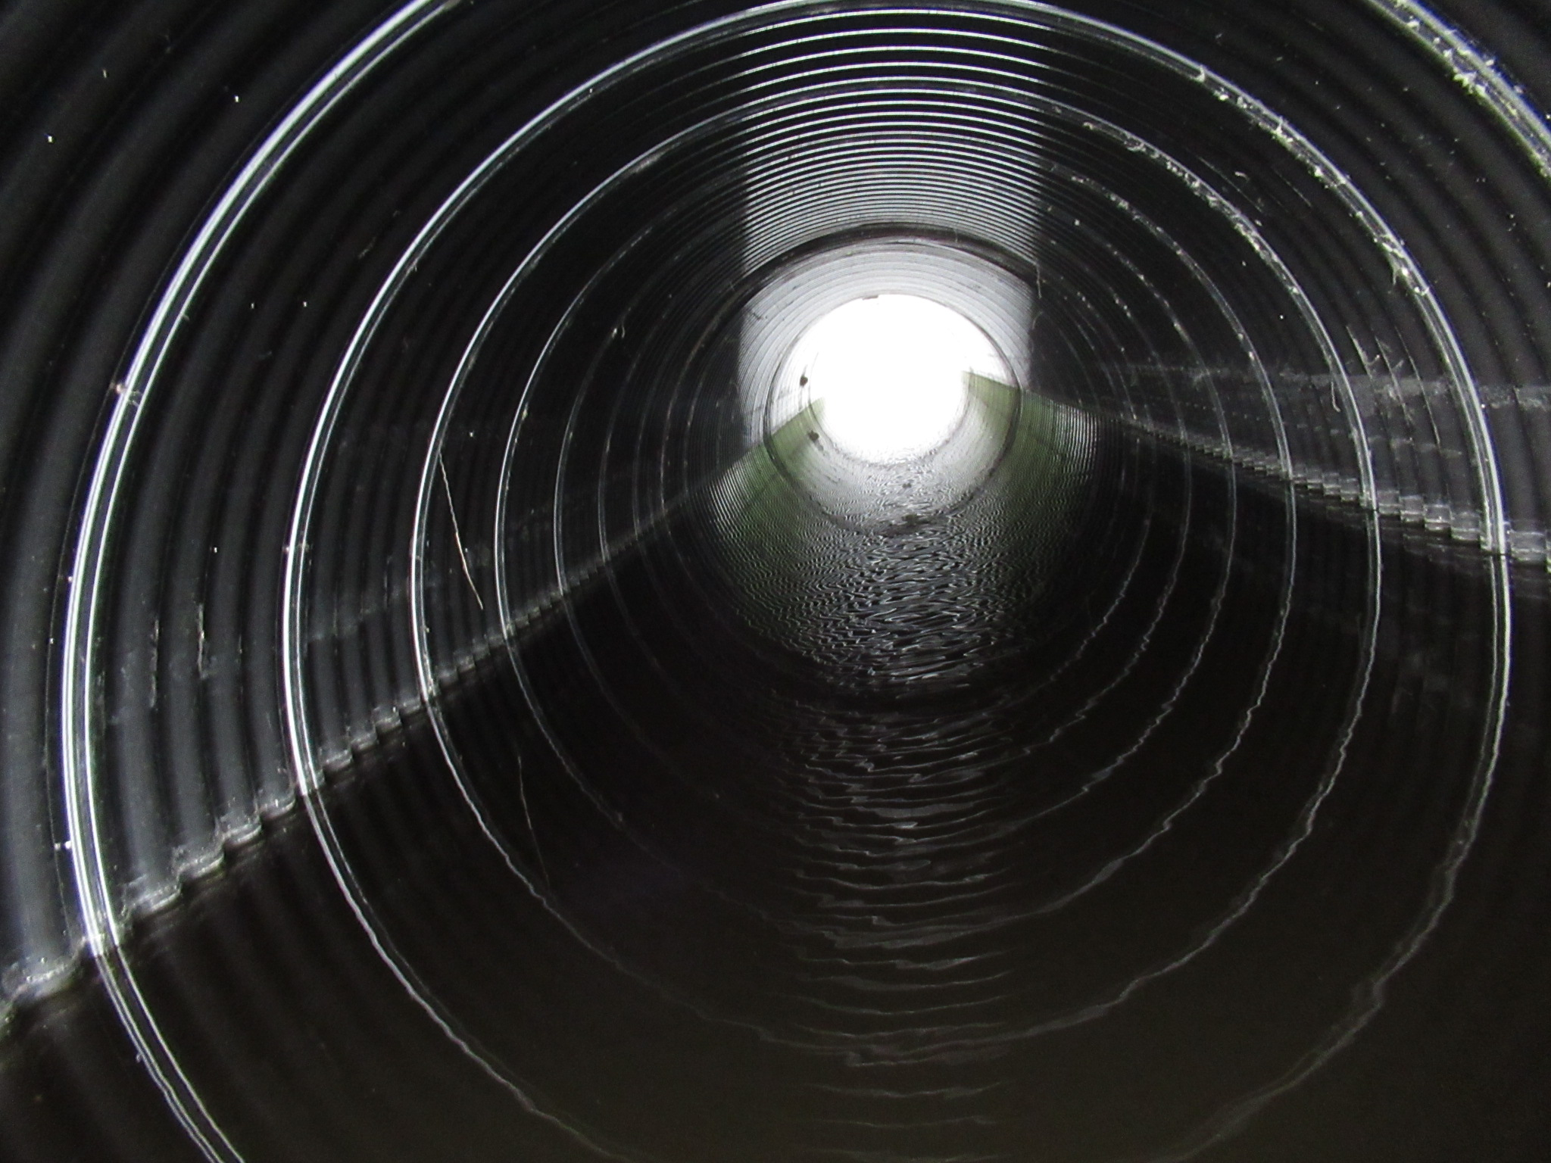
SPCSP - some recent products
New coating systems
Notes:
Black polymer coating for use in areas with corrosive soil.

Slide 22
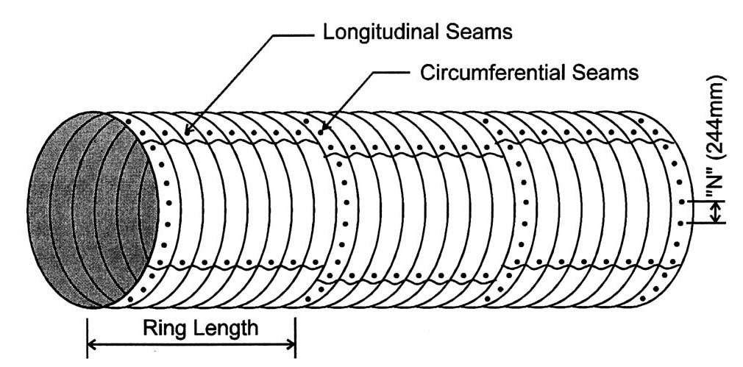
SPCSP (field bolting)
Longitudinal Seam Stagger (1N)

Slide 23
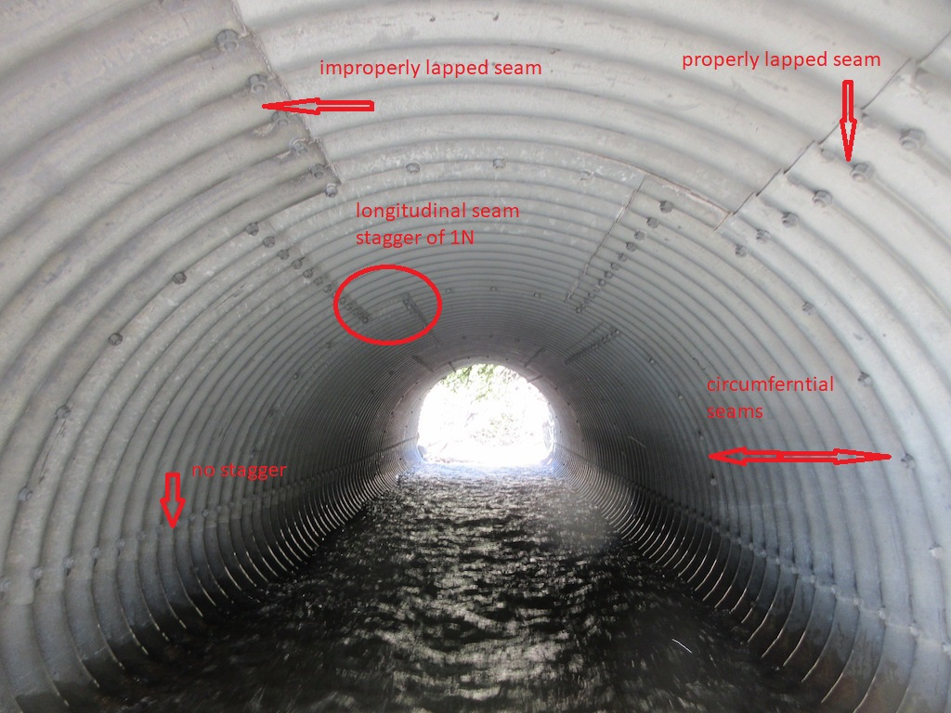
SPCSP Barrel

Slide 24
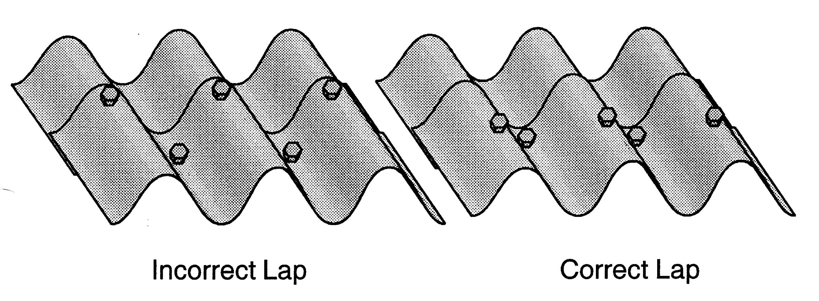
SPCSP (longitudinal lapping)

Slide 25
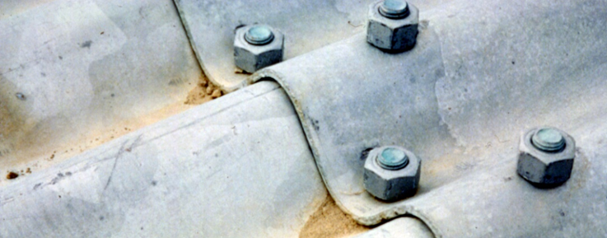
Properly Lapped Seam
Bolt in valley is nearest visible edge

Slide 26
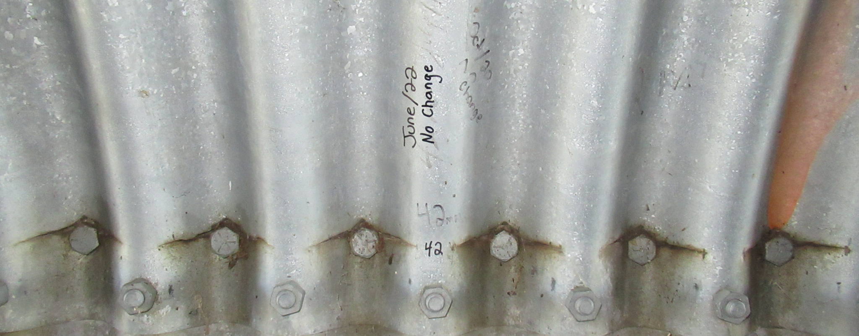
Improperly Lapped Seam
Bolt in valley is farthest from visible edge

Slide 27
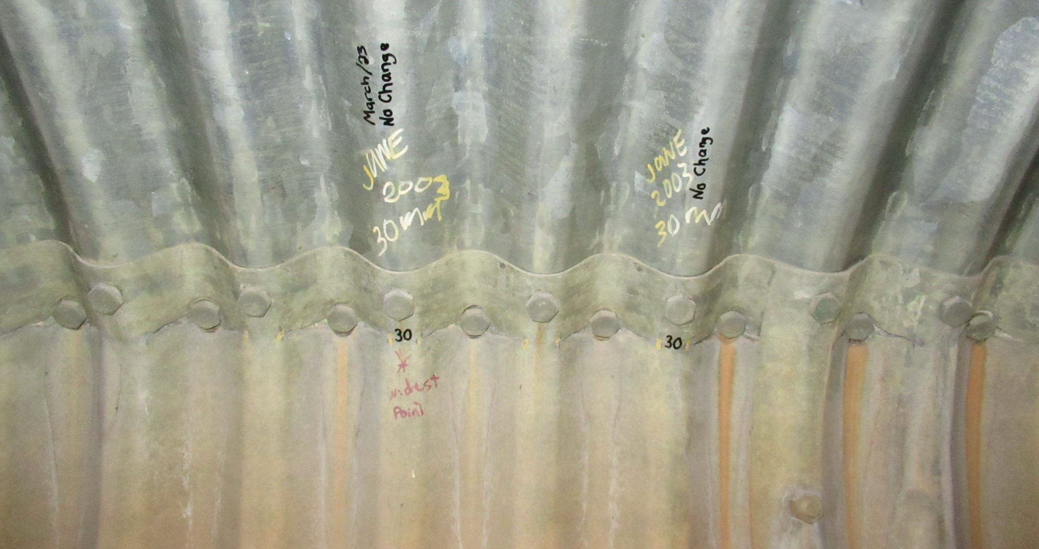
Improperly Lapped Seam
Bolt in valley is farthest from visible edge

Slide 28
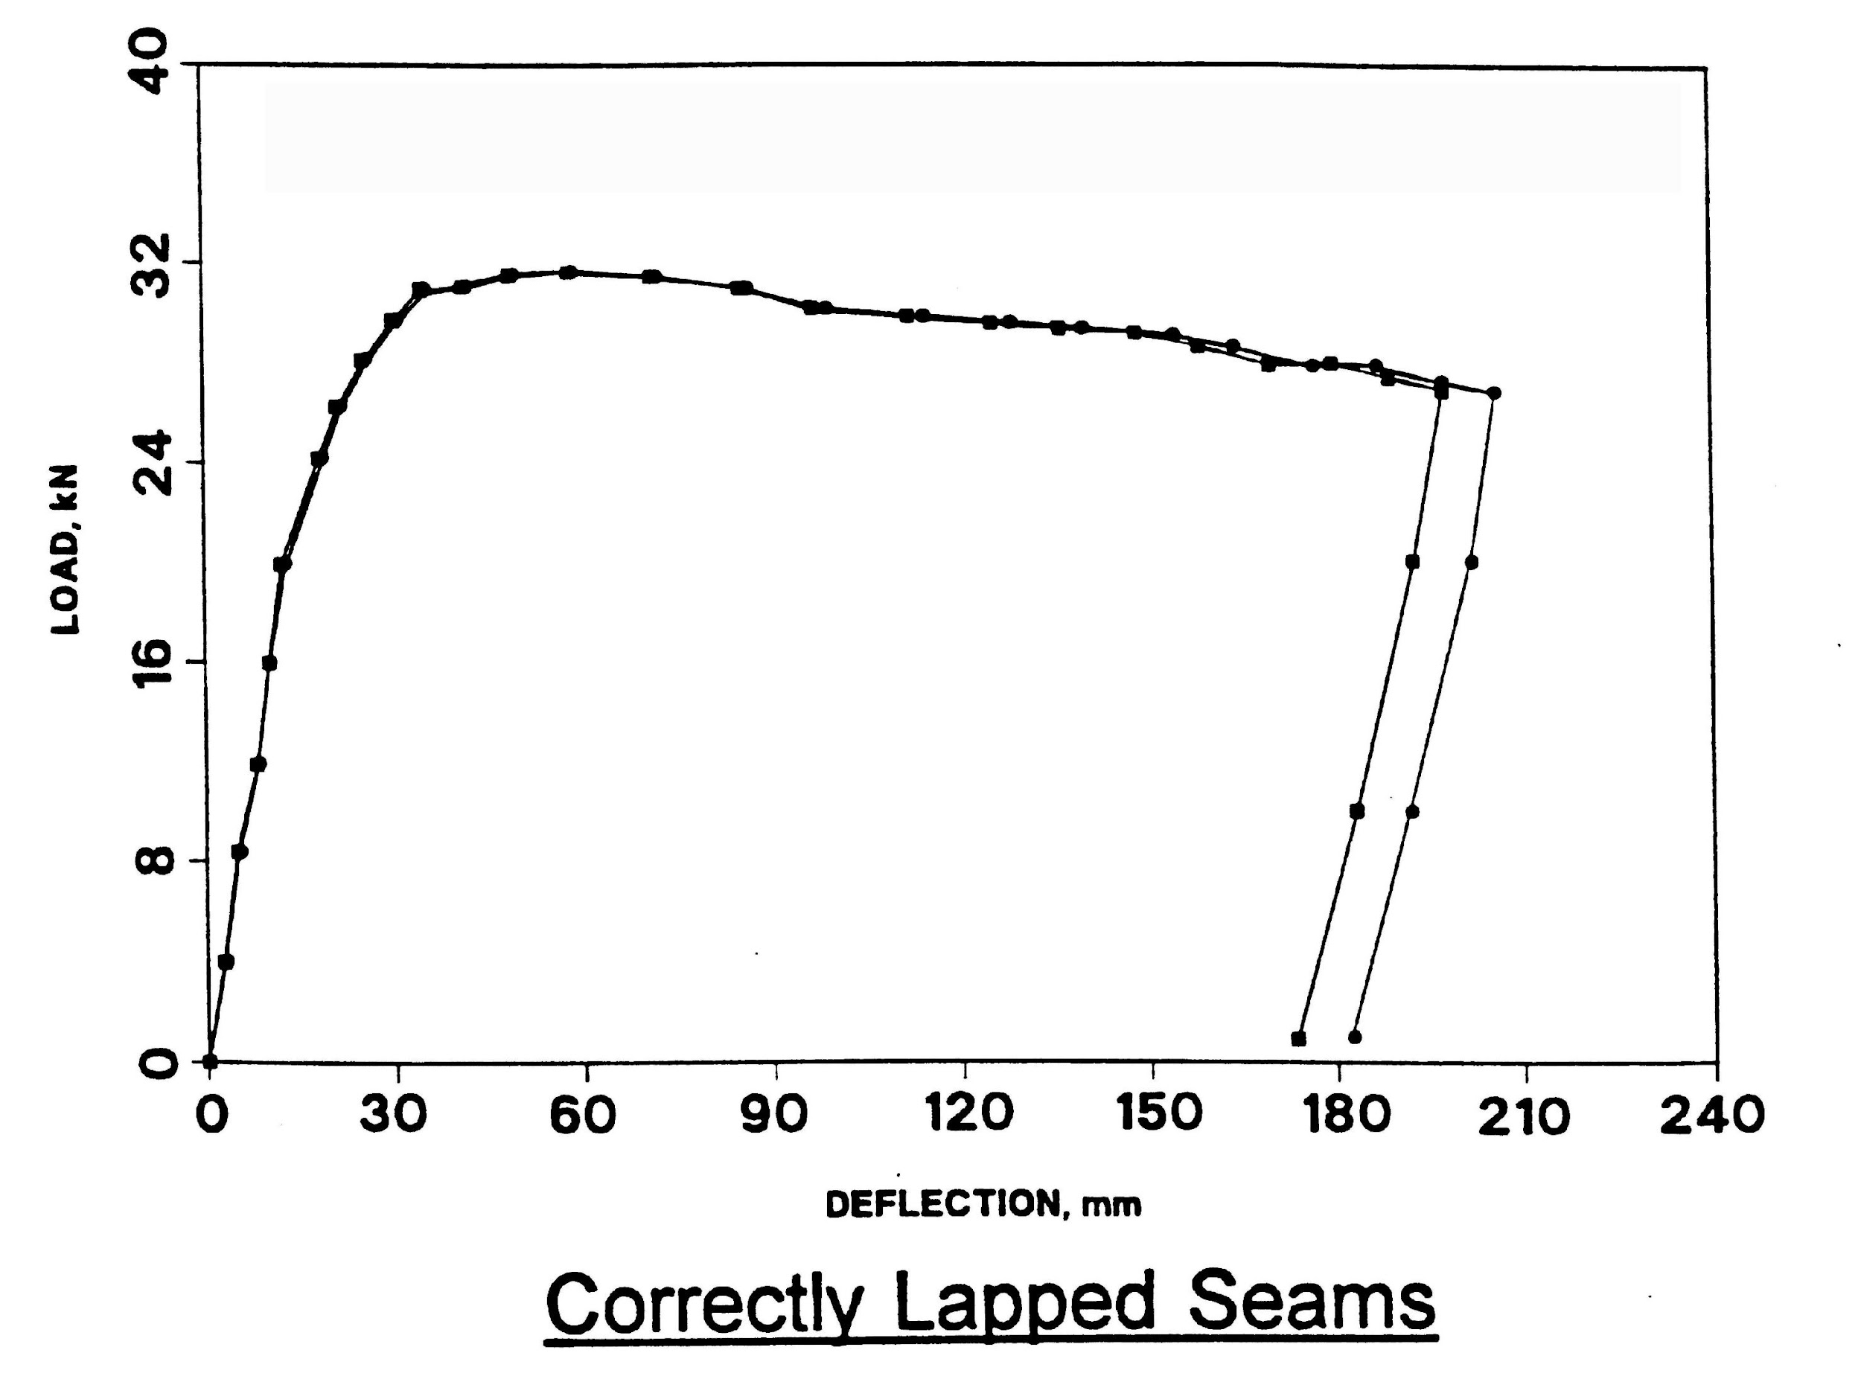
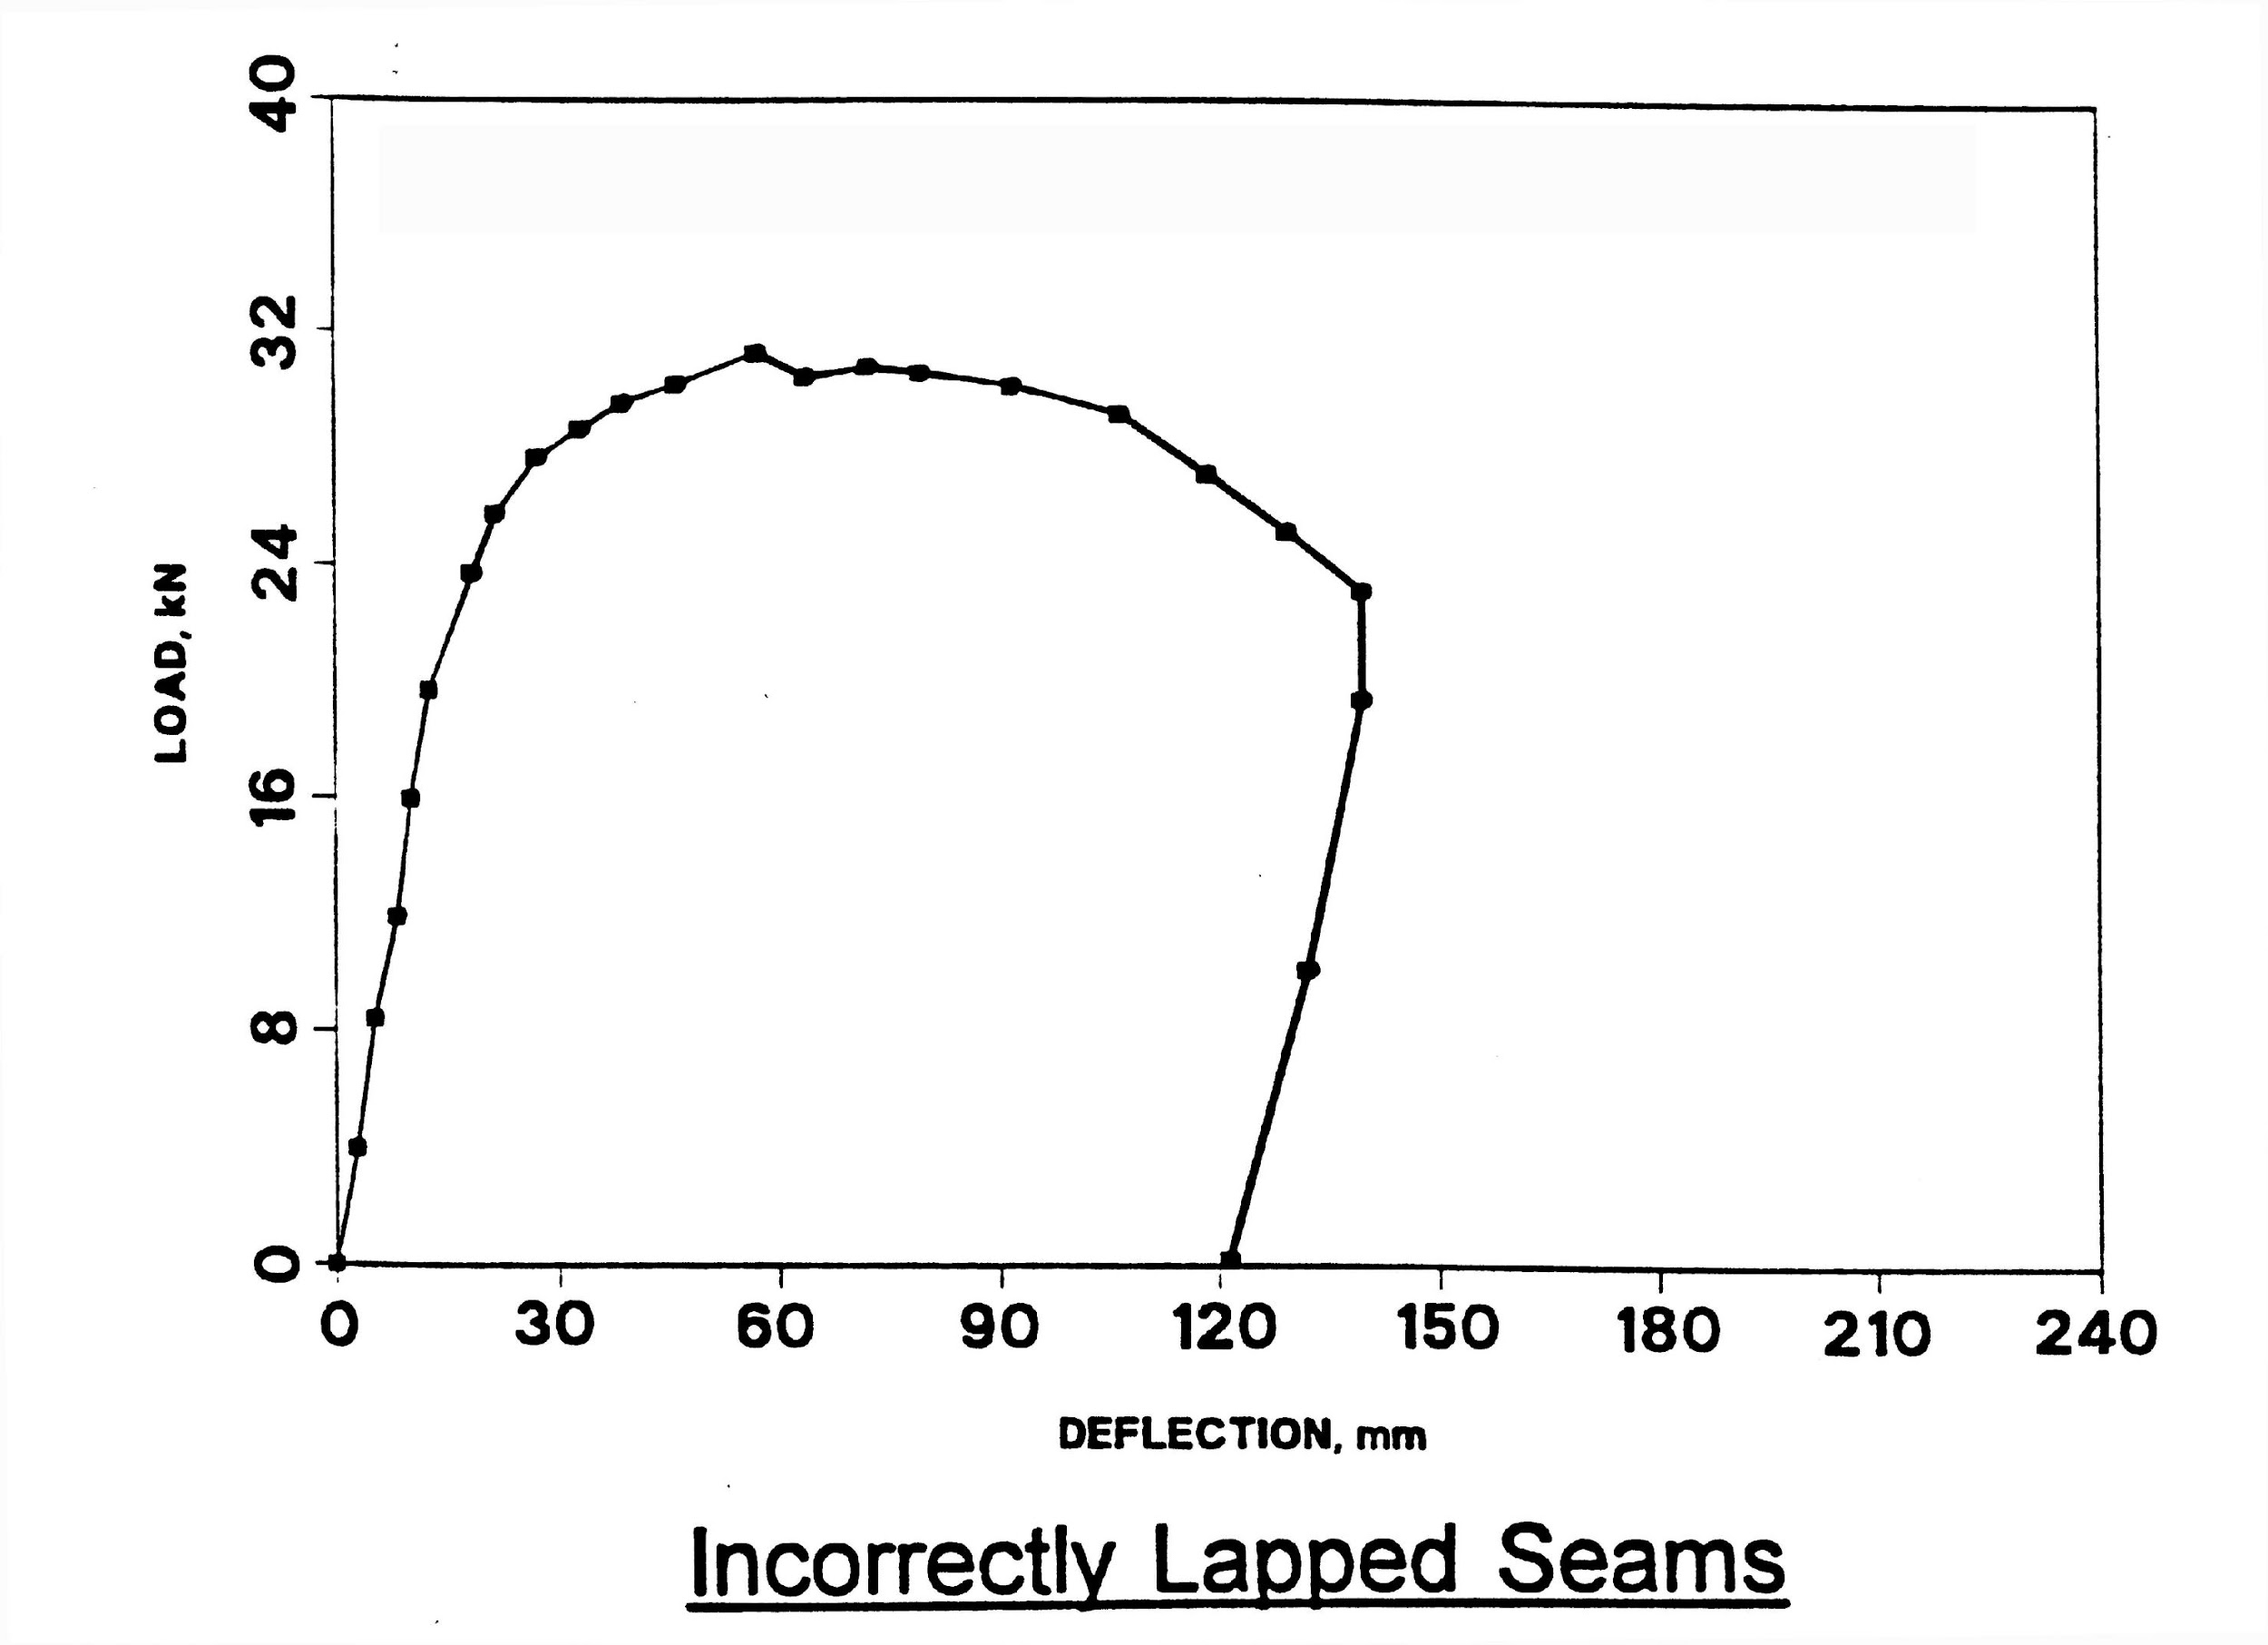
SPCSP (seam strength tests)
Both types of laps can carry about the same load
Correctly lapped seams are more ductile – do not typically develop cracks

Slide 29
Bridge Construction Inspection Manual
https://open.alberta.ca/publications/bridge-construction-inspection-manual-edition-3

Slide 30

Questions?

