Slide 1
CULVERT INSPECTION
& RATING

Slide 2
Introduction
Approximately 63% of all structures are culverts
Bridge sized culverts have an equivalent diameter of 1500mm or greater
May also inspect if multiple small culverts are equivalent in hydraulic capacity to bridge-sized (e.g. 2-1200mm)
May inspect certain other non-bridge sized culverts if several (e.g. LL Xing)

Slide 3
Introduction
Many different types of culverts – refer to Table 1.1 in Manual
Vast majority are CSP or SPCSP in various shapes - round, arch pipe, horizontal and vertical ellipse
Three culvert forms (Cul1, CulE, CulM)
Same forms used for all types of culverts except for Timber pipe (TP) which is inspected using a TT form

Slide 4
Form Types
CUL1
  Single culvert or single culvert extended with same material and size
CULM
  Two or more culverts (MP, SP or BP etc.)
  Includes 1 Upstream & 1 Downstream End section for each Barrel section
  Exception is Concrete Boxes (BP) - single U/S & D/S section for all barrels
  Includes 2 cell box extended with single steel
CULE
  Single culvert extended with different material and/or size
  One U/S section, 2 or more Barrel sections and one D/S section
  Original and extended barrels inspected and rated separately

Slide 5
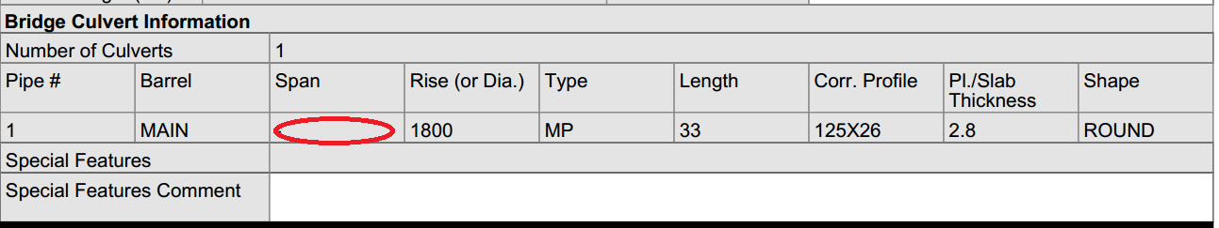
Inventory Information
Extracted from BIS
Span/Rise is original design shape
If round, then only Rise is recorded as shown in example above
Span types – refer to Table 1.1 and Sec. 13.2.3
Corrugation Profile and Plate Thickness selected from Table 13.1 and 13.2 (Manual)
Specific information is provided for all pipes
If original design shape unknown or in question, inspector should consult CPI handbook and/or use the average of the U/S and D/S span and rise measurements.

Slide 6
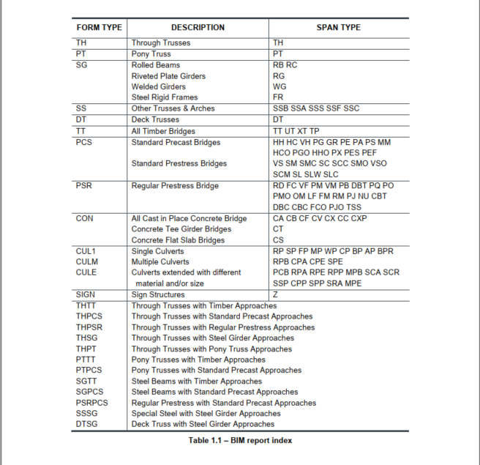
Culvert Span Types

Slide 7
Numbering and Identification
Where the culvert does not carry flow determine “upstream” and “downstream”
  Look in direction of increasing chainage
    (to north or east)
  Left is “upstream” (end 1)
  Right is “downstream” (end 2)
  Keep same choice for each subsequent inspection

Slide 8
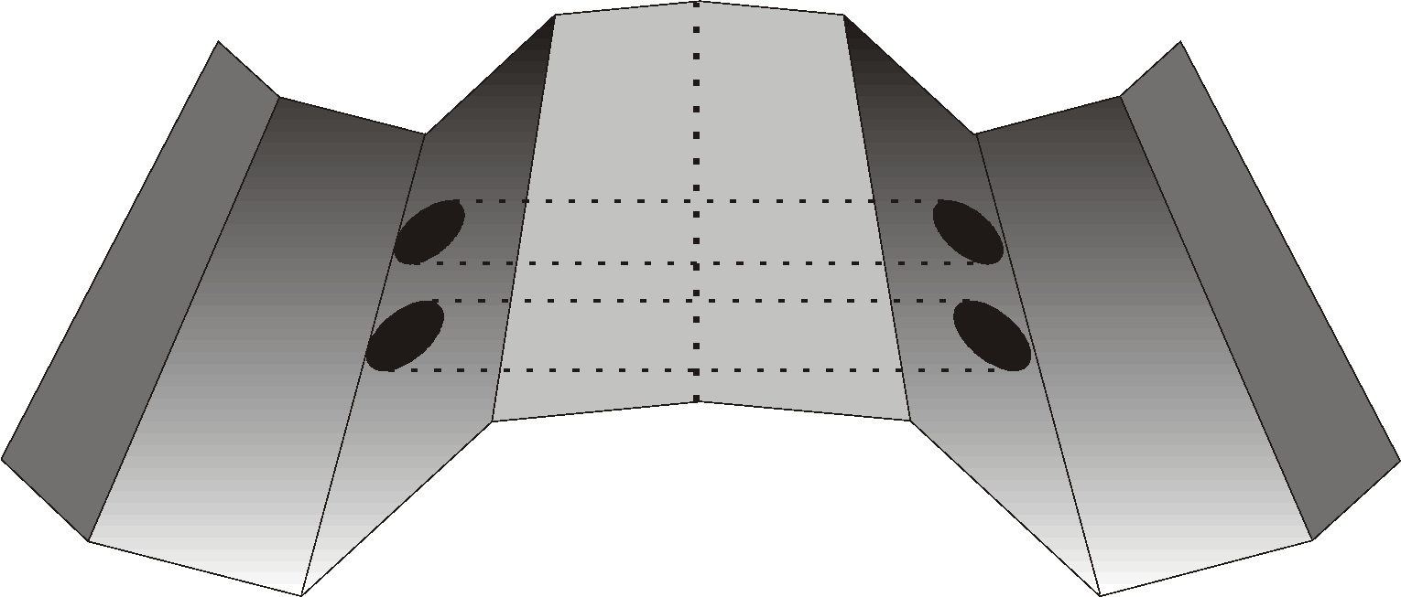
Numbering and Identification
North or East
2
“Upstream”
End 1
“Downstream”
End 2
1
South or West

Slide 9
Numbering and Identification
Primary span is the largest span at the site
Secondary span is the smaller span
Multiple culverts of same dimension are numbered in order of increasing chainage (from south to north or west to east)
Multiple culverts also have same Ring numbering system (R1, R2, R3, etc.)

Slide 10
U/S and D/S Ends - General
Individual rating sections for the Upstream and Downstream ends
Single upstream and downstream end sections for the CUL1, CULE forms
Separate Upstream and Downstream ends for each Barrel section on CULM forms - except Concrete Boxes. Note in explanation of condition which barrel is being inspected (i.e. south, west, #1)
Upstream and Downstream sections are identical
Items are inspected and rated the same way for both ends

Slide 11
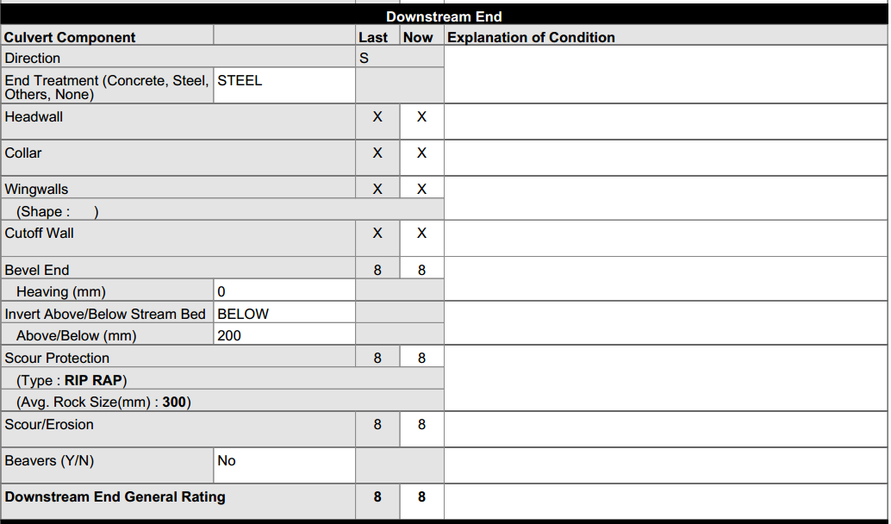
U/S and D/S Ends - General

Slide 12
U/S and D/S Ends - End Treatment
Purpose:
  Improve hydraulic performance
  Prevent undermining due to scour
  Prevent scour of the embankment
  Reduce piping along or under the culvert
  Resist uplift due to buoyancy forces
  Shorten the culvert
  Stiffen the ends
  Improve aesthetics

Slide 13
End Treatment -Types
Steel
  Most common
  Bevel end with no concrete treatment
Concrete
  Presence of any or all of: Headwall, Collar, Wingwall, Cutoff Wall
Other
  Timber Culvert with Timber End Treatment
None
  Square end – no Bevel present

Slide 14
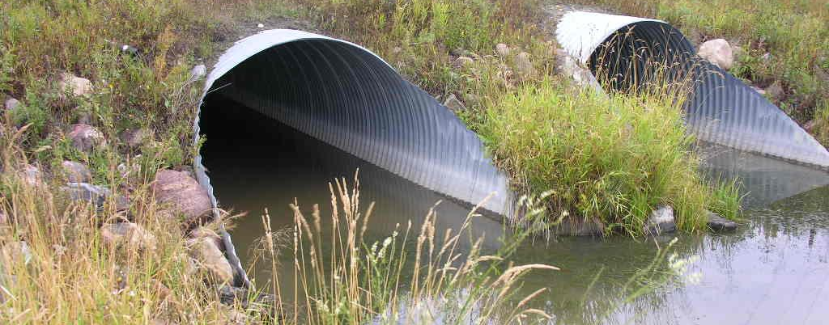
Bevel Ends – End Treatment Type is “Steel”

Slide 15
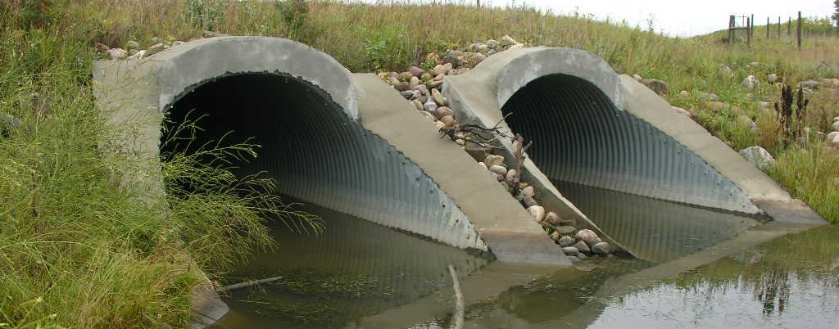
Bevel Ends with Full Concrete End Treatment - Type is “Concrete”

Slide 16
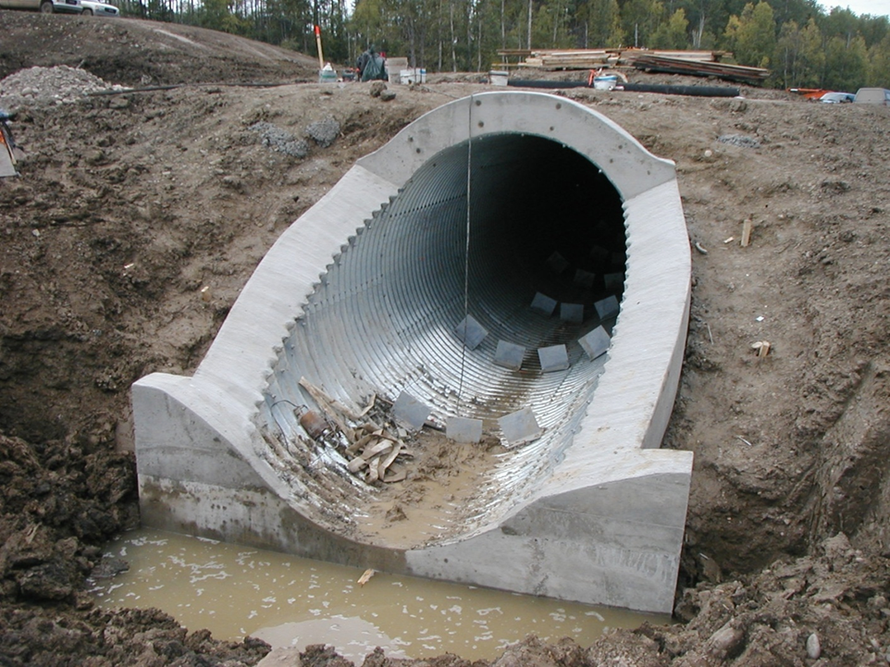
Bevel End with Full Concrete End Treatment (headwall, collar and cut-off wall) - Type is “Concrete”

Slide 17
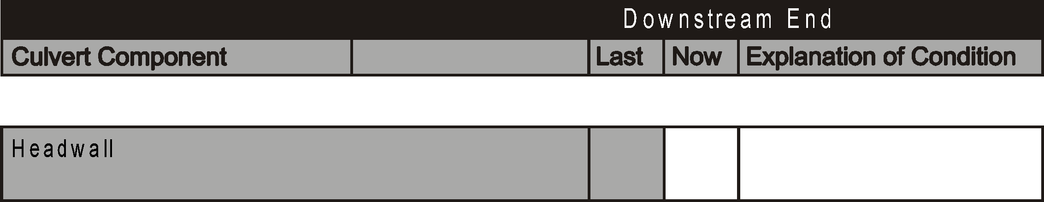
End Treatment - Headwall
Located over the crown
Usually attached to the barrel
Purpose:
  Aesthetics
  Strengthen end
  Resist buoyancy force
  Retaining walls

Slide 18
End Treatment - Headwall
Look for:
  Signs of movement or tilting
  Loose connections
Rate according to condition of material and functionality of component
Condition affecting functionality rate 4 or less

Slide 19
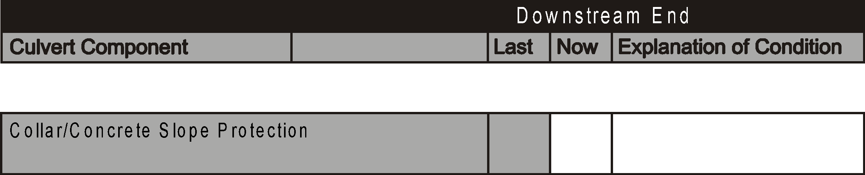
End Treatment - Collar
Located along the beveled slopes of flexible culverts between headwall and cutoff wall
Usually constructed from concrete
Usually used with and connected to headwall and cutoff walls
  May be used alone

Slide 20
End Treatment - Collar
Purpose:
  Stiffen the bevel
  Resist buoyancy force
  Improve hydraulic efficiency of inlet or outlet
  Concrete slope protection
    protect against scour / erosion
    reduces piping potential
    works in conjunction with rip rap

Slide 21
End Treatment - Collar
Look for:
  Evidence of piping or scour / erosion
  Loose connections
  Voids underneath or settlement
Rate according to condition of material and functionality of component
If not connected to culvert, rate 4 or less
If piping, rate 4 or less:
  Also rated under bevel end and barrel

Slide 22
End Treatment - Wingwalls
Generally found at culverts that do not have bevels
Shape is either Parallel, Perpendicular, or Flared to culvert axis
Main difference from Bevel is Wingwall is not attached to the barrel
Usually constructed from concrete or steel
Purpose
  Improve hydraulic efficiency
  Retain embankment fill

Slide 23
End Treatment - Wingwalls
Record Shape as “Parallel”, “Flare”, or “Perpendicular” (to culvert axis)
  Parallel wingwall
    Req’ less scour protection between walls
  Flared wingwalls
    more hydraulic efficient
May have a reinforced concrete slab between
  Prevents undermining of wingwalls due to scour
  Act as struts for greater stability
  If slab is present rate with wingwalls

Slide 24
End Treatment - Wingwalls
Look for:
  Evidence of movement
  Loose connections (gap at barrel)
  Scour / erosion at toe or behind wingwall
If wingwall is unstable rate 4 or less
Separation losing fill rate 4 or less
Includes rating of wingwall floor slab

Slide 25
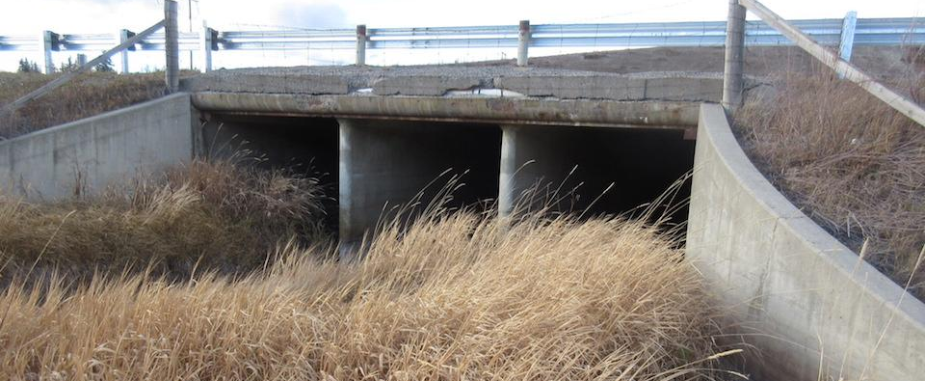
End Treatment – Flared Wingwalls

Slide 26
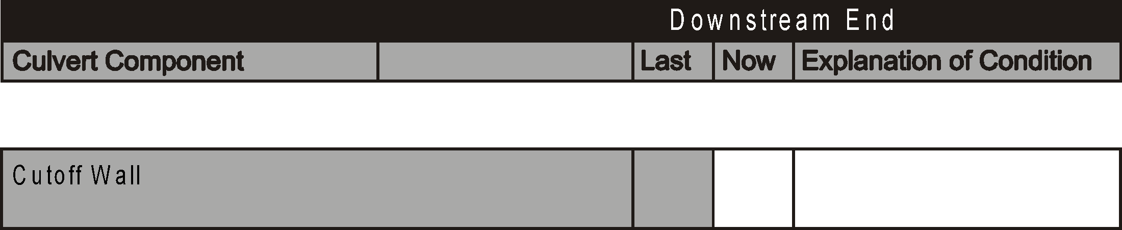
End Treatment - Cutoff Wall
Located at the end of the culvert
Vertical wall extending down below the invert of the pipe
Depth exceeds the depth of the riprap or concrete apron
Usually constructed from concrete or steel
Purpose:
  Reduce potential for undermining of end of culvert
  Minimize possibility of piping
  Resist buoyancy force

Slide 27
End Treatment - Cutoff Wall
Look for evidence of:
  Undermining
  Piping
  Uplift
  Loose connections
Usually not possible to inspect since they are submerged or covered with ice or debris
  If not visible rate “N”
  If certain not present rate “X”
If piping, rate 4 or less
  May also affect Bevel End and Barrel Rating

Slide 28


Slide 29
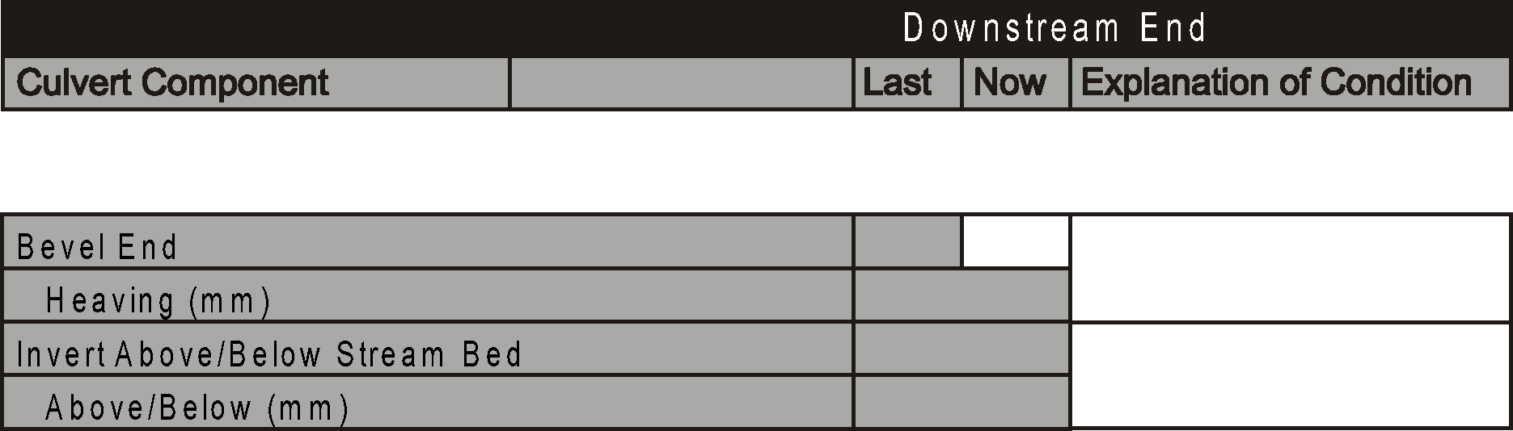
End Treatment - Bevel End
Sloped section at the end of the culvert
Permanently attached to the barrel
Generally parallel to the culvert axis
Bevel types
  Full bevel
  Step bevel

Slide 30
End Treatment - Bevel End
Compared to projecting ends, bevel ends are more:
  Aesthetic
  Economical
  Hydraulically efficient
Compared to projecting ends, bevel ends on corrugated steel culverts are more flexible and susceptible to:
  Deform due to lateral earth pressure
  Uplift due to buoyancy
  Heave due to frost action

Slide 31
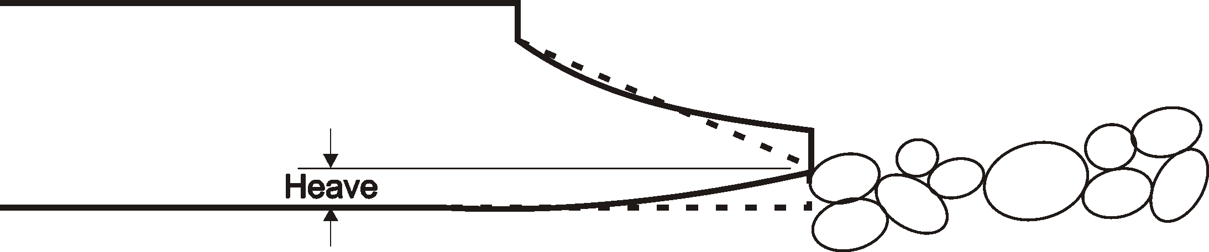
End Treatment - Bevel End
Measure or estimate heaving of bevel and record amount
Often best place to estimate is from inside barrel looking back to Bevel
Use waterline as level
Some heave is tolerable as long as water is entering Bevel

Slide 32
End Treatment - Bevel End
If possible, measure or estimate height above or depth below streambed and record amount in mm. (may not be able to measure or confirm measurements in high water or winter).
Normally “Below” as designed to be buried ¼ diameter below streambed.
If invert is “at streambed” record Above/Below as 0mm.
Find a representative natural streambed location
  Discount presence of localized scour hole or deposits (aggrading) at end of culvert

Slide 33
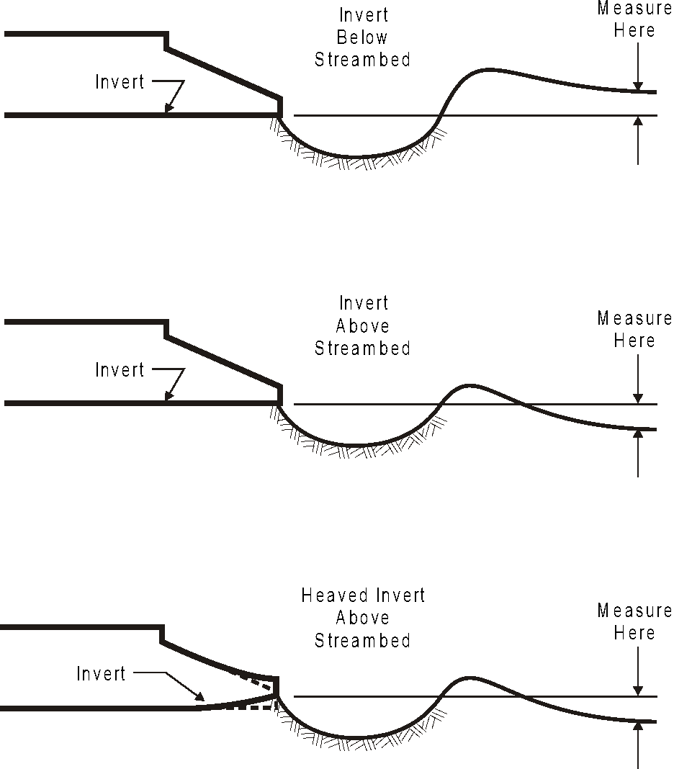
End Treatment - Bevel End

Slide 34
End Treatment – Bevel End
Defects/deformations not affecting function rate 6 or less (un-supported bevel - no heave)
Severe corrosion affecting strength (perforations) rate 4 or less – otherwise corrosions should not affect rating
If no bevel, rate “X”
  Ped and cattle underpasses often have square ends
Look for:
  Piping
  Deformation
  Impact damage
  Corrosion that affects strength
  Abrasion
If piping, rate 4 or less
  Also rated under End Treatment if present

Slide 35
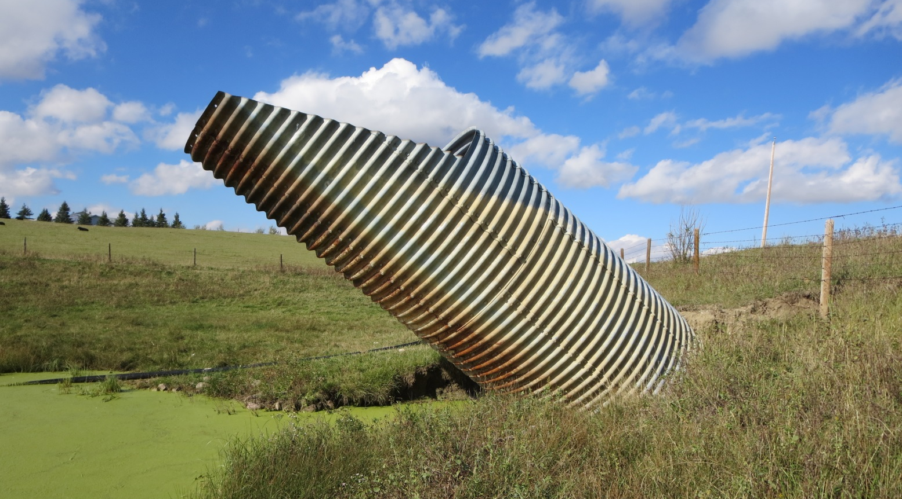
Bevel End – Severe misalignment due to buoyancy forces
35

Slide 36
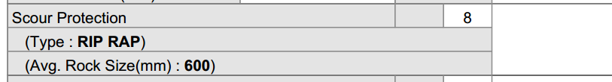
Scour Protection
Usually, heavy rock riprap
The current version of Std. Drawing S-1418-20 shows the minimum requirements for riprap
  Coverage
  Size
  Minimum thickness
  Gradation
  https://www.alberta.ca/assets/documents/trans-bridge-culverts-drawings.pdf

Slide 37
Scour Protection
Purpose is to prevent scour and erosion at culvert ends which may:
  Undermine the culvert
  Undermine the sideslope
  Cause the formation of sand bars

Slide 38
Scour Protection
Record the type of Scour Protection
  Rock, bagged concrete, concrete, gabion baskets, geotextile mats, MSE wall, natural
  If none exists and none is required, record type as “NATURAL”
  If none exists but is required, record type as “NONE”
Estimate and record the average size (rock only)
Look for:
  Durability of riprap - e.g., sandstone is not acceptable
  Shape – flat rocks not desirable
  Displacement or movement
  Scour
  Current standards on S- 1418

Slide 39
Scour Protection Ratings
No scour/erosion or displacement rate 7 or more
If none exists and none is required record type as “NATURAL” and rate 7 or more
If none exists but is required record type as “NONE” and rate 3 or less and make recommendation)
Generally, not rated higher than Scour rating – especially when Scour is 4 or less
Protected area is smaller than required or rock gradation or quality is inadequate rate 4 or less
Concrete protection with excessive settlement or undermining rate 3 or less
Cattlepasses that also handle drainage rate – otherwise X

Slide 40
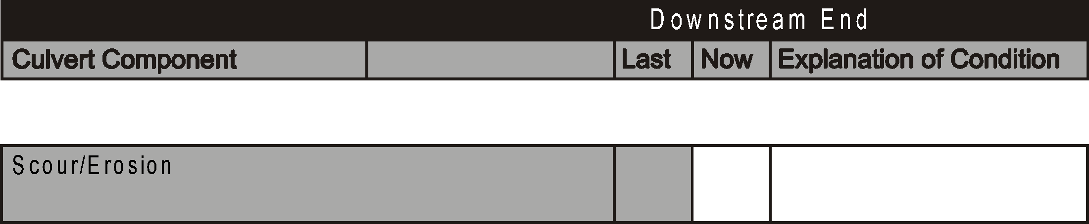
Scour / Erosion
Removal of material from the streambed, banks or sideslopes by the action of flowing water and/or constrictions or obstructions
Effects:
  Undermine the culvert
  Undermine the sideslope and/or road embankment
  Alter culvert hydraulics
  Impede fish passage

Slide 41
Scour / Erosion
Two types:
  General – uniform lowering of original stream
  Local – occurring at specific locations
Look for:
  Scour holes, especially at downstream ends
  Undermining of culvert end or sideslope
  Slumping of sideslope or banks
  Areas where flow impinges on banks, sideslopes or protection systems
  Areas susceptible to high velocities and undermining
    culvert footings
    ends or bottoms of wingwalls and cutoff walls
    sides of collars
    ends or bottoms of protection systems

Slide 42
Scour / Erosion
Rate the presence and extent of scour and adverse effects on culvert, embankment, streambed and banks
If culvert and embankment are not affected, rate 5 or more
Scour/erosion affecting culvert, rate 4 or less

Slide 43
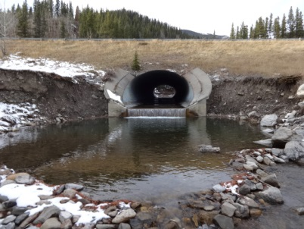
Scour / Erosion

Slide 44
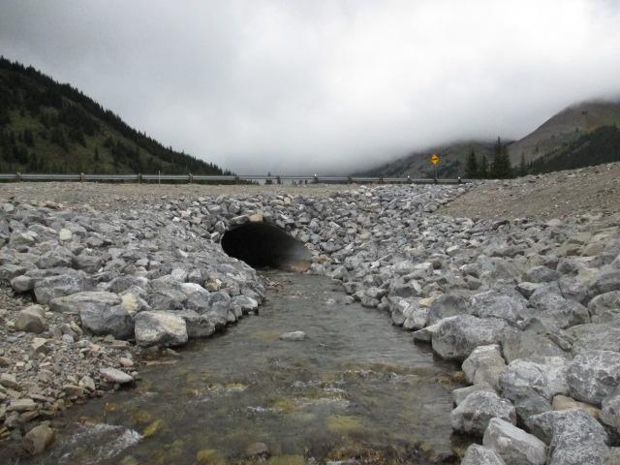
Scour Protection

Slide 45
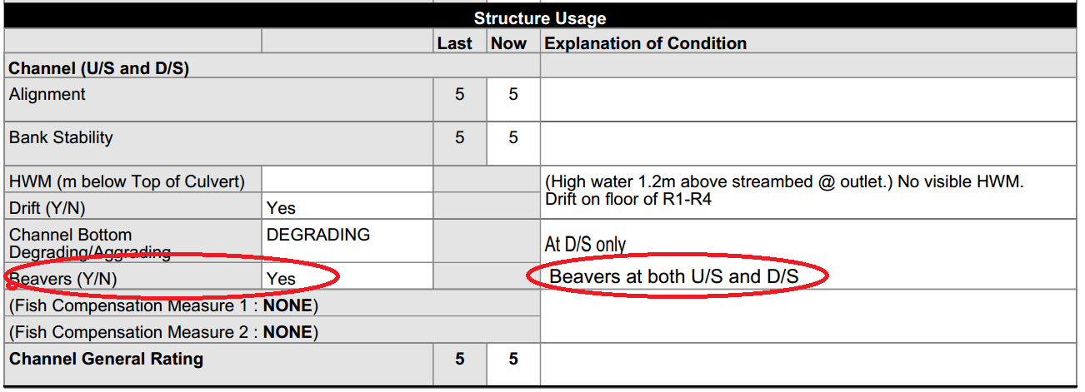
Beaver Activity
Beavers frequently construct dams at inlet or inside culverts
Effects:
  reduced flow capacity
  Flooding upstream
  Scour
  Ponding of water inside culverts preventing inspection

Slide 46
Beaver Activity
Indicate the presence of beaver dams in or near the culvert by Yes or No
If “yes”, provide comment
No rating required but may affect
  End General Rating
  Scour
  Waterway Adequacy in Barrel section

Slide 47
U/S & D/S End General Rating
Governing elements: (Refer to 1.10.7 & 13.5.10)
  Headwall
  Collar
  Wingwall
  Cutoff Wall
  Bevel end
  Scour protection
  If all are rated “X” then provide rating based on general condition of culvert end

Slide 48
Barrel - Rigid Types
Made from concrete or timber or heavy wall steel pipe
Designed to carry loads without deflection (Rise and Span measurements normally not necessary).
Culvert carries entire load with no reliance on surrounding fill for support.
Generally, more expensive but more durable, last longer and require less structural maintenance.

Slide 49
Barrel - Flexible Types
Made from corrugated steel
Low strength as a stand-alone structure
Dependent on surrounding backfill for support
Culvert deflects under load until the backfill picks up the stress
Entire load carrying system cannot be inspected directly (I.e., can inspect culvert but not backfill)
Flexible culverts more susceptible to failure by:
  Change in shape due to excessive deflection
  Defective joints - cracks, open joints, cusped seams, etc.
  Severe corrosion
  Uplift of ends due to buoyancy forces

Slide 50
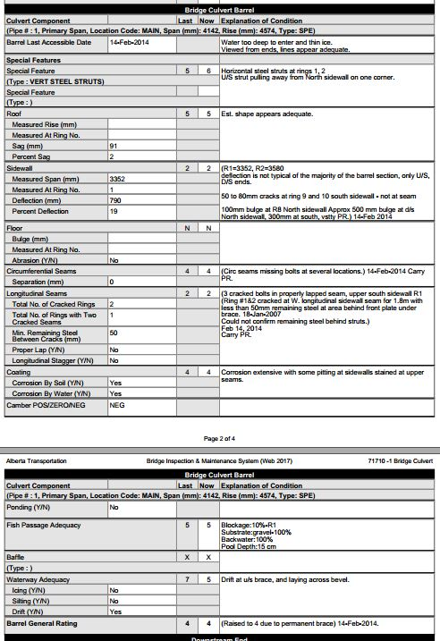

Slide 51
Barrel - General
If barrel is accessible record current date
If barrel is not accessible explain why, take photograph showing condition & retain the previous “last accessible date”. Then 3 possible rating scenarios:
  If the previous critical elements (roof, sidewall, longitudinal seam) ratings were 7 or higher AND the inspector is able to get good sight lines down the barrel from both ends to confirm the shape, the previous roof, sidewall, and Barrel General ratings can all be carried forward.
  If previous roof or sidewall ratings were 6 or less, barrel elements and General Rating are rated N (not visible). Previous comments are retained and dated.
  If previous critical element and Barrel General ratings were 4 or less, elements are rated N with comment indicating previous rating and Gen Rating carried over
If more than one barrel indicate location (west) or span number

Slide 52
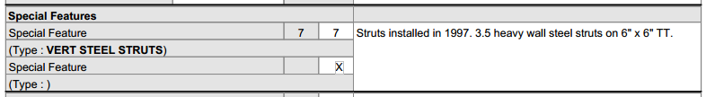
Barrel - Special Features
Cannot be rated under another component
May be temporary or permanent
Must be visible to inspect
  Special design features sometimes not inspectable (ribs, thrust blocks, etc.)
If birds nest present in barrel, note in Explanation of Condition

Slide 53
Barrel - Special Features
Common Examples
  Struts
  Shotcrete beams
  Concrete Floor
  Storm Drains
  Elbow
  Beaver Control Device
Record type
Provide additional information in Explanation of Condition
  Description
  Location
  Dimensions
Provide rating based on condition /functionality

Slide 54
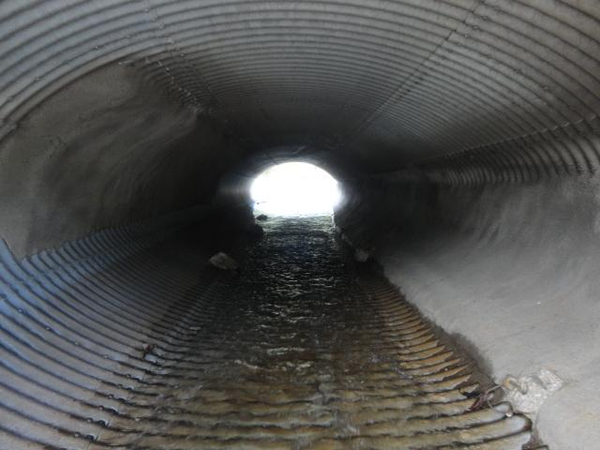
Barrel - Special Features
Shot-crete Beam

Slide 55
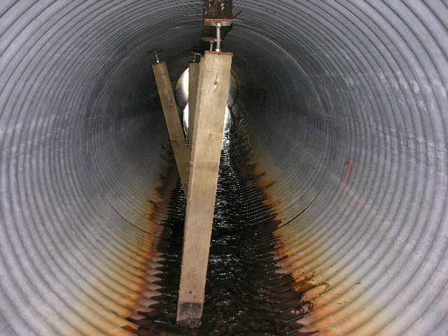
Barrel - Special Features
Struts – Rated 3

Slide 56
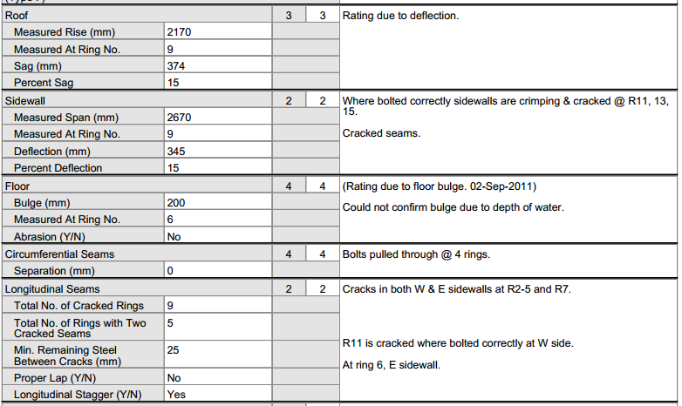
Barrel - Deformation

Slide 57
Barrel - Ring
Different elements make up a complete ring:
  Roof
  Sidewall
  Floor
  Bolted or riveted seams
  Circumferential seams (bolted (SPCSP) or external coupler (CSP))
Purpose:
  Carry water flow or traffic
  carry loads and transmit to surrounding soil
  Prevent infiltration of fill

Slide 58
Barrel - Ring
For round culverts, use approximate arcs shown
  Use longitudinal seam if close
Roof
l
120
l
l
l
a
a
w
w
e
60
60
e
d
d
i
i
S
S
120
Floor

Slide 59
Barrel – Ring Defects
Flexible Steel culverts look for:
  Deformation (measure crest to crest)
  Localized crimping or buckling
  Longitudinal seam problems
  Corrosion
  Abrasion on floor or lower sidewall
Rigid Timber culverts look for:
  Material defects – rot decay
Rigid Concrete culverts look for:
  Structural problems - cracking
  Material defects - corrosion, scaling, freeze-thaw damage

Slide 60
Barrel - Roof
Flexible Culverts:
Record lowest measured Rise in mm (crest-crest). Mark in culvert for future reference if deflections are ≥7%.
Record Ring number where measurements taken.
If floor bulge occurs at same location add bulge to measured rise and explain in comments.
Calculate and record Sag in mm (design rise – measured rise).
Calculate and record % Sag (rounded up or down – e.g. 5.4% is recorded as 5%).
Rate Roof based on % Sag (Table 13.3) or other visual defects.
If not able to measure Rise due to ice, silt, concrete floor, etc. a Roof rating is still required based on visual evidence and estimated sag.

Slide 61
Barrel – Roof Ratings
Flexible culverts - continued
Presence of temporary repairs has no influence.
Sag 5% or <, no corrosion – rate 7
Sag within 7%, corrosion with pitting - rate 5
Sag within 10% – rate 4
Sag 11-15% or isolated perforations – rate 3
Sag >15%, roof flattening, reverse curvature, or extensive perforations – rate 2.
Reverse curvature in flat HE or round under low cover, severe perforations – rate 1.
Consider Longitudinal Seam rating if in Roof.
Rigid Culverts:
Rate Roof based on visual evidence, defects
Measurements not required

Slide 62
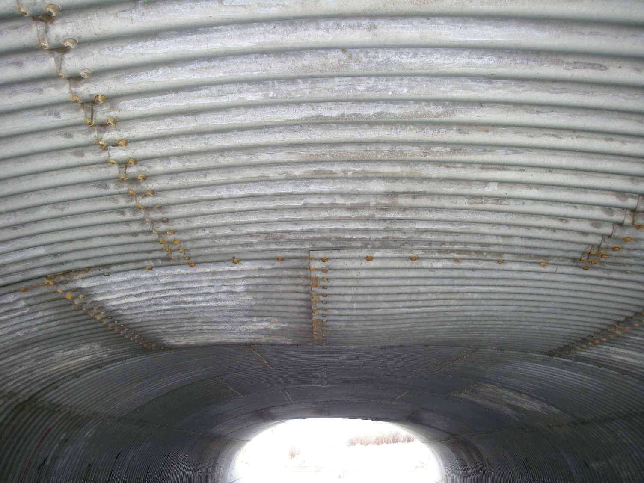
Barrel – Roof Ratings
Reverse Curvature-Rated 2

Slide 63
Barrel - Sidewall
Flexible Culverts:
Record greatest measured span in mm. (crest-crest). Mark in culvert for future reference if deflections are ≥7%.
Record Ring number measurements taken.
Calculate and record Deflection in mm (measured span – design span).
Calculate and record % Deflection (rounded up or down (e.g. 7.7% = 8%)
Rate Sidewall based on % Deflection (Table 13.3) or other visual defects.
If not able to measure span due to size, ice, etc. a sidewall rating is still required based on visual evidence and estimated deflection.

Slide 64
Barrel – Sidewall Ratings
Deflection >15%, crimping/buckling with plate shear, extensive perforations – rate 2 or less.
Consider Longitudinal Seam rating if in Sidewall (e.g. - Longitudinal Seam in Sidewall rated 2 governs Sidewall rating).
Rigid Culverts:
Rate Sidewall based on visual evidence, defects
Measurements are not required
Deflection within 5%, no corrosion - rate 7
Deflection within 7%, corrosion with pitting - rate 5
Deflection within 10% – rate 4
Deflection 11-15%, crimping or buckling, isolated perforations – rate 3 or less.

Slide 65
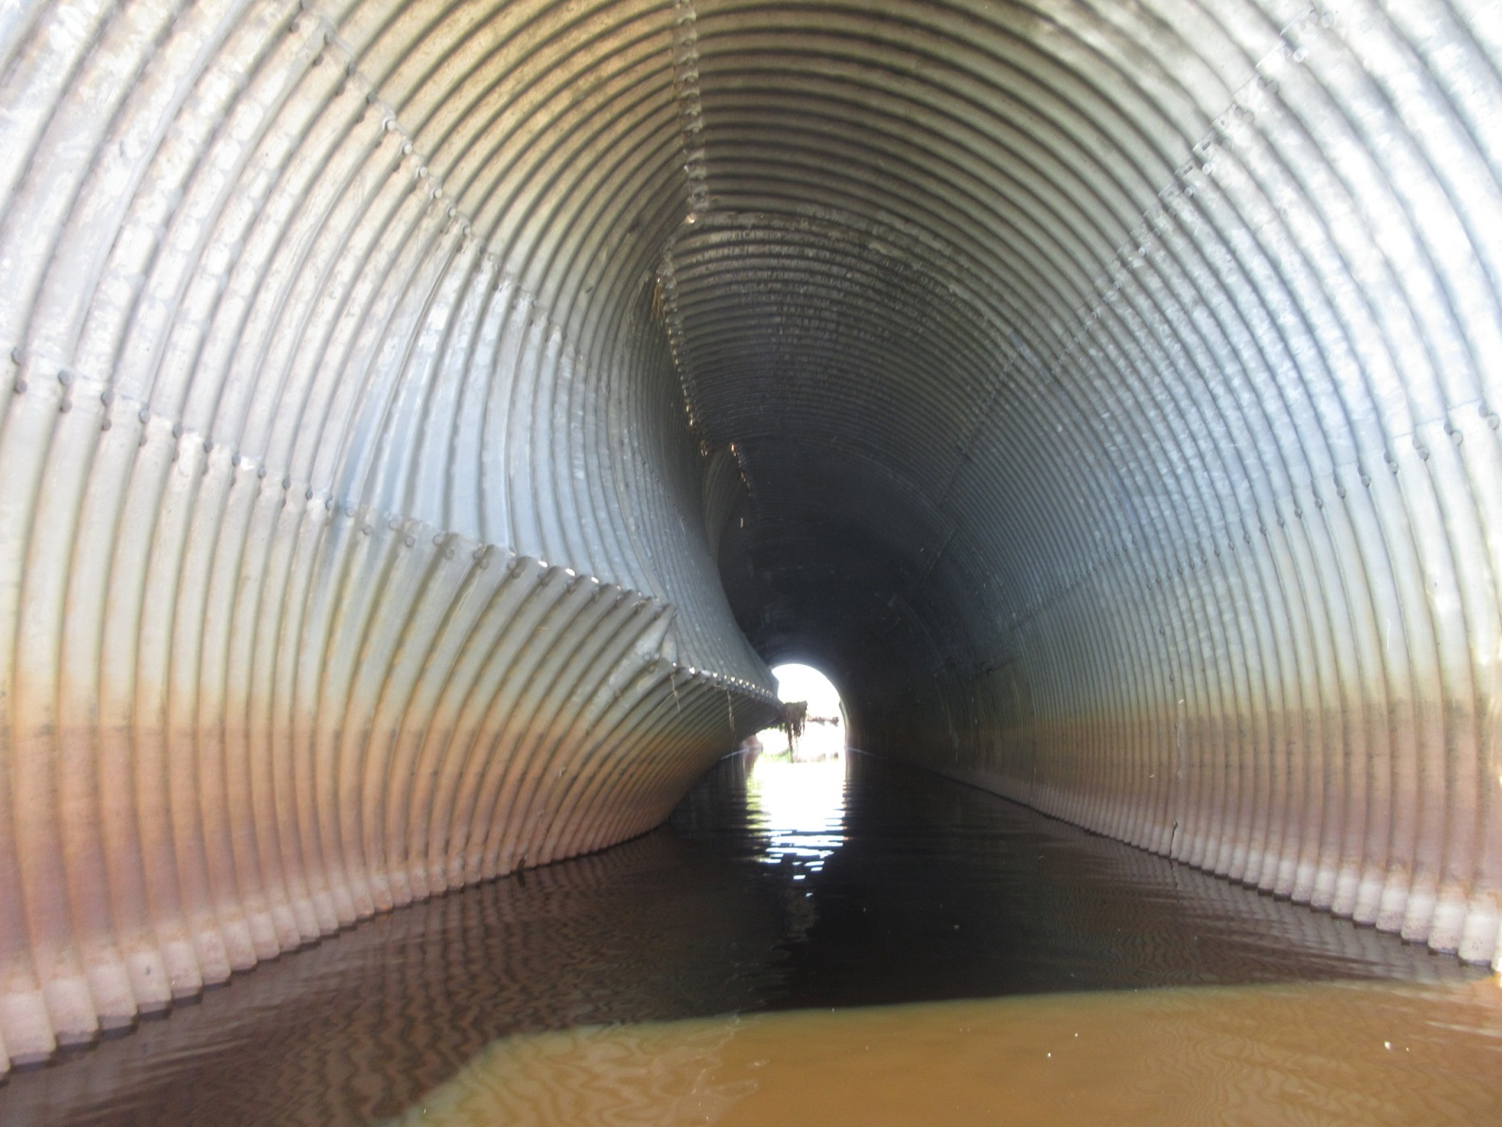
Barrel Sidewall Severe Inward Movement

Slide 66
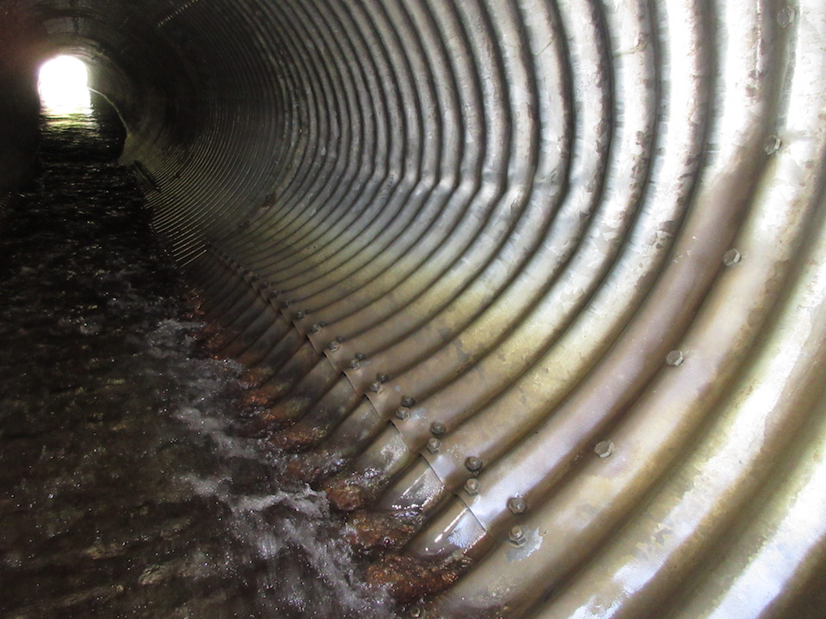
Barrel – Sidewall Buckling Rated 3 or less

Slide 67
Barrel - Floor
Check timber floors for rot, missing sections.
Check concrete floors for cracking, spalling, missing sections.
Check steel floors for cracks, crimping/buckling, defective seams, corrosion, abrasion.
Measure or estimate floor bulge and record ring number.
For flexible culverts - If greatest floor bulge is occurring in same ring as worst roof deflection add bulge to measured Rise
Indicate abrasion on floor by Yes or No. If yes, provide a comment.

Slide 68
Barrel - Floor
Rate flexible culvert floors as per Table 13.3:
  Isolated perforations rate 4
  Extensive perforations rate 3
  Severe perforations rate 2
  <5% bulging, minor abrasion and corrosion, no buckling or seam defects rate 6 or more
  Seam rating may govern if located in floor

Slide 69
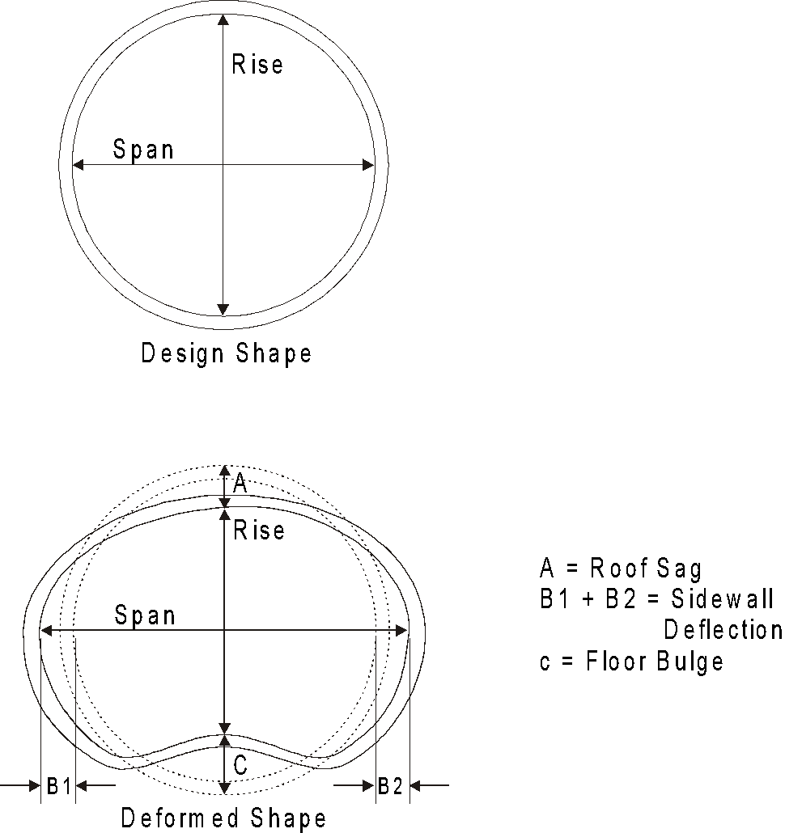
Barrel - Ring

Slide 70
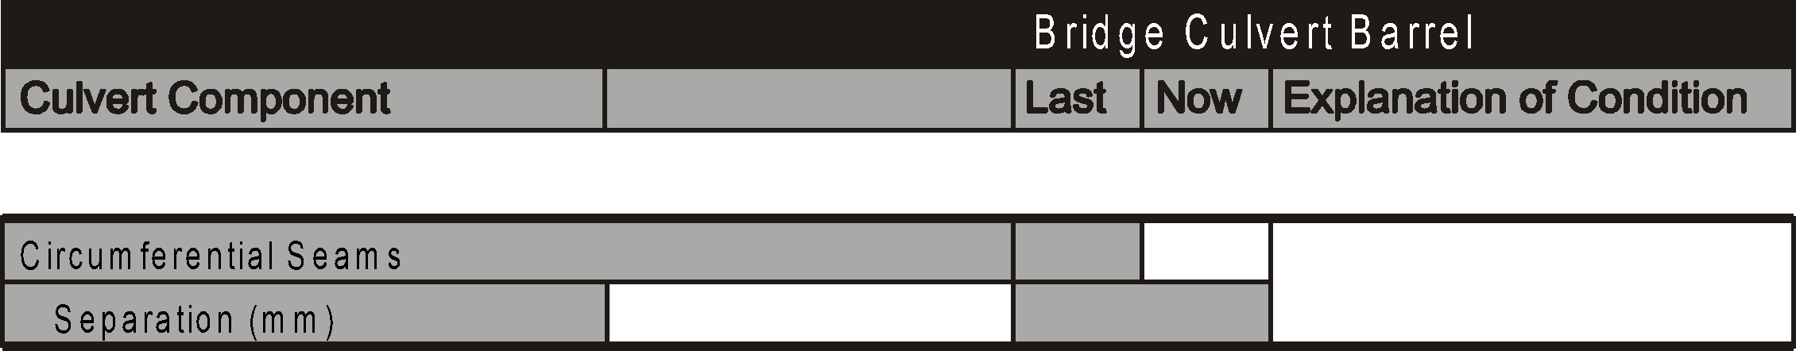
Barrel - Circumferential Seams
Refers to seams joining individual rings or sections of culvert
Found on most types of culverts
  Bolted seams on SPCSP
  Couplers on CSP or Riveted pipes
  Joints in precast concrete
  Construction joints in cast-in-place concrete

Slide 71
Barrel - Circumferential Seams
Purpose
  Join rings
  Prevent infiltration of backfill
Most common problems are separation caused by settlement or corrosion of couplers
  Especially CSP and precast concrete (settlement)
Potential for safety problem if void develops in fill
Look for:
  Separation
  Loose or missing couplers (corrosion)
  Bent or broken edges on the rings
  Misalignment of rings
  Infiltration of backfill
  Voids in surrounding fill

Slide 72
Barrel - Circumferential Seams
Record width of worst separation.
Misalignment with visible fill but no soil infiltration - rate 4 or less.
Misalignment or seperation with minor soil infiltration - rate 3 or less.
Void in backfill from loss of material due to soil infiltration - rate 2 or less.
Severe loss of material due to soil infiltration - rate 1.
Cracking from over torquing of bolts but no growth or problems – rate 5.
Cracking due to roof sag rate 4 or less.
May affect Roof, Sidewall or Floor rating if severe (2 or less).

Slide 73
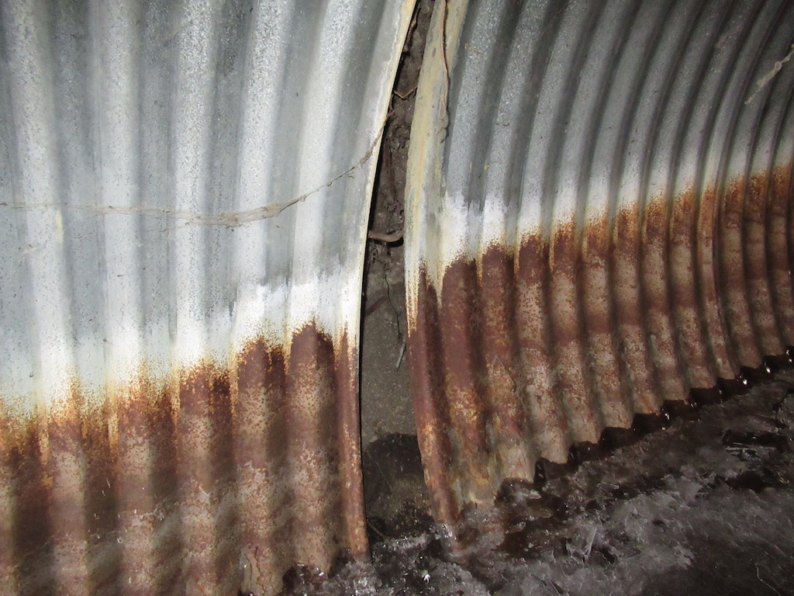
Barrel - Circumferential Seam Material Loss and Void Rated 2

Slide 74
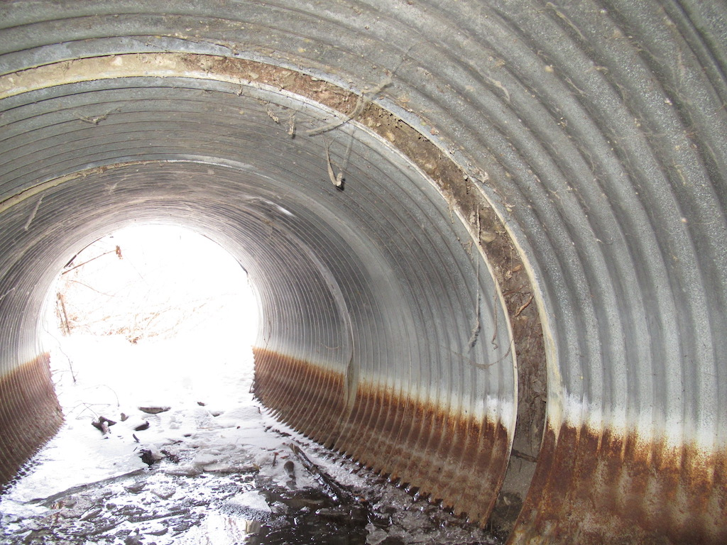
Barrel - Circumferential Seam –
Visible fill and minor loss but no void - Rated 3 or less

Slide 75
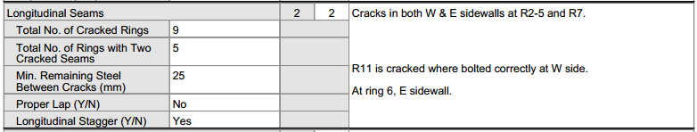
Barrel - Longitudinal Seams
Applies to SPCSP and CSP culverts with riveted seams
All others, Rate “X”

Slide 76
Barrel - Longitudinal Seams
Purpose
  Join individual plates in ring
  Transmit loads between plates
  Approx. 75% bending strength of plates
Indicate if all seams properly lapped by Yes or No
  If No, provide comment
Indicate if seams staggered by Yes or No
  Within same arc only
  At change of arc should not be staggered
  If No provide comment
  Most common problem is cracking
  Especially on improperly lapped seams

Slide 77
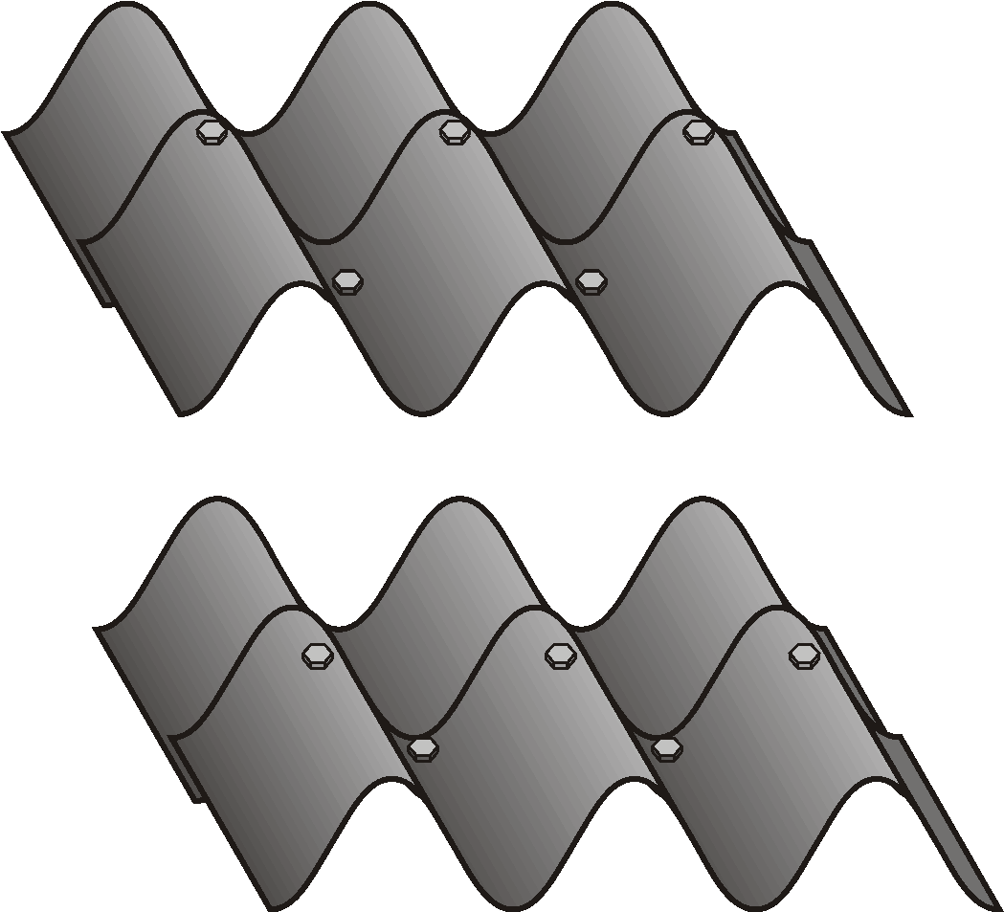
Barrel - Longitudinal Seams
Typical longitudinal seams
INCORRECT LAP
CORRECT LAP

Slide 78

Typical longitudinal seams
Cracked Seam

Slide 79
Barrel - Longitudinal Seams Cracked Seams
Record and comment on number of rings with cracked seams
Record and comment on number of rings with 2 or more cracked seams (may cause catastrophic failure)
Record least remaining steel between cracks and record location in comments (“65 mm rem. steel at R9 west sidewall”)
Mark and date ends of worst cracks – pencil is best for marking ends of cracks. Record measurements with lumber crayon or sharpie.
Properly lapped seam has bolt in valley nearest visible edge of plate

Slide 80
Barrel - Longitudinal Seams Other Problems
  Poorly nested plates
  Improper fabrication and/or poor assembly
  Cusping
  Sharp break or discontinuity in curvature
  Occurs most often at longitudinal seams
  Improper fabrication , poor assembly/plate rotation during torqueing
  Improper backfill
  Bolt tipping
  High ring compression causing plate slippage and/or hole elongation
  Plate distortion
  High ring compression, improper assembly and backfill
  Corrosion

Slide 81
Barrel - Longitudinal Seams Rating
Rate as per Table 13.3
All seams properly lapped and no defects rate 9
Seams are not properly lapped but in otherwise excellent condition - rate 7
>100mm remaining steel between cracks rate 4
50 – 100mm remaining steel between cracks - rate 3
<50mm remaining steel between cracks rate 2
Two or more cracked seams in same Ring – rate 2
Rating for longitudinal seams also affect Roof, Sidewall and Floor ratings
Rate riveted longitudinal seams in CSP

Slide 82
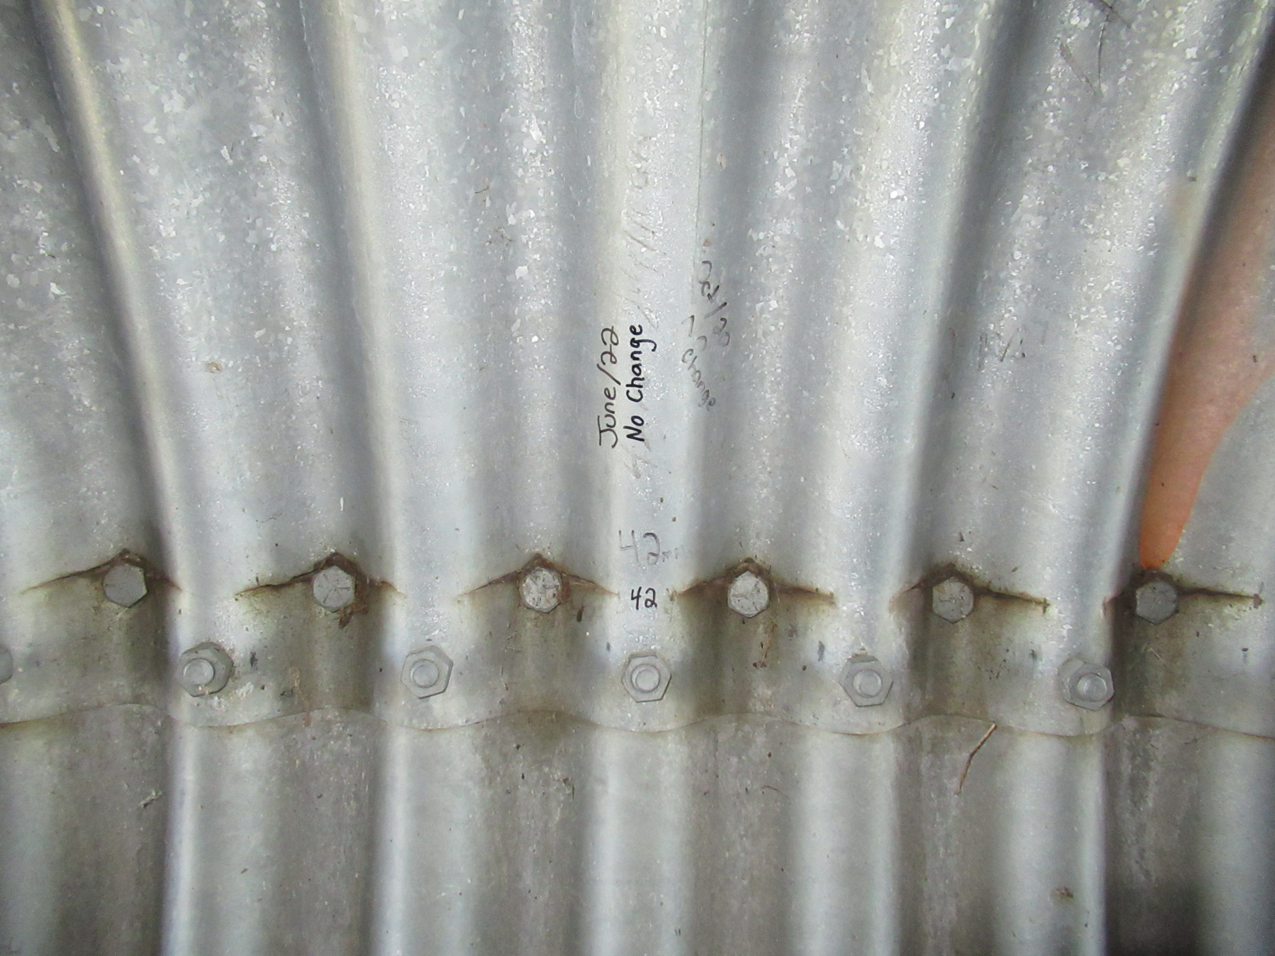
Barrel – Wrong Lap and Cracked Longitudinal Seam with <50mm Remaining Steel - Rated 2

Slide 83
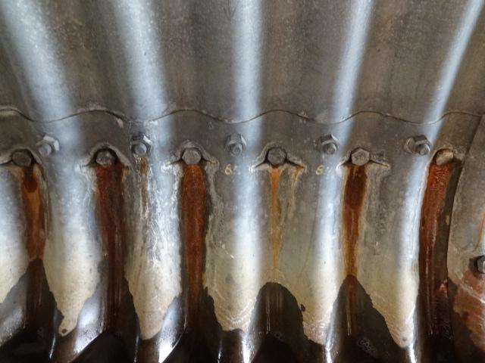
Barrel – Cracked Longitudinal Seam/Wrong Lap <100mm and >50 mm Remaining Steel – Rated 3

Slide 84
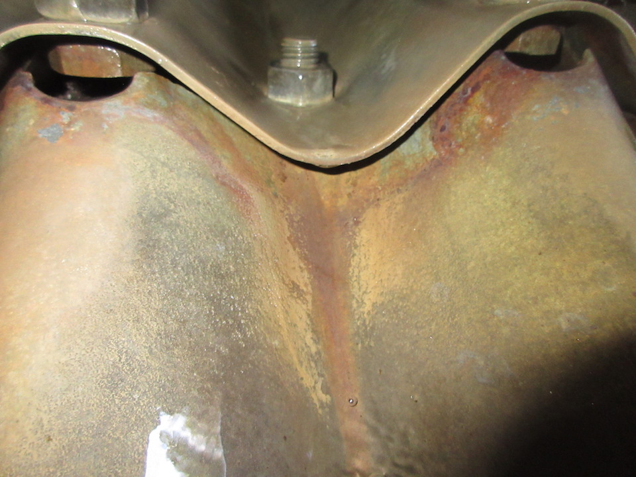
Barrel – Cracked Longitudinal Seam and Wrong Lap

Slide 85
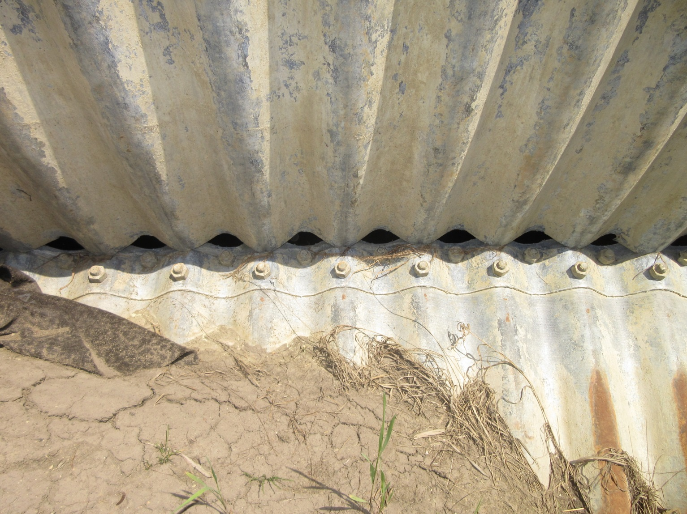
Barrel – Failed Longitudinal Seam

Slide 86
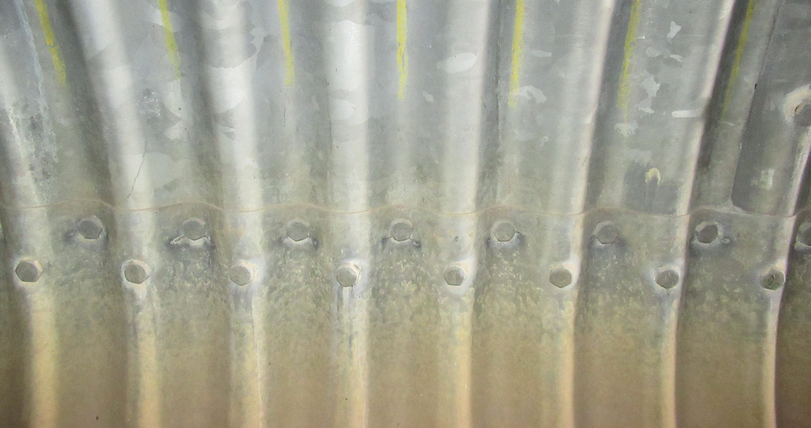
Cracks in Properly Lapped Seam
Bolt in valley is closest to visible edge

Slide 87
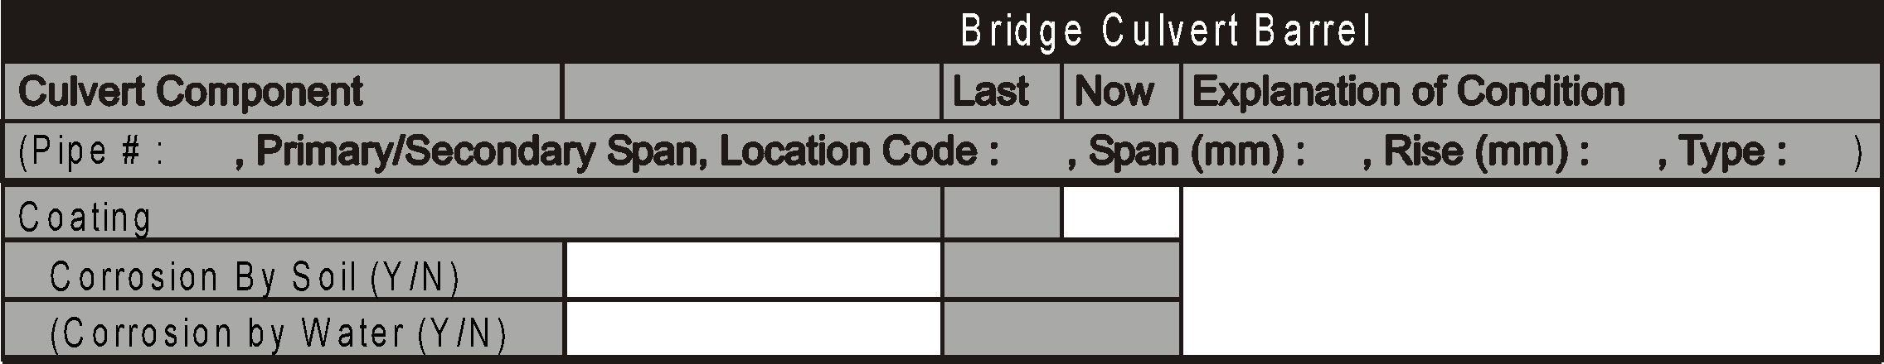
Barrel - Coating
Applicable to steel culverts only
Applies mainly to zinc or aluminized coating
  Can include other types – bituminous, polymer
Purpose is to protect the steel from corrosion
  Zinc & aluminum protect by sacrificial action

Slide 88
Barrel - Coating
Corrosion can occur on soil or water side of culvert
Soil side corrosion is generally visible above waterline and first visible at the seams
  Can lead to perforations
  Difference in backfill resistivity
  Corrosive chemicals in backfill or water in fill
Water side corrosion usually occurs in lower sidewall and floor areas
  Abrasion can remove protective coating
  Water may have low pH or contain corrosive chemicals from agriculture
  Anaerobic bacteria may live in stagnant water

Slide 89
Barrel - Coating
Look for:
  Fabrication or installation defects or damage
  Loss of coating - Corrosion
  Rust stains from bolt holes or seams
  Perforations
Record if corrosion is on SOIL and/or WATER side – provide comment if Yes
Rate according to Table 13.3
Superficial corrosion no pitting – rate 5 or 6
Corrosion with pitting in roof, sidewalls, or floor rate 4
Isolated perforations in roof or sidewall, extensive perforations in floor - rate 3
Extensive perforations in roof or sidewall, severe perforations in floor - rate 2
Severe perforations in roof or sidewall - rate 1
Rating of Coating may affect other elements ratings

Slide 90
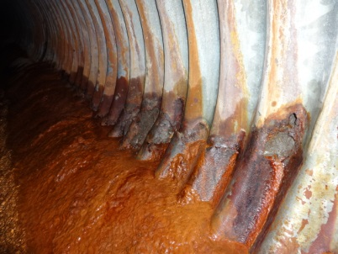
Barrel Coating – Lineal Sidewall Perforations – Rated 2

Slide 91
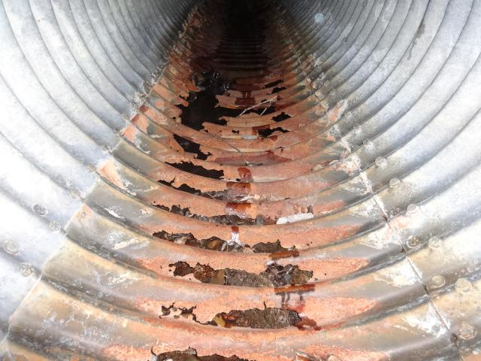
Barrel Coating – Severe Floor Perforations – Rated 2

Slide 92
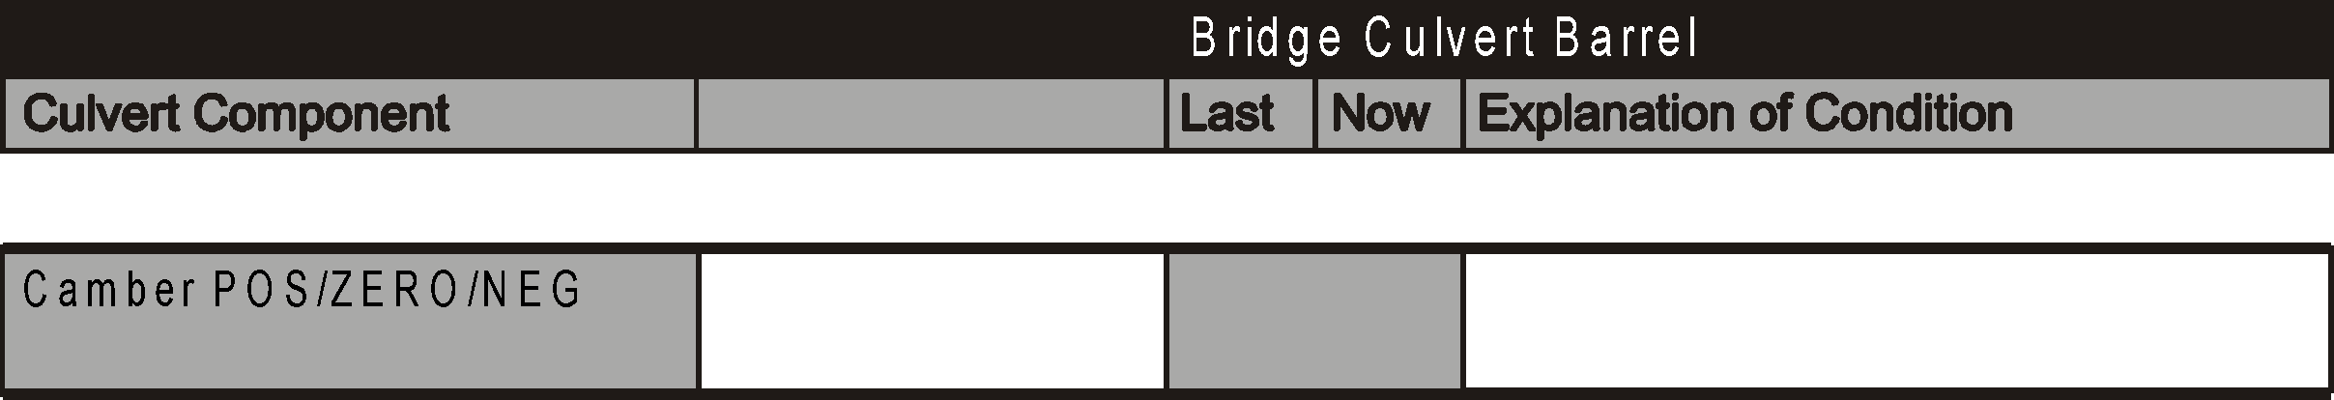
Barrel - Camber
Refers to longitudinal grade line of invert
No rating is required
If water line is level can be used to determine camber
Record whether camber is POSITIVE, Zero (0), or NEGATIVE
If significantly POSITIVE or NEGATIVE provide Explanation

Slide 93
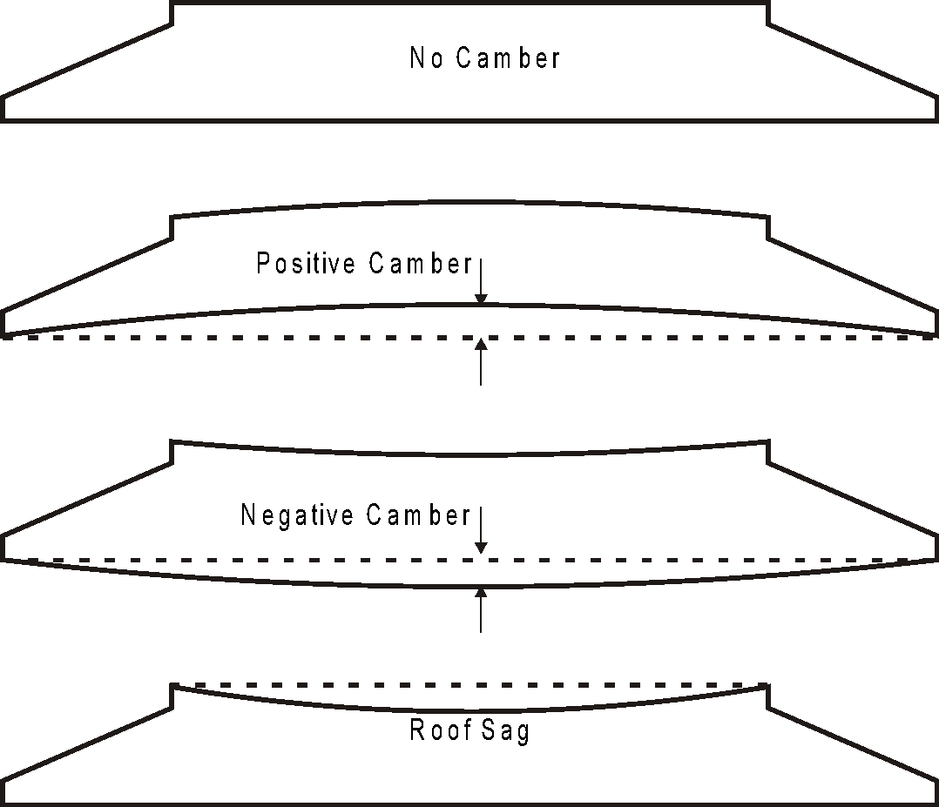
Barrel - Camber

Slide 94
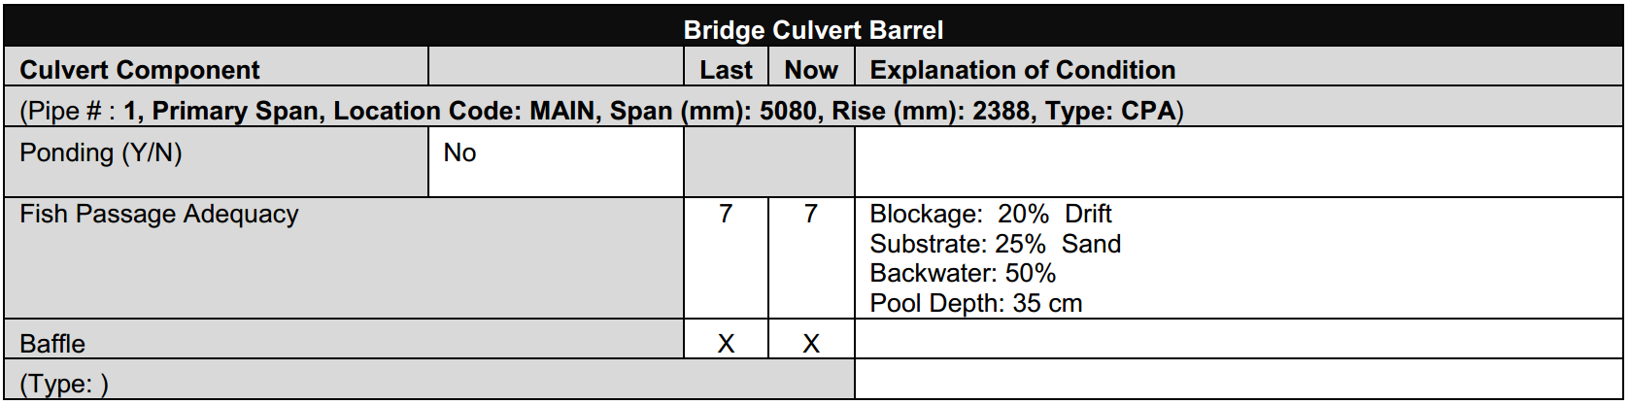
Barrel – Fish Passage Adequacy
x
x
No longer rated.
The previous rating and information from the last inspection may be on the form.
Change rating to X.
Cross out / remove comments from the Explanation of Condition.

Slide 95
Barrel – Fish Passage Adequacy
Types of baffles
  Spoilers
    Concrete or steel projections
  Large boulders
  Weirs
    Extend fully across floor
    May have notches
  Bolted to floor to prevent displacement
Record type of baffle or NONE. Rate the condition and functionality of baffles including anchorages

Slide 96
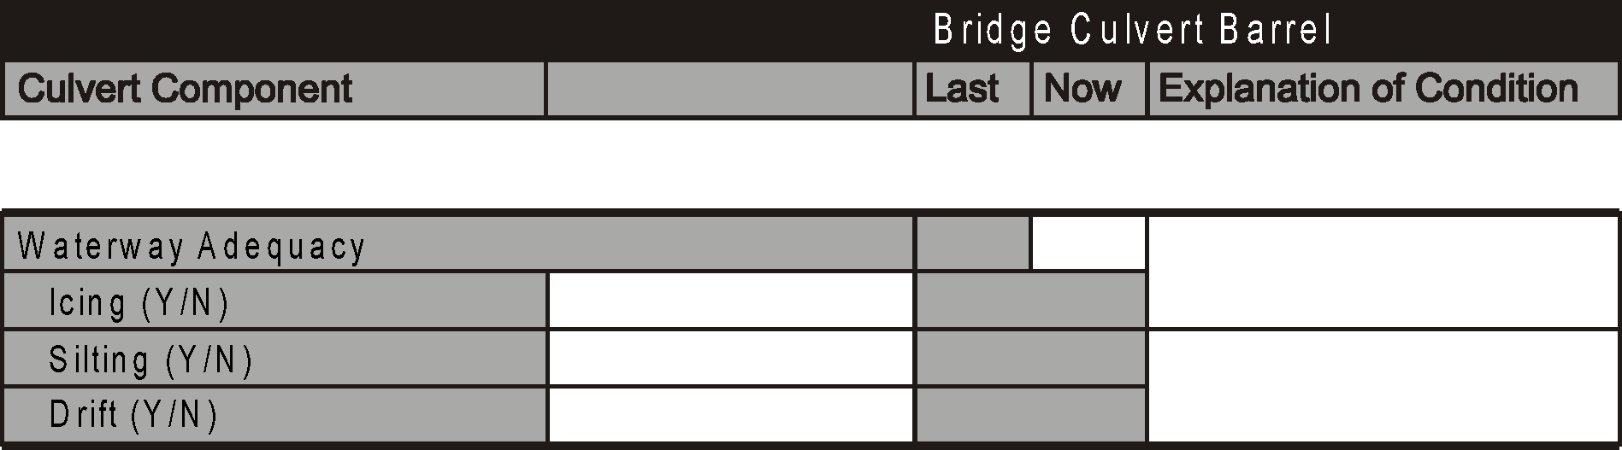
Barrel - Waterway Adequacy
Refers to the ability of the culvert to safely pass the design flow
  Maintain Freeboard
  Pass drift without damage
  No damage from backwater created

Slide 97
Barrel - Waterway Adequacy
Adequately sized culvert may be affected by:
  Ice build up
  Silt deposition
  Drift accumulation
  Beaver dams
  Ponding
  Repair or rehabilitation work
    Shotcrete beams
    Struts

Slide 98
Barrel - Waterway Adequacy
Indicate presence of ice build up (icing) by Yes or No if Yes explain
  Freezing of ponded water
  Results from active springs which freeze and causes layers of ice to build up
  If previously Yes - leave and retain comments adding date of previous inspection
Indicate presence of silt build up (Silting) by Yes or No, if Yes explain
  Invert normally below streambed
  Minor accumulation of silt expected
Indicate presence of drift in Barrel by Yes or No
If “yes”, explain

Slide 99
Barrel - Waterway Adequacy
Look for:
  High water marks (not normal flow lines)
  Potential damage from backwater
  Potential for drift
  Evidence of high velocities
    Scour
    Silt deposition downstream
  Presence and effect of items which can affect adequacy

Slide 100
Barrel - Waterway Adequacy
Rate “X” if not a drainage culvert (cattlepass, pedestrian underpass)
Rate if cattlepass also handles water flow
Adequate opening rate 5 or more
HWM above crown, 4 or less
Culvert blockage 50% or more rate 3 or less
100

Slide 101
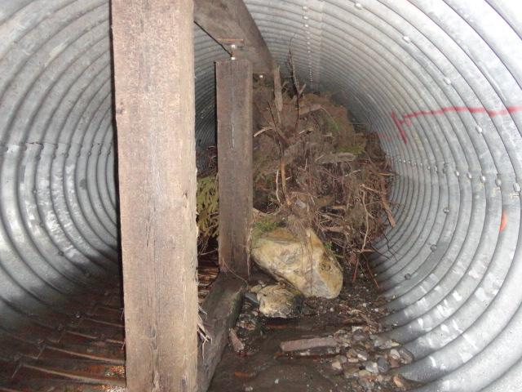
Barrel - Waterway Adequacy - 100% Blockage

Slide 102
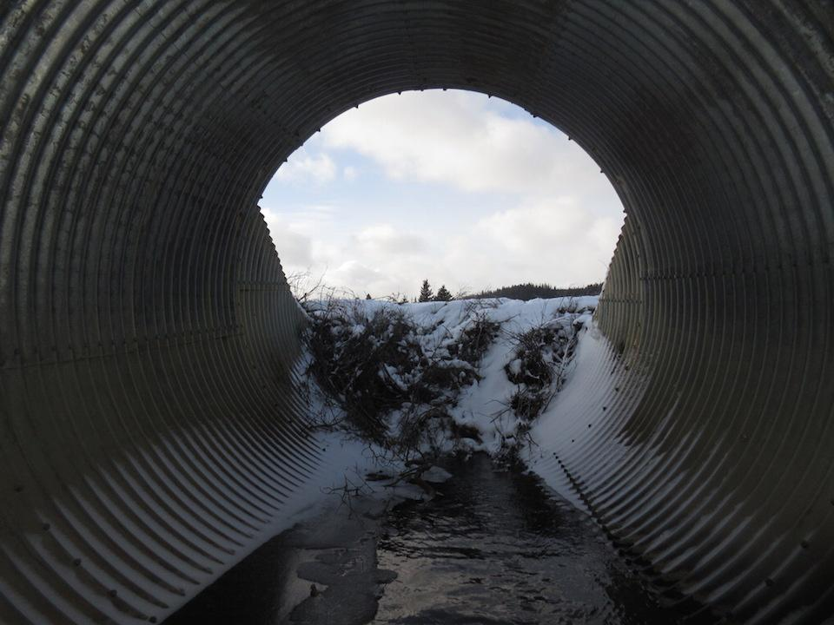
Barrel - Waterway Adequacy - 50% Blockage

Slide 103
Barrel - General Rating
Governed by the following element ratings (refer to 1.10.8 and 13.6.14)
  Roof
  Sidewalls
  Longitudinal seams
  Floor rating of 3 or less
  Circumferential seam rating of 2 or less
  Corrosion rating of 2 or less
  Waterway adequacy rating of 2 or less

Slide 104
Barrel Not Accessible – Critical Element & General Rating
If barrel is not accessible for inspection – 4 possible rating scenarios
Previous Roof, Sidewall, and Barrel General ratings ≥7 AND can obtain sightline of barrel from ends to confirm shape, then previous Roof, Sidewall, and Barrel General ratings are carried forward with comments. Longitudinal Seam is rated N with comment indicating previous rating (e.g. P.R. 8)
Previous Roof, Sidewall, and Barrel General ratings are 5 or 6. Rate barrel elements and Barrel General rating “N”
Previous Barrel General Rating are 4 or less, then barrel elements are rated N and previous General Rating of 4 or less is carried forward with comment indicating “Gen. Rating carried forward”
3. Previous Roof, Sidewall, Longitudinal Seam and Barrel General ratings are 5 or 6, rate barrel elements and Barrel General Rating “N”

Slide 105
Barrel Not Accessible – Critical Element & General Rating
If barrel is not accessible for inspection – Continued
4. Previous Roof, Sidewall, and Barrel General ratings are 5 or more but obvious defect or change noted when viewed from ends (e.g. roof deflection). Reduce applicable element rating and General Rating based on visual evidence and recommend inspection during low water/winter, or Level 2 de-water inspection
Refer to Section 13.6.2 for further information
Barrels not accessible for 2 consecutive inspections recommend inspection during low water/winter, or Level 2 de-water inspection. Refer to 13.9.1.5

Slide 106
Effects of Struts on Barrel General Rating
Inspector may increase General Rating by 1 or 2 points but not exceed rating of 4.
Conditions for increase to rating:
  struts in place more than 2 years (permanent repair)
  struts rated 5 or more
  1 permanent reference point for future monitoring
  struts inspected after any significant event
  consider culvert size and depth of cover (failure of large diameter culvert under high fill may not be as serious as under low fill)
  does not apply when deflections >30% or cracked seams with less than 25mm remaining steel
  applied to general rating only, element ratings remain unchanged

Slide 107

Questions?

