Slide 1
BRIDGE MATERIALS

Slide 2
CONCRETE

Slide 3
What is Concrete?
A mixture of various components which chemically react to form a strong construction material
Unit Weight – normal 2400 kg/m³ or semi 1900 kg/m³
Component Ratios:
  Cement (10 to 15%)
  Aggregate (75 to 80%)
  Water and Air (remainder)
  Admixtures

Slide 4
Cement Manufacturing
Limestone Train
Clay Quarry
Hammermill Crusher
Additive Silos
Preheater Tower
Preblend Dome
Clinker
Finishing Mill
Roller Mill
Gypsum
Rotary Kiln
Cement Silos
4

Slide 5
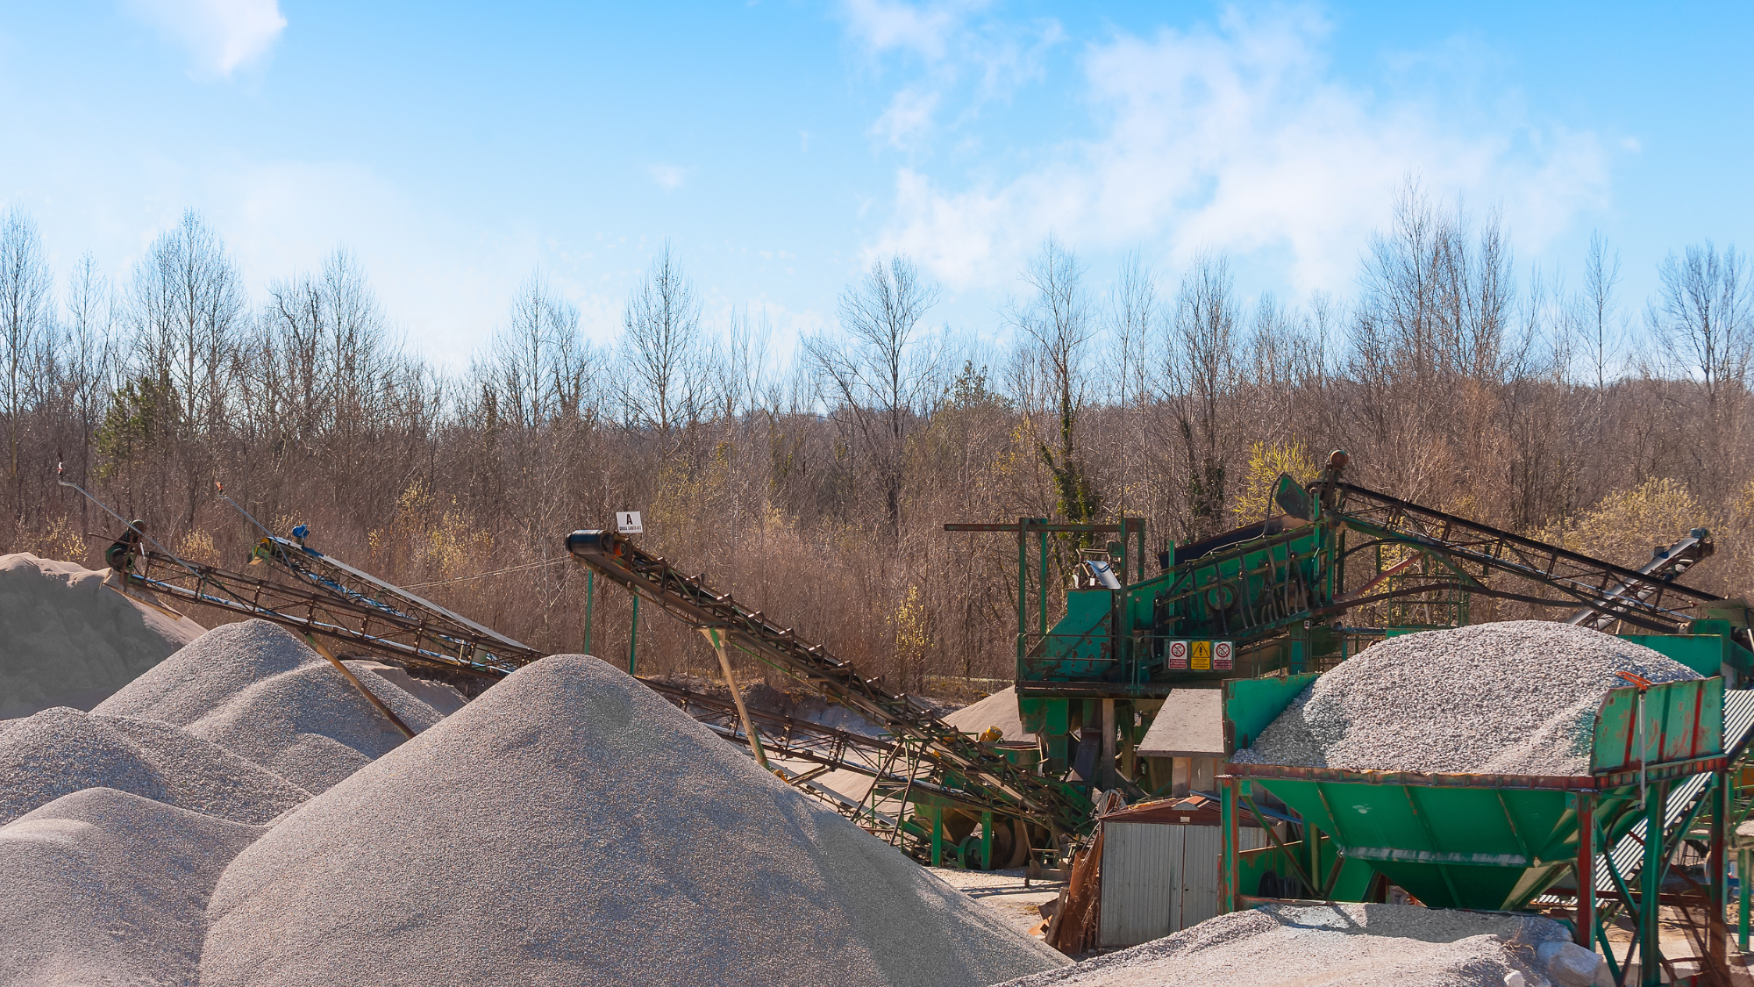
Aggregate
Aggregate qualities for strong and durable concrete:
  Abrasion resistance
  Freeze/thaw resistance
  Chemical stability
  Cleanliness and even gradation
5

Slide 6
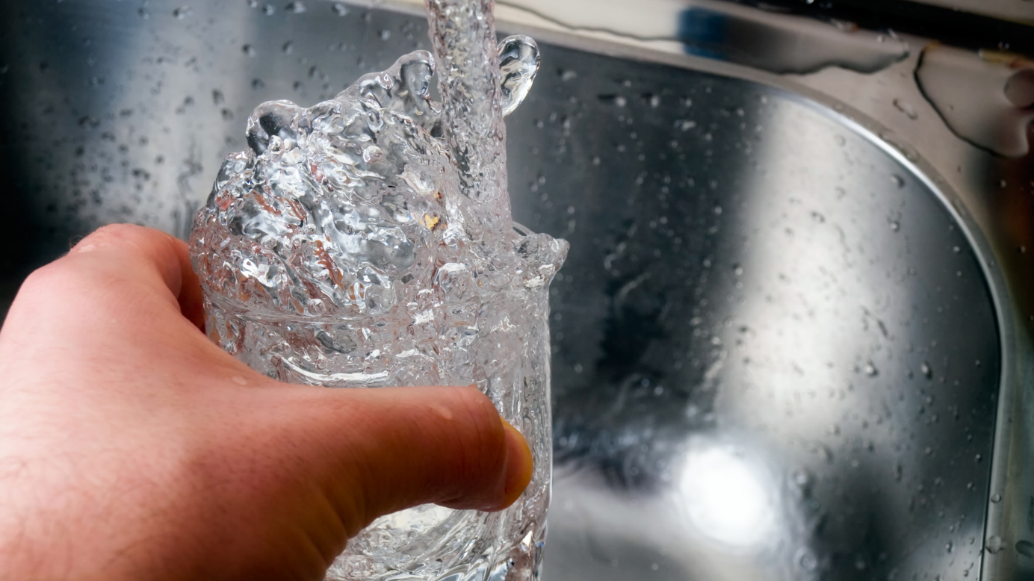
Water

Slide 7
Entrained Air
Entrained air 5% to 8%
Improves freeze thaw resistance
Improves workability
Reduces segregation and bleeding
Improves sulfate resistance

Slide 8
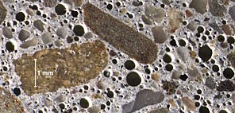
Air-Entrained Concrete

Slide 9

Admixtures
Ingredients used to modify certain properties of concrete to have a desired function
Two types of admixtures:
  Mineral admixtures
  Chemical admixtures

Slide 10
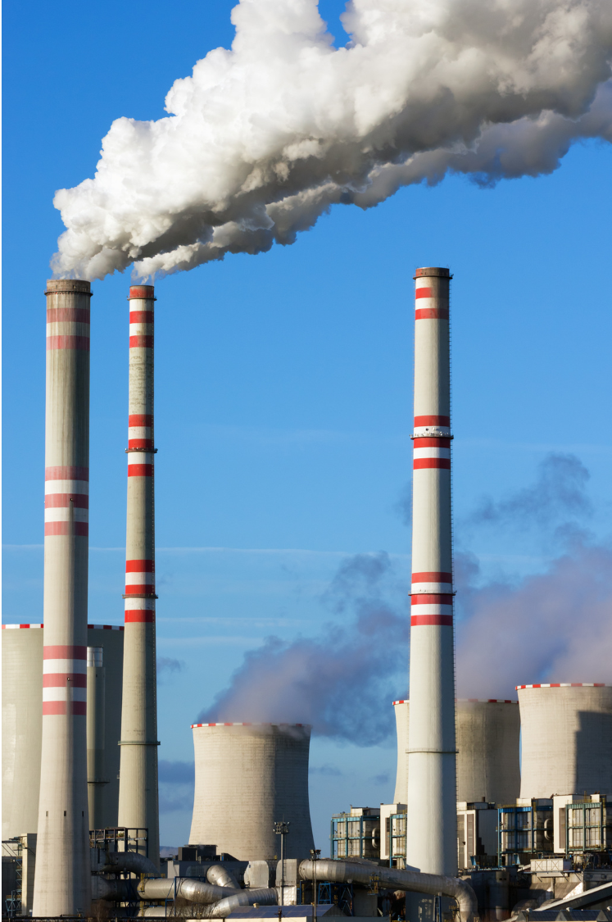
Mineral Admixtures
Fly Ash
Reduces heat of hydration & increases workability
Increases set time & reduces strength
Silica Fume
Increase strength & abrasion resistance
Increases water demand
Reduces permeability & workability
Limestone
First used in trial project in 2022. GU replaced with GUL (up to 15%)
Part of a “green initiative”, more environmentally friendly to produce.

Slide 11

Chemical Admixtures
Water Reducers – reduces water demand
Super Plasticizers – increases slump, workability, strength
Accelerators – decreases set time
Retarders – increases set time

Slide 12
Physical Properties
Compressive strength (f’c) (28 day) (e.g. HPC = 45 Mpa)
Tensile strength (6 to 7% f’c)
Shear strength (12-13% f’c)
Flexural strength (14% f’c)

Slide 13

Physical Properties (Cont’d)
How to increase Compressive Strength
Increased cement content
Increased aggregate strength
Decreased water/cement ratio
Decreased entrapped air
Increased curing time
Use of admixtures

Slide 14
Concrete Stress-Strain Diagram
stress
strain
Notes:
LK - Linear Elastic Region: Stress and strain are proportional, and concrete behaves as a linearly elastic material. The member should be able to retain its original shape if load is removed. The slope of this section is the modulus of elasticity (E). Typically, linearly up to 0.45 f’c
Transition Region: Concrete begins to strain beyond elastic region and begins to exhibit plastic deformation.
Plastic Region: the concrete deforms plastically, and the stress-strain curve levels off (or peaks), which indicates the maximum compressive stress. The concrete is no longer able to withstand additional stress at this point.

Slide 15

Physical Properties (Cont’d)
Creep
Fire resistance
Durability
Isotropy
Permeability
  Affected by
    evaporation of bleed water
    excess water
    micro-cracking
    porous aggregates
    improper mixing, finishing

Slide 16
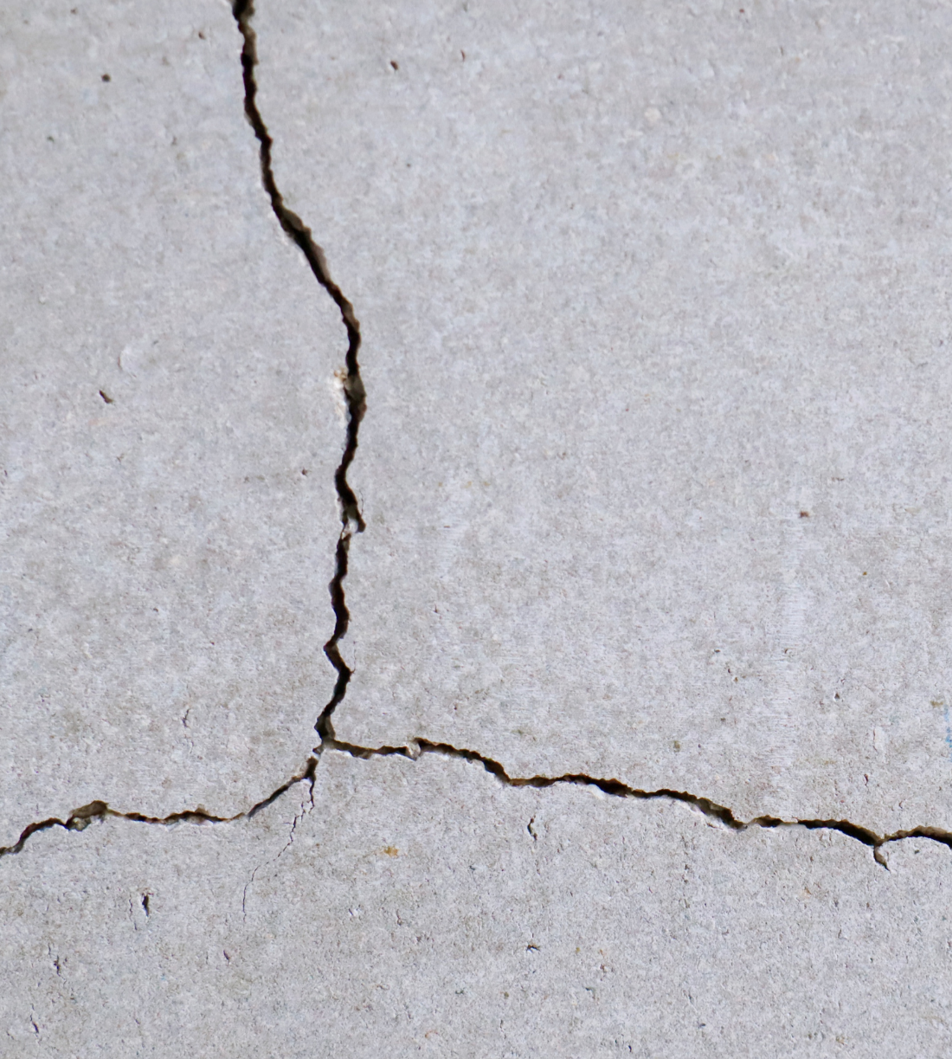
Concrete Damage & Deterioration
1. CRACKS
A crack is a linear fracture in concrete
Working Cracks
Structural Cracks
  Flexure cracks
  Shear cracks

Slide 17
Structural Cracks
Unloaded Beam
Flexural Cracks
Flexural Cracks
Shear Cracks

Slide 18

Concrete Damage & Deterioration
Non-Structural Cracks
Crazing cracks
Temperature cracks
Shrinkage cracks
Crack Size
Hairline less than 0.1 mm
Narrow ≥ 0.1 mm < 0.3 mm
Medium ≥ 0.3 mm < 1.0 mm
Wide ≥ 1.0 mm

Slide 19
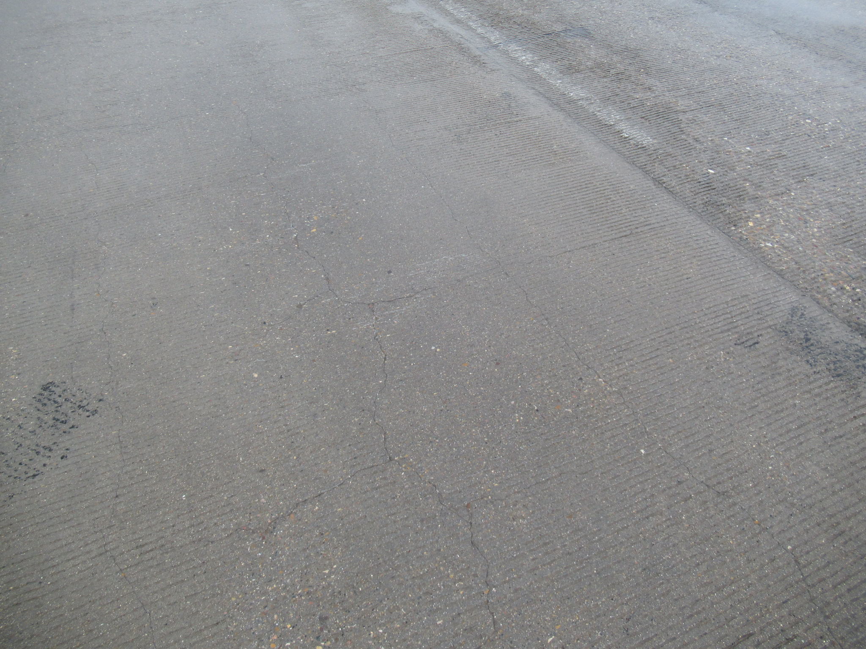
Map Cracking in Concrete Deck

Slide 20
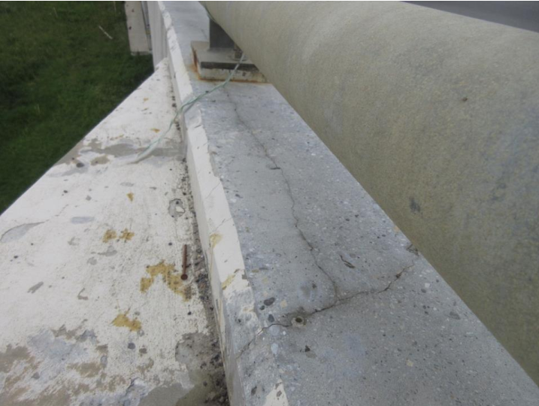
Shrinkage Cracks in Concrete Curb

Slide 21
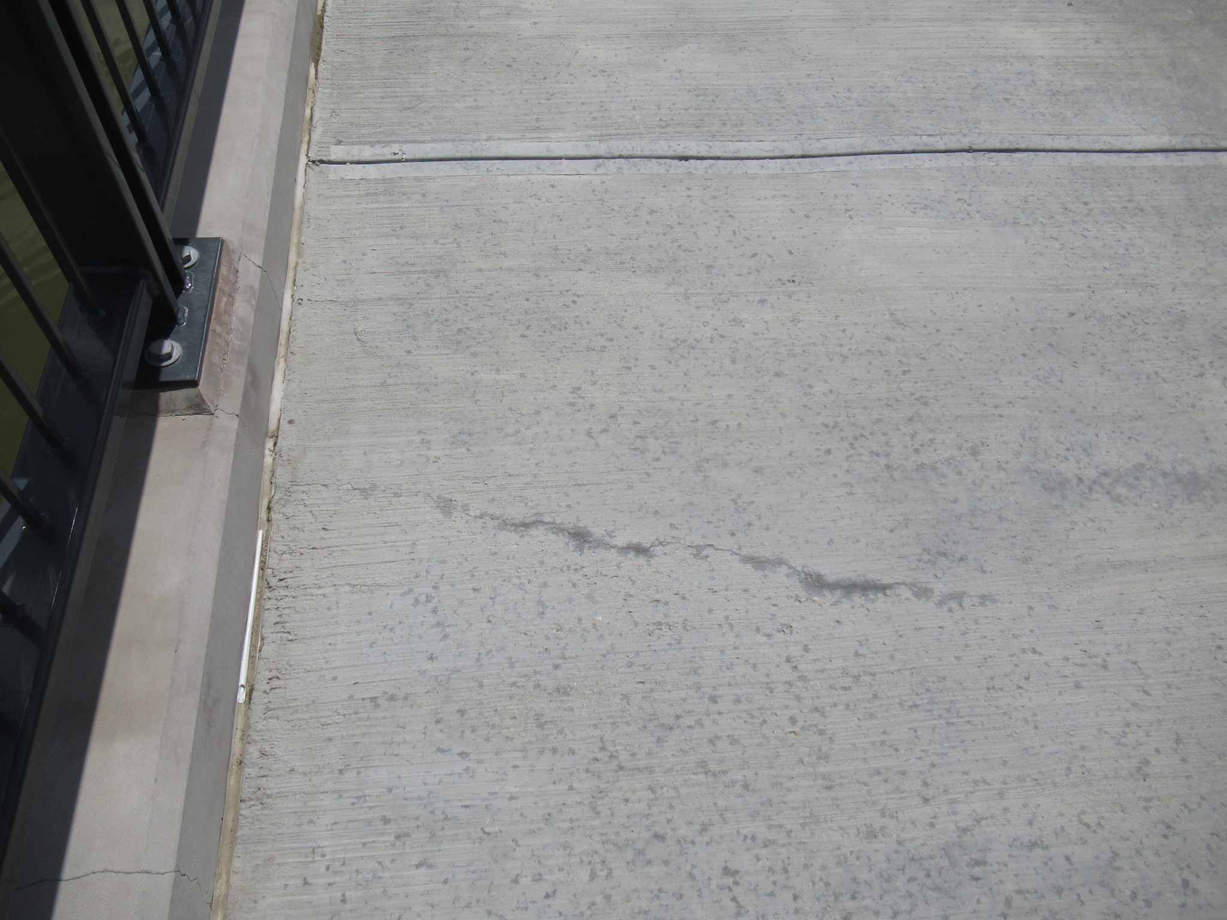
Hairline Transverse Crack in Sidewalk

Slide 22
Concrete Damage & Deterioration
2. SCALING
Scaling is a gradual loss of mortar and aggregate
Categories of Scaling
Light scaling loss of surface mortar 6 mm deep
Medium Scaling loss of surface mortar 6 to 13 mm deep
Heavy scaling coarse aggregate exposed
Severe scaling loss of coarse aggregate

Slide 23
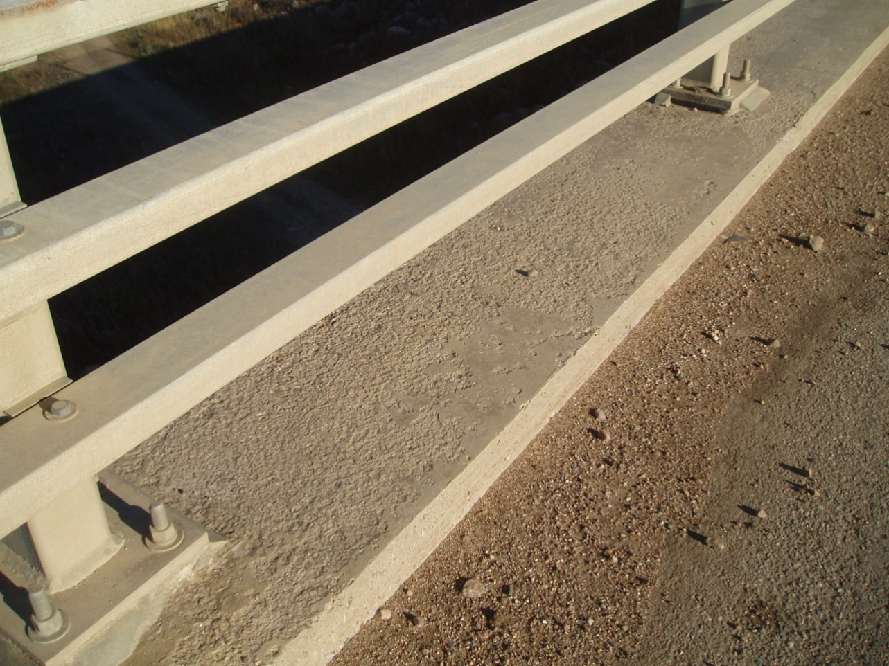
Light Scaling

Slide 24
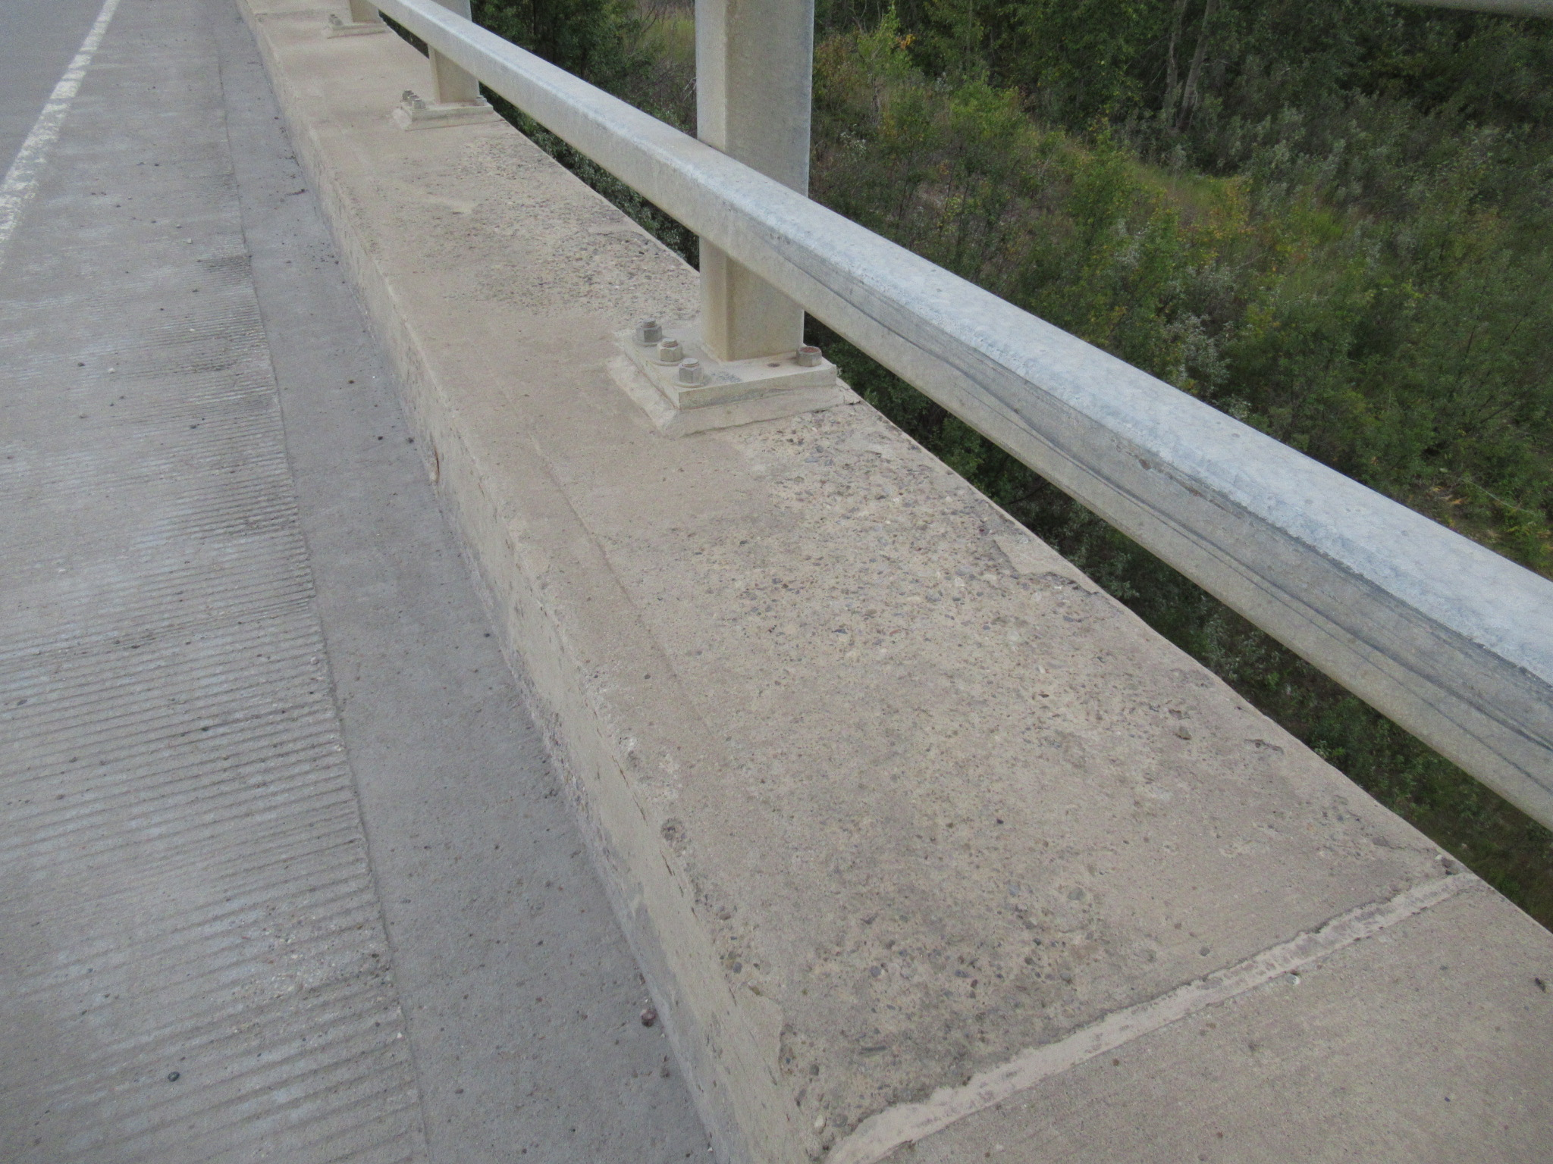
Medium Scaling
Notes:
Aggregate starting to become partially visible

Slide 25
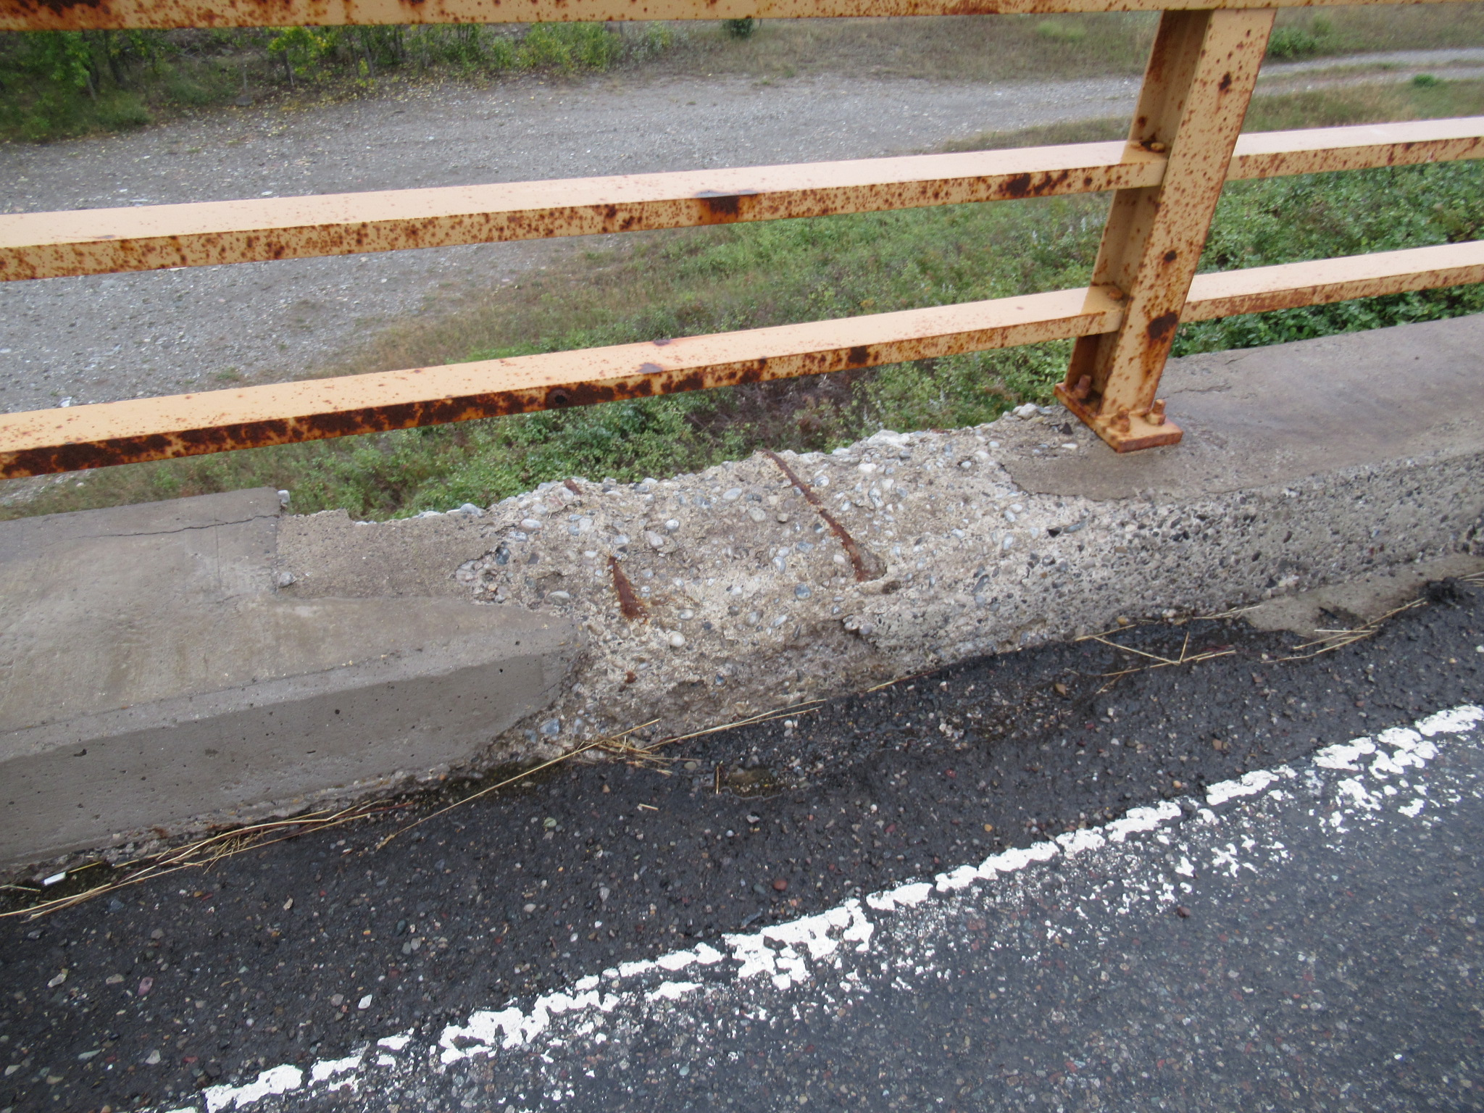
Heavy Scaling

Slide 26
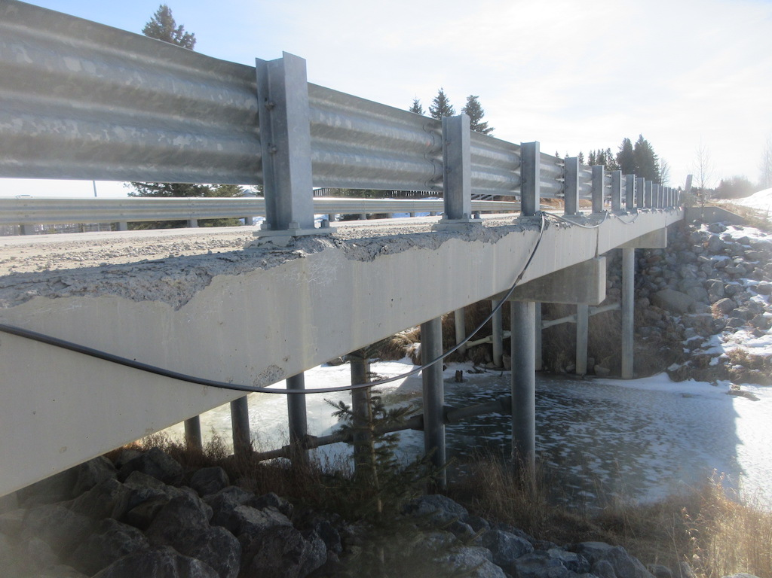
Freeze/Thaw Deterioration of Deck

Slide 27
Concrete Damage & Deterioration
3. POP-OUTS
Due to porous aggregate
4. ABRASION
Due to wheel wear
5. SPALLING
Expansion of corroding rebar and overstressing

Slide 28
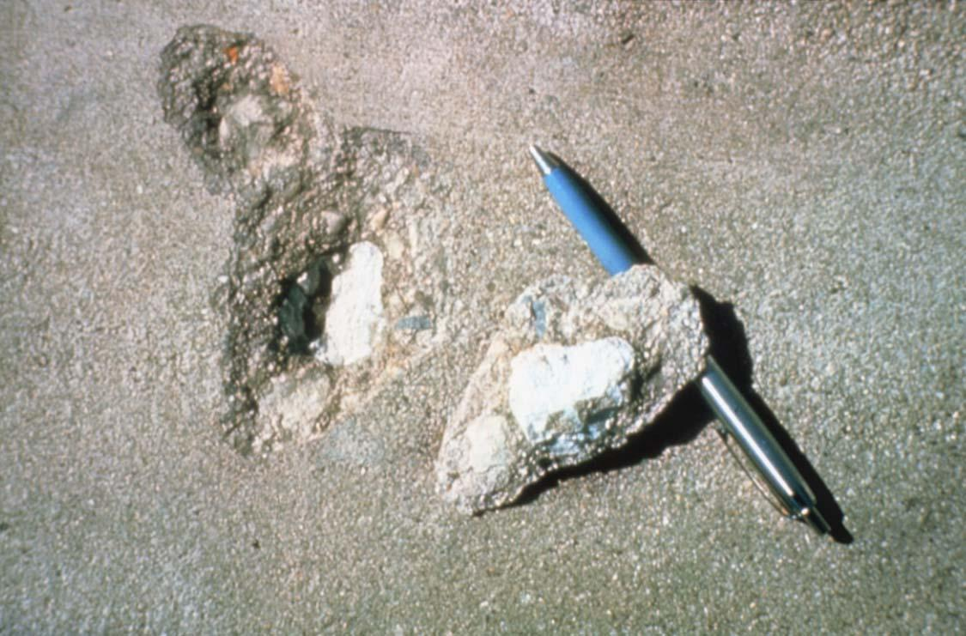
Expansive Aggregate Pop-out

Slide 29
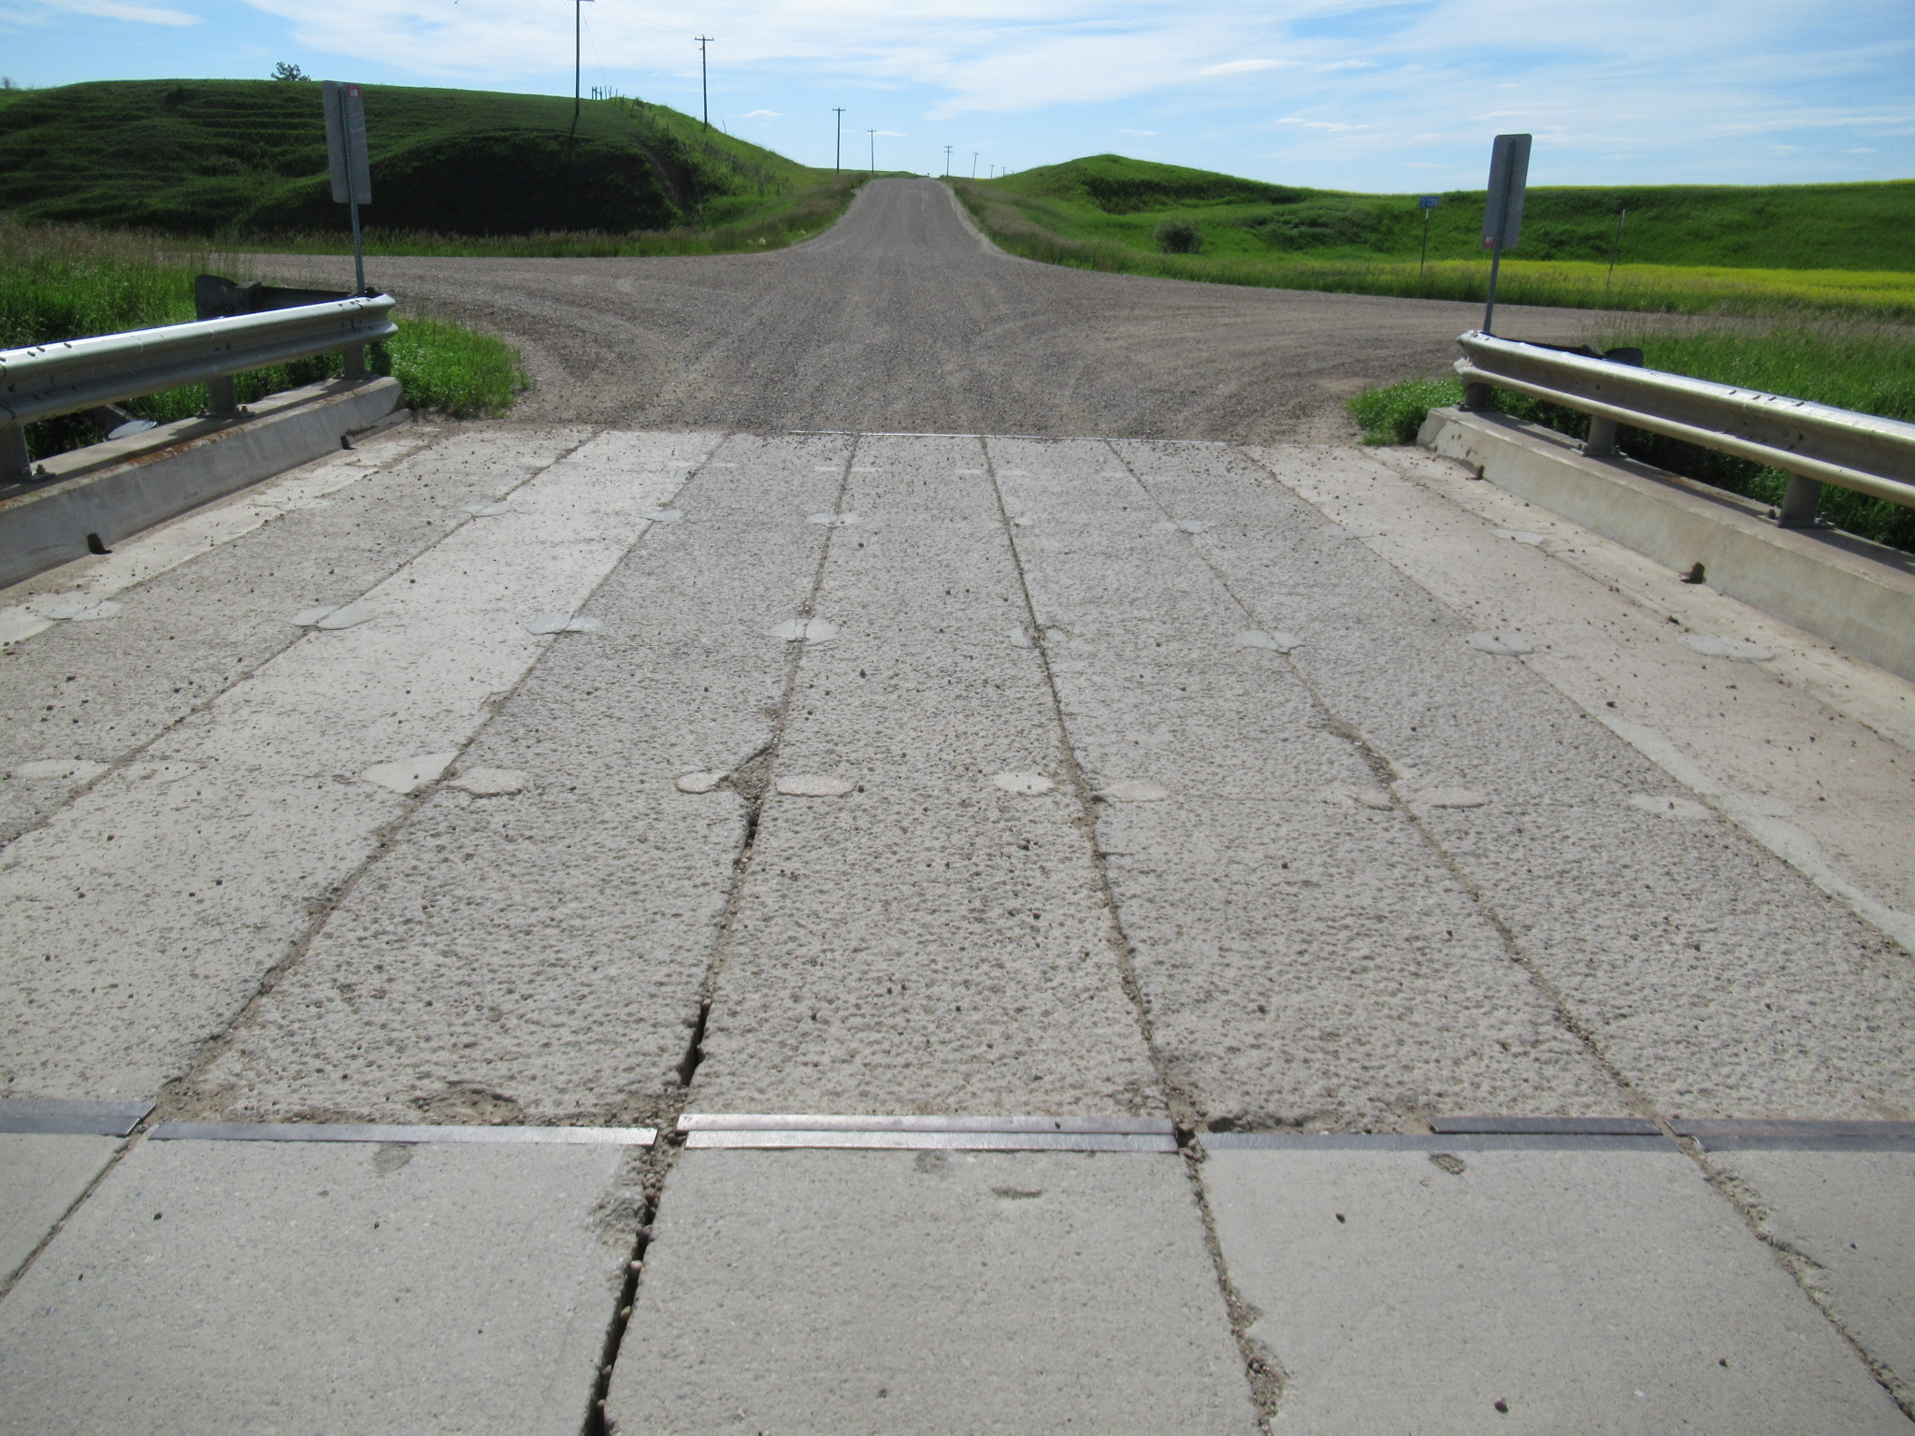
Abrasion Damaged Girders

Slide 30
Concrete Damage & Deterioration
6. DELAMINATION
Delamination is the separation of the paste layer within concrete (i.e. an internal crack). Delamination leads to spalling. Typically caused by the volumetric expansion of corroding rebar.
7. STAINING
Includes rust, efflorescence, or water stains leaching through cracks
8. ALKALAI AGGREGATE REACTION
9. CARBONATION
10. EFFLORESCENCE

Slide 31
Delamination Mechanism
Top of concrete
Wearing surface
Reinforcement
Corrosion by-products

Slide 32
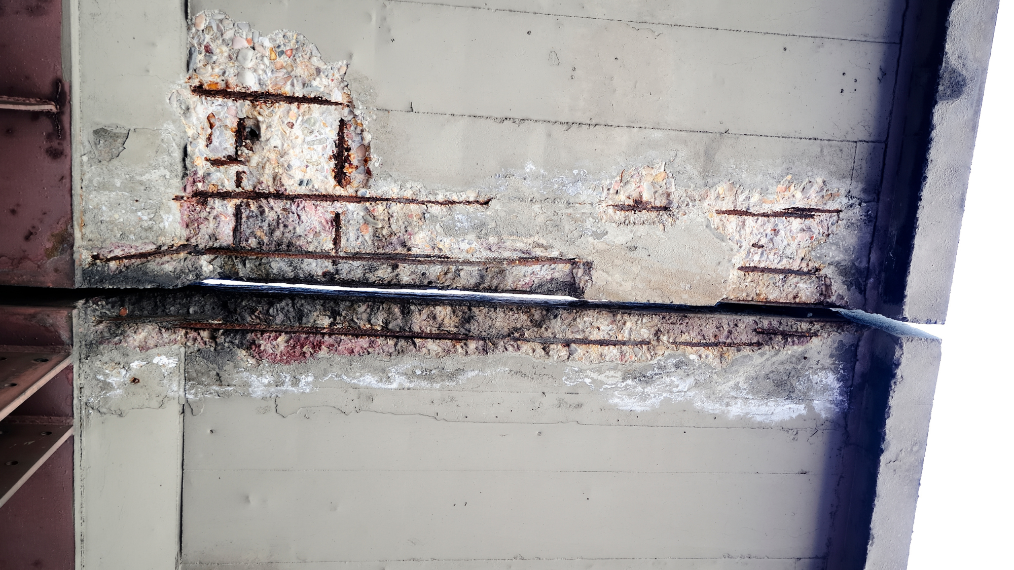
Delamination & Corroded Rebar

Slide 33
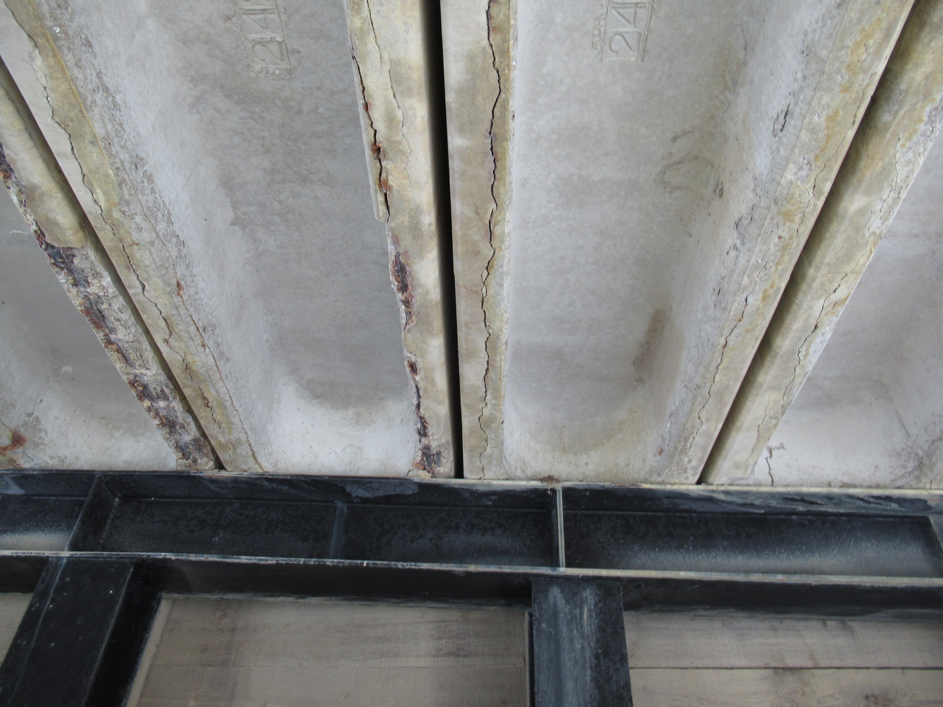
Longitudinal Cracks & Corroded Rebar

Slide 34
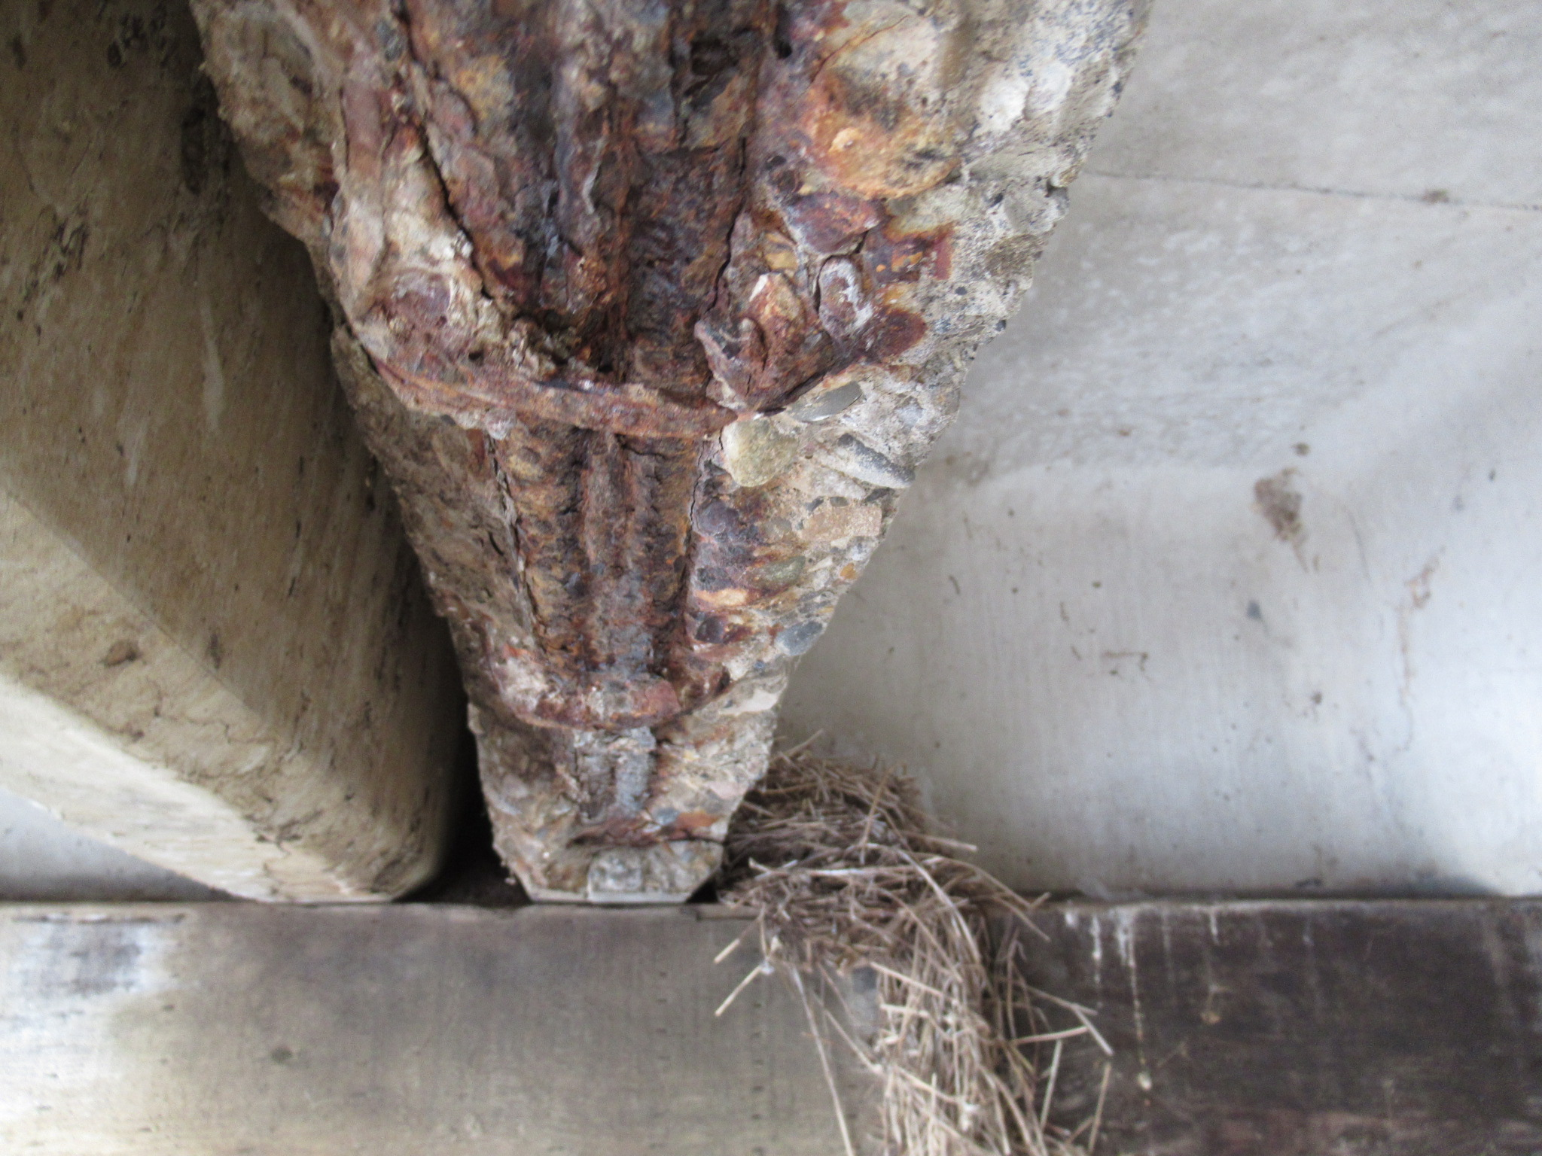
Spalled Concrete – Corroded Rebar and Broken Stirrup

Slide 35
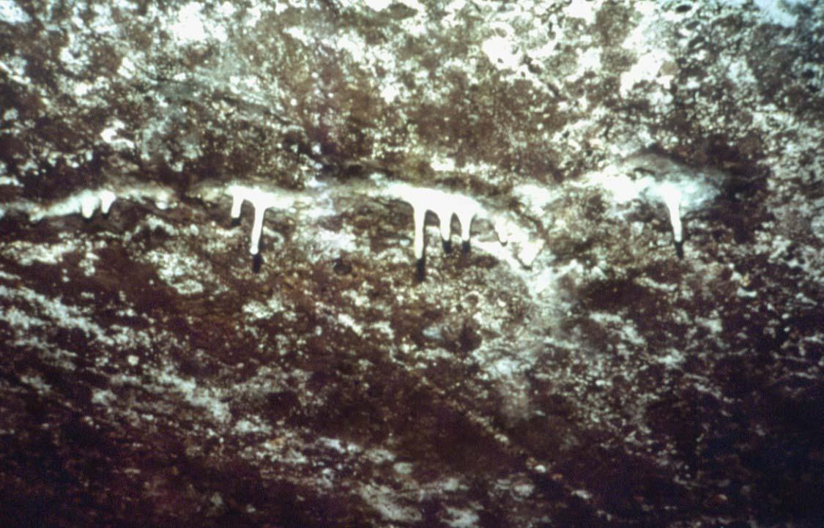
Calcium Carbonate Deposits

Slide 36
Concrete - Steel Combination
Reinforced Concrete
Concrete has high compressive strength and low tensile strength
Typically cracks under tensile load
Traditional reinforcing steel (rebar) carries tensile load
Prestressed Concrete
Use of both rebar and high-strength steel strands
Concrete is pre-compressed as a result of pre-tensioning the steel strands
Carries load without cracking

Slide 37
STEEL

Slide 38
What is Steel?
Steel is an alloy of iron, carbon and other trace metals
Carbon and trace metal ratios:
Carbon 0.15 to 0.3%
Manganese 0.50 to 2.0%
Phosphorus 0.02 to 0.2%
Sulphur 0.02 to 0.06%
Silicon 0.15 to 0.8%

Slide 39
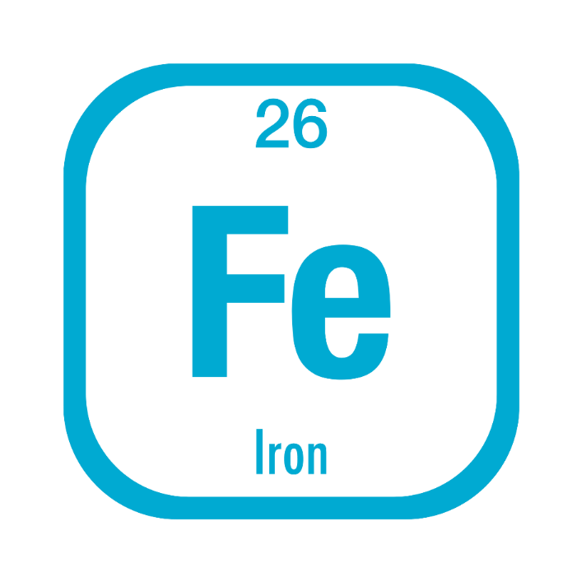
Iron
Iron in the pure form is a soft, shiny metal like aluminum.
However, it is never found in this state.
Iron oxidizes extremely easily.
In nature it is always found as an oxide.

Slide 40
Steel Making Process
Iron ore, coke and limestone are major raw materials.
Raw material is charged into Blast furnace which has a temperature of 1600°C.
Iron melts and settles at the bottom.
Solidified iron is called “Pig Iron”
Molten metal from blast furnace and silicon is taken into Basic Oxygen furnace
Chemical analysis of the molten material is done
Steel billets are heated to 1200°C for rolling and finished products.

Slide 41
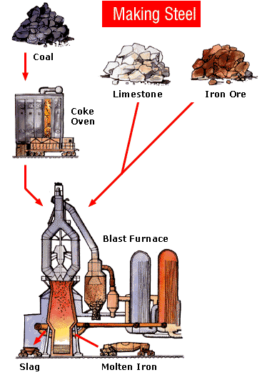
Bridge Materials

Slide 42
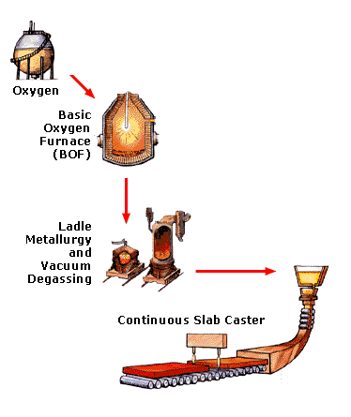
Bridge Materials
Molten Iron

Slide 43
Effects of Various Elements
Effects of Carbon in steel:
Increases strength and hardnessand improves hardenability
Reduces ductility (brittleness increases), toughness, machinability and weldability once heat treated
Effects of Phosphorus in steel:
Increases strength and hardenability
Reduces ductility and weldability

Slide 44
Effects of Various Elements
Effects of Manganese in steel:
Increases strength, hardenability and notch toughness
Reduces weldability
Reduces ill effects of sulfur
Effects of Sulfur in steel:
May cause porosity and hot cracking in welding
Can cause brittleness

Slide 45
Effects of Various Elements
Silicon in steel:
Increases strength, hardenability, and notch toughness
Reduces weldability
Deoxidizer in steel making
Certain amounts of silicon can considerably affect hot-dip galvanizing
Copper, Chrome, Nickel:
Weathering steel (Cor-ten)

Slide 46
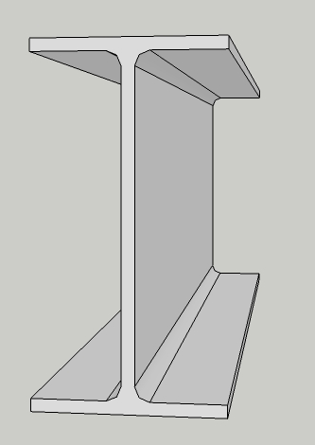
Common Steel Shapes
Wires
Cables
Steel Plates
Steel Bars
Rolled Beams
Built-up Shapes

Slide 47
Rolled Sections
Angle
Channel
Rolled I Beam

Slide 48
Built-up Sections

Slide 49

Important Physical Properties
Strength
  Compression
  Tension
  Fatigue
Ductility
Notch toughness
Weldability
Fire Resistant
Corrosion Resistant

Slide 50
Tension & Compression
Stress Strain Diagram
tension
(+)
shorten (-)
lengthen (+)
compression
(-)

Slide 51
Steel Damage and Deterioration
Corrosion
Environmental corrosion
Stray current corrosion
Stress corrosion
Cracking
Fatigue
Impact
Excessive loading
Steel may also crack when flows are present, especially if near the surface.
Note: Any crack in a steel member is serious

Slide 52
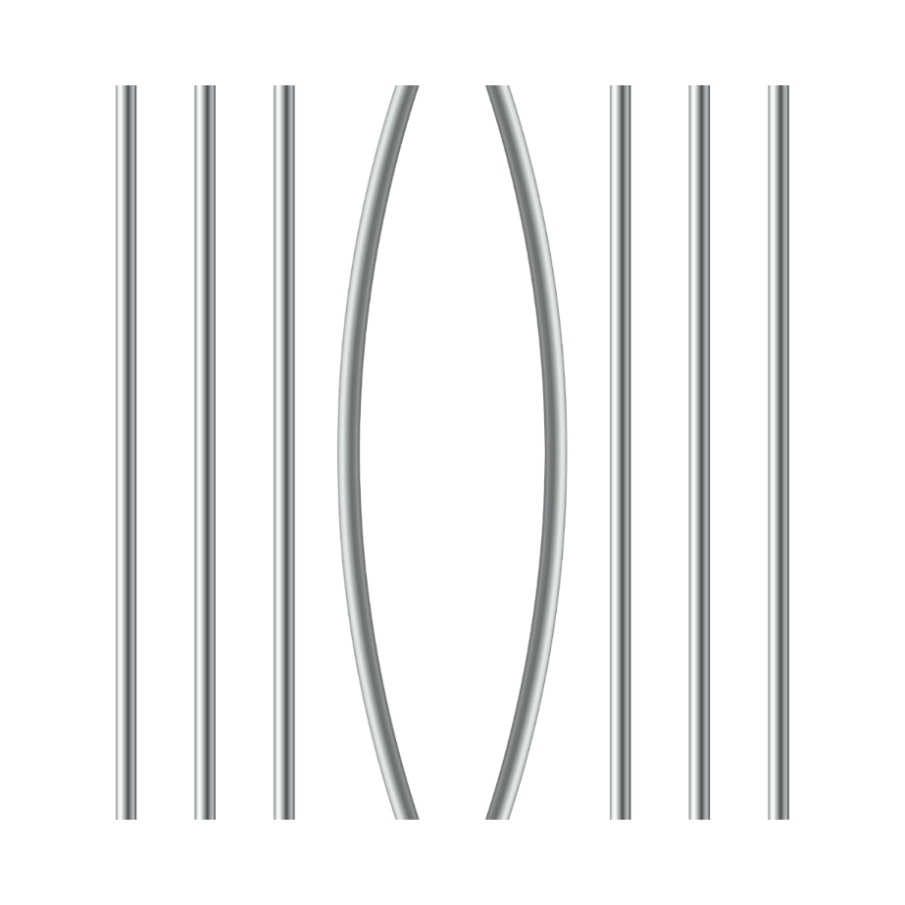
Steel Damage and Deterioration
Deformation
Excessive loading
Heat damage
Impact

Slide 53
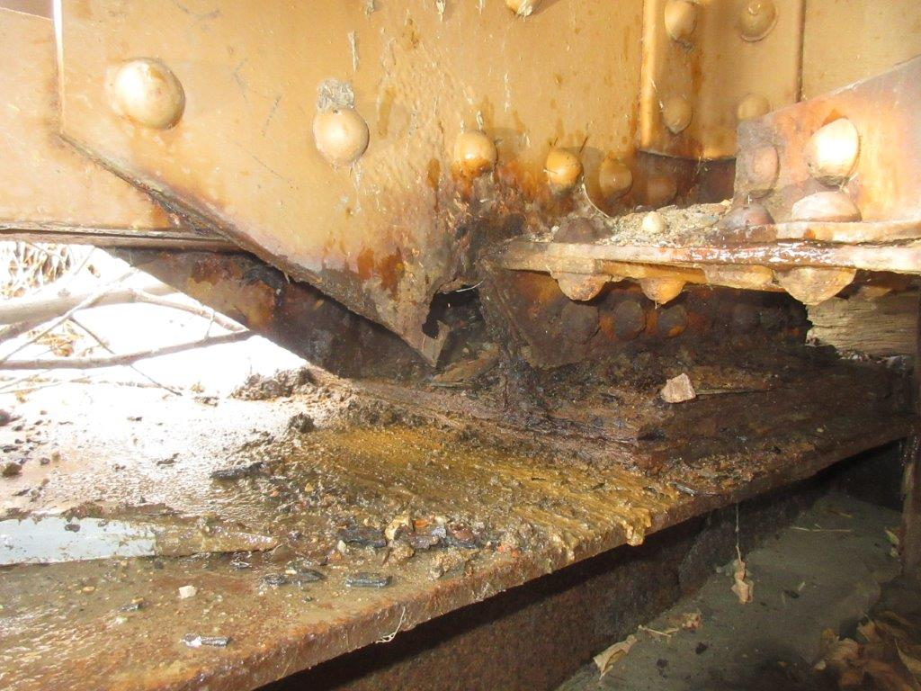
Corrosion Perforations in Tie Plate – BF 9315

Slide 54
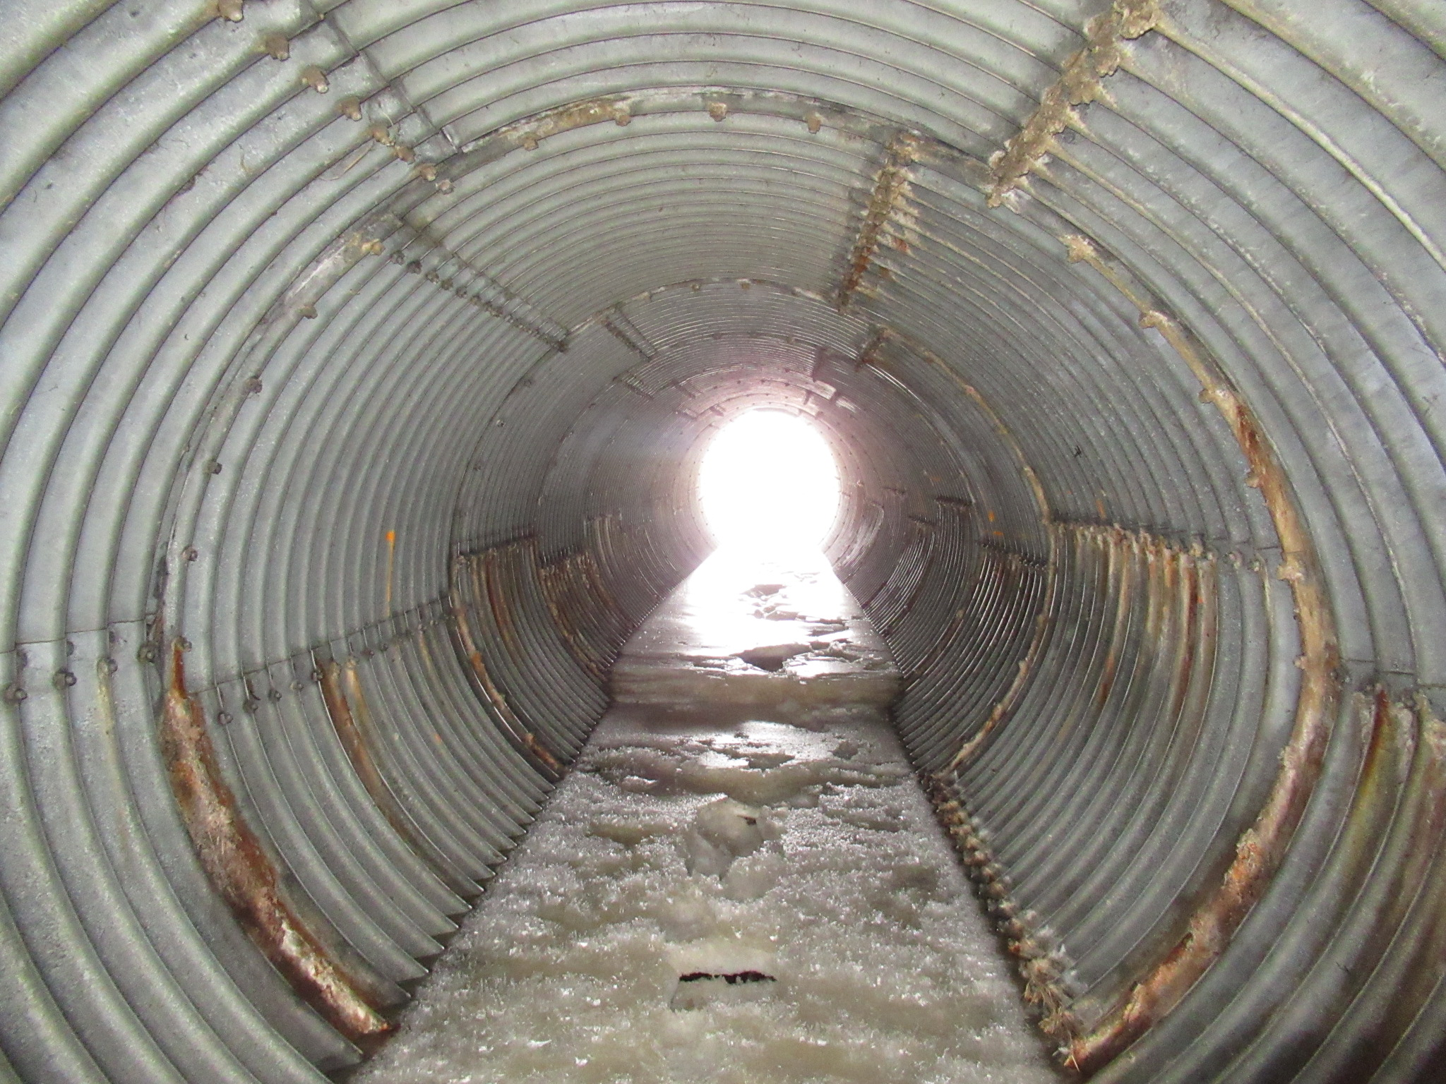
Soil Side Corrosion in Culvert Barrel

Slide 55
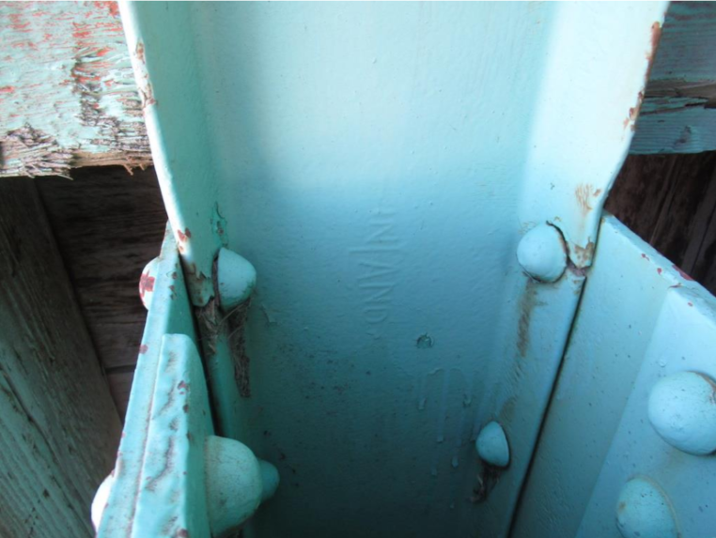
Crack initiated by Bolt Hole

Slide 56
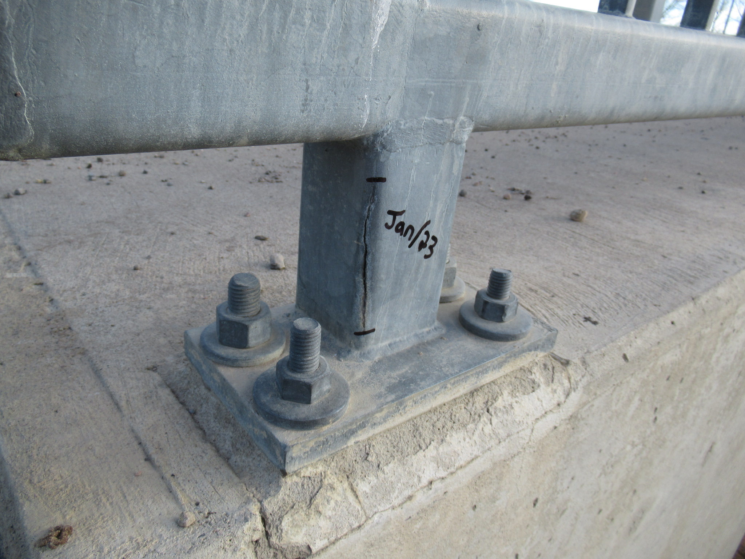
Crack in post base initiated by expanding frozen water

Slide 57
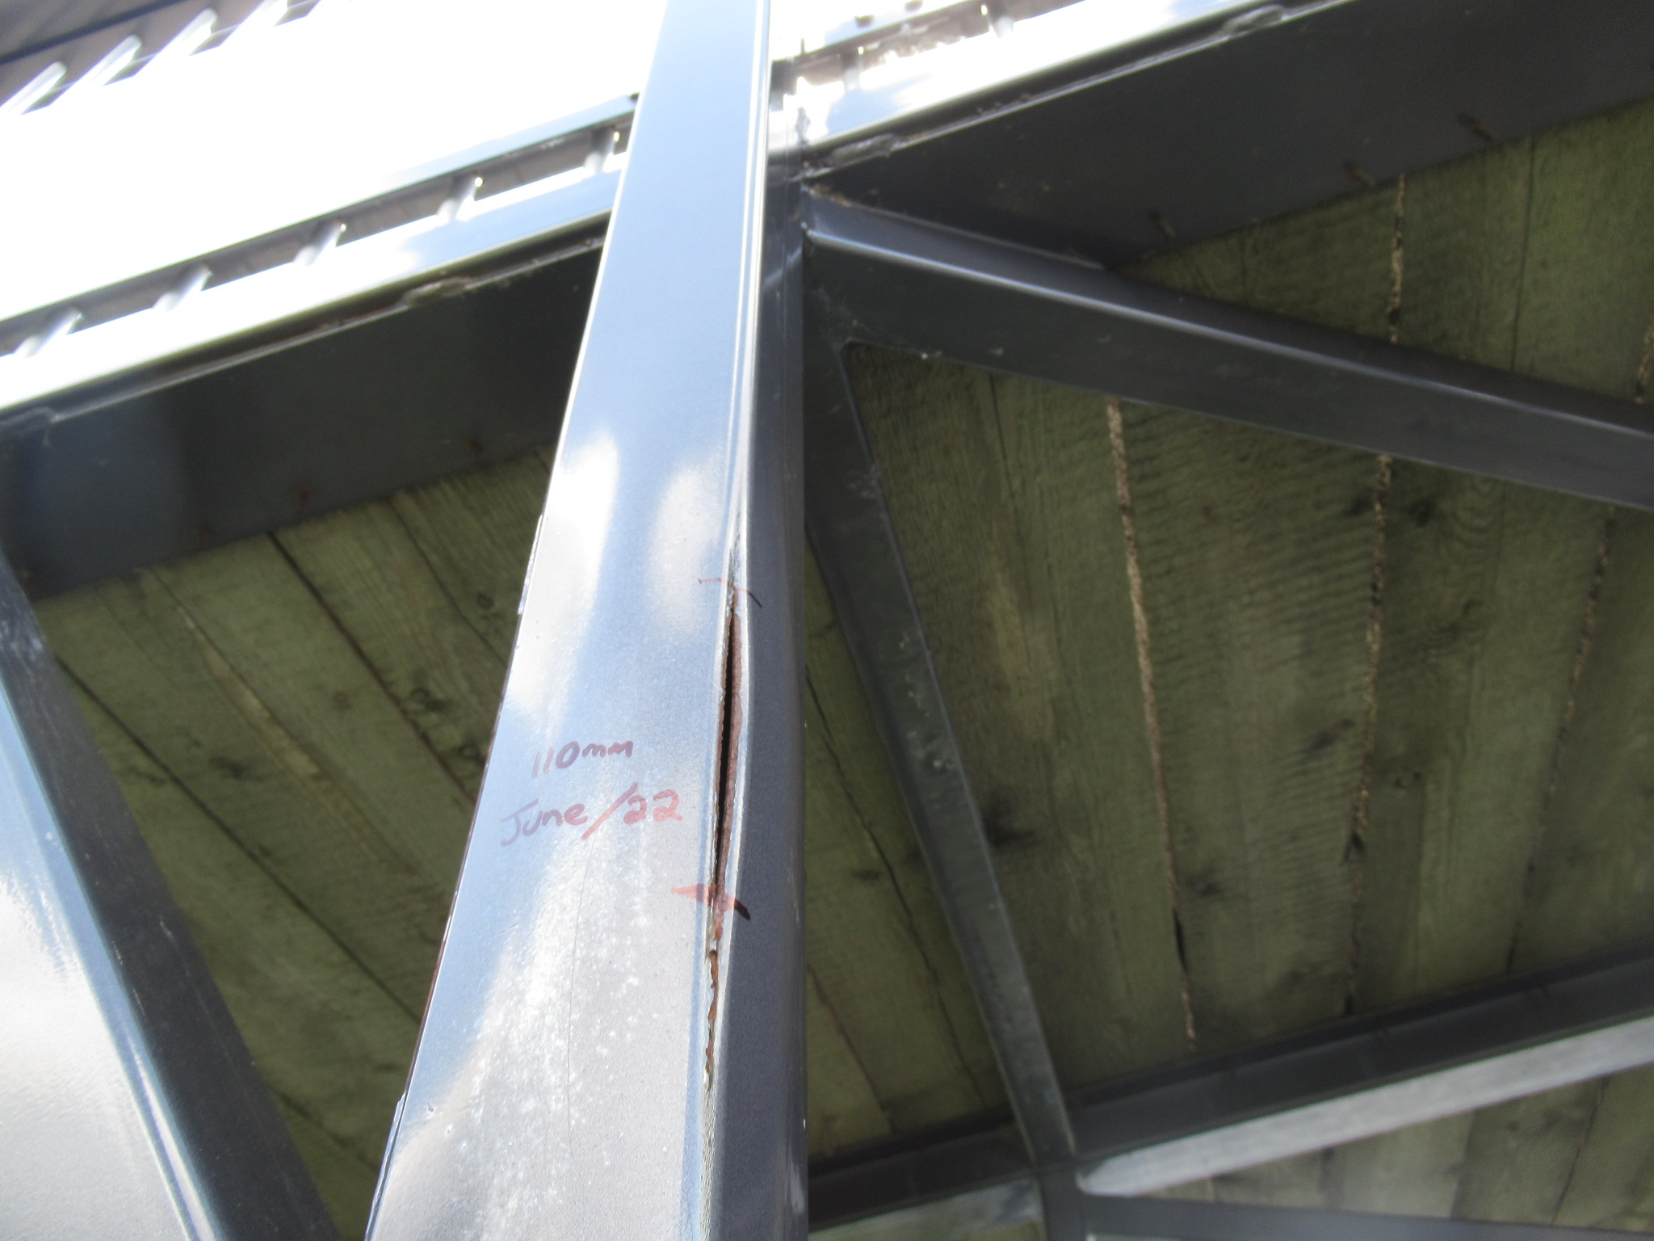
Crack in post initiated by expanding frozen water

Slide 58
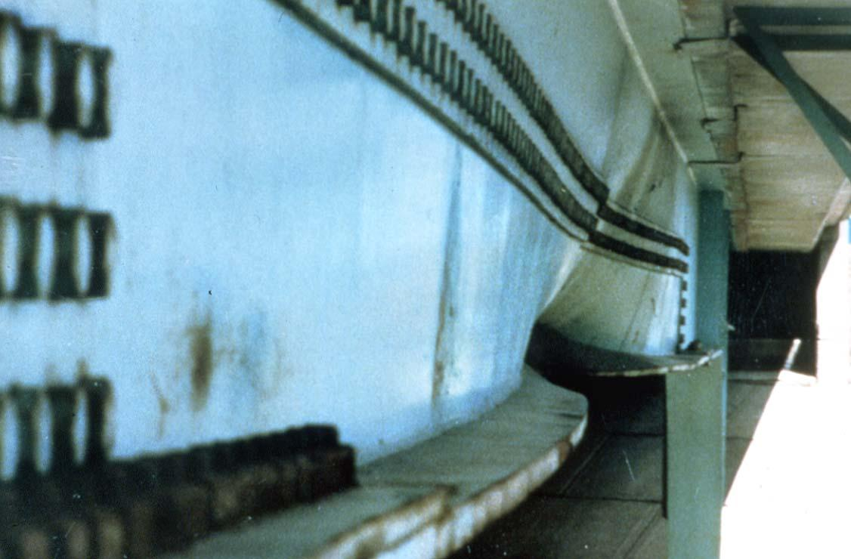
Collision damaged steel girder.

Slide 59
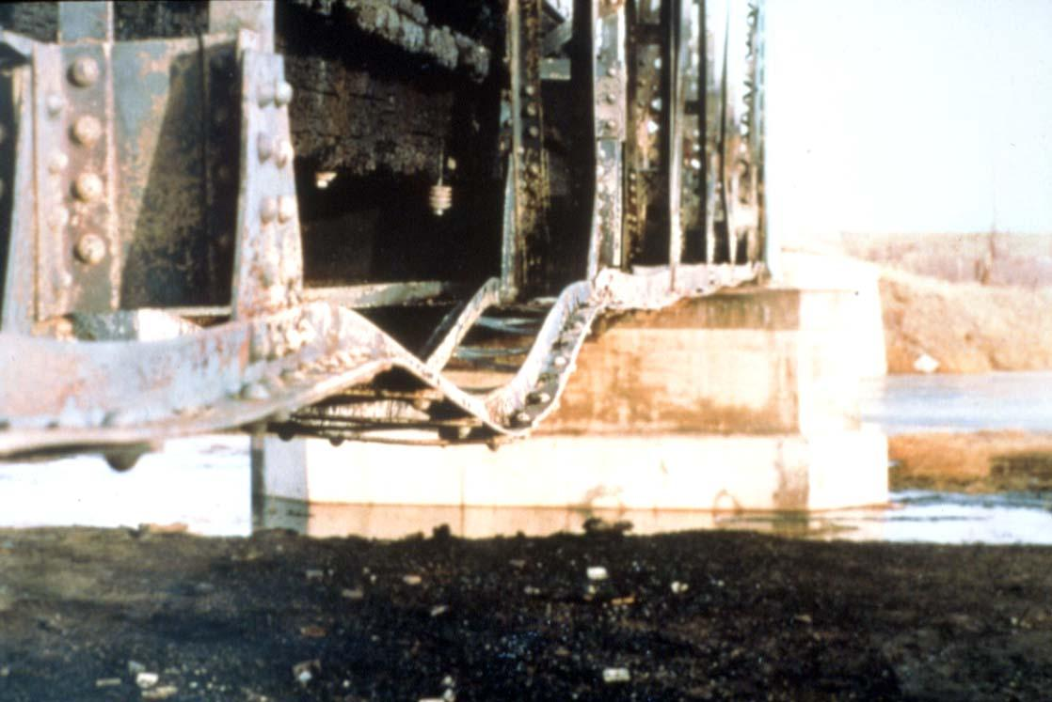
Fire Damaged Truss

Slide 60
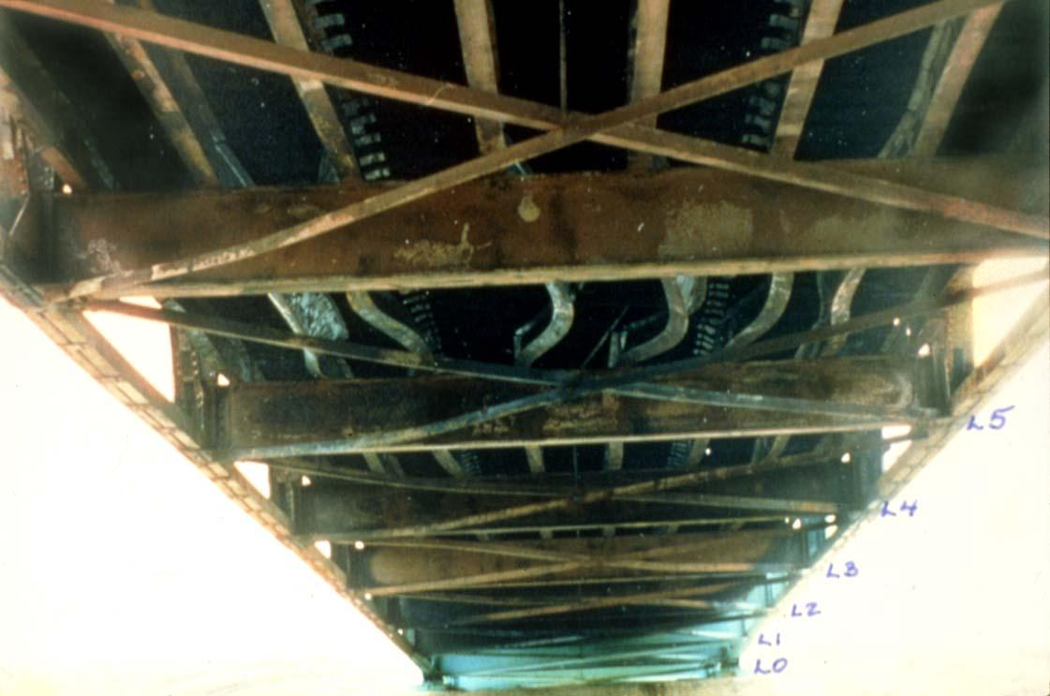
Fire Damaged Truss.

Slide 61
UNCONTROLLED
WELDING
IS NOT ALLOWED
ON BRIDGE
STRUCTURES

Slide 62
TIMBER

Slide 63
Wood
What is wood?
A naturally occurring non- homogeneous material.
Composition of timber:
Carbohydrate fibres
Water
Classification of timber:
Hardwood
Softwood

Slide 64
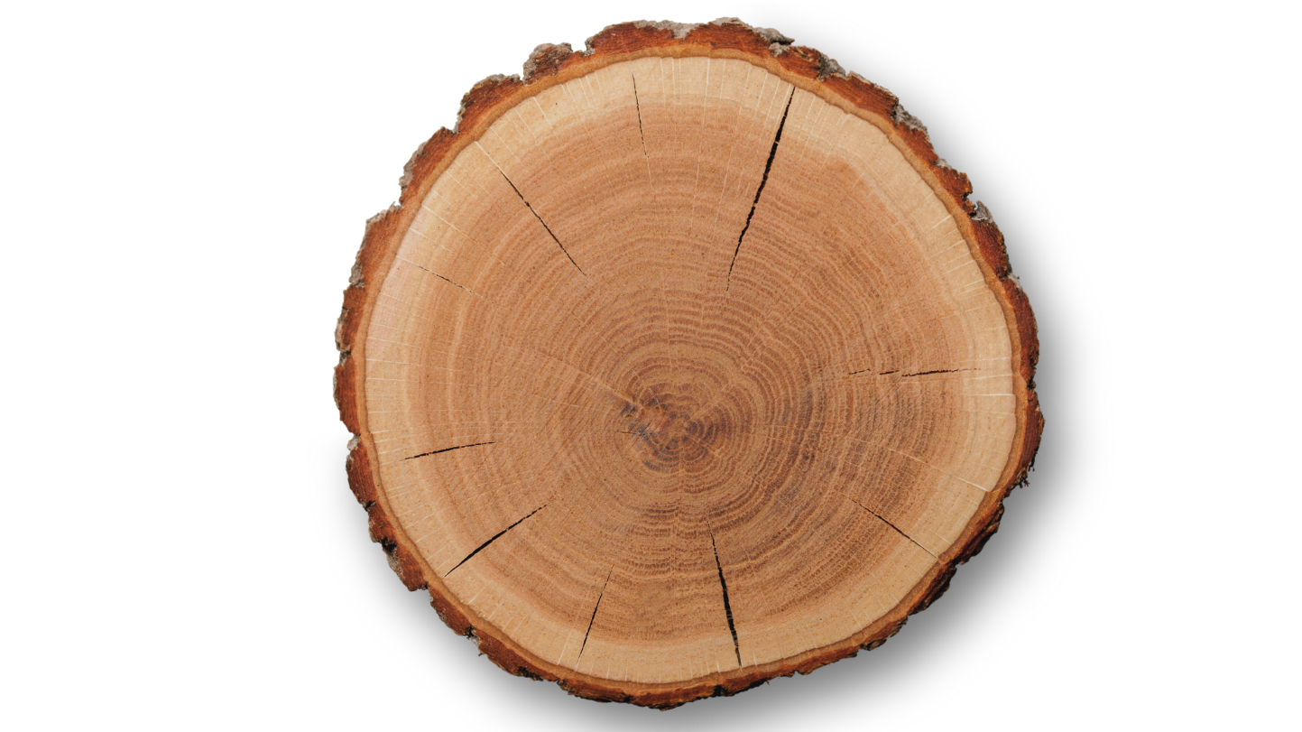
Cross Section of Tree
Outer Bark
Inner Bark
Cambium
Sapwood
Rays
Heartwood
Pith

Slide 65
Growth Features
Growth features
Knots
Splits, Checks
Moisture content
Moisture affects dimensional stability
19% moisture content is considered seasoned wood

Slide 66
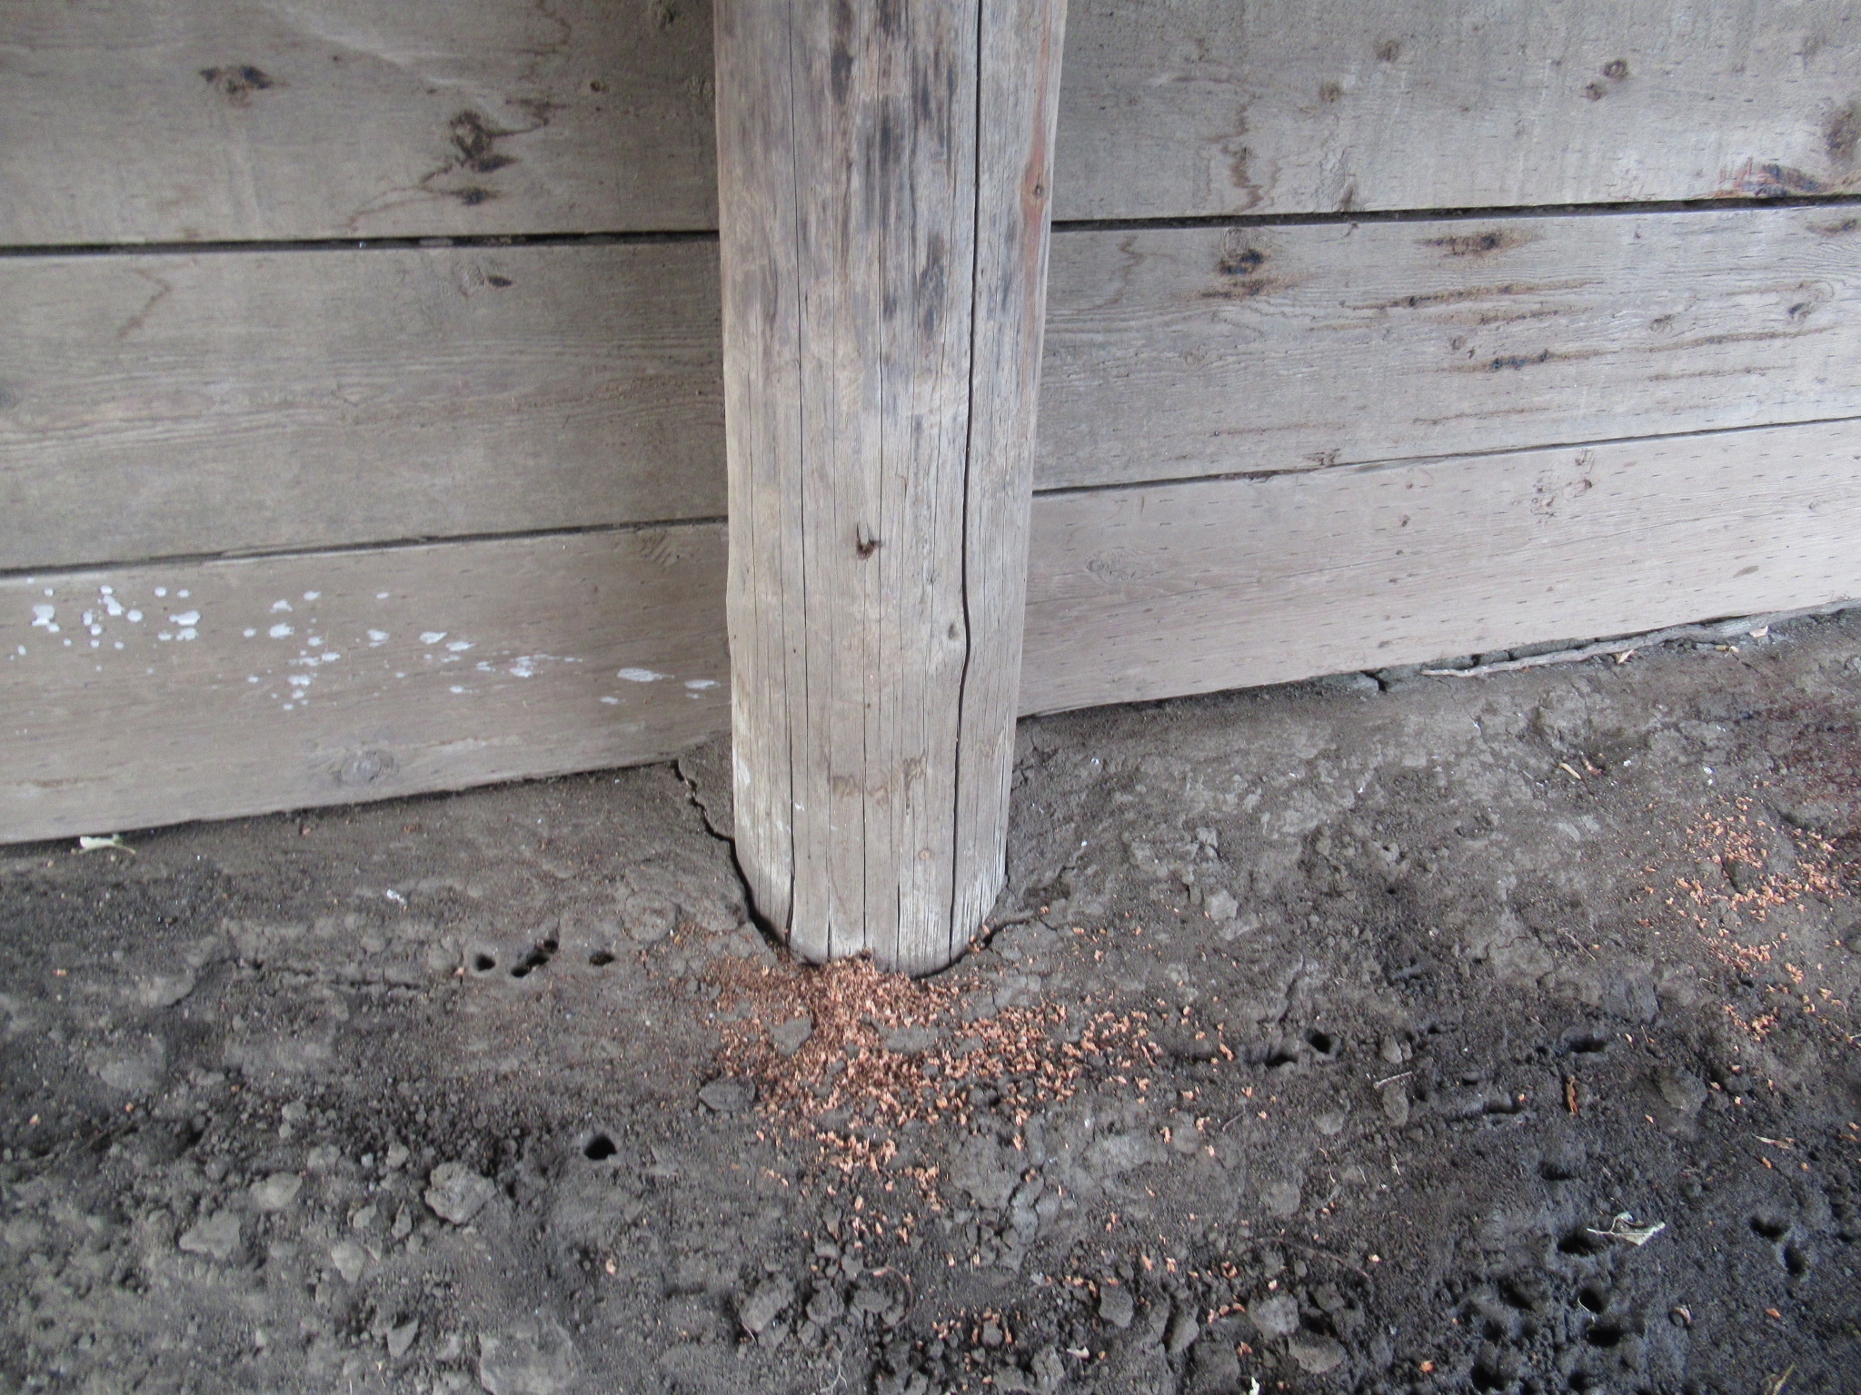
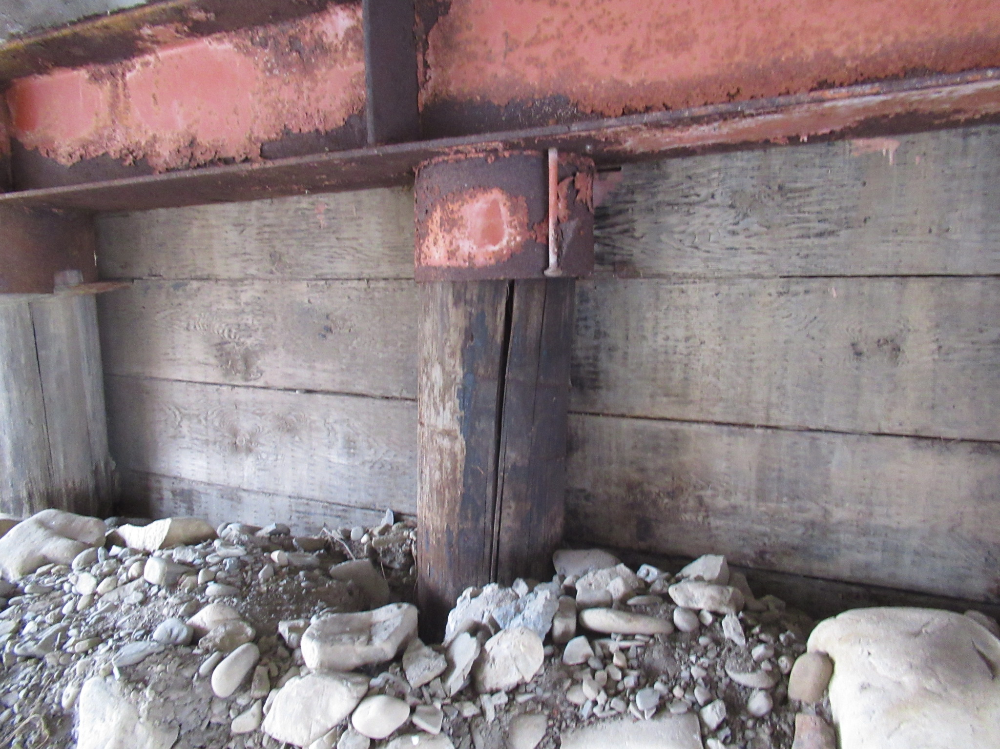
Checks
Occur naturally
Not generally considered a defect in timber
Can be differentiated from cracks by the presence of creosote or other preservatives visible on the inside surface of the check
Cracks that have formed after application of the wood preservative will have not have preservative present at the inside surface.

Slide 67

Physical Properties
Compression
  perpendicular to grain
  parallel to grain
Tension
Bending
Fatigue
Shrinkage
  60% radially
  2% longitudinally

Slide 68
Timber Damage & Deterioration
Decay and fungal growth
Abrasion
Warping
Splits
Wide checks or checks within wet / dry zone of pile (> 25 mm)
Cracking
  Flexural
  Horizontal Shear
Fire Damage
Collision Damage

Slide 69
Timber Damage & Deterioration
Decay is caused by fungi
  Fungi need the following to grow:
    Oxygen
    Temperature
    Food
    Moisture
  Fungal growth will not occur while wood remains submerged under water or buried deep in ground (oxygen depleted environments).
Insects – Pine beetles can be a serious problem in Alberta

Slide 70
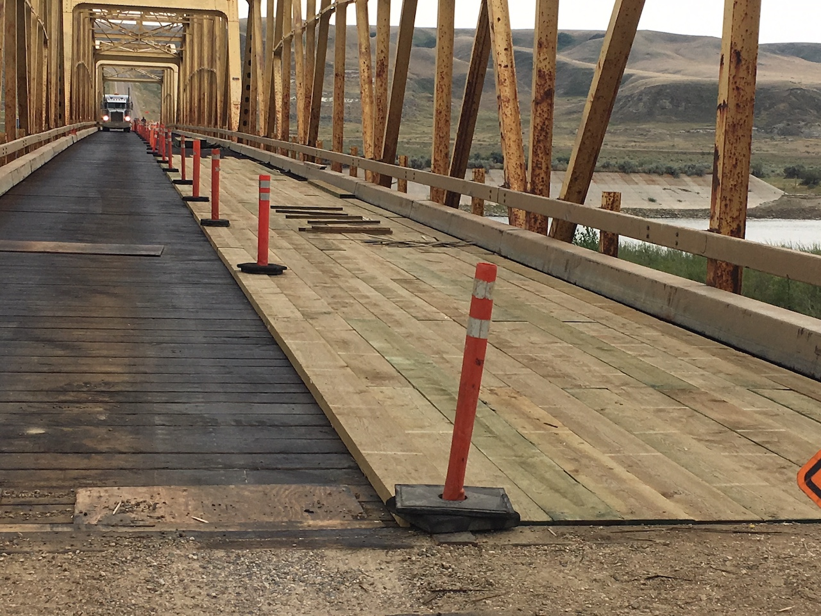
Protective Systems
Water repellents
Preservatives
  Creosote
  Cromated Copper Arsenate (CCA) – green color
  Alkaline Copper Quaternary (ACQ) – brown color
  Ammoniacal Copper Zinc Arsenate (ACZA)
Paint

Slide 71
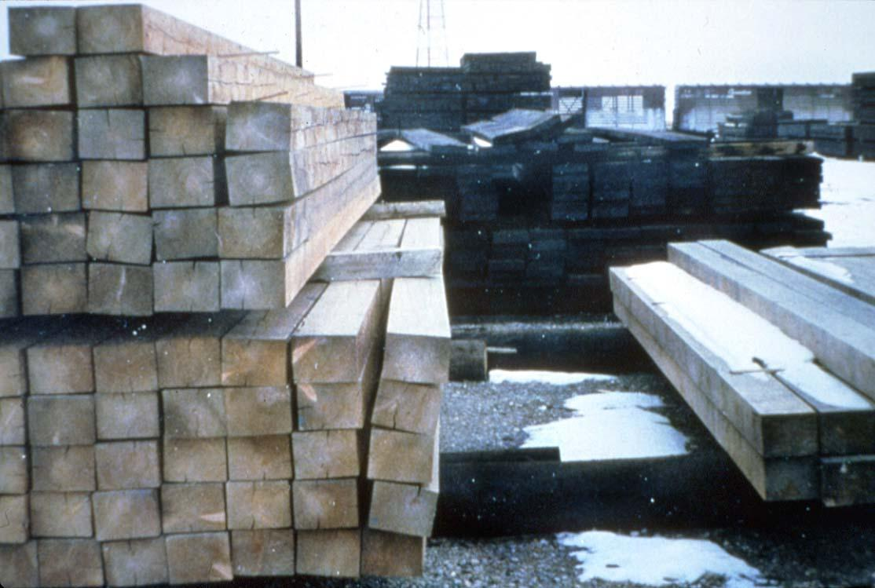
Warping due to Drying Shrinkage

Slide 72
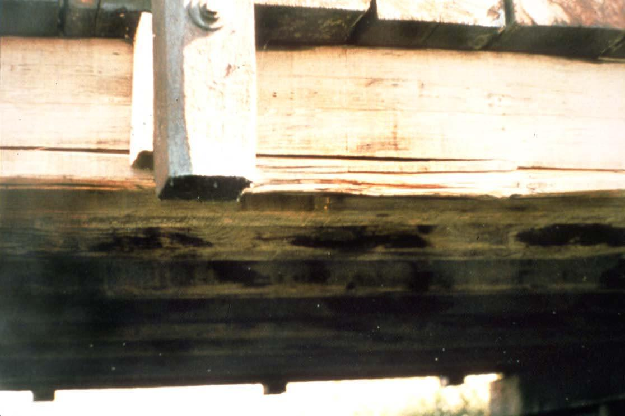
Horizontal Shear Crack.

Slide 73
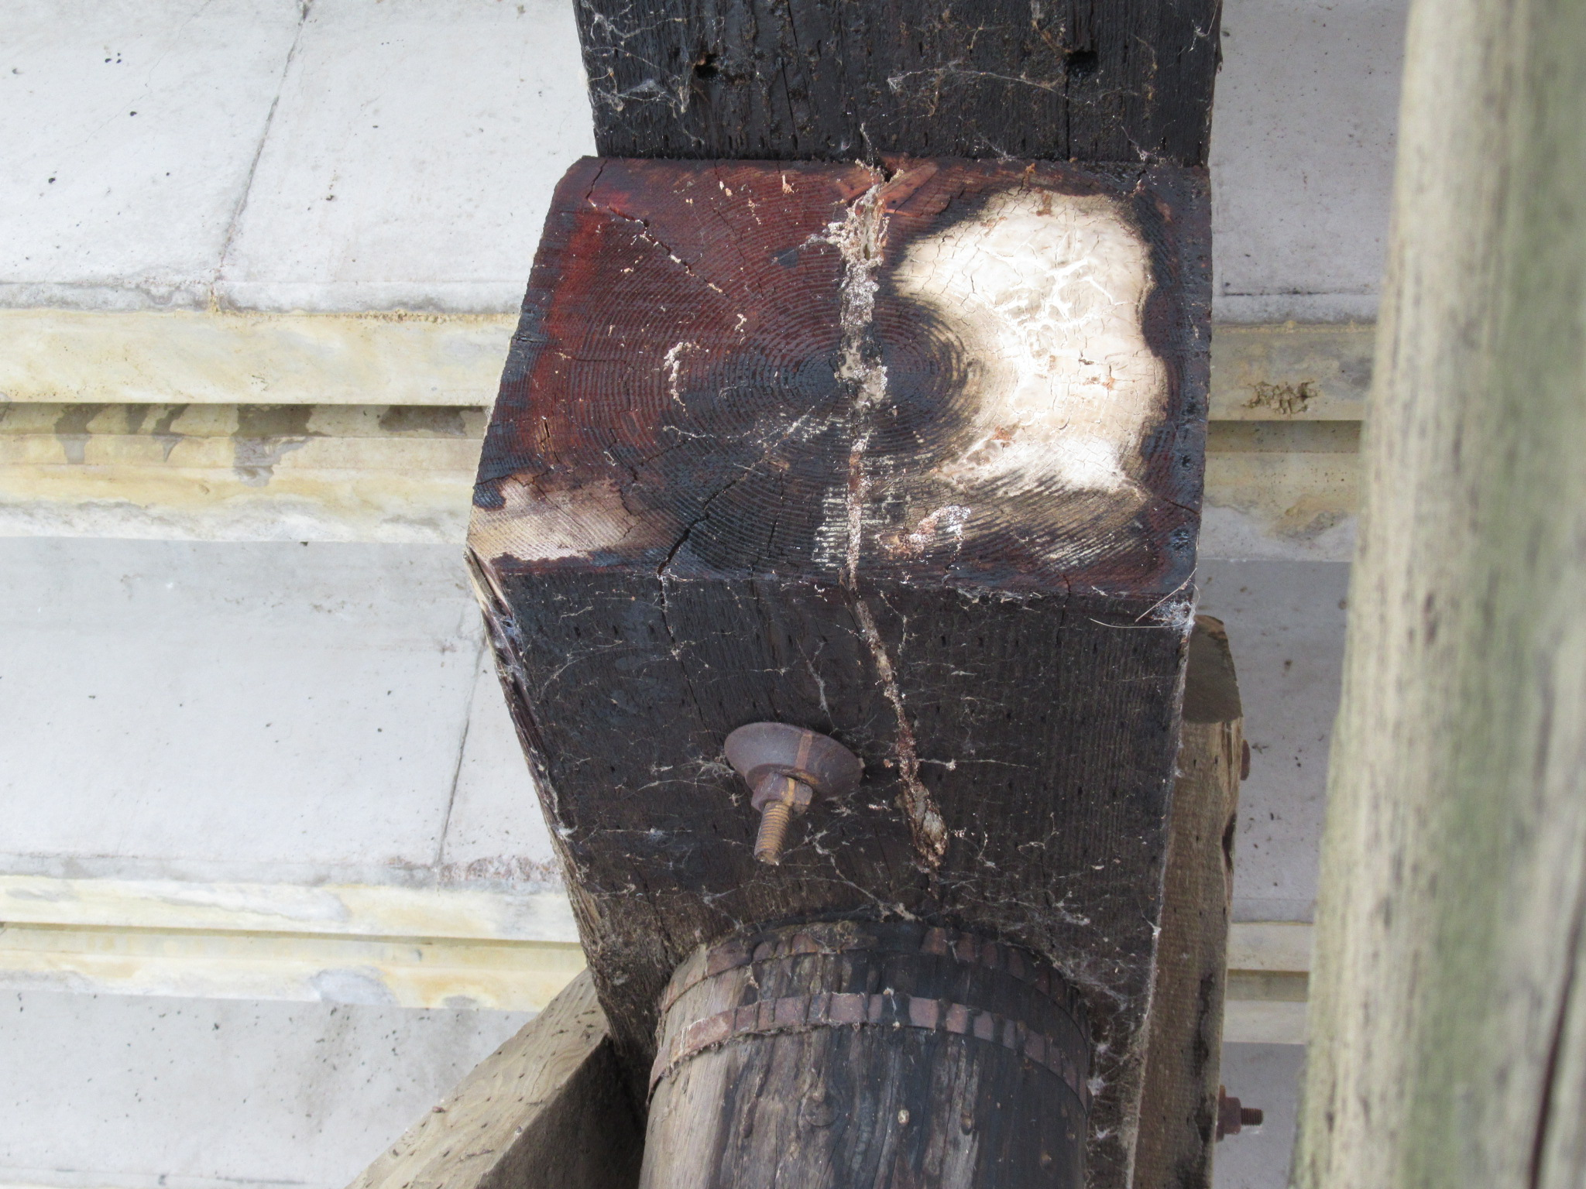
Fungal Growth and Beginning Rot

Slide 74
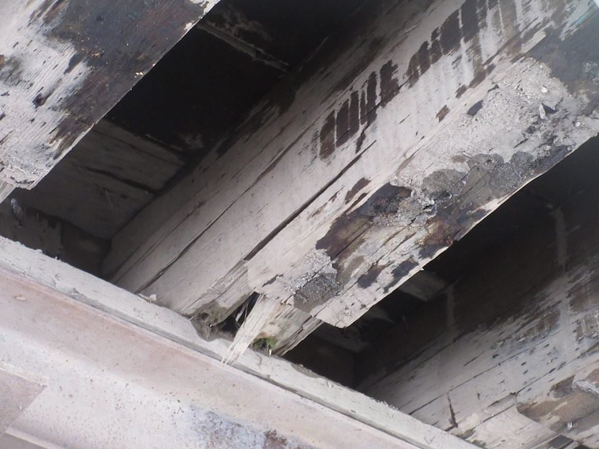
Rot in Stringer End

Slide 75
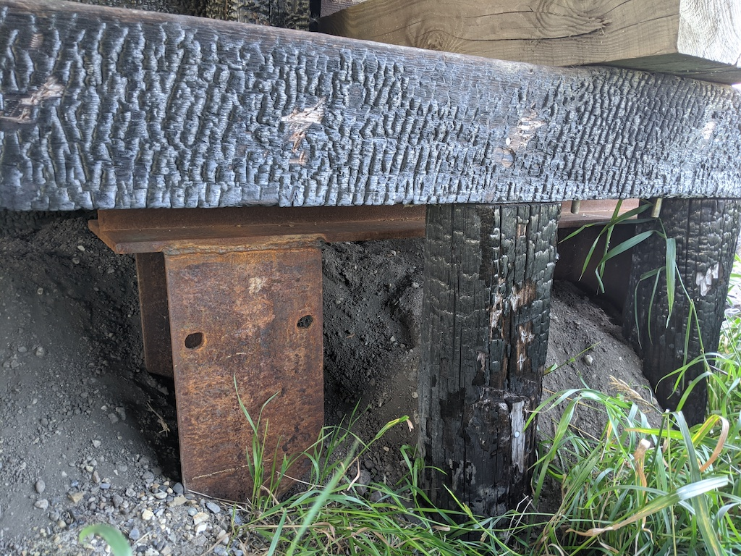
Fire Damaged Timber

Slide 76

Questions?

