Slide 1
WELCOME
Class A Bridge Inspection Course

Slide 2
Course Instructors
Primary Instructors / Trainers
Garry Roberts
Randy Bredo
Guest Lecturers
AT/Department specialists
Sub-consultant specialists
Refer to Course Schedule

Slide 3
General Information
First Aid
Fire Extinguisher
Emergency Protocol
Smoking
No smoking in building or field trip vehicles
Smoking allowed outside at ashtray locations
Note Taking and Course Materials
Course Evaluations

Slide 4
Room Access
Access key required to gain access through double doors from atrium into conference room area.
Access key required when using the washroom.
Access keys will be left at front of room on coffee table for use by students.
Please return the key after use.
Open at 7:45 each morning. Locked at 5:00 each evening. Will remain open during lunch hour.
If using Visitor Parking, then sign in and out daily at front desk

Slide 5
Parking

Slide 6
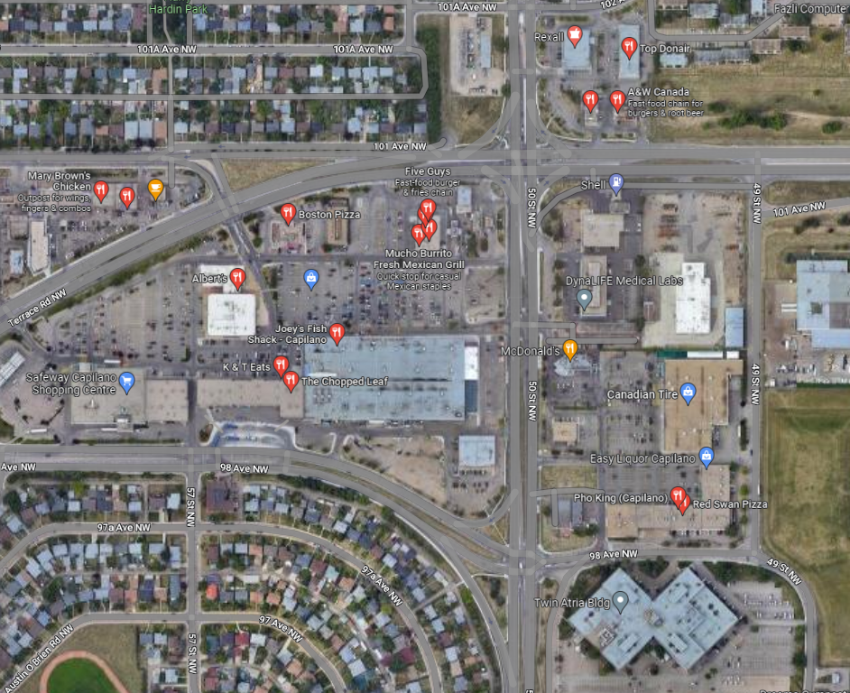
Nearby Lunch Options

Slide 7
General Information Cont’d
Field Trip on Thursday and Friday
Hard Hat, Traffic Vest, Boots (rubber boots if wet/muddy – no hip/chest waders
Other PPE as required by each individuals company safety policy (e.g. hard hat)
Clip board, flashlight, hammer, tape measure, binoculars (recommended)
Transportation provided from Twin Atria
Course Evaluation sheet must be completed and submitted at end of course
Questions allowed at anytime, or before lunch and at end of day

Slide 8
Self Introduction
Name
Organization
Bridge Experience – Type and Years
Present or Proposed Involvement with Bridges and Bridge Inspections

Slide 9
Quizzes
Exams are Tuesday, Wednesday and Thursday (2) mornings.
Pass mark is 70%
Marks posted daily
If you have objections to posting marks contact lead instructor privately

Slide 10
Courtesies
Turn cell phone OFF/vibrate
No text messaging
No talking during exams – leave the room and talk in the hall once the exam is completed.
No cheating or peeking at other peoples exams.

Slide 11
Course Objective
Learn Class A and B differences
Detailed Concrete inspection
Detailed Steel inspection – steel girders and trusses
Learn inspection techniques
Learn advanced terminology
Learn details of inspecting major bridges

Slide 12
Questions?

