Slide 1
INSPECTION OF TRUSSES

Slide 2
Truss Members & Elements
Top Chord
Portal Bracing
Top Chord Bracing
Sway Bracing
Top Chord Bracing Strut
Batter Post
Sway Strut
Stringer
Vertical
Diagonal
Bottom Chord
Floor Beam
Lower Chord Bracing

Slide 3
Level II Truss Inspection
Trusses for Alberta Highways
Bridge system has about 340 sites with 470 truss spans
Majority of these trusses were fabricated between 1920 & 1930
Most of the spans are now on secondary highways and local roads
Approximately 55 truss spans remain in active use on primary highways
Some structures have been used at more than one crossing
Level II Truss inspection started in the early 1970’s
Second round of U/T inspection in 1983 revealed numerous cracked members

Slide 4
Level II Truss Inspection
Frequency of Inspection
Provincial highways 4 – 5 years
Local roads 6 years
Special monitoring – varies depending on truss condition, age, and traffic volumes.

Slide 5
Level II Truss Inspection
Preparation for Inspection
Check previous reports
Obtain inspection forms
Hire ND inspection company
Equipment for U/T
  Ultrasonic testing machine with 60° and 70° probes
  Coupling fluid
  Spare batteries and charging unit
  Extra probe and leads

Slide 6
Level II Truss Inspection
Preparation for Inspection
Submit traffic safety and fall protection plans and obtain approval
Access equipment:
  Lift truck
  Snooper truck
Inspection tools
Personal safety attire

Slide 7
Truss Inspection
Span Numbers
N
U1
U2
U3
U4
U5
U1
U2
U3
U4
U5
U6
U7
L0
L6
L0
L0
L8
L1
L2
L3
L4
L5
L1
L2
L3
L4
L5
L6
L7
1
2
3
4

Slide 8
Truss Member Notation
N
U1
U2
U3
U4
U5
L0
L1
L2
L3
L4
L5
L6
Flow

Slide 9
Top Chord Bracing
U1W
U2W
U3W
U4W
U5W
Portal
Portal
U1E
U2E
U3E
U4E
U5E
East
U/S

Slide 10
Lower Chord Bracing
L0W
L1W
L2W
L3W
L4W
L5W
L6W
Floor Beam
Floor Beam
Floor Beam
Floor Beam
Floor Beam
Floor Beam
Floor Beam
L0E
L1E
L2E
L3E
L4E
L5E
L6E
East
U/S

Slide 11
Level II Truss Inspection
Visual Inspection
Check all members and connections for:
  Cracks
  Missing or loose bolts
  Welds
  Scabs, delamination, gouges and elongated holes
  Note any strain indication
  Note any collision damage
  High water damage on bottom chord and bottom laterals

Slide 12
Level II Truss Inspection
Visual Inspection
Check all members and connections for:
  Sags and buckling characteristics
  Measure and report distortion
  Floor beam copes
  Report on extent of corrosion, pitting and section loss
  Measure and report any top chord sweep for pony trusses
Identify member/s requiring replacement

Slide 13
Level II Truss Inspection
Visual Inspection
Check posted and actual vertical clearance for through trusses
Report condition of deck elements
Check bearings
Check railing

Slide 14
Level II Truss Inspection
Ultrasonic Inspection
U1
U2
U3
U4
U5
m2
m3
m4
m1
m5
L0
L1
L2
L3
L4
L5
L6

Slide 15
Level II Truss Inspection
Ultrasonic Inspection
U1
U2
U3
U4
U5
m2
m3
m4
m5
m1
L0
L1
L2
L3
L4
L5
L6

Slide 16
Level II Truss Inspection
Ultrasonic Inspection
Report any rough holes
Mark any member which has a crack
Report all the findings on the U/T forms
Try to determine the cause of cracking

Slide 17
Level II Truss Inspection
Photographs
Take overall photograph of the entire bridge.
Take photographs to show condition of:
  Deck, curbs, wheel guards
  Bridgerail, bearings
  Overall condition of paint
  Typical underside
  General condition of substructure
  Specific problems

Slide 18
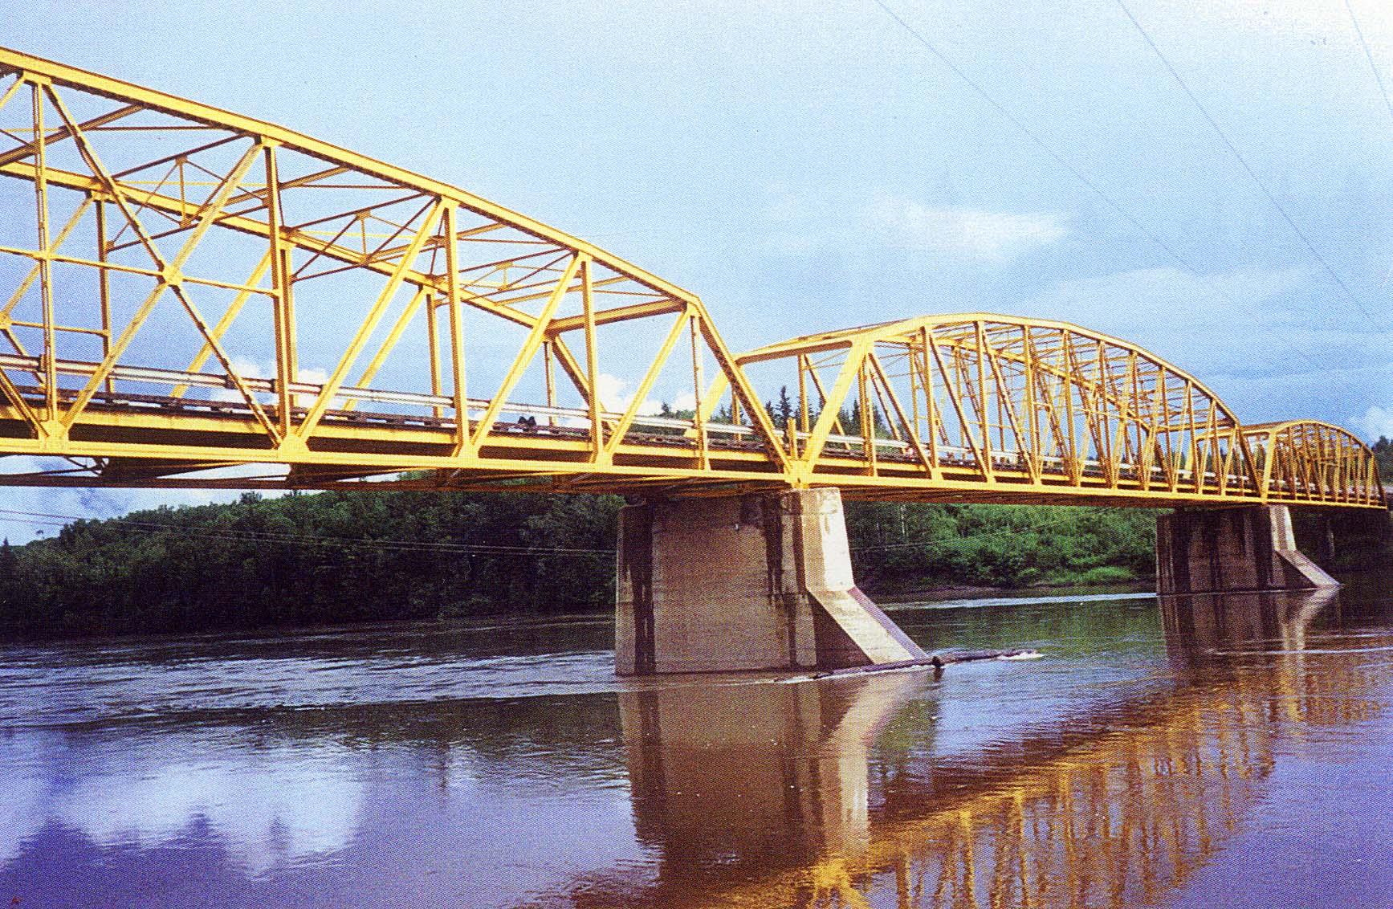
Level II Truss Inspection
Looking East
D/S

Slide 19
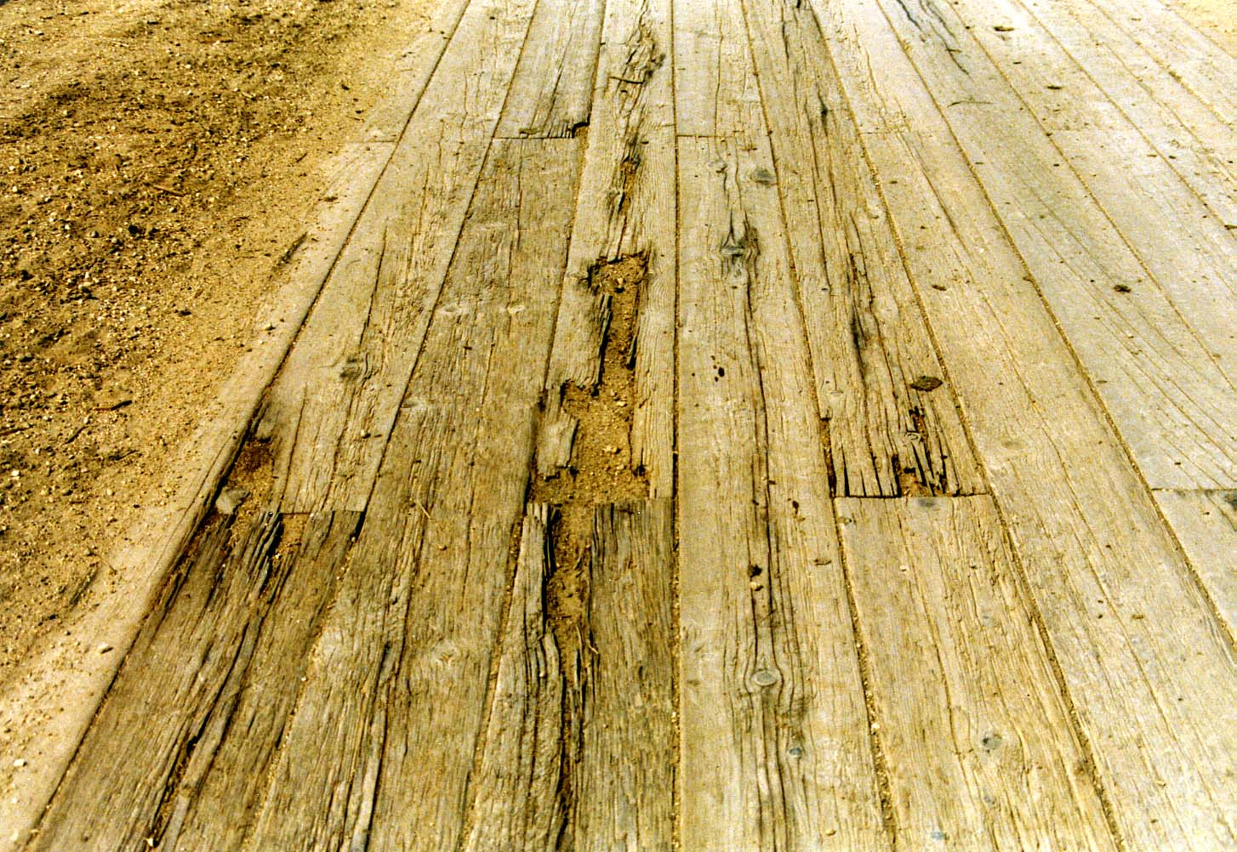
Level II Truss Inspection
Dirty strip deck
with broken &
worn planks

Slide 20
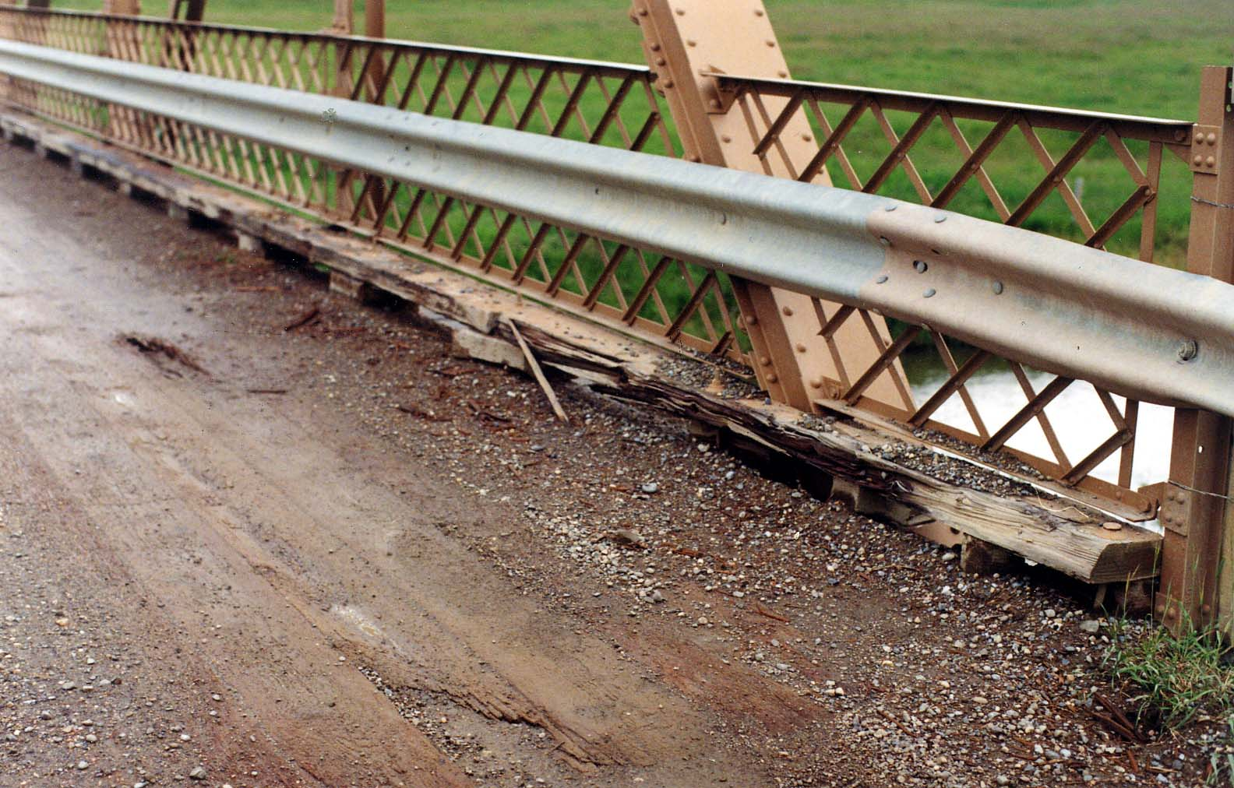
Level II Truss Inspection
Damaged
wheel guard
at SE corner

Slide 21
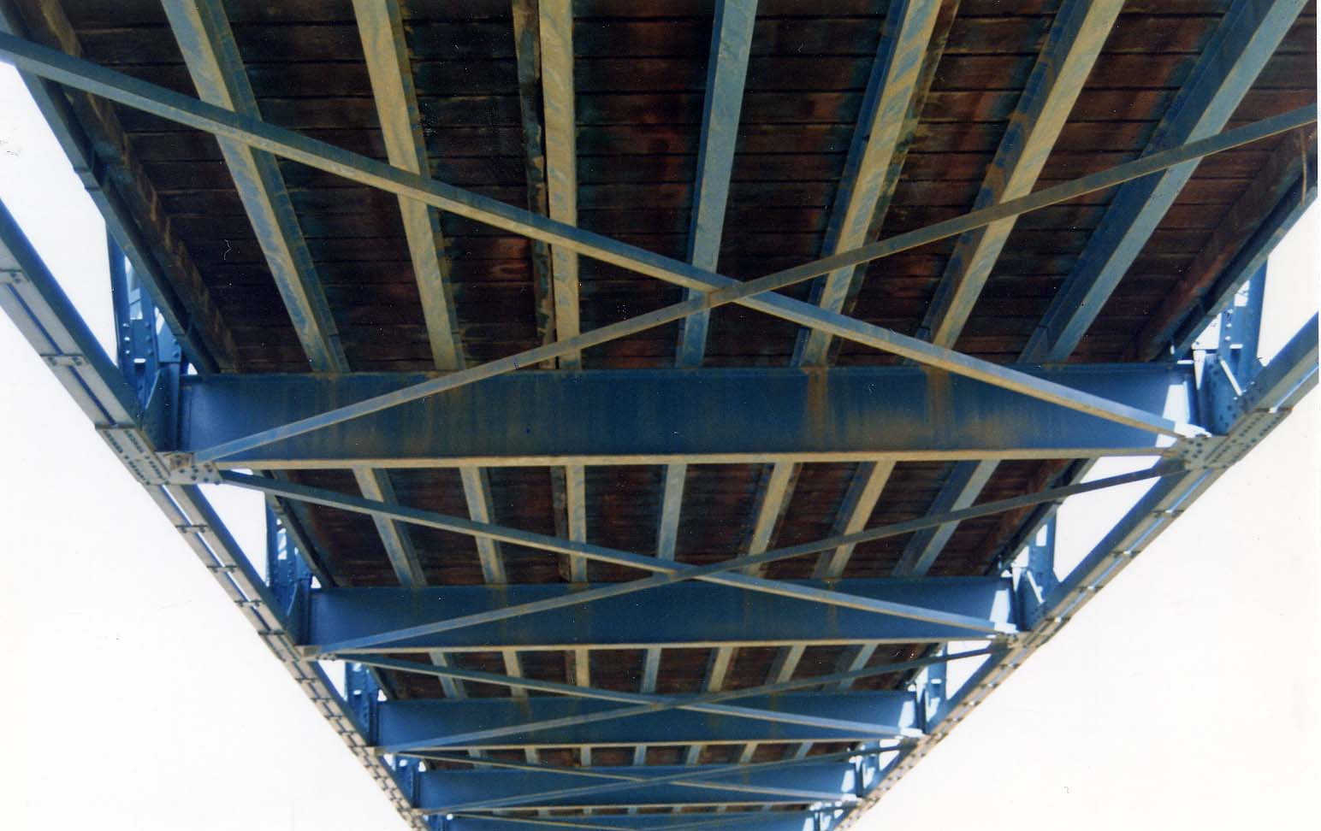
Level II Truss Inspection
Typical U/S

Slide 22
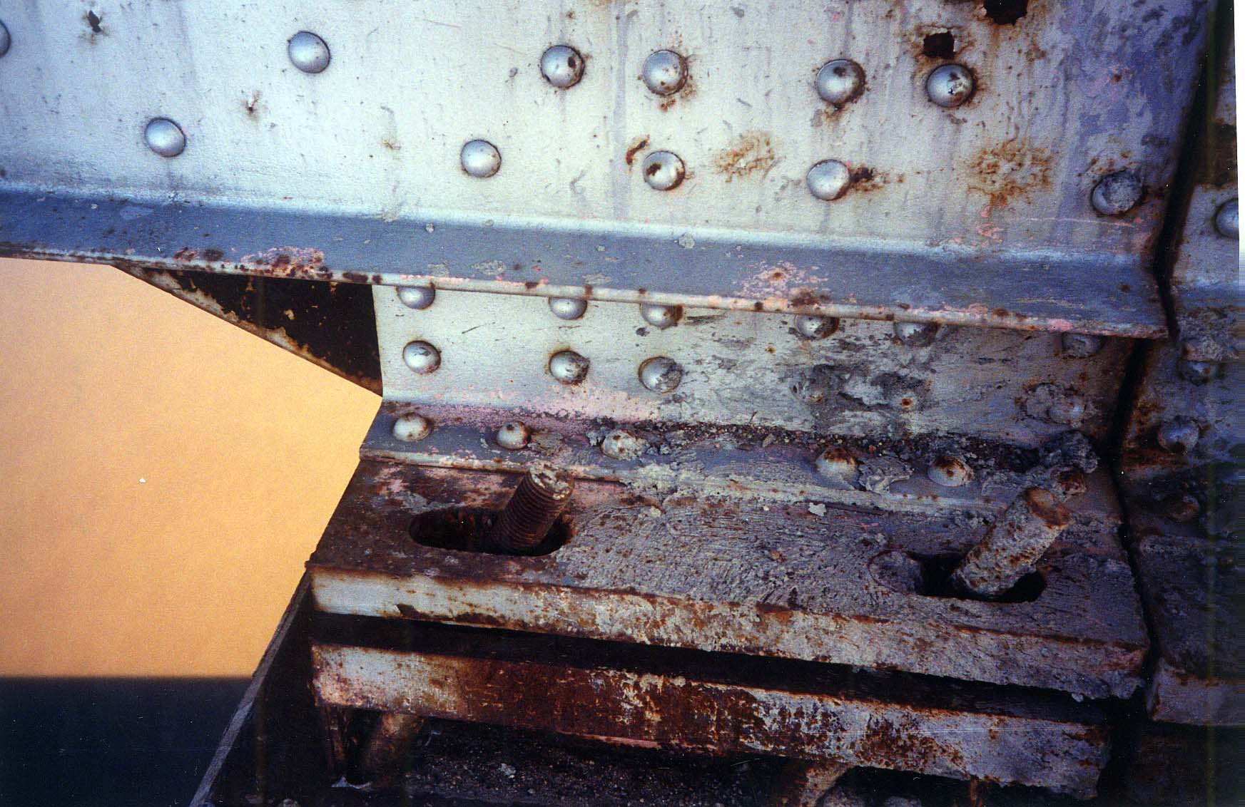
Level II Truss Inspection
Sp. 1- Pier #2 bearing
over expanded
by 125 mm &
bent anchor bolt

Slide 23
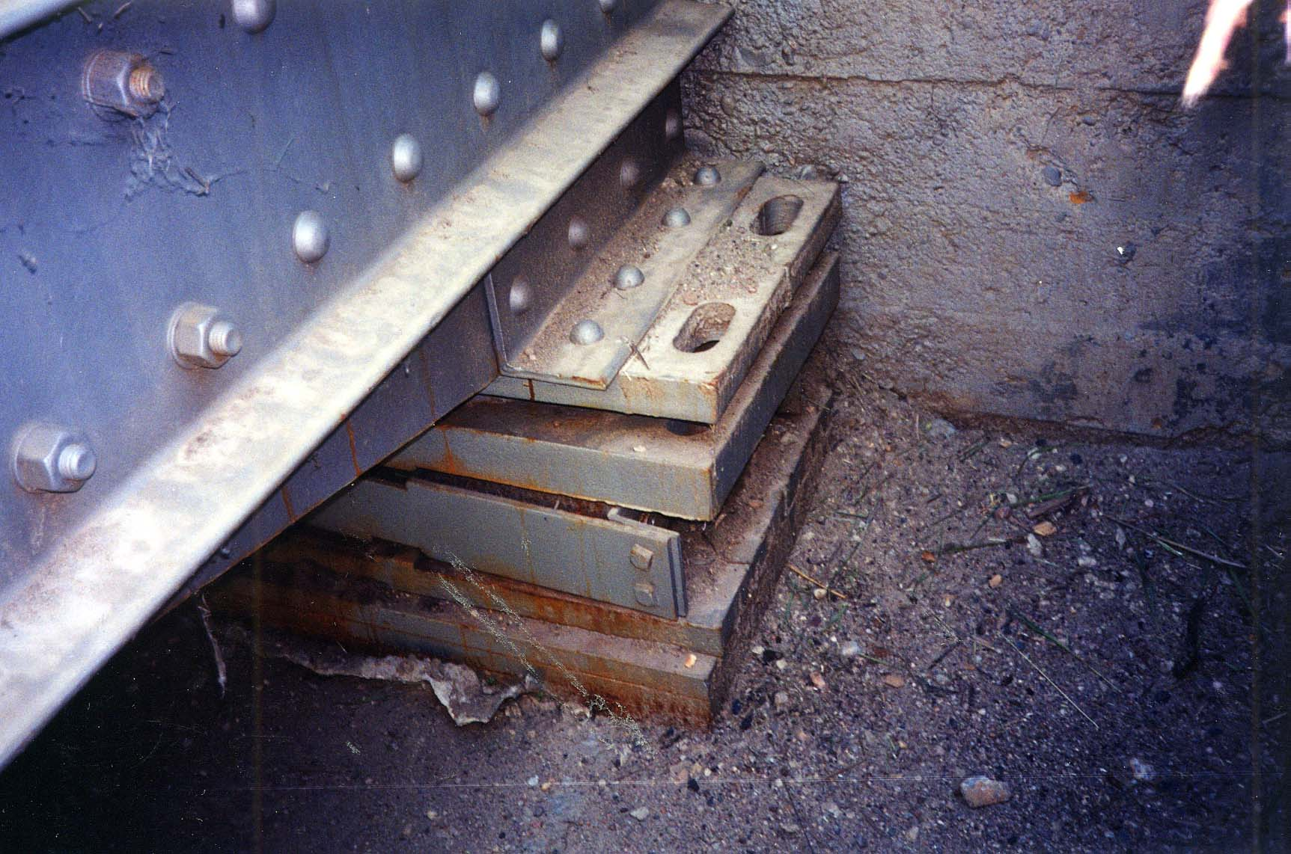
Level II Truss Inspection
Abut. #1 bearing
over expanded
by 60 mm,
twisted 25 mm
and broken anchor bolt

Slide 24
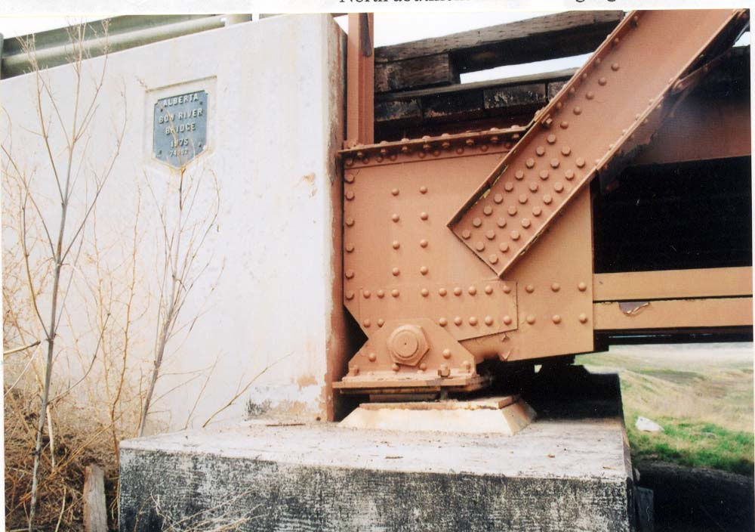
Level II Truss Inspection
South abut. bearings
are over expanded,
neoprene pads are
at the edges of
masonry plates.
Trusses are against
the backwall.

Slide 25
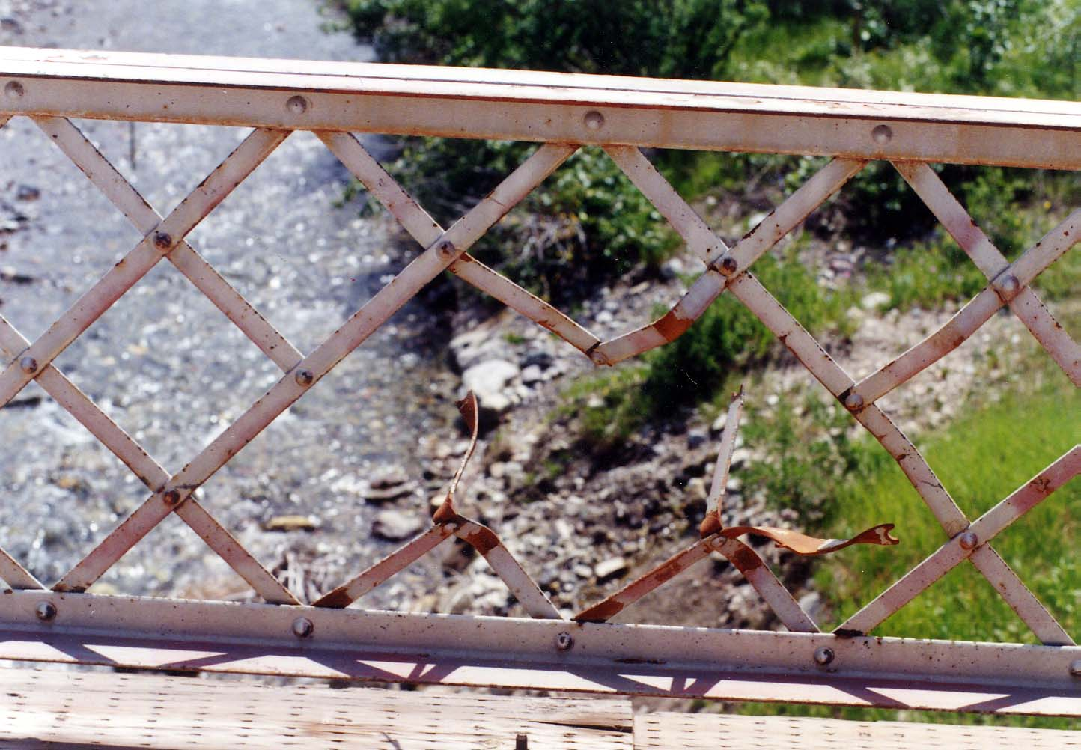
Level II Truss Inspection
Lattice rail
damaged at L1S

Slide 26
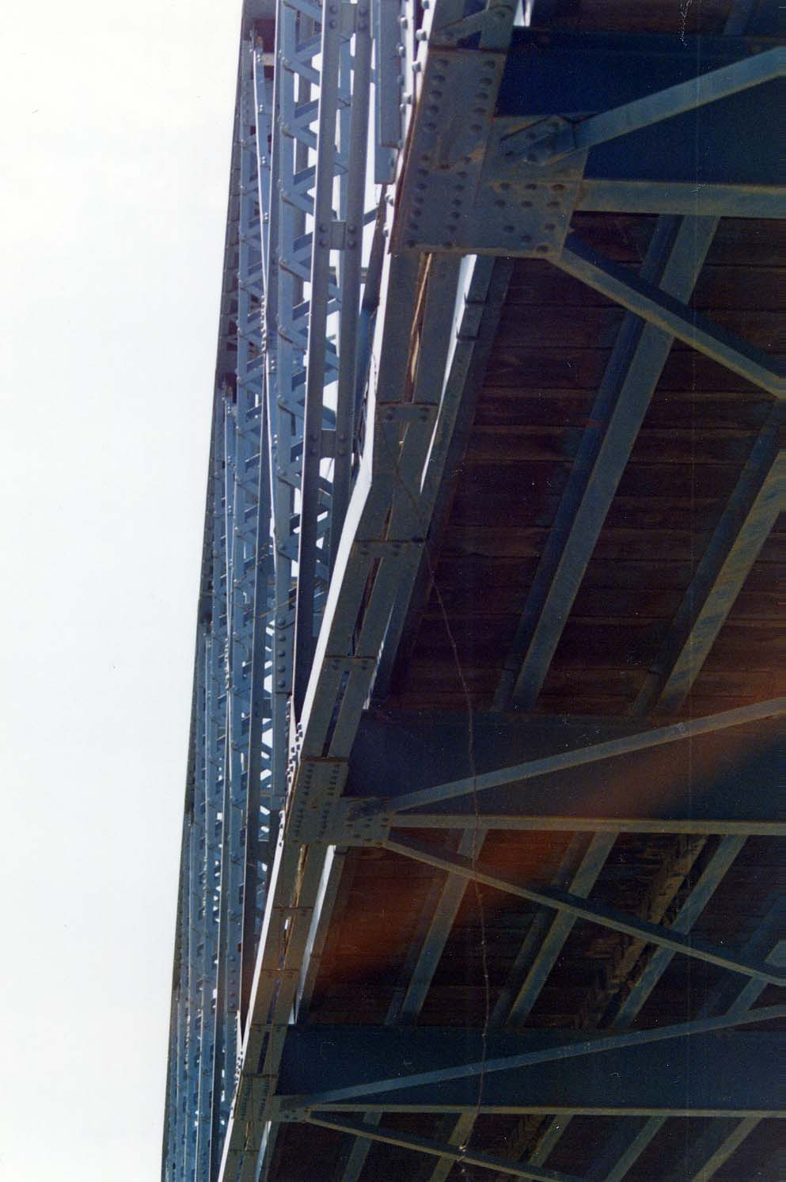
Level II Truss Inspection
Bent bottom chord, L7-L8W (U/S)

Slide 27
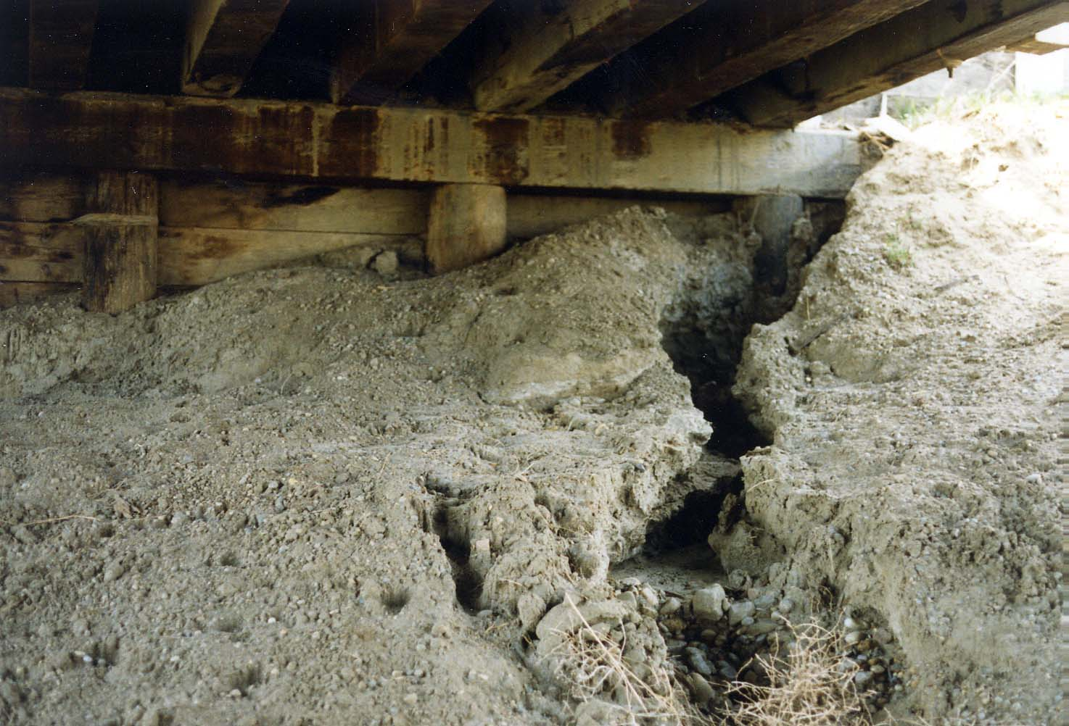
Level II Truss Inspection
Erosion at West
abutment

Slide 28
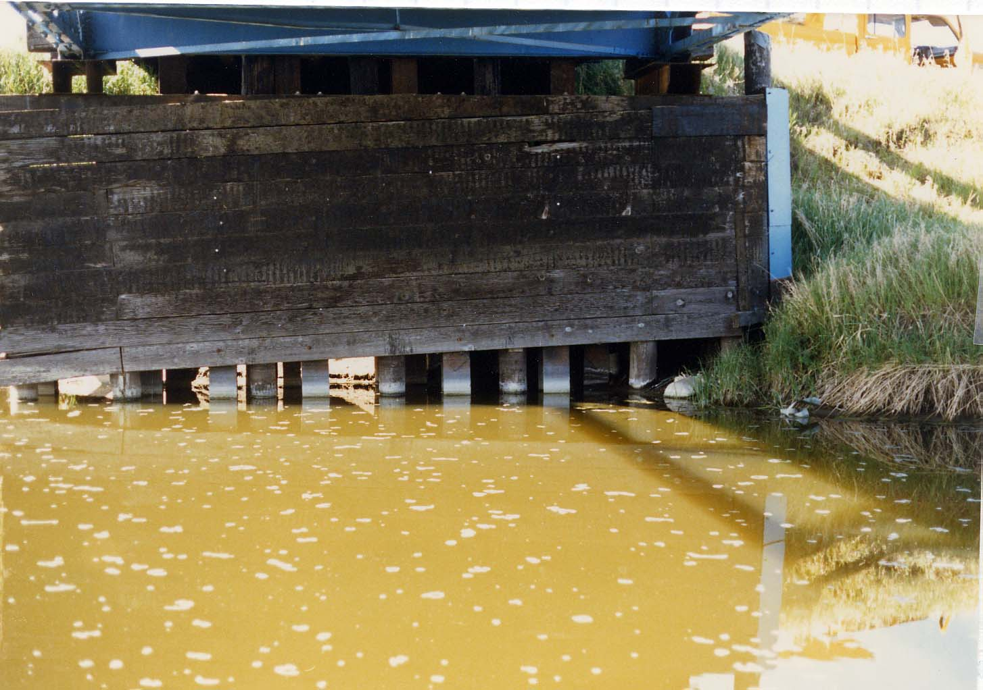
Level II Truss Inspection
Timber planks
missing at South
pier

Slide 29
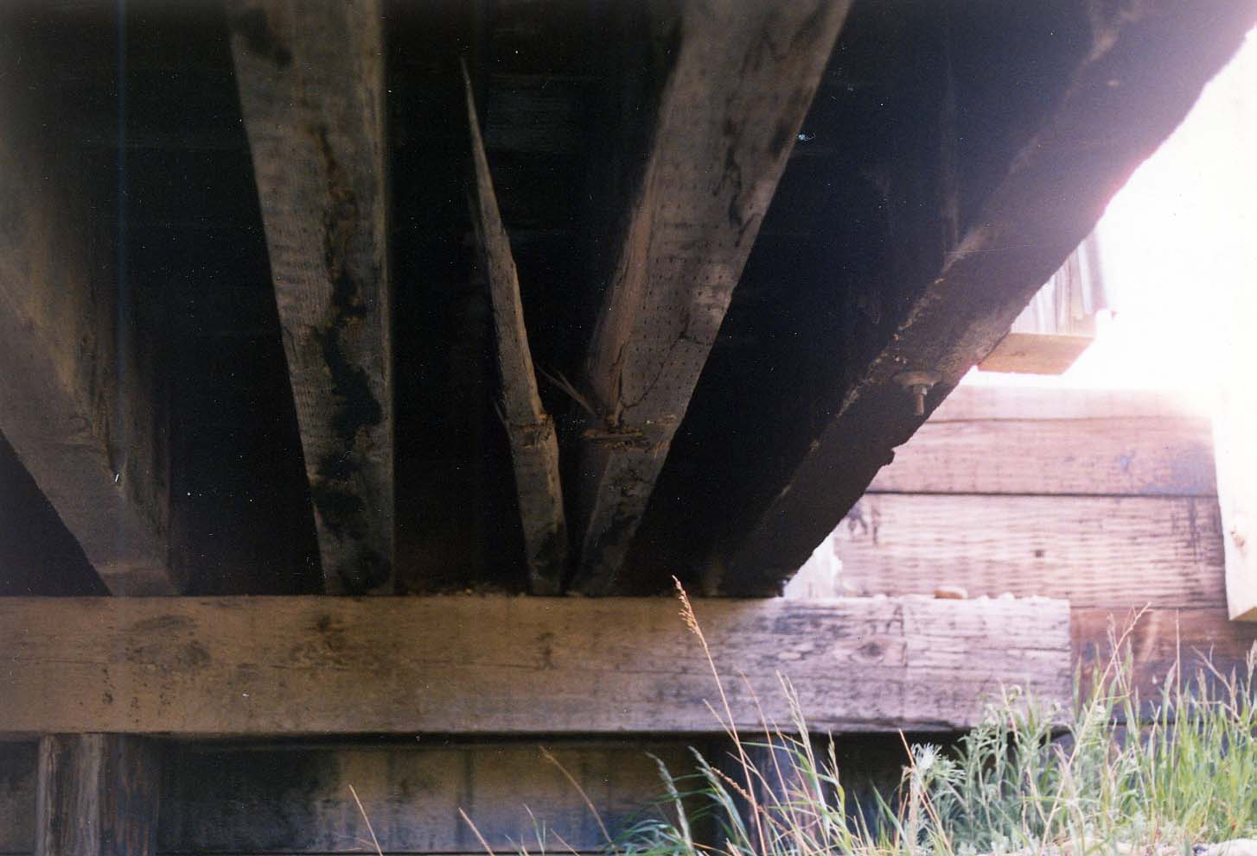
Level II Truss Inspection
Broken stringer
second from U/S
East approach

Slide 30
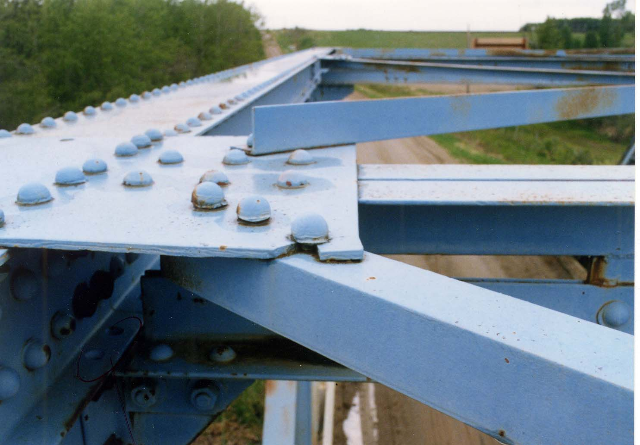
Level II Truss Inspection
Top chord
bracing U3S-U4N
has broken
gusset at U3S

Slide 31
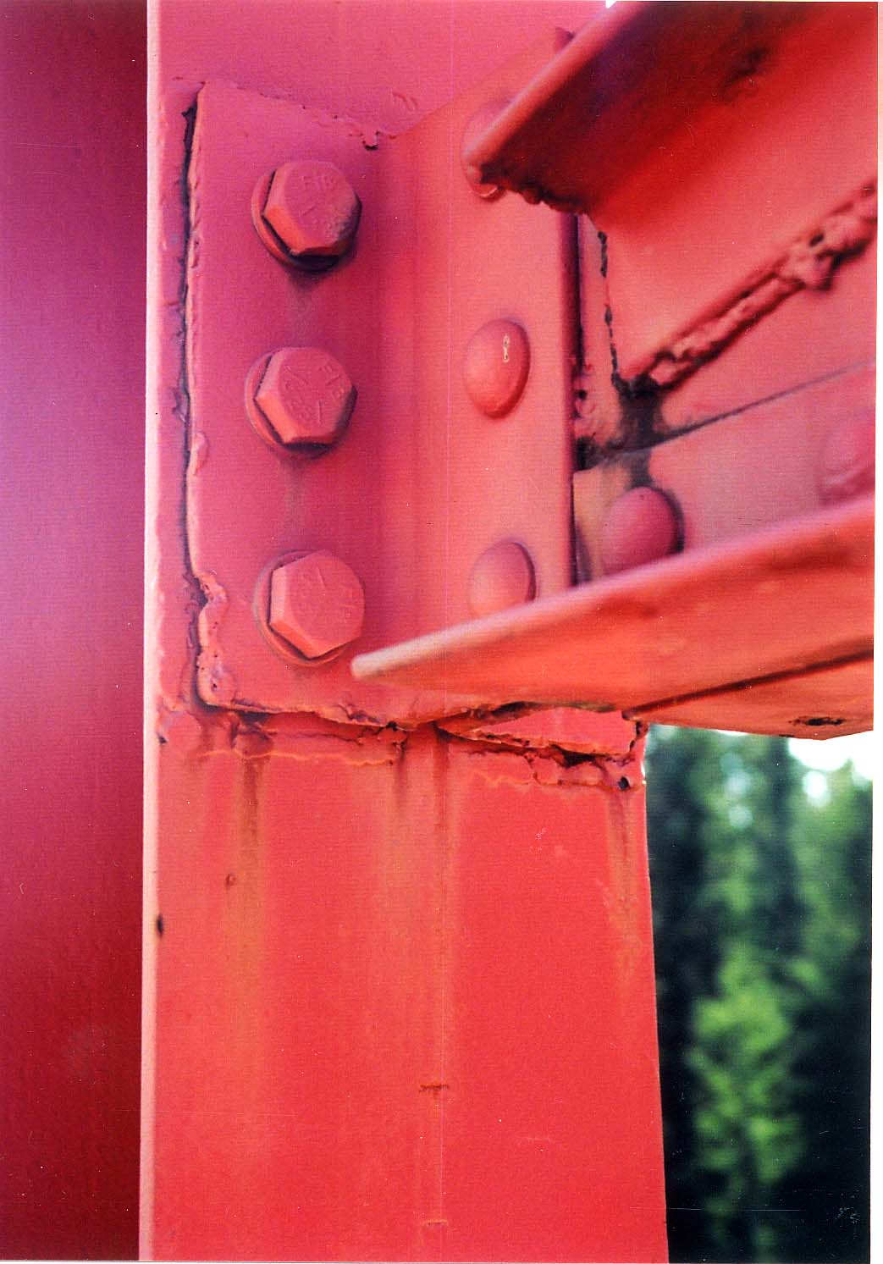
Level II Truss Inspection
Modified sway brace connections
were welded to the verticals, and
then the welds were removed
and bolt fasteners installed.

Slide 32
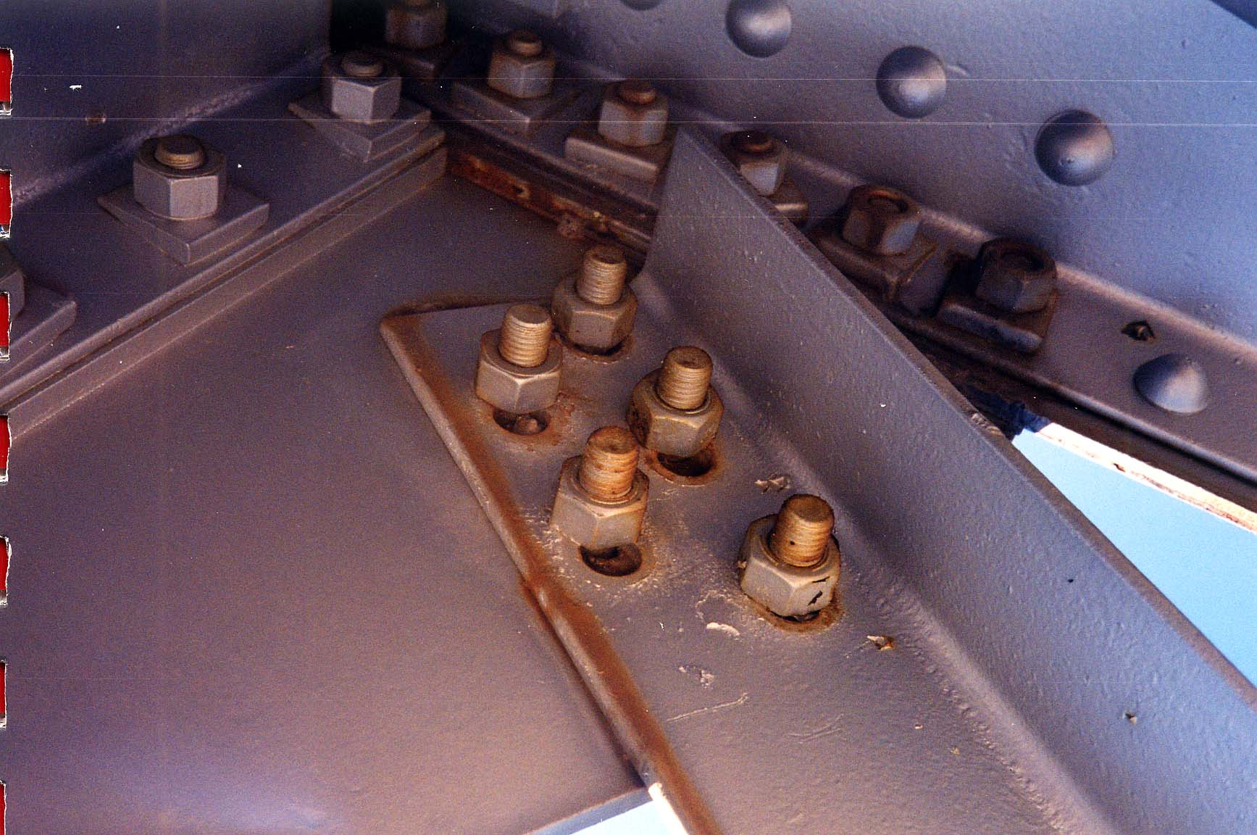
Level II Truss Inspection
Span 2, top chord
bracing U9N-U8S
have slotted holes
at U9N

Slide 33
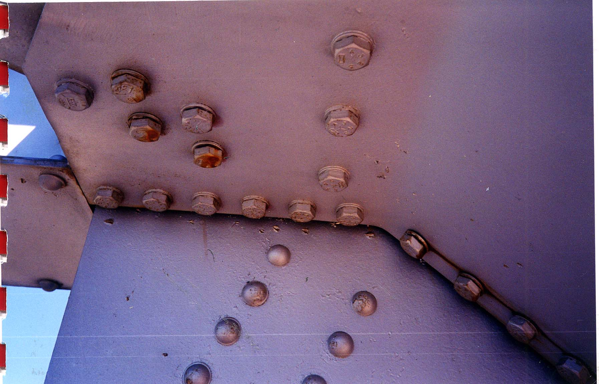
Level II Truss Inspection
Span 2, at U9N,
there are six
loose bolts

Slide 34
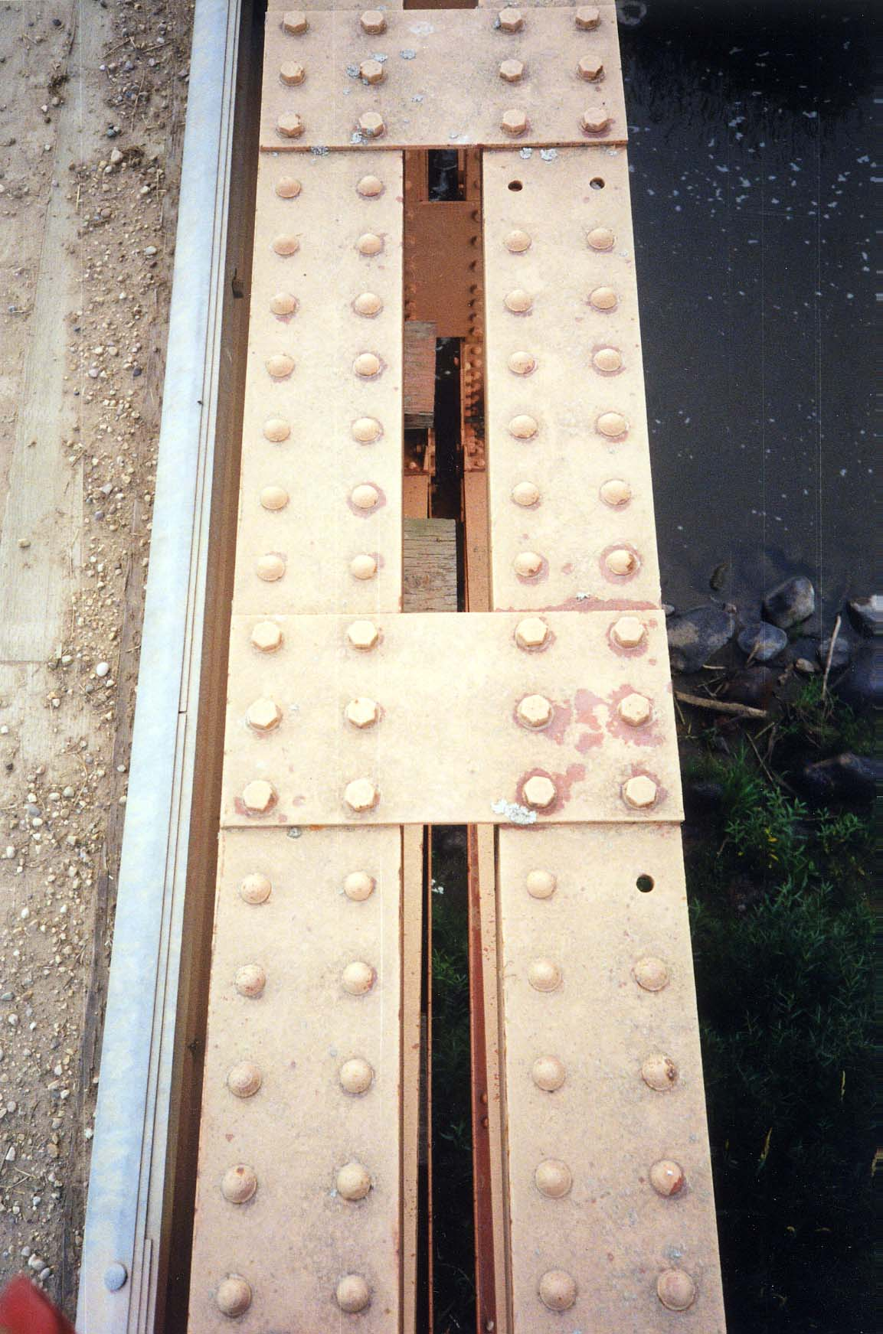
Level II Truss Inspection
Outside top chord U4U5N is
missing 3 bolts

Slide 35
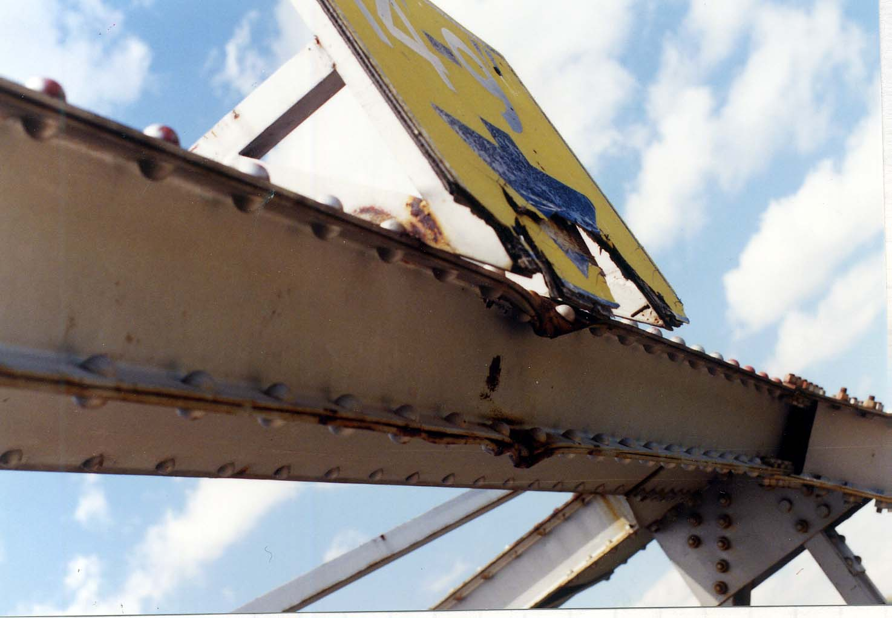
Level II Truss Inspection
Portal U7EU7W
is damaged with
two 50 mm
notches and
broken
clearance sign.

Slide 36
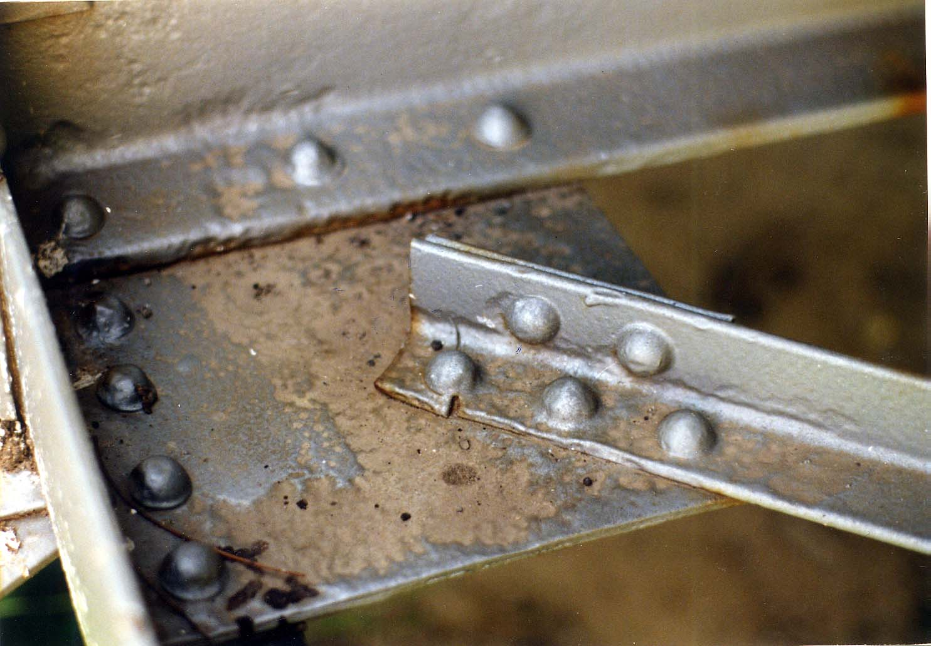
Level II Truss Inspection
Bottom sway
bracing L1S-L2N
is cracked at L1S.
Note corrosion
section loss.

Slide 37
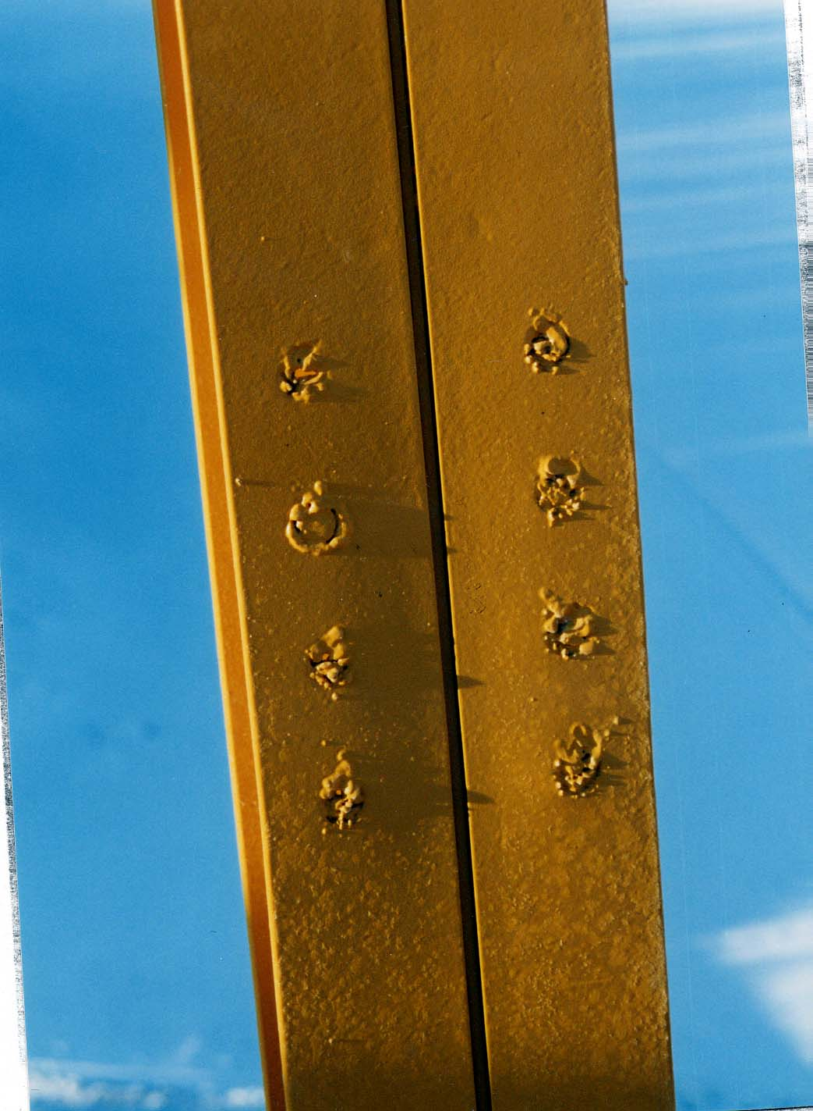
Level II Truss Inspection
All verticals have plug welds at
original sway brace bolt location.

Slide 38
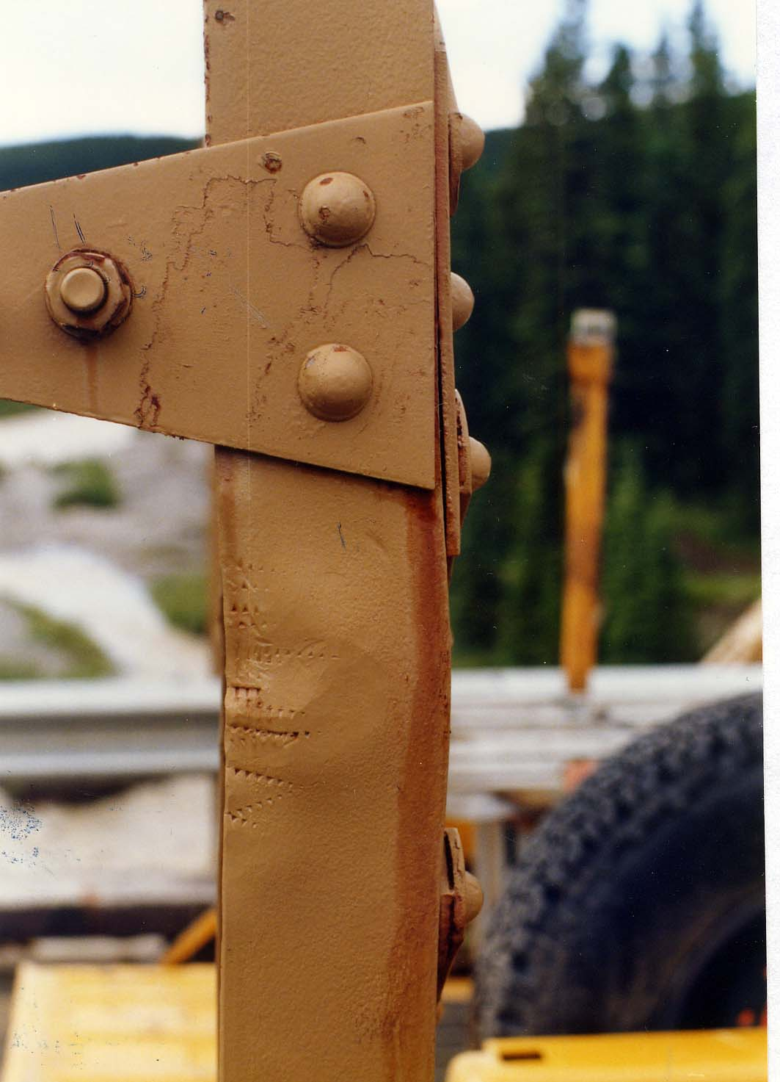
Level II Truss Inspection
Vertical U4-L4N at m5 strut
connection is buckled
and has notches

Slide 39
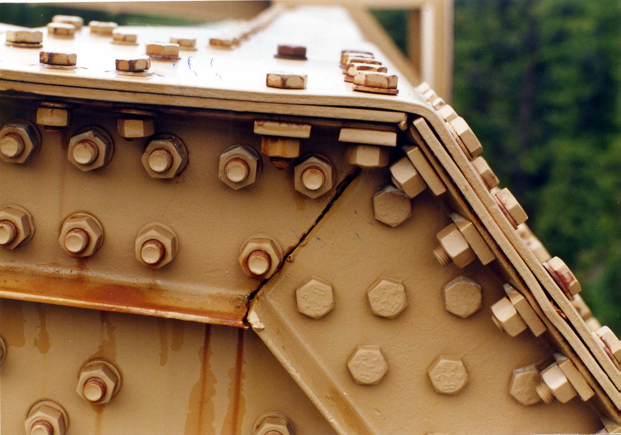
Level II Truss Inspection
At U5N, bevel
faying fit is
torched. Reduced
edge distance

Slide 40
TRUSS INSPECTION
U1 U2 U3 U4 U5
Edmonton
City of Champions
DIRECTION
m1
m2
m3
m4
m5
East
U/S
L0 L1 L2 L3 L4 L5 L6
Exp. Fix
TRUSS
Fix Exp.
MEMBER
ULTRASONIC INS.
MEMBER
A END
B END
OTHER ITEMS
Crack beyond
Crack beyond
Acceptable
A END
B END
Crack under
Crack under
Rivet Head
Rivet Head
Rivet Head
Rivet Head
Member
No Crack
No Crack
Member
Reject
TOP CHORD
L0 - U1
U1 - U2
U2 - U3
U3 - U4
U4 - U5
Welded, U/T done – no crack
U5 - L6
VERTICALS
U1 - L1
Inward dent–20 x 200mm at L2
U2 - L2
U3 - L3
U4 - L4
U5 - L5
Whitemud Ck
2
4
Yy-mm-dd
xxxxx
BRIDGE NAME: -------------------------------------------------------------------- SPAN NO. -------------- OF ---------- DATE: --------------------------- FILE: ----------------
75-3
90’
J. Doe
TRUSS IDENT: A---------------------- 6 PANEL TRUSS ----------------------- FT./M. SPAN, INSPECTOR:---------------------------------------------- PAGE: 1

Slide 41
East
U/S
75mm dent and 12mm crack at L2
bullet hole near middle at inside flange
Whitemud Ck
2
4
Yy-mm-dd
xxxxx
75-3
90’
J. Doe

Slide 42
East
U/S
75 x 200mm dent near L4
E
W
E
W
E
W
E
W
W
E
E
W
W
E
Whitemud Ck
2
4
Yy-mm-dd
xxxxx
75-3
90’
J. Doe

Slide 43
East
U/S
E
W
20mm notch at C/L. Overall bow of 15mm.
W
E
E
W
W
E
E
W
E
W
Whitemud Ck
2
4
Yy-mm-dd
xxxxx
75-3
90’
J. Doe

Slide 44
East
U/S
E
W
W
E
E
W
3mm section loss at horiz. gusset
W
E
E
W
W
E
E
W
W
E
E
W
W
E
E
W
W
E
Whitemud Ck
2
4
Yy-mm-dd
xxxxx
75-3
90’
J. Doe

Slide 45
East
U/S
overall bow of 30mm
Whitemud Ck
2
4
Yy-mm-dd
xxxxx
75-3
90’
J. Doe

Slide 46
Where to Find Cracks in Trusses?
Damaged members.
Tension members
Rough holes
Welds.
Members with stress reversal

Slide 47
Truss Member Fatigue Crack
U1
U2
U3
U4
U5
L0
L1
L2
L3
L4
L5
L6
L2

Slide 48

Questions?

