Slide 1
DECK JOINTS &
BEARINGS

Slide 2
Deck Joints (7.7 in Manual)
Purpose is to:
  bridge the gap between spans
  protect the ends of the girders
  allow for expansion, contraction and rotational movement
  prevent water and salt from leakage
Most important features are:
  watertightness
  proper anchorage
Can be fixed or expansion
  fixed are for rotational movement only
  expansion accommodates translation in addition to rotation
  located over fixed or expansion bearings

Slide 3
Deck Joints
Several types of joints used on Alberta bridges:
Buffer angles
Waterstops
Compression Seals
Sliding Plates
Open Finger Plates
Closed Finger Plates with Troughs
Modular Joint
Gland Joints
  Open
  Cover plated / armored
Thermoplastic Polymer Modified Asphalt
Deck Joint Sealants
Other Patented Devices/Processes
  Fel Span
  Interspan
  Jeene
https://www.alberta.ca/assets/documents/trans-bridge-deck-joints-drawings.pdf
Notes:
Modular joints now added: Modular expansion joints are used when the movements of a bridge exceed the capacity of a single gap joint or a finger type joint. The total movement of the bridge deck is divided among a number of individual gaps, or cells, which are created by horizontal surface beams. The individual gaps are sealed by watertight elastomeric profiles, and surface beam movements are regulated by an elastic control system.

Slide 4
Deck Joints

Slide 5
Deck Joints
Closed Finger Plates
Gland

Slide 6
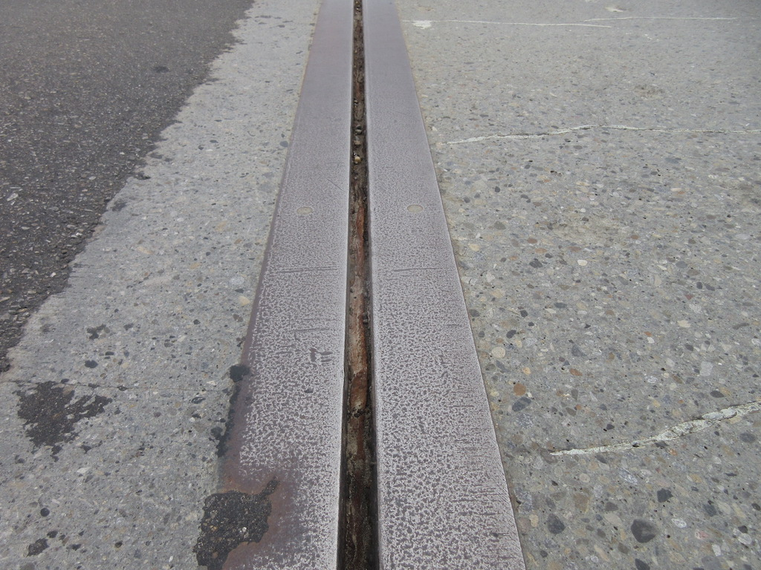
Buffer Angles for Fixed or Minor Expansion

Slide 7
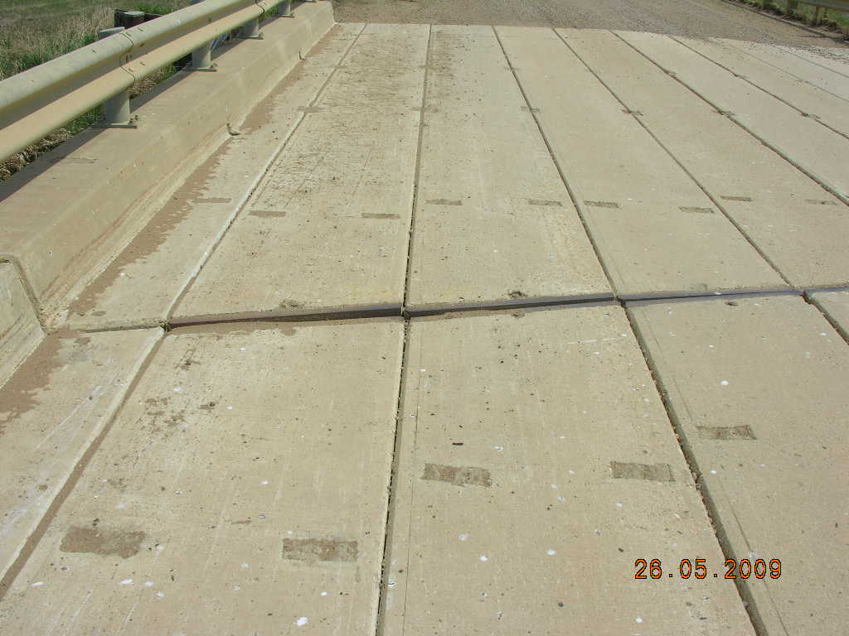
Individual Buffer Angles on Standard Girders

Slide 8
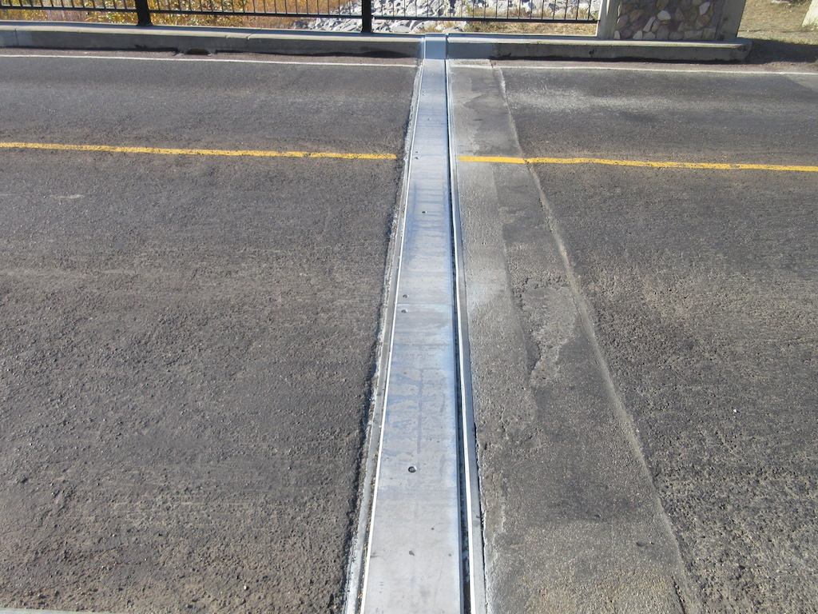
Sliding Plate Expansion Joint

Slide 9
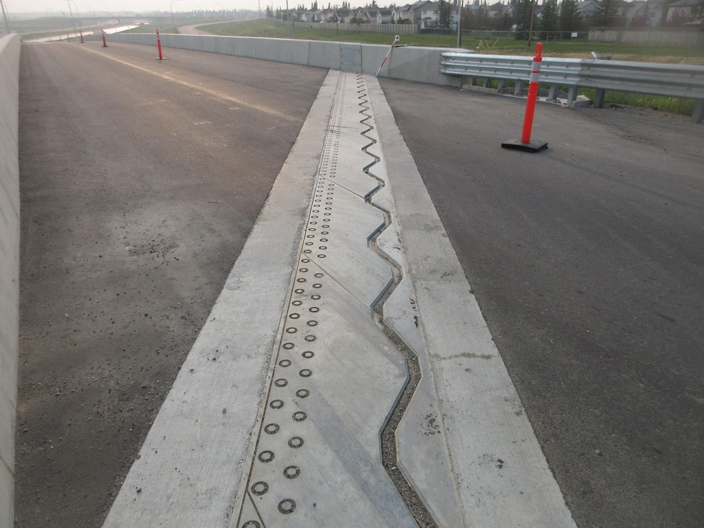
Armored Gland Joint

Slide 10
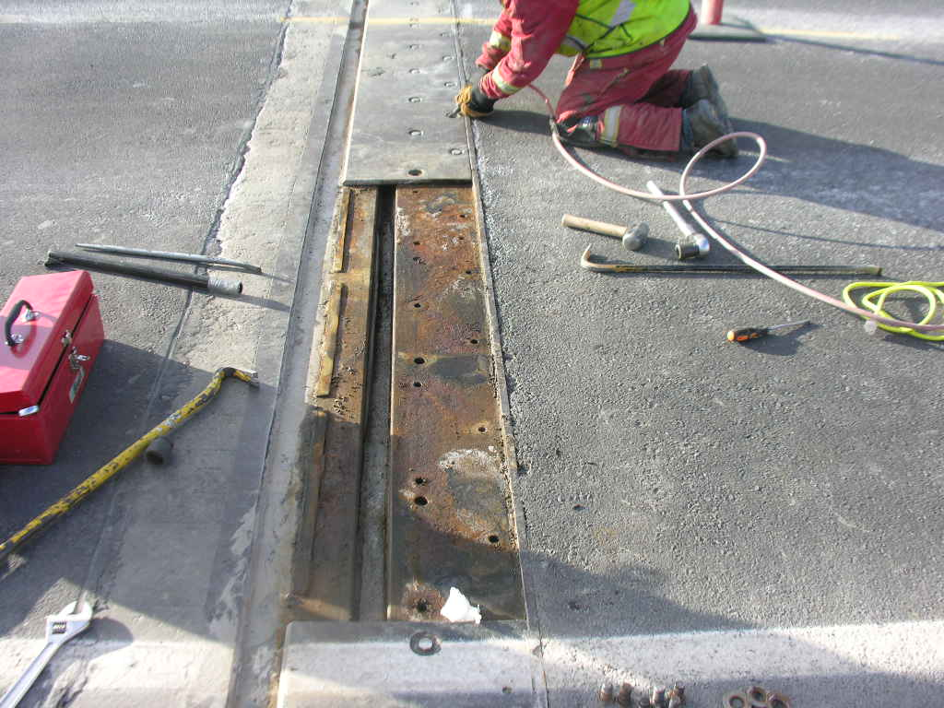
Armored Gland Joint

Slide 11
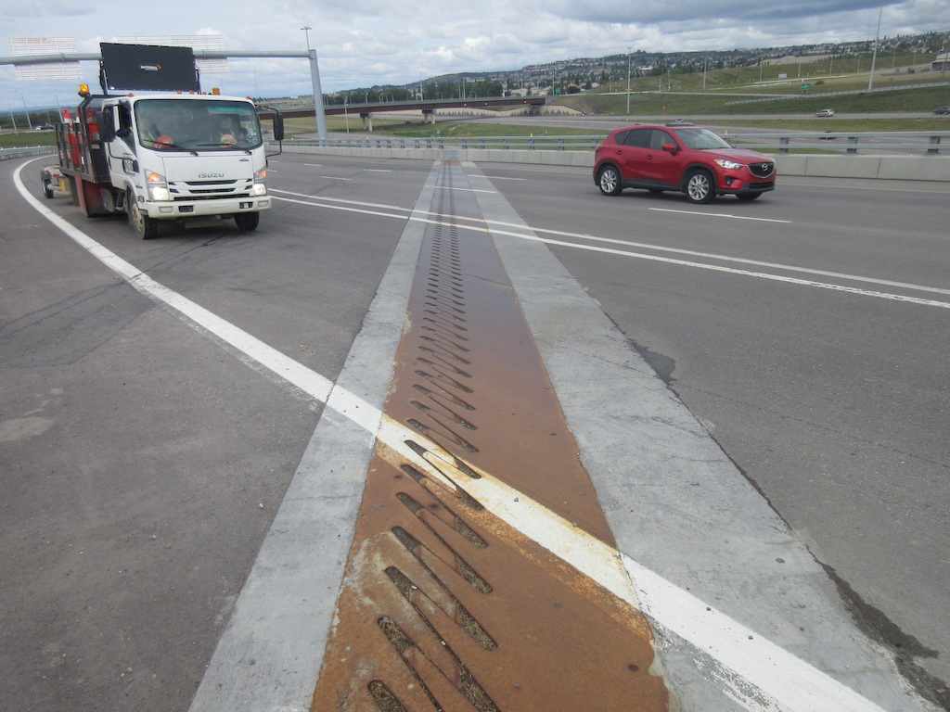
Finger Plate Joint

Slide 12
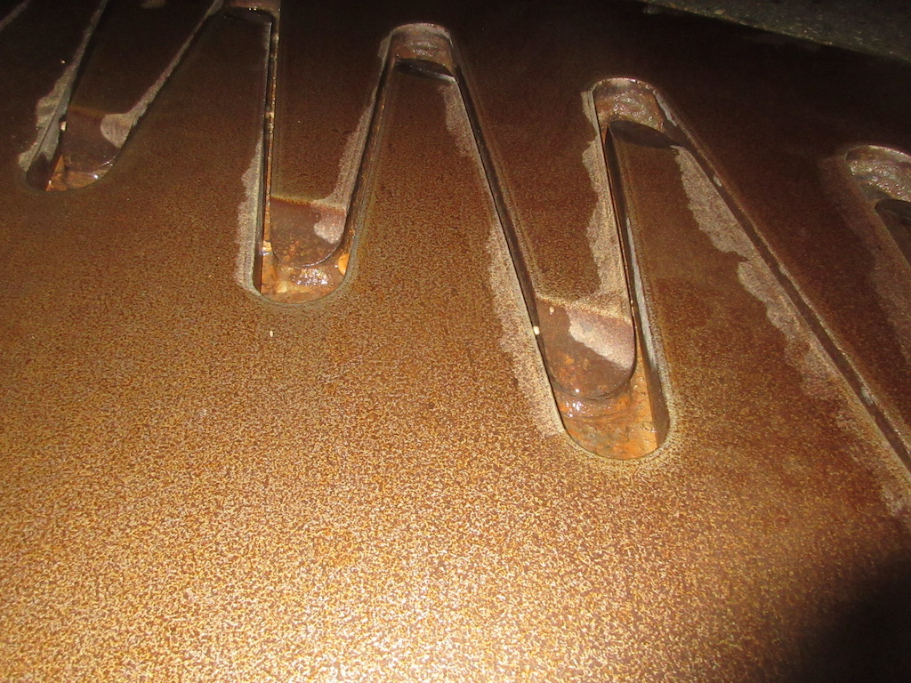
Finger Plate Joint Welds

Slide 13
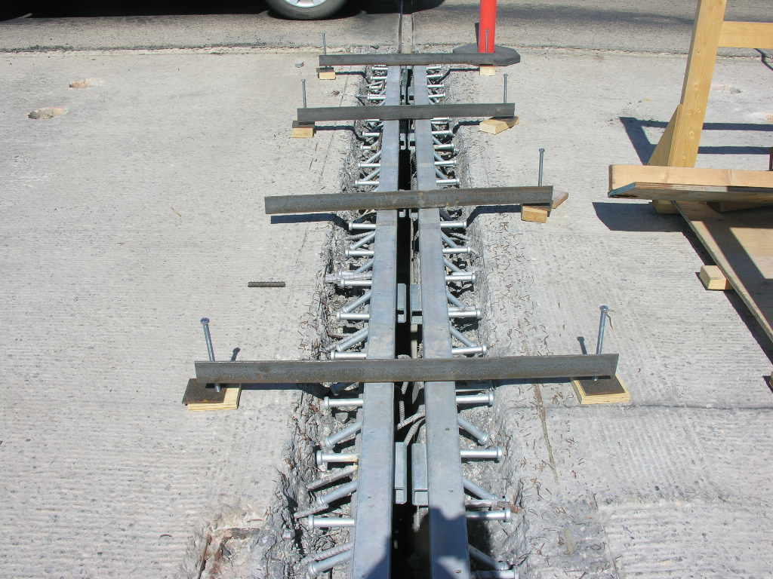
Strip Seal Joint

Slide 14
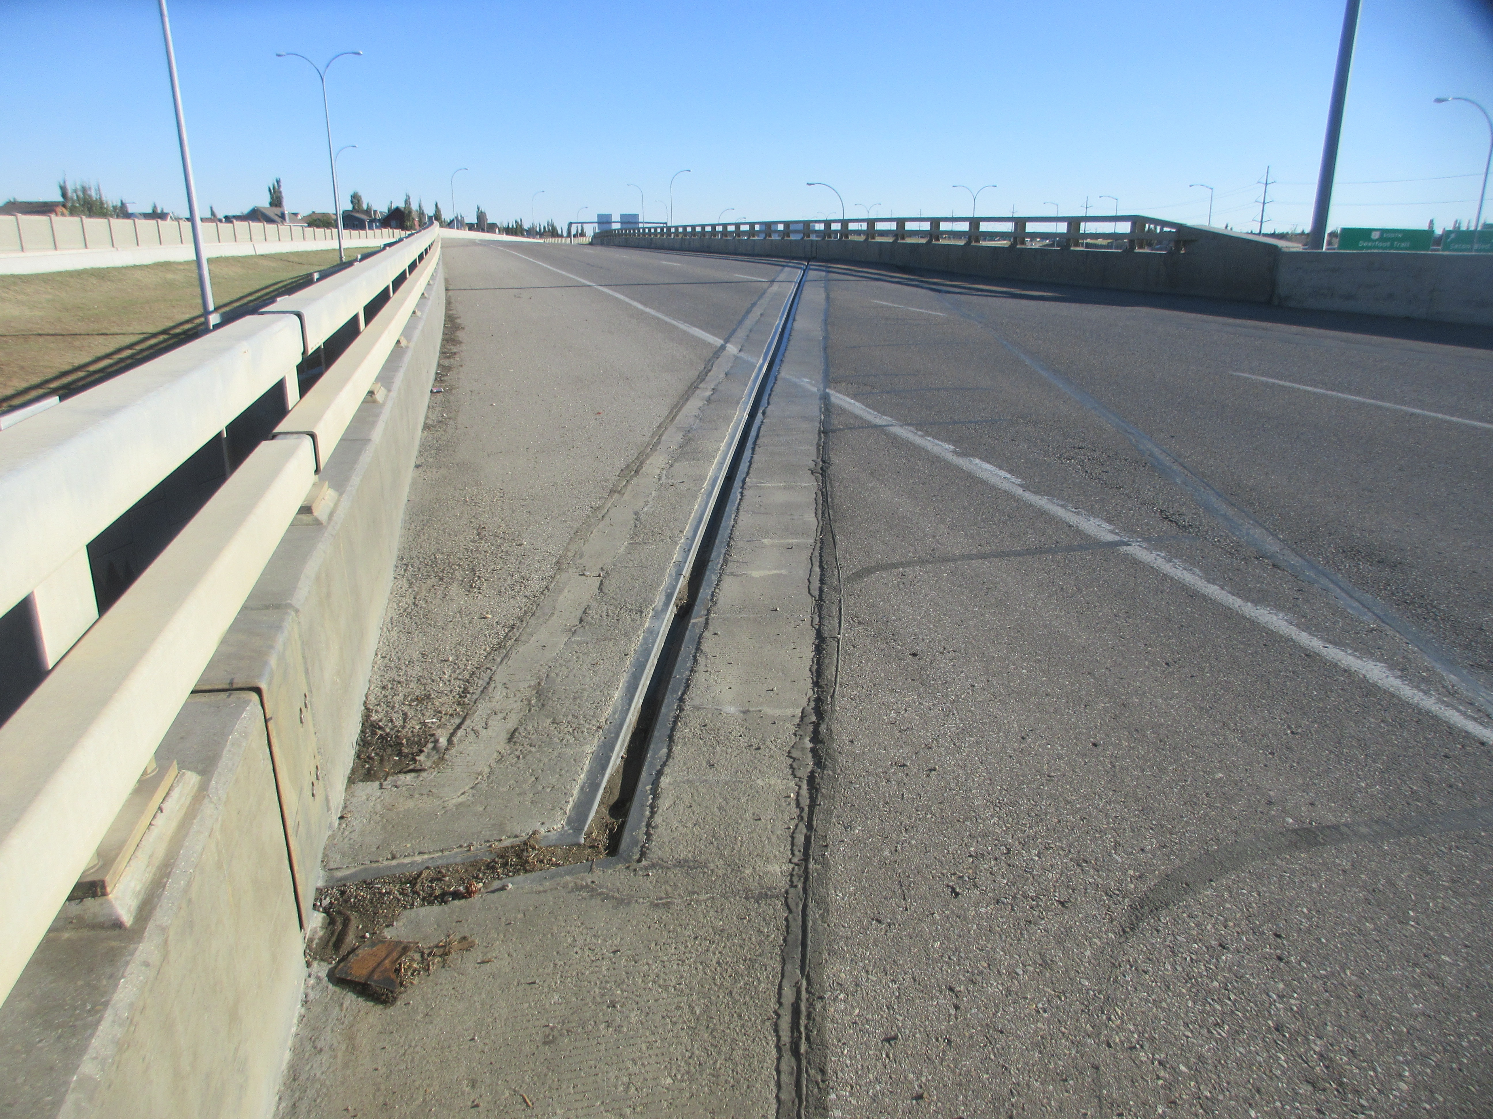
Strip Seal Joint

Slide 15
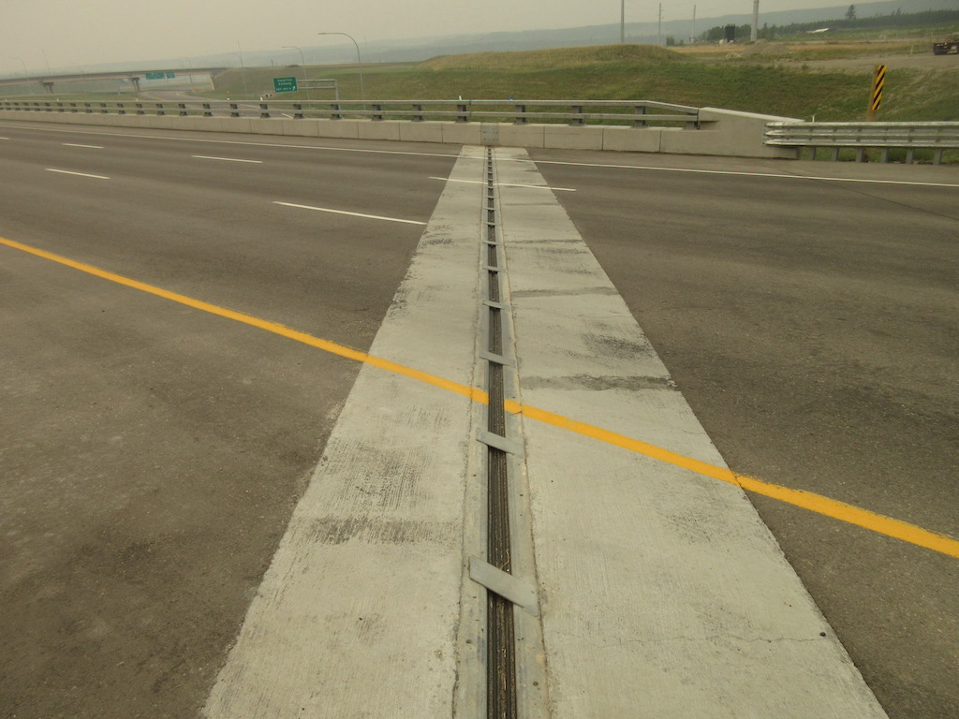
Strip Seal Joint with Plow Guards

Slide 16
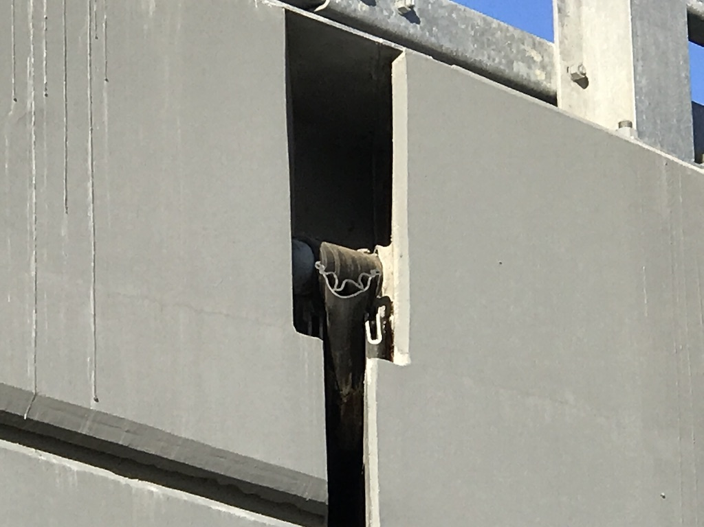
Gland Cross-Section

Slide 17
“Honel” Gland Joint with Bolted Compression Connection

Slide 18
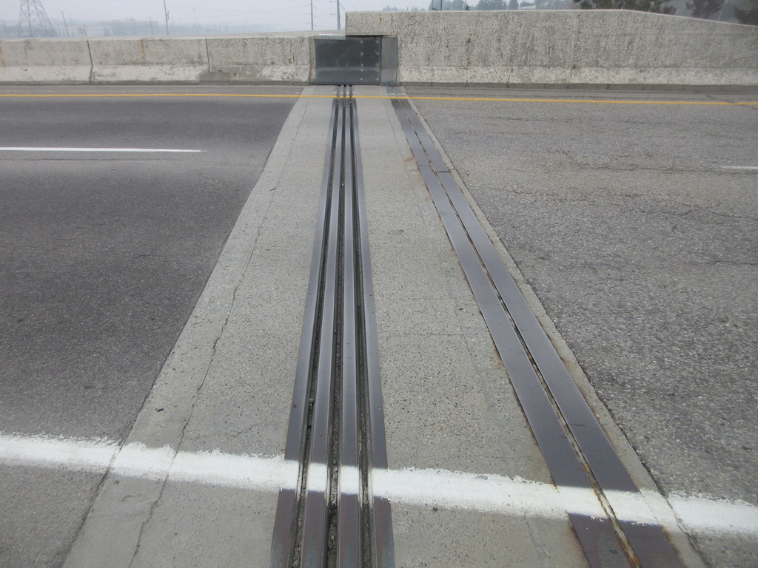
“Modular Joint

Slide 19
“Wabocrete” Joint

Slide 20
Placing Wabocrete Two Component Elastomeric Material

Slide 21
Completed Installation

Slide 22
“Koch” Joint with Elastomeric Material

Slide 23
Completed Koch Joint

Slide 24
Waterstop Joint

Slide 25
“Jeene” Joint Polymer Hot Pour

Slide 26
RCS Dow Corning Epoxy Joint

Slide 27
“Interspan” Joint

Slide 28
Problems and Inspection Considerations
Check for:
Watertightness of sealed joints
    loose or torn seals
    leakage or stains
Freedom of movement
Horizontal alignment
    evenness of gap
    fingers in alignment
Vertical alignment
    joint aligned with deck
    both sides of joint in alignment
Corrosion
Deteriorating concrete around anchorages, incomplete grout
Loose or missing bolts, cover plates or curb plates
Gouged, torn, cracked or broken
    extrusions
    angles
    plates
    fingers
    welds
27

Slide 29
Problems and Inspection Considerations
  Integrity of attachments and connections
    loose or missing bolts
    cracked or broken welds
    loose or open connections
  Check for:
    signs of ponding on the deck
    staining or deterioration on the deck, curbs, girders and substructure
    erosion below downpipe
Observe traffic passing over joints
  listen for unusual noises and watch for movement of the joint
Check drainage system
  plugging of joint opening, troughs and downpipes with debris
  corrosion / perforations
  cracks, breaks or tears in any component

Slide 30
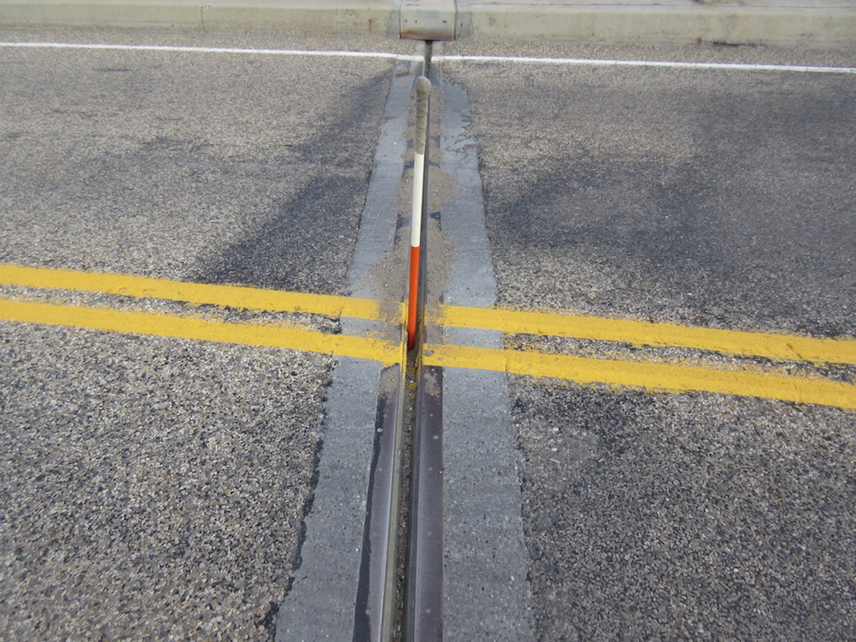
Hole in Gland Joint

Slide 31
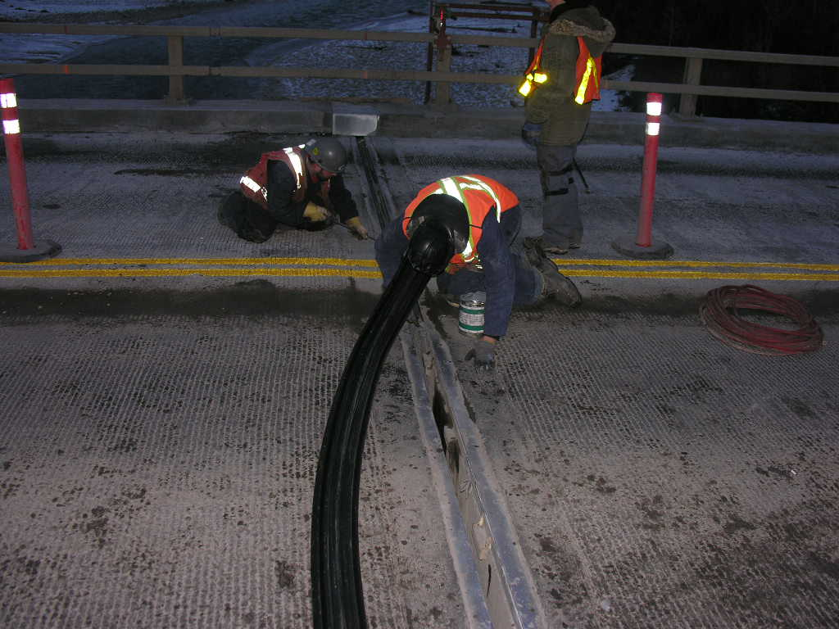
Replace Joint Seal

Slide 32
Testing for Watertightness

Slide 33
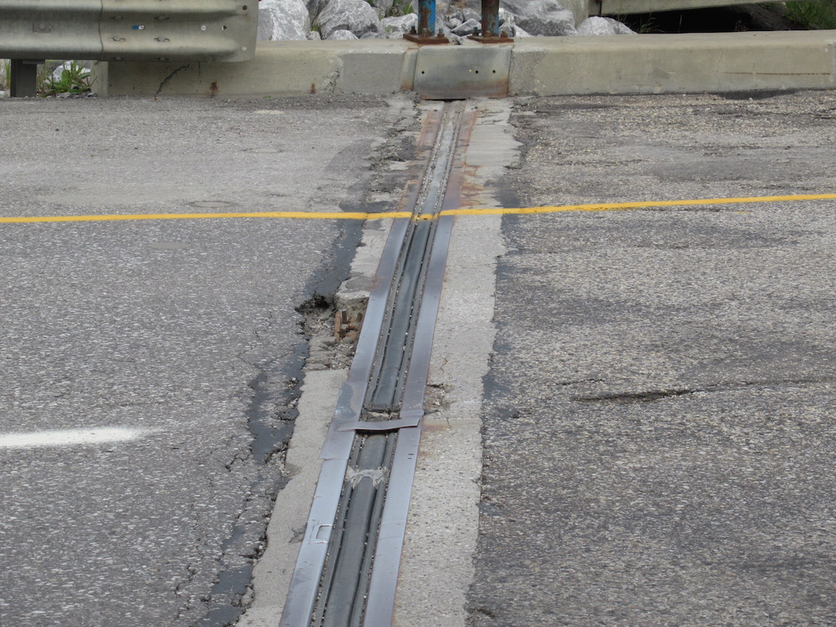
Missing Plow Guards and Spalled Paving Lip

Slide 34
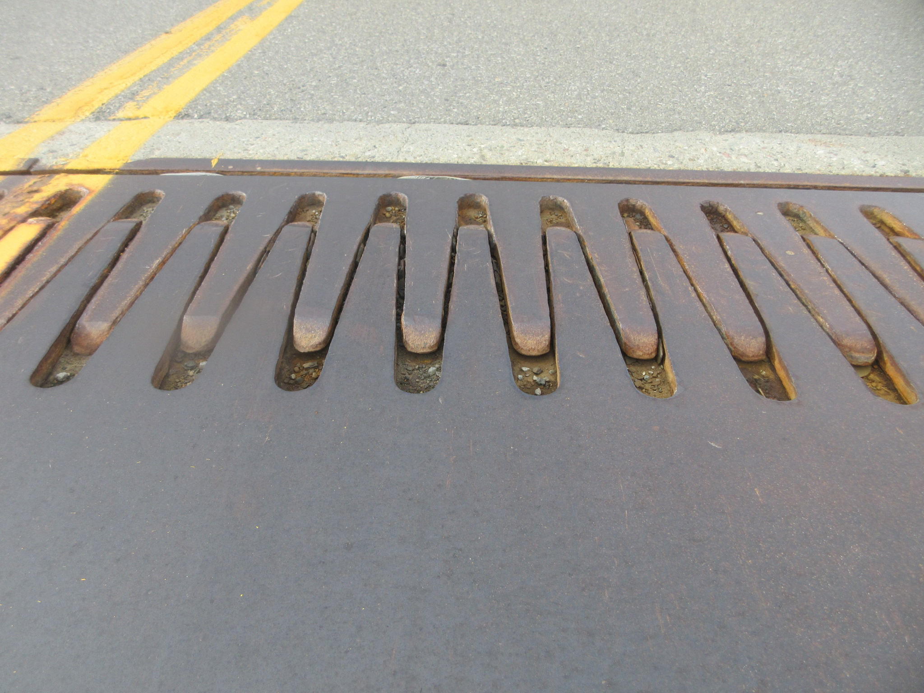
Finger Plate Joint with Broken/Lifted Fingers Welds

Slide 35
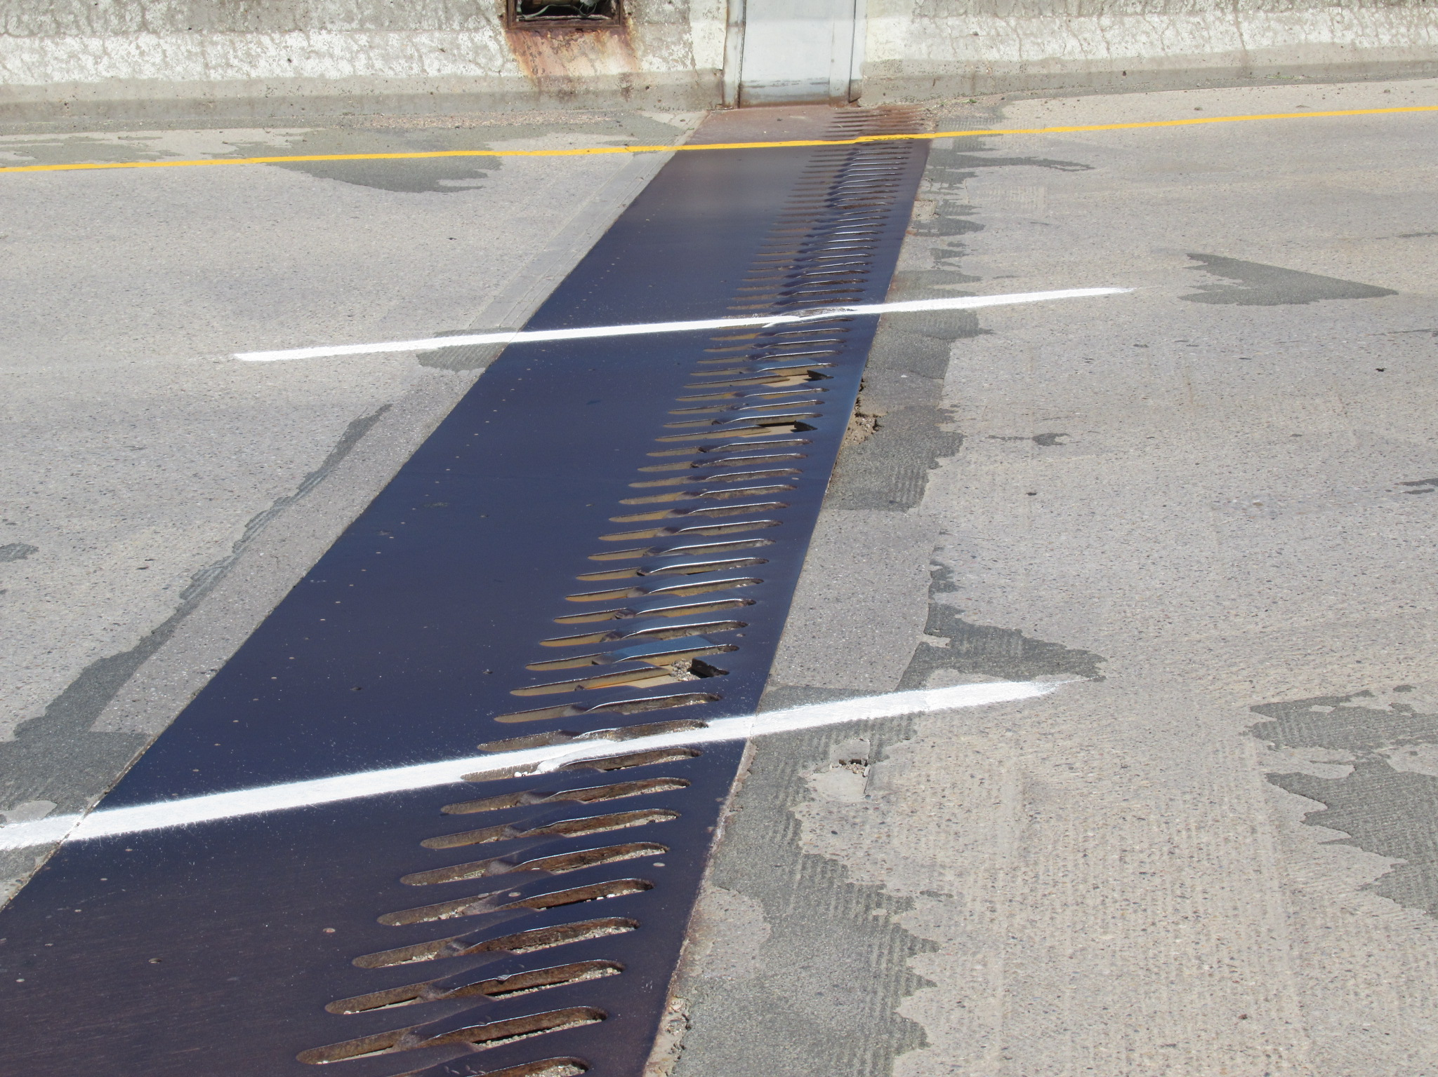
Finger Plate Joint with Broken/Missing Fingers

Slide 36
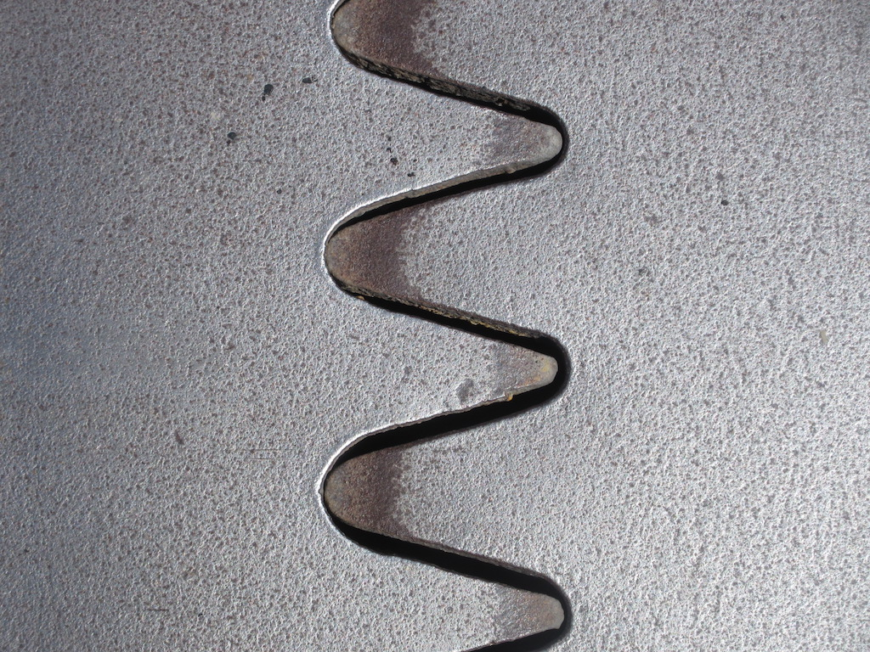
Finger Plate Joint with no Remaining Expansion

Slide 37
Armored Gland Joint - Missing Bolts

Slide 38
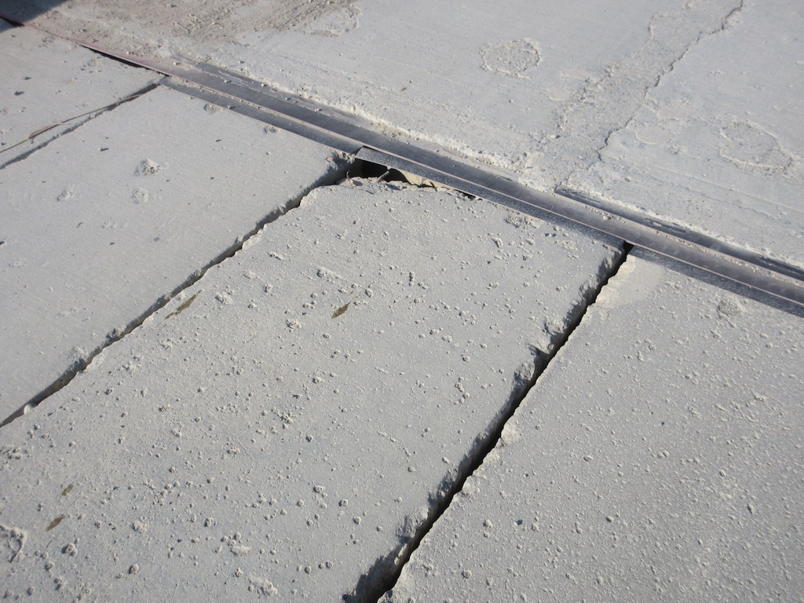
Loose Buffer Angles

Slide 39
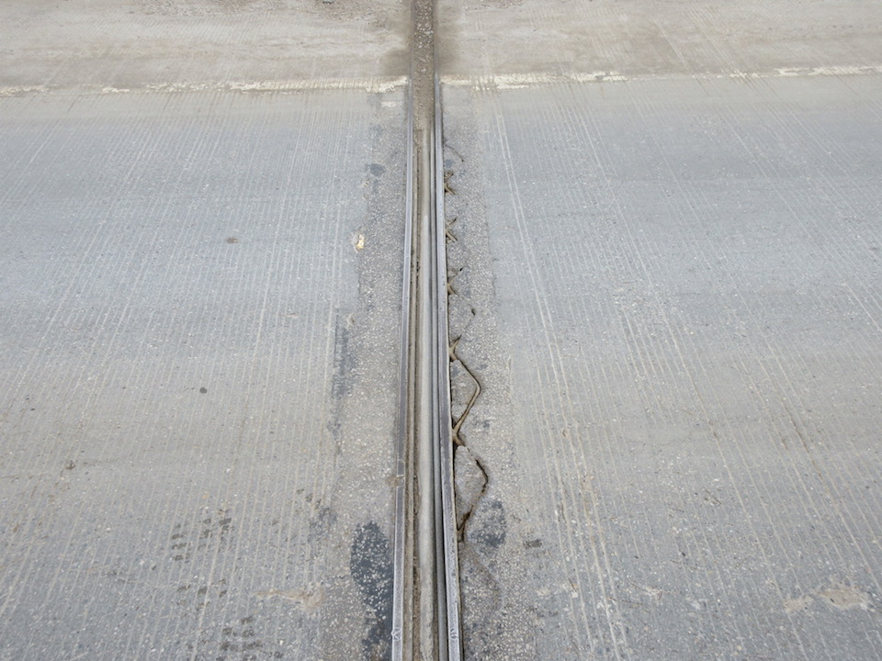
Wabo-crete Joint with De-bonded Material and Exposed Bars

Slide 40
Inspection Form and Rating
Record temperature
Verify joint type
Verify joint function
  fixed
  expansion
Measure and record average gap width in millimeters for each joint

Slide 41
Deck Joint Inspection and Rating
Defects in open joints with plumbing features are also reflected in both the deck joint rating and the deck drainage rating
Leakage problems with open joints without plumbing are rated under deck drainage only
Curb cover plates are rated with the deck joint and not the curb rating
Rate according to existing condition and functionality
Includes condition and functionality of drainage system
Leakage of sealed joints is reflected in both the deck joint rating and the deck drainage rating

Slide 42
Deck Joint Inspection and Rating
Joints that are not fully free to move - Rate 4 or less
Joints designed to be watertight joints which allow leakage of water onto girders, bearings or substructure - Rate 4 or less
Open (non-watertight) joints should not be down rated because of leakage
Joint defects causing problems with structure (e.g. frozen bearings causing pier cap delams) - Rate 3 or less
Joints which are a hazard to traffic - Rate 2 or less

Slide 43
Bridge bearings are generally classified as fixed or expansion type and located under corresponding joints.
Fixed bearings allow rotation but no vertical or horizontal movement.
Expansion bearings allow both rotation and longitudinal movement of the superstructure. Expansion bearings sometimes also permit transverse movement.
Bearings (7.20)
Bearings must transfer loads from the superstructure to substructure.
Bearings accommodate movement caused by temperature changes, deflection, earth pressures, etc.

Slide 44
Bearings
There are usually three distinct components in a bearing:
Sole plate - Steel plate welded, bolted, riveted or cast to bottom of girders
Masonry plate - Similar to sole plate except located on top of substructure element and usually anchored by bolts into concrete
Bearing - Assembly between sole plate and masonry plate that permits movement of the bridge

Slide 45
Bearings
The common types of bearings used on Alberta bridges are:
Elastomeric pads
  Usually neoprene – newer are reinforced with steel shims, older are plain/un-reinforced
  Often include stainless steel and teflon for expansion of longer span girders
Rockers
  Large steel “pie-shaped” bearings designed for large movements
Rocker Plates
  Steel plate with cylindrical side - accommodate rotation only–fixed so no thermal movement
Pot
  Elastomeric pad confined by heavy steel ring & loaded vertically by cover component. Can allow movement in one or more directions, be fixed, and be designed to resist uplift.

Slide 46
Bearings cont’d.
The common types of bearings used on Alberta bridges (continued):
5. Roller/Roller Nest
  Cylindrical steel bearings either in the form of a single roller or in a group (nest). Rollers allow rotation and horizontal movement in one direction.
6. Neoprene Strip Bearing
  Fixed bearing used under short span standard girders not requiring movement
7. Steel Sliding Plate w/Self Lubricating Bronze Plate
  Steel plates with bronze plate between – used primarily under Type O girders (1955-19650
  Problems with freezing and inducing stresses to substructure

Slide 47
Bearings cont’d.
The common types of bearings used on Alberta bridges (continued):
8. Spherical bearings
  Made of spherical machined steel plates that nest together to allow rotation and may have an allowance for horizontal movement
10. Sliding Plates
  steel sliding expansion plates commonly used under pony trusses – simple and no problems
11. Disc/Disc and Dome
  disc bearings (round, confined polyurethane pad)
12. Others
  Rotation Pins - allows truss rotation of fixed bearings
  Pinned – fixed stacked plates (opposite of sliding plates)
  Pedestal

Slide 48
Bearings
ELASTOMERIC PAD
POT BEARING

Slide 49
Bearings
ROCKER BEARING
ROLLER BEARING
48

Slide 50
Bearings
SPHERICAL BEARING
BEARING WITH SLIDING SURFACE

Slide 51
Elastomeric Bearing Showing Pintel, Anchor, Bolts, Sole and Masonry Plates (before grouting)

Slide 52
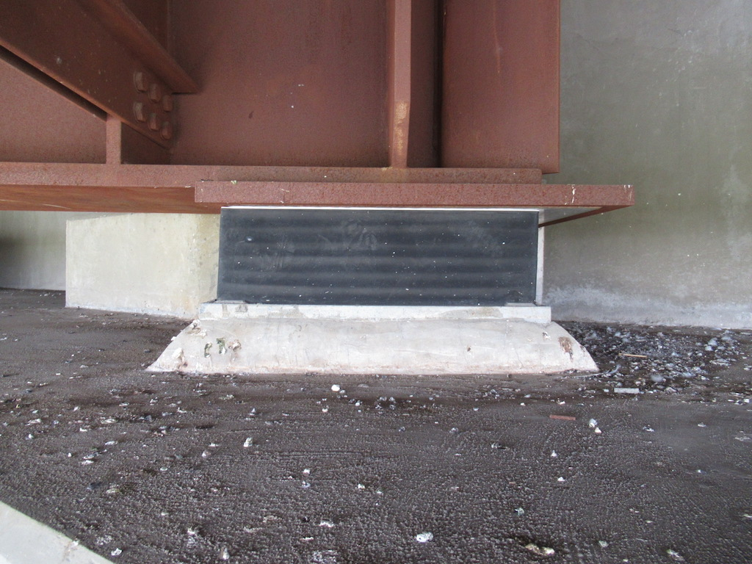
Reinforced Neoprene Expansion Bearing with Teflon & Stainless Steel

Slide 53
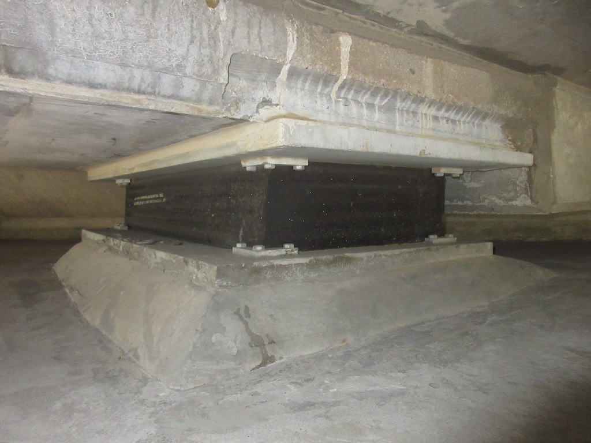
Reinforced Neoprene Bearing without Teflon & Stainless Steel

Slide 54
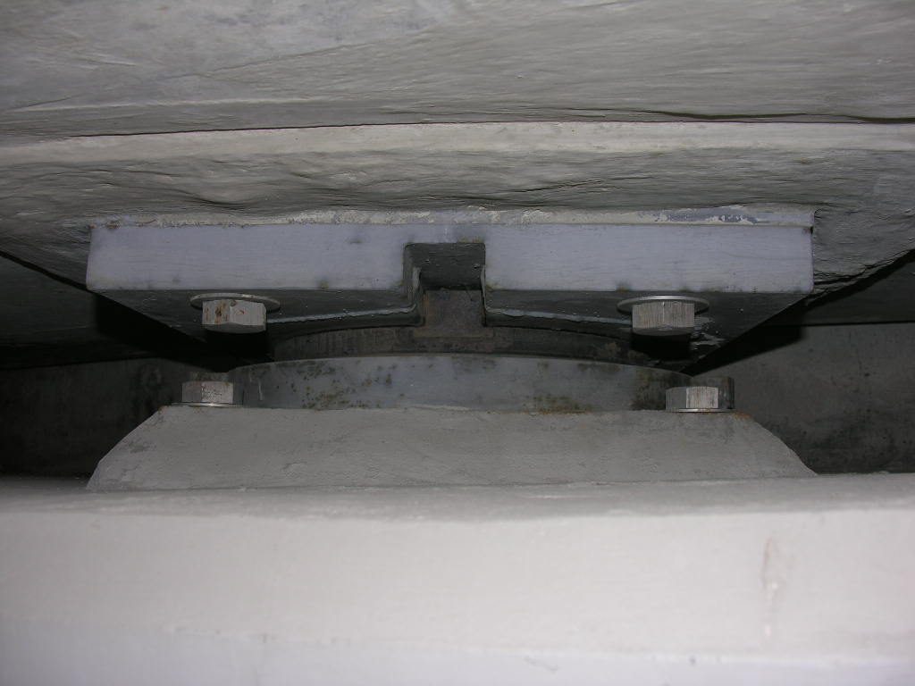
Pot Bearing - Expansion

Slide 55
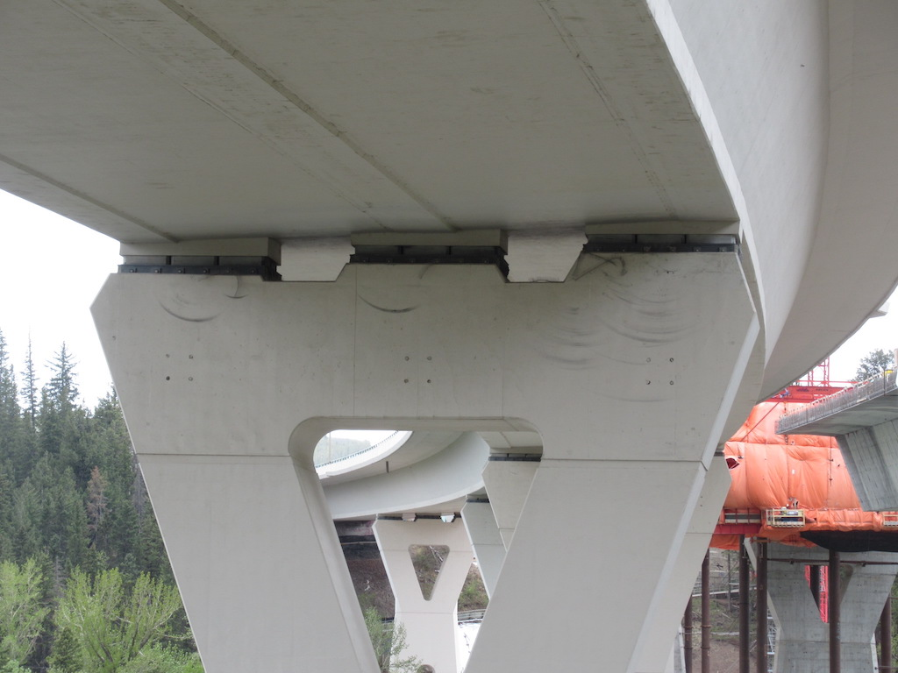
Multi Pot Bearings - Expansion

Slide 56
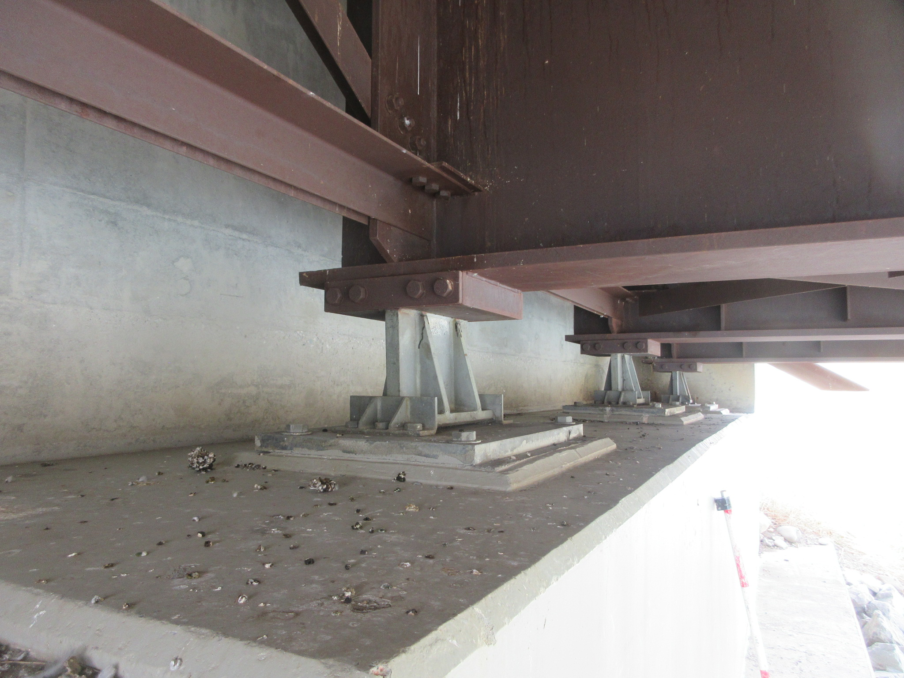
Rocker Bearing Under Steel Girder

Slide 57
Plate Rocker Bearing Under Truss

Slide 58
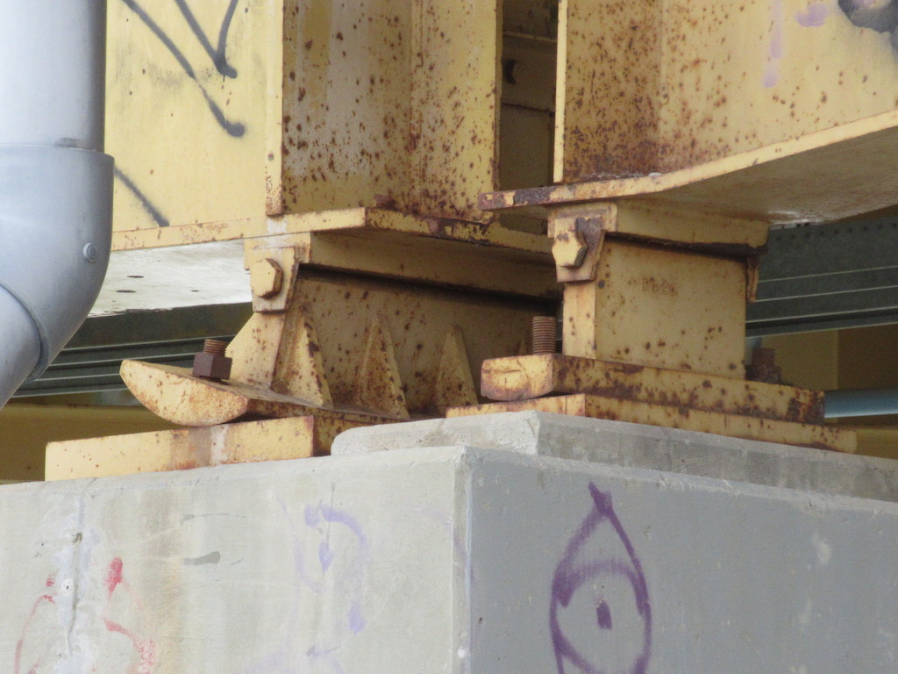
Rocker & Plate Rocker Bearings

Slide 59
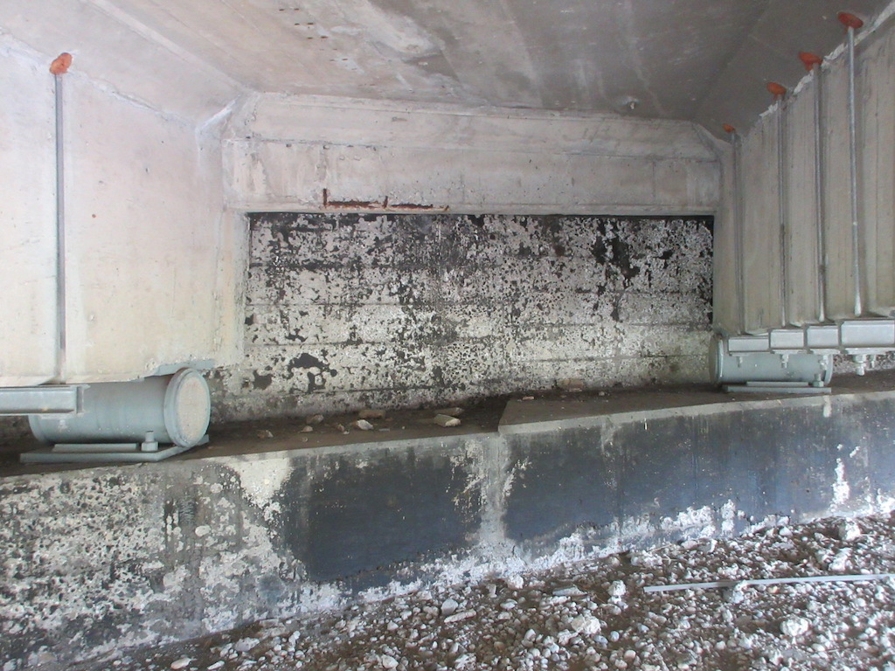
Single Roller Bearing Under Concrete Girder

Slide 60
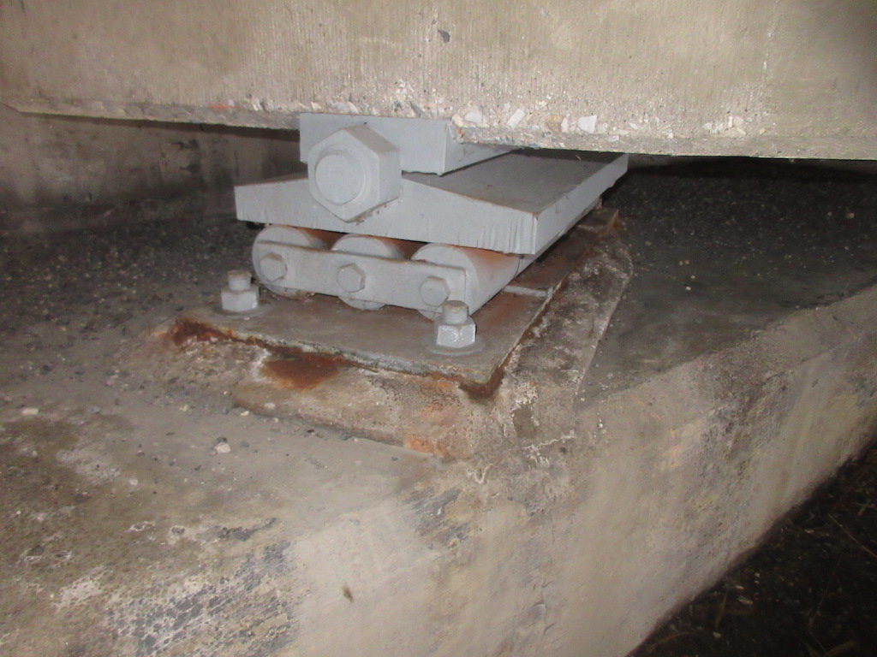
Roller Nest Bearing Under Concrete Girder

Slide 61
Roller Nest Bearing Under Truss

Slide 62
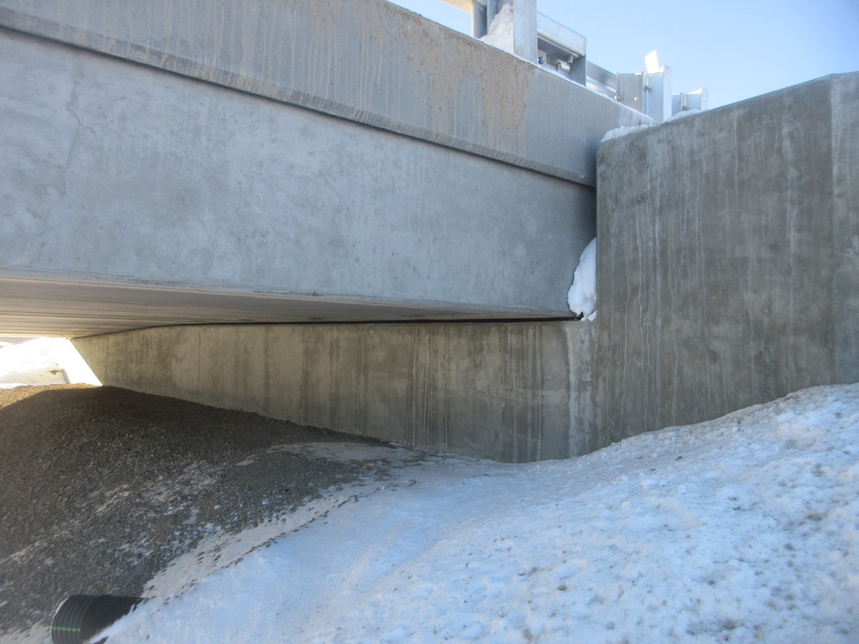
Neoprene Strip Bearing Under Std. Girders

Slide 63
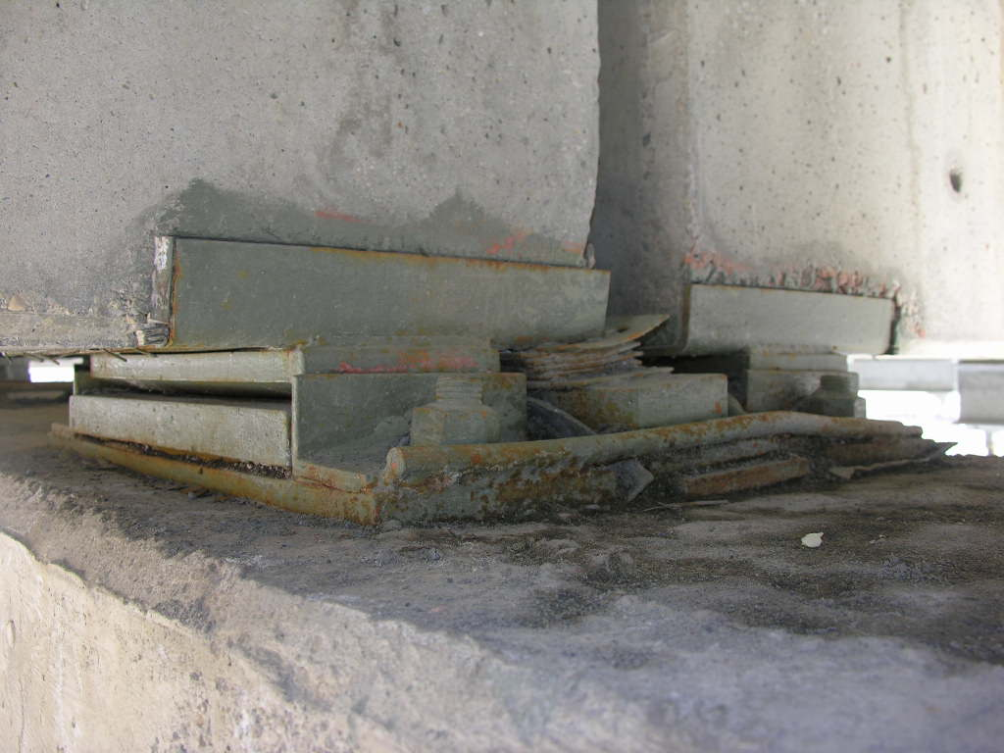
Sliding Plate with Self-Lubricating Bronze Plate (Type PO Girders)

Slide 64
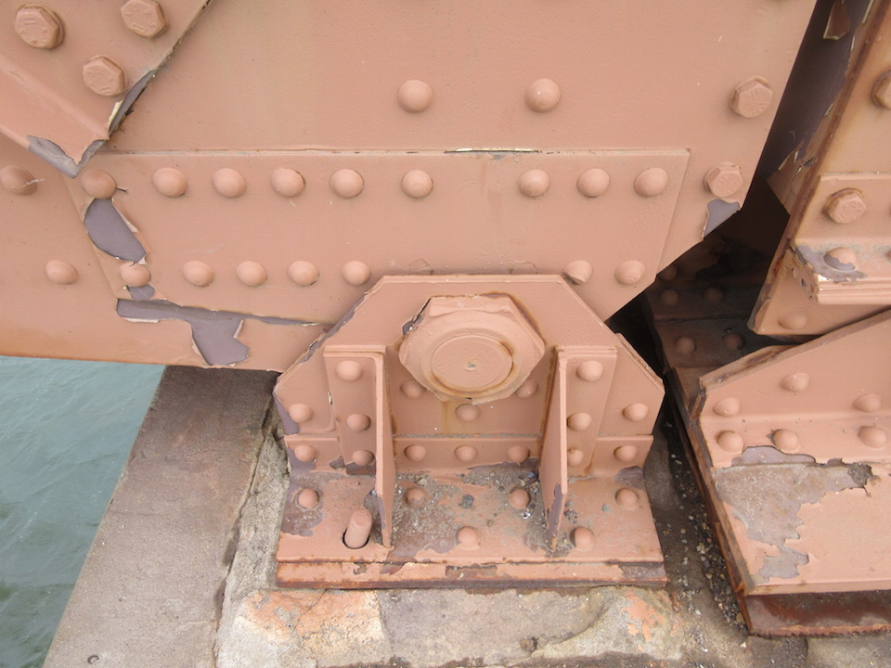
Rotation Pin (Fixed) Bearing Under Truss

Slide 65
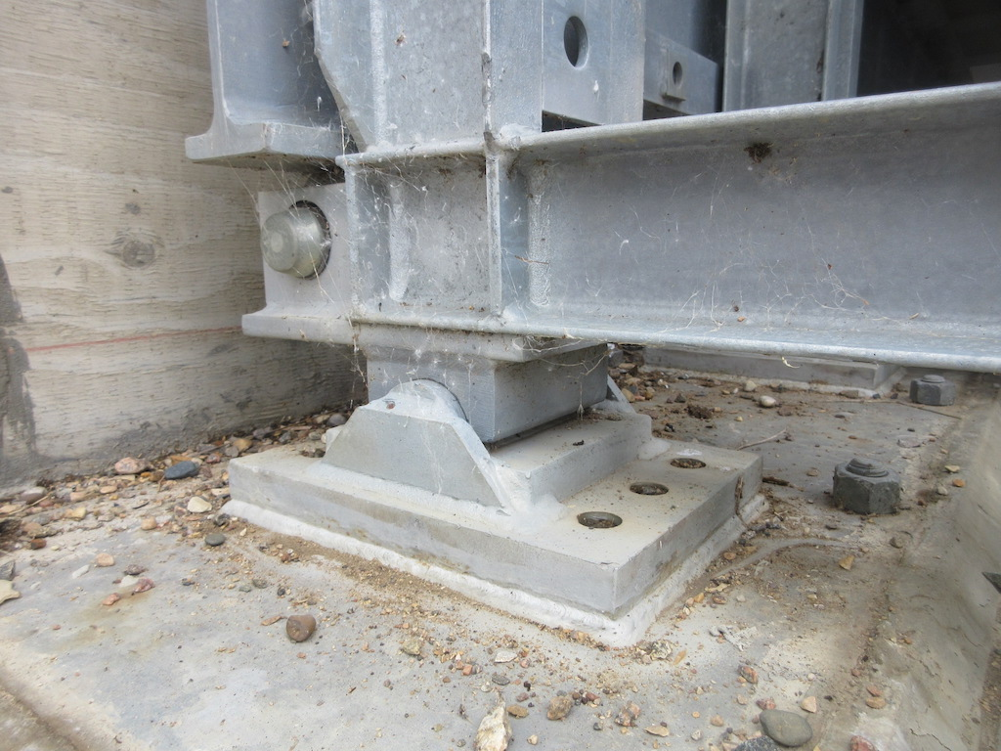
Rotation Pin (Fixed) Bearing Under Acrow

Slide 66
Sliding Plate Under Truss

Slide 67
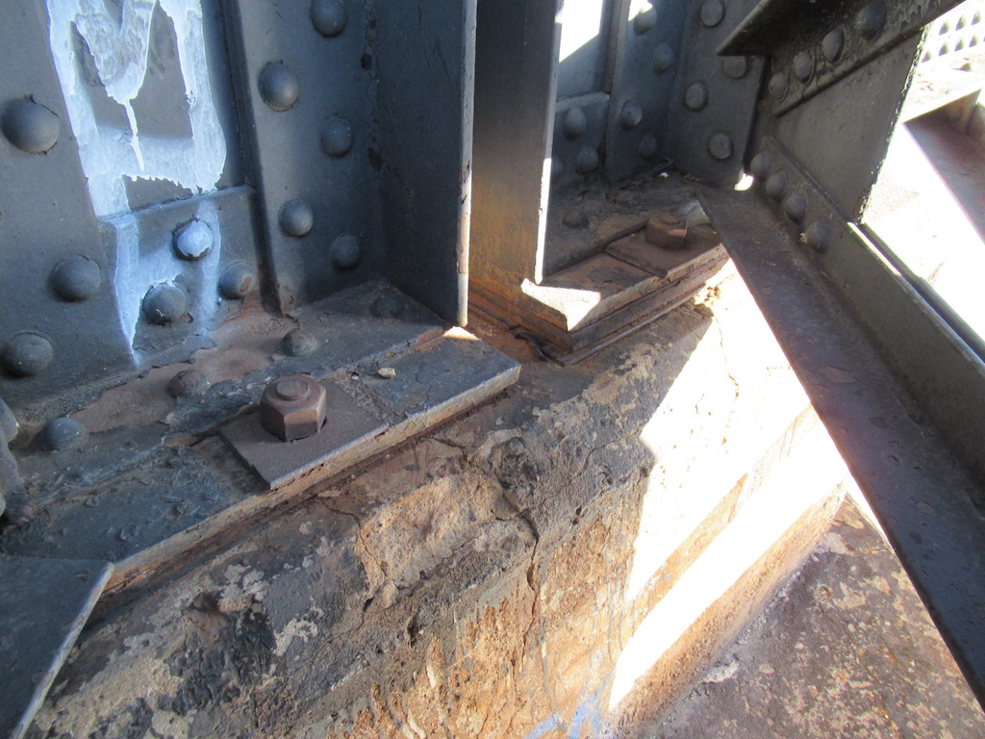
Steel Plate Pinned (Fixed) Bearing

Slide 68
Bearings
Problems and Inspection Considerations
Dirt or debris
  may inhibit movement
  promotes corrosion
Corrosion
  “frozen” bearing (“Type O” bearings most affected)
  deterioration of bearing
    especially under leaking joints

Slide 69
Bearings
Problems and Inspection Considerations
Loose or missing connections, cracked or broken welds
Loss of bearing contact or uneven contact
  rollers moved off masonry or sole plates
  neoprene pads creeping out of position
  can overstress steel or concrete members

Slide 70
Bearings
Problems and Inspection Considerations
Wear
Rocker alignment
  overextension
  should be approximately vertical at 0° Celsius
Failure of elastomer
  splitting, cracks, squeezing out, bulging
  separation of the elastomer at reinforcing plates

Slide 71
Bearings
Problems and Inspection Considerations
Anchor bolts
  corrosion (strike with hammer)
  bent
  surrounding concrete cracked
  nuts not properly secured (jam nut), nuts missing
  binding on shoe plate or bearing device

Slide 72
Bearings
Problems and Inspection Considerations
Indications of a non-functioning bearing
  cracks in the bearing area of the substructure or superstructure
  uneven gaps at expansion joints
    bump at joint
    variable gap in same joint
    jammed joint
    joint gap too wide
  misalignment of superstructure at joint
  unusual noise or movement under traffic

Slide 73
Bearings
Problems and Inspection Considerations
Deterioration caused by leaking deck joints should be noted in Explanation of Condition.
- Deck drainage also gets down-rated
- If joint above was designed to be watertight then joint also gets down rated
Cracks, delaminations or spalls in concrete abutment and pier’s caps / seats / corbels emanating from bearing components should be noted and comments on reduced bearing functionality should be provided.

Slide 74
Bearings
Inspection Form and Rating
Record temperature
Record or verify bearing types and locations:
  expansion
  Fixed
Record if coating intact and functioning to protect bearing from corrosion
Record or verify whether the bearing is functioning as designed
  proper bearing
  proper movement

Slide 75
Bearings
Inspection Form and Rating
Bearings functioning properly and in good condition but have inadequate coating
  Rate 7 or 8
Bearings require resetting
  Rate 4 or less
Bearing movement inhibited by dirt, debris or corrosion (frozen)
  Rate 4 or less
Concrete elements under bearings with wide cracks or visual signs of damage (not accessible for sounding)
  Rate 3 or less
Pin and Hanger bearings with cracked hanger
  Rate 2 or less
  Corrosion, frozen pins, missing windlocks – rate 3 or less

Slide 76
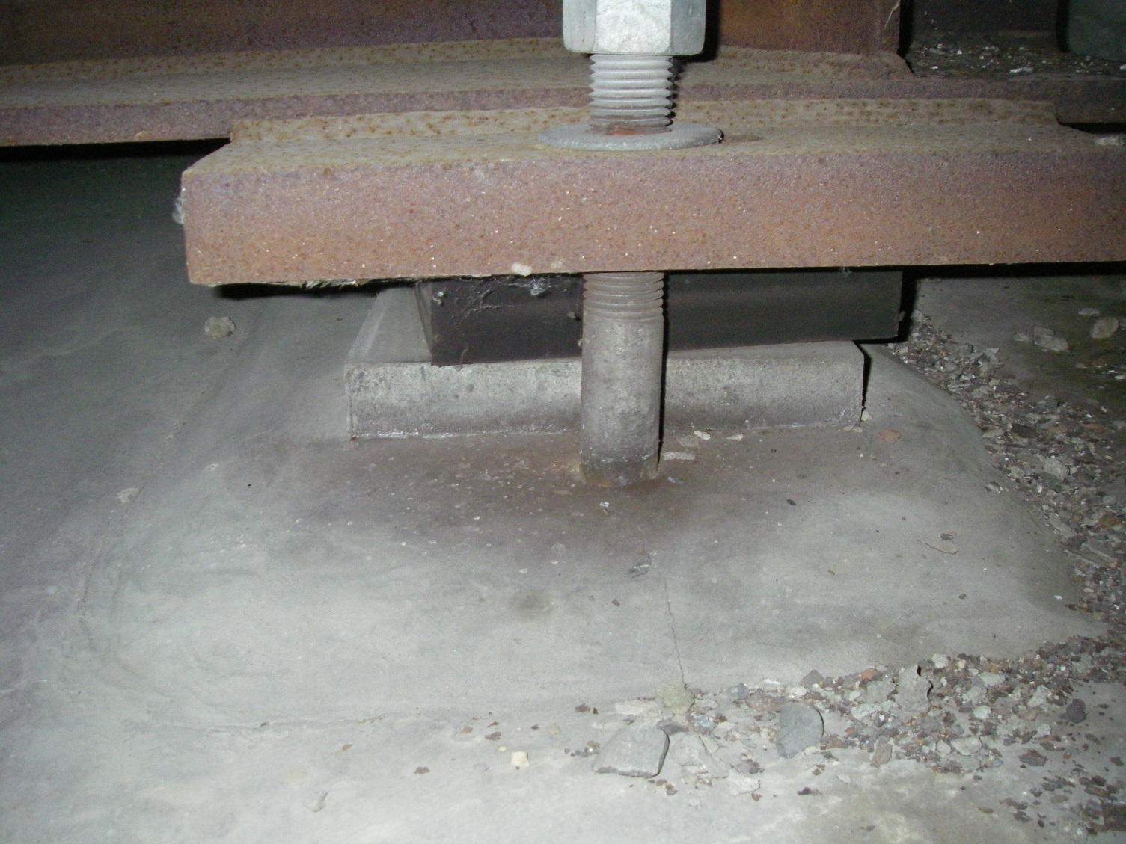
Displaced Neoprene Pad

Slide 77
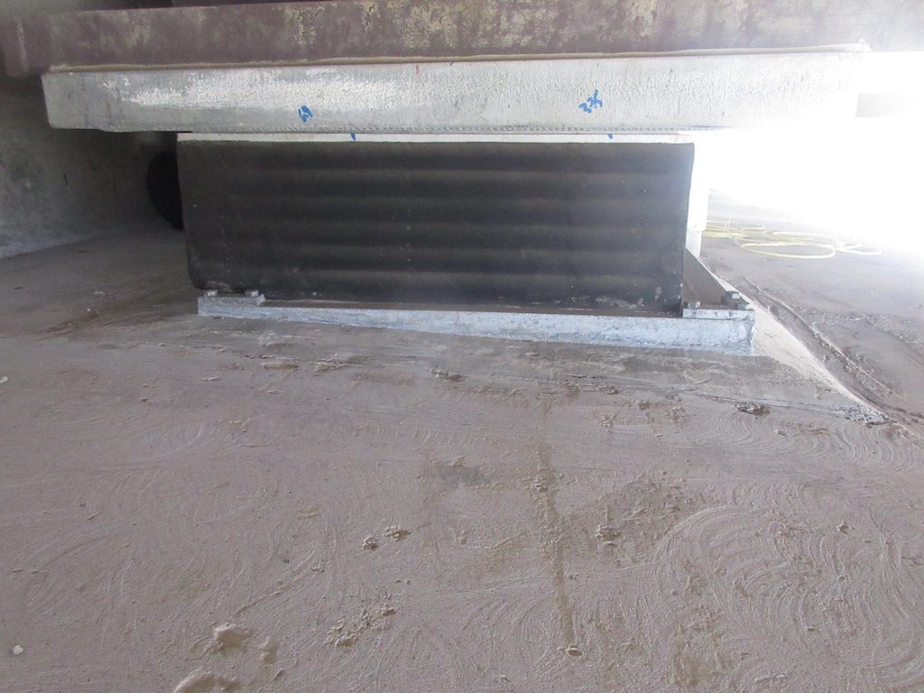
Displaced Neoprene Pad - Over Keepers

Slide 78
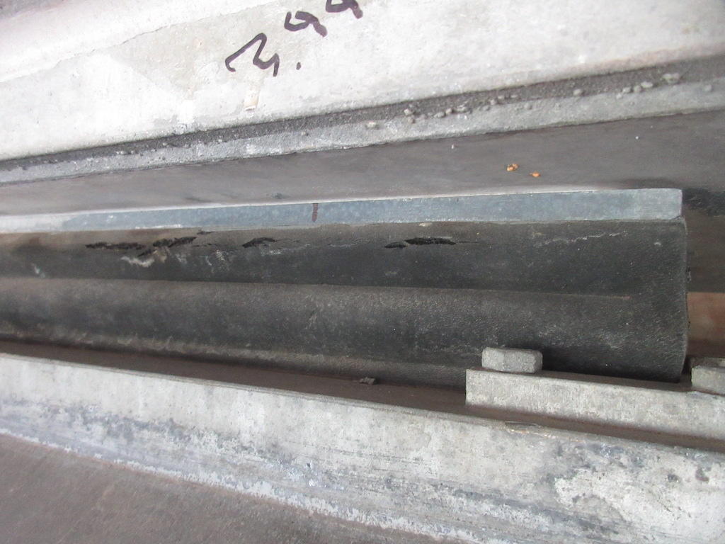
Torn Neoprene Pad Bearing

Slide 79
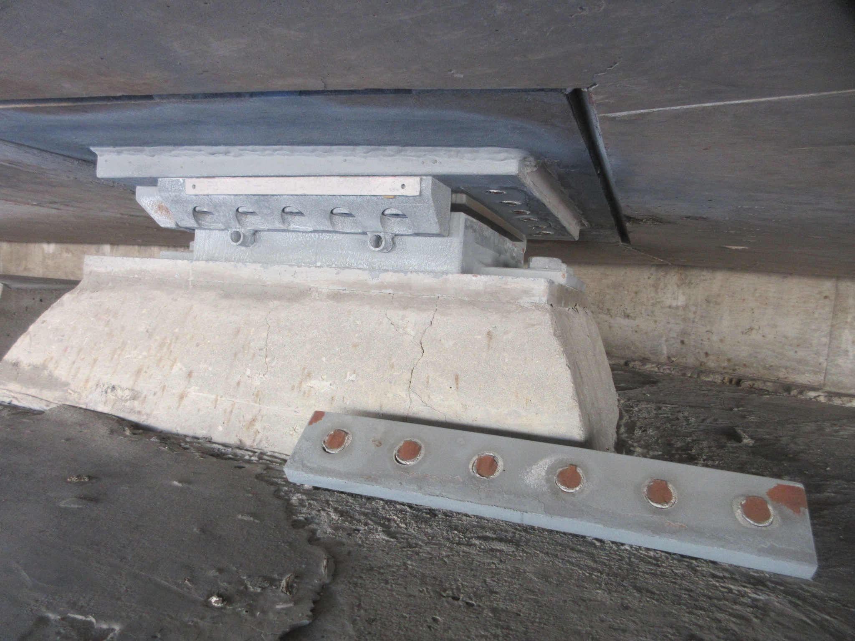
Pot Bearing – Failed Keeper Plate

Slide 80
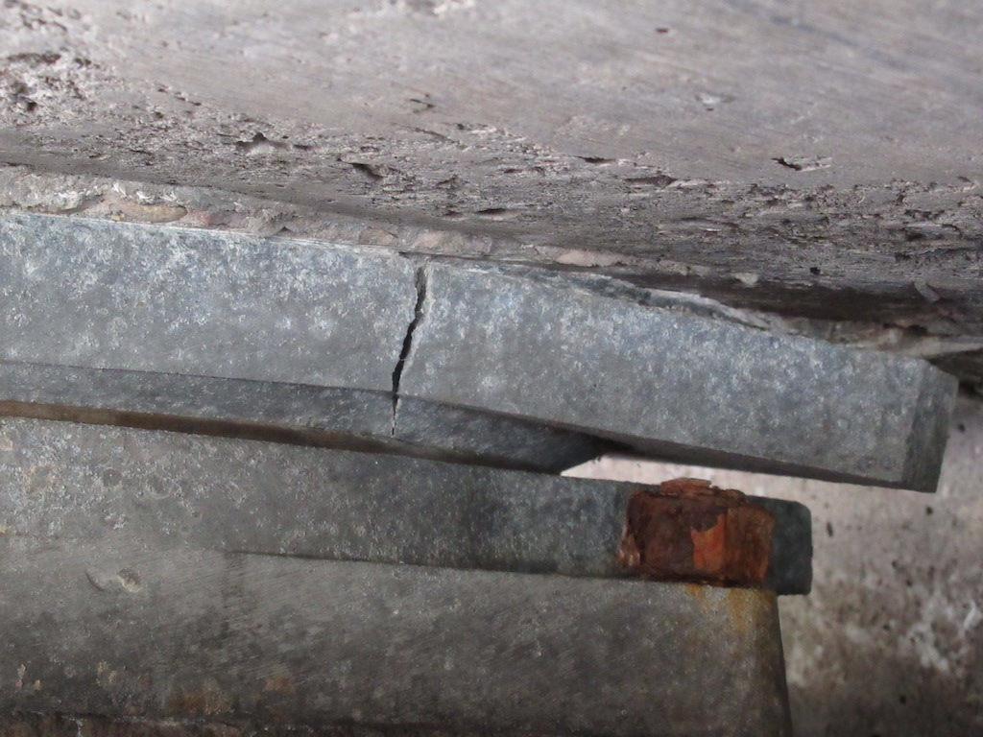
Pot Bearing – Cracked

Slide 81
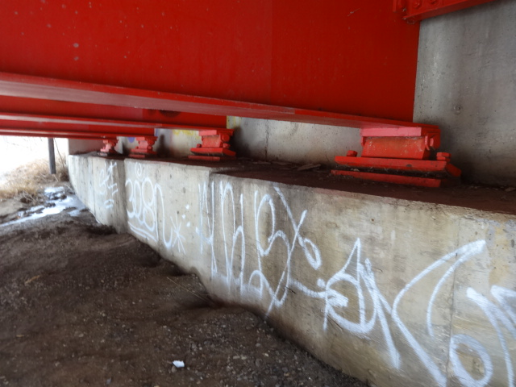
Extended Rocker Bearing (rating dependent on temp)

Slide 82
Failed Rocker/ Roller Bearing

Slide 83
Displaced Roller Nest

Slide 84
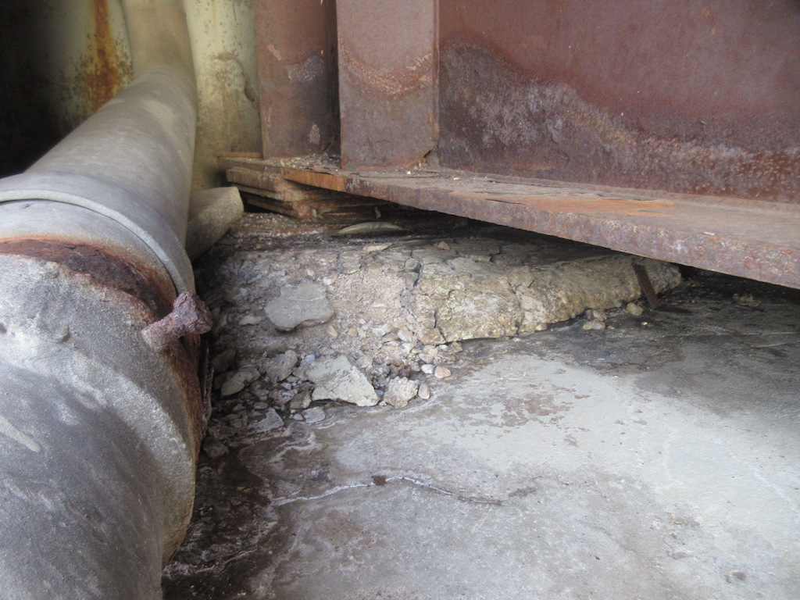
Pinned/Fixed Bearing with Corrosion & Failed Grout Pad

Slide 85
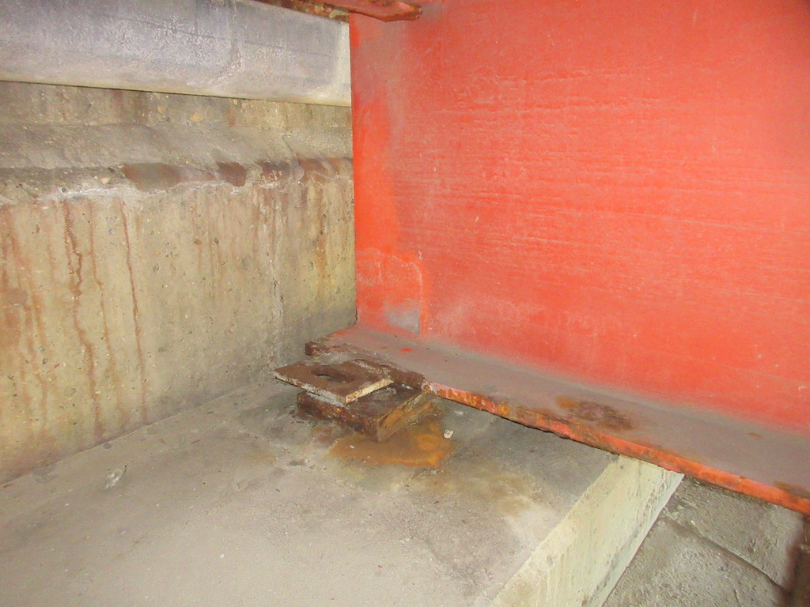
Pinned Bearing with Sheared Anchor Bolt

Slide 86
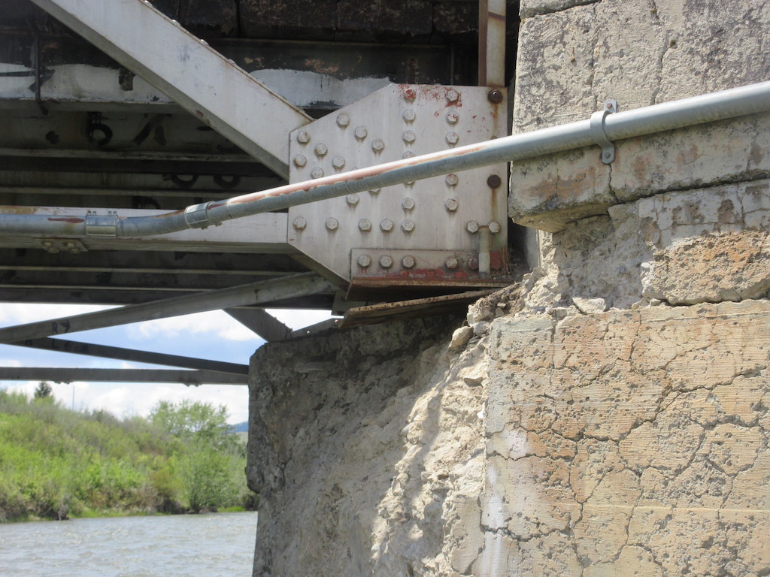
Sliding Plate Bearing Unsupported

Slide 87
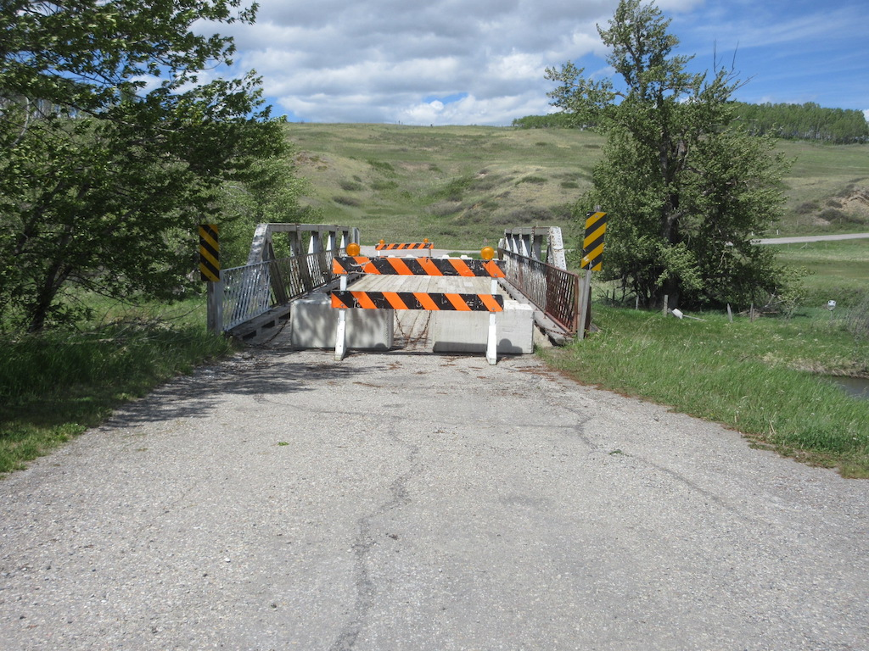
Sliding Plate Bearing Unsupported

Slide 88
Type PO Girder Bearings
Performance issues related to steel sliding plate bearings with self-lubricating bronze plates.
Primarily found under Type “PO” girders between 1955 and 1965, and detailed on Standard Drawing S-701.
Failed bearing at BF 1153 Hwy. 22 over Oldman River discovered during Level 1 BIM inspection. Near catastrophic and led to BIM Bulletin 3 Jan. 2016

Slide 89
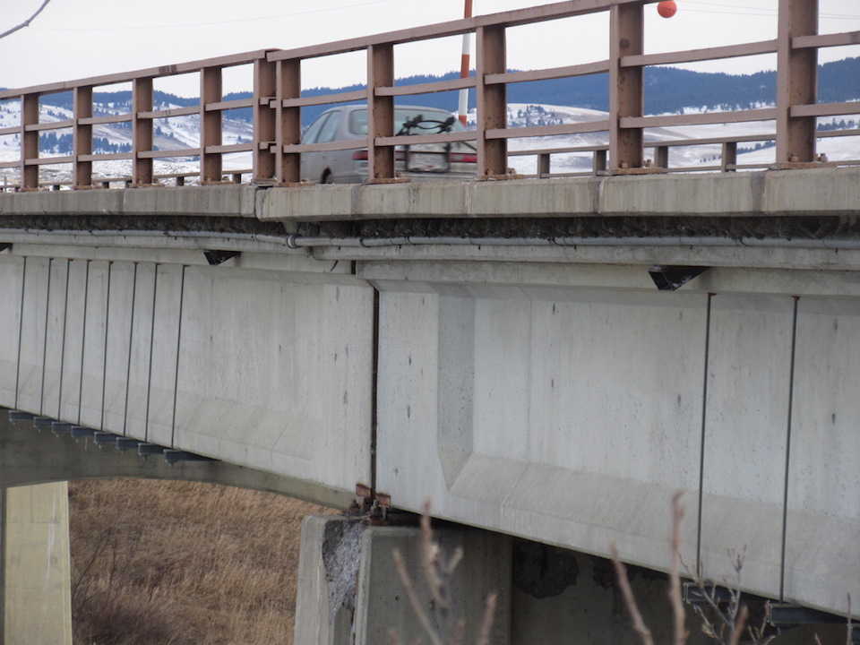
Failed Sliding Plate with Self-Lubricating Bronze Plate Bearing

Slide 90
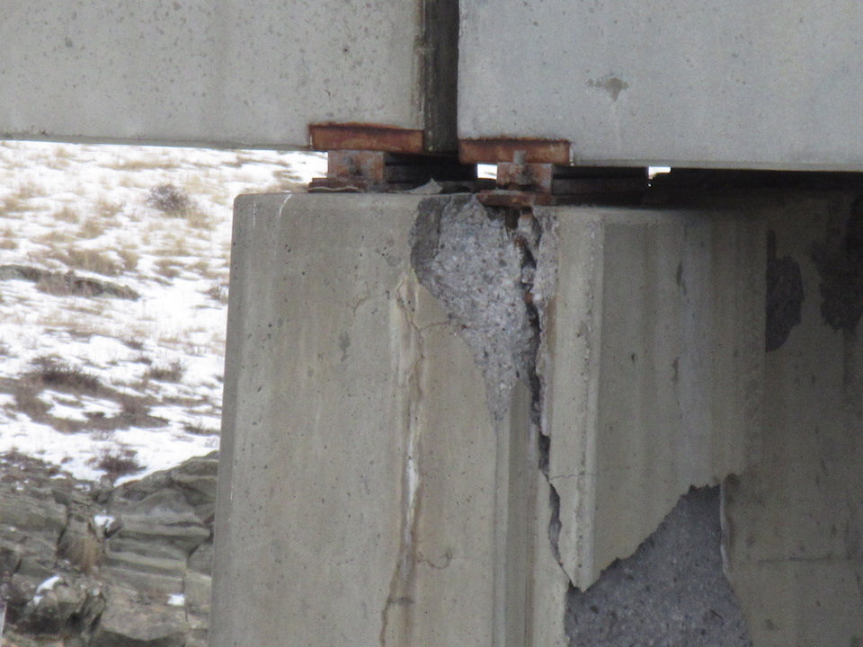
Failed Sliding Plate with Self-Lubricating Bronze Plate Bearing

Slide 91
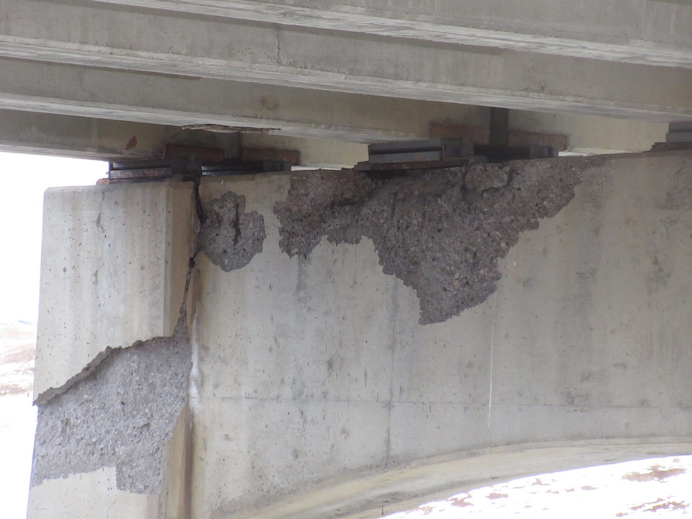
Failed Sliding Plate with Self-Lubricating Bronze Plate Bearing

Slide 92
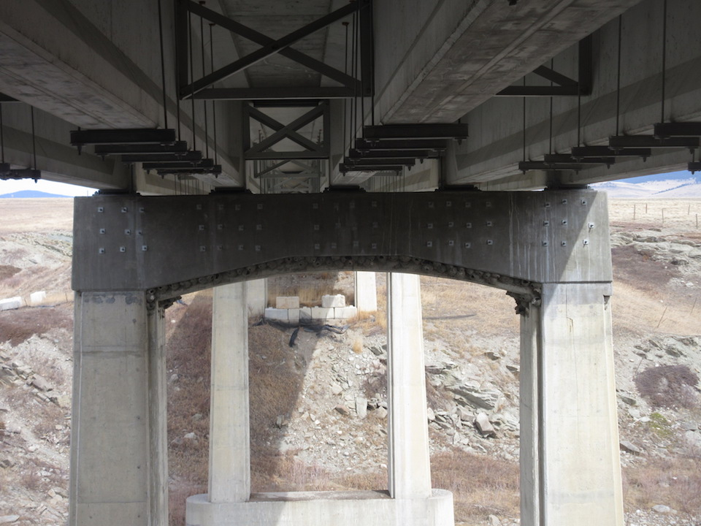
Failed Self-Lubricating Bearing Replaced with Neoprene Pad Bearings

Slide 93

Questions?

