Slide 1
ADVANCED INSPECTION OF STEEL ELEMENTS

Slide 2
Methods of Inspection
Level II inspection in steel elements is made if cracks or potential for cracks or faults is present
Visual
Important for detecting degradation
Logical and systematic procedures
Used to establish non-destructive testing (NDT) techniques

Slide 3
Methods of Inspection
Non-Destructive Testing
To supplement visual inspection
To define the extent of faults

Slide 4
Non-Destructive Test Methods
Dye Penetrant Inspection
Surface requires mechanical cleaning
Low viscosity, high capillary fluid containing red dye is sprayed and allowed to penetrate the cracks and surface defects
Excess fluid is wiped from the surface after a penetration time
Surface sprayed with a developer
Cracks and faults will be apparent by drawn red dye on a surrounding white background

Slide 5
Non-Destructive Test Methods
Dye Penetrant Inspection
Advantages: Low cost, requires minimal skills, portable, not time consuming, can identify extent of surface cracks
Disadvantages: Limited to surface defects

Slide 6
Non-Destructive Test Methods
Magnetic Particle Inspection
Yoke is used to produce a magnetic field in the steel
Fine iron powder is sprayed on the surface
Field is distorted by surface or near surface discontinuities causing concentrations of magnetic lines
Iron powder is drawn to these lines

Slide 7
Non-Destructive Test Methods
Magnetic Particle Inspection
Advantages: portable, requires minimal skills and can define tight cracks
Disadvantages: limited to the inspection of cracks and surface defects near the surface. Depth of cracks cannot be determined and element may become magnetized

Slide 8
Non-Destructive Test Methods
Hardness Testing
Used to determine if mechanical properties have changed. System can be used for determining degradation after fire damage
Telebrineller system principle is comparing hardness of a known test bar to the bridge element hardness
Equipment: Anvil, steel impression bar, microscope, hammer

Slide 9
Non-Destructive Test Methods
Hardness Testing
Anvil is placed on the element and struck. Impact is transmitted to the test bar and the specimen element
Steel ball makes an impression in the test bar and the element
Diameters are measured and read through a microscope to within 0.05 mm

Slide 10
Non-Destructive Test Methods
Hardness Testing
BHN has a correlation to the tensile strength of steel
Advantages: equipment is light weight, portable, reasonably accurate and requires no special training
(
Dia of Impression In Bar
)
2
Dia of Impression In Metal
x BHN of Test Bar = BHN of Specimen Material

Slide 11
Non-Destructive Test Methods
Eddy Current
Similar to MPI, except defect is detected by disturbances in electrical field
Technique involves the use of a coil carrying an alternating current, which produces an eddy current in the part being examined
Eddy current creates an impedance in the exiting coil
Impedance depends on the nature of the part being tested and the exiting coil, magnitude and frequency of the current and the presence of discontinuities in the part
Change is read from a meter

Slide 12
Non-Destructive Test Methods
Eddy Current
Advantages: size and depth of defects can be estimated reasonably and surface conditions such as paint do not affect scanning
Disadvantages: changes in geometry affect the impedance and recalibration is required
Limited use but has potential

Slide 13
Non-Destructive Test Methods
Radiography
Used to detect macroscopic defects and discontinuities
Testing is based on the ability of radiation such as gamma rays to penetrate metal and other opaque materials to produce an image on sensitive film
Gamma rays are produced by the disintegration of radioisotopes or radium of which cobalt or iridium are common sources

Slide 14
Non-Destructive Test Methods
Radiography
Source housed in a lead capsule to avoid radiation danger when not in use
Amount of radiation getting through section being tested depends on section and density
Defects result in less steel to pass through and more radiation gets on to the film placed behind the section
Defect size and shape shows up as a dark area on the film

Slide 15
Non-Destructive Test Methods
Radiography
Planar defects are only detectable if they are parallel to the source axis due to radiation absorption
Accuracy is dependent on the section and location of the crack
Fatigue cracks to 2% of thickness can be detected

Slide 16
Non-Destructive Test Methods
Radiography
Advantages: permanent record and size and shape are determined
Disadvantages: cannot detect planar defects and depth of cracks, hazardous and government licensing is required

Slide 17
Non-Destructive Test Methods
Ultrasonics
Uses high frequency sound waves to detect flaws
Discontinuities act as a reflector for high frequency vibrations
Sound waves are produced by a wave generator and receiving pulses are displayed on a cathode ray oscilloscope
Ultrasonic frequency is 2 MHz or approximately 9500 ft/sec.

Slide 18
Non-Destructive Test Methods
Ultrasonics
Sound waves are transmitted by contact through a crystal and an intervening couplant
Depth, size and nature of the defects are determined from the return signal on the oscilloscope
Signal corresponds to elapsed time between transmission and reception

Slide 19
Non-Destructive Test Methods
Ultrasonics
Time can be converted to distance because the angle and velocity are known
Sensitivity is influenced by the sound frequency, design of the unit, instrumentation processing of the return signal on the oscilloscope and operator skill

Slide 20
Non-Destructive Test Methods
Ultrasonics
Advantages: portability, sensitivity, ability to detect locations and depth of defects
Disadvantages: influenced by operator ability, no permanent record of the display and it can be too sensitive displaying very minor defects

Slide 21
Non-Destructive Test Methods
Sound reflection from fatigue crack at toe weld.
Sound reflection from rollover in fillet weld.

Slide 22
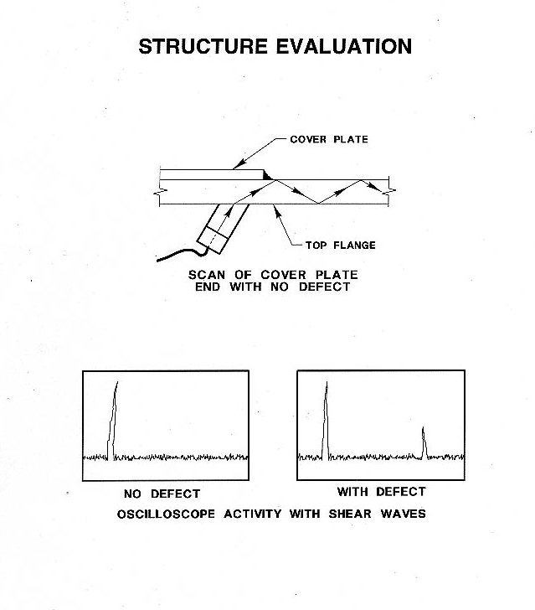
Non-Destructive Test Methods

Slide 23
Methods of Inspection
It is important for the inspector to evaluate the damage and recognize the potential faults
The visual assessment can be used to establish non-destructive testing (NDT) techniques to supplement the visual inspection and define the extent of faults or damage
Assess the significance of damage on the load carrying capacity

Slide 24
Questions?

