Slide 1
SIGN STRUCTURE INSPECTION & RATING

Slide 2
Introduction
Definition – sign or multiple signs with area >4 m2
Signing for Interchanges – normally have associated BF #
Naming Convention
Site file number 75760
Visual identifiers
Z = sign structure
W, E, N, or S = direction of approach
Structure number 2 = 2nd structure (travelling north)
Example 75760-ZN-2
Numbering convention – 1st sign come to (farthest away) is #1
If another sign is added all signs in that direction get re-numbered

Slide 3
Introduction
Refer to Chapter 15 in BIM Manual
Other sections on form are rated consistent with other structures (e.g. Approach Road and Approach Guardrail)
Rating and Recording requirements same as for other structures
Measure and record vertical clearance if possible
Minimum acceptable VC on provincial highways is 6m**. If VC on form is <6m – or if inspector suspects VS is not accurate recommend L2 VC

Slide 4
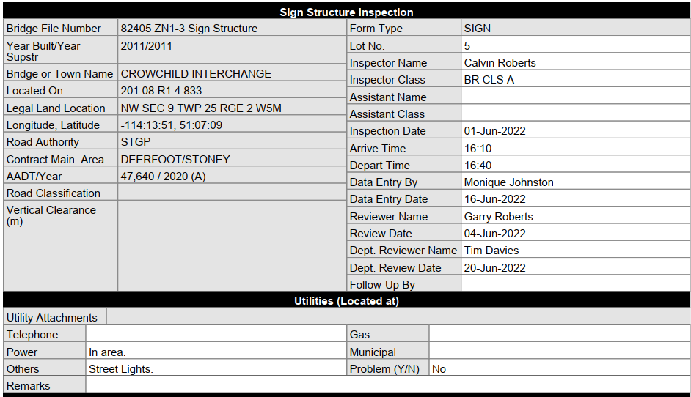
Utilities
Inventory Data
Verify and update
Chapter 4 BIM Manual
Note and record location within 200 m
Many structures have lights
Others have hi-vis sign resolution
Report hazards with utilities immediately (LRN 12/48 hrs)

Slide 5
Approach Road / Safety Features
Horizontal and vertical alignment
Rate same as Chapter 6 of BIM
Traffic Safety Features
Advance warning light, flashing lights, barriers, signs, impact attenuators
Rate function and condition – refer to 15.5.2
Guardrail (rate barriers as TSF)
Inspect and rate according to 15.5.3 – 20 m each direction from sign
Record length and termination Type
Meets standard Yes / No (if “No” explain why)
Current preferred system is flexible HTCB
Refer to 15.5.3.1 for other system types

Slide 6
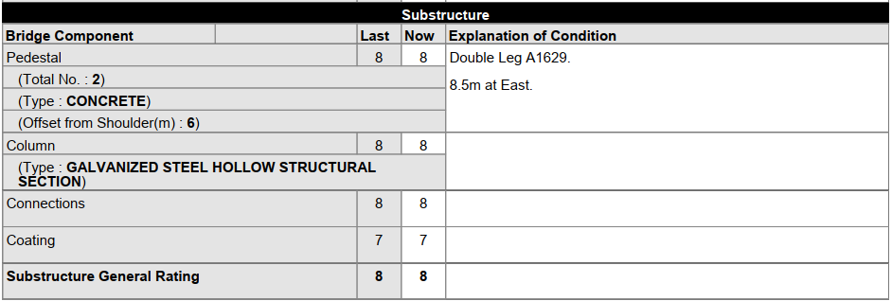
Substructure
Substructure accommodates
Dead Load of sign structure
Live Loads such as wind, collision

Slide 7
Substructure (Cont’d)
Pedestal
Provides base for column attachment
Record number and type (usually concrete, maybe steel)
Measure and record offset from EOP to c/l of pedestal
record min. if more than one present and record offset in comment area if other
Comment if top of pedestal <850 mm above ground
Defects affecting load carrying capacity rate 3 or less
Check for scaling, spalling or corrosion (light scaling not serious)

Slide 8
Substructure (Cont’d)
Column
Carries bridge loads to pedestal
Confirm Steel Ident Tag on column matches form
Generally steel (HSS); susceptible to deicing salts and vehicle damage
Check vertical alignment
Check weld stiffeners at bottom of columns (if present)
Check for collision damage
Check surface condition, welds, connections, etc.
Heavy corrosion or pitting rate 4 or less
Cracks rate 3 or less

Slide 9
Substructure (Cont’d)
Connection / Bearings
refers to column-to-pedestal connection
corrosion resulting in loss of section rate 4 or less
missing or loose nuts, rate 4 or less (suggest missing nuts =3 unless lock nut)
check all welds for cracks – if present rate 3 or less
Coating
refers to coating on column (typically galv) and pedestal (typically none)
top coat deteriorated, primer intact – or no corrosion but touch up req’ rate 5
pitting and / or loss of section (5%) rate 4 or less
pitting and / or loss of section (>10%) rate 3 or less

Slide 10
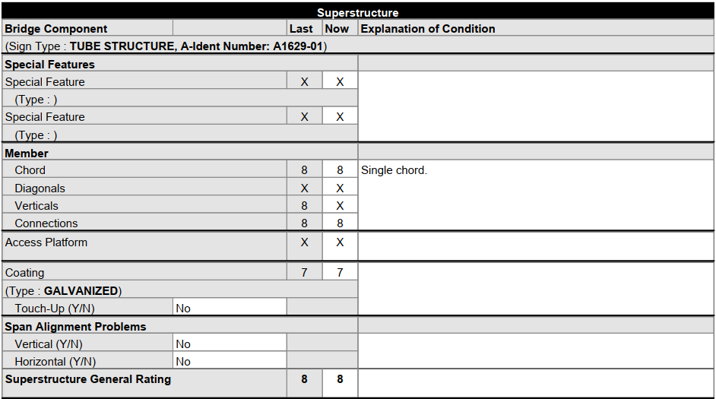
Superstructure
Refers to portion attached to columns and spanning the road

Slide 11
Superstructure (Cont’d)
Special Features
Refers to temporary or permanent
Not items identified as Traffic Safety Features
Typical examples
high load indicators,
special lighting,
hazard signing or flashers,
column brace,
wind deflectors

Slide 12
Superstructure (Cont’d)
Truss Members
rating details Chapter 7.16 of BIM Manual
bottom chord
diagonals
verticals
connections
check lower members for collision damage
tension members look for fatigue cracks
defects affecting load carrying capacity rate 4 or less
corrosion or pitting resulting in section loss rate 4 or less
cracks rate 3 or less

Slide 13
Superstructure (Cont’d)
Access platform (present on older signs)
platform and rail used for maintenance (signs and lights) – laid flat when not used
not for use during routine Level I from ground with binoculars
Check connections
high load damage
Coating
rating same as 15.6.5 Substructure
Span alignment problems
check for bows, sags, bow, buckling, twists, other signs of distress
alignment between columns is level

Slide 14
Signs
Refers to signs on the superstructure
Includes variable message boards
Should be clear, clean and readable

Slide 15
Signs (Cont’d)
Record type of sign (wood or metal)
Digital variable message boards
Sign Board
Over traffic so defects can be serious
damage from wind, high load, etc.
fasteners, and connections
coating damage or deterioration
lighting
Coating
Usually hi-vis reflective with lighting
Diamond grade without lighting
Damage/difficult to read rate 4 or less
Broken lights, loose cords 4 or less
Connections
loose or missing bolts
rate 4 or less

Slide 16
General Ratings
Approach Road / Safety Features
Horizontal and Vertical alignment
Safety concerns
Substructure
Pedestal, Column and Connection ratings
Superstructure
Load carrying elements
Safety concerns
Sign
Sign board, Connections, Coating, Illumination

Slide 17
Sign Structure Maintenance

Slide 18
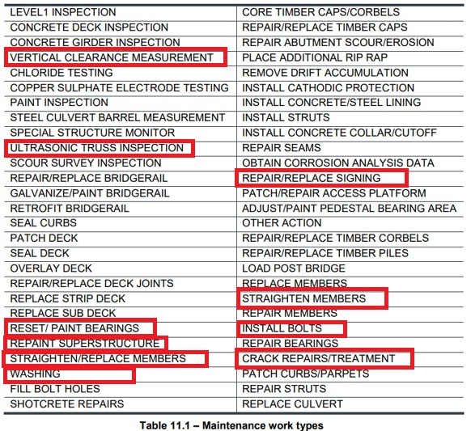
Sign Structure Maintenance Table 11.1

Slide 19
SIGN STRUCTURE TYPES 15.7.2

Slide 20
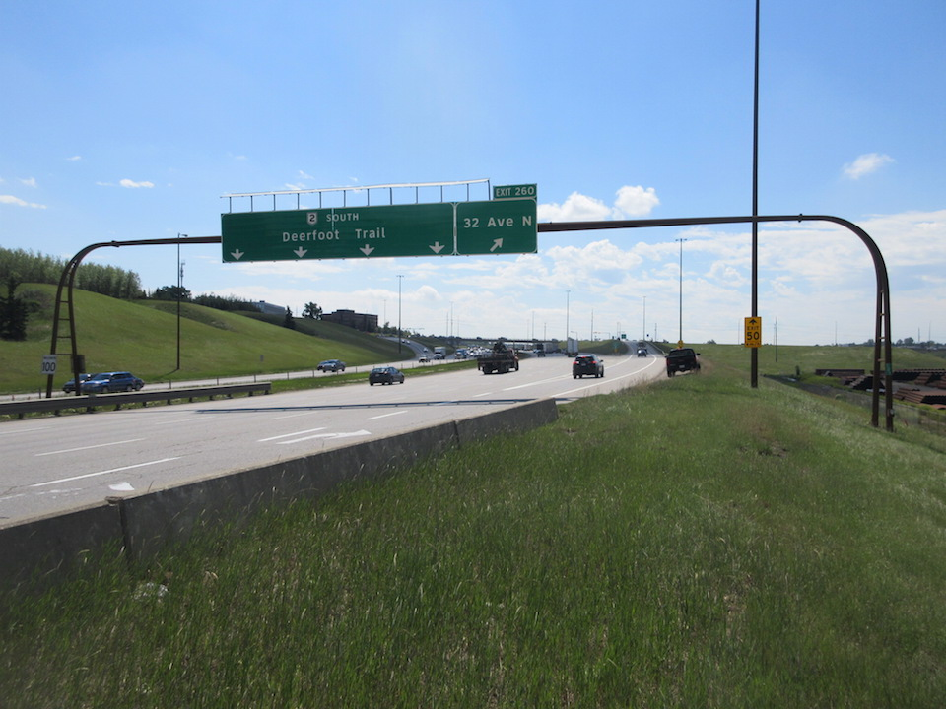
COR10

Slide 21
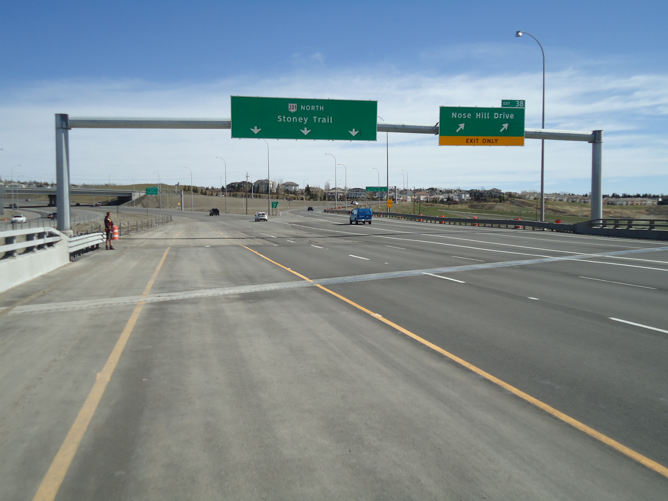
Tube - Double Leg

Slide 22
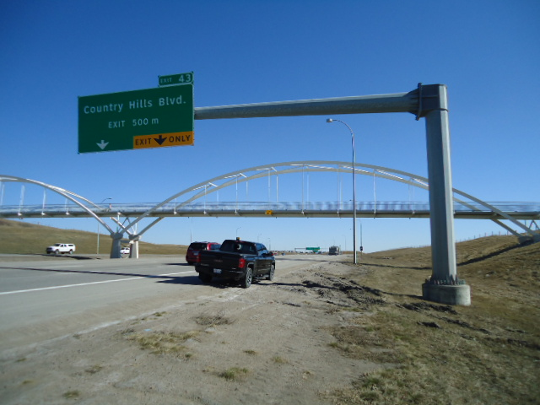
Tube - Cantilever

Slide 23
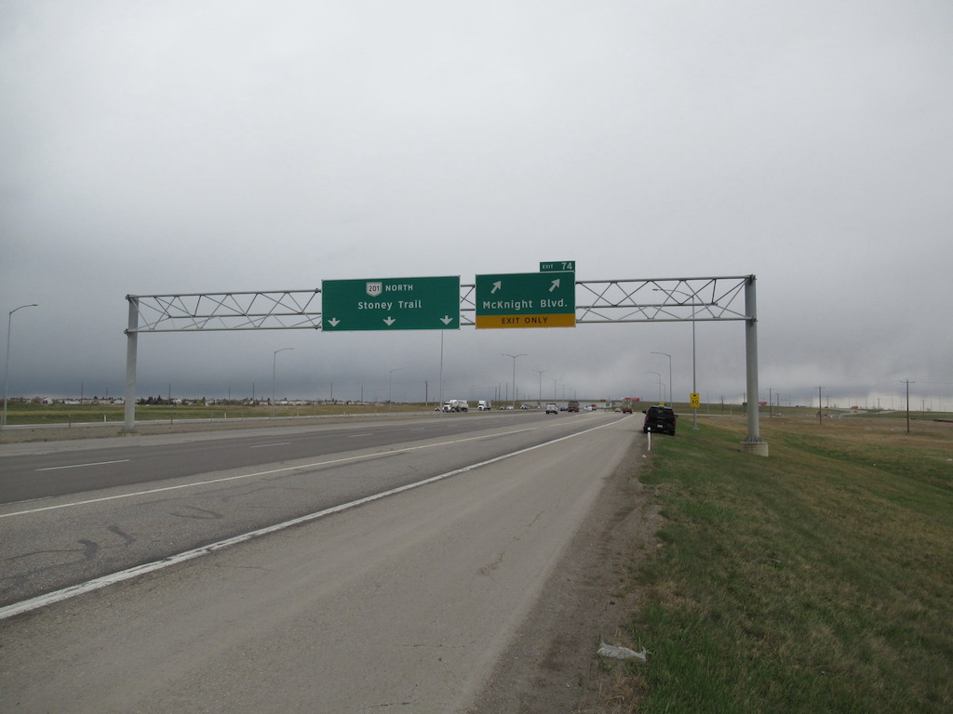
Space Truss – Double Leg

Slide 24
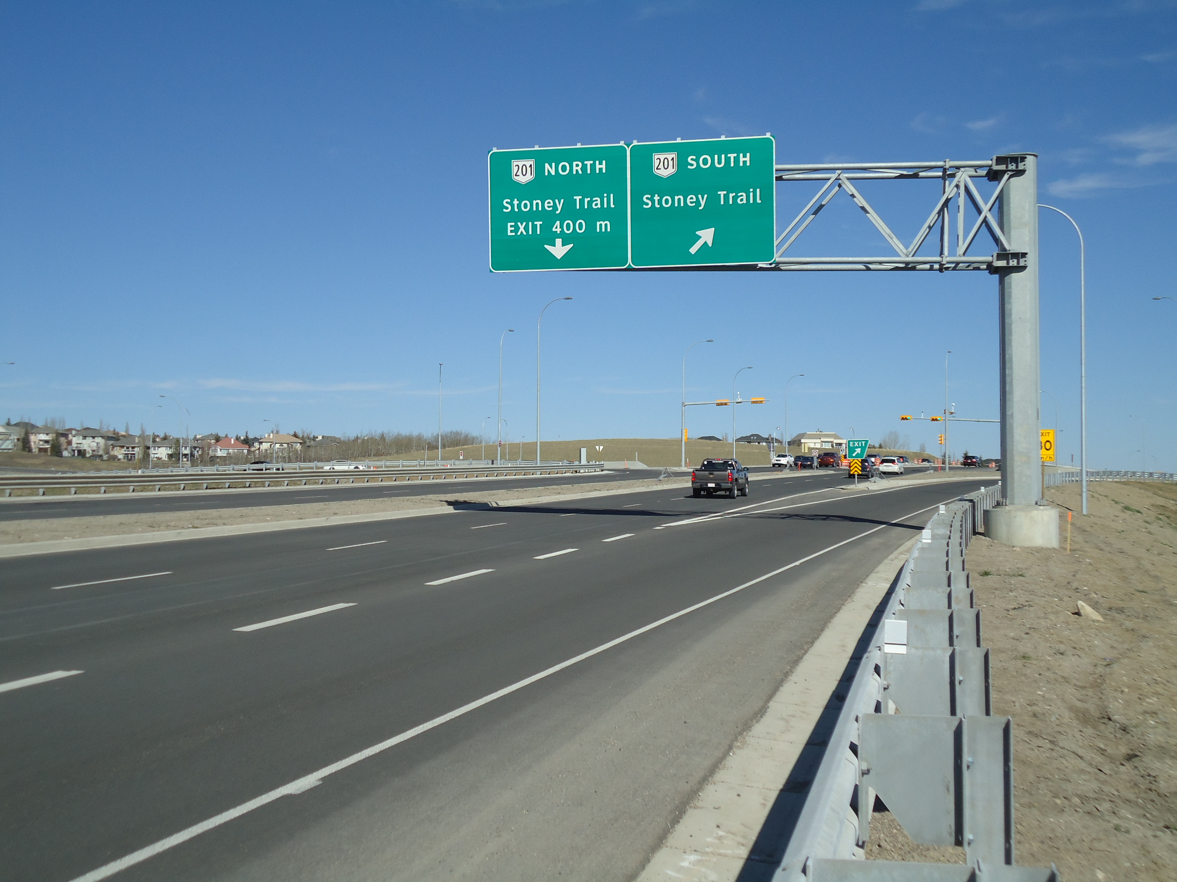
Space Truss – Cantilever

Slide 25
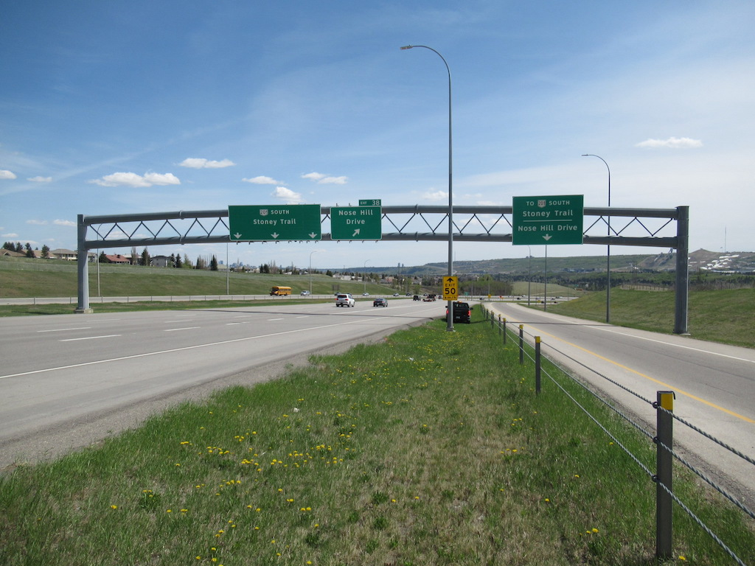
Truss – Double Leg

Slide 26
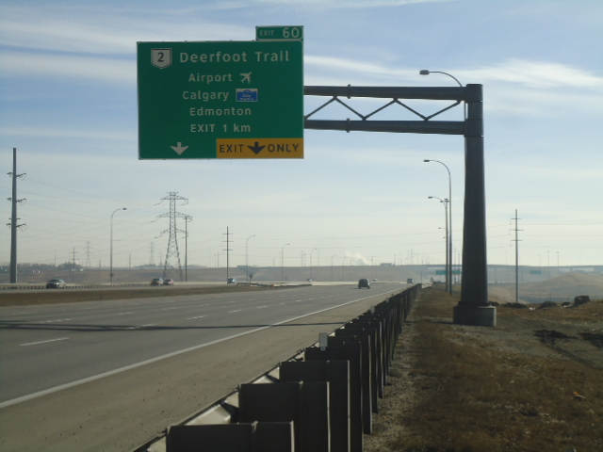
Truss – Cantilever

Slide 27
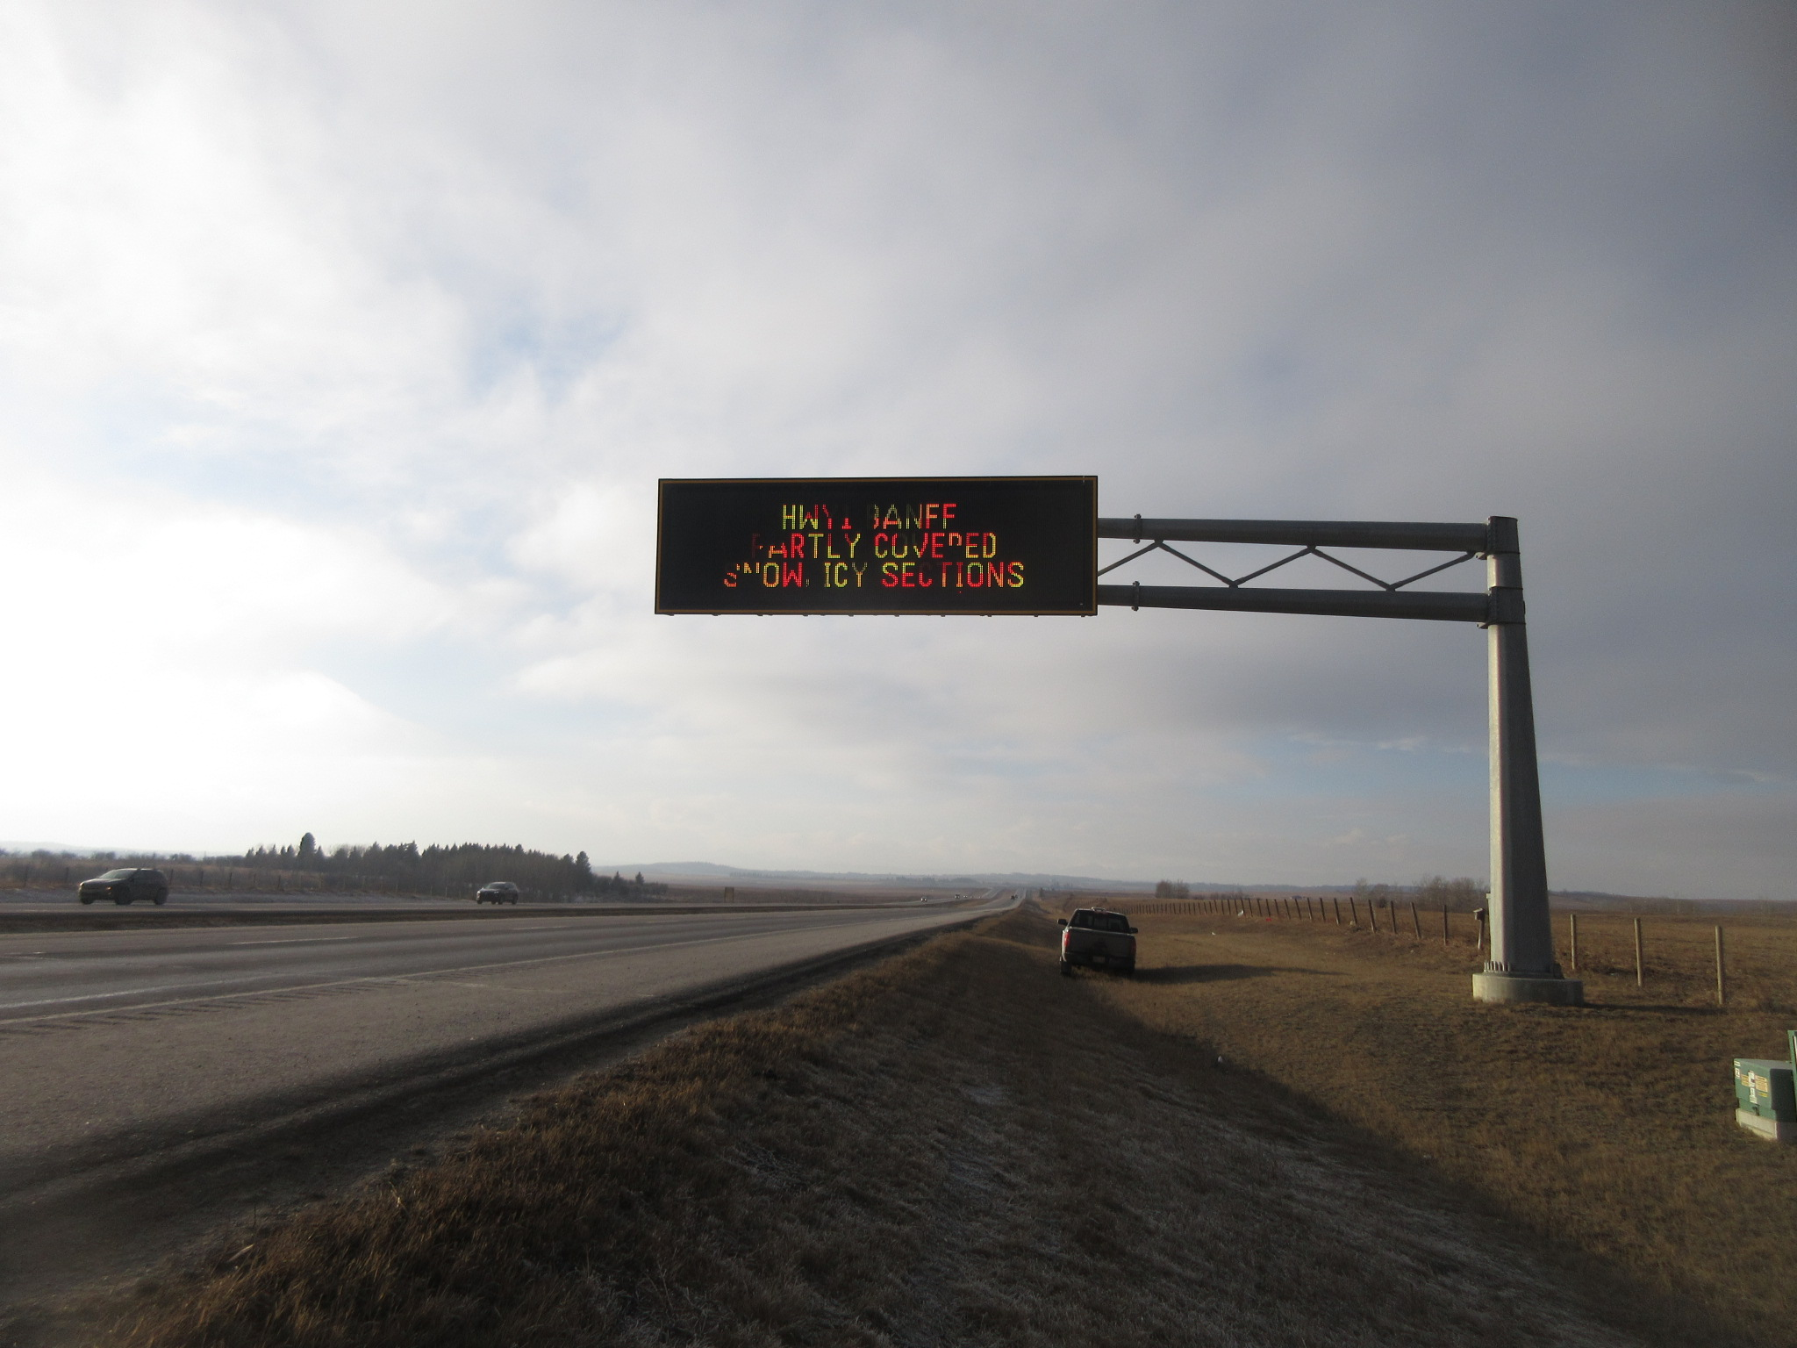
Variable Message Board – Truss Cantilever

Slide 28
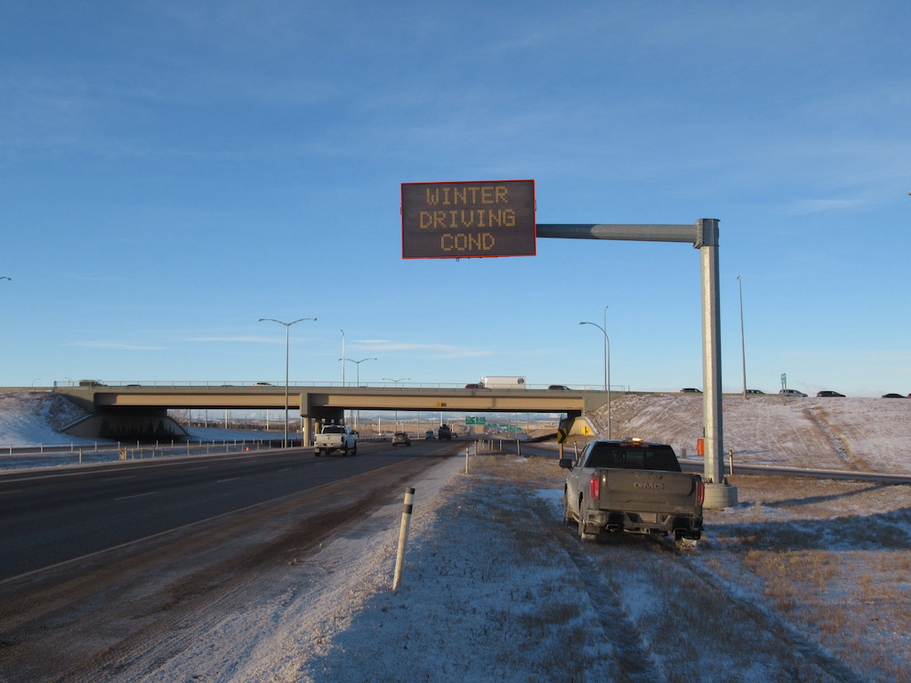
Variable Message Board – Tube Cantilever

Slide 29
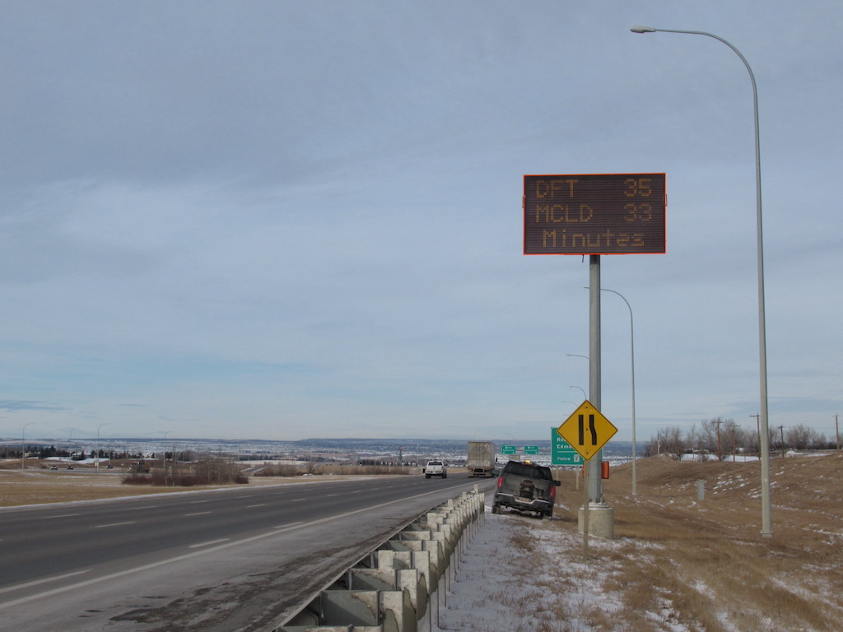
Variable Message Board – Vermac Lollipop

Slide 30
SIGN STRUCTURE SPECIAL FEATURES

Slide 31
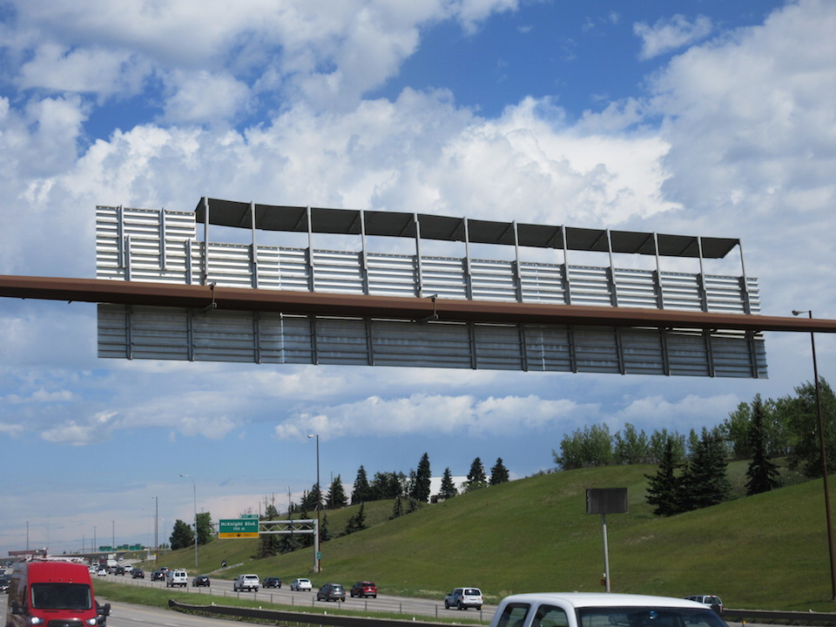
Wind Deflectors on COR10

Slide 32
Wind Deflectors https://www.youtube.com/watch?v=GmEgH6jAV2k

Slide 33
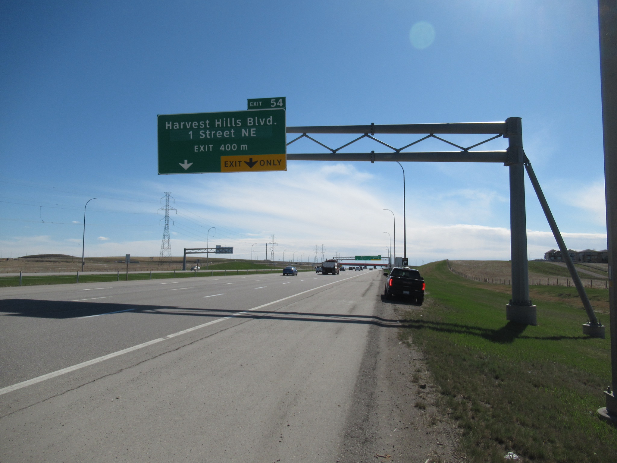
Column Support Arm

Slide 34
SIGN STRUCTURE TYPICAL DEFECTS

Slide 35
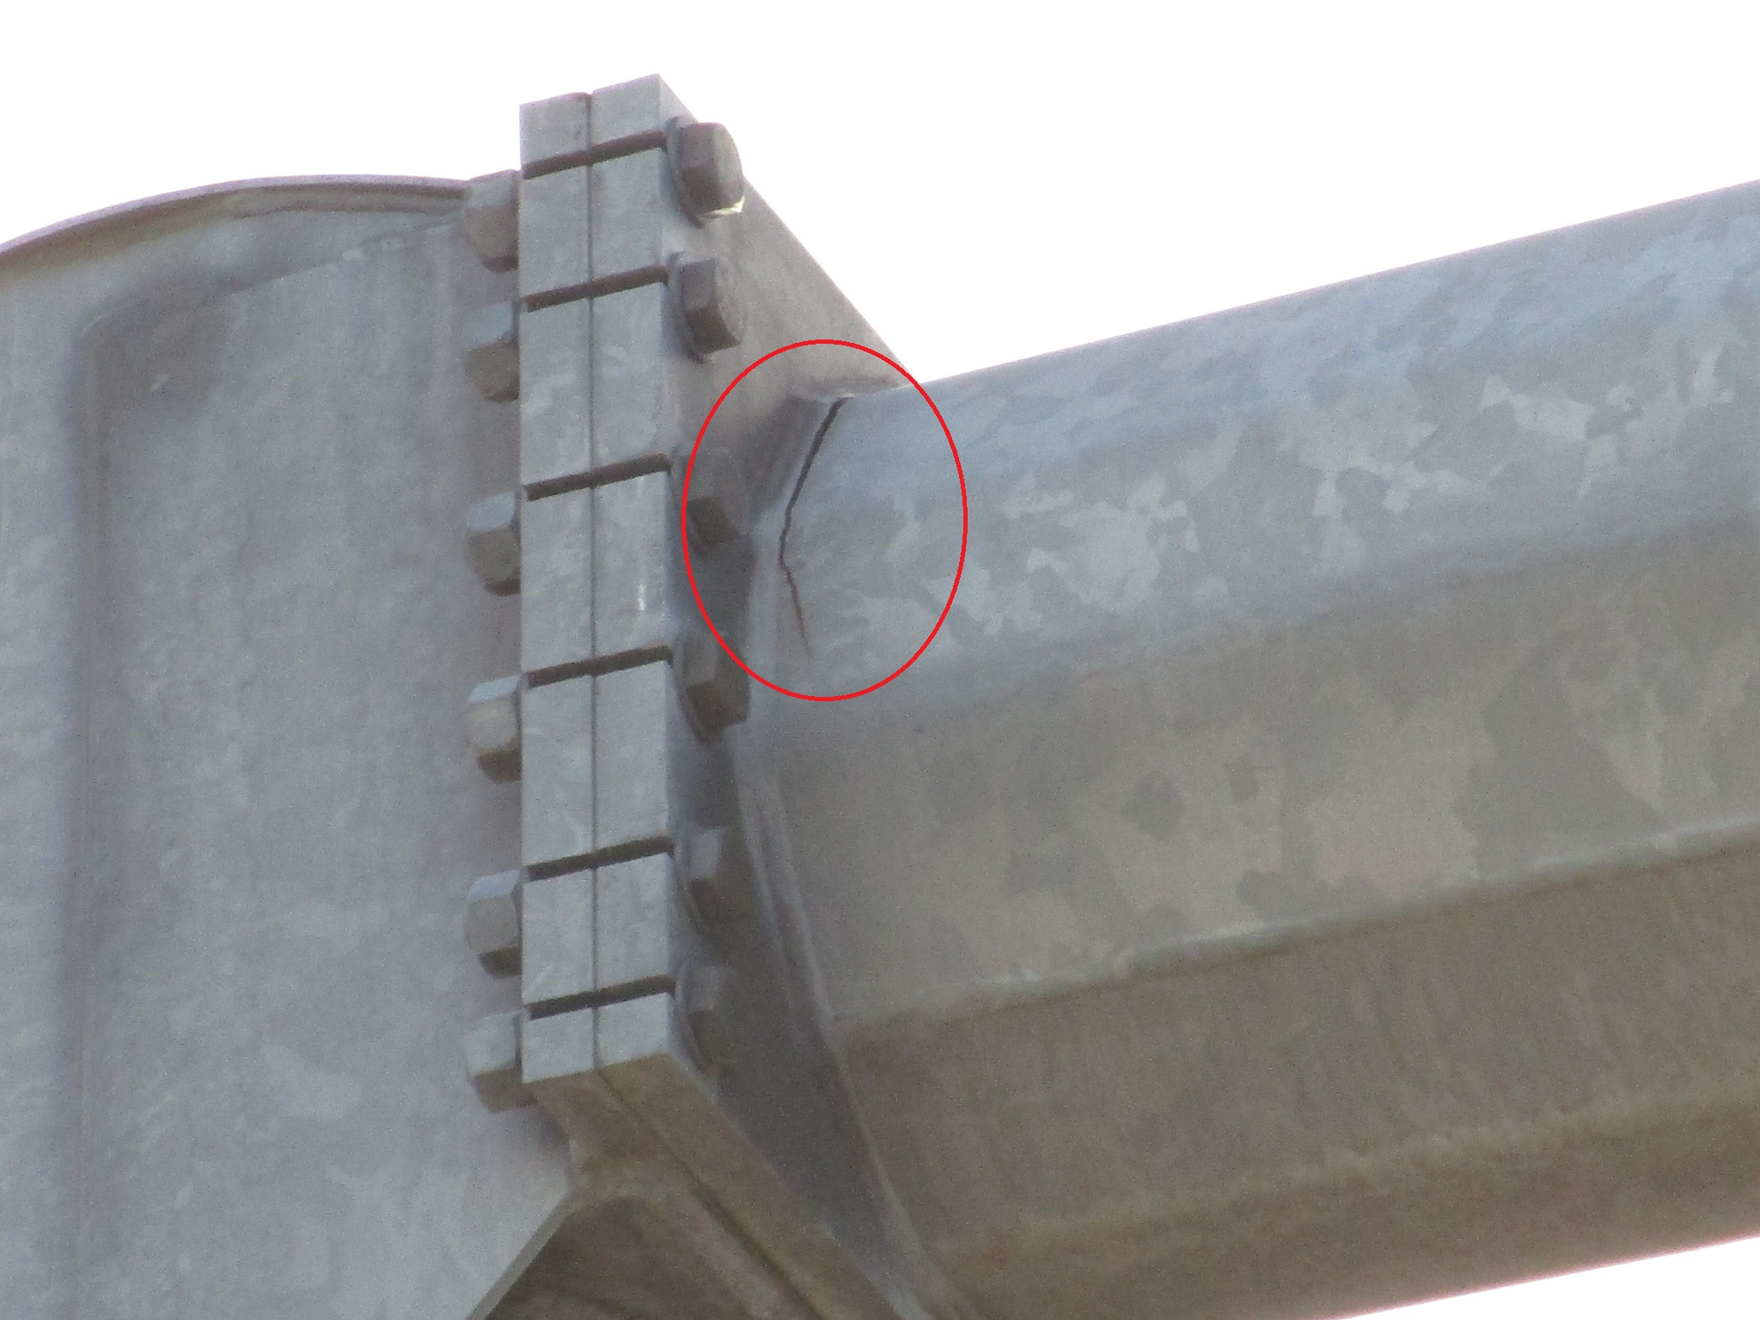
Crack in Top Chord

Slide 36
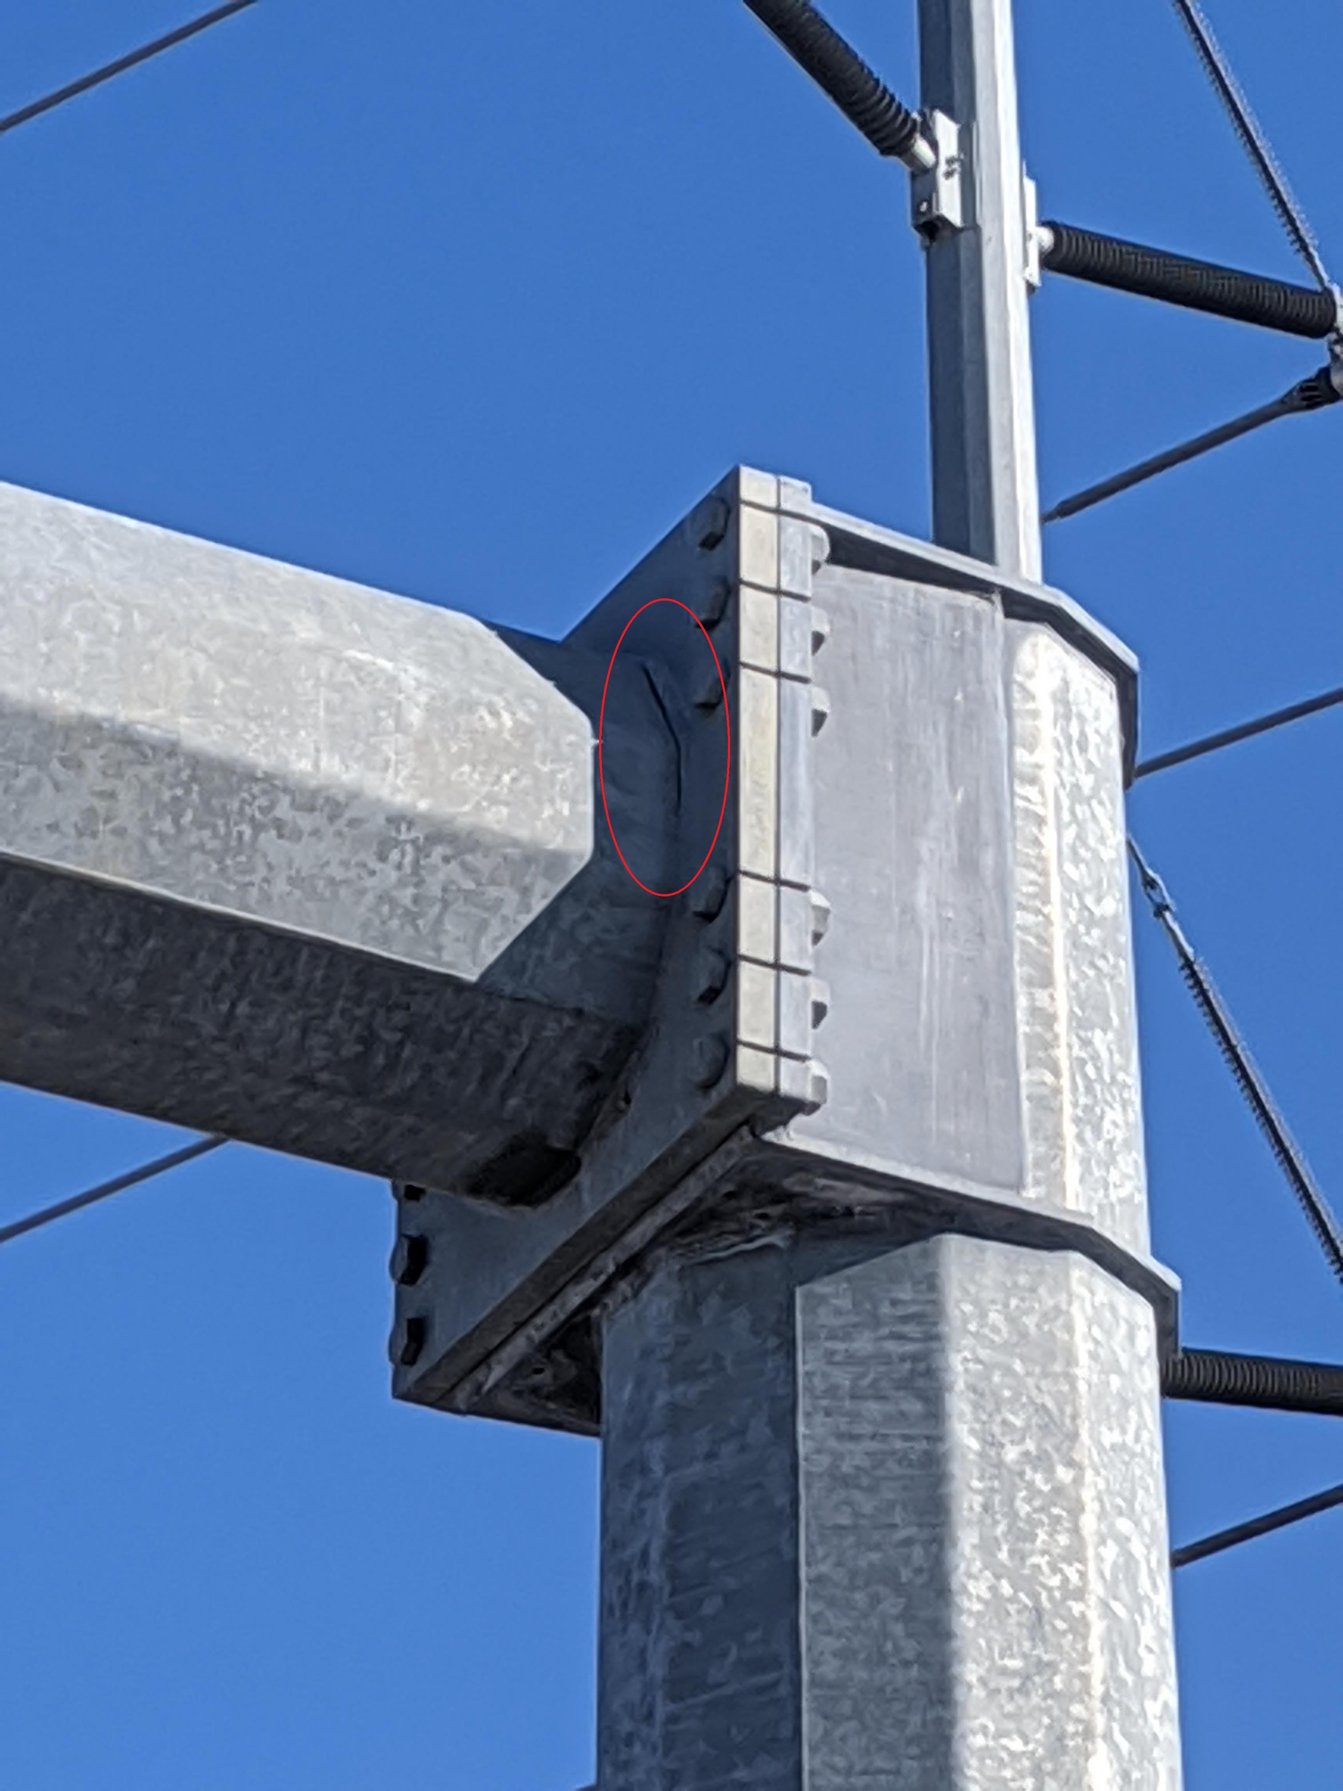
Crack in Top Chord

Slide 37
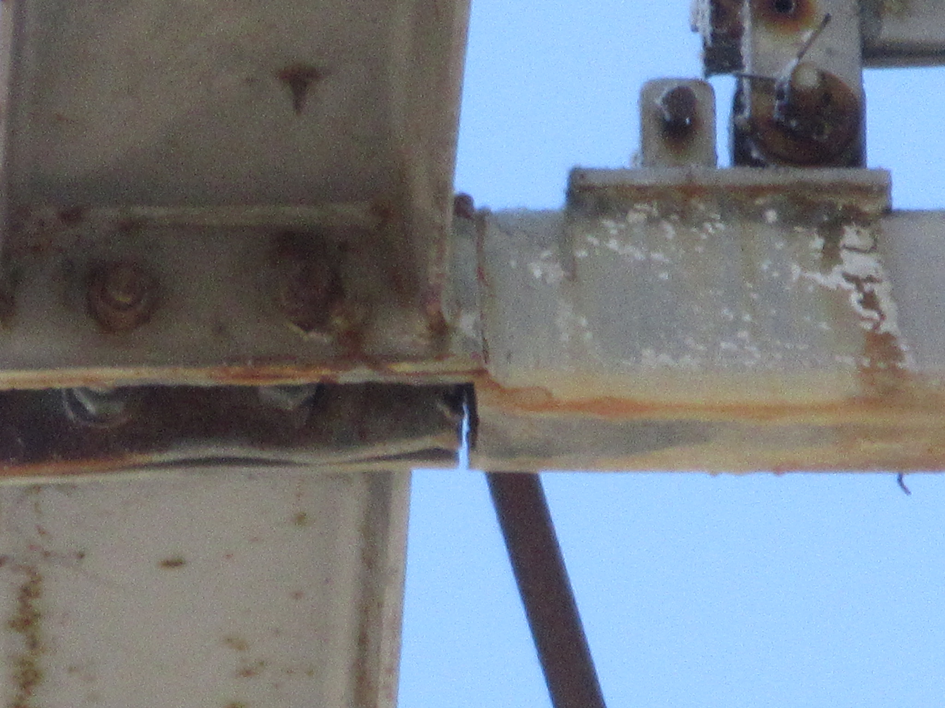
Crack in Access Platform Support

Slide 38
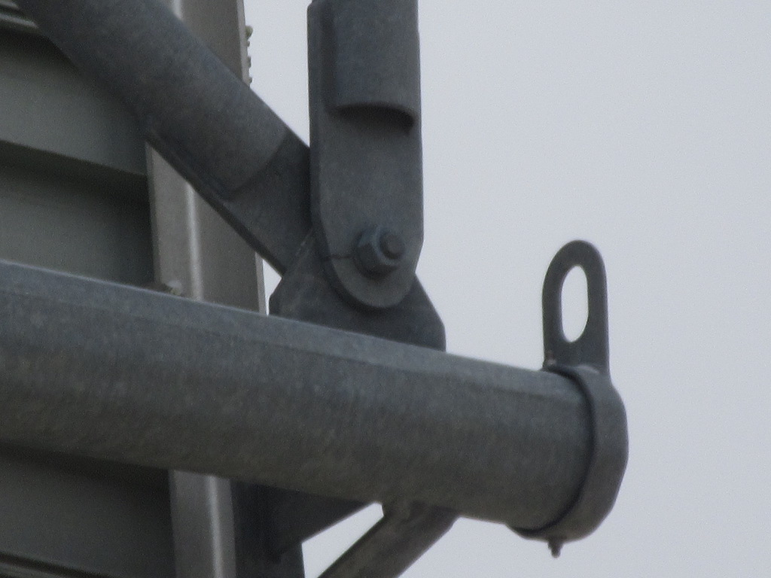
Crack in Vertical at Bolt Hole

Slide 39
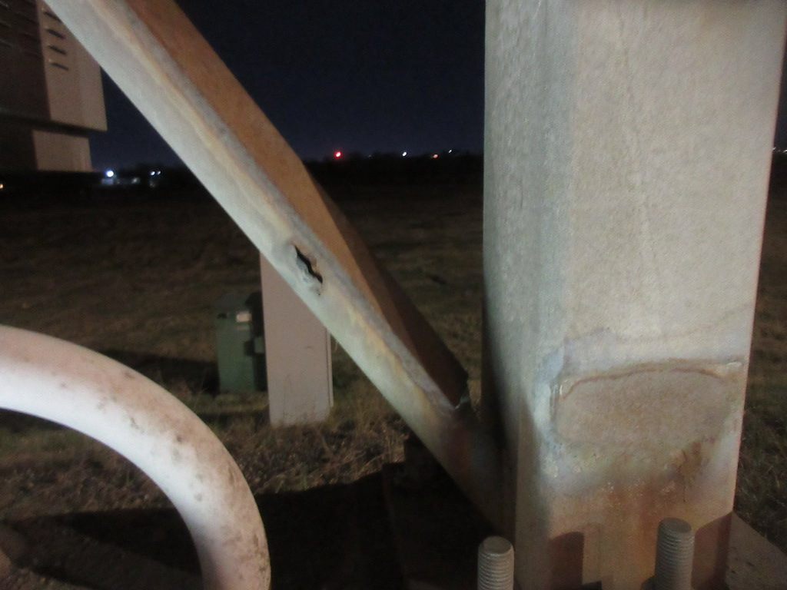
Crack in Diagonal

Slide 40
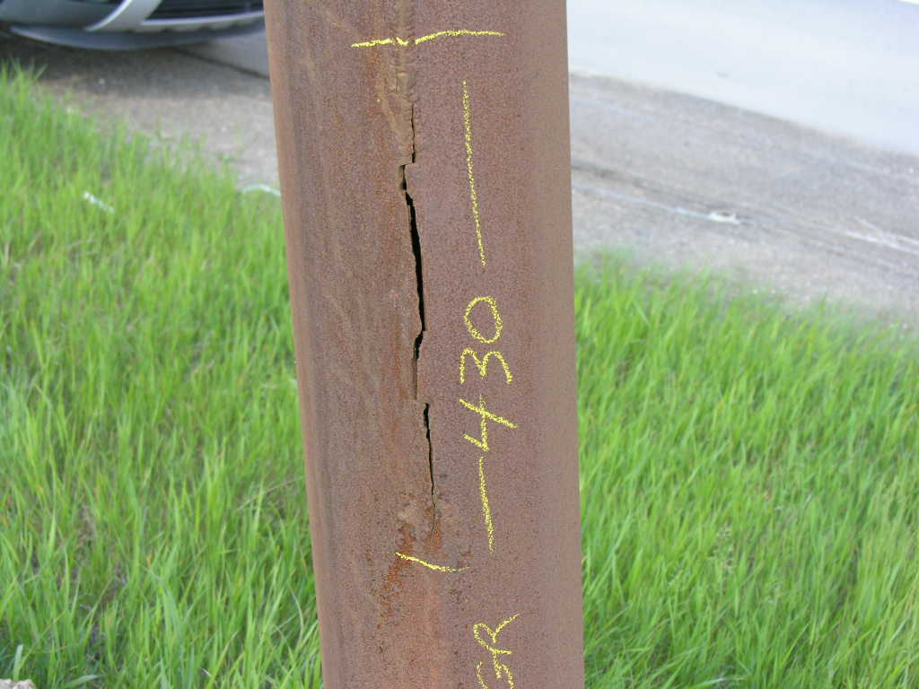
Crack in Column of COR10

Slide 41
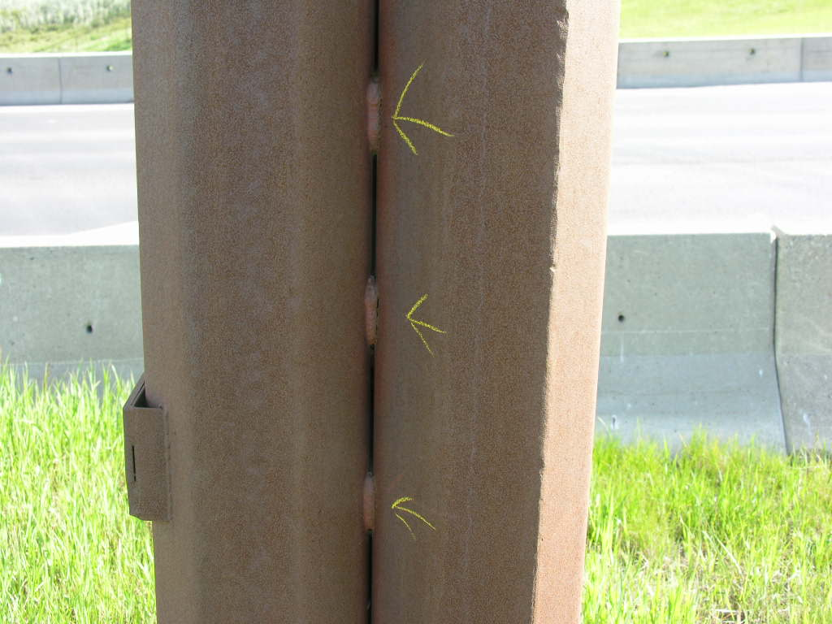
Cracks in Column Joint Welds of COR10

Slide 42
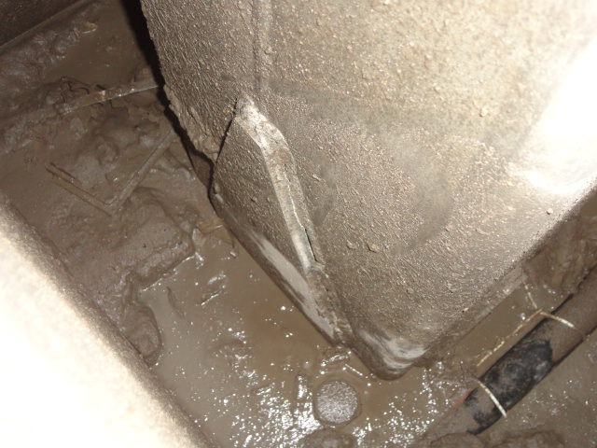
Crack in Column Plate Weld

Slide 43
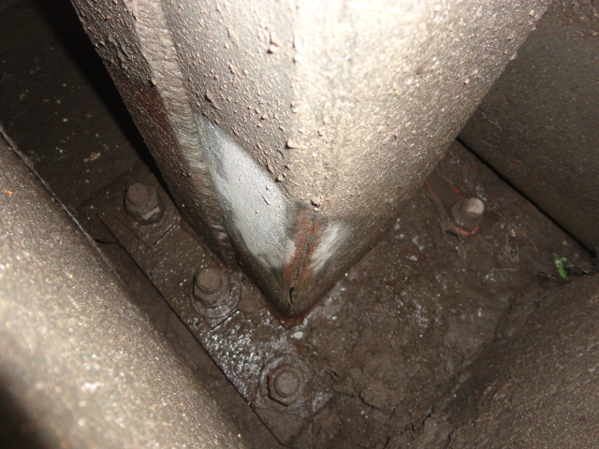
Crack in Column Plate Weld

Slide 44
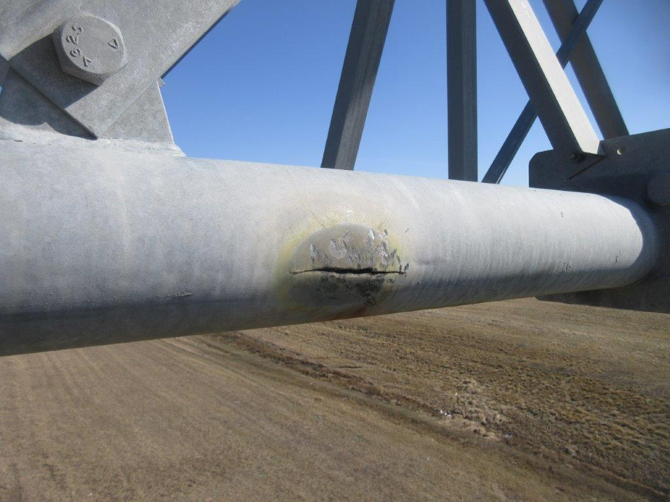
Crack in Bottom Chord

Slide 45
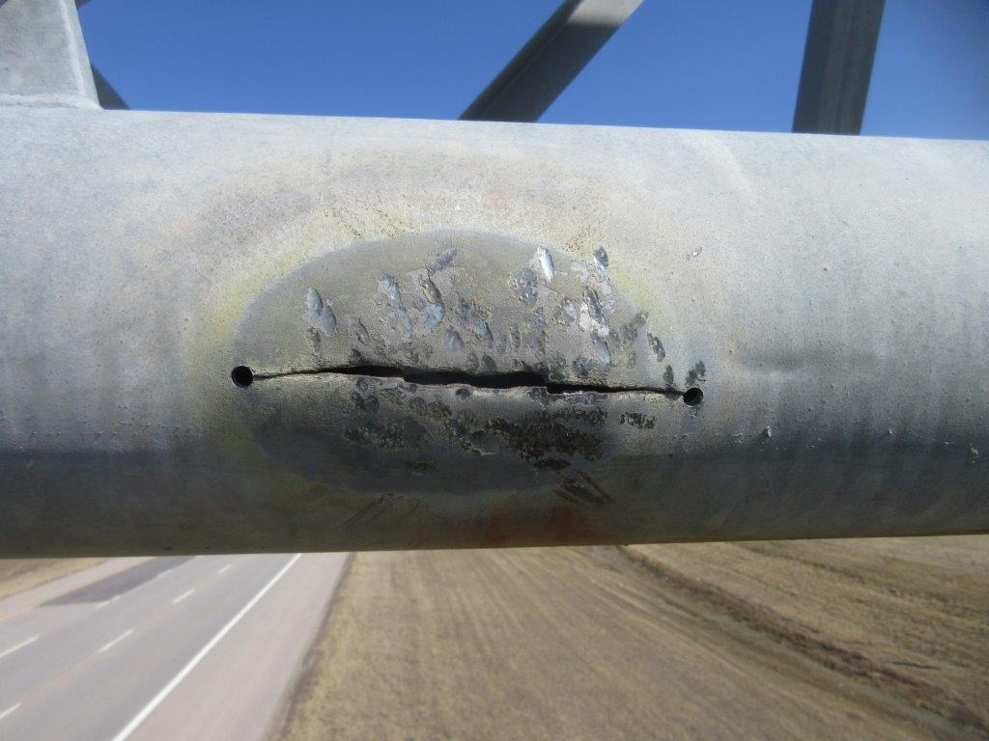
Crack in Bottom Chord – Stop Drilled

Slide 46
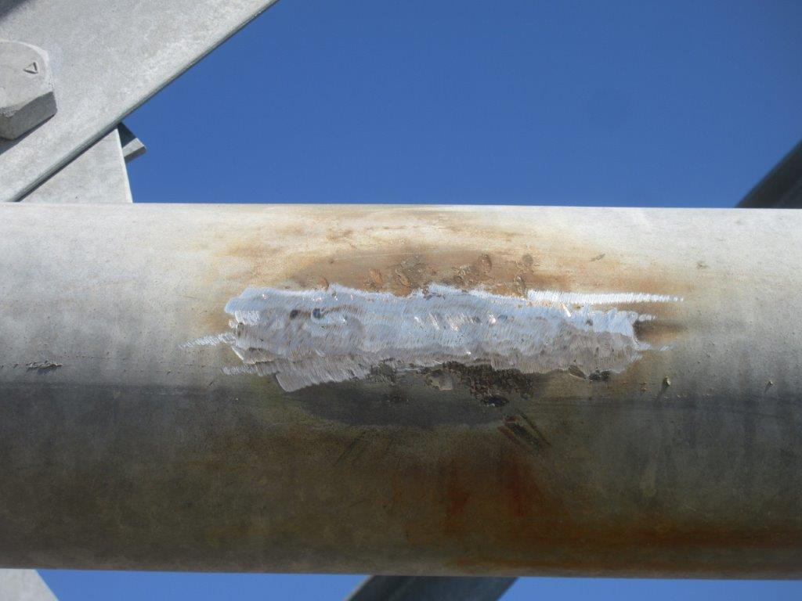
Crack in Bottom Chord – Weld Repair

Slide 47
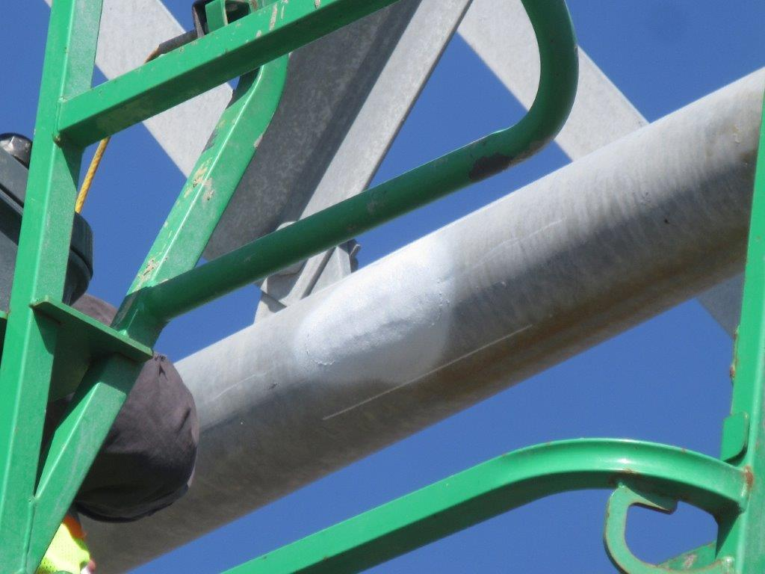
Crack in Bottom Chord – Metallized

Slide 48
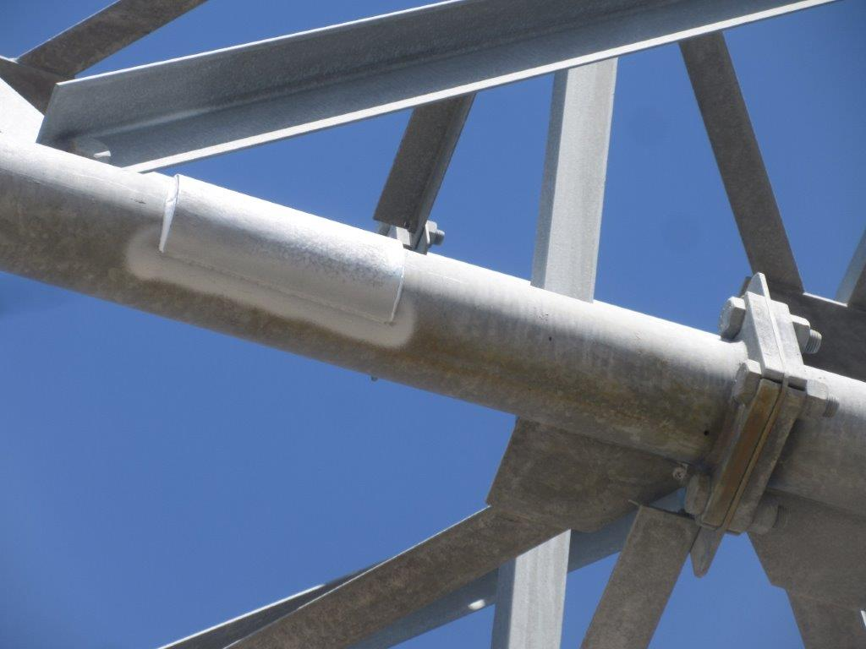
Crack in Bottom Chord – Steel Sleeve

Slide 49
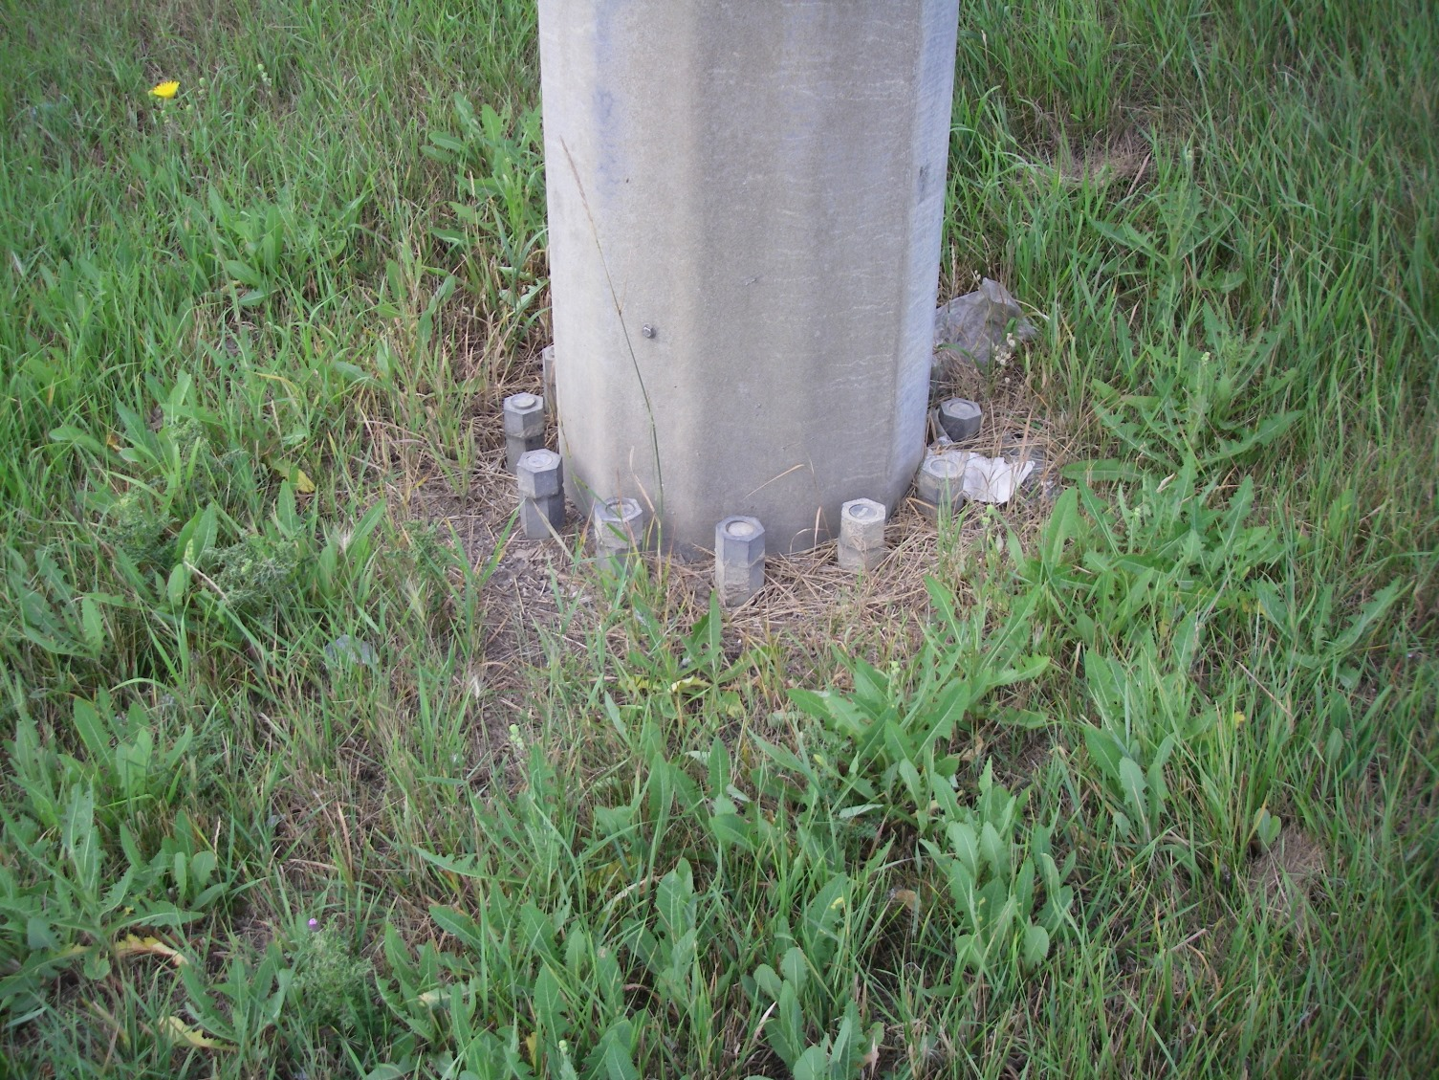
Buried Pedestal

Slide 50
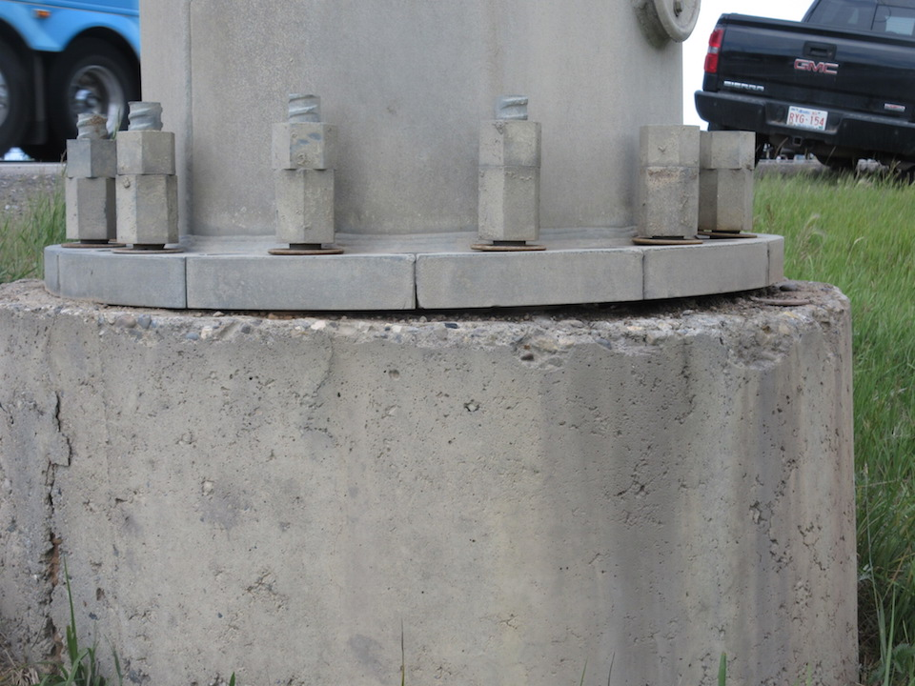
Loose Anchor Bolt Nuts

Slide 51
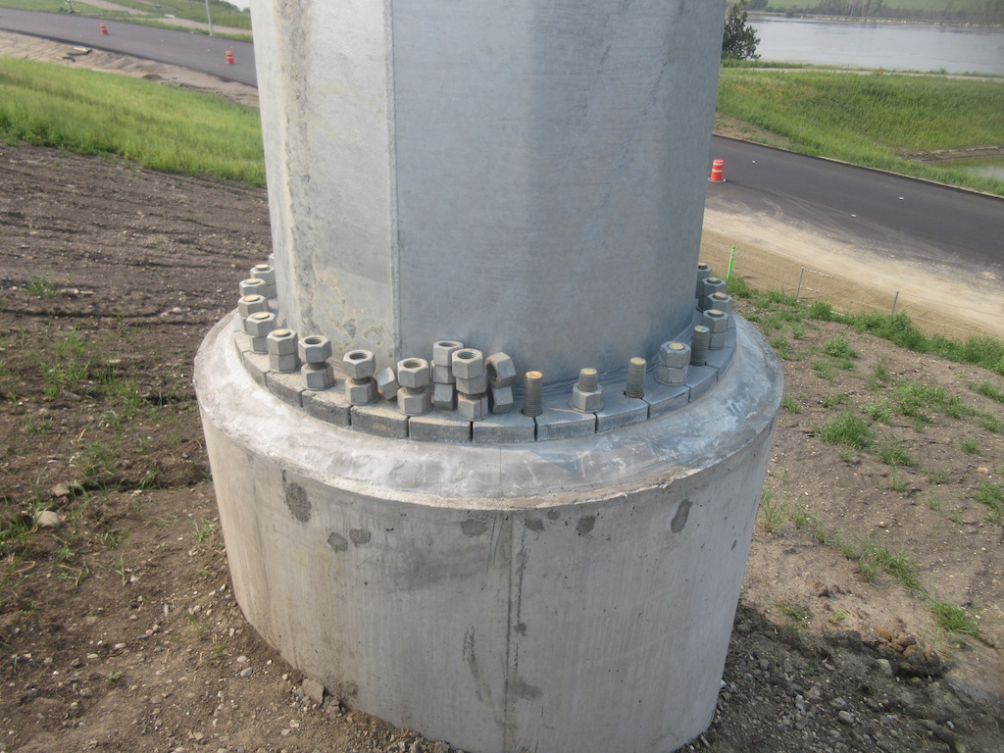
Missing Anchor Bolt Nuts

Slide 52
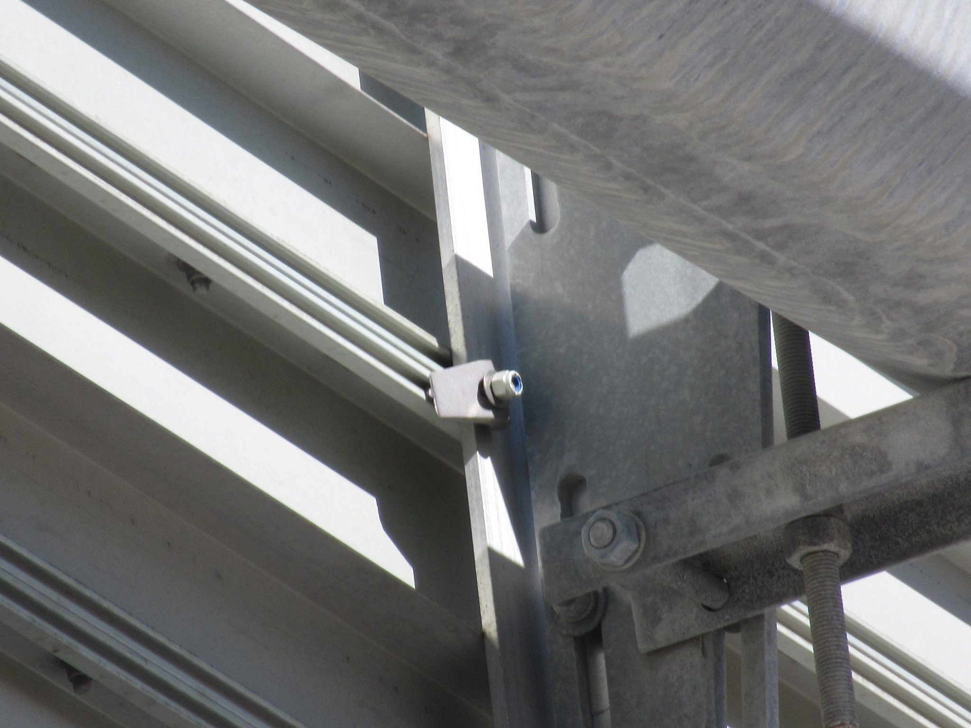
Loose Bolt

Slide 53
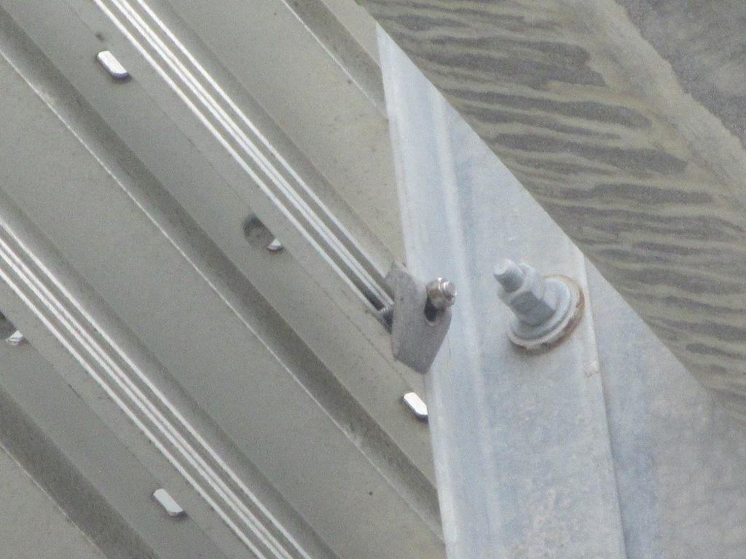
Loose/Displaced Sign Clip

Slide 54
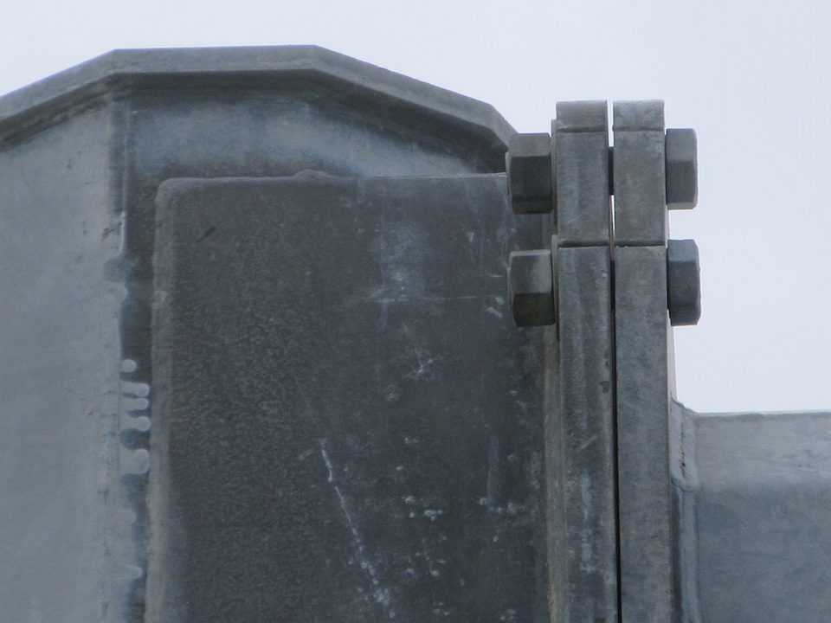
Loose Top Chord Connection Bolts

Slide 55
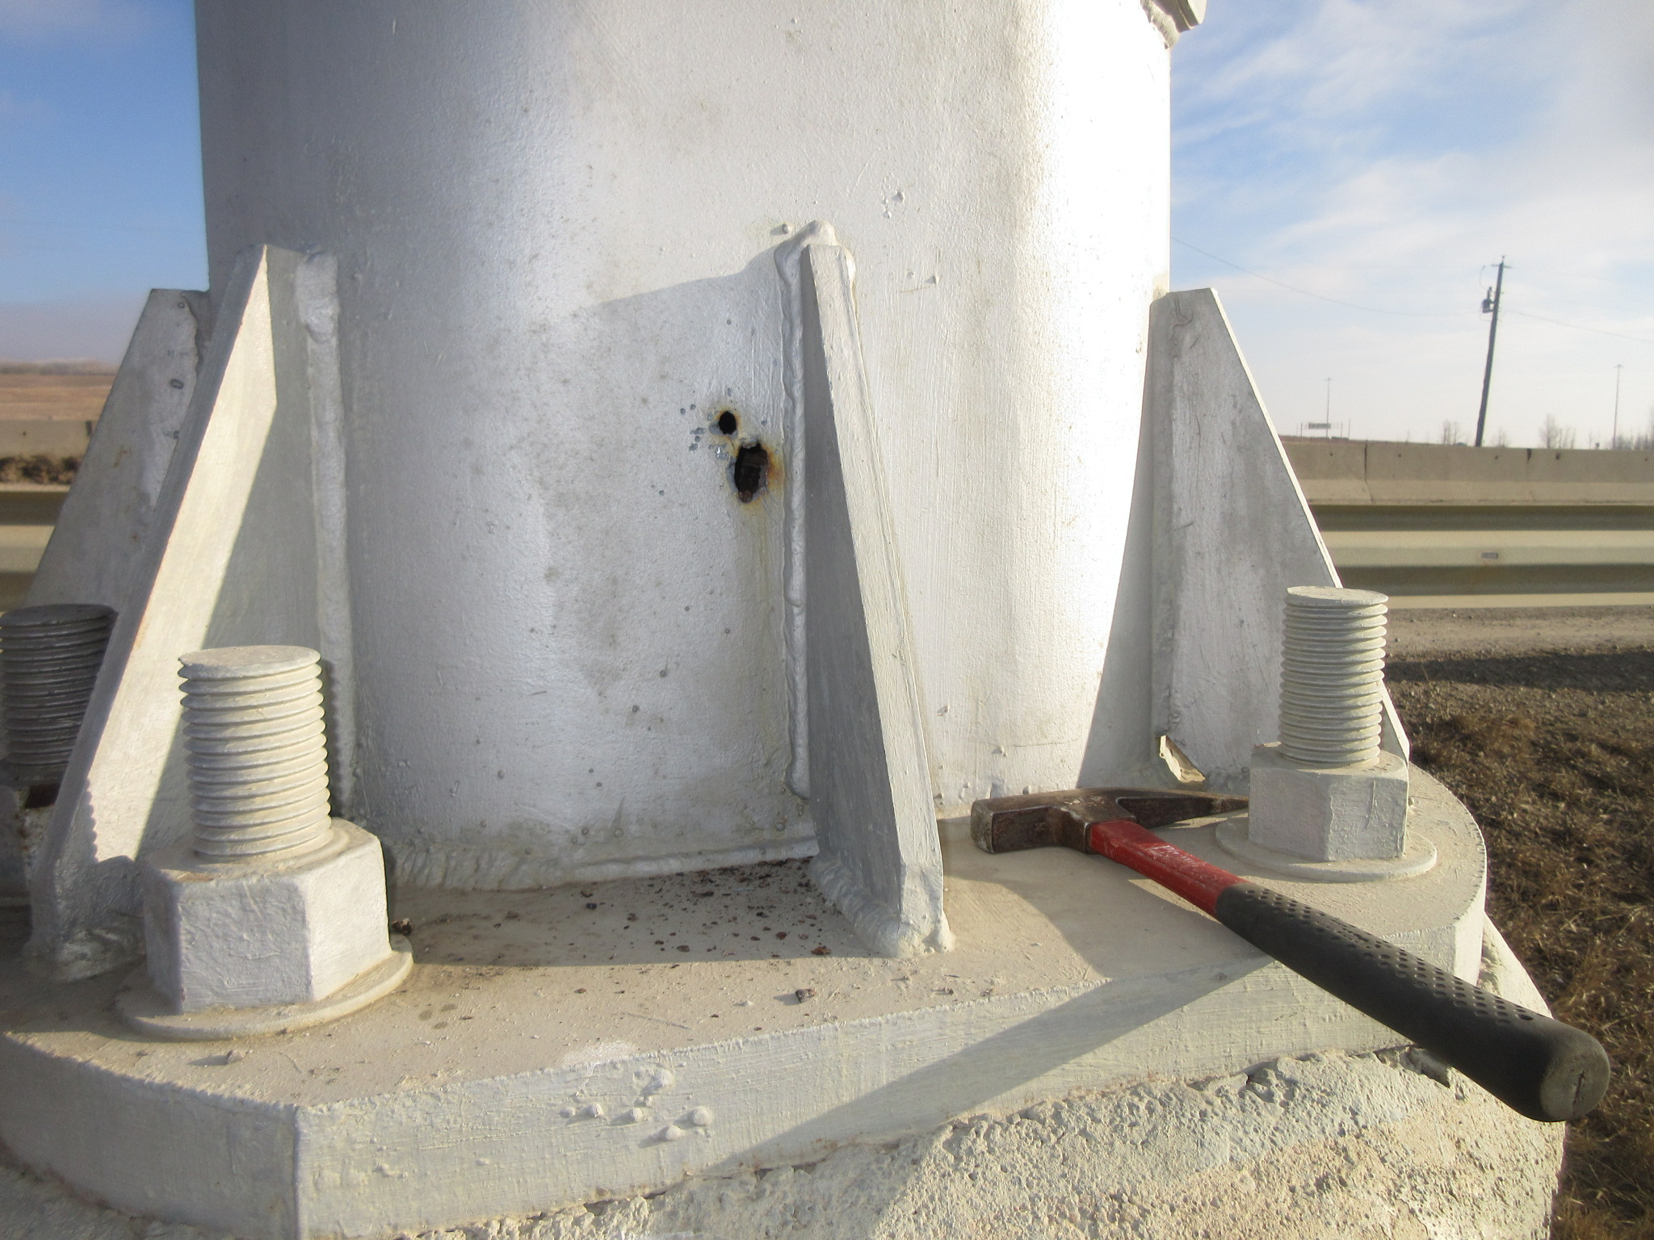
Column Perforations

Slide 56
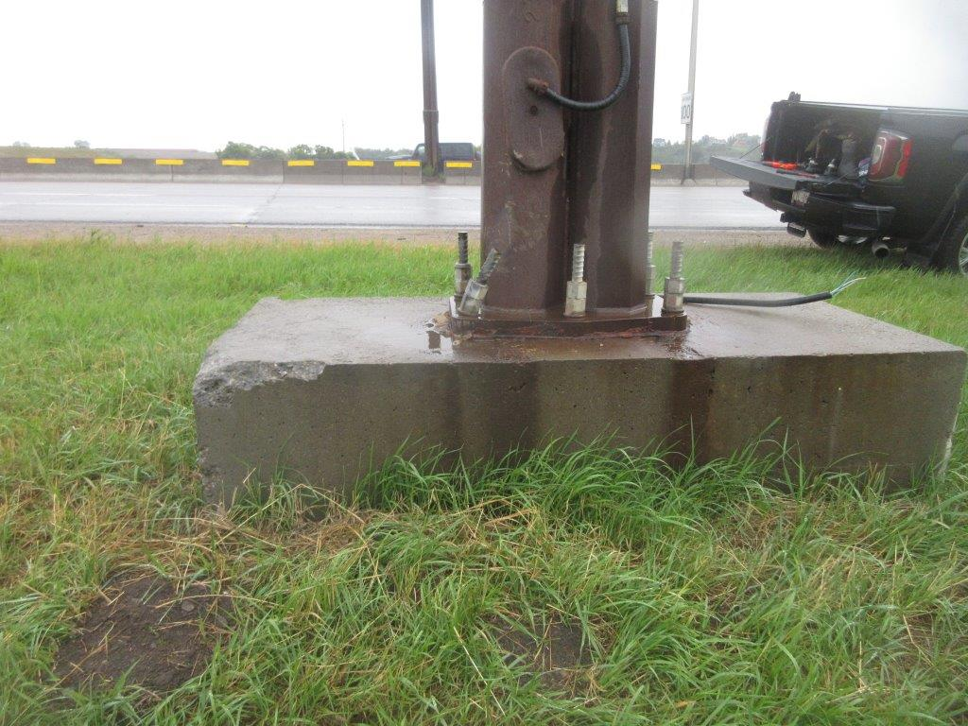
Collision Damage

Slide 57
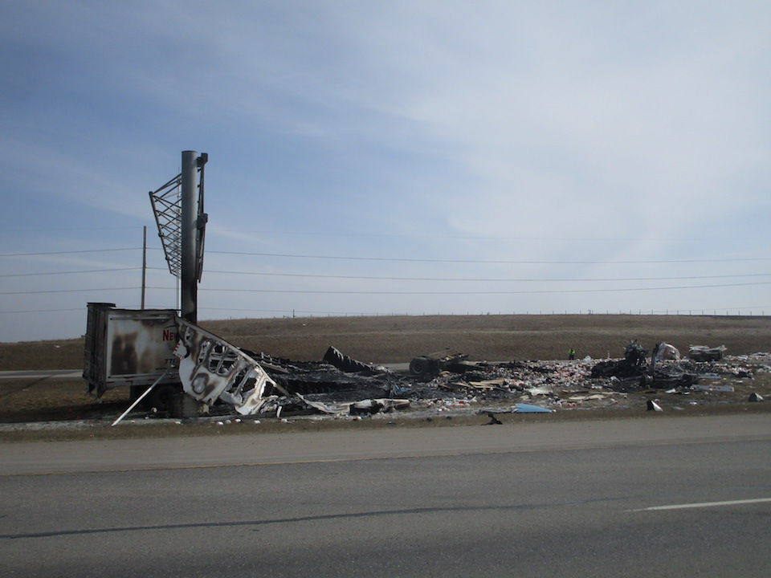
Collision Damage

Slide 58
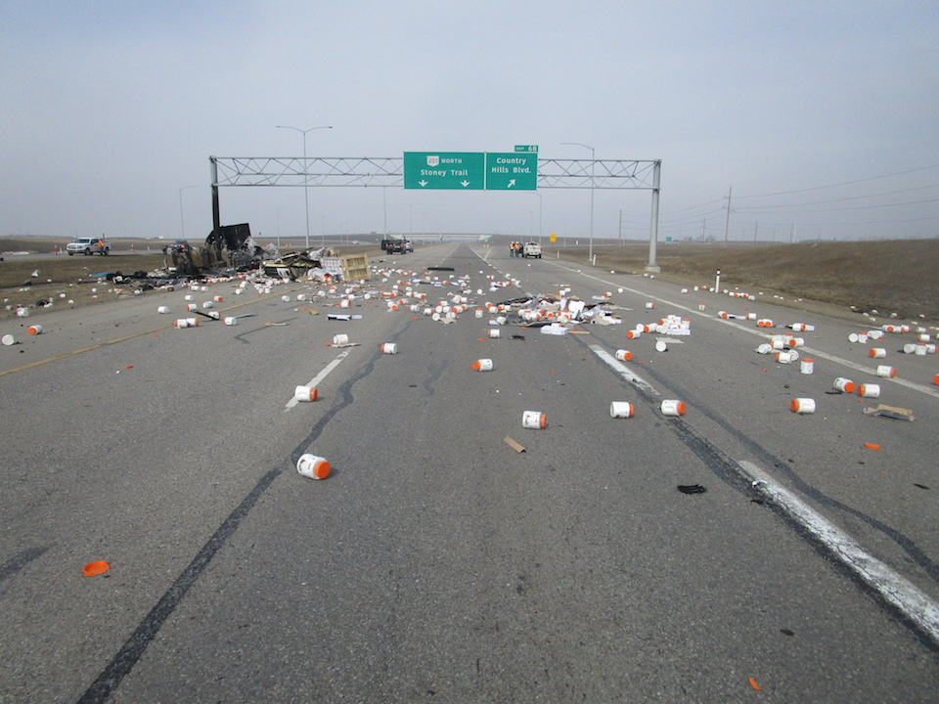
Collision Damage

Slide 59
Questions?

