Slide 1
ADVANCED HYDRO TECHNICAL
CONSIDERATIONS
Notes:
Stream Related Issues for Major Bridges

Slide 2
Overview
Hydrotechnical Review
Pier Scour Inspection
RPW Inspection
Case Study
Notes:
Hydrotechnical Review - HDGHydrotechnical Design Guidelines - Y,Q,V ; Hydraulics ; Constrictions, Blockage ; Vertical – scour, degradation ; Lateral – stream alignment, RPW
Pier Scour Inspection – shallow spread footings, program, sounding
RPW Inspection – function - bank tracking – airphotos ; condition - visual
Case Study – BF78104 McLeod River near Peers, Hwy 32 – pier scour = f(alignment)

Slide 3
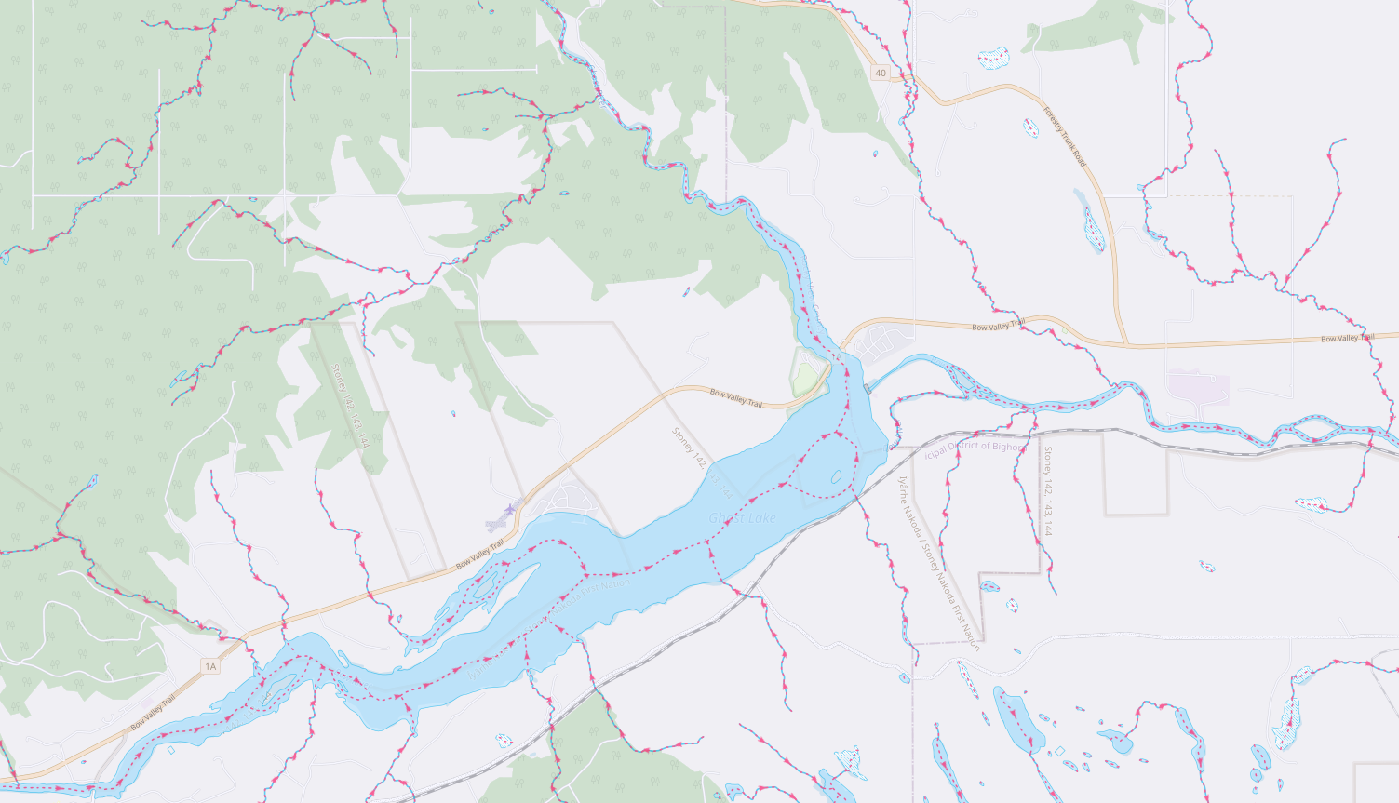
Hydrotechnical Review
Area
Shape
Slope
Channel
Storage
Density
Vegetation
Soil Type
Initial Moisture

Slide 4
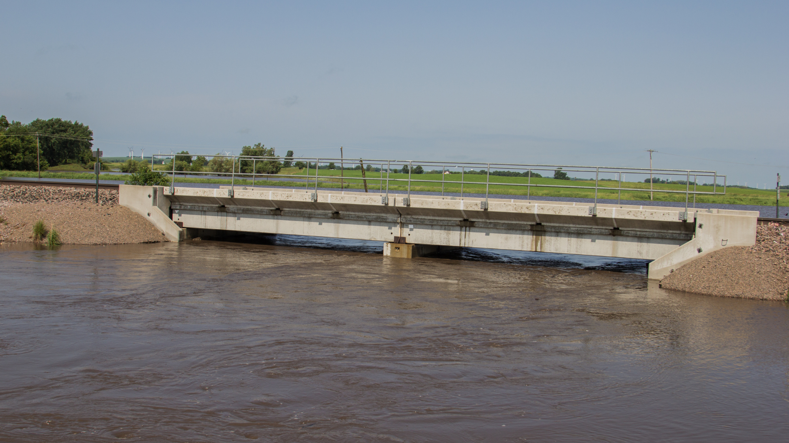
Hydrotechnical Design Guidelines
Channel Capacity
Historic Highwater Data
  Drift, debris
  Scars, erosion
  Locals, photos
Runoff Potential

Slide 5
V = Q
Water Surface
A
Y
A
Q
Thalweg
Notes:
Q - Discharge = the rate of flow of water. It is the volume of water passing through a cross section of a channel in a given period of time. This is not a constant value: it is constantly changing.
A - Area = Cross sectional area of flow in the channel. Assuming a rigid boundary, the area is a function of the geometry of the channel.
V - Velocity = the mean velocity for the cross section, as determined by V=Q/A.
Thalweg - lowest point on streambed
Water Surface - Elevation of surface of flowing water
Y - depth of flow

Slide 6
Bridge
Culvert
Notes:
Bridges and culverts may provide less flow area than the typical channel – constriction.
Impact of constriction varies with magnitude and shape.
Increased V – scour, damage, environmental
Increased headloss – u/s flooding, uplift, overtopping
Increased risk of blockage

Slide 7
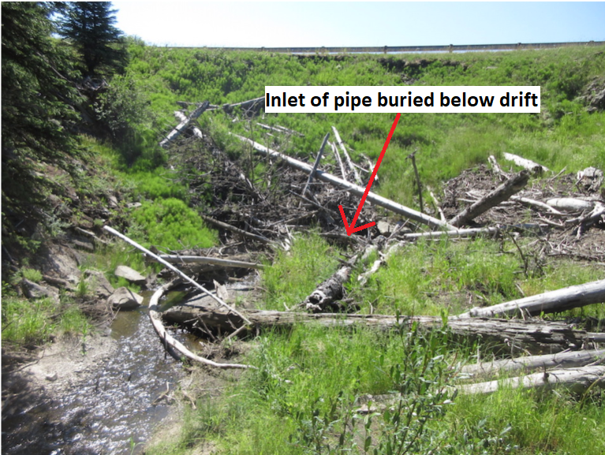
BF 79501 – Hwy 546 West of Diamond Valley
Notes:
June 2013 Floods – Hwy 546 over unnamed watercourse

Slide 10
Flow Parallel to Pier
Flow on Skew to Pier

Slide 11
Dam
Q_{s}D₅₀ ~ QS
Aggradation
Degradation

Slide 12
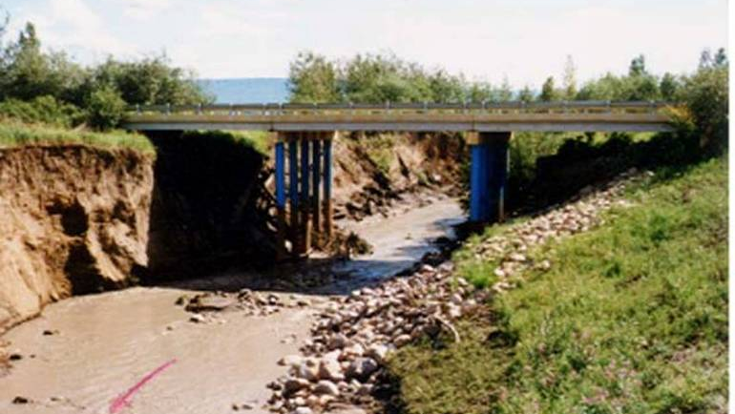
Notes:
Bear Ck East of LaCrete
Channel degradation resulting from channel modifications by AENV.
Note steep channel banks, blue paint on pier piles.

Slide 13
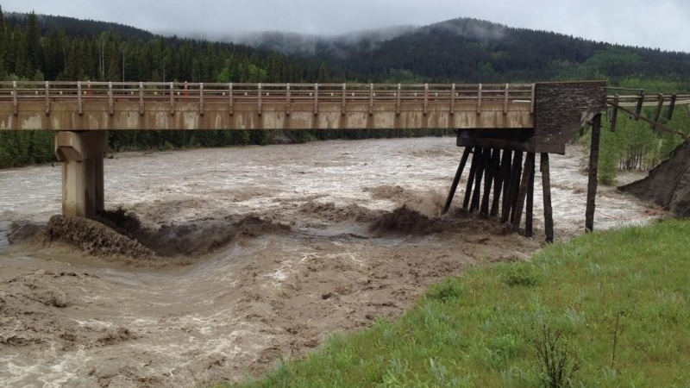
Notes:
BF 71429 Highway 66 during 2013 flood. Loss of east approach road and east abutment backfill and headslope material. Underside of abutment and piles fully exposed.

Slide 14
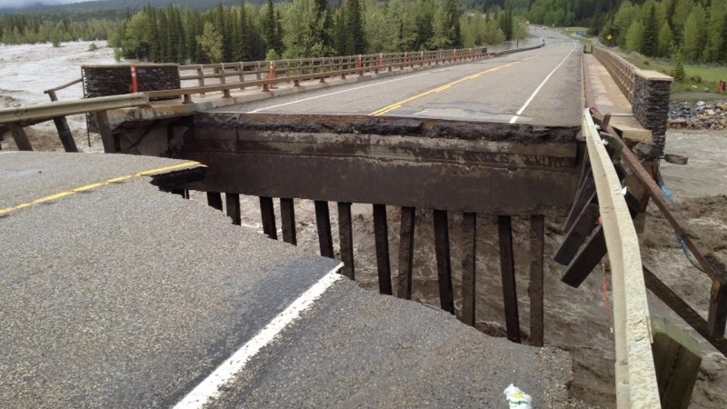
Notes:
BF 71429 Highway 66 during 2013 flood. Loss of east approach road and east abutment backfill material. Underside of abutment and piles fully exposed.

Slide 15
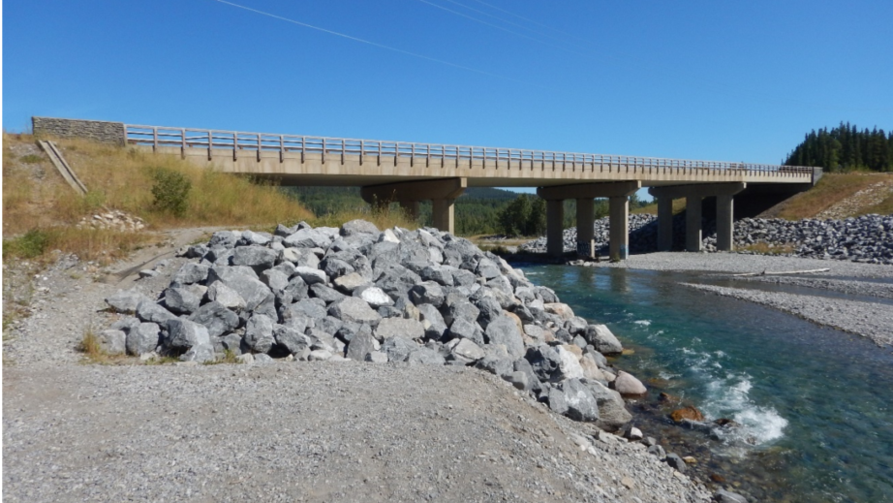
Notes:
BF 71429 Highway 66 – post flood repairs. Previous 3 span bridge now 4 spans with newly built east abutment and east pier (P3)

Slide 16
High
1
2
3a
Relative Stability
3b
4
5
Low
High
Relative Stability
Low

Slide 17
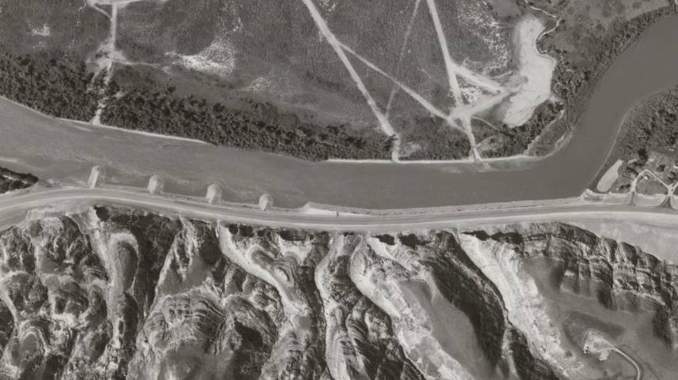
Notes:
Hwy 10 encroachment - Red Deer River - E of Drumheller
Airphoto view of entire reach shortly after construction
Guidebank and spurs built to prevent lateral migration

Slide 18
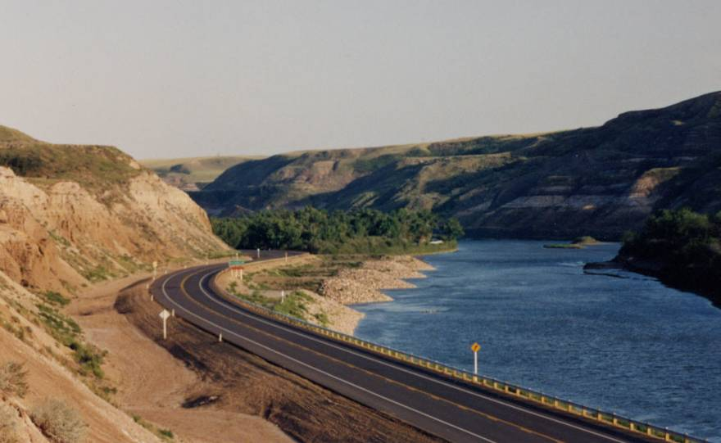
Notes:
Hwy 10 encroachment - Red Deer River - E of Drumheller

Slide 19
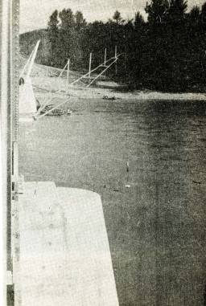
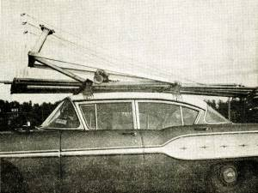
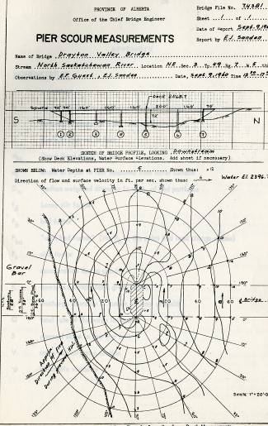
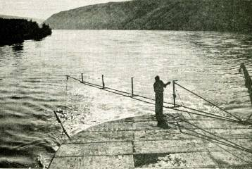
Pier Scour Survey
Notes:
Scour Survey – 1960’s
Boom with sounder off superstructure
Boom carried on roof rack
Boom mounted on pier (BF73949, Peace River near Dunvegan)
Profile and contour survey results from 1960 at BF74381 – North Saskatchewan River on Hwy 22 near Drayton Valley

Slide 20
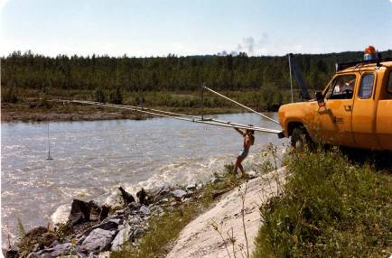
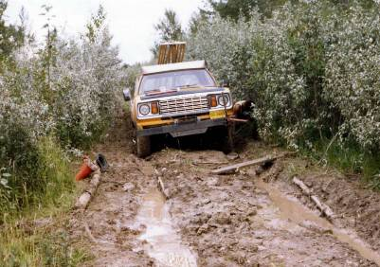
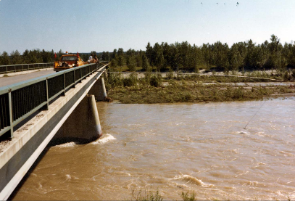
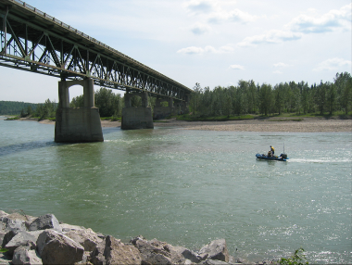
Notes:
Techniques :
Boom with sounder – truck, bridge – access difficulties
Boat with sounder + total station – more recent

Slide 21
Notes:
Type – Contour, profile (handrail, cross section)
History – < 1960 – Now
Factors – floods, surveyor availability, ARC
Systematic – early 1990’s (next slide)
2005 – Post Flood

Slide 22
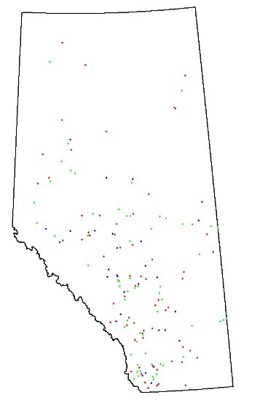
Notes:
Systematic (early 1990’s) :
Initially, screen and prioritize based on theoretical scour depth vs. foundation depth
Later, refined based on observations
Survey (handrail, contour) all high priority sites (1993- 1999)
Now, mostly post flood (next slide)
BPG #7, spread footings, DB of scour vulnerable sites decreasing in number

Slide 23
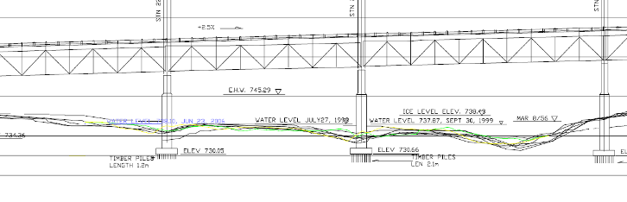
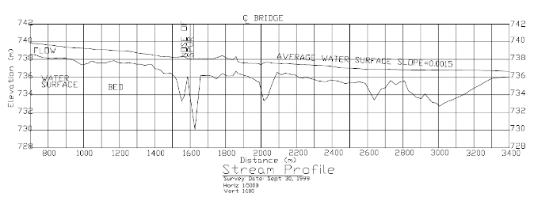
Notes:
Post 2005 Flood Survey – BF74381 – North Saskatchewan River, Hwy 22, near Drayton Valley
Note :
Comparison between past and current survey, superimposed on bridge foundation data
Longitudinal Profile – holes near spur and bridge

Slide 24
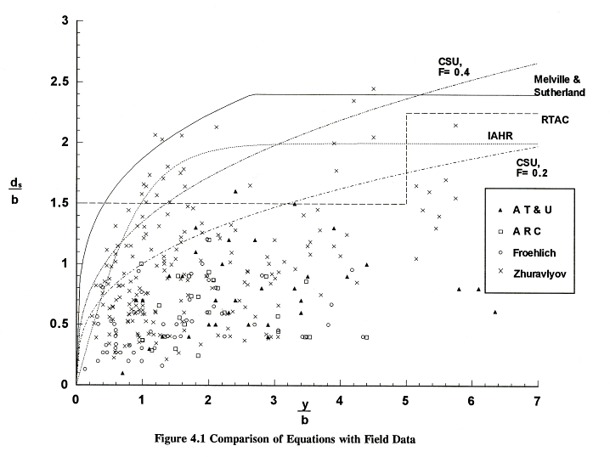
Notes:
Field Scour Data Plot :
Presented at ASCE scour conference in 1993
Compares predictive equations to field data
ds = scour depth, b = pier width, y = flow depth
Alberta data-set one of most comprehensive at time

Slide 25
Location of River Protection Works
Embankment
Spurs
Spurs
Guidebank
Grade Control
Structure
Dyke
Notes:
In addition to lining a headslope or bank with protection materials, some other structures can be employed to improve protection at a site. These include :
Spurs - structures projecting into the flow, placed close to perpendicular to the flow. Intended to stabilize or protect banks by deflecting flows away from the bank. They are usually built in groups or designed to act in combination with a guidebank or other protected structure.
Guidebank - built parallel to the flow. Stabilize banks and align flow through structures, decreasing the effect of the expansion and contraction of flow.
Embankment Spurs - stub fills placed perpendicular to the roadway fill to prevent floodplain flow from flowing parallel to the roadway fill.
Dyke - an embankment that generally parallels the channel to minimize the impact of flood levels on surrounding properties.
Grade Control Structure - a weir placed across the channel downstream of a crossing structure to maintain the bed elevation (arresting degradation and general scour) and generate higher tailwater levels.

Slide 26
Typical Rock Riprap Section
1
2

Slide 27
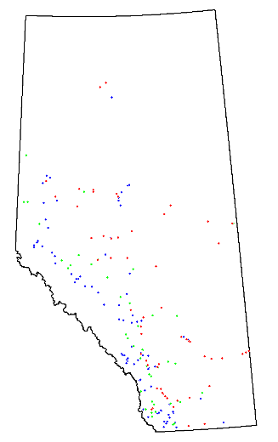
Notes:
Systematic Inspection :
formal program to complement scour survey program
ID sites based on assessment of channel stability, extent of existing RPW
~ 200 sites documented between 1998 and 2000
Functionality – airphoto assessment, bank tracking
Condition – site inspection

Slide 28
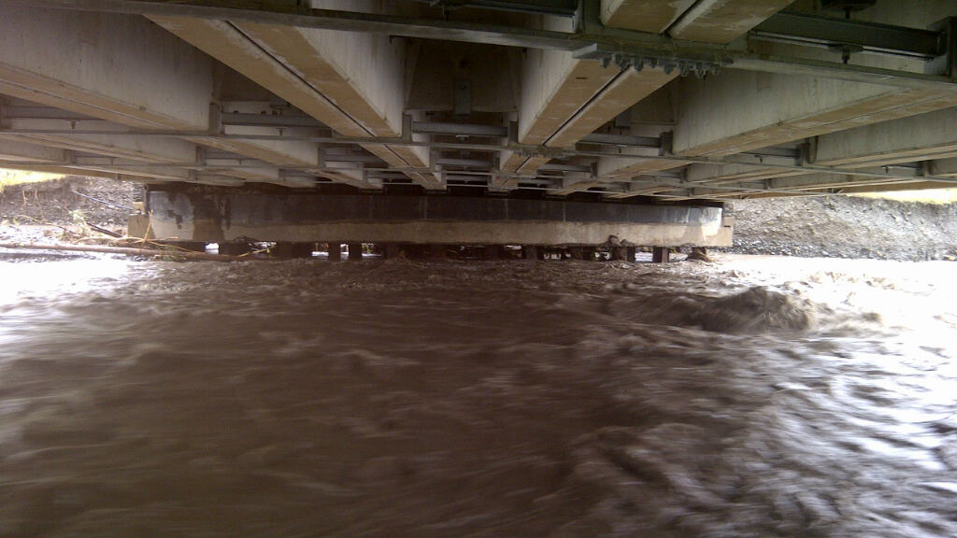

Slide 29
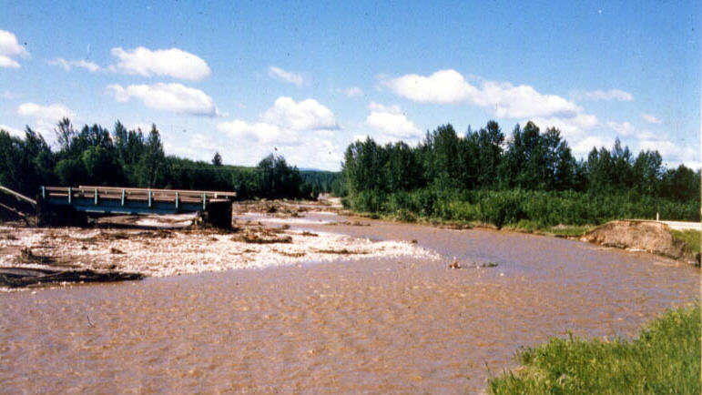
Notes:
BF75904 – Hwy 33 Over Island Ck near Kinuso
Illustration of need for RPW and inspection
1988 Flood – left bridge as an island, 18m bridge, lost ~ 50m of highway
Solution - ~ 40m bridge + 2 guidebanks + 2 upstream spurs

Slide 30
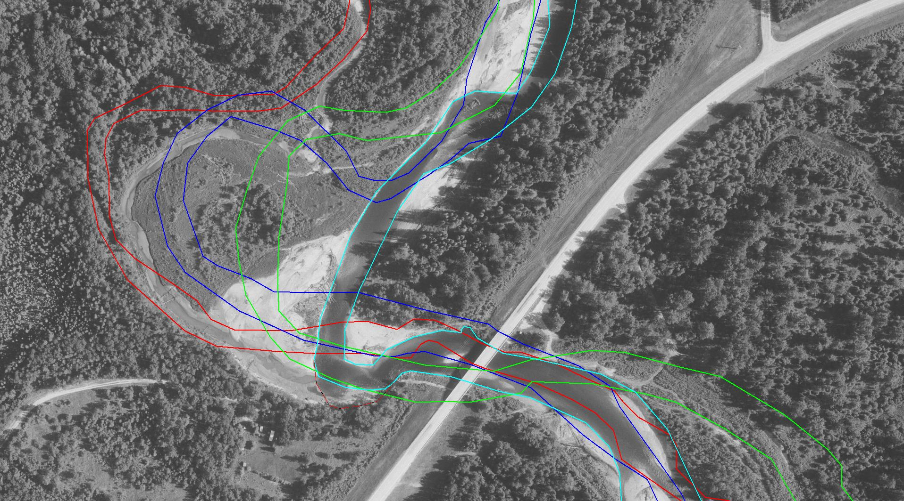
1951
1972
1989
2008
Notes:
BF9259 – Hwy 658 over Freeman River near Ft. Assiniboine
Bank tracking – note changes in flow alignment, river processes, local development
Assess functionality of existing RPW
History of lateral migration
Cutoff in 2001
flow perpendicular to RB just u/s of GB
Flow deflected across onto LB headslope
Migration of high bank towards property
GB still OK, continuing to monitor

Slide 31
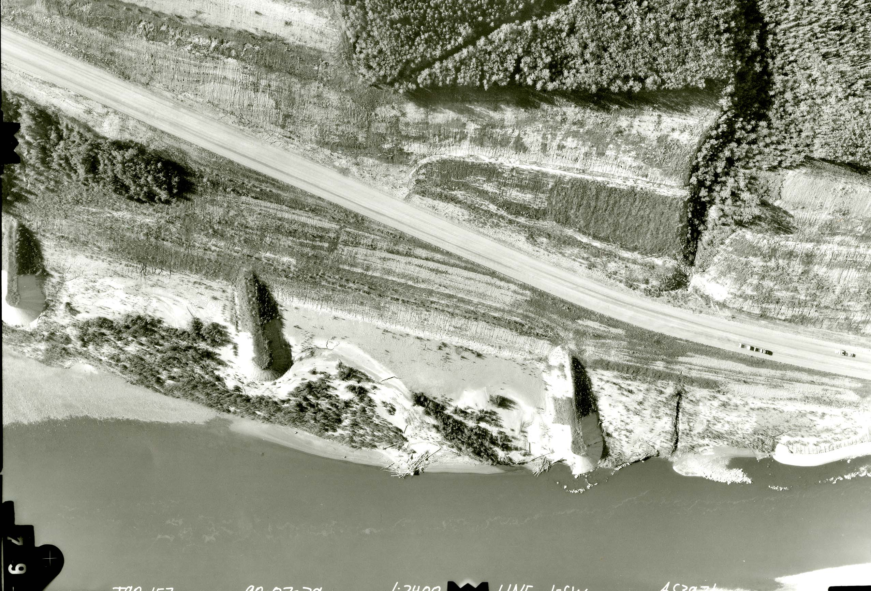
Notes:
Condition - airphoto (BF81778 – Wapiti River adjacent to Hwy 40, south of Grande Prairie) :
Post flood airphoto – 1:2400 (exceptional)
damage apparent but still difficult to assess (even at zoom)
Note flow pattern marks between spurs – assessment of function

Slide 32
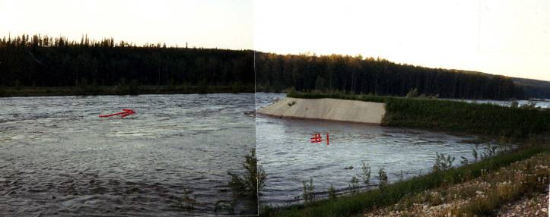
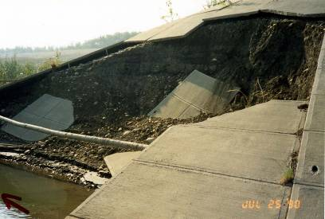
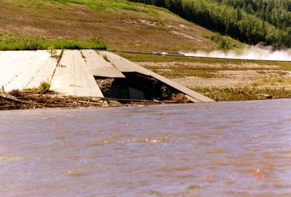
Notes:
Condition – site inspection (BF81778 – Wapiti River adjacent to Hwy 40, south of Grande Prairie – during/post 1990 flood) :
Site inspection provides better assessment of condition of protection works
Can be difficult to assess/access under HW conditions
Loss of rock, fill, damage to concrete, adjacent bank erosion
Document – photo, video, rough measurements, location

Slide 33
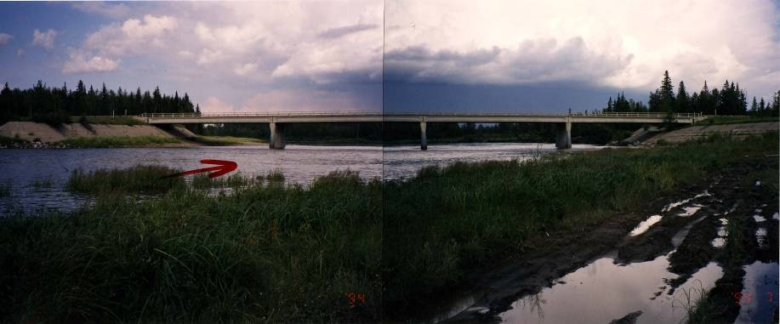
Case Study
BF78104
McLeod River near Peers
Hwy 32
BF78104
McLeod River near Peers
HWY 32
Notes:
BF78104 – McLeod River at Peers, Hwy 32 - Photo of Bridge from RB U/S - illustrates :
Pier Scour – erodible rock, flow alignment impact
Lateral Instability – bank tracking over time
Action taken – pier underpinning

Slide 34
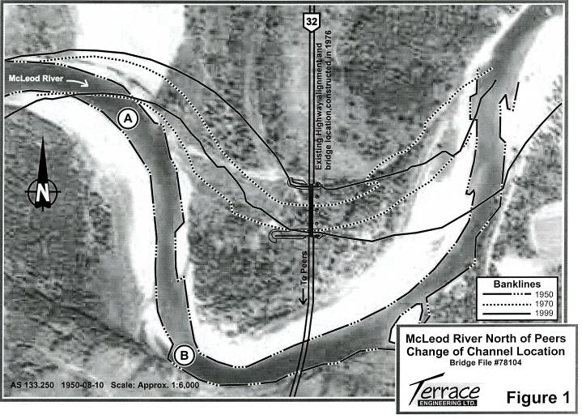
Notes:
BF78104 – McLeod River at Peers, Hwy 32
1950 Airphoto :
note channel realignment associated with bridge construction
Extensive south (right bank) guidebank to protect from river returning to previous channel

Slide 35
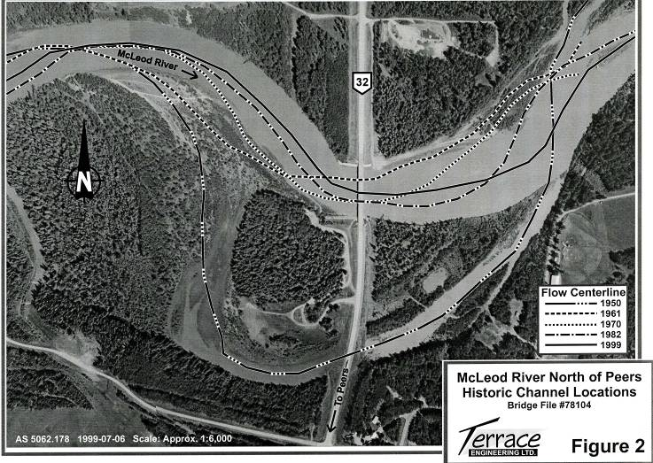
Notes:
BF78104 – McLeod River at Peers, Hwy 32
1999 Airphoto :
River has progressed to north (left bank) – resulting in large skew
Illustrates inability to totally predict river response – design for now, monitor for future

Slide 36
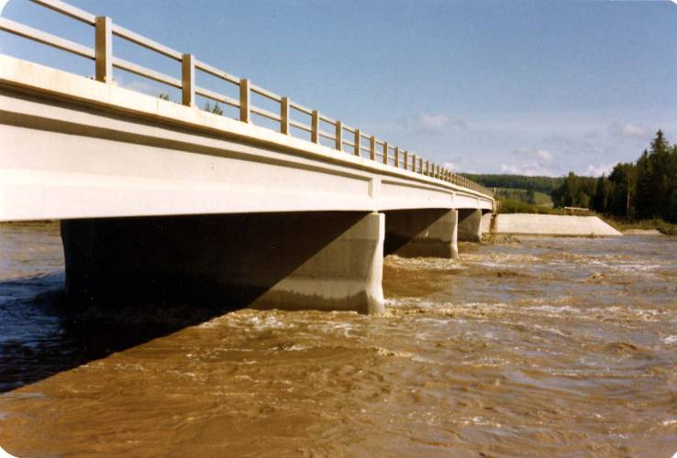
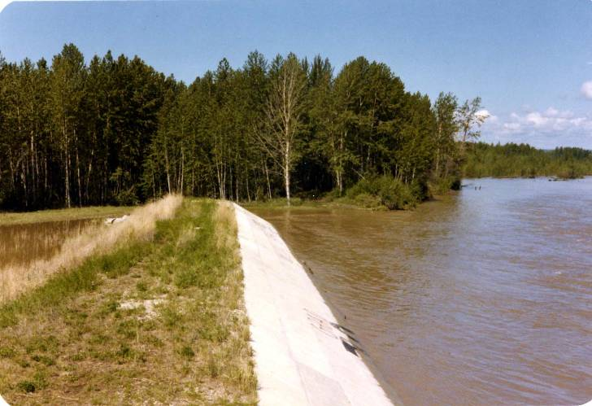
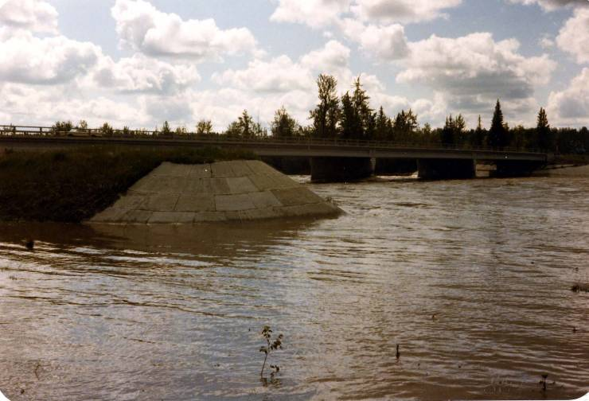
Notes:
BF78104 – McLeod River at Peers, Hwy 32
1980 Flood :
Water behind GB, but mostly pooled
Disruption to flow from piers

Slide 37
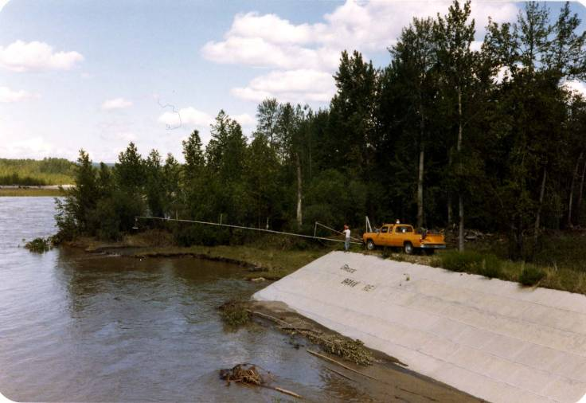
Notes:
BF78104 – McLeod River at Peers, Hwy 32
1980 Flood – scour survey at U/S end of LGB, note treed bank u/s

Slide 38
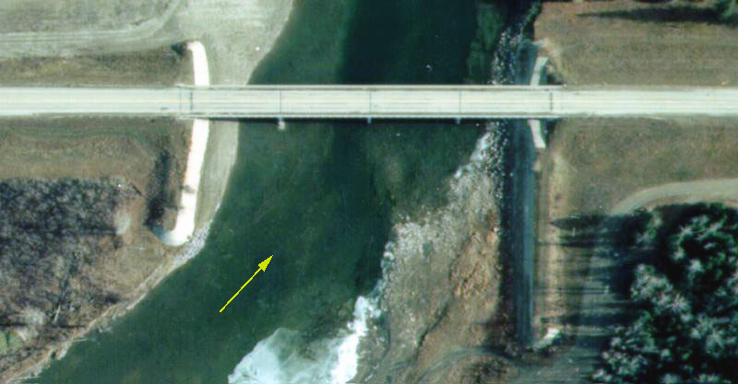
Notes:
BF78104 – McLeod River at Peers, Hwy 32
Impact of flow alignment on local scour at pier

Slide 39
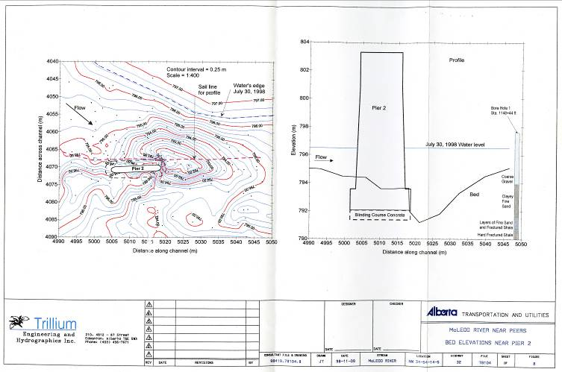
Notes:
BF78104 – McLeod River at Peers, Hwy 32
Contour survey and profile survey from 1998.

Slide 40
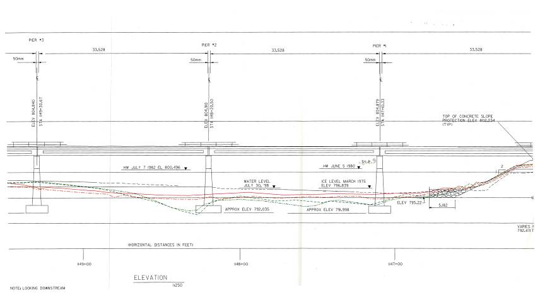
Notes:
BF78104 – McLeod River at Peers, Hwy 32
Handrail profile from 1998.

Slide 41
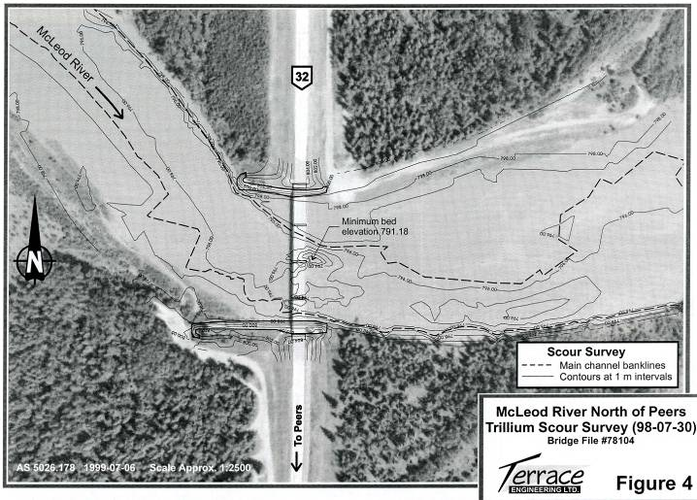
Notes:
BF78104 – McLeod River at Peers, Hwy 32
Scour survey superimposed on airphoto

Slide 42
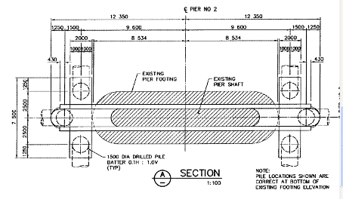
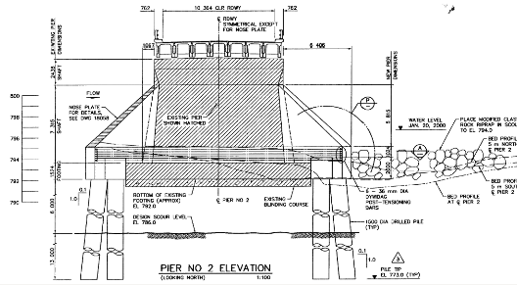
Notes:
BF78104 – McLeod River at Peers, Hwy 32
Underpinning Design – Built in 2000

Slide 43
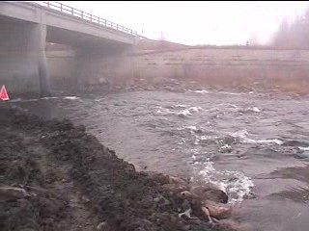
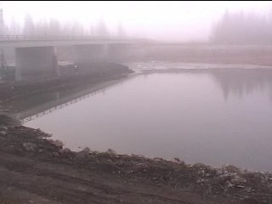
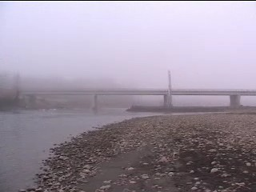
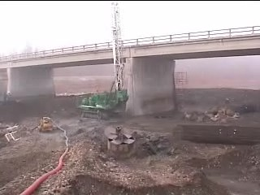
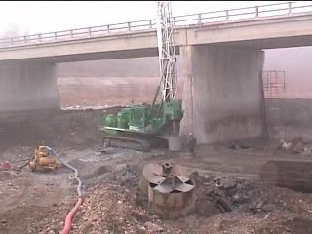
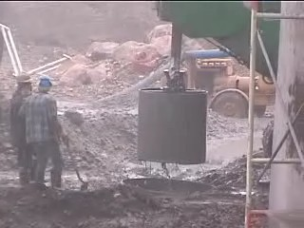
Notes:
BF78104 – McLeod River at Peers, Hwy 32
Photos during construction – berms and constriction of flow, caisson drilling operation

Slide 44

Questions?

