Slide 1
BRIDGE FAILURES
IN ALBERTA

Slide 2
Introduction
Bridges are inspected for three primary reasons
  safety of bridge system
  maintenance of bridges
  management of the bridge system
Inventory or management of the system can be just as important as safety and maintenance

Slide 3

Need to Know
Which bridges are:
  substandard and not adequate to carry full legal loads
  susceptible to flooding
  high priority for replacement

Slide 4
Cause of Failure
70% of failures are caused by factors related to water flow
  scouring of piers
  undermining of the support elements
Structural failure
  element failure due to excess load or material deterioration
Lack of knowledge or good judgment
  Operation
  Construction
  Design

Slide 5
Contributing Factors
Structural engineering is a science
  applied truckloads are known
  material behavior is known and can be accurately predicted
  everything can be accurately calculated and predicted
River engineering is more of an art
  the effects of a flood cannot simply be calculated
  the effects of Mother Nature are not easily predicted
  the velocity and angle of flow, the duration of flooding, etc.

Slide 6
Bear Creek
84 Ave in Grand Prairie
SPCSP HE 5.5 x9m
Installed in 1973
Total collapse of the structure in 1988
No inspection after installation
Notes:
5

Slide 7
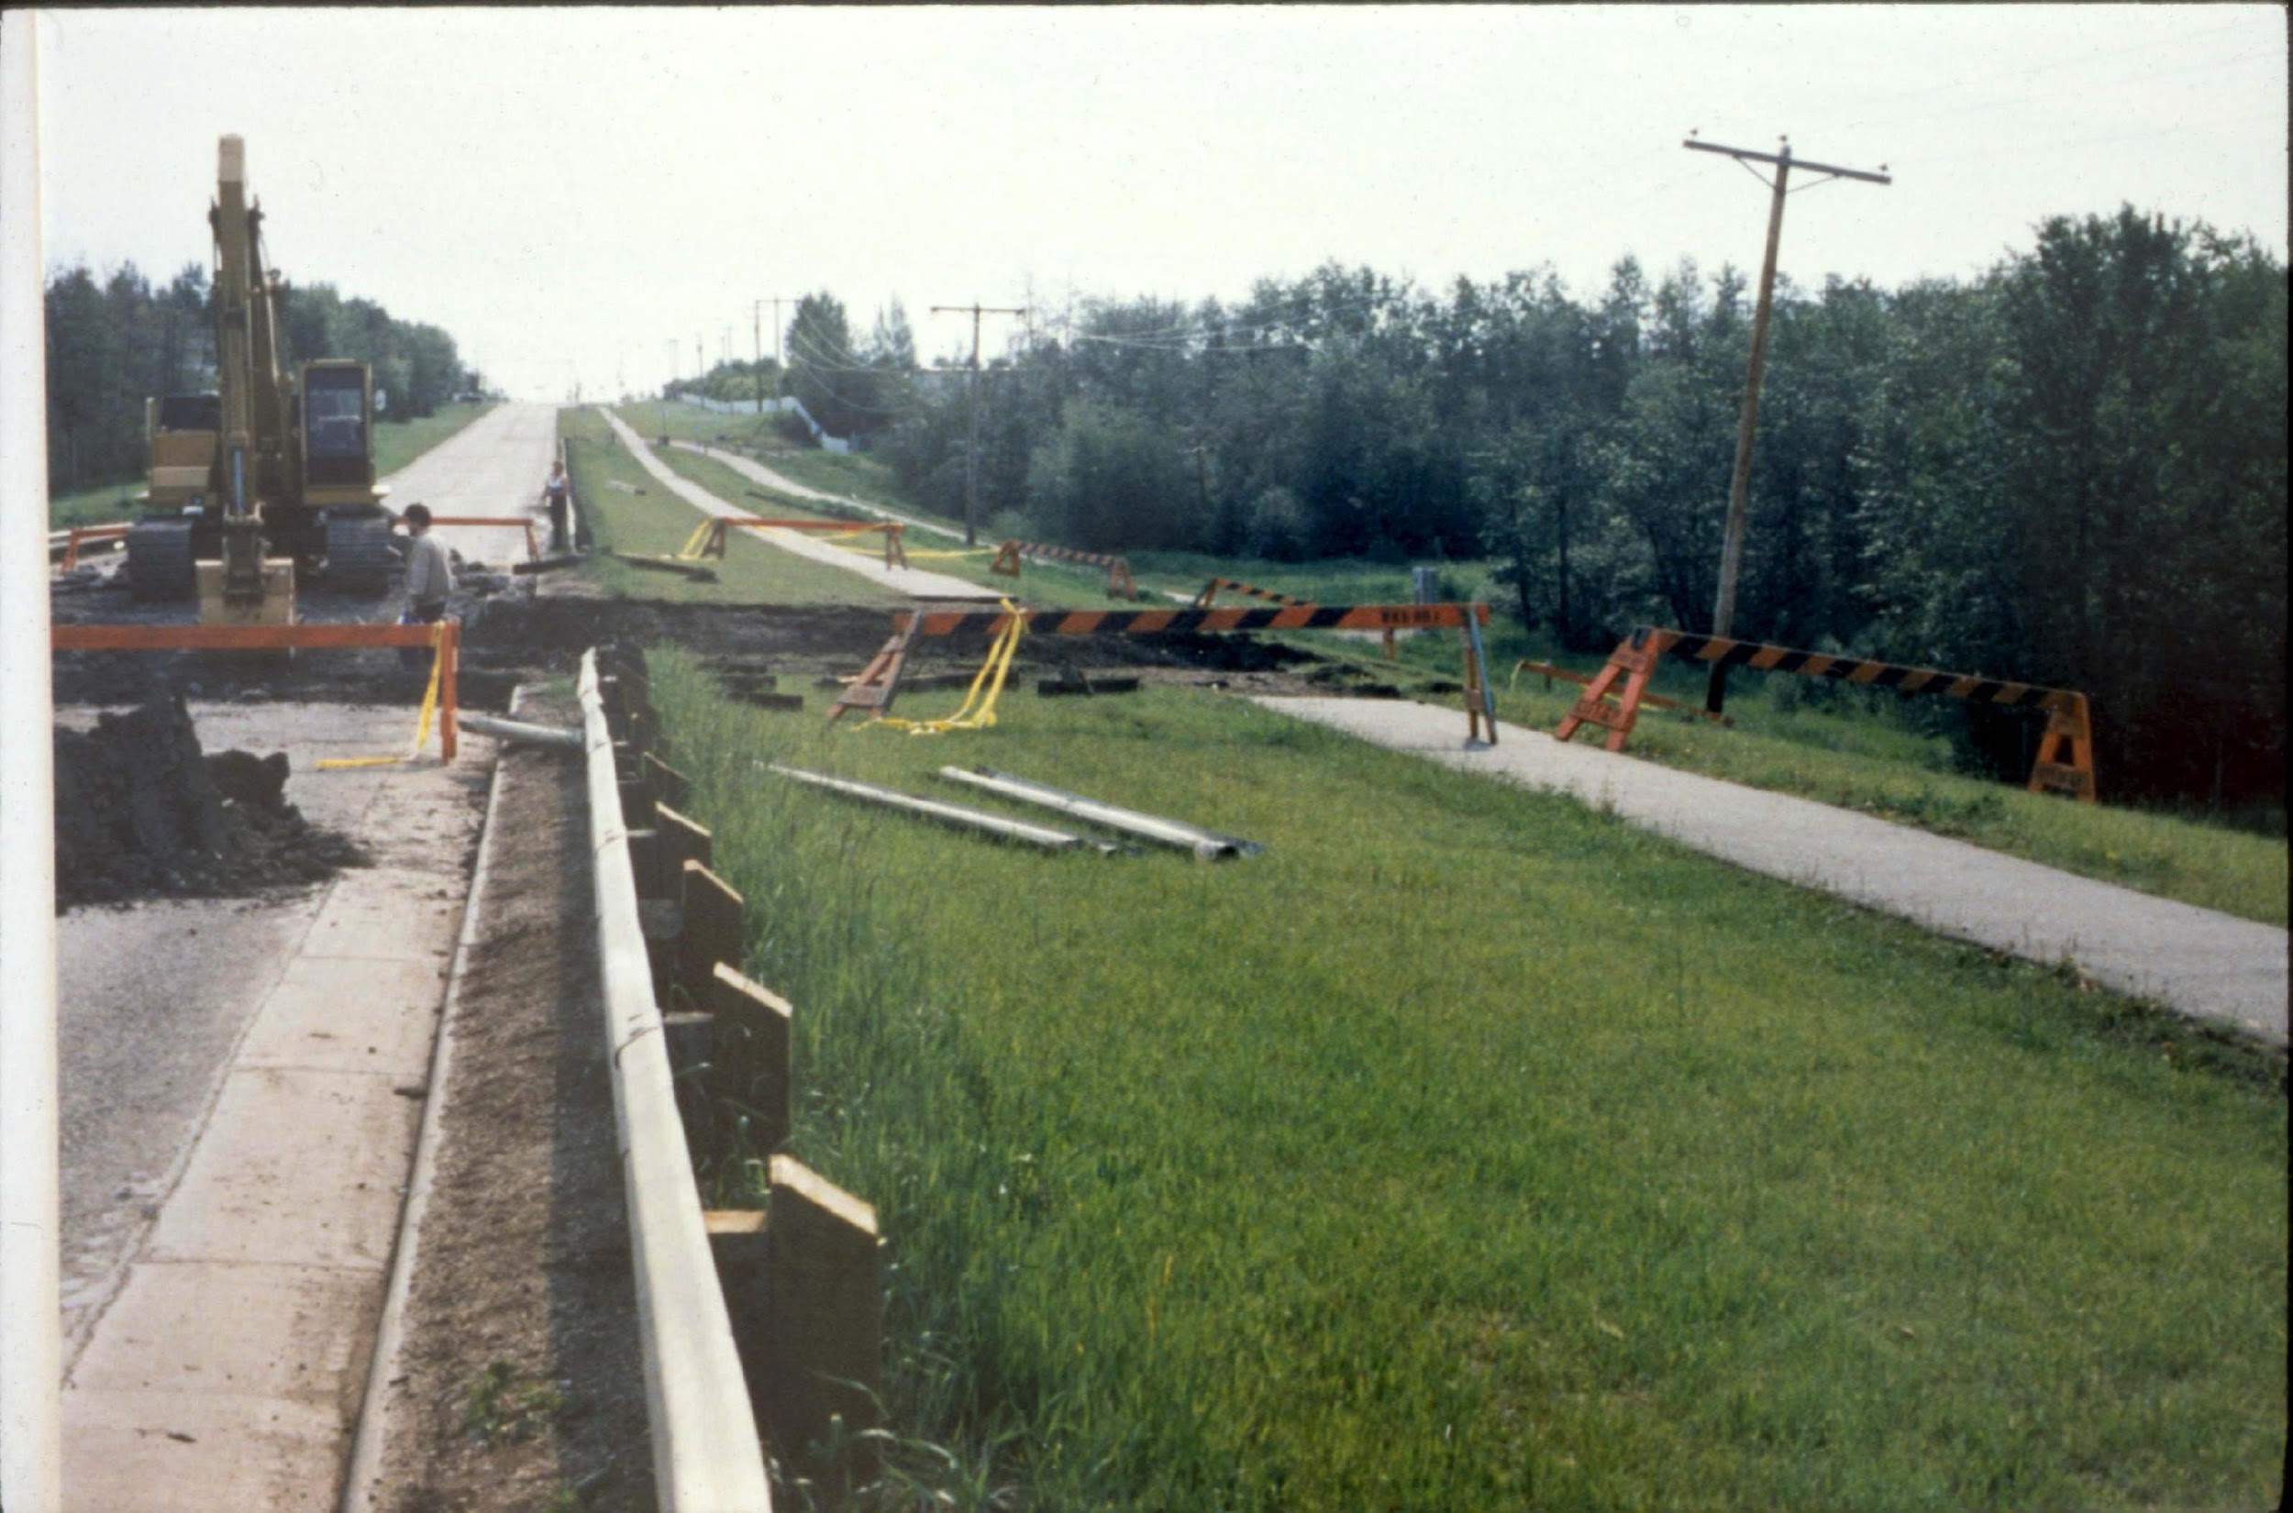
Bear Creek on 84 Ave in Grande Prairie
Structure on 84 Avenue Grande Prairie
Notes:
6

Slide 8
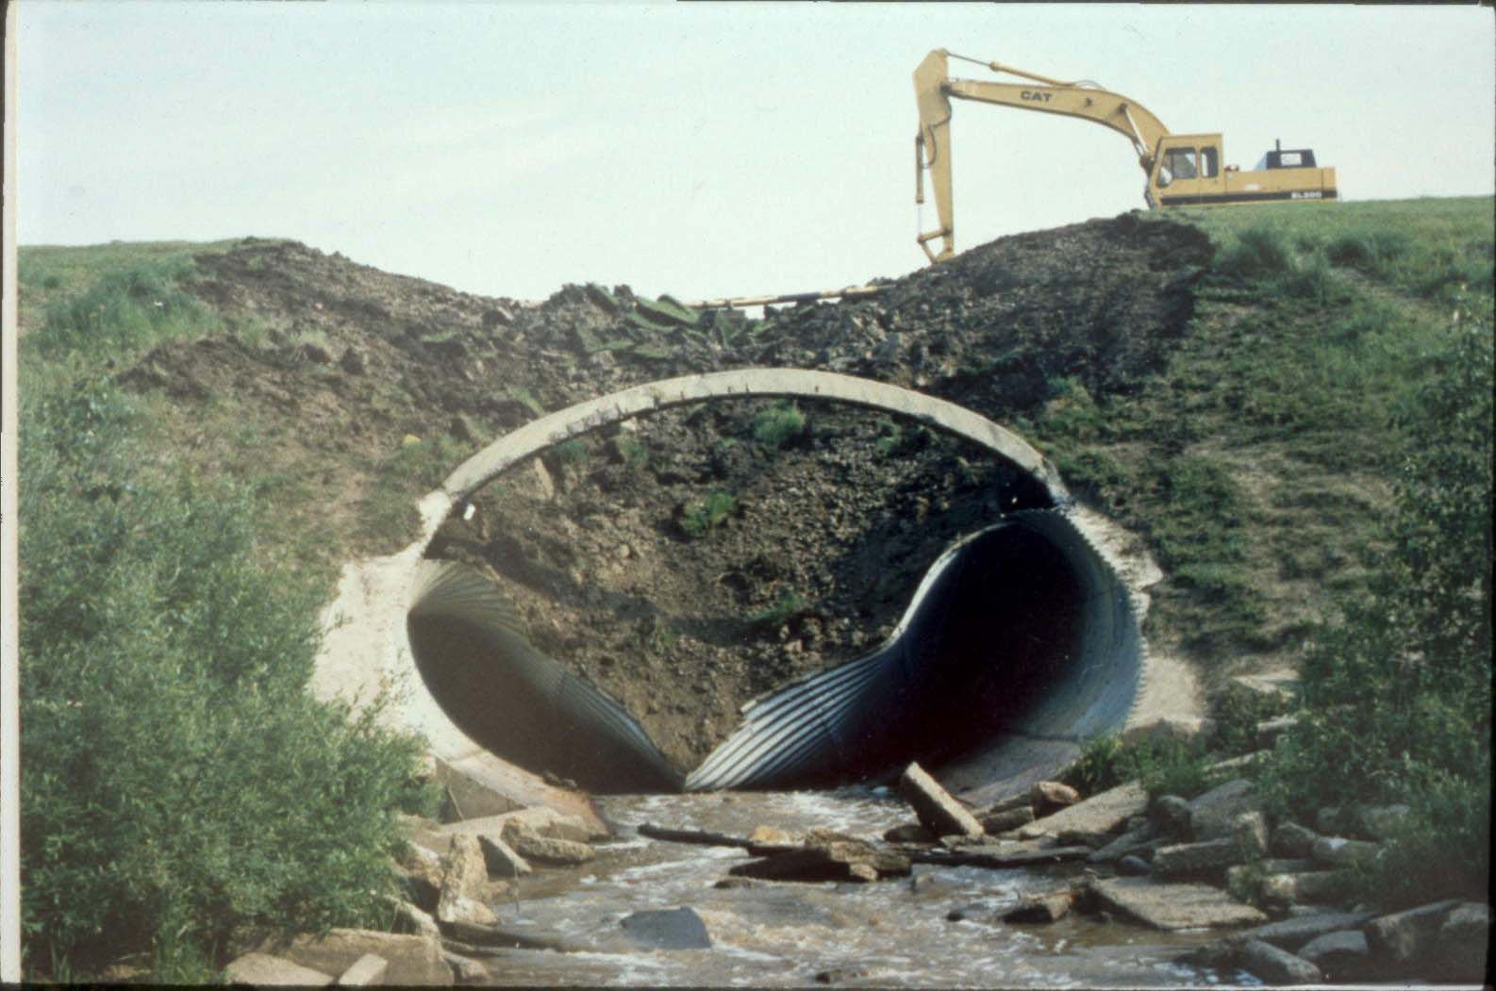
Bear Creek on 84 Ave in Grande Prairie
Total collapse of culvert. Only headwall intact

Slide 9
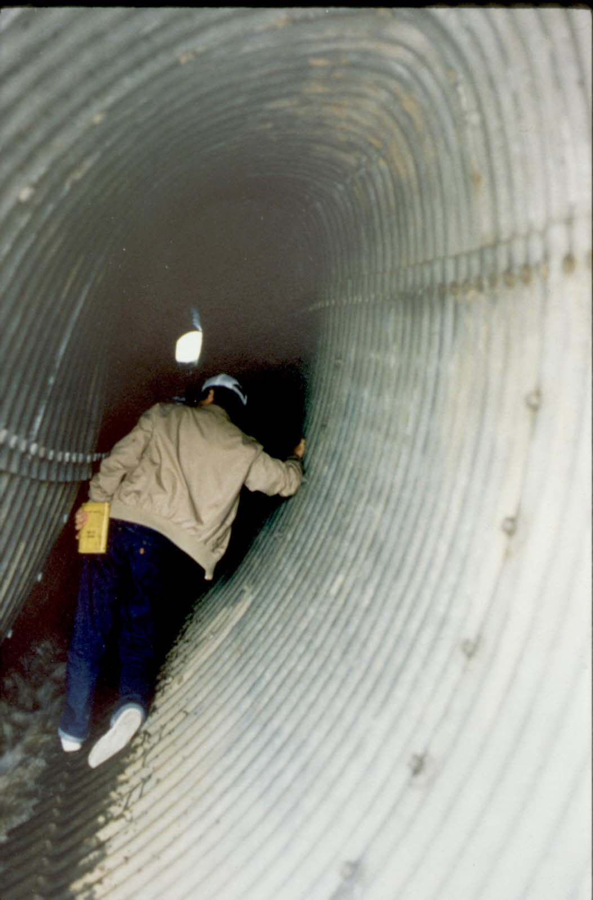
Bear Creek on 84 Ave in Grande Prairie
Inside collapsed culvert

Slide 10
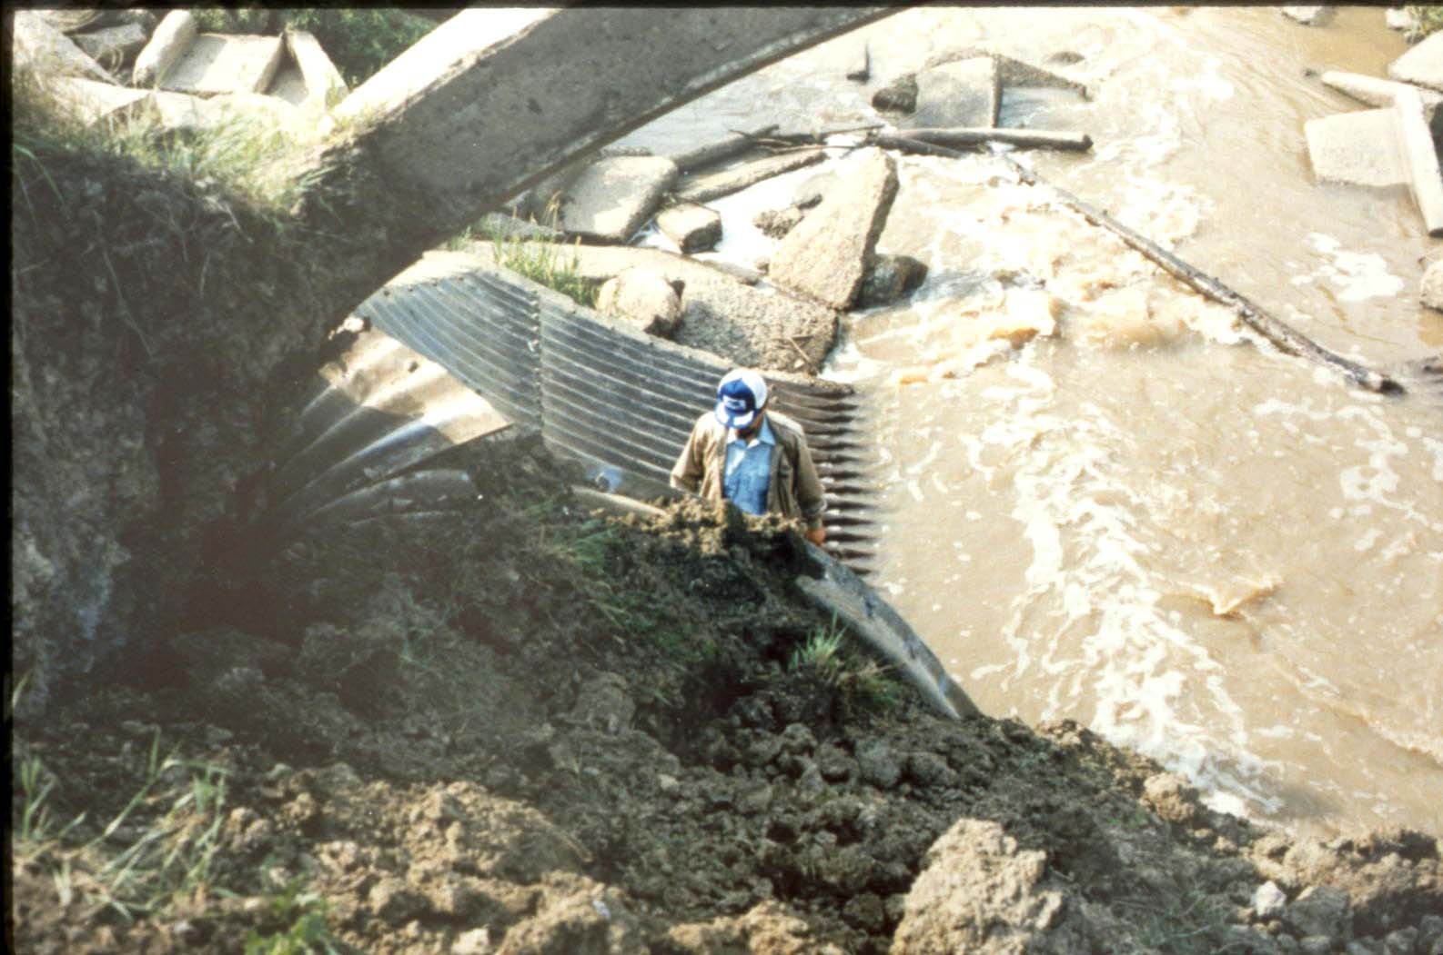
Bear Creek on 84 Ave in Grande Prairie
Outlet of culvert

Slide 11
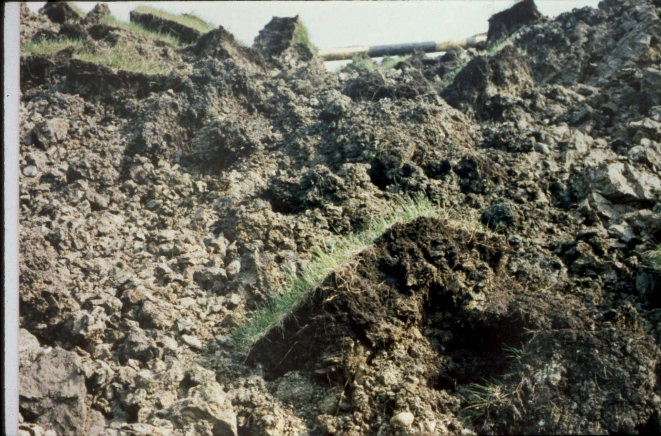
Bear Creek on 84 Ave in Grande Prairie
Backfill characteristics

Slide 12
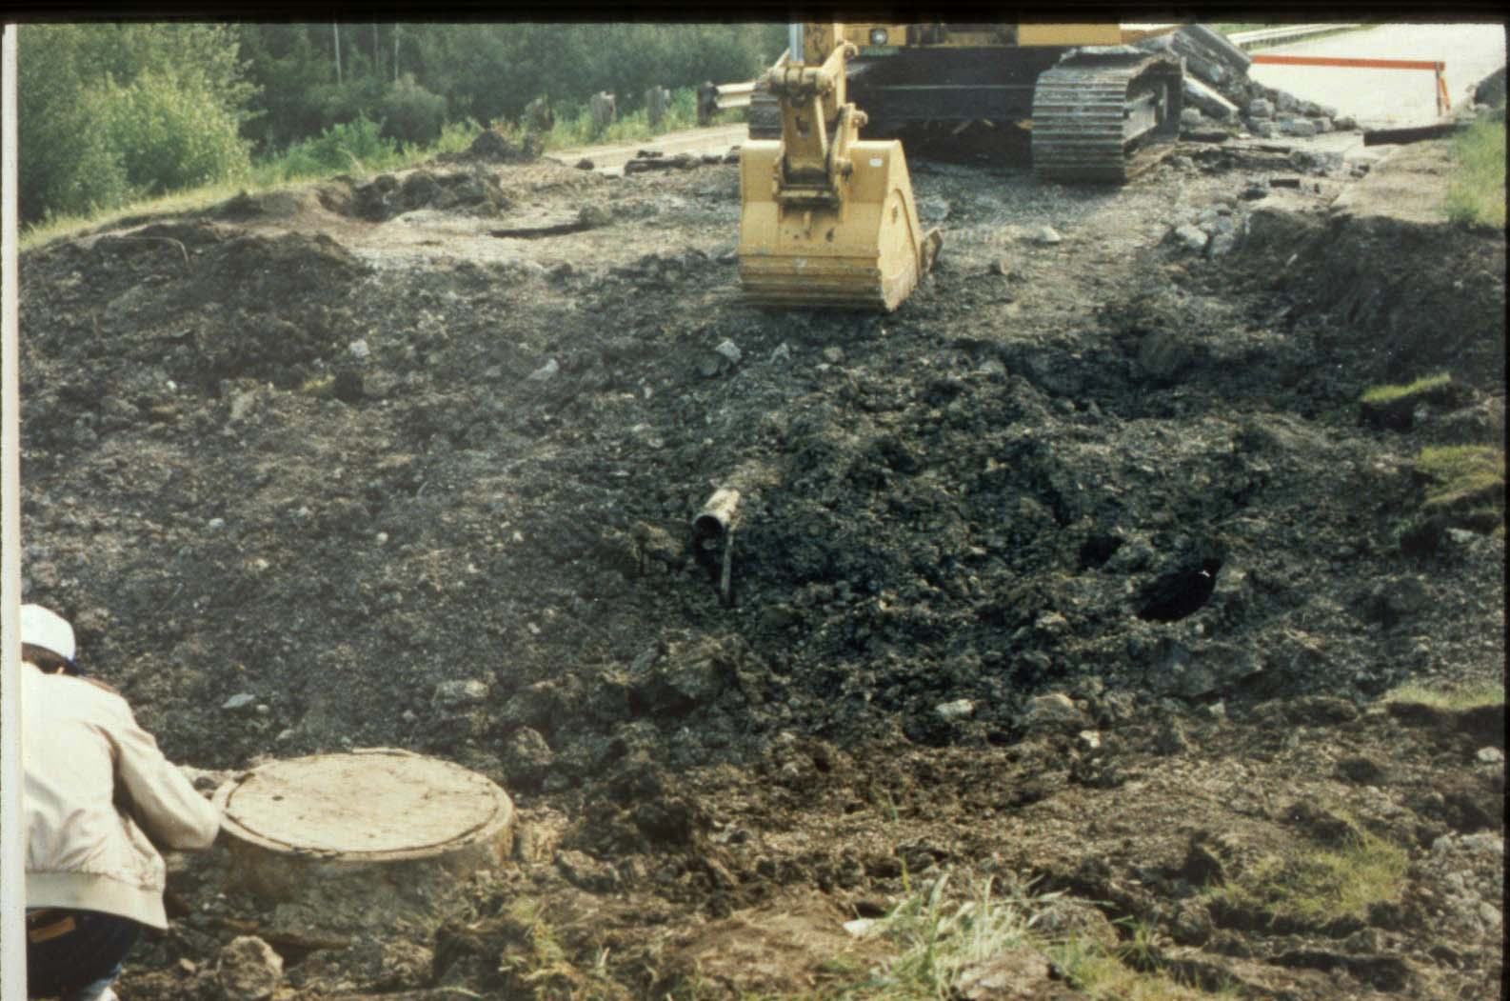
Bear Creek on 84 Ave in Grande Prairie
Water and sewer line in embankment

Slide 13
Beaver Ranch Creek
58 East of Vermilion
SPCSP HE 4.8 x 7.3
Installed in fall of 1987
Extensive deformation in 1988
Total collapse in 1989 while fill being removed for repair of culvert

Slide 14
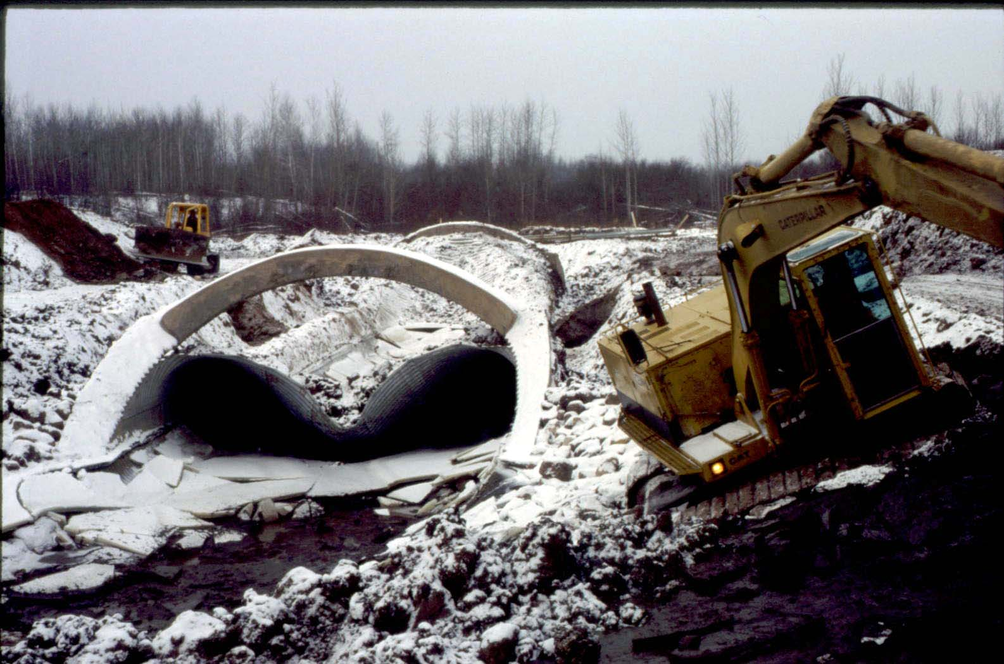
Beaver Ranch Creek – 58 East of Vermilion
Outlet showing intact end treatment

Slide 15
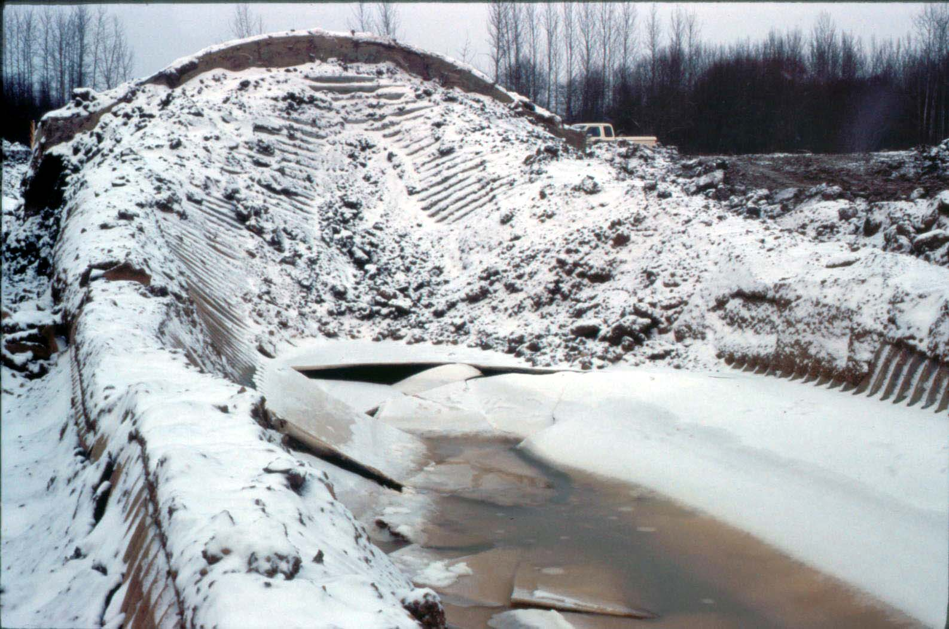
Beaver Ranch Creek – 58 East of Vermilion
Inlet with culvert still connected to headwall

Slide 16
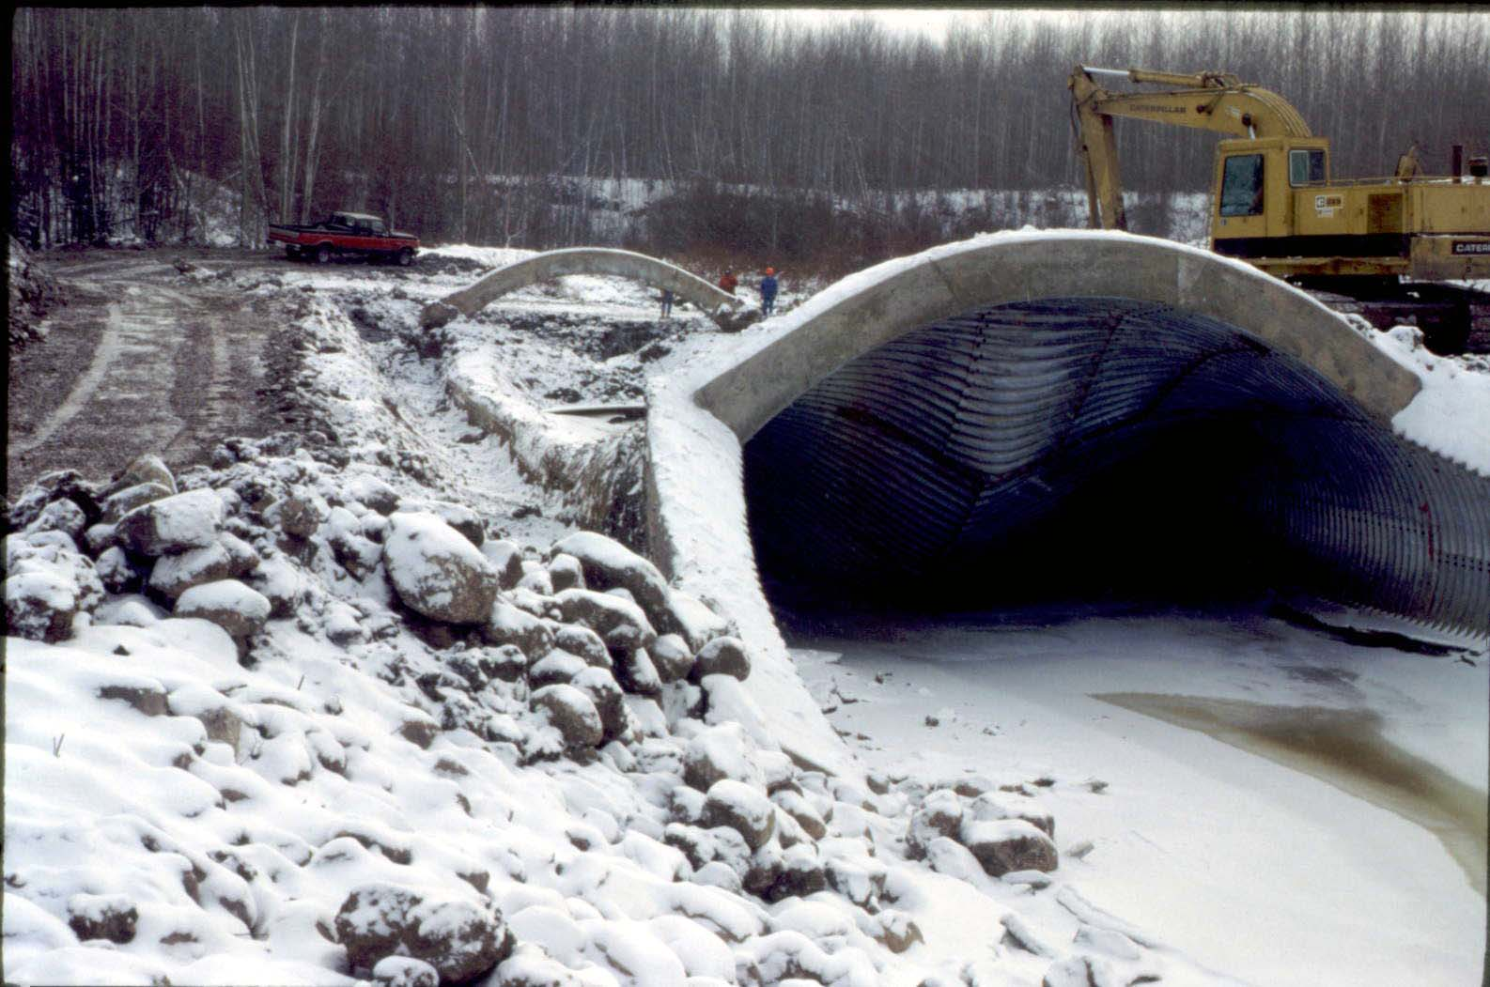
Beaver Ranch Creek – 58 East of Vermilion
Overview of culvert inlet

Slide 17
Weed Creek
Highway 39 Near Thorsby
Arch culvert
Constructed in 1960
Washed out July 3rd, 1990.

Slide 18
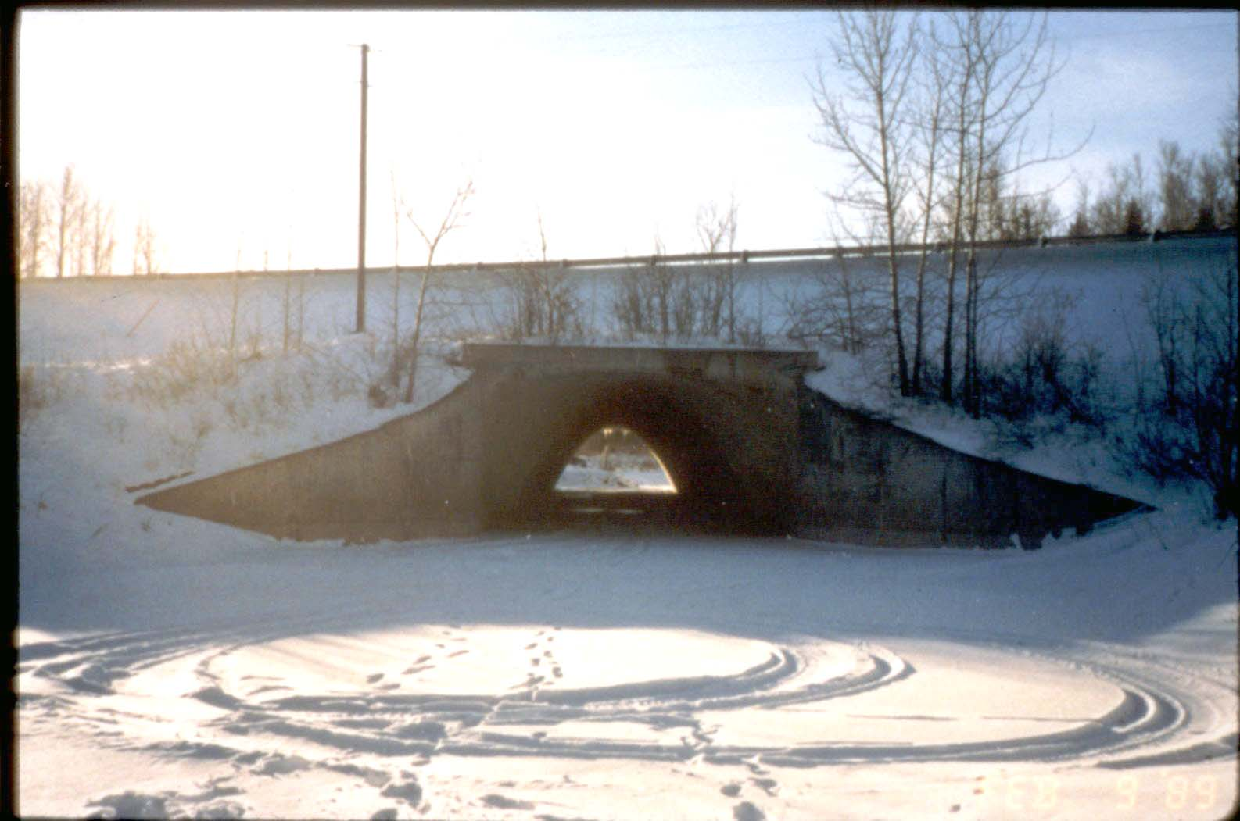
Weed Creek – Hwy 39 Near Thorsby
Concrete arch culvert in 1989

Slide 19
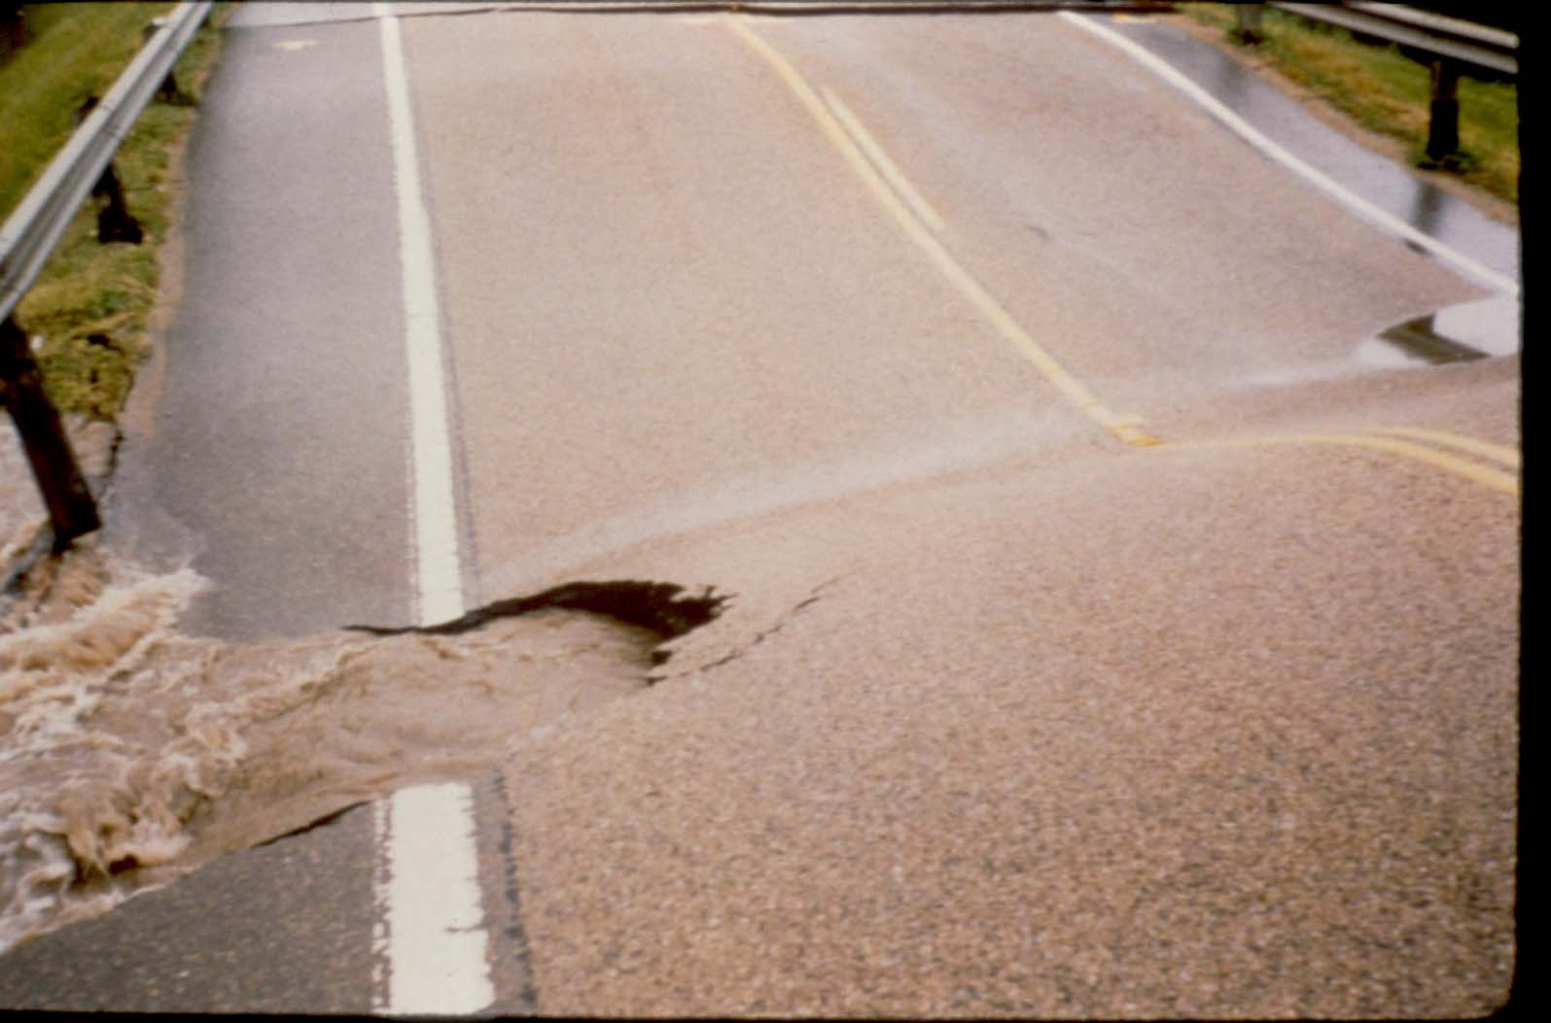
Weed Creek – Hwy 39 Near Thorsby
Water on U/S end up to shoulder of road

Slide 20
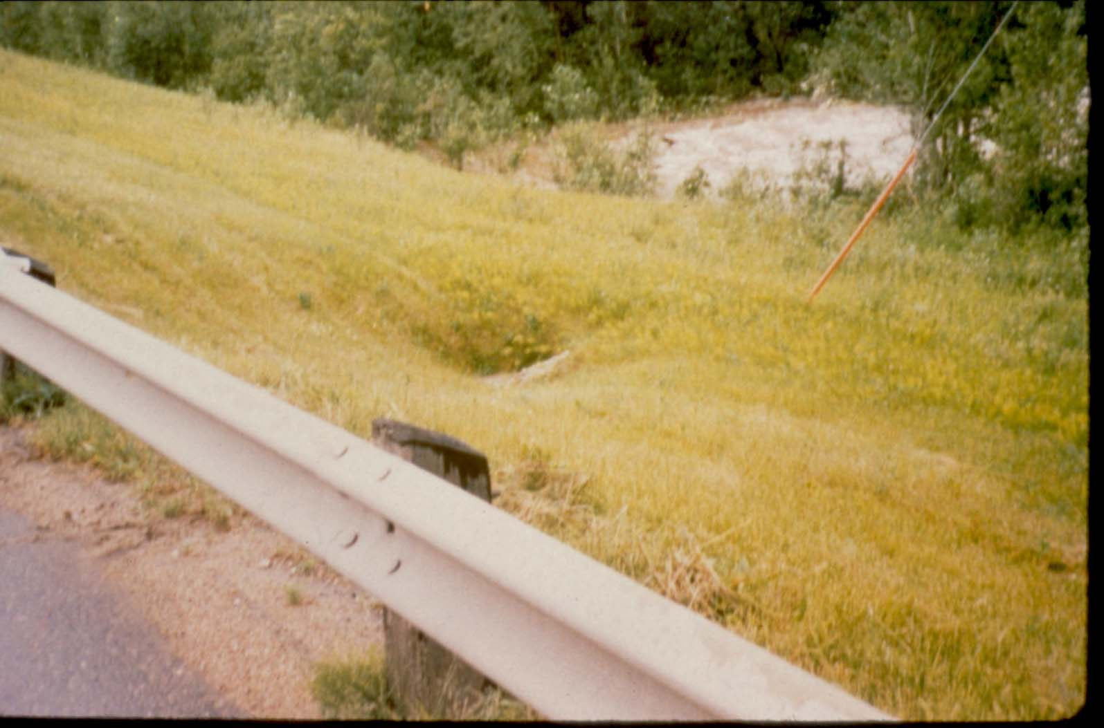
Weed Creek – Hwy 39 Near Thorsby
Hole in side slope of D/S side

Slide 21
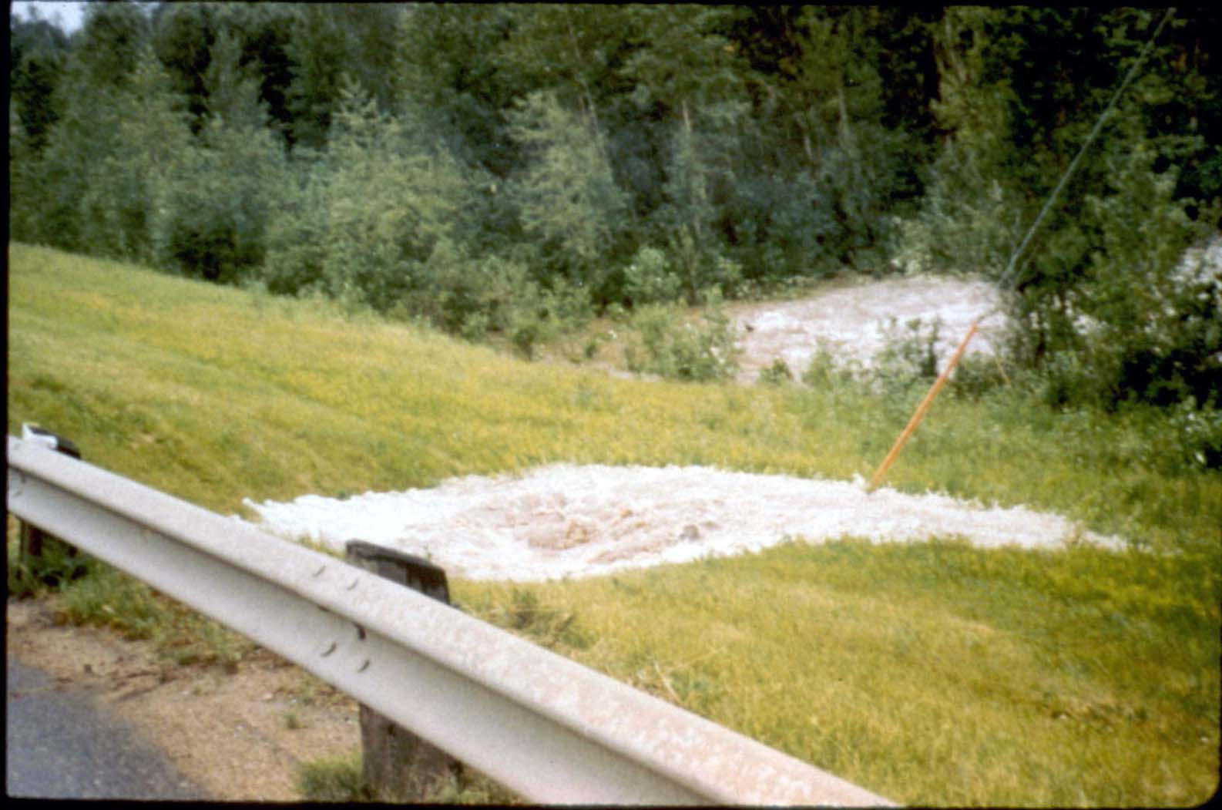
Weed Creek – Hwy 39 Near Thorsby
Water now coming out of D/S fill

Slide 22
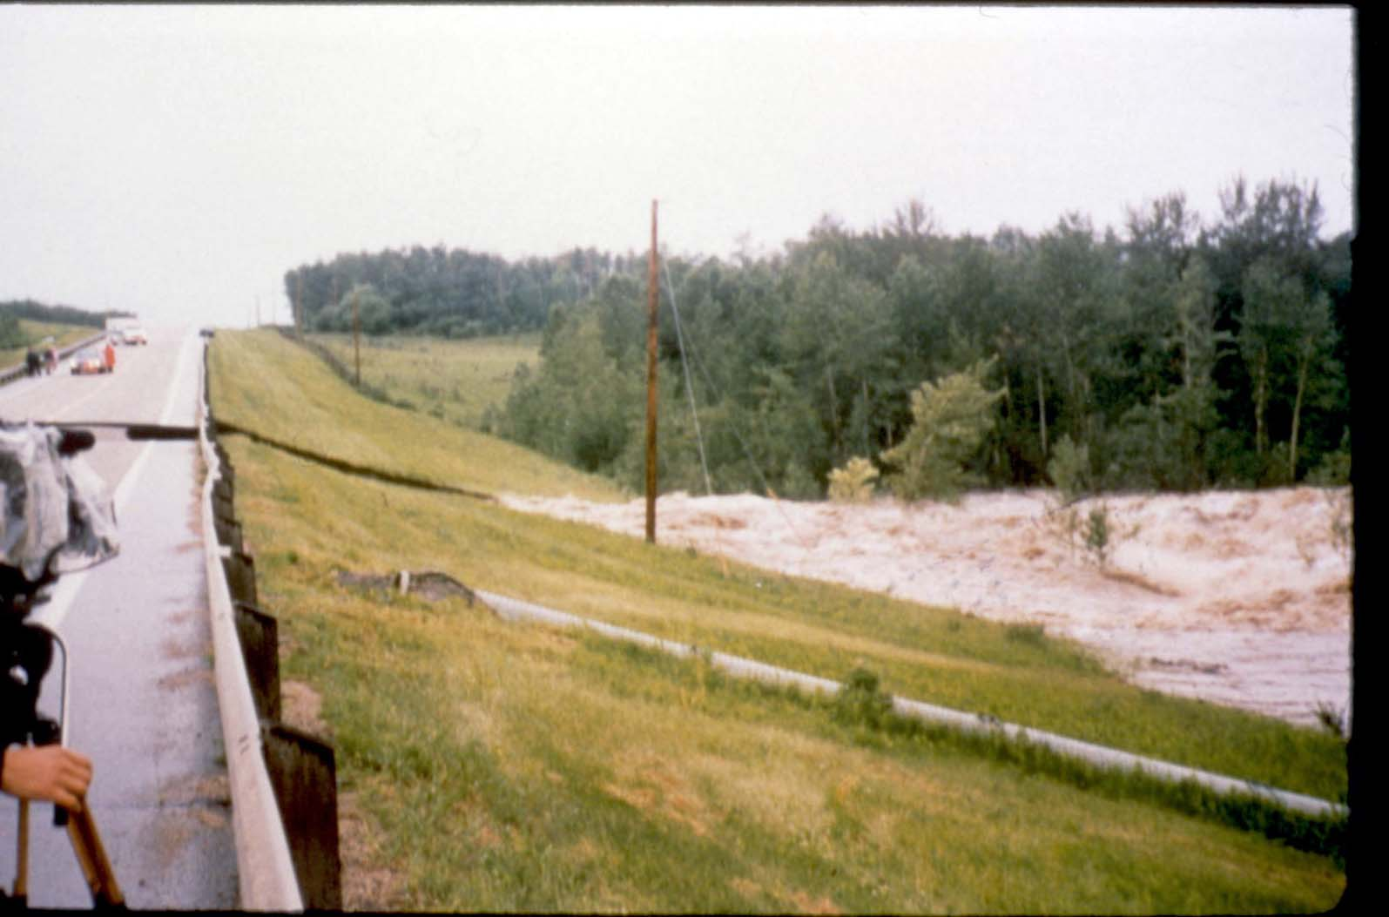
Weed Creek – Hwy 39 Near Thorsby
Road gone

Slide 23
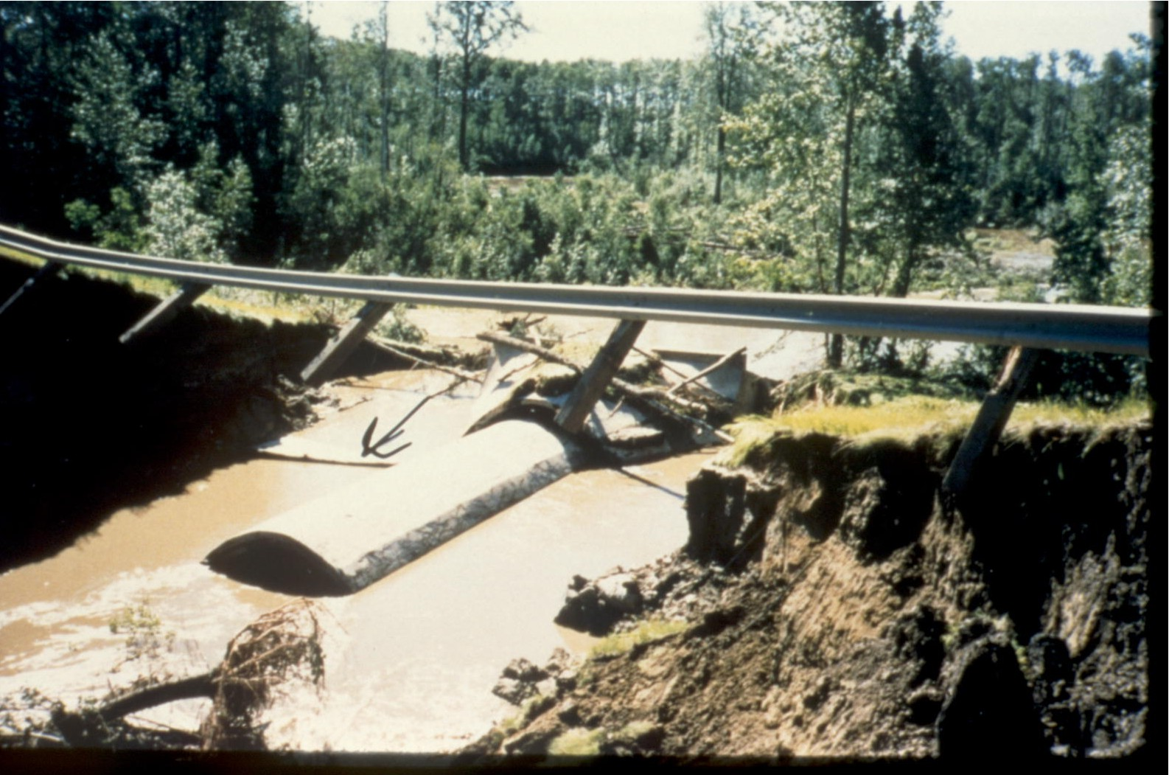
Weed Creek – Hwy 39 Near Thorsby
Upstream Inlet

Slide 24
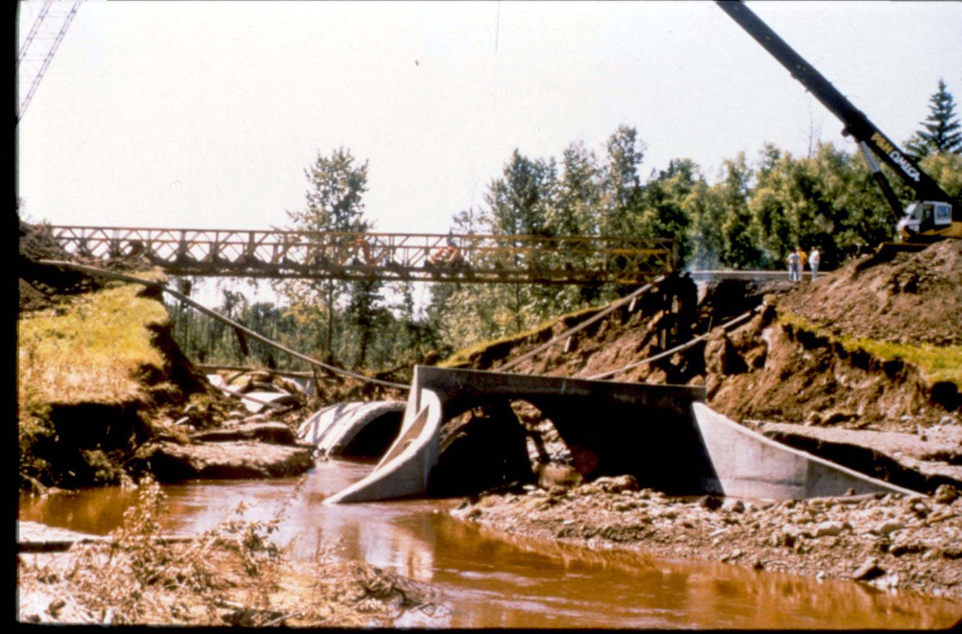
Weed Creek – Hwy 39 Near Thorsby
D/S Outlet

Slide 25
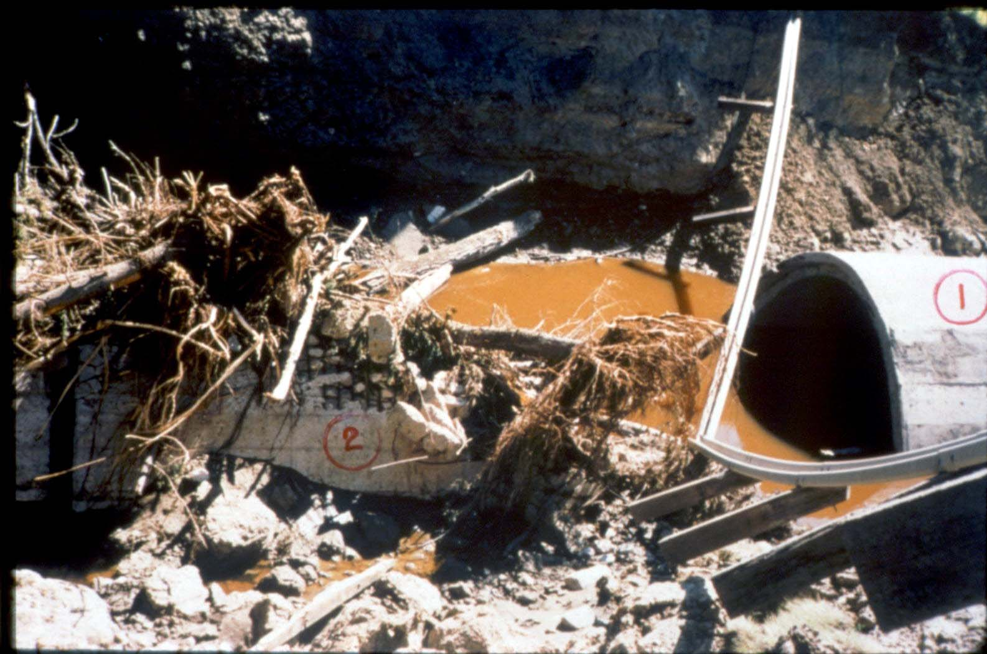
Weed Creek – Hwy 39 Near Thorsby
Centre section of the culvert

Slide 26
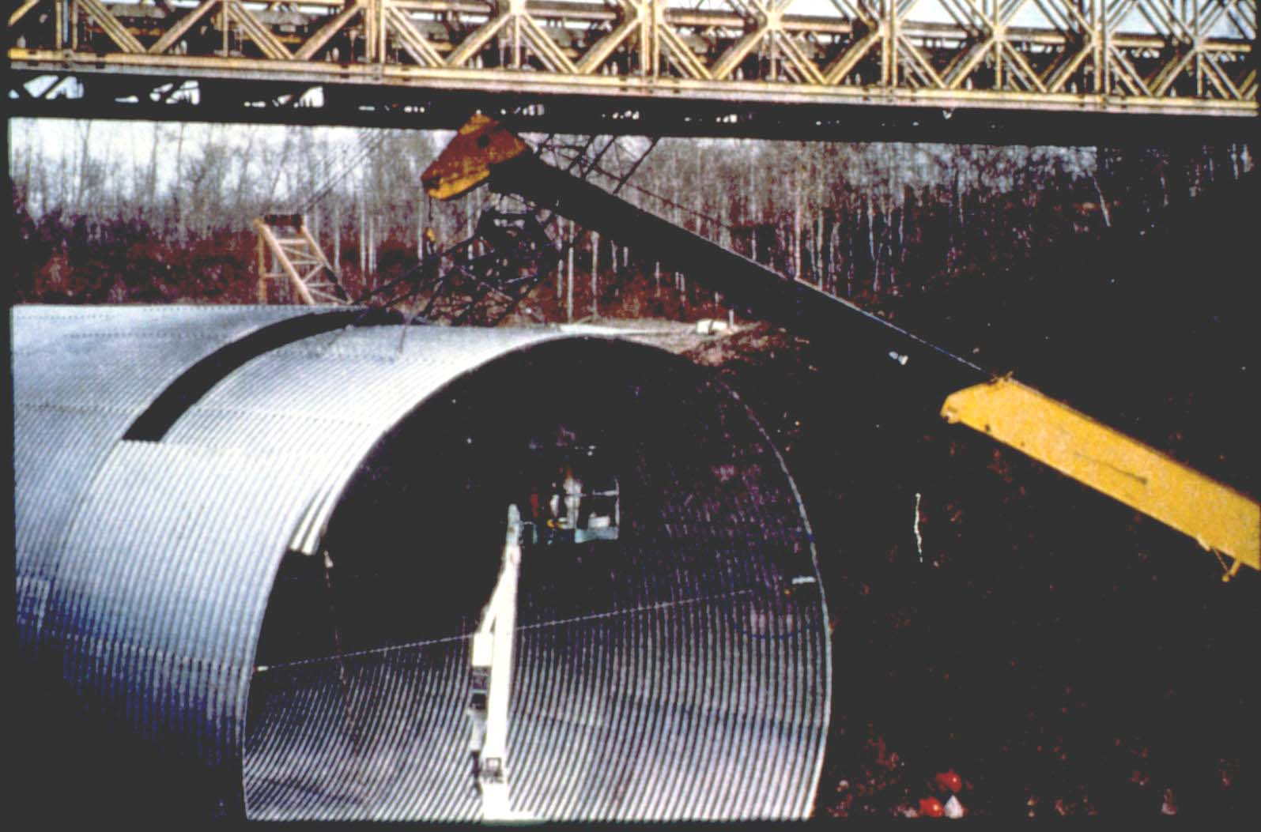
Weed Creek – Hwy 39 Near Thorsby
Erecting 8.5 m SPCSP

Slide 27
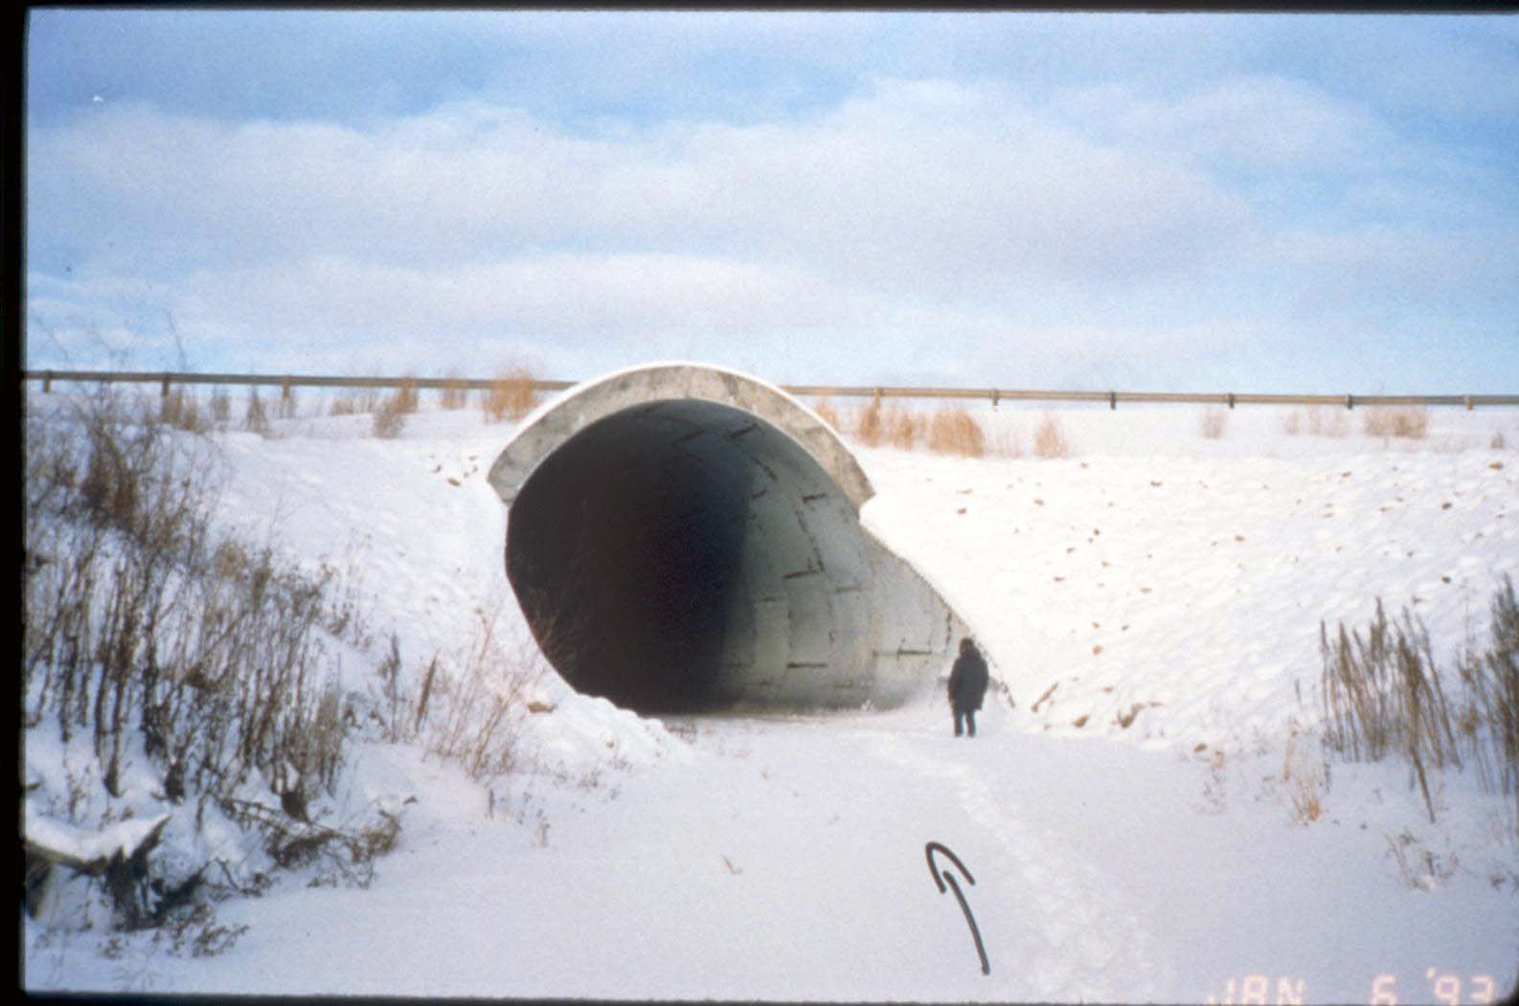
Weed Creek – Hwy 39 Near Thorsby
U/S inlet of new culvert

Slide 28
BF 77496 – Hwy 40
Lineham Creek, Kananaskis
4.3M diameter Structural Plate Ellipse (SPE) culvert installed in 1983.
53M invert length.
9.1M road to streambed height.
Washed out during 2013 flood event.

Slide 29
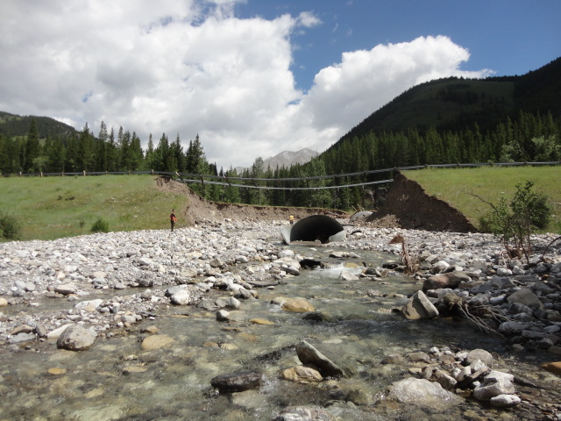
BF 77496 – Looking D/S at scale of washout (30m wide vs. 4.3M pipe).

Slide 30
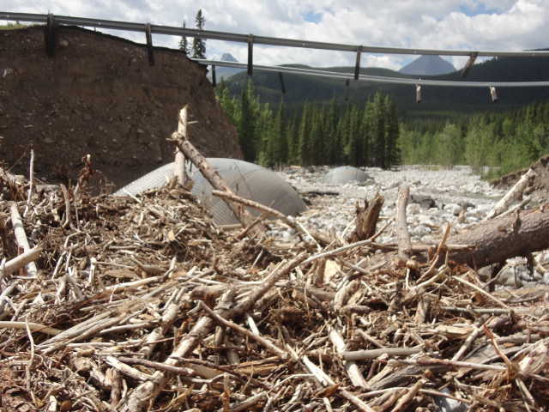
BF 77496 – Drift blockage across inlet and heaved barrel.

Slide 31
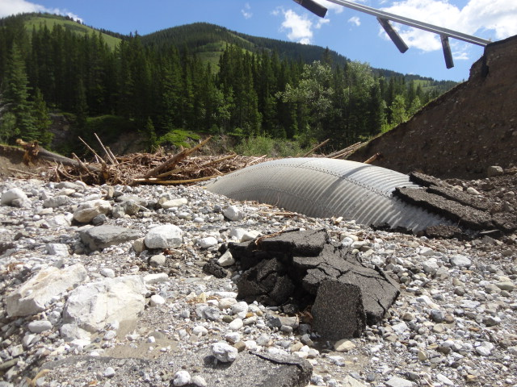
BF 77496 – Inlet blockage and barrel heave

Slide 32
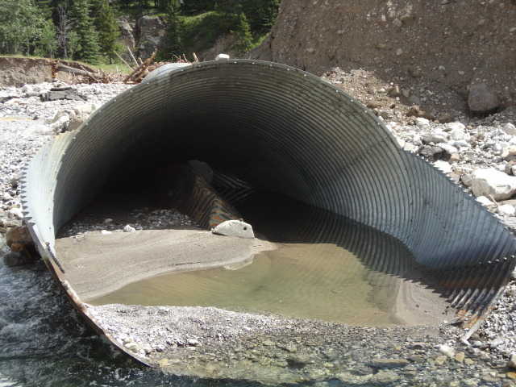
BF 77496 – Outlet and barrel floor folded and heaved nearly to roof

Slide 33
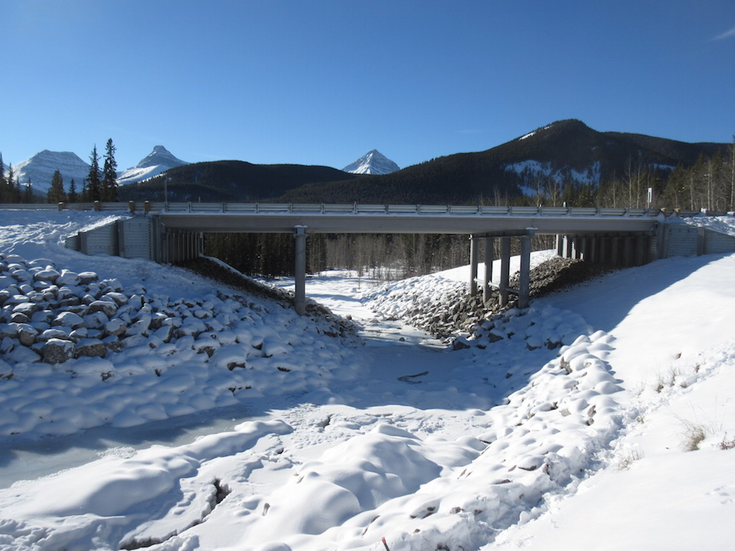
BF 77496 – Replaced in 2015 with new 8-14-8 M SLW girder bridge

Slide 34
Red Willow River
Local Road near Rio Grande
150’through truss built in 1927
Bridge posted for 17 tons
Bridge collapsed in 1977
Failure of rotten abutment corbel

Slide 35
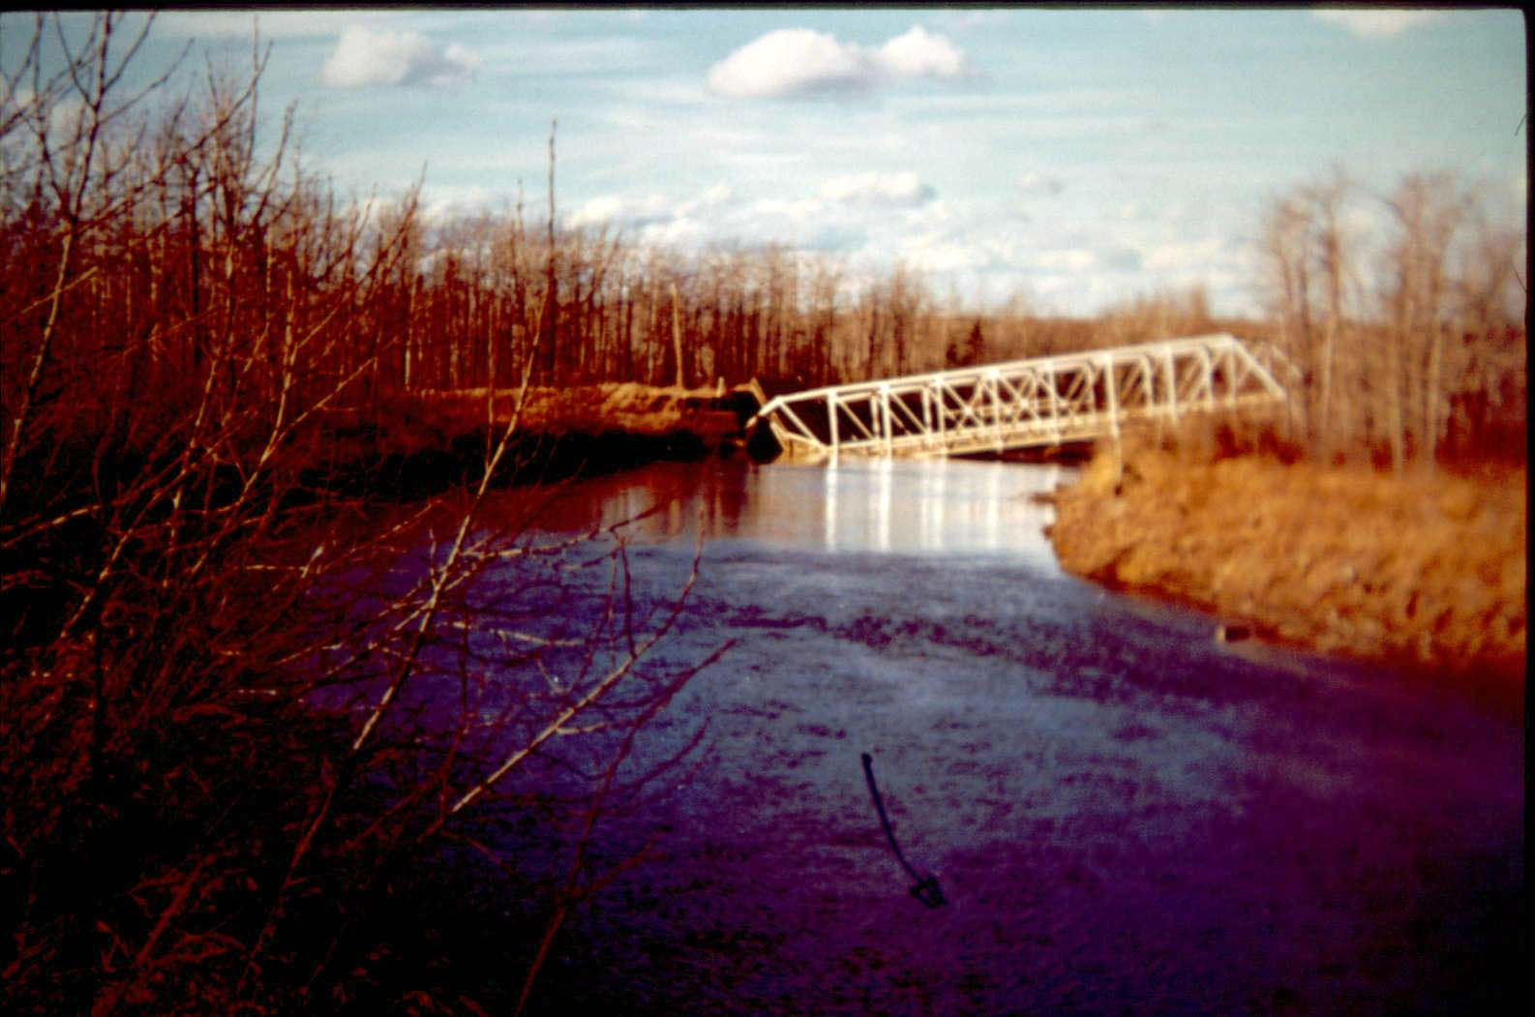
Red Willow River on Local Road near Rio Grande
Collapsed Bridge

Slide 36
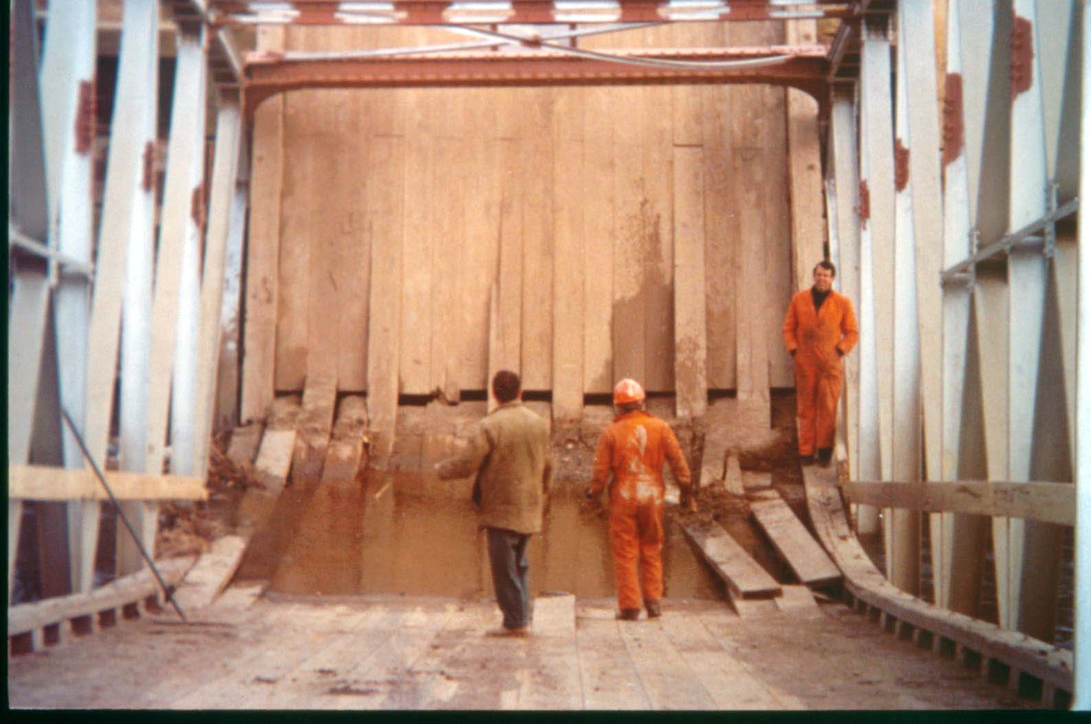
Red Willow River on Local Road near Rio Grande
Abutment end of the bridge showing timber decking etc.

Slide 37
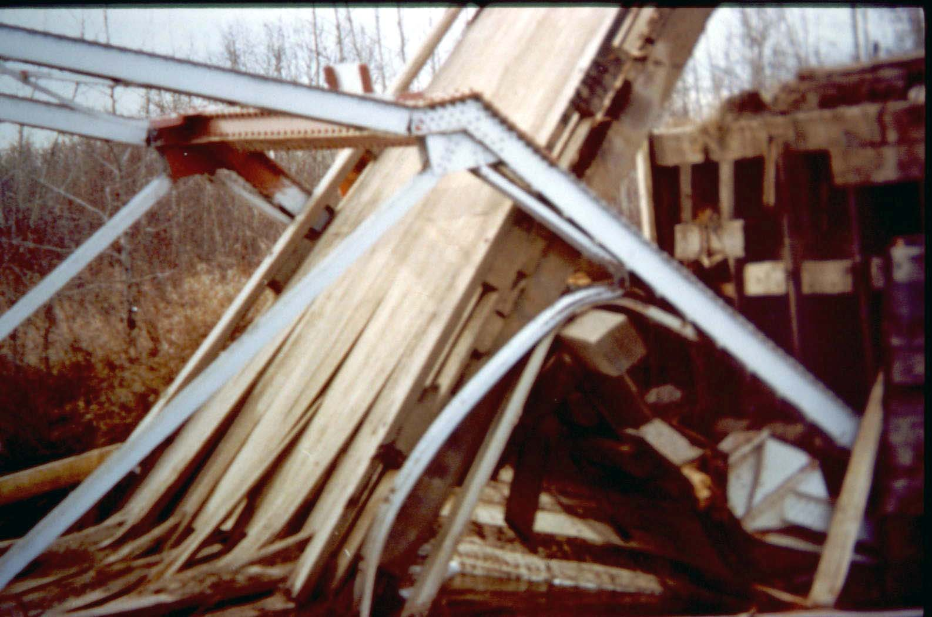
Red Willow River on Local Road near Rio Grande
Abutment end of truss dropped and buckled the bottom chord

Slide 38
Castle River Bridge
Local Road West of Pincher Creek
built in 1951 designed by a consultant in Toronto
Concrete T girder in poor condition in 1961
replaced in 1981

Slide 39
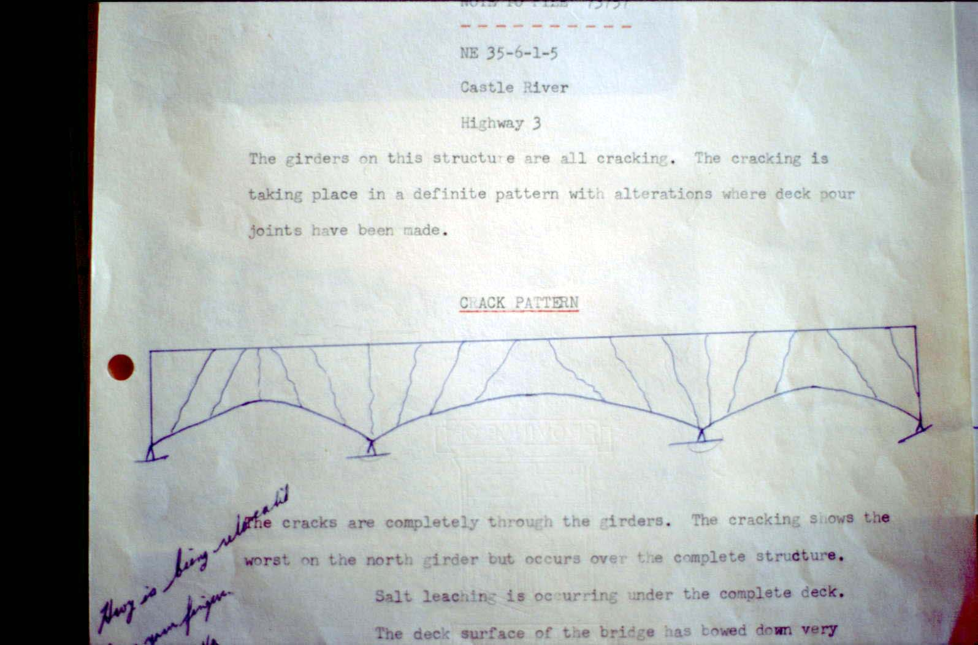
Castle River Bridge on Local Road West of Pincher Creek
Recorded crack pattern in 1964

Slide 40
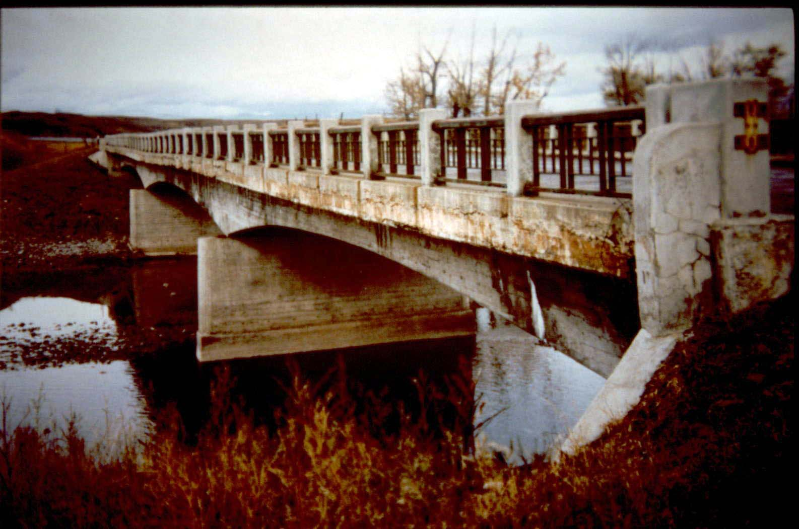
Castle River Bridge on Local Road West of Pincher Creek
Bridge condition in 1979 (28 years old)

Slide 41
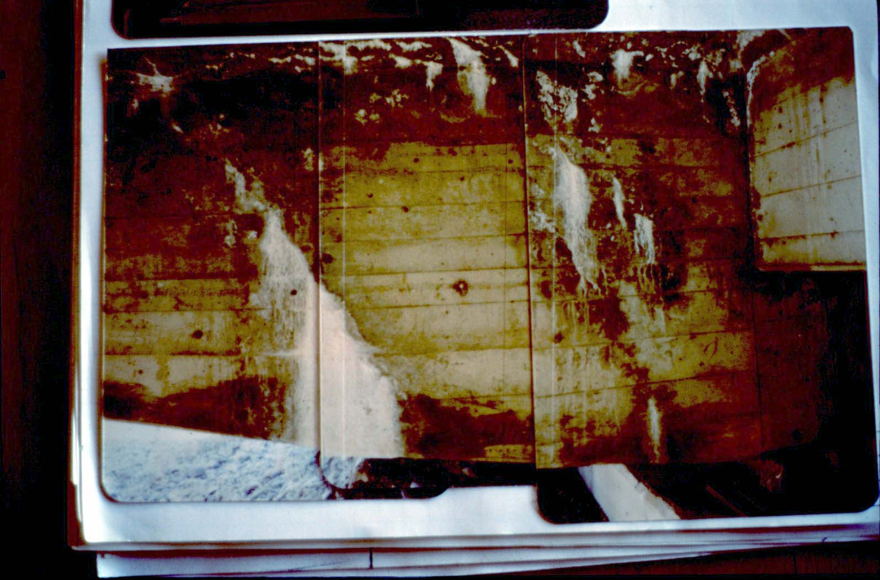
Castle River Bridge on Local Road West of Pincher Creek
Shear crack in girder and efflorescence from cracks

Slide 42
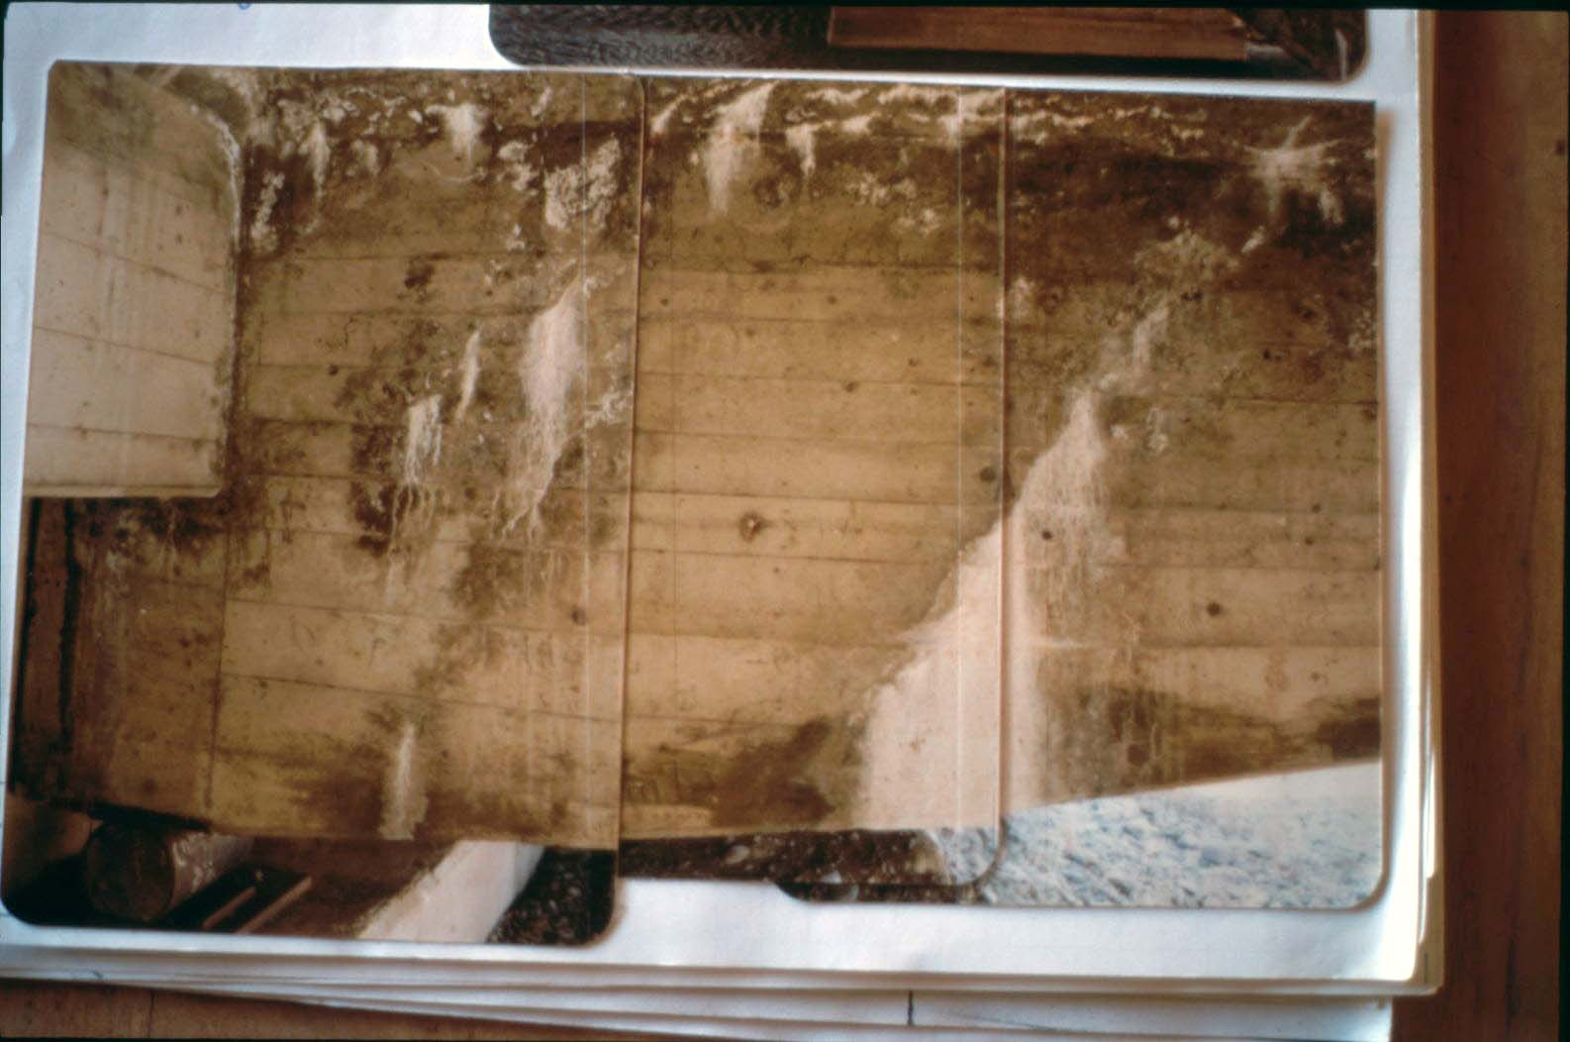
Castle River Bridge on Local Road West of Pincher Creek
Shear crack at girder end

Slide 43
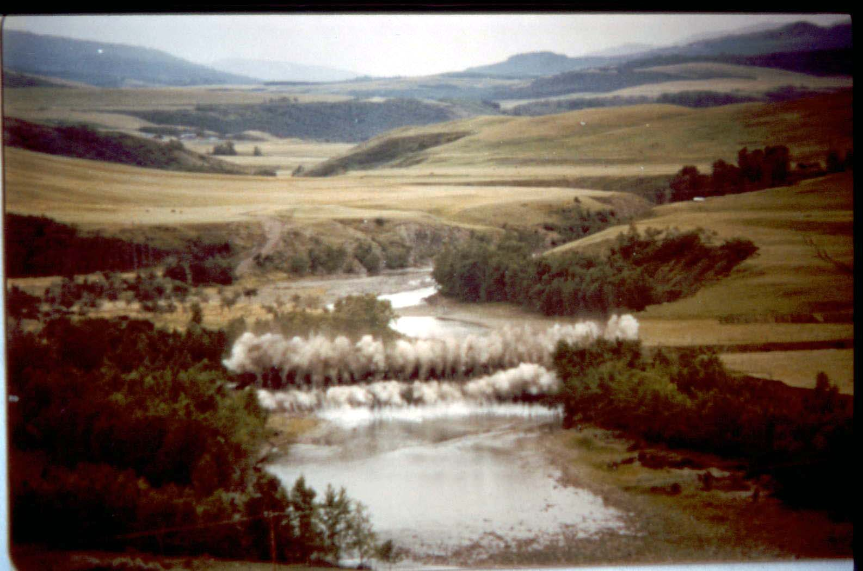
Castle River Bridge on Local Road West of Pincher Creek
Removing the bridge in August 1980

Slide 44
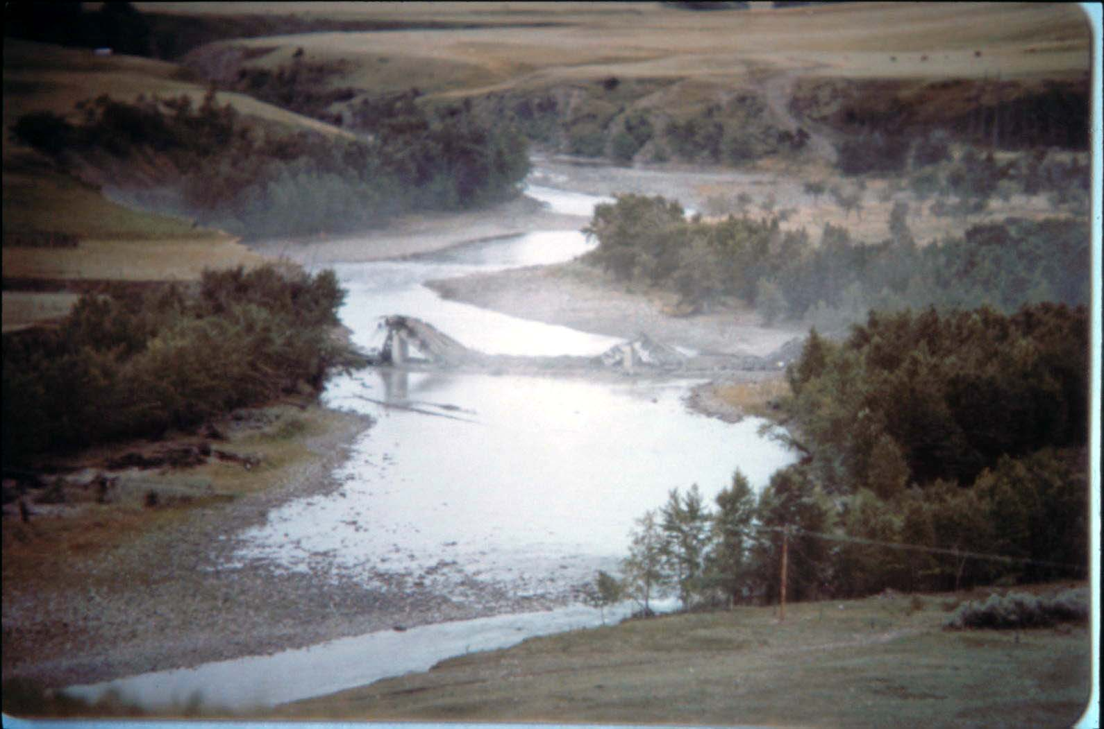
Castle River Bridge on Local Road West of Pincher Creek
Bridge Down

Slide 45
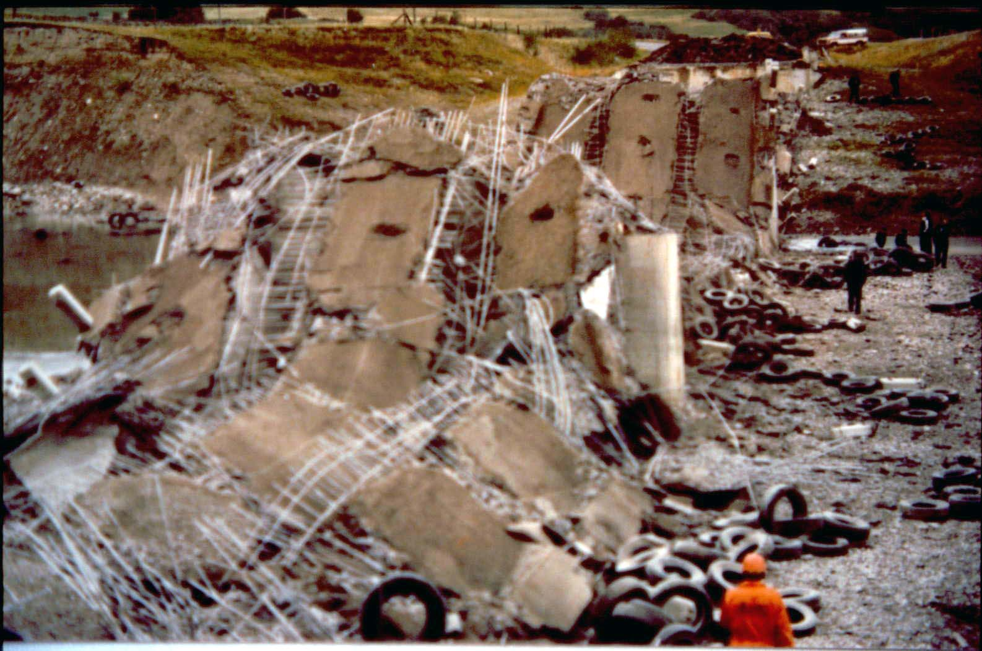
Castle River Bridge on Local Road West of Pincher Creek
Bridge remains

Slide 46
Simonette River Bride
Forestry Trunk Road (South of Debolt)
Timber and Bailey built in 1960 deck to s/b 3m
1982, 2 through trusses 60.96m 9m deck to s/b
Washed out in 1987 (Tornado Flood)
Rebuilt in 1988

Slide 47
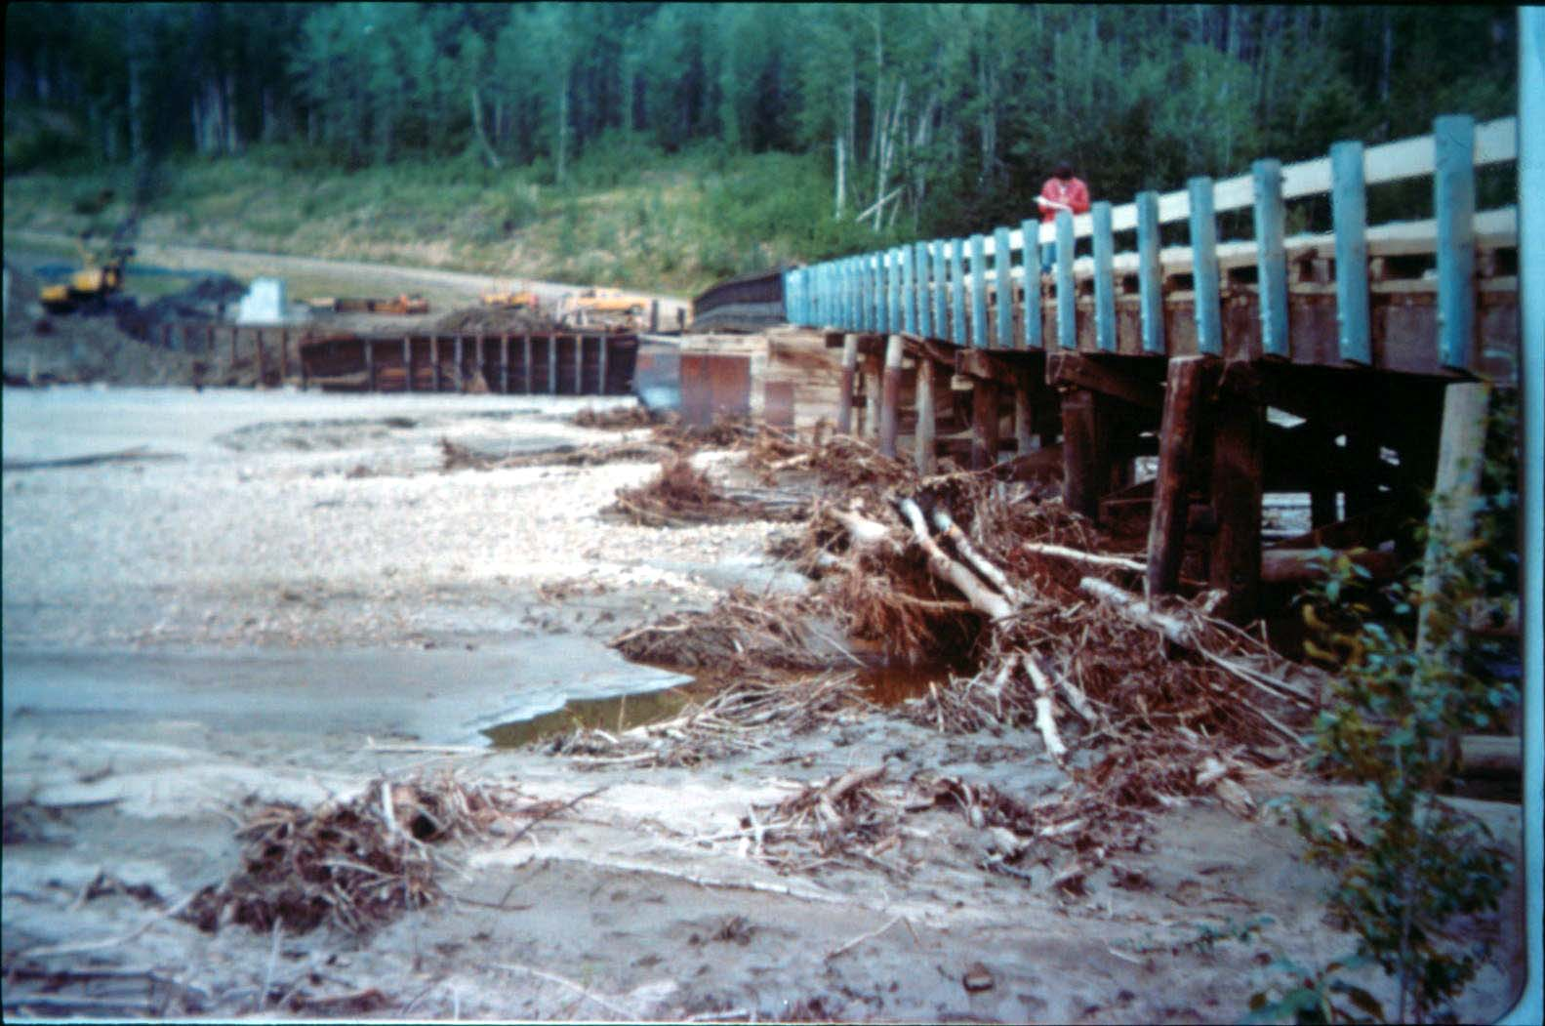
Simonette River Bridge on Forestry Trunk Road (South of Debolt)
Forestry bridge built in 1960, 380 ft. long bridge

Slide 48
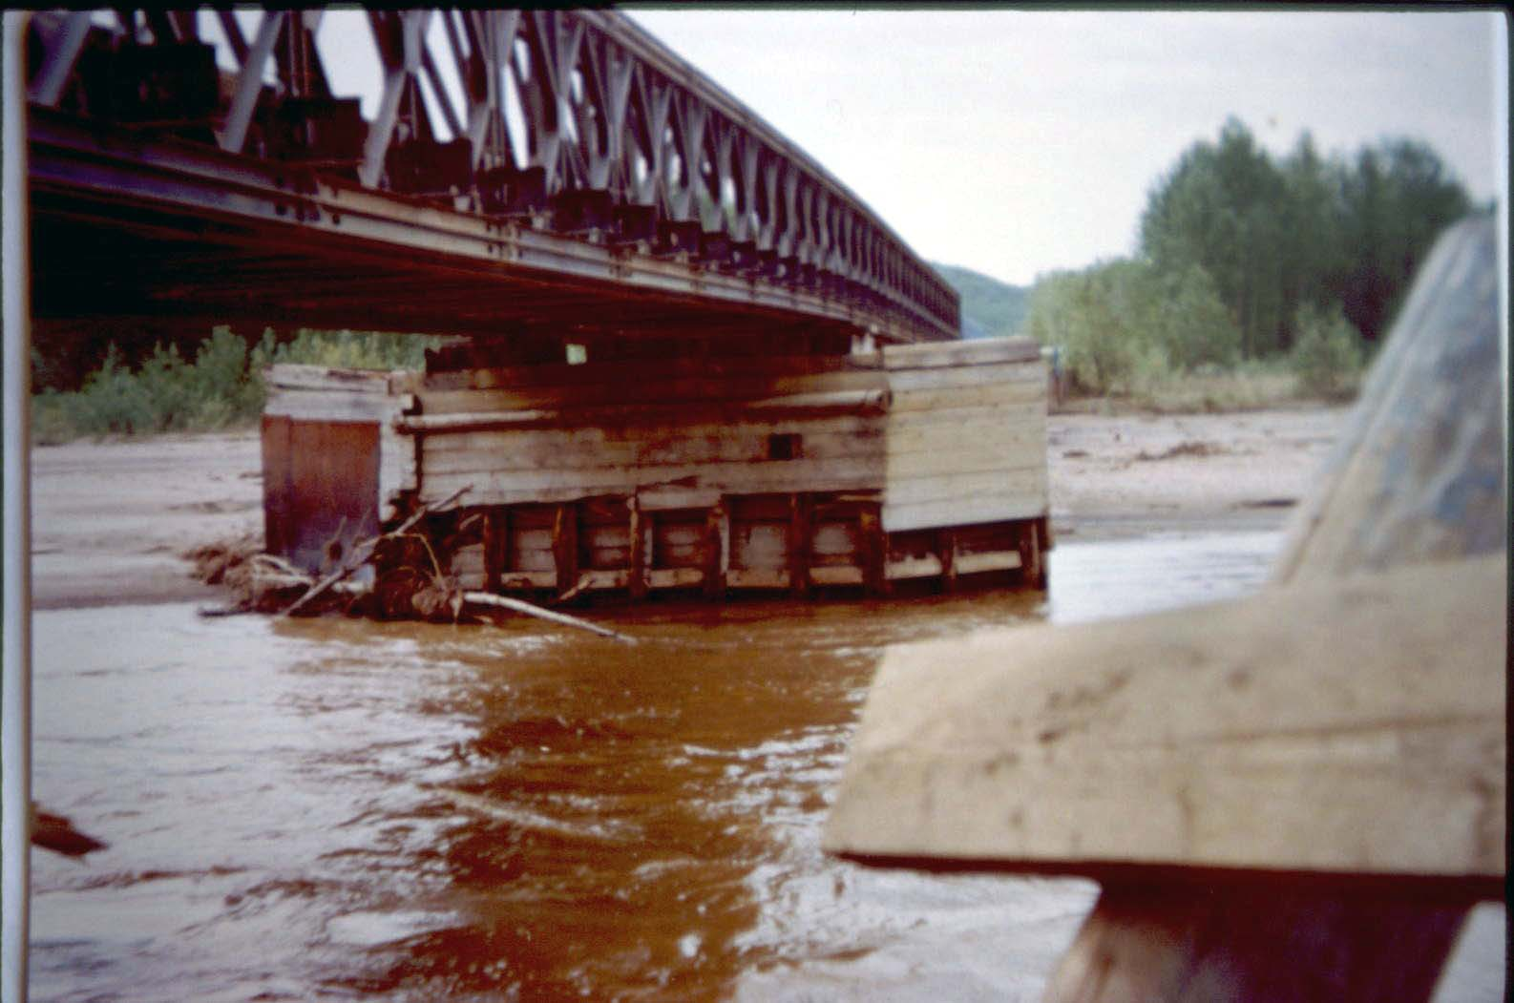
Simonette River Bridge on Forestry Trunk Road (South of Debolt)
Forestry Double Bailey, chord reinforced 2 @ 100 ft.

Slide 49
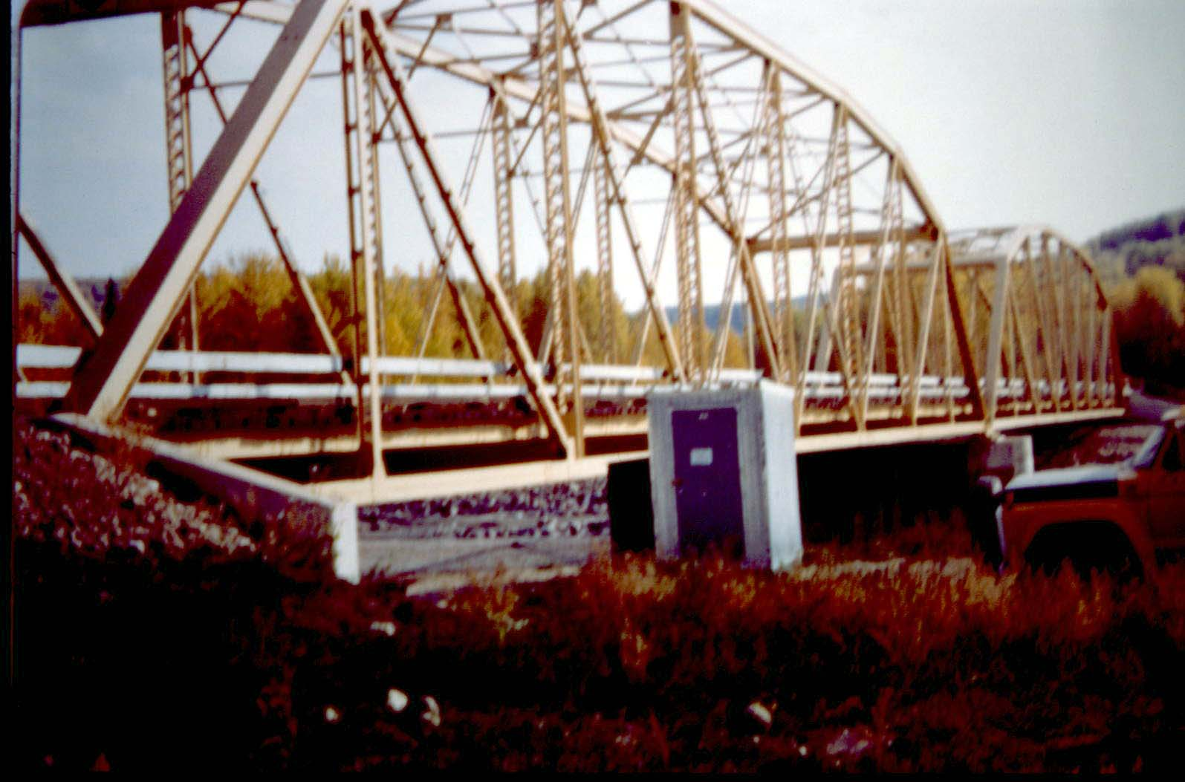
Simonette River Bridge on Forestry Trunk Road (South of Debolt)
Bridge built in 1982, 122m bridge

Slide 50
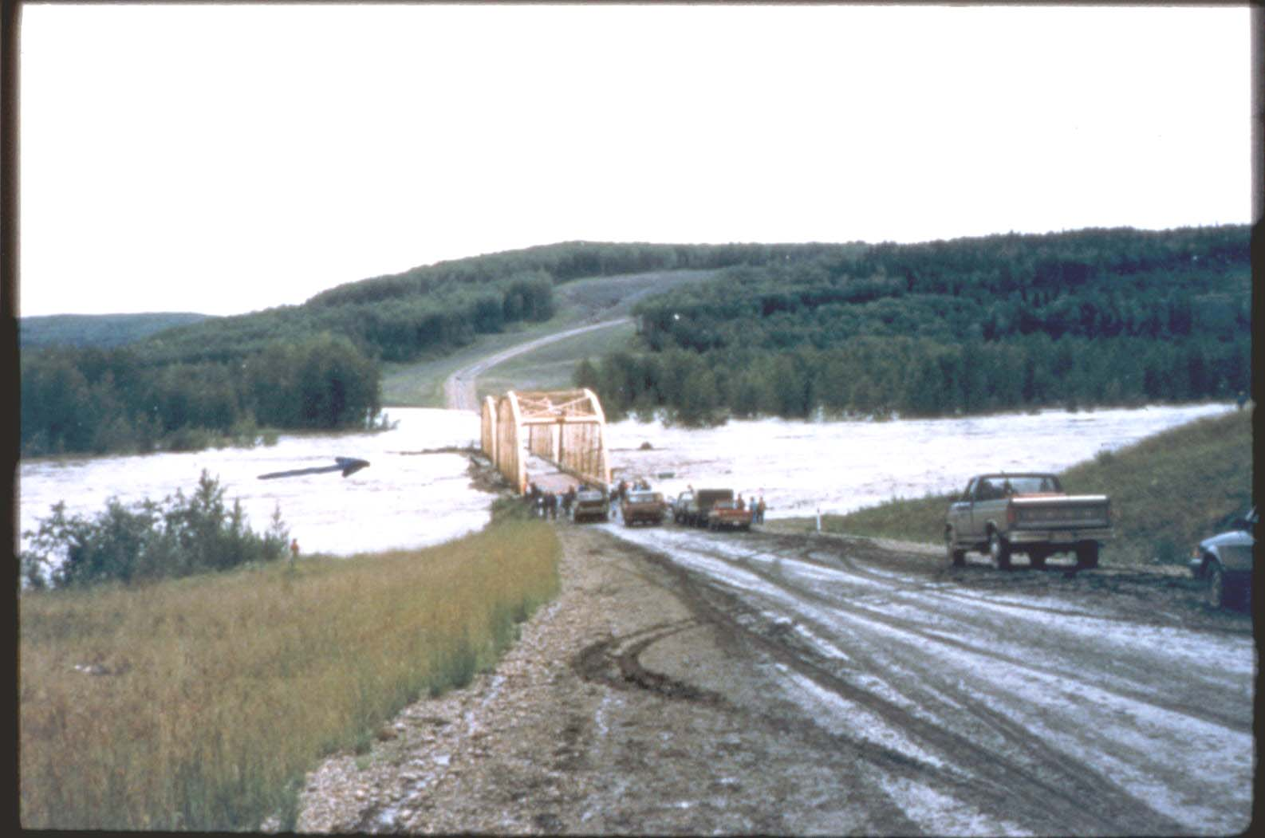
Simonette River Bridge on Forestry Trunk Road (South of Debolt)
Forestry road with river in floor, 1987

Slide 51
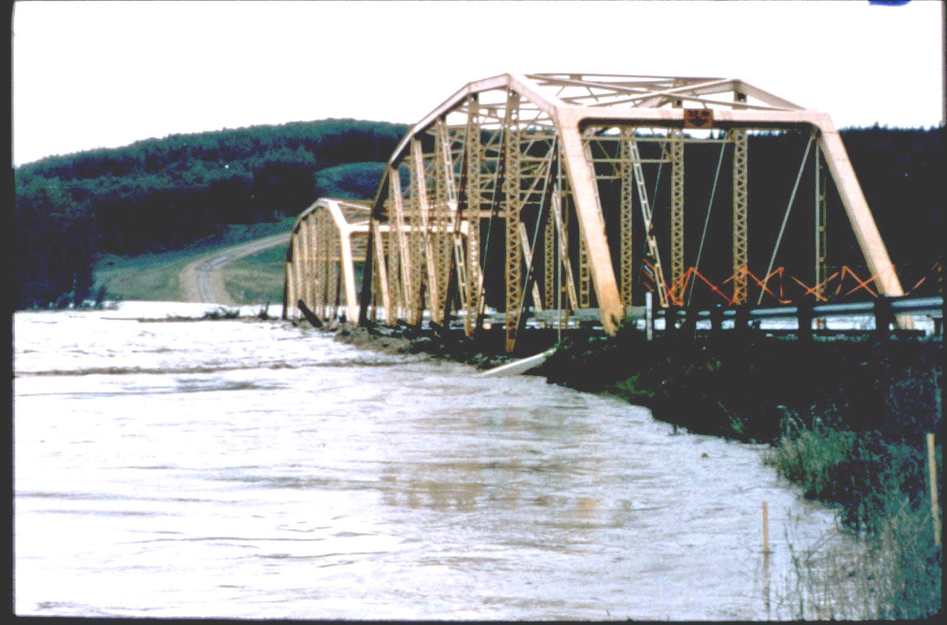
Simonette River Bridge on Forestry Trunk Road (South of Debolt)
Truss partly under water

Slide 52
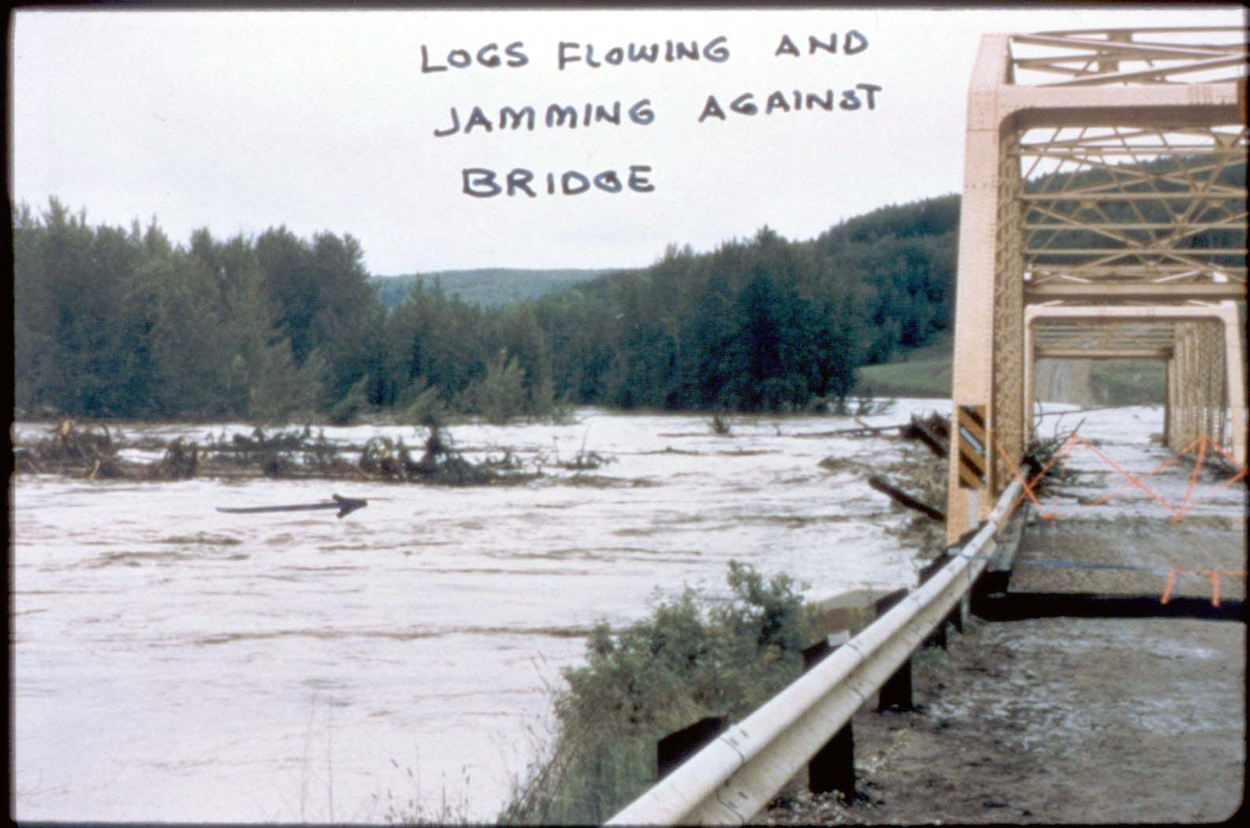
Simonette River Bridge on Forestry Trunk Road (South of Debolt)
Drift jamming under bridge

Slide 53
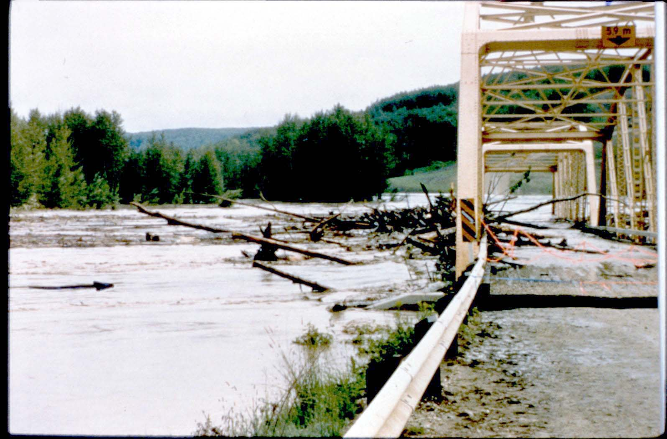
Simonette River Bridge on Forestry Trunk Road (South of Debolt)
Bridge floating and starting to shift

Slide 54
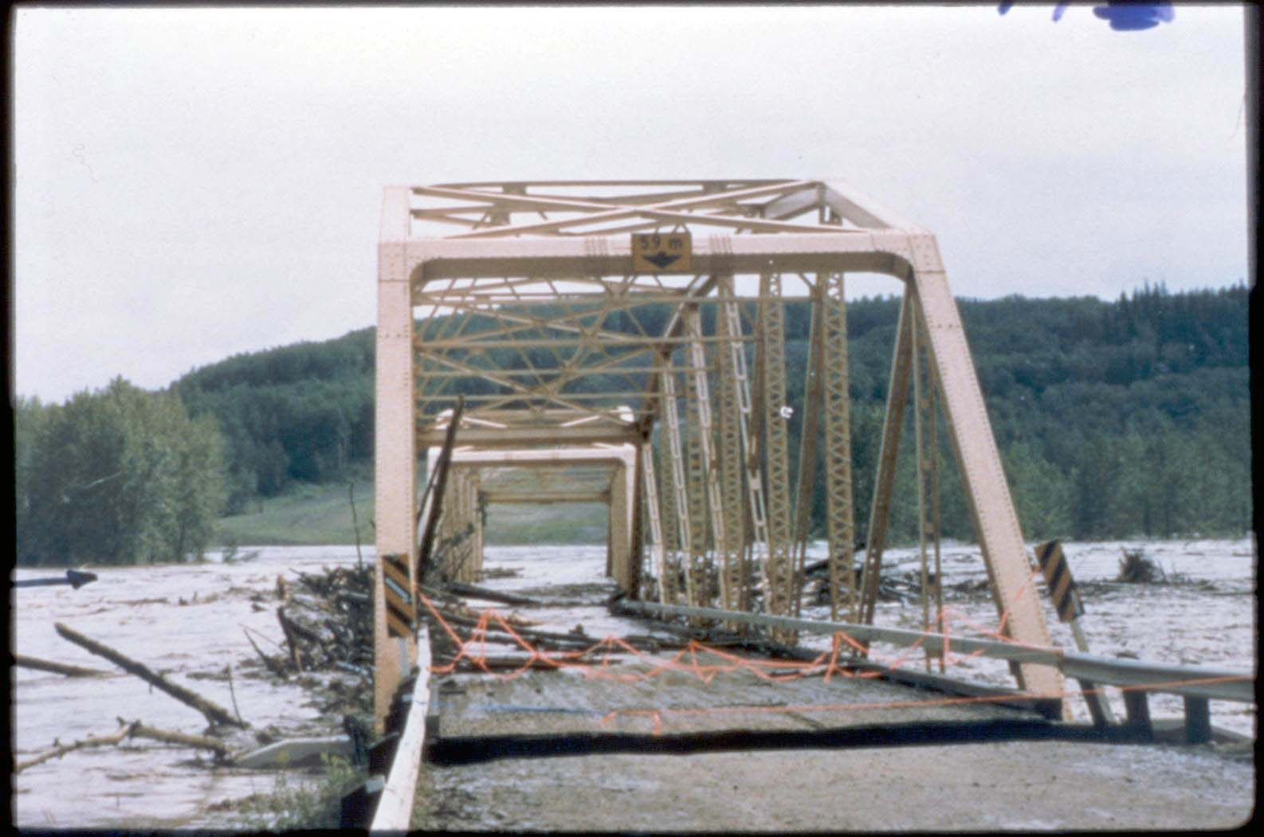
Simonette River Bridge on Forestry Trunk Road (South of Debolt)
Bridge starting to move laterally

Slide 55
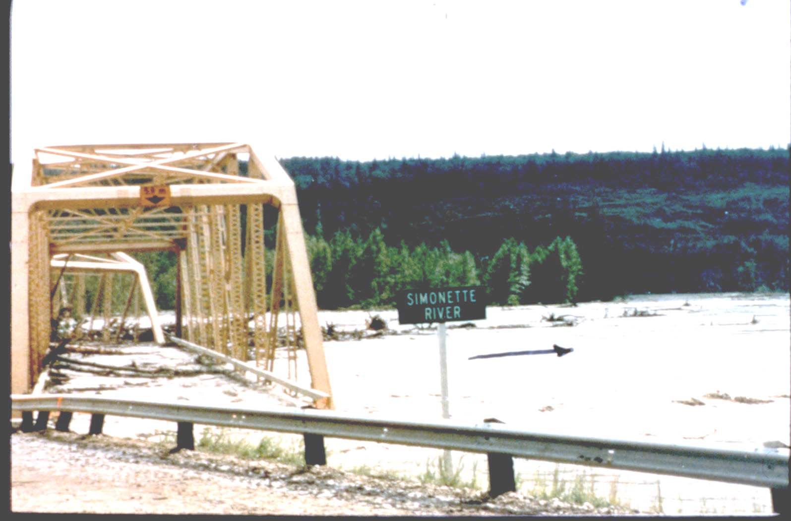
Simonette River Bridge on Forestry Trunk Road (South of Debolt)
Bridge floating downstream

Slide 56
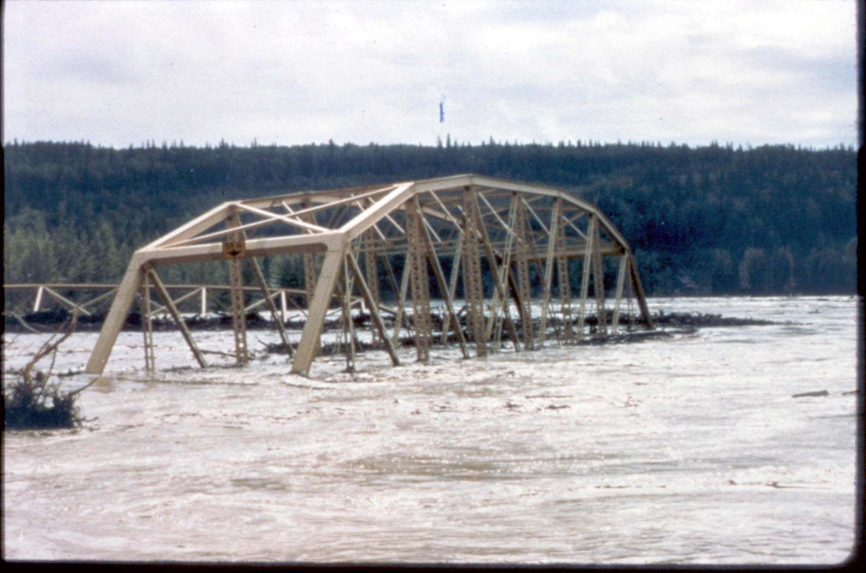
Simonette River Bridge on Forestry Trunk Road (South of Debolt)
One span tipped in middle channel and other one around near shore.

Slide 57
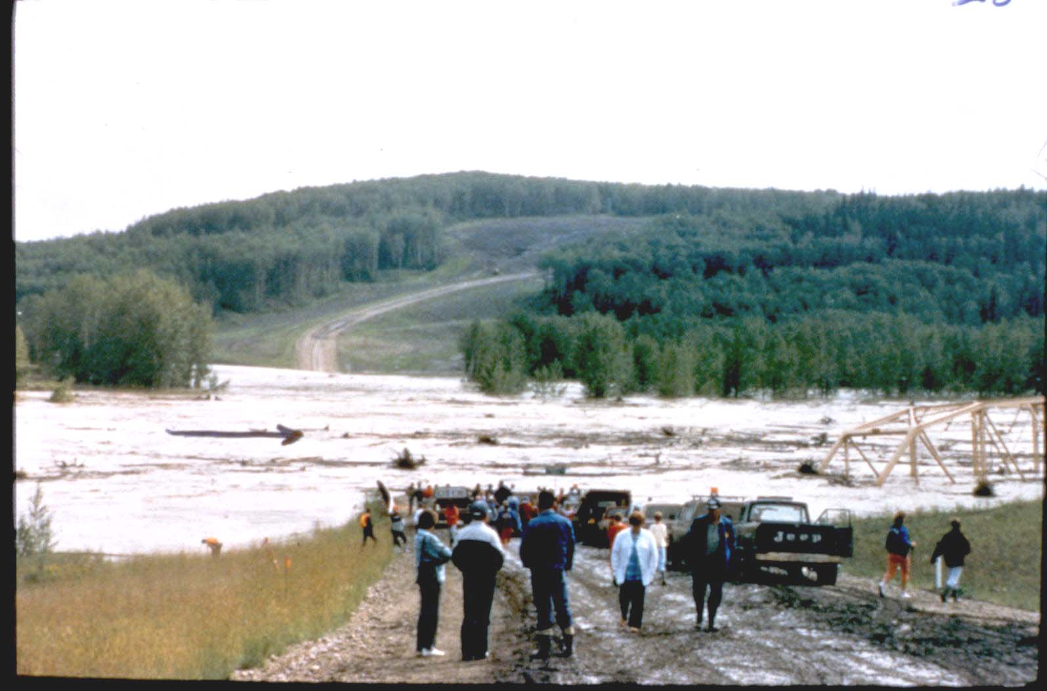
Simonette River Bridge on Forestry Trunk Road (South of Debolt)
Bridge gone.

Slide 58
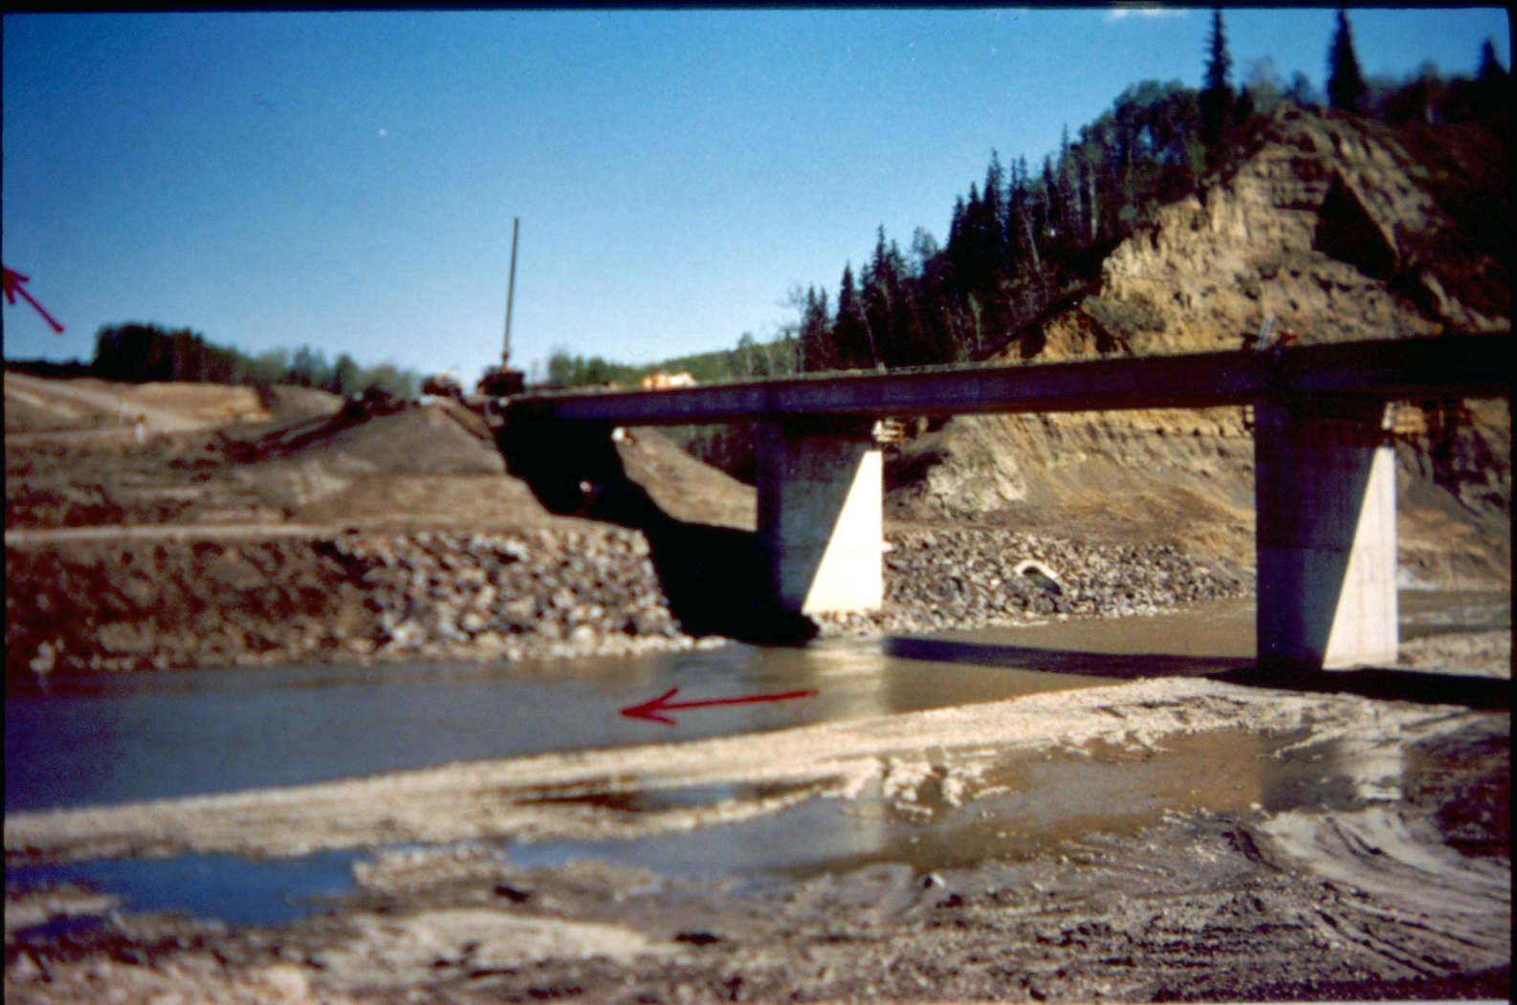
Simonette River Bridge on Forestry Trunk Road (South of Debolt)
New bridge.

Slide 59
Beaverhill Creek
Local Road North of Lamont
3-28’ Precast Concrete
Constructed in 1959
North pier cap failure in August 1980

Slide 60
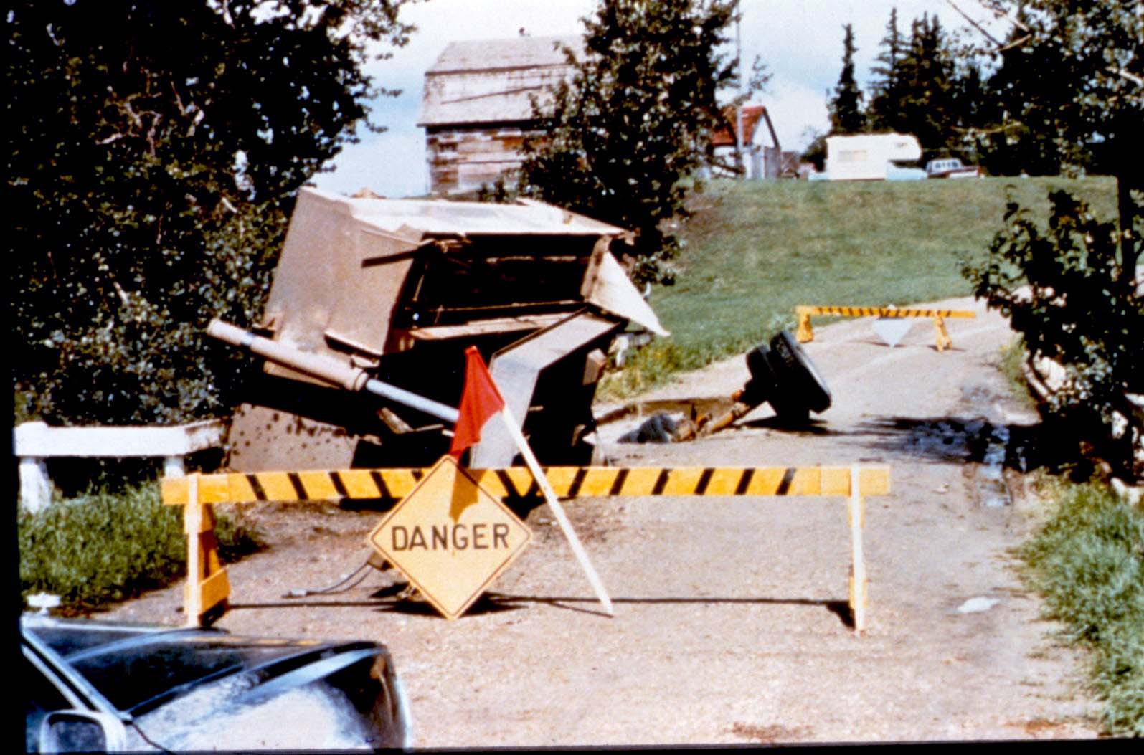
Beaverhill Creek on Local Road North of Lamont
Local road with gravel truck pup remaining on bridge

Slide 61
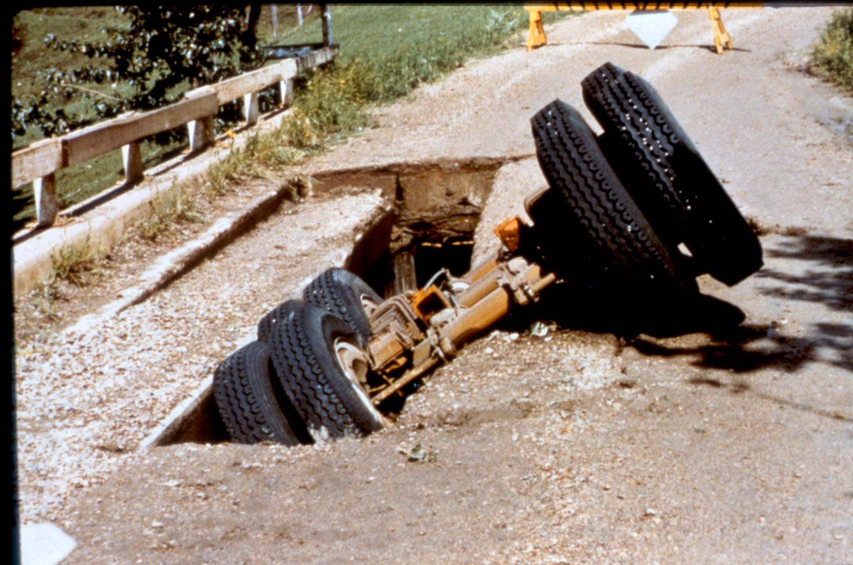
Beaverhill Creek on Local Road North of Lamont
Pup tandem axle in hole left by dropped girder

Slide 62
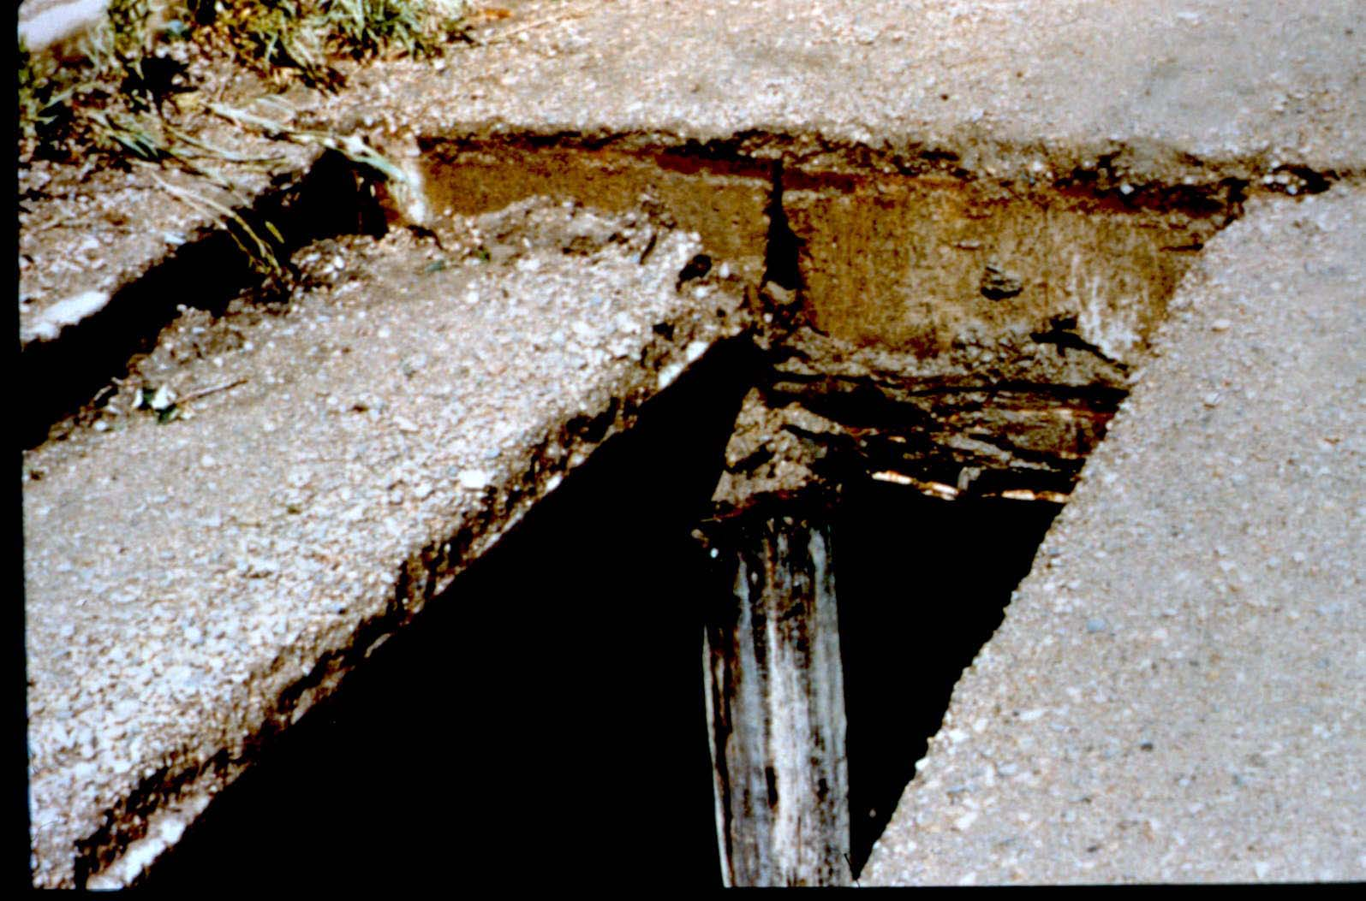
Beaverhill Creek on Local Road North of Lamont
Sheared timber cap. One girder hung up on pile.

Slide 63
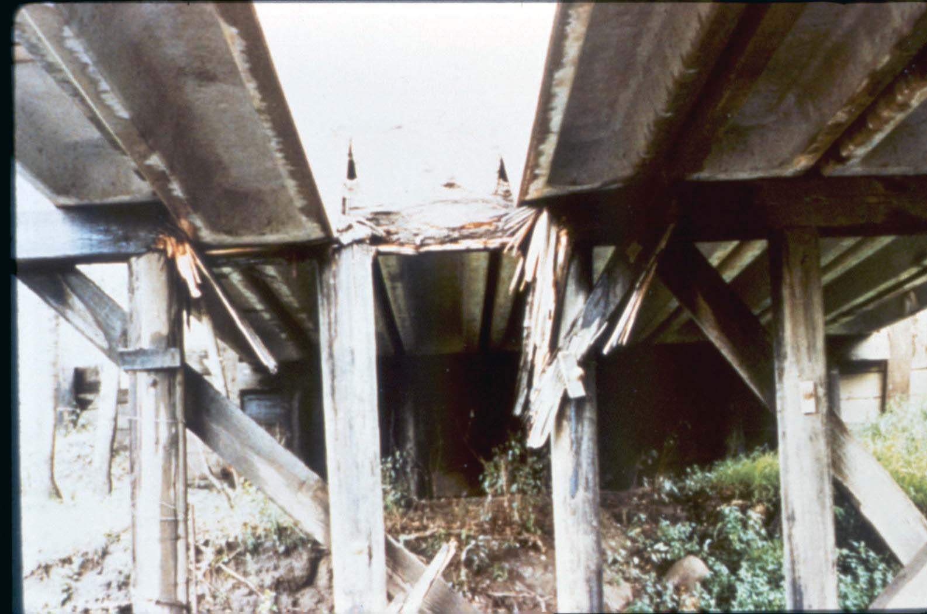
Beaverhill Creek on Local Road North of Lamont
Failed pier cap

Slide 64

Beaverhill Creek on Local Road North of Lamont
Failed pier cap with girder dropped to pile top level.

Slide 65

Beaverhill Creek on Local Road North of Lamont
Bottom of cap with piled punching (North pier)

Slide 66
Little Smoky Bridge
SH 744
Constructed in 1954
150 span failed in 1980 by cat and blade on high boy

Slide 67


Little Smoky Bridge on SH 744
Broken hanger U7 - L7 and
first diagonal U7 - L6
Severed batter post U7- L8

Slide 68

Little Smoky Bridge on SH 744
Members L6 – U5 and U5 – L5 buckeled

Slide 69

Little Smoky Bridge on SH 744
Inside of truss sagged 2’-0 leaning 10”

Slide 70
BF 1153 – Hwy. 22 over Oldman River near Lundbreck
3 span Type PO girders on concrete substructure -built 1959.
Span lengths of 20.7 – 29 – 29 M.
Typ. Sliding Plate Bearing with Self-Lubricating Bronze Plates.
Expansion Bearings at P1 and P3. Deck height is 18.5M.
Routine Level 1 BIM inspection of December 2015 noted frozen bearings at the west end of P1 under Span 1 - G1 and G2.
Significant portion of concrete pier cap under G1, G2 bearings had failed due to induced stresses into pier from frozen bearings resulting in G1 un-supported and near collapse.
Lane above immediately closed and truck traffic detoured.
Subsequent BIM Advisory bulletin #3 issued January 20, 2016.

Slide 71

BF 1153 – Hwy. 22 Oldman River 21-29-29-27m Type PO Girders – Deck Height 19m - 1959

Slide 72

BF 1153 – Standard Drawing S-701

Slide 73

BF 1153 – Failed concrete at west end of P1 from frozen bearings under G1, G2. G2dbreck

Slide 74

BF 1153 – Failed pier concrete and un-supported bearing under Sp. 1-G1.

Slide 75

BF 1153 – 30mm drop in rail and curb over Sp.1-G1.

Slide 76

BF 1153 – Neoprene Pads & Widened/Strengthened Pier Caps

Slide 77


Slide 78

Questions?

