Slide 1
CONCRETE PHYSICAL & MECHANICAL PROPERTIES

Slide 2
Introduction
Composition
Physical Properties
Mechanical Properties
Defects & Deterioration

Slide 3
COMPOSITION

Slide 4
Composition
Portland Cement.
Aggregate.
Mixing Water.
Entrapped Air.
Admixtures.
Supplementary Cementing Materials.

Slide 5
Proportions of Materials in Concrete
Cementing
materials
15 %
Water
18 %
Air
8 %
Fine agg.
28 %
Coarse agg.
31 %
Mix 1
Air-Entrained
Concrete
7 %
14 %
4 %
24 %
51 %
Mix 2
15 %
21 %
3 %
30 %
31 %
Mix 3
Non air-Entrained
Concrete
7 %
16 %
1 %
25 %
51 %
Mix 4

Slide 6
Cross-section of Concrete

Slide 7
Portland Cement
Invented in 18th century in England and was called Portland cement due to its similarity to Portland stone, a type of building stone commonly used.
Chemical compound which reacts with water (hydration) to form a stone like mass.
Tricalcium Silicate
Dicalcium Silicate
Water
Calcium Silica Hydrate
Calcium Hydroxide
C₃S + C₂S + H₂O C₃S₂H₂ + CH

Slide 8
Portland Cement
73% Limestone
23% Clay
2% Iron
3% Sand
Grind
Grind
Portland
Cement
Heat
1500°C
Clinker
+
Gypsum

Slide 9
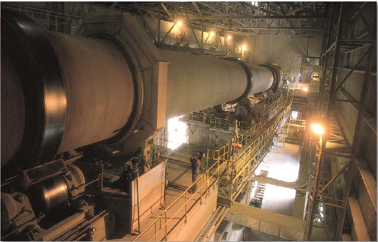
Cement Manufacture

Slide 10
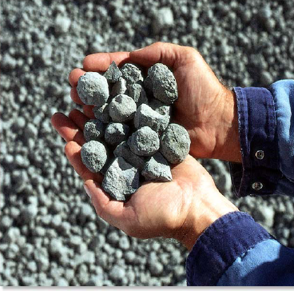
Cement Manufacture

Slide 11
Types of Cement
Type “GU” – General use.
Type “GUL” – 1st test project in Alberta in 2022 – 15% limestone added
Type “HE” – High early strength.
Type “MS” – Moderate sulfate resistance.
Type “HS” – High sulfate resistance.
Type “MH” – Moderate heat of hydration.
Type “LH” – Low heat of hydration.
Notes:
Think of uses. HE precasters
MS/HS sea water, corrosive soils
MH/LH hydration. Not common for us. Maybe mass pours?

Slide 12

Water
Potable water
Impurities cause
  abnormal set
  decreased strength
  volume change
  efflorescence
  corrosion of reinforcement

Slide 13
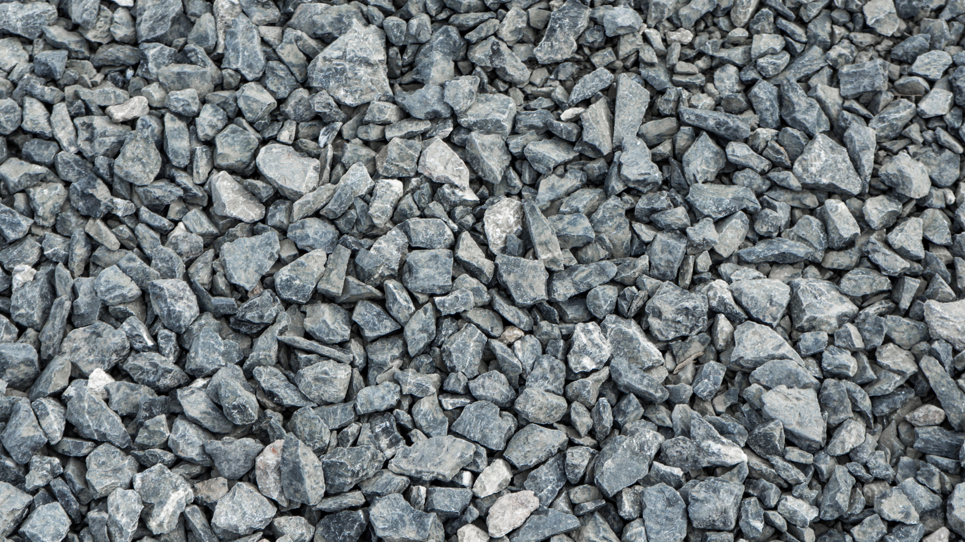
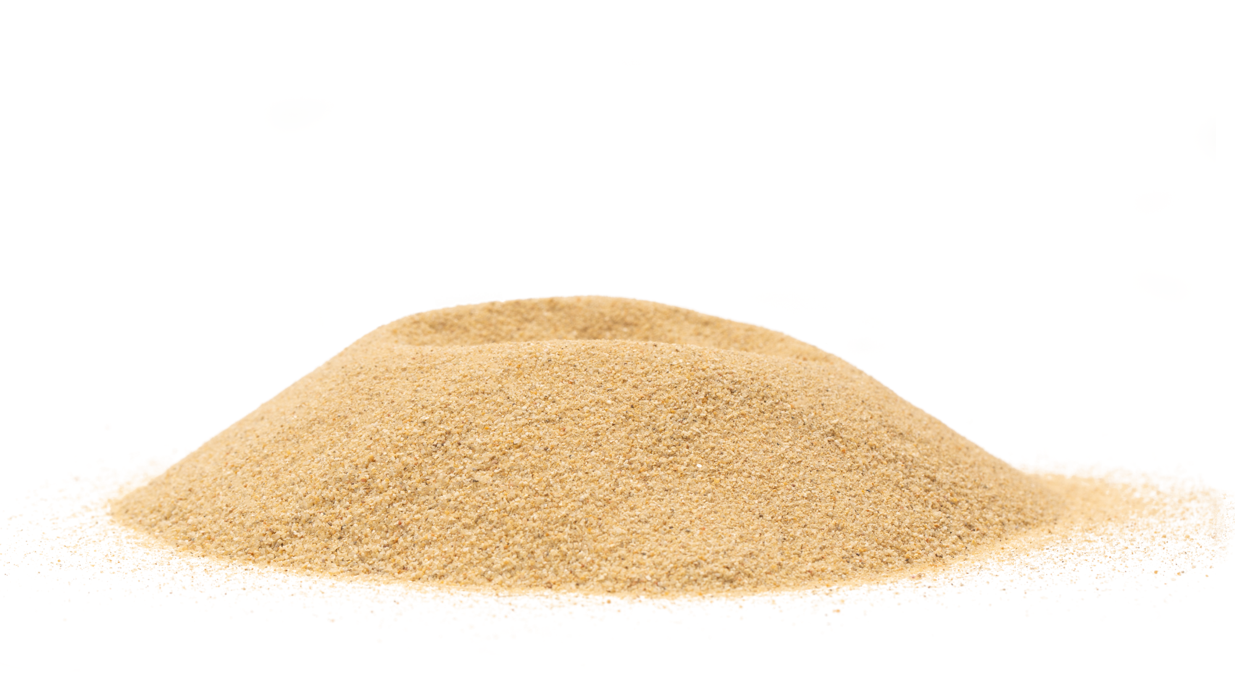
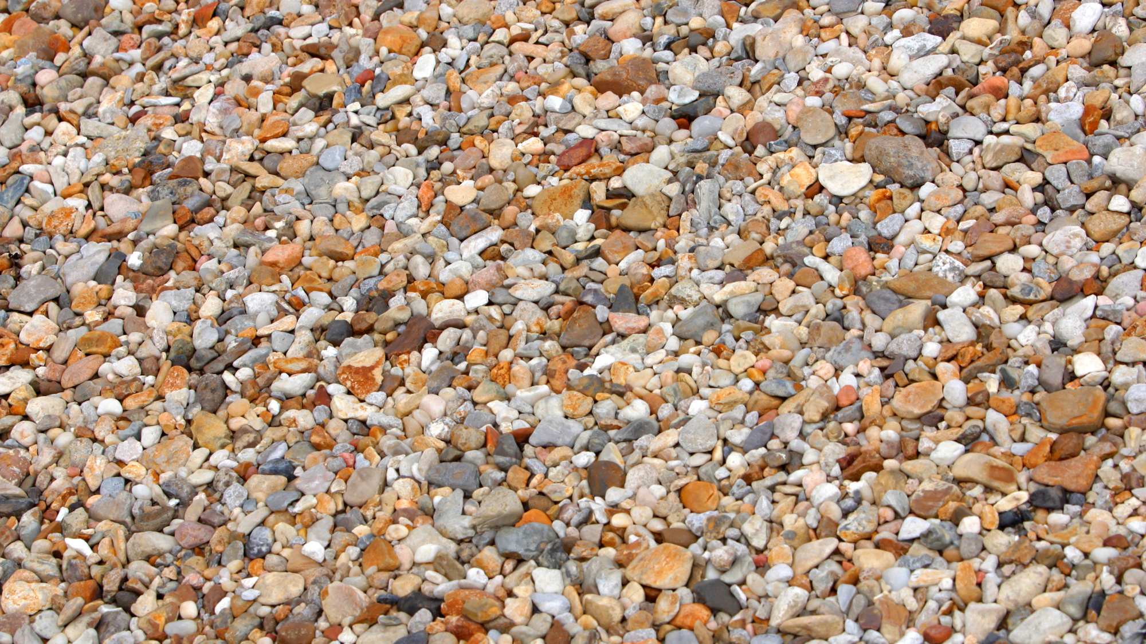
Aggregate

Slide 14
Characteristics of Aggregate
Clean & sound.
Abrasion resistance
Freeze & thaw resistance
Wetting & drying properties
Chemical stability
Alkali aggregate reactivity
Shape and surface texture
Aggregate grading

Slide 15
Grading Limits
100
80
60
Percent Passing by Mass
Fine Aggregate
40
Coarse Aggregate
20
160
315
630
1.25
2.5
5
10
20
40
56
µm
mm
Sieve sizes - nominal opening

Slide 16
Fineness Modulus
Sieve Size | Percentage Retained by Mass
10 mm | 0
5 mm | 2
2.5 mm | 15
1.25 mm | 35
630 µm | 55
315 µm | 79
160 µm | 97
Total | 283
Fineness Modulus = 283/100 = 2.83

Slide 17
Air-Entrained Concrete
Improves freeze-thaw resistance
Improves workability
Finishes sooner
Reduces water
Reduces segregation and bleeding
Improves sulfate resistance
Entrained air content from 5% to 8%
Notes:
Freeze-thaw

Slide 18
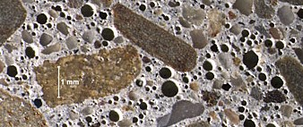
Air-Entrained Concrete
Notes:
Dark bubbles are air

Slide 19
PHYSICAL PROPERTIES

Slide 20
Physical Properties
Thermal expansion:
  Concrete 9.9 x 10⁻⁶/°C
  Steel 12.0 x 10⁻⁶/°C
Volume change due to moisture:
  Swelling
  Shrinkage

Slide 21
Swelling/ Shrinkage
Swelling
Stored in water
Stored in air
Shrinkage
Time
Notes:
Curing prevents shrinkage cracks.

Slide 22
Water/Cement Ratio & Shrinkage of Paste
3.2
W/C = 0.65
2.4
W/C = 0.55
W/C = 0.45
Drying Shrinkage 10⁻⁶
1.6
W/C = 0.26
0.8
7
28
90
180
270
360
Age (Days)
Notes:
More shrinkage in concretes with higher water-cement ratios

Slide 23
MECHANICAL PROPERTIES

Slide 24
Mechanical Properties
Strength
  Compressive (28 day – f’c)
  Tensile (10% of f’c)
  Shear (12% to 13% of f’c)
  Flexural (14% of f’c)
Abrasion resistance
Creep
Fire resistance
Durability
Permeability
Notes:
Good compression. Not good tension. It cracks. This is why we add rebar

Slide 25
Water/Cement Ratio vs. Strength
60
50
Non air-entrained concrete
40
28 day compressive strength MPa
30
20
Air-entrained concrete
10
0.3
0.4
0.5
0.6
0.7
0.8
0.9
W/C Ratio
Notes:
As w/c increases. Strength decreases. However, workability.
Less air voids, higher strength. Freeze-thaw

Slide 26
Effect of Curing on Strength
60
Moist cured entire time
50
In air after 28 days moist curing
40
In air after 7 days moist curing
Compressive Strength MPa
In lab. air cured
30
20
10
0
7
28
91
365
Age at Test Days

Slide 27
Compressive Strength & Air Content
W/C Ratio
70
0.3
0.4
0.5
60
Compressive Strength @ 90 days - MPa
50
40
0
1
2
3
4
5
6
7
Air Content %
Notes:
Class C and HPC w/c is 0.4
Air is 5-8

Slide 28
Wear vs. Strength
10
7.5
Depth of Wear (mm)
5.0
2.5
0
7
14
21
28
35
Compressive Strength MPa
Notes:
Basically describing relationship btwn low strength resulting in low surface durability & abrasion resistance. E.g. concrete bridge decks resisting tire and snowplow wear, concrete floors in culvert resisting rock/gravel abrasion. Durability increases as strength increases. Abrasion primarily affected by strength

Slide 29
Concrete Strength & Creep
10
7.5
Concrete Strength 27.6 MPa
Creep Strain
5
Concrete Strength 41.4 MPa
0
250
500
750
1000
1250
Age (Days)
Notes:
Higher strength means less creep.
Creep is deformation under constant (not changing) load

Slide 30
Curing Method & Creep
7 days moist cured
Atmospheric steam cured
Creep Deformation
High-pressure steam cured
0
50
100
150
200
250
300
350
Time after loading (Days)
Notes:
Better curing reduces creep.

Slide 31
Age of Loading & Creep
10
Age of loading
28 days
7.5
Creep Strain
90 days
5
180 days
0
250
500
750
1000
1250
Age (Days)
Notes:
Age of girders when they are installed affects creep

Slide 32
Freeze/ Thaw Resistance, Air & W/C Ratio
6000
Fog cured 14 days
Dried 76 days at 50% RH
5000
4000
Air entrained
concrete
3000
Non-air entrained
concrete
2000
Cycles of freezing & thawing to 25% loss in mass
1000
0
4000
Fog cured 28 days
No drying
3000
2000
1000
0
0.3
0.4
0.5
0.6
0.7
0.8
W/C Ratio
Notes:
Air entrainment helps for all cases.

Slide 33
Permeability, W/C Ratio & Curing
50
Non-air entrained concrete
40
1 day moist, 90 days in air
30
Permeability cm/secx10⁻¹⁰
7 days moist, 90 days in air
20
10
0
0.3
0.4
0.5
0.6
0.7
0.8
W/C Ratio

Slide 34
DEFECTS AND DETERIORATION

Slide 35
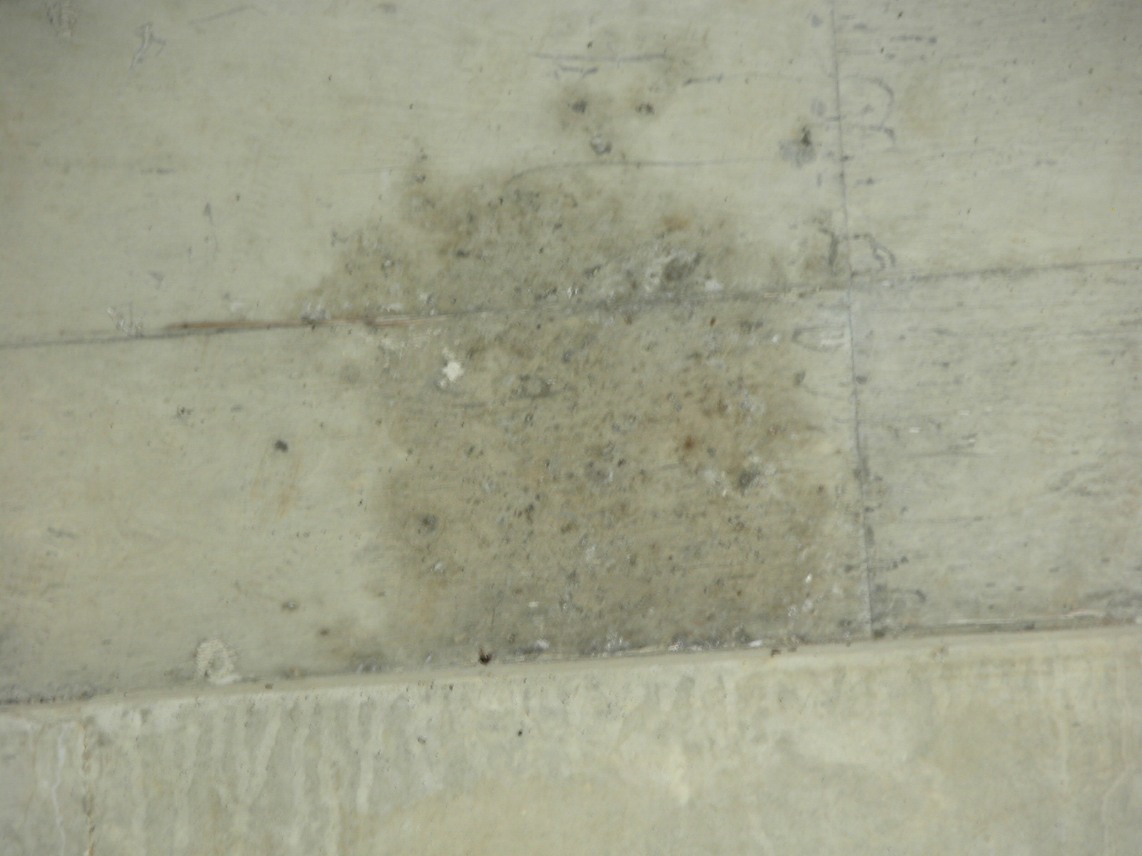
Deterioration Stains
Notes:
Water working its way through deck

Slide 36
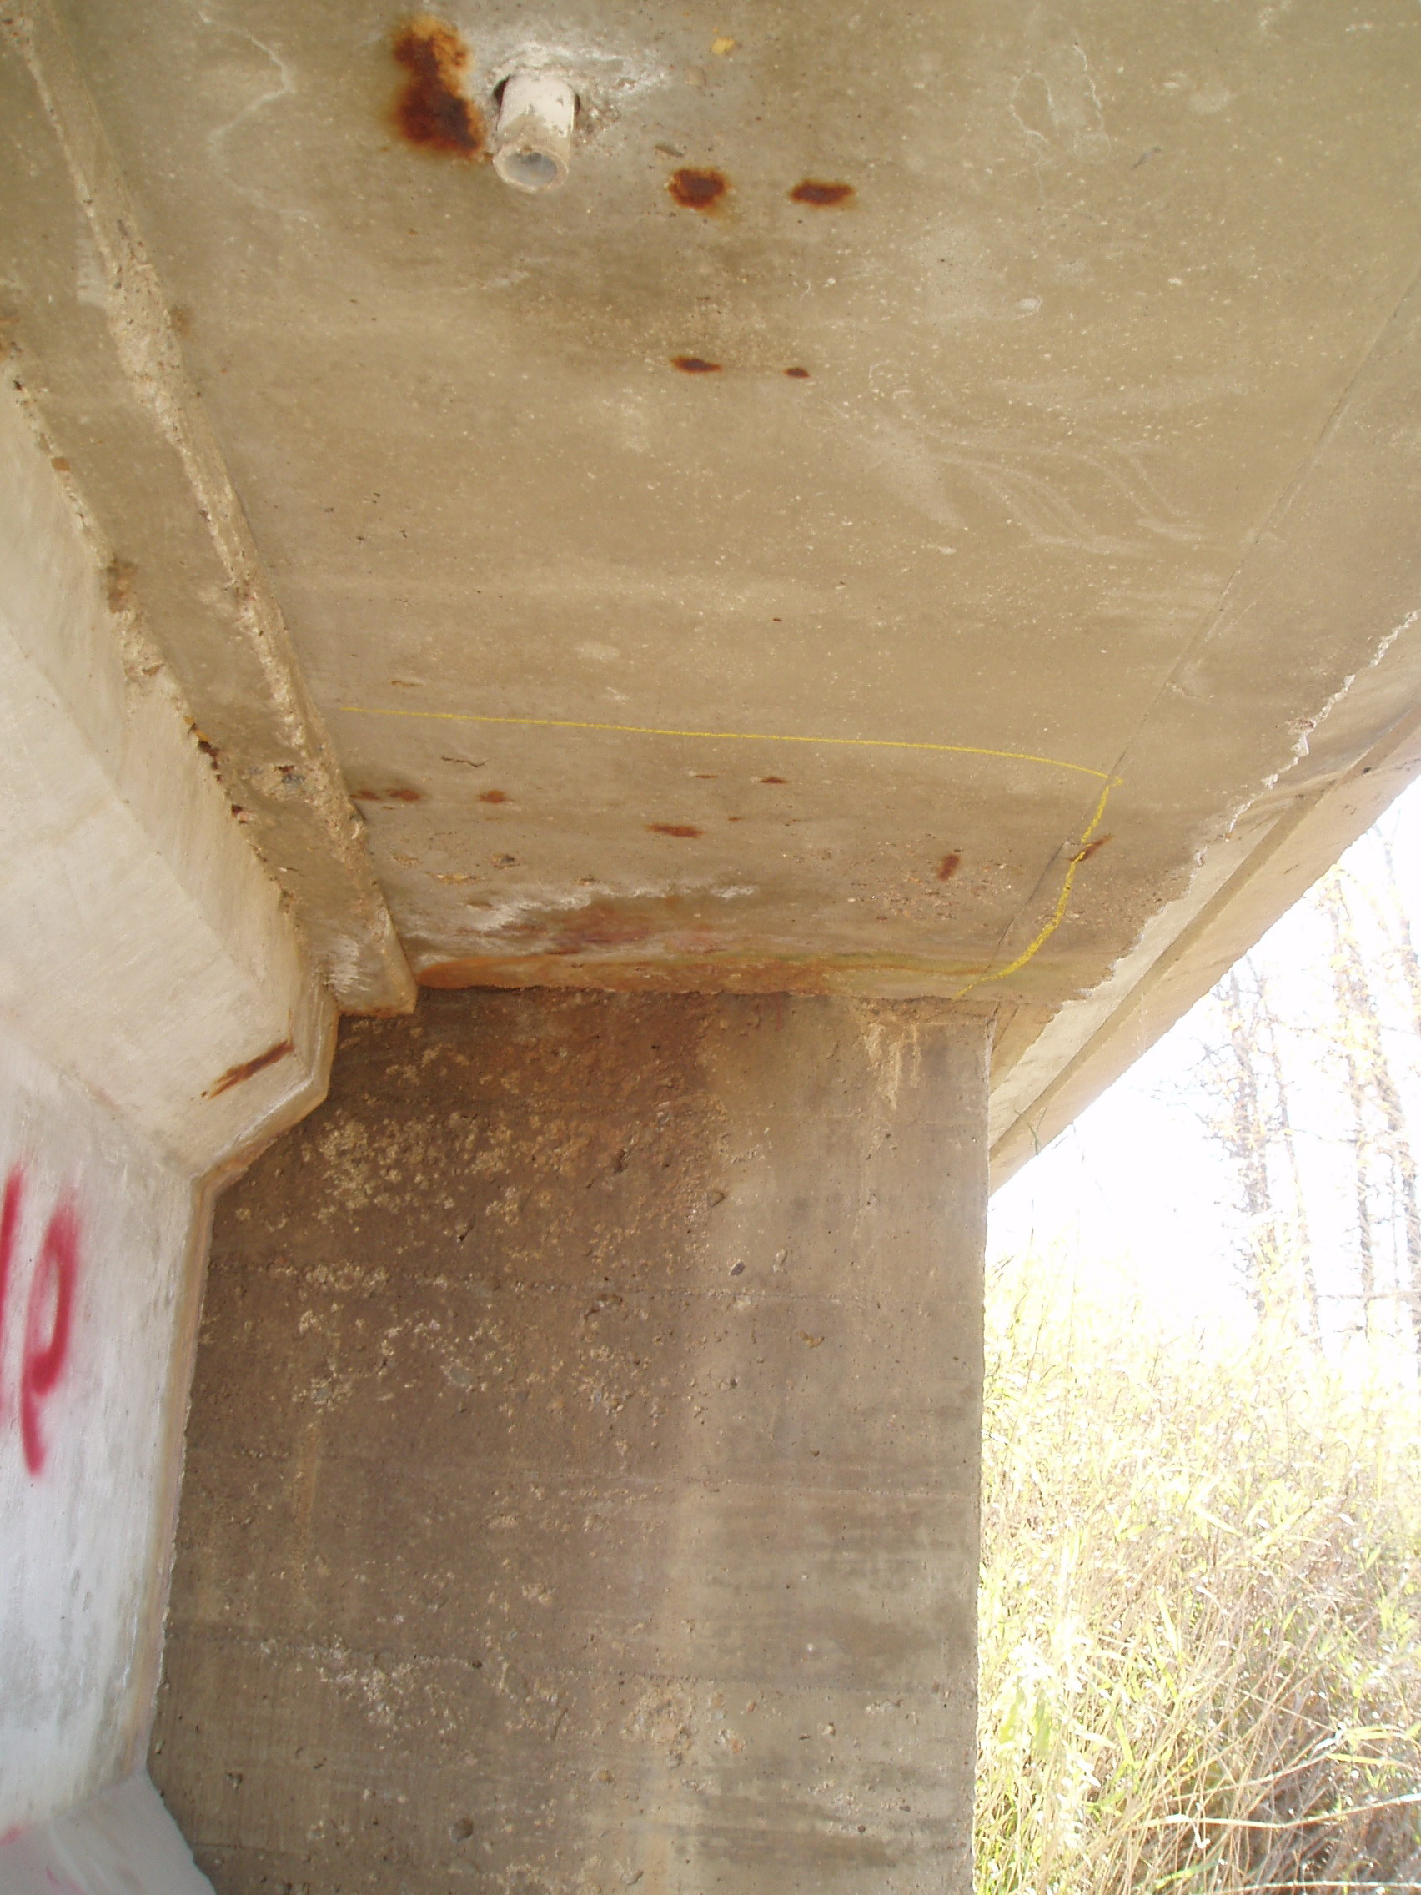
Staining, Efflorescence & Corrosion

Slide 37
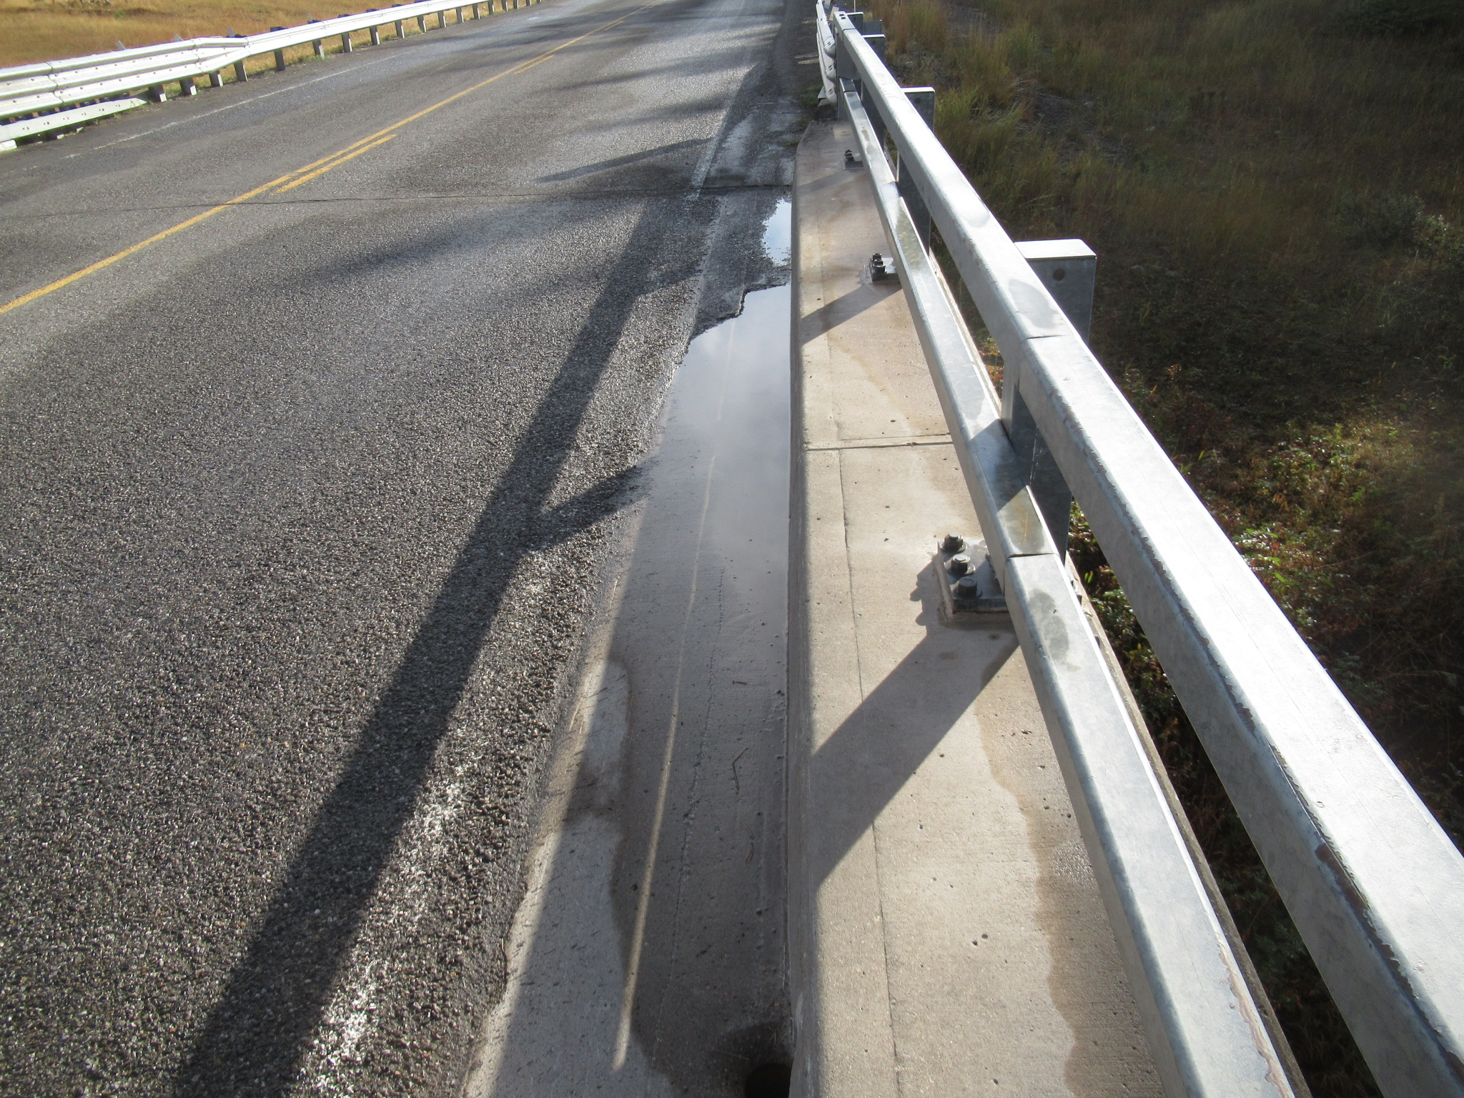
Deck Ponding

Slide 38
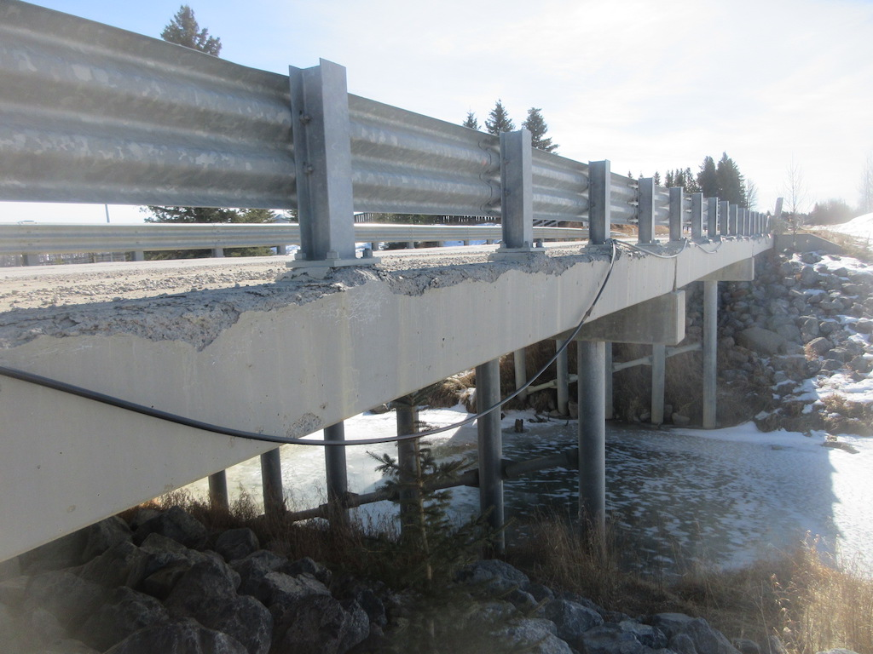
Freeze – Thaw Damage

Slide 39
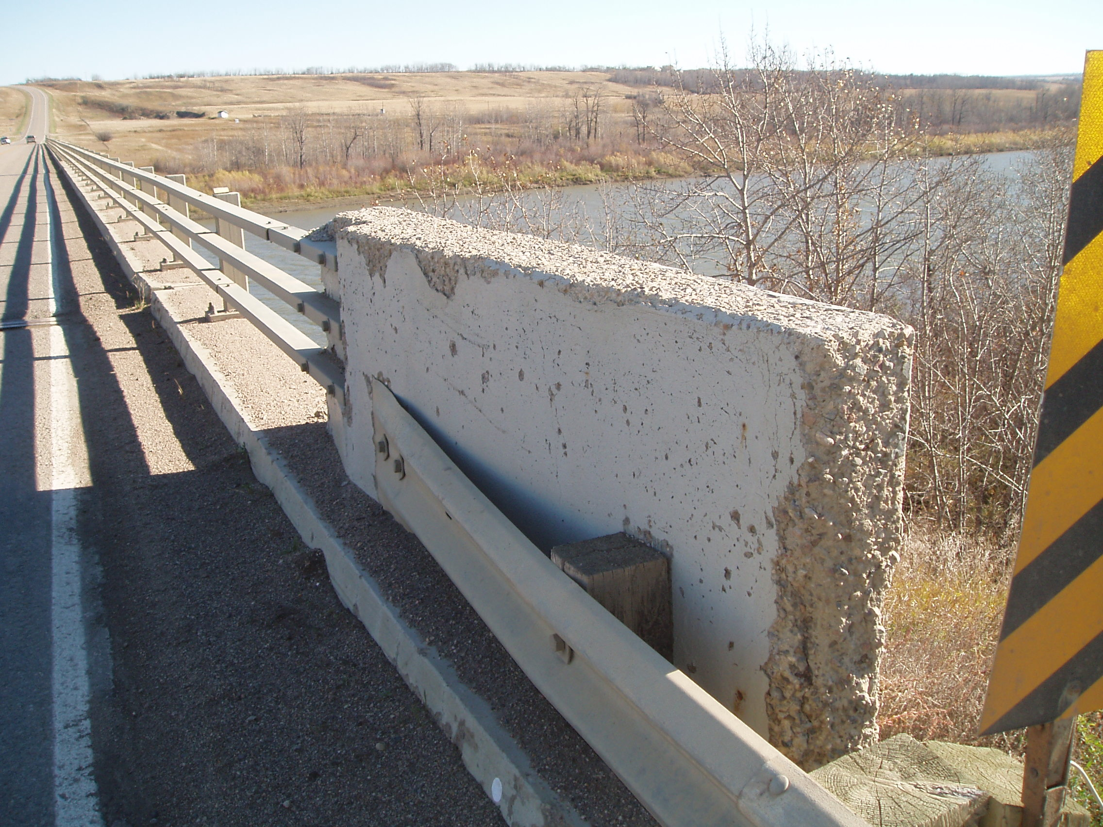
Scaling Damage

Slide 40
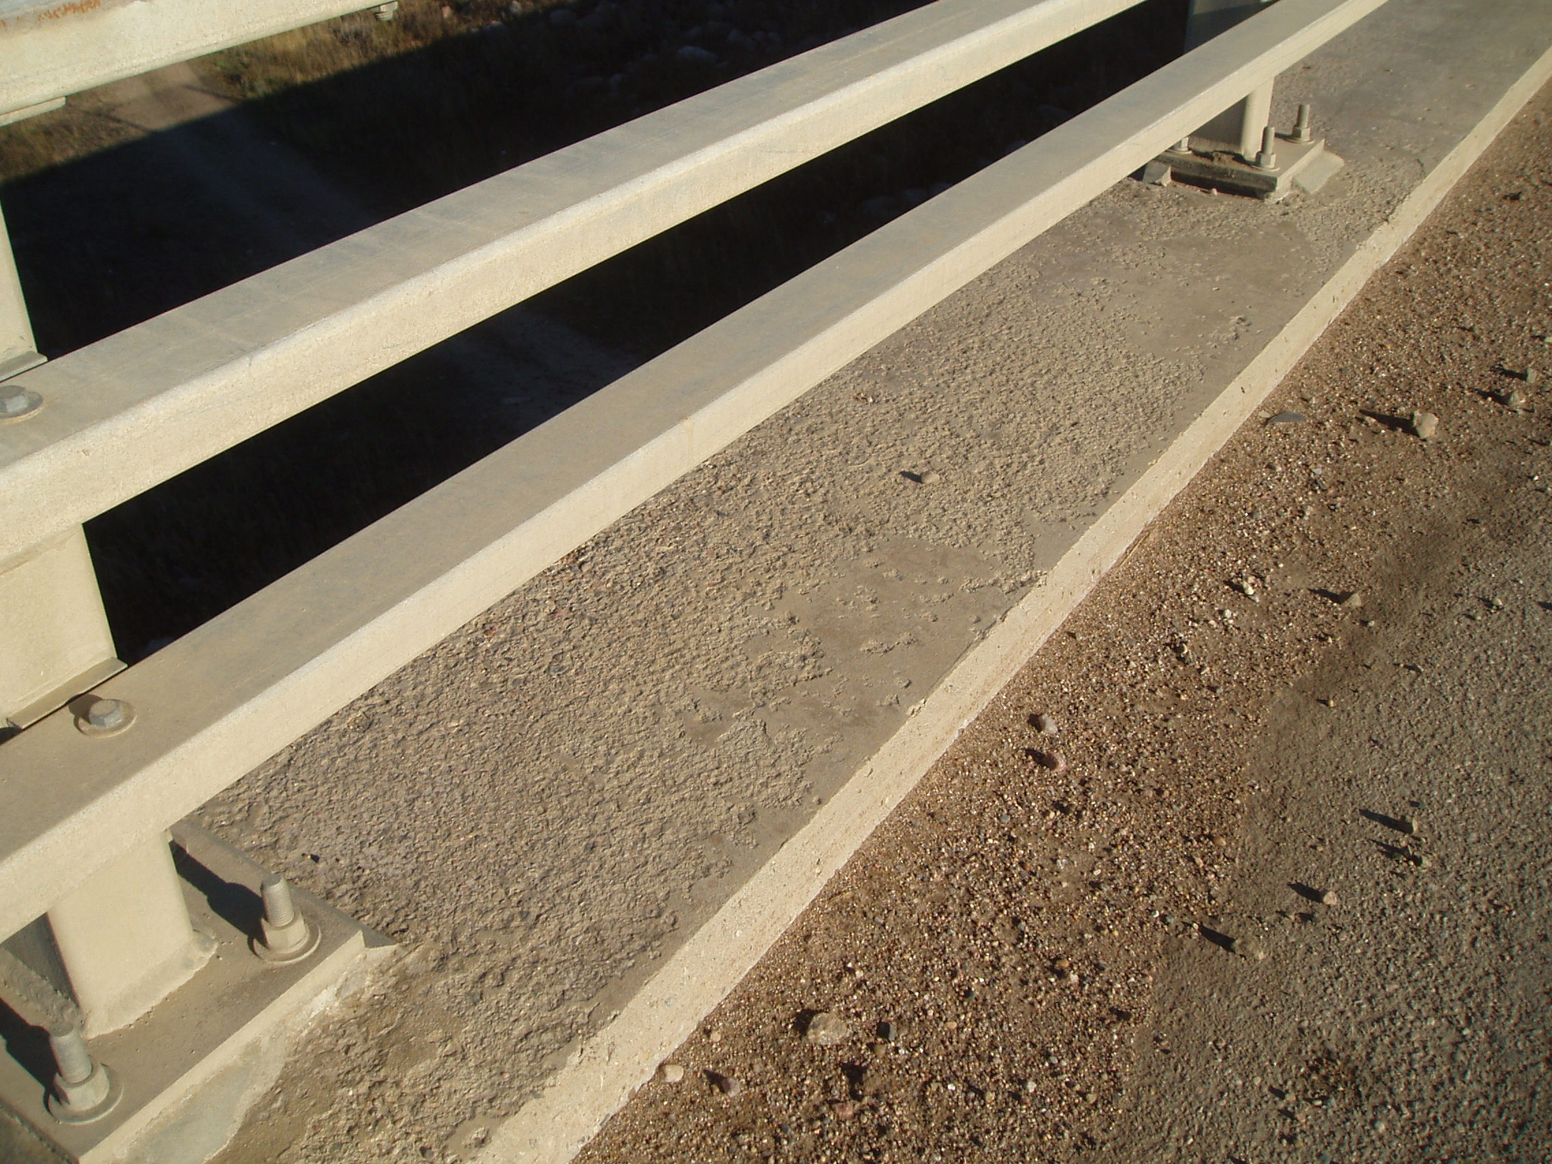
Light Scaling

Slide 41
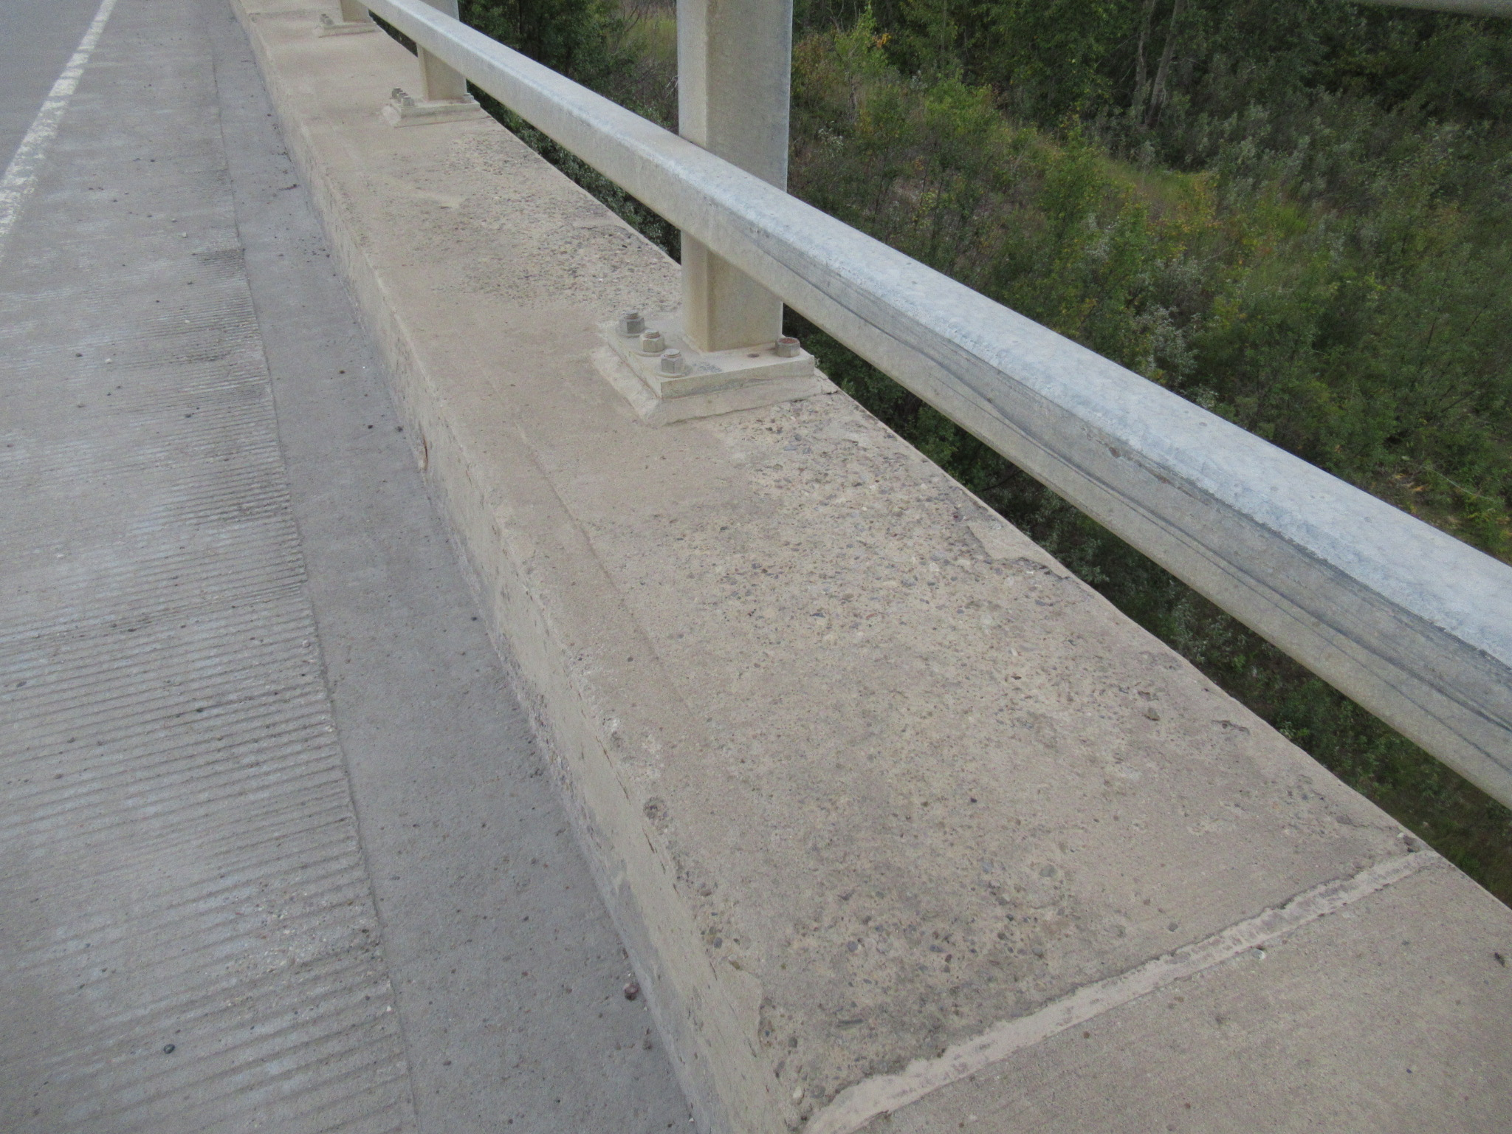
Medium Scaling

Slide 42
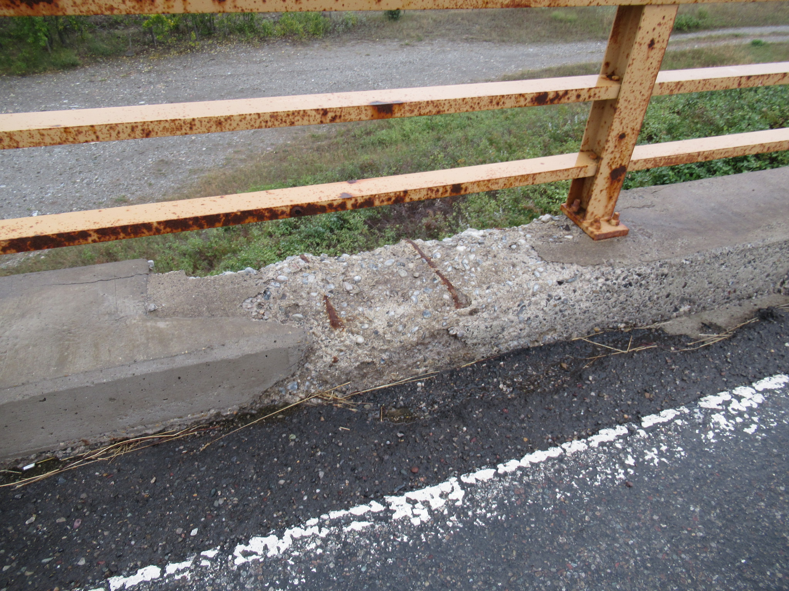
Heavy Scaling

Slide 43
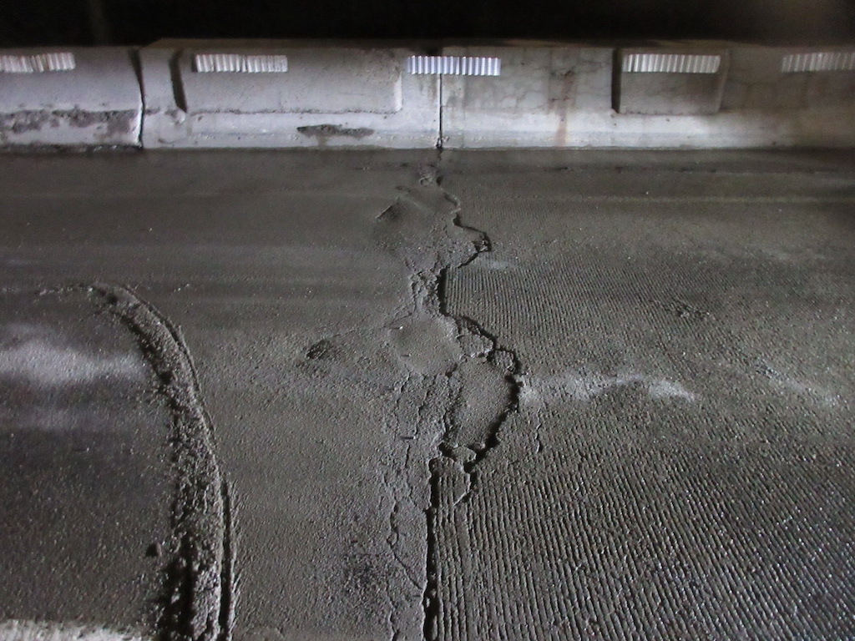
Deteriorated Concrete Approach Slab
Notes:
Flexible ACP at road side of approach slab often leads to deterioration of more rigid concrete wear surface of approach slab from vehicle impact ;loading. App slab is poured on granular bed and is prone to settlement if granular compaction is poor

Slide 44
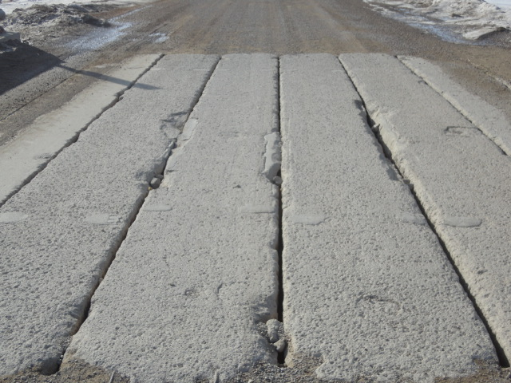
Surface Abrasion

Slide 45
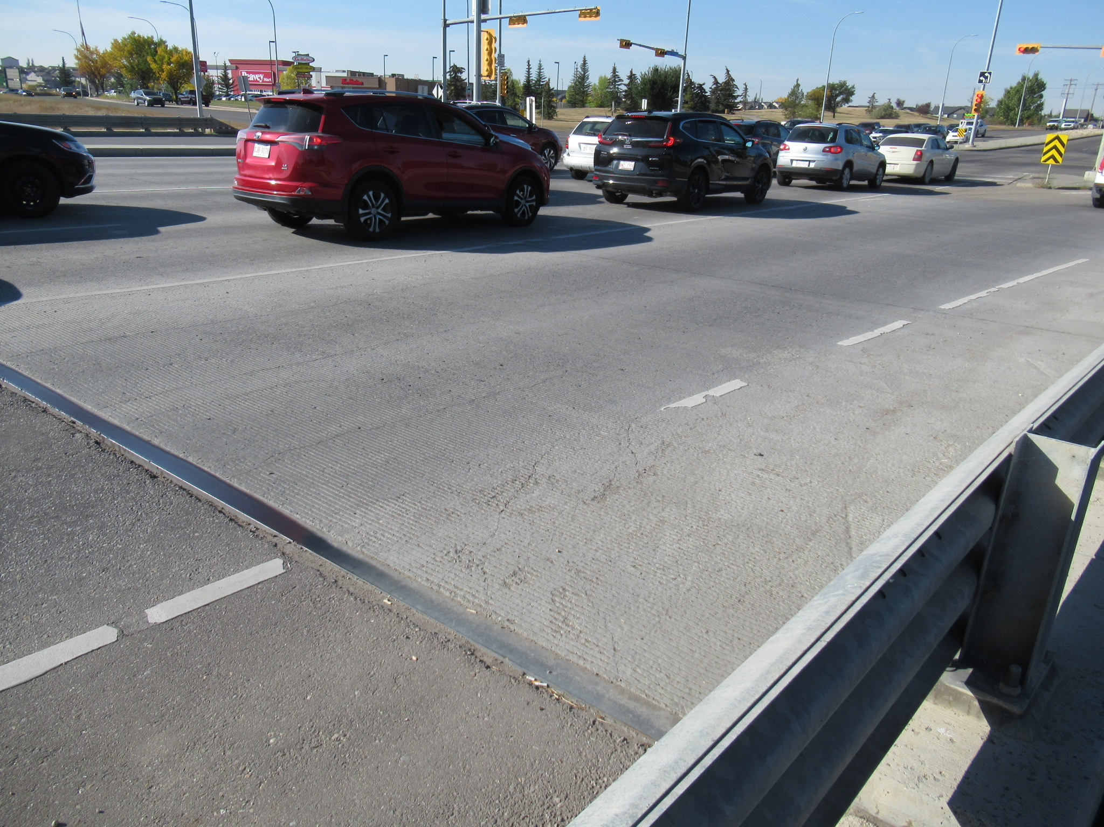
Sound Concrete Deck

Slide 46
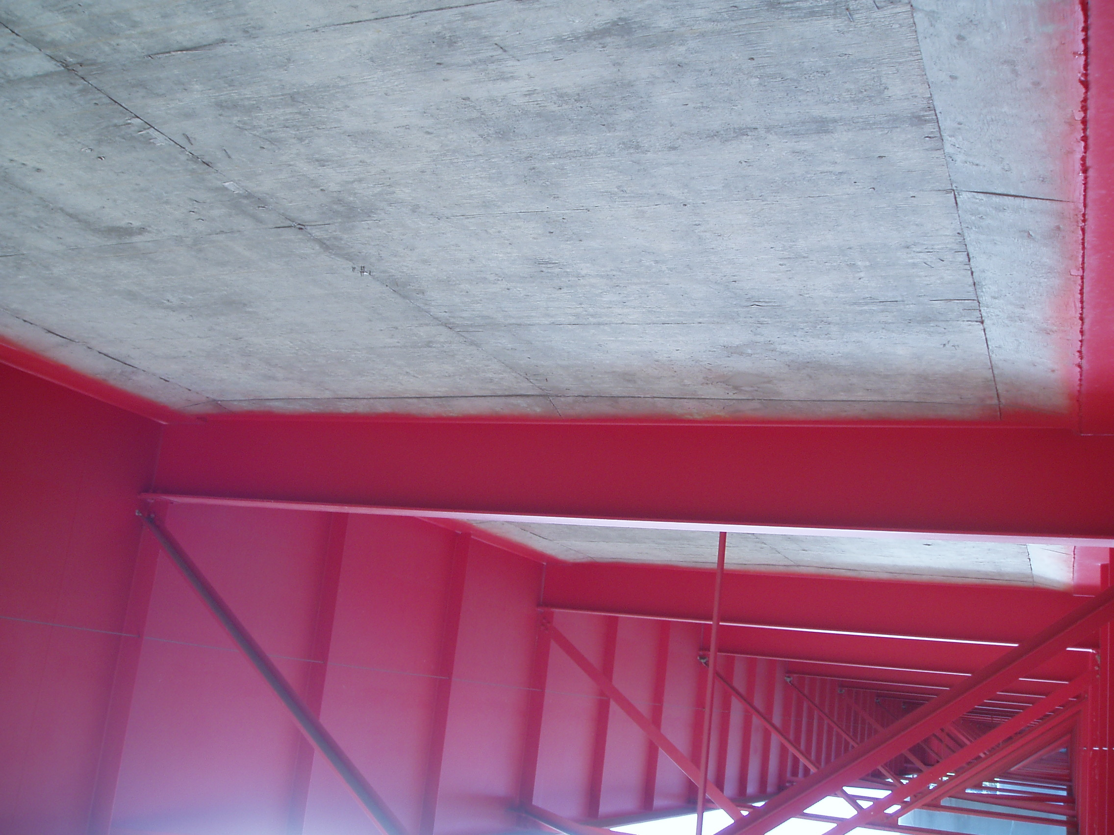
Sound Concrete Deck Underside

Slide 47
Concrete Stress- Strain Relationship
f’c
Strain =
L/L
L = 0.003x300 = 0.9 mm
Concrete Stress MPa
Concrete Strain
0.003
Notes:
crushing

Slide 48
High – Performance Concrete
High strength.
High modulus of elasticity.
High abrasion resistance.
Low permeability and diffusion.
Resistance to chemical attack.
High resistance to frost.
Ease of placement

Slide 49
Self – Compacting Concrete
Able to flow and consolidate on its own.
Must be cohesive to fill spaces without segregation.
Useful wherever placing is difficult.
SCC reduces the need for vibration.
It is based on increasing the amount of fine material without changing the water content.

Slide 50
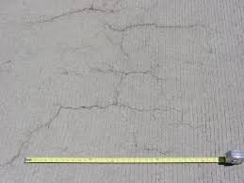
Shrinkage Cracks

Slide 51
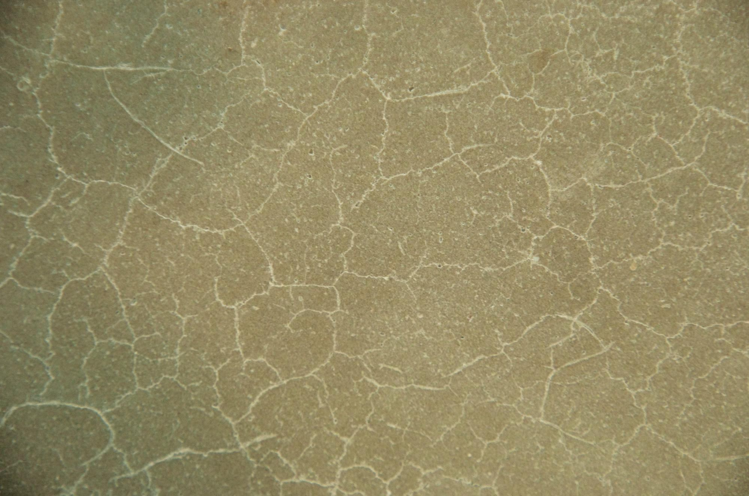
Map Cracking

Slide 52
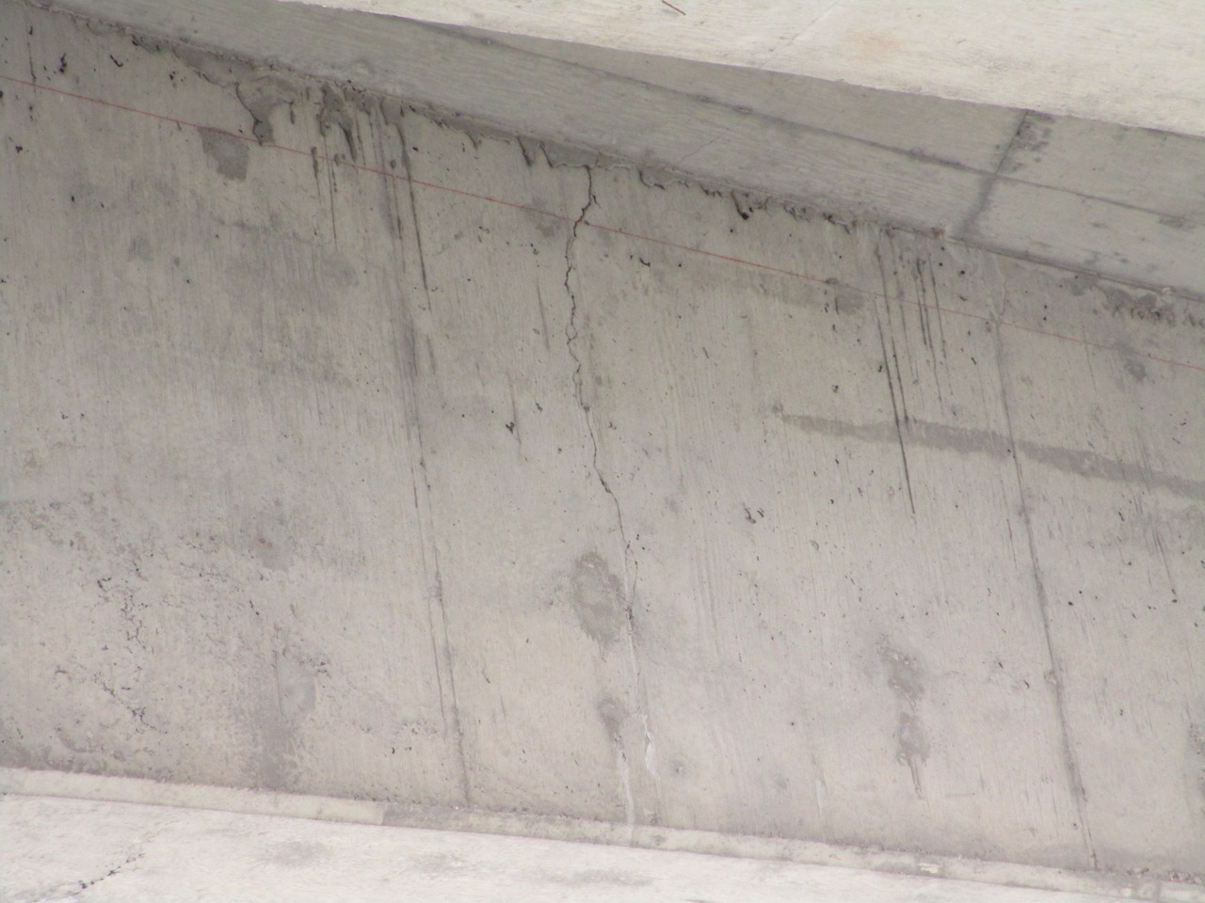
Flexural Cracks

Slide 53
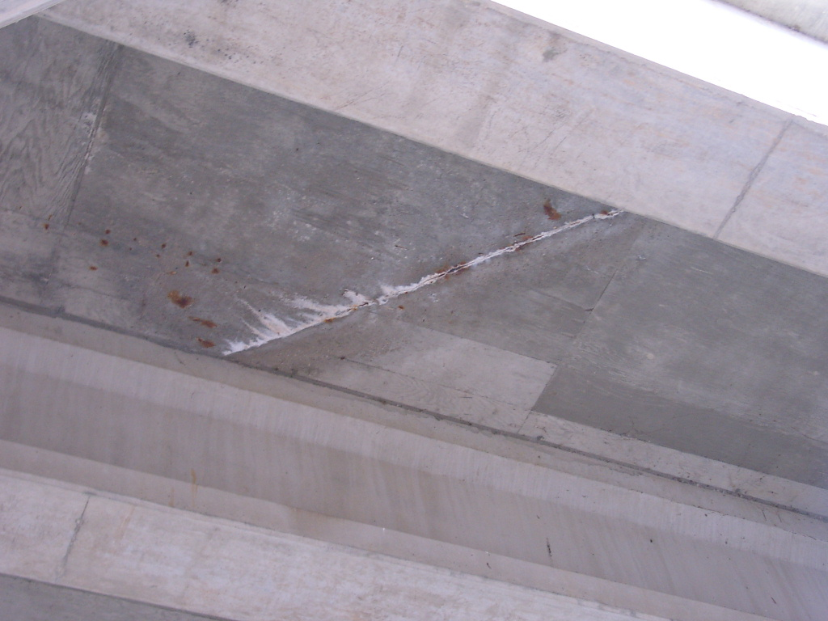
Construction Joint

Slide 54
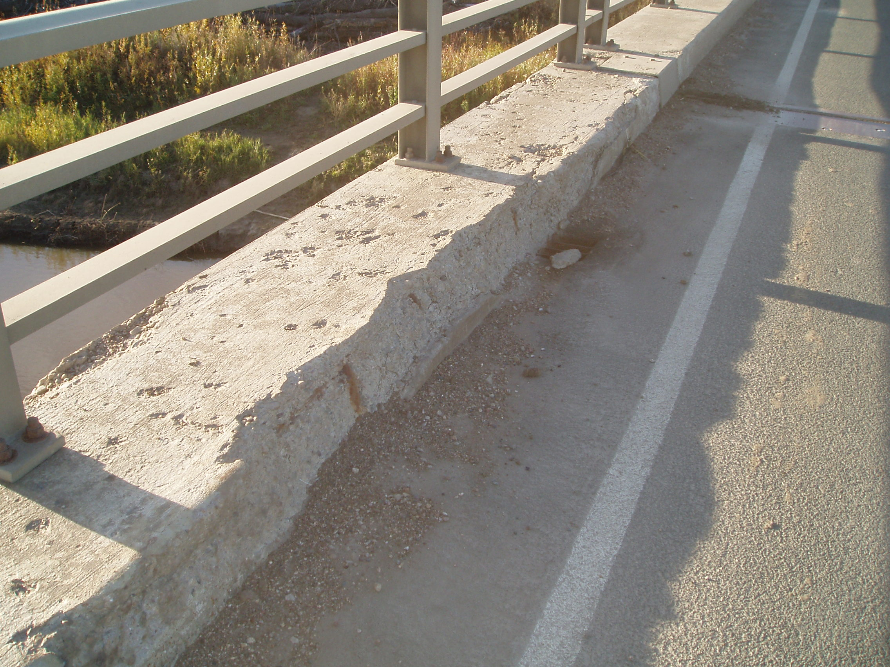
Corrosion Spalls & Pop – outs

Slide 55
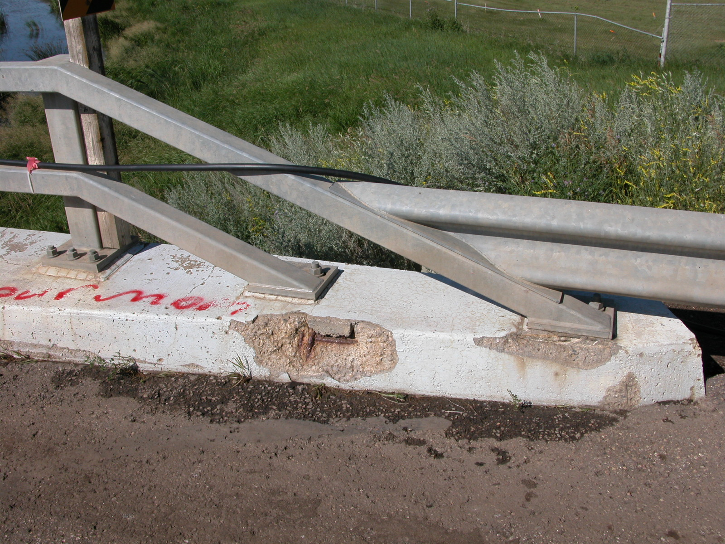
Corrosion Spall

Slide 56
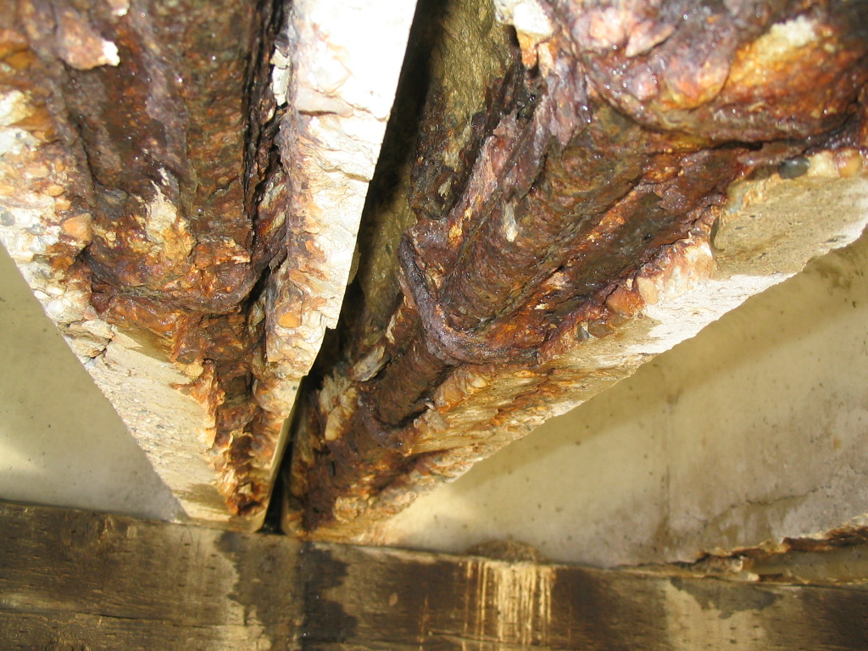
Corrosion Spall

Slide 57
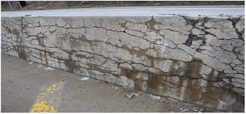
Alkali Aggregate Reaction

Slide 58
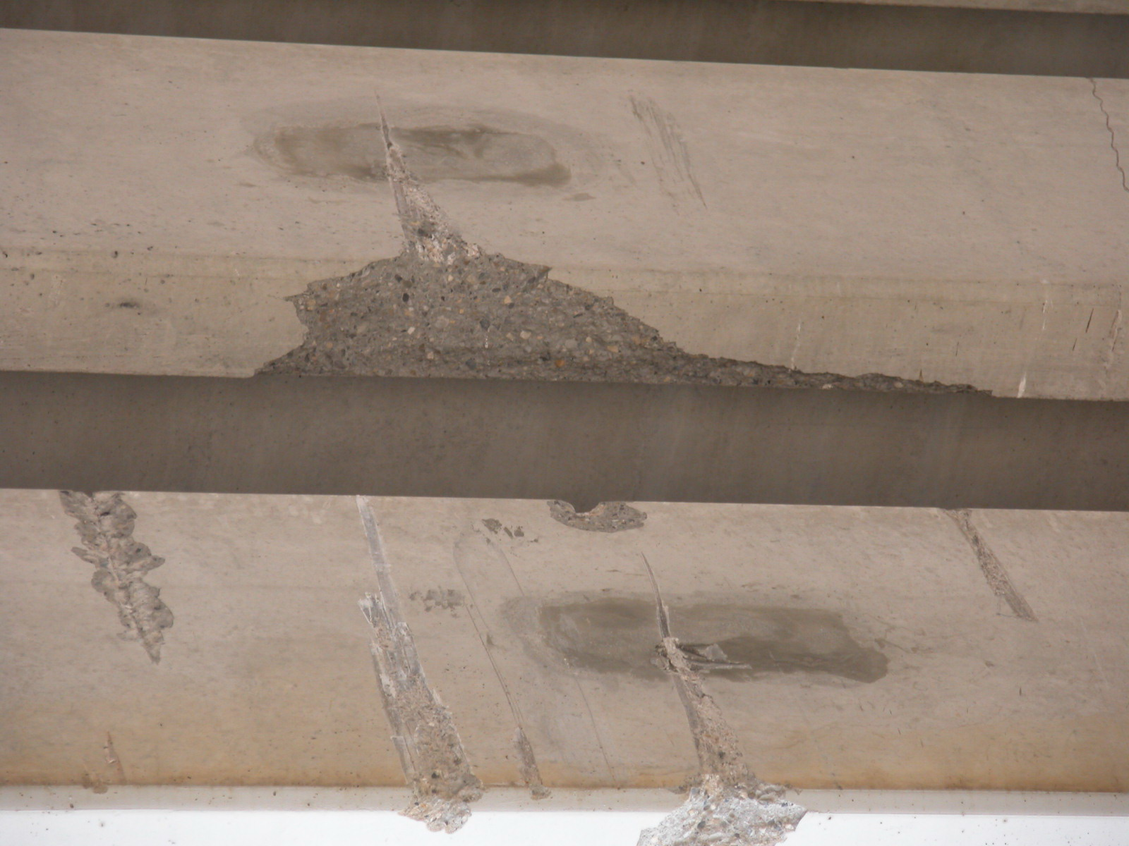
High Load Impact

Slide 59
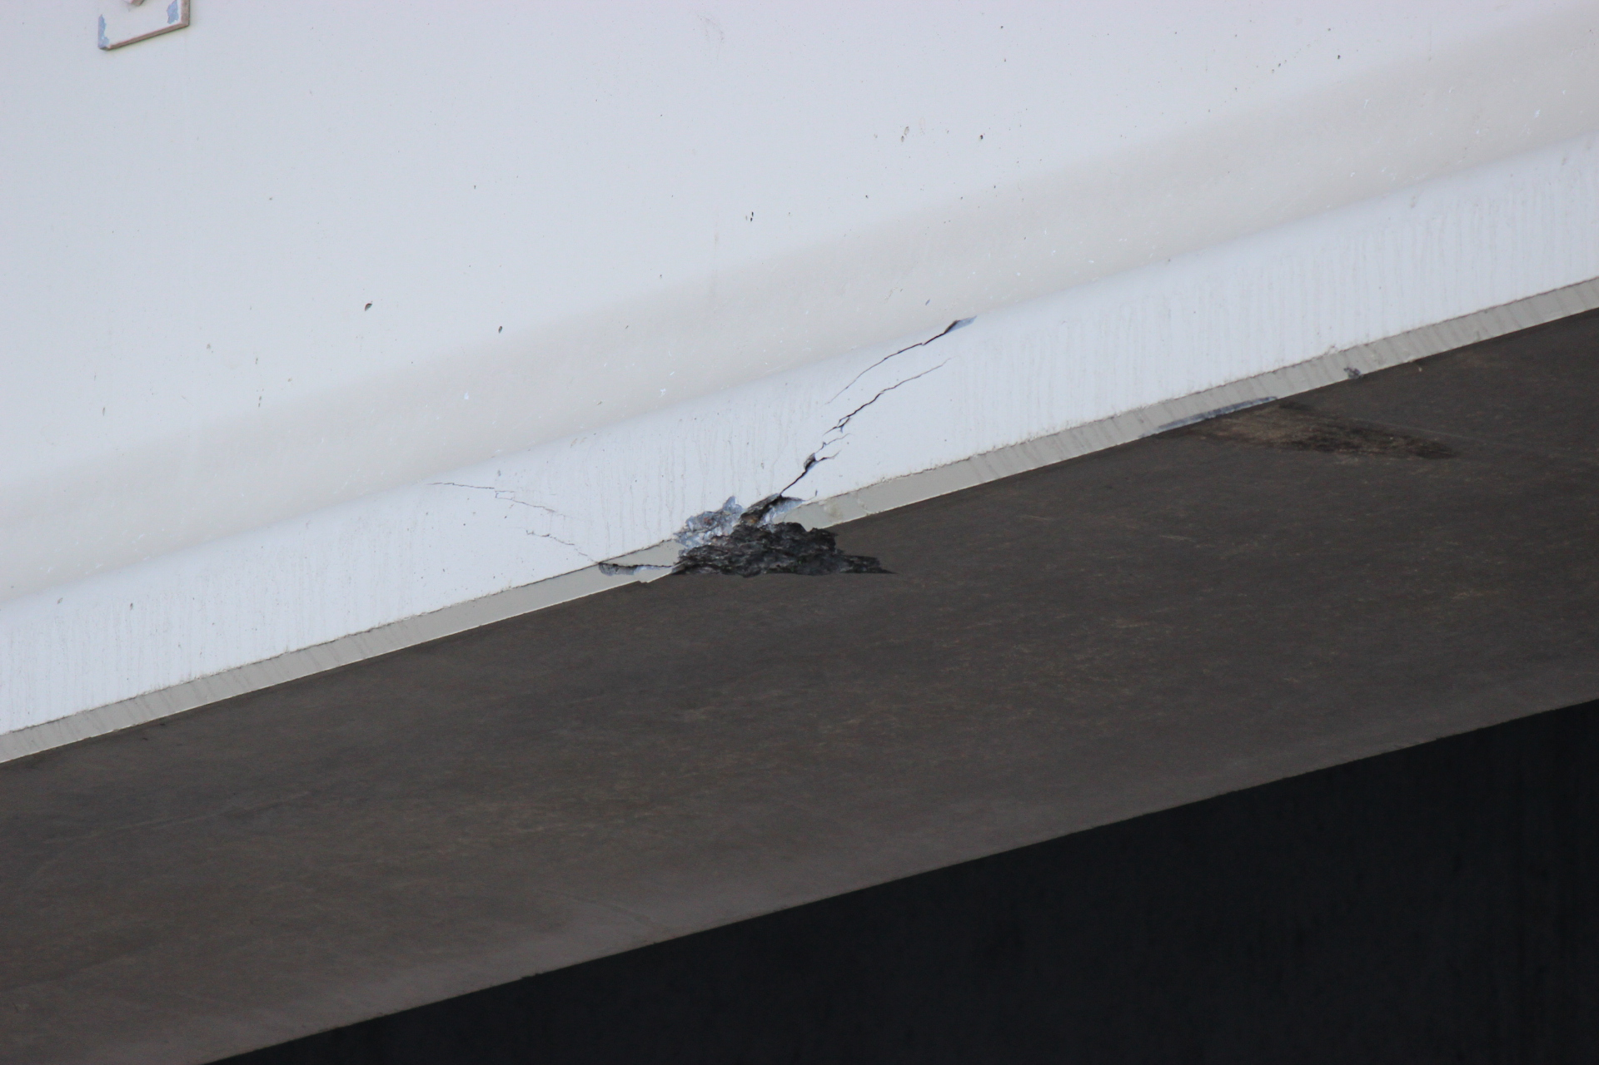
High Load Damage

Slide 60
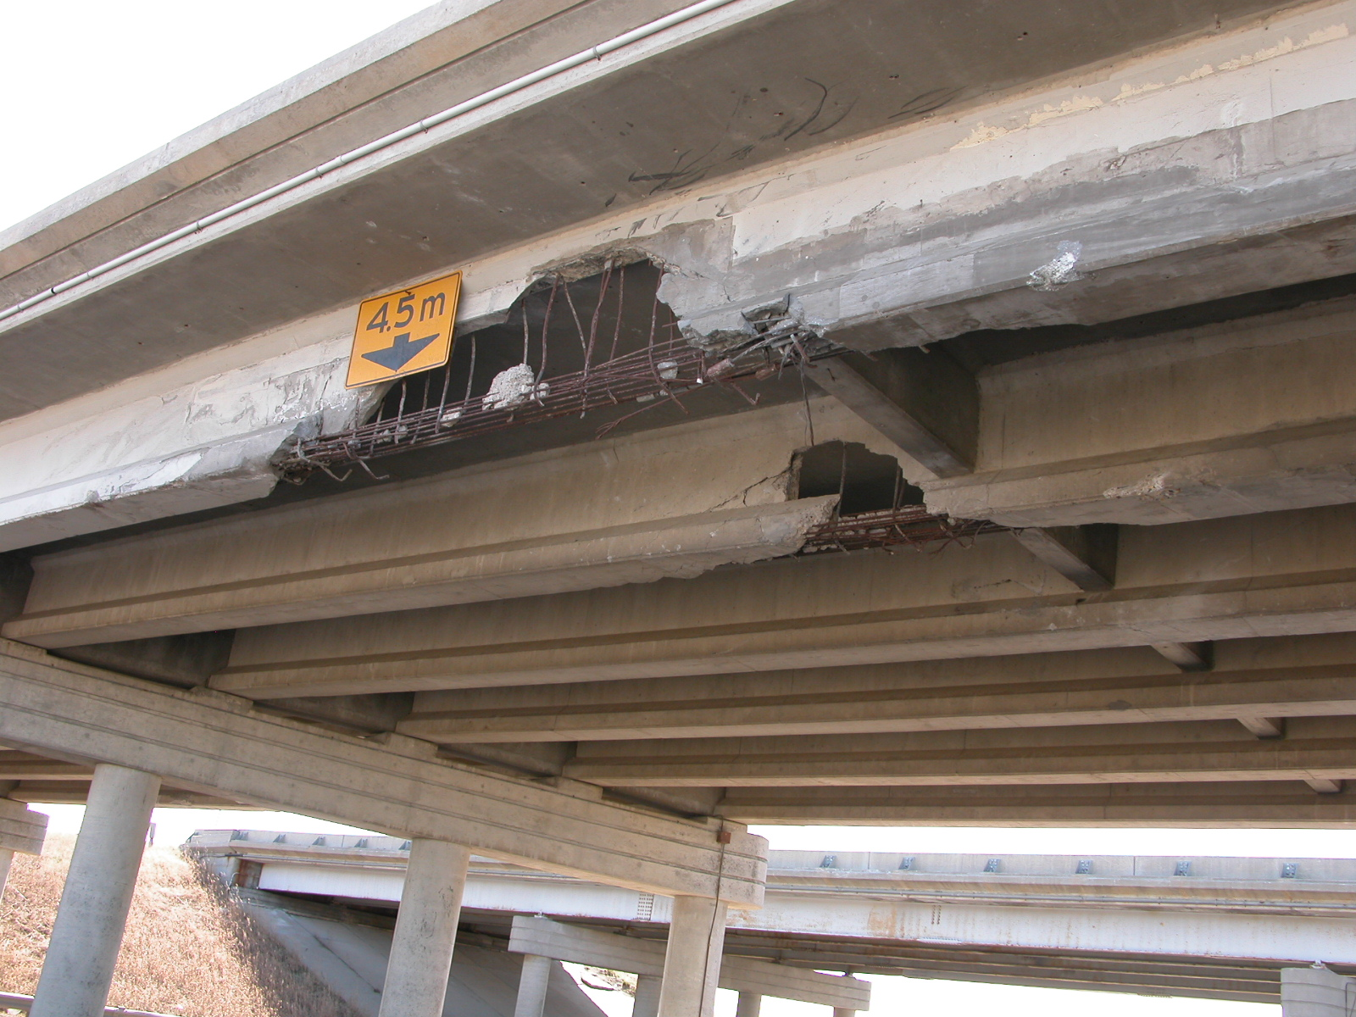
Severe High Load Damage

Slide 61

Questions?

