Slide 1
STRUCTURAL
CONSIDERATIONS
FOR TRUSSES

Slide 2
Introduction
U1
U2
U3
U4
U5
U6
L0
L7
L1
L2
L3
L4
L5
L6
Pratt Truss
Notes:
Truss members carry axial loads (tension and compression), rather than bending like beams/girders.
Floorbeams and stringers carry in bending
Advantages because design is simply on the cross section area, with buckling considerations. Small members.
Why else would we use truss bridges?
Why don’t we today?

Slide 3
Truss Types
Three types of trusses in Alberta:
  Pony trusses
  Through trusses
  Deck trusses
Traffic loads are transferred to the trusses by a floor system.
Notes:
Pony truss. No vertical restrictions for traffic. Can’t carry heavy loads. Top chord is not braced
Through truss. Has vertical restrictions. Can carry heavy loads
Deck truss. No vertical restriction. Can carry heavy loads. Lots of superstructure below deck. (clearance below)

Slide 4
Floor System
Deck supported by
Stringers
Truss Panel Point
Wind Bracing
Floor Beams supported by
Trusses at Truss Panel Points
Stringers supported
by Floor Beams
Notes:
Stringer to floorbeams to panel points.
Truss analysis is a discrete “point”

Slide 5
Pony Truss
Wind Bracing
Floor Beams

Slide 6
Through Truss
Upper Wind Bracing
System
Portal Brace
Batter Posts

Slide 7
Portal Brace & Batter Posts
Wind Load
Portal Brace
Batter Posts
Floor Beam
Notes:
These are axially loaded members either.

Slide 8
Deck Truss
Lower Wind Bracing
System

Slide 9
Deck Truss – Wind Bracing
Upper Wind
Bracing System
Diagonal
Bracing
Main Truss
Members
Lower Wind
Bracing System

Slide 10
Truss Configurations
The way truss members carry loads depends on the configuration of the truss.
Most trusses in Alberta are either Pratt or Warren trusses.

Slide 11
Pratt Truss
Crossed Diagonals
Top Chord
U1
U2
U3
U4
U5
U6
Vertical
M1
L0
L1
L2
L3
L4
L5
L6
L7
Diagonal
Bottom Chord

Slide 12
Warren Truss
Top Chord
U1
U2
U3
U4
U5
U6
U7
Vertical
L0
L1
L2
L3
L4
L5
L6
L7
L8
Bottom Chord
Diagonal

Slide 13
Truss Curvature
Top Chord
Bottom Chord
Tension
Notes:
Tension and compression
Buckling of top chord
Cracks in bottom chord
Be concerned

Slide 14
Loads in Diagonals
U1
U2
U3
U4
U5
U6
M1
L0
L1
L2
L3
L4
L5
L6
L7
Notes:
Loads applied to the right

Slide 15
Loads in Diagonals
U2
U3
This side of the panel is being held up by the left support
This side of the panel is being pulled down by the loads to the right
L2
L3
Notes:
tension

Slide 16
Loads in Diagonals
U1
U2
U3
U4
U5
U6
M1
L0
L1
L2
L3
L4
L5
L6
L7

Slide 17
Loads in Diagonals
U2
U3
This side of the panel is being pulled down by the loads to the left
This side of the panel is being held up by the right support
L2
L3
Notes:
compression

Slide 18
Loads in Diagonals
U1
U2
U3
U4
U5
U6
M1
L0
L1
L2
L3
L4
L5
L6
L7

Slide 19
Loads in Diagonals
U2
U3
This side of the panel is being held up by the left support
This side of the panel is being pulled down by the loads to the right
L2
L3
Notes:
Tension and compression

Slide 20
Loads in Diagonals
U1
U2
U3
U4
U5
U6
U7
L0
L1
L2
L3
L4
L5
L6
L7
L8

Slide 21
Loads in Diagonals
U2
U3
This side of the panel is being held up by the left support
This side of the panel is being pulled down by the loads to the right
L2
L3
Notes:
compression

Slide 22
Loads in Diagonals
U1
U2
U3
U4
U5
U6
U7
L0
L1
L2
L3
L4
L5
L6
L7
L8

Slide 23
Loads in Diagonals
U2
U3
This side of the panel is being pulled down by the loads to the left
This side of the panel is being held up by the right support
L2
L3
Notes:
tension

Slide 24
Summary – Loads in Diagonals
Diagonals that slope away from the nearest support as they approach the bottom chord are primarily tension members.
Some diagonals near the center of the truss may go into compression.
Diagonals that slope towards the nearest support as they approach the bottom chord are primarily compression members.
Crossed diagonals are tension members.
Notes:
They can all be both
Crossed are tension because buckling of same member will be significantly less than tension of other member

Slide 25
Summary – Loads in Diagonals
Diagonals
Slope away from nearest support approaching BC | Slope towards nearest support approaching BC | Crossed
Tension | Compression | Tension

Slide 26
Loads in Verticals
U1
U2
U3
U4
U5
U6
M1
L0
L1
L2
L3
L4
L5
L6
L7

Slide 27
Loads in Verticals
U2
Top chord in compression
Vertical
Diagonals in tension
Bottom chord in tension
L2
Notes:
compression

Slide 28
Loads in Verticals
U2
Top chord in compression
Vertical
Diagonals in compression
Bottom chord in tension
L2
Notes:
tension

Slide 29
Loads in Verticals
U1
U2
U3
U4
U5
U6
M1
L0
L1
L2
L3
L4
L5
L6
L7

Slide 30
Loads in Verticals
U1
Batter Post
Vertical
Diagonal
Bottom chord in tension
L1
Notes:
tension

Slide 31
Loads in Verticals
U1
U2
U3
U4
U5
U6
M1
L0
L1
L2
L3
L4
L5
L6
L7

Slide 32
Loads in Verticals
U1
Batter Post
Vertical
Diagonal
Bottom chord in tension
L1

Slide 33
Loads in Verticals
U1
U2
U3
U4
U5
U6
U7
L0
L1
L2
L3
L4
L5
L6
L7
L8

Slide 34
Loads in Verticals
U2
Top chord in compression
Vertical
Diagonal
Diagonal
L2

Slide 35
Summary – Loads in Verticals
Verticals connected to diagonals at both ends will be in compression if the diagonals are in tension and in tension if the diagonals are in compression.
Verticals connected to diagonals at the top chord only will be in tension for pony and through trusses and will be unloaded for deck trusses.
Verticals connected to diagonals at the bottom chord only will be in compression for deck trusses and will be unloaded for pony and through trusses.
Notes:
Explain deck truss examples for warrant truss. Bottom chord and top chord can only take axial loads. Or it would be so flexible that it’ll be the diagonals alone that carry the load. It’s got to get to those diagonals though in order to carry.
Draw example on whiteboard of warren truss

Slide 36
Summary – Loads in Verticals
Vertical Connected to
Diagonals at both ends |  | Diagonals at top chord |  | Diagonals at bottom chord
Diagonals in tension | Diagonals in compression | For pony & through trusses | For deck truss | For pony & through trusses | For deck truss
Compression | Tension | Tension | Zero | Zero | Compression

Slide 37
Summary – Loads in TC, BC & BP
Top chords are in compression.
Bottom chords are in tension.
Batter posts are in compression.

Slide 38
Steel Sections
Single Angle
Double Angles
Four Angles
Channel
Double Channel
W-Section

Slide 39
Tension Member

Slide 40
Compression Member
Misalignment of Member

Slide 41
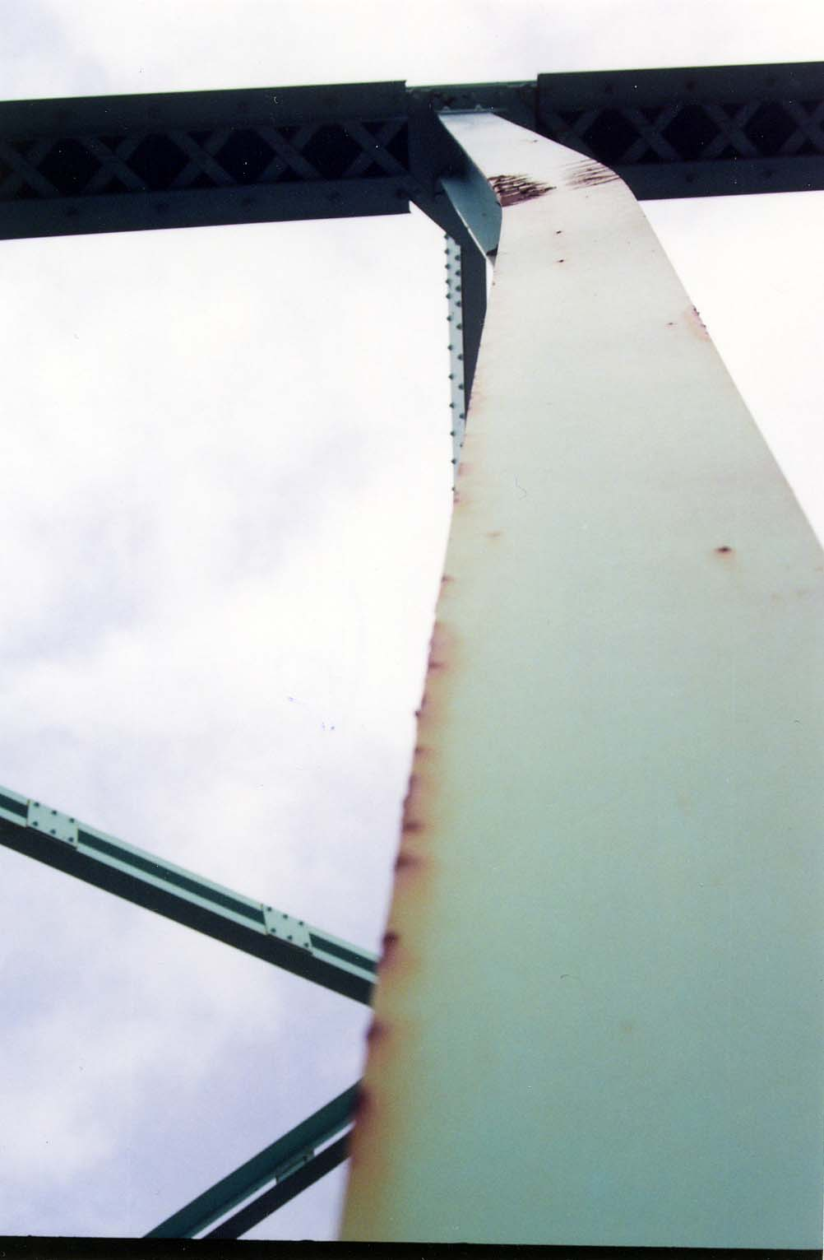
Compression Member
Bent Member

Slide 42
Compression Member
Rippling of Plate

Slide 43
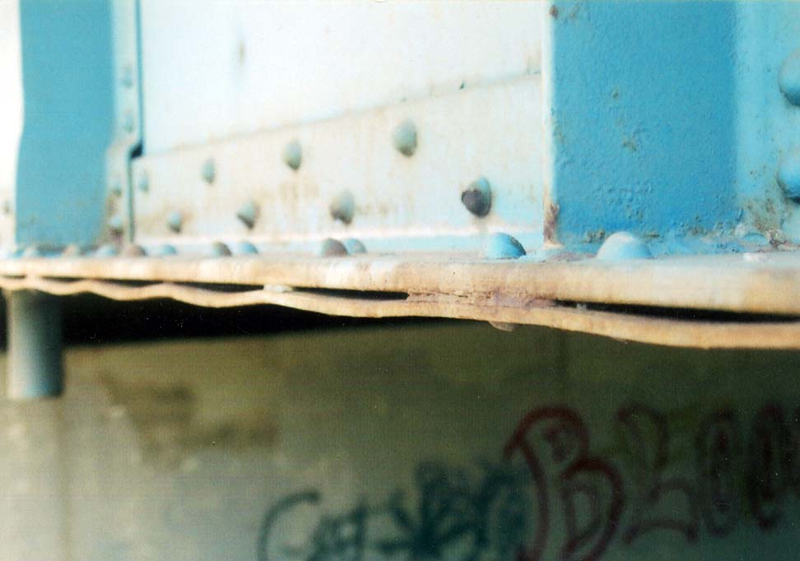
Compression Member
Rippling of Plate

Slide 44
Compression Member
Bracing

Slide 45
Class Exercise
U0
U1
U2
U3
U4
U5
U6
U7
U8
1
3
4
2
L0
L1
L2
L3
L4
L5
L6
L7
L8
Notes:
1 – Compression
2 – Tension
3 – Tension
4 - Zero

Slide 46
Class Exercise
U1
U2
U3
U4
U5
U6
U7
U8
9
5
8
6
7
10
L0
L1
L2
L3
L4
L5
L6
L7
L8
L9
Notes:
5 – Tension
6 – Tension
7 – Compression, oh wait Tension
8 – Compression
9 – Compression
10 - Tension

Slide 47
Truss Loads
U1
U2
U3
U4
U5
U6
U7
60°
60°
L0
L8
L1
L2
L3
L4
L5
L6
L7
5
10
10
10
10
10
10
10
5
40
40
Notes:
Start at L0
Sum forces in y. L0-U1 only member with y-component. Therefore can solve
Sum forces in x. Use L0-U1 to get L0-L1
Move to L1
Sum forces in y. L1U1 = 0
Sum forces in x. L1L2=L0L1
Move to U1
Sum forces in y. Get U1L2
Sum forces in x. Use U1L2 to get U1U2

Slide 48
Truss Loads
U1
34.6
U2
34.6
U3
46.2
U4
46.2
U5
34.6
U6
34.6
U7
40.4
0
0
0
28.9
17.3
5.8
5.8
10
17.3
28.9
40.4
10
10
10
L0
L8
20.2
L1
20.2
L2
43.3
L3
43.3
L4
43.3
L5
43.3
L6
20.2
L7
20.2
Compression Force
Tension Force
Notes:
Uniform load across structure. Normal loading condition
BC – Large tension forces in middle
TC – Large Compression forces in middle
Diagonals – Larger forces near ends (tension or compression)

Slide 49

Questions?

