Slide 1
MAJOR BRIDGE
INSPECTION FORMS

Slide 2
Inspection Form Types
Each form has a unique identification or form ID
9 different inspection report forms for bridges with a single span type
1 report for sign bridges
Custom forms can be generated to suit the number & type of spans

Slide 3
Standard Bridge Inspection Form
Form ID | Span Description | Span Types
TT | Timber Bridges | TT, UT, UX
PCS | Standard Precast Bridges | HH, GC, VH, PG, GR, PE, PPS, VS, SM, SMC, SC, SCC
CUL1 | Single Culvert | RS, SP, FP, MP, WP, TP, CP, BP, AP, XP, RPA, RPO, RPP, RPE, MPL
CULM | Multiple Culverts | Same as CUL1 in any combination
CULE | Culvert extended with a different material or size | RPX, APX, CPX, MPX

Slide 4
Major Bridge Inspection Forms
Form ID | Span Description | Span Types
TH | Trough Truss Bridges | TH
PT | Pony Truss Bridges | PT
DT | Deck Truss Bridges | DT
SG | Steel Girder Bridges | RB, RG, WG, FR
PSR | Regular Prestressed Girder Bridges | RD, FC, VF, PM, VM, PB, DBT, PQ, PO, LF, FM, RM, PJ
CON | All Cast-In-Place Concreate Concrete Tee Girders Bridges Concrete Flat Slab Bridges | CA, CB, CF, CV, CX, CC CT CS
SS | Other Trusses and Arches | SS
SIGN | Sign Structures | Z

Slide 5
Common Major Bridge Form Sections
Bridge Site Inventory
Bridge Inspection Details
  Name, Date, Arrive/Depart times
Approach Road
Posting Information
  Vertical clearance
  Posted loading
  Utilities
Structural Condition Rating
Sufficiency Rating
Special Comments for Next Inspection
ERY
Next Inspection Date and Inspection Cycle

Slide 6
Common Major Bridge Form Sections
Channel
Grade Separation
Structural Condition Rating
Sufficiency Rating
Special Comments for Next Inspection
ERY
Next Inspection Date and Inspection Cycle

Slide 7

Unique Major Bridge Form Sections
Superstructure
Substructure
Maintenance Recommendations

Slide 8
Superstructure Section
Common Elements
  Special Features
  Deck Rideability
  Bridge Rail
  Sidewalk
  Span Alignment Problems
  General Rating

Slide 9
Wearing Surface
SG, DT, CON,
and SS forms
PT, and TH forms
PSR forms

Slide 10
Deck Top
SG, DT, PSR and
CON forms only
PT, TH and SS have no Deck Top Element

Slide 11
Deck Joints
SG, DT, PSR
and SS forms
PT, TH and
CON forms

Slide 12
Deck Drainage
SG, DT, PSR, CON
and SS forms only
PT, TH form - No Drainage Element
Curbs/ Medians / Wheel / Guards
SG, DT, PSR, CON and SS forms
PT and TH forms

Slide 13
Truss Members
Pony and Through Trusses (PT & TH)
TH only
TH only
TH only

Slide 14
Deck Truss, Other Trusses & Arches (SS)

Slide 15
Girders/ Beams
PSR only
SG only
CON and SS

Slide 16
Diaphragm / Cross Frames
SG, DT, PSR, CON, SS
none on PT, TH
Paint
SG, DT, PT, TH, SS
others none

Slide 17
Bearings
Not on PT and TH

Slide 18
Deck Underside
SG, PSR, and CON forms
DT and SS forms
PT and TH forms

Slide 19
Substructure - Abutments
PT, TH and SS only
PT, TH and SS only
PT and TH only

Slide 20
Substructure - Piers
Not on CON
PT, TH and SS only
PT, TH and SS only
Not on CON

Slide 21
Form Review
Inventory items
  Shaded fields on form (TIMS)
  Verify/revise data on form
Element Ratings
  fill all blank fields
  use N or X if necessary
Data on LH Side of Form or Explanation of Condition
  Verify & check off if visible
  Carry over if not visible

Slide 22
Reason for Inspection
Safety
Maintenance
Management
Condition
Functionality
Rating Considerations

Slide 23
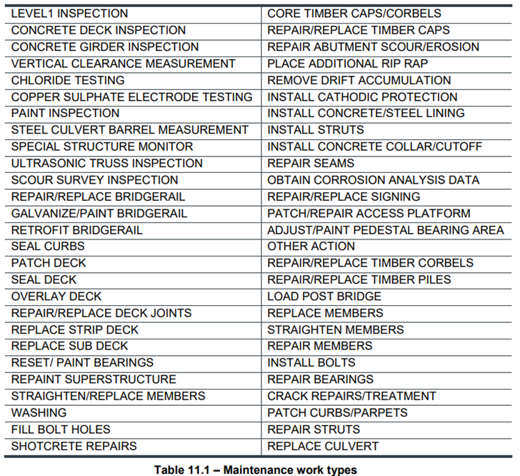
Maintenance Recommendations (Table 11.1)
Not on PSR

Slide 24
Maintenance Priority
Rating | Maintenance Priority
5 | No maintenance required
4 | Low priority Recommended is not required If made – not likely before next inspection
3 | Medium priority Before next inspection (6 mo. To 3 years)
2 | High priority Monitor until work is done (within 6 months)
1 | Immediate action

Slide 25
Road Classification
Indicates current desirable standard (Refer to Table 4.2)
Current Departmental standards are:
Highway Type | Road Classification
Local Roads (graveled) | RUL 207G-60 RUL 208G-60 RUL 208G-90 RUL 209G-90 RUL 210G-90 RUL 210G-100
Local Roads (Paved) | RUL 208-100 RUL 208-110
Secondary Highways | RCU 208-110 RCU 209-110 RCU 210-110

Slide 26
Road Classification (cont’d)
Indicates current desirable standard (Refer to Table 4.2)
Current Departmental standards are:
Highway Type | Road Classification
Primary Highways (undivided) | RAU 209-110 RAU 210-110 RAU 211.8-110 RAU 213.4-110 RAU 213.4-120
Primary Highways (divided) | RAD 412.4-120 RFD 412.4-130 RAD 616.6-130 RFD 616.6-130 RFD 820.8-110 RFD-1024.5-110

Slide 27
Major Bridges – Concrete (Table 11.3)
Life Expectancy
Type | Low | Ave | high
Prestressed Girder** | 45 | 55* | 70*
Precast Girder** | 30 | 35 | 50
Cast-in-Place** | 40 | 50 | 60
Use maximum of 50 years for timber sub-structure
Add 5 years if overlaid with concrete
Add 5 years if strengthened or laterally stressed

Slide 28
Major Bridges – Steel (Table 11.3)
Life Expectancy
Type | Low | Ave | High
Ridge Frame | 60 | 70 | 80
Welded Girder | 60 | 70 | 80
Deck Truss | 60 | 70 | 80
Rolled Beams | 50 | 60* | 80*
Riveted Plate Girder | 40 | 50 | 70*
Through Truss | 40 | 50 | 70*
Pony Truss | 40 | 50 | 70*
Bailey and Other Types | 30 | 40 | 50
Use maximum of 50 years for timber substructure

Slide 29
Estimated Remaining Life
Major Bridges
Considerations
  Traffic characteristics
    volume, amount of truck traffic, log haul
  Salt usage
    road surfacing, traffic, climatic conditions
  Deck drainage, leakage
  Decay favorable conditions
  Design or rated load capacity

Slide 30

Questions?

