Slide 1
INTRODUCTION
Bridge Inspection & Maintenance System (BIM)
Notes:
Tips:
use an icon that best represents the concept you are presenting on. Icons are available at: alberta.ca/identity
If you don’t have a subtitle, move your name and title up to create balance with the main title

Slide 2
BIM System Definition
A comprehensive inventory management system with the ability to process inspection and component information to support:
Inspection management
Maintenance programming
Strategic & Life Cycle planning
  Rehabilitation programs
  Replacement programs
  Budget development
  Section 1.2 in Manual

Slide 3
BIM System Functions
Ensures appropriate levels of safety and service.
Helps to maximizes life and utility of bridge structures.
Assists service life prediction of bridge elements or structure types.
Identifies the need for continued monitoring.
Provides an electronic system for managing inspection information and collecting and verifying inventory data.
Provides data for setting priorities.

Slide 4
BIM System Functions (cont’d)
Assists with the allocation of resources.
Provides information to develop maintenance costs (.i.e., materials, quantities).
Provides a system to track the status of maintenance recommendations.
Facilitates information exchange with others.
Provides a framework for training and evaluation of inspectors.
Provides information for evaluating design, construction and maintenance standards.

Slide 5
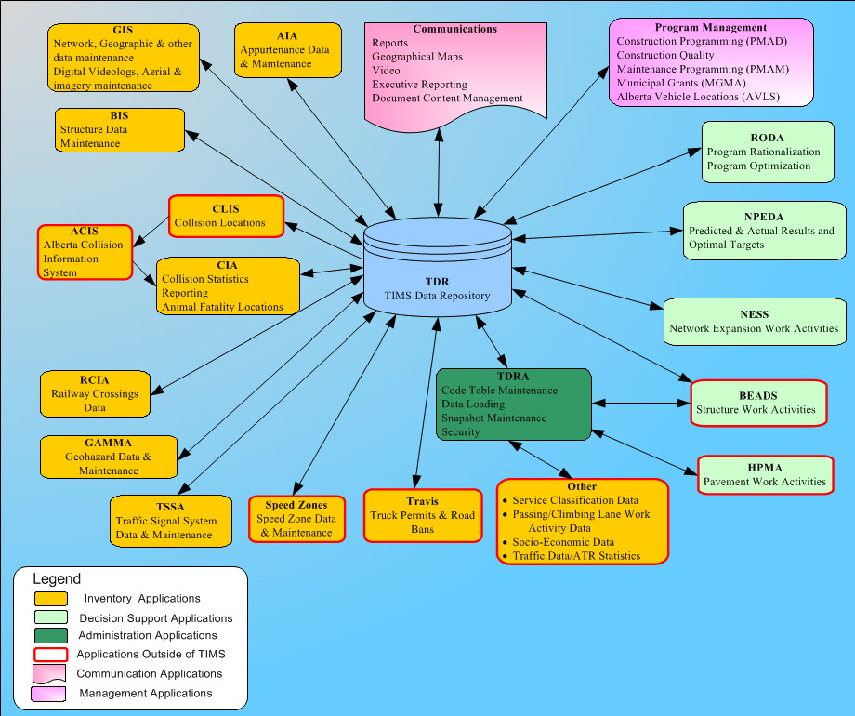
BIM Management System
Alberta Transportation uses a single Web Based knowledge system designed to manage infrastructure assets known as the Transportation Infrastructure Management System (TIMS).

Slide 6
BIM System Management
TIMS
BIS Application (BIM)
Inventory
Inspection
Maintenance
TIMS - BIS Application
Standard Bridge: BF 02397
Culvert: BF 77444

Slide 7
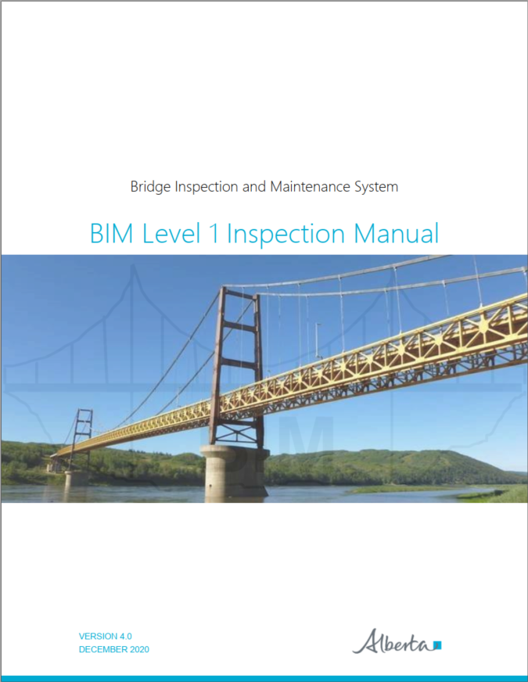
Bridge Information
System (BIS)
TIMS
BIS Application (BIM)
Inventory
Inspection
Maintenance

Slide 8
Bridge Structure Categories
Standard Bridges (inspected by Cl. B or A)
  A bridge constructed using “standard” components and “standard” drawings. (except standard girder bridges with composite overlays, (SMC, SCC, and SLC)
Culverts (inspected by Cl. B or A)
  Bridge-sized culverts have an equivalent diameter of 1500 mm or larger (or multiple smaller diameter culverts with equivalent hydraulic capacity (e.g. - 2-1200mm)
Major Bridges (inspected by Cl. A)
  All bridges which are not standard
  Includes Standard bridges with composite overlays (SMC, SCC, SLC bridges)
Sign Structures (inspected by Cl. A)
  Overhead sign structures and variable message boards
Watercourse Training Structures (inspected by Cl. B or A)
  May consist of spurs, guidebanks, berms, extended rock, located >50 m from bridge

Slide 9
Bridge Structure Categories
3 MAIN categories are Standard Bridges, Culverts, and Major Bridges

Slide 10
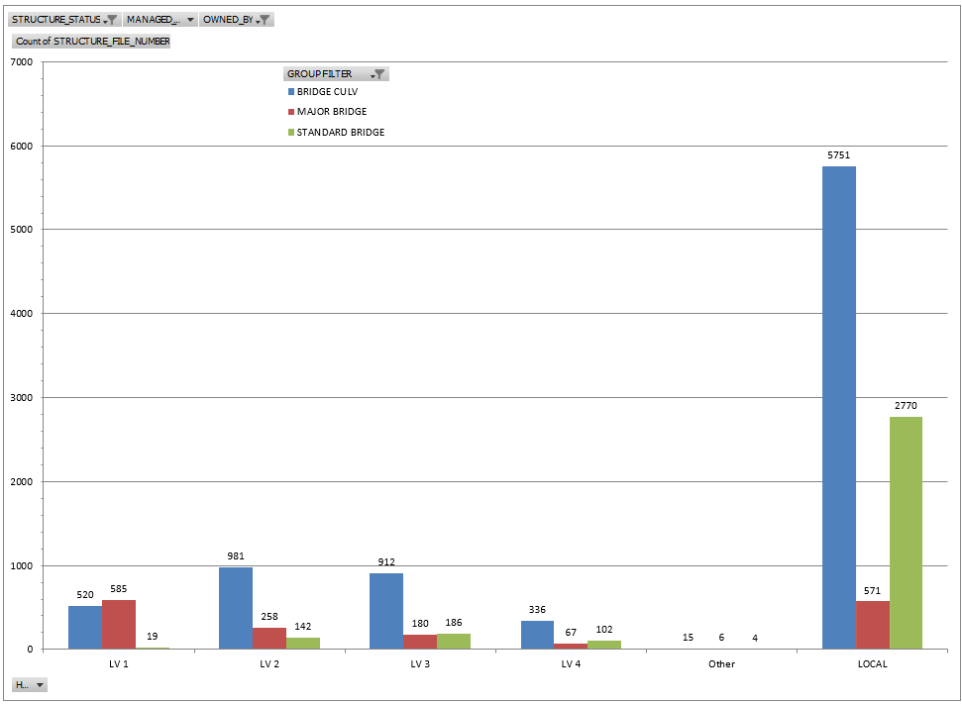
BIM – Bridge Structure Statistics
8,515
1,667
3,223
Total = 13,405
Notes:
LIKELY NEEDS UPDATING

Slide 11
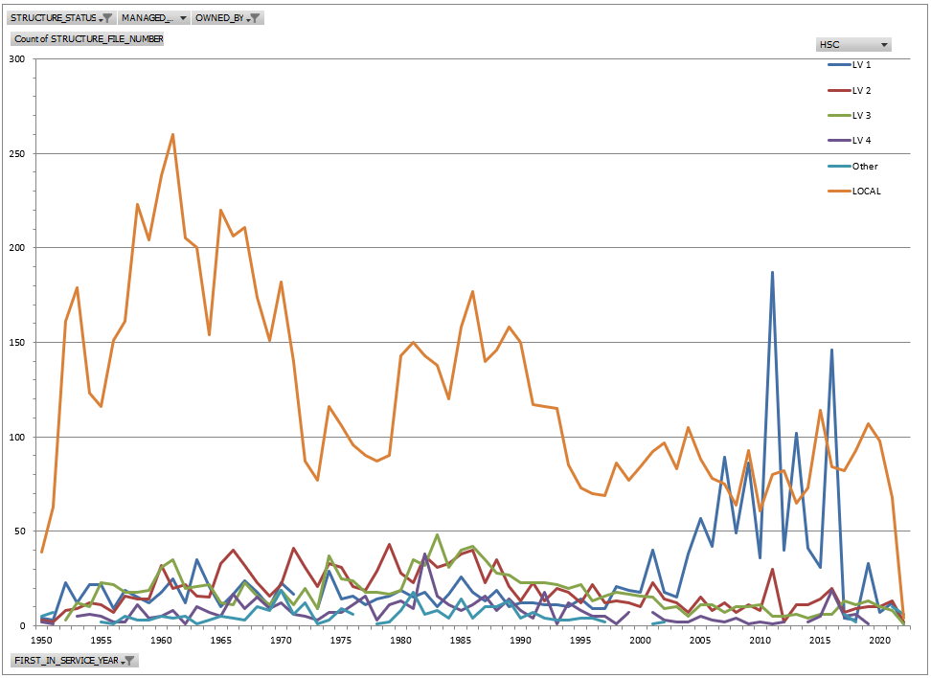
Bridge Structures Statistics
Number of Bridge Structures Built per Year by Road Type
Year of Construction
Notes:
SHOULD BE UPDATED

Slide 12
BIM System – Critical Considerations
The accuracy of the information contained within the BIM system directly impacts the effectiveness of the system.
  Consistency of inspection standards
  Inspection accuracy
  Inventory accuracy
  Maintenance accuracy
The bridge inspector must adhere to the highest standard at all times.

Slide 13

Questions?

