Slide 1
BRIDGE POSTING AND
UTILITIES

Slide 2
Posting and Utilities Information
Posting refers to Posted Loading or Posted Vertical Clearance
Information is entered into TIMS BIS application at first inspection
On subsequent BIM reports
Inspectors verify information is correct
Inspectors revise if incorrect
Note and report changes in Posting information for system updating
Notes:
This information is covered in Chapter #5 of the BIM Manual
Posting and utilities information is entered into the TIMS BIS application after first inspection
Subsequent BIM reports are then generated with this information in it
Inspectors are required to ensure information is correct
Noting any changes and updating the system information

Slide 3
Responsibility for Posting
All bridges on local roads are responsibility of Local Road Authority (County, MD, Town, Village, rtc)
  passing by-laws
  purchasing, installing and maintaining signage
Notes:
Posting or signing for all bridges (major and standard) on local roads is the responsibility of LRA (Counties and M.D.s)
This includes passing by laws; purchasing, installing and maintenance of signs

Slide 4
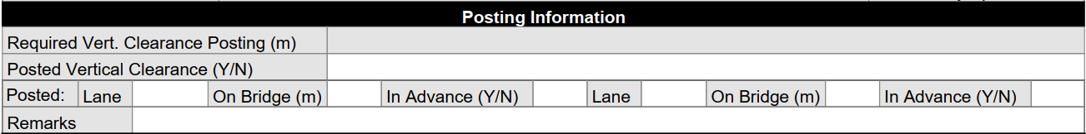
Vertical Clearance
On culvert Grade Separations and other various Major bridge forms
Mounted at midpoint over travel lanes
Advance warning in each direction
Legal height in Alberta without a permit is 4.15m
New grade separation structures are designed for 5.35m clearance
Notes:
One area of bridge posting is vertical clearance
The Vertical Clearance section would only appear on the BIM report when the structure is a TH, GS, PS, RO or RU
Posted on the structure at the midpoint over the travel lanes
Advanced signing of vertical clearance are posted in each direction of travel
Legal vertical loading for bridge structures in Alberta is 4.15 metres.
New grade separations are designed with a minimum 5.35 metres clearance
Question – Can anyone tell me how the vertical clearance measurement that you see posted on a bridge structure is determined?
Answer Posted vertical clearance determined by:
-minimum measured height between the lowest point of the structure and the clear roadway
-rounded down to 0.1m and 0.1m tolerance subtracted

Slide 5
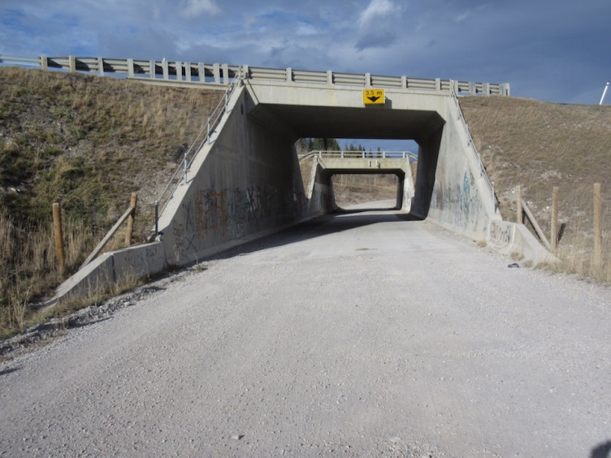
Vertical Clearance
Inspection and Coding
  look for signs in advance and on bridge
  legible and visible
  clearance values consistent
  If signs are missing record as “No”
  note direction and location if missing and notify RRA
  look for new pavement or gravel
  notify RRA if signs are incorrect or inconsistent
Notes:
As part of your BIM Inspection you should
-look and document signs posted in advance and at the bridge structure in both directions of travel
-signs should be legible and visible to public
-advance sign must have the same vertical clearance as on structure
-if signs are missing the inspector should record as “No”
-missing advance warning of vertical signs should be noted as well as the direction of travel that is affected
-new pavement or gravel which could indicate potential for reduced clearance
-notify BM or LRA if measurement is needed and where traffic control is required to obtain

Slide 6
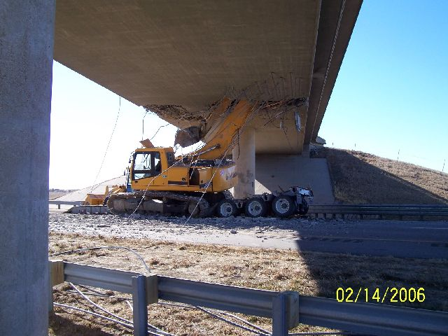
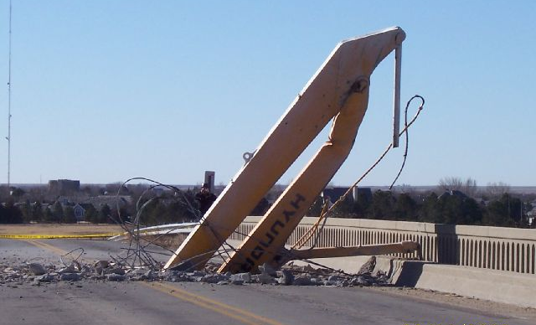
Vertical Clearance Posting is Important!
Notes:
-signing is very important, but in some instances may still not be adequate.
- This bridge was in Idaho USA.

Slide 7
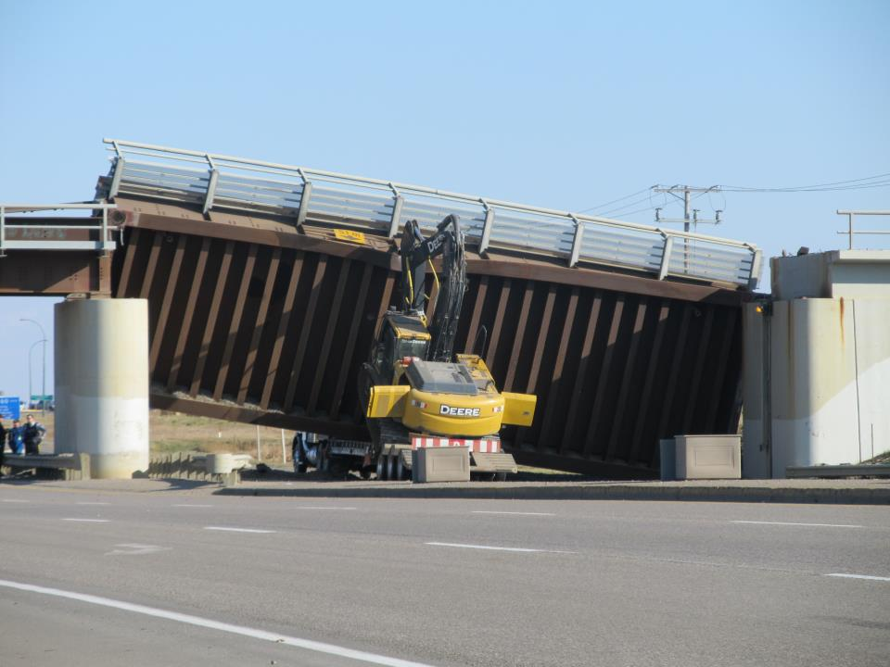
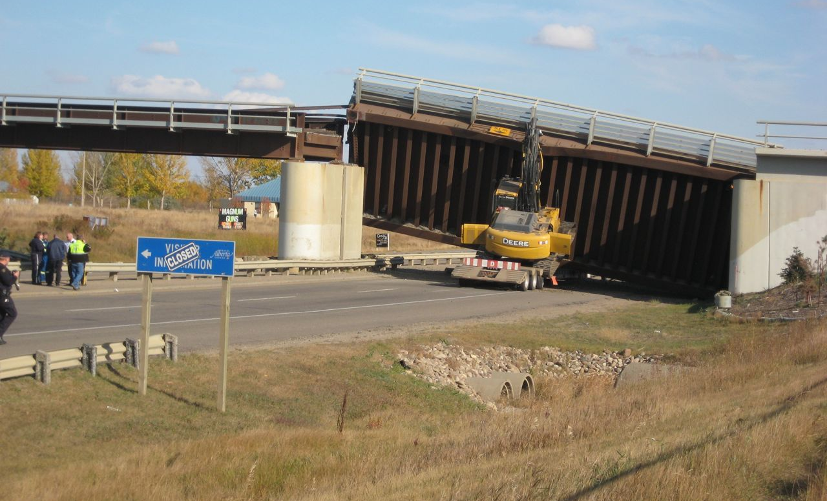
Vertical Clearance Posting is Important!
Notes:
-signing is very important, but in some instances may still not be adequate.
- This bridge was in Lloydminster AB

Slide 8
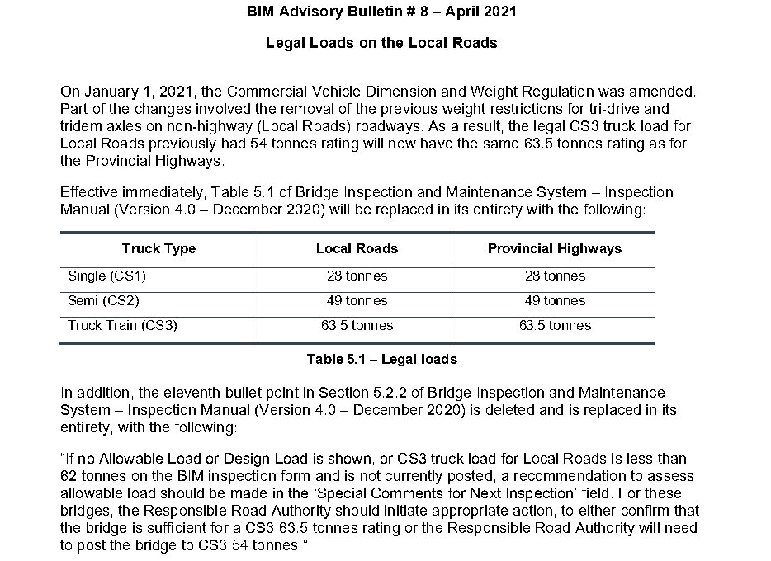
Posted Loading – BIM Bulletin #8
*previously 54 tonnes
Notes:
All bridge structures that cannot carry the legal load should be posted accordingly
At present the legal loads for local roads are:
Single CS1 28 tonnes
Semi CS2 49 tonnes
Truck train CS 63.5 tonnes
The legal loads for Provincial highways are:
Single CS1 28 tonnes
Semi CS2 49 tonnes
Truck train CS3 63.5 tonnes
Note info in Table 5.1 of manual is superseded by BIM Bulletin 8 issued April 2021 – revise 54 to 63.5 under Local Road column and make note to refer to Bulletin 8
Bridge structures that can carry legal load are not load posted

Slide 9
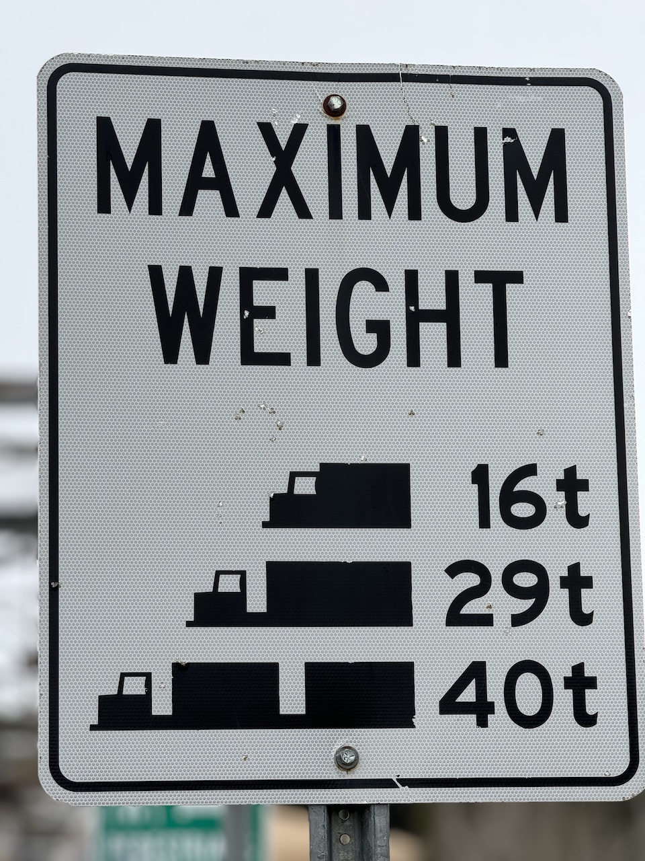
Posted Loading
Bridges that cannot accommodate legal loads are posted
Legal Loading on:
Local Roads
  CS 1 28 tonnes
  CS 2 49 tonnes
  CS 3 63.5 tonnes
Provincial Highways
  CS 1 28 tonnes
  CS 2 49 tonnes
  CS 3 63.5 tonnes
Notes:
All bridge structures that cannot carry the legal load should be posted accordingly
At present the legal loads for local roads are:
Single CS1 28 tonnes
Semi CS2 49 tonnes
Truck train CS 63.5 tonnes (previously 54)
Make change in your manual Table 5.1 from 54 to 63.5T & to refer to BIM Bulletin 8 (April 2021)
The legal loads for Provincial highways are:
Single CS1 28 tonnes
Semi CS2 49 tonnes
Truck train CS3 63.5 tonnes
Bridge structures that can carry legal load are not load posted

Slide 10
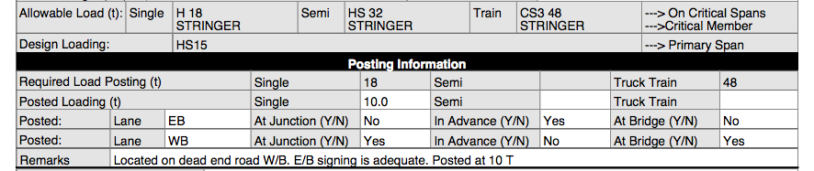
Posted Loading
Inspection and coding
  compare Allowable Load to legal loads to determine if posting is required
  loading values on sign consistent with “Allowable Loading” and “Required Load Posting” on report
  note posting at the junctions of roads leading to bridge, in advance, and at the bridge structure
  legible and visible
  note missing or incorrect signs, report to responsible authority
Notes:
-compare Allowable Loading to legal loads to determine if posting is required
-inspector should be aware of all loading signs posted at the junctions of the bridge, in advance and at the bridge structure in both directions of travel
-signs should be legible and visible. Judgement on the inspectors part is required when bridge is located at or near junction. In some cases only 2 signs (and maybe 1) will be required if junction is vey close to bridge.
-all signs must indicate same loading
-if rated loading is below the legal limit - the bridge structure should be posted for rated loading, the inspector must verify the posted values are in agreement
-In some instances the bridge may be posted below rated loading for condition, reasoning can be confirmed with the Regional Bridge Manager
-missing signs should be noted in the “Remarks” area
-the responsible road authority should be notified of any problems or missing signs
-if posting not required, note remarks

Slide 11
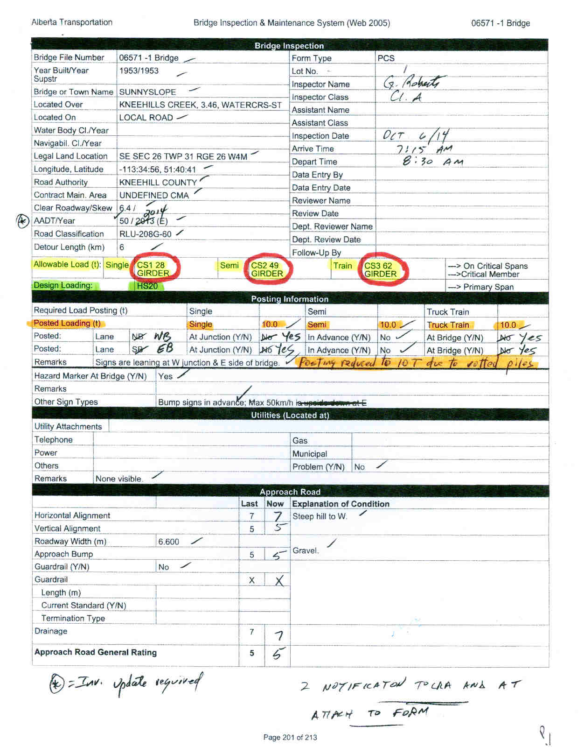
Posted Loading
Notes:
- This bridge form shows allowable Loads meets legal loads and does not require posting. Bridge is posted at 10T for other reasons

Slide 12
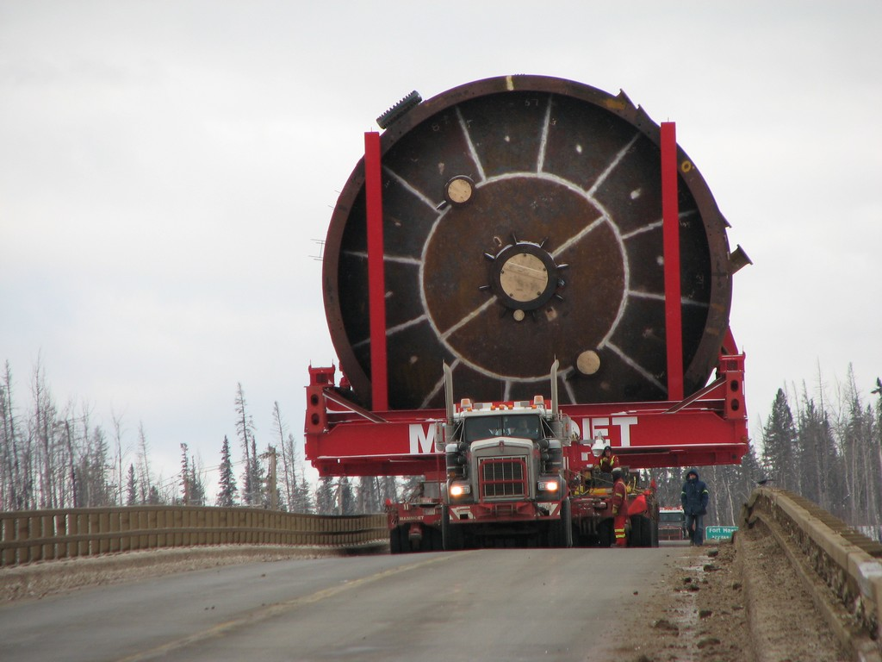
Posted Loading
Notes:
Note sag in span that over-load is on

Slide 13

Hazard Markers
All bridges when bridge clear road less than approach road
All standard bridges on local roads – except when bridge is wider than road.
Black stripes point down and toward road
Notes:
Hazard markers are required when the bridge clear road width is less than the approach road width;
They are required on all standard bridges on local roads and low level crossings
When required on undivided roadways hazard markers should be installed at all four corners of the bridge
Proper installation is important, black stripes should be slanted downwards toward the roadway

Slide 14
Hazard Markers
Inspection and Coding
  noting orientation and location (in line with bridge railing & 1200mm above deck top/wearing surface) except when required to be higher due to snow banks
  note condition
  If not installed because not required record “No” and “Not req” in “Remarks” area
  If some missing record as Yes or No? Make comments in “Remarks” area
  If all missing record as “No” and make maintenance recommendation to install
  problems notify responsible authority
Other Signs
Narrow Bridge, Speed Limit, Curve, Bump,
  note condition, legibility
  record type and location
Notes:
-when inspecting note proper installation and condition (in line with bridge rail & 1200mm above the deck top/wearing surface) sometimes need to be higher due to snow banks
-if 2 of 4 haz markers are present record Yes and make comments regarding missing HM in Remarks field
If 3 of 4 or all 4 are missing record No and make comments in Remarks field
Comment on damaged or leaning HM
-if hazard markers are not installed because they are not required record as No and make comment in Remarks “Not Required”
-sometimes installed back to back at opposite/diagonal corners – record as Yes and make comment in Remarks field
-the responsible road authority should be notified of any problems
Other signs that are to be documented on the BIM form that appear before the bridge structure might include:
Narrow bridge
Speed limit
Sharp bends
Slippery when wet, etc.
Signage prior to the bridge is important in evaluating approach road ratings.

Slide 15
Utilities
Utility owner responsible for maintenance or removal if requested by RRA
Note only those on or within 200 m of bridge or culvert
Check if utility
  overloads bridge
  interferes with maintenance or operations
  hazard to public or bridge
  unattractive appearance (corrosion, loose and sagging)
Installed only after review and approval of AT or LRA staff
Notes:
The owner of the utility is responsible for its inspection, maintenance and operation – and for removal if requested by RRA
Inspector is only interested in the location of the utilities on the bridge or on site and its possible impact on bridge structure
The inspector must check if utility:
-overloads the bridge
-interferes with routine maintenance
-constitutes a hazard to the travelling public or the bridge
-presents an unattractive appearance
The department discourages the installation of utilities on bridges
The owner must apply for permission from the Bridge Manager or LRA before permanent installation of any utility on bridges
The application must have engineering drawings, showing details, proposed location and method of installation of the utilities

Slide 16
Utilities Proper Locations
Newer prestressed concrete bridges
  Voids/ducts in curbs for Telephone and Power
Reinforced concrete precast
  clamp on curb fascia
Older pre-stressed concrete precast
  in outside void of stringer
Should not interfere with bridge or culvert maintenance
Notes:
On newer concrete or steel bridges:
-a continuous conduit is provided for utilities in both curbs for utilities such as Telus and power
-other utilities may be located between the girder legs on the underside of the deck attached using clamps
For standard reinforced concrete precast:
-utilities may be attached on side of the curb using “U” clamps
On standard prestressed bridges
-utilities are typically located in the outside void of the curb unit stringer
On truss bridges
-utilities are typically located on utility trays/supports or clamped on the bottom chord

Slide 17
Utilities Improper Attachments
Drilled into pre-stressed girders
Explosive fasteners in steel or concrete
Welding or drilling on steel members or in culvert barrels
Oversize holes in timber
Failure to treat cut timber
Notes:
The following methods of attachment are not permitted and if present should be noted on the BIM report:
-drilling into prestressed girder legs
-explosive driven attachments to both concrete or steel
-welding on or drilling into steel members
-drilling larger than required holes in timber components or failure to treat and/or plug the holes

Slide 18
Utilities
Inspection and Coding
  note location of power, phone, etc. within 200m (i.e. East ROW)
  remark if hazardous, report to owner
  look for improper installation
  look for leaks in water, sewer or gas
  check connections for safety
Notify RRA (AT or LRA) concerning problems or defects
Notes:
When inspecting:
-note the location of each utility
-remark if it is a hazard to the travelling public
-look for excessive sagging that may cause cracks or leaks or reduce vertical clearance
-look for signs of damage on utility and its supports
-check for evidence of leaks on water or sewer pipes
-the distance between fixed and expansion joints should approximately match those on the bridge
-utilities that are damaged or showing signs of future problems should be reported to the owner

Slide 19
Culverts
Vertical clearance only if underpass
No load posting
Utilities typically not in culverts
May have ducts in headwalls
Record location of power, phone, etc. within 200m (i.e. West ROW)
Notes:
Will only have a vertical clearance posting if it is an underpass
Will not have load posting
Will typically not have utility in culvert
May have ducts in headwalls of new culverts
Record locations of all utilities

Slide 20
Major Bridges
Local Road Authorities are responsible for signing of major bridges on Local Roads
Lack of signs
  legal liability
  damage bridges
  damage / injury to public
Report missing or incorrect Posted Loading signs to Bridge Manager & Bridge Preservation Specialist, or LRA as appropriate.
Notes:
LRAs do not complete BIM inspections for major bridges but are responsible for the signing
Proper signing is a concern for
-Legal liability
-Potential damage to the bridge structure
-and most importantly risk of creating a safety hazard to the travelling public
Review department policy on damage to bridges
Department completes repairs and pursues claims
-will not charge LRA unless they contribute to damage on collection of damage claim
-improper signing – could be grounds to bill LRA
If accident occurs it is important to know what load signing and other signing was on the bridge immediately before accident

Slide 21

Questions?

