Slide 1
APPROACH ROAD INSPECTION AND RATING

Slide 2
Introduction
Approach road is the road leading up to the bridge or culvert
Basic rule is alignment OVER is rated in Approach Road section and Alignment UNDER is rated in Grade Separation or Channel section
For purpose of this presentation are referencing the road OVER (road under bridge or through culvert is covered in Grade Separation presentation)
For culverts it includes the road fill over the culvert
Considerations for rating
  Geometric alignment at the bridge site
  Condition of approach fill
  Inventory and condition of guardrails on approaches
  Drainage on approaches to bridge

Slide 3
Road Use
Drivers unfamiliar with the area
Vehicles/Tires in poor condition
All of these factors have to be accommodated by the approach road alignment.
Roads are used by:
People with reduced abilities
People who just got licensed or new to driving
Inattentive drivers
Dangerous / erratic drivers

Slide 4
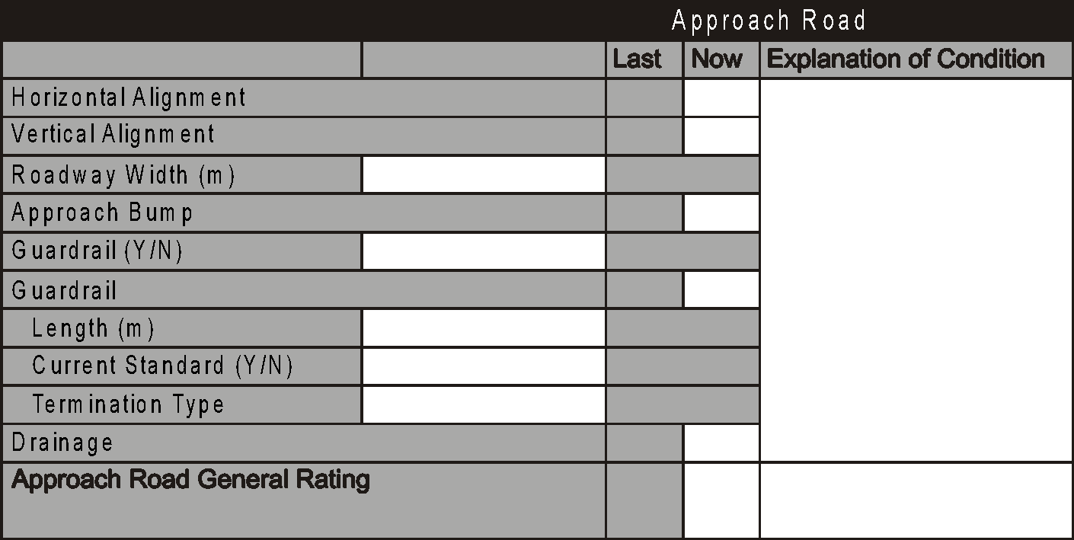
Approach Road Section - Bridges

Slide 5
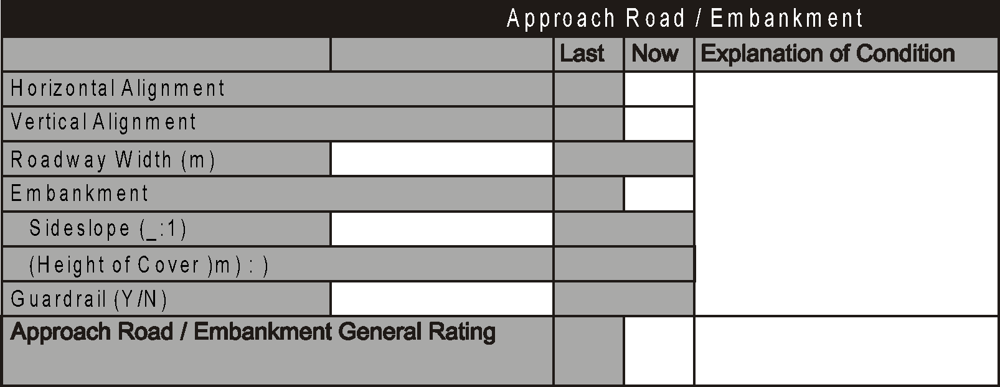
Approach Road Section - Culverts
Upstream End
End Treatment (Concrete,
Direction
Steel, Others, None)
Headwall
Wingwalls
Collar/Concrete Slope Protection
(Shape : )

Slide 6
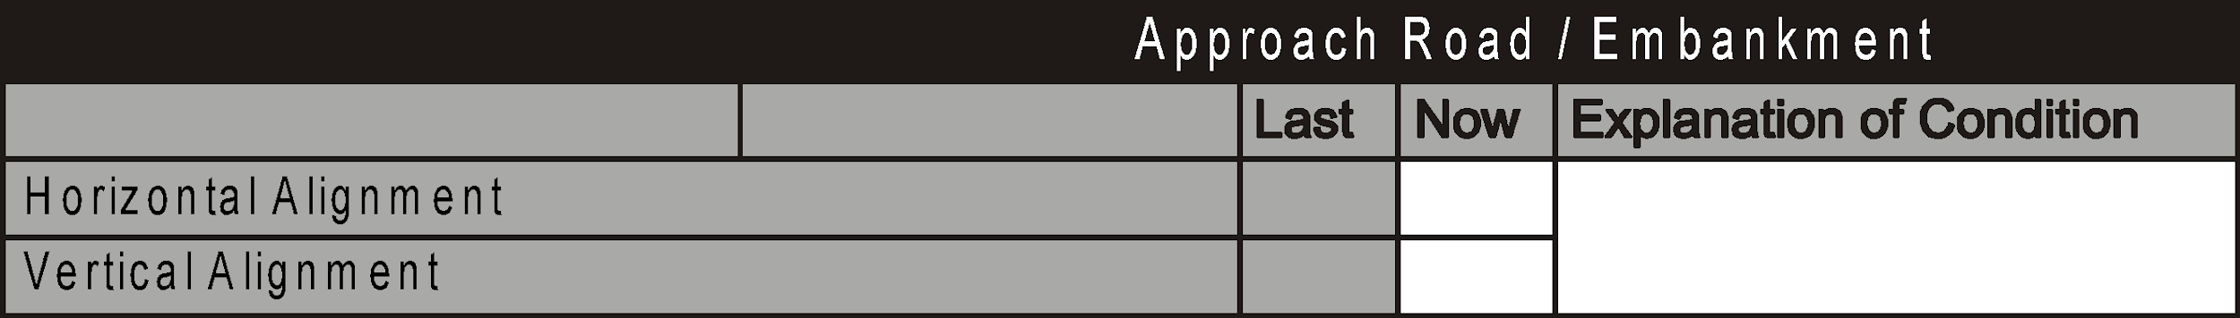
Alignment
Separate ratings are provided for horizontal and vertical alignments
Defects in alignment must be categorized in either the horizontal or vertical components
Inspector should consider road alignments are used during adverse weather or road conditions – e.g. fog, heavy rain, snow, un-gravelled surfaces, icy roads

Slide 7
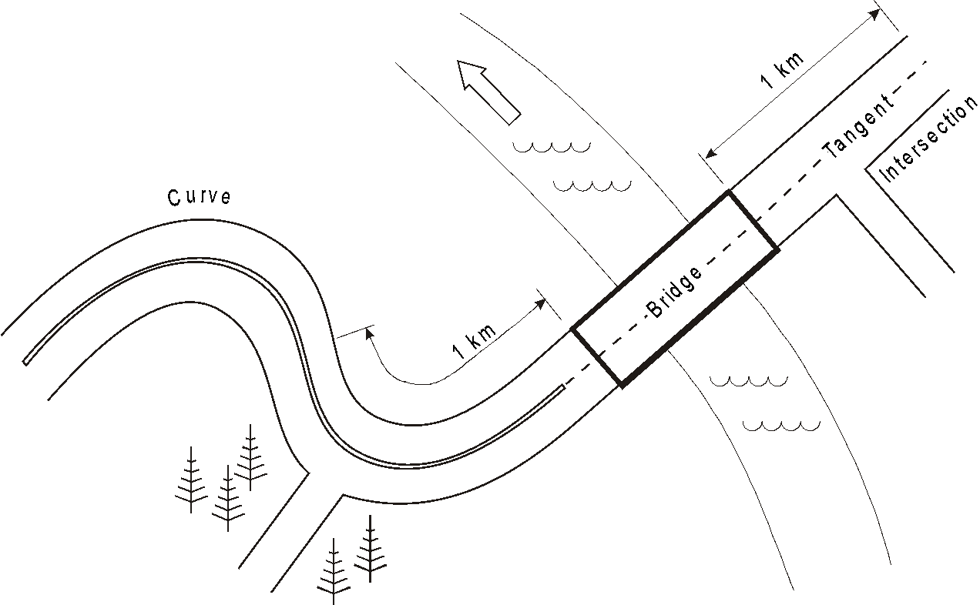
Length of Approach

Slide 8
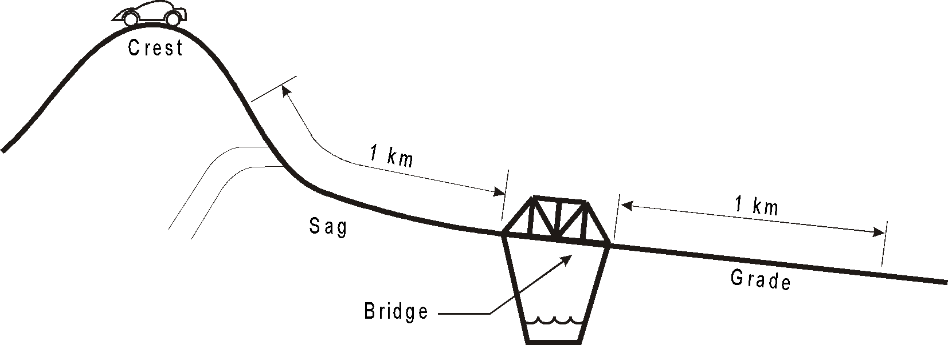
Length of Approach

Slide 9
Alignment
Design speed is the posted legal speed for road plus 10 kph
Evaluate by driving legal speed limit - if safe to do so and conditions permit.
Observe sight distances
Note if bridge is super-elevated
Note presence of speed limit or other signs
  Sharp curve
  Steep hill
  Intersection ahead
    Could indicate sight distance problem

Slide 10
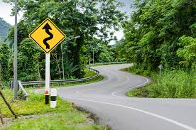
Horizontal Alignment
Horizontal defects result in a reduction in speed to drive the road safely. They include:
  Reduced visibility – trees, buildings, embankments
  Sharp corners
  Intersecting or access roads
  Bridge is at beginning of or in curve
  Bridge is offset from straight alignment
  Limited sight distance for passing safely

Slide 11
Horizontal Alignment Ratings
Note presence and record location of intersections or access roads including residential or commercial (field accesses do not affect rating).
  Rate 7 or less depending on visibility, traffic volume and traffic type.
  Rating may be 8 or 9 if on tangent and no intersections within 1km
If horizontal defect is cause of reduced speed, then rate:
  6 or more if driven safely at legal speed limit
  5 can be driven safely and posted not more than 20 km/hr below legal speed limit
  4 or less if posted more than 20 km/hr below the legal speed limit
  4 or less if sharp or blind curves
  5 if Land Access bridge and appropriate warning signs are in place
Rate 2 if combined effect of horizontal and vertical alignment is hazardous (e.g. very steep hill combined with sharp hair-pin curve)

Slide 12
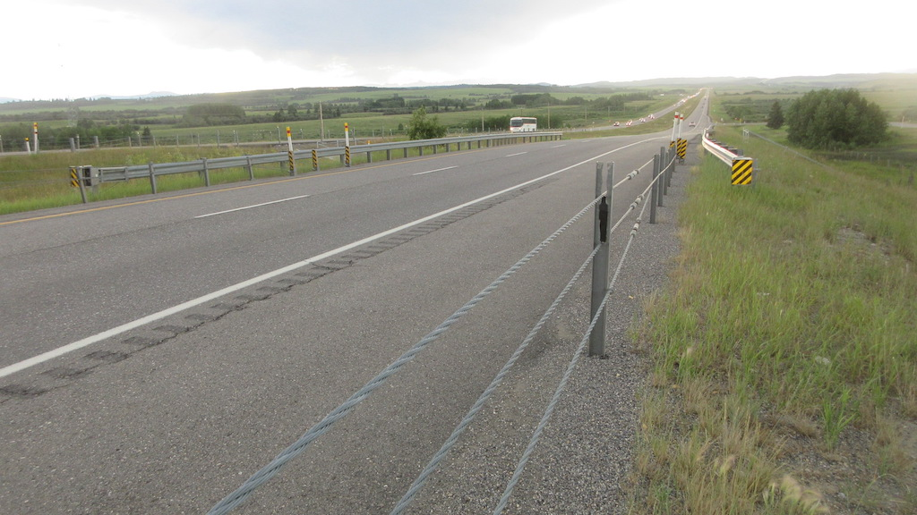

Slide 13
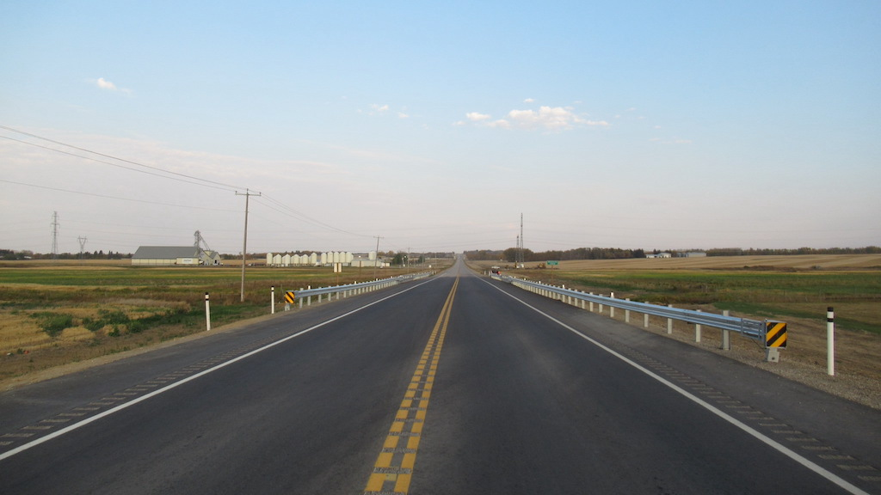

Slide 14
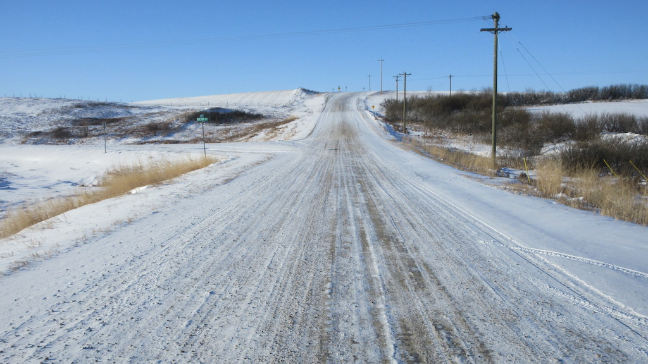

Slide 15
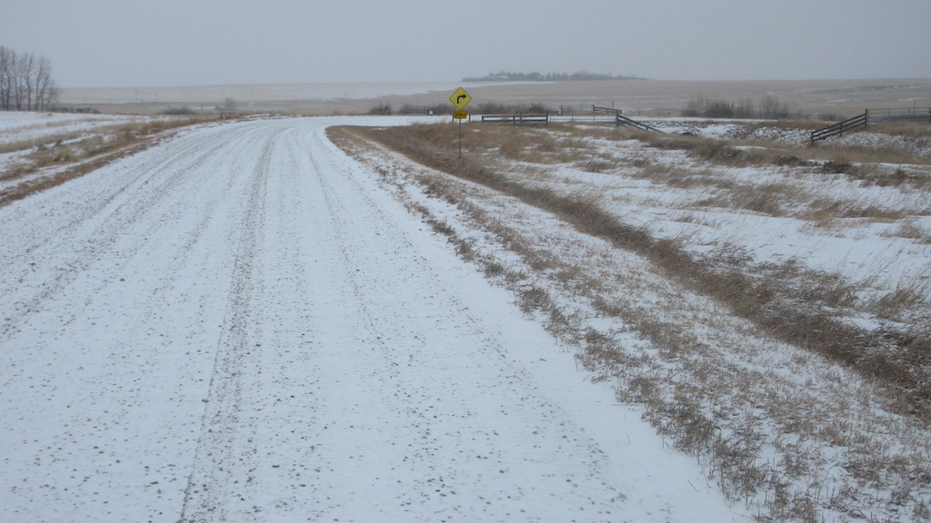

Slide 16
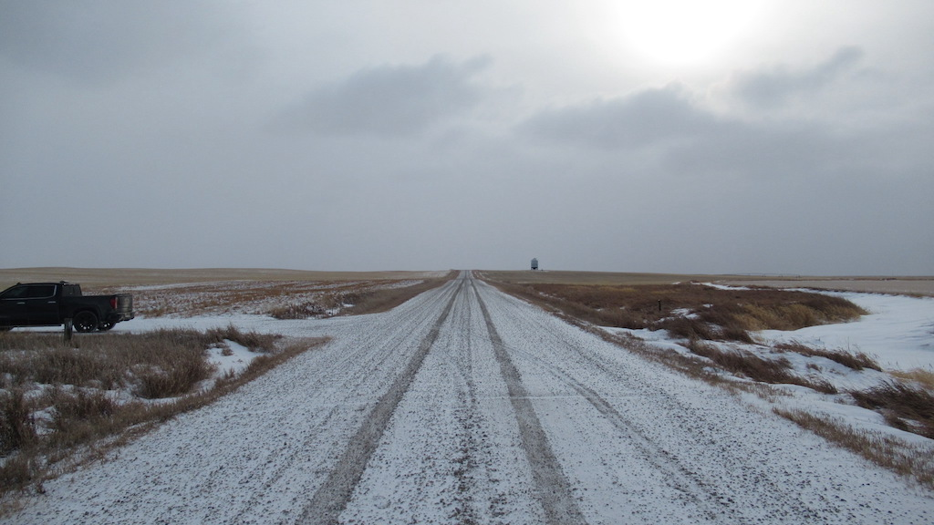

Slide 17
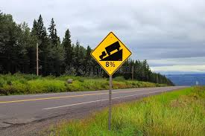
Vertical Alignment
Vertical alignment defects result in a reduction in speed to drive the road safely. They include:
  Reduced visibility – crests
  Steep grades (take into consideration road surface e.g. loose gravel)
  Adequate sight distance for stopping or passing
  Intersecting roads

Slide 18
Vertical Alignment Rating
Vertical alignment with a straight grade of 1% or less - rate 9
If road can be driven safely at legal speed limit rate 6 or more
If road can be safely driven and posted not more than 20 km/hr below legal rate 5
Rate 4 or less if:
  posted more than 20 km/hr below posted speed
  sight distance is less than required
  Steep grades, blind crest curves
Rate 2 if combined effect of horizontal and vertical alignment is hazardous (e.g. very steep hill combined with sharp hair-pin curve)
Rate 5 if Land Access bridge

Slide 19
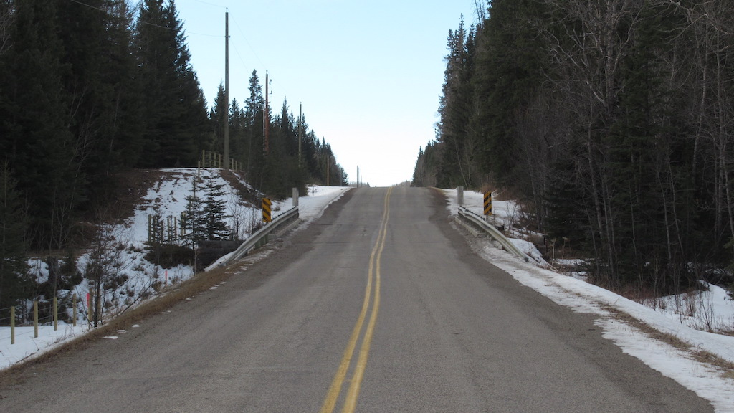

Slide 20
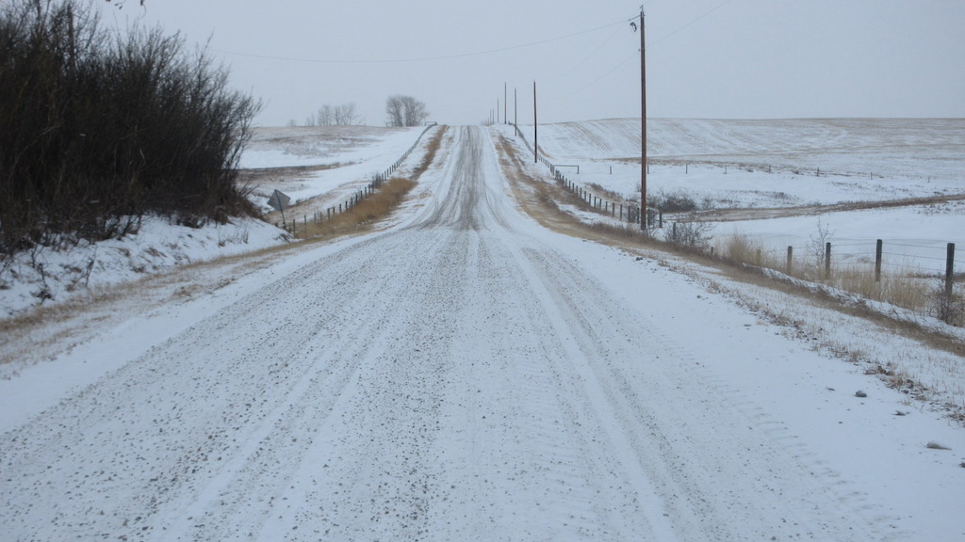

Slide 21
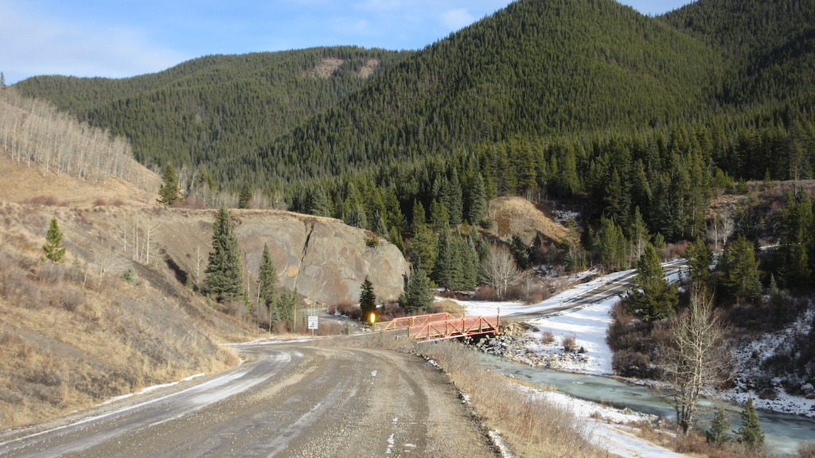

Slide 22
Alignment – Vertical And Horizontal
For land access structures:
  Road services land only, not residential access, minimal traffic
  Appropriate warning signs in place
  Previous rating guidelines do not apply – rate 5
Alignment of railway, pedestrian and animal overpasses, and utility structures crossing over top are rated X
If both Horizontal and Vertical alignments rated X, General Rating is rated 5.
  Pedestrian bridges over streams/watercourse or roadways
  Grade Separation - Wildlife crossing over top of roadway
  Grade Separation - Railway crossing over roadway

Slide 23
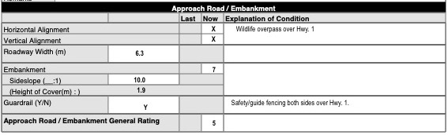
Culvert Grade Separation – Wildlife Over
Horizontal & Vertical Approach Road Alignment Rated X so Gen. Rating = 5

Slide 24
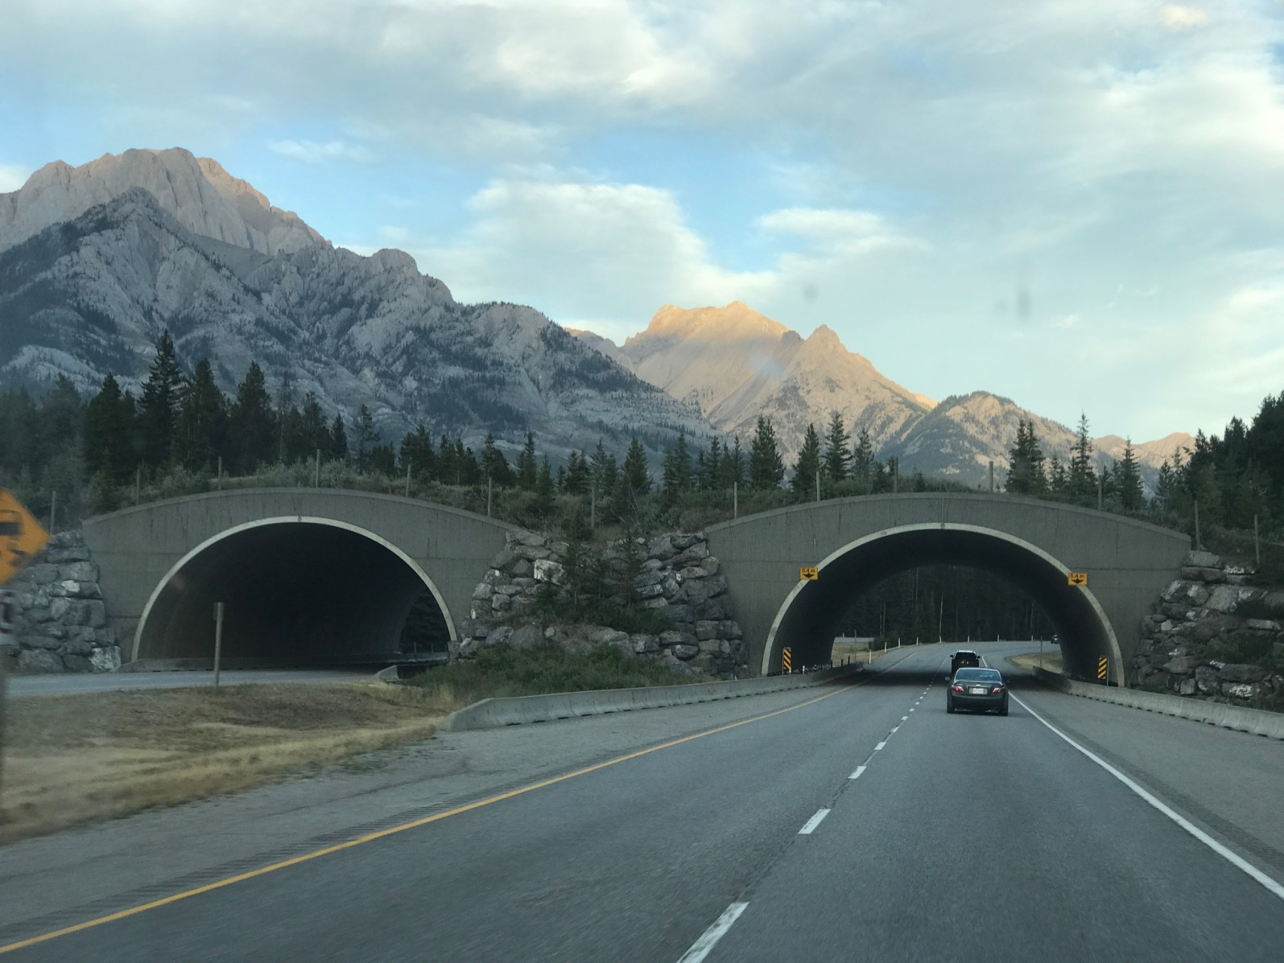
Culvert Grade Separation - Wildlife Overpass Vertical & Horizontal Road Alignment OVER Rated X, Gen. Rating = 5

Slide 25
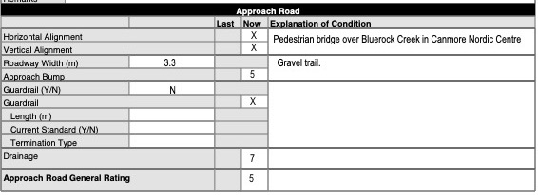
Pedestrian Bridge – Stream Under
Horizontal & Vertical Approach Road Alignment Rated X – Gen. Rating =5

Slide 26
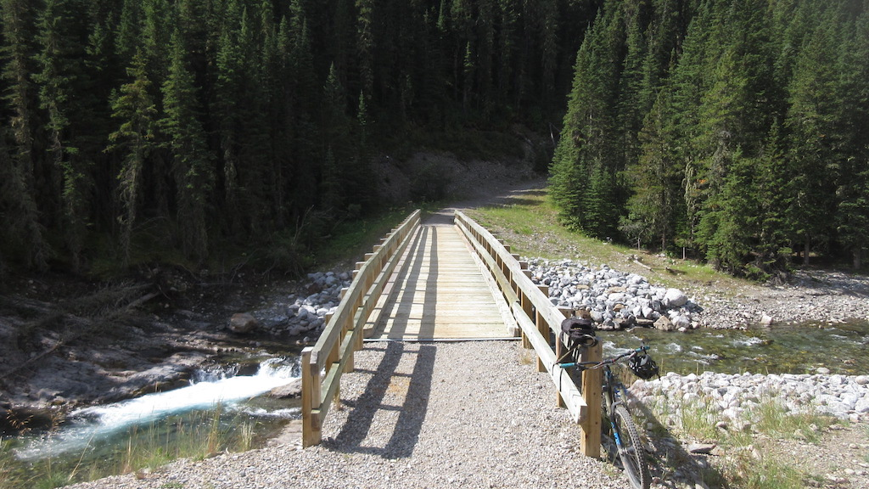

Slide 27
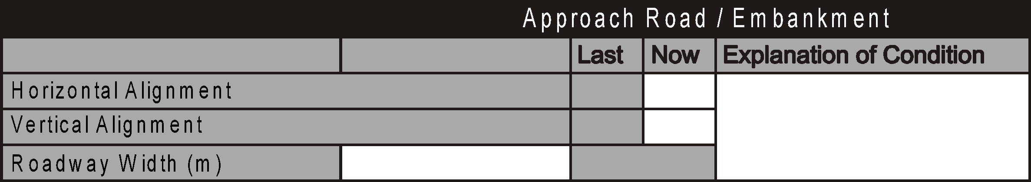
Roadway Width
This is the width of the traveled lanes and shoulders
Do not include median width if present on approach road
If curbs on the approach road, measure between faces
Measure at a representative cross-section
Record minimum width to the nearest 0.1m if different between ends
Provide explanation if different on each side of structure

Slide 28
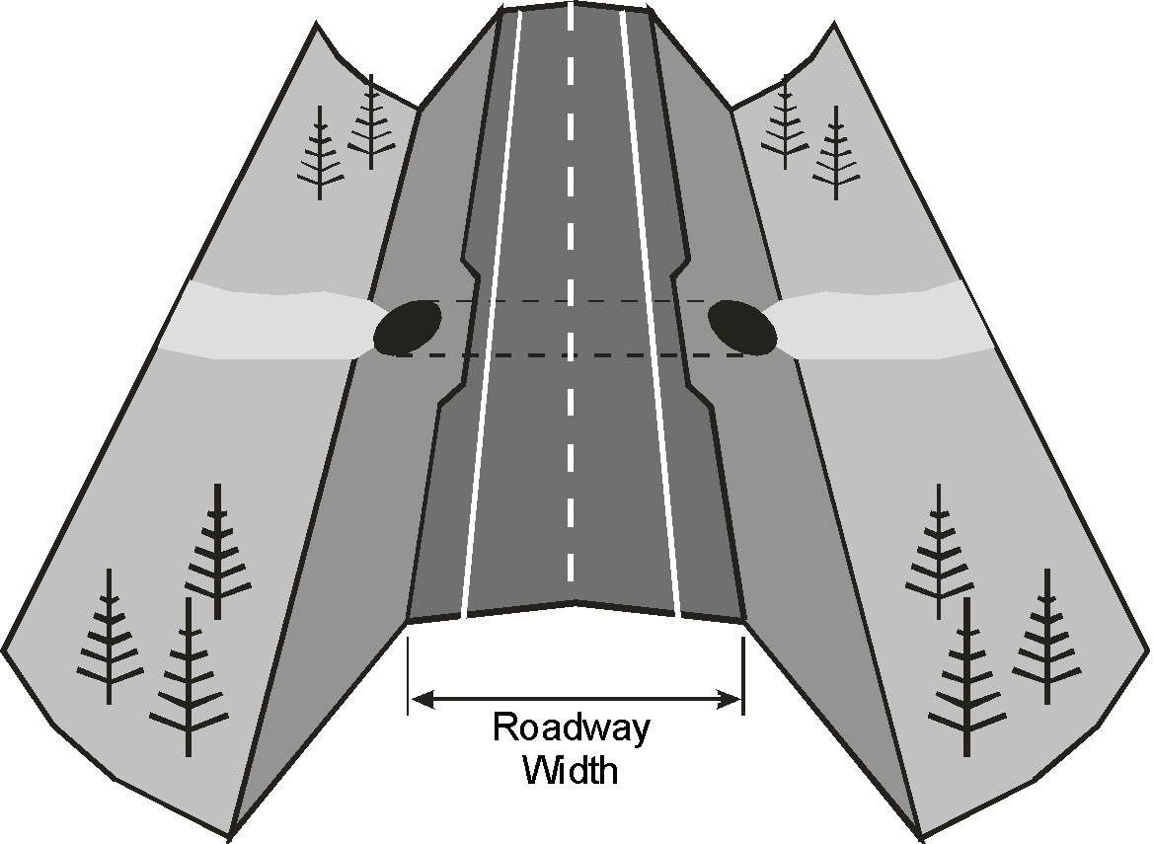
Roadway Width

Slide 29
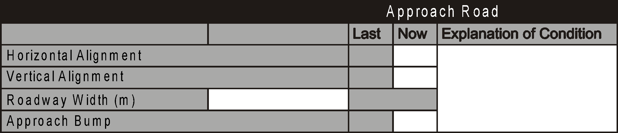
Approach Bump
Bridges only
Refers to the smoothness of the transition onto the structure
Severe bump
  Can be hazard to traffic (2 or less)
  Can lead to increased impact loading on structure (4 or maybe 3 or less)

Slide 30
Approach Bump
May be a symptom of
  Settlement of the approach fill
  Instability of the fill (slumping)
  Undermining of fill by water
  Settlement of or damage to approach slab
Drive over at legal speed if safe – or at safest speed that conditions allow
Observe traffic crossing structure
If no defects and smooth transition rate 9
If bump is noticeable but tolerable - rate 5
If speed must be reduced - rate 4 or less
If causing significant impact loading on bridge deck – rate 3 or less
If hazardous to traffic - rate 2 or less

Slide 31
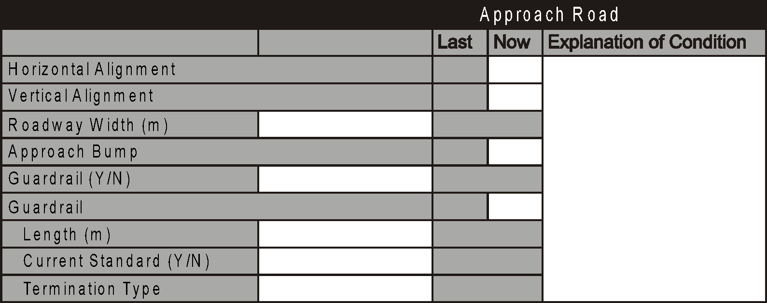
Guardrail
Refers to guardrail or other traffic barrier along edges of the approach road
Purpose:
  Prevent traffic from leaving the roadway at the structure
  Prevent traffic from impacting structure

Slide 32
Guardrail - Culverts
Rating is not required
Record the presence of guardrail by Yes or No
Provide comment if guardrail is on one shoulder only
Guardrail that is too short or is otherwise ineffective – provide comment and maintenance recommendation
Provide comment and maintenance recommendation if missing and is required for safety
Note defects (e.g. - broken posts, damaged rails) and provide comment and maintenance recommendation
No indicates no guardrail

Slide 33
Guardrails - Bridges
Record the presence of guardrail by Yes or No
Record the minimum length to the nearest meter
  Comment/Explain if different lengths exist
Maximum is 99 m
Record the type of termination
  Common type is Turned Down End, Wing End, Attenuator, Fleat
Built based on current Standard Drawings
Since 2001 most common S1643, 1649, 1651, 1652, 1653, and S1705 (newest)
Record if the guardrail meets current standards (Yes/No)
  Explain if “No”
  Common acceptable explanation is “Not thriebeam” or “Not attenuator”
HTCB is currently preferred standard and may transition with W-beam
https://www.alberta.ca/assets/documents/trans-bridge-barrier-drawings.pdf

Slide 34
Guardrails - Bridges
Inspect up to 20 m from bridge
Inspect all components of guardrail
  Posts
  Rail
  Connections
  Splices
  Termination (if within 20 m)
  Rate according to condition only - not standard (do not down-rate if not built to current standard. Rate condition and functionality)
Minor damage but still functional – rate 5
Missing bolts or improper laps - 4 or less
Damaged - requires replacement – rate 3 or less
Damaged – potential hazard – rate 2 or less
Rate “X” if no guardrail exists
  If required, comment and recommendation

Slide 35
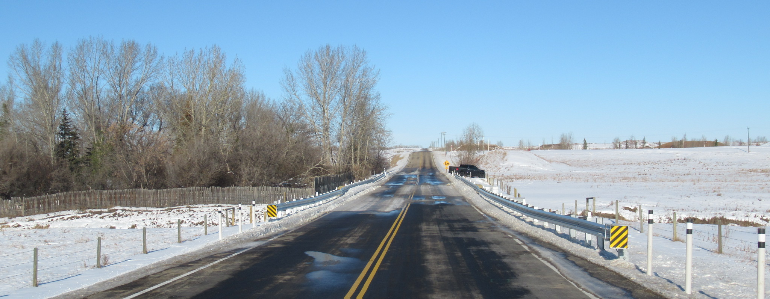
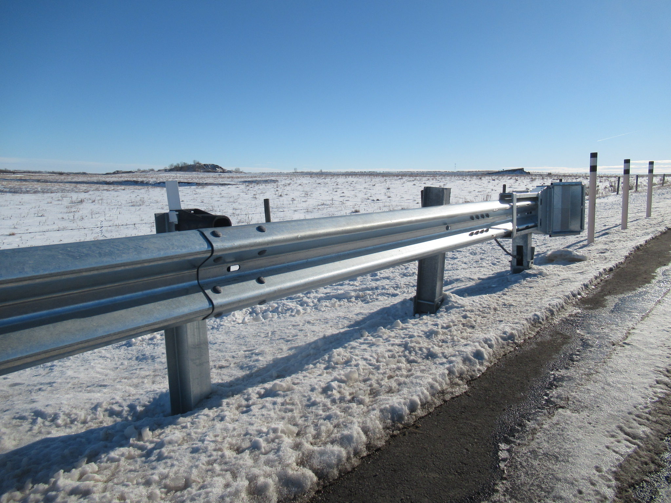
Guardrails – RDG-B1.5
New W-Beam guardrail installed with Fleat 350 Energy Absorbing Terminals
By design, the 3rd post from the Fleat 350 Terminal is left unbolted from the rail. Does not affect the guardrail rating.

Slide 36
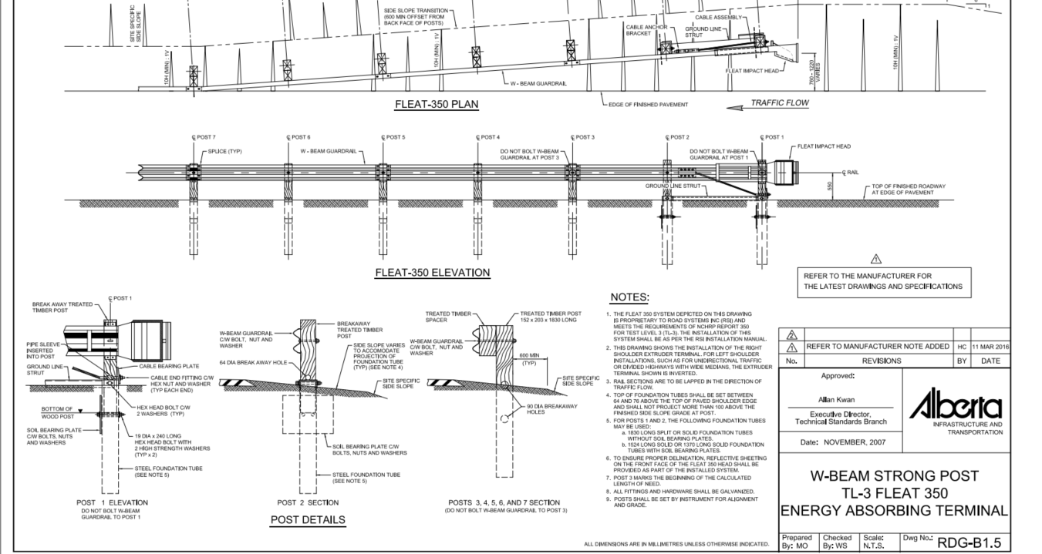
http://www.transportation.alberta.ca/Content/docType233/Production/RDG-B1-5.pdf

Slide 38
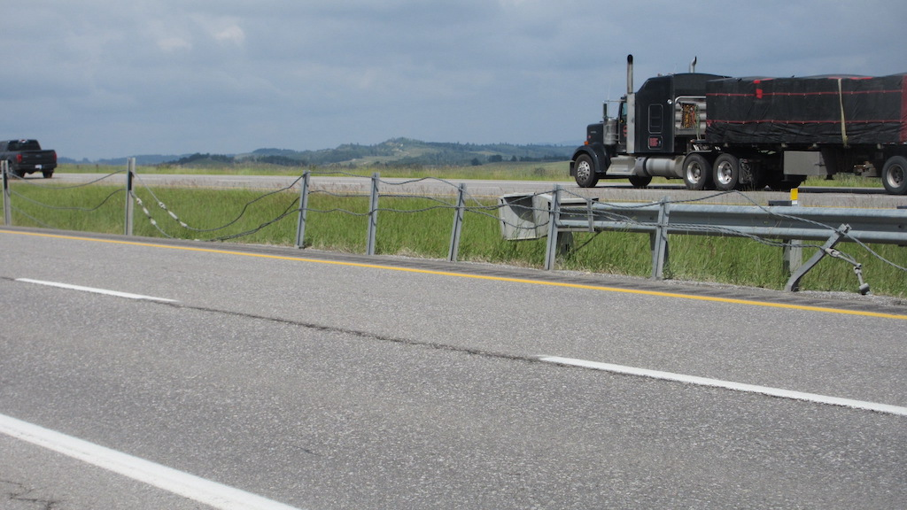

Slide 39
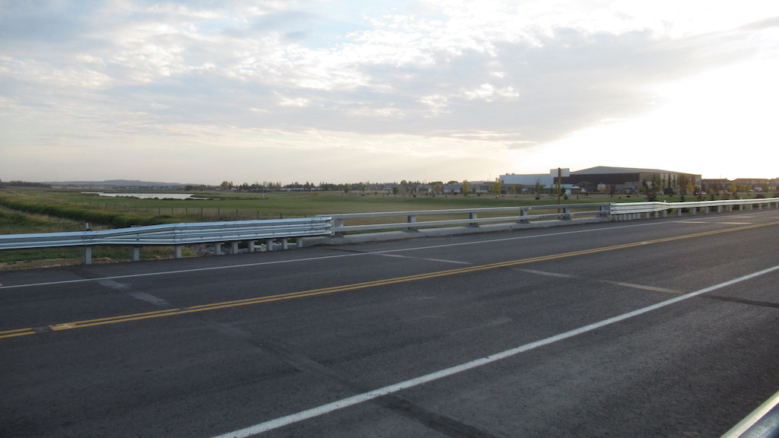

Slide 40
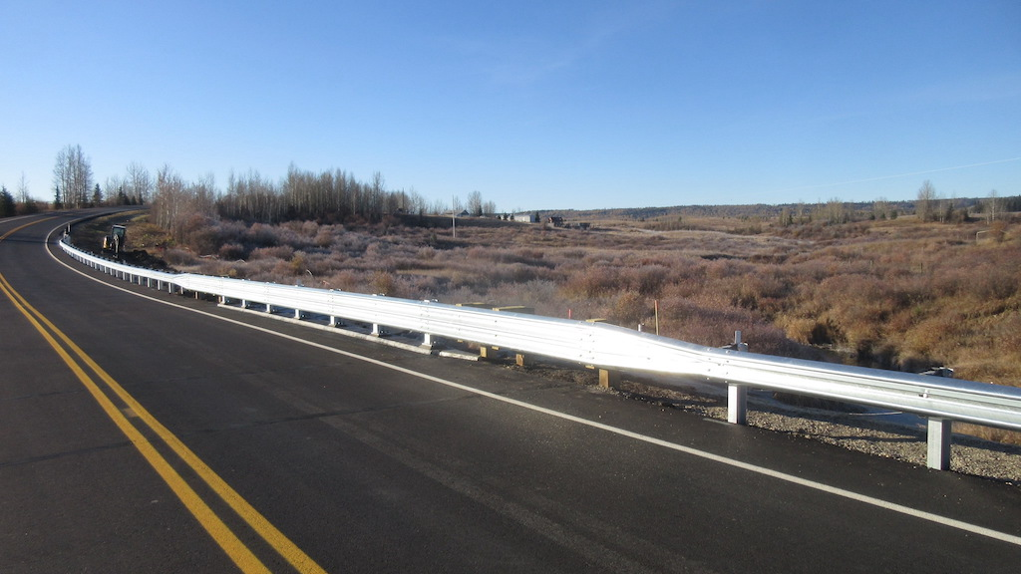

Slide 41
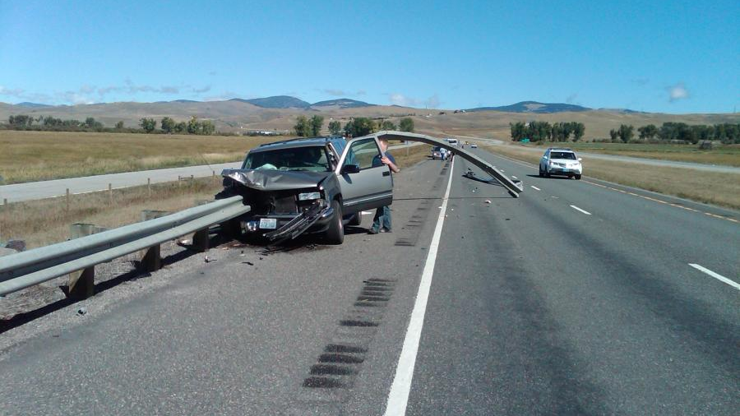

Slide 42
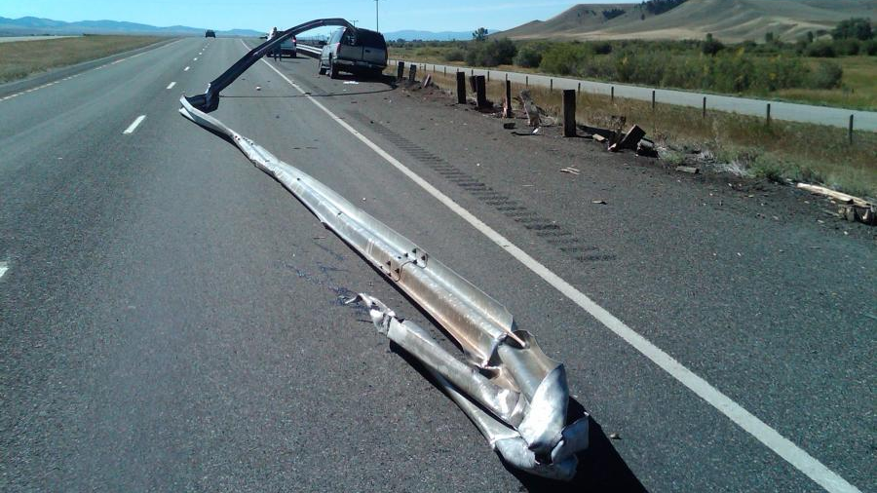

Slide 43
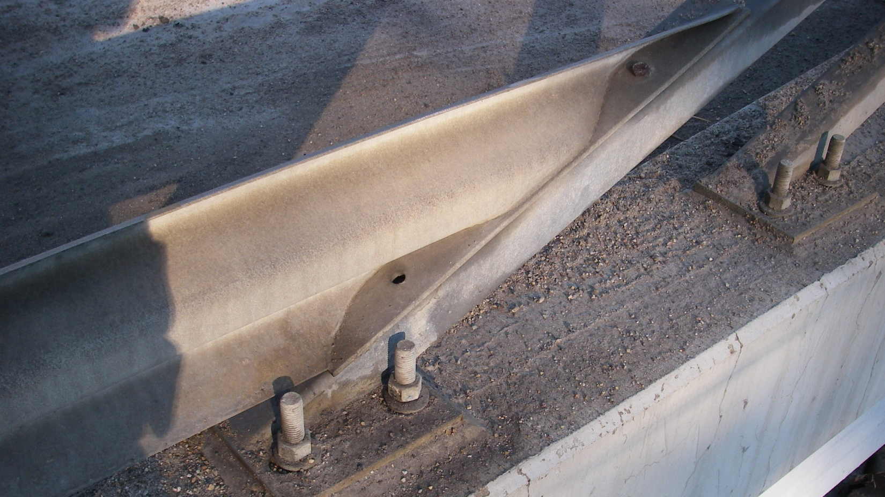

Slide 44
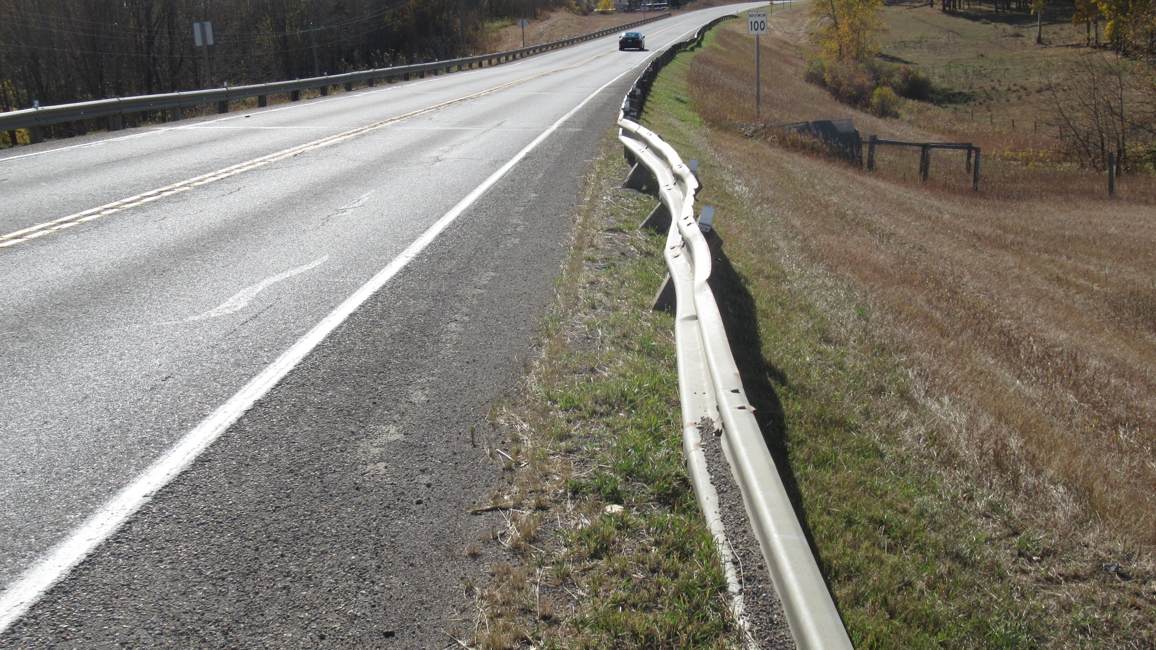

Slide 45
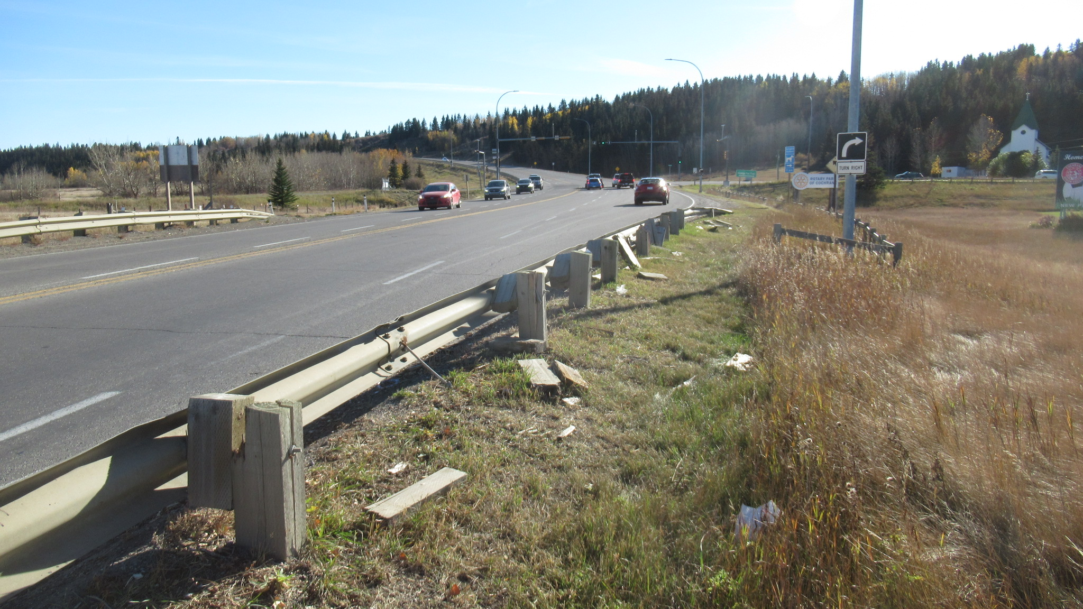

Slide 46
Drainage
Applies to bridges only
Refers to the ability of the approaches to handle drainage
  Must not allow water to drain onto structure
  Must not allow damage to fills or headslopes
  Must not pond on approaches
Includes drain troughs on approaches
Water may originate from
  Precipitation onto approaches
  Runoff from roadway
  Runoff from structure

Slide 47
Drainage
Look for:
  Ponding of water on approaches or ends of structure
  Erosion of fills, road embankment, headslope or ditches
  Voids under approach slabs or abutments
  Undermining of drain troughs
  Damage or deterioration of drain troughs

Slide 48
Drainage
Good drainage away from bridge – rate 5 or more
Drainage onto bridge gutters - rate 4 or less
Drainage onto bridge driving lanes-rate 3 or less
Drainage eroding headslope or sideslope – rate
4 or less
Erosion from approach road ditch drainage – rate 4 or less
Drainage causing a hazard - rate 2 or less (e.g. ponding or icing into travel lanes)

Slide 49
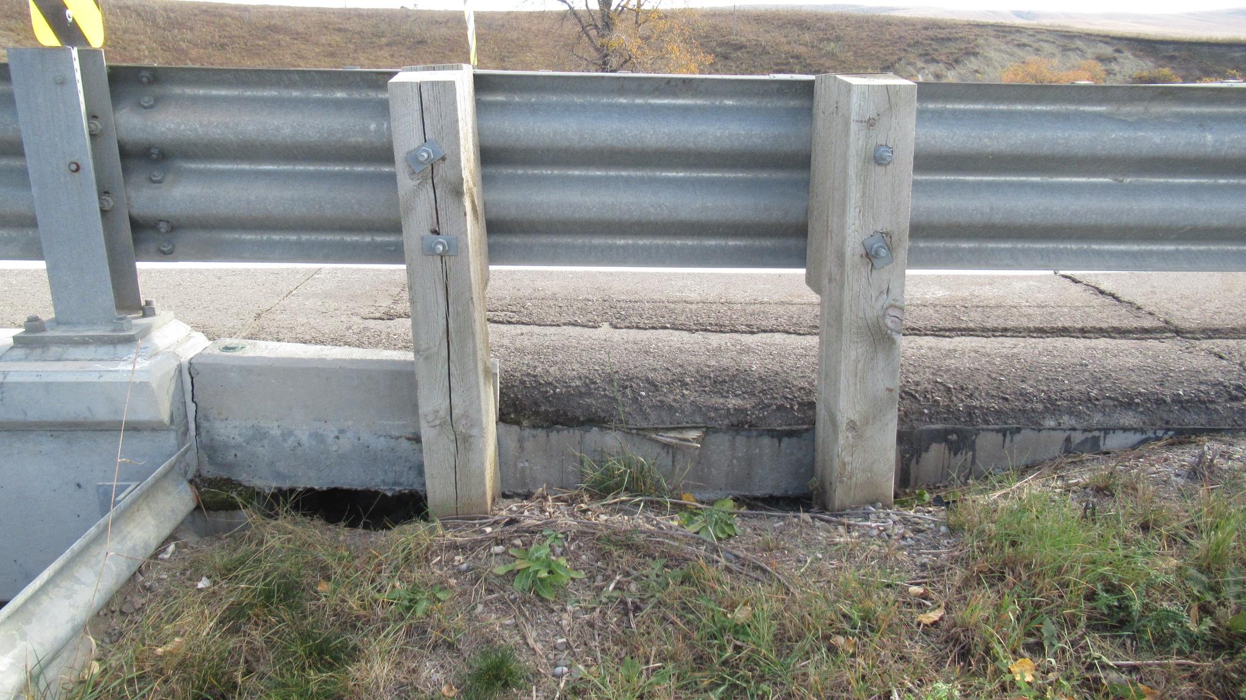

Slide 50
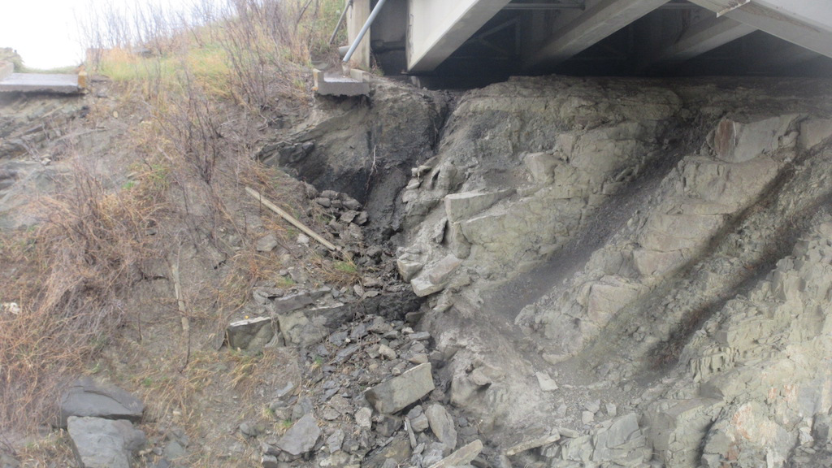

Slide 51
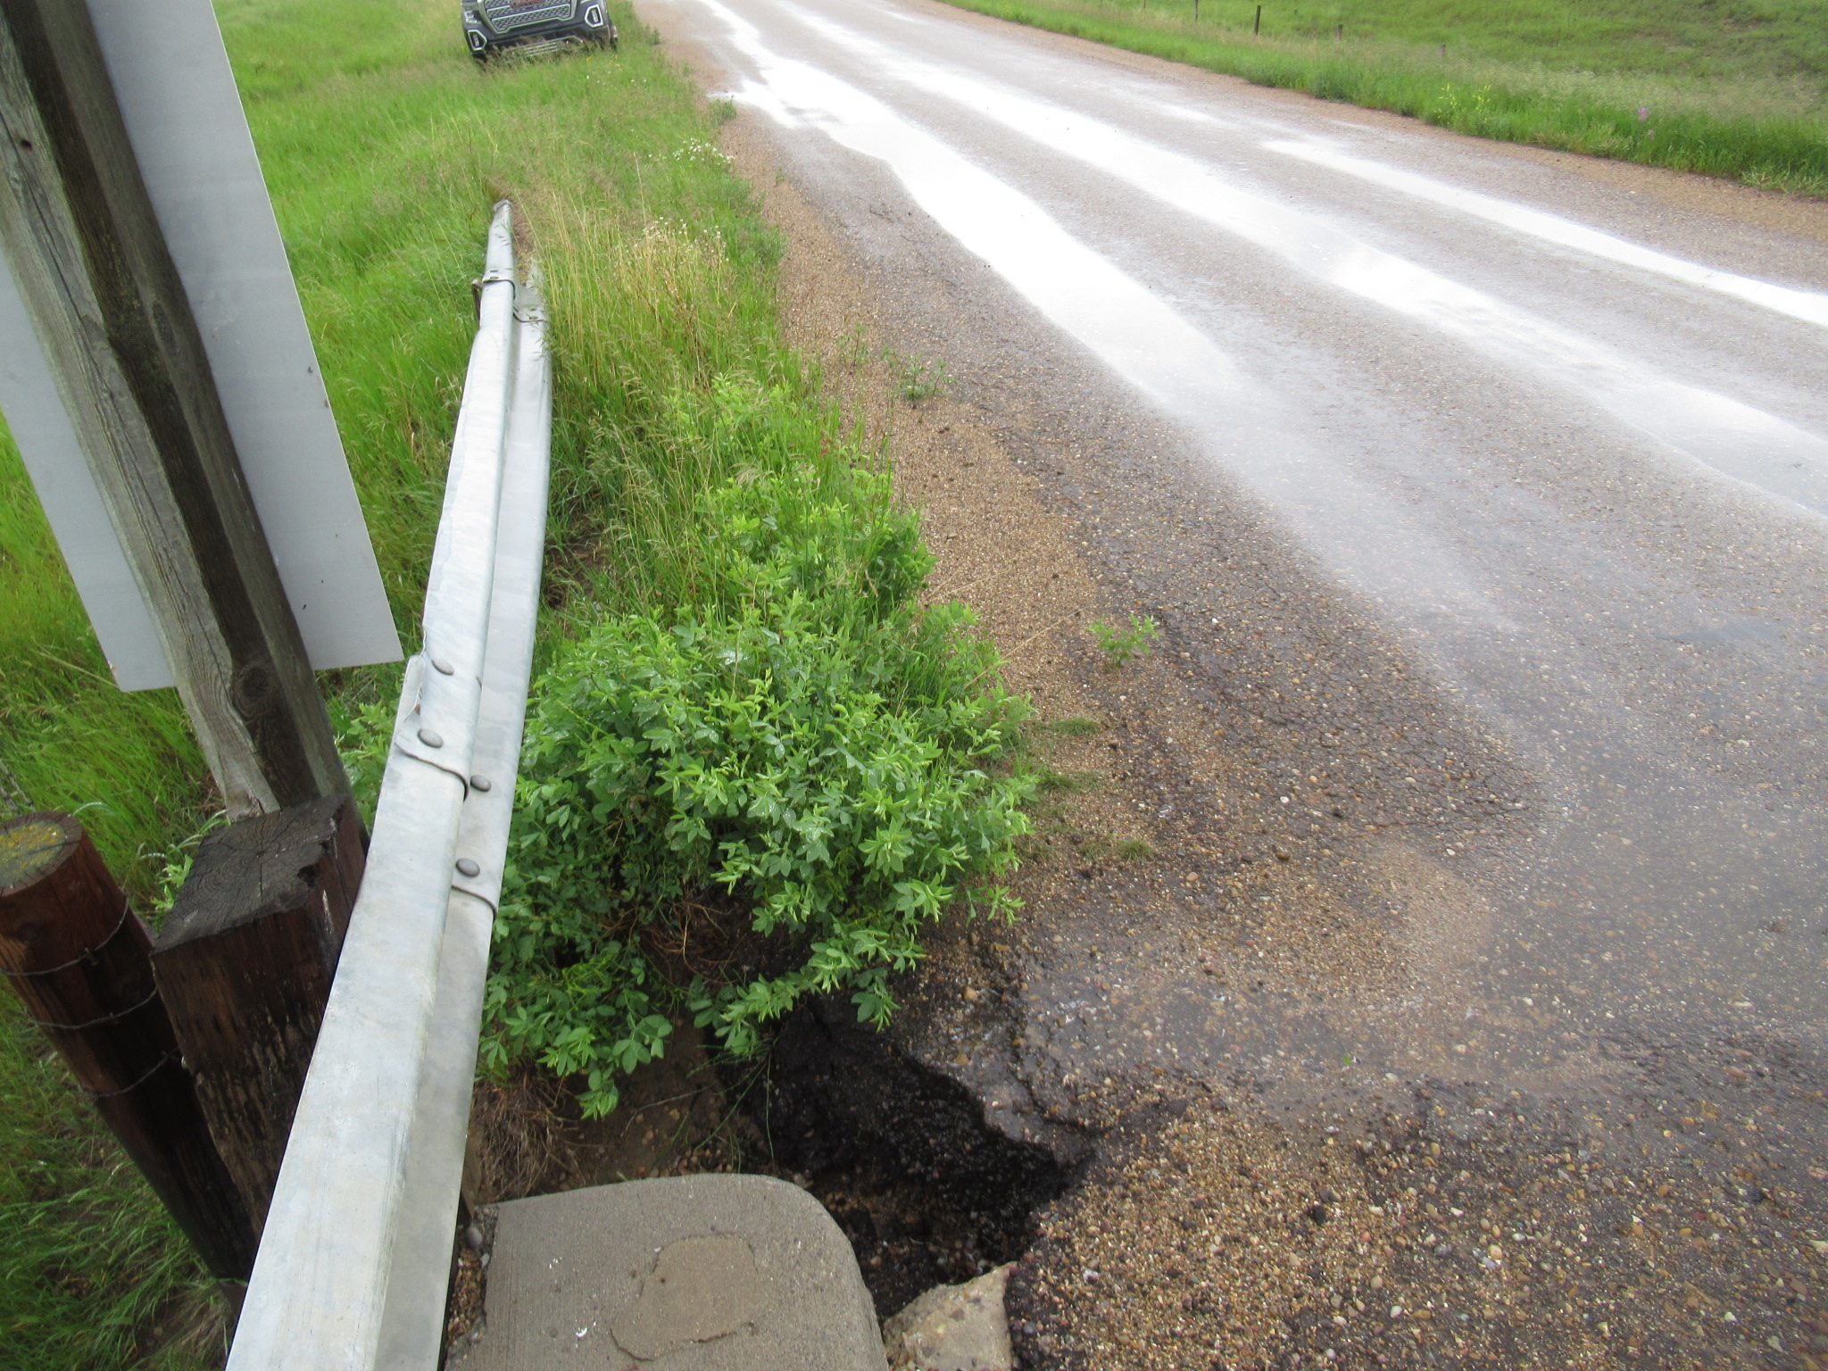

Slide 52
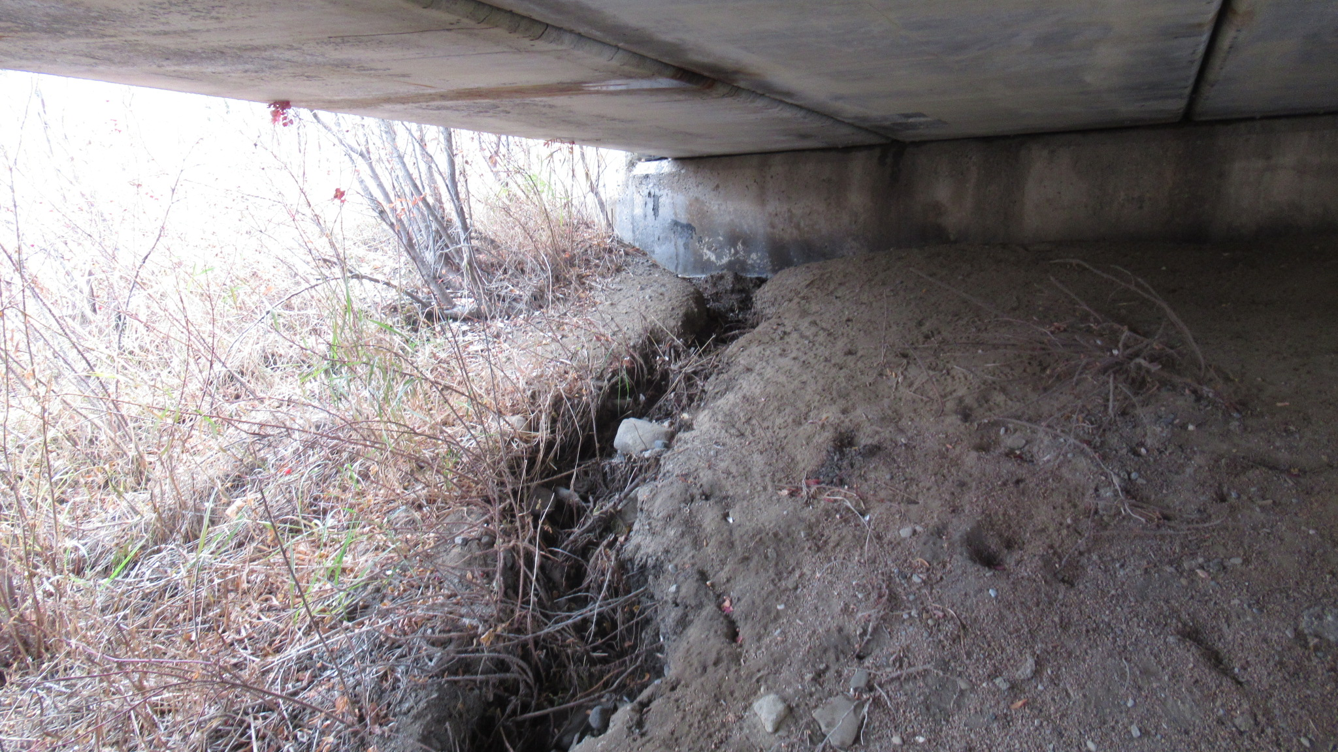

Slide 53
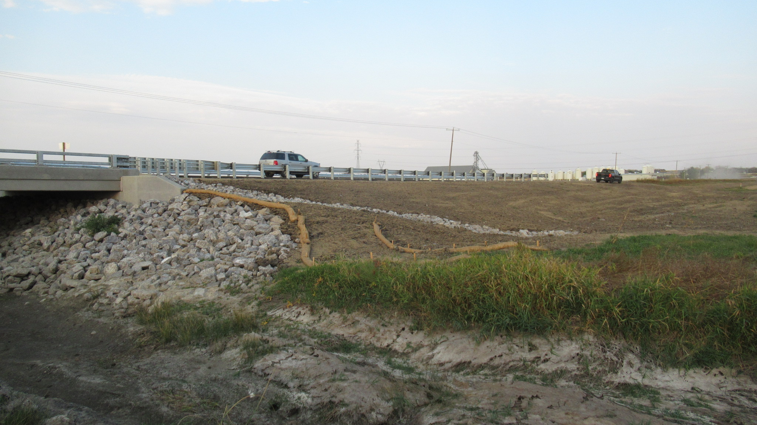

Slide 54
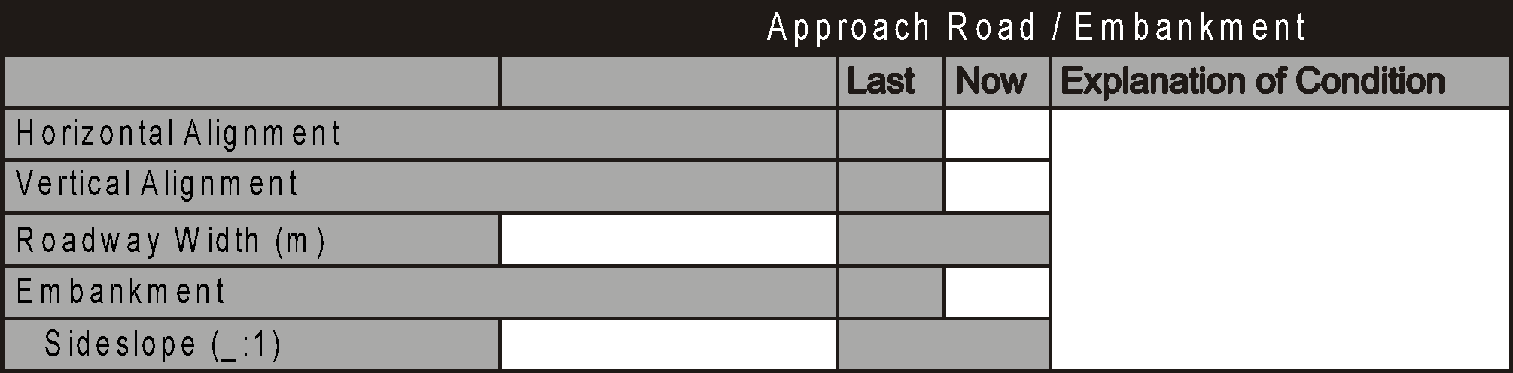
Embankment
Applies to culverts only
Rates the stability of the road embankment at the culvert and the effects on:
  traffic
  structural and functional integrity of the culvert
Evaluates:
  roadway surface
  Side slopes
  transitions at ends of culvert

Slide 55
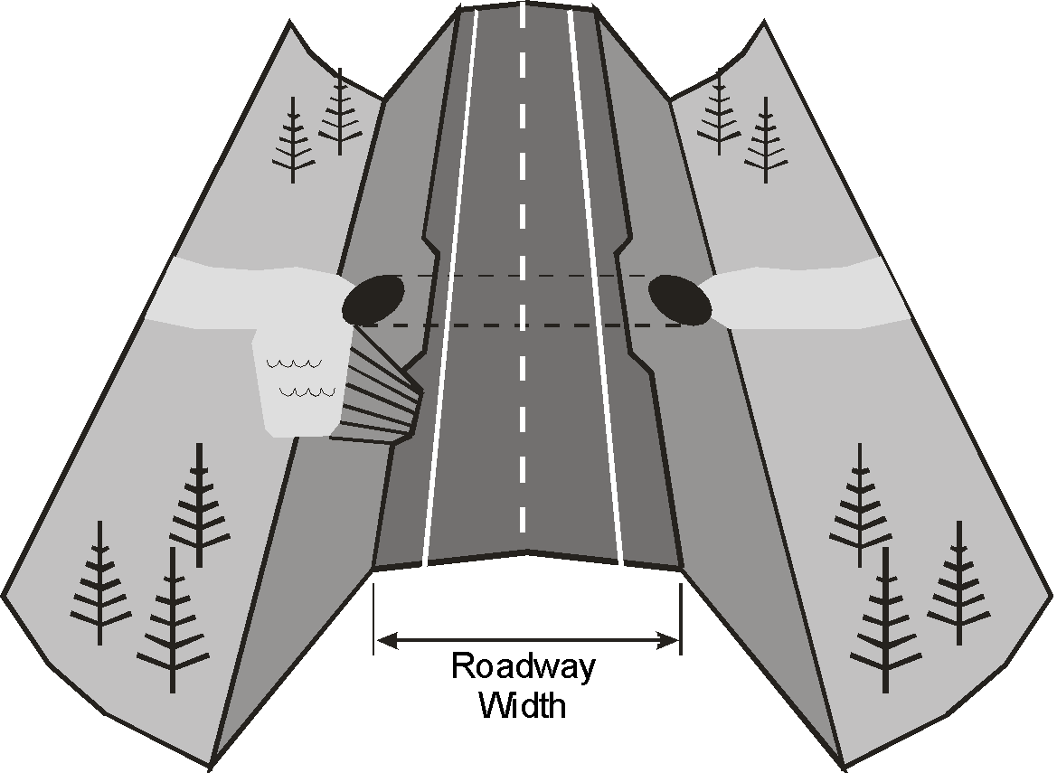
Embankment – Culvert Approach Road

Slide 56
Embankment
Refers to Culvert Approach Roads
Look for:
  cracks or other evidence of instability
  signs of erosion such as gullying on sideslopes
  scour at toes of sideslopes or end transitions
Embankments with no instability or scour/erosion - rate 7 or better
Embankments with erosion problems - rate 4 or less
Unstable embankments causing damage to the culvert - rate 3 or less
Unstable embankments affecting roadway - rate 3 or less

Slide 57
Sideslopes
Not rated
Estimate or measure the slope of the sideslope (h:v)
Record steeper of upstream or downstream sideslope
If berms or different slopes on the same side, record steepest slope
  Do not record average slope
Explain if sideslopes are irregular
  varying slopes
  benches or berms
  different slopes on each sideslope

Slide 58
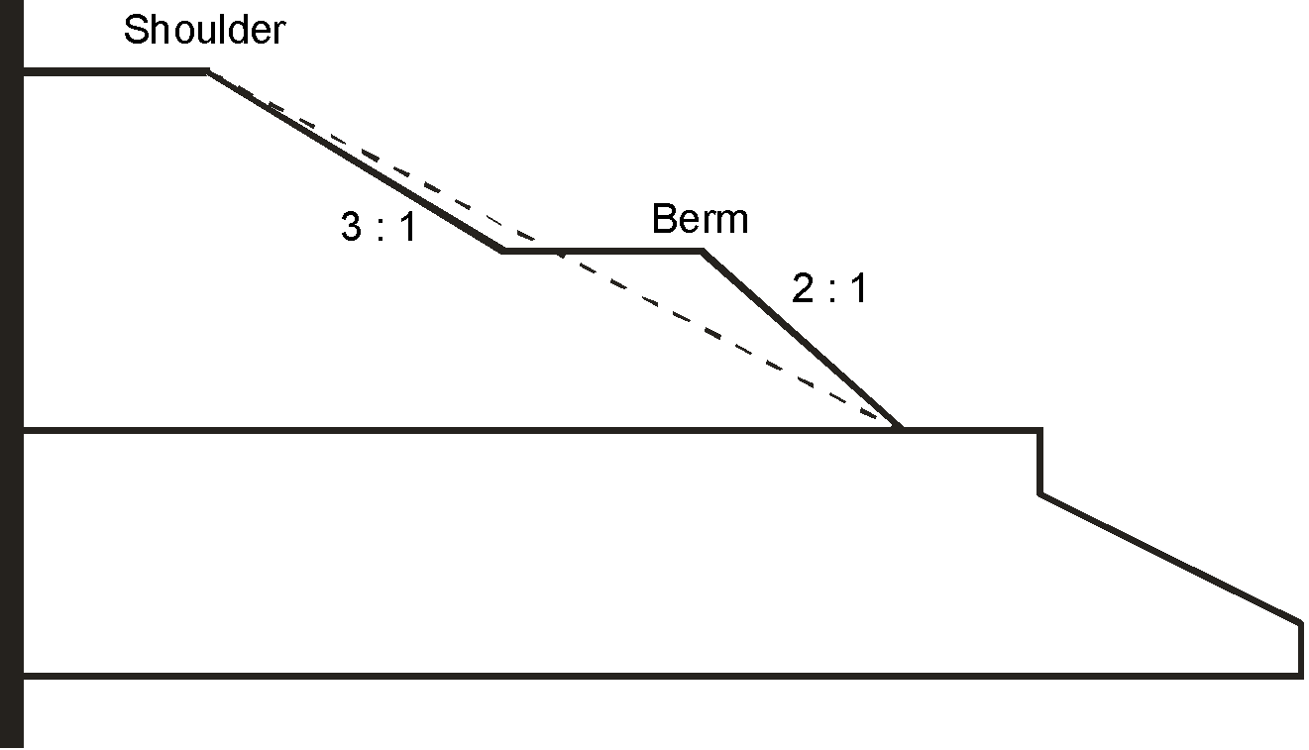
Sideslopes

Slide 59
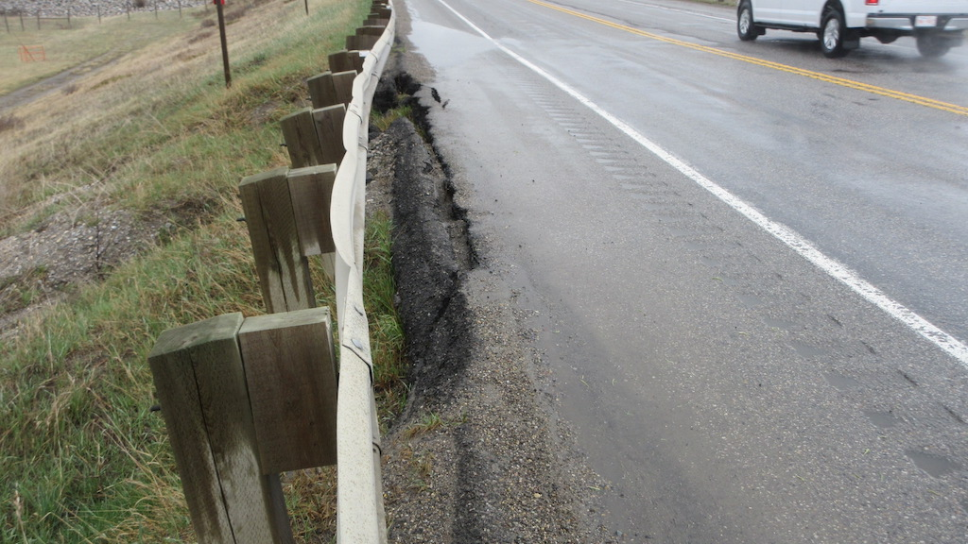

Slide 60
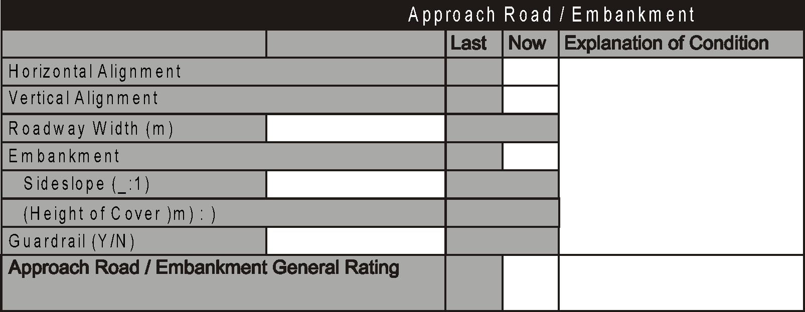
Height of Cover
Inventory item (grey box on form). Provide HOC if blank, revise if incorrect.
The vertical distance between top of roadway at centerline and top of the culvert at the upstream end
Need to be accurate, especially for low covers
  Live load effects are greater
Record to the nearest 0.1m

Slide 61
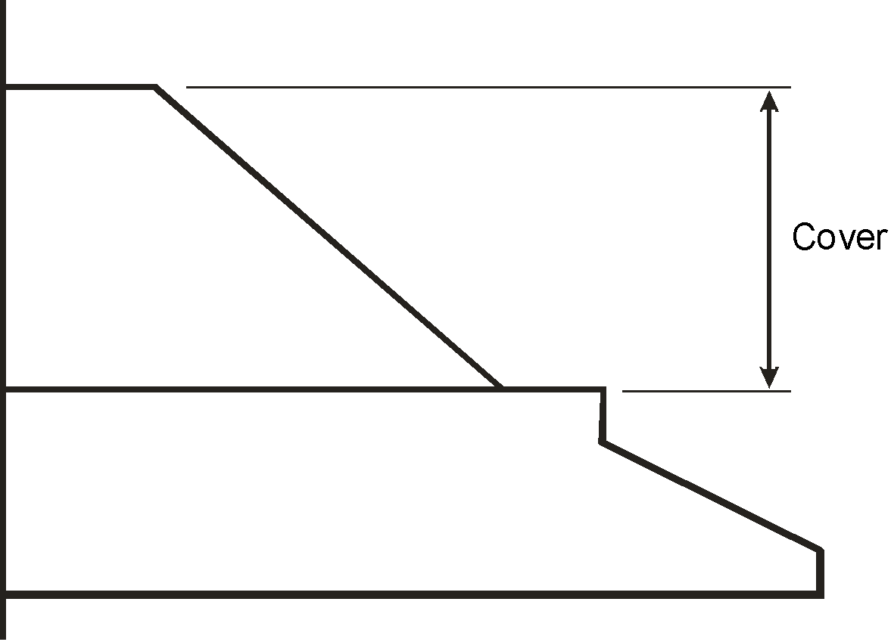
Height of Cover
Top of Road
Top of Roof at U/S
Flow

Slide 62
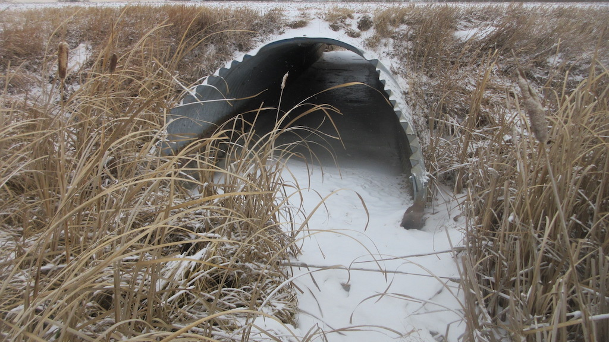

Slide 63
General Rating
Refer to 1.10. 1 and 6.8 (Bridges)
Refer to 1.10.6 and 13.4.6 (Culverts)
Governing Elements
  Horizontal alignment
  Vertical alignment
  Safety Concerns (severe approach bump)
  Potential hazards (Drainage causing ponding/icing
  Embankment rating of 3 or less (Culverts)
  Guardrail that is damaged resulting in a hazard (i.e. missing sections)
No approach rails but hazardous governs the General Rating (rate 2)
Horizontal and Vertical alignment rated X – General rating is 5

Slide 64

Questions?

