Slide 1
BRIDGE LOADING AND RATING

Slide 2
LOADS

Slide 3
Types of Loads
Bridges are subjected to many different types of loads.
There are three important types of bridge loads:
Dead load
Live load
Other loads (wind, snow etc.)

Slide 4
Dead Load
Dead load consists of the self-weight of the bridge.
The load is usually stationary and permanent.
Typical dead loads are:
Beams and girders
Concrete deck
Asphalt wearing surface
Curbs
Railing

Slide 5
Live Load
Live loads are usually temporary and are applied in a short duration of time.
The loads are usually moving.
Typical types of live loads are:
Truck load
Dynamic load allowance (impact)
Pedestrian load
Longitudinal live load

Slide 6
Other Loads
The bridge is subjected to other loads beside dead and live load.
Other typical bridge loads are:
Wind load
Earth pressure
Ice pressure
Temperature effects
Collision loads

Slide 7
Rating Bridges
Many older bridges were designed to carry smaller and lighter trucks.
Are these older bridges capable of carrying today’s heavier and longer legal truck configurations?
Bridges are rated to determine the load carrying capacity of the bridge.
Generally, only the superstructure is load rated.
The ratings normally assume that the bridge is in good structural condition.

Slide 8
Real Truck Configurations
There are many truck configurations that can legally travel on Alberta roads.
The truck configurations are grouped into three categories:
Single unit trucks
Tractor semi-trailers
Truck trains
Within each of the categories there are many different weights and axle configurations.

Slide 9
Typical Legal Single Unit Trucks
22.5 tonnes
5.5 t
8.5 t
8.5 t
3.0
1.2
29.2 tonnes
6.1 t
6.1 t
8.5 t
8.5 t
1.0
5.0
1.2

Slide 10
Typical Legal Tractor Semi-Trailer Units
39.5 tonnes
5.5 t
8.5 t
8.5 t
8.5 t
8.5 t
3.0
1.2
5.0
1.2
46.5 tonnes
5.5 t
8.5 t
8.5 t
8.0 t
8.0 t
8.0 t
3.0
1.2
5.5
1.8
1.8
50.4 tonnes
7.3 t
8.5 t
8.5 t
9.1 t
8.5 t
8.5 t
3.5
1.2
3.5
3.5
1.2

Slide 11
Typical Legal Truck Trains
56.5 tonnes
5.5 t
8.5 t
8.5 t
8.5 t
8.5 t
8.5 t
3.0
1.2
5.0
1.2
5.0
1.2
8.5 t
60.5 tonnes
5.5 t
8.5 t
8.5 t
8.5 t
8.5 t
6.0 t
7.5 t
7.5 t
3.0
1.2
5.1
1.2
2.5
5.9
1.2
63.5 tonnes
5.5 t
8.5 t
8.5 t
8.0 t
8.0 t
8.0 t
8.5 t
8.5 t
3.0
1.2
5.5
1.5
1.5
5.5
1.2

Slide 12
Rating Truck Models
Each one of the trucks produces unique forces and stresses in the bridge.
It is not practical to load rate the bridge for each one of the real truck configurations.
A model truck is used to represent each one of the truck configuration categories.
CS1 Rating Truck Model - Single unit trucks
CS2 Rating Truck Model - Tractor semi-trailer
CS3 Rating Truck Model - Truck trains

Slide 13
Rating Truck Models
CS1 Rating Truck Model
28 tonnes
7.0 t
21.0 t
4.0
CS2 Rating Truck Model
49 tonnes
7.0 t
21.0 t
21.0 t
4.0
6.0
CS3 Rating Truck Model
63.5 tonnes for Primary & Secondary
Highways
63.5 tonnes for Local Roads (Bulletin 8, 2021)
6.1 t
18.8 t
18.8 t
18.8 t
4.0
6.0
6.0

Slide 14
Load Rating a Bridge
Step 1
calculate load carrying capacity of critical member
Step 2
calculate Dead Load this member is required to carry
Step 3
member capacity less Dead Load, etc. is Live Load that the member can carry

Slide 15
Rating Equation
Rating Equation
Where:
LLCF = Live Load Capacity Factor (fraction of rating truck the bridge can safely carry for the load effect considered)
R = Resistance, load effect the bridge can safely carry
D = Dead load effect of the bridge
L = Live load effect due to the rating truck model
I_{D} = Impact (dynamic) factor for live load
R - D
LLCF
=
L (1 + I_{D})
Notes:
Load effect (Moment and Shear)
Multiple LLCFs in calculation
Critical one (lowest) is what is reported, and included in BIS/Inspection Reports for each truck configuration CS1 CS2 CS3
ULS not SLS

Slide 16
Rating Equation (cont’d)
Live Load Capacity Factor (LLCF) is calculated for each rating truck model.
A LLCF of 1.0 or greater indicates that the bridge is capable of safely carrying the current legal load for the particular truck category.

Slide 17
Legal Loads on Alberta Roadways
Truck Type | Provincial Highways | Local Roads
Single (CS1) | 28 | 28
Semi (CS2) | 49 | 49
Truck Train (CS3) | 63.5 | 63.5 (2021/previously 54)
Note: Loads are expressed in tonnes

Slide 18
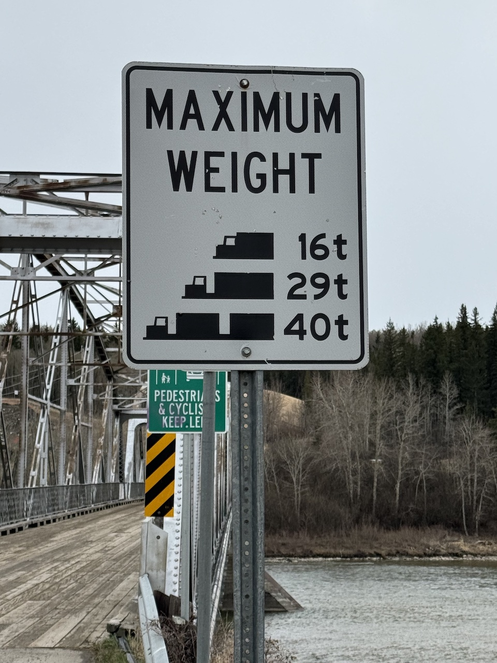

Slide 19
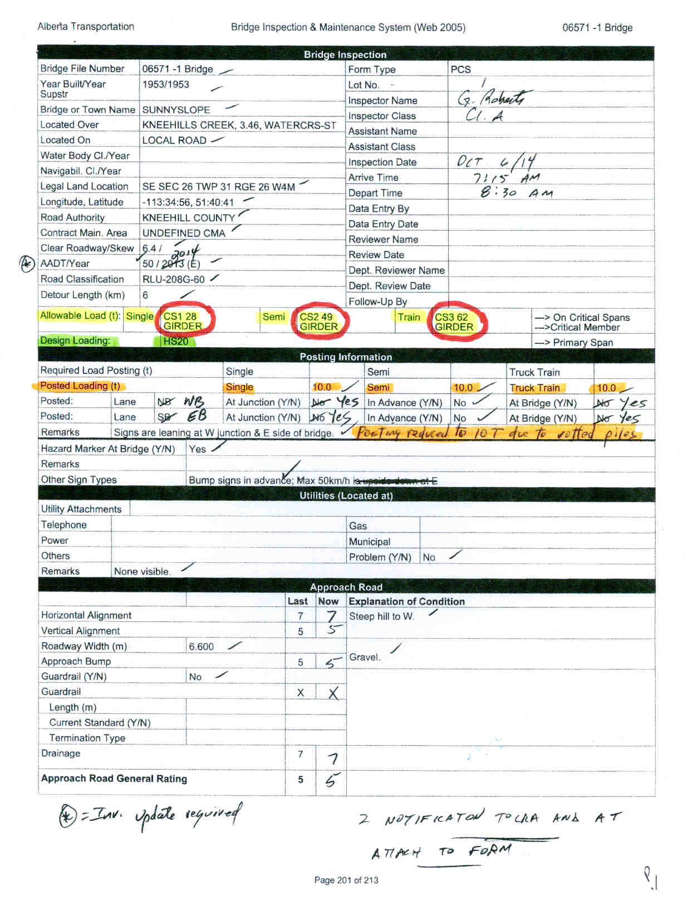

Slide 20
Bridge Load Evaluation Manual”
For further information refer to
Alberta Transportation “Bridge Load Evaluation Manual” at:
https://open.alberta.ca/publications/7027044

Slide 21
Questions?

