Slide 1
INSPECTION FORM COMPLETION

Slide 2
Verifying and Updating Inventory Data
Inventory data is usually found in grey boxes on forms
Inspector is responsible for obtaining, verifying and updating inventory data during inspection
Check off each inventory item to indicate it was verified
If item cannot be confirmed/verified do not check off – make comment why
Not necessary to change data if measurement is only slightly different
Inventory changes are made directly on the inspection form

Slide 3
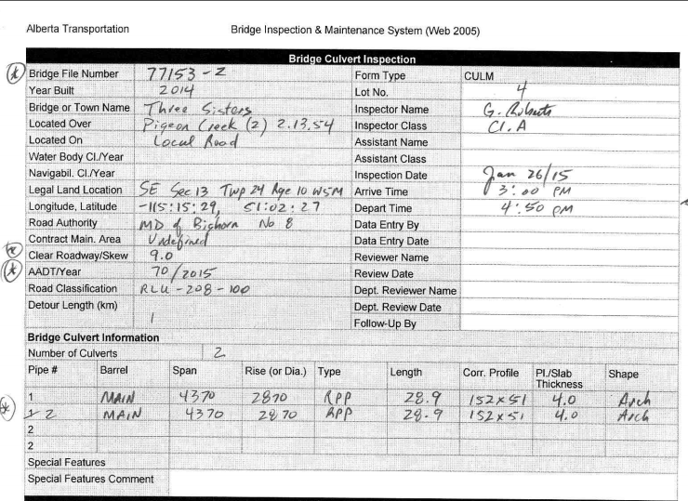
Verifying and Updating Inventory Data
Inventory changes/revisions made directly in the grey fields on the inspection form

Slide 4
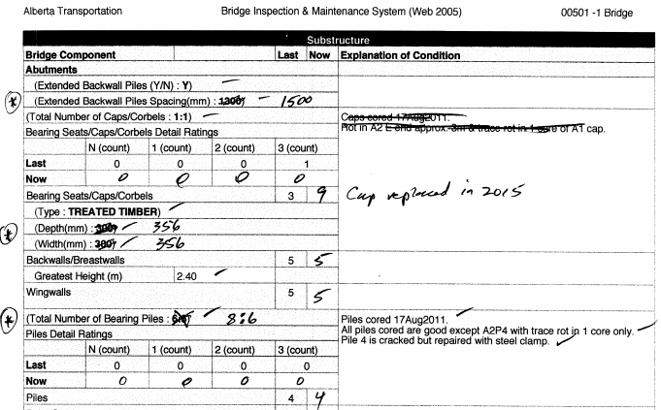
Verifying and Updating Inventory Data
Inventory changes are made directly on the inspection form

Slide 5
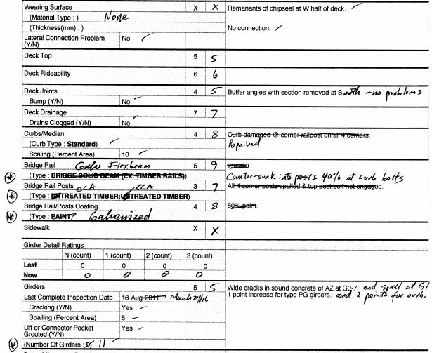
Verifying and Updating Inventory Data
Inventory changes are made directly on the inspection form

Slide 6
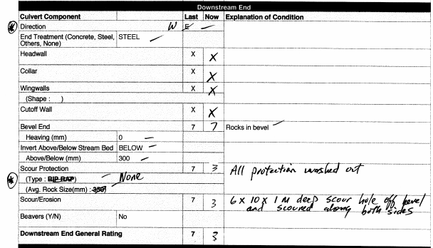
Verifying and Updating Inventory Data
Inventory changes are made directly on the inspection form

Slide 7
Verifying and Updating Inventory Data
Culvert design dimensions are shown on first page of culvert form
SPCSP equivalent round should be changed to correct dimensions (e.g. form indicated pipe is round but is clearly 5% vertical ellipse)
Used to determine sagging and deflecting measurements
If culvert is not deformed, excessive sag and deflection measurements may indicate wrong design dimensions on the form
  Take measurements at ends of pipe where typically least deformed from design shape
  Use average of U/S and D/S measurements to determine design shape

Slide 8
Verifying and Updating Inventory Data
Incorrect Inventory data is changed by inspector by crossing out incorrect previously recorded value and writing in new information
Update and verify Inventory data directly on the form
Record data only in values that box is asking for (mm, m, %, Y/N)
Minor changes to things like roadway width are not required

Slide 9
Supporting Information
Use ONLY approved abbreviations found in BIM manual Section 16.1 when making comments
Ratings of 4 must have supporting comment (explanation of condition) and supporting photograph
Ratings of 3 or less must have 3 things;
  Supporting comment
  Supporting photograph
  Recommendation for action
Critical or Hazardous ratings of 2 or less require Low Rating Notification sent out to authorities
Action may be in the form of:
  Maintenance recommendations
  Monitoring on regular inspection cycle
  Monitoring on a shorter inspection cycle if warranted
  Don’t overuse monitoring – must be measurable
Photographs, quantities, measurements and/or sketches are provided for ratings of 3 or less or any maintenance recommendation regardless of rating
Page 8

Slide 10
BIM Y/N Inventory Questions
Explanation of condition is required when answering YES for certain areas
Exceptions for Class B inspector are
  approach guardrail meeting standards
  Longitudinal seams with proper lap
  Longitudinal seam stagger (ok to comment “1N
  or “2N stagger”)
if NO, provide comments explaining why
Page 9

Slide 11
Significant Changes From Previous Rating
Ratings of most elements do not change significantly over an inspection cycle
Provide an explanation of condition and a photograph if rating has changed significantly
Required even if rating is 5 or more
For example:
  treated timber piles rated 8, then 21 months later piles rated 5 - why the drastic change?

Slide 12
Significant Changes From Previous Rating
Sometimes normal for elements to change significantly over an inspection cycle
For example:
  Timber strip deck rated 8 and 57 months later, rating reduced to 4
  Scour protection rated 7 and after flood reduced to 3
Page 11

Slide 13
Measurement Based Ratings
Record the actual measured values in space provided or if space not provided, record in Explanation of Condition
  e.g. culvert Rise, Span, Sag/mm, %Deflection, in boxes provided
Record the location of any measurements of defects in space provided or if space not provided, record in the Explanation of Condition
  250 x 400 spall in A1 abutment seat under G3
  wide longitudinal crack in unsound concrete of Sp1-G3 AZ in 1 leg.

Slide 14
Previous Comments
Comments from previous inspection which no longer apply must be deleted
Carry over previous comments if information adds value but cannot be confirmed or denied
  place brackets around comment and add date the comment originated – if unknown use last inspection date. (e,g, deck ices in WBL, May 3/23)
If element cannot be seen or is not accessible to confirm comments or data
  Do not check mark data (don’t confirm)
  Explain why inaccessible or not visible (e.g. snow covered)
  Retain comment in brackets. Add date comment originated - if known

Slide 15
Previous Comments
Types of information retained:
  measurements that cannot be verified
  previous high water marks
  information recorded during particular weather conditions
  information recorded during particular season

Slide 16
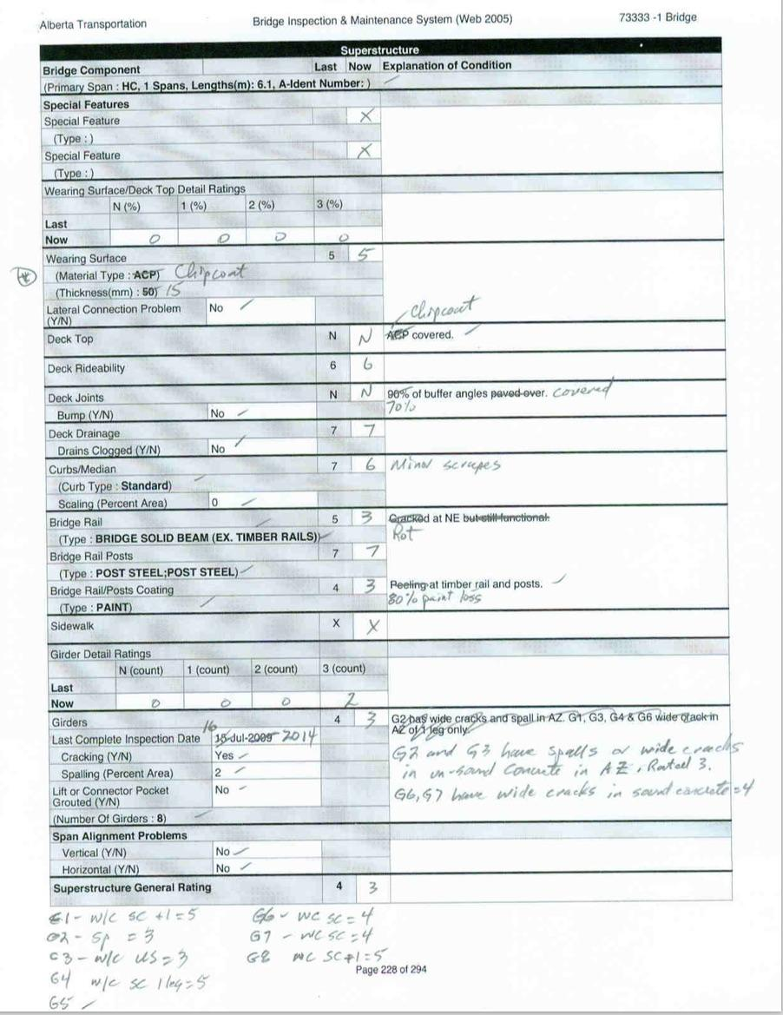
Sample Completed Form

Slide 17
Photographs and / or Sketches
Refer to Section 1.12.7 in BIM Manual for additional important information
Excellent means of providing supporting information
Photograph required for all ratings of 4 or less
Required for all maintenance recommendations regardless of rating
Required for inaccessible culvert barrels
Not acceptable to say “see photo” on form

Slide 18
Photographs
5 standard photos typically required for a bridge;
  Road alignment approaching bridge from both directions (2 photos)
  Profile – normally U/S
  Channel alignment looking U/S
  Channel alignment looking D/S

Slide 19
Photographs
7 standard photos typically required for a culvert;
  Road alignment approaching culvert from both directions (2 photos)
  Channel alignment looking U/S
  Channel alignment looking D/S
  Looking D/S towards inlet area (U/S profile)
  Looking D/S through the barrel
  Looking U/S through the barrel

Slide 20
Photographs
Submit color photos with inspection form to AT Review & Data Entry consultant
Taken with a minimum 10 megapixels camera
Two photos per page (3 ½ x 5 or 4 x 6) with descriptive text, inspector and stream name, date, BF# , Page #.
Submit electronic copies of photos with inspection reports in pdf file with min. 300 dpi and unlocked for copying in following format;
- BF12345-01_LVL1_YYYYMMDD_P.pdf
Also submit one hard copy of all photos – double sided is ok

Slide 21
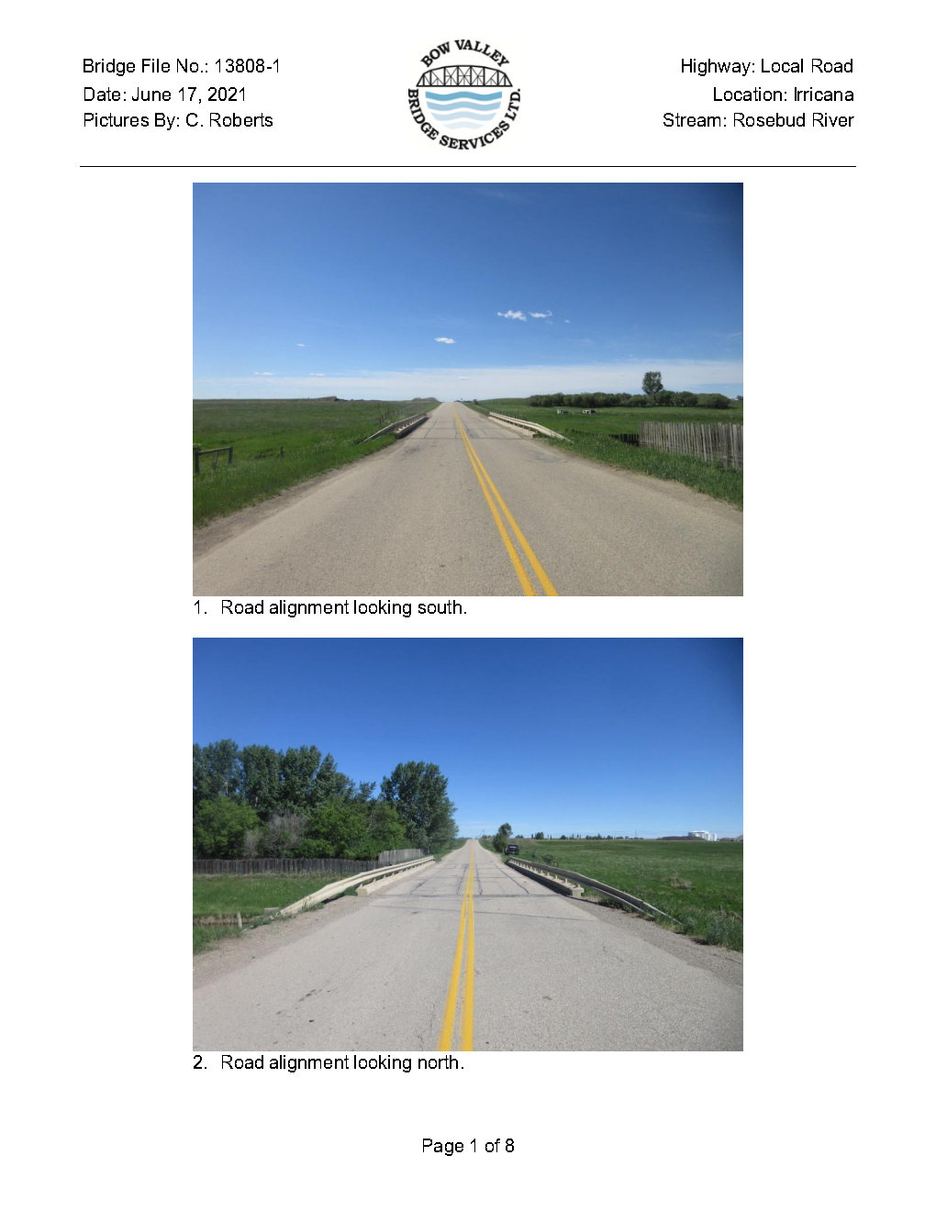
Standard Bridge - Photographs and Sketches
BF13808-01_LVL1_20210617_P

Slide 22
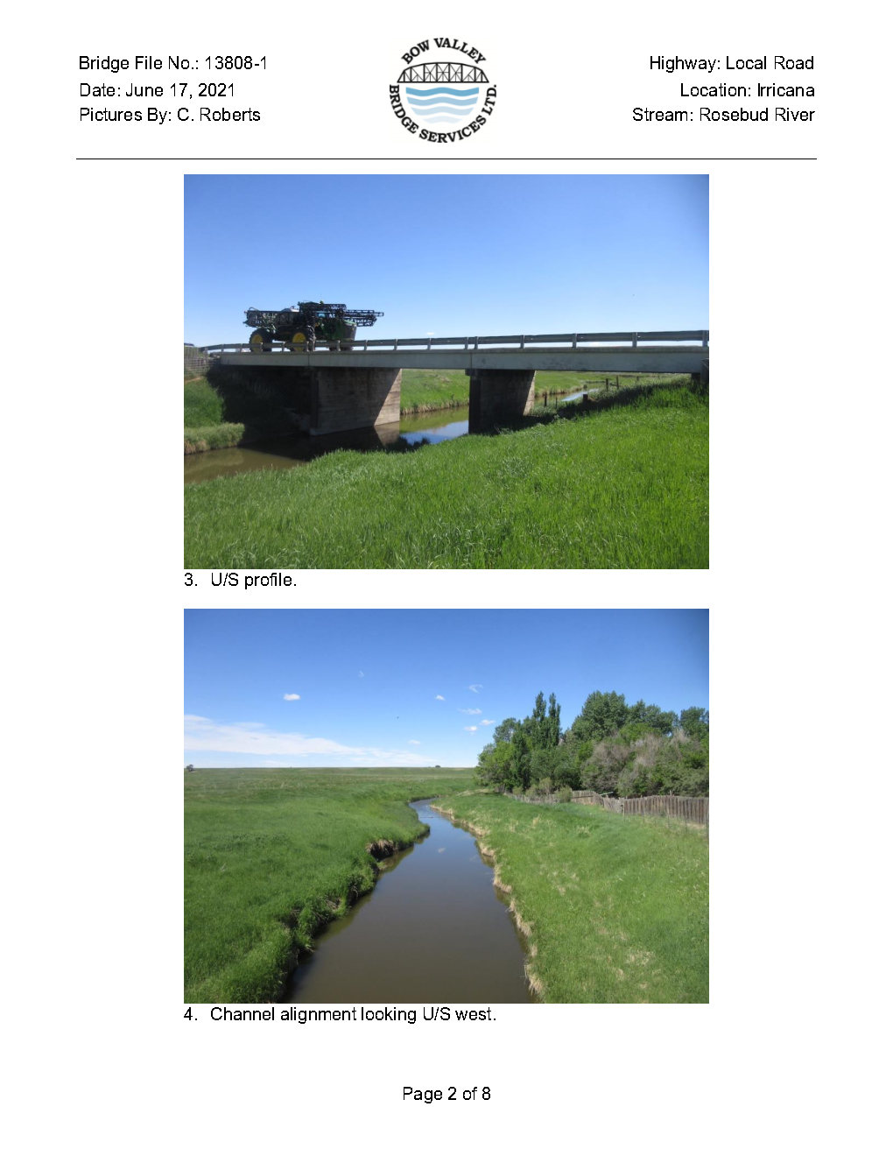
Standard Bridge - Photographs and Sketches
BF13808-01_LVL1_20210617_P

Slide 23
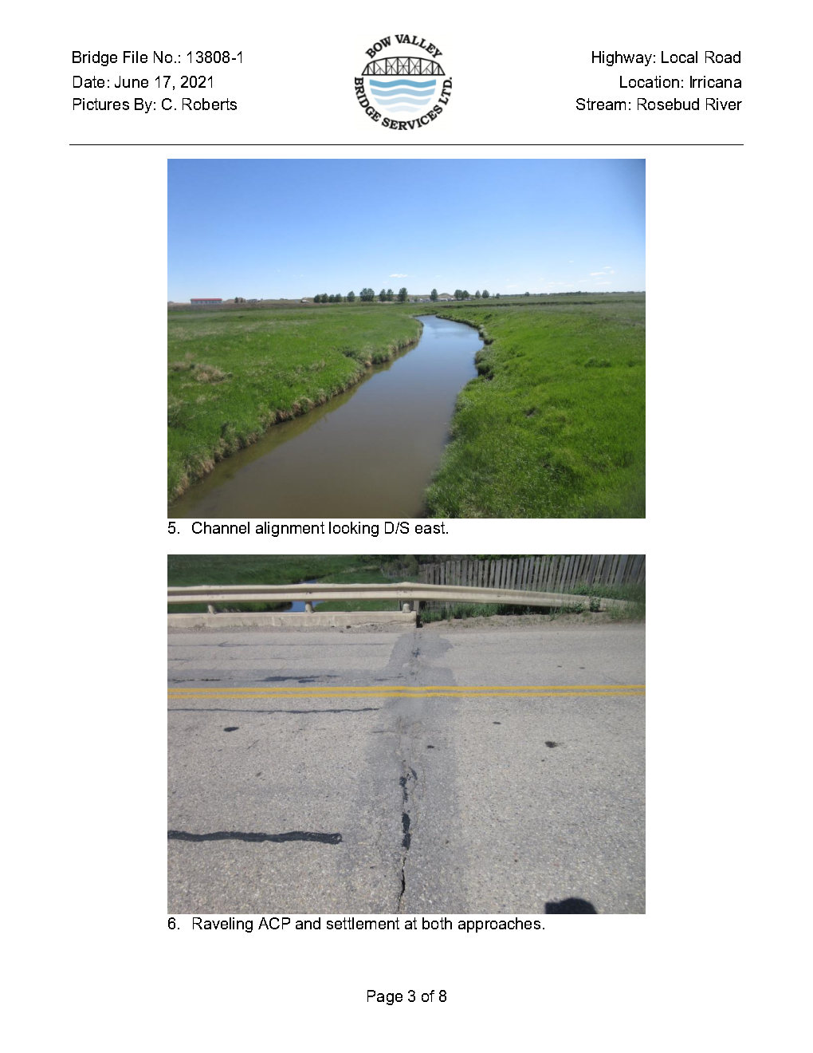
Standard Bridge - Photographs and Sketches
BF13808-01_LVL1_20210617_P

Slide 24
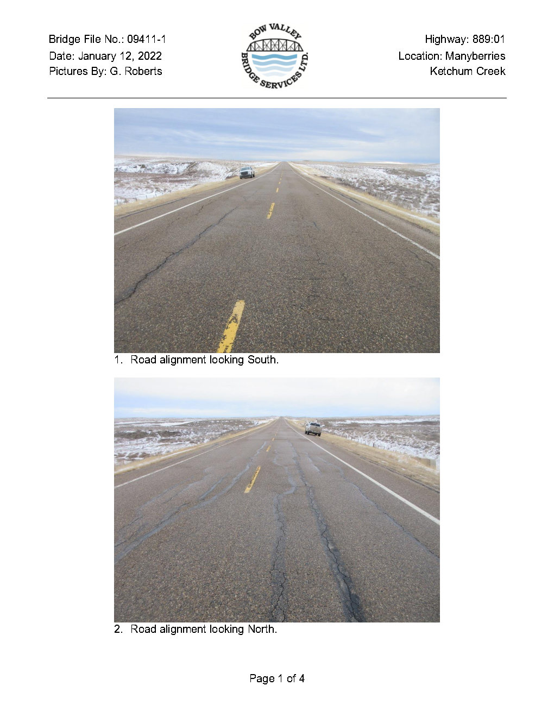
Typical Culvert - Photographs and Sketches
BF09411-01_LVL1_20220112_P

Slide 25
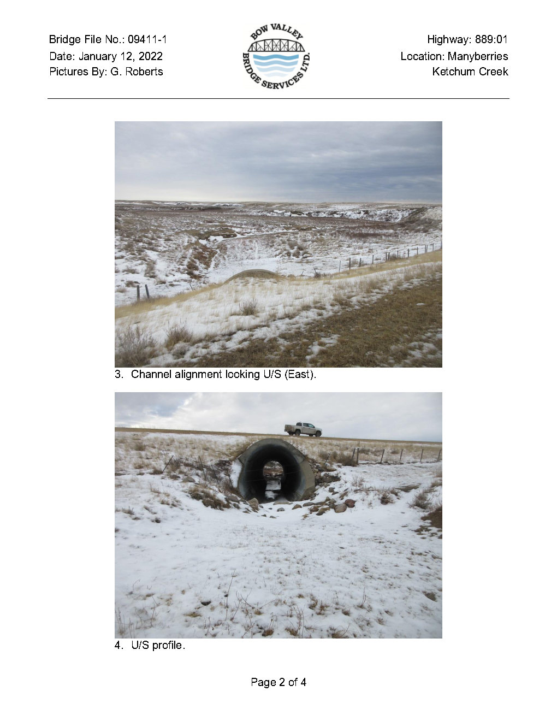
Typical Culvert - Photographs and Sketches
BF09411-01_LVL1_20220112_P

Slide 26
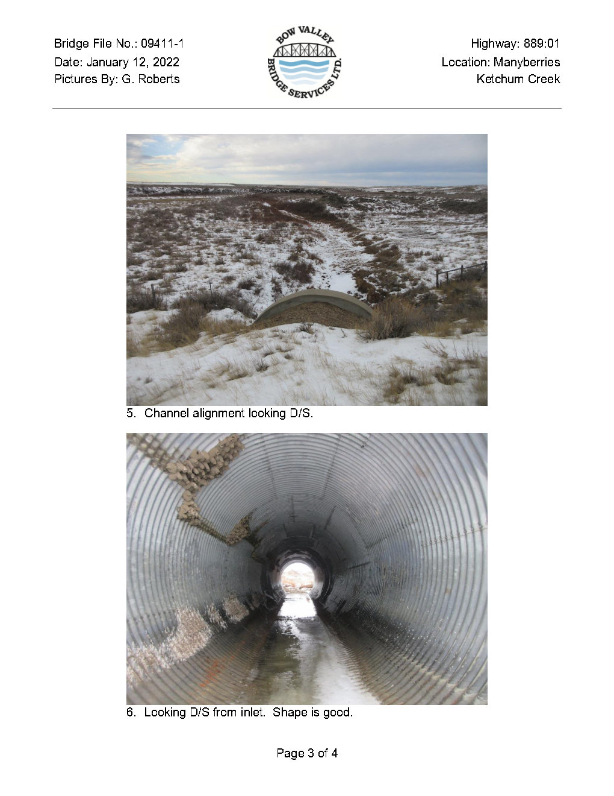
Typical Culvert - Photographs and Sketches
BF09411-01_LVL1_20220112_P

Slide 27
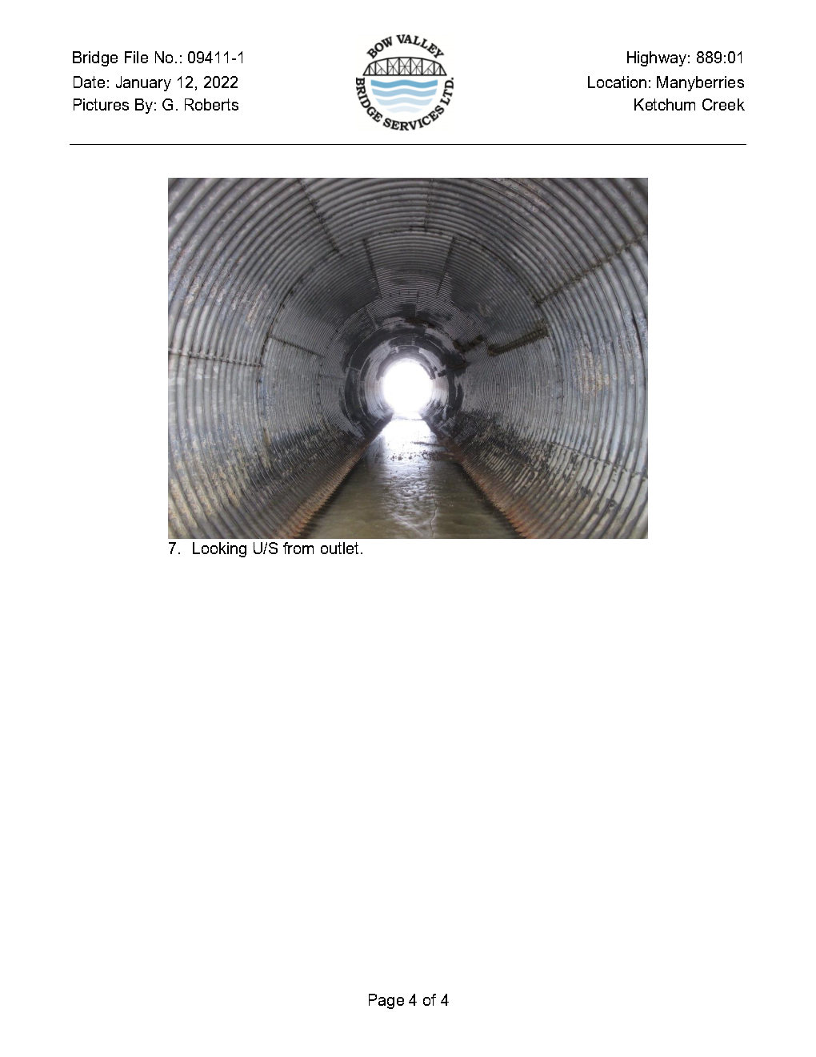
Typical Culvert - Photographs and Sketches
BF09411-01_LVL1_20220112_P

Slide 28
Estimating Quantities
Inspectors are to record actual or estimated quantities for recommended repairs and maintenance
Record in Maintenance Inspector Comments (expandable). Use separate sheet only if necessary
Use pre-prepared Maintenance Work Types (Table 11.1). Avoid “Other Action” – use only as last resort when prepared work types are not suitable
Examples:
  PLACE ADDITIONAL RIPRAP - 3m³ Class 1 rock at D/S end
  PATCH DECK - 5 timber stripdeck planks, each 75x300x 3 m long

Slide 29
Inspection Check
  4 ratings are supported by
    Comment
    photo
  3 or less ratings supported by
    comment
    photo
    recommendation for maintenance, monitoring. other appropriate action
  inventory information verified or changed
  maintenance recommendations are appropriate and supported with material dimensions and quantities.
  only approved abbreviations used
Inspector should do the following checks before leaving the site:
  all ratings have been entered
    element condition ratings entered
    General Rating entered
    Estimated Replacement Year
  condition ratings consistent with BIM manual

Slide 30
Inspection Checks
Additional follow-up:
  Low Rating Notifications sent to Regional Bridge Manager and Bridge Preservation Specialist within 48 hours of inspection.
    Photos with descriptive text mounted in a template are to be included with all notifications.
    If structure on a local road, then notification sent to LRA only.
  Answer questions raised during the inspection
  Review previous inspection history in BIS
  Review standard or site-specific drawings
  Review for appropriate maintenance, monitoring and timing
  Load restrictions and other signing
  Prepare photos in standard format with descriptive comments

Slide 31
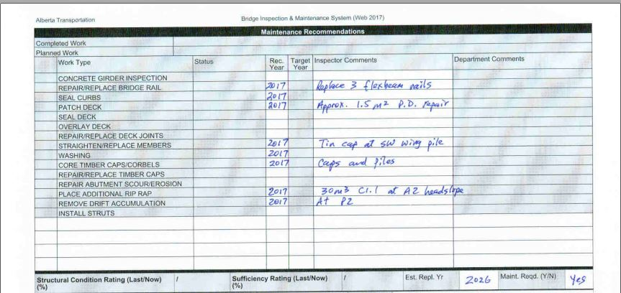
Bridge Maintenance Recommendations
Use ONLY pre-prepared Work Type recommendations selected from Table 11.1
Use “Other Action” only if pre-prepared maintenance Work Type item is not suitable
Record “Recommended Year” based on priority levels associated with ratings
Provide specific comments, material sizes and quantities in “Inspector Comments” area

Slide 32
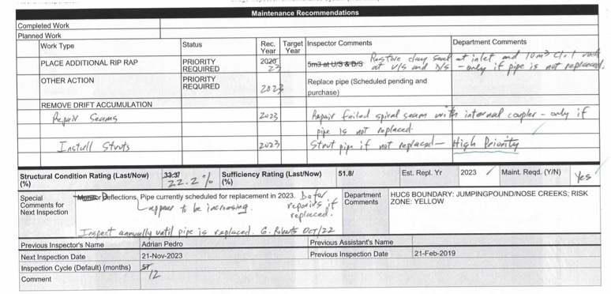
Culvert Maintenance Recommendations
Use ONLY pre-prepared Work Type recommendations selected from Table 11.1
Use “Other Action” only if pre-prepared maintenance Work Type item is not suitable
Record “Recommended Year” based on priority levels associated with ratings
Provide specific comments, material sizes and quantities in “Inspector Comments” area

Slide 33
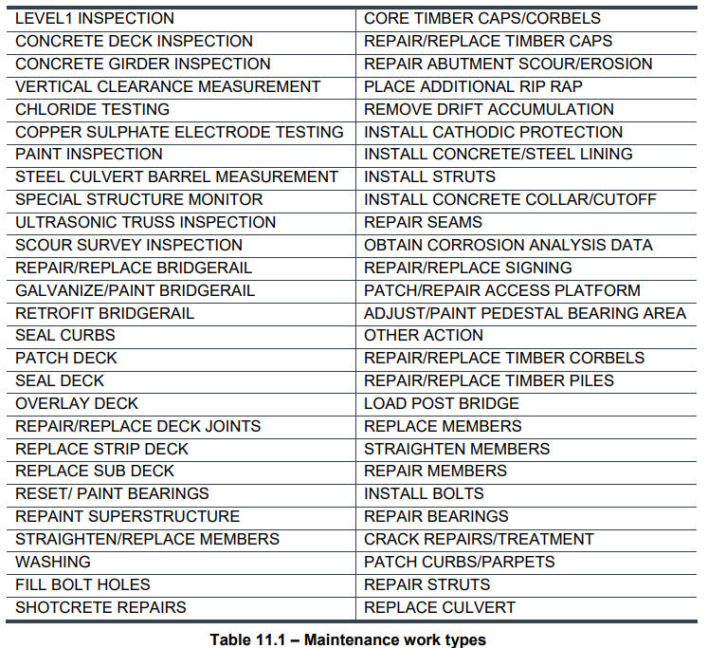
Table 11.1 – Maintenance Work Types

Slide 34
Level II Inspections
Detailed inspection requiring specialized equipment and/or expertise
Gathers specific measurements or observations
Recommended by Level I inspectors
Reviewed and approved by Bridge Manager or LRA
Do not proceed until Bridge Manager or LRA has been contacted regarding:
  technical need
  funding

Slide 35
Timber Coring
Recommended when there is suspicion of rot in structural timber
Conducted by Class A inspector
Focus normally on critical structural elements:
  caps
  piles
  stringers

Slide 36
Level 2 - Culvert Barrel Measurement
Recommended when critical barrel elements rated 3 or less and safety concerns identified
  roof rating
  sidewall rating
  longitudinal seam rating
Recommended when two consecutive inspections completed without access to barrel section
  or
  schedule Level I inspection during low flow or winter conditions
Some culverts barrels are inaccessible year round

Slide 37
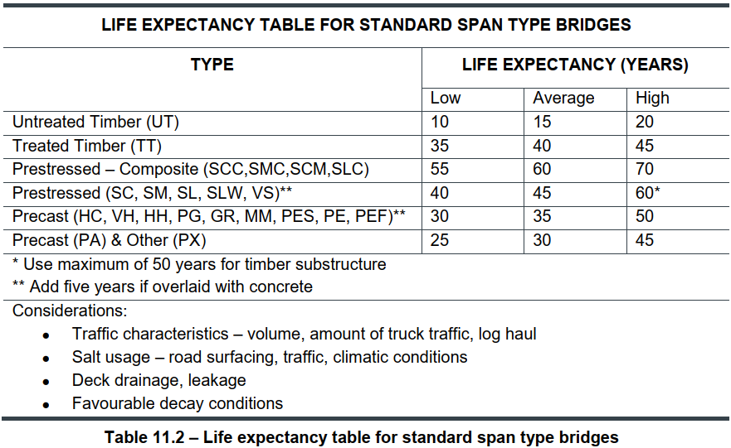
Estimated Replacement Year
Standard Bridges (Table 11.2)

Slide 38
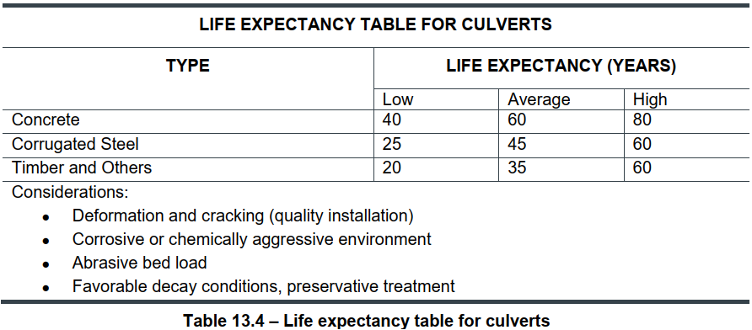
Estimated Replacement Year Culverts (Table 13.4)
Page 37

Slide 39
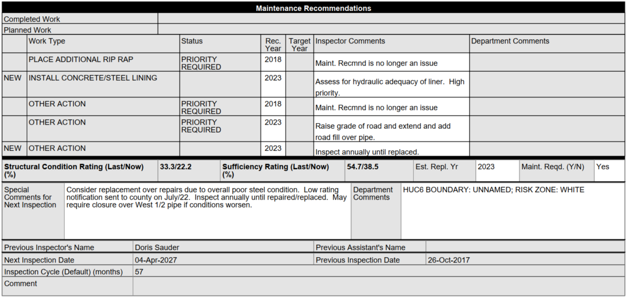
Special Comments
LEVEL 1 INSPECTION
Special comments useful for next inspector/inspection
  Notice to BM or LRA of low structural ratings (Low Rating Notification)
  Measurements for monitoring purposes and Monitoring locations
  Recommendation for reduced cycle
  Draw attention to site hazard (e.g. “steep un-stable slope under A1”)
  Data is not sortable

Slide 40
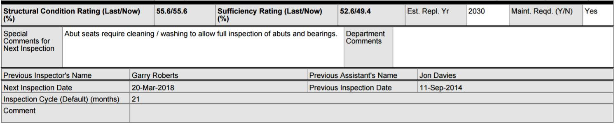
Supporting Information
Input from systems data base (SCR, Sufficiency, Previous Inspectors)
Inspection Cycle shown is normally default but may be reduced
Reduction to inspection cycle cannot be done by inspector – only recommended by inspector
Reduced Cycle approved and set by Department

Slide 41

Questions?

