Slide 1
BRIDGE MAINTENANCE & INSPECTION RESPONSIBILITIES

Slide 2
Need for Inspection and Maintenance
Safety
Protection of investment
Maximize functional life

Slide 3
Legislation
Municipal Government Act
  Definitions
    (z) road… includes a bridge forming part of a public road
    16 (1) The title to all roads in a municipality, other than a city is vested in the Crown in right of Alberta

Slide 4
Municipal Government Act
(Continued)
18 (1) …a municipality has the direction, control and management of all roads within the municipality
532 (1) Every road… must be kept in a reasonable state of repair by the municipality having regard to
  (a) character of road…
  (b) the area it is located
532 (2) The municipality is liable for damage caused by… failing to perform its duty…
532 (4) A municipality is not liable… unless…loss or damage beyond what is suffered by… all other persons affected by the state of repair.

Slide 5
Municipal Government Act
(Continued)
532 (6) A municipality is liable… only if “it” should have known of the state of repair
532 (7) A municipality is not liable… if “it” proves that it took reasonable steps to prevent the disrepair...
533 A municipality is not liable for damages caused if it took reasonable steps to prevent…
  (a) by the presence, absence or type of any wall, fence, guard rail… traffic control device… adjacent… in… on a road.

Slide 6
Public Highways Development Act
(4) All provincial highways are subject to direction, control and management of the Minister
(8) The Minister may make regulations… for
  (a) design and standards for construction for secondary roads
  (b) standards for maintenance for secondary roads

Slide 7
Public Highways Development Act
(2) ...each highway authority is responsible for costs of construction and maintenance of all highways subject to its control and management
19) The Minister has the direction, control and management of
  (a) roads in improvement districts
  (b) highways through Indian Reserves…
  (c) highways in cities if title vested in Crown.
  (forestry roads & secondary highways by agreement…)

Slide 8
Public Highways Development Act
(Continued)
21 (1) The Minister may enter into an agreement with any… municipality… “to” contribute to the cost of construction and maintenance of any street or road…
52 (1) …the Minister may direct construction or maintenance of a bridge… or enter into an agreement… for
  (a) paid by Crown
  (b) Paid by municipality… or other person
  (c) apportioned between Crown and… other
whichever the Minister directs.

Slide 9
Traffic Safety Act
15 (1) …municipality may authorize… placing of traffic control devices
16 (1) …municipality may make by-laws
  (a) …restricting weights of vehicles…
  (p) …closing or restricting… highway… bridge...

Slide 10
Department Policies
Outline methods of operation
How legislation is implemented

Slide 11
Legal Liability
Responsibilities defined by
  legislation
  policies and procedures
Cannot guarantee accidents will not happen or damage will not occur
Liable - exposed or open to something undesirable such as loss arising from injury or damage to another person or property

Slide 12
Due Diligence
Not liable for damages or loss if:
  work is in keeping with legislation, policies or procedures
  work in keeping with accepted / prevailing standards
  actions are “reasonable”

Slide 13
Current Maintenance Delivery Process - LRA
LRA’s complete required maintenance activities using either in-house work forces or contracted forces.
The LRA relies heavily on the accuracy and completeness of the BIM inspection report.
Quantities shown in the maintenance section of the BIM report form the basis of the scope of work.
A quality BIM report is expected, and greatly assists the LRA in the delivery of their maintenance program.

Slide 14
Current Maintenance Delivery Process - AT
AT Regional bridge offices currently utilize their respective Highway Maintenance Contractor (HMC) to complete required maintenance activities.
Maintenance and Rehabilitation work is also delivered through the provincial tender process.
If utilizing the HMC, a Bridge Maintenance Authorization is generated which details the scope of work and the quantities. This document also forms a part of the contractual agreement between AT and the HMC.
In either case, contractors submit quotes based on the scope of work and quantities, among other things.

Slide 15
Current Maintenance Delivery Process - AT
Similar to the LRA, AT bridge staff also rely heavily on the accuracy and completeness of the BIM inspection report.
Quantities shown in the maintenance section of the BIM report form the basis of the scope of work for either the HMC BMA or provincial tender.
A quality BIM report is expected, and greatly assists AT bridge staff in the delivery of their maintenance program.
A second trip to the field by AT staff to gather or confirm quantities is not desirable.

Slide 16
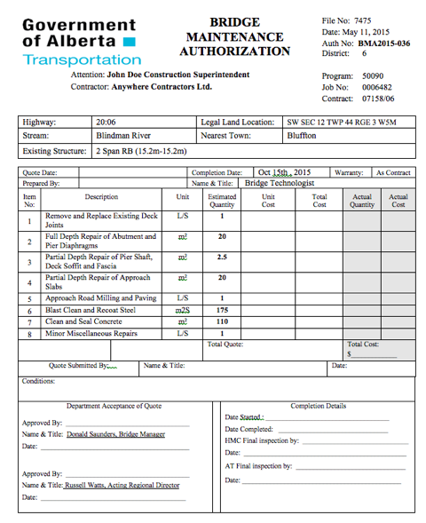
Current Maintenance Delivery Process - AT

Slide 17

Questions?

