Slide 1
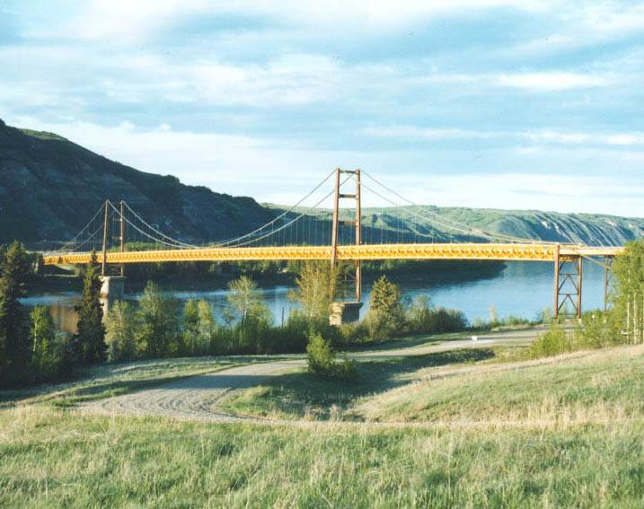
Bridge Engineering Section
Technical Standards Branch

Slide 2

Bridge Engineering Section
TSB Bridges - Role
Standards
Knowledge Transfer
Engineering Review
Advice – Complex Projects

Slide 3
Bridge Engineering Section
TSB Bridges - Role
Role Clarity Document:
Standards Management (How)
Project Participation
Programs
Other Projects
Notes:
Role
Other:
Level 2 inspections
Code Committees
Programming?
Document management
System Analysis
Special Projects (audit, LRBP, modules, branding …), coordination
Document – Clarity, how we do standards

Slide 4
Bridge Engineering Section
TSB Bridges - Role
Programs and Support:
Level 2 Inspection Programs
BIM Inspector Training/Cert.
Document Management
System Enhancement
System Analysis
Other - Products, Costs, Flood
Notes:
L2 Programs – concrete deck, steel (UT, cover plate, pin and hanger, CIF), pier scour, RPW banktracking
Inspector – arrange for training, manage certification and re-certification, lead BIM technical committee
Document Management – profiling drawings, file archives, system management, drawing numbers, mylar storage
System enhancement – TIMS, BIM
System Analysis – stats and figures (replace cost), performance measures, RODA needs lists
Other – Product list updates, innovative solution evaluation, cost database and publication, flood data collection and publication (HIS)

Slide 5
Bridge Engineering Section
TSB Bridges - Role
Projects:
LRBP Review
BIM Audit
System Impact - Modules, Log.
Flood Recovery
Regulatory – NWPA, DFO…
Climate Change

Slide 6
Bridge Engineering Section
Tina Bridger
Admin Support
Des Williamson
Director
Conceptual
Structural
Materials
Construction
Preservation
Ernie Waschuk
Bridge Planning
Specialist
John Alexander
Bridge Structural
Specialist
TBD
Bridge Materials
Specialist
Greg Whyte
Bridge Construction
Specialist
Byron Chelak
Bridge Preservation
Specialist
Caroline Watt
Bridge Hydrotechnical
Engineer
Clayton Matwychuk
Structural Standards
Engineer
TBD
Bridge Fabrication
Engineer
Joe Tse
Bridge Construction
Engineer
Bryan Wai
Bridge Management
Engineer
Matt Spratlin
Bridge Design
Engineer
Wayne Cappellani
Sr. Bridge Maint.
Technologist
Dave Besuyen
Bridge Materials/
Construction Engineer
Terry Gullekson
Bridge Inf. Data
Technologist
Junaid Iqbal
Bridge Design
Engineer
Wilf Schneider
Bridge Standards
Technologist
TBD
Bridge
Technologist
Deanna Stenzel
Doc. Profiling
Technologist (T)
Notes:
Org Structure – functional grouping

Slide 7
Bridge Engineering Section
Functional Planning
Bridge Management
Bridge Inspection
& Maintenance
New
New Bridge
or Existing?
Existing
Bridge
Assessment
Replace
Repair or
Replace?
Repair
New Design
Rehabilitation
Design
Conceptual
Design
Detailed
Design
Tender Preparation
and Advertisement
Construction
Notes:
Bridge Management – Engineering Functions

Slide 8
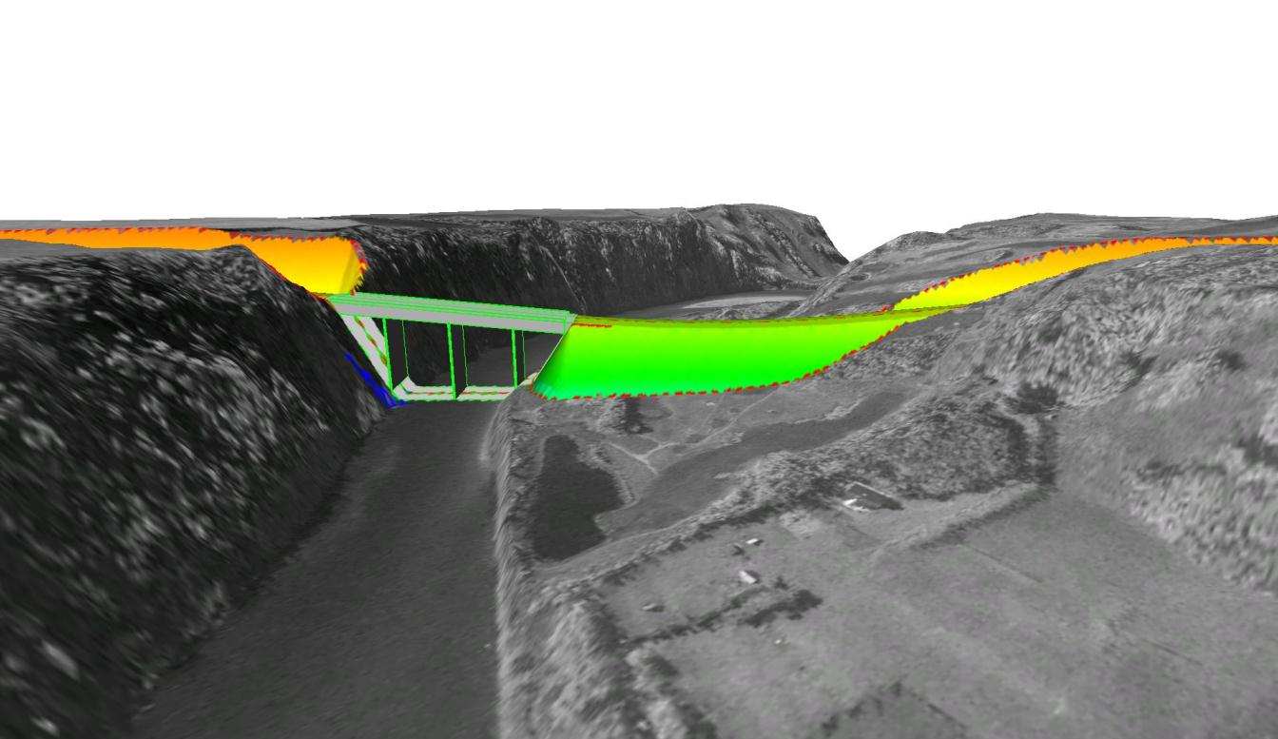
Bridge Engineering Section
Bridge Conceptual Design
Notes:
Bridge Planning:
Function: Optimize location, geometry, value for bridges
Project: Conceptual Design (to DD’s), River engineering, Assessments, Functional Planning Studies
Other: BIM (pier scour, RPW), Flood Data

Slide 9
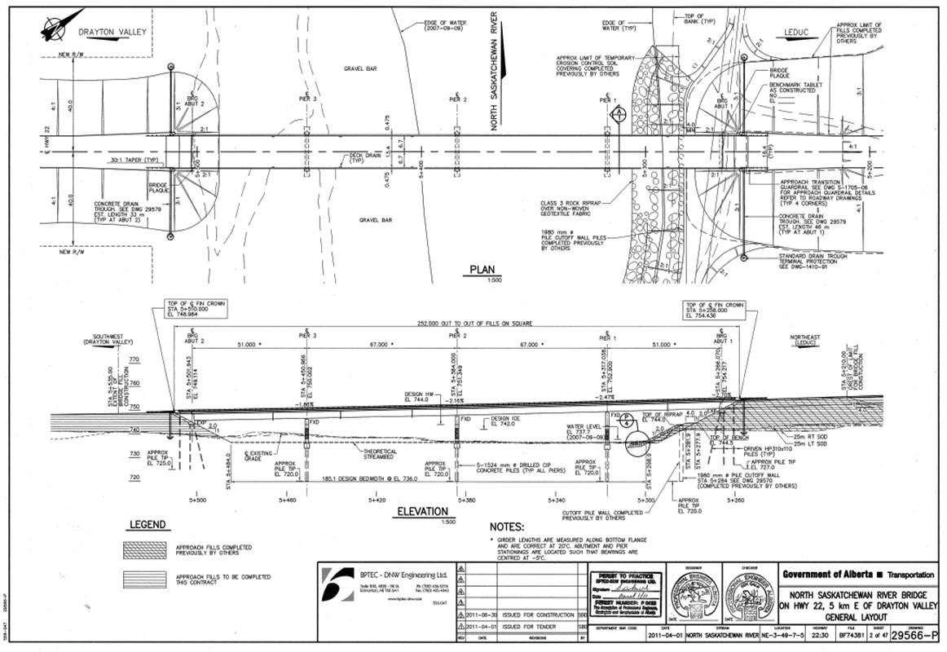
Bridge Engineering Section
Structural Engineering
Notes:
Structural Engineering
Function : Detailed (Structural) Design and Analysis
Project : Detailed Design – DD to Tender Package, Load Rating Analysis
Other : Development of Standard Drawings, TAC/CHBDC Participation ; Document Management

Slide 10
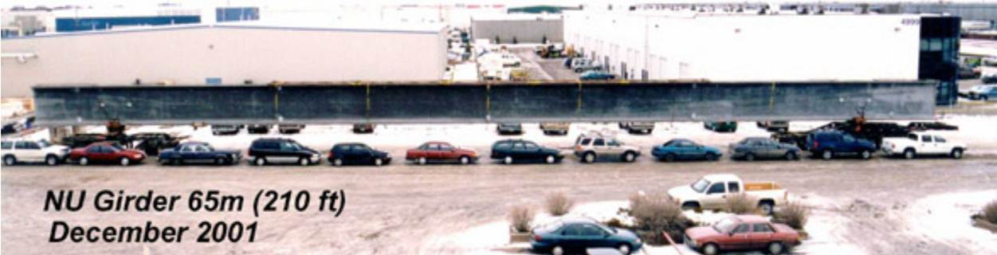
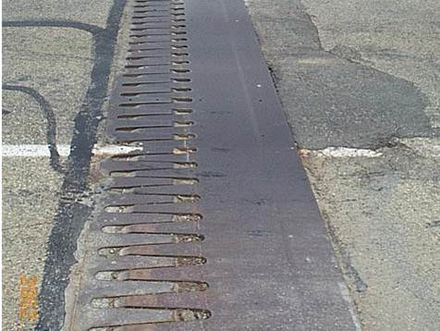
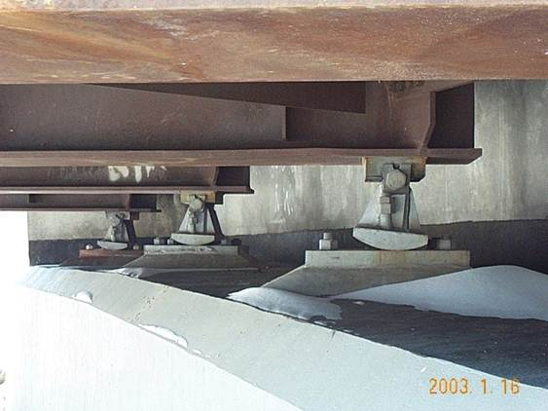
Bridge Engineering Section
Bridge Materials
Notes:
Bridge Materials
Function : Manufacture, Detailed Inspection of Bridge Components (QA)
Project : Review - design dwg., tender package, procedures, shop drawings; Quality Assurance (Plant Inspection) – acceptance, repair details
Other : Level 2 inspection – steel (truss, girder) and concrete deck, evaluate new materials/products

Slide 11
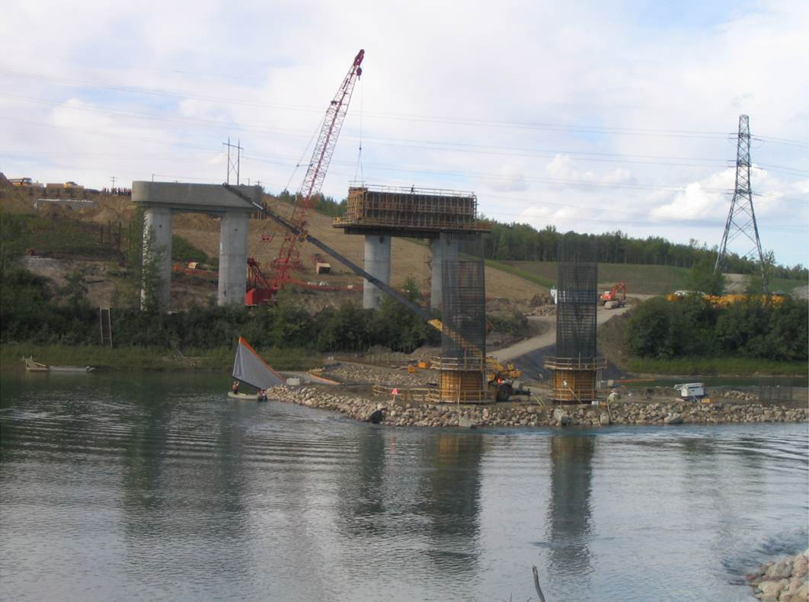
Bridge Engineering Section
Bridge Construction
Notes:
Bridge Construction
Function : Supervision of Bridge Construction – New and Rehab (QA)
Project : Review - design dwg., tender package, erection plans; Site Inspection – monitor compliance, support regions
Other : specifications, cost database, associations

Slide 12
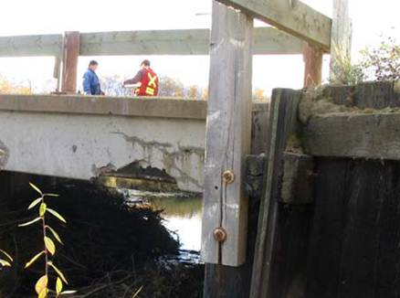
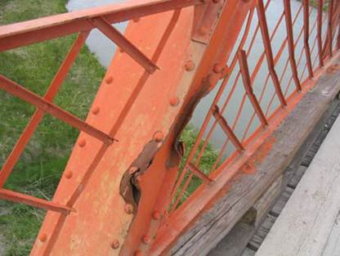
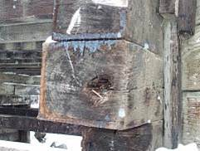
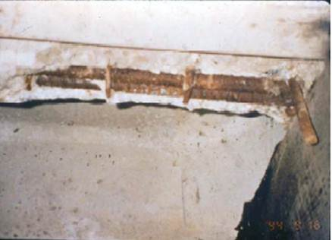
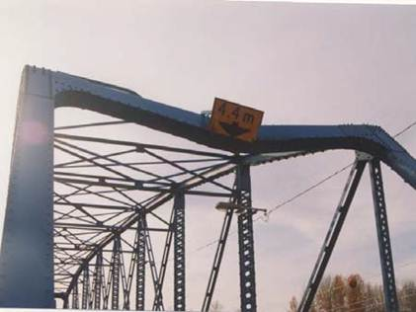
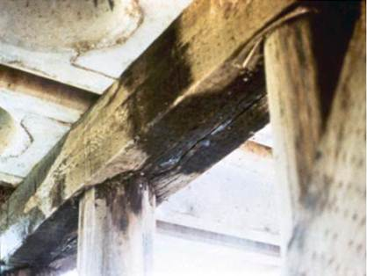
Bridge Engineering Section
Bridge Preservation
Notes:
Bridge Preservation
Function : Bridge Rehabilitation, Life Cycle Management, Inspection System
Project : Assessments – rehabilitation options; Design – rehabilitation works
Other : Manage BIS/BIM Systems

Slide 13



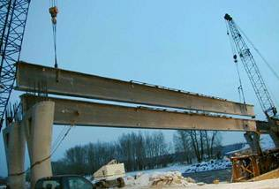
Bridge Engineering Section
Key Messages
Notes:
Key Messages:
Knowledge Centre
Standards – Develop, maintain ; advice, training
Here to Serve
Ultimately – cost effective transportation system

