Slide 1
Bridge Management
Functional Planning
Bridge Management
Bridge Inspection
& Maintenance
New
New Bridge
or Existing?
Existing
Bridge
Assessment
Replace
Repair or
Replace?
Repair
New Design
Rehabilitation
Design
Conceptual
Design
Detailed
Design
Tender Preparation
and Advertisement
Construction
Notes:
Bridge Management – Engineering Functions

Slide 2
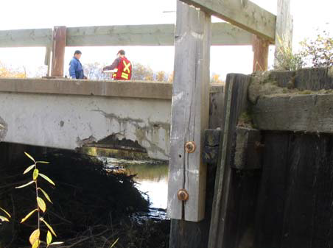
Bridge Management
BIM Level 1 Inspections
Visual, rating (1 – 9)
Worst condition
Detailed forms
Certified Inspectors
Set schedule
Low Rating Advisory
Maintenance Recomm.

Slide 3
Bridge Management
BIM Level 2 Inspections
Special equip., knowledge
Programmed:
  Concrete Deck
  UT Truss
  Special Steel
  Pier Scour
  RPW – bank tracking
Other (as needed):
  Timber coring
  Barrel measurements

Slide 4
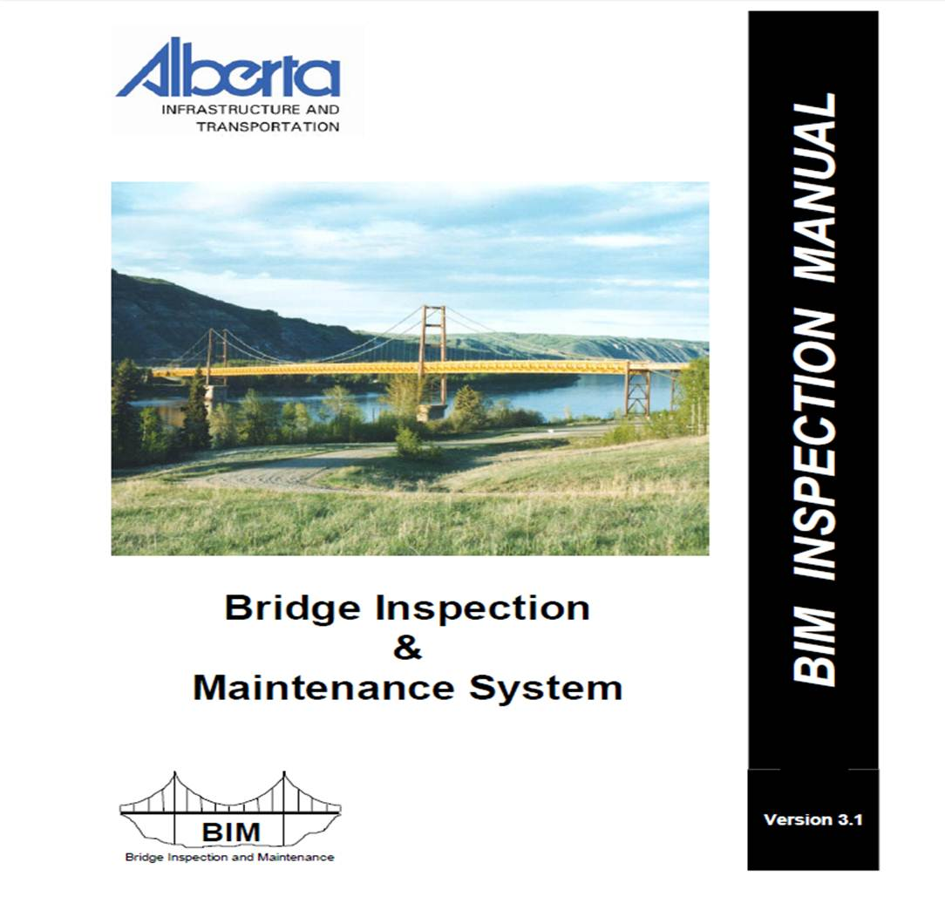
Bridge Management
BIM Documents
Guidelines
  BIM Insp. Manual
  BIM Ref. Manual
  BIM L2 Insp. Manual

Slide 5
Bridge Management
Functional Planning
Bridge Management
Bridge Inspection
& Maintenance
New
New Bridge
or Existing?
Existing
Bridge
Assessment
Replace
Repair or
Replace?
Repair
New Design
Rehabilitation
Design
Conceptual
Design
Detailed
Design
Tender Preparation
and Advertisement
Construction
Notes:
Bridge Management – Engineering Functions

Slide 6

Bridge Management
Assessments
Decision on Action
  Repair
  Rehabilitation
  Replace
  Restrict/Monitor
  Permit Vehicle
  Do Nothing

Slide 7
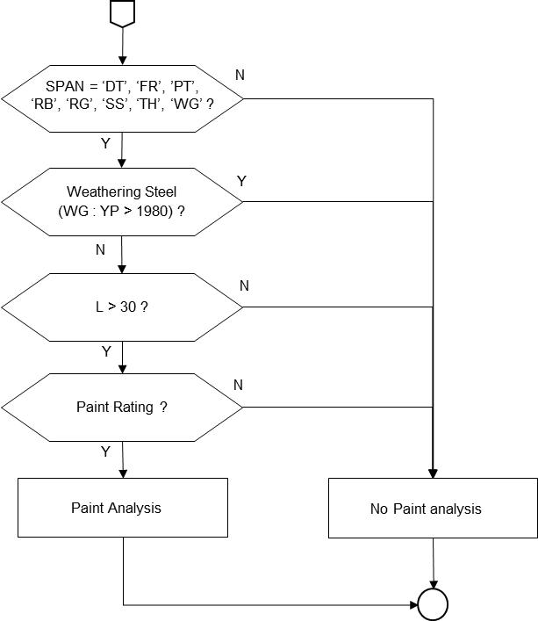
Bridge Management
Assessments
Components
  Collect Data
  ID Deficiencies
  Analyse, Predict
  Develop Strategies
  Life Cycle Cost Analysis
  Constrained Funding

Slide 8
Bridge Management
Strategies
Check for limitations to strategies due to replacement requirements
Width Need ?
Y
Add strategies combining widen action with range of condition based strategies
N
Develop strategy of no rehab and replace
Y
Add strategies combining strengthen action with range of condition based strategies
Strength Need ?
N
Develop strategy of no rehab and close
Add strategies combining widen and strengthen action with range of condition based strategies
Width and Strength Need ?
Y
Develop strategies to meet all condition based needs for assumed replace years ranging from 5 to 65 years
N
Select optimal strategy (lowest NPV)

Slide 9
Bridge Management
Life Cycle Cost Analysis
Net Present Value
4% discount rate
50 year analysis period
Current year cost estimate
Residual value – linear
User Costs – time, collision, vehicle
Replace
Rehab
0
50
Residual

Slide 10
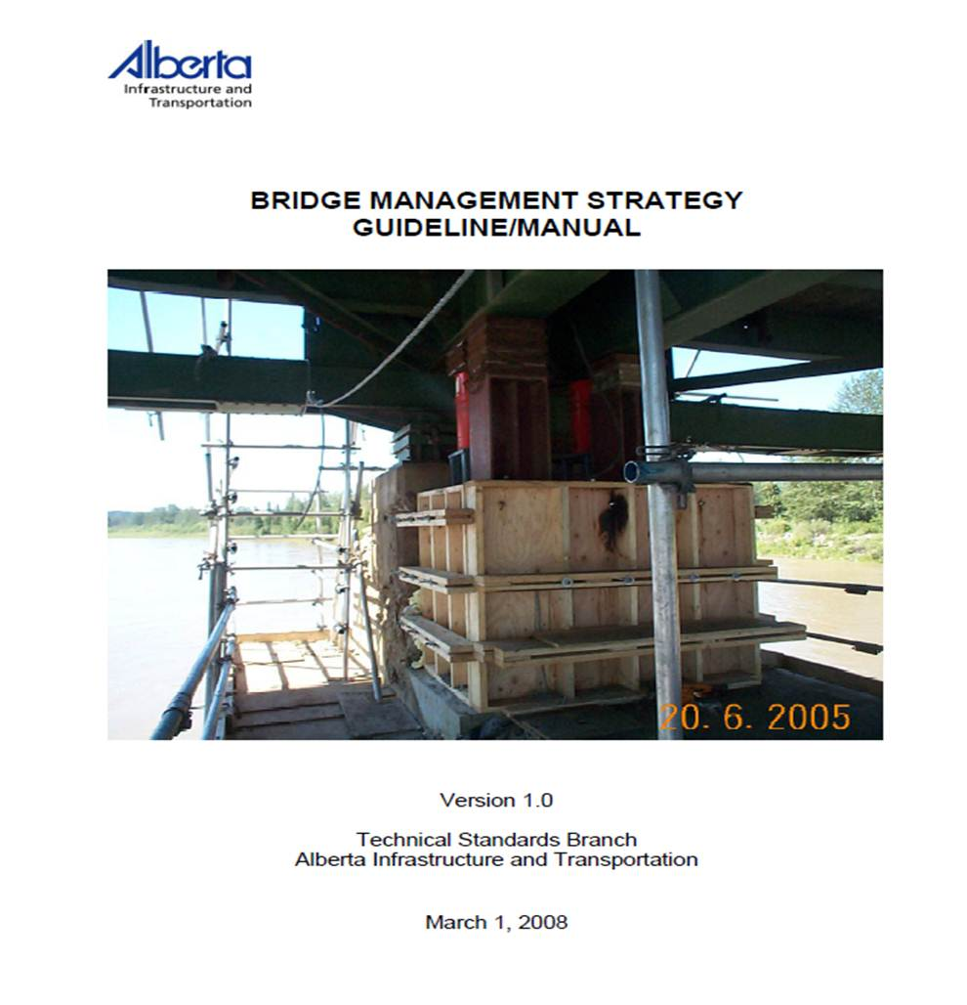
Bridge Management
Assessments
Guidelines
  Management Strategy
  Assessment BPG
  Benefit/Cost Manual (upcoming)

Slide 11
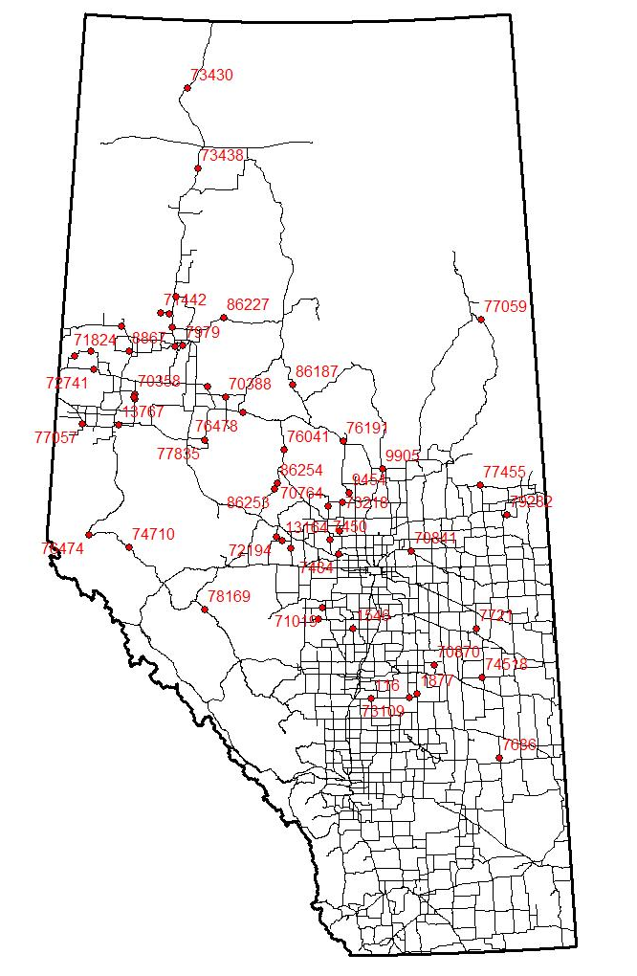
Bridge Management
Assessments
System Analysis
  Funding Requests
  Programming Support
  Business Plan Reporting

Slide 12
Bridge Management
Functional Planning
Bridge Management
Bridge Inspection
& Maintenance
New
New Bridge
or Existing?
Existing
Bridge
Assessment
Replace
Repair or
Replace?
Repair
New Design
Rehabilitation
Design
Conceptual
Design
Detailed
Design
Tender Preparation
and Advertisement
Construction
Notes:
Summarize – data to support decisions, manage large system

