Slide 1
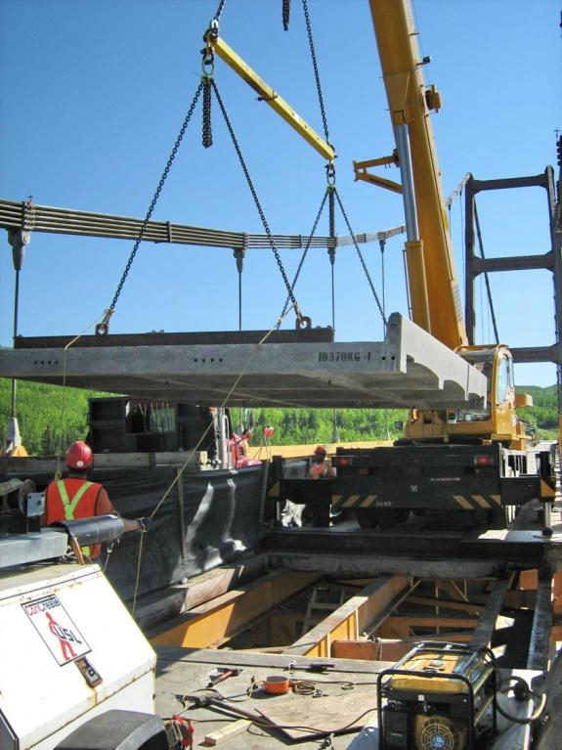
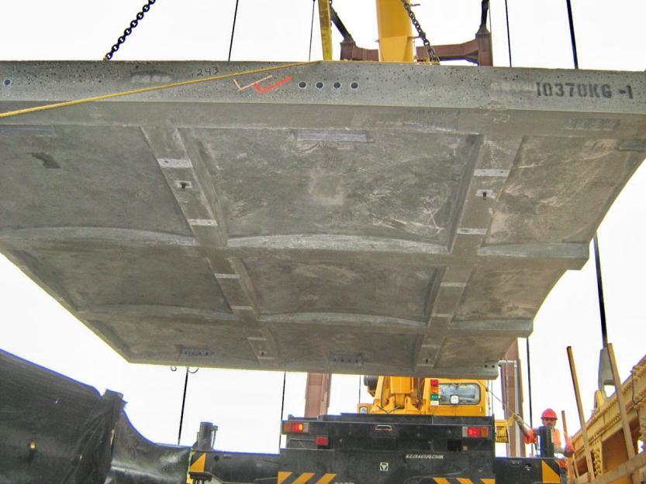
Bridge Engineering Section
Bridge Rehabilitation
Notes:
Bridge Rehabilitation
Very specialized area of bridge engineering.
AT’s bridge inventory is very diverse and the management and rehabilitation requirements are equally diverse in scope.
For example a multi million dollar deck replacement with full depth biaxial stressed precast panels

Slide 2
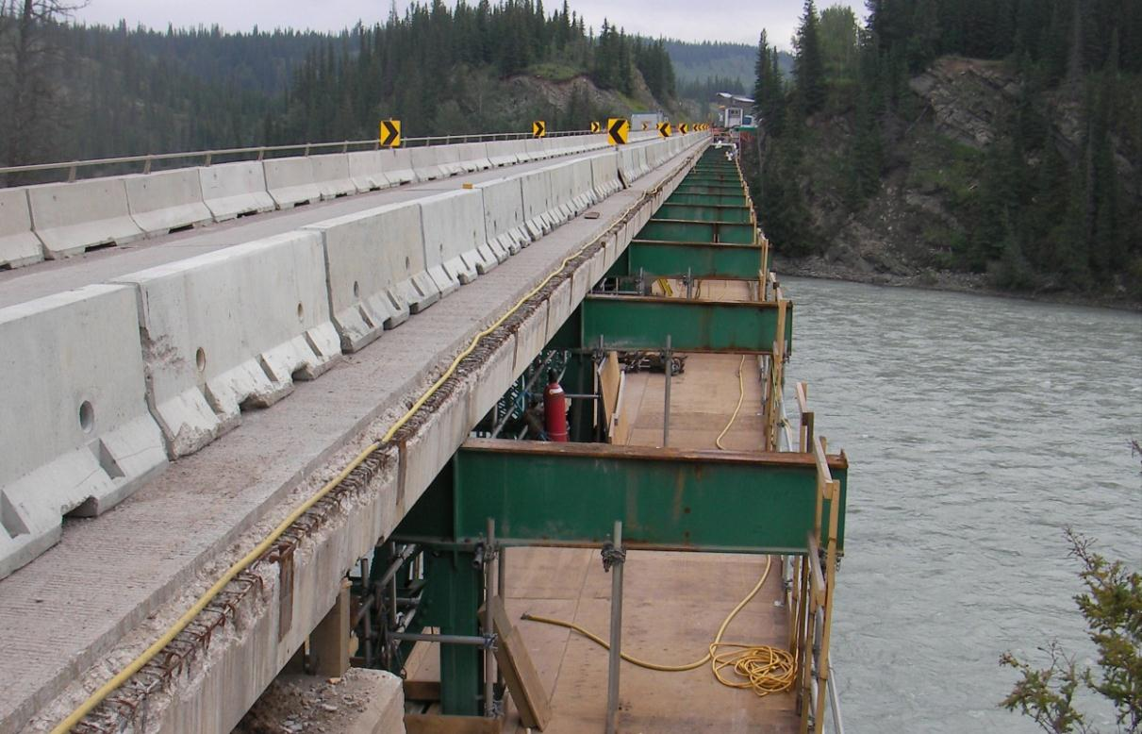
Bridge Engineering Section
Bridge Rehabilitation
Notes:
Bridge Rehabilitation
Truss bridge rehabilitation with deck/stringer replacement

Slide 3
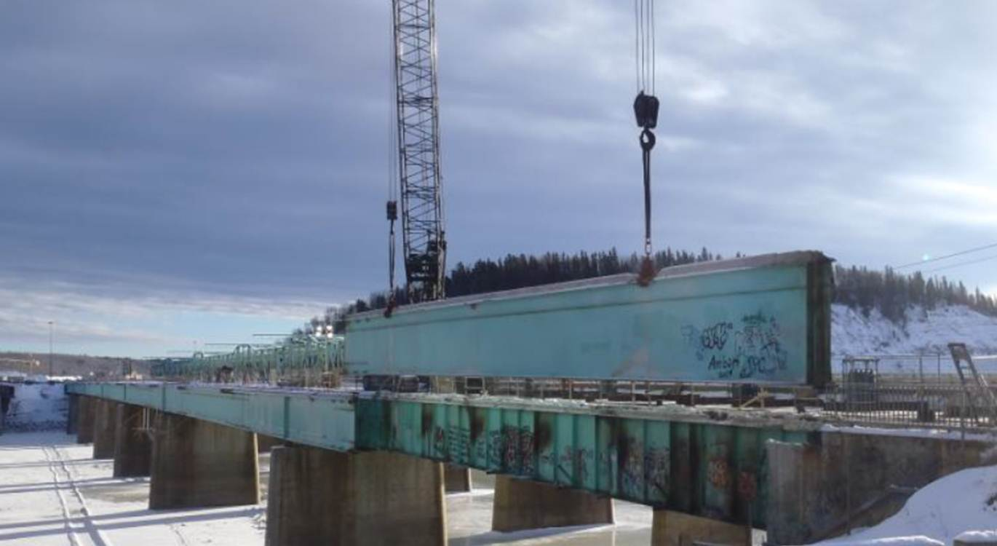
Bridge Engineering Section
Bridge Rehabilitation
Notes:
Bridge Rehabilitation
Complex Superstructure Replacements:

Slide 4

Bridge Engineering Section
Bridge Rehabilitation
Notes:
Bridge Rehabilitation
Constraint Induced Fracture or CIF rehabilitations have been a Department focus over the past number of years. There remains a number of bridges within our inventory that have poor steel girder details and we continue to be address the issue.

Slide 5
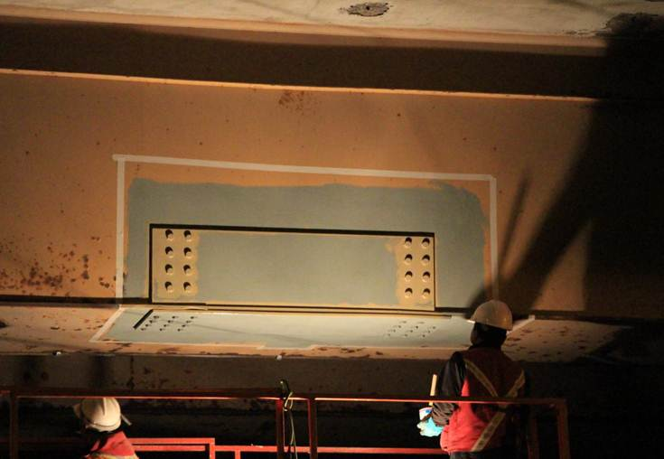
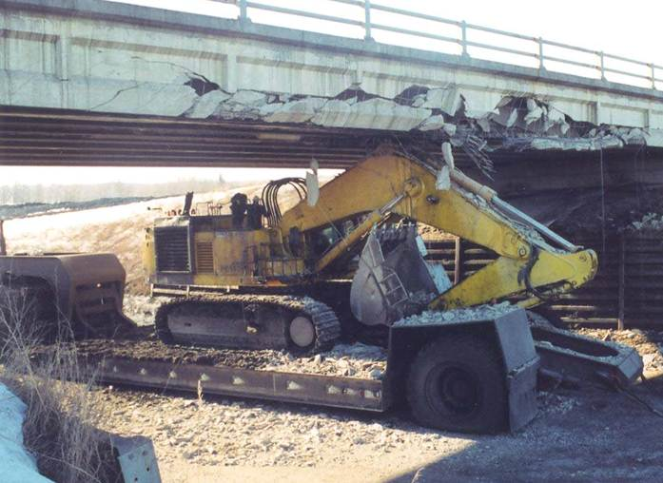
Bridge Engineering Section
Bridge Rehabilitation
Notes:
Bridge Rehabilitation
High load damage repairs

Slide 6
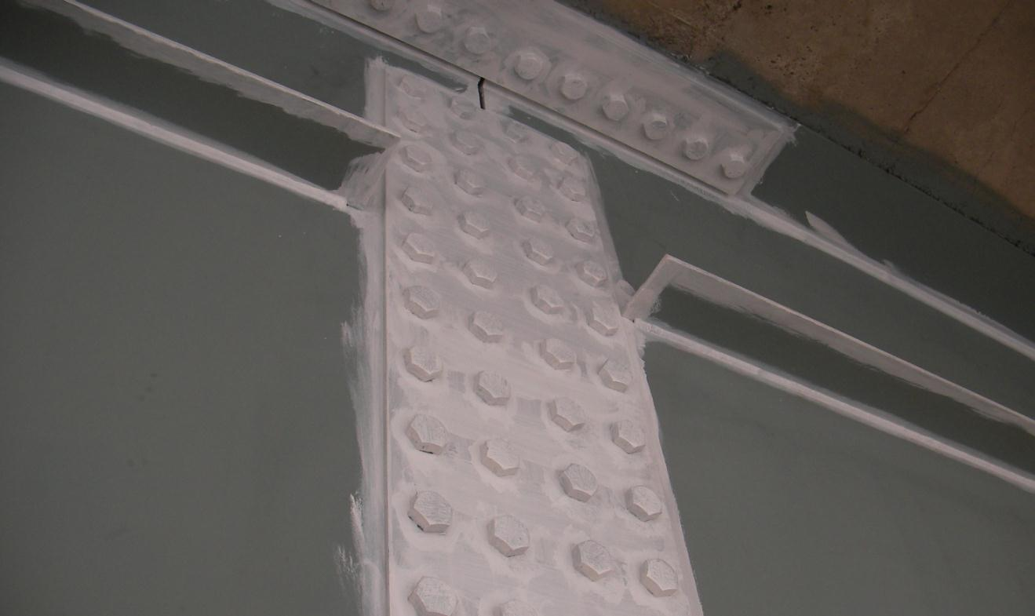
Bridge Engineering Section
Bridge Rehabilitation
Notes:
Bridge Rehabilitation
Bridge Painting

Slide 7
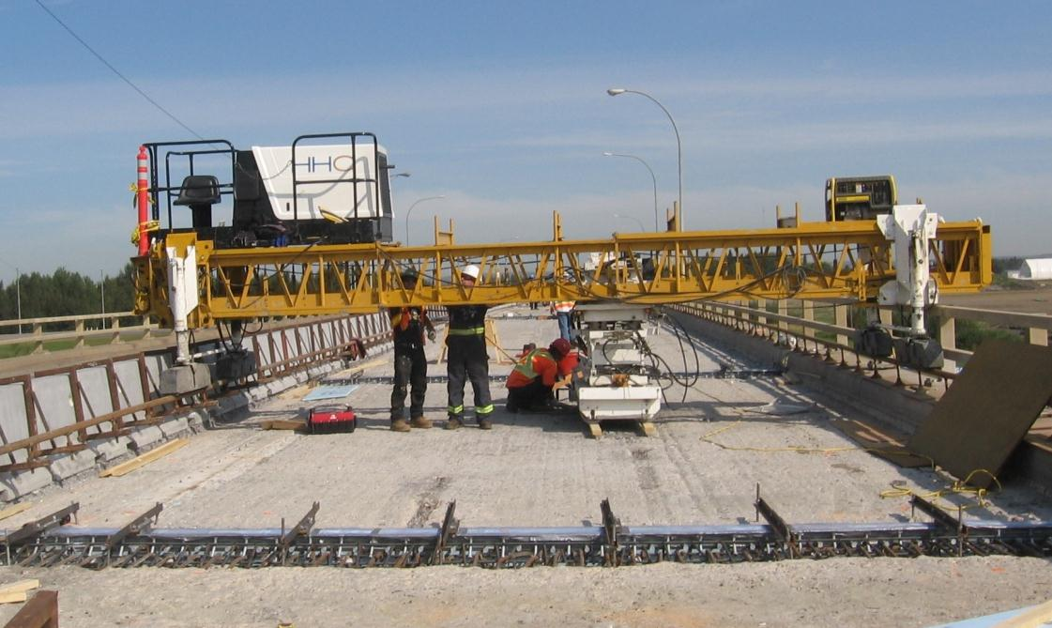
Bridge Engineering Section
Bridge Rehabilitation
Notes:
Bridge Rehabilitation
More standard concrete overlay and deck joint replacement:

Slide 8
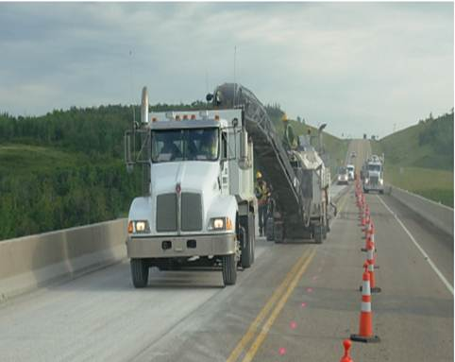
Bridge Engineering Section
Bridge Rehabilitation
Notes:
Bridge Rehabilitation
As the Department has almost exclusively used hot rubberized asphalt membranes and asphalt deck protection systems since the mid 80’s repairs and rehabilitation of this system type are becoming increasingly common.

Slide 9
Bridge Engineering Section
Functional Planning
Bridge Management
Bridge Inspection
& Maintenance
New
New Bridge
or Existing?
Existing
Bridge
Assessment
Replace
Repair or
Replace?
Repair
New Design
Rehabilitation
Design
Conceptual
Design
Detailed
Design
Tender Preparation
and Advertisement
Construction
Notes:
Bridge Construction
Once the decision to repair a bridge has been determined from an assessment, this leads to rehabilitation design activities.

Slide 10
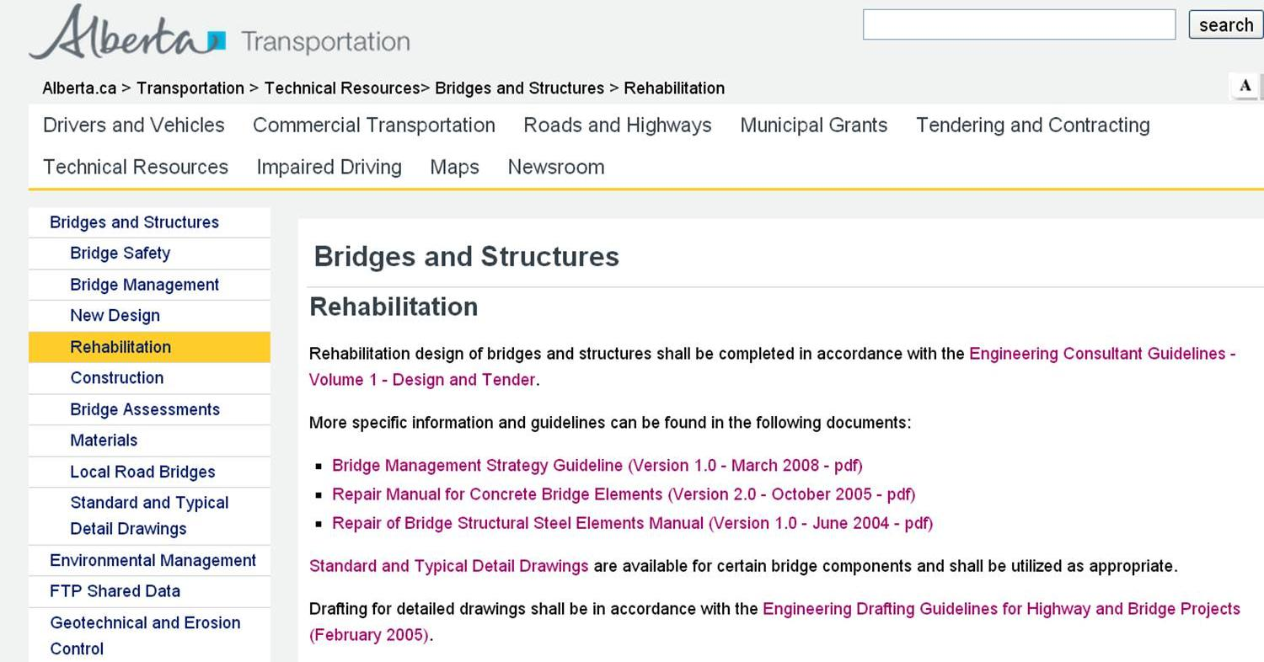
Bridge Engineering Section
Bridge Rehabilitation
Notes:
Bridge Rehabilitation
On AT’s technical resources website under the rehabilitation heading there are a number of applicable resource materials to draw on for rehab assignments.
As with all consulting services, bridge rehabilitation is no exception and the Engineering Consultant Guidelines form the basis for all work completed for the Department. Similar to new design practices, engineering drafting standards should be followed for development of rehab drawings. Standard drawings should be used where ever applicable for rehabilitation works as well.

Slide 11
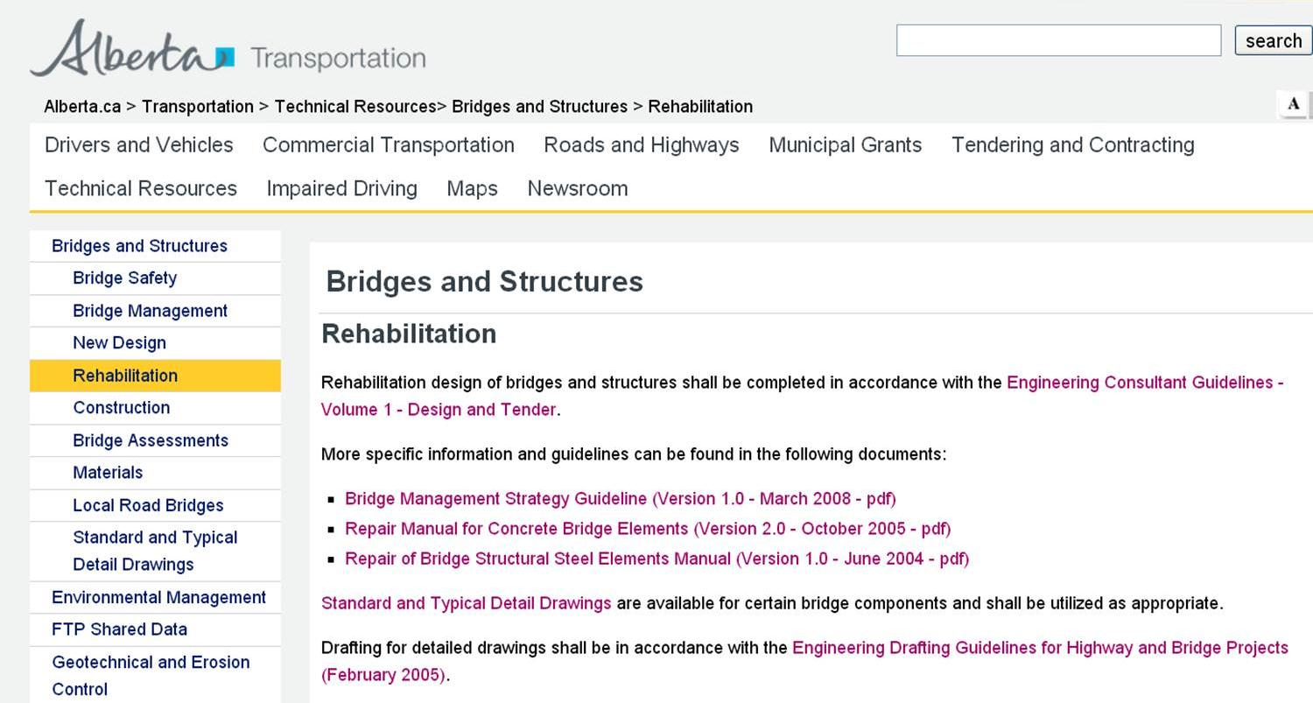
Bridge Engineering Section
Bridge Rehabilitation
Notes:
Bridge Rehabilitation

Slide 12
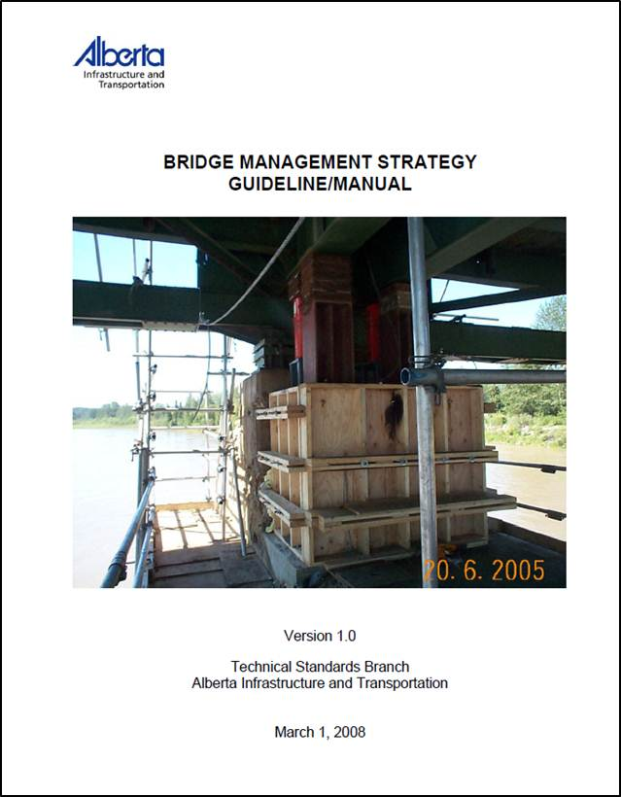
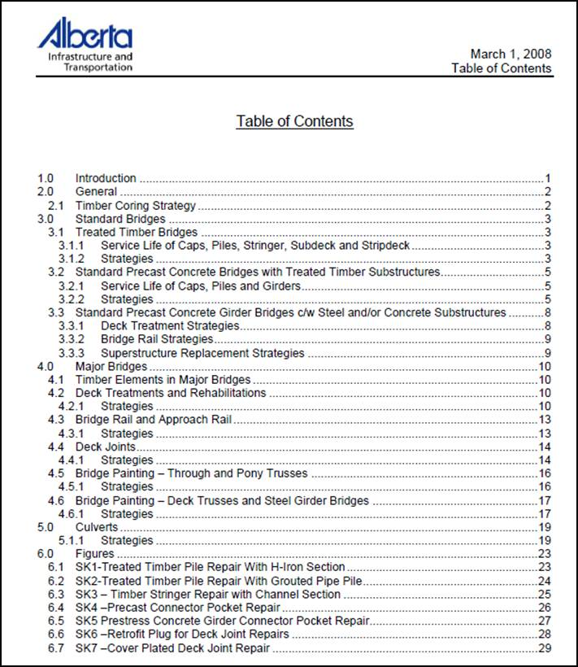
Bridge Engineering Section
Bridge Rehabilitation
Notes:
Bridge Rehabilitation
The Department’s bridge management strategy guideline/manual provides context to some of the more common and basic types of strategies related to bridge rehabilitation. It summarizes Department experiences with certain structure types, common problems and outlines basic strategy development. At present the document is fairly limited in scope, but future work has been discussed that would update best practices, outline rehabilitation project processes and how related department requirements are to be incorporated.

Slide 13
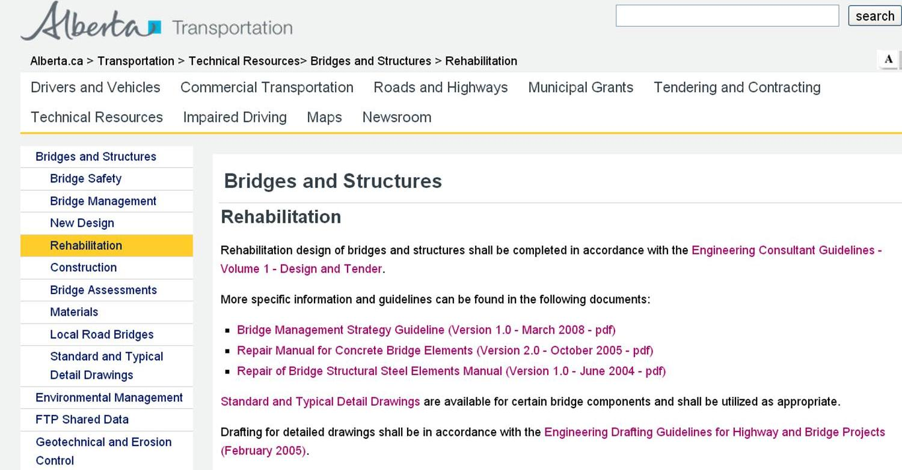
Bridge Engineering Section
Bridge Rehabilitation
Notes:
Bridge Rehabilitation
In addition to the bridge management strategy guideline/manual, there are also valuable and detailed repair guidelines for both concrete and steel bridge elements.
These manuals are excellent reference material for rehabilitation work and in particular they provide good background and context for specialized high load damage assessment and repair work.

Slide 14
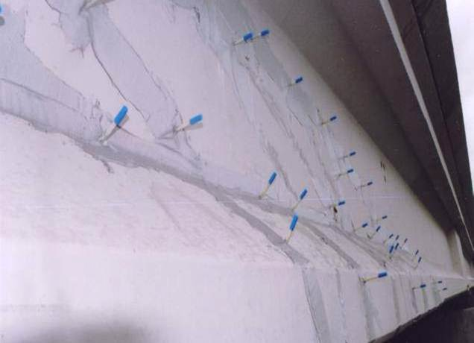
Bridge Engineering Section
Bridge Rehabilitation
Notes:
Bridge Rehabilitation
For example: what requirements should be incorporated for epoxy injection of concrete girders or

Slide 15
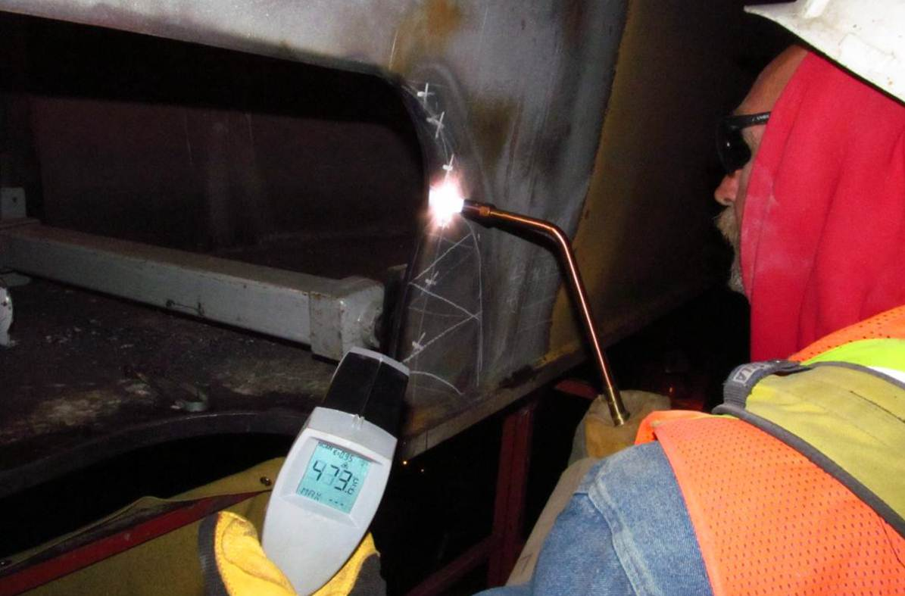
Bridge Engineering Section
Bridge Rehabilitation
Notes:
Bridge Rehabilitation
what temperature ranges should be adhered to for heat straightening repairs.

Slide 16
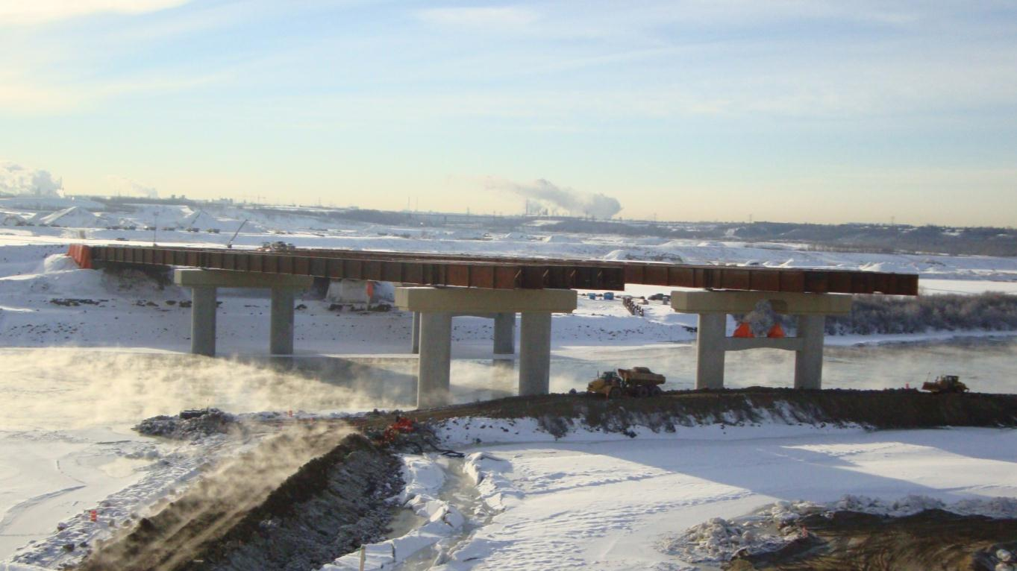
Bridge Engineering Section
Bridge Construction
Notes:
Bridge Construction
Weather it is bridge rehabilitation or new construction the work activities that bring the detailed designs to completion general fall under the umbrella of Bridge Construction.

Slide 17
Bridge Engineering Section
Functional Planning
Bridge Management
Bridge Inspection
& Maintenance
New
New Bridge
or Existing?
Existing
Bridge
Assessment
Replace
Repair or
Replace?
Repair
New Design
Rehabilitation
Design
Conceptual
Design
Detailed
Design
Tender Preparation
and Advertisement
Construction
Notes:
Bridge Construction
The there are two general tasks associated with bringing those detailed designs to completion.
The “Tender” phase involves the development and creation of the final construction contract, and the “Construction” phase which involves contract administration and post construction services.

Slide 18
Bridge Engineering Section
  Crucial to the bidding process
  Framework for contract administration
  If we get this right
      The world unfolds as it should
  If we don’t
      Delayed tenders, addendums
      Increased risk
      Higher prices
Tender Preparation
and Advertisement
Bridge Construction
Notes:
Bridge Construction
The development of complete and accurate tender documents are crucial to the bidding process and provides the framework for contract supervision and administration.
If we get this right, “the world unfolds as it should”.
If we don’t, projects may not get tendered on time, time and effort is wasted, we require addenda, we don’t get the best prices, we increase the risk to the Department for claims and in the worst case scenario tenders are cancelled.

Slide 19
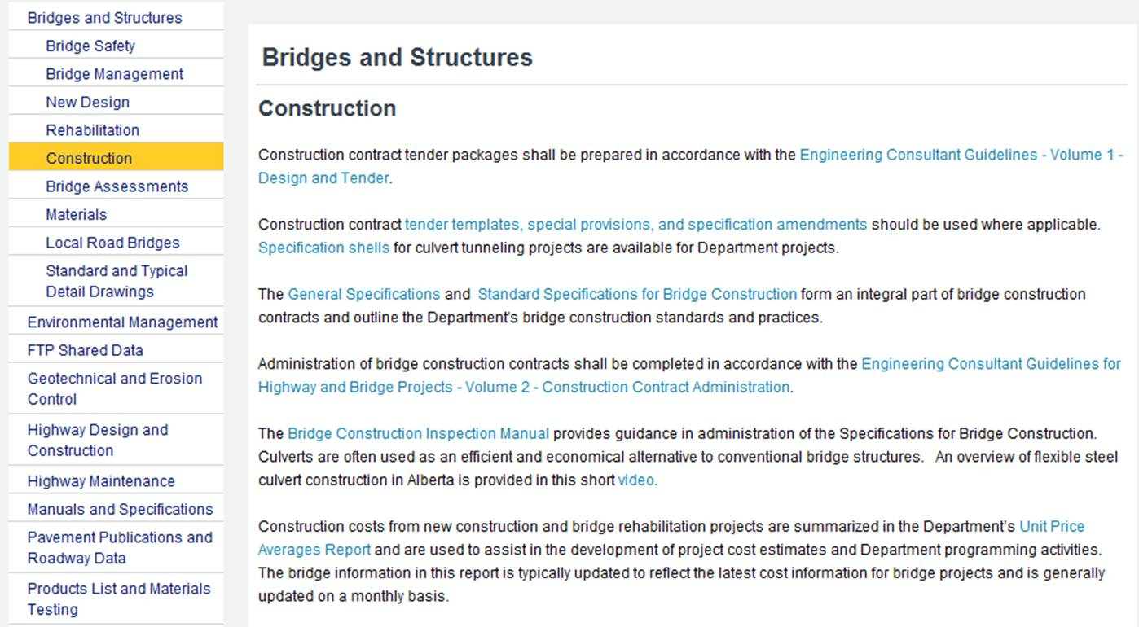
Bridge Engineering Section
Bridge Construction
Notes:
Bridge Construction
Under the ‘construction’ heading of the bridge and structure technical resource page - all links to resources that are relevant in the development of tender packages are presented.
The Engineering Consultant Guidelines Vol 1
Tender templates, special provisions, and spec amendments/supplementals etc.
- General Specifications for Highway and Bridge and Standard Specifications for Bridge Construction
Construction costs are also summarized and reported for use in developing Type A,B or C cost estimates

Slide 20
Bridge Engineering Section
Bridge Construction
Notes:
Bridge Construction
It is important to have a good understanding of the related documents for those assisting in tender package preparation, but it is imperative that a thorough understanding of the general and standard specifications for bridge construction be developed before attempting to complete such tasks. This is because any project specific requirements outside of those within the standard specifications need to be thoroughly addressed in the tender package to ensure appropriate contract administration.

Slide 21
Bridge Engineering Section
Bridge Construction
Notes:
Bridge Construction
The unit price average report is a very important document to be used in development of any type of cost estimate prepared for Department projects. The report is updated on a regular basis should be used in development of project cost estimates such that Department wide programming can be as efficient as practically possible.

Slide 22
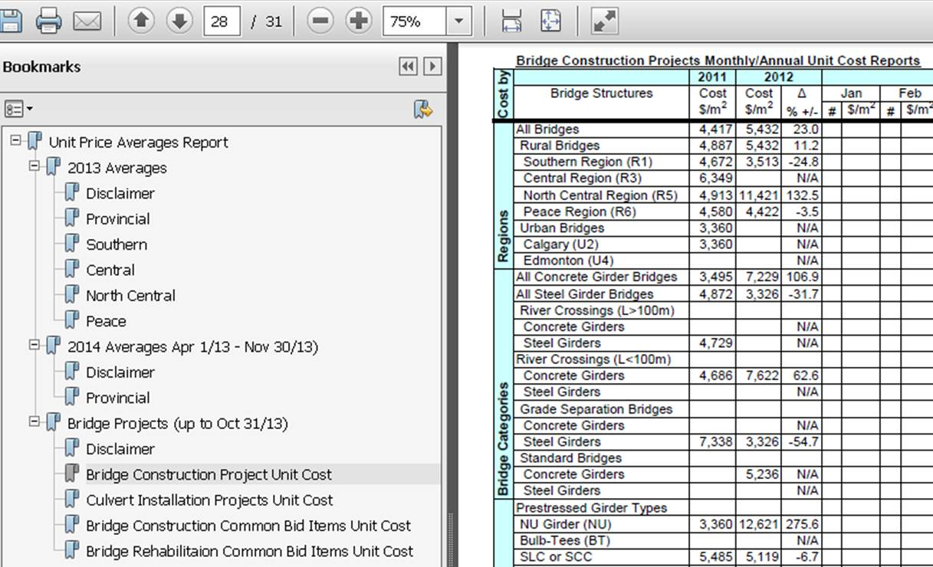

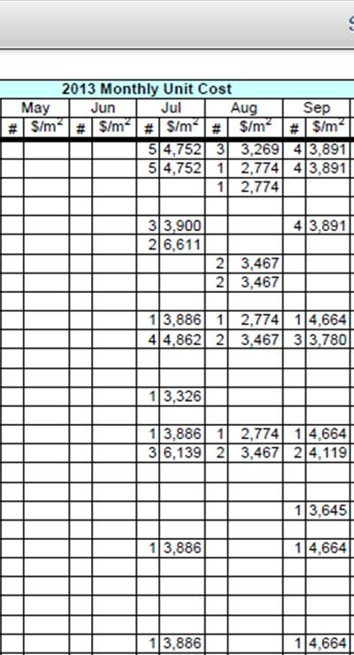
Bridge Engineering Section
Bridge Construction
Notes:
Bridge Construction
The unit price averages report has detailed cost information summarized by region, structure type (steel vs. concrete / major vs. standard / river vs. grade separation etc.) on a monthly basis. The higher level cost estimate information is useful for functional planning or bridge assessment type work.

Slide 23
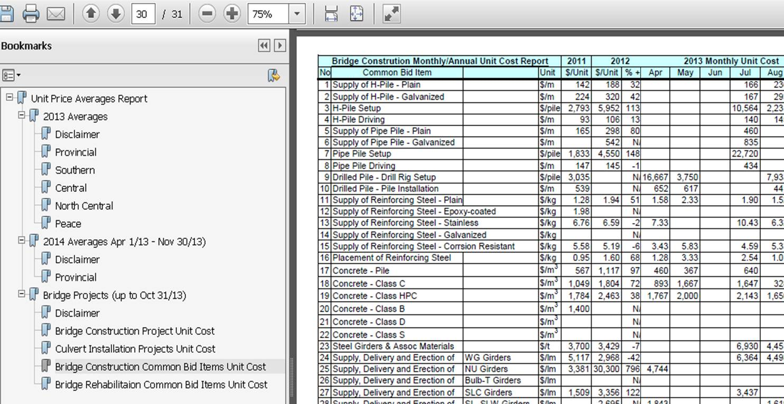
Bridge Engineering Section
Bridge Construction
Notes:
Bridge Construction
Within the unit price averages report there is also common construction bid items summarized for both new construction and rehabilitation work. This information is very useful and required to be used for type A,B, or C cost estimates for the department.

Slide 24
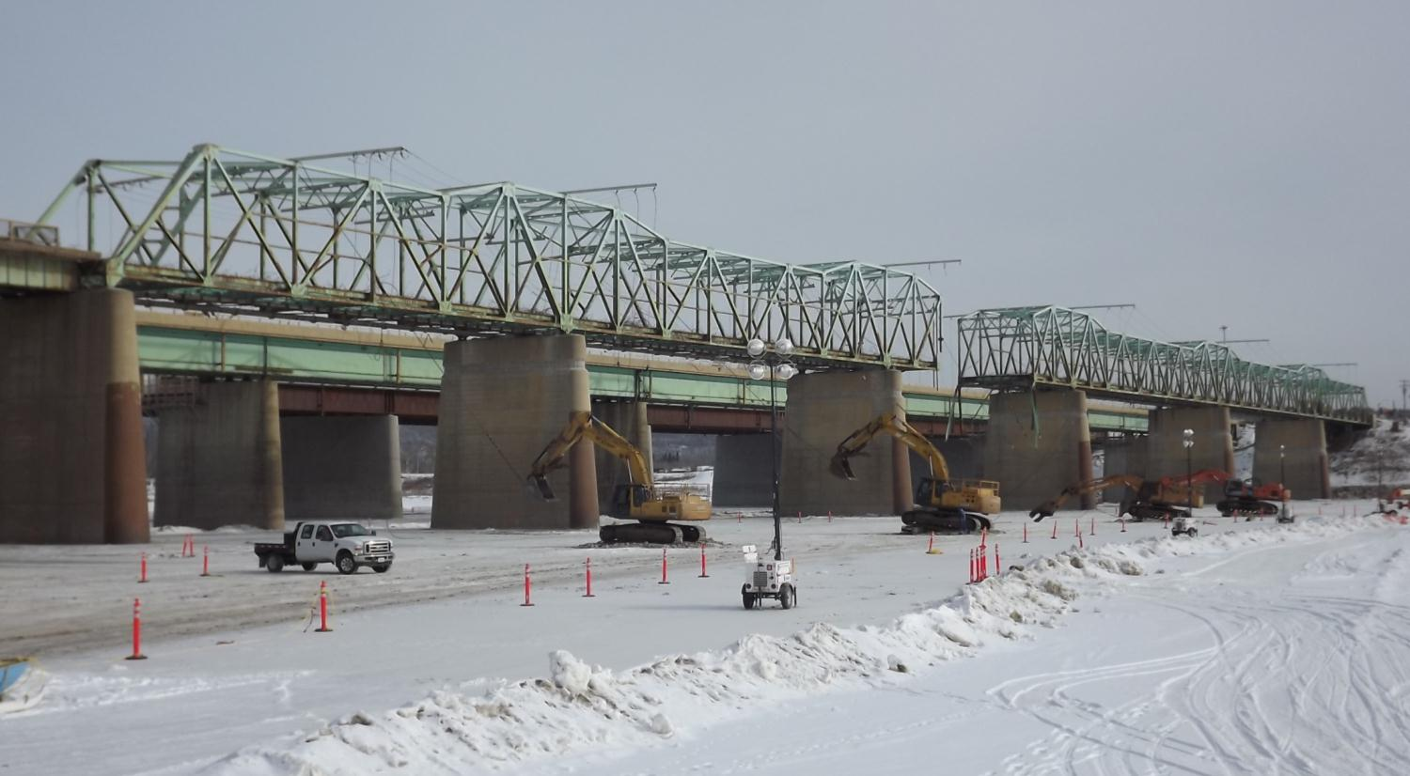
Bridge Engineering Section
Bridge Construction
Notes:
Bridge Construction
Once the tendering process is completed, contracts are awarded the more glamorous construction activities such as pile driving or bridge demolition can commence. This is the Grant MacEwan Bridge in Ft. McMurray that recently when major substructure modification and superstructure replacement.

Slide 25
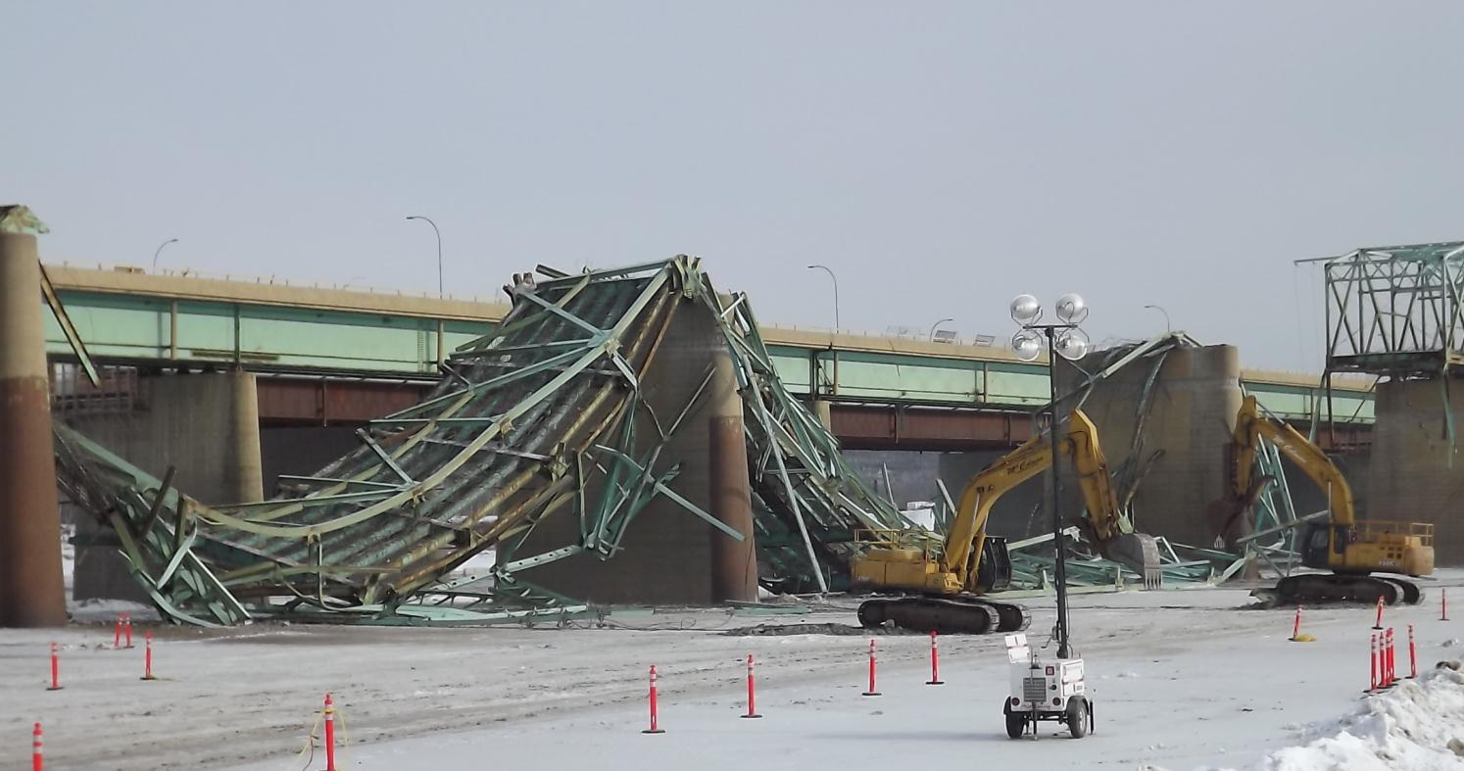
Bridge Engineering Section
Bridge Construction
Notes:
Bridge Construction
Demolition is always a spectacular milestone and one that in this case our maintenance guys were very happy to see.

Slide 26
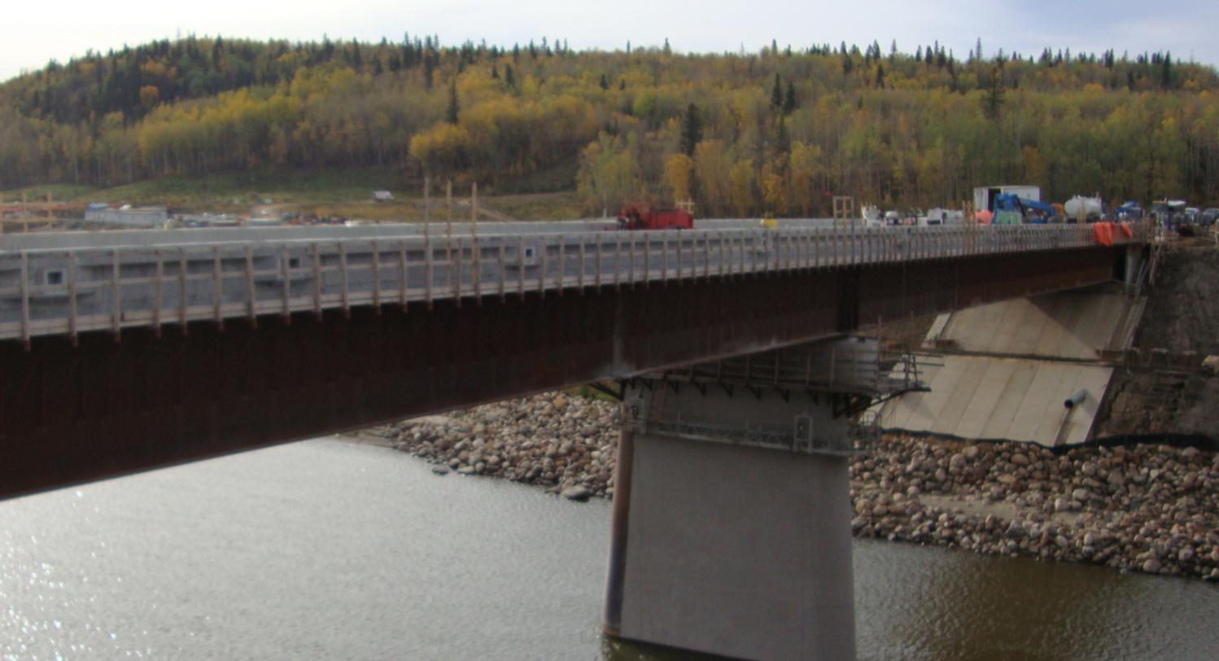
Bridge Engineering Section
Bridge Construction
Notes:
Bridge Construction
The new bridge nearing completion.

Slide 27
Bridge Engineering Section
Functional Planning
Bridge Management
Bridge Inspection
& Maintenance
New
New Bridge
or Existing?
Existing
Bridge
Assessment
Replace
Repair or
Replace?
Repair
New Design
Rehabilitation
Design
Conceptual
Design
Detailed
Design
Tender Preparation
and Advertisement
Construction
Notes:
Bridge Construction
“Construction” phase involving contract administration and post construction services is the last in the stop in our flowchart before bridge inspection & maintenance and functional planning start the life cycle adventure all over again.

Slide 28

Bridge Engineering Section
Bridge Construction
Notes:
Bridge Construction
Again, under the ‘construction’ heading of the bridge and structure technical resource page - all links to resources that are relevant to contract administration, and bridge construction inspection are presented.
- A revised version of the Engineering Consultant Guidelines Vol 2 is hot off the presses and provides guidance on what the contract administration requirements are for our Consultants and what services must included when proposing on providing contract administration services for bridge projects.
- As with tender package preparation and even more intimate working knowledge of the General Specifications for Highway and Bridge Construction and Standard Specifications for Bridge Construction is imperative

Slide 29
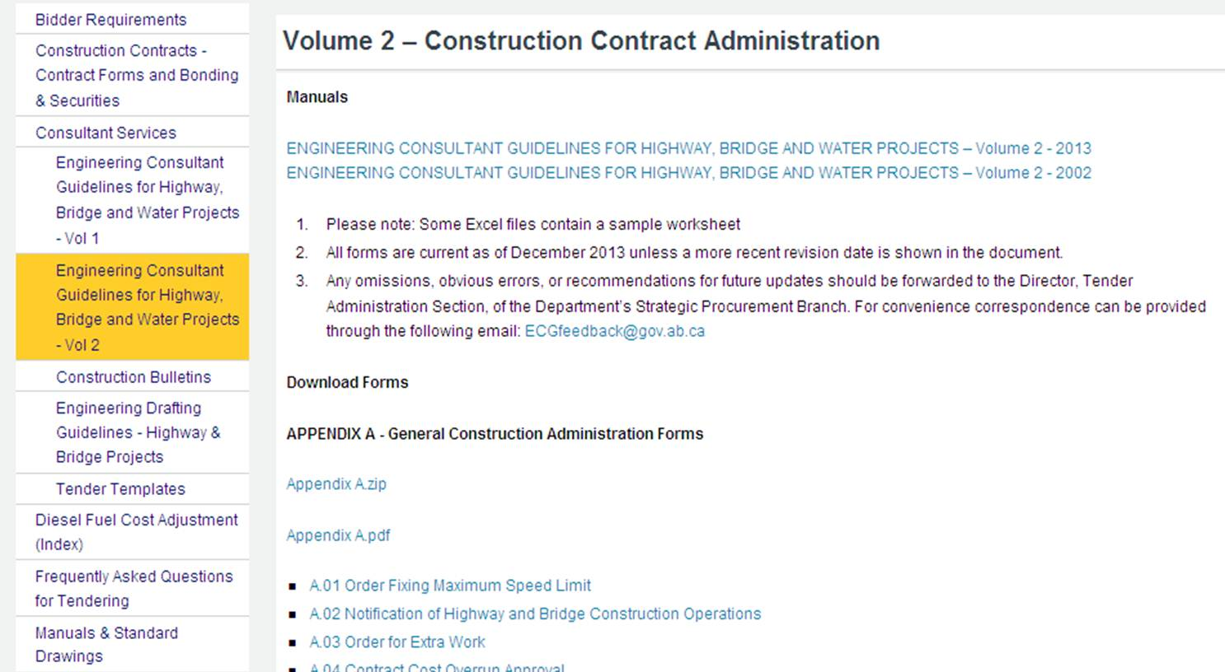
Bridge Engineering Section
Bridge Construction
Notes:
Bridge Construction
In addition to significant content changes within the Vol 2 consultant guideline itself,

Slide 30
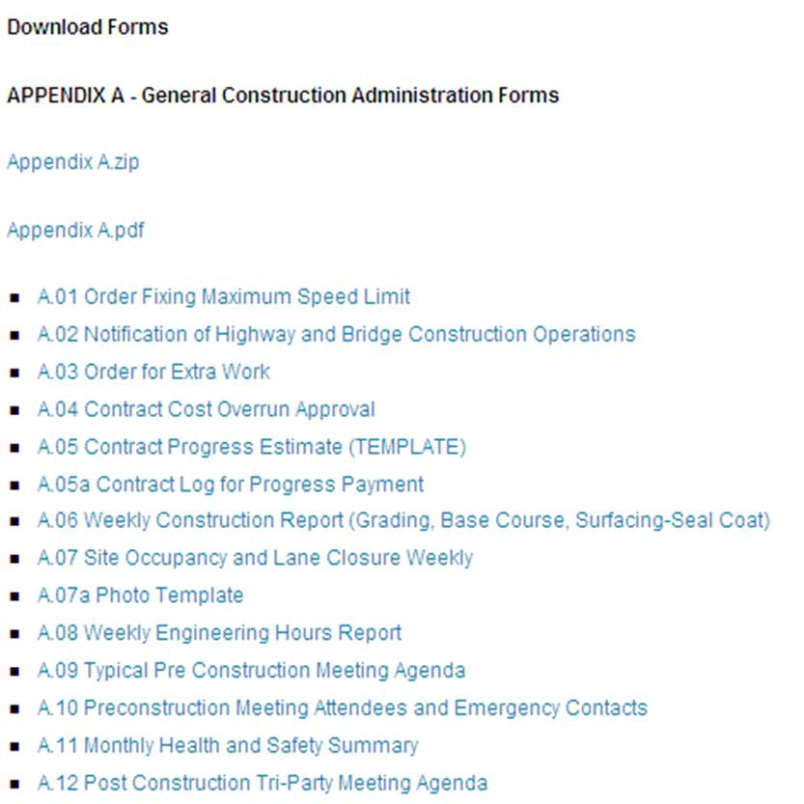
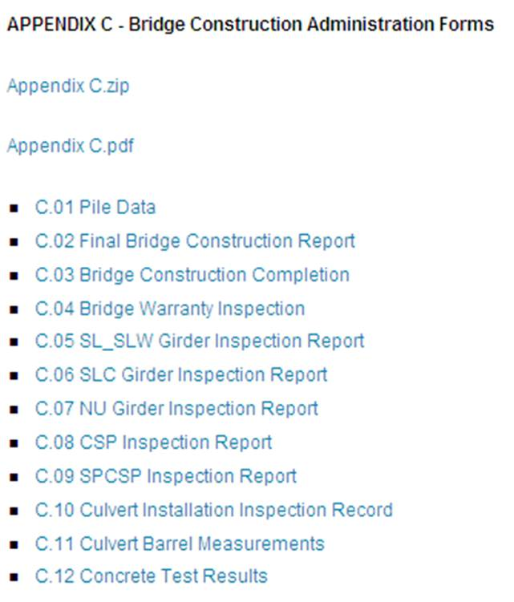
Bridge Engineering Section
Bridge Construction
Notes:
Bridge Construction
Downloadable forms are now available for a significant portion of construction administration tasks. In addition to the general construction admin forms such as orders for extra work, weekly construction reports, construction photo templates there are also bridge specific project administration forms that should be used where applicable.

Slide 31
Bridge Engineering Section
Bridge Construction
Notes:
Bridge Construction
- As with tender package preparation and even more intimate working knowledge of the General Specifications for Highway and Bridge Construction and Standard Specifications for Bridge Construction is imperative

Slide 32
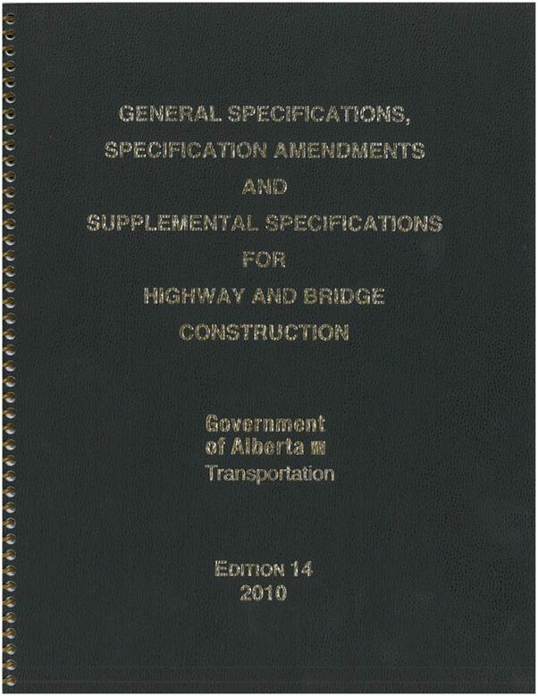
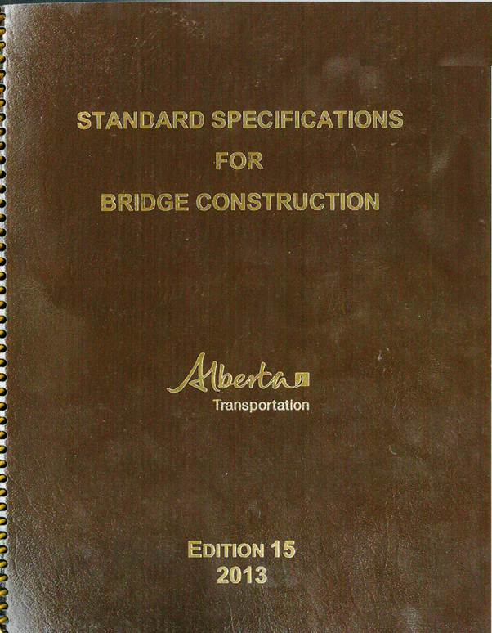
Bridge Engineering Section
Bridge Construction
Notes:
Bridge Construction
These documents, in combination with tender package form the contractual obligations that the Contractor must fulfil. It is important that the requirements of the specifications are enforced such that good construction practices will be followed and there is consistency in contract administration Provincially.

Slide 33

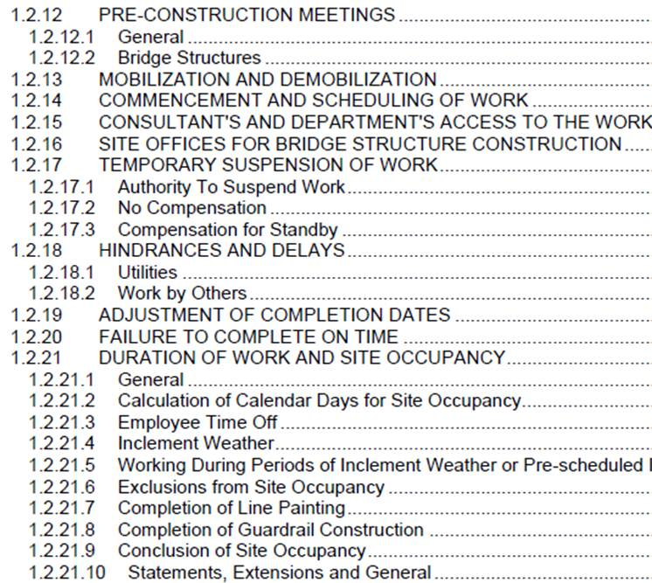
Bridge Engineering Section
Bridge Construction
Notes:
Bridge Construction
The General Specifications provide detailed contract administration requirements such as:
Preconstruction meetings,
the process to assess a contractor’s proposed contract design change
Site office requirements for bridge structure construction
Penalties
Determination of site occupancy days,
Etc.

Slide 34
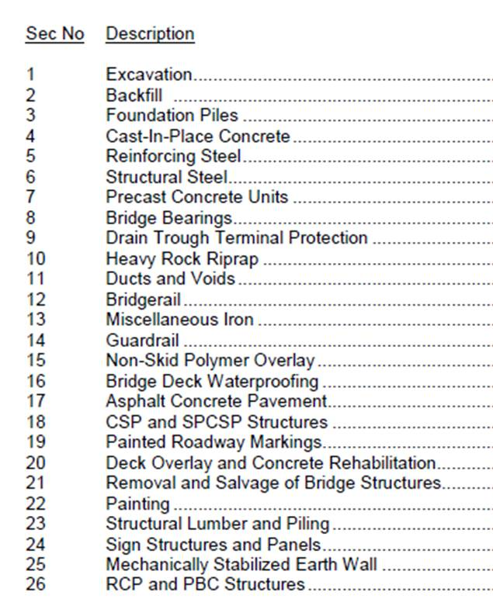
Bridge Engineering Section
Bridge Construction
Notes:
Bridge Construction
The Standard Specifications for Bridge Construction provide very detailed technical requirements as well as some contract administration items such as bid item payment conditions.
There are 26 section in total ranging from Foundation Piles to Bridge Deck Waterproofing
The standard specifications are comprehensive. The document is substantial at ~ 350 pages that requires thorough review and understanding to ensure Department requirements are met.

Slide 35
Bridge Engineering Section
Bridge Construction
Notes:
Bridge Construction
The completion of a bridge structure is a team effort between design, material, and construction personnel, requiring academic knowledge and many years of related experience. Successful completion of the bridge depends on the efforts of the Contractor and to a very large extent the quality of the inspection performed during construction.
Informed inspection is the link between design and construction.
A reference document for inspection and contract administration for the Project Engineer and Bridge Inspector is the Department’s Bridge Construction Inspection Manual.

Slide 36
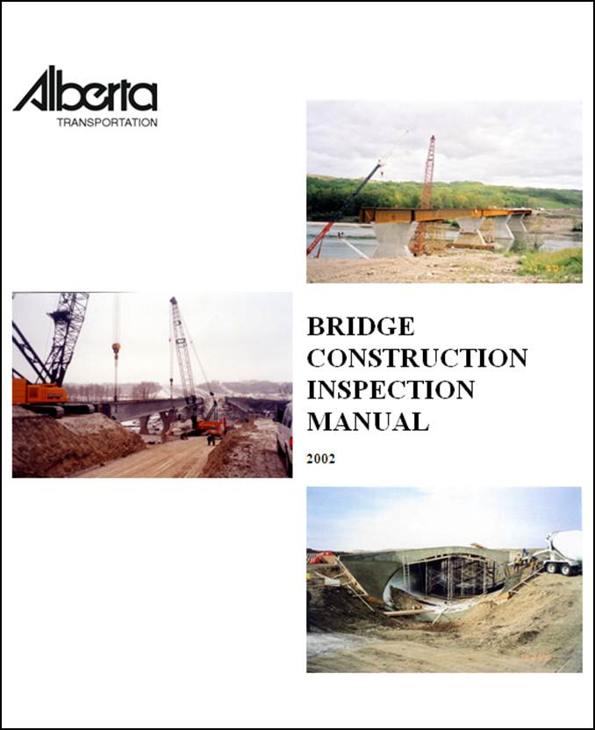
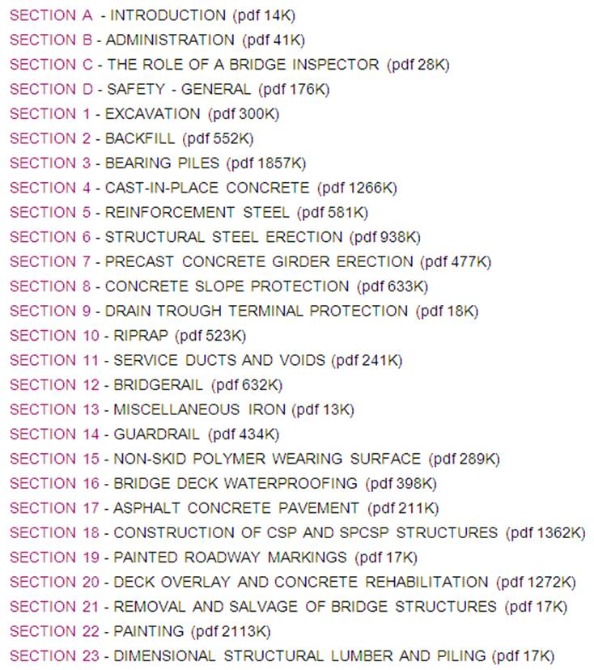
Bridge Engineering Section
Bridge Construction
Notes:
Bridge Construction
The manual should be reviewed regularly by even the most experienced Bridge Inspector.
Sections B, C, and D of describe administrative duties, the role of a bridge inspector, and safety considerations.
Subsequent sections deal with the technical details of inspection and provides guidance and understanding of phase of the work.
You can notice that the inspection manual layout follows (or I should say followed) the Standard Specifications for Bridge Construction Sections. The Department is currently in the process of revising this manual to align with the 2013 edition and is schedule for completion by the fall of 2014.

Slide 37
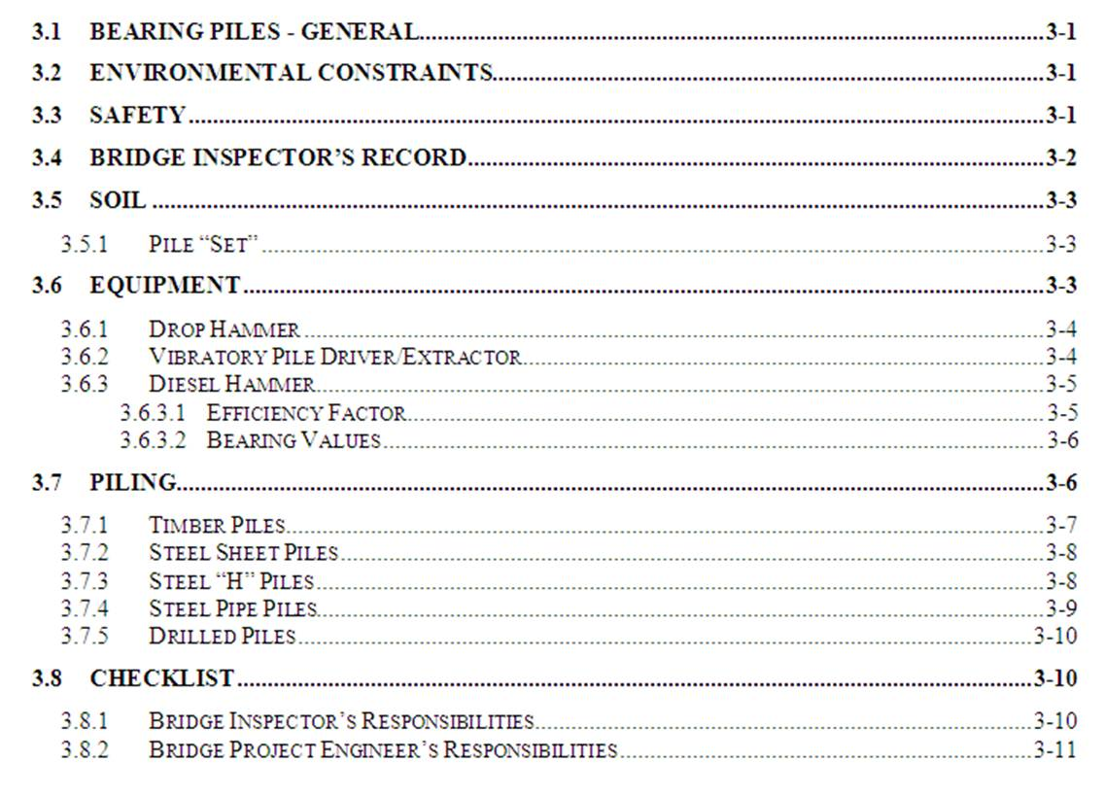
Bridge Engineering Section
Bridge Construction
Notes:
Bridge Construction
Section layouts are generally similar. For example the foundation pile section contains, Genera, Environmental, Safety, Inspector Records, Technical Specific considerations, Inspector checklists and responsibilities.

Slide 38
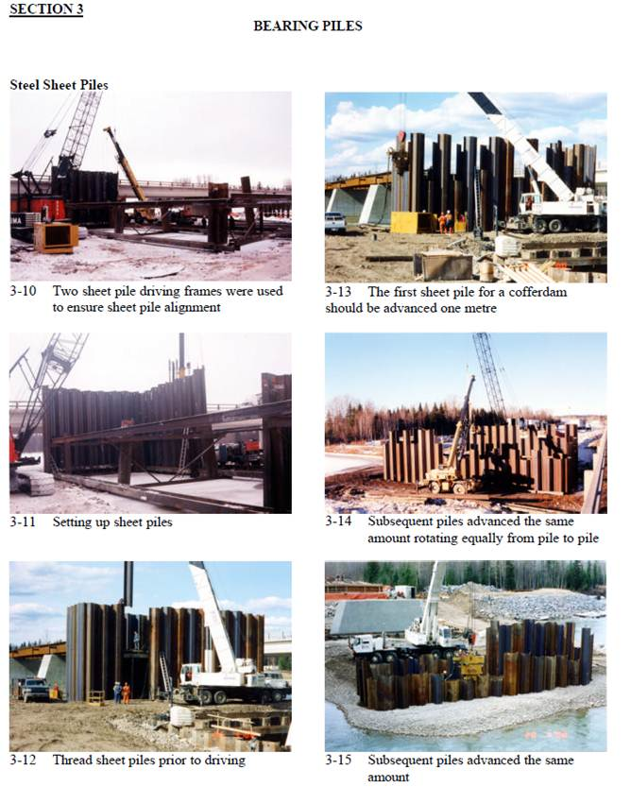
Bridge Engineering Section
Bridge Construction
Notes:
Bridge Construction
Also included in the manual are reference photos depicting different construction and inspection operations. As part of the manual update photo quality and relevance will be improved for inspector reference.

Slide 39
Bridge Engineering Section
Bridge Construction
Notes:
Bridge Construction
The consultant guidelines volume 2 also provides guidance on requirements for post construction services.

Slide 40
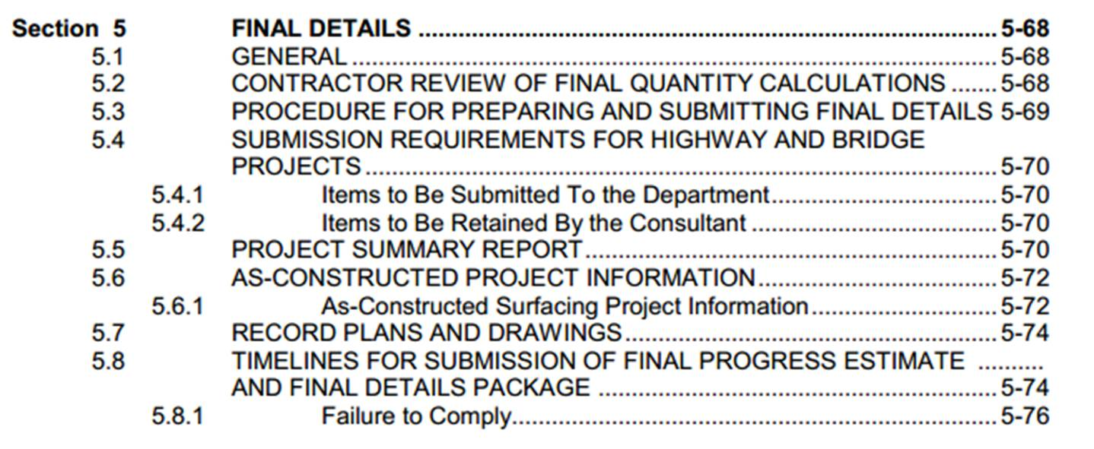
Bridge Engineering Section
Bridge Construction
Notes:
Bridge Construction
Section 5 of the guidelines also summarizes the requirements of post construction or final details.

Slide 41
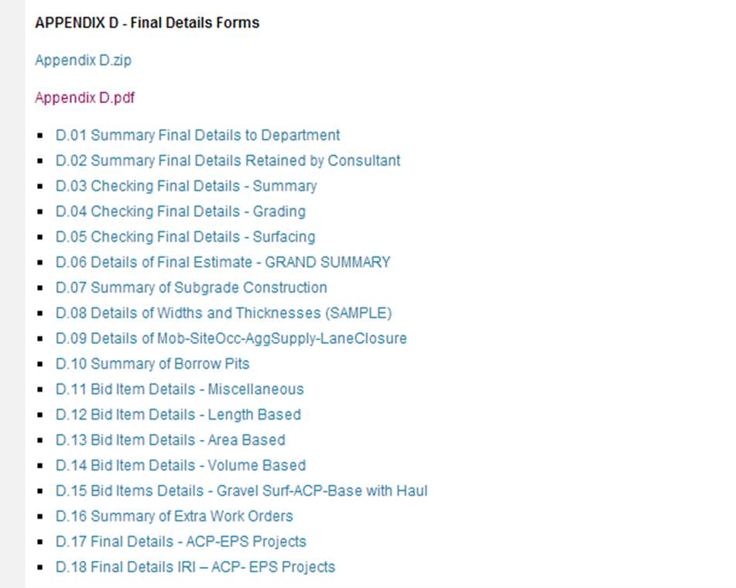
Bridge Engineering Section
Bridge Construction
Notes:
Bridge Construction
And Appendix ‘D’ is provides detailed checklists and forms to use in completion of final detail packages.

Slide 42
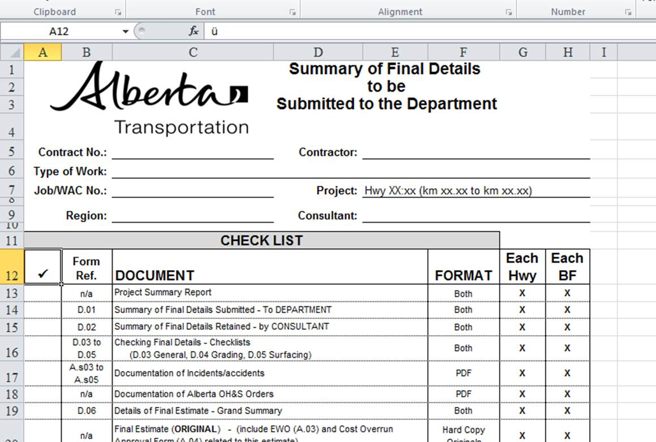
Bridge Engineering Section
Bridge Construction
Notes:
Bridge Construction
The checklists here ensure that all required project information is captured and submitted for department records. Accurate and detailed information is very important to the ongoing maintenance and management of our bridge inventory.

Slide 43
Bridge Engineering Section
Functional Planning
Bridge Management
Bridge Inspection
& Maintenance
New
New Bridge
or Existing?
Existing
Bridge
Assessment
Replace
Repair or
Replace?
Repair
New Design
Rehabilitation
Design
Conceptual
Design
Detailed
Design
Tender Preparation
and Advertisement
Construction
Notes:
Bridge Construction
As we’ve seen throughout the presentation today there are many requirements and expectations when working in various area of bridge engineering for Alberta Transportation. Hopefully we were able to convey a brief summary of the resources available and where they are located. This concludes our overview of bridge engineering at TSB.

