Slide 1
Tender Packages
(Consistency with Current Design Bulletins)
Basic Knowledge for Roadway and Bridge Projects Seminar for CEA Members
Edmonton
February 12, 2014

Slide 2
Design Bulletin 18
Rumble Strip Placement Practices
April, 2012

Slide 3
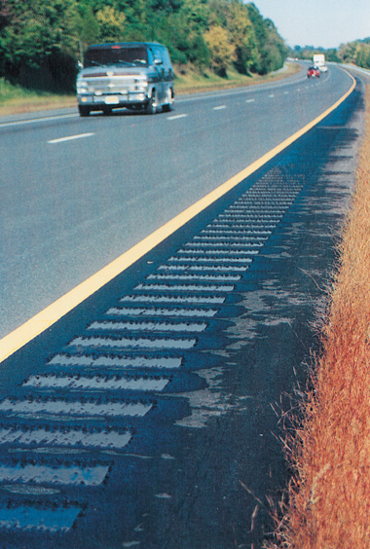
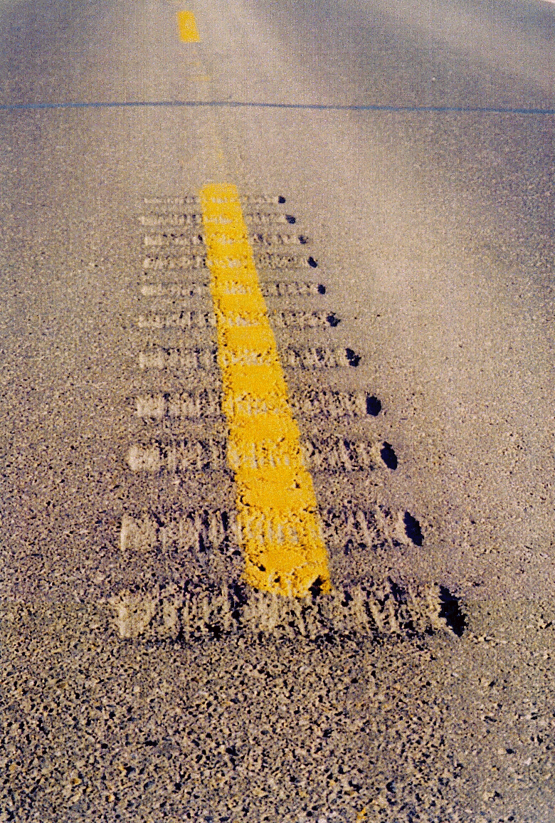
Rumble Strips …
… are a preventative measure

Slide 4
Rumble Strips …
… are a preventative measure
… reduce cross-the-centre incidents

Slide 5
Rumble Strips …
… are a preventative measure
… reduce cross-the-centre incidents
… reduce run-off-road incidents*
* 40% of rural injury crashes are
run-off-road type.

Slide 6
Why Use Rumble Strips?
Rumble Strips are considered to be the most cost-effective safety measure that has not been universally adopted to date.
Can reduce fatigue-related crashes by between 20% and 80% (according to published studies).

Slide 7
Shoulder Rumble Strips
On two-lane highways
- shoulders are 1.4 m wide or greater.

Slide 8
Shoulder Rumble Strips
On two-lane highways
- shoulders are 1.4 m wide or greater.
On multilane (divided) highways
- right shoulder is 1.4 m wide or greater.

Slide 9
Shoulder Rumble Strips
On two-lane highways
- shoulders are 1.4 m wide or greater.
On multilane (divided) highways
- right shoulder is 1.4 m wide or greater.
- left shoulder (median) is 0.6 m wide or greater.

Slide 10
Centreline Rumble Strips
- warranted on all undivided paved highways

Slide 11
Transverse Rumble Strips
On the stop-controlled approaches
of all stop-controlled intersections

Slide 12
Transverse Rumble Strips
On the stop-controlled approaches
of all stop-controlled intersections
- in rural areas;

Slide 13
Transverse Rumble Strips
On the stop-controlled approaches
of all stop-controlled intersections
- in rural areas;
- where the posted speed limit is 80 km/h or greater;

Slide 14
Transverse Rumble Strips
On the stop-controlled approaches
of all stop-controlled intersections
- in rural areas;
- where the posted speed limit is 80 km/h or greater;
- highway and intersecting approaches are paved;

Slide 15
Transverse Rumble Strips
On the stop-controlled approaches
of all stop-controlled intersections
- in rural areas;
- where the posted speed limit is 80 km/h or greater;
- highway and intersecting approaches are paved;
- not less than 300 m of a residence.

Slide 16
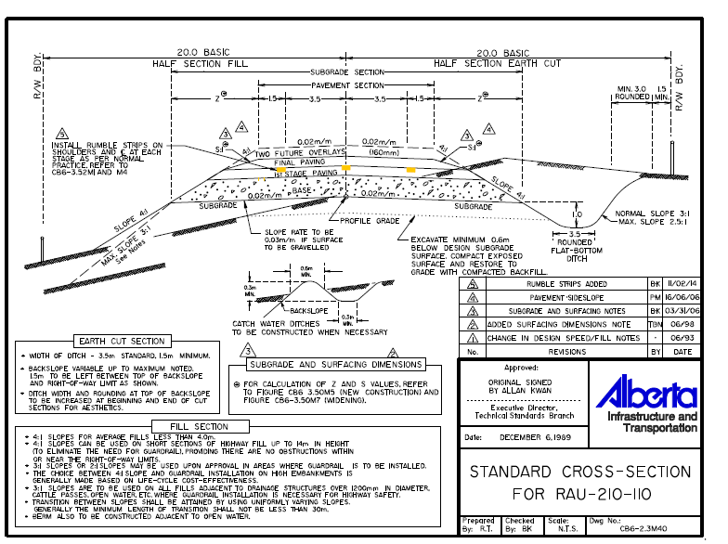

Slide 17
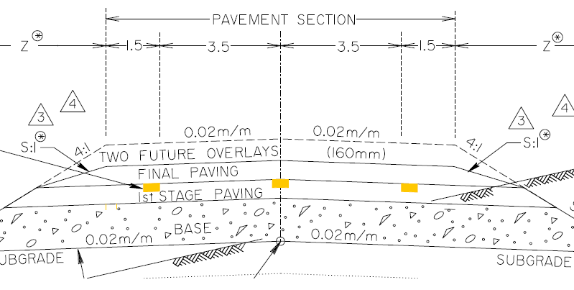
Rumble Strips shown on standard cross-sections.

Slide 18
Design Bulletin 75
High Tension Cable Barrier System -
Median and Roadside Installation
April, 2012

Slide 19
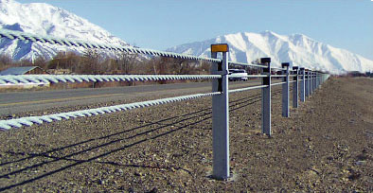
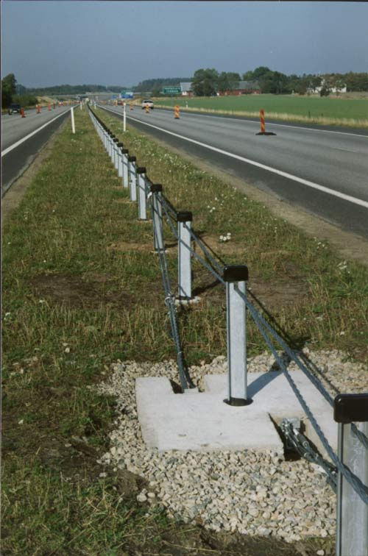
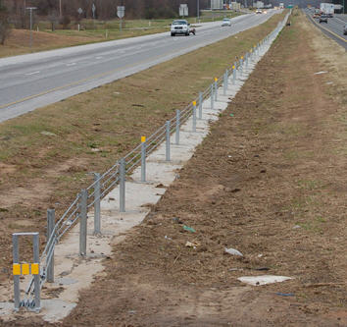
High Tension Cable Barrier Systems

Slide 20
Where do serious collisions occur?
60% of fatal crashes involve one vehicle (USA)
70% of single vehicle fatal crashes are Run-off-Road – fixed object or overturn.
Alberta data is similar – about half of fatal collisions occur on roadside.

Slide 21
3 Types of Longitudinal Barriers
Rigid:
  Concrete

Slide 22
3 Types of Longitudinal Barriers
Rigid:
  Concrete
Semi-Rigid:
  Strong posts of steel, wood or plastic
  Steel beams

Slide 23
3 Types of Longitudinal Barriers
Rigid:
  Concrete
Semi-Rigid:
  Strong posts of steel, wood or plastic
  Steel beams
Flexible Barriers:
  High Tension Cable
  Low Tension Cable
  Weak Post Steel Beam

Slide 24
High Tension Cable Barrier
All types of median barriers can prevent crossover collisions on divided highways.
HTCB is the most forgiving and least costly.

Slide 25
Traffic Barrier System Selection
Designers are encouraged to
select the most forgiving barrier system
that will provide the required level of protection for the given circumstances and constraints.

Slide 26
Design Bulletin 68
Roundabout Design Guidelines on Provincial Highways
February, 2011
(new draft currently being produced)

Slide 27

Safety effects of Roundabouts.
Collision rate reduction 39%
Notes:
Our degree of confidence in using these figures is high due to multiple sources. The collision reporting rules (especially for pdo’s) varies around the world which accounts for some differences in the predicted impacts. Also, the familiarity of the driving public with roundabouts can relate to performance.

Slide 28
Safety effects of Roundabouts.
Collision rate reduction 39%
Fatal collision reduction 90%
Notes:
Our degree of confidence in using these figures is high due to multiple sources. The collision reporting rules (especially for pdo’s) varies around the world which accounts for some differences in the predicted impacts. Also, the familiarity of the driving public with roundabouts can relate to performance.

Slide 29
Safety effects of Roundabouts.
Collision rate reduction 39%
Fatal collision reduction 90%
Injury collision reduction 76%
Notes:
Our degree of confidence in using these figures is high due to multiple sources. The collision reporting rules (especially for pdo’s) varies around the world which accounts for some differences in the predicted impacts. Also, the familiarity of the driving public with roundabouts can relate to performance.

Slide 30
Safety effects of Roundabouts.
Collision rate reduction 39%
Fatal collision reduction 90%
Injury collision reduction 76%
Pedestrian Crash reduction 73%
Source: Transport Canada, Clearinghouse for CMFs, Desktop Reference for CRF (FHWA), NCHRP 617 (TRB).
Notes:
Our degree of confidence in using these figures is high due to multiple sources. The collision reporting rules (especially for pdo’s) varies around the world which accounts for some differences in the predicted impacts. Also, the familiarity of the driving public with roundabouts can relate to performance.

Slide 31
Roundabout Policy
Roundabouts shall be considered as the first option
for intersection designs where
a greater degree of traffic control than
a two-way stop is required on a paved roadway.
e.g. signalization or 4-way stop control.
Notes:
Our degree of confidence in using these figures is high due to multiple sources. The collision reporting rules (especially for pdo’s) varies around the world which accounts for some differences in the predicted impacts. Also, the familiarity of the driving public with roundabouts can relate to performance.

Slide 32
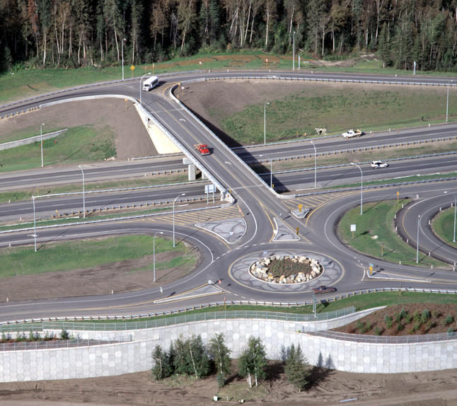
Partial Dumbbell
King St Interchange, Fort McMurray, AB

Slide 33
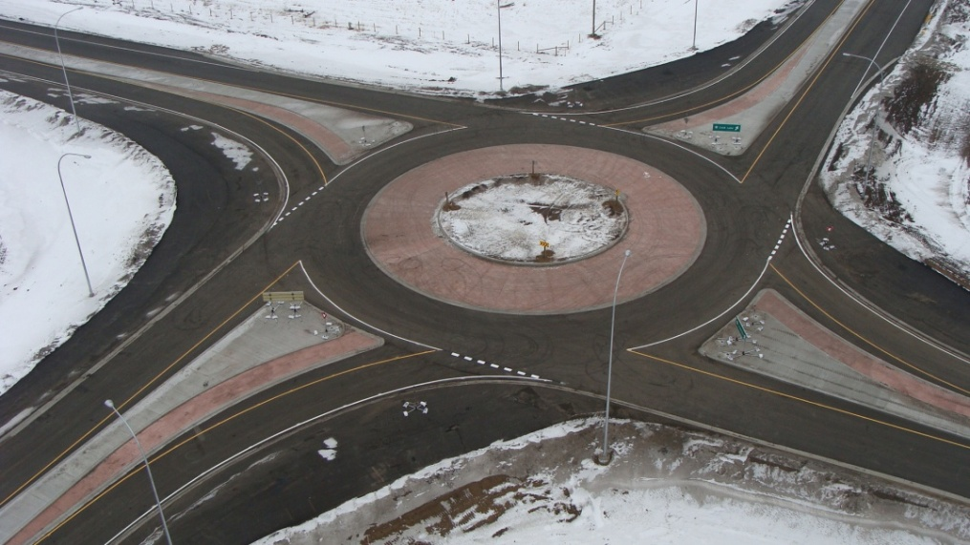
Single Lane, Major Highway
Hwy 55 & 892, near Cold Lake, AB

Slide 34
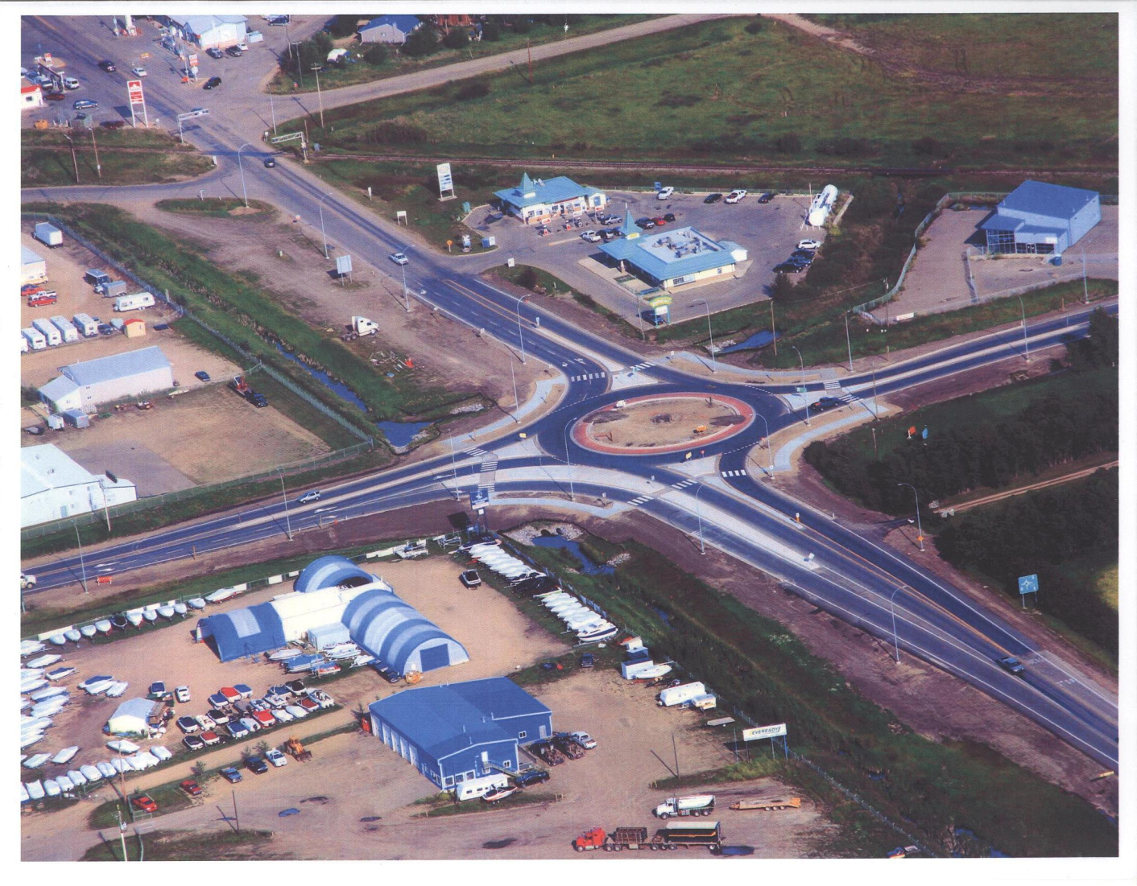
Urban Fringe
Highway 11A & 20, Sylvan Lake, AB

Slide 35
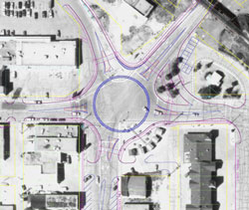
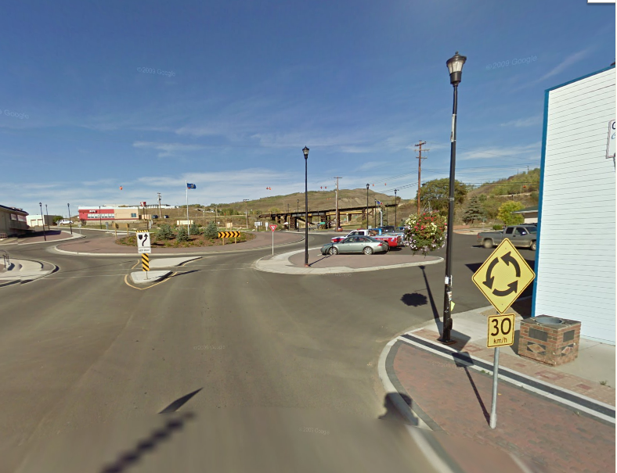
Urban Highway
Highway 774 & Main Street
Peace River, AB

Slide 36
Design Bulletins contain updates to standards or practices after consultation / approval has been obtained currently have produced over 75 bulletins
If bulletins are not followed, there should be a design exception or some documentation to show rationale / approval for the choice.

Slide 37
Some jobs have been tendered that do not comply with the current standards.
Examples are:
Omission of rumble strips
(centreline and / or shoulder)
Use of conventional barrier instead of HTCB
Implications on safety and operating costs

Slide 38
Possible Remedies:
- knowledge of design bulletins (up-to-date);
- note in Terms of Reference to follow bulletins;
- Region to check the tender package prior to submission;
- projects being returned from shelf should consider design bulletin content;
- consultants double-check estimates
(two signatures).

Slide 39
Red Flags
Bid items that are included:
- W-beam guardrail;
- Thrie Beam;
- Concrete Barrier.
- Signals.
Bid items that are not included:
- Rumble Strip items are zero.

