Slide 1
Environmental Management Services
February 2014

Slide 2
Today…
Who we are…
What we do…
Where you can go for help…

Slide 3
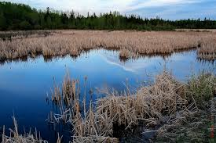
Our mission…
Environmental Management Services is a Centre of Excellence in Environmental Management
Notes:
Simple, we want to be a center of excellence in environmental management

Slide 4
What do we do?

Slide 5
Provide leadership and innovation in:
Developing of standards, guidelines, specifications, and processes for environmental management
Streamlining regulatory approval processes in partnership with Federal and Provincial authorities
Promote awareness of environmental issues and tools to successfully complete projects
Notes:
Provide leadership and innovation in developing of standards, guidelines, specifications, and processes for environmental management
Provide leadership and innovation in streamlining regulatory approval processes in partnership with Federal and Provincial authorities
Promote awareness of environmental issues and tools to successfully complete projects

Slide 6
Provide expertise, advice and training
What we do continued…
Ensure compliance with relevant environmental legislation and policies
Maintain and promote the department’s Environmental Management System
Notes:
Provide expertise, advice and training to project delivery staff in the regions and across the department
Ensure the Department’s activities are carried out in compliance with relevant environmental legislation and policies
Maintain and promote the department’s Environmental Management System

Slide 7
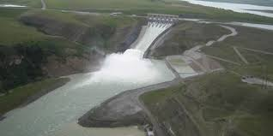
Oversee environmental assessment and environmental components of major and complex transportation and water management projects

Slide 8
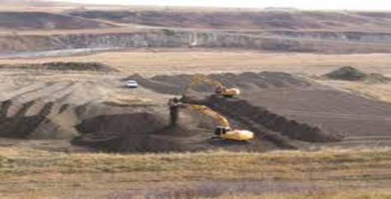
Oversee contaminated site assessments and remediation on behalf of the ministry and other Government of Alberta departments

Slide 9
Represent the department on cross-ministry and intergovernmental initiatives to ensure the department’s interests are met in developing or refining legislation, regulations, guidelines and policies

Slide 10
- Support the Regional Environmental Coordinators
- Provide environmental management expertise, support and training to department staff and external stakeholders

Slide 11
Who are we?

Slide 12
Don Snider Director, Environmental Services

Slide 13
Joy Bliss Administrative Support

Slide 14
Darren Carter Manager, Environmental Performance

Slide 15
John Englert Manager, Environmental Regulation

Slide 16
Mark Svenson Provincial Transportation Environmental Coordinator

Slide 17
Dana Becker Manager, Environmental and Aquatic Resources

Slide 18
Sameh Elsayed Senior Environmental Engineer

Slide 19
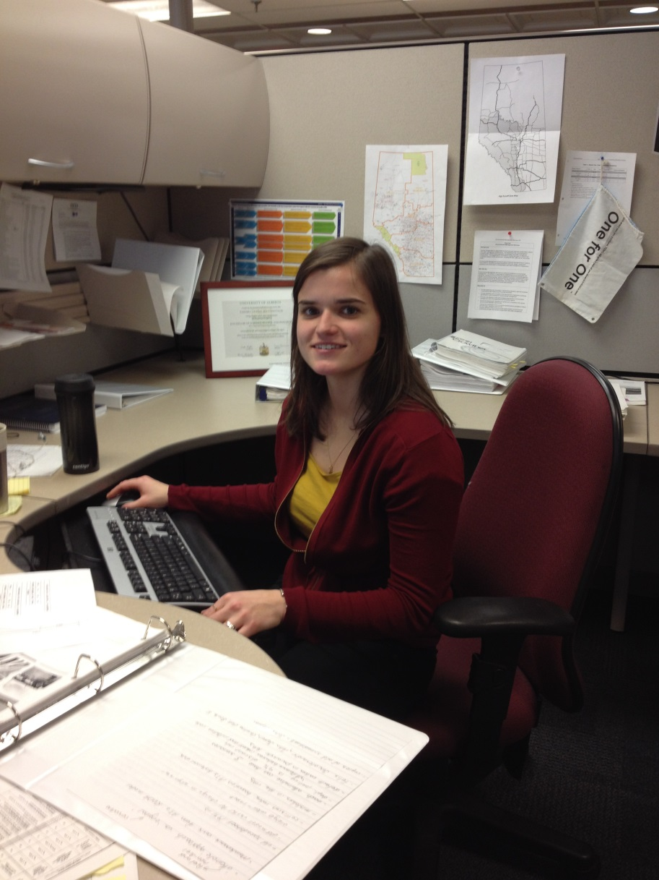
Tamara Soltykevych Engineering Intern

Slide 20
Where to go for help?
Notes:
So…where can you go for help?

Slide 21
Alberta Transportation Website:
Bridges and Structures
Engineering Consultant Guidelines (Volume 1)
http://www.transportation.alberta.ca/915.htm
Chapter 4
Environmental Risk Assessment
Weed Surveys
Contaminated sites
Inspection and monitoring
Spill reporting

Slide 22
Alberta Transportation Website: Environmental Management http://www.transportation.alberta.ca/571.htm
Environmental Management Documents:
Borrow Excavation
ECO Plan Framework 2013
Environmental Management System (EMS) Manual
Fish Habitat Manual
Alberta Transportation Environmental Protection Plan
The Conversion of Nephelometric Turbidity Units
Planning Considerations for Wildlife Passage in Urban Areas
Alberta Transportation Environmental Evaluation Terms of Reference June 2011
Alberta Transportation Environmental Assessment Terms of Reference June 2011
Guidelines for Navigable Waters Protection Act
Turbidity

Slide 23
Environmental Management System
Definition – An organized and formal approach to managing environmental issues with the goal of making environmental considerations part of daily activities

Slide 24
Environmental Management System Manual
http://www.transportation.alberta.ca/2643.htm
Specifies departmental environmental policy
Outlines roles and responsibilities of staff, consultants and contractors
Outlines process for inspections, monitoring, correcting and documentation
Provides Regulatory Approvals Framework

Slide 25
Regulatory Approvals Framework
Part of Environmental Management System Manual
Consists of checklists and flowcharts to help ensure environmental legislation is considered in project planning
Provides means to document considerations and decisions
Ensures approvals are in place prior to construction commencing
Provides generalized timelines for process to help project planning

Slide 26
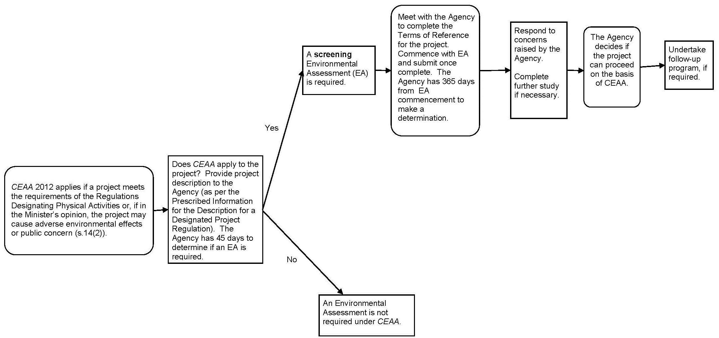
Alberta Transportation Environmental Approvals Framework Supplementary Canadian Environmental Assessment Act (CEAA 2012) Screening Process Flow Chart

Slide 27
Regulatory Approval Flow Charts & Checklists
Fisheries Act
Water Act
Historical Resources Act
Environmental Protection and Enhancement Act
Public Lands Act
Navigable Waters Protection Act
Natural Resources Conservation Board Act
Canadian Environmental Assessment Act

Slide 28
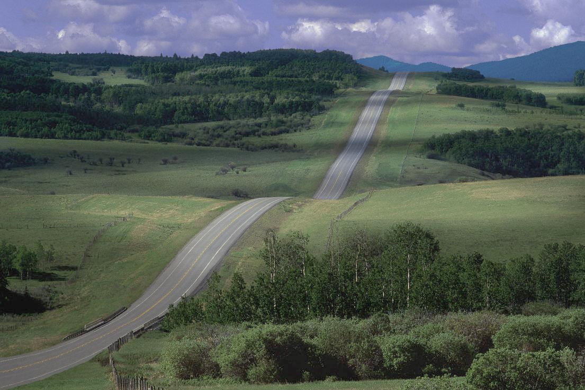
Regional Environmental Coordinators
Provide advice and assistance to Project Sponsors and Project Administrators regarding environmental aspects of road, bridge and water management projects
Establish working relationships with regulatory agencies in region
Review draft applications for regulatory approvals
Monitor, track and report on departmental or regional environmental non-compliance issues that have been identified by Service Providers or by Department employees and ensure proper follow-up

Slide 29
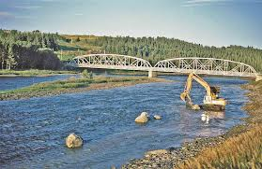
Who are your regional contacts in Alberta Transportation?

Slide 30
Regional Environmental Coordinators
Michael Brown: – Peace Region
Stephen Legaree: – North Central and
Fort McMurray Regions
Trisha Bichel: – Central Region
Leslie Wensmann: – Southern Region

Slide 31
Thank You!
…Questions?

