Slide 1
Intelligent Transportation System
When to deploy ITS?
ITS
How much is ITS?
What are the ITS applications?
To increase the safety and capacity
of existing facilities

Slide 2
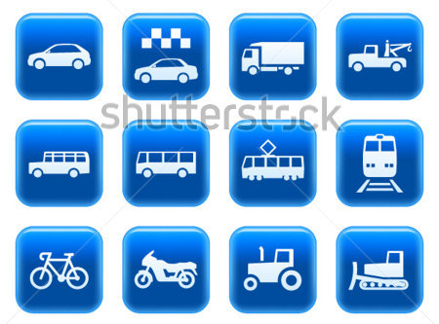
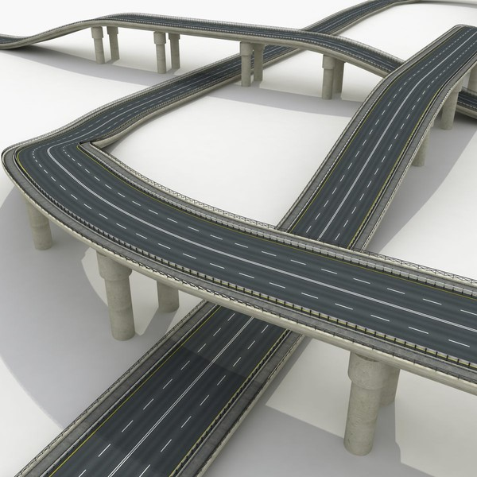
Vehicles
Users
Infrastructure

Slide 3
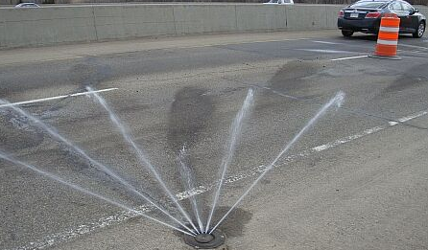
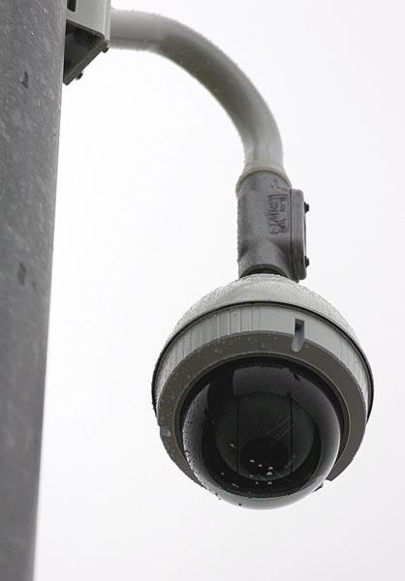
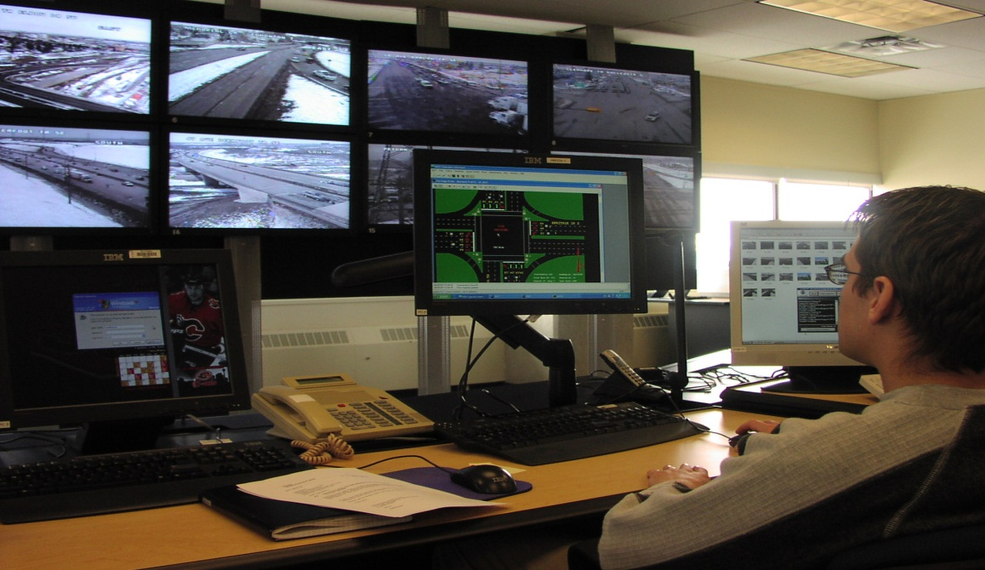
Vehicles
Users
Infrastructure
Smart Infrastructure

Slide 4
Should I take this or that route; should I go or not go?
Vehicles
511
Users
social media
Are the winter driving conditions ok?
crowdsourcing
Infrastructure
Is traffic backed up? Accidents?
Smart Users
Users Choices

Slide 5
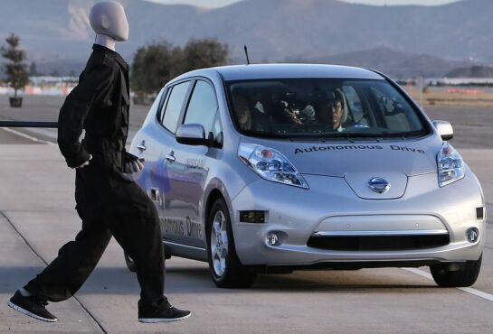
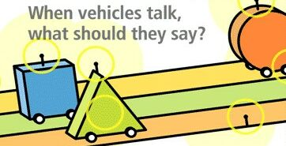
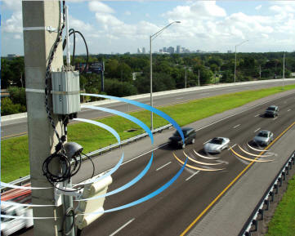
Legislation
Vehicles
Users
V2V
Infrastructure
Human factors?
V2I
Connected Vehicles

