Slide 1
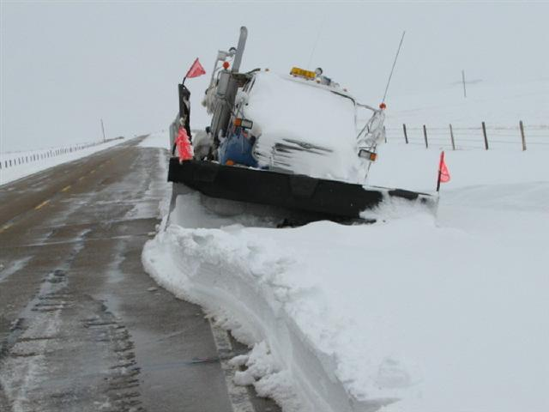
Highway Operations Section
Technical Standards Branch
Section overview

Slide 2
HIGHWAY OPERATIONS SECTION
Technical Standards Branch, Engineering & Policy Division
Operations

Slide 3
HIGHWAY OPERATIONS SECTION
Technical Standards Branch, Engineering Services Division
Operations
Traffic Engineering

Slide 4
HIGHWAY OPERATIONS SECTION
Technical Standards Branch, Engineering Services Division
Operations
Traffic Engineering
ITS and Safety

Slide 5
HIGHWAY OPERATIONS SECTION
Technical Standards Branch, Engineering Services Division
Operations
Traffic Engineering
ITS and Safety
Utility Coordination

Slide 6
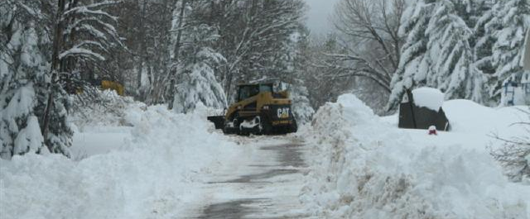
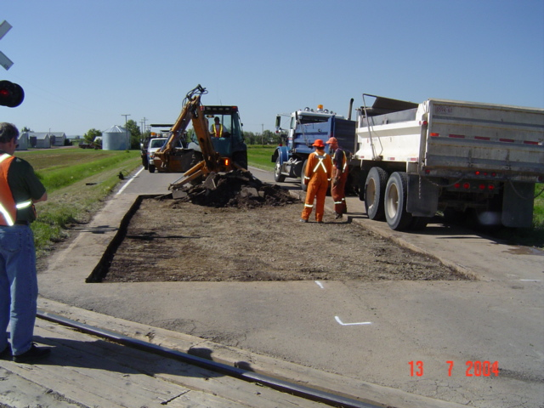
OPERATIONS GROUP
The Operations group is involved with:
Developing standards:
  Highway Maintenance Specifications
  Contract Administration Manual (Highway & Bridge Maintenance),
  Surface Condition Rating Manual,
  Ferry Operations Manuals
Setting up new highway maintenance contracts

Slide 7
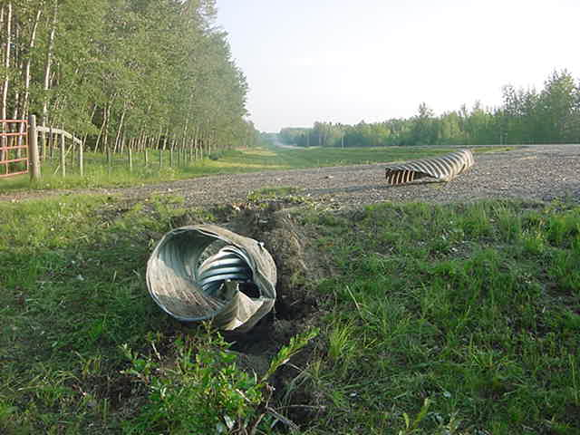
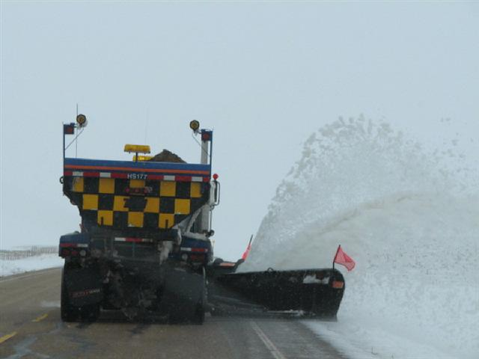
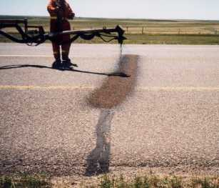
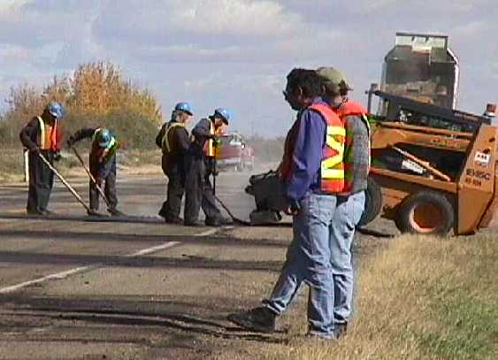
Gives advice within the department and works with other provinces & cities
So here’s what ya gotta do…..

Slide 8



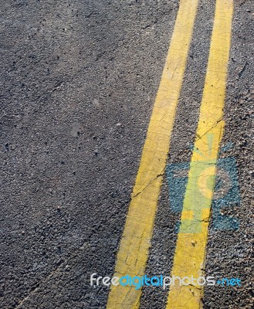
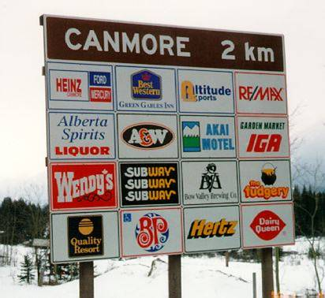
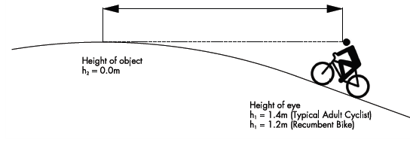
TRAFFIC ENGINEERING GROUP
The Traffic Engineering group is involved with:
Developing standards for all types of traffic control devices
  (traffic signals, signs, pavement markings,
  highway lighting, speed limits, rail crossings, the Tourism Highway Signage Program)

Slide 9
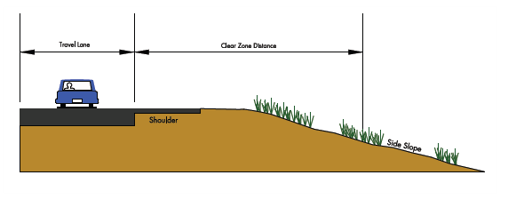

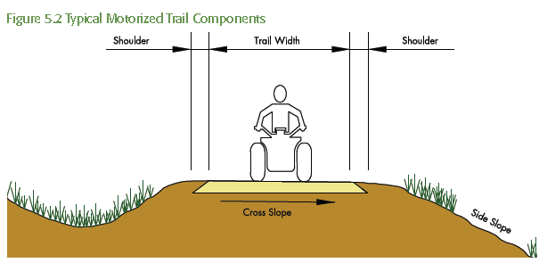
Provides Advice to consultants, contractors and to department staff
So here’s what ya shudda done...

Slide 10
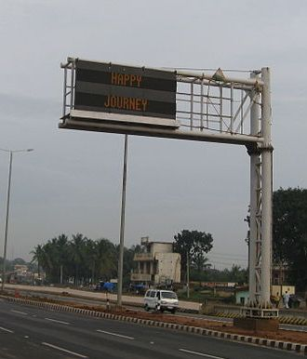
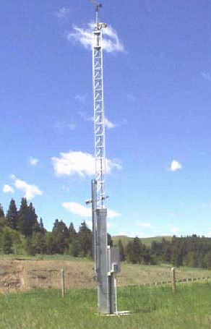
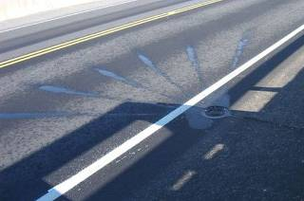
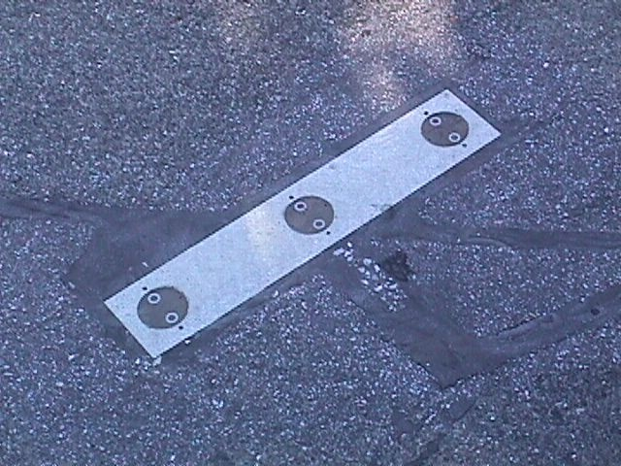
Intelligent Transportation Systems (ITS) and SAFETY GROUP
The ITS and Safety group is involved with:
Developing policies and standards for ITS initiatives:
  dynamic message display signs,
  road weather information systems,
  automated vehicle locating systems,
  traffic monitoring and management systems,
  fixed anti-icing spray technology systems)
Pavement Sensors

Slide 11
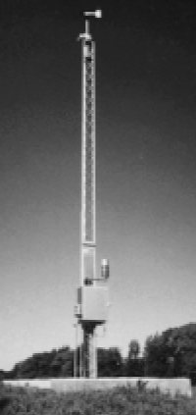
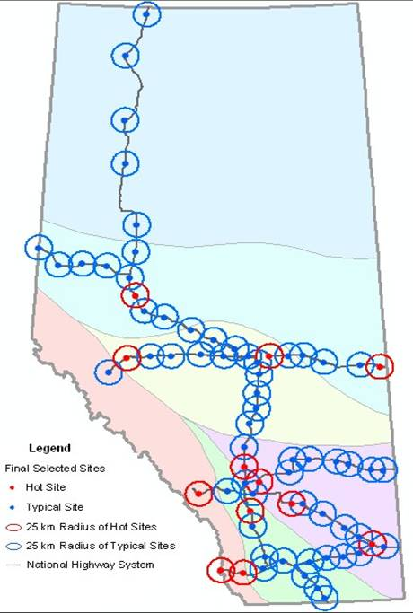
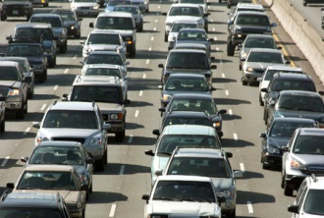

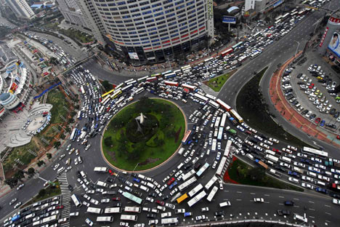
Does our ITS deployment plan

Slide 12
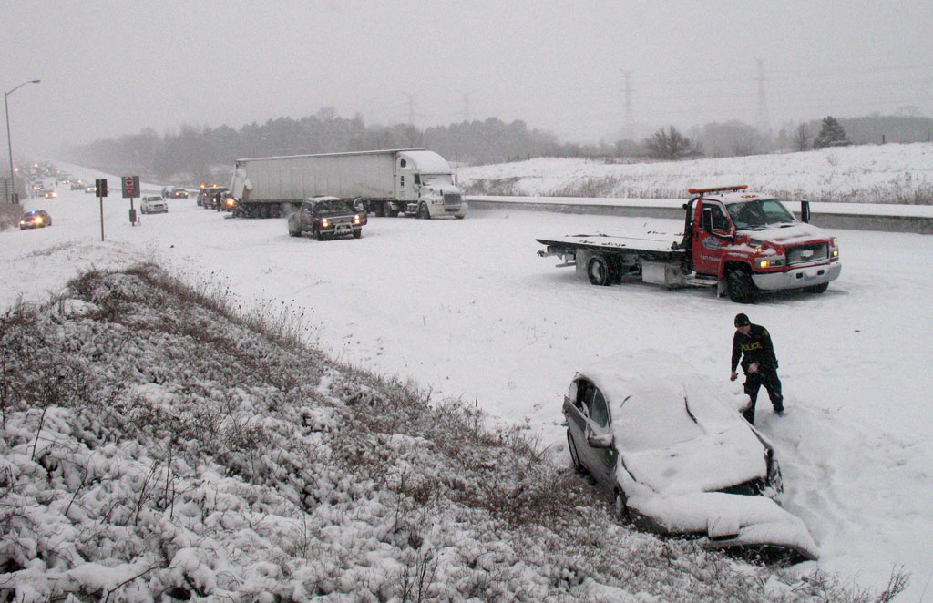
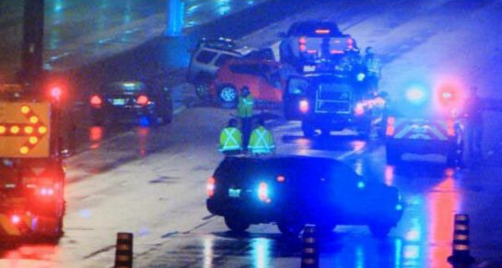
Reviews road safety audits and conducts in-service safety reviews
Provides expert advice and guidance to department and consultant staff
So here’s how ya can fix it…..

Slide 13
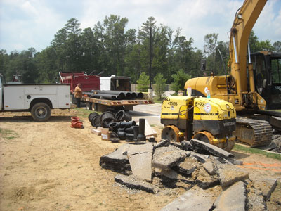
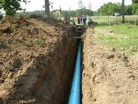
UTILITIES
So why didn’t ya ask me sooner?
The Utility Specialist is involved with:
Developing standards for utility agreements and permits
Providing expert advice and guidance for utility and transportation safety to consultants, contractors and department staff

Slide 14
Next Up -
Blair Knott Traffic Operations
Allan Lo ITS
Joe Mah Utilities

