Slide 1


Slide 2
Who We Are – The Planning Group
Mike Bradley -
TransportationSystems
Investment Strategies Branch
Systems Planning
Network Planning
Multi-Modal
Cross Ministry
Robert Duckworth-Modelling & Analysis
Investment Strategies Branch
Travel Forecast Modelling
Economic Modelling
NESS
Jarret Berezanski-Major Capital Planning
Major Capital Branch
Urban Functional Planning
Ring Road Planning
Regional Ring Road
Complex Projects
Jim Der- Highway & Roadside Planning
Technical Standards Branch
Highway Planning Stds
Roadside Planning Stds
Assist Regions - Studies

Slide 3
Transportation - History
Early 1800’s immigration from Europe began to swell U.S. and Canada’s population – first signs of urban sprawl
Walking distances increased – lack of sidewalks and paved streets made long distance trips difficult and time consuming
Situation resulted in the beginnings of public transportation in North America

Slide 4
Transportation - History
Public transportation began in what is now New York
Entrepreneur named Abraham Brower in 1827 introduced a horse drawn vehicle
Was successful but because of muddy streets was quite slow
Led to the laying of rails – trips faster and smoother
Also led to more opportunities to develop more land for residential sites
1873 – first cable car system in San Francisco

Slide 5
Transportation - History
Transportation came into the modern era in the early 1900’s with invention of automobile
Henry Ford mass produced cars in the early 1910’s - began the long decline of public transportation
Americans loved the freedom of the car – not restricted to steel rail system but could go where ever they wanted to go
Expanded residential land uses which in turn expanded demands for more and better roads.

Slide 6
Transportation - History
In earlier years of century, most travel was limited to work trips
People had neither the time nor money for social and recreational trips, nor adequate transportation facilities available
Now lots of travel
  25% work trips
  15% school trips
  40% personal (shopping, banking, social, recreational)

Slide 7
Transportation - History
Transportation and land use are inextricably related
This has been the case since civilization began and is just as true today
Our mobility has affected where we live and work as well as where society has chose to locate other human activities
Accessibility is key to land use decisions
Without a good transportation system:
  cannot moved products to market efficiently
  Cannot commute easily

Slide 8
Factors affecting office/factory location
Nearness to material/suppliers/customers
Availability of human resources
Availability of infrastructure –power, communication, water
Availability of transport
Amenities – health, education, recreation
Environment – healthy environment
Cost of space
Government laws

Slide 9
WHY DO
WE PLAN?

Slide 10
Why Plan?
Planning without Action is Futile
Action without Planning is Fatal

Slide 11
Why Plan?
To achieve the best overall, cost effective, and safe solution
To minimize disruption, effectively coordinate development and transportation needs
Notes:
2/11/2014
The Alberta Transportation and Utility Corridor (TUC) program was developed in 1974 by the creation of the Restricted Development Areas (RDA’s) Regulation.
This legislation enabled the Government to use RDA’s to protect TUC land, assemble TUC land, and protect adjacent lands from the adverse effects of highway, power line, and pipeline developments.
In 1984, The Edmonton and Calgary Transportation and Utility Corridor Reassessment Study refined the implementation strategy and brought the TUC planning from conceptual to functional level. This refinement of the plans reduced the width of the TUC and the amount of land required and as shown in the blue area on the diagram.
The Calgary TUC is 87 km in length, which does not include the southwest edge of the city, and covers about 4,600 hectares.

Slide 12
Why Plan
Planning should not be confused with budgeting
Planning is done to accommodate future travel and to keep a jurisdiction economically competitive
Budgeting is about implementation. Implement when the need is evident and when you have the funds.

Slide 13
Why Plan?
A good plan considers many inputs such as
  Vision
  Objectives
  Network
  Costs
  Environment
  Public/stakeholder
  Standards
There are no perfect solutions, but solution should be optimum
Notes:
2/11/2014
The Alberta Transportation and Utility Corridor (TUC) program was developed in 1974 by the creation of the Restricted Development Areas (RDA’s) Regulation.
This legislation enabled the Government to use RDA’s to protect TUC land, assemble TUC land, and protect adjacent lands from the adverse effects of highway, power line, and pipeline developments.
In 1984, The Edmonton and Calgary Transportation and Utility Corridor Reassessment Study refined the implementation strategy and brought the TUC planning from conceptual to functional level. This refinement of the plans reduced the width of the TUC and the amount of land required and as shown in the blue area on the diagram.
The Calgary TUC is 87 km in length, which does not include the southwest edge of the city, and covers about 4,600 hectares.

Slide 14
Why Plan?
Planning is dynamic
  If plan inputs change it may need to be changed
Any plan that is developed has to allow flexibility
If facility is not needed or is downsized can always use land for something else
  Converse is not true, it is very disruptive if you have to relocate development to build roads
  It is more cost effective to add to (expand) infrastructure rather than replace it due to poor planning
Notes:
2/11/2014
The Alberta Transportation and Utility Corridor (TUC) program was developed in 1974 by the creation of the Restricted Development Areas (RDA’s) Regulation.
This legislation enabled the Government to use RDA’s to protect TUC land, assemble TUC land, and protect adjacent lands from the adverse effects of highway, power line, and pipeline developments.
In 1984, The Edmonton and Calgary Transportation and Utility Corridor Reassessment Study refined the implementation strategy and brought the TUC planning from conceptual to functional level. This refinement of the plans reduced the width of the TUC and the amount of land required and as shown in the blue area on the diagram.
The Calgary TUC is 87 km in length, which does not include the southwest edge of the city, and covers about 4,600 hectares.

Slide 15
Why Plan?
Lack of proper planning can result in:
  Lower highway standards
  Earlier obsolescence
  Less effective network with longer travel distances
  More environmental impacts
  More public resistance to projects
  Delays in project implementation
  Higher project costs
  More development impacts
  Higher user costs

Slide 16
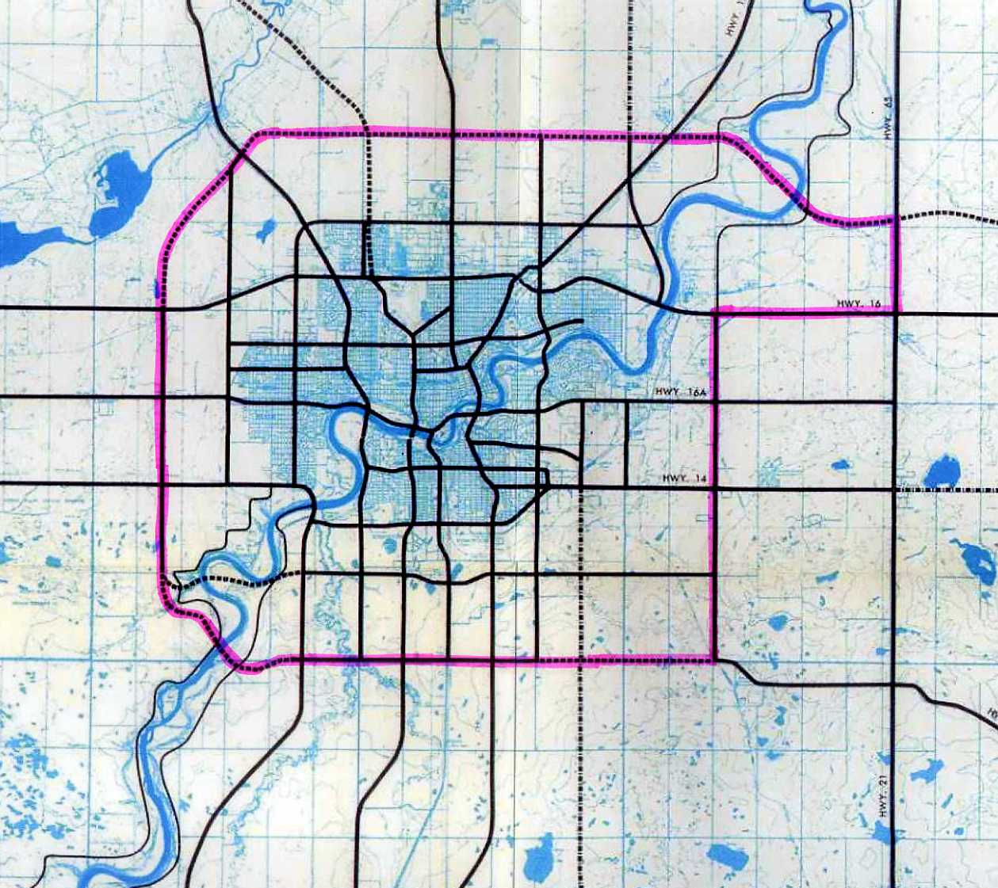
Why Plan?
Source: Metropolitan Edmonton Transportation Study (METS) 1963
Source: Calgary Transportation Study (CALTS) 1968
Notes:
The idea of a Ring Road around Edmonton dates back to a transportation studies conducted in the 1950s by the Edmonton Regional Planning Commission.
In 1963, a major planning initiative called the Metropolitan Edmonton Transportation Study, or METS, was undertaken which identified a system of Freeways and rapid transit for the Edmonton Region and again put forward the concept of a Ring Rd as an integral part of this overall transportation scheme.
The idea of a Ring Road around Edmonton dates back to a transportation studies conducted in the 1950s by the Edmonton Regional Planning Commission.
By 1973 the Department of Highways and Transport had developed the outer ring concept shown by the pink line.
Right of way protecting and land acquisition began in 1974 through the Calgary, Edmonton, and Sherwood Park West Restricted Development Area Regulations and eventual Transportation/Utility Corridor (TUC) program.
The Alberta Transportation and Utility Corridor (TUC) program was developed in 1974 by the creation of the Restricted Development Areas (RDA’s) Regulation.
This legislation enabled the Government to use RDA’s to protect TUC land, assemble TUC land, and protect adjacent lands from the adverse effects of highway, power line, and pipeline developments.
In 1984, The Edmonton and Calgary Transportation and Utility Corridor Reassessment Study refined the implementation strategy and brought the TUC planning from conceptual to functional level. This refinement of the plans reduced the width of the TUC and the amount of land required and as shown in the blue area on the diagram.
The Calgary TUC is 87 km in length, which does not include the southwest edge of the city, and covers about 4,600 hectares.

Slide 17
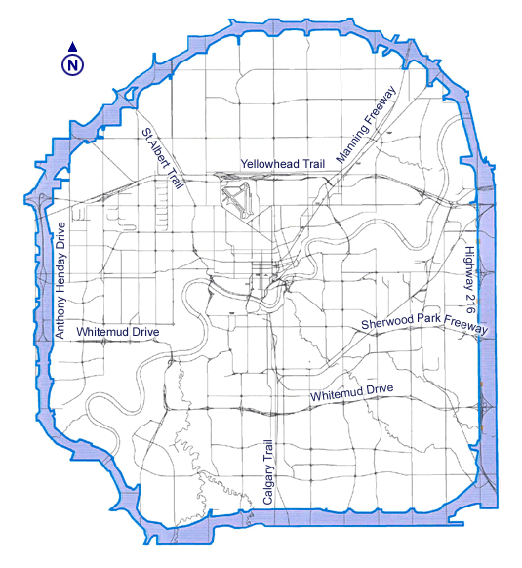
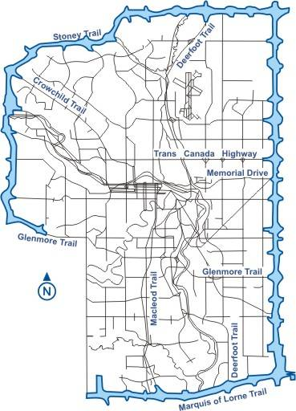
Calgary & Edmonton Ring Roads
Notes:
The idea of a Ring Road around Edmonton dates back to a transportation studies conducted in the 1950s by the Edmonton Regional Planning Commission.
Some major routes you see today such as Whitedmud Drive, Argyll Rd and 137th Avenue follow alignments generally described as part of this early Ring Rd concept shown by the green line.
In 1963, a major planning initiative called the Metropolitan Edmonton Transportation Study, or METS, was undertaken which identified a system of Freeways and rapid transit for the Edmonton Region and again put forward the concept of a Ring Rd as an integral part of this overall transportation scheme. This is shown by the blue line.
By 1973 the Department of Highways and Transport had developed the outer ring concept shown by the pink line.

Slide 18
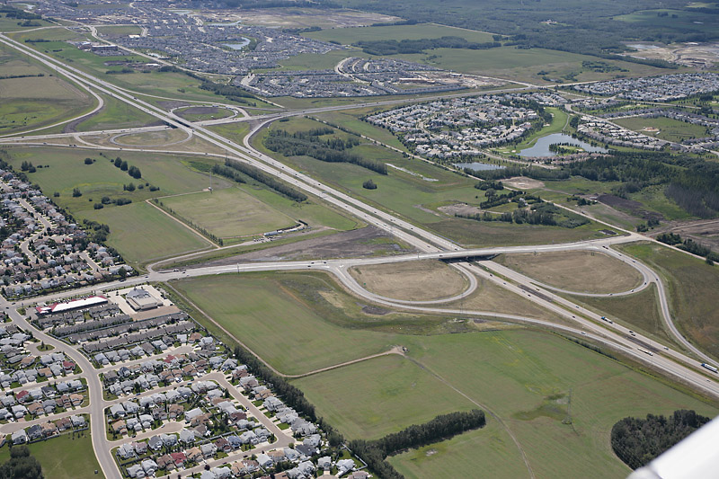
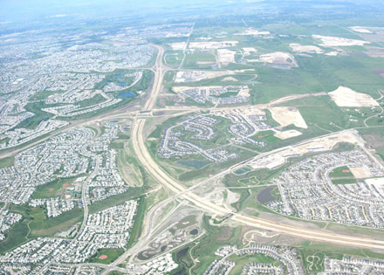
Why Plan?
Early identification and continuous planning for these facilities enabled the protection of the route and has allowed construction of the roadways where they are today.
Notes:
2/11/2014
The TUC has served to protect the Ring Road alignment from urban development pressure, which in the past had forced the alignment further outwards, and to protect major linear utilities routes through critical areas threatened by urban expansion and rural residential development on the urban fringe.
As shown in the photo of Stony Trail under construction on the north side of Calgary, urban growth leap-frogged over the TUC but did not compromise the path of the future freeway.

Slide 19
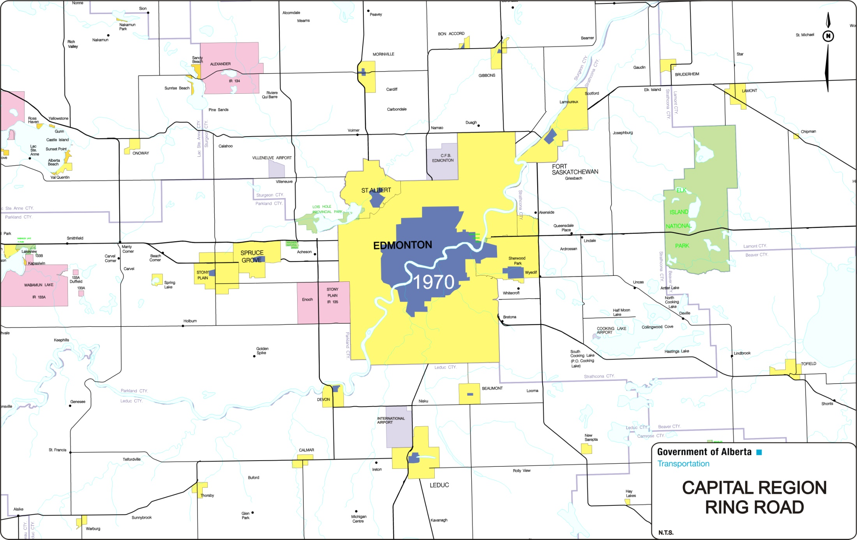
Urbanized Area
1970
Notes:
1970 extent of urban development is shown in blue

Slide 20
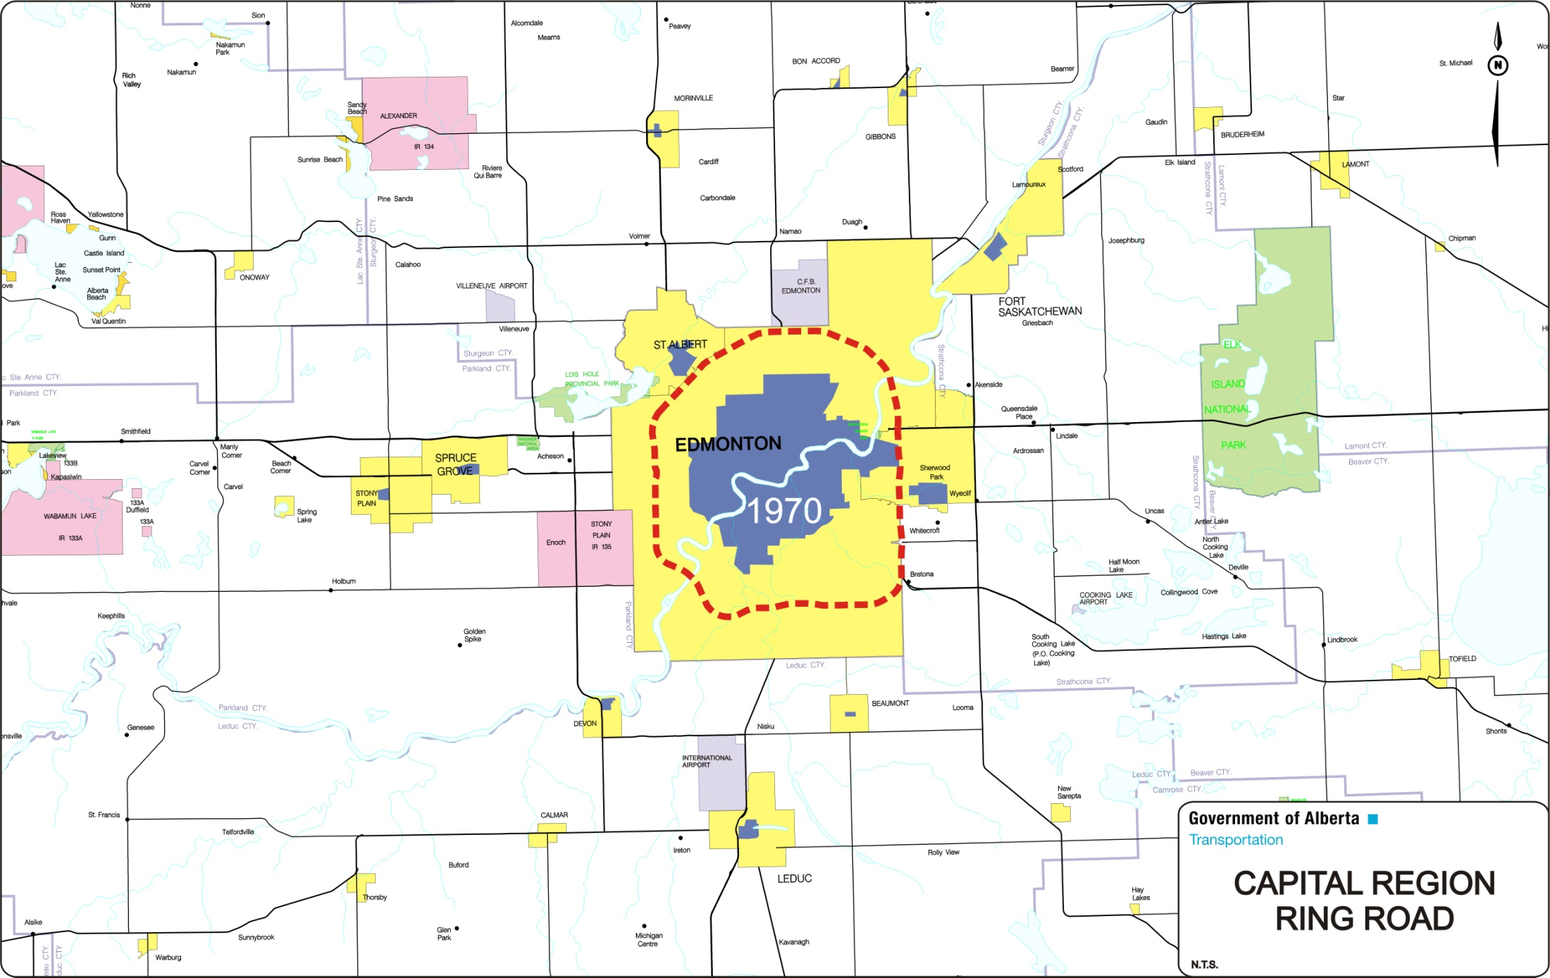
Planning for Anthony Henday Drive initiated
Notes:
Approximate location of the Ring Road was confirmed in 1972. Restricted Development Areas designated in 1974 (eventual TUC).
The TUC was placed with the expectation that the city would grow out to the corridor and eventually beyond.

Slide 21
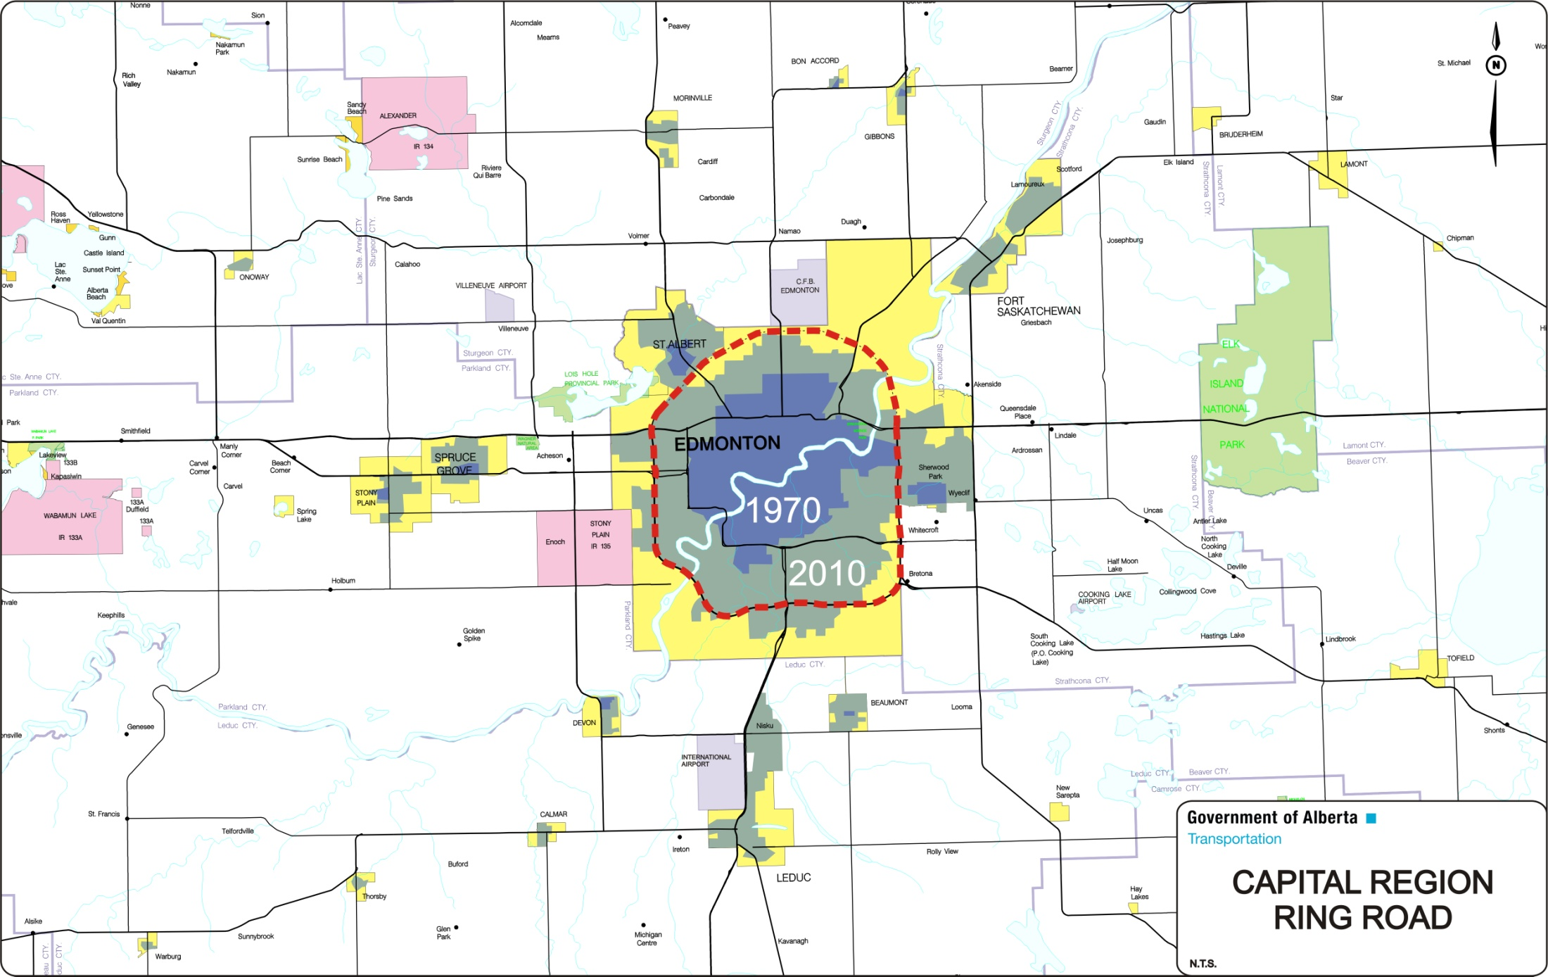
Urbanized Area
2010
Notes:
In 2010 the urbanized area has expanded up to and in some cases beyond the ring road.

Slide 22
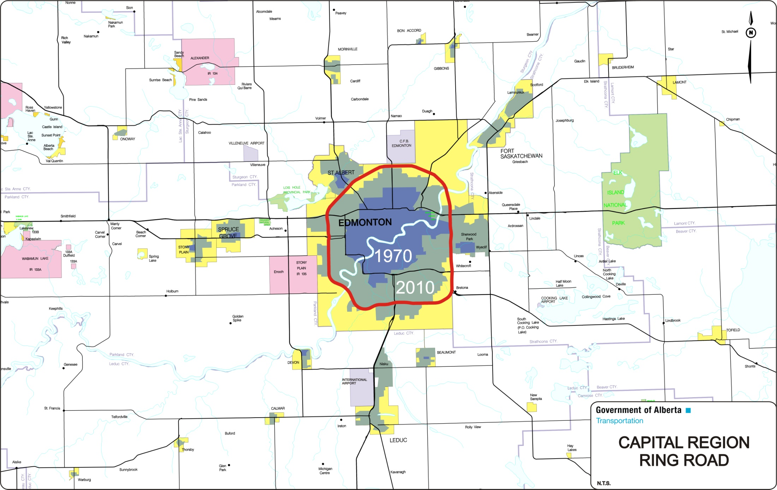
Anthony Henday Drive completed
2016
Notes:
Anthony Henday Drive is expected to be completed by 2016, about 45 years after the initial planning began.
The freeway provides high standard connections between the major highways in the Capital Region and serves to distribute traffic in and around the region in an efficient manner.
Construction would be much more difficult (perhaps impossible) without prior identification and designation of the corridor.

Slide 23
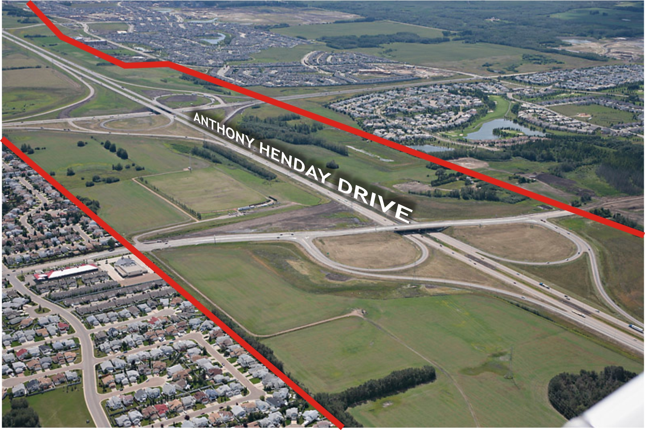
TUC boundaries established over 40 years ago
Notes:
Allows time for land owners to adjust
90 to 95% of the land for Anthony Henday Drive was purchased from willing sellers

Slide 24
Development grew up to the TUC boundary…

Slide 25
What if the TUC had not been established?
…and jumped over it

Slide 26
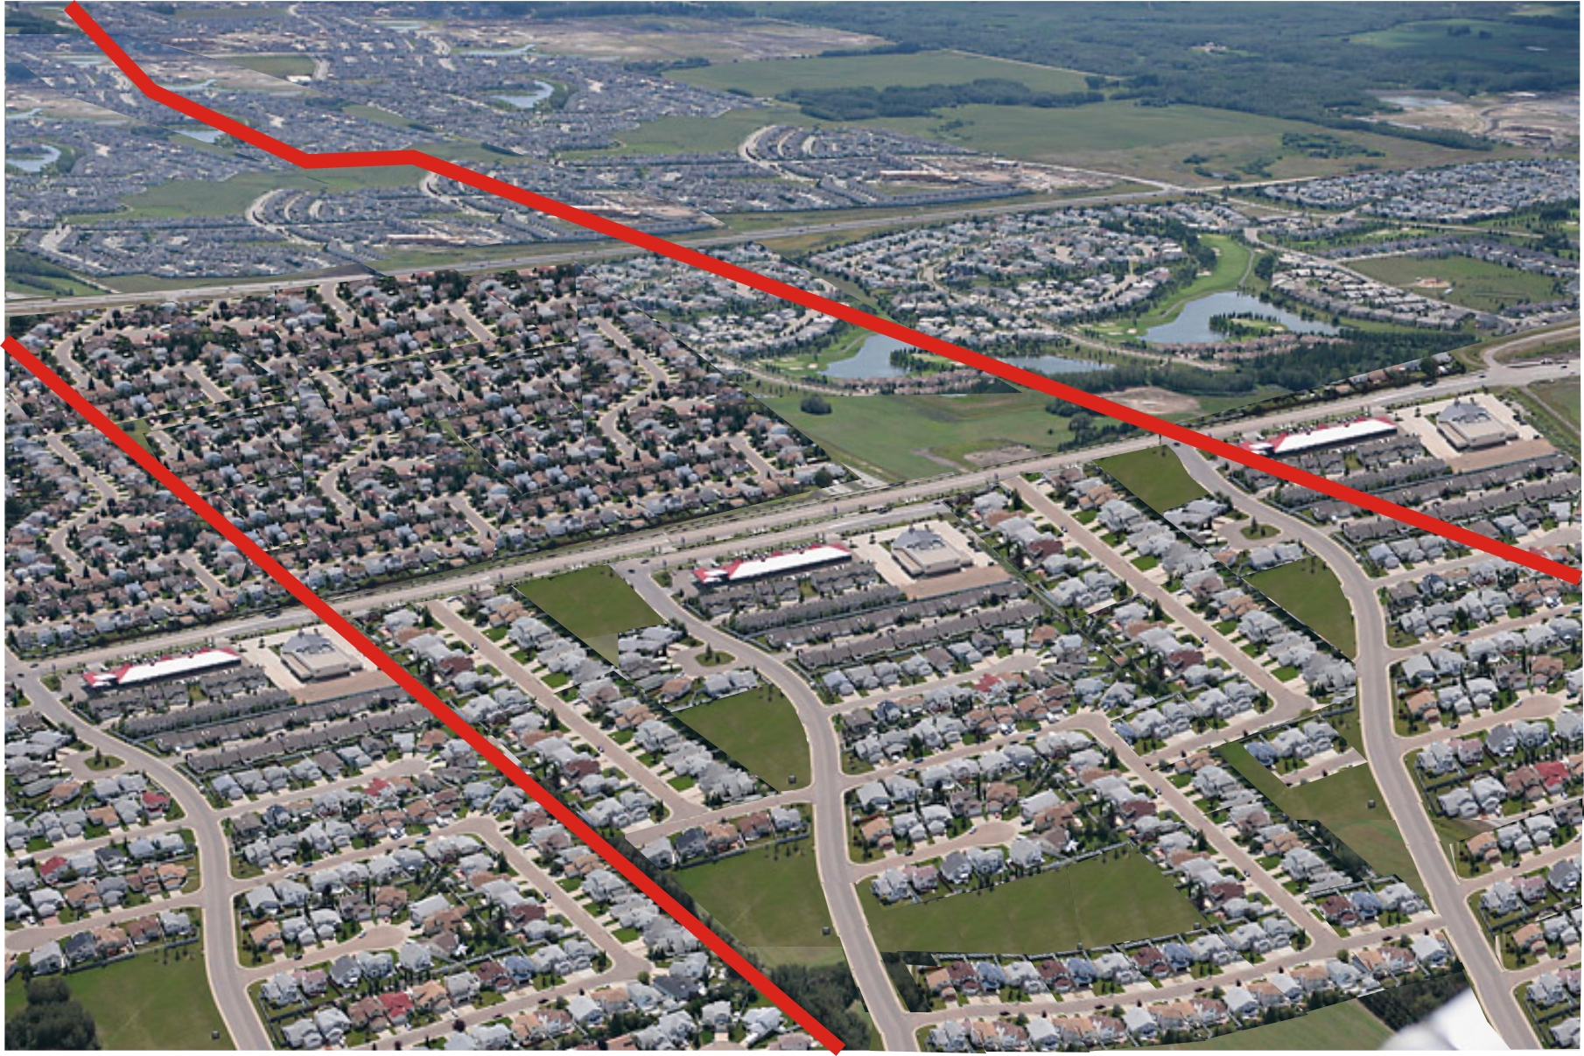
Development fills in lands needed for future highway
Notes:
In contrast this was not done for the SW portion of the Calgary Ring Road

Slide 27
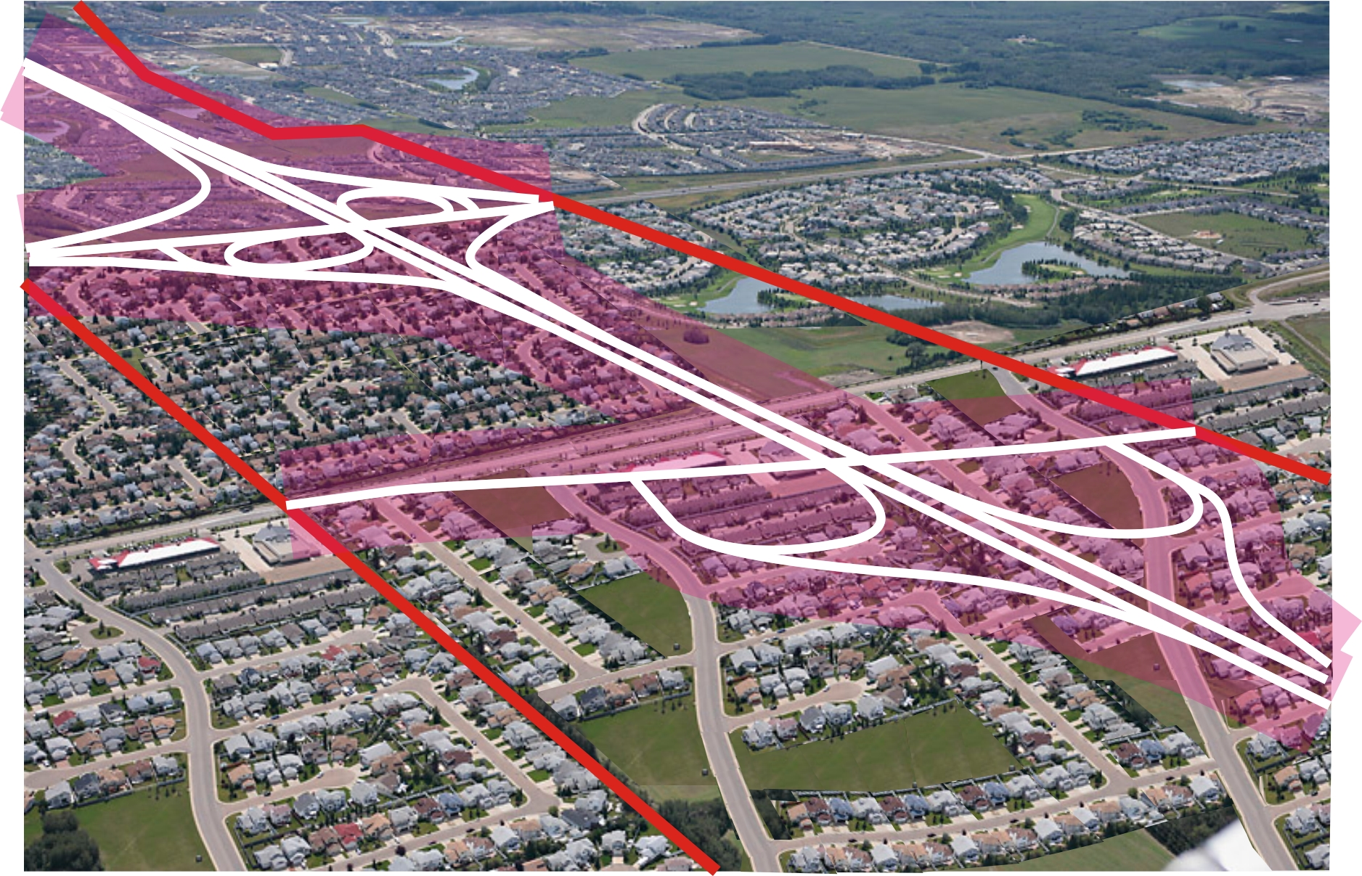
Extensive and disruptive property purchases needed to construct roadway
Notes:
Efforts to complete the ring are proving very difficult and disruptive, and may result in a very costly and/or low standard and /or no roadway.

Slide 28
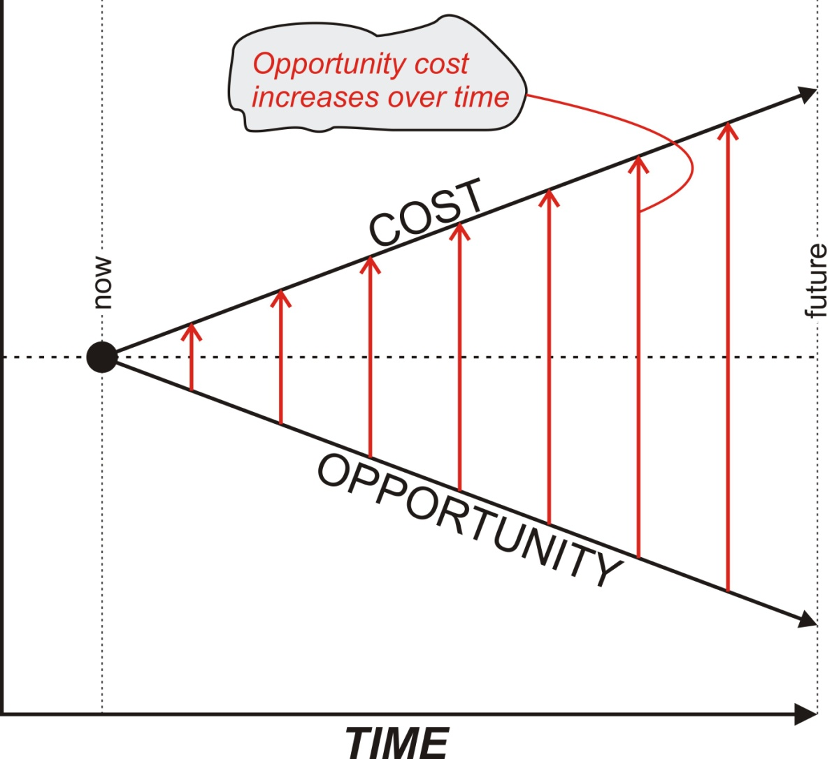
Decreasing Flexibility / Increasing Cost
Over Time
Notes:
-simply put, these are the four possibilities
Protect and Need CRRR
-A variety of facilities can be cost-effectively implemented within protected corridor
-Successful diversion from other routes (existing highways and penetrator) corridors, providing additional capacity internal to the CRRR
-Potential to meet a variety of functions with a single new facility (regional bypass, truck route, connection of PGAs and employment areas, urban commuter capacity, etc.)
-Flexibility to consider innovative solutions (HOV, dedicated transit, etc.) within the corridor
-Flexibility to implement corridor in segments over time
Do Not Protect Corridor and CRRR needed
Risks
-Transportation capacity is not available when needed
-Implementation of a corridor without prior protection would require considerable urban land impacts and associated costs
-Economic / environmental impacts of excessive urban congestion or gridlock
Potential Mitigation
-Restrict future growth to available network capacity
-Accept economic / environmental impacts
Protect Corridor and CRRR not needed
Risks
-Protection of unnecessary corridor will have induced sprawling land use pattern
-Un-used corridor will divide urban areas
-Land purchase investment / impacts were unneeded
Potential Mitigation
-Use existing land-use review / approval authority to ensure that unwanted sprawl does not occur (i.e. – do not approve it in the first place)
-Use “shadow planning” to plan logical in-fill of corridor, if it is ultimately not used as intended (similar to City of Edmonton policy for evolution / infill of TOD sites)
-Sell surplus lands to recoup land purchase investment
Do not Corridor and CRRR not needed
Outcome
-Land use and transportation will have developed as needed

Slide 29
What are the Risks?
Notes:
-simply put, these are the four possibilities
Plan and Need
A variety of facilities can be cost-effectively implemented within protected corridor
-Successful diversion from other routes (existing highways and penetrator) corridors, providing additional capacity internal to the CRRR
-Potential to meet a variety of functions with a single new facility (regional bypass, truck route, connection of PGAs and employment areas, urban commuter capacity, etc.)
-Flexibility to consider innovative solutions (HOV, dedicated transit, etc.) within the corridor
-Flexibility to implement corridor in segments over time
Do Not Pland and Need
Risks
-Transportation capacity is not available when needed
-Implementation of a corridor without prior protection would require considerable urban land impacts and associated costs
-Economic / environmental impacts of excessive urban congestion or gridlock
Potential Mitigation
-Restrict future growth to available network capacity
-Accept economic / environmental impacts
Pland Don’t Need
-Protection of unnecessary corridor will have induced sprawling land use pattern
-Un-used corridor will divide urban areas
-Land purchase investment / impacts were unneeded
Potential Mitigation
-Use existing land-use review / approval authority to ensure that unwanted sprawl does not occur (i.e. – do not approve it in the first place)
-Use “shadow planning” to plan logical in-fill of corridor, if it is ultimately not used as intended (similar to City of Edmonton policy for evolution / infill of TOD sites)
-Sell surplus lands to recoup land purchase investment
Do not Plan and not needed
Outcome
-Land use and transportation will have developed as needed

Slide 30
PLANNING
CONTINUUM

Slide 31
Planning Cycle
Vision of organization
Transportation Master Plan
Facility Planning
Movement of
  Goods?
Balanced plan?
Mobility?
Affordability?
Support growth?
Strategy
Network planning
Model split
  Air/rail/transit/
  Ports/Private/
  walk/bike
Nodes
  Residential/
  Commercial/
  Institutional
Travel Forecast
Travel forecast
Planning horizon
Functional planning
Updates

Slide 32
Transportation Planning
Vision of organization
Direction from Senior Levels
50 Year Integrated Transportation Strategy – ways to move goods/services/products
Provides overarching direction to GOA
Forms decisions on transportation investments, policies, and programs
Public Consultation stage
Information can be found at: bit.ly/1aNNwhZ.

Slide 33
Transportation Planning
Transportation Master Plan
Strategic Plan will determine our emphasis on modal splits – transit/private vehicles/walk/bike
How will we integrate with rail/air/marine ports
Network planning
Network Plan for Northern Alberta completed
Future network include Edmonton Area
Functions of highways - freeways/arterials
Travel forecast – modelling at strategic level

Slide 34
Transportation Planning
Facility Planning
NESS – Network Expansion Support System – Snapshot of existing network
Travel forecast – modelling at tactical and corridor level
Functional planning – laying out plans on paper
Roadside planning – preserves the highway function
Standards development

Slide 35
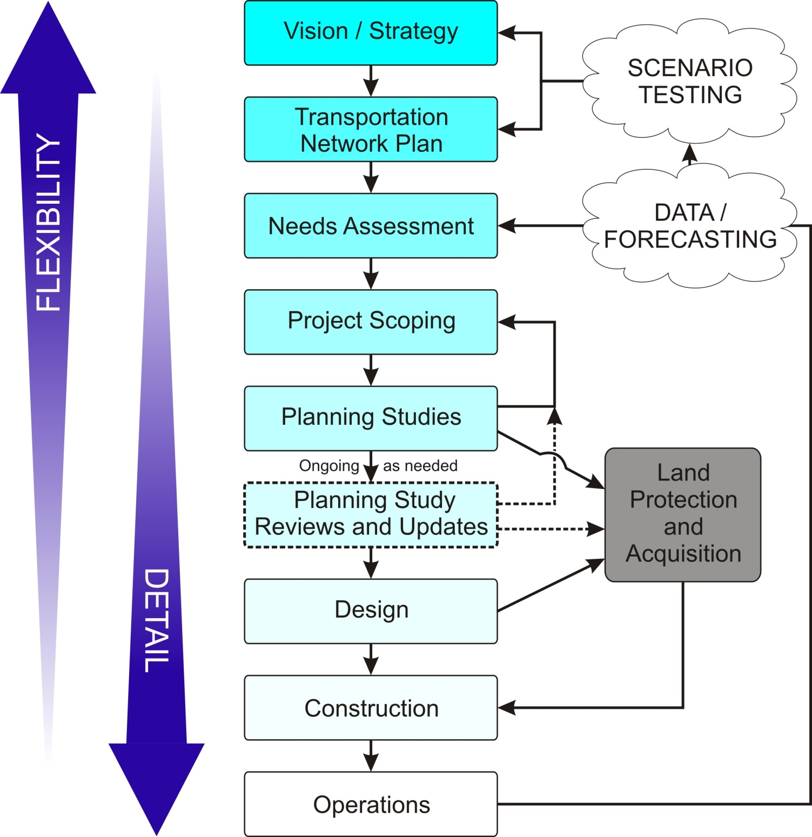

Slide 36
PLANNING
HORIZONS

Slide 37

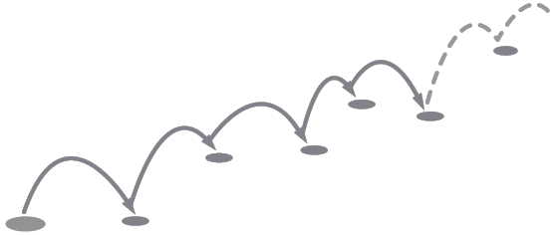


Planning Horizon
Future
Present
Notes:
“Federal regulations relating to transportation and air quality require states and metropolitan planning organizations to complete long-range transportation plans and programs for a 20-year forecast period. For transportation planning processes to integrate sustainability objectives, the forecast period must be at least 40 years.”
When making plans for infrastructure that will last potentially hundreds of years it is prudent to plan for them far in advance.
Planning for critical infrastructure corridors requires long-term vision and governance.

Slide 38
Planning – how far into the future?
Tricky question
In one camp
  Beyond 20 years can’t predict with any degree of certainty
  But is that any reason to not think beyond 20 years?
  Will we still have cars (wheels on pavement) or will we be in the Jetson age?
  Autonomes – lead car pulling other cars – increases capacity, but will not replace cars
  Reliance on transit

Slide 39
Planning – how far into the future?
Tricky question
In the other camp
  Will still drive in 2 dimensions, not 3, in foreseeable future
  With growth and to be competitive, will need to accommodate more cars and trucks
  Transit usage at 9% and cars and trucks at 77%. Even with transit doubling will still have large percentage by vehicles
  Bottom line if you believe Alberta will grow to 10 – 15 million people, you need to plan for that future
  50 years plus
  Later on will talk about the time frames for the Ring Roads in Edmonton and Calgary

Slide 40
What are we doing?
Question – do you think it is prudent to forecast traffic for 20 or 30 years only? What happens after 30 years?
Forecasting long term future transportation needs
Reserving lands
Build in stages – define long term plans, then build what is needed for today
Plans are expandable

Slide 41
Planning Horizon
  The “design” year of 20 years has evolved based on the supposition that beyond a 20 year period traffic, financing and other developments cannot be predicted with reasonable accuracy
  For planning purposes the 20 year period is appropriate but only when consideration is given to a longer period of time as well – say 50 years plus

Slide 42
Planning Horizon
_______________________________________________
Functional Planning - average number of years for implementation (urban)
  Traffic survey 0 years
  Transportation planning 2 years
  approval in principle/final approval 2 years
  functional planning 2 years
  land acquisition 2 years
  Environmental study/approval 2 years
  design 1 years
  construction 2 years
  Average total (up to) 13 years

Slide 43
Planning Horizon
  Given the length of time required to do planning, design, and acquire right-of-way, obtain approvals, and construction, by the time a project is open to traffic, about ½ of its design life would have been used up.
  An approach therefore would be to design and construct for the 20 year period, but with consideration for how the facility will fit into a second period beyond the 20 years, and how it can be expanded or modified to meet the longer term needs.
  Long range planning together with reviews every 5 years to update the plan, should constitute the planning process

Slide 44
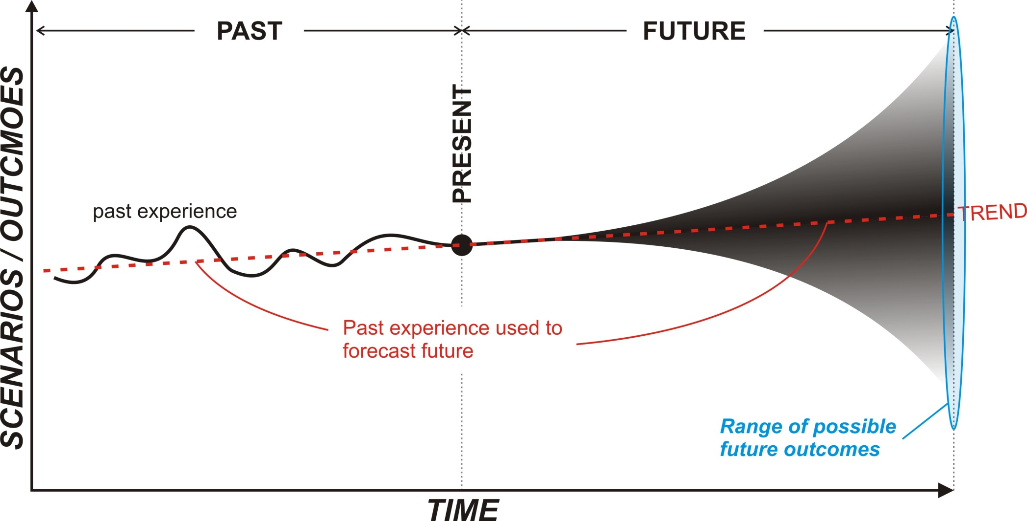
A good plan has enough flexibility to accommodate a range of future outcomes.
Notes:
The Opportunity to consider how it will interact with the rest of the Capital Region’s transportation network if that scenario presents itself in the future.
FHWA views scenario planning as an enhancement of the traditional transportation planning process.
As a result, scenario planning can help stakeholders to make decisions for the present and prepare for future needs.
The hallmark of scenario planning is identifying land-use patterns as variables (rather than as static inputs) that could affect transportation networks, investments, and operations.
Scenario planning is a process that can help transportation professionals to prepare for what lies ahead. It provides a framework for developing a shared vision for the future by analyzing various forces (e.g., health, transportation, livability, economic, environmental, land use), that affect communities. The technique was originally used by private industry to anticipate future business conditions and to better manage risk.
Since 2004, the Federal Highway Administration (FHWA) has encouraged transportation-focused scenario planning as an approach that enhances the traditional planning process. This type of scenario planning is a technique designed to help citizens and stakeholders in the public and private sectors understand how demographic and land-use changes could potentially impact transportation networks in a state, community, region, or study area.
Scenario planning is a flexible approach that can be used in areas of fast, slow, or declining growth to address questions related to quality of life, development, transportation infrastructure, and financial resource management. The technique has been used at a range of geographic scales (including at the nationwide, statewide, regional, community, and corridor-specific levels).

Slide 45
Travel
Forecasting

Slide 46
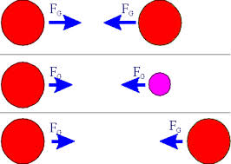
Travel Modelling – Gravity Model
Attraction between two objects or nodes (production and attraction nodes)
Mass increases - attraction increases
Distance decreases - attraction decreases

Slide 47


Travel Modelling – Gravity Model
Mathematically, the gravity model often takes the form:

Slide 48
Travel Modelling – Gravity Model
Tij= Trips between origin i and destination j
Ti= Trips originating at i
Tj= Trips destined for j
Cij= travel cost between i and j
Ki, Kj= balancing factors solved iteratively.
f = distance decay factor
doubly constrained so that Trips from i to j equal number of origins and destinations

Slide 49
Travel Modelling – Gravity Model
Or simply put, gravity model states that:
  the attractive force between any two bodies is directly related to their masses and inversely related to the square of the distance between them:
      = mass_{i} * mass_{j}
        ------------------
        distance² _{ij}
  Where i= origin
  j= destination
Many refinements since the first rudimentary gravity models but principle is the same

Slide 50
Travel Modelling – Gravity Model
The first gravity models had problems
      “all or nothing”
If choice of two or more roads, first road will fill up first then traffic moves onto the second road until that is filled and then onto the third and so on

Slide 51
Travel Modelling – EMME
That’s not how people travel
AT uses EMME model – developed in the UK
Version 3 – EMME/3
  Distributes trips according to travel times (and cost)
  Trips are assigned to a route with least time
  When time on that route exceeds another route(s), reassigns trips to the other routes
  Keeps distributing trips based on times until times are equalized and a state of equilibrium is reached or the model converges

Slide 52
Travel Modelling – EMME
EMME/3 used to model travel in Edmonton and Calgary
Assumptions for metropolitan areas
  Land use now and future – based on municipal land use plans and growth plans – 5 year increments
  Transportation network – existing and future
  In general holding capacity is used for travel projections
  Land uses and road network subject to changes – updates done regularly

Slide 53
Why Do We Model Travel?
Traditionally:
  To explore future land use and / or transportation alternatives
  To give demand estimates by mode, for design
More Recent Applications:
  To examine short-term issues (detours; traffic operations measures, including Intelligent Transportation Systems)
  To assess environmental /air quality issues

Slide 54
Why Do We Model Travel?
Why not just do things and see what happens?
  Real world trial and error approach is risky
  Consequences of error may be very costly
  Impacts may take time to develop
Mathematical Travel Models
  Allow trial and error testing
  Allow us to look into the future today
  Give quantified results -used to assess benefits / impacts of policies / projects
  Provide a basis for discussion of assumptions & issues/ understanding of results

Slide 55
Issues for Transportation Planners
Growth in Population / Employment
Changing demographic profiles
Level of Service on System
Aging infrastructure
Environmental concerns
Community Impact concerns
Priorization of Limited Funding

Slide 56
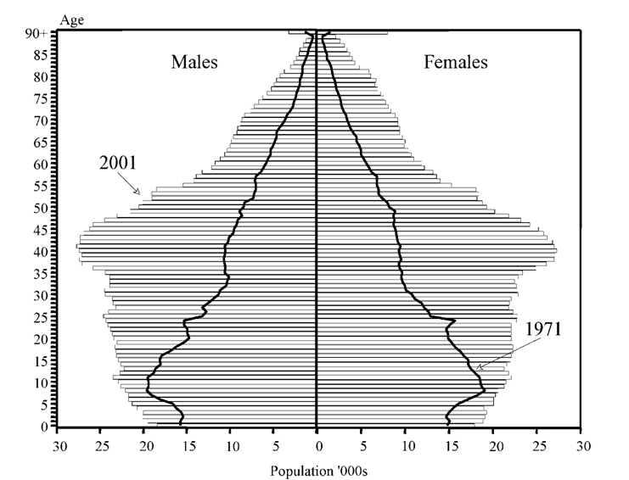
Population Age-Sex Distribution, Alberta
By 2015 Seniors will outnumber children
(seniors 55+)

Slide 57
Edmonton Example - Population Change
2012 Pop – 817,492
Historical 1.5%/yr.
Recent growth 2%/yr.

Slide 58
Edmonton Passenger Vehicles
1988 - 2002
Car ownership increased 2.8%/yr. from 1997 to 2002

Slide 59
Fundamental Travel Concepts - Personal Travel
What trips do we make?
Why do we travel?

Slide 60
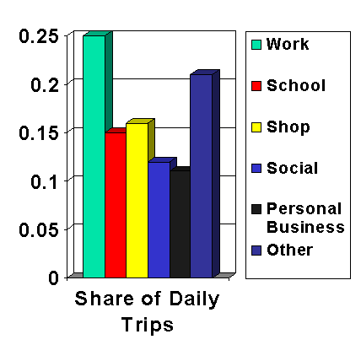
Edmonton Travel Purpose Choices - Fall Weekday
Compulsory Purposes (Work; School) - make up 40% of trips
Shopping / Social / Personal Business Trips make up 40%
Remaining 20% of trips for Other Purposes

Slide 61
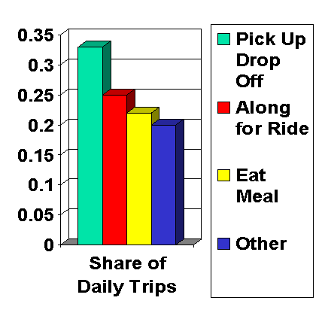
Edmonton “Other Purpose” Trips - Fall Weekday
Pick Up / Drop Off Passengers significant - 33% of Other Trips
Along for Ride Purpose also significant - 25% of Other Trips
Eat Meal - 22%

Slide 62
Edmonton “Other Purpose” Trips - Fall Weekday
Edmonton residents make 3.64 trips per person per day; up from 3.58 trips in 1994
Trips vary by Age; reflects different life stages
“Super-mom” effect in 25-44 age group 4.2 trips

Slide 63
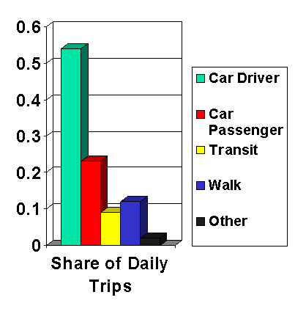
Edmonton Travel Mode Choices - Fall Weekday
Auto Driver (54%) and Passenger (23%) used most (77% by vehicles)
Transit used for 9% of Trips (to CBD higher)
Non-motorized mode (14%)

Slide 64
Travel Behaviour
2005 Daily Mode Share by Age Group
Transit use highest under 25 years of age
Car use highly prevalent right through to later stages in life

Slide 65
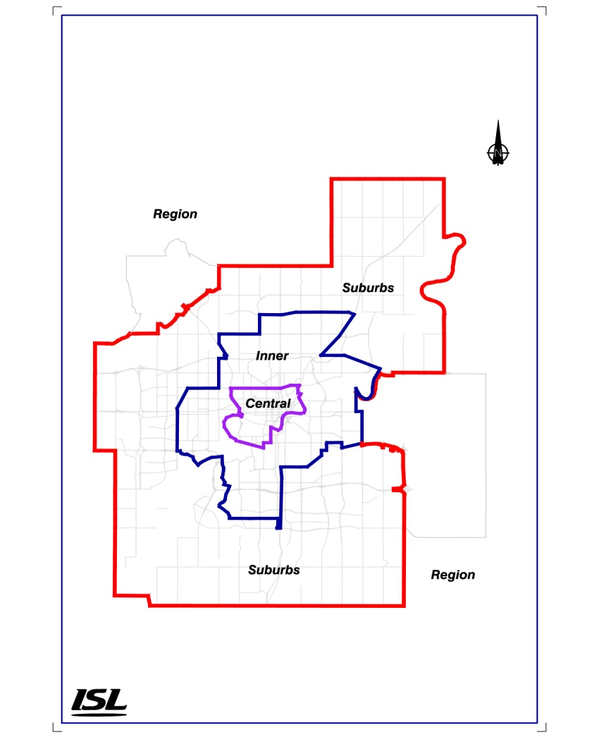
Travel Behaviour Weekday Daily Trips by Geographic Area
Suburban to suburban travel is highest

Slide 66
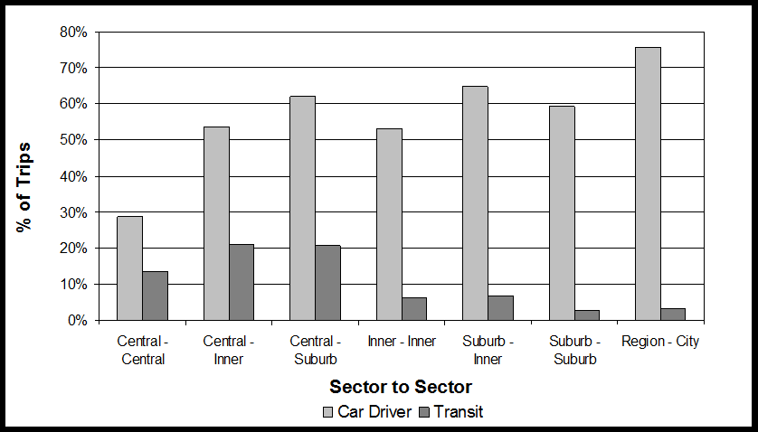
Travel Behaviour Weekday Daily Mode Shares by Geographic Area
Car driver dominates mode share
Transit use is highest for centrally oriented travel

Slide 67
Weekday Personal Travel - When do we Travel?

Slide 68
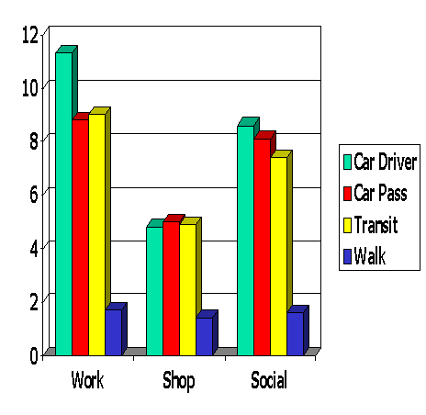
Average Weekday Trip Lengths - Edmontonians
Work trip 10 km
Shop trip 5 km
Social trip 8 km

Slide 69
Personal Travel - Why do We Travel?
Do people have a daily “Travel Time Budget”?
  60 minutes (France)
  90 minutes (USA)

Slide 70


Three vehicles types were used to carry the majority of goods and services throughout the Edmonton Region….
1
Passenger vehicles including pick-up trucks, vans, SUV’s and cars.
2
Many different types of three or more axle multi-unit trucks.
3
As well as two or more axle single-unit trucks.

Slide 71
2002 Daily Commercial Vehicle-km: Edmonton Region

Slide 72
A total of about 3.16 million vehicle-km are estimated to be traveled in the Edmonton region on a daily basis for the delivery of goods and services. This represents about 11% of all vehicle-km traveled on any given day.
Private vehicle-km (26,200,000)
Goods and service
delivery vehicle-km
(3,160,000)

Slide 73
What are we doing?
Modelling for 4 million population in Edmonton metropolitan area
Generally holding capacity for metropolitan area
Will that happen? What will be the population level for Alberta?
  10 million?
  12 million?
  15 million?
Edmonton annexation plans – effects?
When will that population be reached?
  Don’t know, but will be ready when that happens

Slide 74
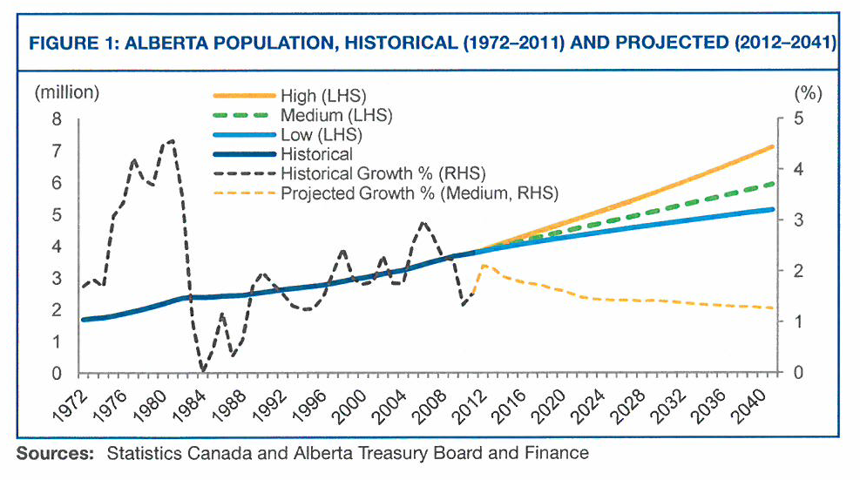
Treasury Board 2041 Pop. Projection
7
7 million
6 million
5 million
2013 population – 4,025,00, 3.5% year-over-year increase from 2012

Slide 75
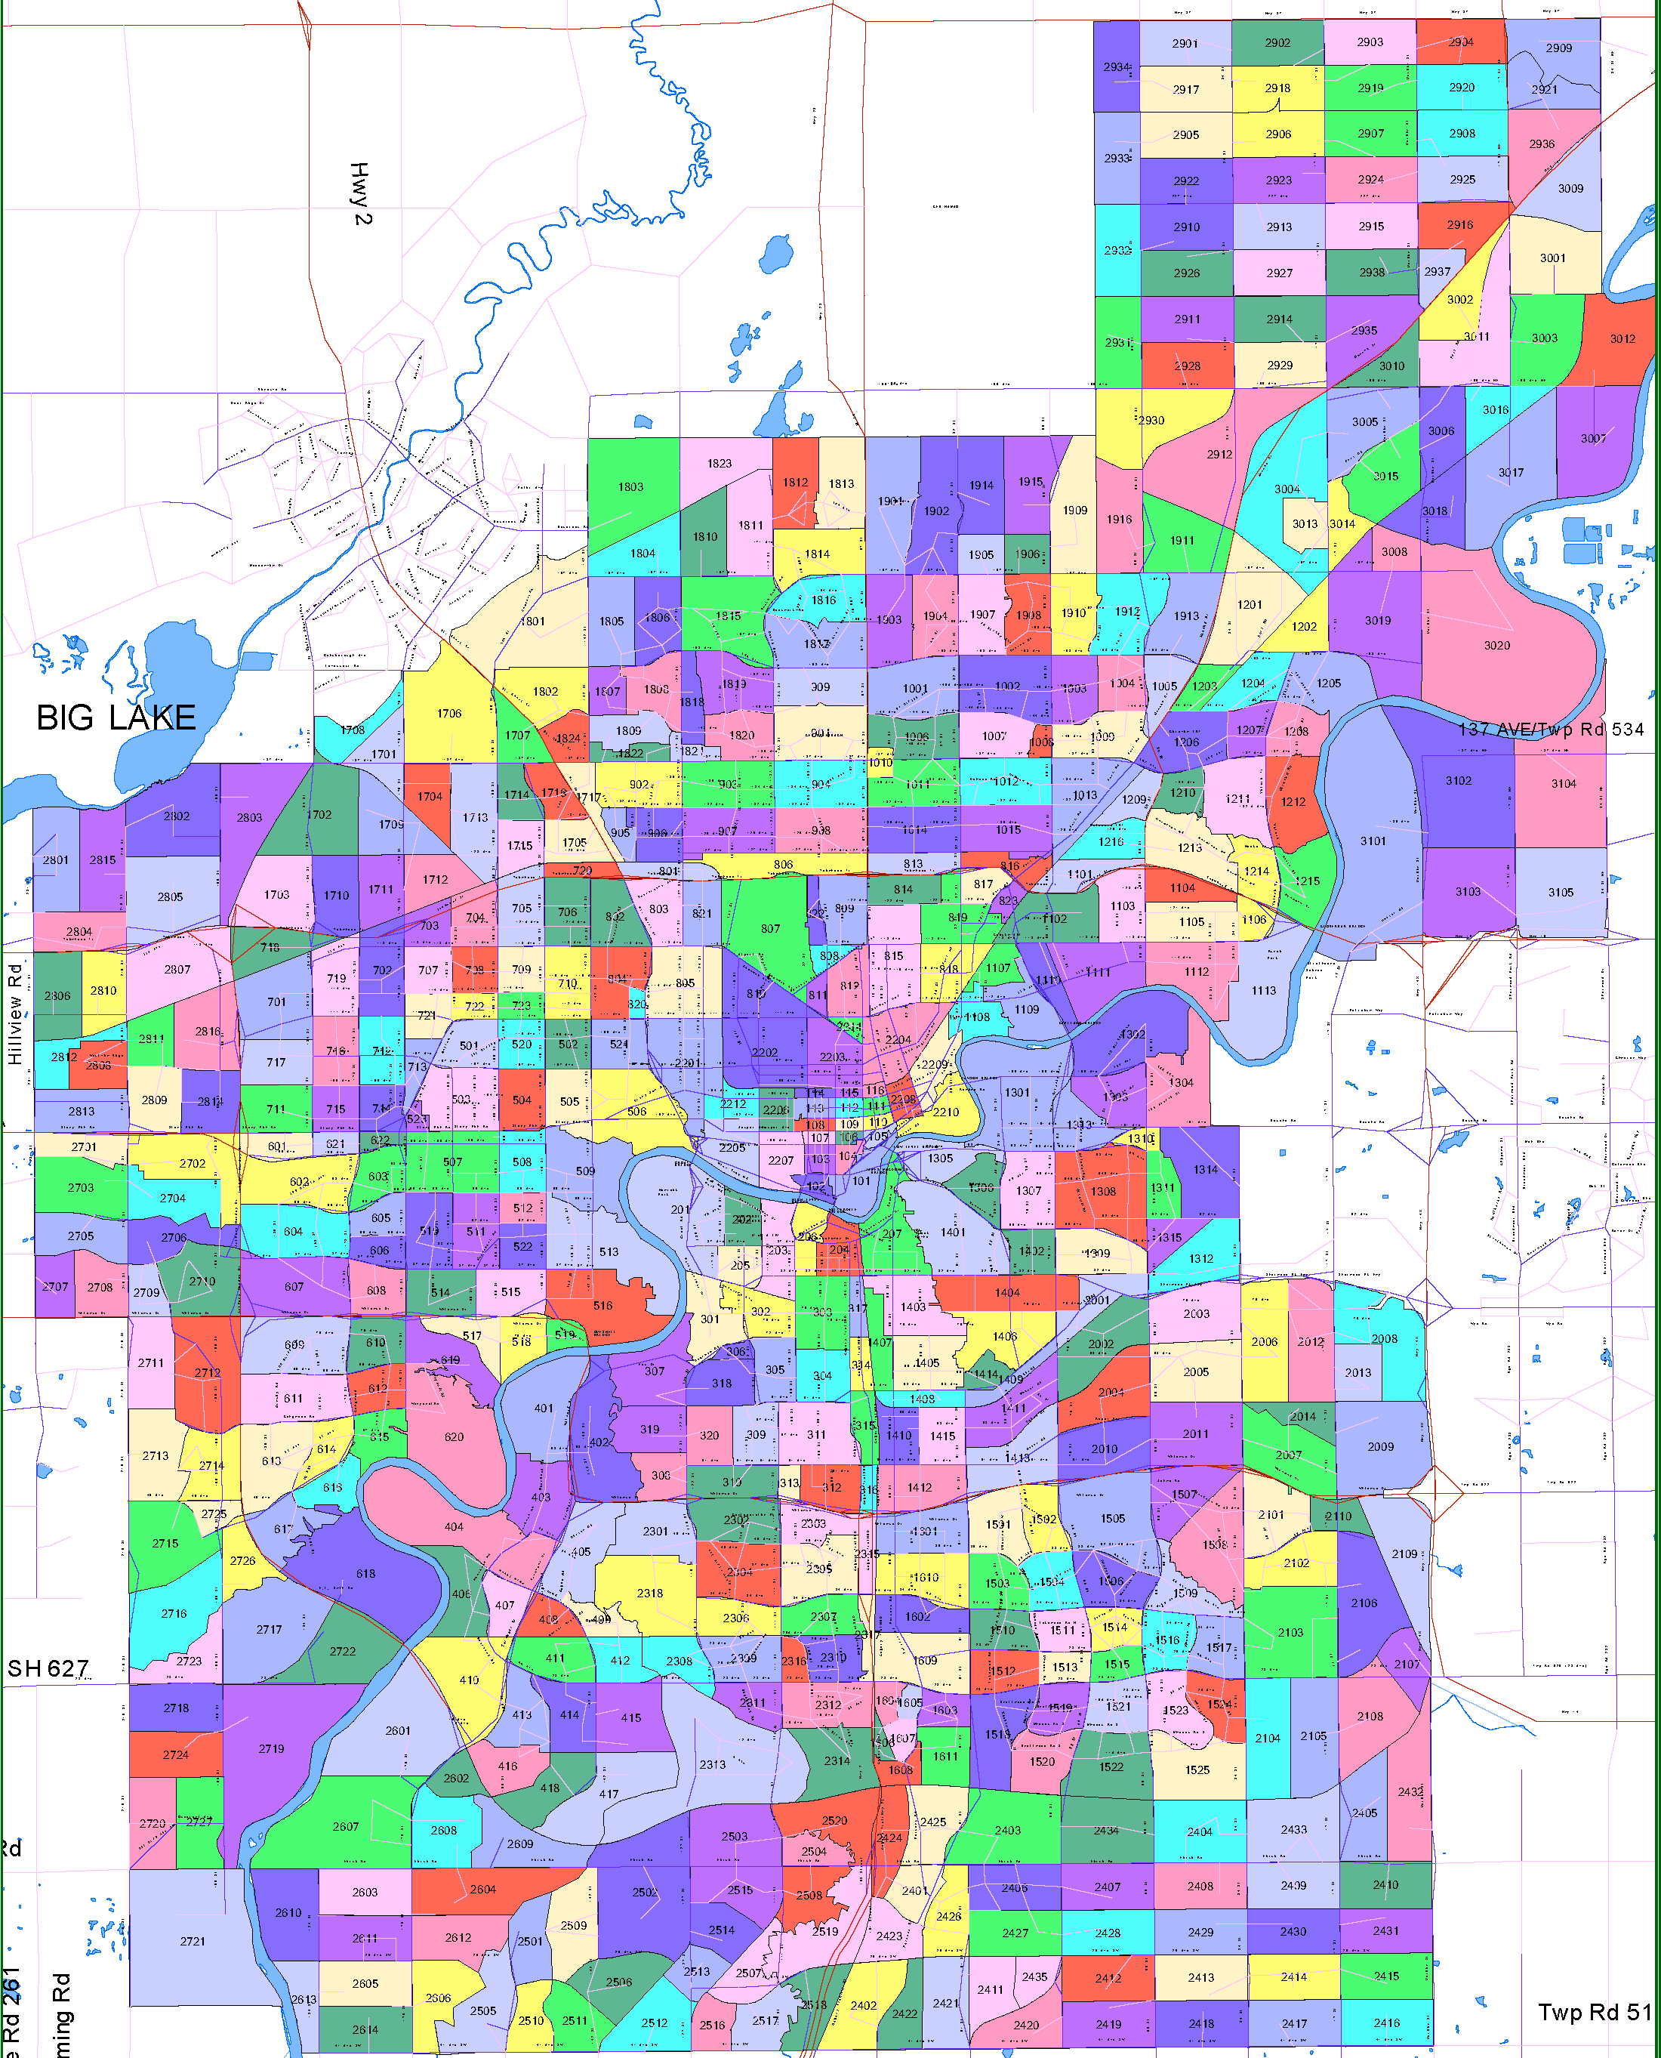
City of Edmonton Traffic Zones

Slide 76
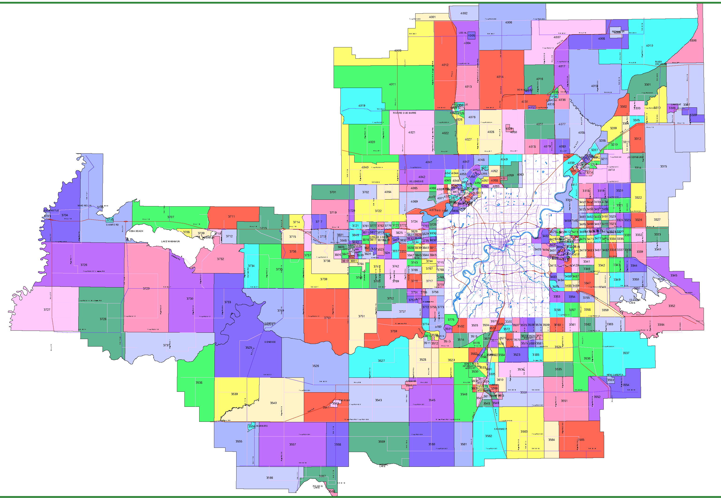
Edmonton Region Traffic Zones

Slide 77
Travel Model Output
Zone to Zone Trip Tables
By person/purpose segment, mode and time of day
Volume on road, transit, walk, and bicycle networks
Turning movements at intersections
Network performance data (speeds, congestion)
By time of day
Vehicle emission estimation

Slide 78
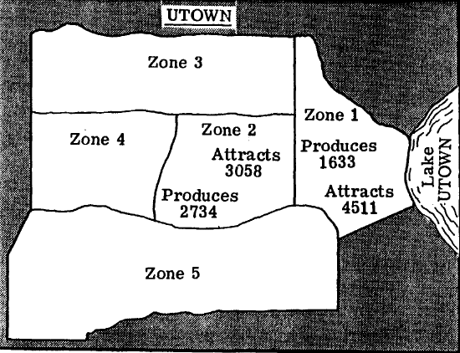
Example of Trip Table
Trip generation results - Total Number of trip produced and attracted by each zone in the study area

Slide 79
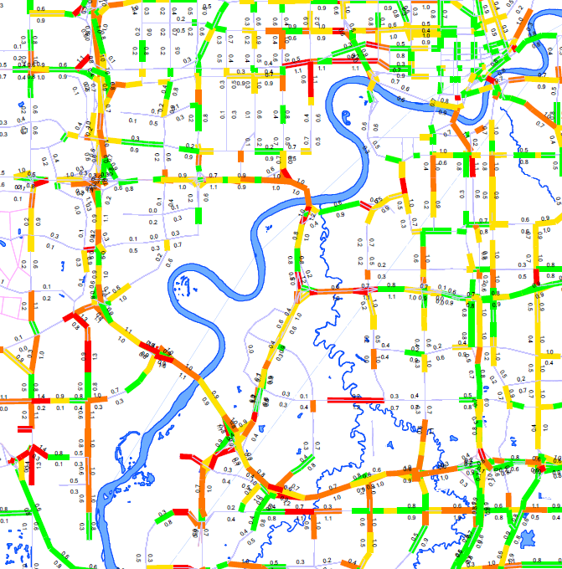
Edmonton Example – V/C Ratio

Slide 80
ROADWAY
HIERARCHY

Slide 81
Roadway Hierarchy
  A cost effective transportation network requires a mix of types or roads and modes.
  Important to organize network into categories in order to provide a systematic approach
  Reduce biases / subjectivity
  Supports needs identification
  Guides / informs investment decisions
  Roadway networks and land uses are dynamic
  Need to update routinely (typically every 5 ~ 10 years)
  Have to work with existing system on a go-forward basis

Slide 82
Roadway Classification Categories
  Service Classification
  Relative importance
  Functional Classification / Design Designation
  Physical attributes
  Roadside Management Classification
  Operating characteristics and future land requirements

Slide 83
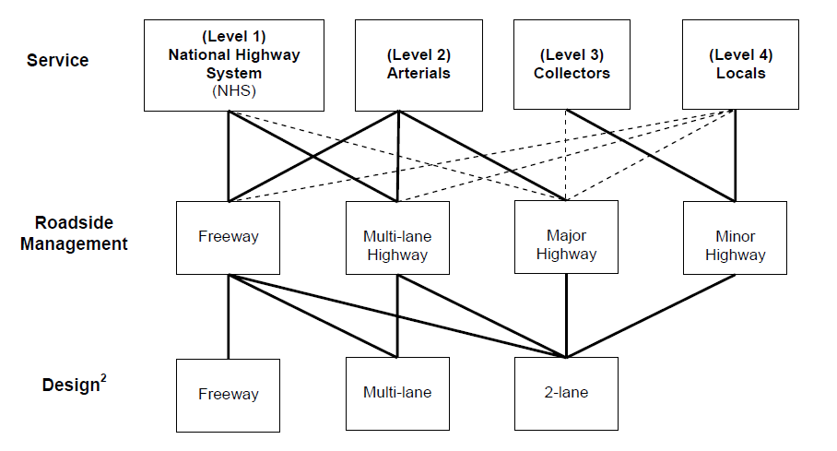
Relationship Between Classification Systems
LOS is a quality measure describing operational conditions within a traffic stream, in terms of speed and travel time, freedom to maneuver, traffic interruptions and comfort and convenience. (degree of congestion)
- LOS could be quantify(max service flow rate, etc.)

Slide 84
Service Classification
  Categorization of roadways based on relative strategic importance
  Dependent on trip purpose, trip length, destinations served
  Independent of traffic volumes
  Goals are influenced by community values
  public will usually tolerate narrower, rougher roadways, lower speed limits and more delay on lower service class roadways
  public expects high degree of mobility on Level 1 Highways (twinning has been completed or is planned on most Level 1 highways despite low traffic volumes)

Slide 85
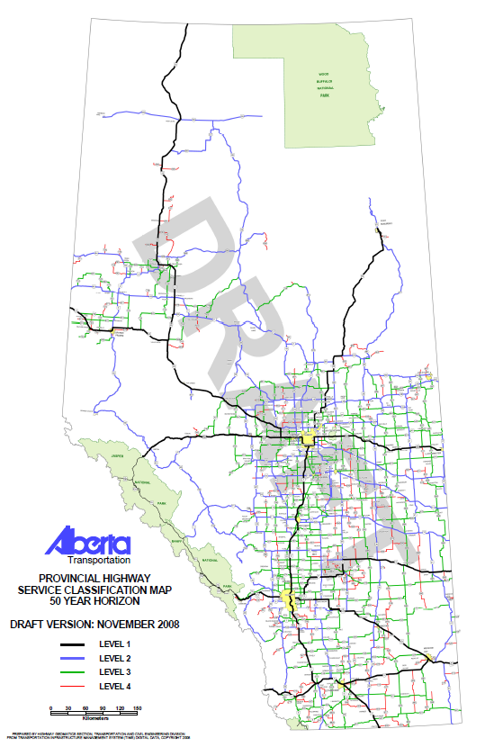
Service Classification
  Alberta’s Service Classification System
  Last updated in 2008
  Available on department website under design bulletin #27
  http://www.transportation.alberta.ca/Content/docType233/Production/50_year_service_class_mod_jan_2009.pdf
  Four Service Classifications
  Level 1
  Level 2
  Level 3
  Level 4

Slide 86
Service Classification
  Level 1 (Highway 1, Highway 16, Highway 43, etc.)
  Accommodate the movement of people, goods and services
  inter provincially and internationally.
  Are core route in the National Highway System
  Typically serve long trip lengths
  Level 2 (Highway 36, Highway 58, etc.)
  similar to the Level 1 roadways as they accommodate the movement of people, goods and services but mainly intra-provincially
  Also typically serve long trips

Slide 87
Service Classification
  Level 3:
  Typically carry traffic from major generators such as communities and/or resource and developments but with overall shorter travel distances.
  Provide connection between Level 4 and Level 2 roadways, and generally serve traffic of an intra regional or inter county nature
  Level 4:
  Typically serve traffic of an intra-jurisdictional nature or traffic within a localized area.
  Park roads are also included

Slide 88
National Highway System
  National systems of roadways designated by the Council of Ministers (of each province) responsible for Transportation and Highway Safety
  Consists of core routes, feeder routes, and northern and remote routes
  Includes roadways under jurisdiction of federal, provincial, and municipal governments
  Performance standards for NHS included minimum 90km/hr operating condition

Slide 89
National Highway System
  Minimum standards laid out for each jurisdiction to follow
  Alberta Transportation has adopted National Highway System standards for planning and design of the NHS core routes
  All planning studies on National Highway System core routes require sign-off by Engineering and Policy Division

Slide 90
National Highway System
  In Alberta
  Majority of routes are under jurisdiction of Alberta Transportation
  Portions are under federal jurisdiction (highways through National Parks) and municipal jurisdiction (such as Airport Trail in Calgary and Yellowhead Trail in Edmonton)

Slide 91
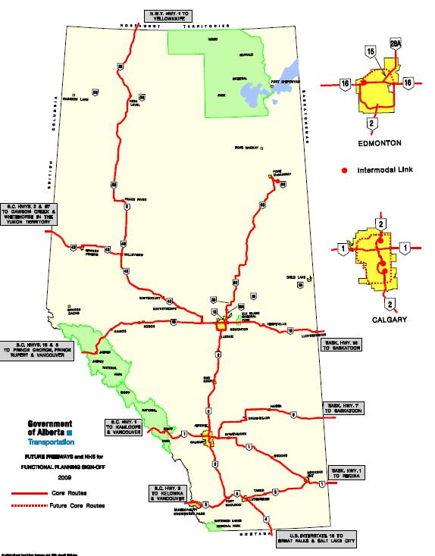
National Highway
System
  Map of National Highway System core routes in Alberta is available on intranet: https://intranet.transportation.alberta.ca/TCE/Planning/hr/Shared%20Documents/REPORT%20SIGN%20OFF%20GUIDELINES.pdf

Slide 92
Functional / Design Classification
  Describes the physical form of the roadway
  Defines the design parameters that will enable the desired service level goals
Design Speed
Functional Class
RAU-212-110
Cross Section

Slide 93
Roadside Management Classification
Defines the minimum access spacing (rural areas)
Defines the approximate long term land requirements (for development set-backs, etc.)
Roadside Management Classification is based on:
  Service Classification
  Functional / Design Classification in long term (based on 50 years of traffic growth)

Slide 94
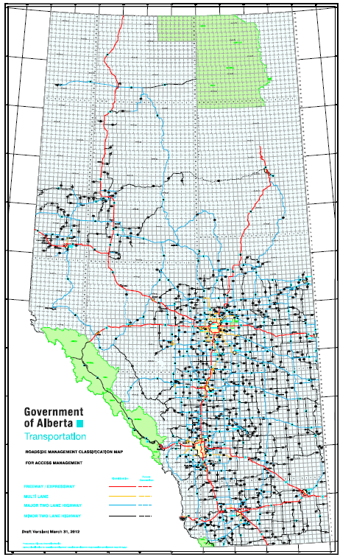
Roadside Management Classification
Last updated in March 2012
Available on intranet:
https://intranet.transportation.alberta.ca/TCE/Planning/hr/Shared%20Documents/Roadside%20Management%20Classification%20Map%202012.pdf

Slide 95
Access
Management

Slide 96
What is Access Management?
A systematic control of the location, spacing and operation of both public and private access to a roadway or street facility.
  Involves managing access to connecting public roads and adjacent land developments while simultaneously preserving the flow of traffic on the surrounding road system in terms of safety, capacity, and speed.
  Applies to all types of roads and streets
Notes:
Access management is the systematic control of the location, spacing and operations of both public and private access to a roadway or street.
Access Management involves managing access to adjacent lands while preserving the flow of traffic on the road system in terms of safety, capacity and streets.
Access management applies to all road classifications.

Slide 97
Why is Access Management Important?
To preserve the integrity of the roadway system by reducing the amount of interference from local traffic
To promote increased safety of the roadway system by decreasing the number of conflict points and reducing/simplifying driver work load, consistent with the functional classification
Notes:
The major purpose for access management is to provide standards applicable to different highway classifications, to provide order to intersections, and to ensure that when access is allowed it is constructed in a manner that will preserve the safety and integrity of the roadway.

Slide 98
Why is Access Management Important?
In rural Alberta 6-10% of collisions and fatalities involves errant vehicles striking approaches .
Many involved hitting farm/field/residential approaches rather than road approaches
Hitting an approach is akin to hitting a wall
In Manitoba, a controlled access road has 40% less collisions than on a non-controlled road.
In Saskatchewan a controlled access road has 33% to 50% less collisions than on a non-controlled road.
Notes:
The major purpose for access management is to provide standards applicable to different highway classifications, to provide order to intersections, and to ensure that when access is allowed it is constructed in a manner that will preserve the safety and integrity of the roadway.

Slide 99
Why is Access Management Important?
Well planned access management
  Increases safety
  Improves traffic flow (reduced congestion and travel times, lower road-user costs) and provides a more efficient roadway system
  Promotes the roadway hierarchy (reduced “cut through” traffic for example)
  Offers less strenuous driving environment
  Helps protect public investment and extends roadway life by delaying the need for capital improvements
Notes:
Access management protects the investment the public has in the roadway system and looks to the future to ensure that what is allowed today does not compromise the future safety and efficiency of the roadway.
In addition, application of access management standards allows for economic certainty for adjacent landowners and developers.

Slide 100
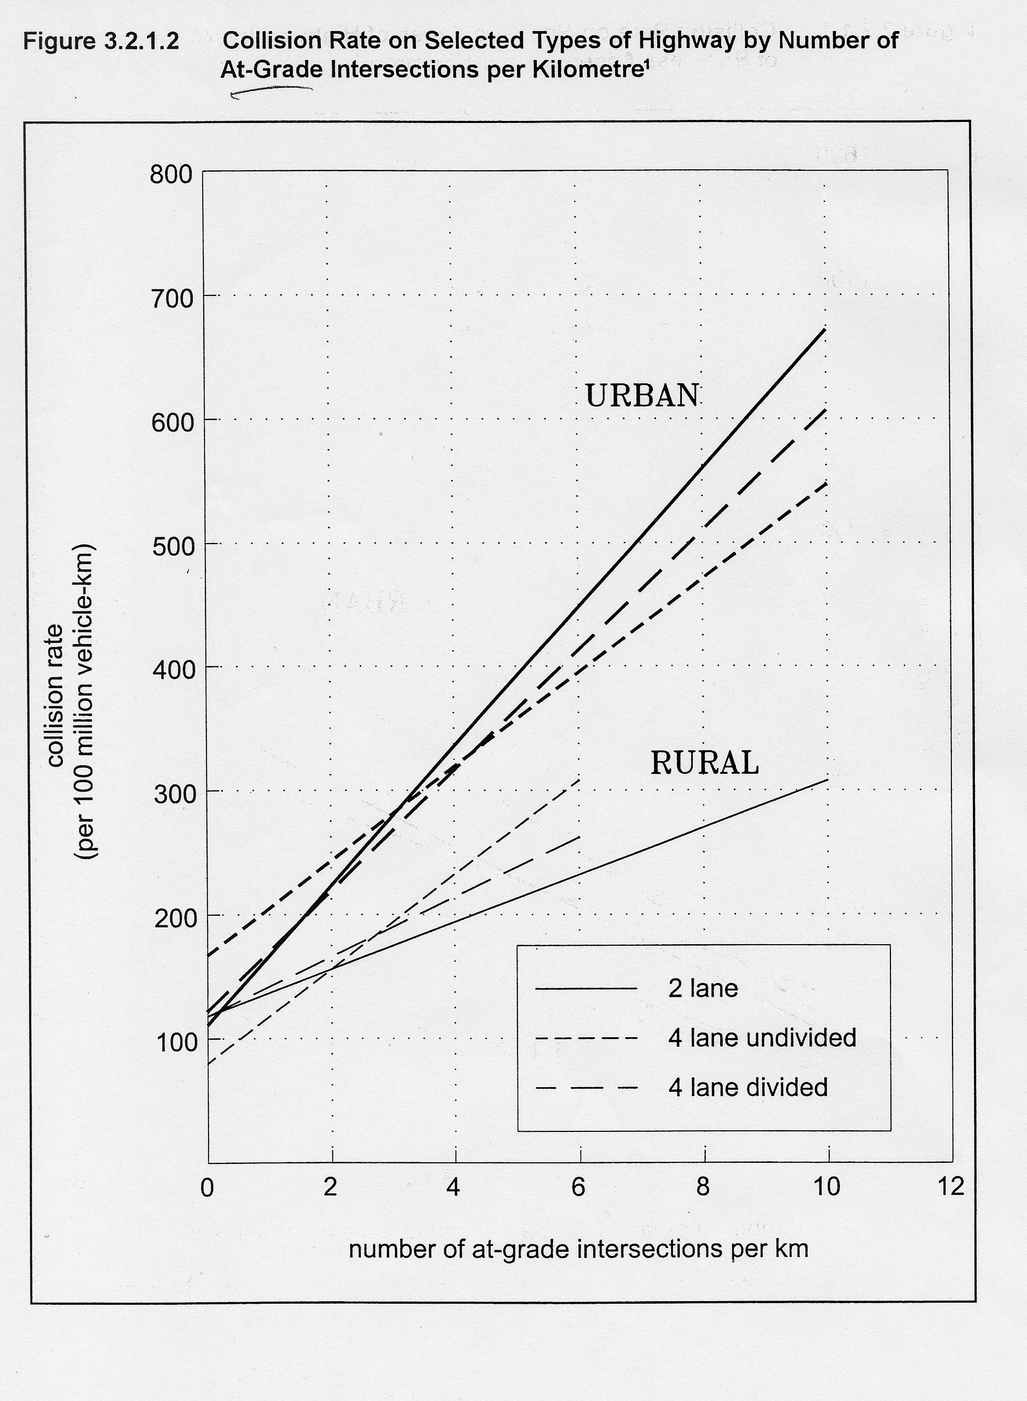
Access Management increases safety
by reducing the number of conflict points

Slide 101
Access Management Principles
Road system classified by primary function
Decreasing amount of access provided with increasing functional classification
Promote intersection hierarchy
  Freeways connect to arterials
  Arterials connect to collectors

Slide 102
Access Management Principles
Preserve the functional area of intersections and interchanges
  Access too close to intersections or interchange areas can cause conflict and impair the function of the roadway element
  Don’t put access points on tapers leading up to an intersection
    collectors connect to locals;
      and locals connect to approaches.

Slide 103
Roadway Function and Access
The relationship between serving land access and traffic mobility varies inversely
As traffic mobility increases/decreases land access decreases/increases

Slide 104
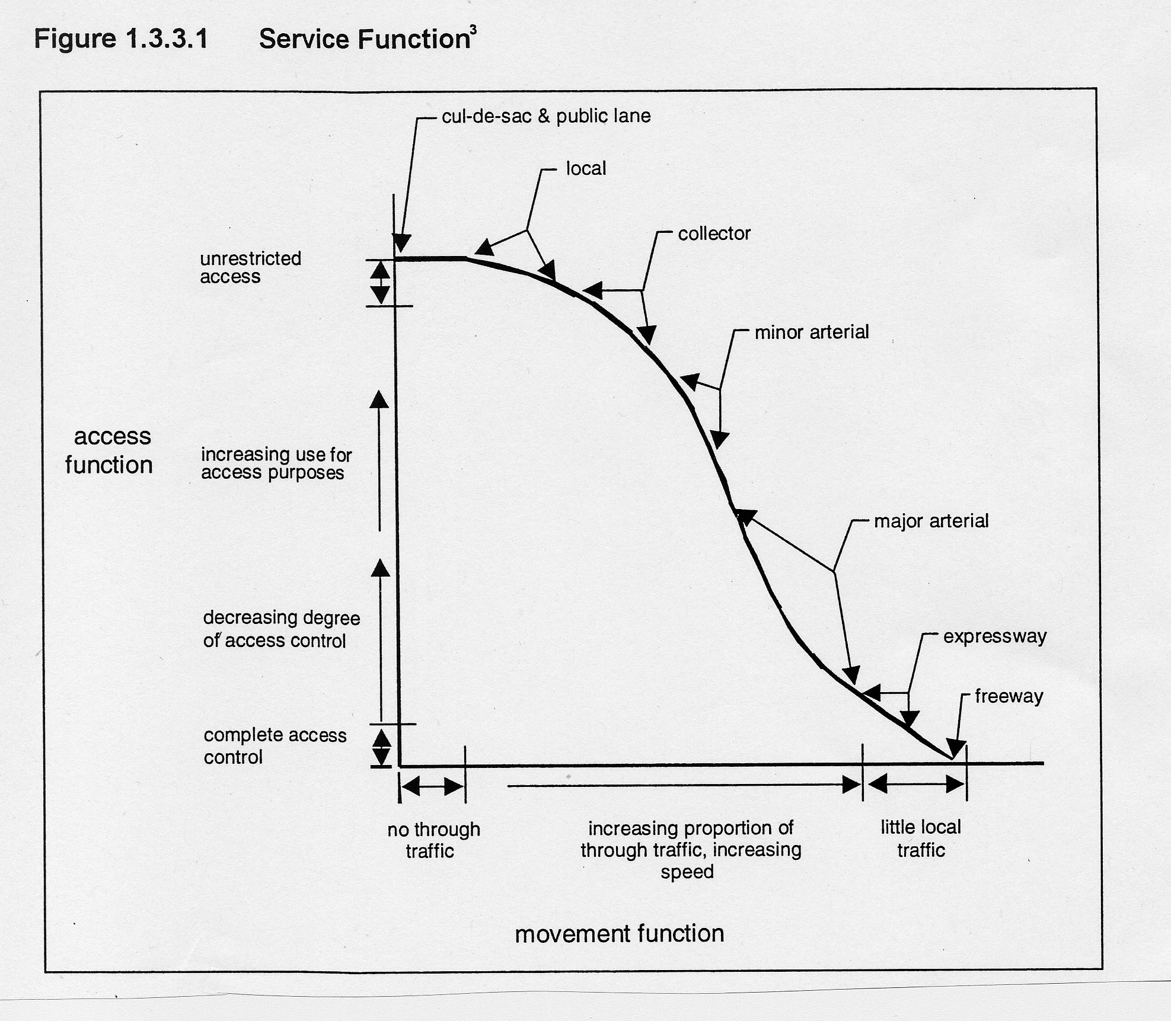
Roadway Function and Access

Slide 105
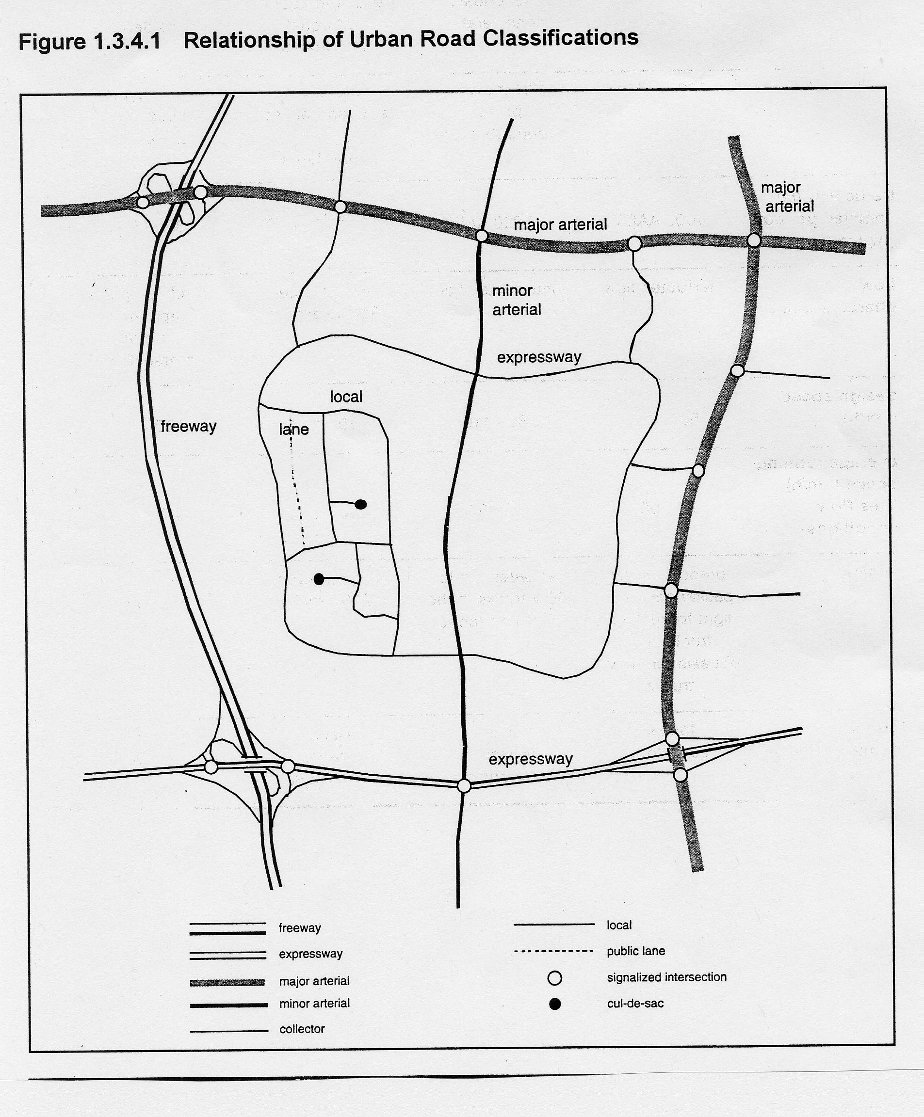
Roadway Function and Access

Slide 106
How to manage access points?
Access to minor roads rather than major roads.
Proper land use planning
Access to new developments directed to local roads rather than creating a new access
Eliminate minor access points and provide service road to next major intersection or interchange
When you are doing your next pavement rehab or highway improvement is the appropriate time to do it. Will take time and land but this is one of the most cost-effective measure to reduce collisions.
Oftentimes field access points not needed
May take several iterations of road rehab but if keep at it will be successful

Slide 107
FREEWAYS &
INTERCHANGES

Slide 108
Freeway Best Practices
Freeway Best Practices is a design philosophy
  Addresses “softer” design principles (not calculated design parameters)
  Key principle: enhance safety and operations by applying consistency in design to satisfy driver expectation
“Best Practices for Planning and Design of Freeway Facilities” was adopted by the department in 2004
  Available on department website under Design Bulletin #30
http://www.transportation.alberta.ca/Content/docType233/Production/freewyfclty.pdf
Notes:
2/11/2014
The Alberta Transportation and Utility Corridor (TUC) program was developed in 1974 by the creation of the Restricted Development Areas (RDA’s) Regulation.
This legislation enabled the Government to use RDA’s to protect TUC land, assemble TUC land, and protect adjacent lands from the adverse effects of highway, power line, and pipeline developments.
In 1984, The Edmonton and Calgary Transportation and Utility Corridor Reassessment Study refined the implementation strategy and brought the TUC planning from conceptual to functional level. This refinement of the plans reduced the width of the TUC and the amount of land required and as shown in the blue area on the diagram.
The Calgary TUC is 87 km in length, which does not include the southwest edge of the city, and covers about 4,600 hectares.

Slide 109
Freeway Best Practices
Highlights
Level of Service
  LOS “C” or better in rural areas
Barrier-free cross section design
Interchange minimum spacing
  2 km between successive service interchanges
  3 km between service and system interchanges
  8 km in rural areas
Notes:
2/11/2014
The Alberta Transportation and Utility Corridor (TUC) program was developed in 1974 by the creation of the Restricted Development Areas (RDA’s) Regulation.
This legislation enabled the Government to use RDA’s to protect TUC land, assemble TUC land, and protect adjacent lands from the adverse effects of highway, power line, and pipeline developments.
In 1984, The Edmonton and Calgary Transportation and Utility Corridor Reassessment Study refined the implementation strategy and brought the TUC planning from conceptual to functional level. This refinement of the plans reduced the width of the TUC and the amount of land required and as shown in the blue area on the diagram.
The Calgary TUC is 87 km in length, which does not include the southwest edge of the city, and covers about 4,600 hectares.

Slide 110
Freeway Best Practices
Highlights (cont’d)
Consistent interchange application along freeway corridor
Appropriate rest areas
Long term planning horizon (30+ years)
Notes:
2/11/2014
The Alberta Transportation and Utility Corridor (TUC) program was developed in 1974 by the creation of the Restricted Development Areas (RDA’s) Regulation.
This legislation enabled the Government to use RDA’s to protect TUC land, assemble TUC land, and protect adjacent lands from the adverse effects of highway, power line, and pipeline developments.
In 1984, The Edmonton and Calgary Transportation and Utility Corridor Reassessment Study refined the implementation strategy and brought the TUC planning from conceptual to functional level. This refinement of the plans reduced the width of the TUC and the amount of land required and as shown in the blue area on the diagram.
The Calgary TUC is 87 km in length, which does not include the southwest edge of the city, and covers about 4,600 hectares.

Slide 111
Interchanges
Two basic types
  Service – provides access to the freeway system
  System – provides connection between two freeways
Interchange best practice principles:
  Consistent right hand entrance/exits
  One exit per interchange (destination roadway)
  Route continuity
  Modeled traffic numbers are only a tool
Notes:
2/11/2014
The Alberta Transportation and Utility Corridor (TUC) program was developed in 1974 by the creation of the Restricted Development Areas (RDA’s) Regulation.
This legislation enabled the Government to use RDA’s to protect TUC land, assemble TUC land, and protect adjacent lands from the adverse effects of highway, power line, and pipeline developments.
In 1984, The Edmonton and Calgary Transportation and Utility Corridor Reassessment Study refined the implementation strategy and brought the TUC planning from conceptual to functional level. This refinement of the plans reduced the width of the TUC and the amount of land required and as shown in the blue area on the diagram.
The Calgary TUC is 87 km in length, which does not include the southwest edge of the city, and covers about 4,600 hectares.

Slide 112
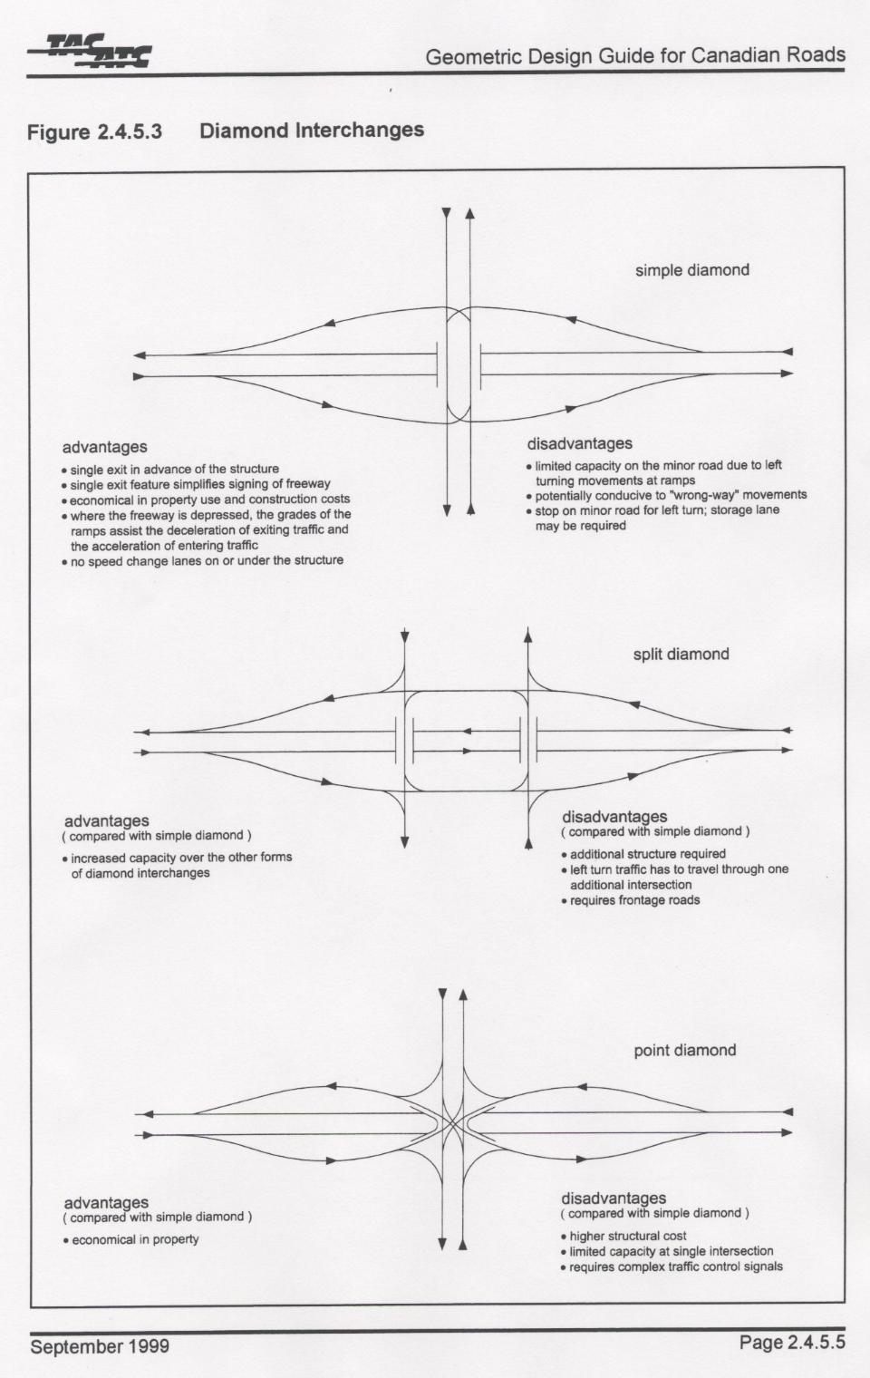
Service interchanges
Diamonds
  Spread
  Tight
  Split
  Single point
  Diverging

Slide 113
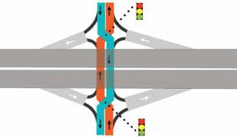
Service interchanges – Diverging
Biggest advantage – higher capacity - no opposing traffic for left turning vehicles and less loss time for amber
Notes:
First used in in France in the 1970’s
First used in the USA in 2009
Have not used one yet in Alberta, although it is being considered in ft. McMurray (Hwy 63 and McKenzie Road)

Slide 114
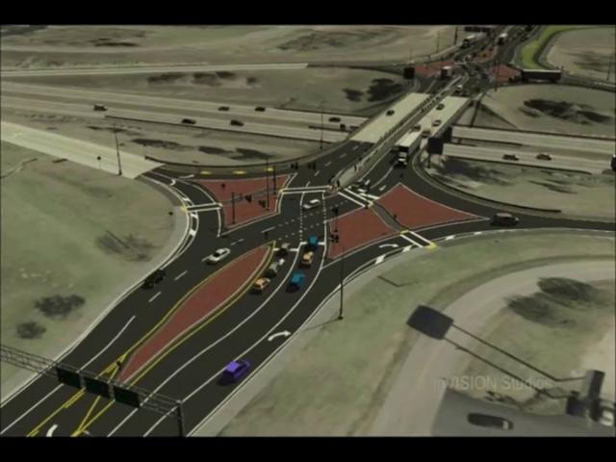
Service interchanges - Diverging Diamonds
Notes:
Angle of the intersection is about 65⁰

Slide 115
Diverting Diamond
Left turn- no opposing traffic

Slide 116
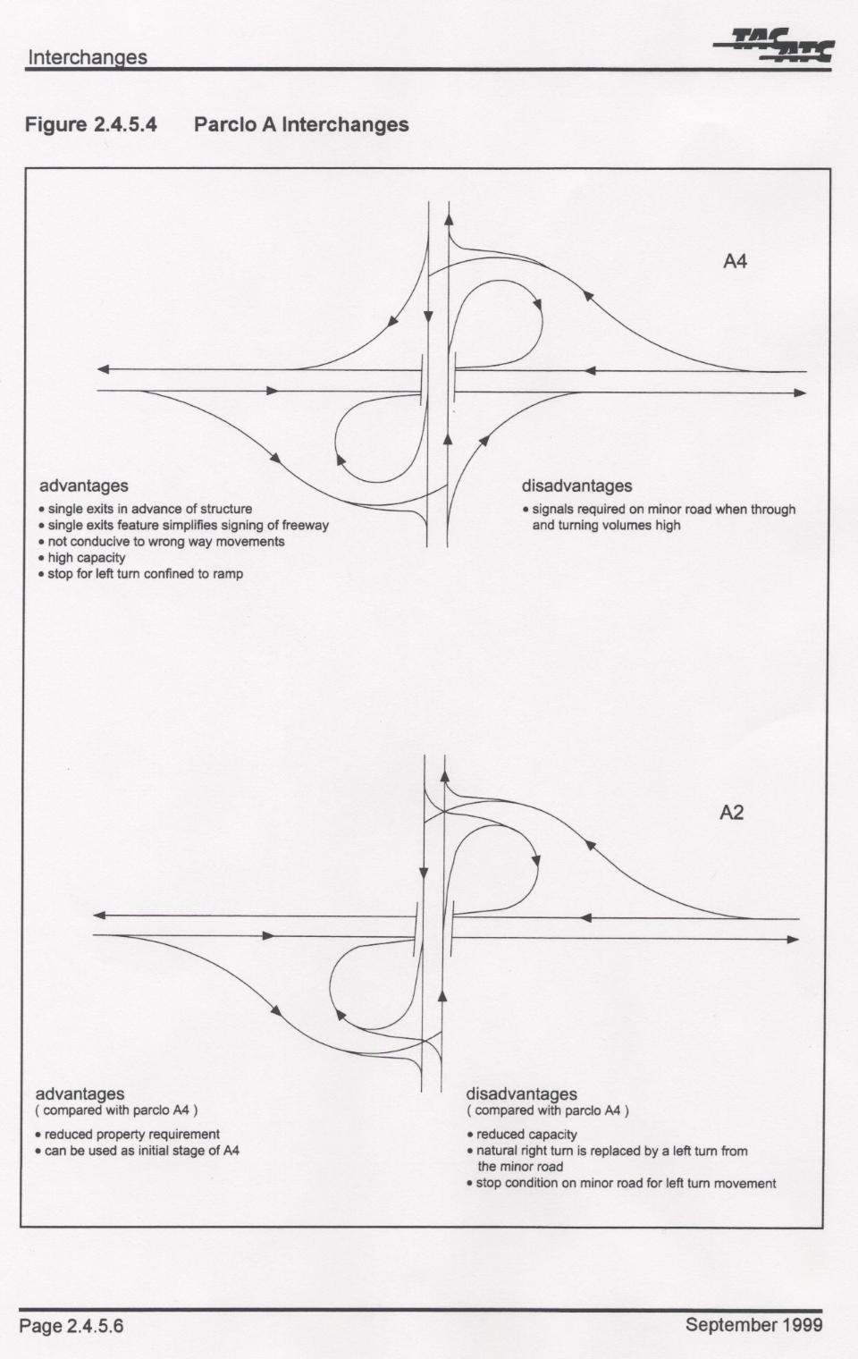
Service interchanges
“A-loops”
  Parlco A4
  Parclo A2
  Single loops

Slide 117
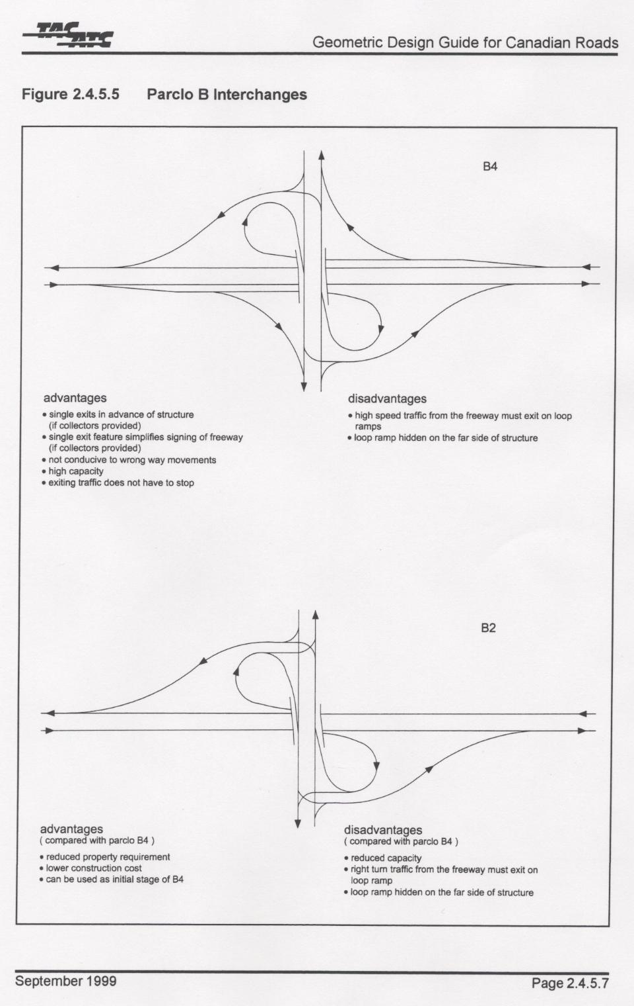
Service interchanges
“B-loops”
  Parclo B4
  Parclo B2
  Single loops

Slide 118
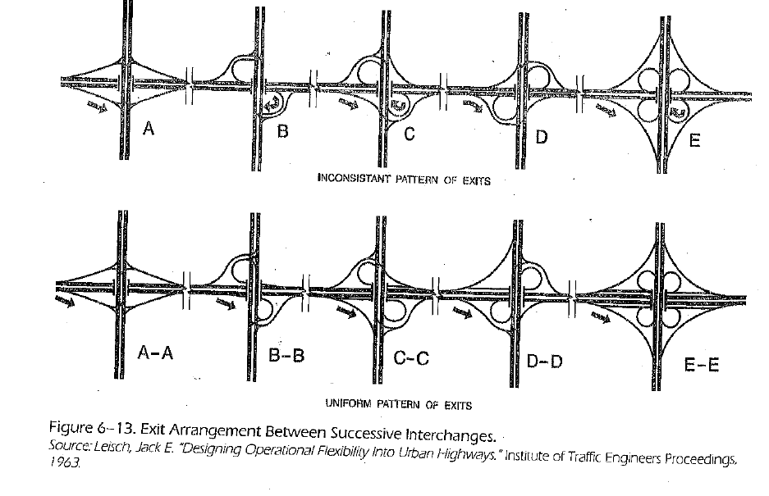
Consistent right hand entrance/exits
One exit per interchange (destination roadway)
Notes:
Illustrates single exits

Slide 119
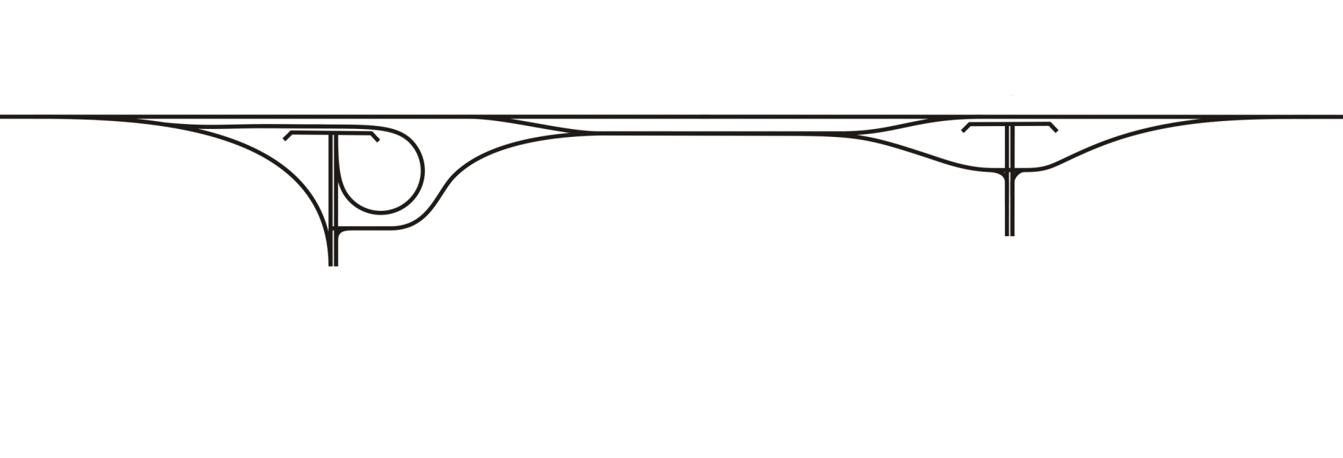
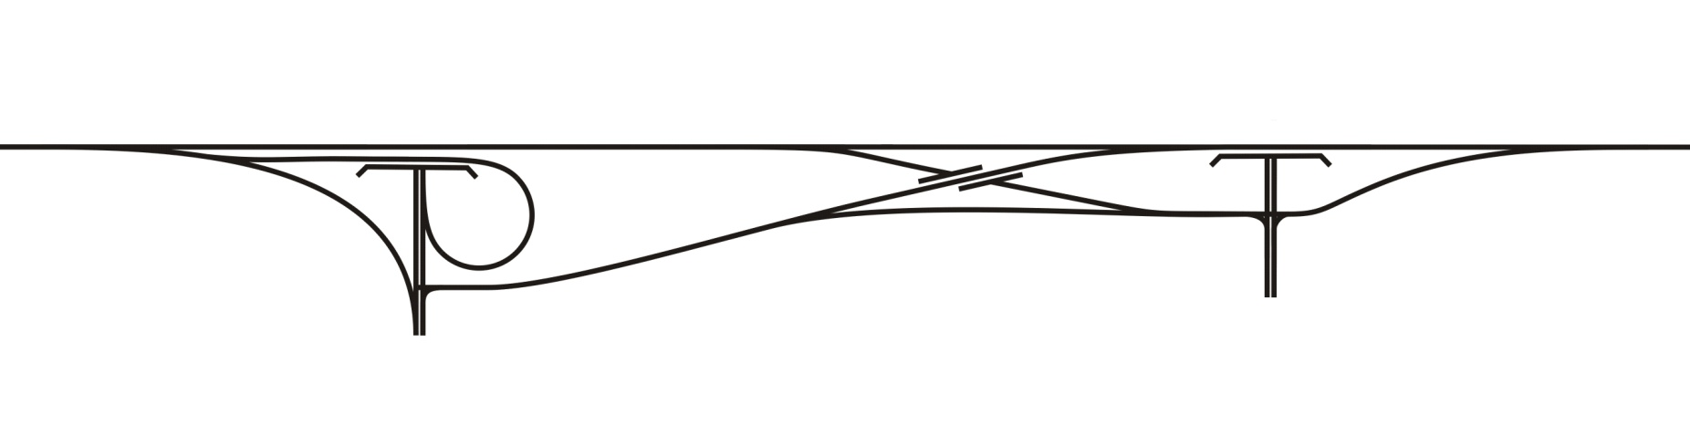
Closely spaced interchanges - solutions
C-D roads ($)
  Can remove weaving from mainline, provide additional capacity for weaves
Basket weaves($$)
  Can reduces total weaving volume
Notes:
2/11/2014

Slide 120
Closely spaced interchanges - solutions
  Word of caution
  Make sure you are not just shifting the problem elsewhere. The best way to reduce and eliminate weaving issues is to minimize the number of closely spaced interchanges and provide sufficient flyovers and parallel arterial connection to reduce the amount of local traffic using the freeway system (discretionary trips).
Notes:
2/11/2014
The Alberta Transportation and Utility Corridor (TUC) program was developed in 1974 by the creation of the Restricted Development Areas (RDA’s) Regulation.
This legislation enabled the Government to use RDA’s to protect TUC land, assemble TUC land, and protect adjacent lands from the adverse effects of highway, power line, and pipeline developments.
In 1984, The Edmonton and Calgary Transportation and Utility Corridor Reassessment Study refined the implementation strategy and brought the TUC planning from conceptual to functional level. This refinement of the plans reduced the width of the TUC and the amount of land required and as shown in the blue area on the diagram.
The Calgary TUC is 87 km in length, which does not include the southwest edge of the city, and covers about 4,600 hectares.

Slide 121
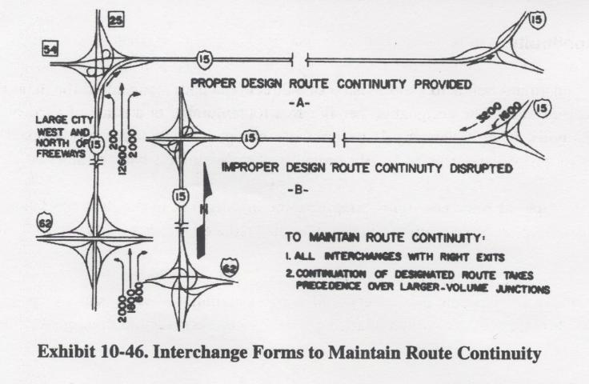
Route continuity

Slide 122
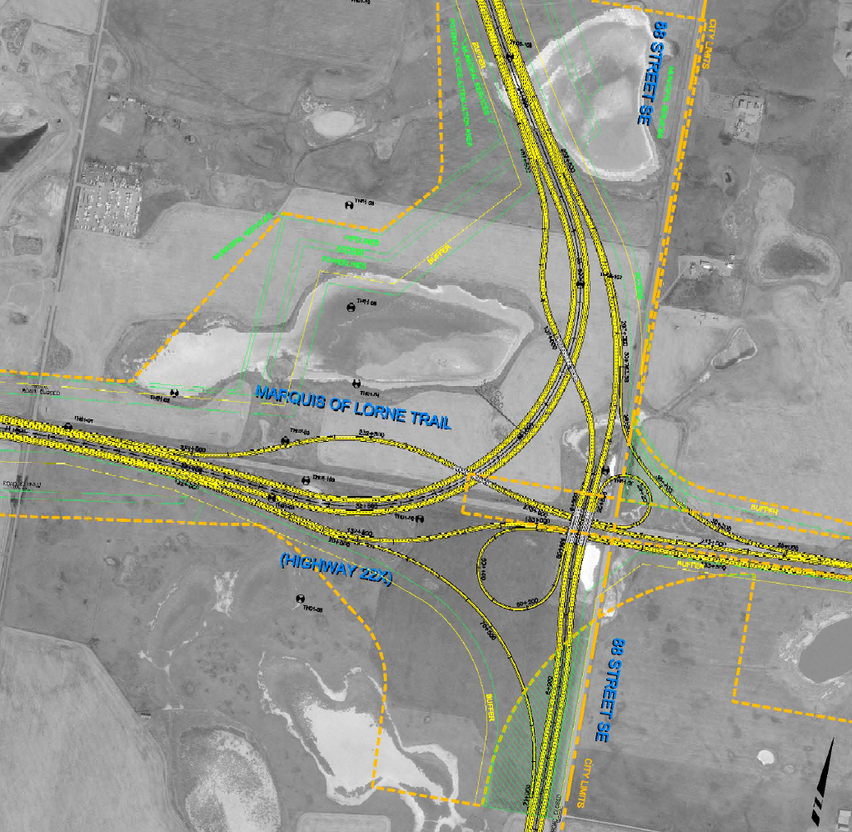
Route continuity
Calgary Ring Road example
901

Slide 123
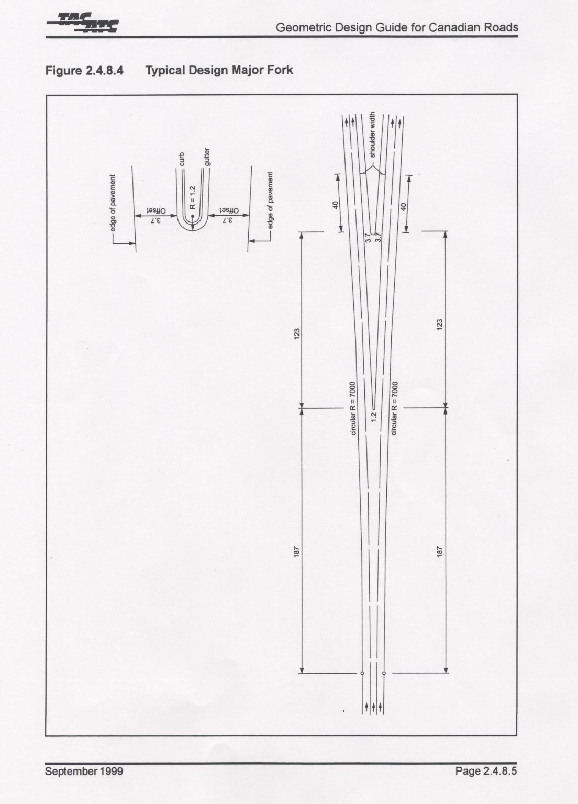
Major fork
Notes:
Both roads are important – therefore give equal importance to both roads by not having exits
Could use even if one is somewhat more minor, and right hand is more major. Then you don’t have to build a structure for “exit”

Slide 124
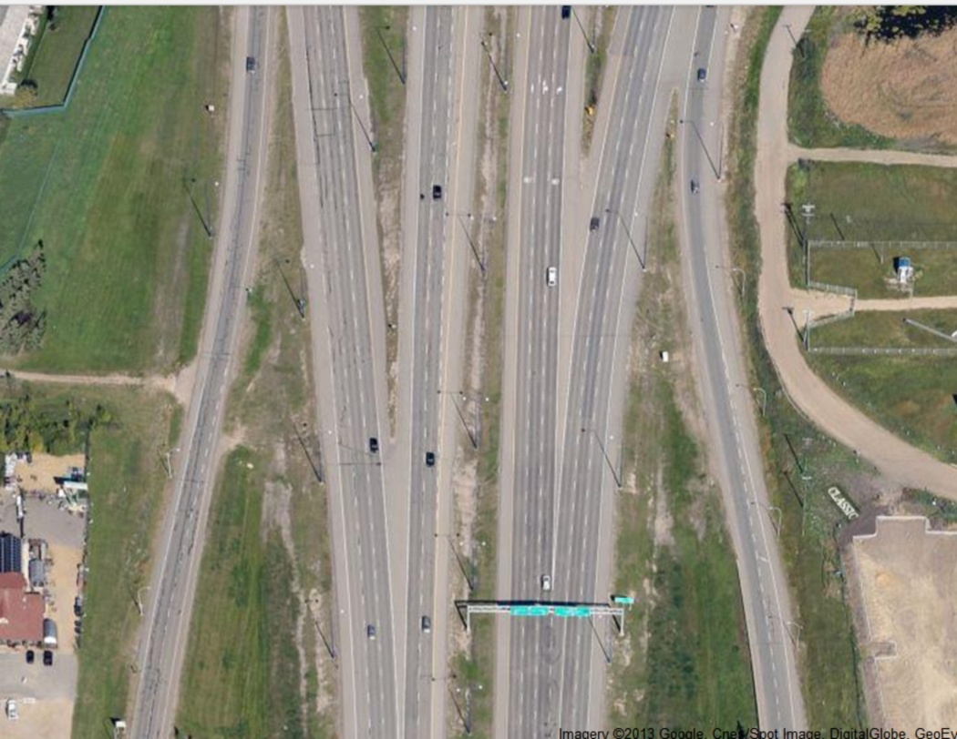
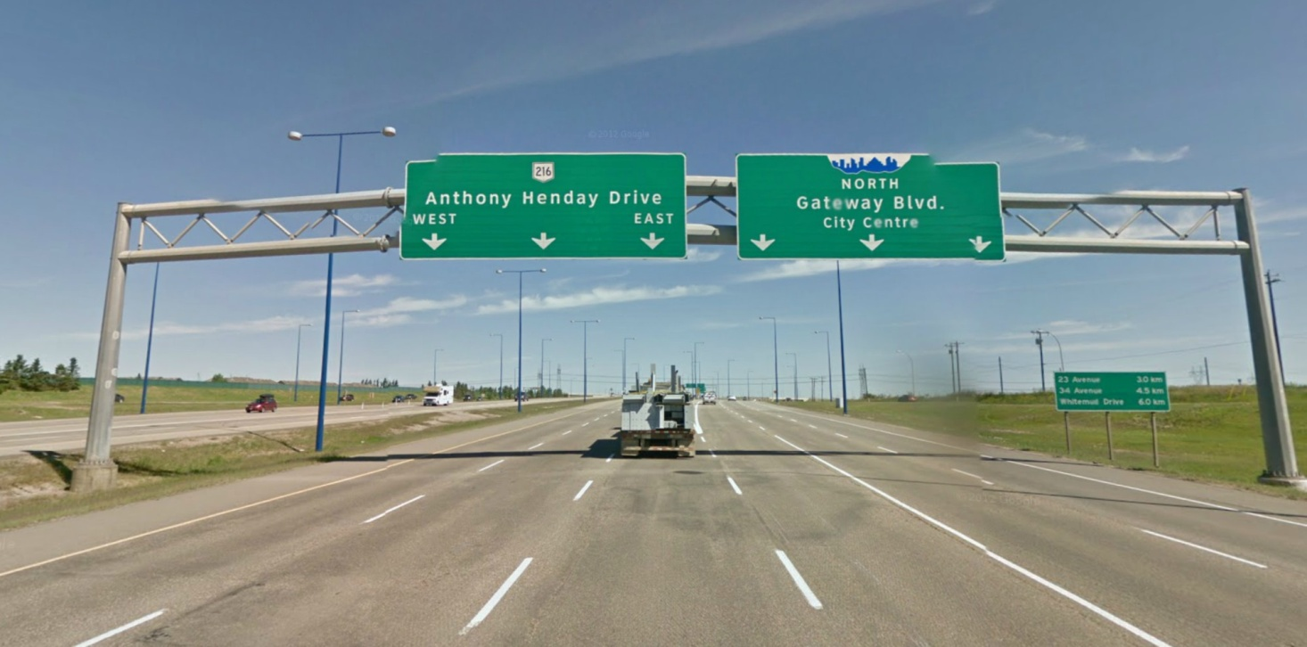
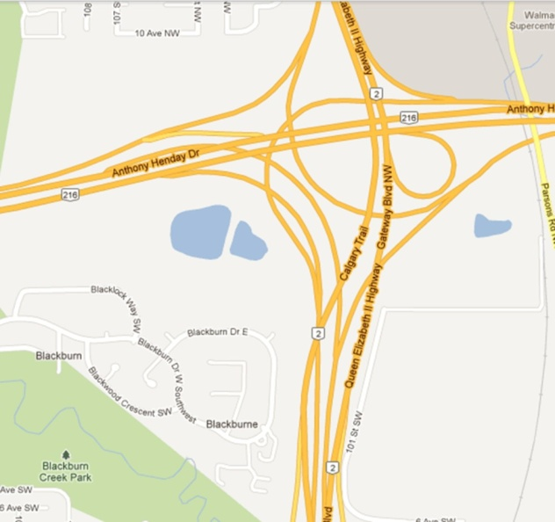
Anthony Henday Drive
& Hwy 2
Equal number of lanes – left and right
Continuous freeway lanes on left side
Semi-direct ramp

Slide 125
Basic Lanes
Basic number of lanes is defined as a minimum number of lanes designated and maintained over a significant length of a route
  Determine based on expected traffic volumes
  Localized variation (between interchanges) is ignored
  Auxiliary lanes are used when localized demand exceeds capacity of basic lanes
Notes:
2/11/2014
The Alberta Transportation and Utility Corridor (TUC) program was developed in 1974 by the creation of the Restricted Development Areas (RDA’s) Regulation.
This legislation enabled the Government to use RDA’s to protect TUC land, assemble TUC land, and protect adjacent lands from the adverse effects of highway, power line, and pipeline developments.
In 1984, The Edmonton and Calgary Transportation and Utility Corridor Reassessment Study refined the implementation strategy and brought the TUC planning from conceptual to functional level. This refinement of the plans reduced the width of the TUC and the amount of land required and as shown in the blue area on the diagram.
The Calgary TUC is 87 km in length, which does not include the southwest edge of the city, and covers about 4,600 hectares.

Slide 126

Lane Balance
Notes:
2/11/2014
The Alberta Transportation and Utility Corridor (TUC) program was developed in 1974 by the creation of the Restricted Development Areas (RDA’s) Regulation.
This legislation enabled the Government to use RDA’s to protect TUC land, assemble TUC land, and protect adjacent lands from the adverse effects of highway, power line, and pipeline developments.
In 1984, The Edmonton and Calgary Transportation and Utility Corridor Reassessment Study refined the implementation strategy and brought the TUC planning from conceptual to functional level. This refinement of the plans reduced the width of the TUC and the amount of land required and as shown in the blue area on the diagram.
The Calgary TUC is 87 km in length, which does not include the southwest edge of the city, and covers about 4,600 hectares.

Slide 127

Co-ordination of
Lane Balance and
Basic Lanes
N_{C}=N_{F}+N_{E}-1
N_{C}=N_{F}+N_{E}
N_{C}=N_{F}+N_{E}-1
Nc
Nc
Notes:
2/11/2014
A driver operating in one of the basic lanes should not have to change lanes to remain in through movement
Simply stated, the lane balance principle for exits provides for one more lane going away that will help flush traffic away from the divergence area.
Exits – after exit number of lanes should be total lanes plus 1
Entrances – after entrance number of lanes should be total lanes minus 1
Lanes should be only dropped by one lane at a time

Slide 128

Over versus Under
Stages better
Drains better
Start/stop better
Visibility better
Easier to expand
PREFERRED CASE
Notes:
2/11/2014
The Alberta Transportation and Utility Corridor (TUC) program was developed in 1974 by the creation of the Restricted Development Areas (RDA’s) Regulation.
This legislation enabled the Government to use RDA’s to protect TUC land, assemble TUC land, and protect adjacent lands from the adverse effects of highway, power line, and pipeline developments.
In 1984, The Edmonton and Calgary Transportation and Utility Corridor Reassessment Study refined the implementation strategy and brought the TUC planning from conceptual to functional level. This refinement of the plans reduced the width of the TUC and the amount of land required and as shown in the blue area on the diagram.
The Calgary TUC is 87 km in length, which does not include the southwest edge of the city, and covers about 4,600 hectares.

Slide 129
NOISE

Slide 130
Noise
Sound is a sensation caused by fluctuations in air pressure detected by the human ear. When the sound is unwanted it is described as noise
Noise is generally described in measurement of loudness
Traffic noise can often be attenuated, but at a price

Slide 131

Noise Measurement
Sound pressure levels are measured in terms of decibels (dB), a logarithmic function of the pressure, and the levels of likely sound are covered on a scale of 0 to 140
dB is measured on a logarithmic scale

Slide 132
Noise Measurement
  dB condenses intensity of traffic noise (total noise energy) into a single number that can be read with a Sound Meter
  “A” is the weighting scale for the pitch component of noise produced by traffic – hence we use the term dBA
  L_{eq} is the average (non-fluctuating) sound level, which over a period of time contains the same amount of energy as the ranging levels of traffic noise
  dBA L_{eq} 24 is used to describe the noise intensity level over a 24 hour period of time during which the sound level fluctuated

Slide 133

Noise Measurement
Traffic Noise relationships with changes in volume or distance to recipient
  An increase of 10 dB doubles the noise level (loudness)
  The human ear can discern a change of about 3 dBA
  Doubling traffic volumes at source increases the noise levels by 3 dBA
  If distance from the source is doubled the noise level will decrease by about 3 dBA
  Reducing vehicle speed from 100 km/h to 80 km/h will reduce noise levels by about 2 dBA

Slide 134
Noise Management
There are many variables that contribute to traffic noise
The following are the main areas where noise reduction can be systematically approached
  Land use and development control
  Building design and standards
  Roadway planning and design
  Operational control of vehicles on roadways
  Vehicle design

Slide 135

Office towers
Noise Generator
Commercial
Residential

Slide 136

Noise
Department’s current Noise Attenuation Guidelines were adopted in October 2002
Available on intranet: http://www.transportation.alberta.ca/Content/docType490/Production/NoiseGuidelines.pdf

Slide 137
Noise
The “trigger level” of 65 dba (leq 24) applies to cities and urban areas only
Noise attenuation is linked to roadway changes.
The guidelines provide consistency from a provincial highway perspective
There is provision to add further noise attenuation at the discretion and financial commitment of the local jurisdiction

Slide 138
Noise Attenuation
Typical ways to attenuate noise are
  Earth berms
  Barrier walls
  Distance
  Noise reducing pavement
The effectiveness of a barrier is dependant on a number of factors, including location, length, height, topography, etc.
  For maximum effectiveness, a barrier should be close to either the source or the receiver and it should be high enough and long enough to block line of sight to the road
  It is best modeled to accurately determine its effectiveness

Slide 139
Noise Attenuation – Trees??
Noise seeps through openings
Generally vegetation is not an effective means of attenuation
Trees need to be planted closely and several rows to reduce some noise (no openings)
Maybe some psychological benefit to trees, but expensive to plant and maintain

Slide 140

Noise Attenuation

