Slide 1
International Roughness Index (IRI) for
Construction Acceptance
Technical Standards Branch
Knowledge Presentations to the CEA
February 13th, 2014
Jim Gavin, P.Eng.

Slide 2
Outline
Measuring road profiles
Ride Quality Indices (PrI, IRI)
AT Smoothness Specification
2013 Inertial Profiler Certification
Observations from 2013 projects
Consultant monitoring and reporting
Specification fine-tuning

Slide 3
IRI Implementation
Fall 2012 – Begin to insert into select tenders.
  Southern: Hwys 3:10 and 1:02
  Central: Hwys 2:20, 2:24 and 592:02
  North Central: Hwy 770:04
  Peace: Hwy 2:70
Fall 2013 – Review test results and industry feedback.
February 2014 - Revised specification to be inserted within all paving tenders.

Slide 4
What is a True Profile?
Longitudinal profile: a two-dimensional slice of road taken along an imaginary line

Slide 5
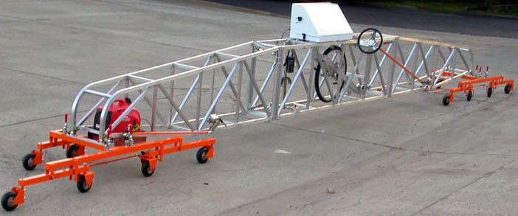
Pavement Smoothness
California Profilograph used since late 1970’s.
  First agency in Canada.
End product specifications with bonus/penalties payments since early 1990’s
  Another first in Canada.
Cox CS8200 models, Paveset and high speed inertial profilers now in use.

Slide 7
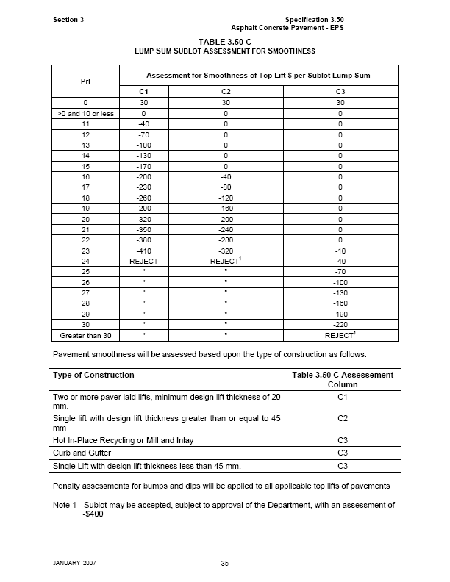

Slide 8
Profile Data Collection and Analysis
High Speed Inertial Profilers

Slide 9
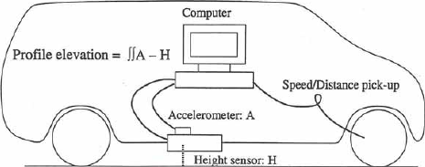
Hi-Speed Inertial Profiler
Profile data collected at speeds ranging from 25 km/hr to 110 km/hr.
Data is filtered to remove long and short
wave lengths.
Analyzed to give roughness statistics – IRI, PrI, etc.

Slide 10
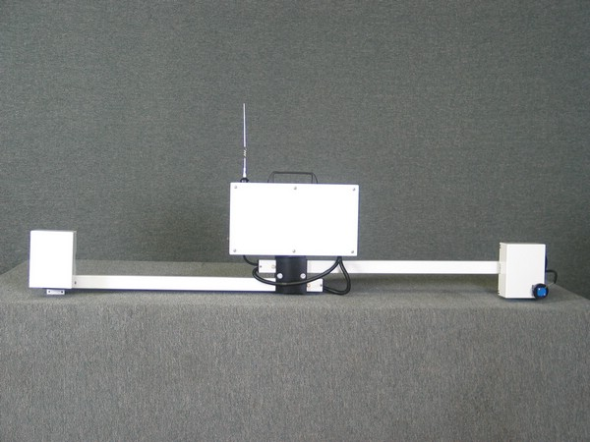
Profiler - Bumper Mounted Units

Slide 11
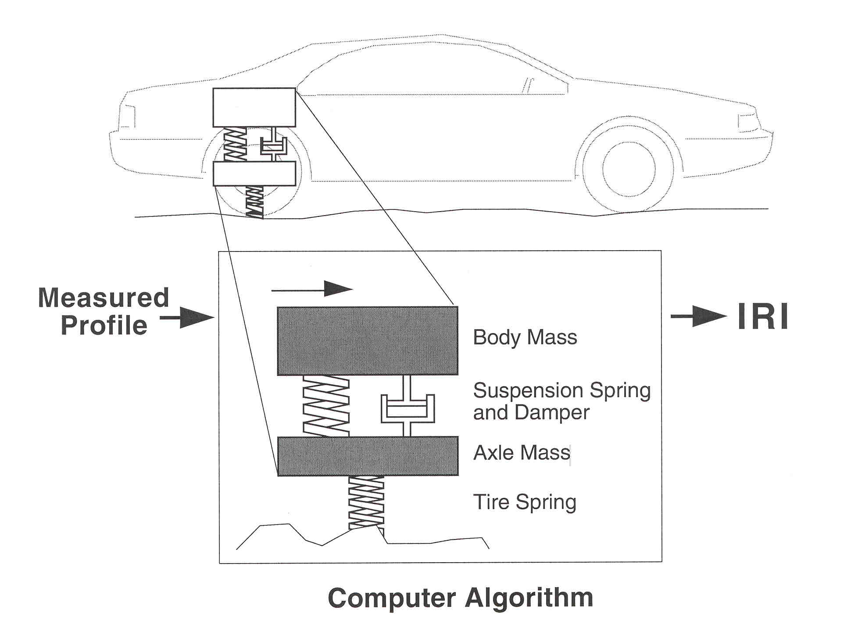
International Roughness Index

Slide 12
IRI Determination
Profile measured within each wheel path.
IRI determined for each wheel path based upon the “quarter car” model described in ASTM E1926.
Mean IRI (MIRI) is the average IRI of the left and right wheel path. Expressed in terms of m/km of vehicle movement.

Slide 13
C-TEP Short Course
Smoothness Testing of Pavements
One day course on Smoothness Testing of Pavements to include:
  Definition of Pavement Smoothness
  Technologies for Measuring Roadway Profiles
  Reference Profiles and Survey Methodologies
  Roughness Indices (PrI and IRI)
  Certification
  Profile Explorations using ProVAL
Presenter – Dr. Darel Mesher
Mid April – Edmonton, Calgary

Slide 14
Certification Type Testing
Inertial Profilers
2013
AASHTO Standard R 56
Certification of Inertial Profiling Systems

Slide 15
Reference Profilers
Reference profilers obtain true profile of pavement
Used for verification of profilers
Types of Devices
  Rod and Level
  Dipstick®
  Walking Profiler

Slide 16
Rod and Level
1. Reference elevation = instrument height
2. Height relative
to reference = rod
longitudinal
reference point
3. Longitudinal distance
measured with tape or laser

Slide 17
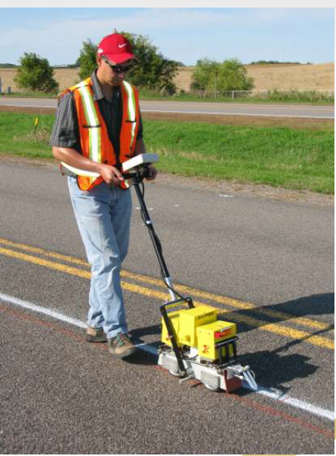
SurPRO Walking Profiler
Class 1 reference profiler
Used by AT for
certification-like testing of
inertial profilers.
IP units complete five
runs. Assessed for
accuracy and repeatability.

Slide 18
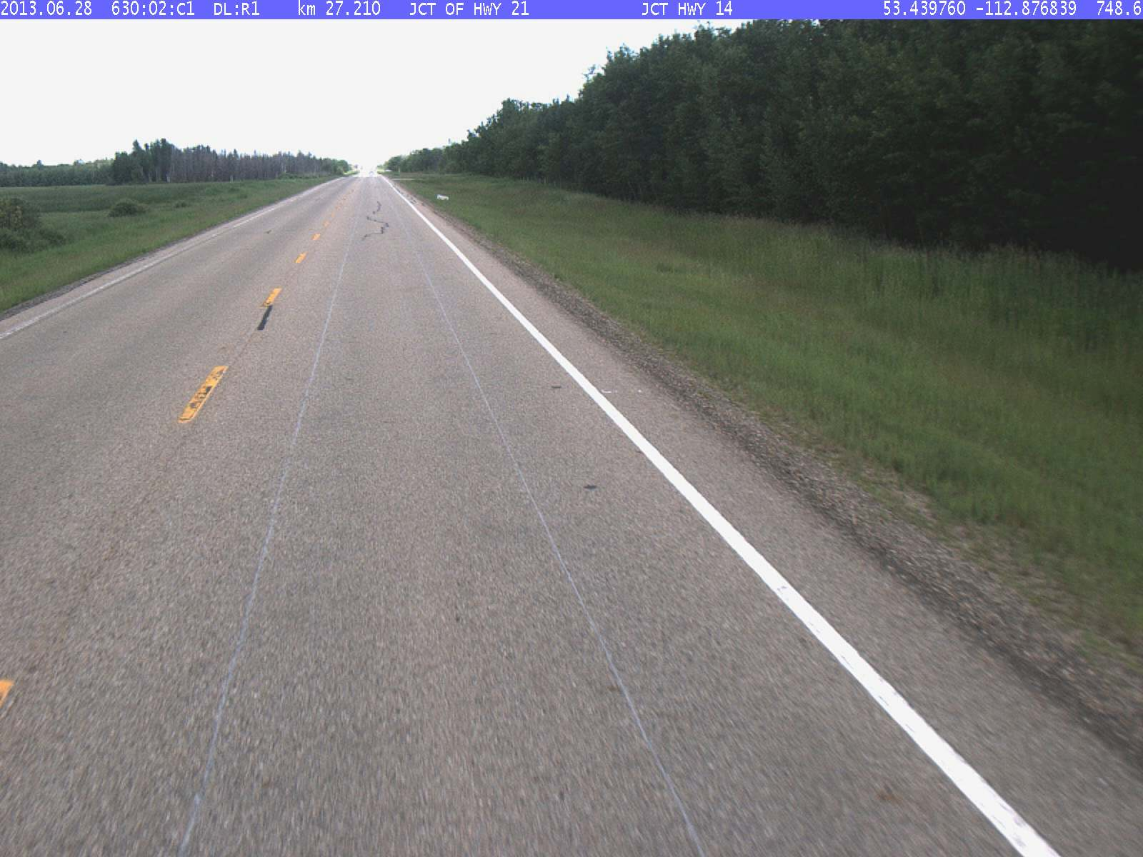
Edmonton Verification Site

Slide 19
Inertial Profiler Assessment
2013 - Five IP units assessed against reference profiler using two procedures.
AT Procedure
  IP average IRI to be within 10% of Class 1 value.
  All individual runs to be within 5% of average IRI.
  All IP units easily passed.
AASHTO R56 Procedure
  Mathematical analysis to compare the IP profile to the Class 1 profile on a point by point basis.
  Not all IP units passed.
  Other agencies report the same.

Slide 20
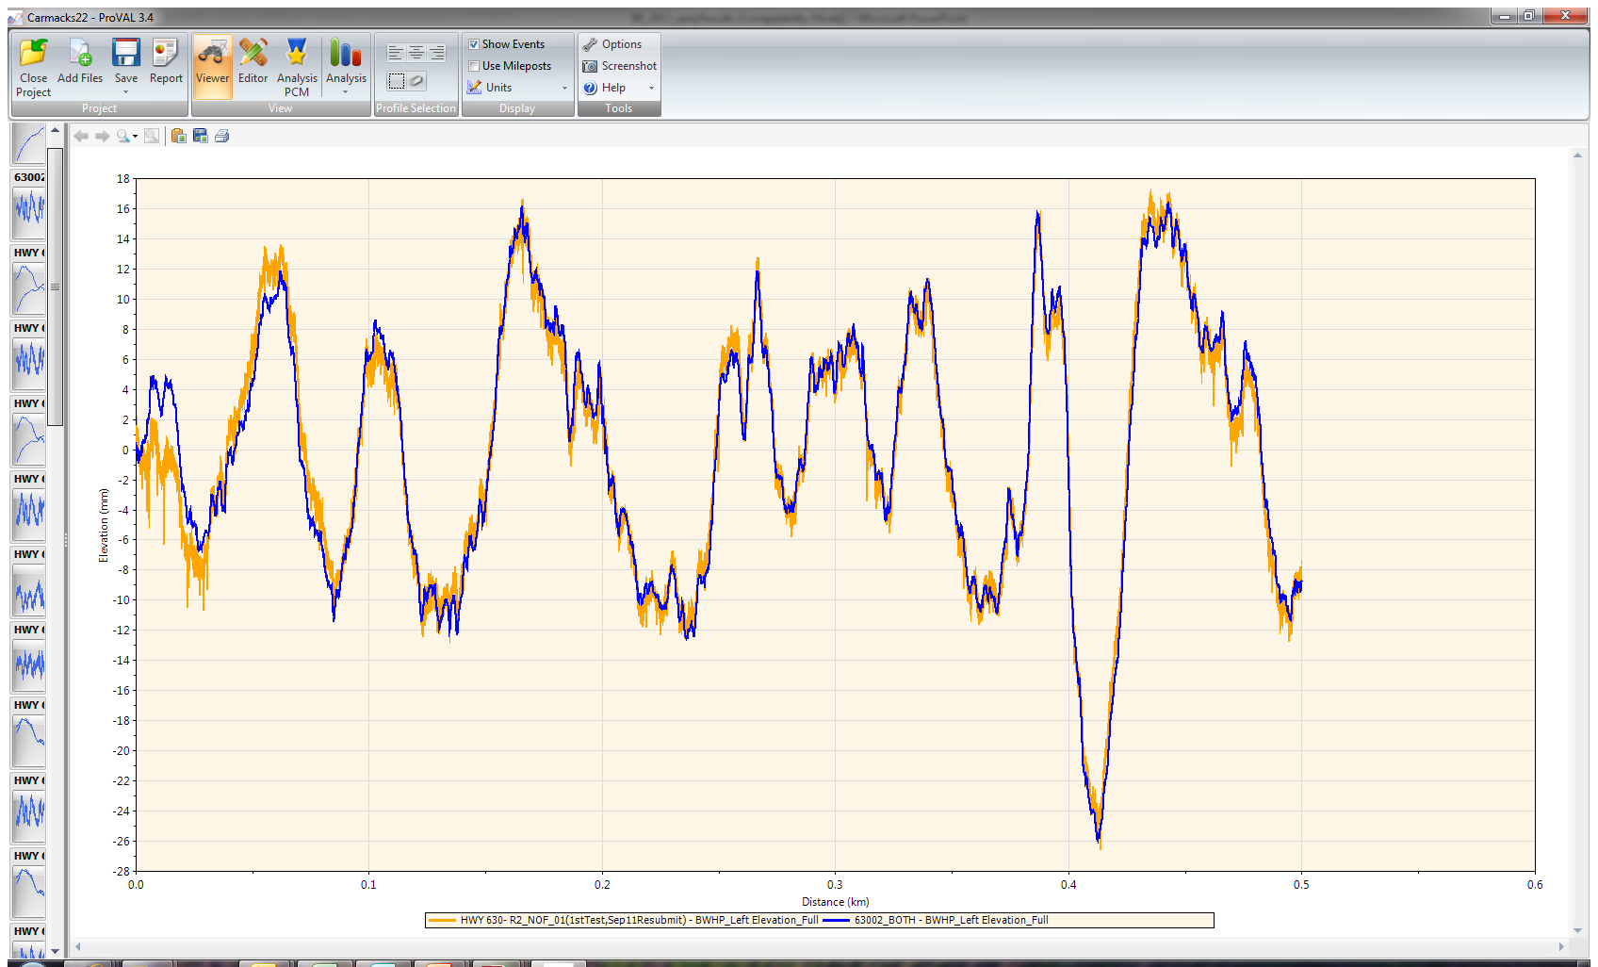
Hi-Pass Filtered Profiles

Slide 21
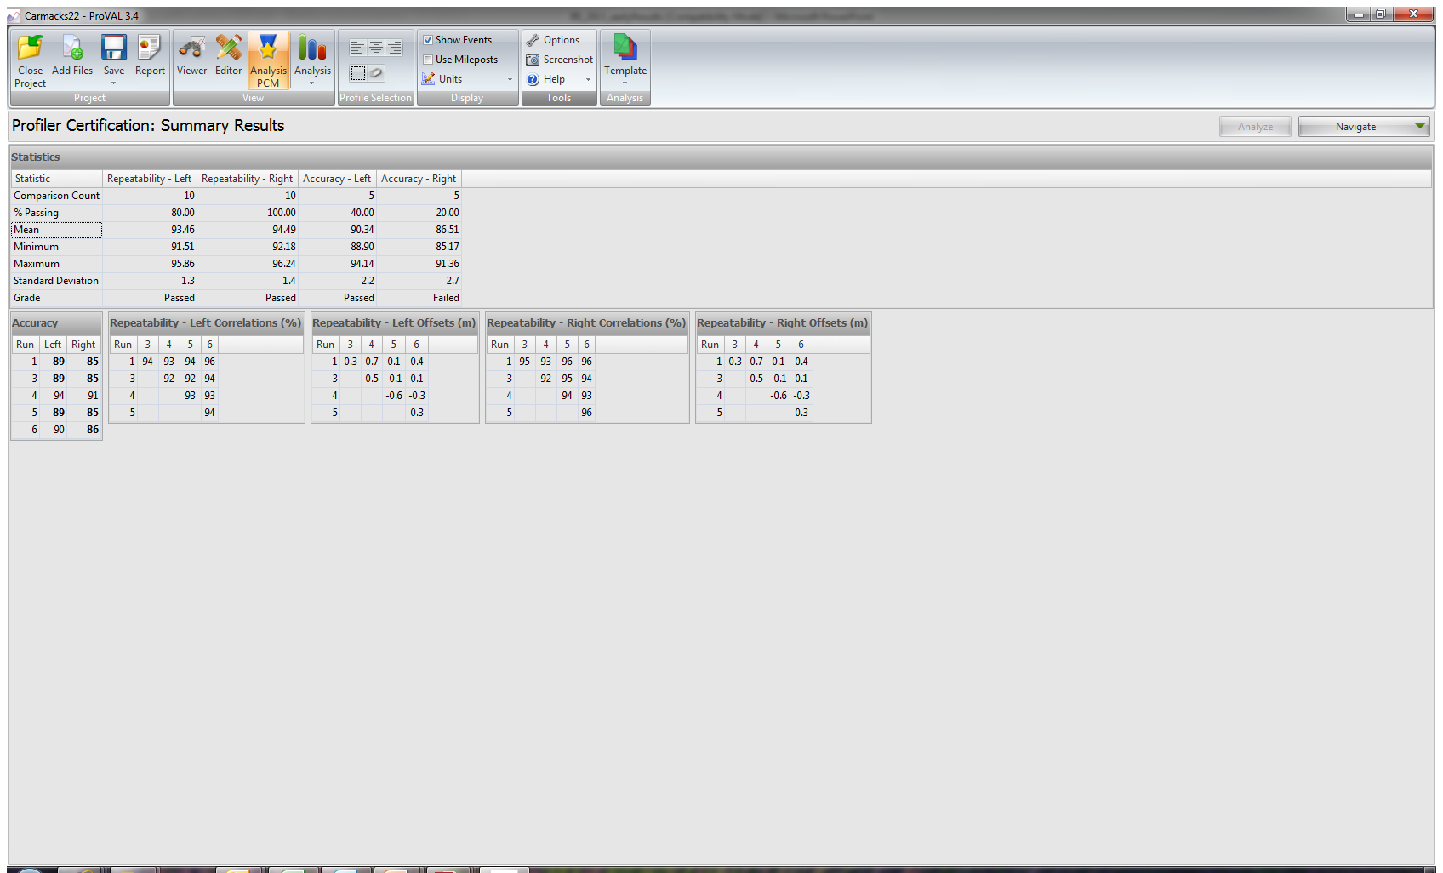
ProVAL Profiler Certification Results

Slide 22
Review of IRI Smoothness Specification 2013

Slide 23
Smoothness Assessment
Ride Quality (RQ) determined on a 100 metre sublot basis and assessed for:
  Acceptance with either: bonus, no adjustment or penalty
  Reject; must repair.
  Similar to existing profilograph specifications.
  Ride Quality Module used in ProVAL software.
Areas of Localized Roughness (ALR)
  Similar to existing bump/dip assessment.
  IRI determined over a 7.62 m moving baseline.
  Smoothness assurance module in ProVAL
Contractor to supply IP testing.
  Department may undertake verification testing.

Slide 24
Ride Quality Assessment -2013
MIRI (m/km) Average of left and right wheel paths | Assessment for Ride Quality of Top Lift ($ per Sublot)
 | S I | S II | S III
<0.55 | 50 | 50 | 50
0.55 – 0.70 | 30 | 30 | 30
0.71 – 0.80 | 0 | 30 | 30
0.81 – 1.04 | 0 | 0 | 0
1.05 – 1.20 | 720 – (730 x MIRI) | 0 | 0
1.21 – 1.54 | 720 – (730 x MIRI) | 1090 – (930 x MIRI) | 0
1.55 – 1.84 | Reject⁽¹⁾ | Reject⁽¹⁾ | 740 – (490x MIRI)
>1.85 | Reject⁽¹⁾ | Reject⁽¹⁾ | Reject⁽¹⁾

Slide 25
Areas of Localized Roughness
Remedial work for ALR.
  IRI > 2.00 m/km and ≤ 2.80 m/km repair at Consultant’s discretion.
  IRI > 2.80 m/km “must correct” to an IRI value of 2.00 m/km or less.
Penalty assessment for ALR.
  $12 per metre (as per ProVAL analysis) SI construction.
  $4 per metre for SII and SII construction.
IRI trigger value and assessment rates revised in 2014.

Slide 26
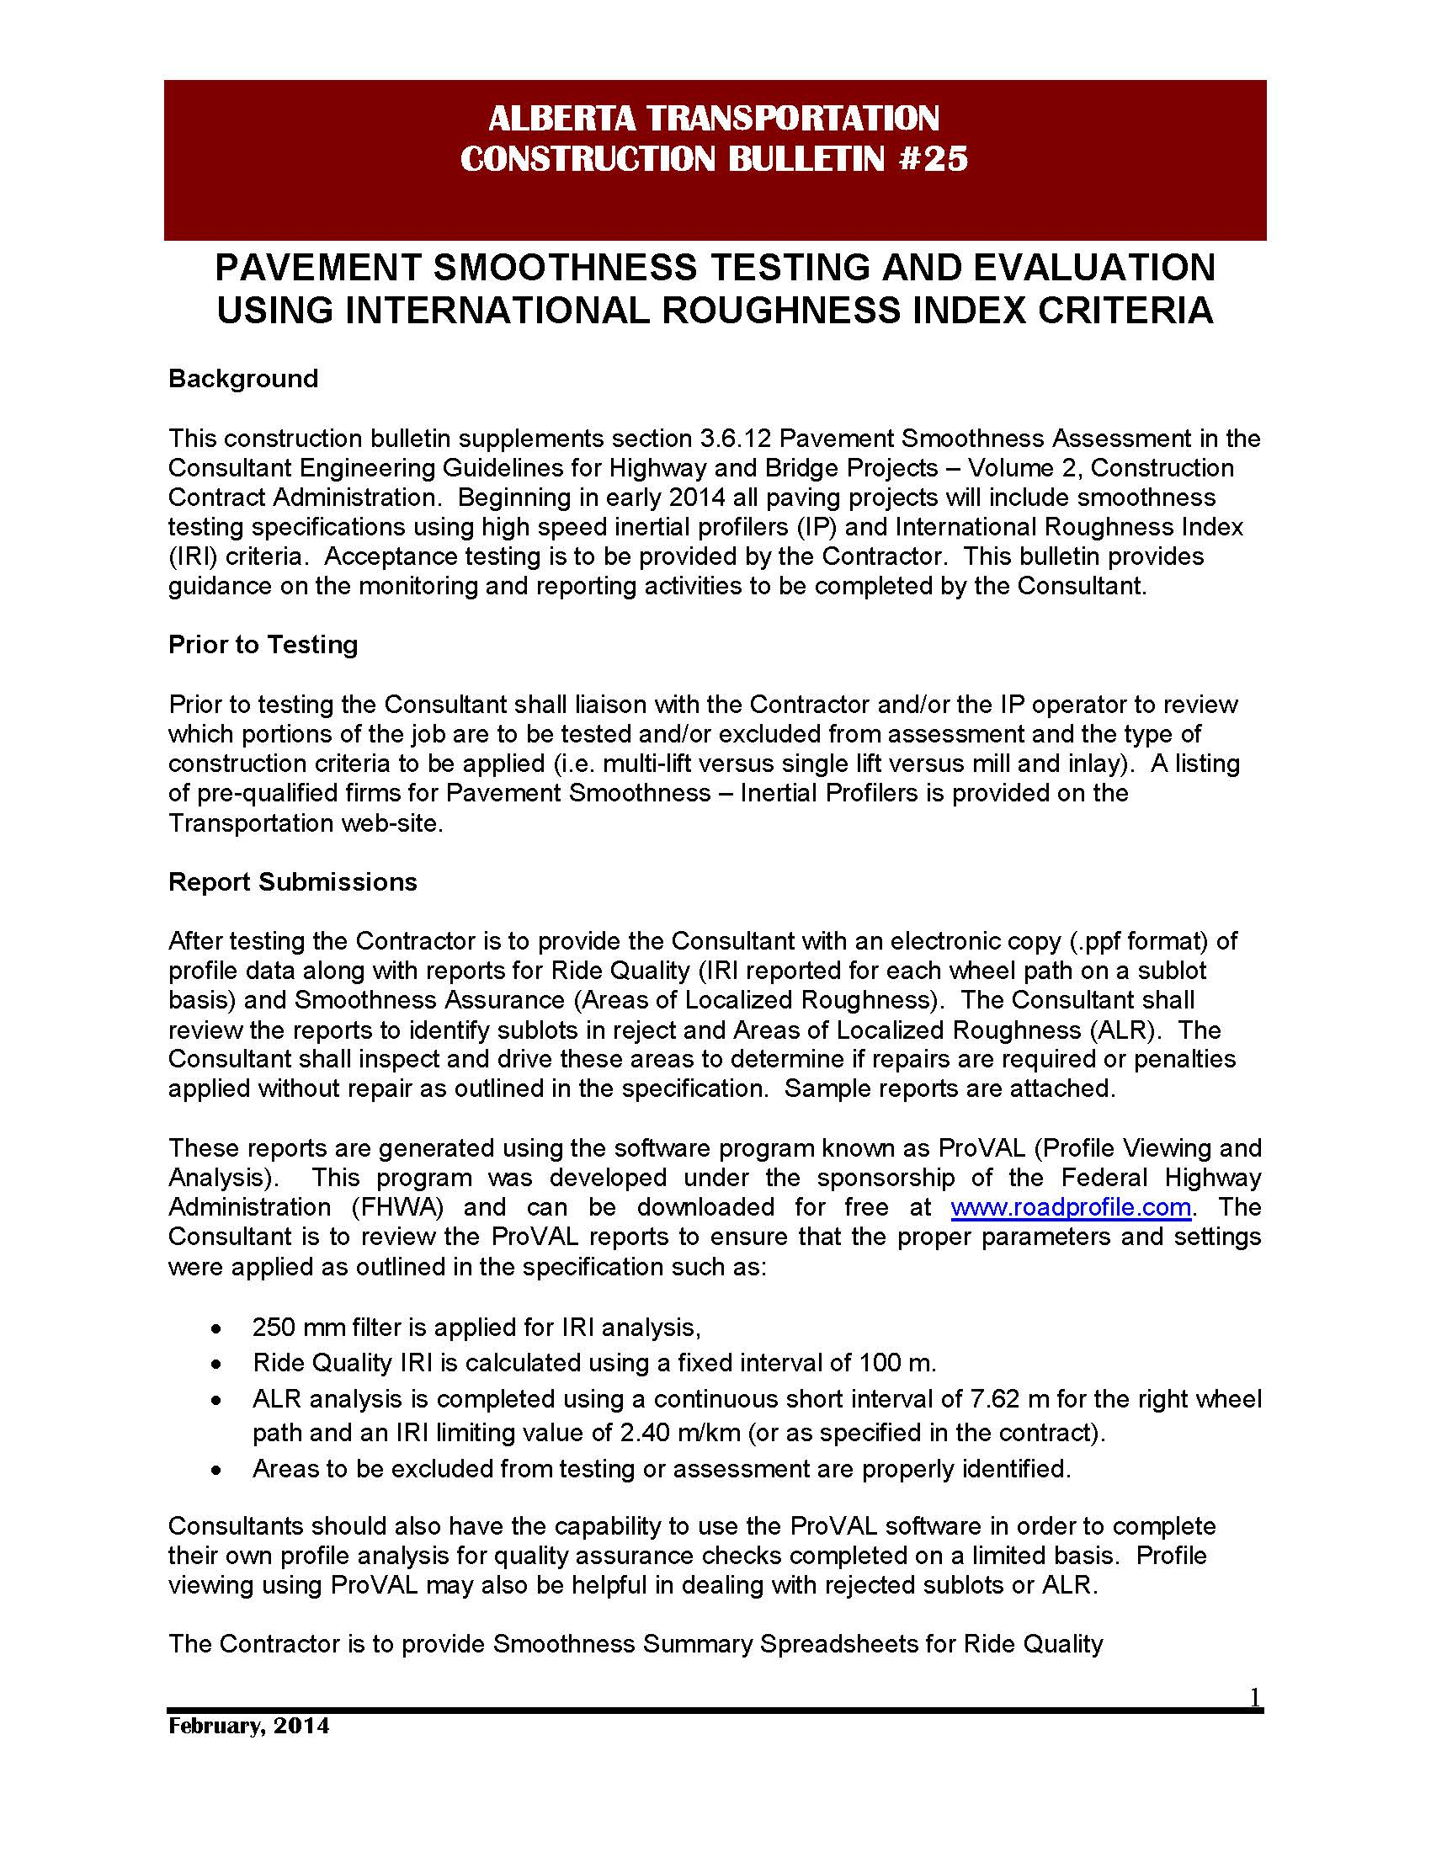

Slide 27
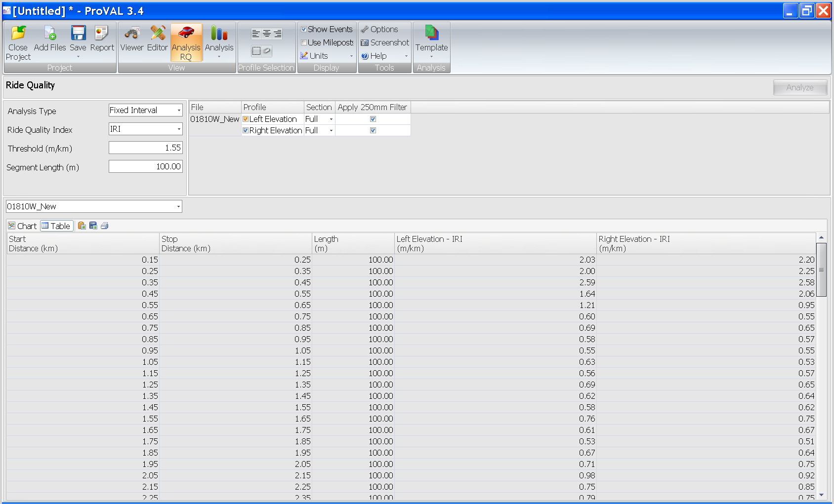
Ride Quality Screenshot
Table View

Slide 28
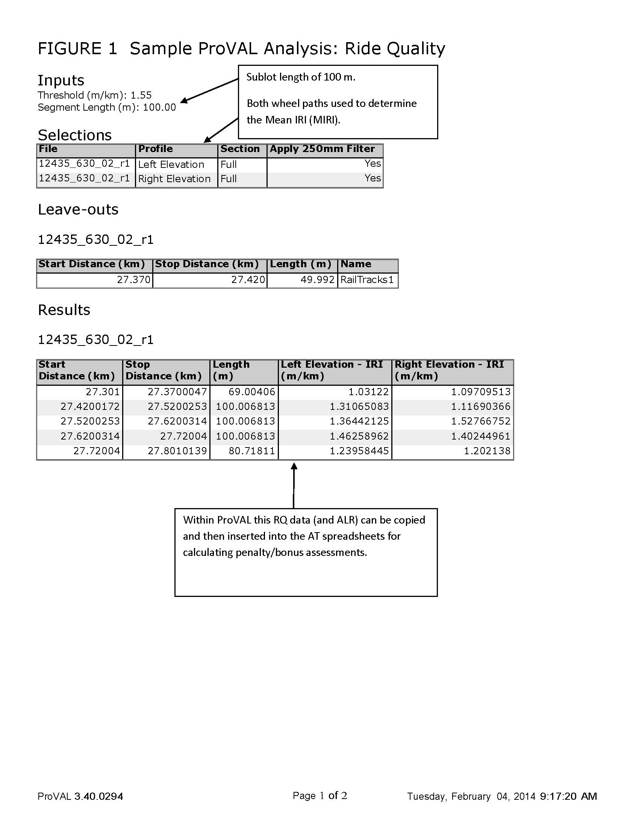

Slide 29
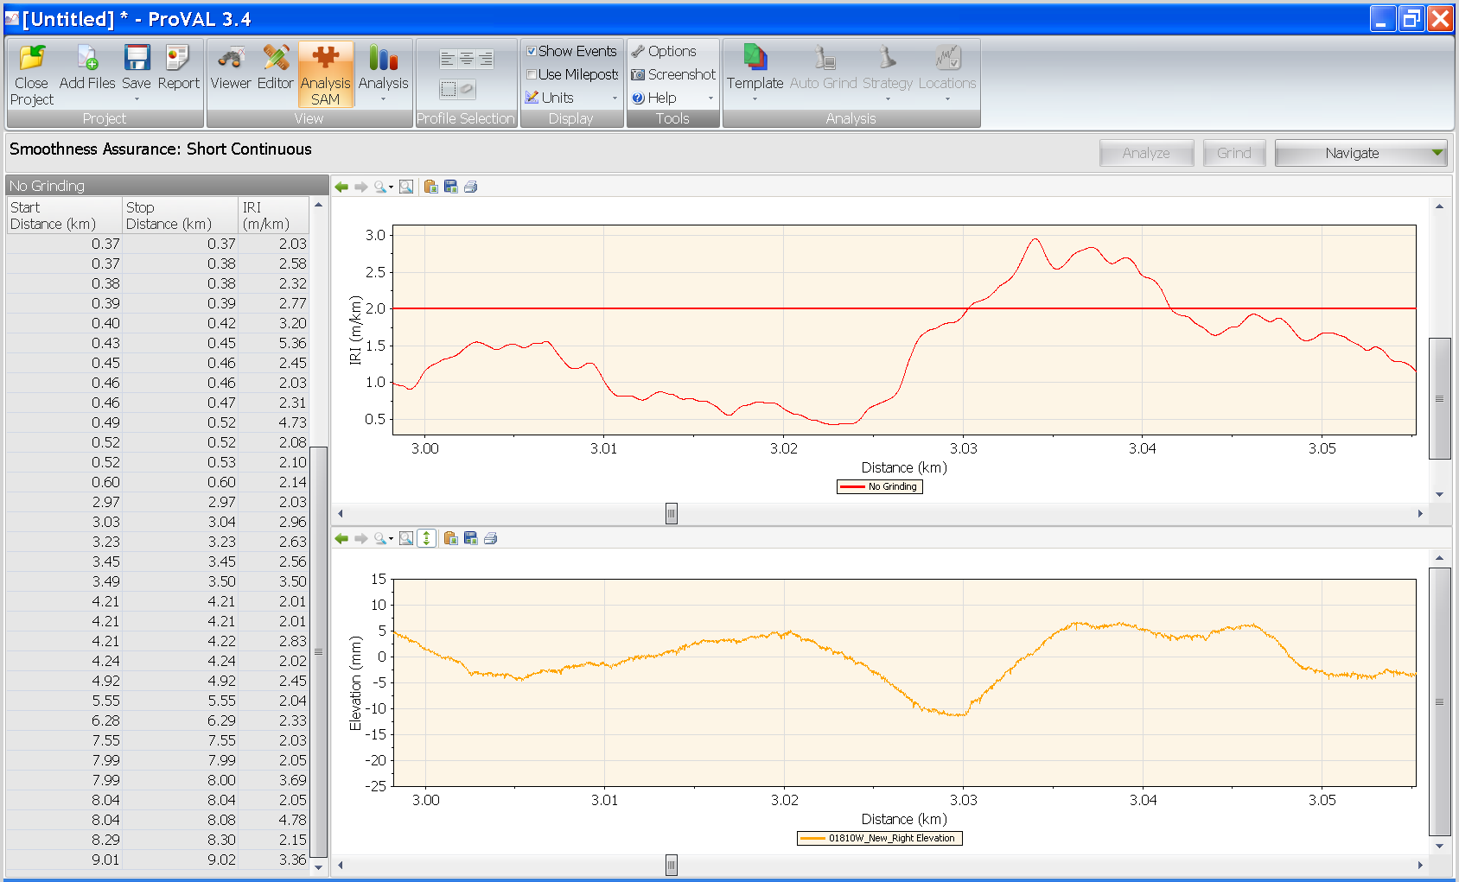
Areas of Localized Roughness

Slide 30
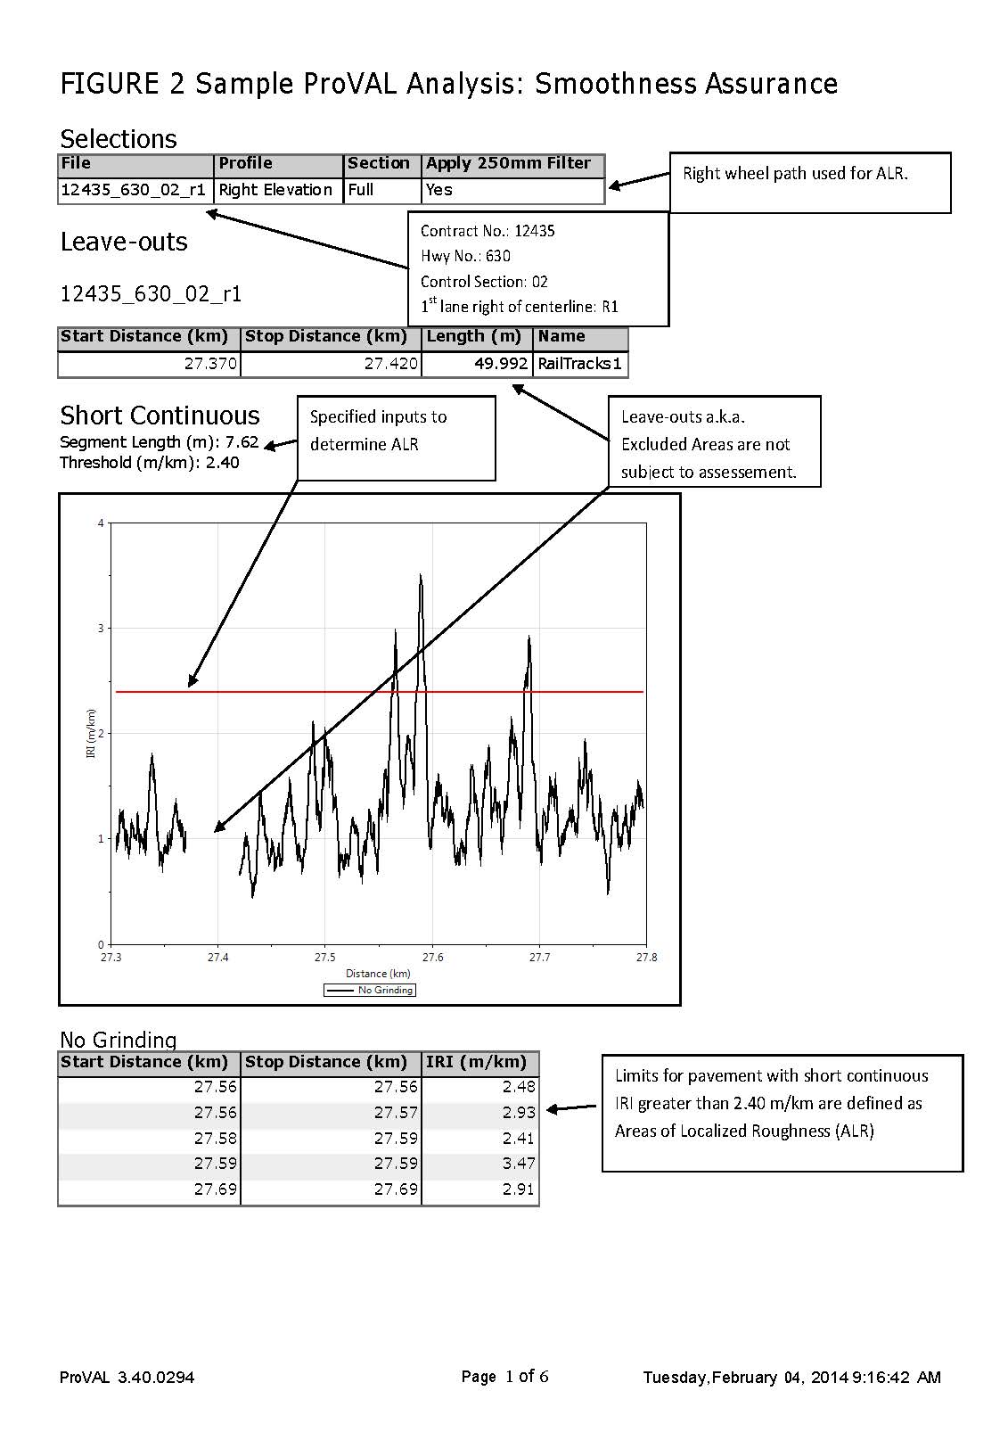

Slide 31
Spreadsheet – Assessment for Ride Quality

Slide 32
2013
Results & Observations

Slide 33
Overall Numbers
Total of 530 lane.km tested.
Overall combined net assessment
IRI Ride Quality plus ALR
  -$5,000
Sublot PrI plus Bump/Dip
  -$16,000
Four projects with increased assessment using IRI criteria.
Three projects with decreased assessment using IRI criteria.

Slide 34
Sublot Comparison
IRI versus PrI

Slide 35
ALR – Bump/Dip Comparison
Areas of Localized Roughness
  IRI > 2.0 m/km
  $12/m for multi-lift pavement
  $4/m for single lift pavement
  Total penalty of - $46,000
Bump/Dips
  > 8 mm
  $300 per b/d for multi-lift
  $100 per b/d for single lift
  Total penalty of - $86,000

Slide 36
Specification Comparison
IRI & ALR versus PrI & B/D

Slide 37
2013 Observations
First year of certification-like testing for inertial profilers was successful.
  Basic level of comfort that IP units were accurate and repeatable.
  Some pit falls identified in using the AASHTO R56 procedure.

Slide 38
2013 Observations
Challenges with the ALR criteria.
  A few sites with ALR had no subjective ride problem.
  ALR is not the same measurement as a bump/dip defect analysis.
  Not all ALR identified as “must repair” is repairable or even needs to be repaired.
  Agencies elsewhere are reporting similar challenges.
Field locating ARL can be a challenge.
  Need to work with testing firms to improve.
  GPS referencing may be one option.

Slide 39
2014 Specification Revisions
ALR
  IRI trigger value increased from 2.00 to 2.40 m/km.
    Results in 50% less sites and 55% less metres of ALR.
    Overall number of ALR sites approximately equal to the number of B/D sites.
  Reference to “must repair” ALR removed.
    Consultant to decided based upon ride.
  Penalty rates increased.
    Multi-lift paving increased to $40/m.
    All other paving increased to $15/m.
    Closer match to that using a Bump/Dip assessment.

Slide 40
2014 Specification Revisions
Ride Quality for Sublot assessment.
  Penalty formula for multi-lift paving reduced by as much as 5% - 10%.

Slide 41

Spreadsheet for Ride Quality
 |  |  |  | Contract No: |  | 12435 | Type of Test: | Acceptance
 |  |  |  | Hwy Number: |  | 630 | Contractor: | ABC Paving
 |  |  |  | Control Section: |  | 2 | IP Operator: | John Fisher
 |  |  |  | Lane: |  | R1 | Test Date: (mm/dd/yyyy) | 2/4/2014
 |  |  |  | Direction: |  | EB
Ride Quality Bonus/Penalty Summary
Appendix B20.a |  |  |  |  |  |  | Excluded Area? | Type of Cons. | Sublot Payment
Sublot | Station (km) |  | Length | IRI (m/km) |  | MIRI | Yes or | SI,SII,or SIII | Assessment
Number | Start | End | (m) | Left | Right | (m/km) | No |  | ($)
1 | 27.301 | 27.370 | 69 | 1.03 | 1.10 | 1.06 | no | SII | 0.00
2 | 27.420 | 27.520 | 100 | 1.31 | 1.12 | 1.21 | no | SII | -35.30
3 | 27.520 | 27.620 | 100 | 1.36 | 1.53 | 1.45 | no | SII | -258.50
4 | 27.620 | 27.720 | 100 | 1.66 | 1.60 | 1.63 | no | SII | -500.00
5 | 27.720 | 27.801 | 81 | 1.24 | 1.20 | 1.22 | yes | SII | Excluded Area
Total Assessment |  |  |  |  |  |  |  |  | -793.80
Comments: Rail tracks excluded from km 27.370 to 27.420. Sublot #5 speed limit < 70 km/hr.

Slide 42

Spreadsheet for ALR
 |  |  | Contract No: | 12435 | Type of Test: | Acceptance
 |  |  | Hwy Number | 630 | Contractor: | ABC Paving
 |  |  | Control Section | 2 | IP Operator: | John Fisher
 |  |  | Lane: | R1 | Test Date: (mm/dd/yyyy) | 2/4/2014
 |  |  | Direction: | EB
Appendix B20.b | Areas of Localized Roughness Summary
Station (km) |  | IRI (m/km) | Length | Excluded Area? | Type of Cons. | Penalty
Start | End | Right | (m) | Yes or No | SI,SII,or SIII | Assessment $
27.562 | 27.563 | 2.48 | 1 | no | SII | -$15.00
27.563 | 27.567 | 2.93 | 4 | no | SII | -$60.00
27.585 | 27.585 | 2.41 | 0 | no | SII | $0.00
27.586 | 27.594 | 3.47 | 8 | no | SII | -$120.00
27.686 | 27.692 | 2.91 | 6 | no | SII | -$90.00
Total Assessment |  |  |  |  |  | -$285.00
Comments:

Slide 43
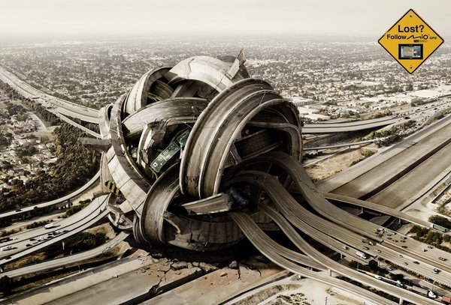
Questions

