Slide 1
Alberta Bridge Inventory
In Alberta there are about 13000 bridge size structures (Provincial and local road).
Types of bridges in Alberta:
  Standard bridges 3500
  Major bridges 1500
  Bridge size culverts 8200

Slide 2
Types of Bridges
Girders or Beams
Trusses
Flat Slabs
Rigid Frames
Arches
Suspension
Notes:
1
1
1

Slide 3
Typical Bridge Components
DECK
SUPERSTRUCTURE
ABUTMENT PART OF
SUBSTRUCTURE
PIER PART OF
SUBSTRUCTURE

Slide 4
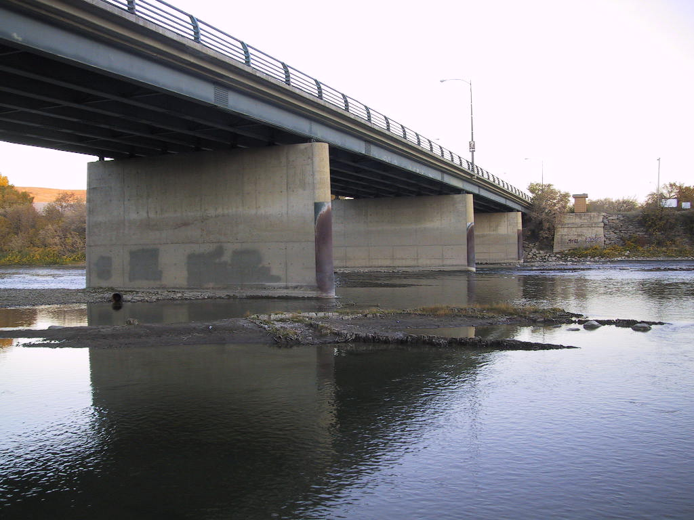
Steel Girder Bridge
Notes:
3
3
3
4

Slide 5
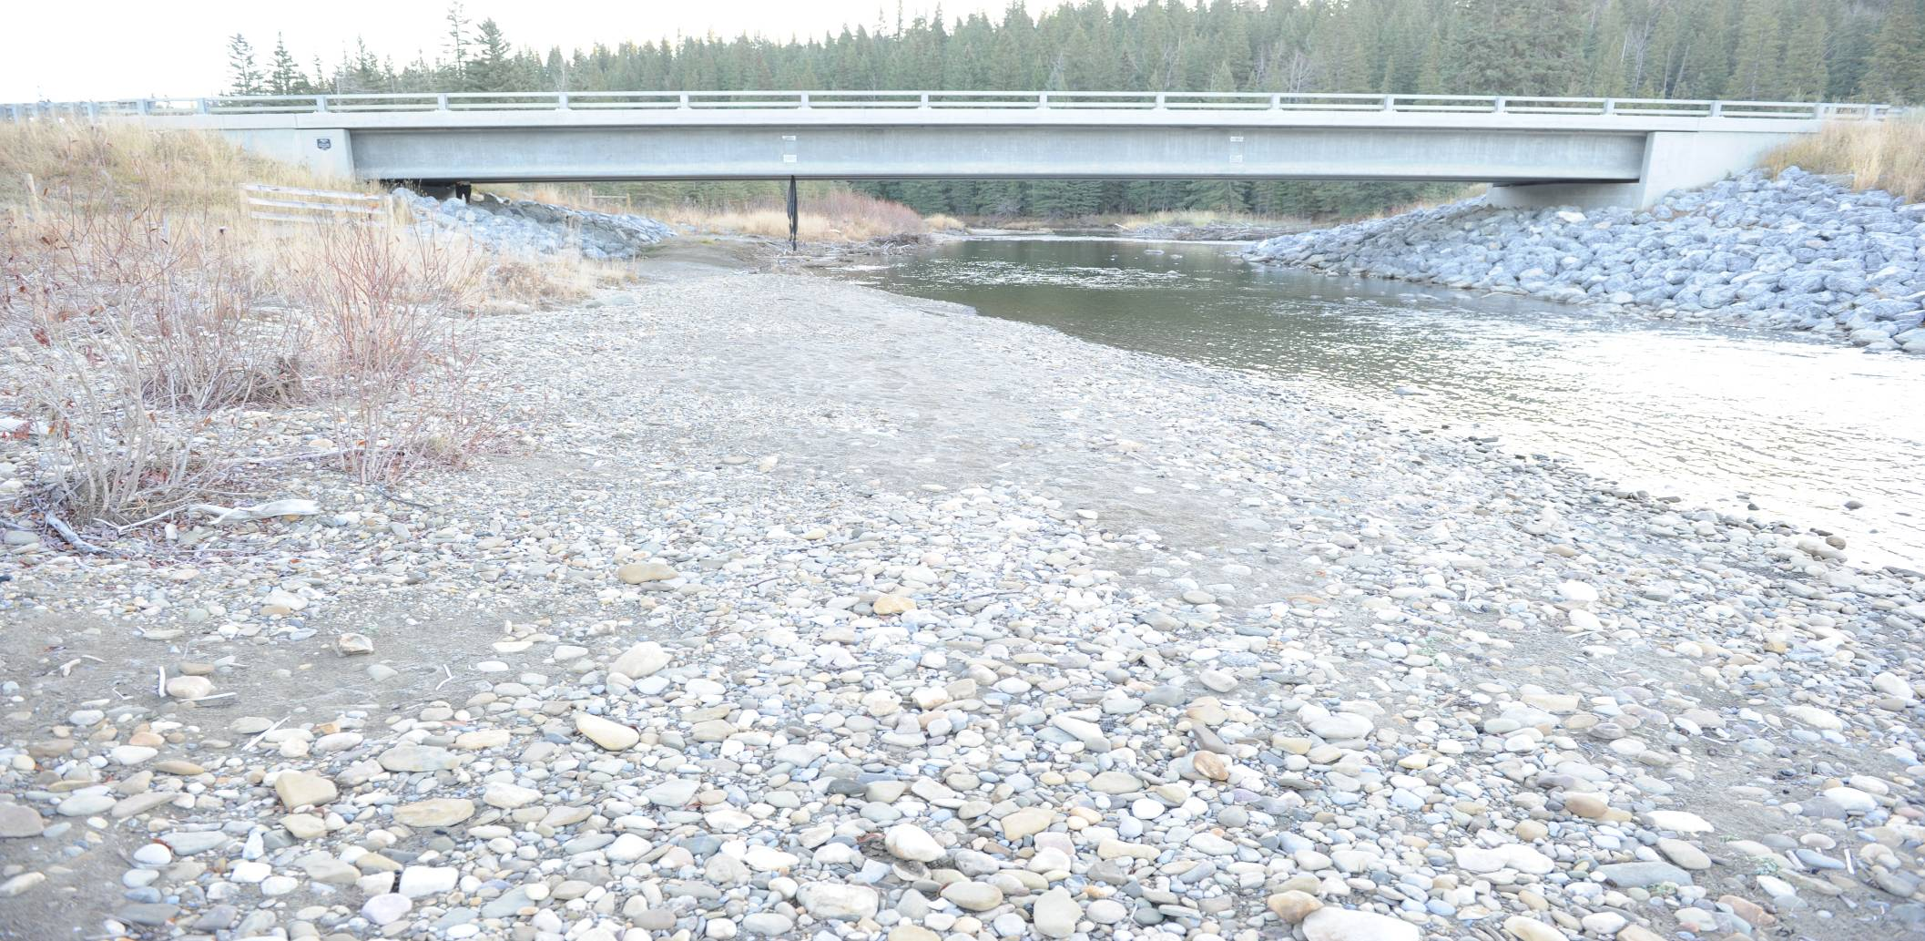
Concrete Girder Bridge
Notes:
6
6
6
7

Slide 6
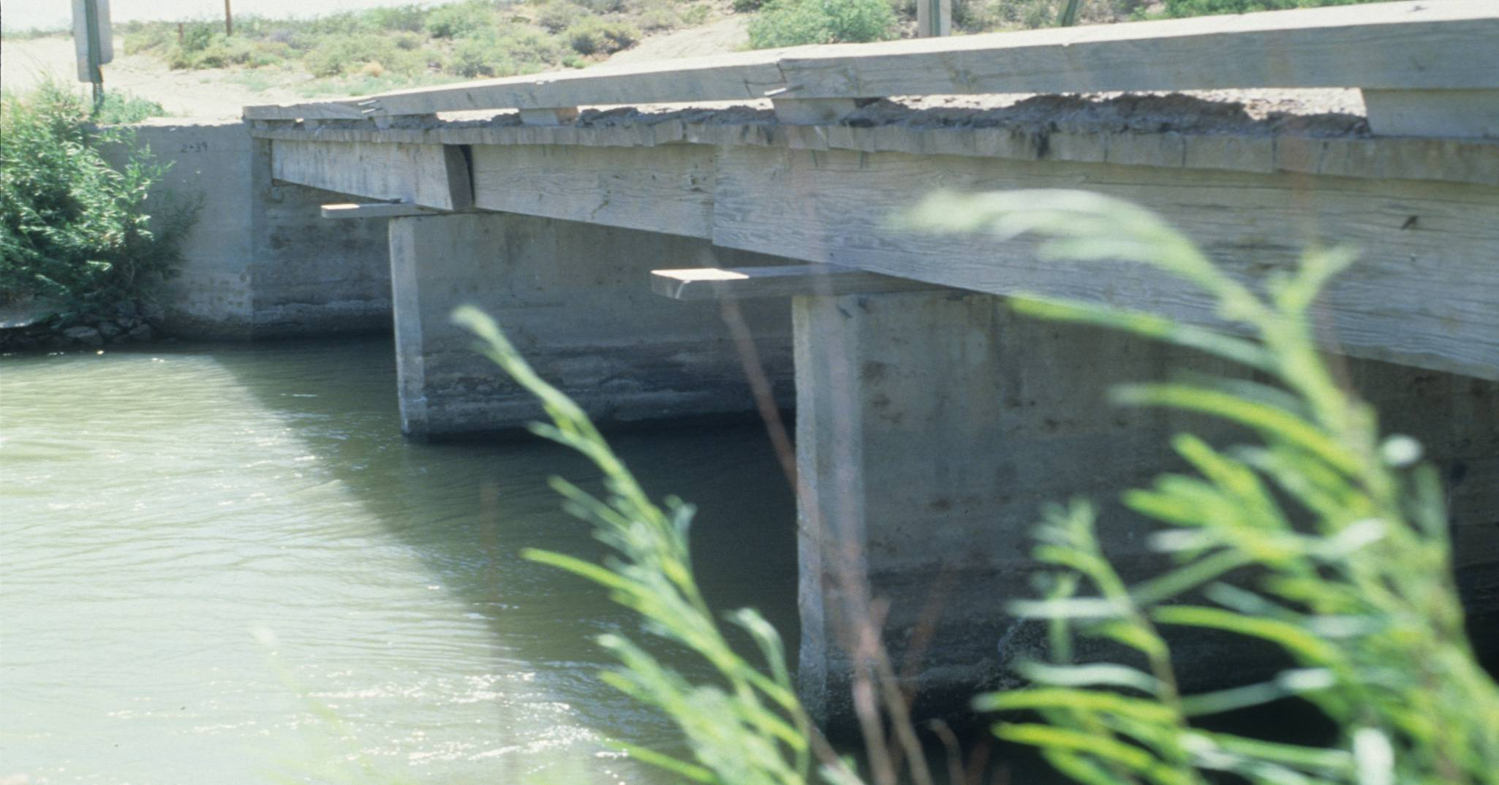
Timber Girder Bridge
Notes:
11
11
11
12

Slide 7
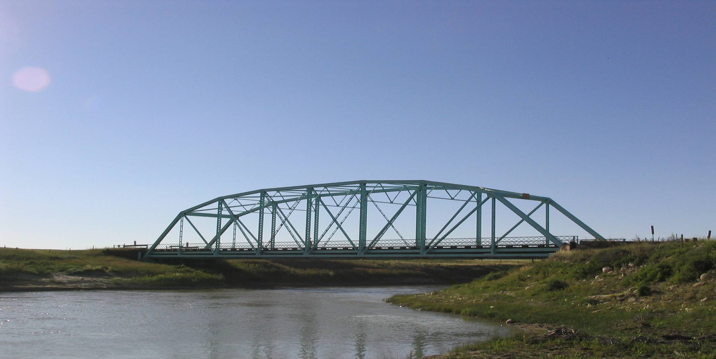
Through Truss Bridge
Notes:
12
12
12
13

Slide 8
What is a Culvert?
Culvert Components
Culvert Design and Construction
Culverts – Pros / Cons

Slide 9
Buried Structure
Design – soil interaction
Below Road
Parallel to Stream
>= 1.5m DIA flow area

Slide 10
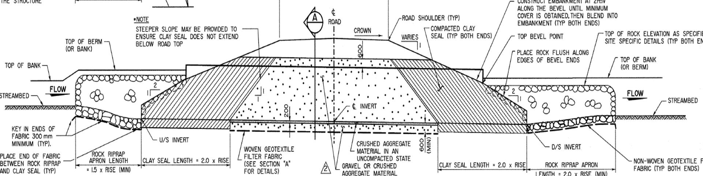
Cover
Road
Inlet
Outlet
Rock
Barrel
Bevel End
Clay Seal
Burial
(Embedment)
Crown
(Obvert)
Invert
Streambed
Elevation View

Slide 11
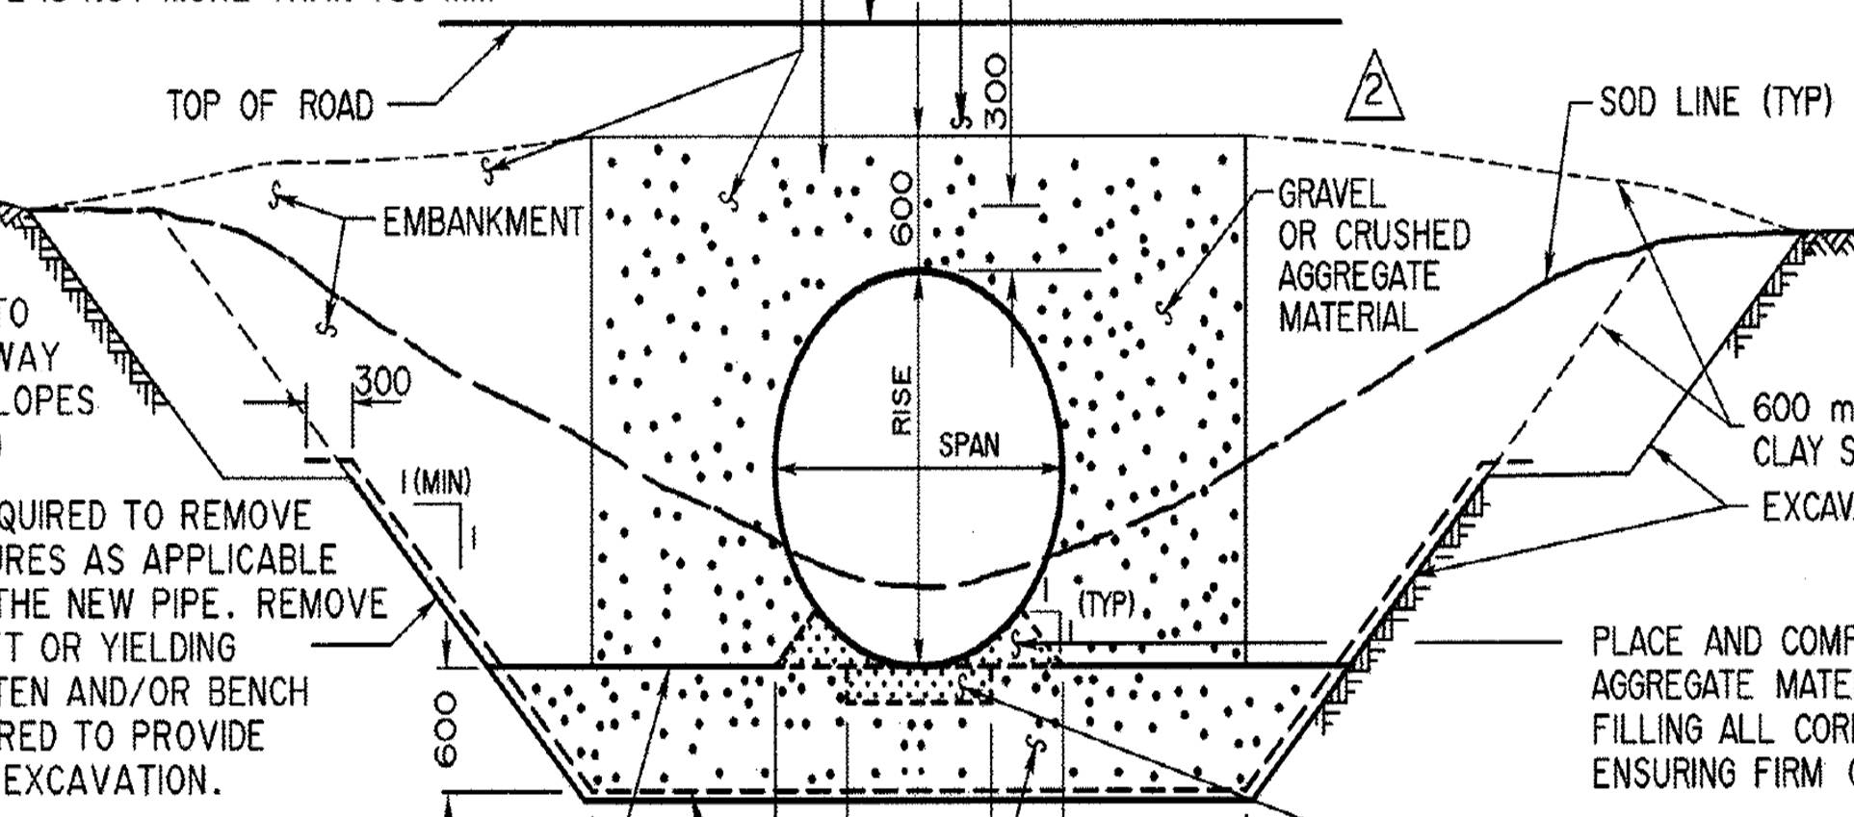
Road
Cover
Rise
Burial
(Embedment)
Haunch
XS View
Span

Slide 12
Culvert Shape in AT System
Arch
Box
Ellipse
Round
All (~2820)

Slide 13
Culvert Size in AT System

Slide 14
Culvert Age in AT System

Slide 15
Culvert Design and Construction

Slide 16
Soil Steel Structures – No backfill
Notes:
Steel culverts are soil-steel structures:
Without compacted backfill, they will not carry the load
The culvert will buckle and fail if not supported

Slide 17
Soil Steel Structures – Compacted backfill
Notes:
Steel culverts are soil-steel structures:
With compacted backfill, the soil will prevent buckling

Slide 18
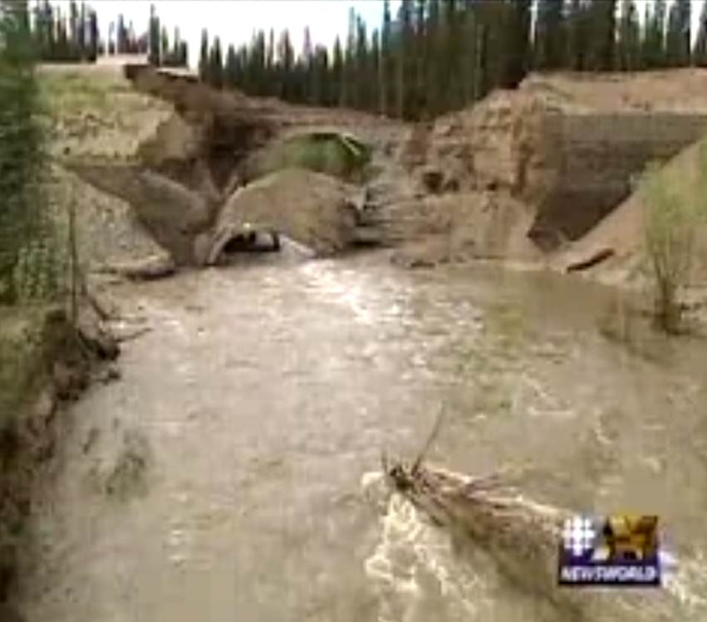
Open
Bottom
Notes:
Steel culverts are soil-steel structures:
With compacted backfill, the soil will prevent buckling

Slide 19
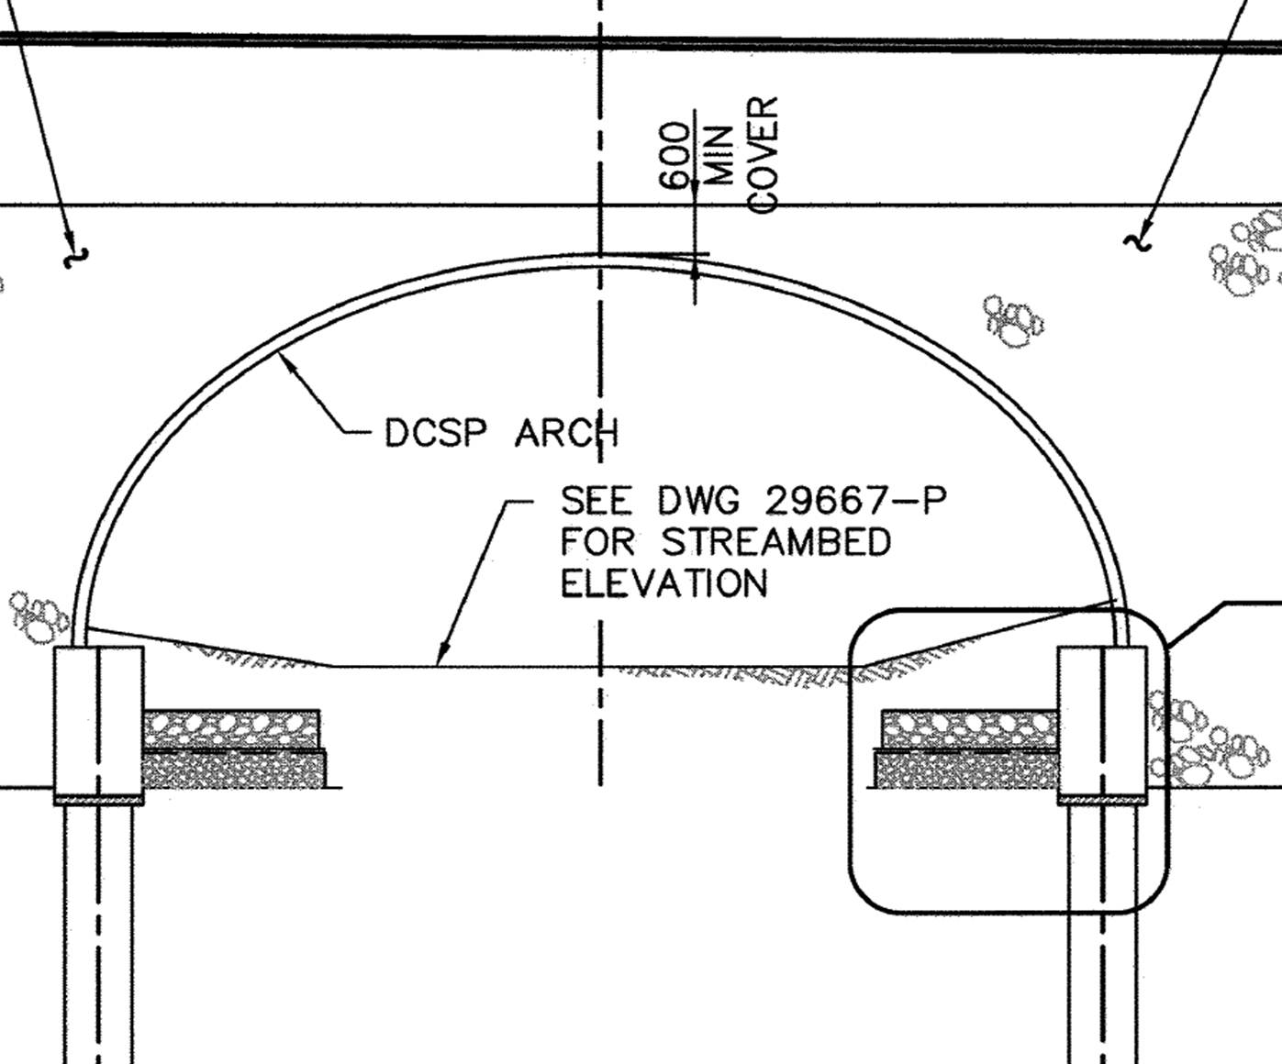
Notes:
Steel culverts are soil-steel structures:
With compacted backfill, the soil will prevent buckling

Slide 20
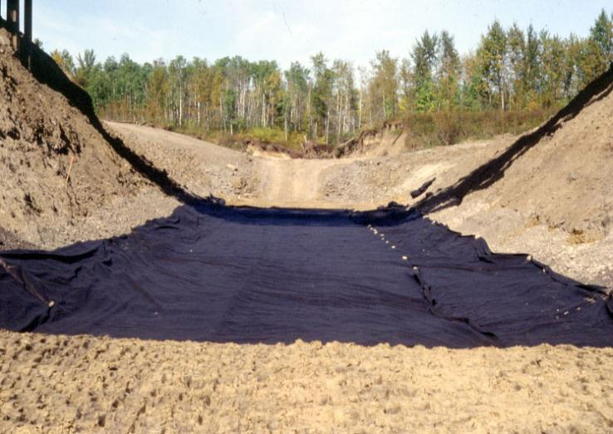
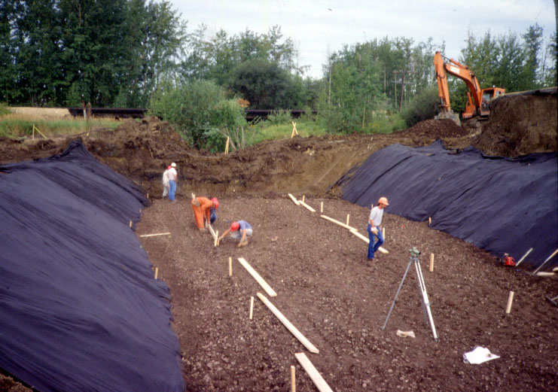
Base Preparation
Notes:
Geotextile used to stabilize soft foundations
Typically woven geotextile (stronger, less flexible) for stabilization
Add cushion layer of crush granular on top of geotextile to minimu=ize puncturing by equipment

Slide 21
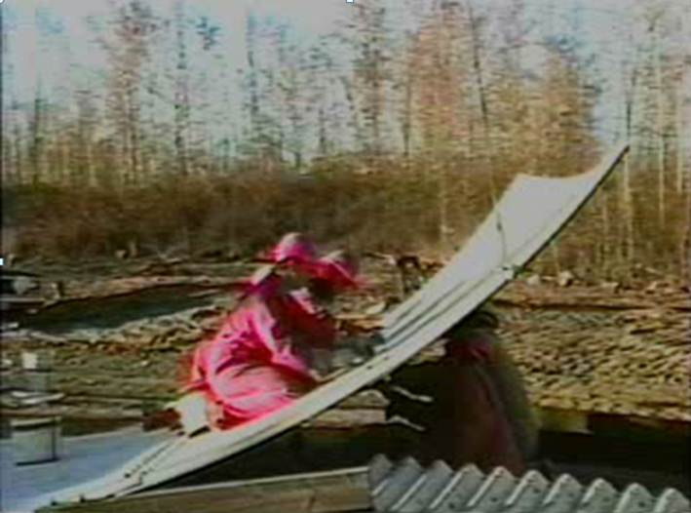
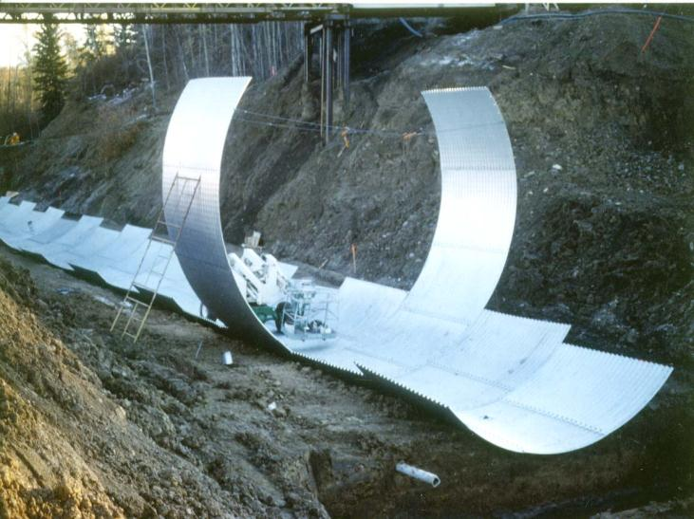
Assembly – Side Plates
Notes:
Side plates, roof plates, and bevel ends can be pre-assembled off to the side while the floor plates are being assembled
Side plates are attached to the floor alternating side to side to minimize spiralling from eccentric loads

Slide 22
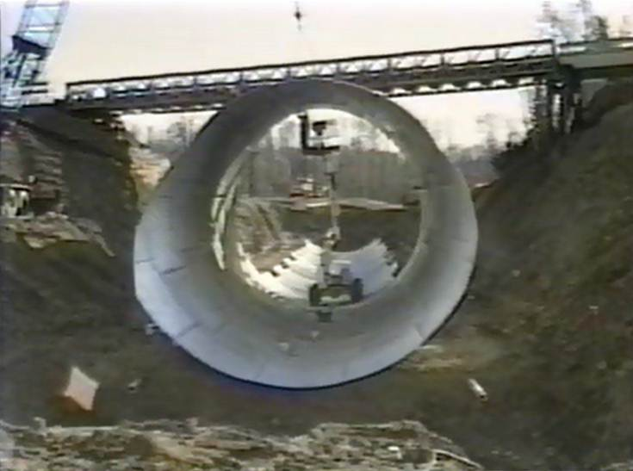
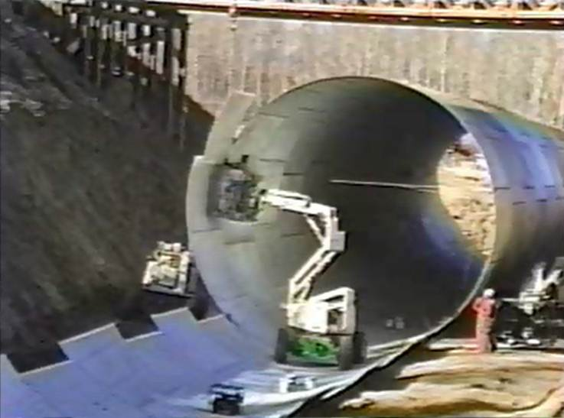
Assembly – Roof Plates
Check Dimensions
Control Shape
Notes:
Roof plates are then added
After 2 complete rings – check dimensions
Control shape with cable stays and/or scaffolding

Slide 23
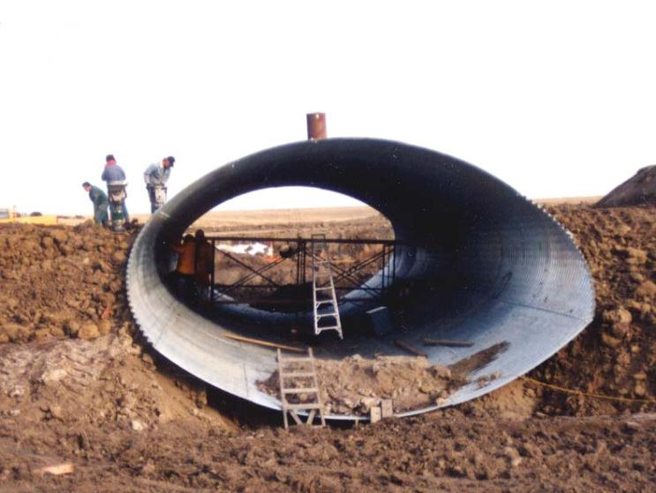
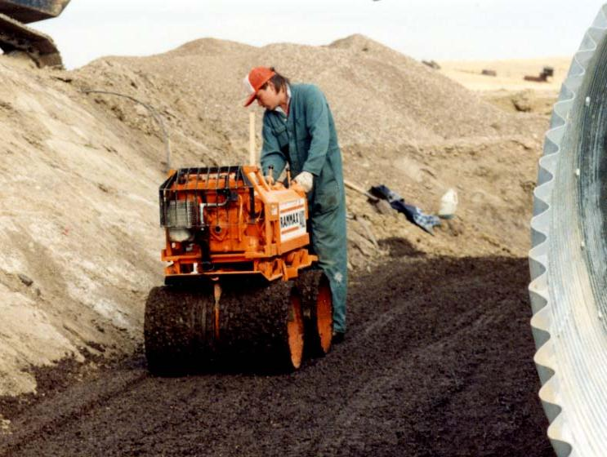
Backfill - Sides
Notes:
Above haunches – still use small equipment (minimize stresses on pipe)
Spread and compact in 150mm layers
Keep balanced (within 300mm) on both sides – avoid distortion, rolling)
Move equipment parallel to the pipe

Slide 24
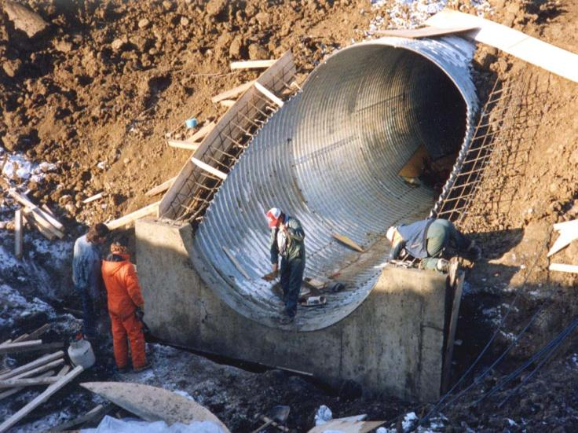
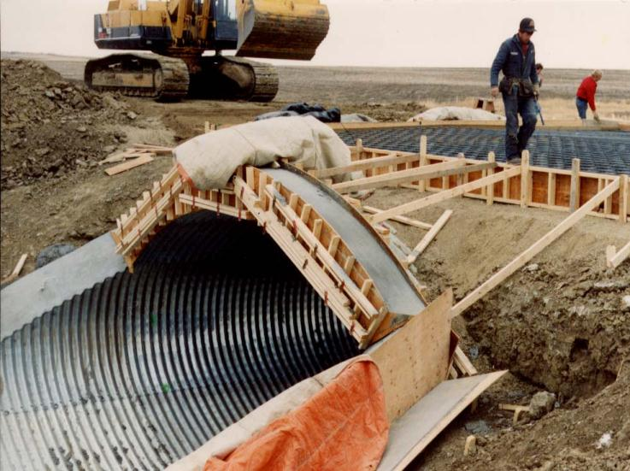
Concrete End Treatment
Notes:
Purpose:
Reinforce bevel ends
Resist uplift forces
Prevent piping

Slide 25
Culvert – Pros / Cons

Slide 26
Cost
Culvert = $2000/m2 * pi * L * D
Bridge = $7500/m2 * L * W
Culvert |  |  | Bridge |  |  | Ratio
D | L | Cost | L | W | Cost
2 | 40 | 500,000 | 14 | 10 | 1 Mil | 0.5
3 | 40 | 750,000 | 15 | 10 | 1.1 Mil | 0.68
4 | 40 | 1 Mil | 16 | 10 | 1.2 Mil | 0.83
5 | 40 | 1.3 Mil | 17 | 10 | 1.3 Mil | 1

Slide 27
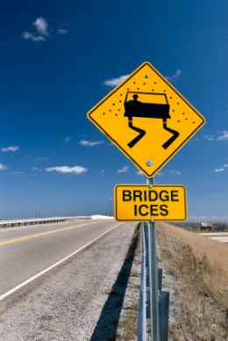
Bridge Preferential Icing

Slide 28
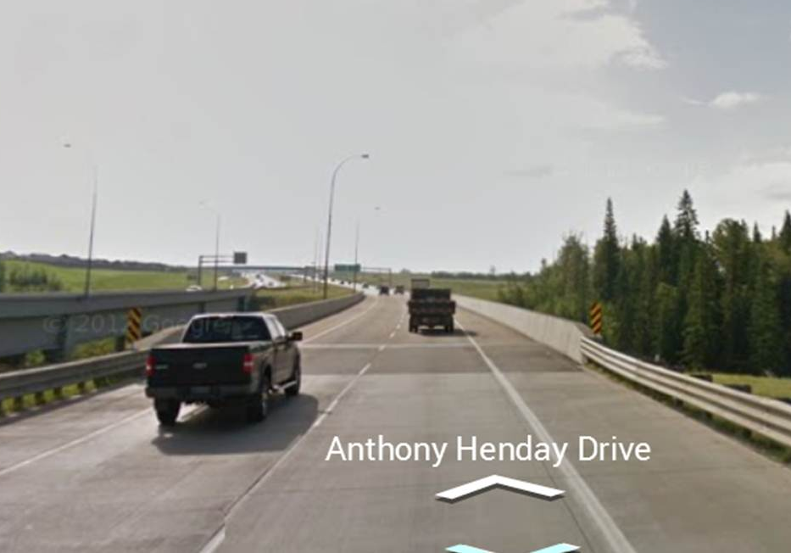
Bridge Barriers

Slide 29
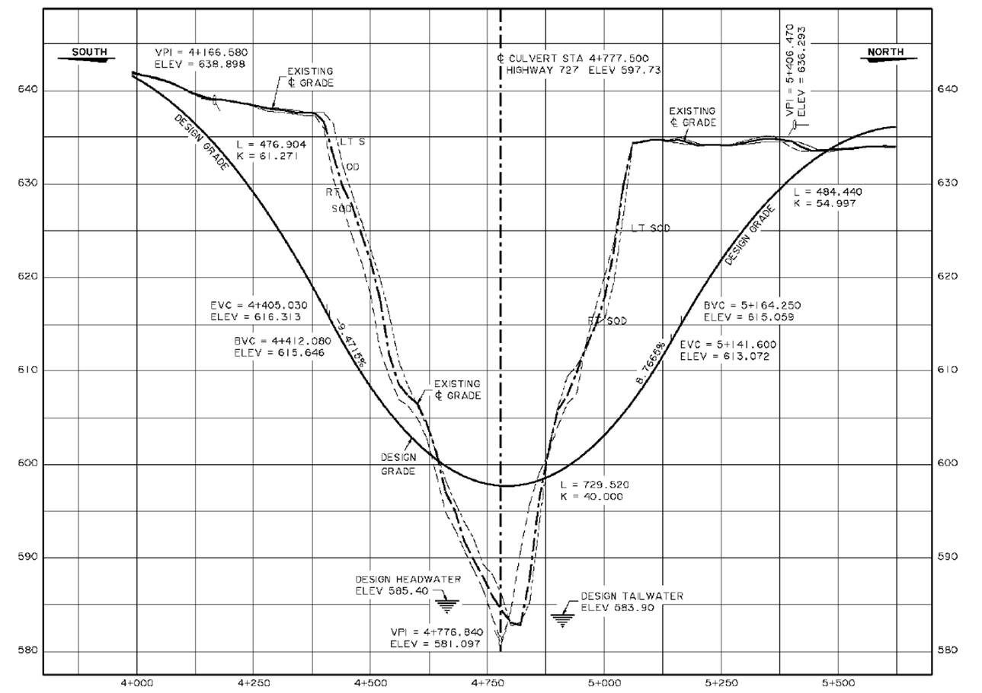
Unstable Valley Walls

Slide 30
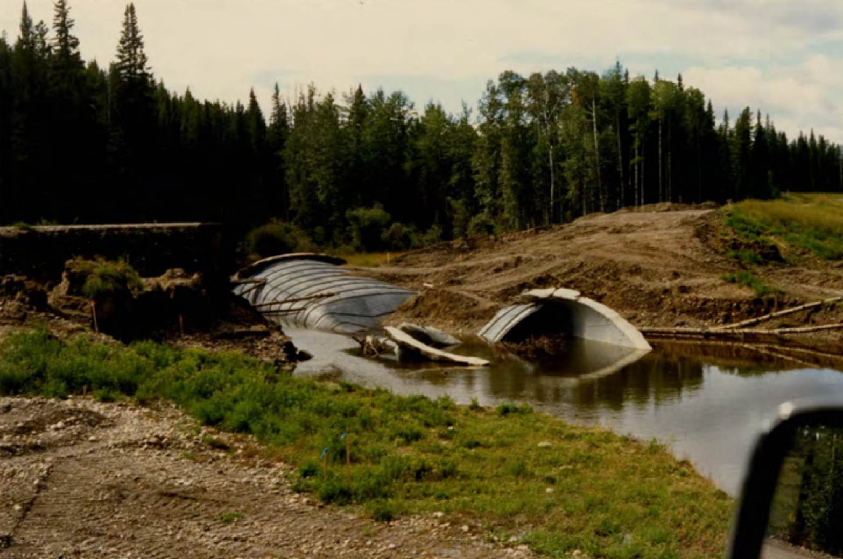
Need Soil Support
Notes:
Steel culverts are soil-steel structures:
With compacted backfill, the soil will prevent buckling

Slide 31
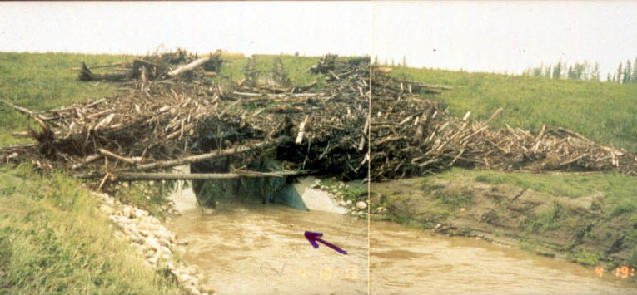
Blockage - Drift/Icing
Notes:
Steel culverts are soil-steel structures:
With compacted backfill, the soil will prevent buckling

Slide 32
Pros | Cons
Cost | Need Soil Support
Preferential Icing | Channel Work
No Barriers | Drift, Icing
Unstable Valleys
Quicker construction
Lower maintenance
Hydraulics, Fish Passage ????
*Selection of structure is based on an optimization process involving assessment of a range of options (Bridge Conceptual Design Guidelines)

